Slide 1
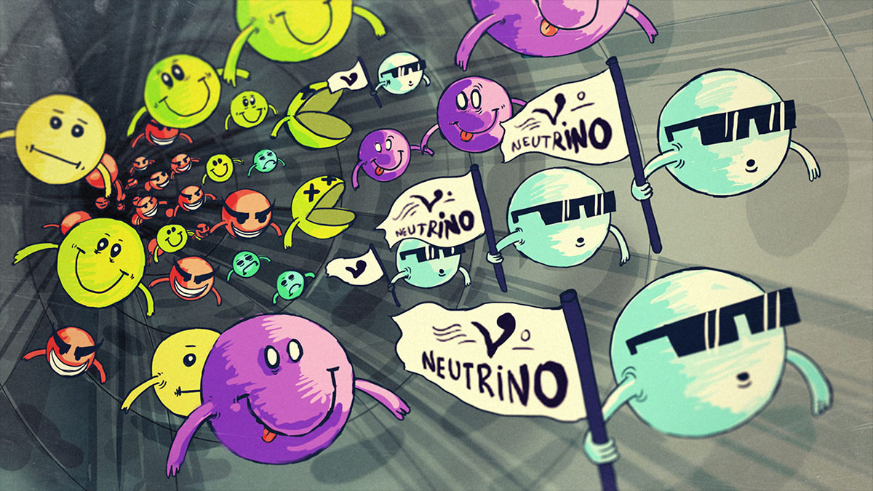

Making a Neutrino Beam
Group A: Nilay Bostan¹, Shota Izumiyama², Kunal Kothekar³, Elisabetta Montagna⁴
1.University of Notre Dame (US) 2.Tokyo Institute of Technology (Japan) 3.Univeristy of Bristol (UK) 4.University of Bologna - INFN
Credit: Symmetrymagazine.org

Slide 2
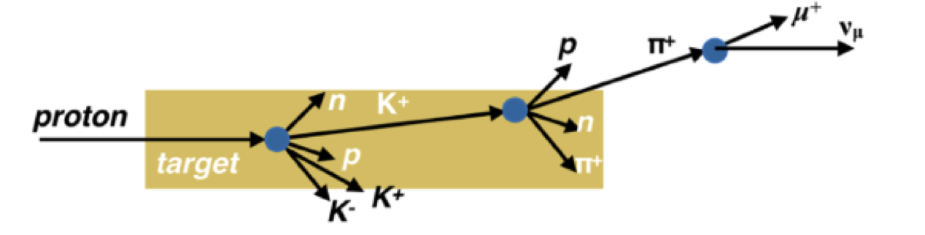
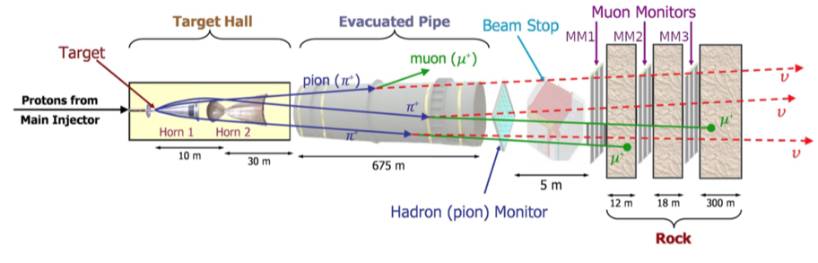
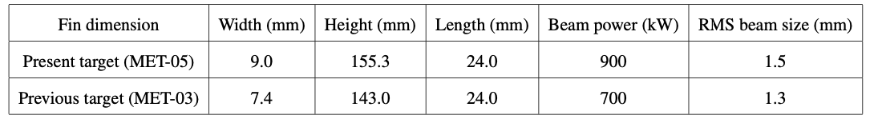
Simulations: NuMI target, FLUKA, Flair, GEANT4
Target features:
(Graphite 1.78 g/cm³)
Title of the project is “making a neutrino beam”. We have used following softwares/simulation packages to answer some questions like:
→ Composition of neutrino beam ( by comparing pi+, pi-, K+, K-, K0 spectra)
→ Compare the hadron spectra in different angular bins etc.
A summary about the softwares used:
FLUKA (FLUktuierende KAskade) is a fully integrated Monte Carlo simulation package for the interaction and transport of particles and nuclei in matter.
FLAIR ( Fluka advanced user interface) is an all in one graphical interface, which provides an easy to interact front end for FLUKA and facilitates running and monitoring of the status of a run (runs).
GEANT Geant4 is a toolkit for the simulation of particles passing through and interacting with matter. We used it as an alternative to Fluka, as the installation experience of FLUKA wasn’t exactly smooth.

Slide 3
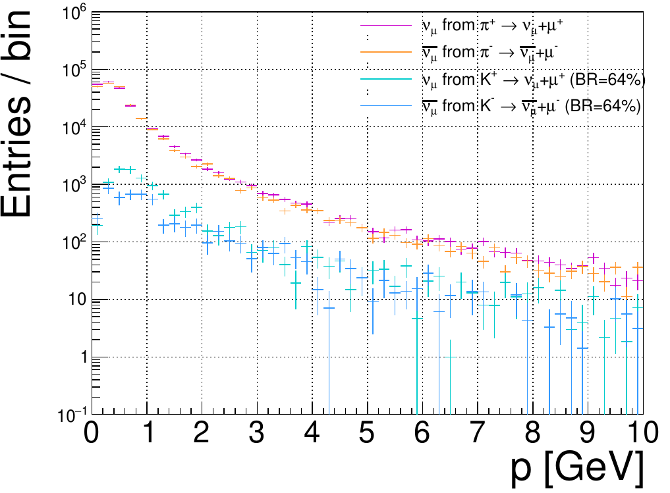
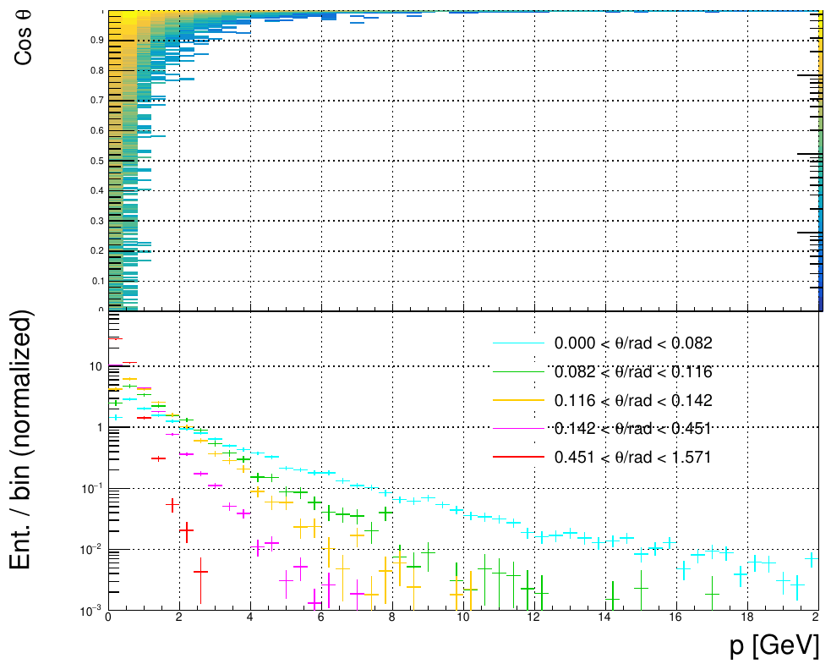
Analysis and results
FLUKA -> only hadron production
Considered ν spectrum is only came from π/K-decay, not μ-decay
  *This is not a perfect simulation
More density in lower energy spectrum.
ν momentum
ν
π
Lorentz boost
Considering
only 4 channels
μ
π-decay at rest
ν angle v.s. momentum
Non-negligible contribution
from K
π~ 70% (total)
K ~ 10%
cf
NOvA: 0.014 rad
T2K: 0.043 rad
  π+ : π- : K+ : K- : K0
  ~ 35% : 35% : 5% : 5% : 5%
Higher energy is supperessed
by off-axis (but lower intensity)

Slide 4
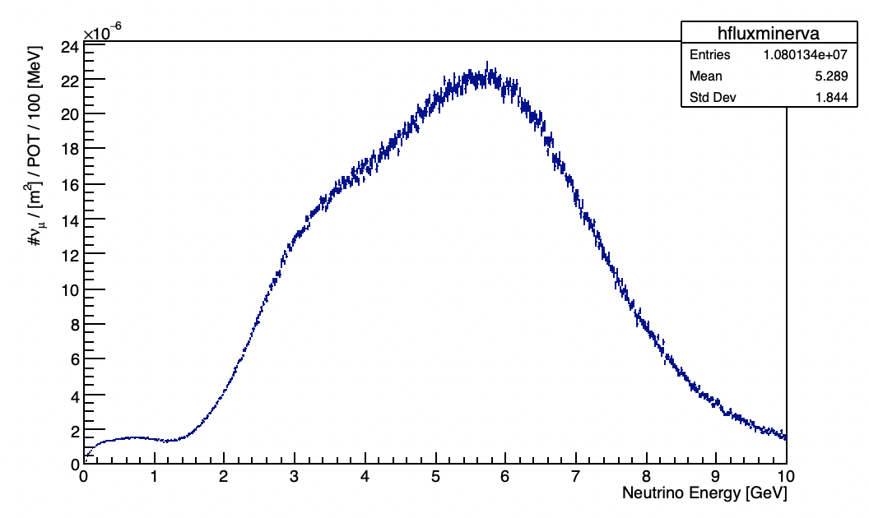
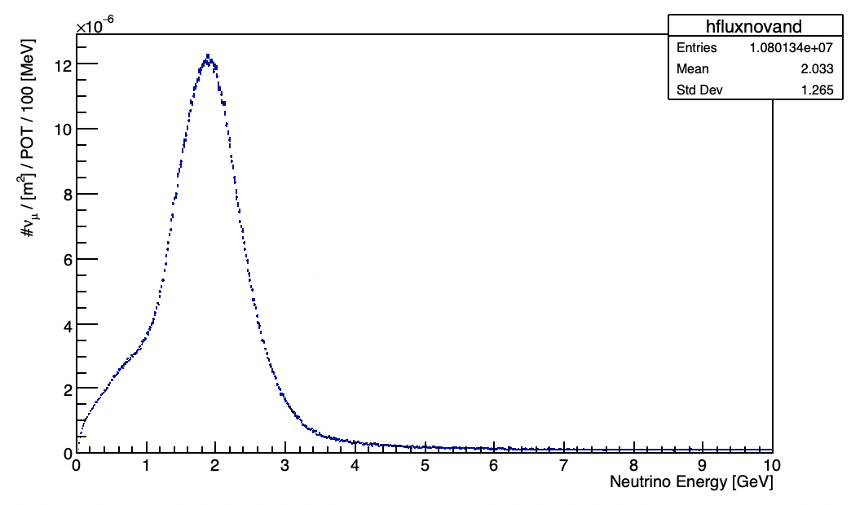
Analysis and results
on-axis
off-axis
Comparison between energy spectra versus neutrino flux at the on-axis detectors (MINERνA) and off-axis detectors (NOνA):
The ν_{µ} flux spectrum for the MINERvA location shows the energy peak is around 6 GeV with a small bump at around 3 GeV because of over-focused pions for MINERvA flux
In the off-axis (14.6 mrad) near detector case, the spectrum of neutrino energy for ν_{µ} flux has a peak at lower energy than in the on-axis case (MINERvA), the neutrino flux for NOvA has an energy peak at approximately 2 GeV. In addition, the energy peak for NOvA is narrower enough than the energy peak prediction for on-axis experiments like MINERvA.

Slide 5
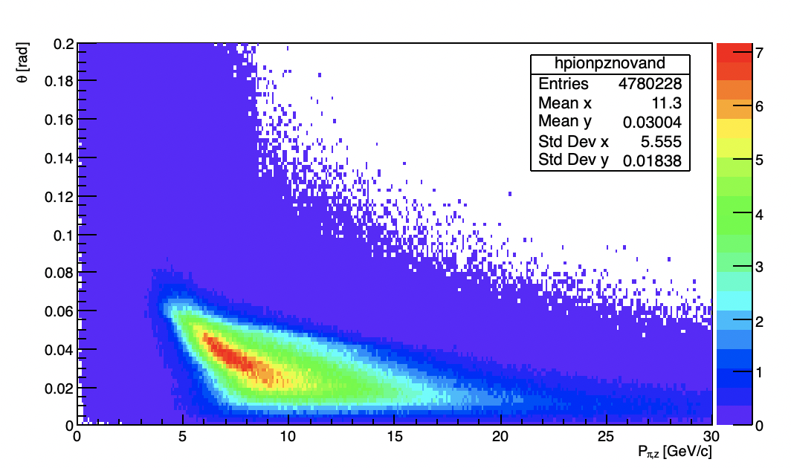
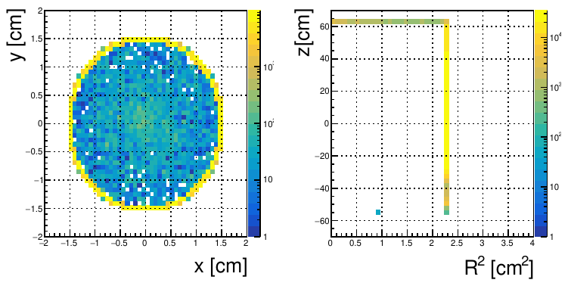
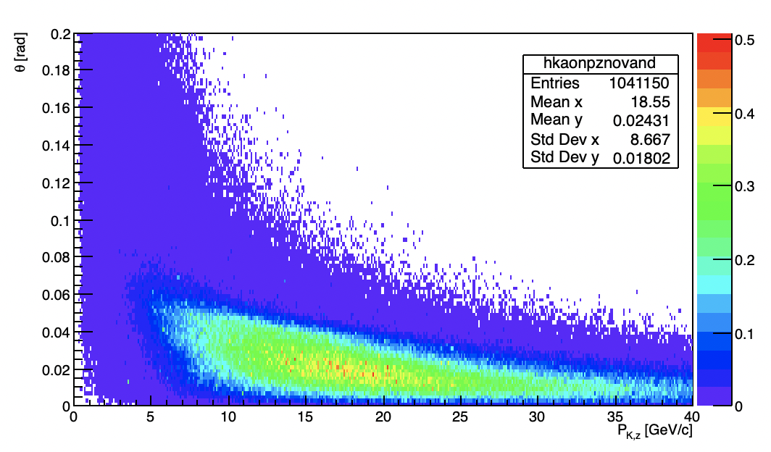
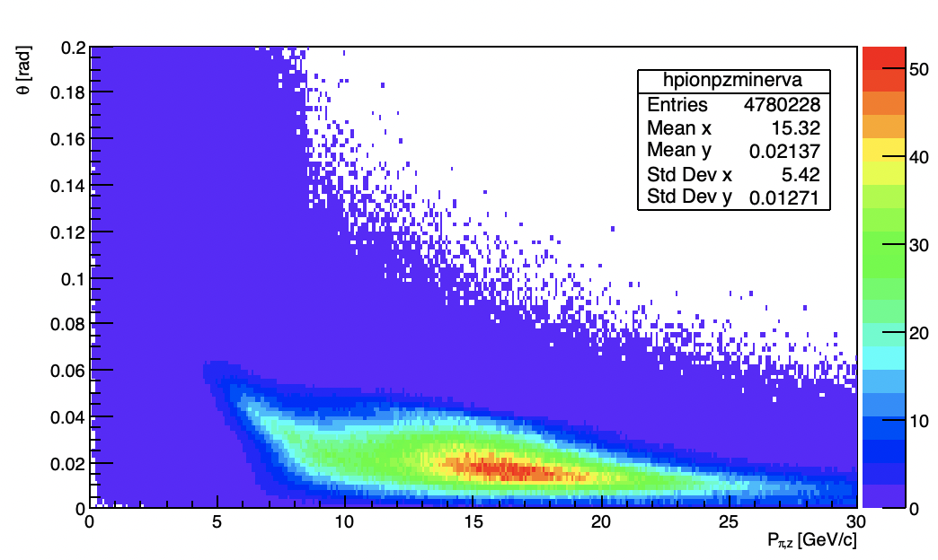
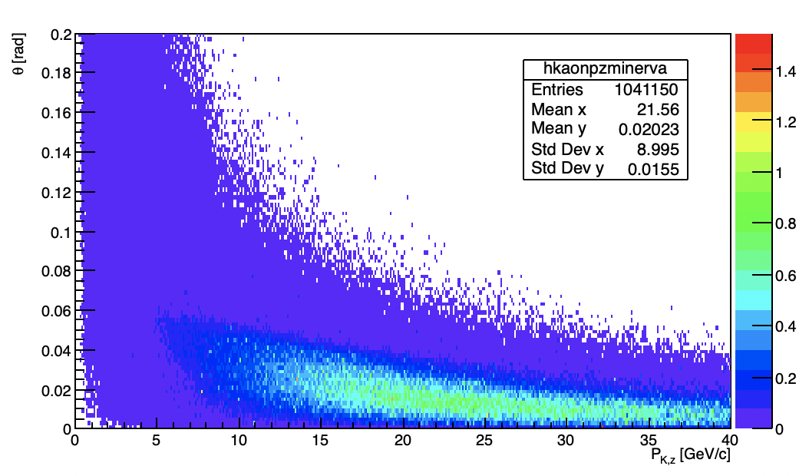
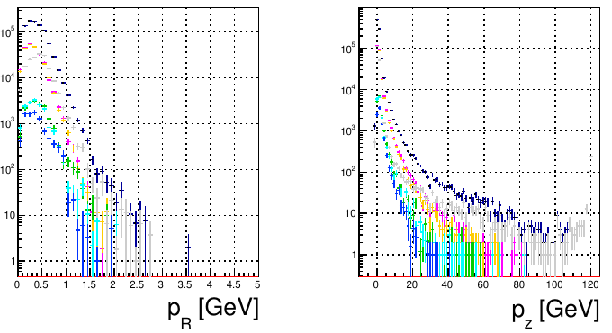
Analysis and results
Exiting points of hadron
Target is simple one: cylindrical shape
Black: all
Magenta/orange: pion
Cyan/green/blue: kaon
Transverse/z momentum
Phase-spaces with NOvA ND and MINERvA detector weights for pion and kaon production

Slide 6
Summary and learnings
Simulated hadron production with simple target of NuMI
  -> Cylinder of graphite (radius = 30mm, length ~ 1200 mm ~ 2 interaction length)
Momentum spectrum
  -> Almost same amount of π+ / π- → de-focusing with horn is essensial for v / anti-ν discrimination
  -> K amount ~ 1/7 of π, but non neglible contribution to neutrino in higher momentum ( > 5 GeV)
Momentum v.s. outgoing angle
  -> off axis technique reduces higher energy composition in hadron level
  The detectors are situated on-axis like MINERvA experiment, the decay angle is zero. The relation between the neutrino energy and pion (kaon) parents are Eν ≈ 0.43 Eπ (Eν ≈ 0.95 Ek) for the on-axis location experiments.
  For off-axis location experiments, θν is different from 0, for instance, θν = 14.6 mrad for NOvA experiment. As a result, unlike the on-axis, for off-axis location, the relation between the energy of neutrino and its parent is non-linear due to the Lorentz boost factor in the definition depending on parent energy.
  In the Medium Energy run, the target is pulled away from the horn to produce the neutrino flux peaking at ∼ 6 GeV for MINERvA and ∼ 2 GeV for NOvA.

Slide 7
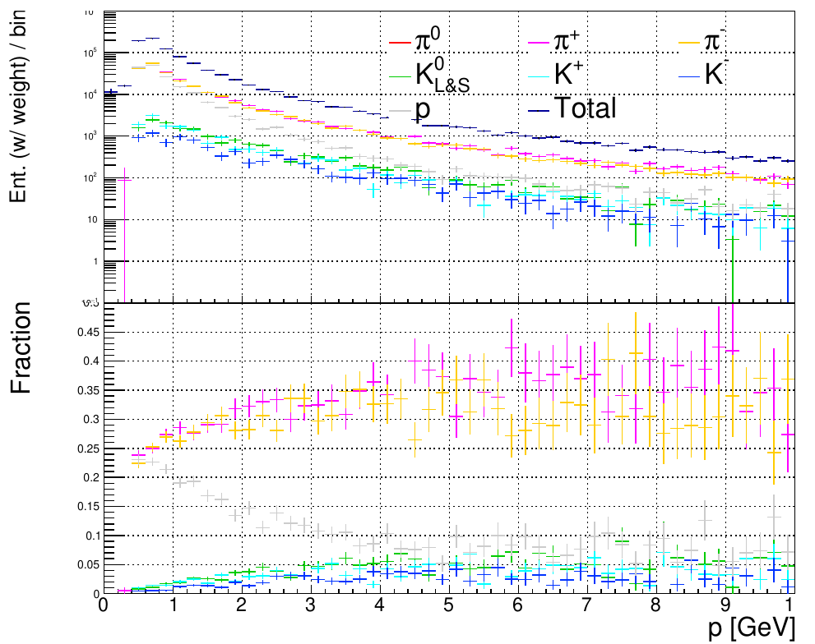
Backup
Hadron momentum
Momentum spectrum
  -> Almost same amount of π+ / π- → de-focusing with horn is essensial for v / anti-ν discrimination
  -> K amount ~ 1/7 of π

