Slide 1
V-tap wire strain relief enforcement
H. Prin
Cryo Meeting, Wednesday 23rd Feb 2021,
https://indico.cern.ch/event/1011474/

Slide 2
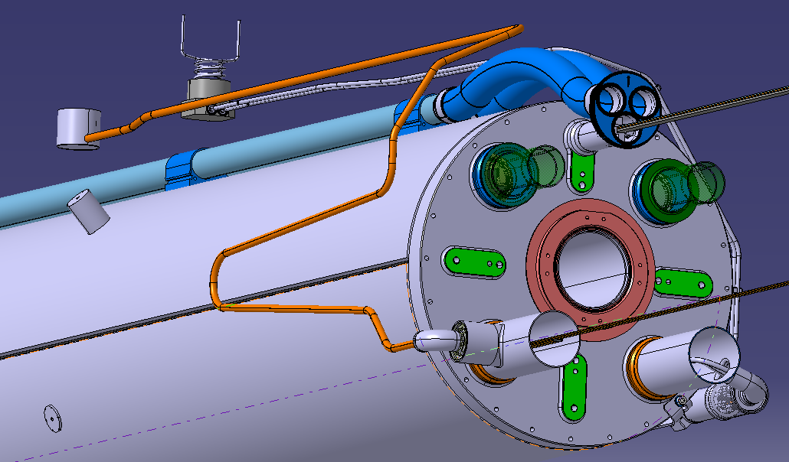
As the wires are theoretically fixed within the IFS capillary the excess wires after the exit from the warm head alleviate any stress placed on the soldered joints to the cover flange feedthroughs.
Same applies on the other side from the cold head to the pins connected along the leads, the quench heaters, the cryo heaters or the temperature sensors.

Slide 3
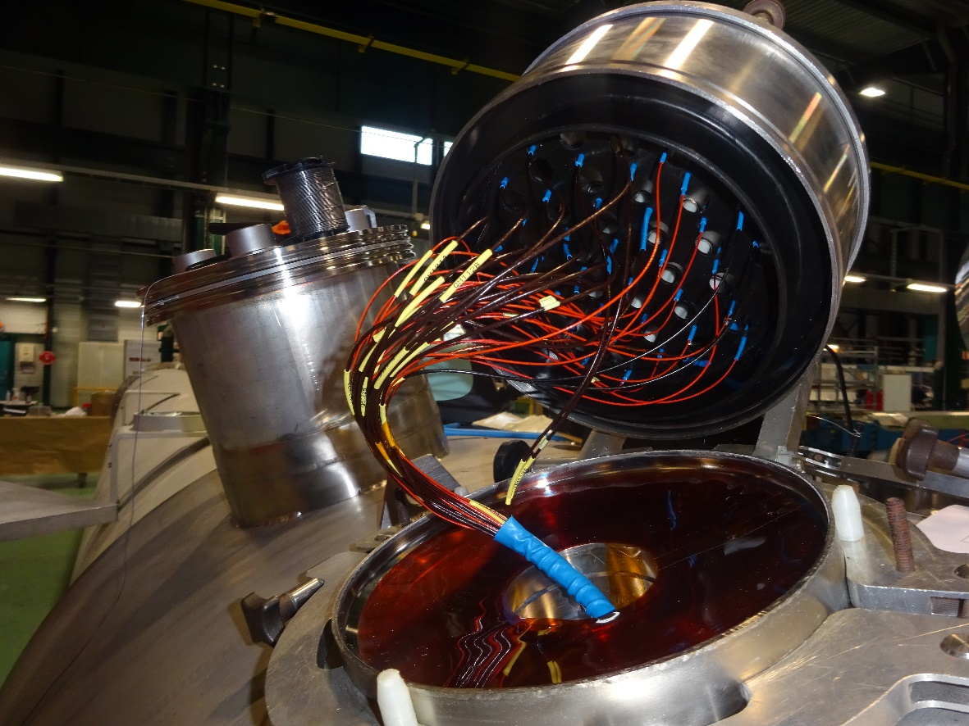
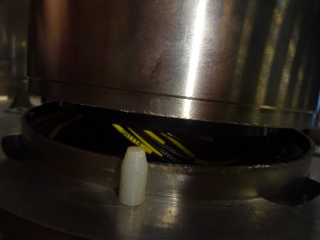
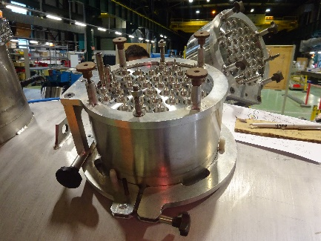
Situation bellow the cover flange
Cautious positioning of the cover flange upon the cryostat flange
Positioning tool for cover flange tack welding
Protection cover
Excess wire (40 to 50cm)
Kapton foil

Slide 4
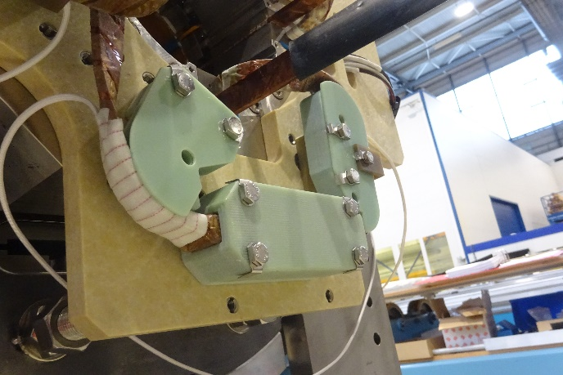
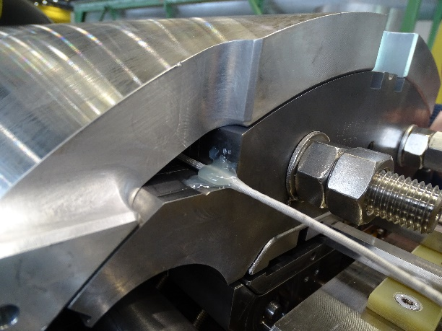
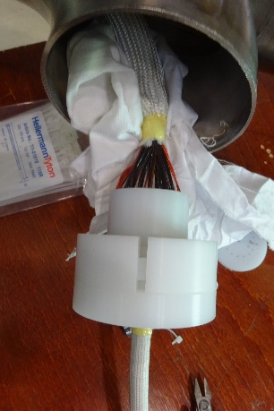
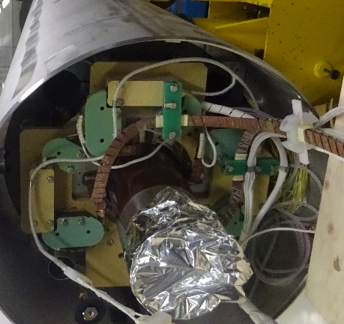
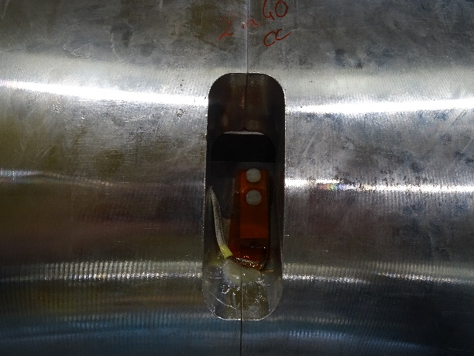
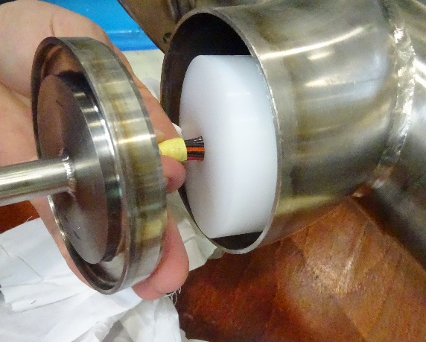
Situation upstream to the cold head
Cables are fixed either ends.
Along their path, they are wrapped in a fibber glass sleeve, guided inside supports that do not overly constrain them. In between two supports cable are have a certain freedom of liberty due to over length.

Slide 5
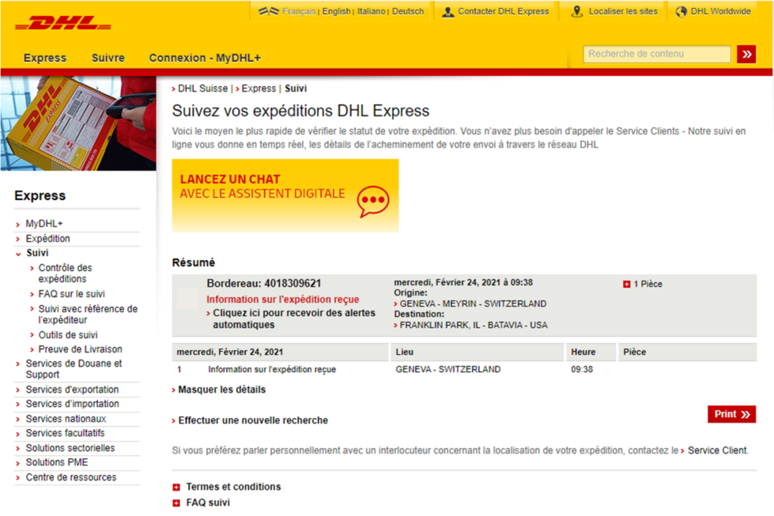
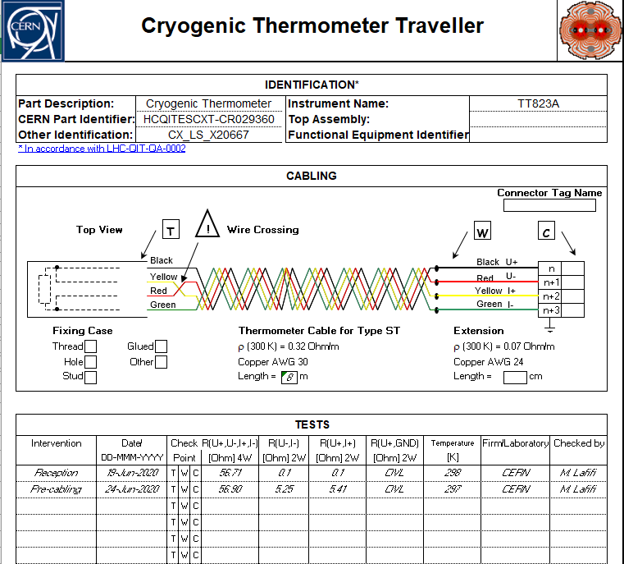
Thermometers cable length
CRG group agrees to exchange the cable length initially specified to 8m to 9 or 10m.
A coil of 100m of 4 cables AWG30 was sent yesterday to FNAL through DHL in this sense, If needed a second coil will be sent in the next shipment for the second batch of thermometers.
The electrical measurements shall be recorded in the electronic traveller and uploaded in the MTF. Nicolas Vauthier (Nicolas.Vauthier@cern.ch) proposes to crosscheck the results for validation before using the temperature sensors in the cold mass.
Deliveries:
1batch (07/2020)
HCQITESCXT-CR029360
HCQITESCXT-CR029420
HCQITESCXT-CR029580
HCQITESCXT-CR029640
HCQITESCXT-CR029650
HCQITESCXT-CR029670
HCQITESCXT-CR029680
HCQITESCXT-CR029700
2nd batch (11/2020)
HCQITESCXT-CR025000
HCQITESCXT-CR025010
HCQITESCXT-CR025040
HCQITESCXT-CR025080
HCQITESCXT-CR025270
HCQITESCXT-CR025280
HCQITESCXT-CR025300
HCQITESCXT-CR025410

