Slide 1
Stand 4 Cryogenic Operations for Testing MQXFA Magnets
R. Rabehl
February 24, 2021

Slide 2
Test Stand 4
The test stand (test bench) occupies the fourth position on our cryogenic distribution box.
Test Stand 4
Test Stand 5
Test Stand 6

Slide 3
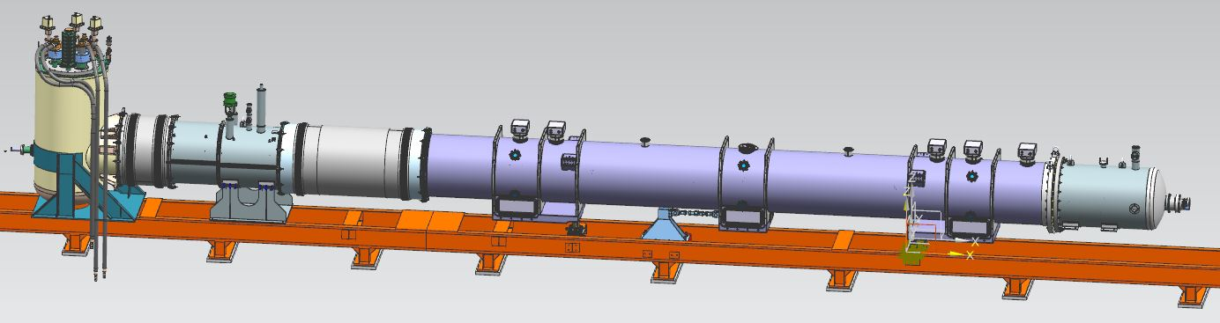
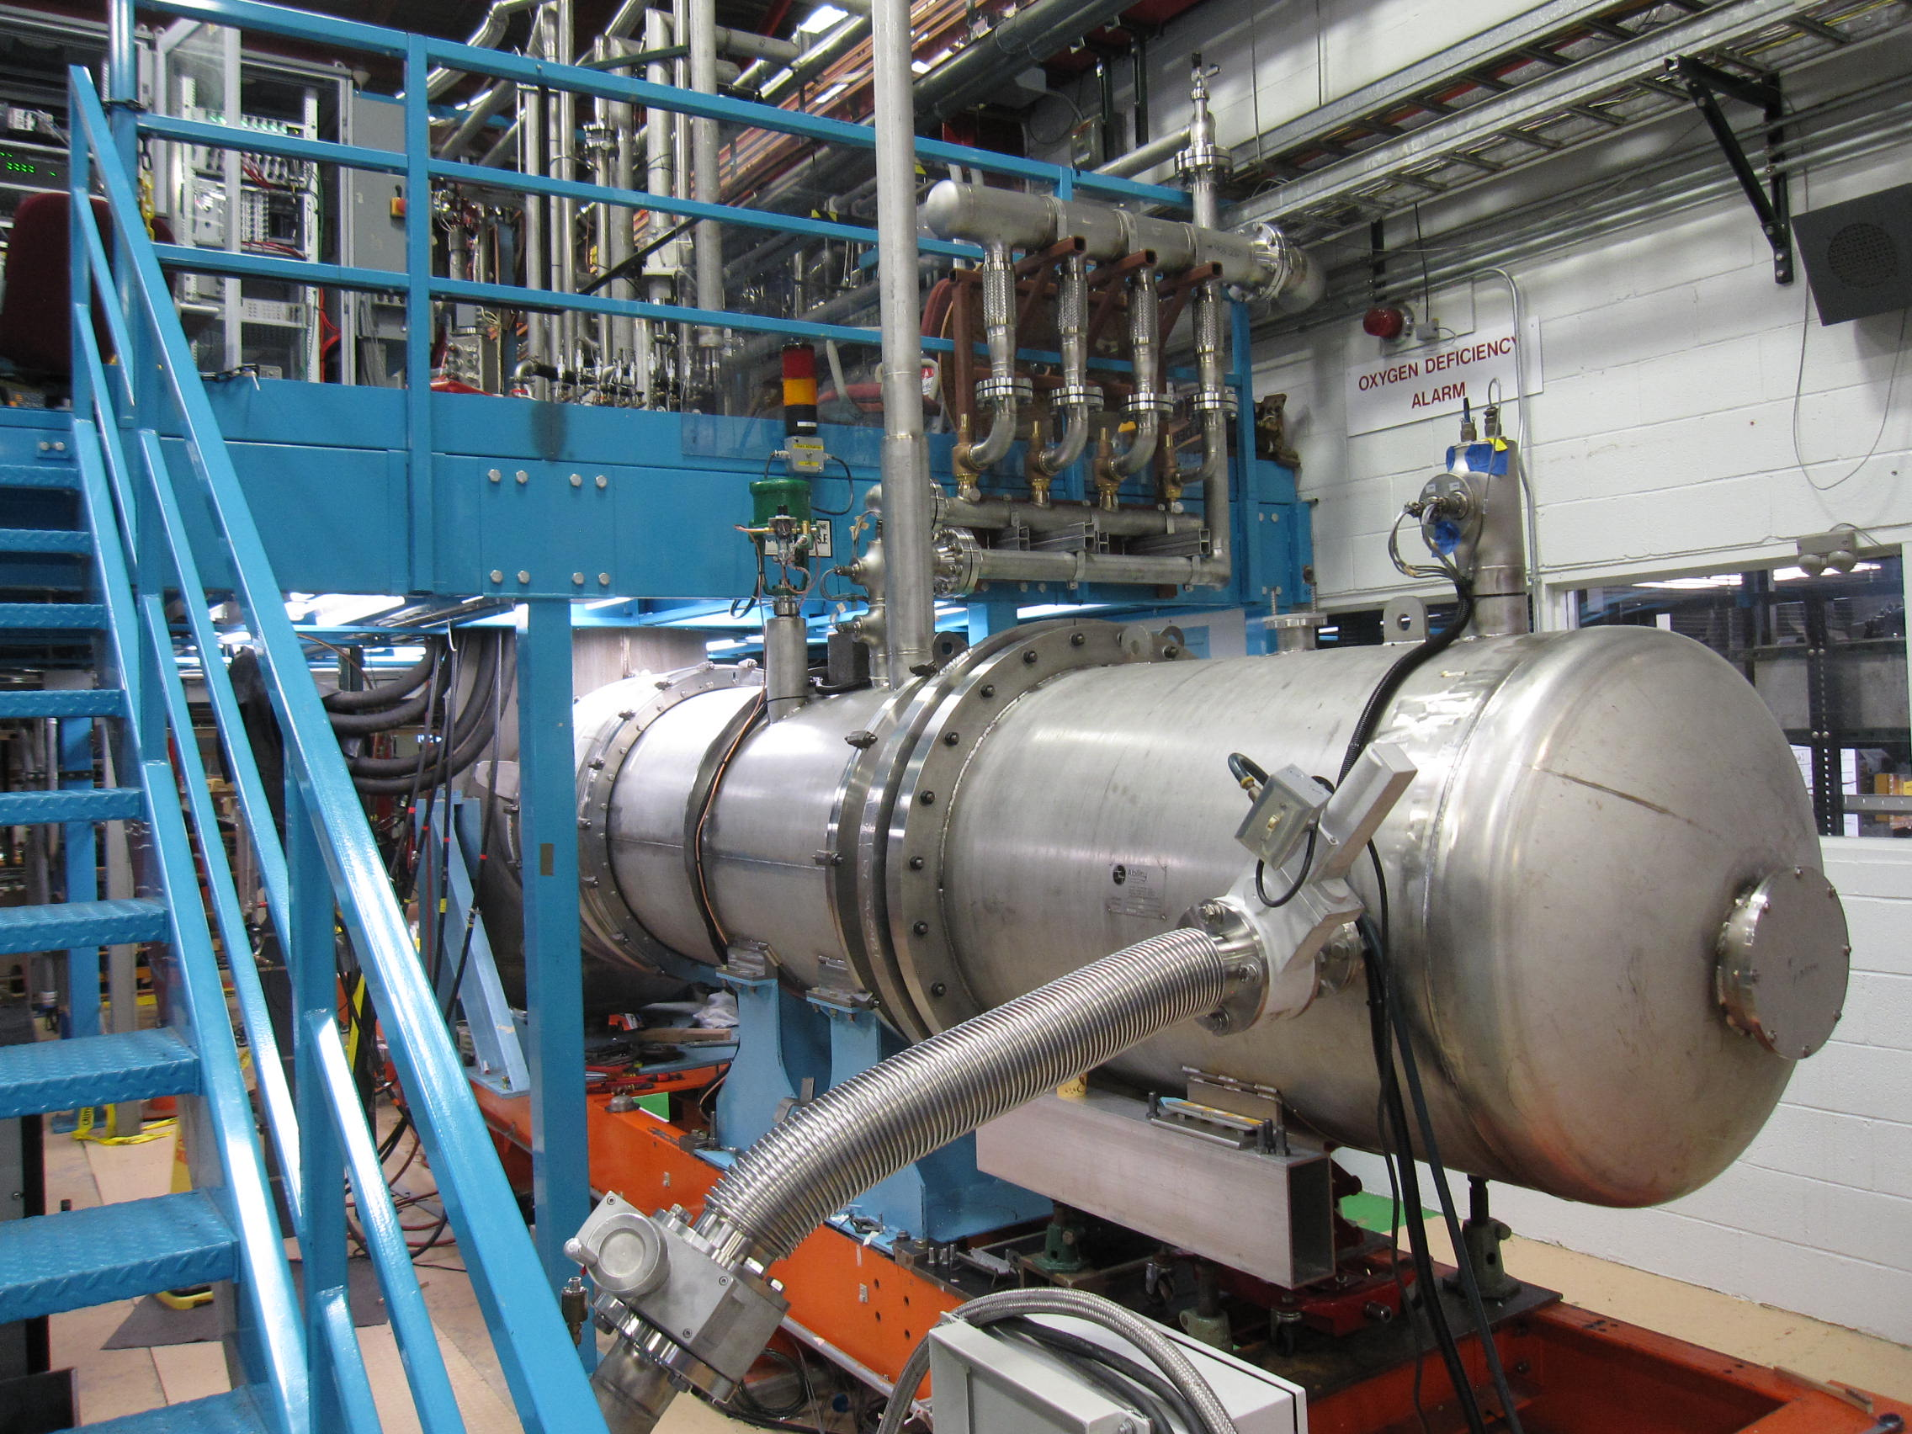
Test Stand 4 Equipment
An Adapter Box was installed on the existing Feed Box.
A new return end vacuum vessel was built.
Production Test
Zero Magnet Test
Feed Box
Adapter Box
Return end vacuum vessel

Slide 4
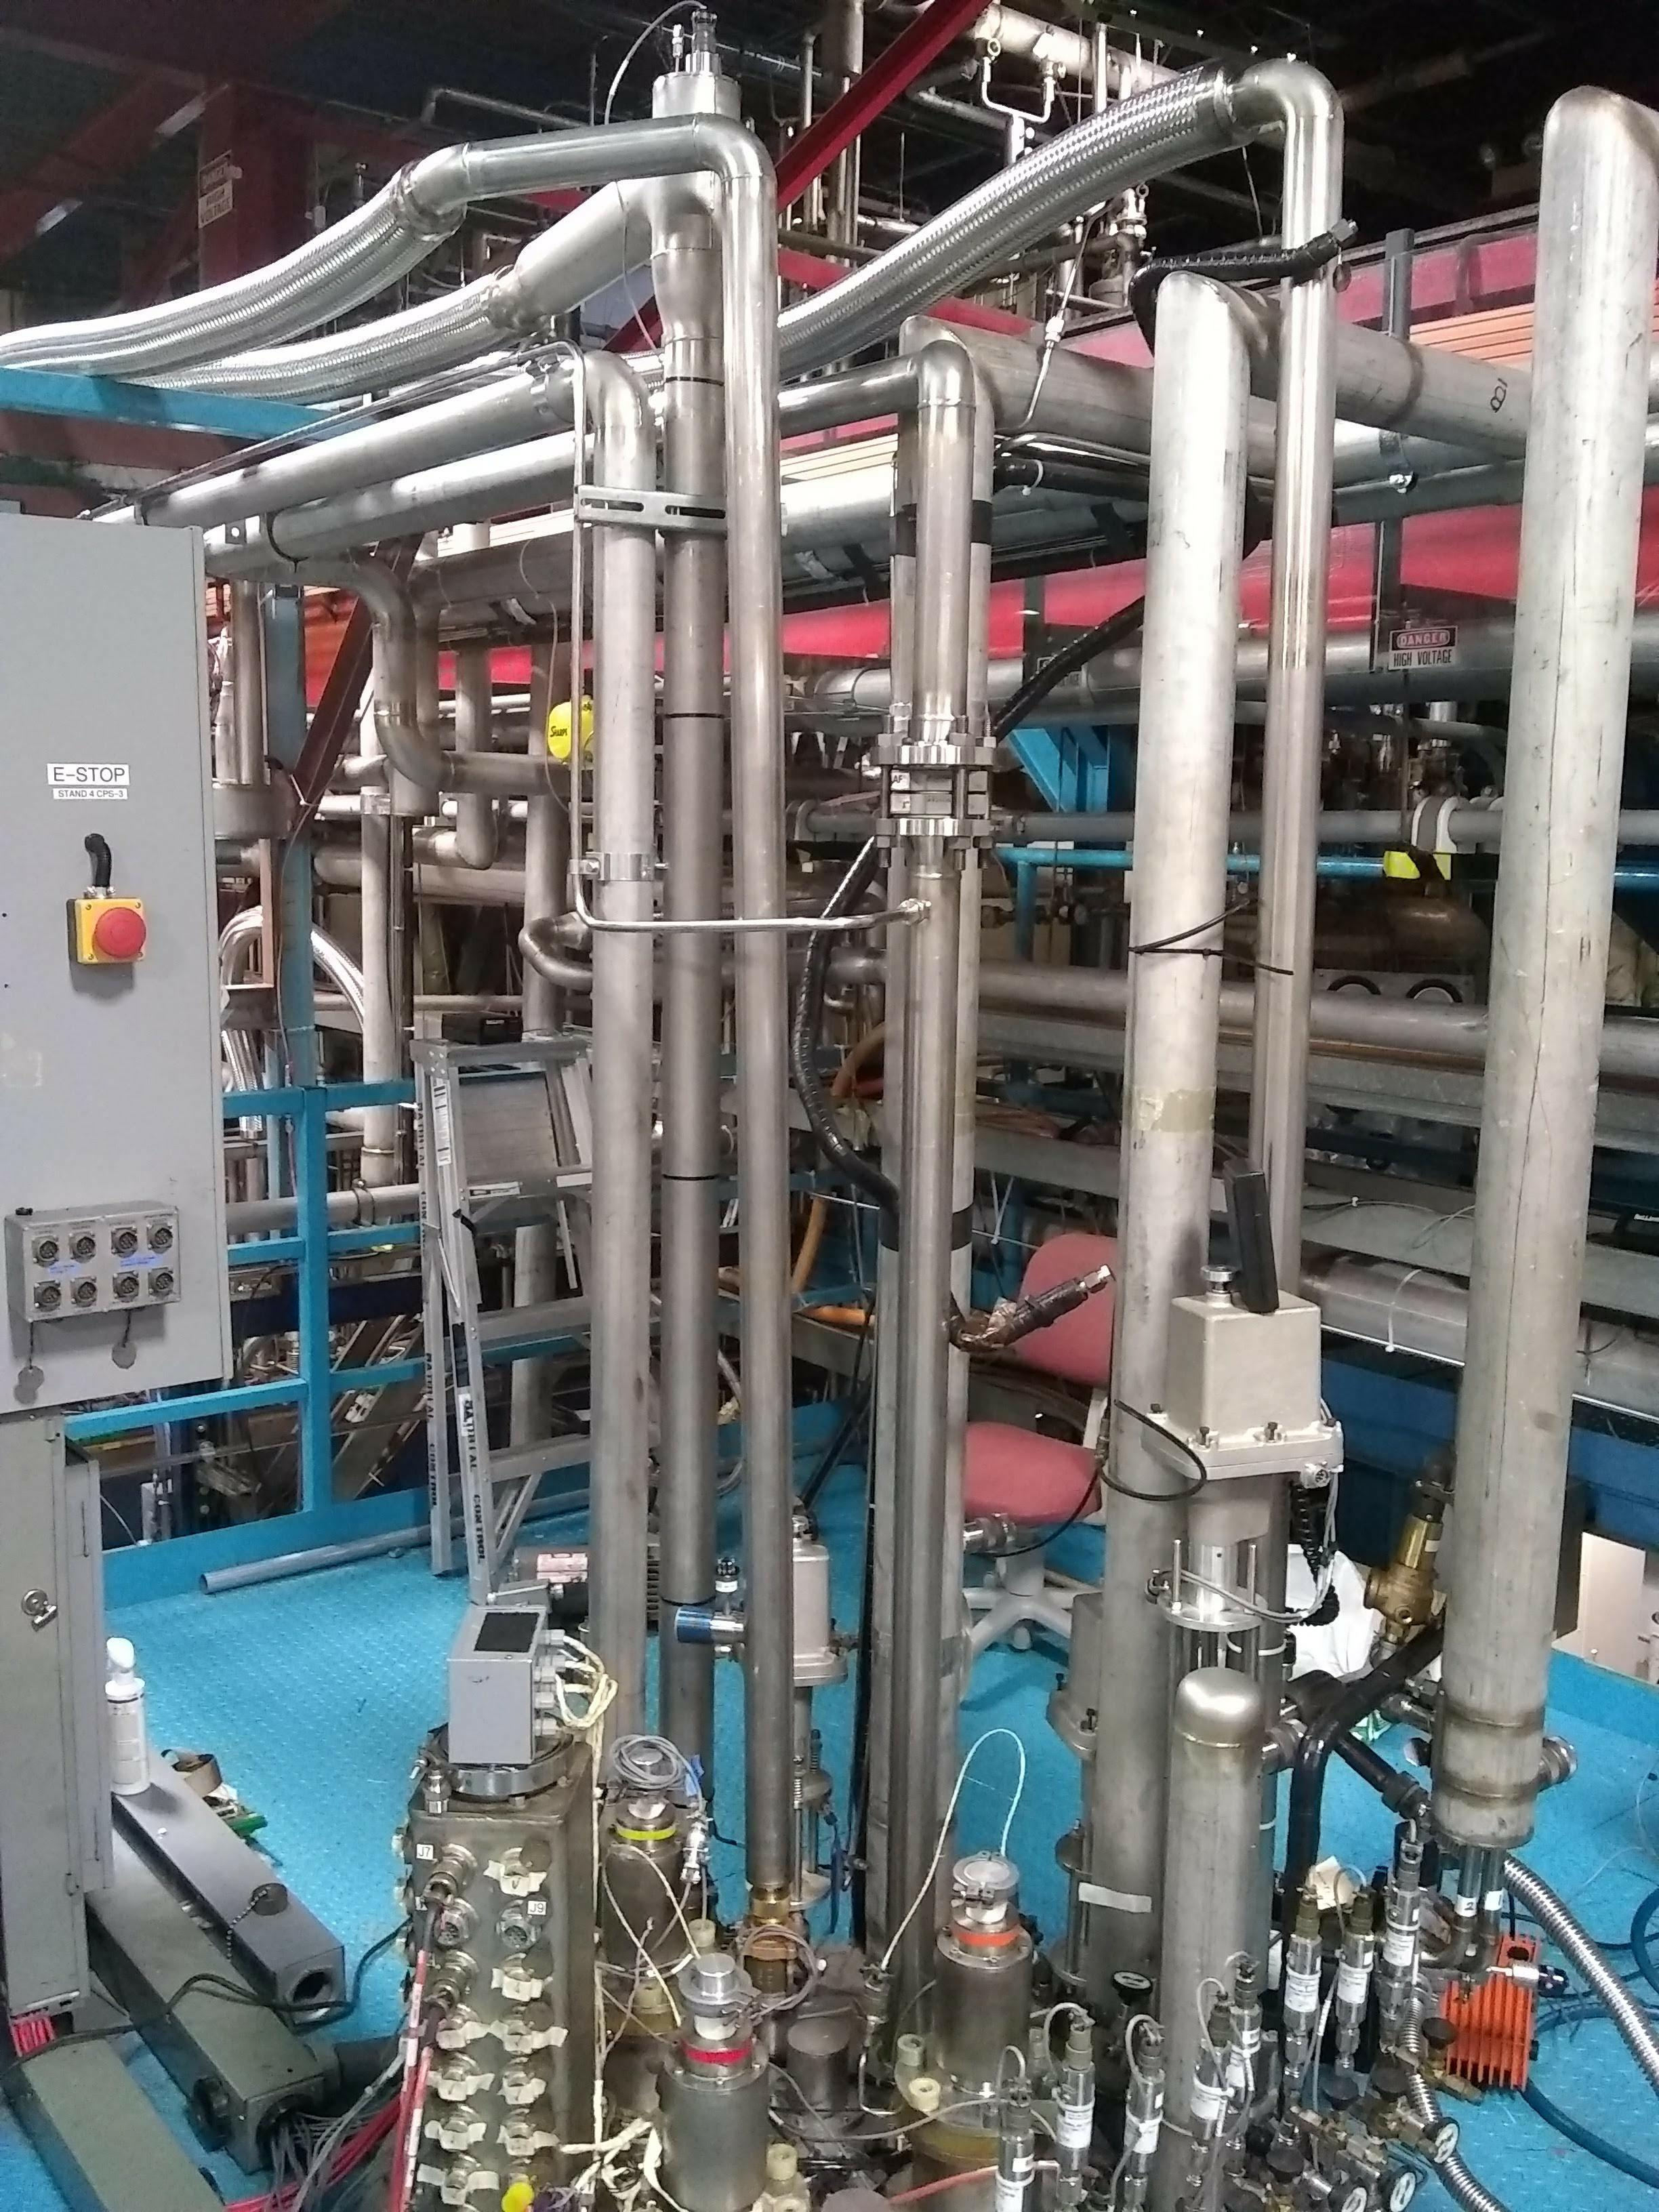
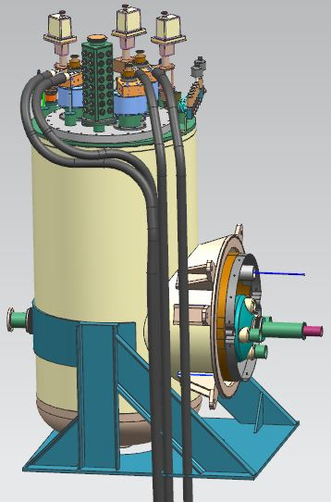
Test Stand 4 Equipment – Feed Box
Interfaces
  LHe and GHe supplies
  LN2 and GN2 supplies
  (3) 15 kA vapor-cooled current leads
  Pumping line
  Fill valves
  Instrumentation

Slide 5
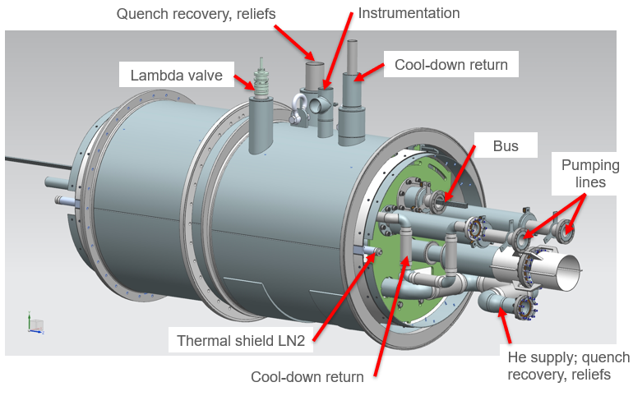
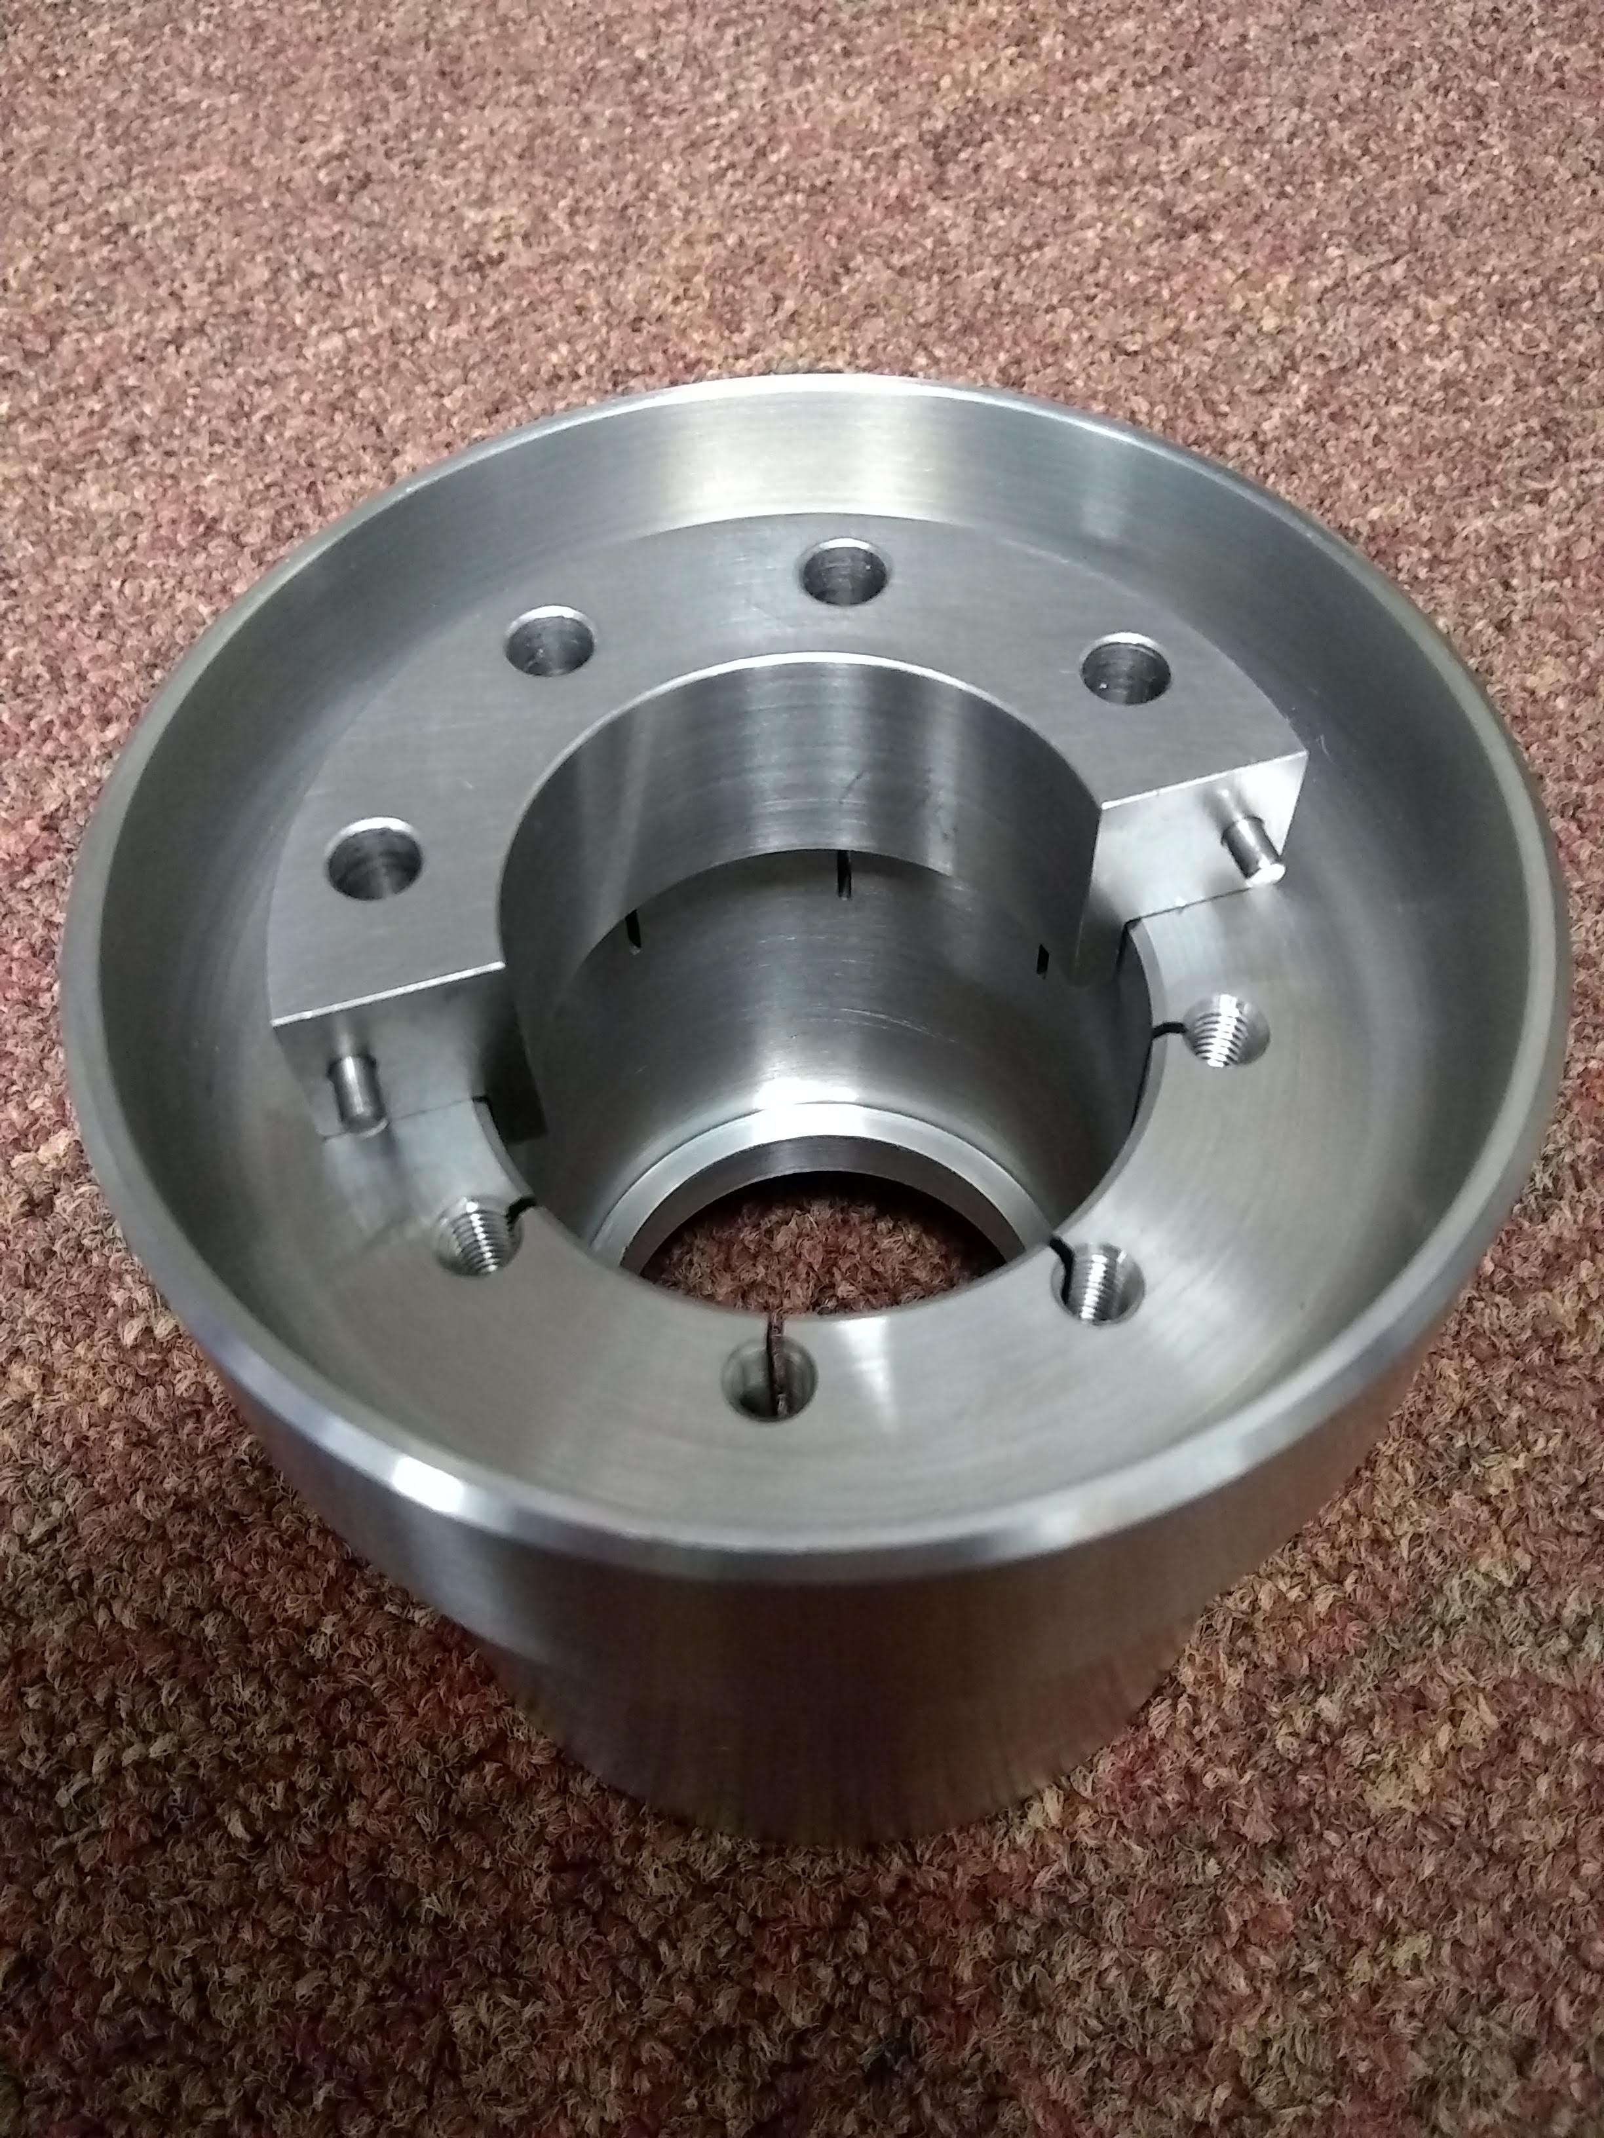
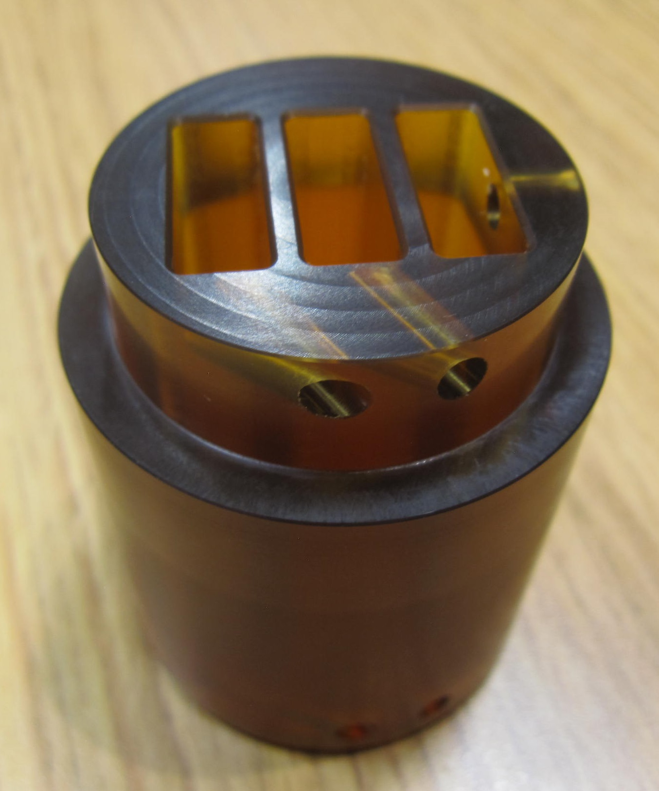
Test Stand 4 Equipment – Adapter Box
Interfaces
  Non-IP end interconnect
  Thermal shields
  Lambda plug
  Lambda valve
  Cooldown return
  Quench line
  Cold mass relief valves
  Instrumentation
Adapter Box

Slide 6
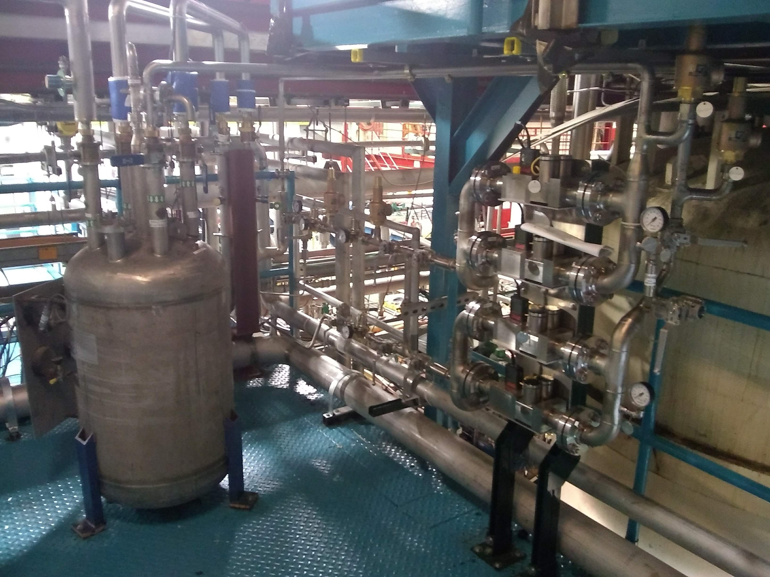
Test Stand 4 Operations – Cooldown/Warmup
Controlled cooldown/warmup are automated through the process controls PLC based on requested mass flow rate, measured cold mass temperature, and ΔT requirement.
For a GHe supply temperature between 300 K and 80 K, mix 300 K GHe with 80 K GHe.
For a GHe supply temperature below 80 K, mix 80 K GHe with 4.5 K LHe.
Flow into the Feed Box and then through the Adapter Box and the Cold Mass.
Flow returns through the LD line and the Adapter Box cooldown return, back to the compressors.
Mass flow controllers
LN2 bath

Slide 7
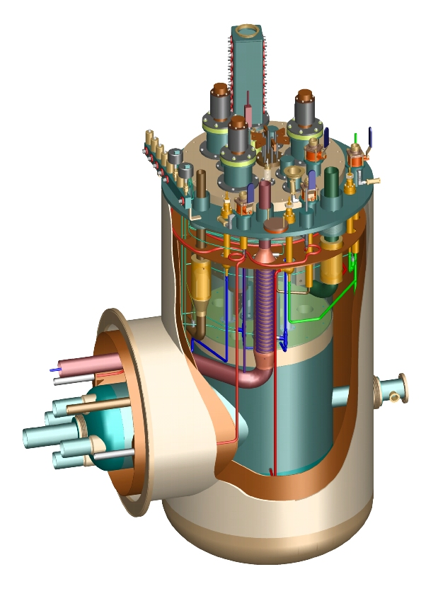
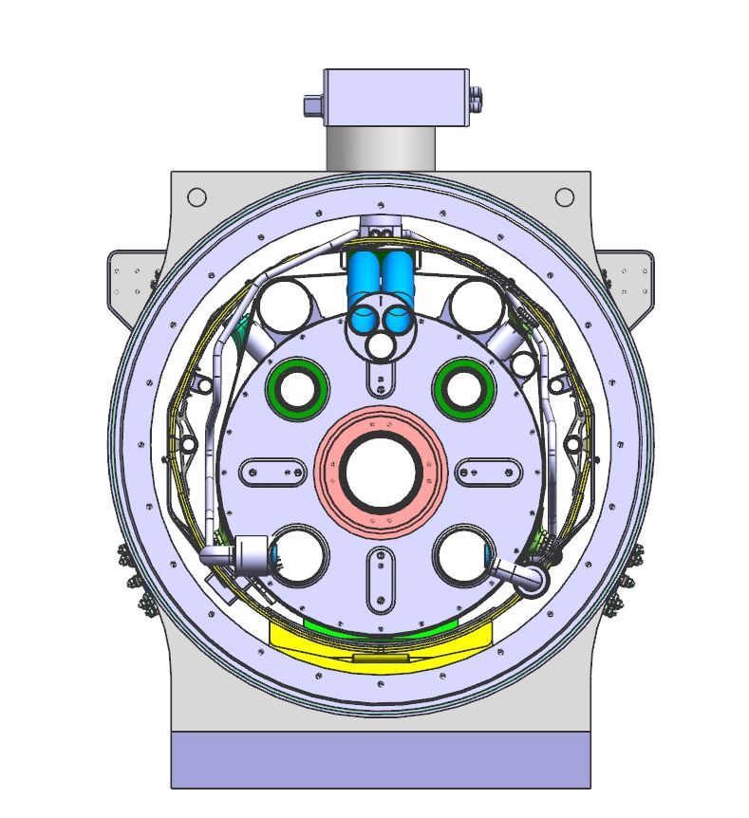
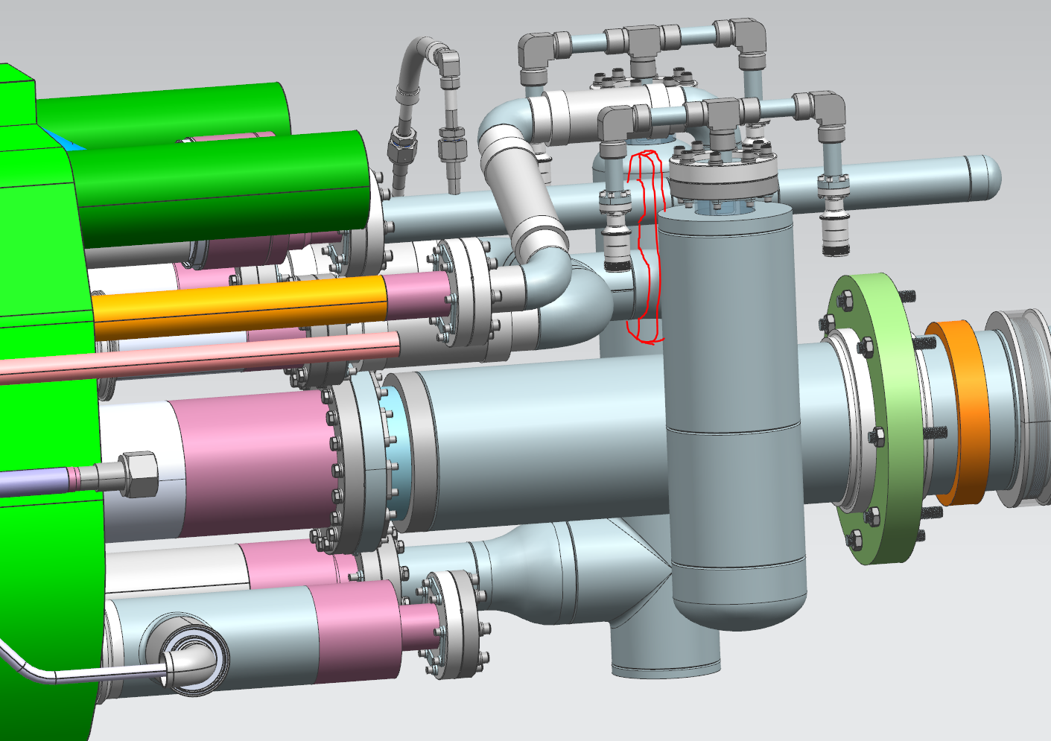
Test Stand 4 Operations – 1.9 K operations
Supply LHe to the X line heat exchangers from the Feed Box, which includes a J-T heat exchanger.
LHe collects in a reservoir at the return end (IP end) of the Cryo-Assembly.
X lines are connected through the Adapter Box to the Feed Box pumping line.
1.9 K Cryo-Assembly is separated from the 4.5 K Feed Box by the lambda plug and lambda valve built into the Adapter Box.
Pumping line
J-T HX
Return end (IP end) reservoir
X (1.9 K HX)

Slide 8
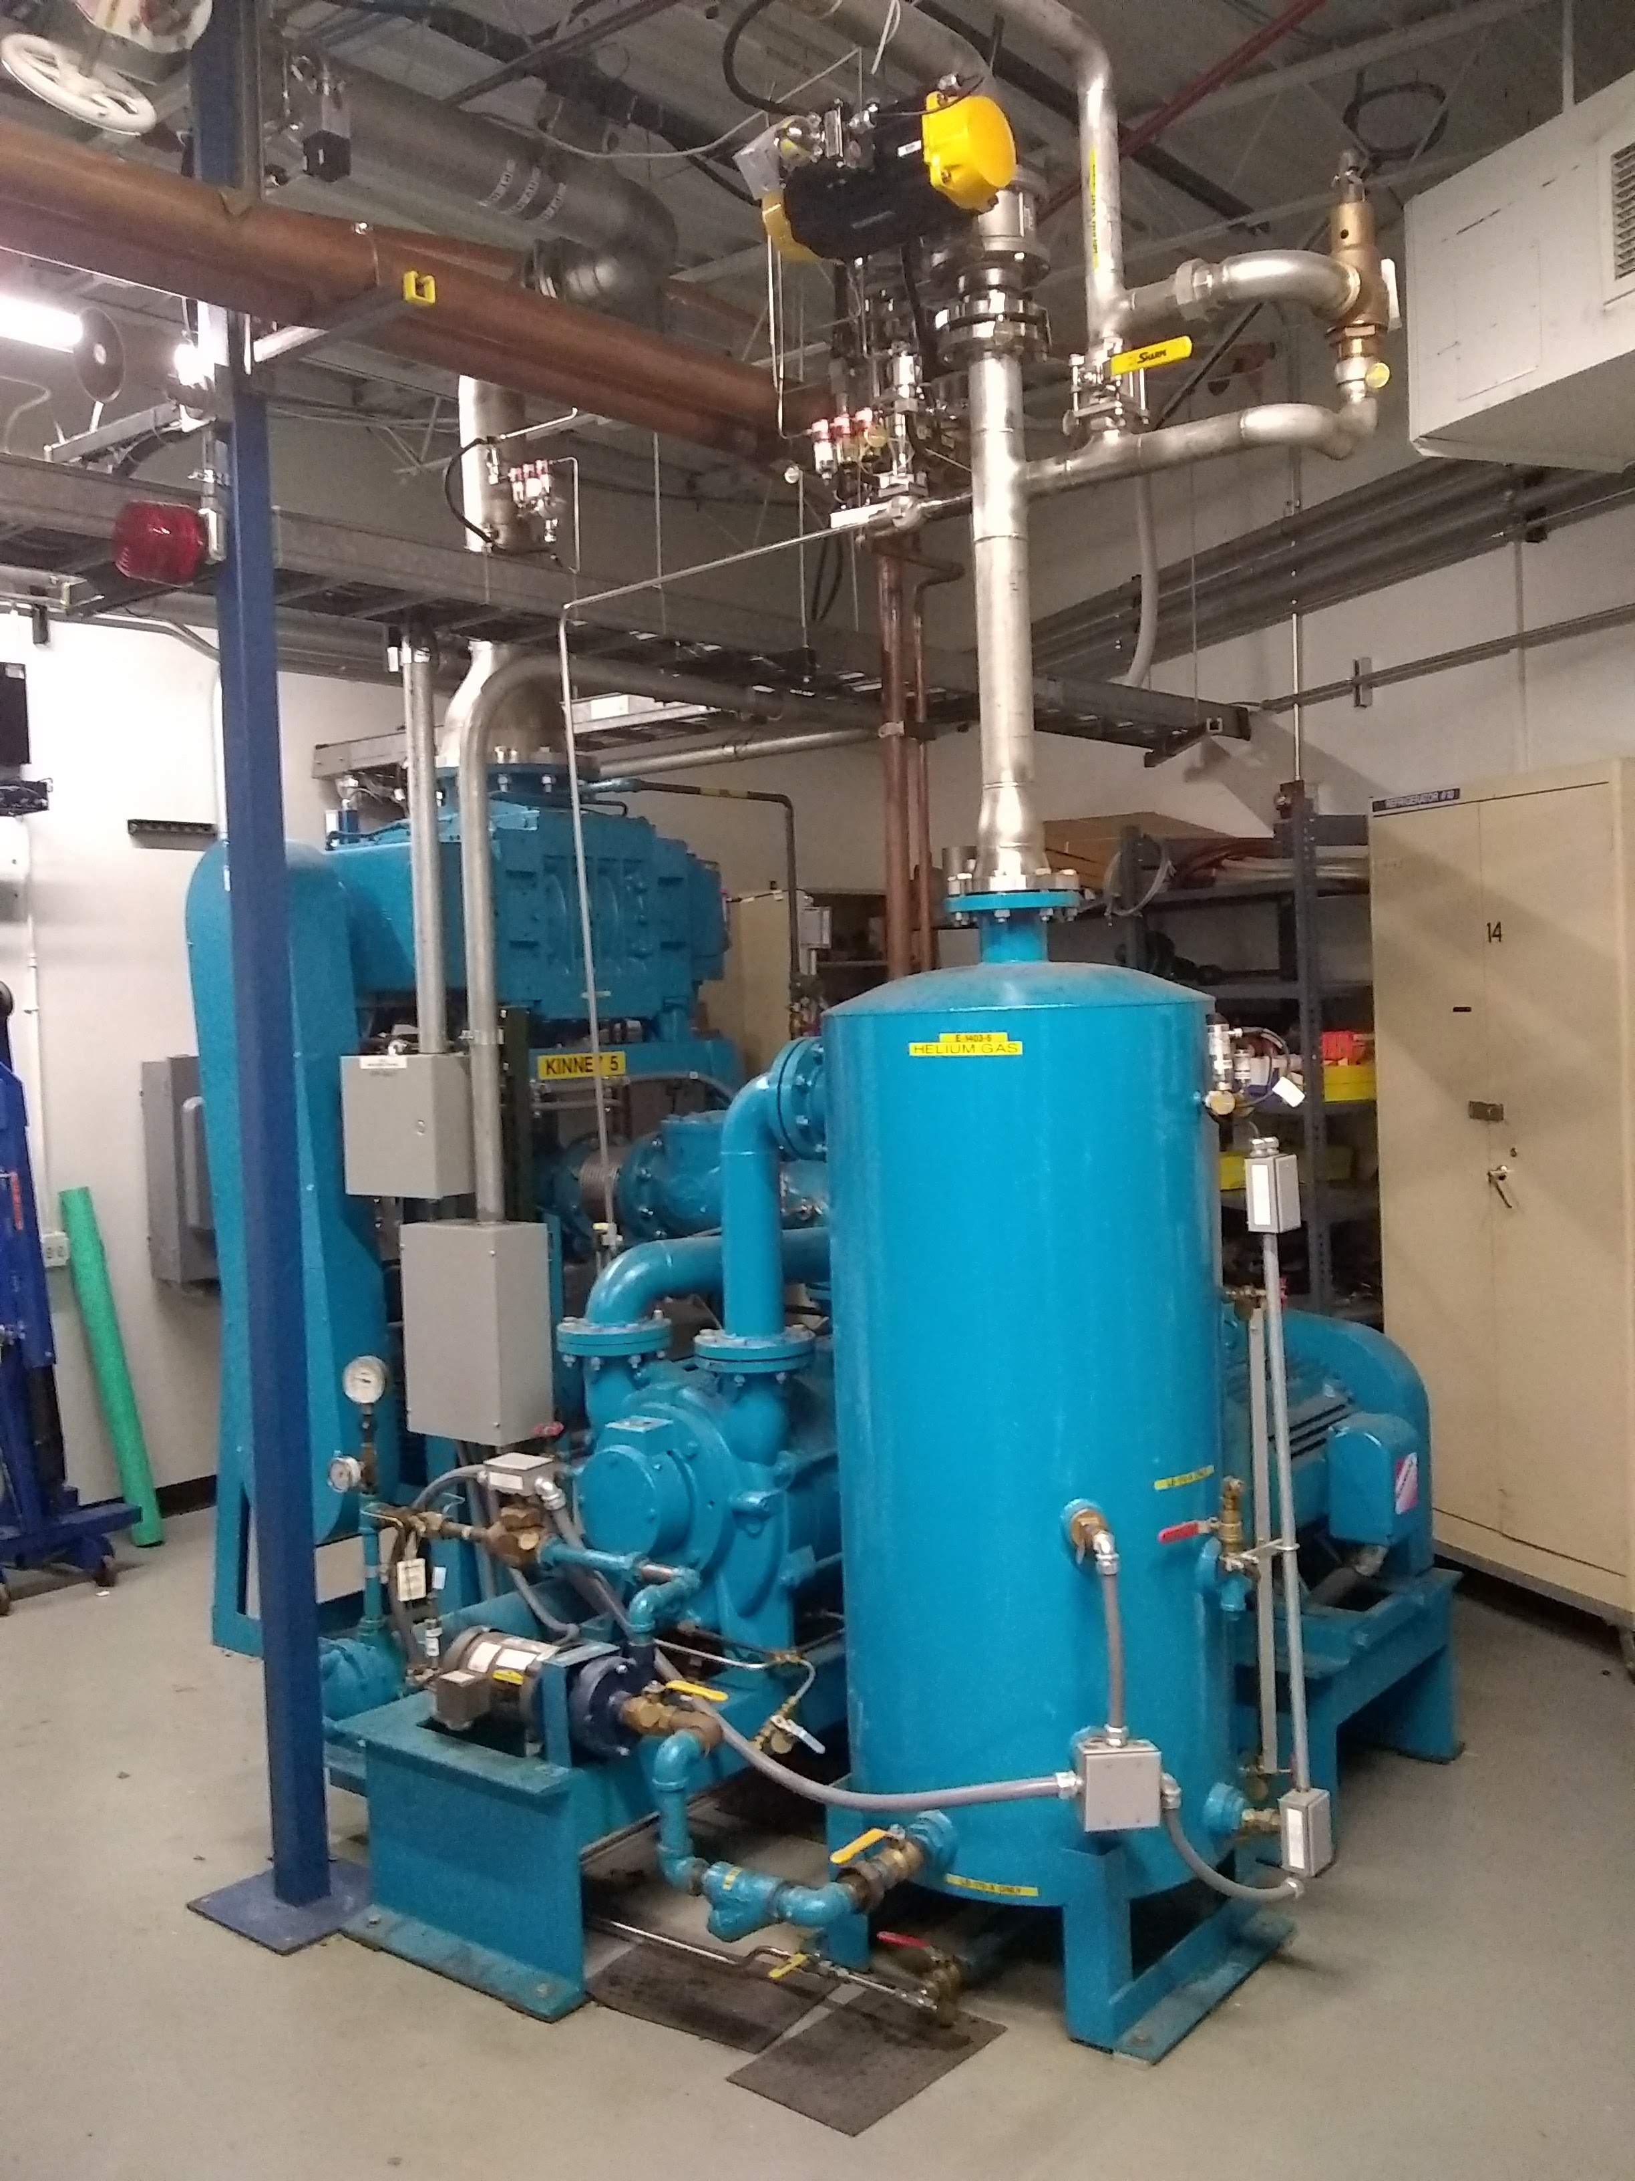
Test Stand 4 Operations – 1.9 K operations
Test stand is pumped on by two Roots blower/liquid ring pump vacuum skids.
Upstream control valve throttles pumping speed to control Cryo-Assembly temperature.

Slide 9
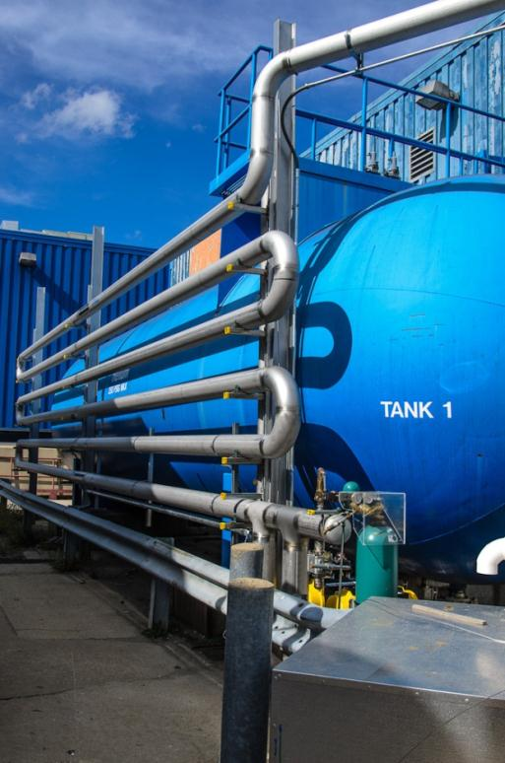
Test Stand 4 Operations – Quenching
Through the Adapter Box and an intermediate valve, the Cryo-Assembly can be connected to the Quench Tank.
The Quench Tank is one of the test facility’s 30,000 gallon (114 m³) GHe storage tanks that can be reconfigured.
Quench line

