Slide 2
Thermo-mechanical modelling
C. Garion, M. Moronne, TE/VSC
Motivations of the 3D model.
Strategy for the 3D model.
Thermal analysis of the magnet cooldown.
Test of a series magnet.
CFD-thermal model.
Comparison with transient CFD-thermal model.
Steady state thermal mechanical results.
Model description.
Results and comparison with measurements.
Conclusions and next steps.

Slide 3
Motivations for a 3D model
Study and explain the overall behaviour of the cold mass during thermal cycles and powering. In particular, how the longitudinal force of about 500 kN per aperture is transferred to the structure?
Assess the stress/strain fields in the complex coil end zones and analyse presence of potential local weak points during these loading conditions.
Study potential mitigation solutions.

Slide 4
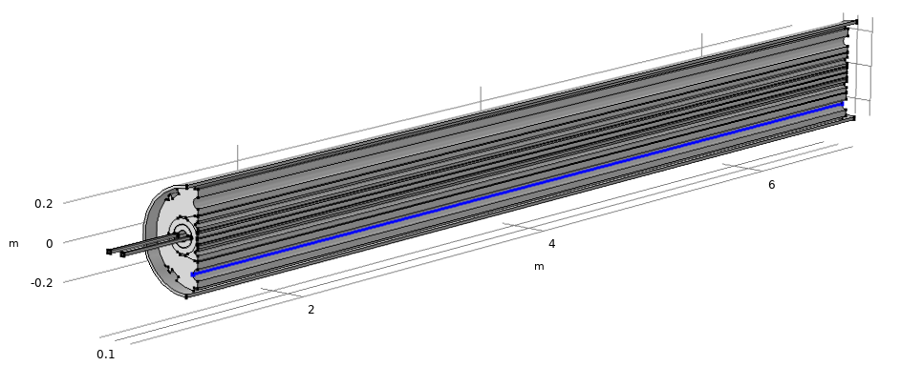
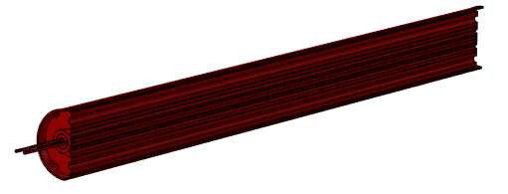
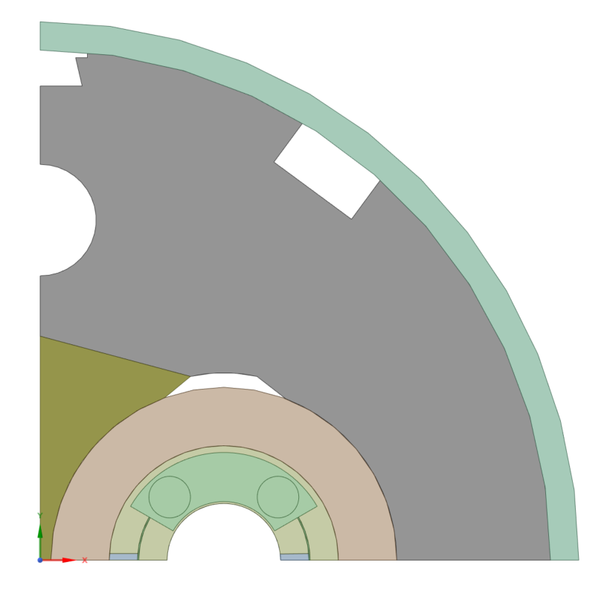
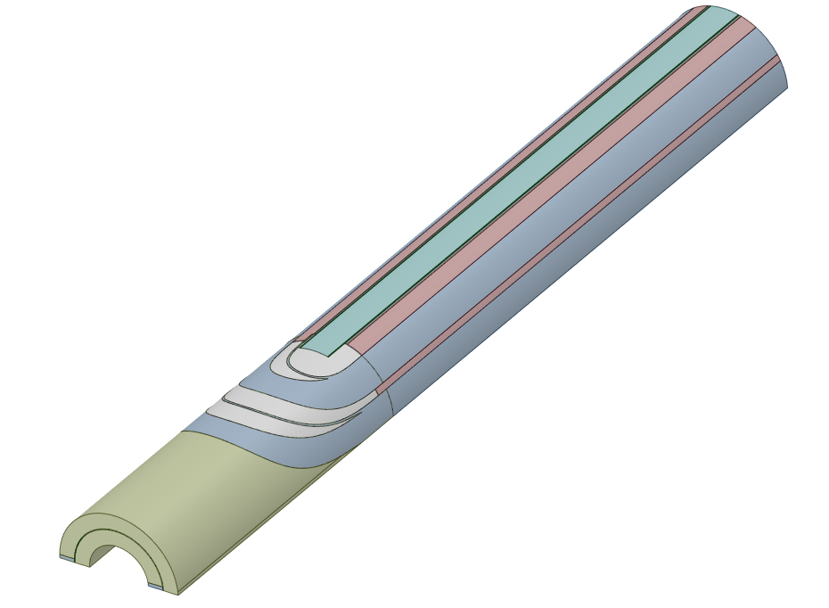
Strategy for the 3D model
Multiphysics model (final objective)
Thermal properties (T)
Helium flow properties
Simplification of the flow in 1-D
Thermal model
CFD-THERMAL coupling
Transient local temperature field during cool down
Thermal mechanical properties (T)
Flexible structure
Transient and steady state overall behavior and local stress/strain fields
Electromagnetic forces
Thermo-mechanical model with submodelling
Results shall be compared with local and overall measures (temperature, strain, forces,…)

Slide 5
Strategy for the 3D model
Multiphysics model (Status)
Thermal properties (T)
Helium flow properties
Simplification of the flow in 1-D
Thermal model
CFD-THERMAL coupling
Transient local temperature field during cool down
Thermal mechanical properties (4K)
Flexible structure
Uniform temperature
Steady state overall behavior and local stress/strain fields
Electromagnetic forces
Thermo-mechanical model

Slide 6
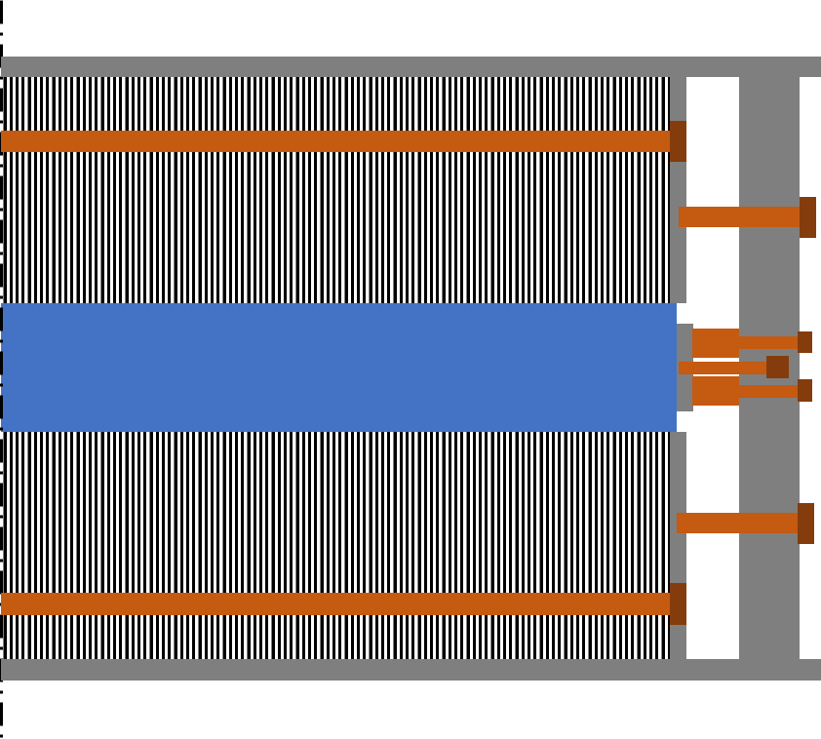
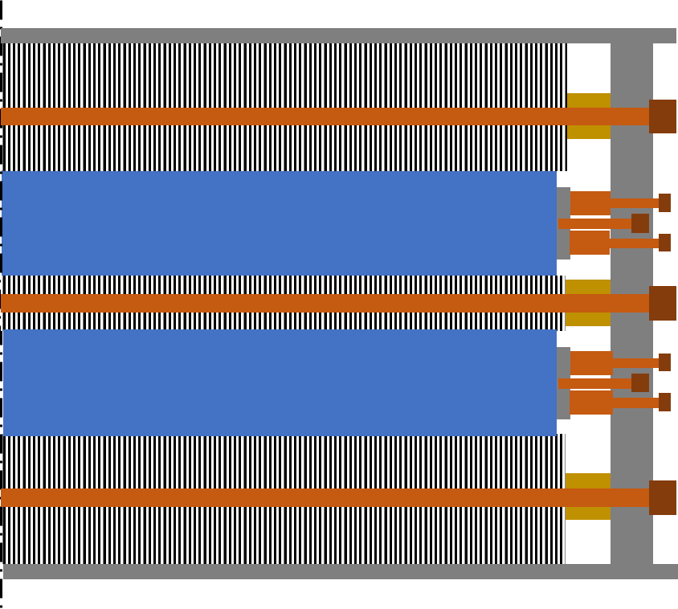
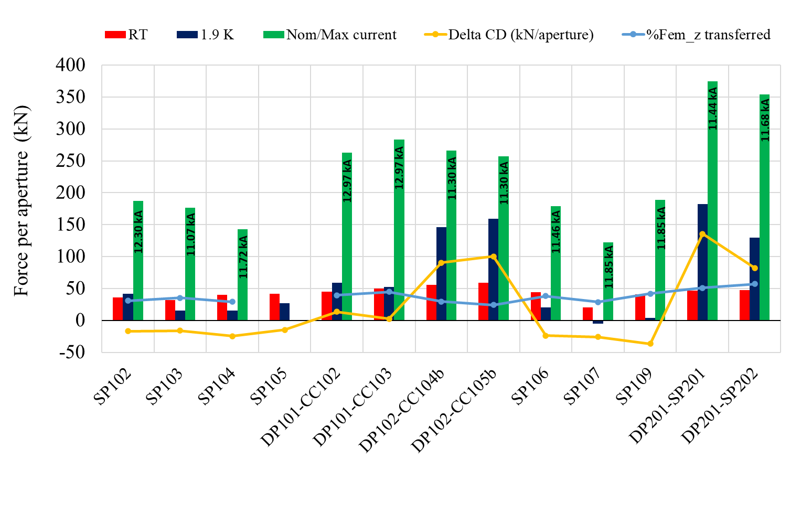
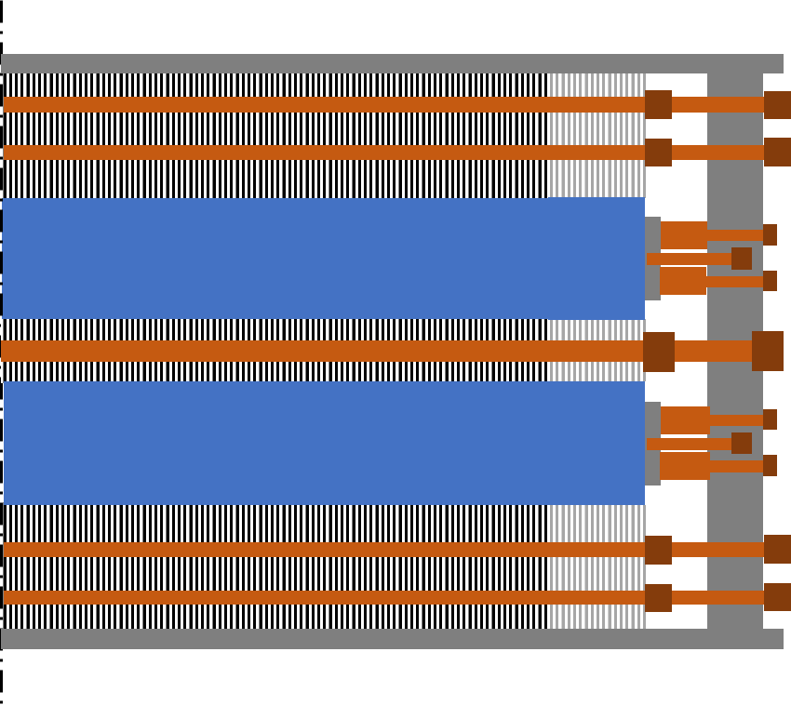
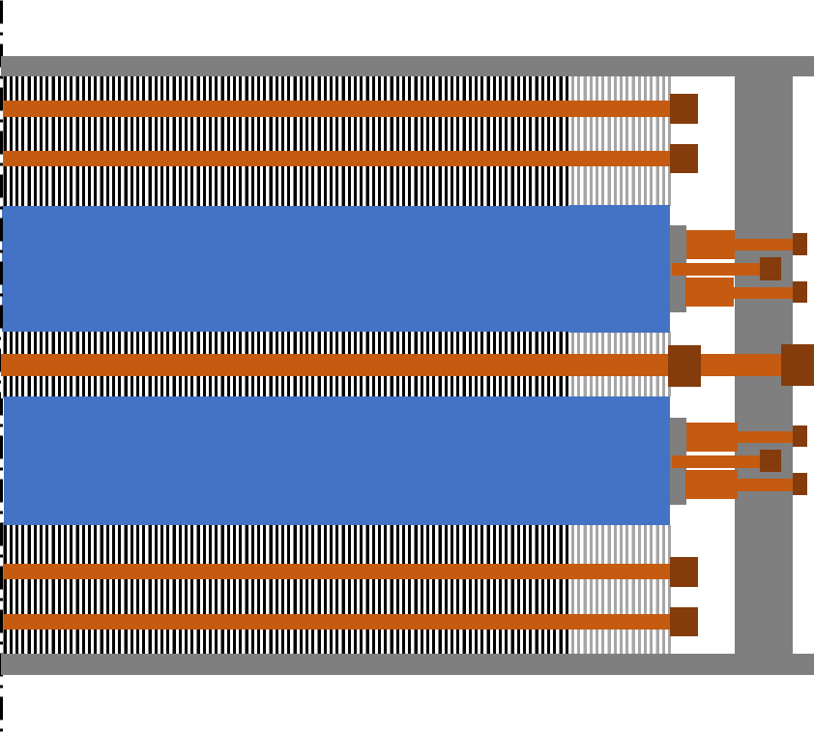
Strategy for the 3D model
Different 11T prototype variants (single aperture, double aperture) exist leading to significant differences in the overall observed behaviour during cooldown.
Shell
End plate
Yoke
Coil
Bullet
Single aperture (SP10X)
Double aperture (DP101)
Courtesy E. Gautheron
2nd & 3rd Double Aperture (DP102&DP201)
Series magnets
A qualitative study (simple 1D analytical consideration based on relative stiffnesses and thermal contractions) has been made and explains this difference.
The 3D model considered in study is focused on the 11T series design.

Slide 7
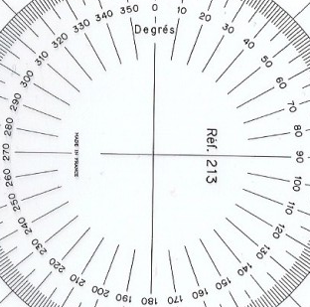
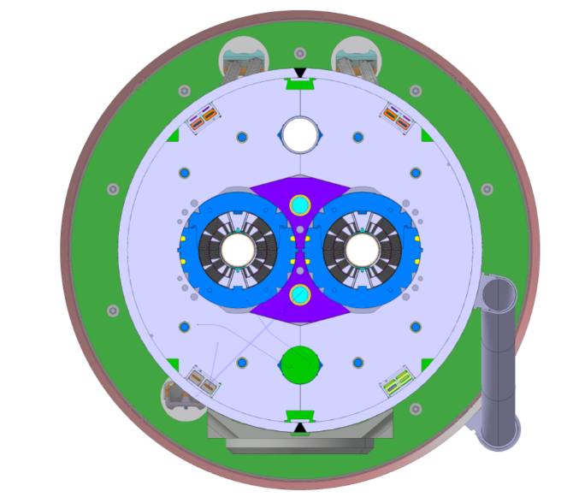
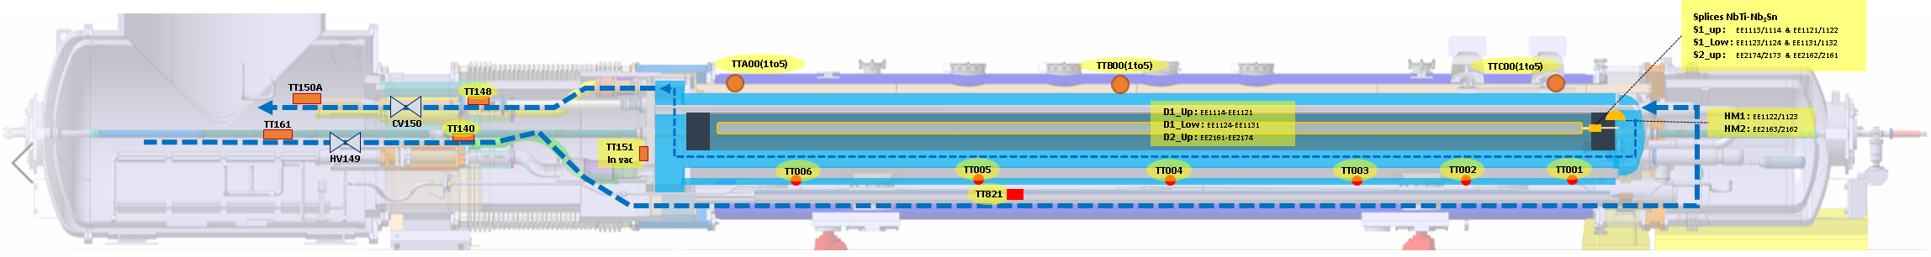
Thermal analysis – Test of a series magnet
The instrumented S2 magnet has been tested in August 2020.
1
2
5 sensors on the shell at 3 longitudinal positions (TTA, TTB, TTC)
5
3
Outlet temperature
Inlet temperature
4
Connection side (CS)
Cooling configuration:
50 g/s
ΔT_{inlet_outlet}= 30 K
Temperature sensors inside the main cooling channel of 11T (TT001 to 006)
Average temperature of the coils and splices by resistance measurements
Main results *:
Symmetry left/right respected for the shell and the coils
Temperature gradient in helium along main cooling channel of about 10-13 K
On the shell, temperature gradient up to 30K longitudinally and <8K in a cross-section
Splice temperature following closely the inlet gas temperature (<6K)
Temperature difference splice/shell of about 25 K at the start
*Y. Leclerc: https://indico.cern.ch/event/968910/

Slide 8
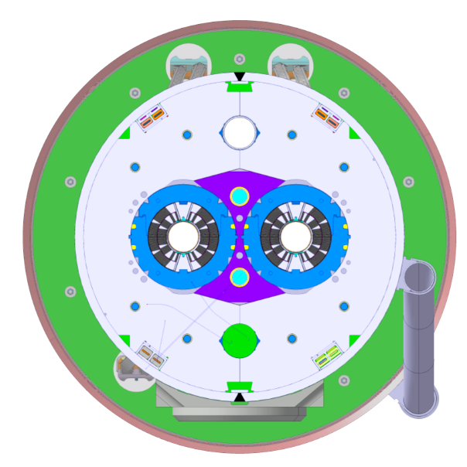
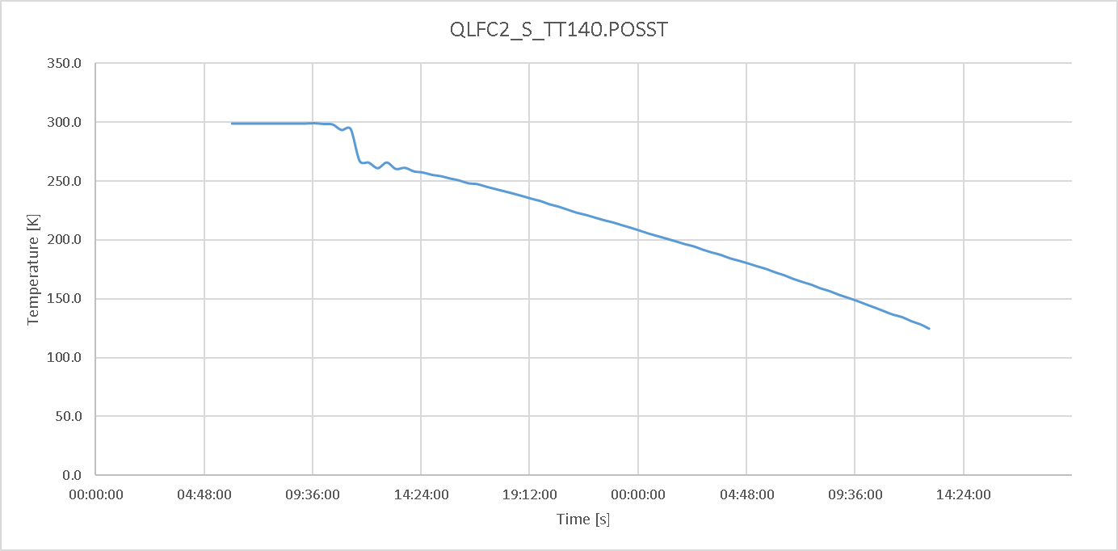
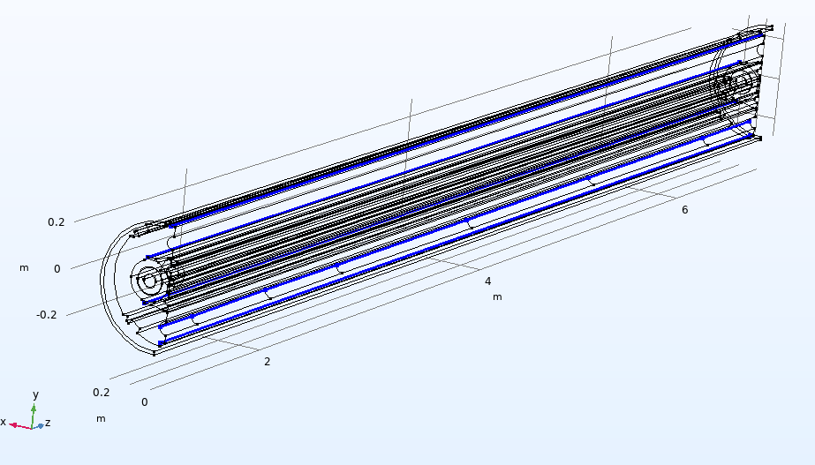
CFD-Thermal model
The CFD calculation is simplified in a 1-D approximated flow. Advection is considered (No NS/RANS equations computed);
The convective heat coefficient is automatically calculated through analytical formulations;
The input parameters are: pipe shape & dimensions, friction model for pressure loss, inlet pressure, temperature, tangential velocity, mass flow rate.
The thermal physics (heat equation) is coupled with the CFD physics to account for the convective heat flux;
Temperature dependence of material properties is accounted.
Total flow: 50 g/s, P=3.5 bara
Measured Inlet temperature is used as input of the model.
Symmetry conditions are used.
2 X
d_{hyd} ≈ 23 mm
m = 5g/s (10%)
2a
3b
4 X
d_{hyd} ≈ 18 mm
m = 5.0 g/s (10%)
Temperature profile at the inlet as input
2b
1
Ø60mm
m = 20 g/s (40%)
Cooling channels for the CFD model
Mass flow distribution

Slide 9
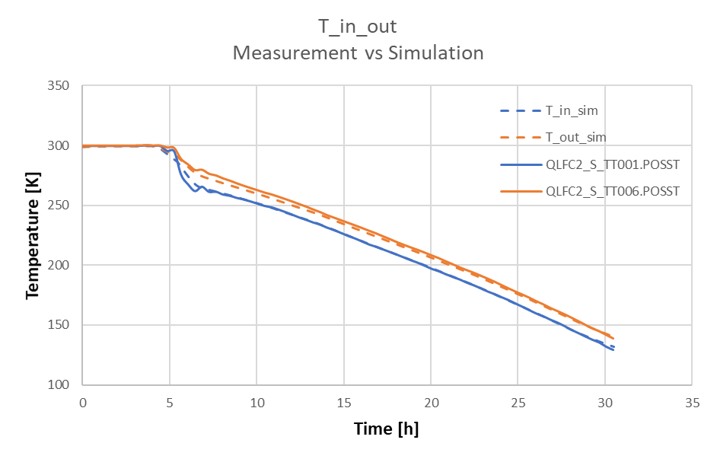
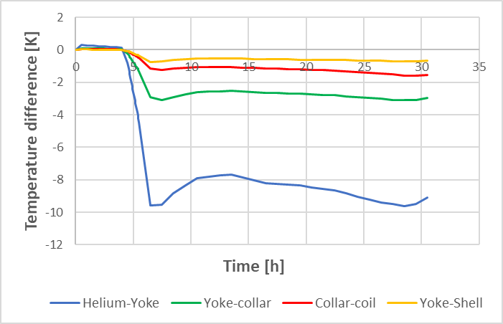
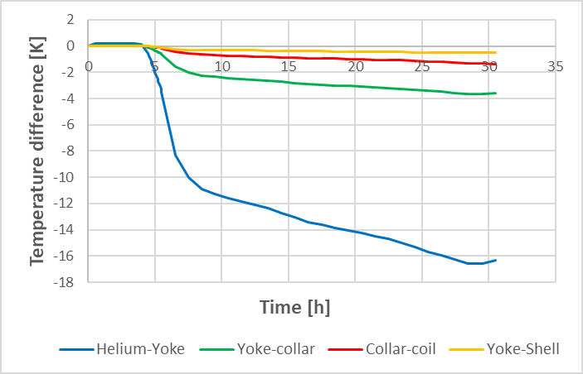
Cooldown simulations
Temperatures obtained by simulations are in good agreement with measurements.
maximum temperature difference between the measurements and simulations is below 3% for the main cooling channel.
Maximum difference simulation/measurement of 9 % is obtained on the shell.
Comparaison measurement/simulation of the inlet and outlet temperatures
Main results:
Temperature gradient in helium along main cooling channel around 13 K.
Longitudinal temperature gradient in the structure around 20 K.
Radial average temperature difference in the magnet structure around 5K.
Collar temperature at CS always lower than coil temperature.
Average temperature difference on CS
Average temperature difference on NCS side

Slide 10
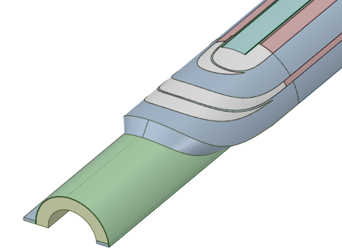
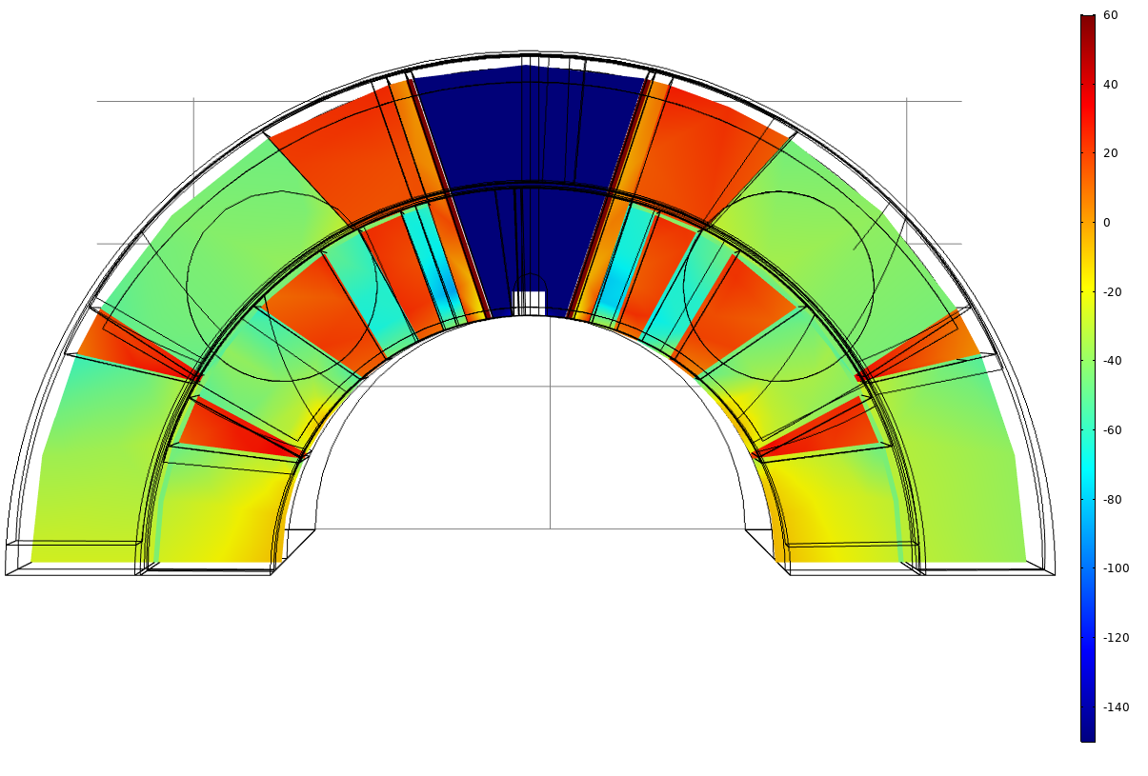
Thermal-mechanical model
Geometry:
A quarter of half a magnet, connection side, is modelled.
Gap between spacers and wedges are considered.
Contact (pole/coil, yoke/collar) are considered.
Pole
Materials and associated constitutive model:
Elastic properties at 4 K.
Coefficient of Thermal Expansion (CTE) integrated from 300 K to 4 K.
Most of the material data are available. Cable block properties (orthotropic material) to confirm.
Laminated structures (yoke, collar) are taken into account.
No gap with winding key
Wedges
Spacers
Winding key
Cables (bulk)
Saddle
Geometry of the coil end
60
Loads are applied in sequential steps:
Azimuthal prestress of the coil (offset in the gap pole/coil)
Shell welding (equivalent thermal strain)
Bullet loading (30 MPa → about 40 kN/aperture)
Cooldown (quasi-static uniform decrease 300K → 4K)
Powering (440 kN/aperture shared between inner/outer coils)
0
Longitudinal stress after cooldown
-140

Slide 11
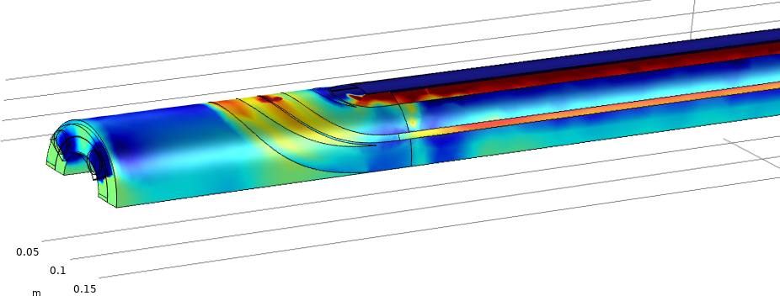
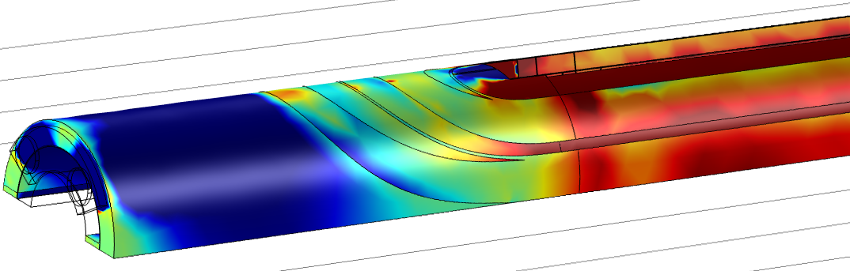
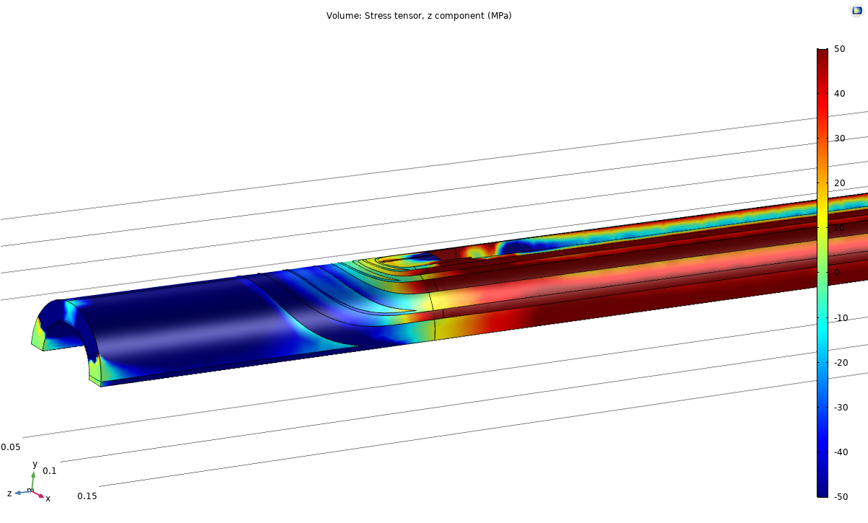
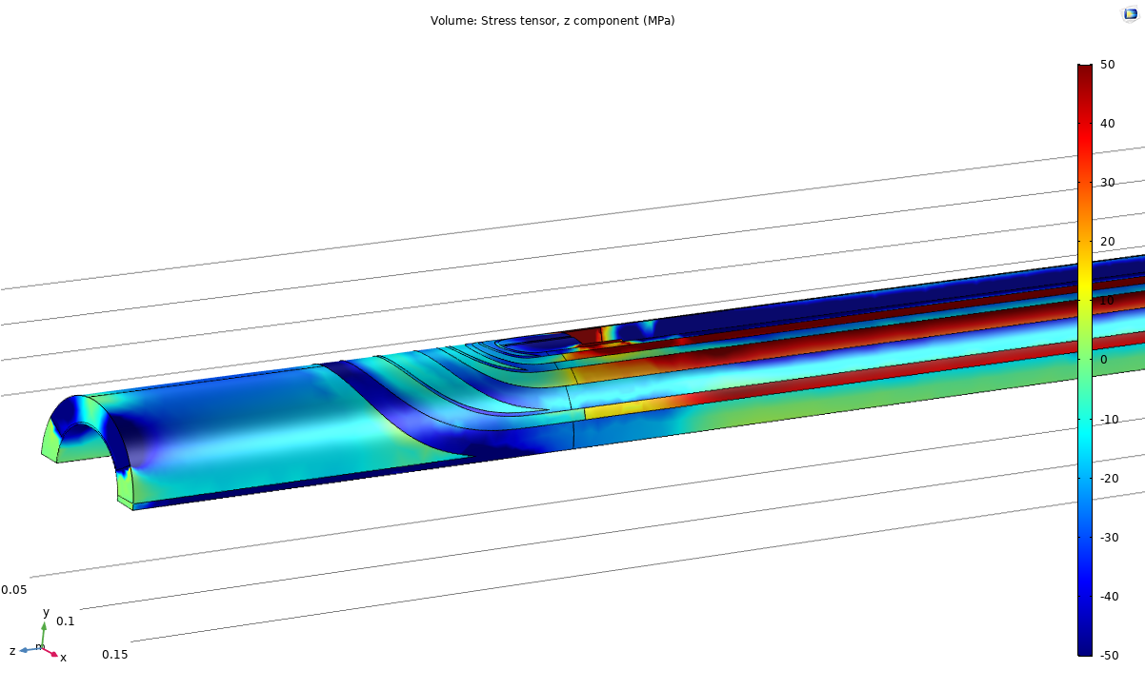
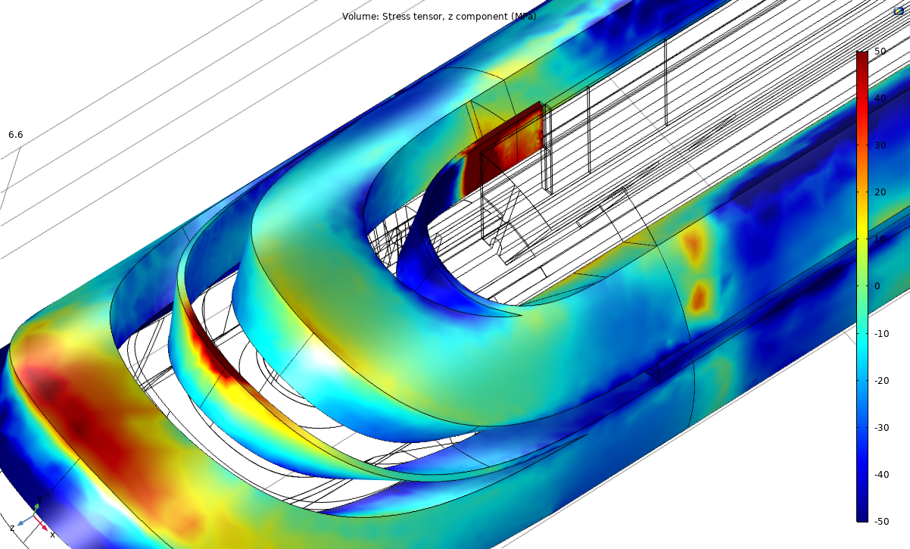
Steady state thermal mechanical results
Bounded spacers - wedges
Upper coil
Upper coil
140 MPa
70 MPa
10 MPa
30 MPa
70 MPa
Lower coil
Lower coil
50 MPa
20 MPa
50 MPa
Longitudinal stress after cooldown
Longitudinal stress after powering
→ After cooldown, a non-uniform profile of the longitudinal stresses is observed at the extremity.
In particular, a peak appears in the first block, upper coil.
→ Longitudinal stress in the range of 10 MPa are observed in the conductors with a peak up to 140 MPa, induced by the CTE mismatch between the coil and the titanium pole.
→ During powering, stresses increase up to 70 MPa in the straight part of the conductors.

Slide 12
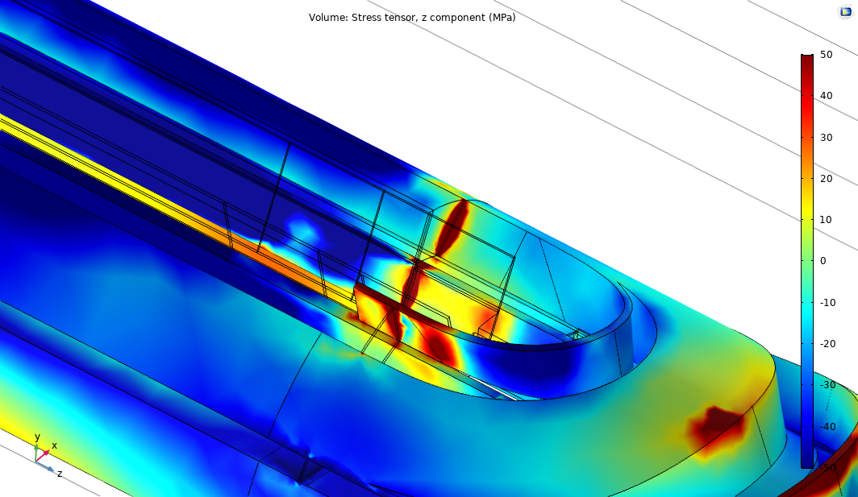
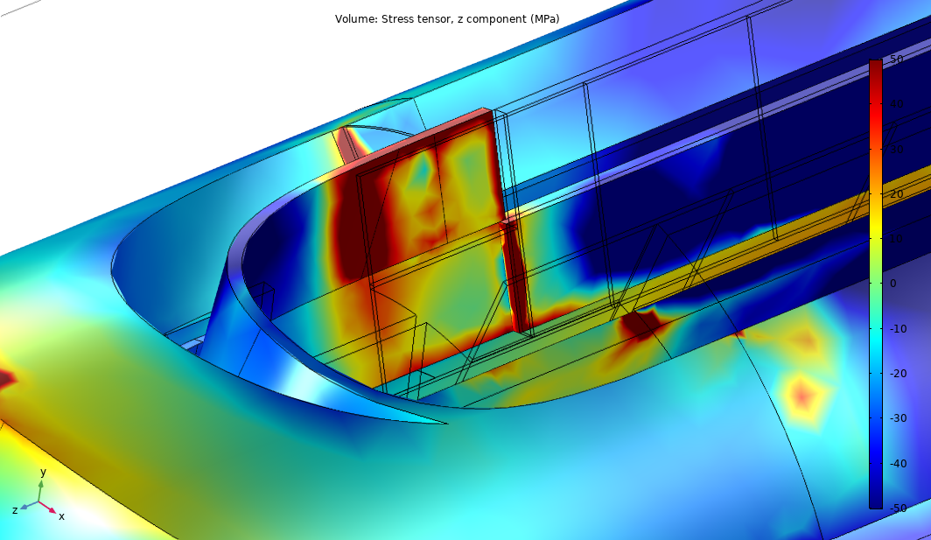
Steady state thermal mechanical results
Gap between spacers - wedges
Due to CTE mismatch and no gap pole/winding key
70 -230 MPa
Due to spacer/wedge decoupling
Longitudinal stress after cooldown in the conductor blocks
In case of gap between spacers and wedges (failure of the brittle resin), additional stress concentrations appear in the conductor blocks during the cooldown.
Stresses of around 230 MPa are observed locally.
Submodelling is required to better assess the local stress concentration.

Slide 13
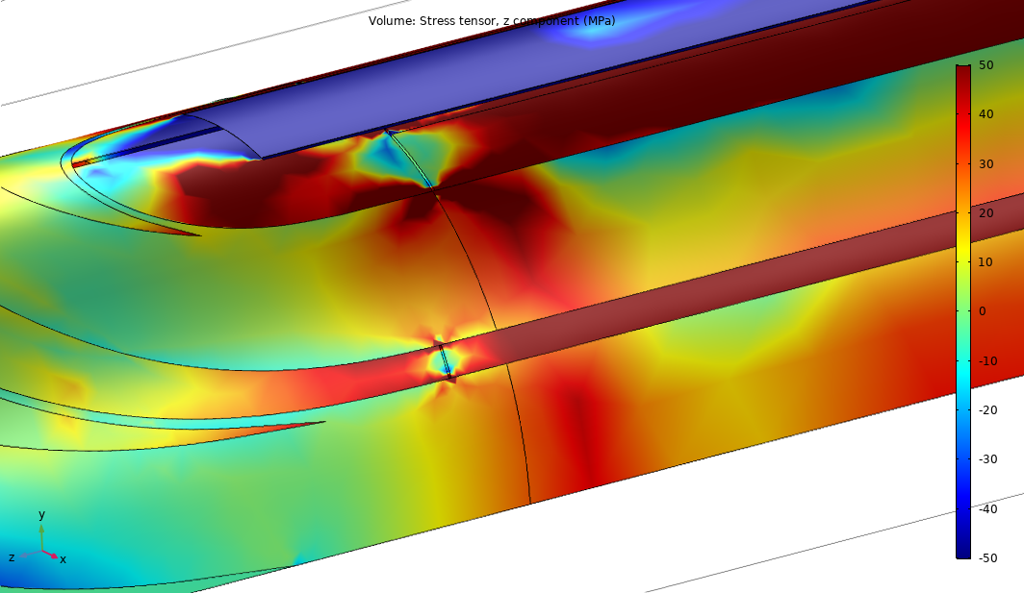
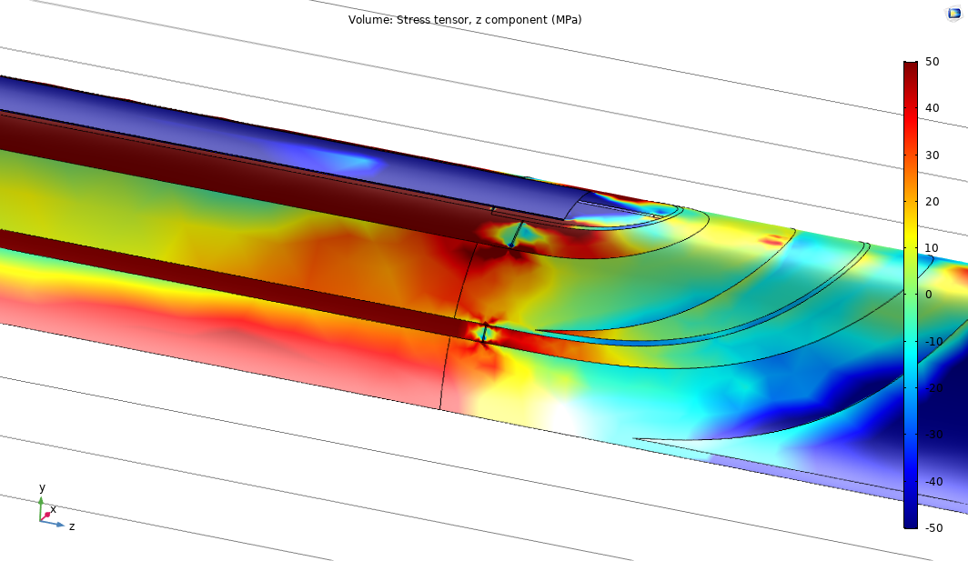
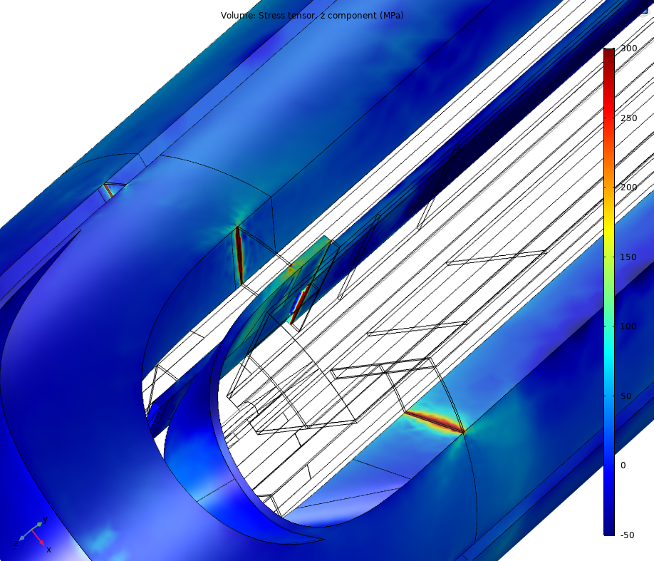
Steady state thermal mechanical results
Gap between spacers - wedges
80 MPa
80 MPa
Longitudinal stress during powering
Stress concentration is increased during the powering up to the order 300-400 MPa.
Submodelling is required to better assess the local stress concentration.

Slide 14
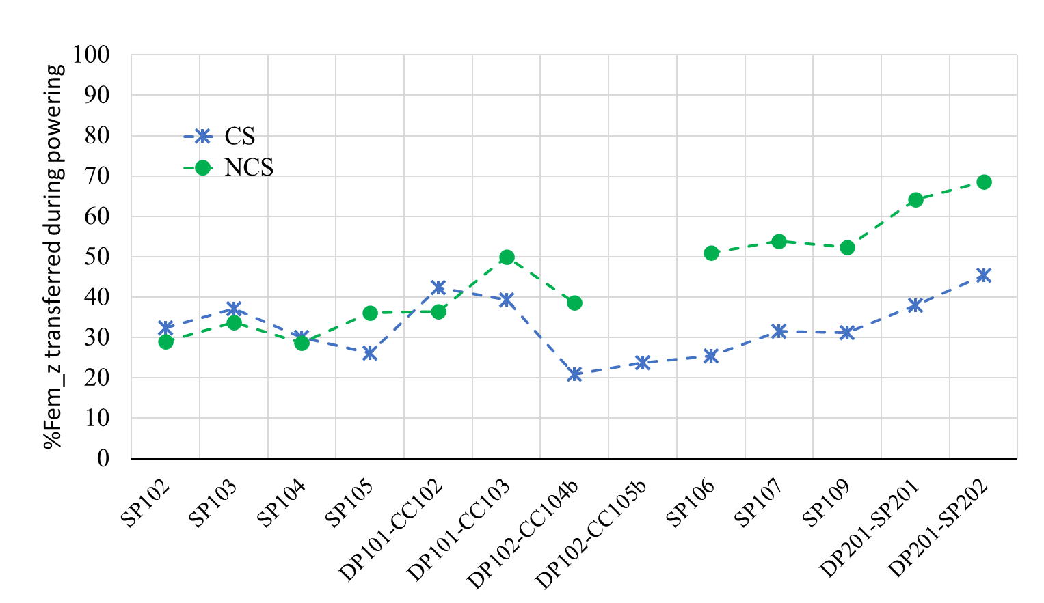
Steady state thermal mechanical results
Comparison with measurements
Longitudinal behaviour is assessed by the forces in the bullets.
Powering
Cooldown
Estimated variation of the force in the bullets due to the cooldown is around 130 kN/aperture, compared to the 80-140 kN observed.
80% of the longitudinal EM forces is expected to be transferred to the bullets, compared to the 40-50% measured.
Only 40-50% transferred → How the missing part is shared between the collar/structure ☺ or the coil ☹?
→ The present model is a bit too stiff (known and will be improved).

Slide 15
Conclusions
A 3D CFD-thermal-mechanical model of the 11T has been developed. Most of the thermal mechanical materials properties have been confirmed or re-evaluated.
The CFD-thermal model and cooldown test on an instrumented magnet do not exhibit any specific issue or critical areas related to the cooldown transient.
The model allows a much deeper understanding of the overall thermal mechanical behaviour of the magnet. Results of the overall behaviour are in rather good agreement with measurements.
The transition between the curved and straight parts of the coils seems to be the most critical. It cumulates:
Effect of the thermal contraction mismatch between the Ti pole and the coil.
Powering longitudinal force not fully transferred to the mechanical structure due to a soft longitudinal support (saddle).
Geometrical singularities.
Flexible structure

Slide 16
Next steps
Refine the thermal-mechanical model:
confirm the longitudinal stiffness of the conductor blocks.
Young’s modulus evolution of the blocks in the curved parts.
Submodelling of critical zones.
Study mitigation solutions.
Effect of the thermal contraction mismatch between the Ti pole and the coil → gap pole/winding key,…?
Powering longitudinal force not fully transferred to the mechanical structure due to a soft longitudinal support (saddle) → stiffer support, additional features,…?
Prepare test magnet (if approved):
Define the configuration (mitigation implementation?).
Define the instrumentation to assess overall and local behaviour during cooldown and powering.
Flexible structure

Slide 18
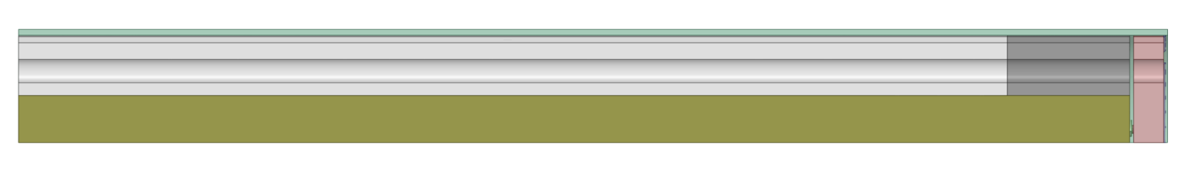
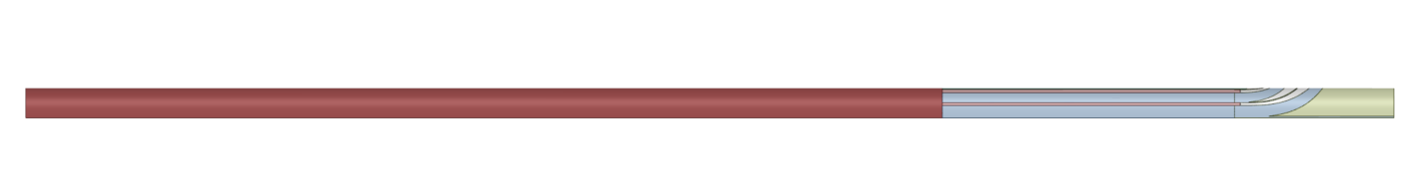
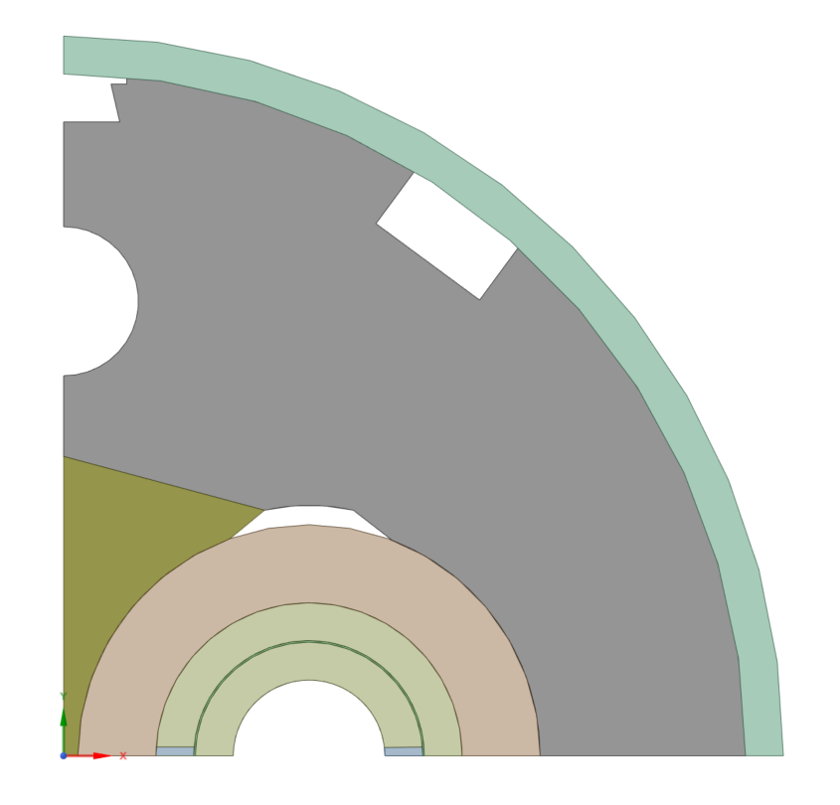
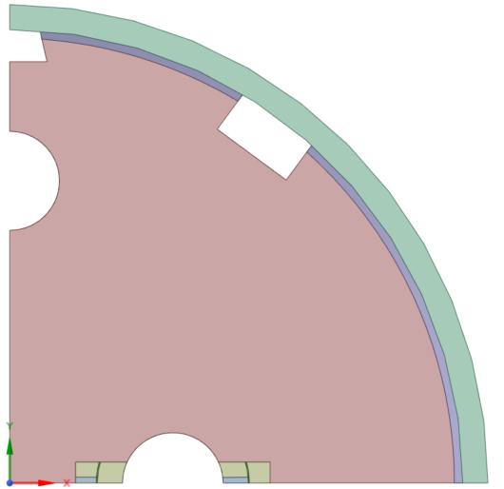
Thermal-mechanical model
Geometry
A quarter of half a magnet, connection side, is modelled by adopting some simplifications :
2875 mm
Yoke (bulk)
Kawasaki
(bulk)
End
plate
Central lamination (bulk)
2474 mm
306 mm
75mm
Equivalent coil (bulk)
Detailed coil
1862 mm
918 mm
Shell
Transversal cross-sections
Weld
Collar
Half moon
Coil
End plate
Bullets

Slide 19
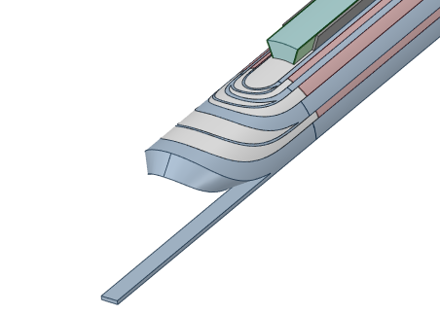
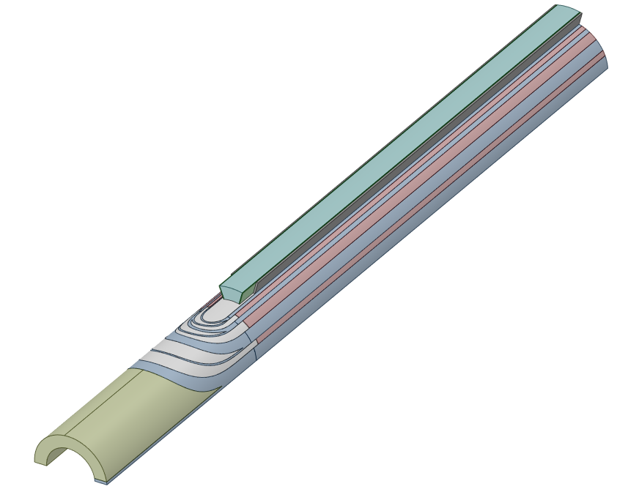
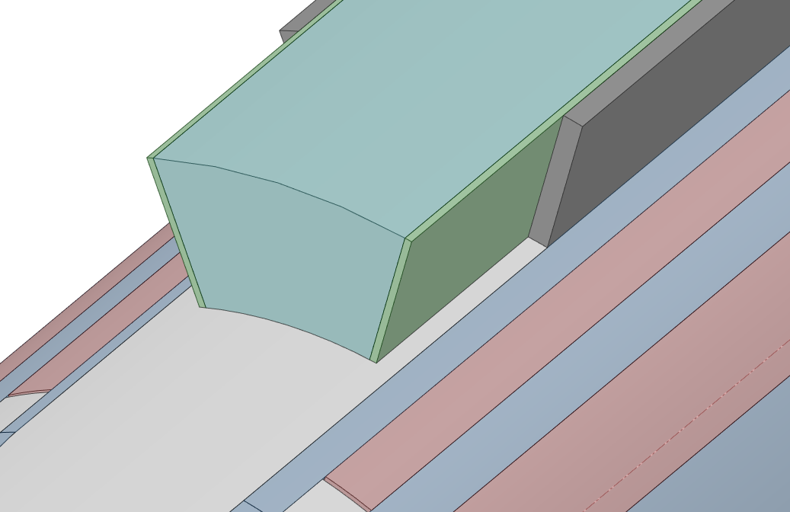
Thermal-mechanical model
Geometry
Outer and inner coils
Pole
Pole
No gap with winding key
Loading plate
Wedges
Wedges
Spacers
Spacers
Winding key
Cables (bulk)
Insulation layer
Cables (bulk)
Saddle
Saddle

Slide 20
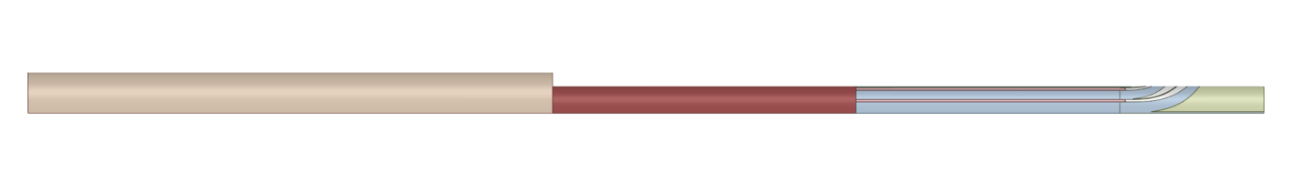
Thermal-mechanical model
Materials and associated constitutive model
Material properties at 4 K. Coefficient of Thermal Expansion (CTE) integrated from 300 K to 4 K.
Shell
(316 LN)
Isotropic
E=210 GPa
ν= 0.3
CTE= -2.95E-3
Yoke - central laminations
(Magnetil)
Equivalent to account the lamination structure
based on:
E=210 GPa
ν= 0.3
CTE= -2.05E-3
Austenitic yoke
(KHMN30L-Kawasaki steel)
Equivalent to account the lamination structure
based on
E_{T}=210 GPa
ν= 0.3
CTE= -1.85 E-3
End plate
(316 L)
Isotropic
E=206 GPa
ν= 0.3
CTE= -2.94E-3
[1]
[2]
[3]
[4]
Collar
(X8CrMnNiN19-11-6)
Equivalent to account the lamination structure
based on
E=202 GPa
ν= 0.33
CTE= -2.5 E-3
Coil
(composite)
Equivalent
E=100 GPa
ν_{T}= 0.3
CTE= -2.78E-3
Spacers –Winding key
(316 L)
Isotropic
E=206 GPa
ν= 0.3
CTE= -2.94E-3
Saddle
(G11)
Isotropic
E=23.2 GPa
ν= 0.21
CTE= -2.5E-3
[5]
[6]
[4]
[7]

Slide 21
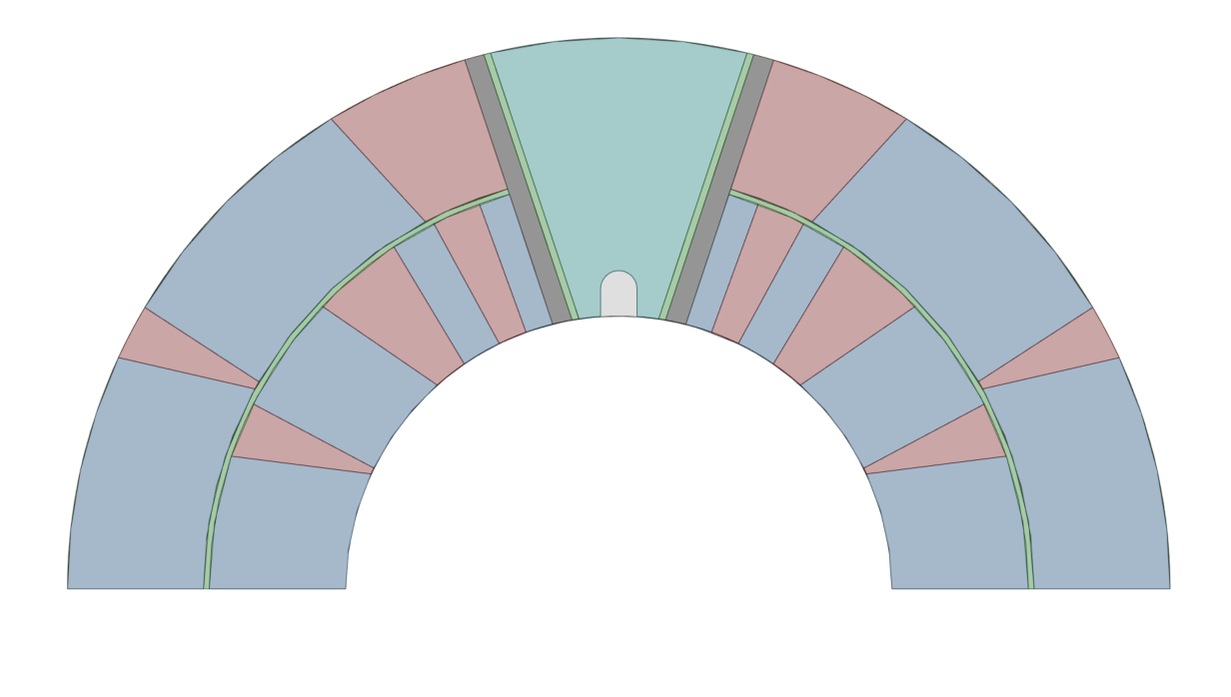
Thermal-mechanical model
Materials
Material properties at 4 K. Coefficient of Thermal Expansion (CTE) integrated from 300 K to 4 K.
Loading plate
(316 L)
Isotropic
E=206 GPa
ν= 0.3
CTE= -2.94E-3
Insulation layer
(kapton)
Isotropic
E=8.96 GPa
ν= 0.34
CTE= -12E-3
[4]
[8]
Pole
(Ti 6Al-4V)
Isotropic
E=127 GPa
ν= 0.3
CTE= -1.74E-3
[9]
Wedge
(ODS-Copper Discup C3/30)
Isotropic
E=93 GPa
ν= 0.3
CTE= -3.07E-3
Cable block
(Nb₃Sn)
“Simple” orthotropic elastic
ν= 0.3
E_long. = 95 GPa
E_rad. = 80 GPa
E_azim. = 31 GPa
CTE_long. = -2.8E-3
[10]
[11]

Slide 22
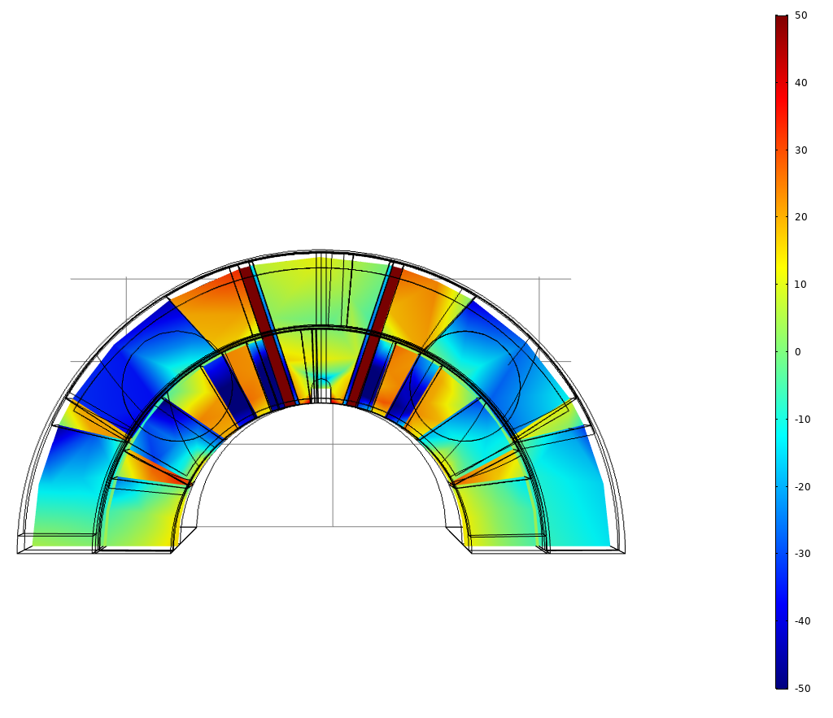
Loading steps
Loads are applied in sequential steps:
Azimuthal prestress of the coil
Shell welding
Bullet loading
Cooldown
Powering
Azimuthal prestress
Cooldown
Longitudinal stress in the straight part of the coil

Slide 23
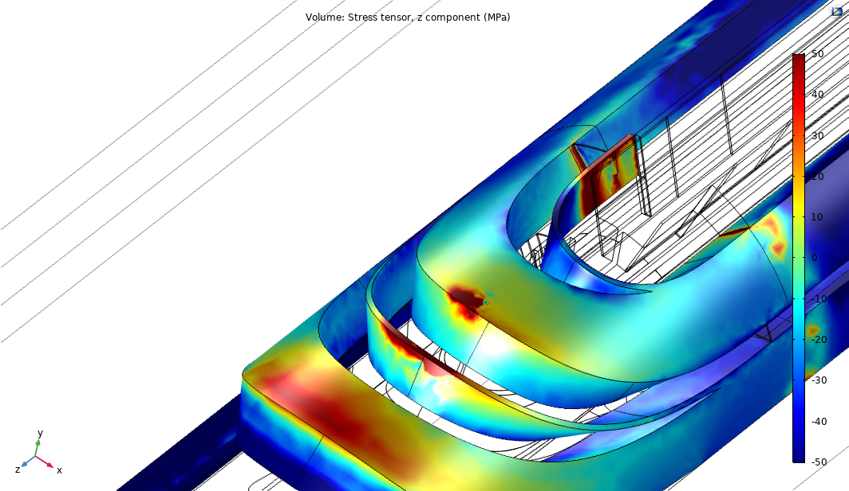
Effect of gaps after cooldown
Upper coil only
Longitudinal stress [MPa]
No gap between cable and wedge
Cooldown

Slide 24
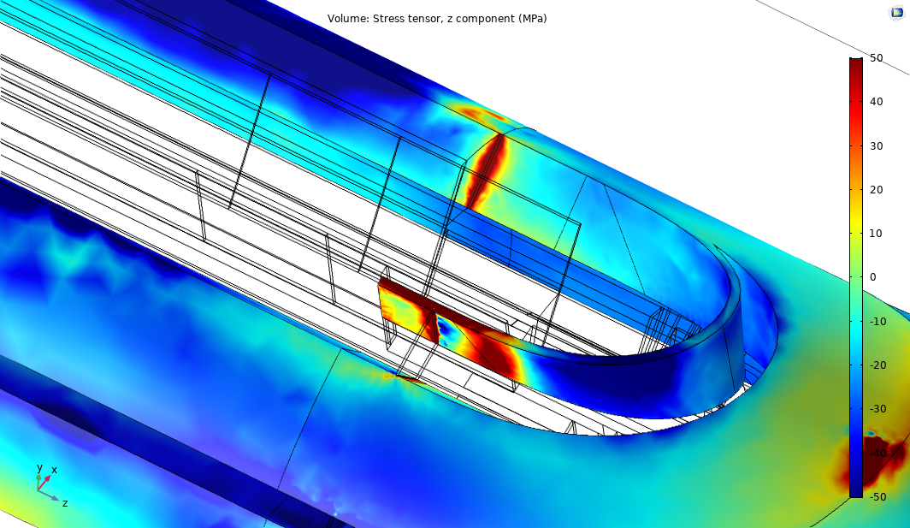
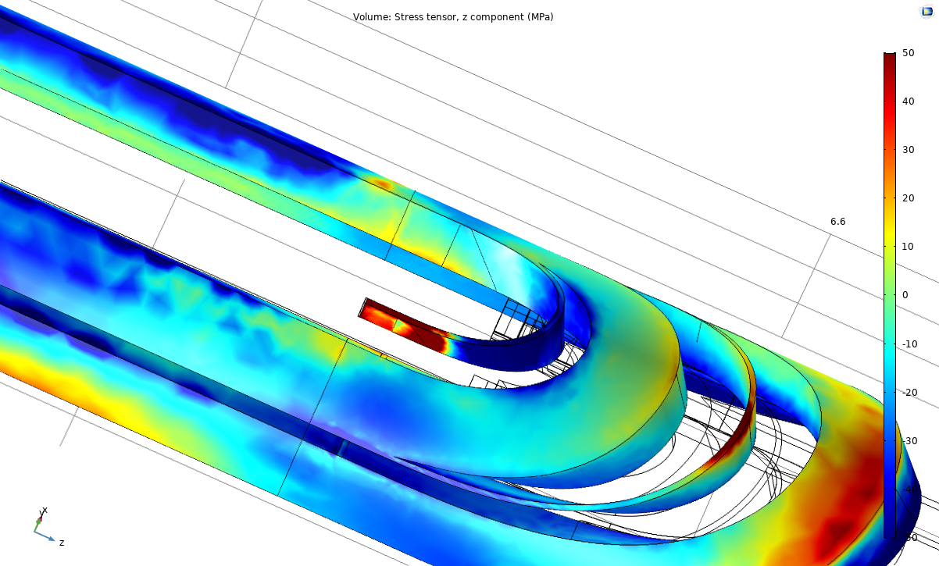
Effect of gaps after cooldown
Longitudinal stress [MPa]
Upper coil
No gap between cable and wedge

Slide 25
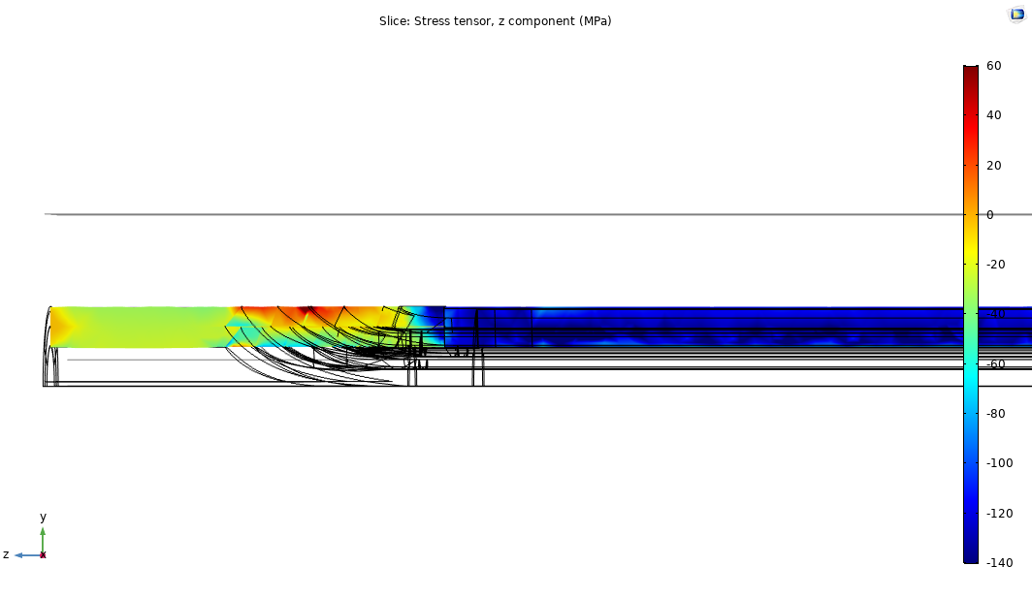
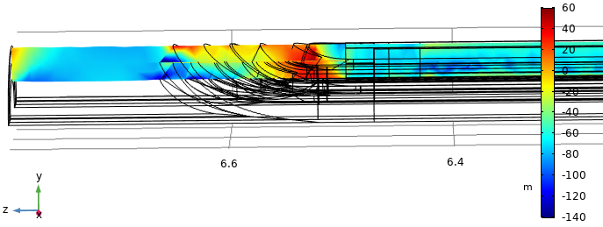
Longitudinal cut considering gaps
Longitudinal stress [MPa]
After cooldown
After powering

Slide 26
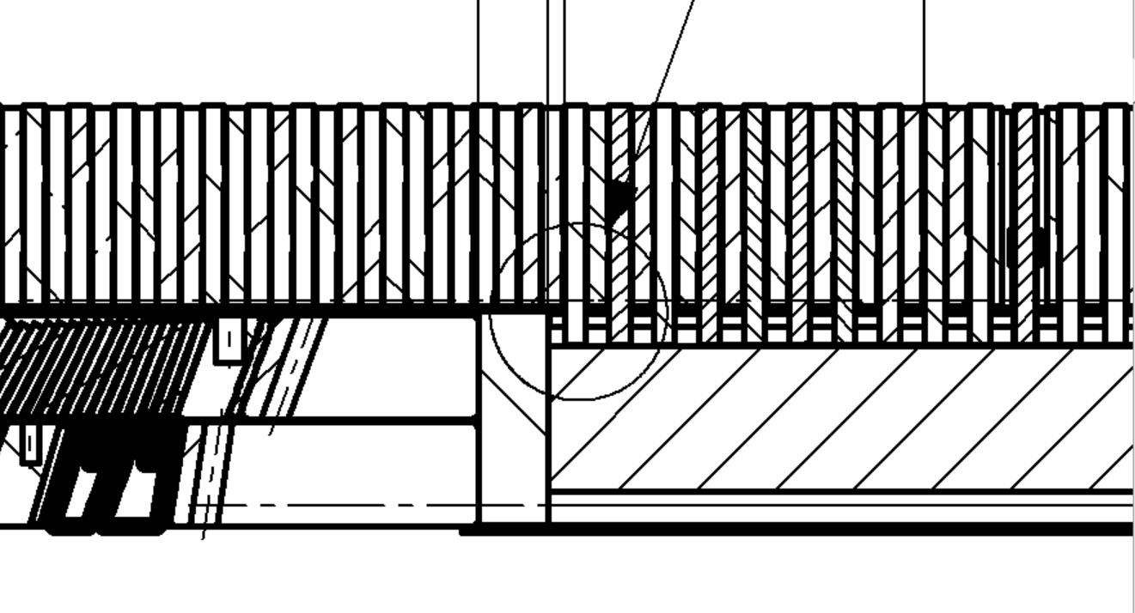
Why issues appeared on long magnet?
From mechanical point of view, if iso-strain in the coil-pole assembly is assumed, there is no reason explaining that longer magnet are more critical than the short one.
But if the pole is not perfectly coupled longitudinally with the coil (iso-strain not respected), then the effect at the extremity of the CTE mismatch on the stress profile is more pronounced for longer magnet.
In addition, the production of long magnet has been accompanied with structural modifications leading to significant impact:
Shell/yoke decoupling →larger force after cooldown
The insulating piece at the pole extremity has been removed
Shell
End plate
Yoke
Coil
Bullet
Single aperture (SP10X)
Double aperture (DP101)
«soft» G11 insulation part
2nd & 3rd Double Aperture (DP102&DP201)
Series magnets
Winding key
Ti pole
Short model

Slide 27
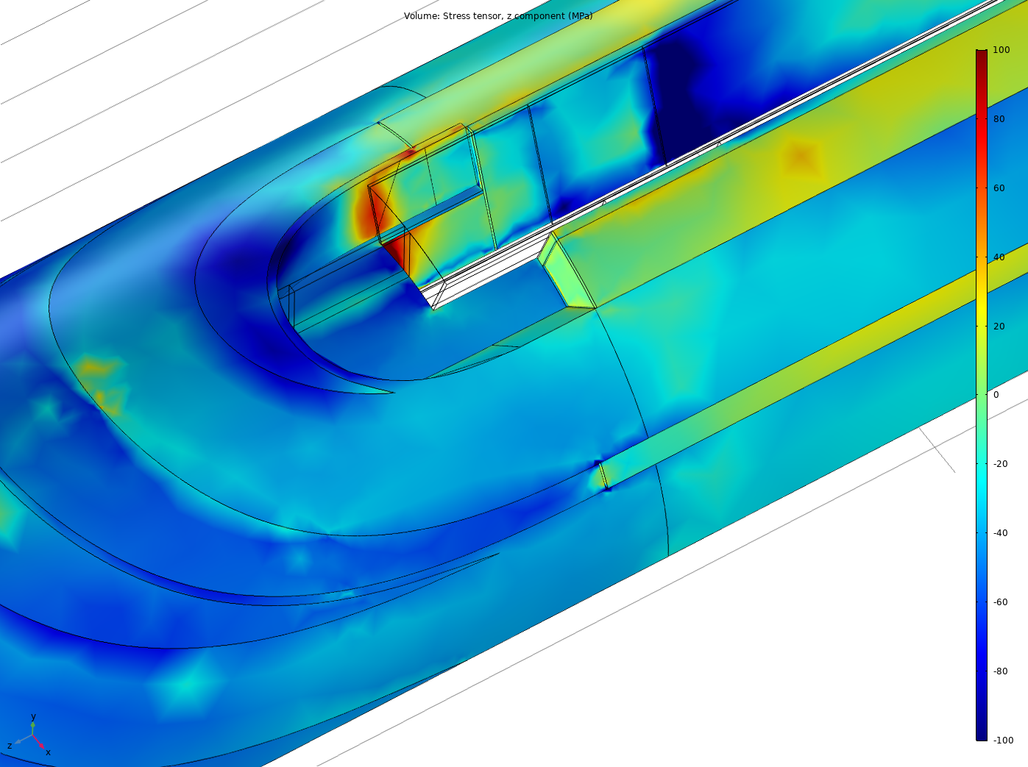
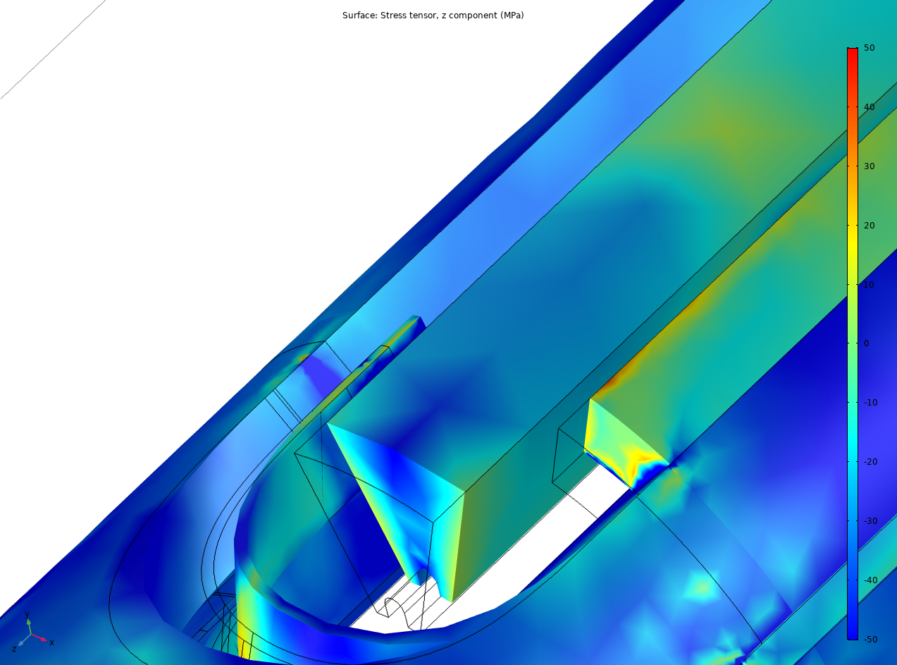
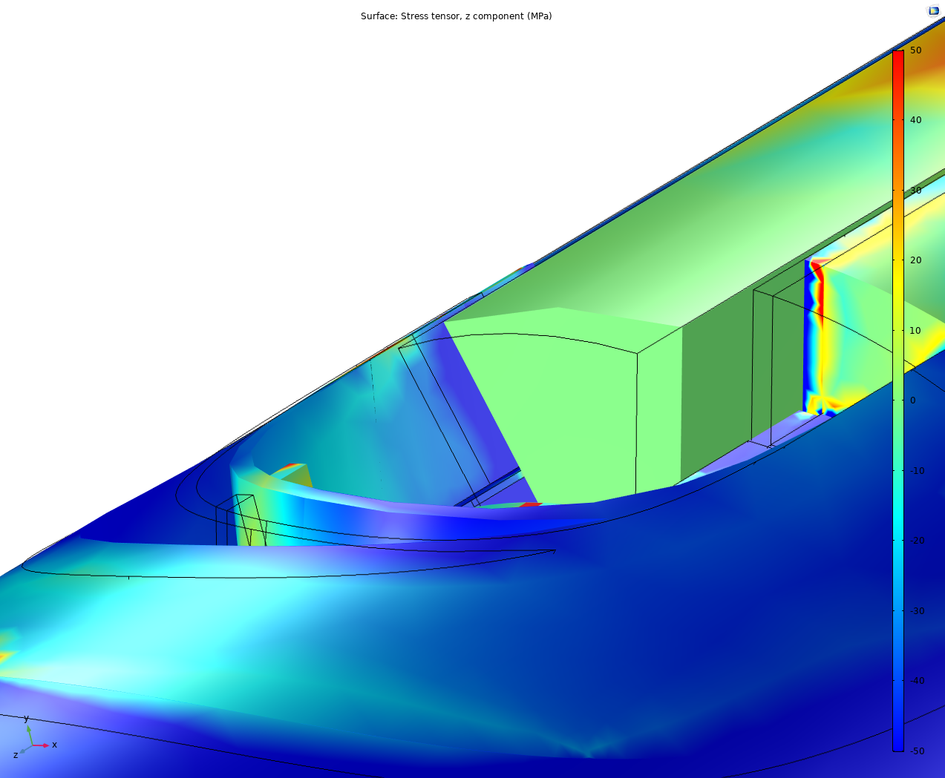
Effect of the pole CTE mismatch
Pole in Cu
Stress concentration observed with titanium pole mounted without gap with the winding key disappears with copper (as example) material or an initial gap.
10 mm gap between pole-winding key

