Slide 2
11T QA QC
R. Principe,
C-MAC Review, Mar-1, 2021
EDMS 2492001

Slide 3
Motivation
A QMS for the 11T project in the production phase:
Have a global view of the project;
Understand who does what and when;
To be sure 11T will be in time for components, materials, tooling (purchase, storage, conformity of the components at the delivery, availability at T0);
Cover the entire production chain:
Identify all production steps (tasks);
Define clear interfaces.
Have competent personnel on a specific task;
Profit of the LS1 experience;
Focus on production.

Slide 4
Method
Identify all production steps and precise interfaces:
Flow charts;
Comprehensive manufacturing procedures;
Control procedures;
MIPs, follow-up files and check-lists;
NB1: iterative process;
NB2: from production to general procedures = provide clear work instruction first.
Traceability:
Non conformities (Root Causes Analysis);
Record of the working methods;
Identify the tools: EDMS, MTF, EAN.
Competence:
Documental corpus as a tool for training;
Personnel (Skill Matrix).

Slide 5
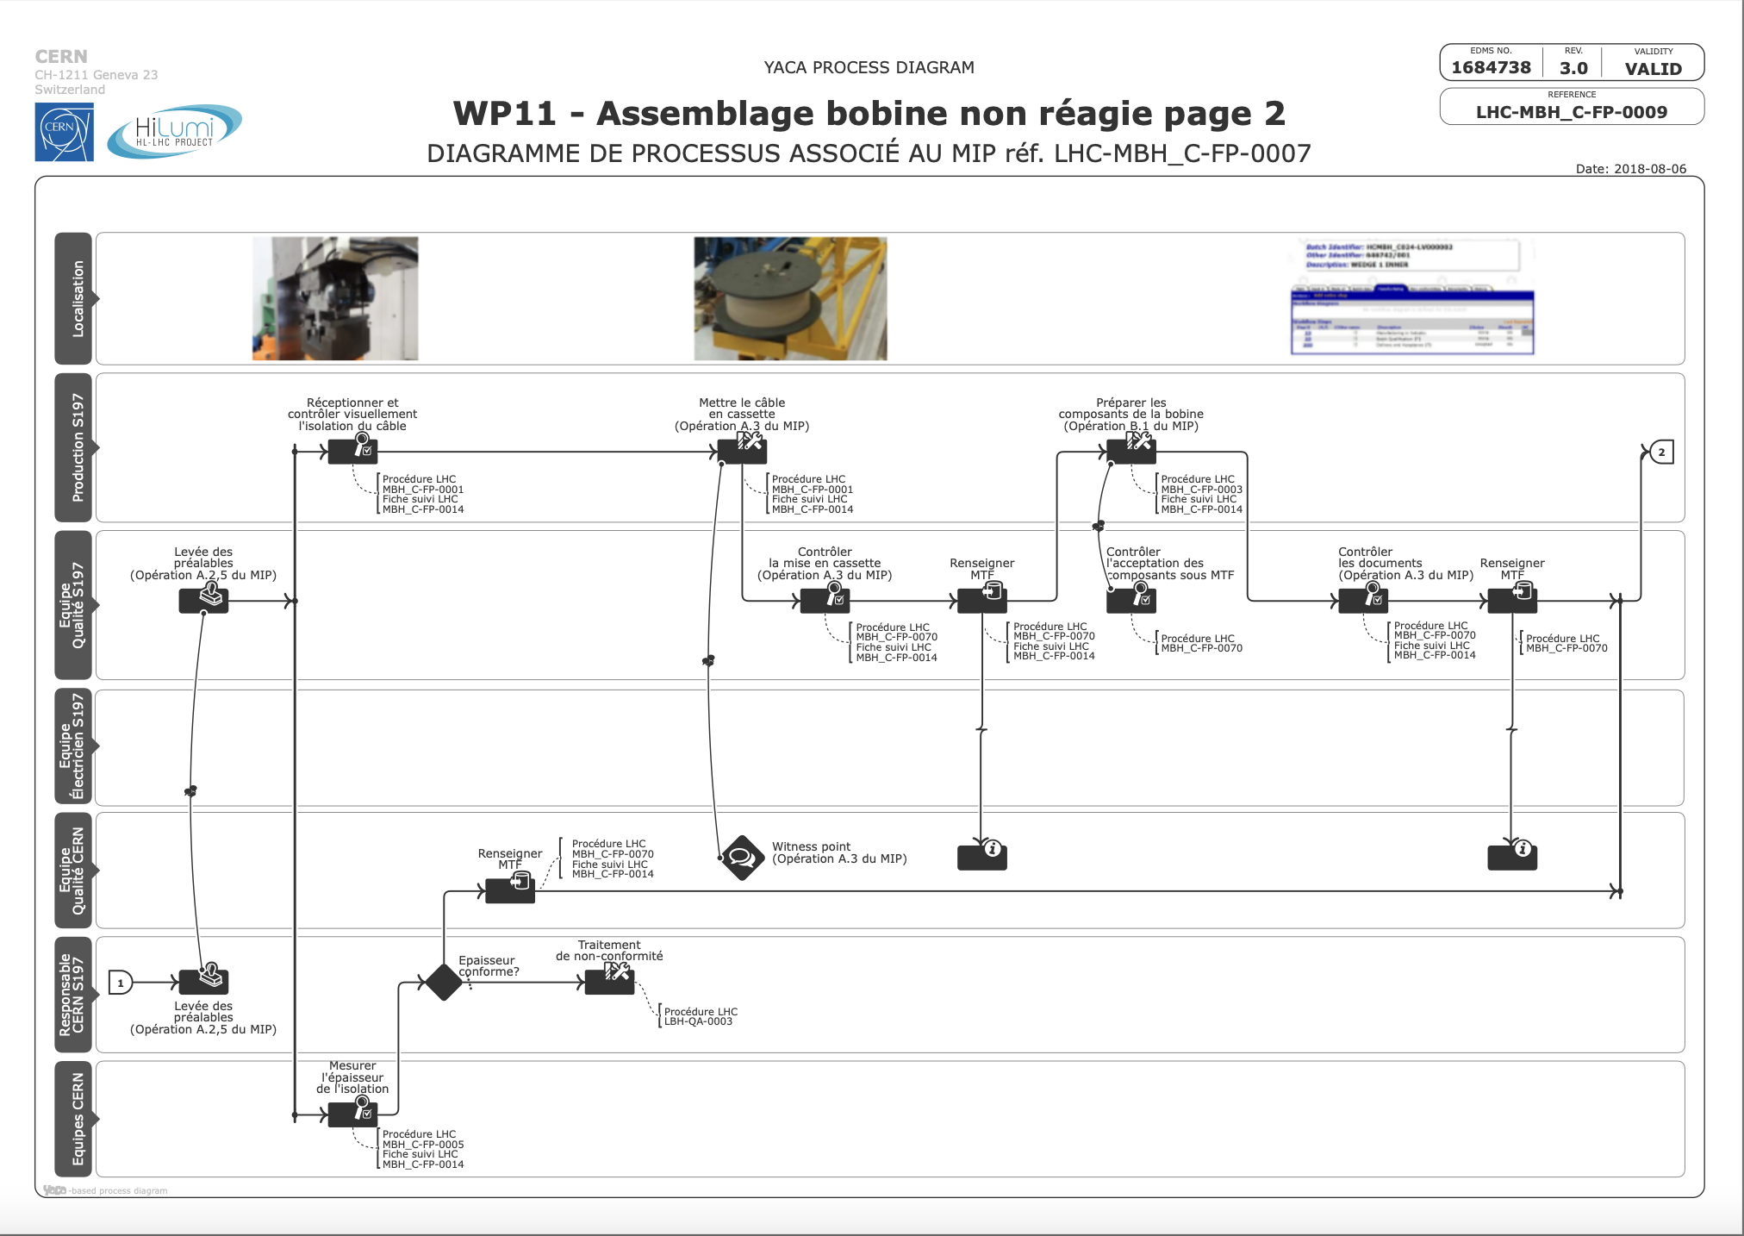
Manufacturing flow charts
YACA method;
Identify the task;
Reference to:
Fabrication procedure
Control procedure
MIP;
Execution team.

Slide 7
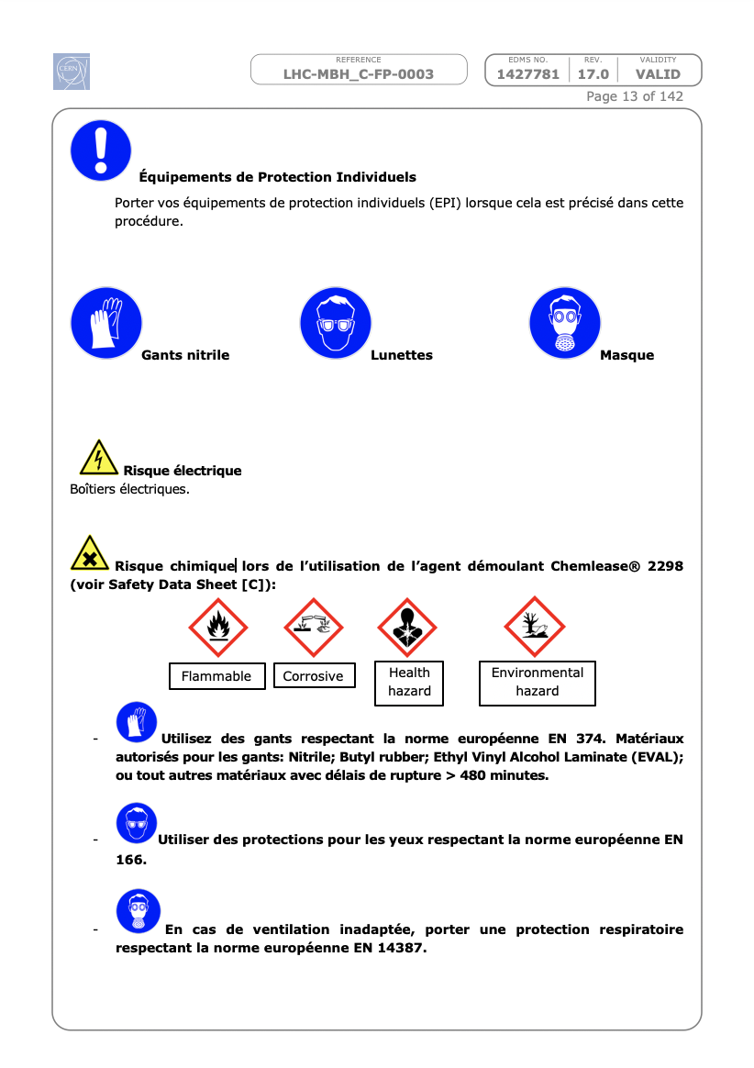
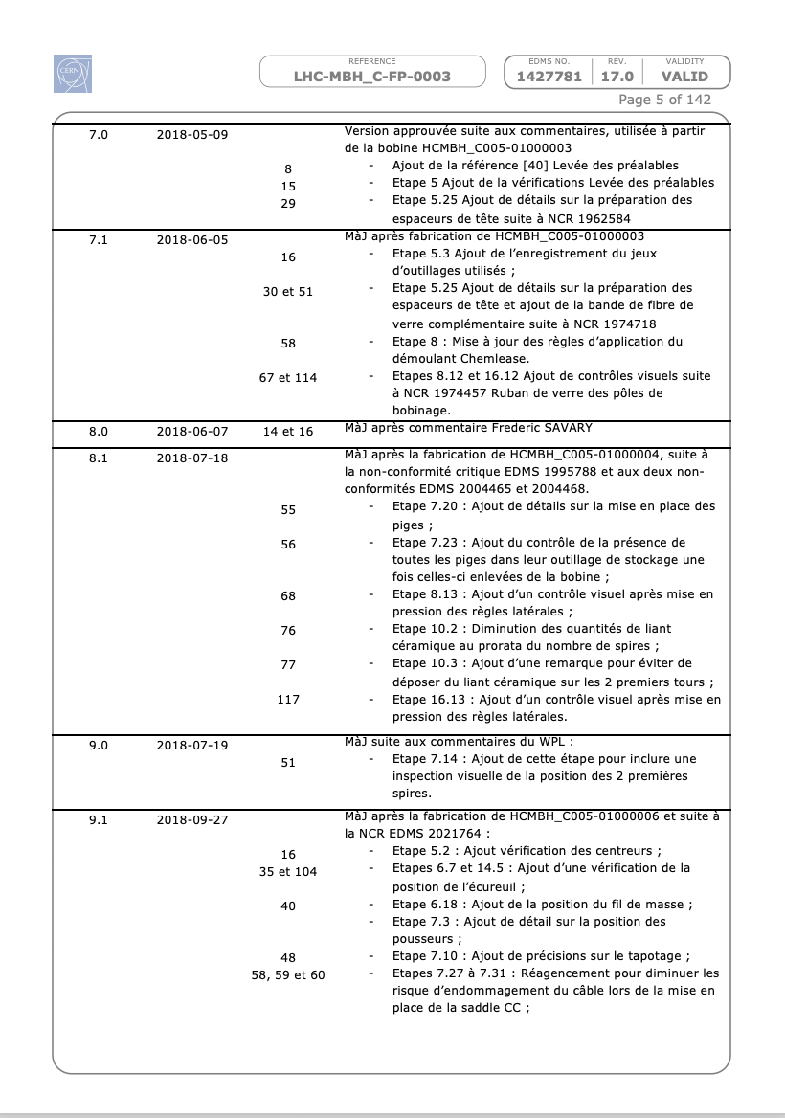
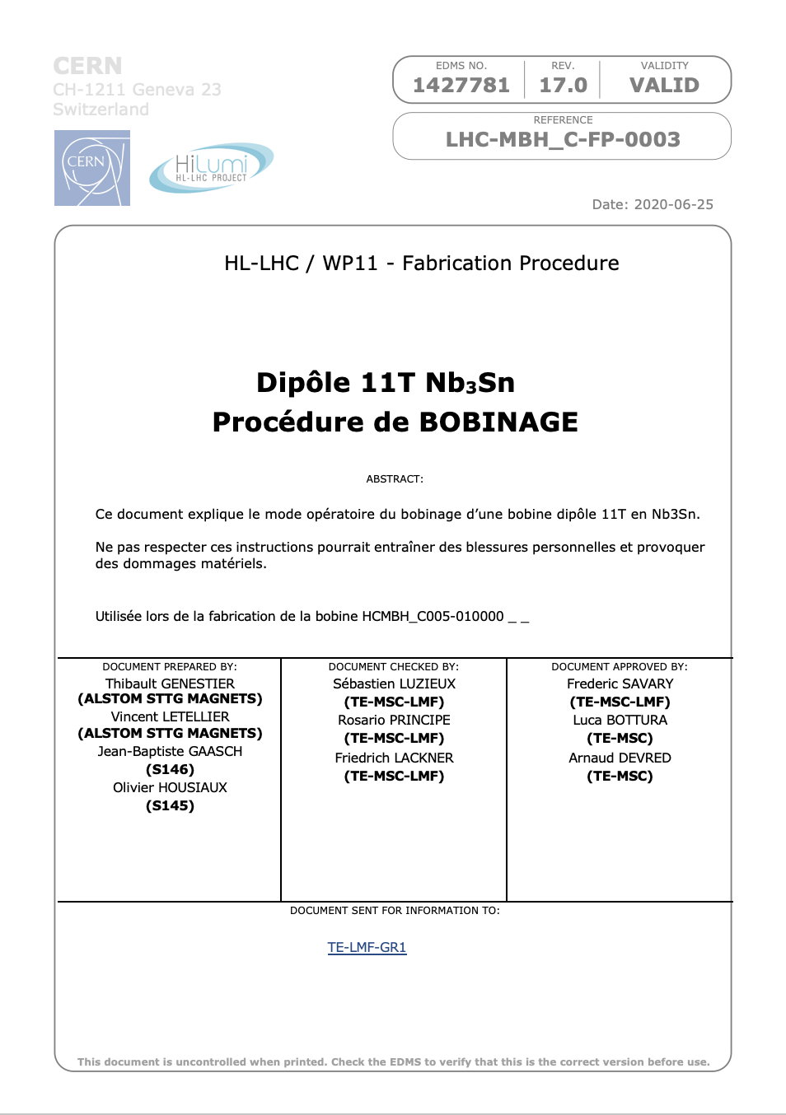
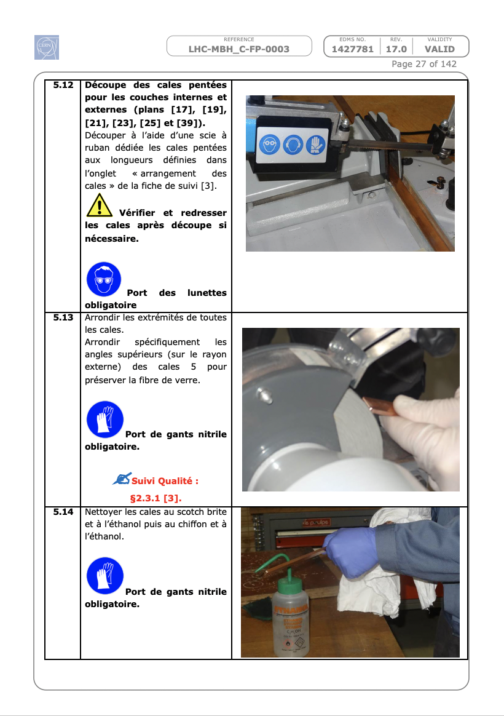
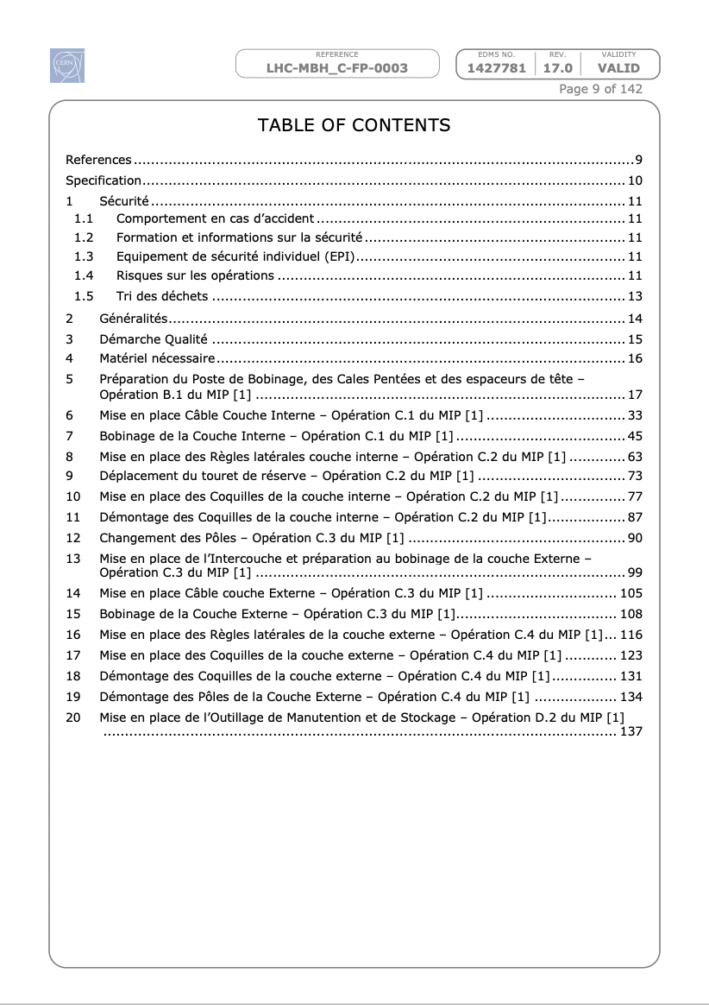
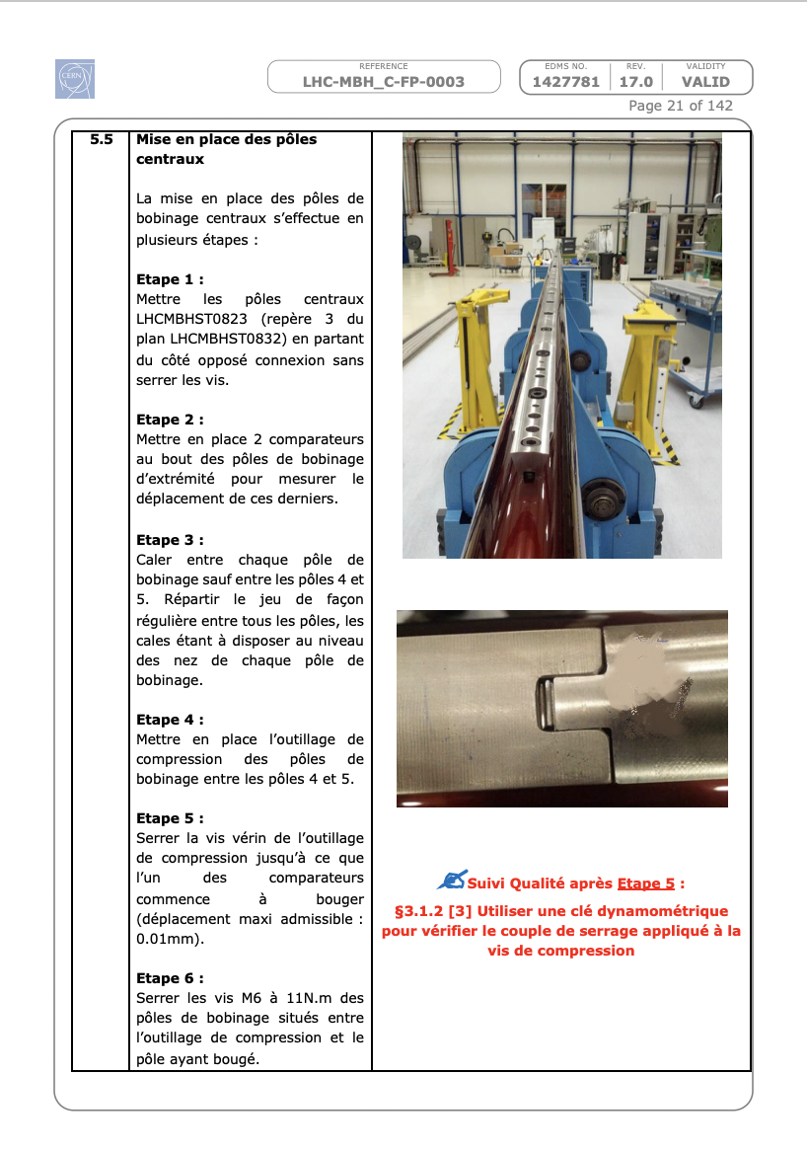
Manufacturing procedures

Slide 8
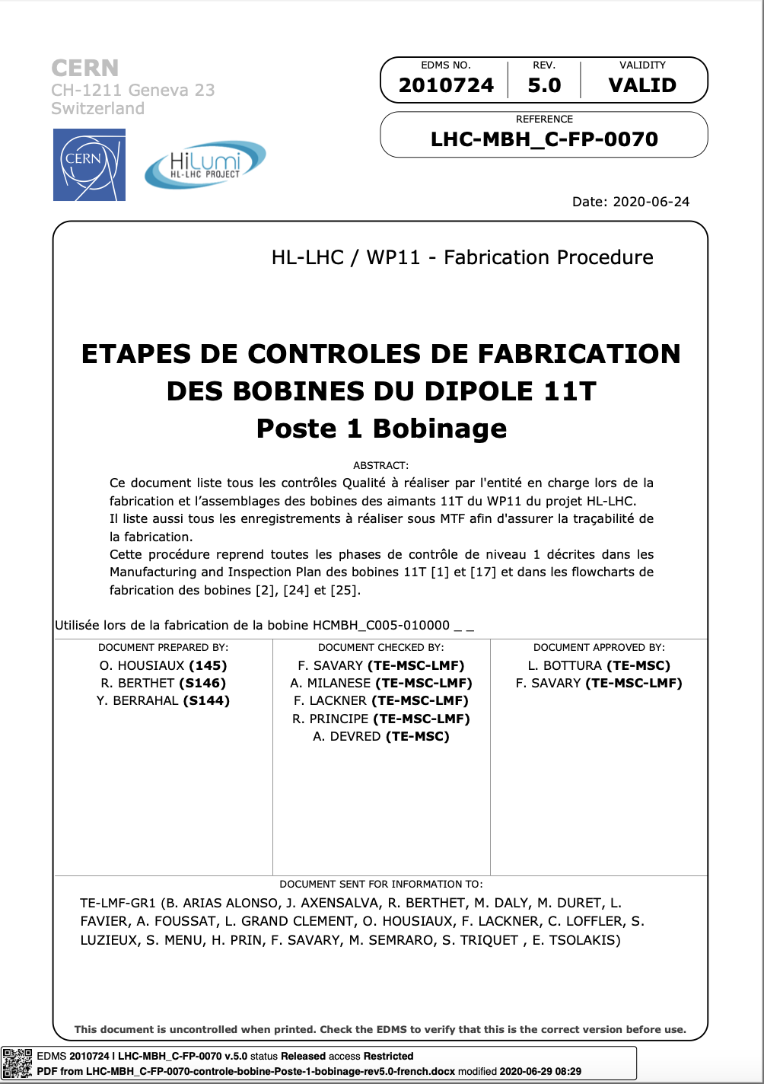
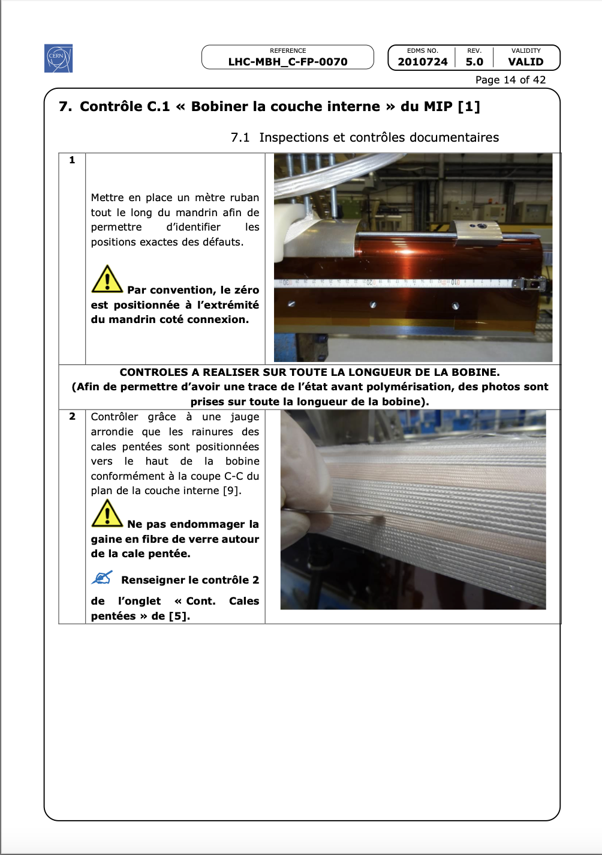
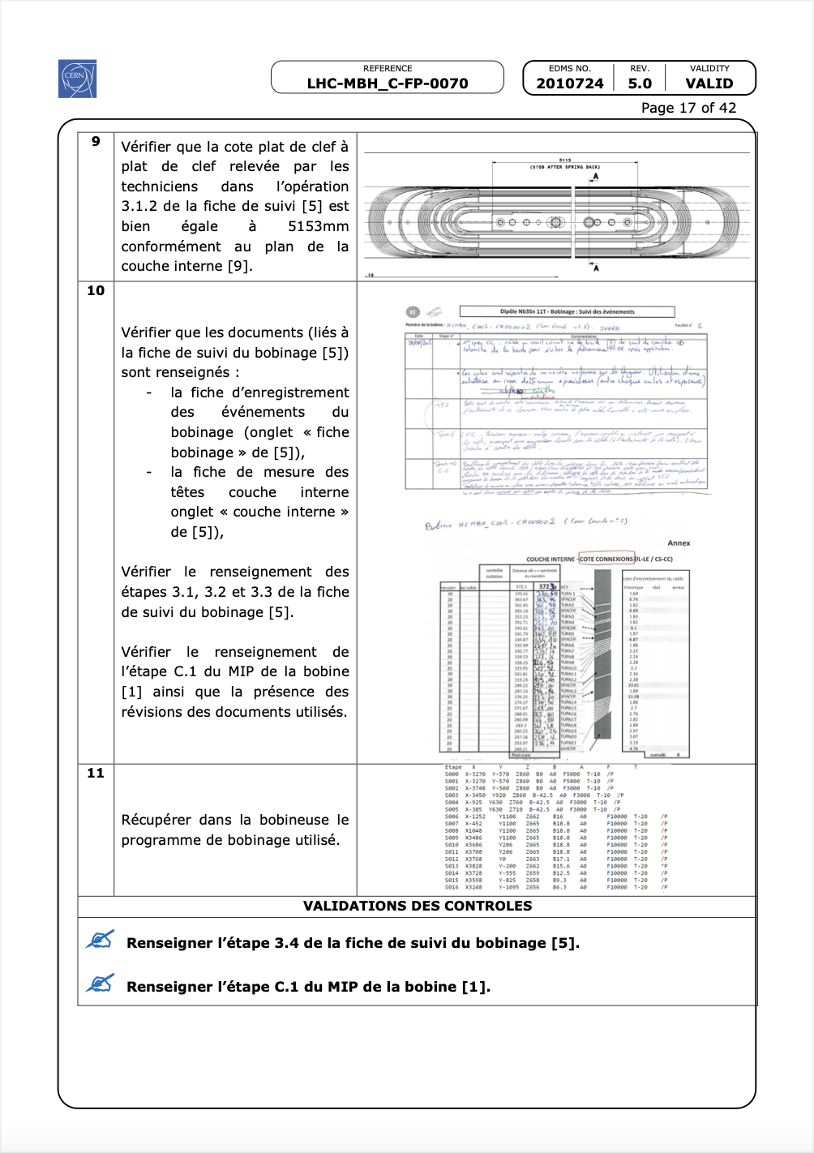
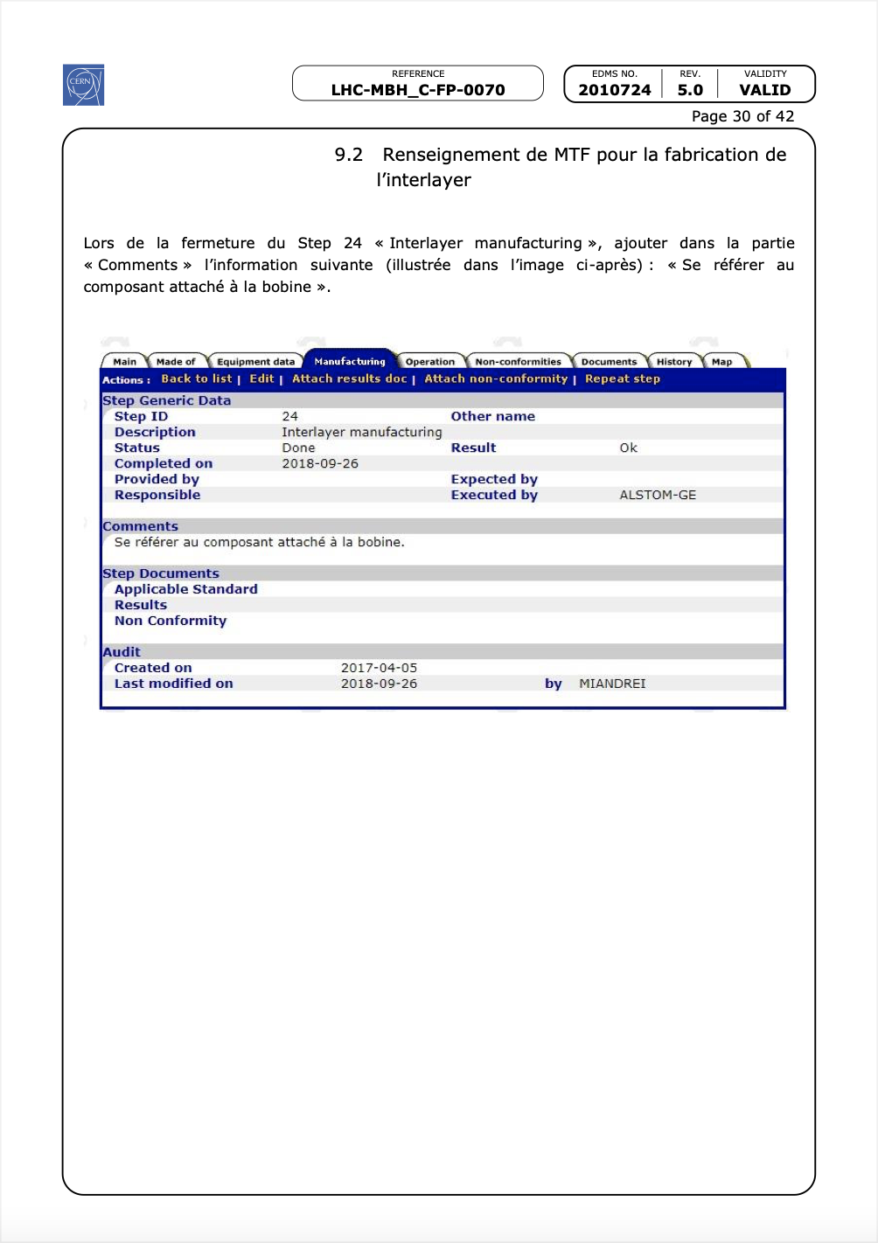
Control procedures

Slide 9
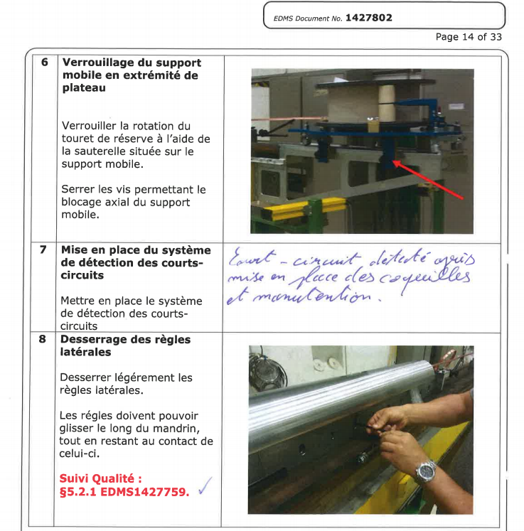
Annotated procedures

Slide 10
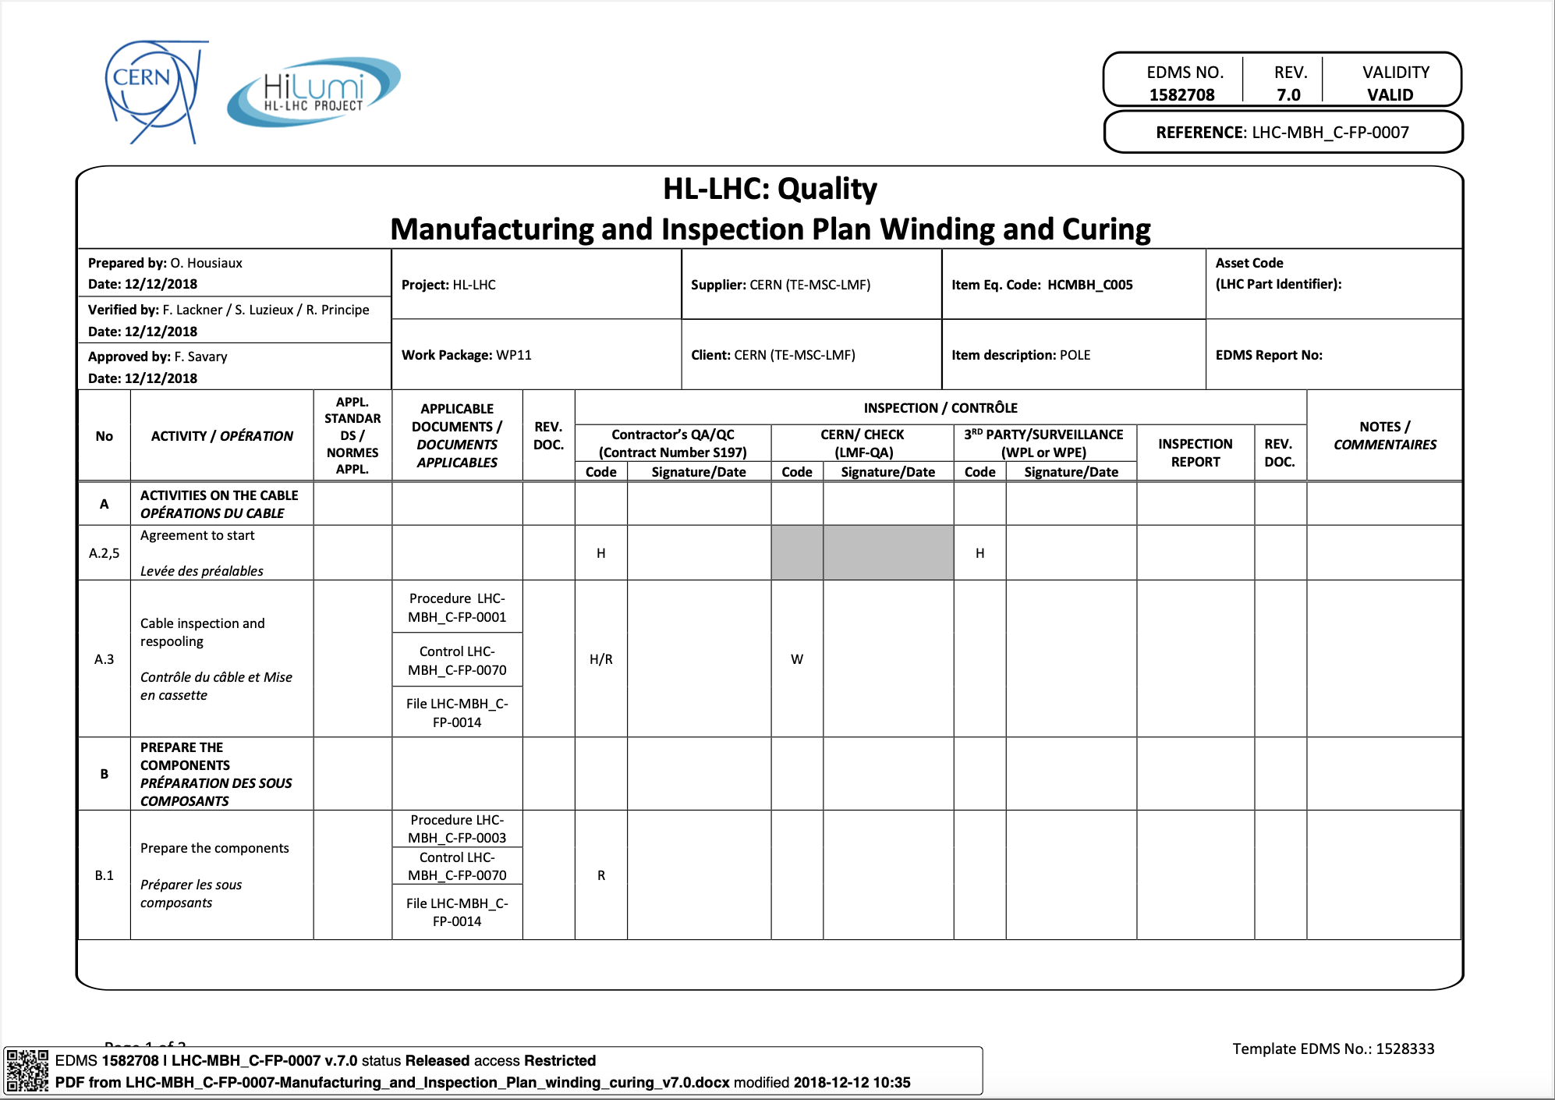
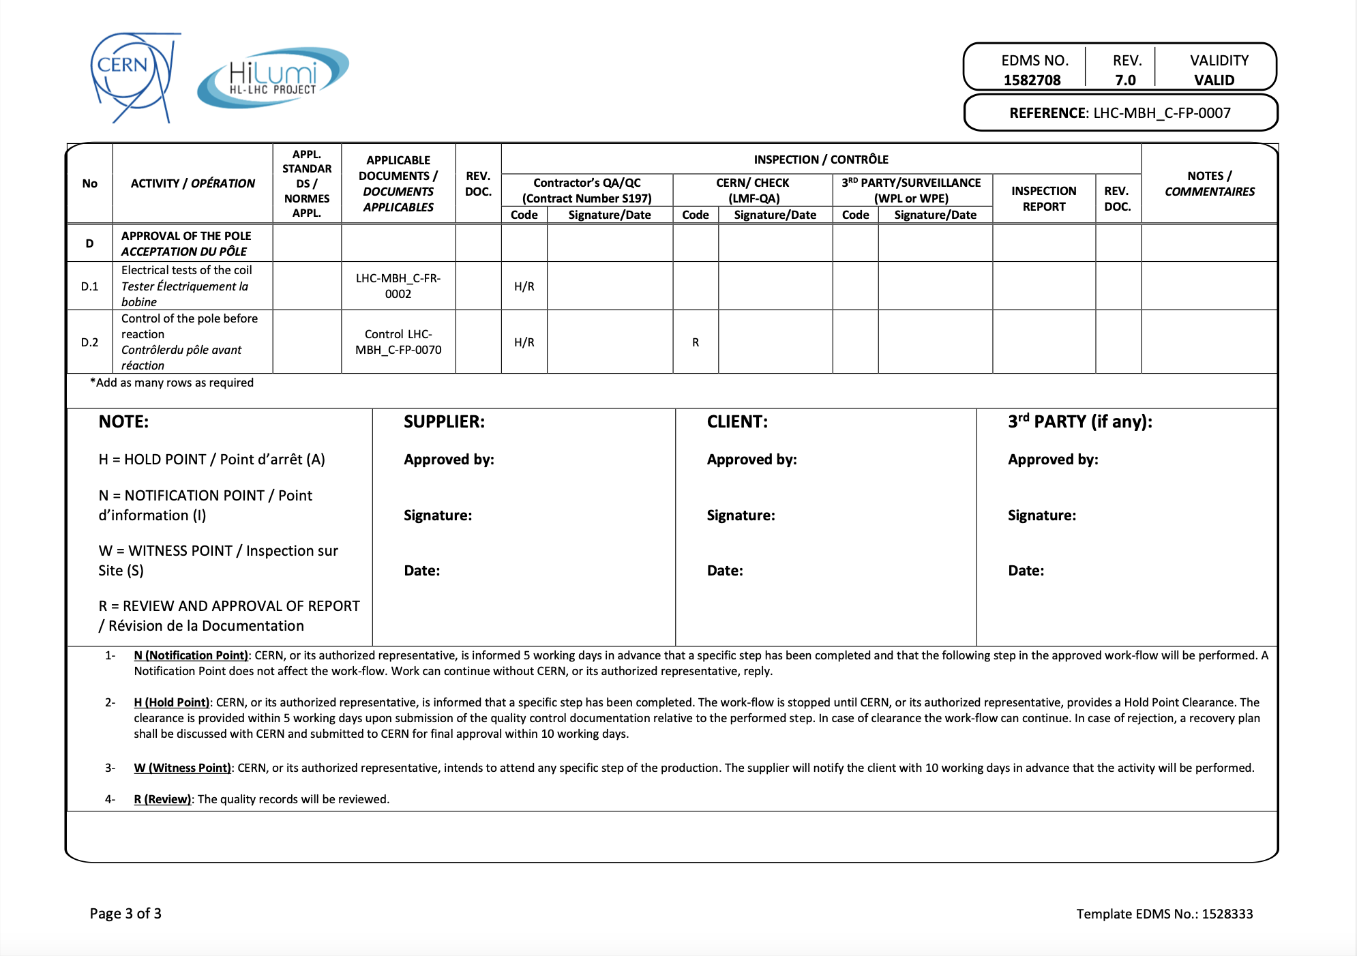
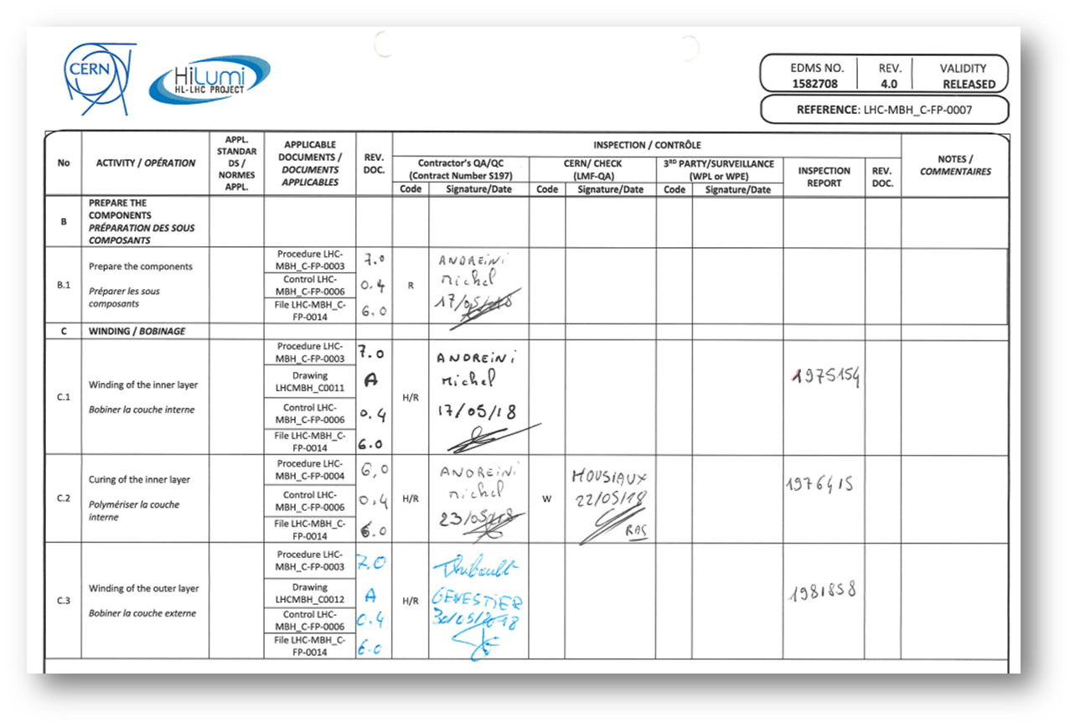
Manufacturing and Inspection Plan (MIP)

Slide 11
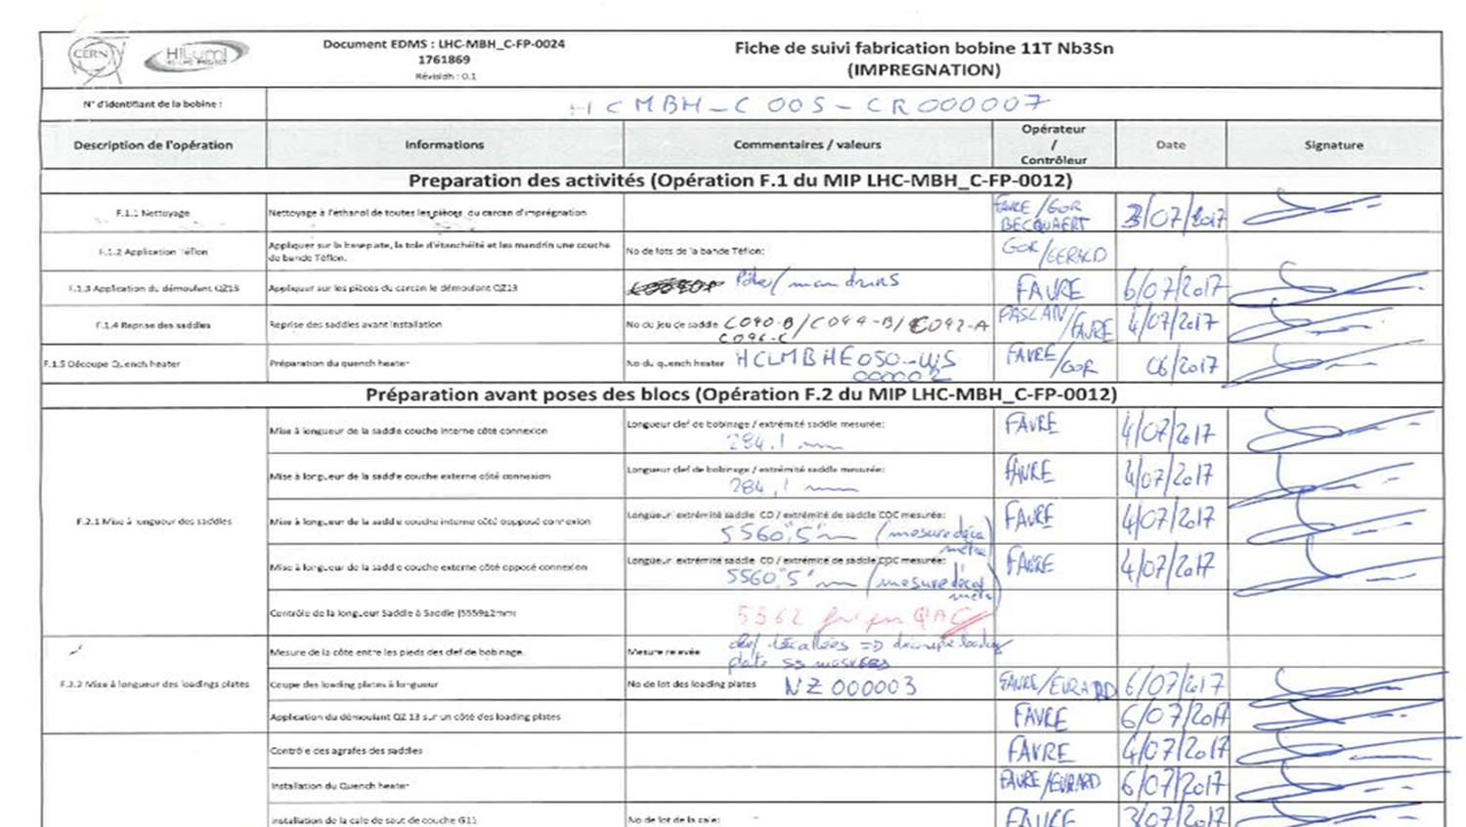
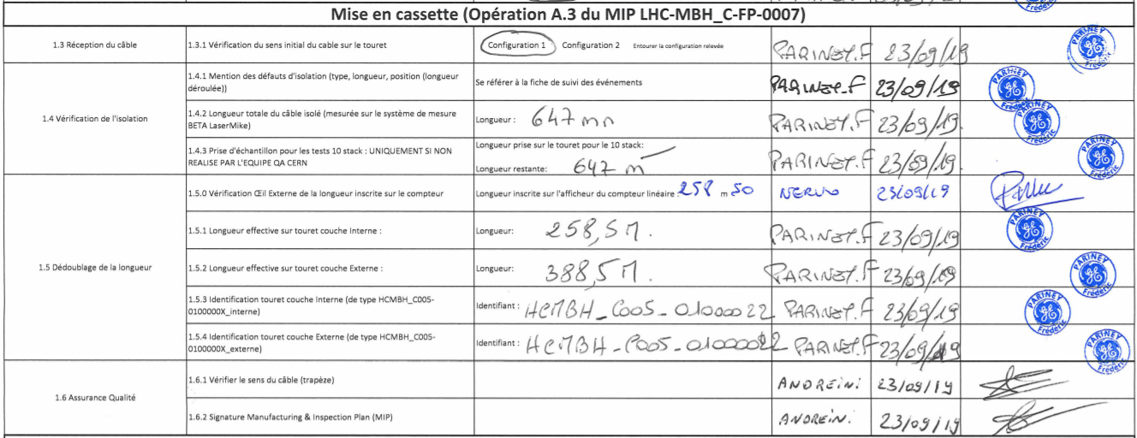
Follow up files and check lists

Slide 12
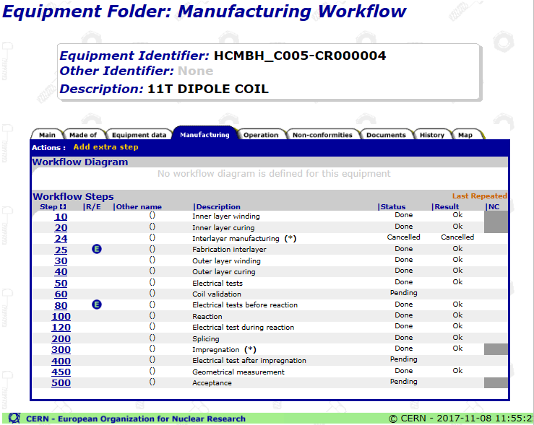
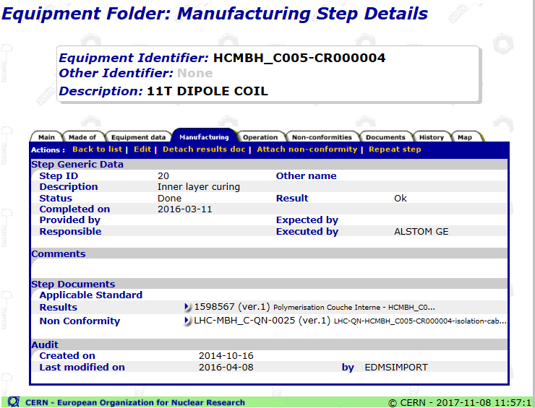
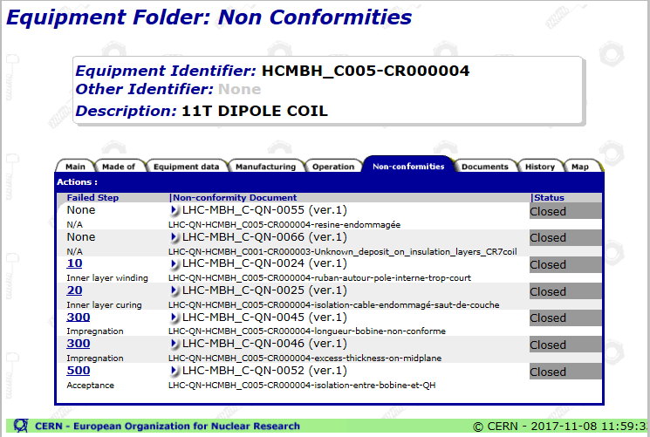
EDMS AND MTF
EDMS = Equipment Data and Management System (EDMS)
Structure by Project
All documents produced by TE-MSC in EDMS is mirrored in the EDMS HL-LHC structure
Manufacturing and Test Folder (MTF)
Structure by Object
LMF QA web page:
https://te-dep-msc-lmf.web.cern.ch

Slide 13
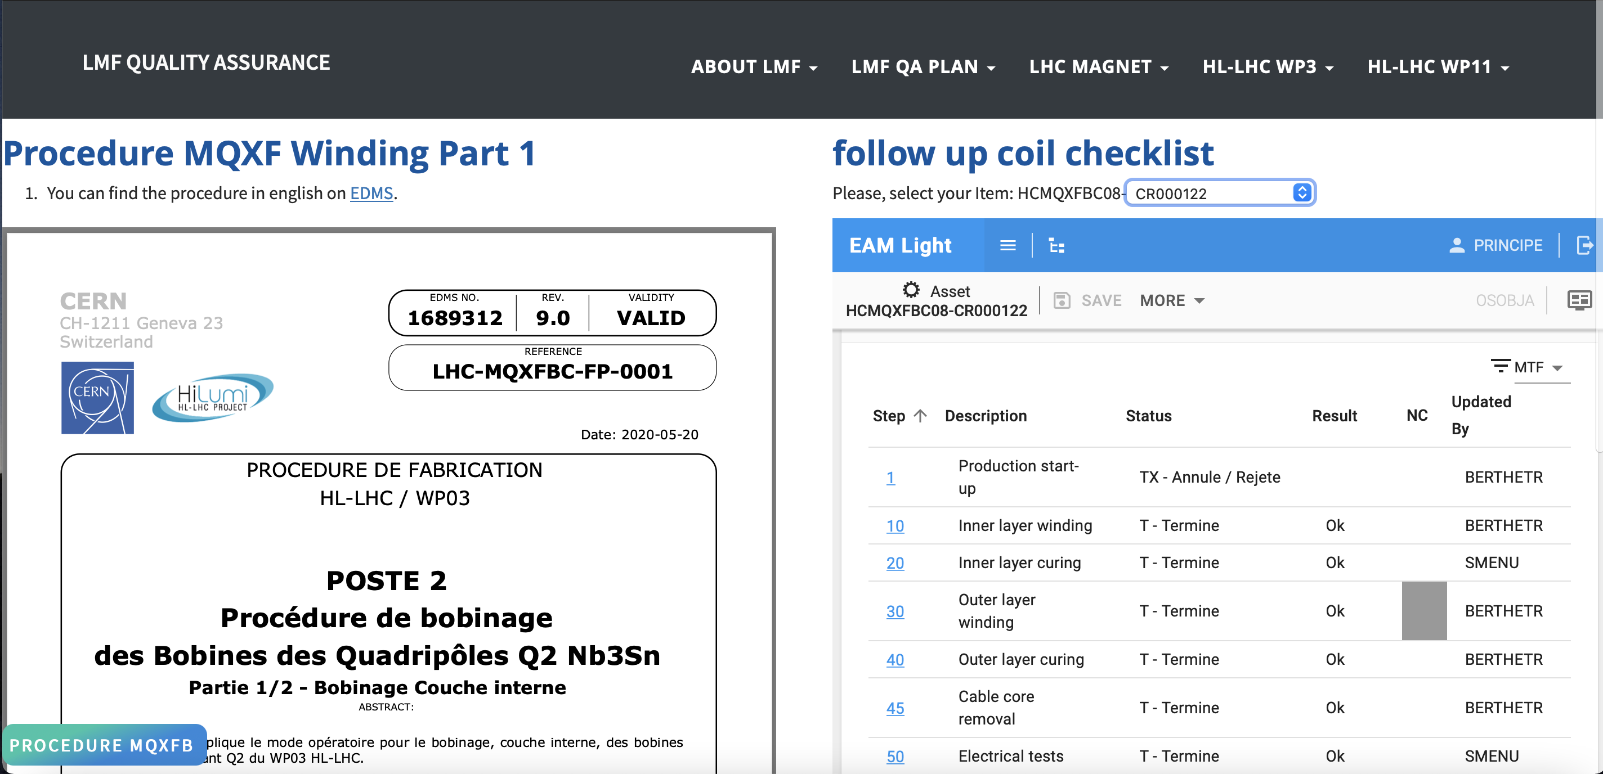
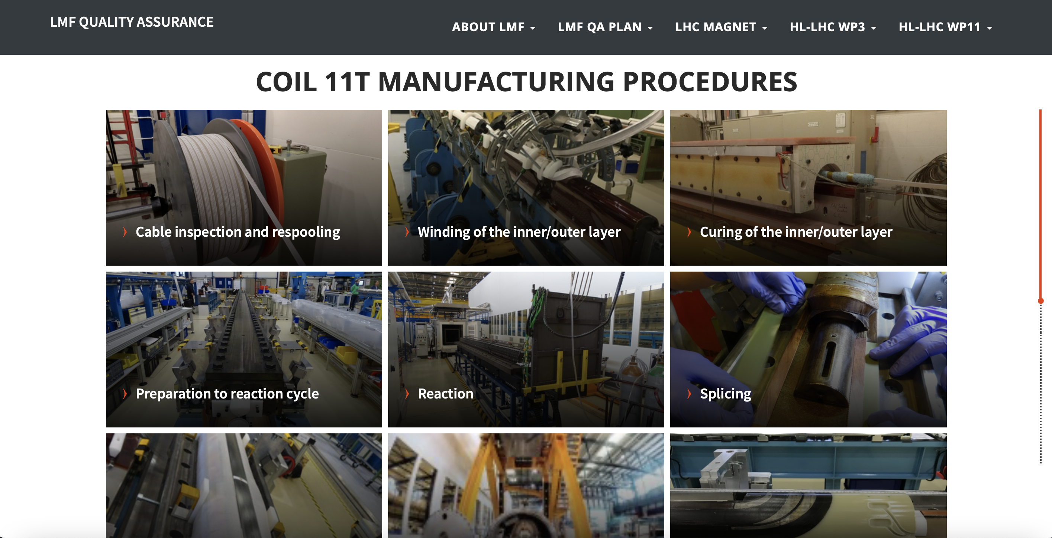
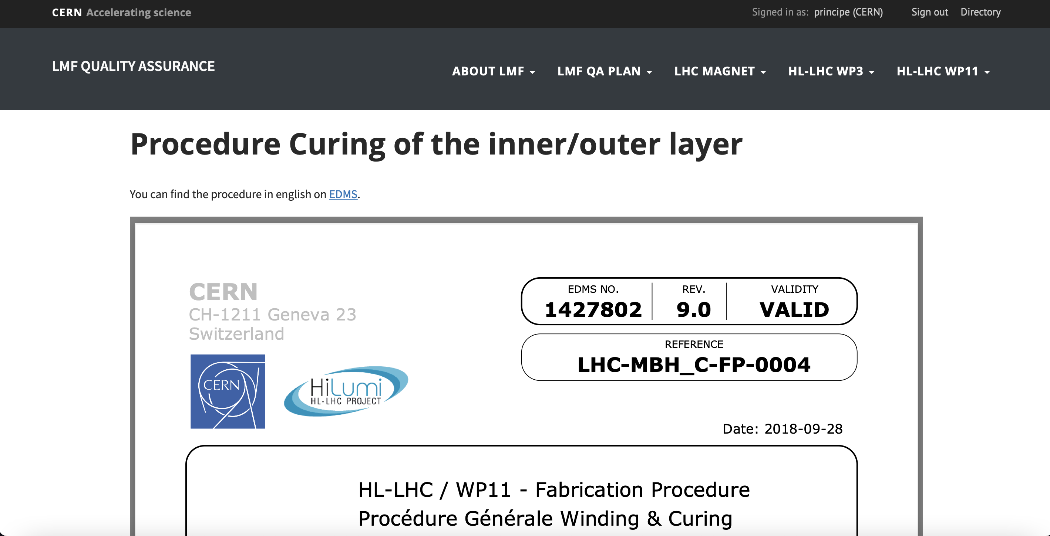
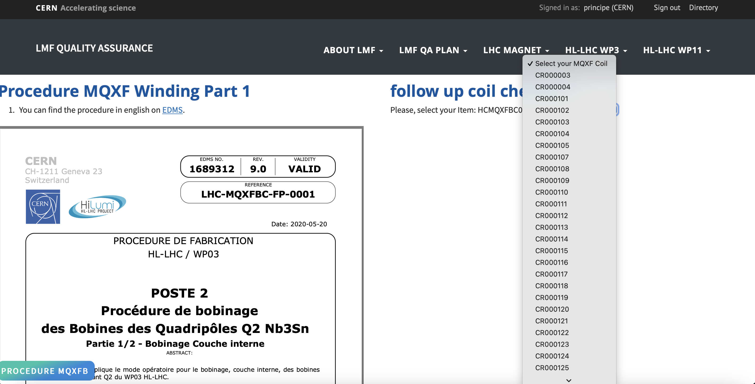
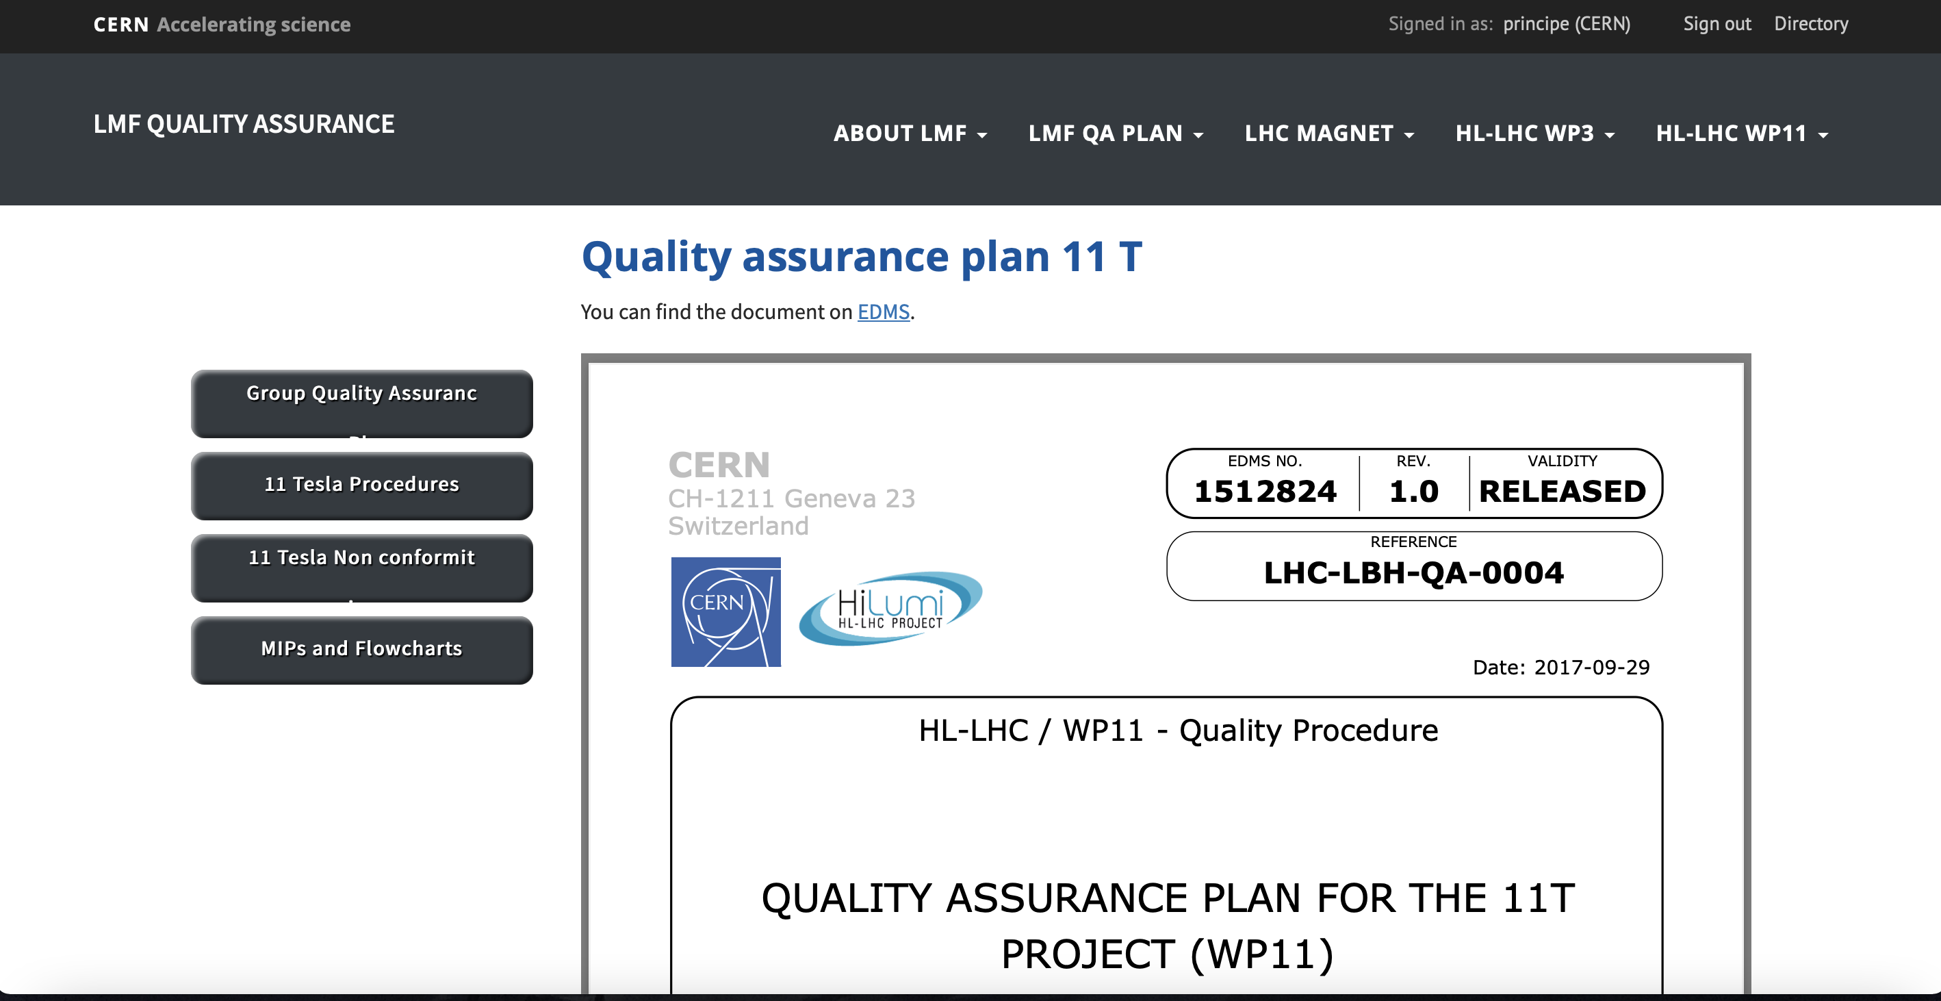
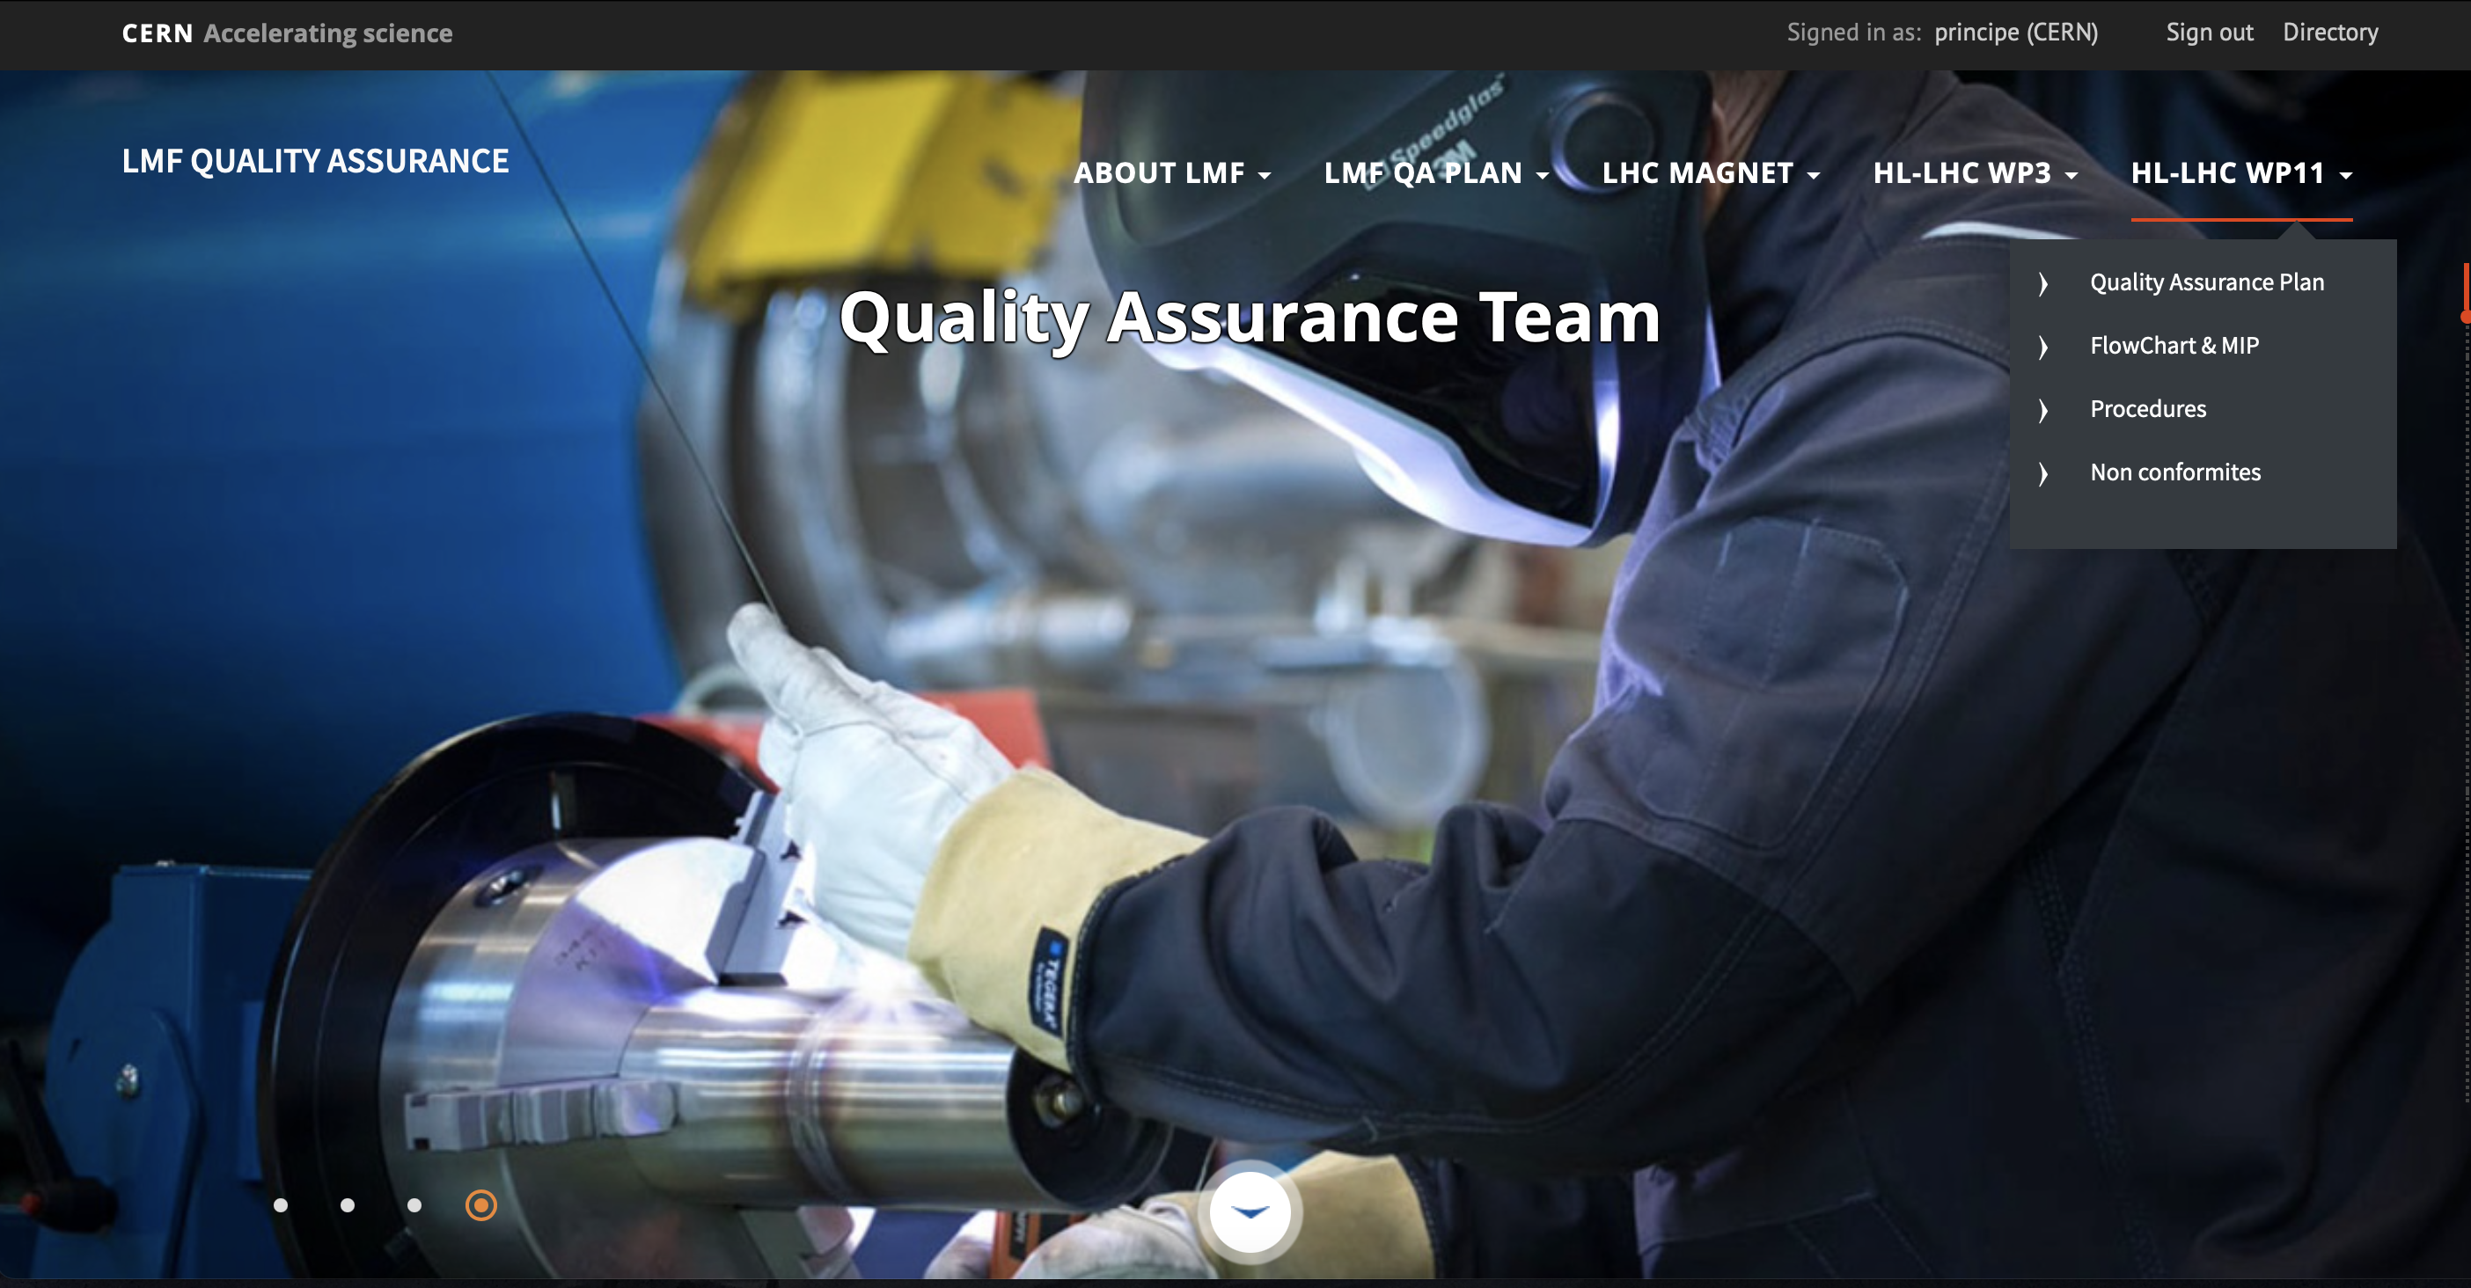

Slide 14
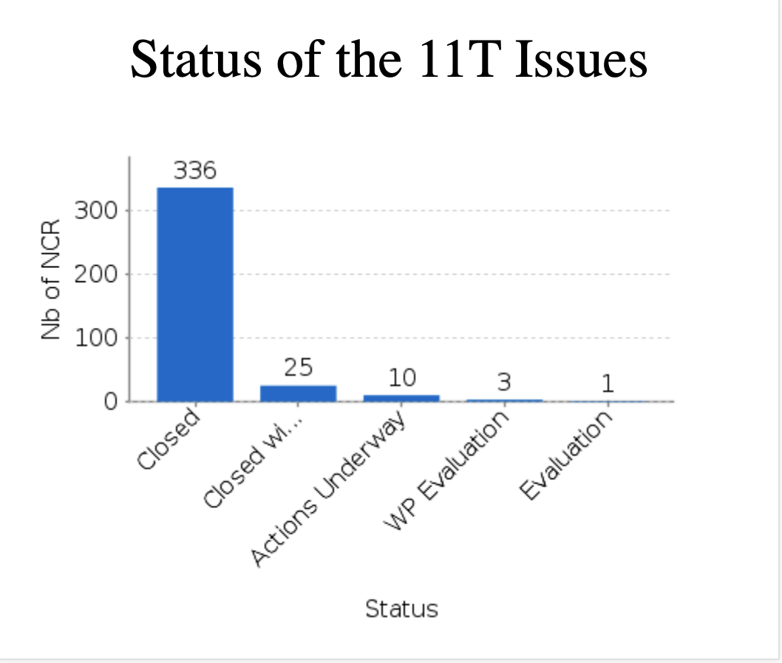
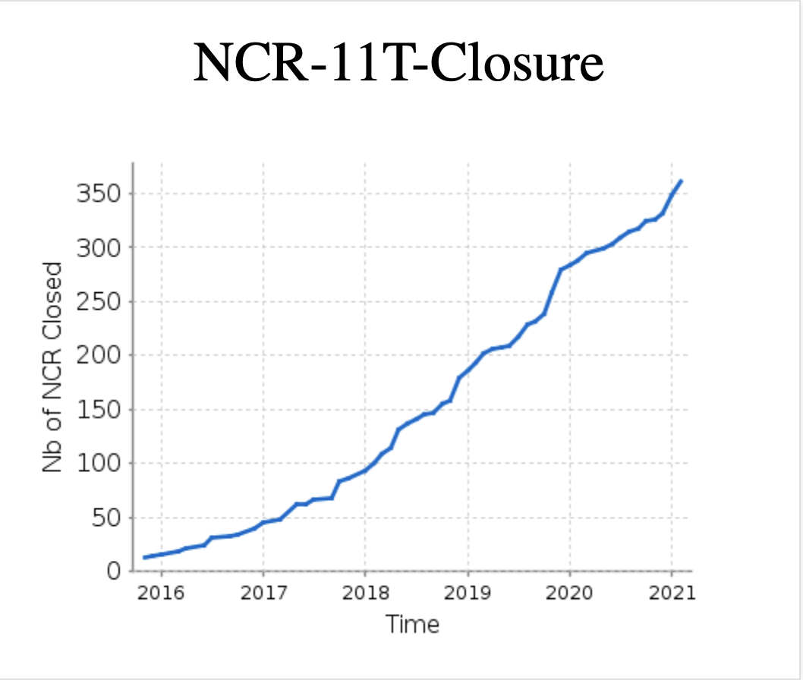
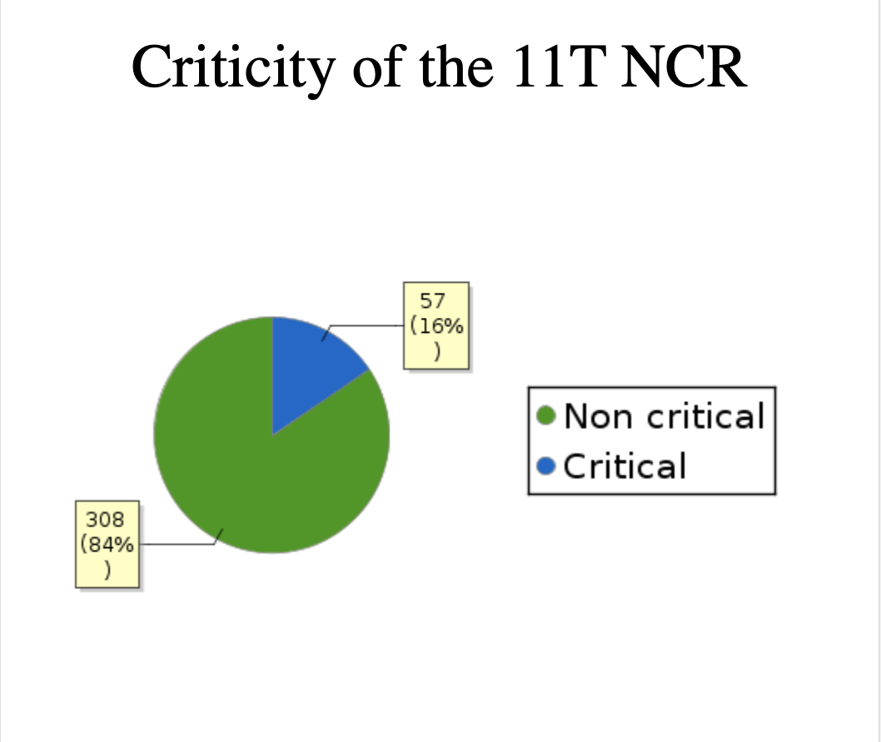
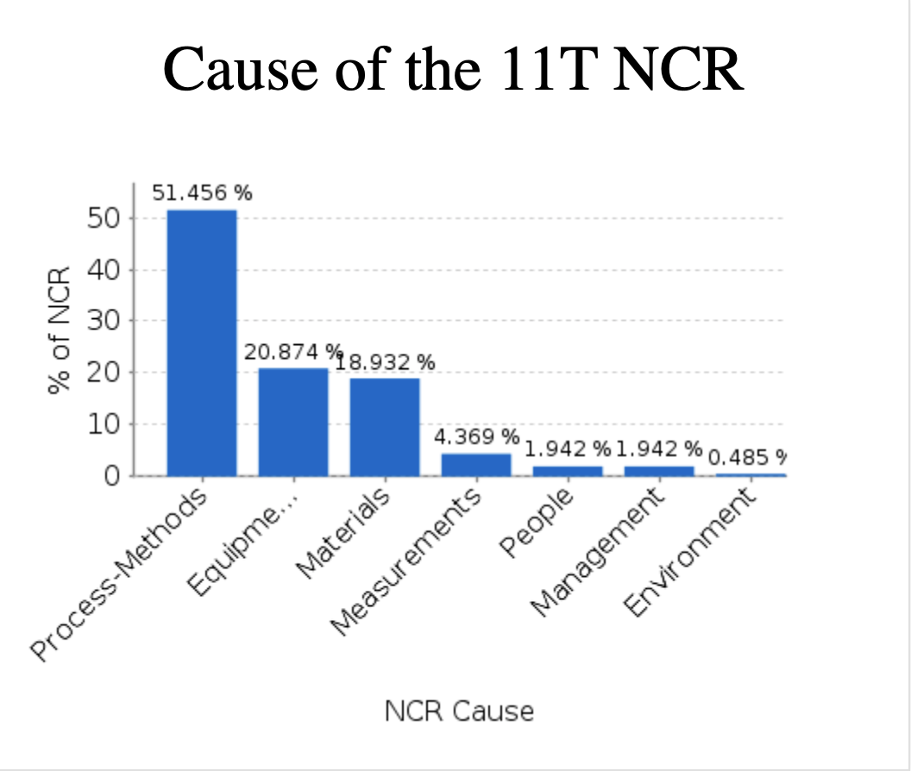
Non-conformities

Slide 15
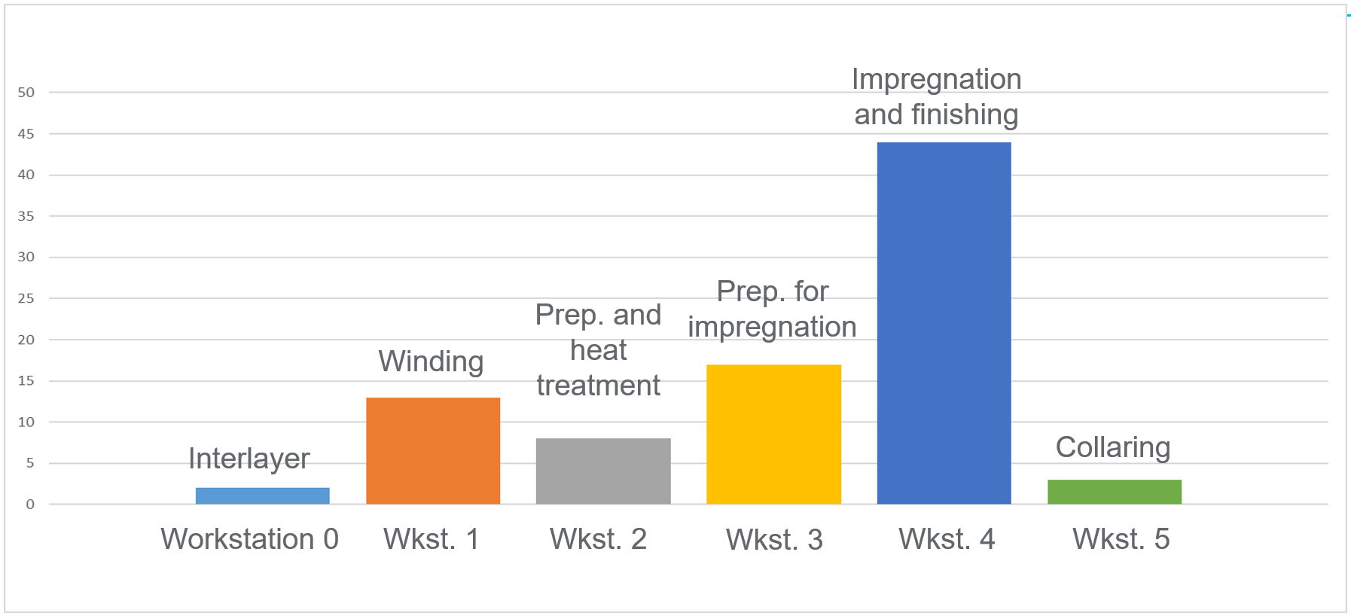
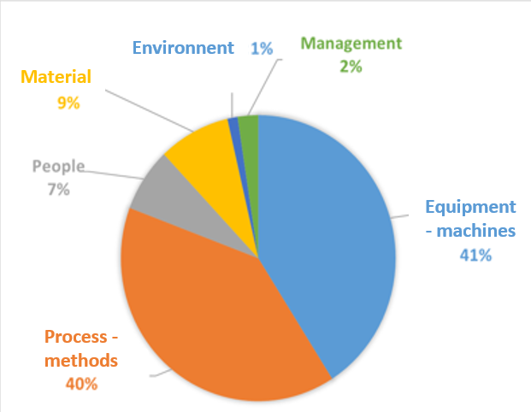
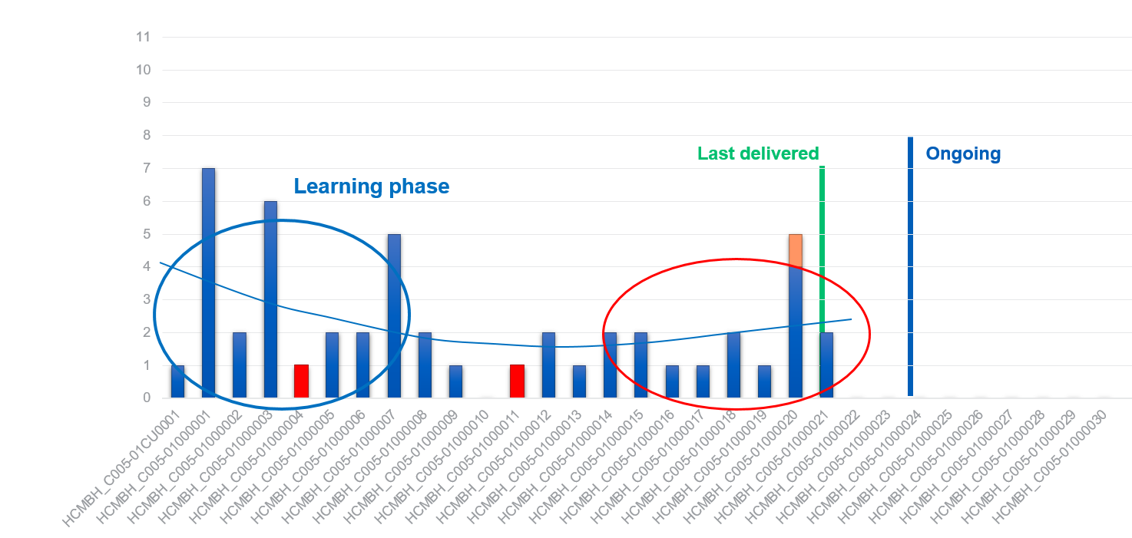
Statistics and “deverminage” sessions

Slide 16
NC Impact
EDMS Criticality | NC Type | Impact (X)
Critical | Level 5 Extreme | X > 1 MCHF or 6 months
Critical | Level 4 Major | X < 1 MCHF or 3 months
Critical | Level 3 Moderate | X < 100 kCHF or 1 month
Non Critical | Level 2 Minor | X < 10 kCHF or 1 week
Non Critical | Level 1 Negligible | X < 1 kCHF or 1 day

Slide 17
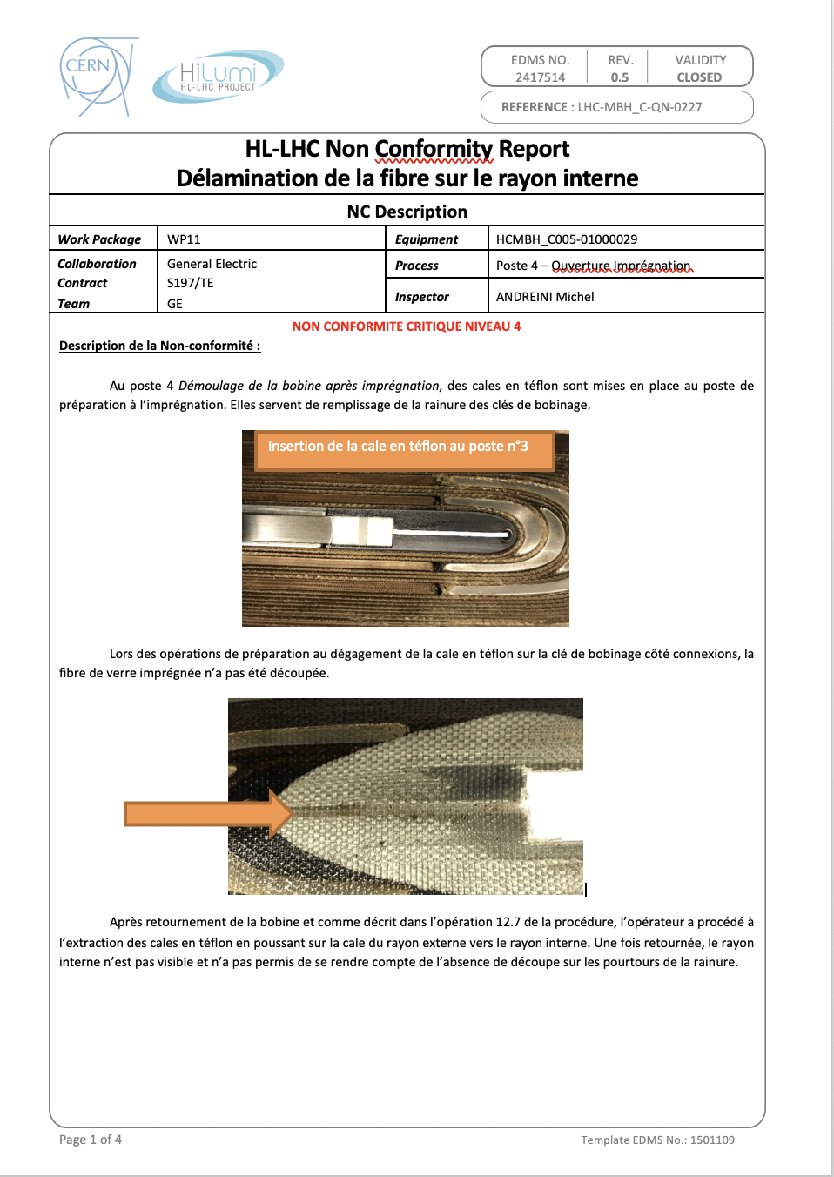
Non Conformity Report (NCR)
Open a NC = provide a NCR
Description (essential info)
Decision (Action Plan)
Root Cause Analysis required for a CRITICAL NC (LEVEL 3, 4 or 5)
Closure (after implementation of the Action Plan)

Slide 18
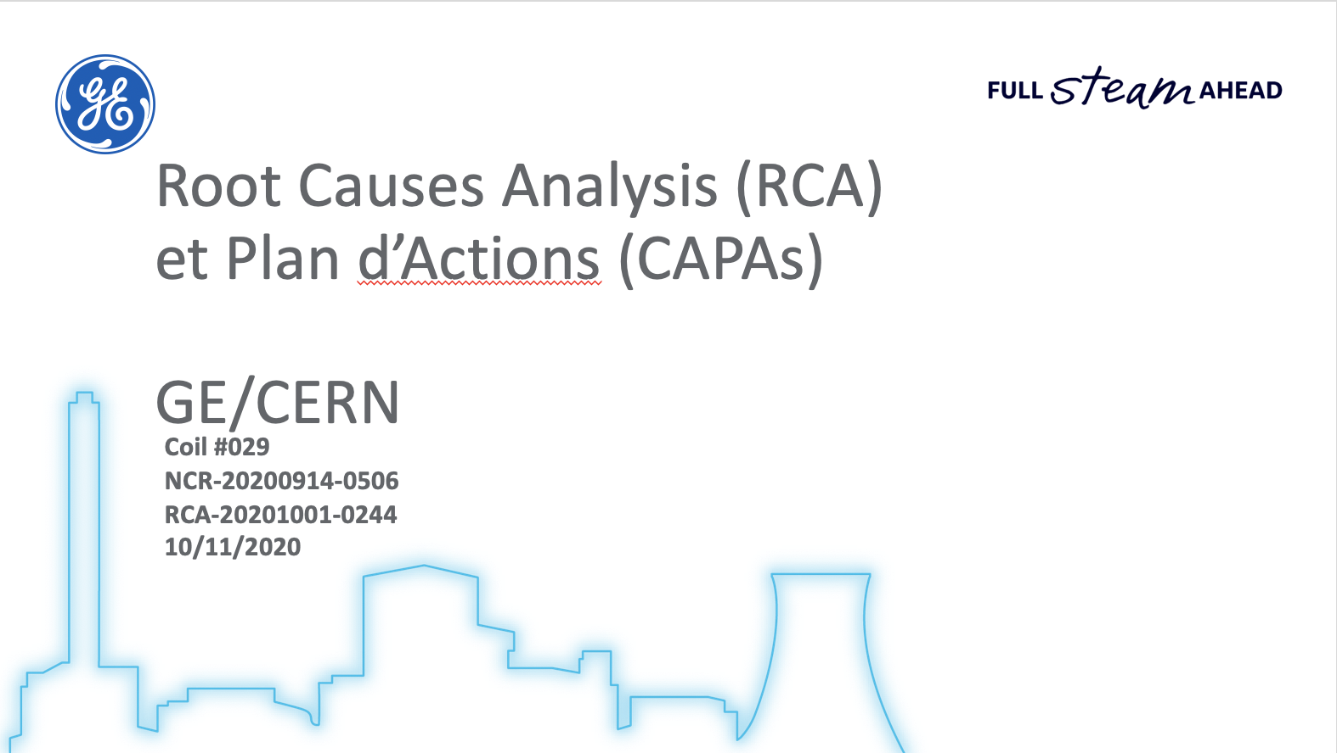
Root Cause Analysis (RCA)

Slide 19
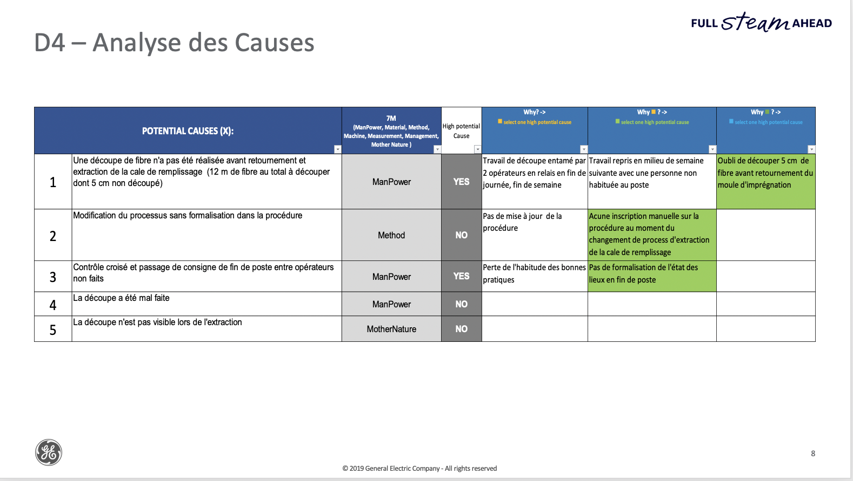
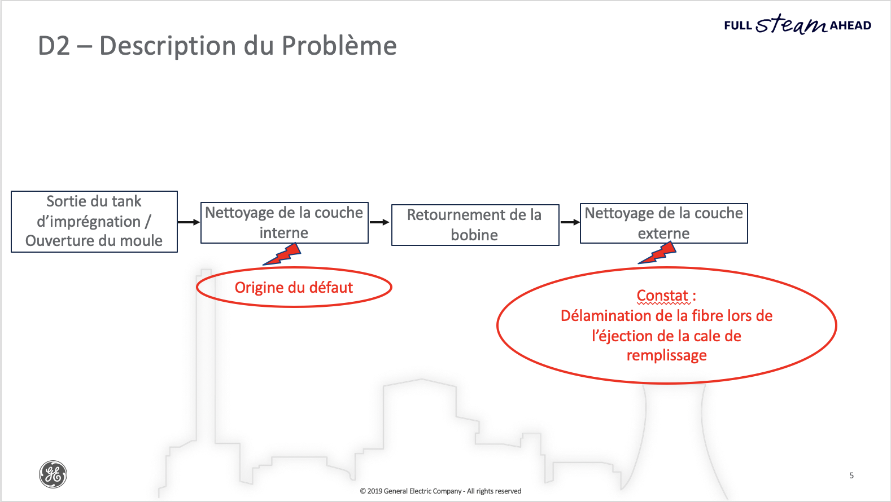
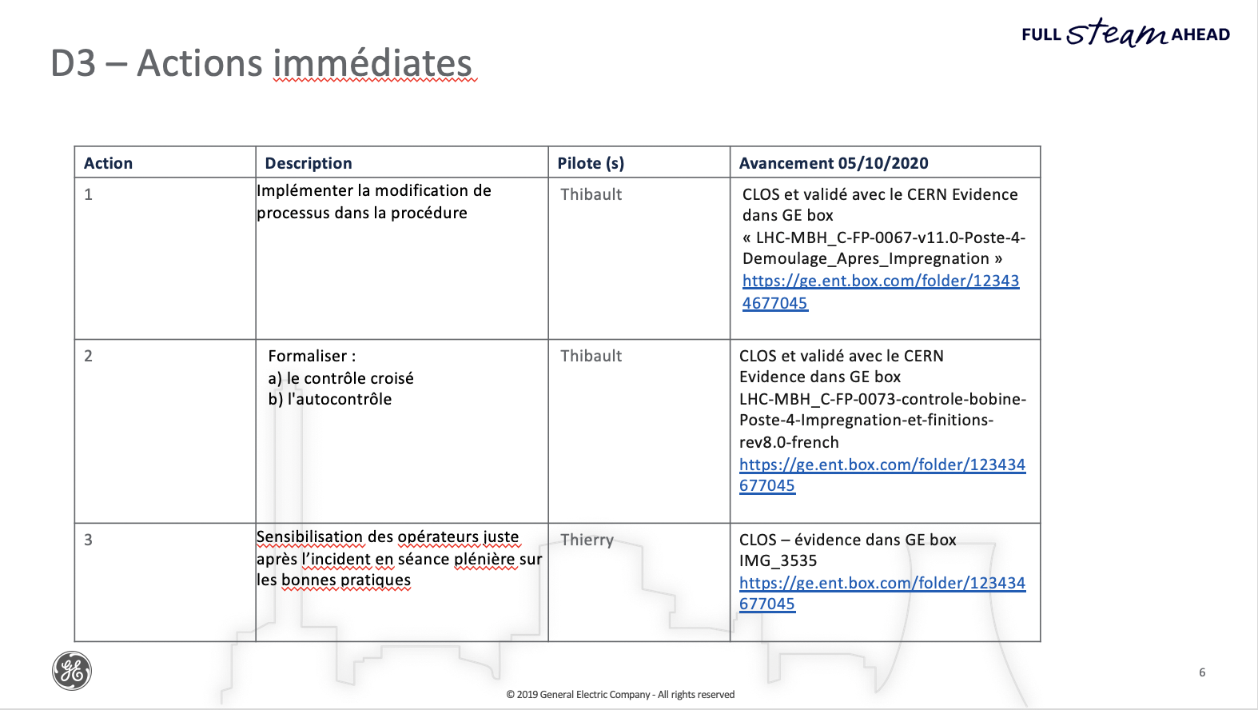
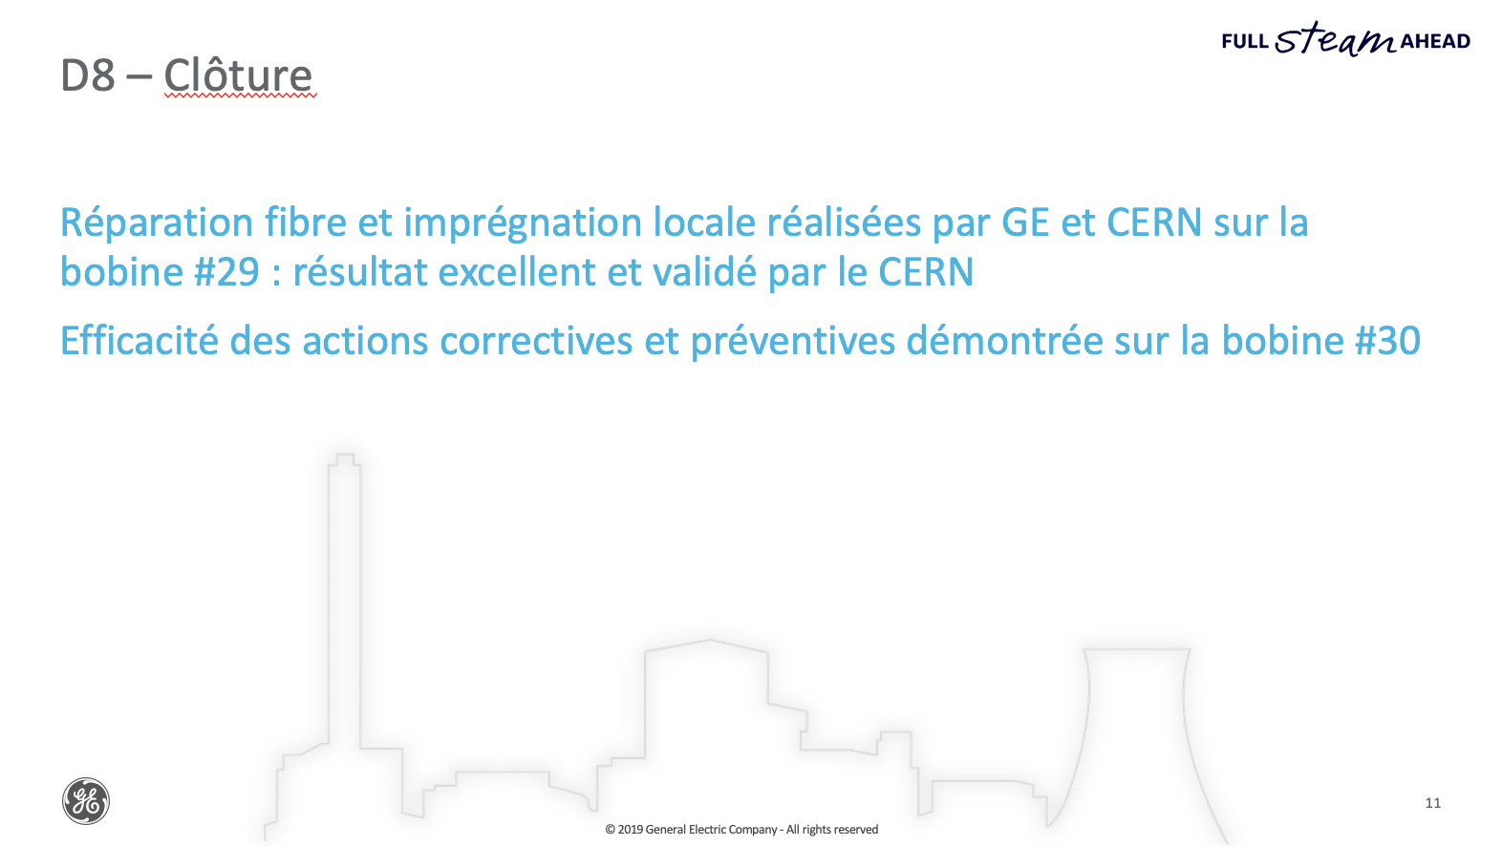
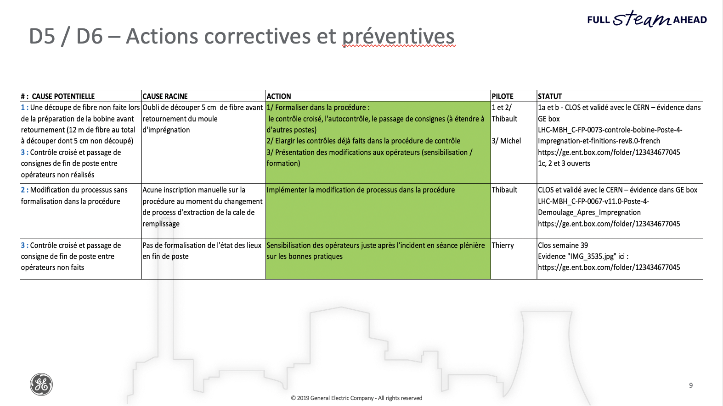

Slide 20
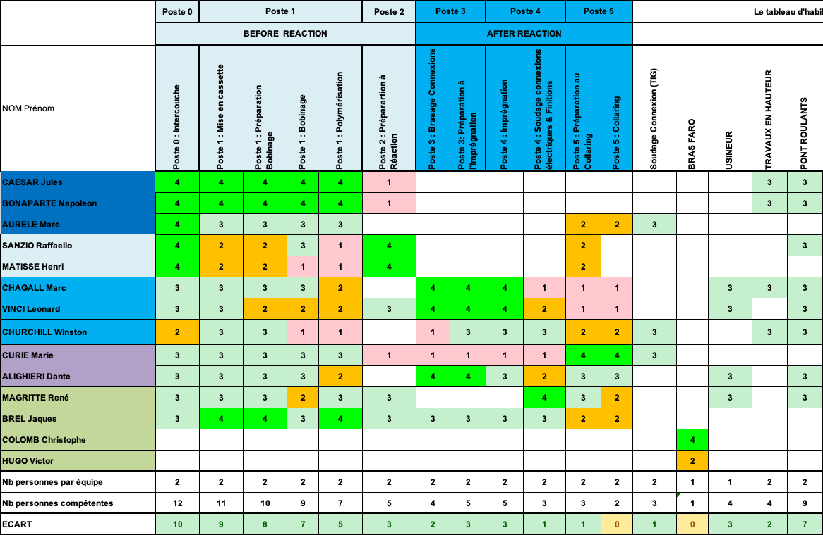
Skill matrix
S197 coil production;
Personnel experience per production step:
Team (at
To be trained;
In training;
Autonomous;
Expert-trainer.
Team: at least one level 3 or 4, not more than 2 level 1 or 2.

Slide 21
Sharing experience
Documental corpus as a tool for training (weekly in field);
QA meeting WP3-WP11 (weekly);
Dedicated sessions QXF-11T (in 2020):
Coiling 11T (MON @ EDMS 2393474);
Reaction MQXFB (EDMS 2399369);
Splicing 11T (EDMS 2407230);
Quality Controls (EDMS 2414703).
Other local exchanges.

