Slide 1
11 T Strategy Proposal (Updated)
30 November 2020
1 February 2021
25 February 2021
Version 6.2
Arnaud Devred with inputs from many colleagues
Group Leader Magnets, Superconductors and Cryostats

Slide 2
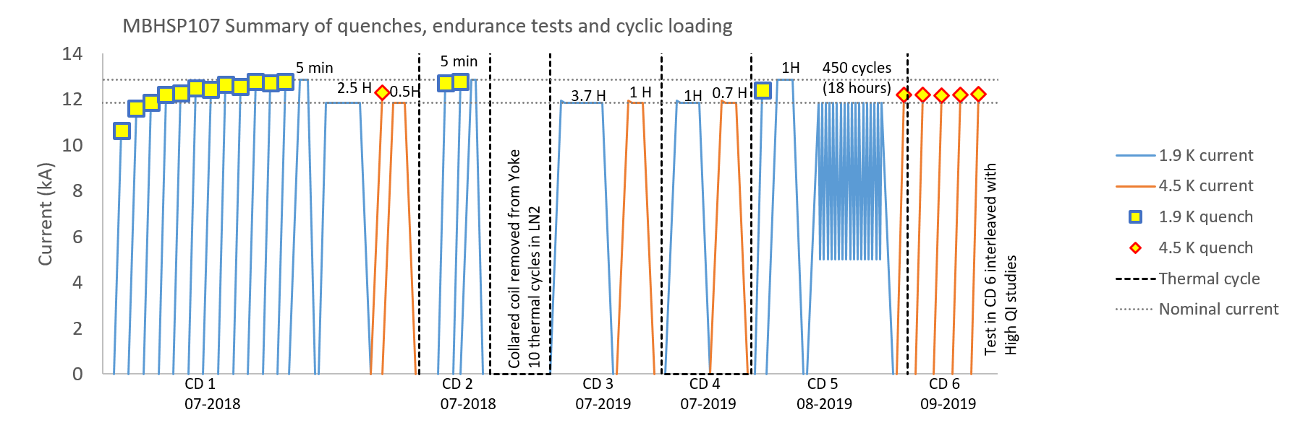
SP107 Test History
SP107 is the first single-aperture, short model magnet issued from the 11 T Task Force with optimized collaring process; it underwent endurance testing (5 WUCD to LHe, 10 WUCD to LN2, over 450 EM cycles).
It repeatedly achieved nominal current (and went 3 times to ultimate current).
V-I measurements were only carried out after 3rd cooldown to LHe and do show limited voltage increase on midplane turns at high currents (near or above nominal); reproducible from CD to CD.
(Courtesy G. Willering, TE-MSC)
7.5 TeV
7 TeV

Slide 3
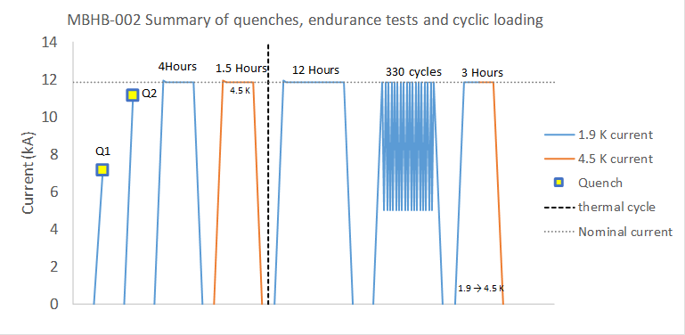
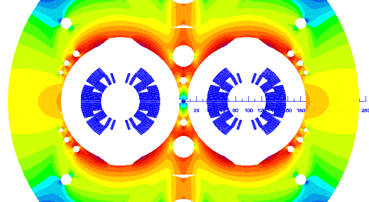
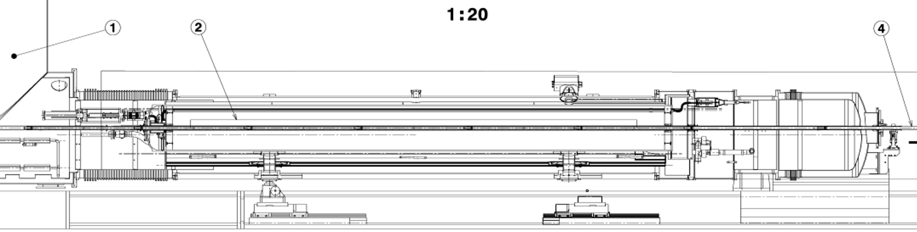
LMBHB002 (S1) Test History
(Courtesy G. Willering, TE-MSC)
LMBHB002 (S1) is the first twin-aperture, full-length, dipole magnet issued from series production.
As all series magnets, it benefited from 11 T Task Force outcome.
Power testing was limited by management to nominal current + 100 A.
It underwent ~340 power cycles to maximum current and 1 WUCD.
No performance degradation was observed, but V-I diagnostics were not yet implemented.
It relies on impregnated QH, which were not tested to machine conditions.
7 TeV
6.5 TeV
D1
D2
NCS
Q1: 7164 A
Q2: 11135 A
CS
Q2
Q1

Slide 4
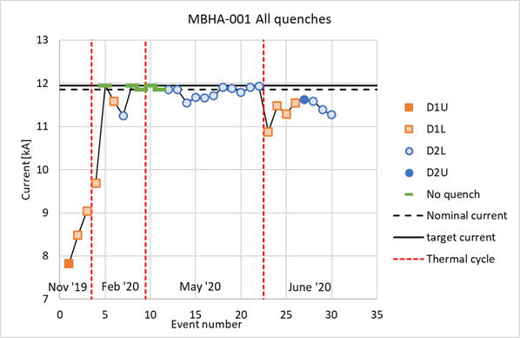
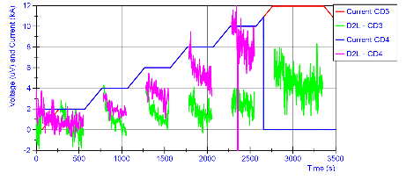
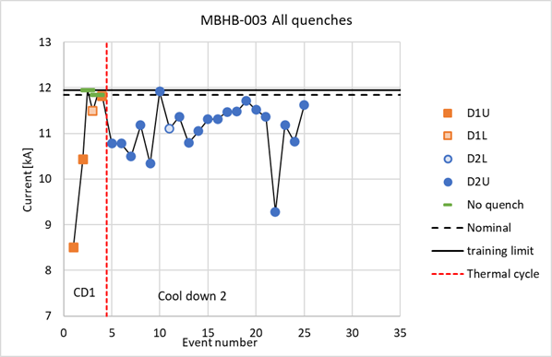
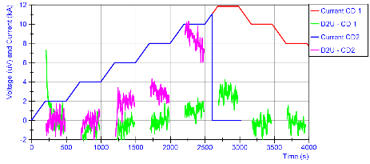
LMBHA001 (S2) & LMBHB003 (S4) Test History
LMBHA001 (S2) reached maximum current after 2nd and 3rd cooldown, but exhibited performance degradation after extensive QH firing (~80, for spike investigation).
Test of S2 (which relies on impregnated QH) ended with a QH-to-coil #12 failure during lifted voltage test to simulate machine conditions.
LBMBHB003 (S4) reached maximum current after 1st cooldown, but exhibited performance degradation after 2nd cooldown.
Test of S4 (which relies on external QH) ended with a QH trace to wire jointing failure in coil #17.
CD3
CD4
CD4
Aperture 2
CD3
CD1
CD2
CD2
Aperture 2
CD1
(Courtesy of G. Willering)

Slide 5
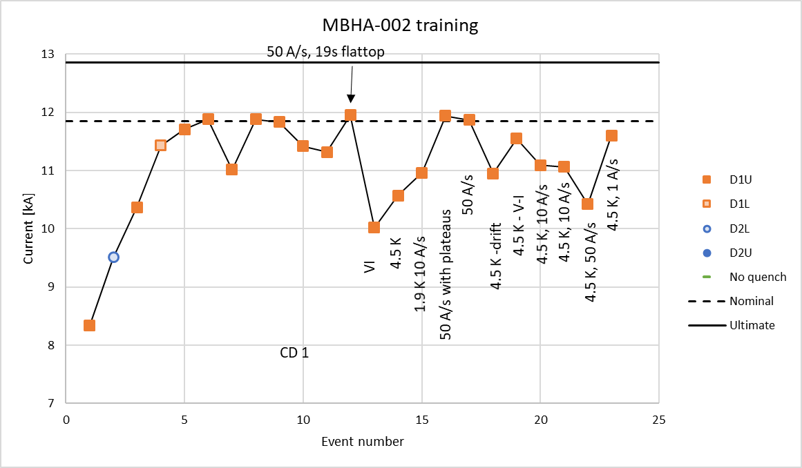
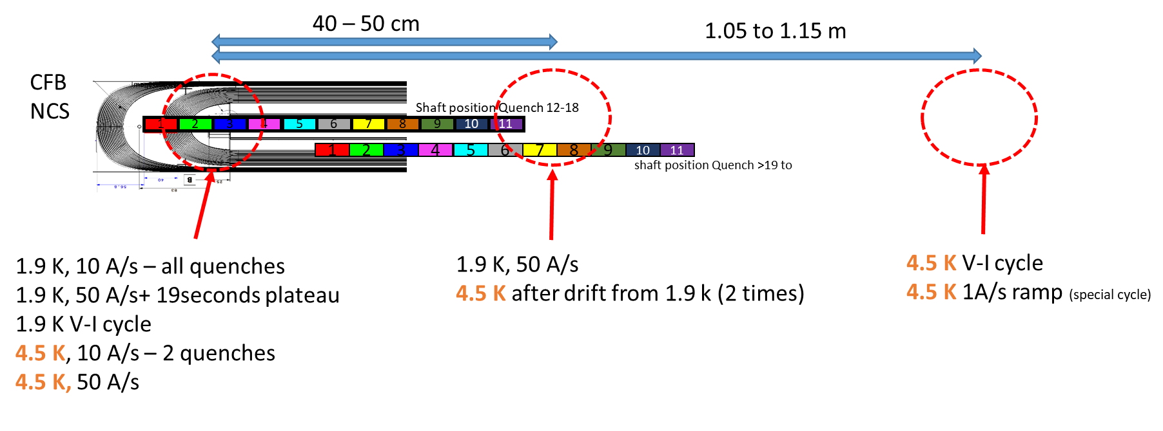
LMBHA002 (S3) Test History
LMBHA002 (S3) exhibited a performance limitation in one of the coils (D1U, non-connection side) after 1st cooldown.
Test of S3 (which relies on external QH) ended with a QH trace to wire jointing failure in coil #14 (like in S4).
(Courtesy of G. Willering, TE-MSC)

Slide 6
Why is it so Hard to Determine Quench Origin?
Present understanding of the phenomenology of quench origin and development points to 3 different mechanisms that may have distinct locations
a local conductor degradation, that generates a current imbalance among cable strands, which may be very large and may diffuse over a long length;
A high field instability that will be triggered whenever a strand exceeds the instability threshold in the current, field and temperature space;
A precursor (likely of mechanical origin) that generates some heat and pushes strands carrying high current over the instability threshold.
Disentangling these 3 mechanisms is not easy (and a multi-physics analyst dream), but it is likely that the local conductor degradation results from a macroscopic defect, which leads to the current imbalance and, eventually, the high field instability that is fostered (or not) by a precursor.
Prime goal is to localize/identify the original macroscopic defect; parameters for investigation during testing (dating back from HERA and SSC) are: current ramp rates and pre-cycles (to affect current imbalance) and temperature (4.5 K vs. 1.9 K to get closer to the critical surface).
V-I measurements are a very powerful tool enabling early detection of degradation.

Slide 7
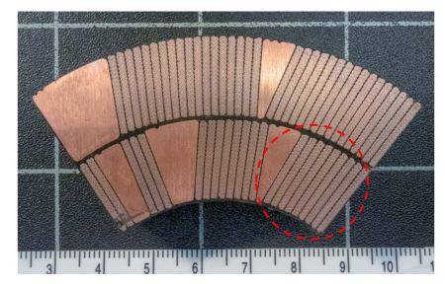
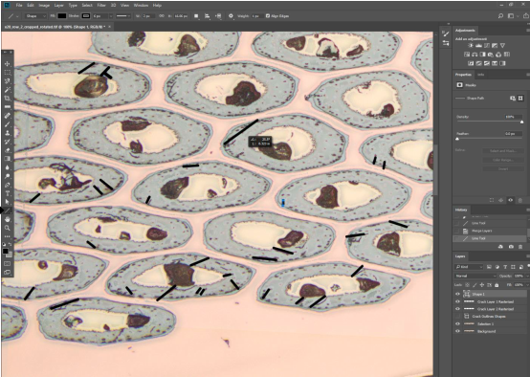
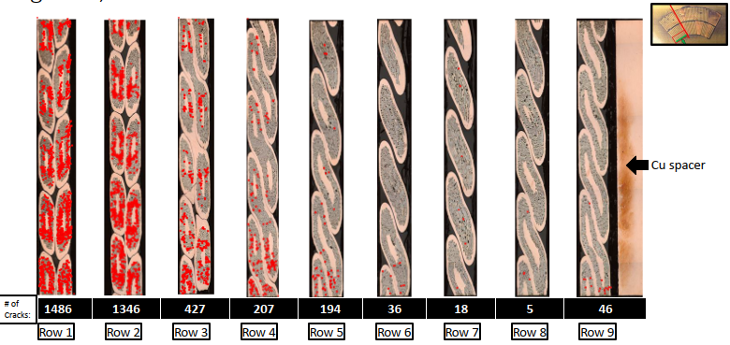
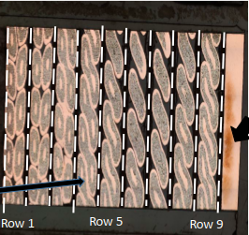
Why Do We Worry?
Electromagnetic and thermal cycling degradations are common issues to Nb3Sn magnets (e.g., ITER Toroidal Field and Central Solenoid magnets).
Nb₃Sn strands are sensitive to transverse compression and may crack upon bending or under tension; paradigm is to manage prevention of conductor displacement or deformation without squeezing them too much.
Evidence of filament cracking (one of likely causes of irreversible degradation) has been observed on a section cut from DP102 coil #109 (a coil was used/re-used for several assemblies, which were cold tested/energized).
Midplane Turn
(Courtesy of R. Mullinix, O. Van Oss, J. Cooper,
S. Balachandran, B. Starch and P.J. Lee, NHMFL)

Slide 8
11 T Status
Fifth cryo-magnet (S5-LMBHA003) was completed in October 2020 but not tested, to permit additional investigations of the likely causes of performance degradation observed on previous magnets and, hopefully, devise solutions to improve behavior (as well as fixing the issue with electrical connection to quench heaters).
GE scope of work for coil production was completed on 29 January 2021 with coil #35 (option for last coil exercised in November 2020); in absence of non-conformities, there are 8 “virgin” coils that are being put in storage (inside collars with no preload).
Re-assembly of collared coil 6 (with coils #10 & 14 and new procedure for electrical connection to quench heaters) has been completed by GE in presence of CERN staff for training; assembly of last two cryo-magnets (S6 and S7) has been put on hold.
Investigations are on going to identify origins of performance degradation, including:
Root cause analysis;
3D modeling and analyses of mechanical support of coil ends throughout magnet life cycle;
Examination of “damaged” coil sections by X-ray tomography.

Slide 9
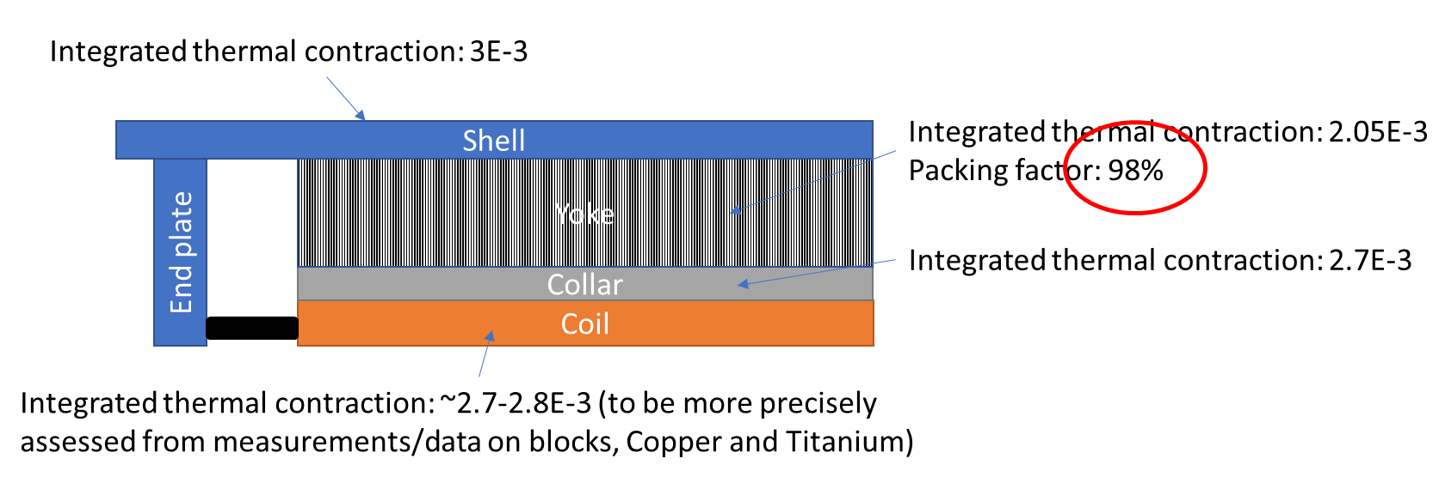
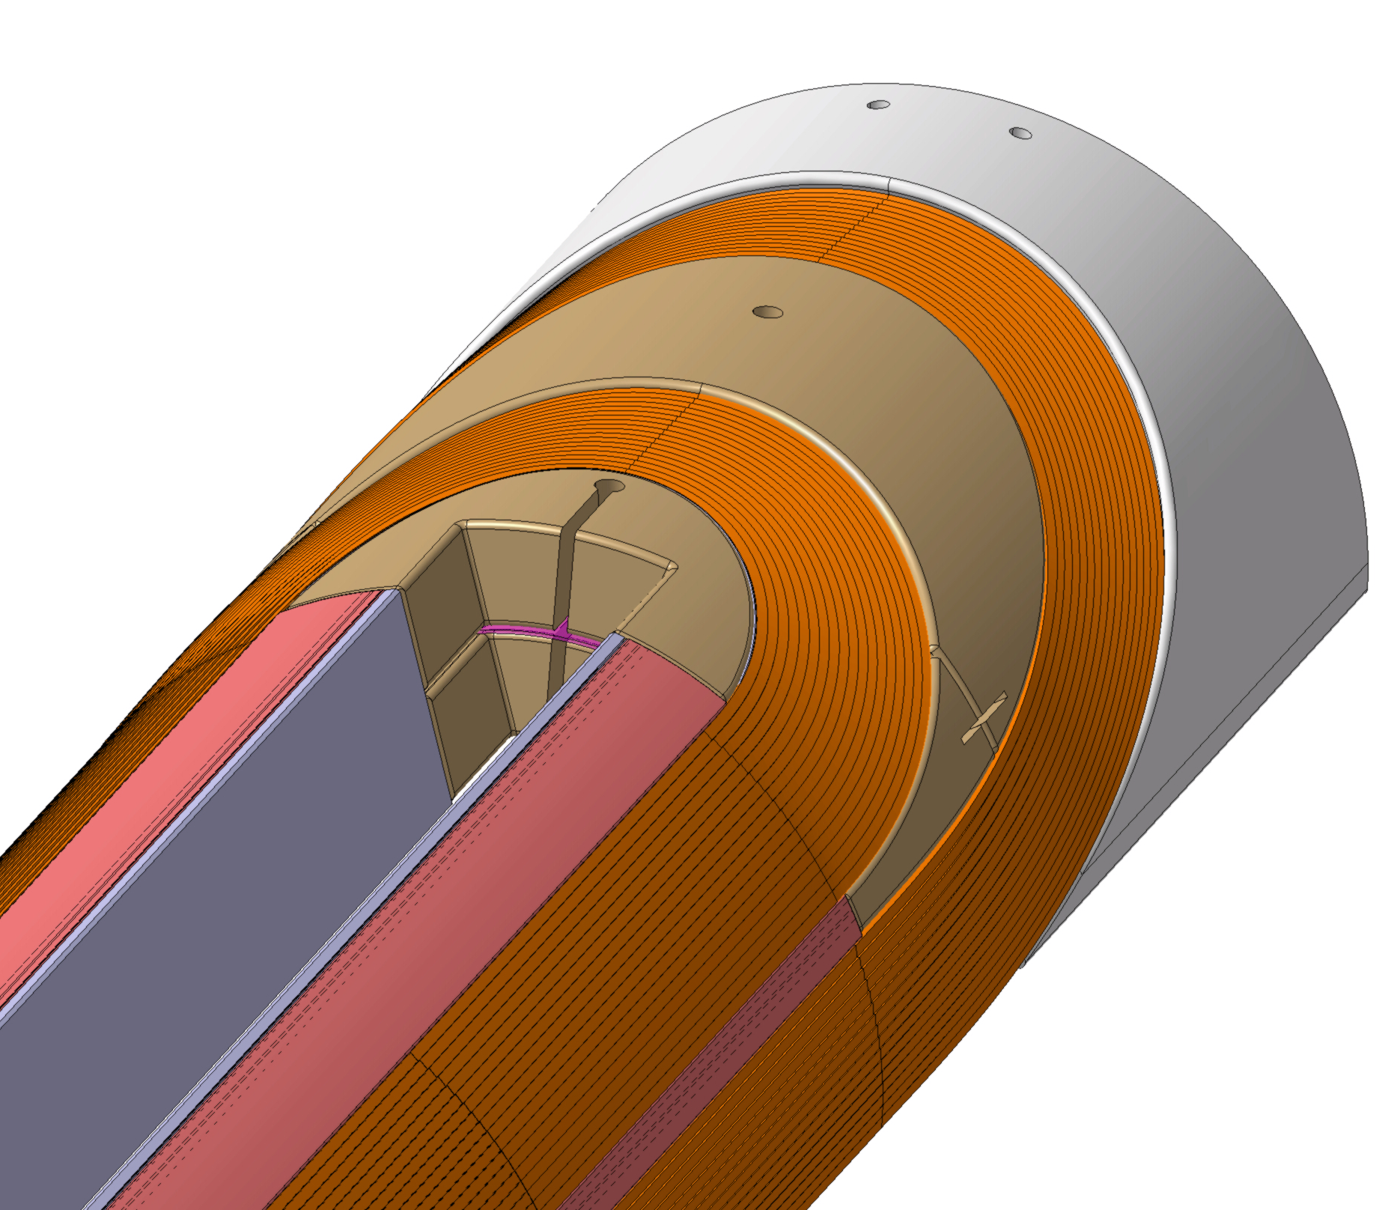
3D Mechanical Support of Coil Ends
Mechanical design relies on tight clamping of collared-coil assembly by yoke and shell, and set screws through end plates, to contain the coil and prevent fragile Nb₃Sn conductor deformation.
In axial direction, thermal shrinkage should be governed by the shell, while the Lorentz force tends to stretch the coil outwardly.
Present assembly, based on LHC dipole magnet experience, aims at ensuring contact between coil and set screws at the end of cooldown, but model magnet results show that only a fraction of the axial Lorenz load (~50%) is taken by the screws (to be confirmed on a long magnet).
A combination of weak coil end compliance and thermal shrinkage differentials may result in local spots where conductors can deform, eventually triggering Nb₃Sn filament cracking.
Need to devise ways of improving conductor support in all conditions, especially at cold.
Set Screws
F_{L,z}
(Courtesy of M. Morrone & C. Garion, TE-VSC)
F_{L,z}
 | Axial Component of Lorentz Force (kN/per aperture at 11,850 A)
LHC | 240
11 T | 450
G11
SS
Nb₃Sn
Pack
Cu
SS
(Courtesy of S. Izquierdo-Bermudez, TE-MSC)
(Courtesy of J.L. Rudeiros-Fernandez
& E. Gautheron, TE-MSC)

Slide 10
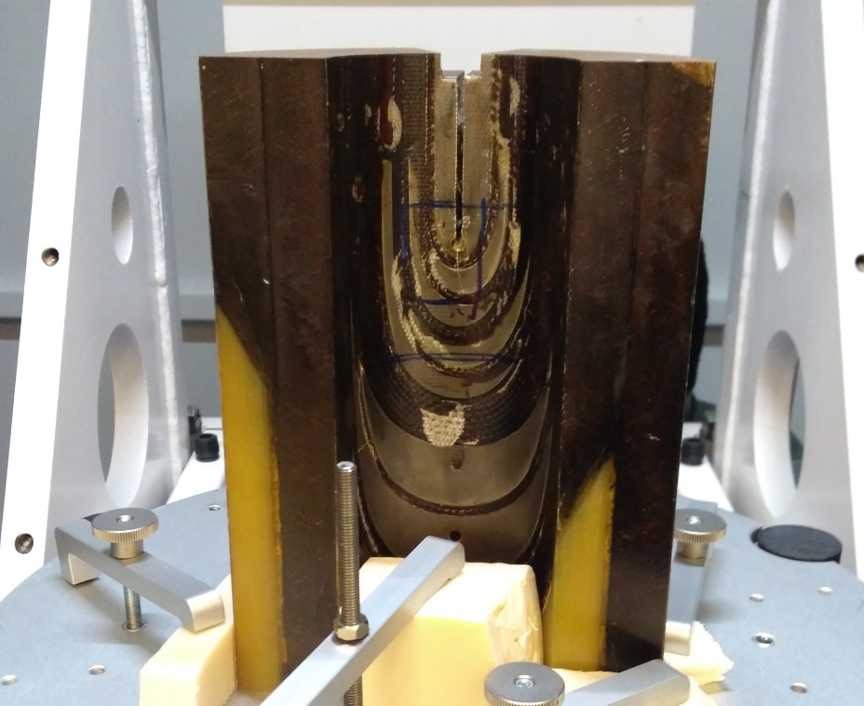
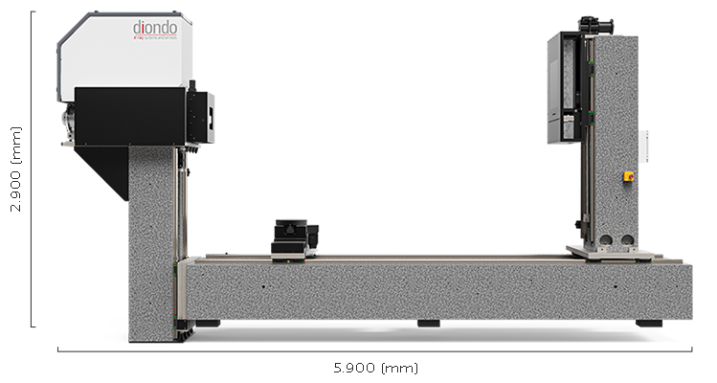
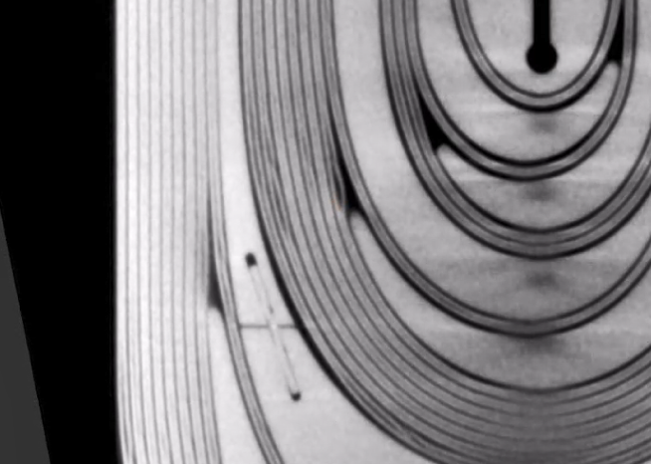
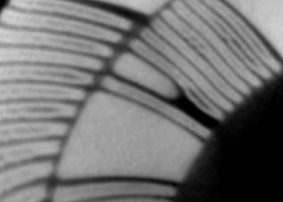
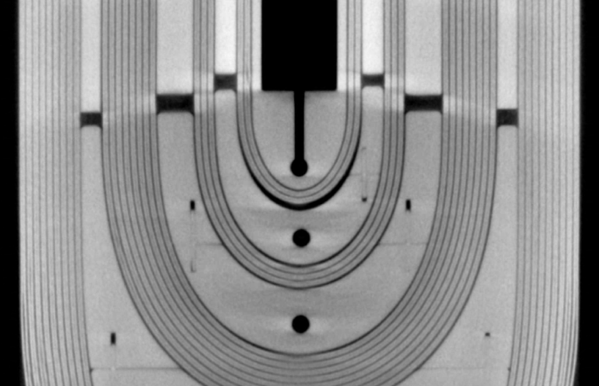
In-Situ Examination of Coil Sections
(Courtesy of M. Jedrychowski & S. Sgobba, EN-MME)
EN-MME has identified a 6 MeV LINAC tomograph at TEC-Eurolab in Modena that enables non-intrusive and non-destructive 3D imaging and in-depth inspection of relatively large sections cut from coils.
Technique can be used to inspect “damaged” and “undamaged” coil sections (by “damaged” sections, we mean sections where limiting quenches have been localized or sections across which resistive voltages have been measured).
First observations on coil #02 (limiting coil of 1st hybrid assembly) already provide powerful insights; more statistics are needed.
To be complemented by metallographic examinations of zones of interest to assess status of Nb₃Sn wires.
CS end of Coil #02
Evidence of conductor bulging at exit of coil end spacer
NCS end of Coil #02
Evidence of gap (likely filled with pure resin) at outer radius of 1st conductor block

Slide 11
Coil Classification
Class 1
Virgin coils
Lowest probability of failure
Can be used
Class 4
Coils tested at cold
Medium probability of failure, higher than for Class 2
Only 1 cool down
Could be used, if V-I data are clean
Class 2
Virgin coils
Low probability of failure
Collared according to the series production process
Can be used
Class 5
Coils tested at cold
Highest probability of failure, or limiting coil
More than 1 cool down, or fast cool down
Coils presumably degraded
Class 4, with measurable V-I signal
Not to be used
Class 3
Tested at cold and qualified
However, V-I not performed and to be done
Impregnated QHs
Class 6
Lost in production, or quarantined

Slide 12
11T status March 2021 – Coils, Collared Cs, Magnets
Magnet | Collared Coils | Coils | Quench Heaters | CD-WU | Class | Note
P1 – Hybrid | D1: CC01 | GE02_Upper | Impregnated | Fast | Class 5 | Limiting coil Cut for inspection, tomography, …
P1 – Hybrid | D1: CC01 | GE03_Lower | Impregnated | Fast | Class 5
P1 – Hybrid | D2: CC02 (proto) | C05_Upper (proto) | Impregnated | Fast | - | Not classified (from prototype)
P1 – Hybrid | D2: CC02 (proto) | C04_Lower (proto) | Impregnated | Fast | - | Not classified (from prototype)
S1 – Type B | D1: CC02 | GE05_Upper | Impregnated | ΔT_{MAX} 30K | Class 3 | Qualified to LHC standard, no V-I meas. done
S1 – Type B | D1: CC02 | GE01_Lower | Impregnated | ΔT_{MAX} 30K | Class 3 | Qualified to LHC standard, no V-I meas. done
S1 – Type B | D2: CC03 | GE07_Upper | Impregnated | ΔT_{MAX} 30K | Class 3 | Qualified to LHC standard, no V-I meas. done
S1 – Type B | D2: CC03 | GE06_Lower | Impregnated | ΔT_{MAX} 30K | Class 3 | Qualified to LHC standard, no V-I meas. done
S2 – Type A | D1: CC05 | GE12_Upper | Impregnated | ΔT_{MAX} 30K | Class 5 | Issue with large spikes and QH failure
S2 – Type A | D1: CC05 | GE13_Lower | Impregnated | ΔT_{MAX} 30K | Class 5 | Limiting coil, and issue with large spikes To be cut for inspection, tomography, …
S2 – Type A | D2: CC04 | GE08_Upper | Impregnated | ΔT_{MAX} 30K | Class 5 | Issue with large spikes
S2 – Type A | D2: CC04 | GE09_Lower | Impregnated | ΔT_{MAX} 30K | Class 5 | Limiting coil, and issue with large spikes To be cut for inspection, tomography, …
S3 – Type A | D1: CC07 | GE15_Upper | External | ΔT_{MAX} 30K | Class 5 | Limiting coil To be cut for inspection, tomography, …
S3 – Type A | D1: CC07 | GE16_Lower | External | ΔT_{MAX} 30K | Class 4 | V-I Signals OK – No V build-up – !QH jointing!
S3 – Type A | D2: CC06 | GE10_Upper | External | ΔT_{MAX} 30K | Class 4 | V-I Signals OK – No V build-up
S3 – Type A | D2: CC06 | GE14_Lower | External | ΔT_{MAX} 30K | Class 4 | QH trace to wire jointing failure, repaired V-I signals OK – No V build-up

Slide 13
Magnet | Collared Coils | Coils | Quench Heaters | CD-WU | Class | Note
S4 – Type B | D1: CC09 | GE20_Upper | External | ΔT_{MAX} 30K | Class 4 | V-I Signals OK – No V build-up
S4 – Type B | D1: CC09 | GE21_Lower | External | ΔT_{MAX} 30K | Class 4 | V-I Signals OK – No V build-up
S4 – Type B | D2: CC08 | GE17_Upper | External | ΔT_{MAX} 30K | Class 5 | Limiting coil QH trace to wire jointing failure
S4 – Type B | D2: CC08 | GE19_Lower | External | ΔT_{MAX} 30K | Class 5 | V-I Signal > 3𝜇V (low but visible)
S5 – Type A | D1: CC10 | GE23_Upper | External | ΔT_{MAX} 30K | Class 2 | Completed but not tested at cold - !QH jointing!
S5 – Type A | D1: CC10 | GE22_Lower | External | ΔT_{MAX} 30K | Class 2 | Completed but not tested at cold - !QH jointing!
S5 – Type A | D2: CC11 | GE25_Upper | External | ΔT_{MAX} 30K | Class 2 | Completed but not tested at cold - !QH jointing!
S5 – Type A | D2: CC11 | GE24_Lower | External | ΔT_{MAX} 30K | Class 2 | Completed but not tested at cold - !QH jointing!
S6 – Type B | D1: CC12 | GE26_Upper | External | ΔT_{MAX} 30K | Class 1 | This coil is one of the last 8 coils produced
S6 – Type B | D1: CC12 | GE28_Lower | External | ΔT_{MAX} 30K | Class 1 | This coil is one of the last 8 coils produced
S6 – Type B | D2: CC13 | GE29_Upper | External | ΔT_{MAX} 30K | Class 1 | This coil is one of the last 8 coils produced
S6 – Type B | D2: CC13 | GE31_Lower | External | ΔT_{MAX} 30K | Class 1 | This coil is one of the last 8 coils produced
S7 – Type A | D1: CC14 | GE32_Upper | External | ΔT_{MAX} 30K | Class 1 | This coil is one of the last 8 coils produced
S7 – Type A | D1: CC14 | GE33_Lower | External | ΔT_{MAX} 30K | Class 1 | This coil is one of the last 8 coils produced
S7 – Type A | D2: CC15 | GE34_Upper | External | ΔT_{MAX} 30K | Class 1 | This coil is one of the last 8 coils produced
S7 – Type A | D2: CC15 | GE35_Lower | External | ΔT_{MAX} 30K | Class 1 | This coil is one of the last 8 coils produced

Slide 14
Magnet | Collared Coils | Coils | Quench Heaters | CD-WU | Class | Note
- | - | GE4 | - |  | Class 6 | Lost in production, before impregnation
- | - | GE11 | Impregnated |  | Class 6 | Lost in production, however completed Cut for inspection, tomography, metallography
- | - | GE18 | External |  | Class 6 | Lost in production, however completed
- | - | GE27 | - |  | Class 6 | Lost in production, before impregnation
 | - | GE30 | External |  | Class 6 | NC during production – conductor degradation suspected, tests in Fresca needed, quarantined

Slide 15
Coil Inventory
Class | Quench Heaters | Number | Note
Class 1 | External | 8 | Can be reused for tunnel magnet
Class 2 | External | 4 | Can be reused for tunnel magnet
Class 3 | Impregnated | 4 | S1 magnet, to be retested to check QH and V-I signals
Class 4 | External | 5 | Can be reused for prototyping
Class 5 | both | 9 | To be discarded
Class 6 | both | 5 | Lost or quarantined
12 12 coils (up to 3 magnets)
12 4 coils (1 magnet to be reassessed)

Slide 16
11 T Strategy (EDMS: 2441806)
A strategy proposal for the 11 T program was developed and presented to the DG on 30 November 2020 (see thereafter).
The proposal was agreed and is being implemented.
The schedule has been updated based on present progress.
In addition, the CERN SPC has requested a special meeting of the CMAC on 1st March 2021 that may recommend additional studies.

Slide 17
11 T Strategy: Phase 1
Phase 1 (now until March 2021 June 2021): continue investigations to identify causes of performance limitation. At present, two families of causes are under consideration:
weaknesses in mechanical support of coil ends;
weaknesses internal to the magnet coils.
Internal review in March/April 2021 end of June 2021 to assess results and decide on next step:
if analyses point to issues with mechanical support of coil ends
worth pursuing investigations by testing a hybrid magnet assembly, made up of 2 different collared-coils to be powered independently and with additional mechanical features and instrumentation;
if observations cast serious doubts on conductor support inside coils
solution requires re-engineering and re-qualification efforts at coil level that are beyond WP11 scope.

Slide 18
11 T Strategy: Phase 2
Phase 2 (April-November 2021 July 2021-March 2022)
preparation and test of hybrid assembly (details TBD);
development of a resource-loaded plan and cost estimate for relaunching 11 T magnet production;
New plan needs to integrate co-activities with MQXFB production and testing, which will be given priority.
(International) review in November/December 2021 End of March 2022 to review test results, plan and cost estimate.
Decision on how to proceed in December 2021 April 2022.

Slide 19
Proposal for New Hybrid Magnet
Magnet | Collared Coils | Coils | Quench Heaters | CD-WU | Class | Note
P2 – Hybrid | D1: CC12 | GE26_Upper | External | ΔT_{MAX} 30K | Class 1 | This coil is one of the last 8 coils produced
P2 – Hybrid | D1: CC12 | GE28_Lower | External | ΔT_{MAX} 30K | Class 1 | This coil is one of the last 8 coils produced
P2 – Hybrid | D2: CC06 | GE10_Upper | External | ΔT_{MAX} 30K | Class 4 | V-I Signals OK – No V build-up
P2 – Hybrid | D2: CC06 | GE14_Lower | External | ΔT_{MAX} 30K | Class 4 | QH trace to wire jointing failure, repaired V-I signals OK – No V build-up
For D1
Coils from latest part of production
Collaring and loading conditions in the ends as per outcome of Phase 1
QH trace to wire jointing to be done as per final procedure, wire soldered directly on trace terminal
For D2
Repaired CC06; collaring as per series production procedure (done)
QH trace to wire jointing as per final procedure, wire soldered directly on trace terminal (done)
Coldmass to be equipped with mechanical instrumentation, strain gauges on collars, bullets, shrinking cylinders, and other locations to be studied, e.g., magnet end plates, …

Slide 20
11 T Strategy: Phase 3
Phase 3 (TBD): relaunch of 11 T magnet production
Cost and schedule to be reassessed during Phase 2
Wire procurement to be anticipated as it has a long lead time
(~200 kCHF per coil);
Issue of coactivity with MQXFB coil and magnet production if launched before 2024 (for reference, service contract costs were: ~160 kCHF per coil manufacture; ~120 kCHF per collared-coil assembly);
Program duration of ~5 years (from wire procurement to 4th magnet available for tunnel installation).
Viability of proposed solution will be demonstrated by the results of Phase 2; but before launching Phase 3, it may also be worth waiting for the results of proton operations during run 3.

Slide 21
Plan for 4 Magnets
Magnet | Collared Coils | Coils | Quench Heaters | CD-WU | Class | Note
S1 – Type B | D1: CC02 | GE05_Upper | Impregnated | ΔT_{MAX} 30K | Class 3 | Qualified to LHC standard, no V-I meas. done
S1 – Type B | D1: CC02 | GE01_Lower | Impregnated | ΔT_{MAX} 30K | Class 3 | Qualified to LHC standard, no V-I meas. done
S1 – Type B | D2: CC03 | GE07_Upper | Impregnated | ΔT_{MAX} 30K | Class 3 | Qualified to LHC standard, no V-I meas. done
S1 – Type B | D2: CC03 | GE06_Lower | Impregnated | ΔT_{MAX} 30K | Class 3 | Qualified to LHC standard, no V-I meas. done
S5 – Type A | D1: CC10 | GE23_Upper | External | ΔT_{MAX} 30K | Class 2 | Rebuilt with Ph.1 loading, and new QH jointing
S5 – Type A | D1: CC10 | GE22_Lower | External | ΔT_{MAX} 30K | Class 2 | Rebuilt with Ph.1 loading, and new QH jointing
S5 – Type A | D2: CC11 | GE25_Upper | External | ΔT_{MAX} 30K | Class 2 | Rebuilt with Ph.1 loading, and new QH jointing
S5 – Type A | D2: CC11 | GE24_Lower | External | ΔT_{MAX} 30K | Class 2 | Rebuilt with Ph.1 loading, and new QH jointing
S6 – Type B | D2: CC13 | GE29_Upper | External | ΔT_{MAX} 30K | Class 1 | This coil is one of the last 8 coils produced
S6 – Type B | D2: CC13 | GE31_Lower | External | ΔT_{MAX} 30K | Class 1 | This coil is one of the last 8 coils produced
S6 – Type B | D1: CC14 | GE32_Upper | External | ΔT_{MAX} 30K | Class 1 | This coil is one of the last 8 coils produced
S6 – Type B | D1: CC14 | GE33_Lower | External | ΔT_{MAX} 30K | Class 1 | This coil is one of the last 8 coils produced
S7 – Type A | D2: CC15 | GE34_Upper | External | ΔT_{MAX} 30K | Class 1 | This coil is one of the last 8 coils produced
S7 – Type A | D2: CC15 | GE35_Lower | External | ΔT_{MAX} 30K | Class 1 | This coil is one of the last 8 coils produced
S7 – Type A | D1: CC16 | AddC01_Upper | External | ΔT_{MAX} 30K | New | This is a new coil to be produced
S7 – Type A | D1: CC16 | AddC02_Lower | External | ΔT_{MAX} 30K | New | This is a new coil to be produced

Slide 22
Plan for 2 Spare Magnets
Magnet | Collared Coils | Coils | Quench Heaters | CD-WU | Class | Note
S8 – Type B | D1: CC17 | AddC03_Upper | External | ΔT_{MAX} 30K | New | This is a new coil to be produced
S8 – Type B | D1: CC17 | AddC04_Lower | External | ΔT_{MAX} 30K | New | This is a new coil to be produced
S8 – Type B | D2: CC18 | AddC05_Upper | External | ΔT_{MAX} 30K | New | This is a new coil to be produced
S8 – Type B | D2: CC18 | AddC06_Lower | External | ΔT_{MAX} 30K | New | This is a new coil to be produced
S9 – Type A | D1: CC19 | AddC07_Upper | External | ΔT_{MAX} 30K | New | This is a new coil to be produced
S9 – Type A | D1: CC19 | AddC08_Lower | External | ΔT_{MAX} 30K | New | This is a new coil to be produced
S9 – Type A | D2: CC20 | AddC09_Upper | External | ΔT_{MAX} 30K | New | This is a new coil to be produced
S9 – Type A | D2: CC20 | AddC10_Lower | External | ΔT_{MAX} 30K | New | This is a new coil to be produced
- | - | AddC11 | External | ΔT_{MAX} 30K | New | This is a new coil to be produced, a spare one
- | - | AddC12 | External | ΔT_{MAX} 30K | New | This is a new coil to be produced, a spare one
In case S1 turns out to be degraded after re-test
S10 – Type B | D1: CC21 | AddC13_Upper | External | ΔT_{MAX} 30K | New | This is a new coil to be produced
S10 – Type B | D1: CC21 | AddC14_Lower | External | ΔT_{MAX} 30K | New | This is a new coil to be produced
S10 – Type B | D2: CC22 | AddC15_Upper | External | ΔT_{MAX} 30K | New | This is a new coil to be produced
S10 – Type B | D2: CC22 | AddC16_Lower | External | ΔT_{MAX} 30K | New | This is a new coil to be produced
- | - | AddC17 | External | ΔT_{MAX} 30K | New | This is a new coil to be produced, a spare one

Slide 23
Component Inventory
Coils
Missing 12 to 17 coils (depending on whether S1 can be reused)
Collared-Coils
(to be completed)
Coldmass
6 sets of components, of which some have already been used but can be re-used for new coldmasses, and other ones which are readily available
One notable exception: shells and transition rings, which cannot be re-used. There are shells & transition rings for 3 cold masses, need to buy 6 or 7.
Limited number of spare parts, see table …
Cryostat
6 sets of components, of which some have already been used but can be re-used for new cryo-magnets, and other ones which are readily available
No spare parts

Slide 24
Timeline and Decision Flow Chart
(Courtesy of F. Savary, TE-MSC)
2020 | 2021 |  |  |  | 2022
Q4 | Q1 | Q2 | Q3 | Q4 | Q1 | Q2
CMAC Meeting
Phase 2: Solution & demonstration
Development of a solution, revision of assembly and loading conditions (radial & axial, as needed)
Preparation and test of hybrid assembly with additional mechanical features and instrumentation
Comprehensive test at cold (incl. endurance)
Phase 3: Production
(launch may be deferred after run 3 proton operations)
Phase 1: Causes?
Analysis of performance test data
3D mechanical analysis (FEM, …)
Coil inspection (tomography, …)
Measurement of coil contraction
11T CERN Internal Review
11T International Review
Decision to Proceed
(End of-June 2021)
YES
YES
Decision to Proceed (April 2022)
NO
NO
Beyond WP11
Scope
Beyond WP11 Scope
2020-Q4 | 2021-Q1 | 2021-Q2 | 2021-Q3 | 2021-Q4 | 2022-Q1 | 2022-Q2

