Slide 1

Results of the laser-polished sample B-5.5 test (preliminary)
D. Tikhonov, Authors
ARIES WP meeting
Presenter
Dmitry Tikhonov
Early stage researcher
Helmholtz-Zentrum Berlin
dmitry.tikhonov@helmholtz-berlin.de
+49-30-8062-12922
EASITrain – European Advanced Superconductivity Innovation and Training. This Marie Sklodowska-Curie Action (MSCA) Innovative Training Networks (ITN) has received funding from the European Union’s H2020 Framework Programme under Grant Agreement no. 764879

Slide 2
Rs vs B for 400 MHz
Results for pre-laser polishing and after for 2.5 K, ~400 MHz:
Higher surface resistance

Slide 3
Rs vs B for ~400 MHz
Results for pre-laser polishing and after for 4.5 K, ~400 MHz:
Rs vs B is more “smooth”, one spot is better
Possible problems: problematic spot could be at higher field region
Maximum film is about same as previously tested (27 mT). Probably, problematic spot was not reached by laser.
B_{max} ~27 mT

Slide 4
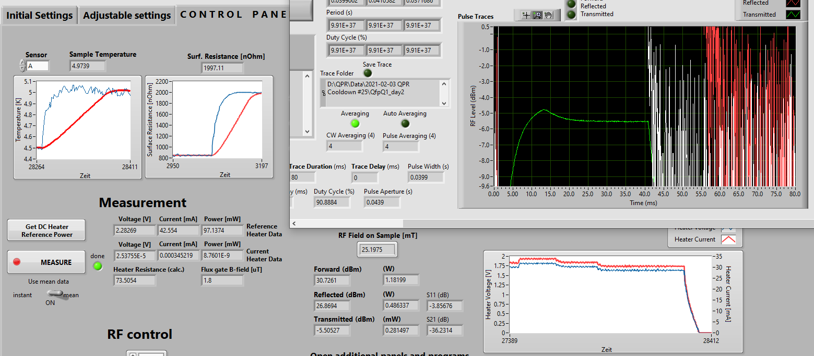
Max field, 416 MHz
At max field 27 mT, 416 MHz: Temperature significantly increased (but not complete quench)
Only part of the film quenched (not full film because temperature stays <9.3K)
Quench field depends on temperature:
Pulse shape (transmitted)

Slide 5
Rs vs B for ~850 MHz
Results for pre-laser polishing and after for ~850 MHz:
Maximum film is about 22 mT.
B_{max} ~22 mT

Slide 6
Rs vs B results for 2 modes
Q1 vs Q2

Slide 7
Rs vs T, ~400MHz
Rs vs T results for pre-laser polishing and after for ~416 MHz:
Rs vs T: Most of the ‘additional’ resistance come from temperature-depend part
Residual resistance is approximately same:
Residual resistance
‘eye’ estimation (416 MHz):
 | R_{res}
B-5.4 | ~67 nOhm
B-5.5 | ~76 nOhm

Slide 8
Rs vs T, ~400MHz
Rs vs T results for pre-laser polishing and after for ~416 MHz:
Rs vs T: Most of the ‘additional’ resistance come from temperature-depend part
~85 nOhm
~35 nOhm
4.5
2.5

Slide 9
Rs vs T, ~400MHz
Rs vs B results for pre-laser polishing and after for ~416 MHz:
Rs with subtracted ~BCS temperature dependent part at 4.5 K (approximation):
Probably increased BCS came from impurities and defects due to wrong polishing procedure
With subtracted BCS contribution from both tests the field dependent part is more or less comparable except higher field ‘jump’

Slide 10
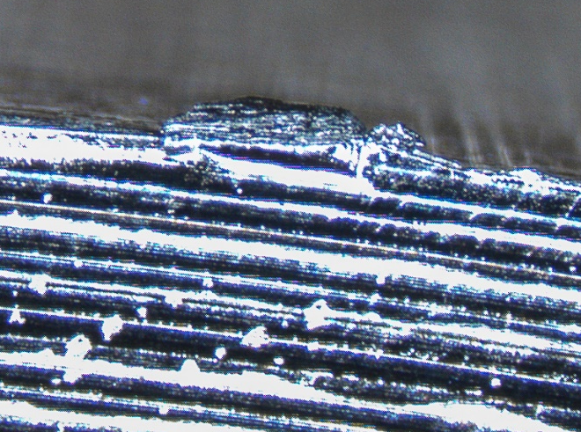
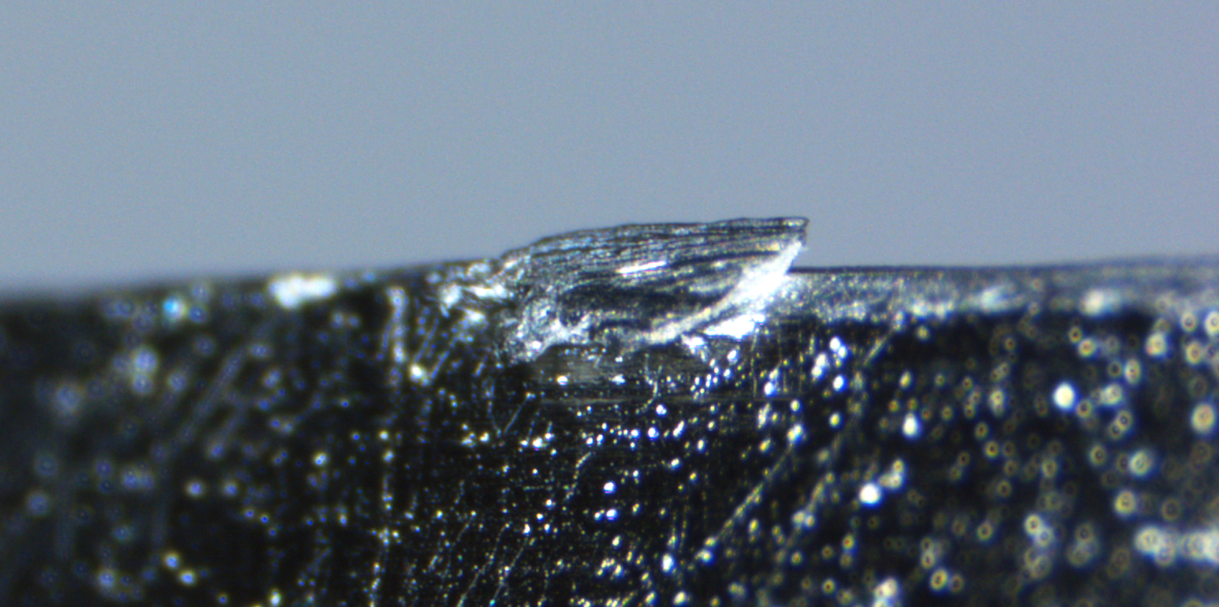
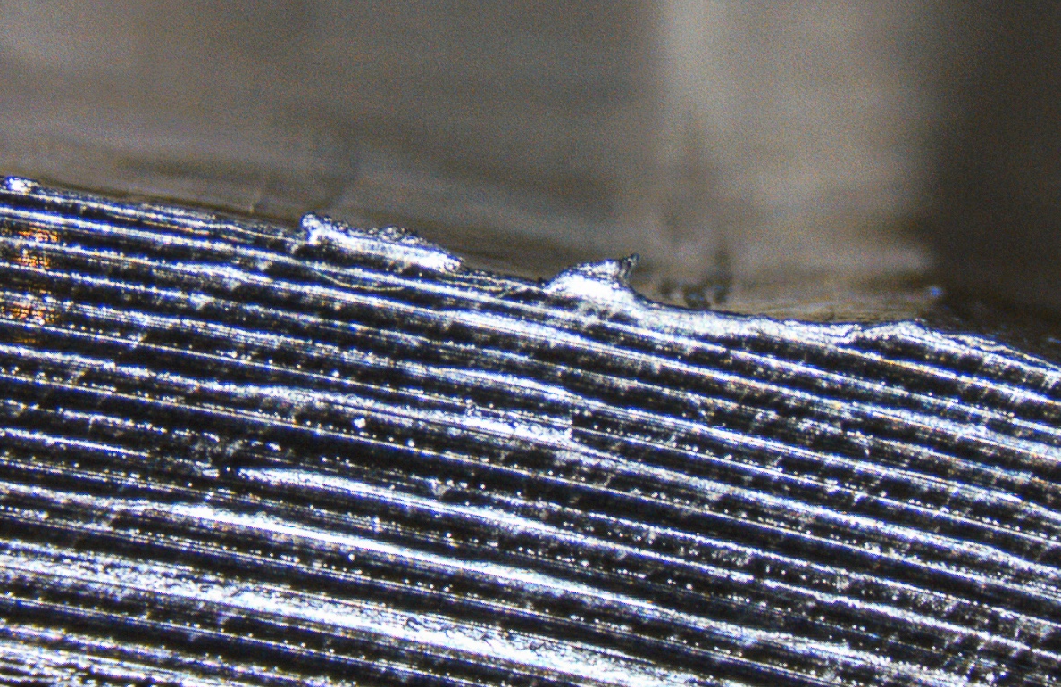
Jumps in surface resistance: edges

Slide 11
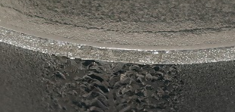
Jumps in surface resistance: edges
B-5 sample
Conclusions:
For the reliable data, next samples should be treated same way (flash etching, etc) to remove sharp pieces of Nb from edges
B-4 sample

Slide 12
F vs t results for pre-laser polishing and after

Slide 13
F vs t results for pre-laser polishing and after
Impurities/Defects?

Slide 14
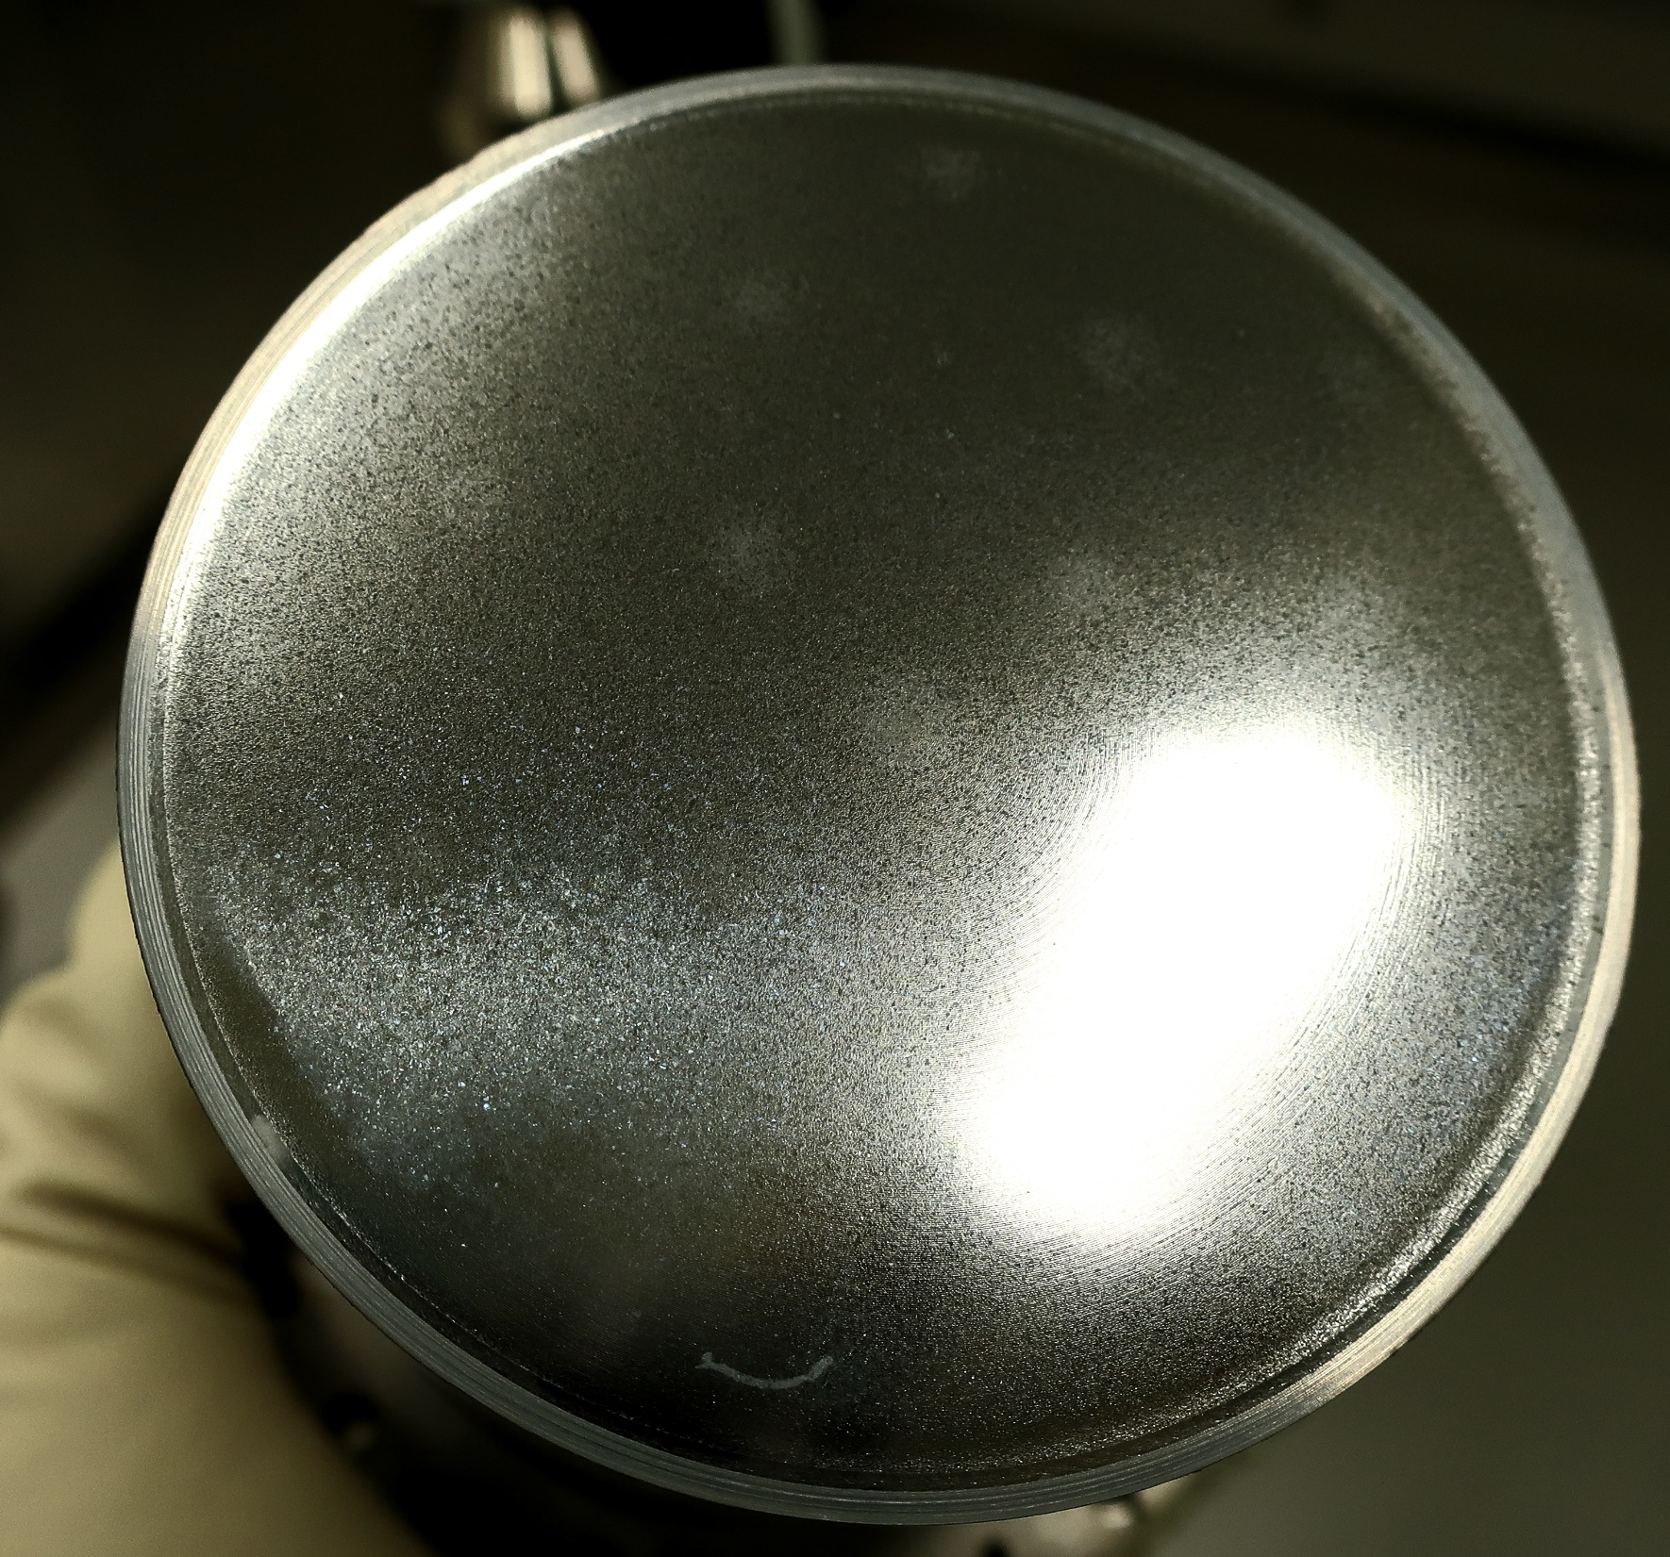
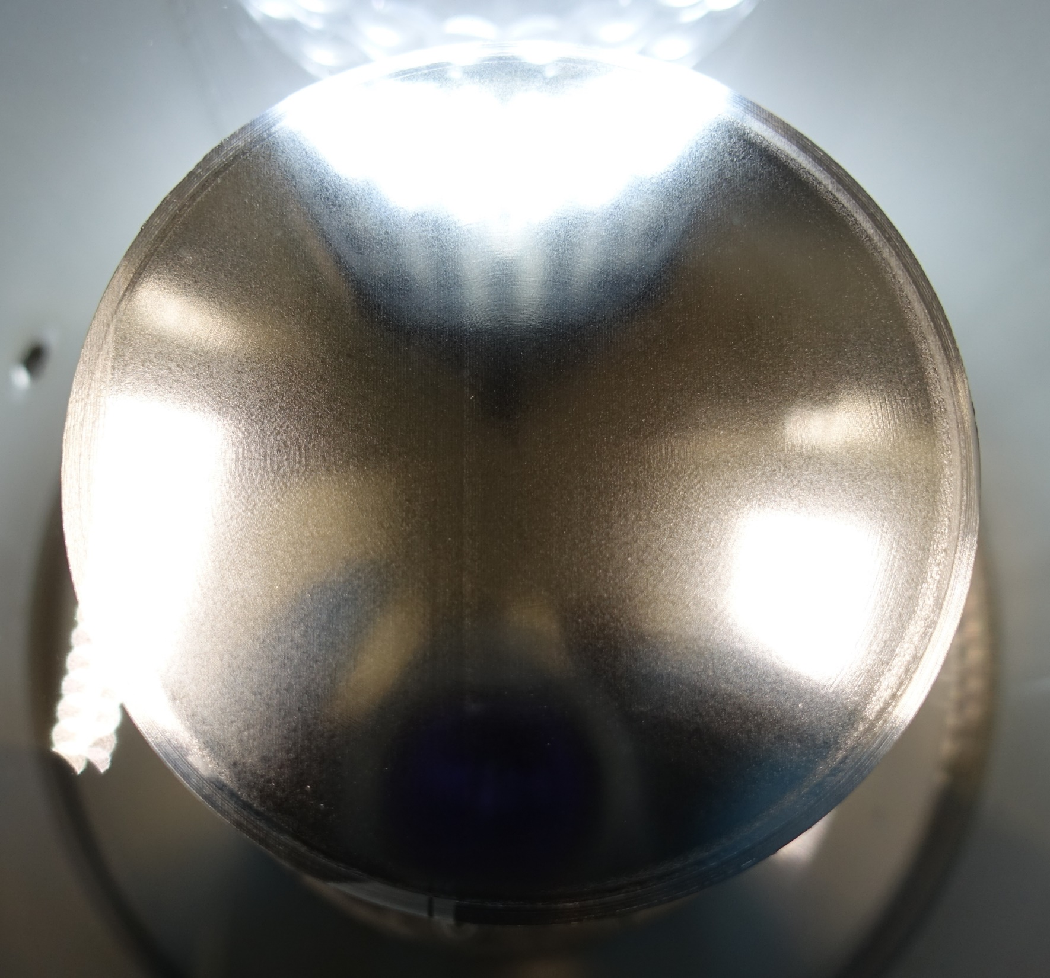
Post-test sample scan: comparison
Pre LP:
Post LP:

Slide 15
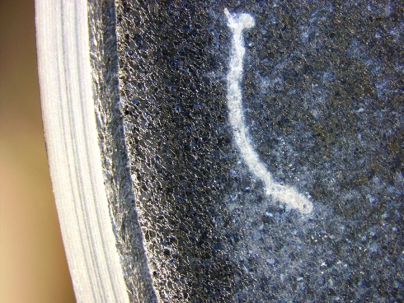
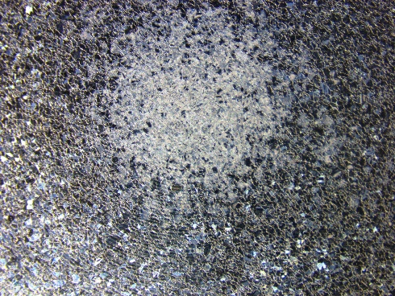
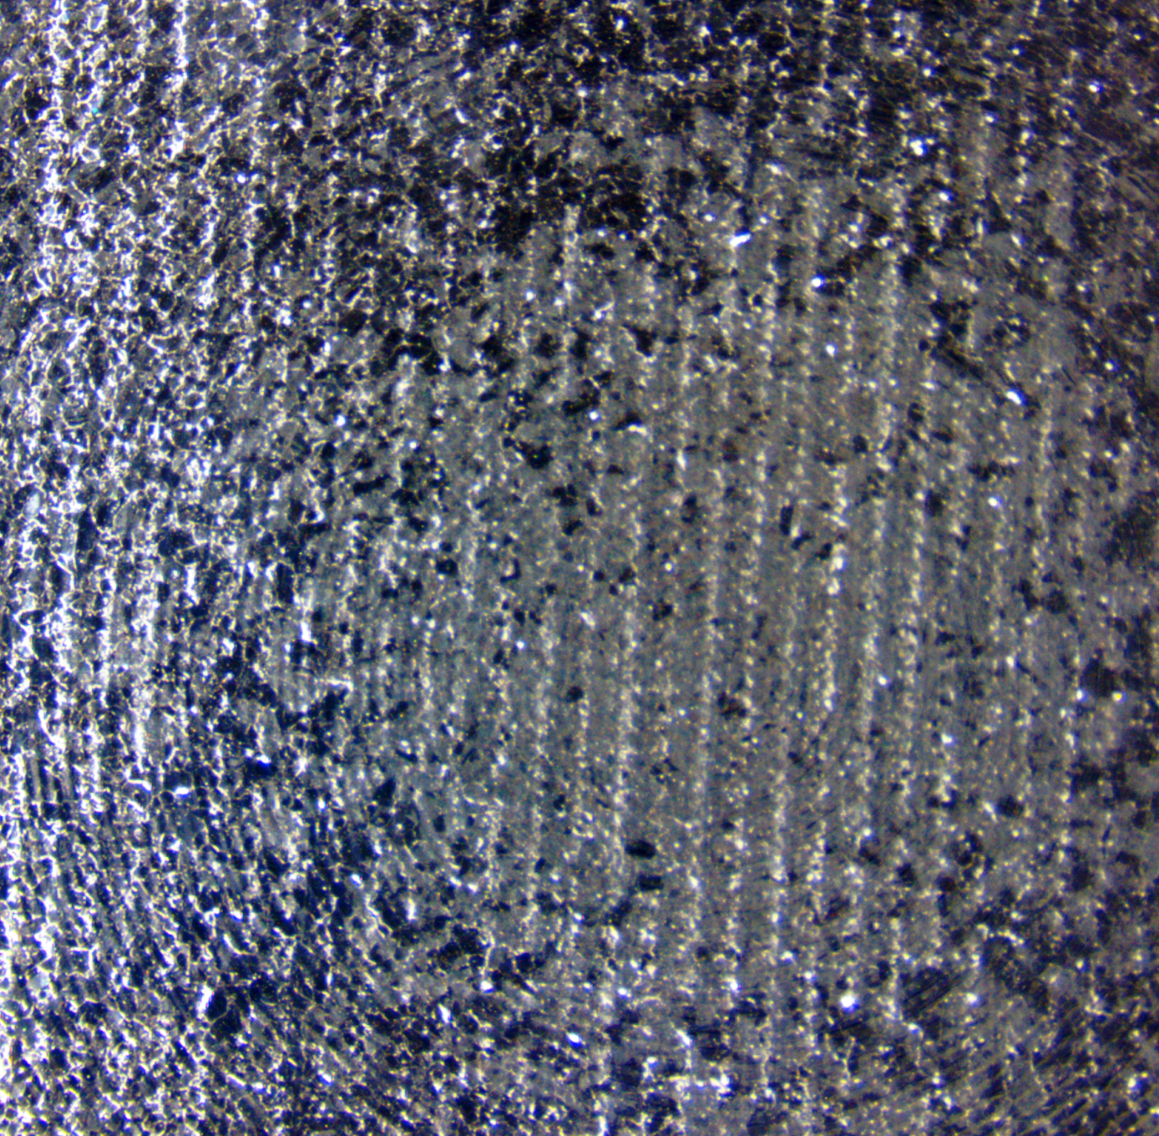
Post-test sample scan: comparison
Some defects removed or partially removed
Post LP:
Pre LP:

Slide 16
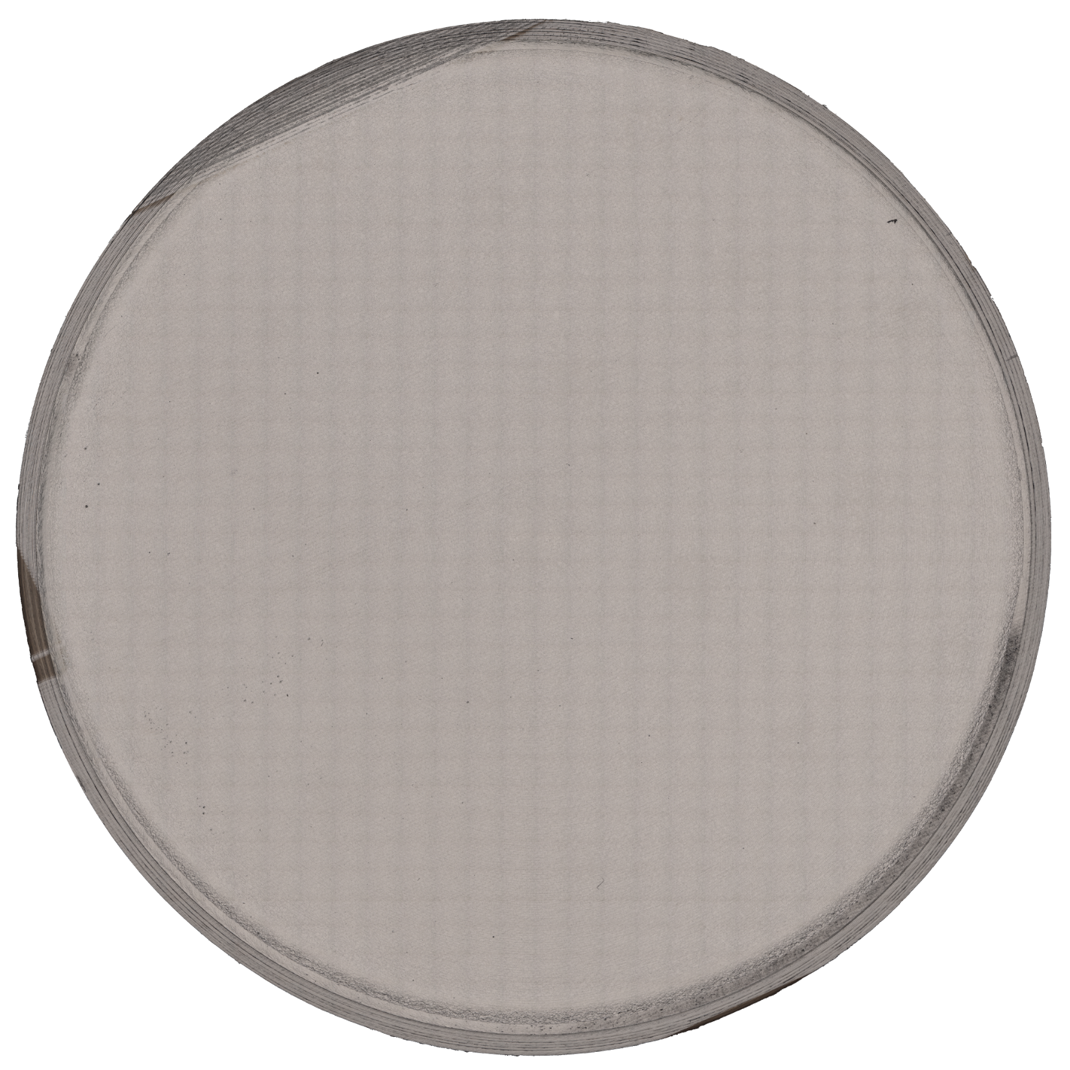
Post-test sample scan: Overview
Sample scanned with the laser microscope:
Defects detection
Roughness measurements
Full size JPEG picture (34 MB) and other data are on the CERNbox folder (note, that some features = dust)

Slide 17
Post-test sample scan: Surface defects & roughness
3
1
Some observed features:
2
Major defect near the edge
Minor craters in high field region
Laser traces (overpower?) near the edge
A “group of craters”
4
This pattern = effect of stitching

Slide 18
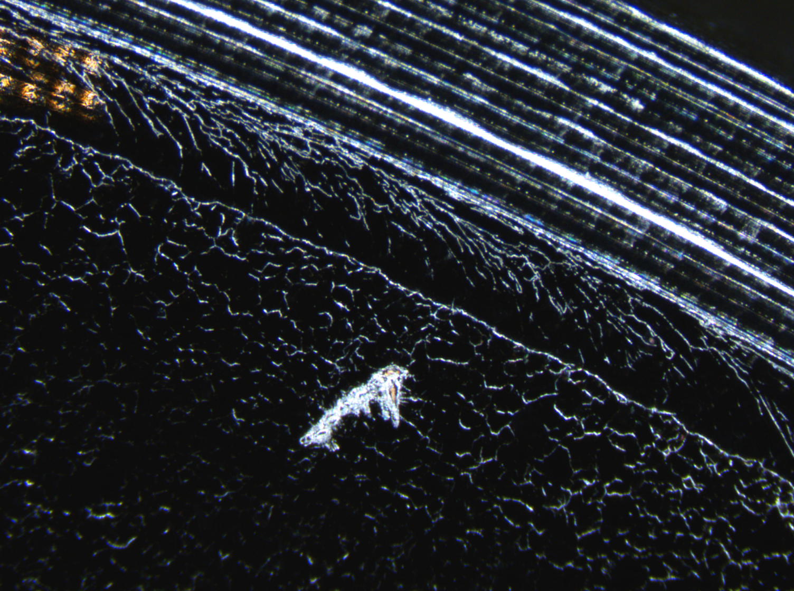
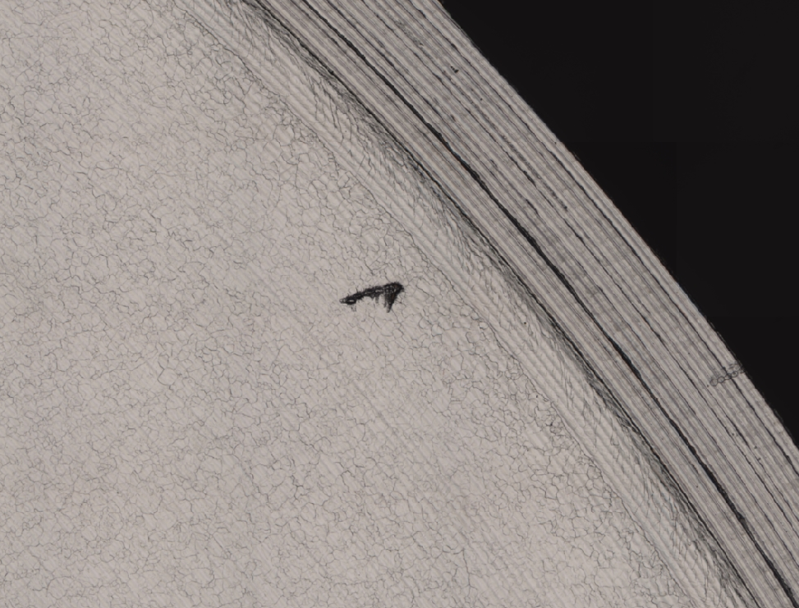
defect: number 1
Defect 1 found near the edge:
Laser microscope view (5x):
Optical microscope view:

Slide 19
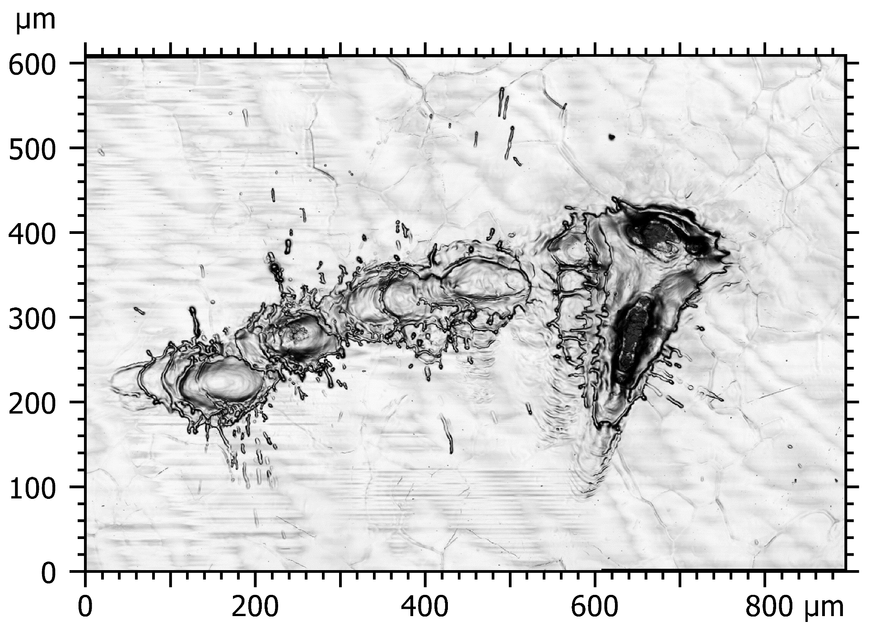
defect: number 1
Defect 1 found near the edge:
Laser microscope view (5x):
Laser microscope view (20x):

Slide 20
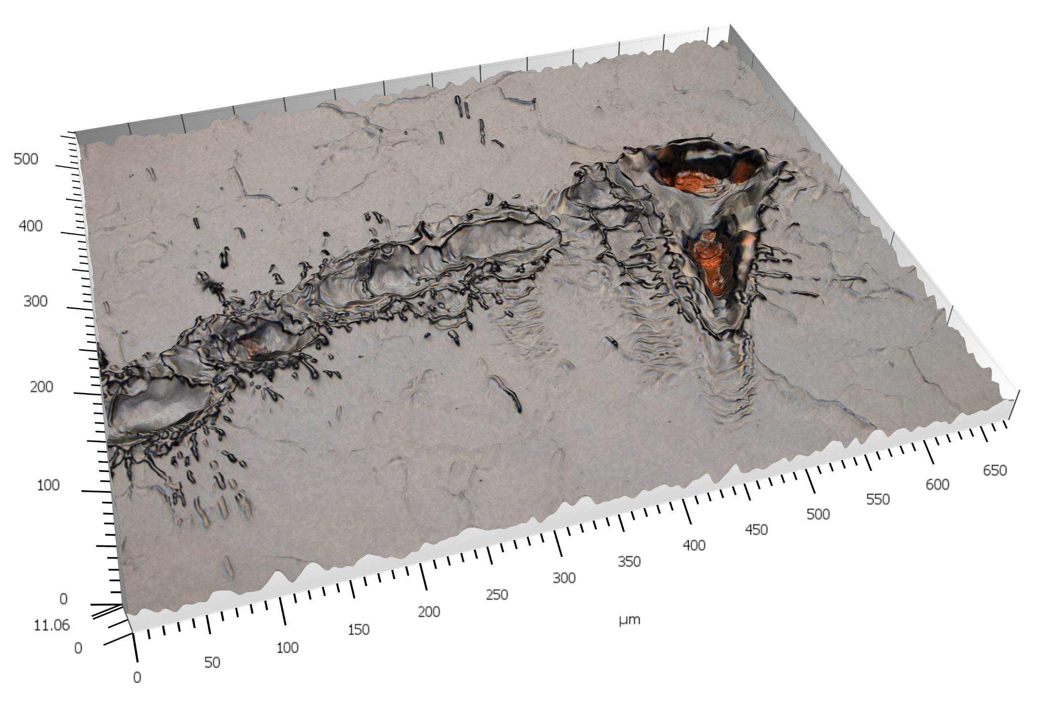
defect: number 1
Defect 1 view from optics in 3D:
The defect was not found so far on pre-laser coated sample
Shape of the defect: the laser could give overpowered pulse
The film is completely penetrated by the “shot”, substrate is exposed to RF
Cu?

Slide 21
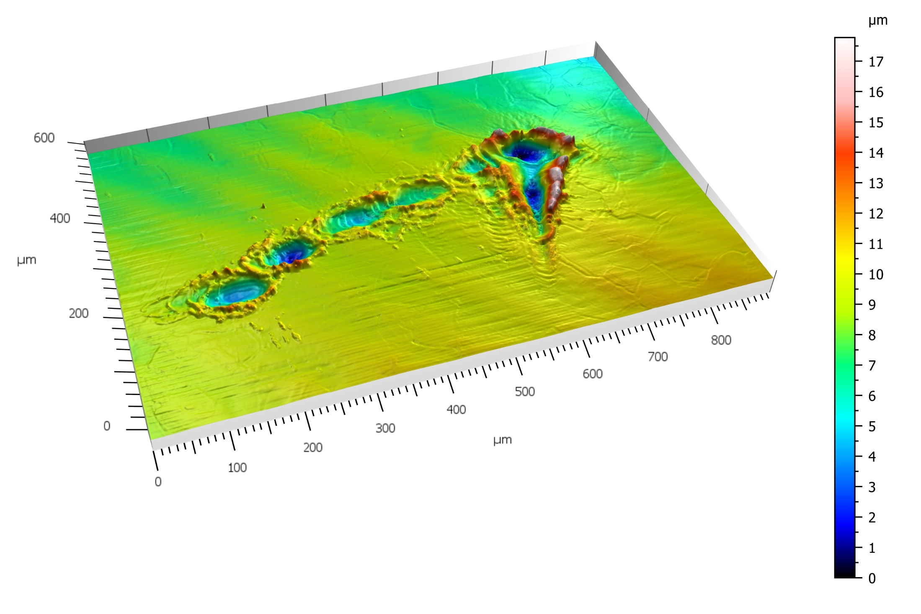
defect: number 1
Defect 1 view in 3D:

Slide 22
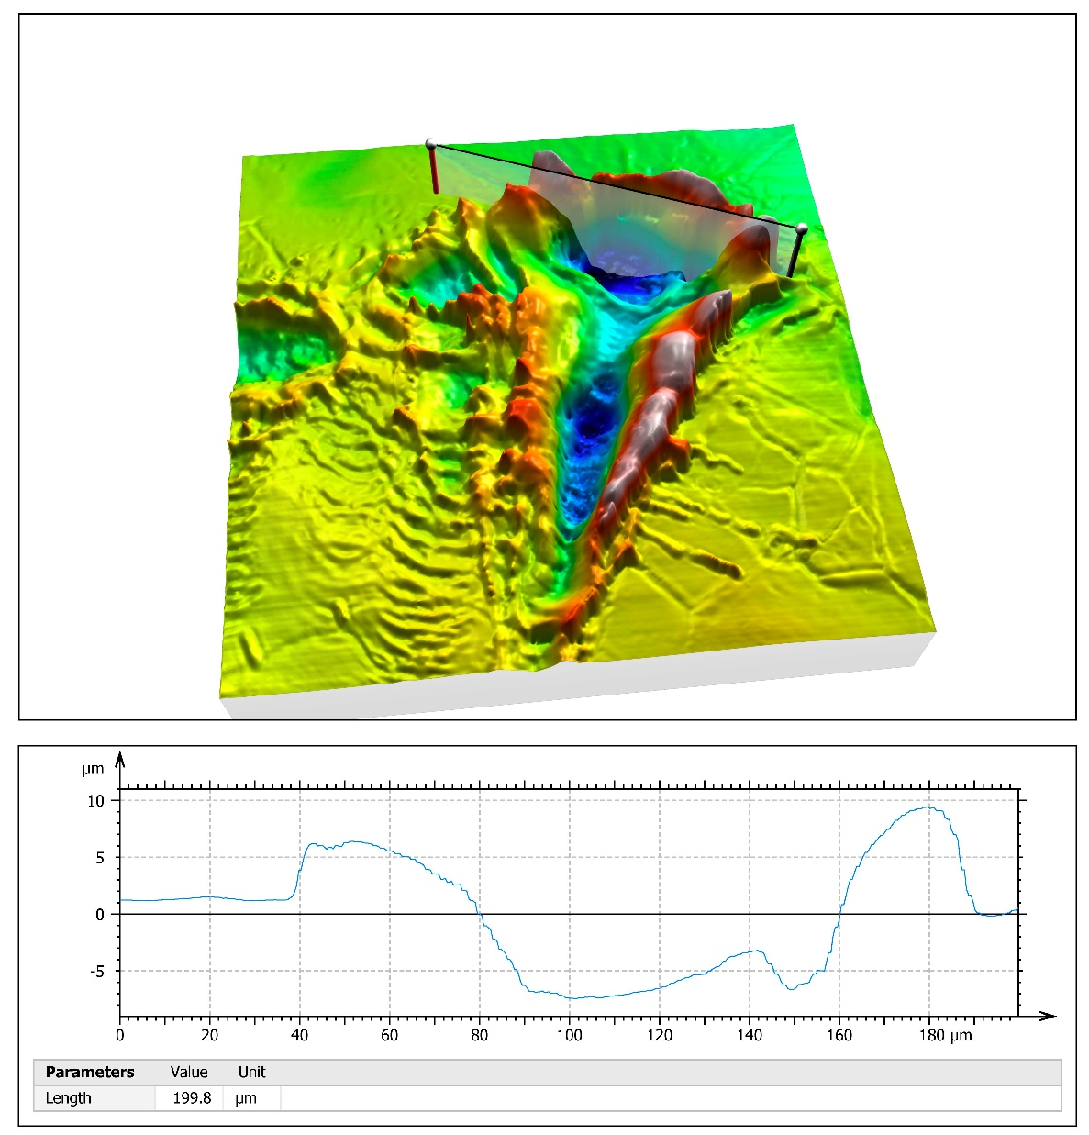
defect: number 1
Defect 1 view in 3D:
The film deepness can be estimated about 5 mkm

Slide 23

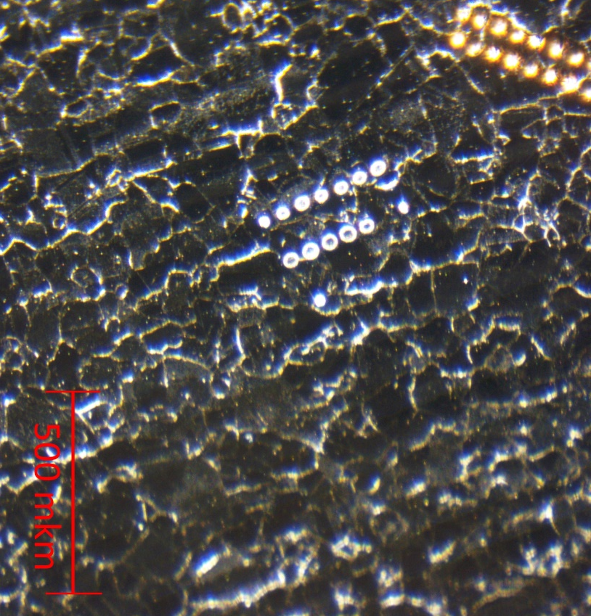
defect: number 2
Defect 2 found in the high RF field region:
Laser microscope view (5x):
Optical microscope view:

Slide 24
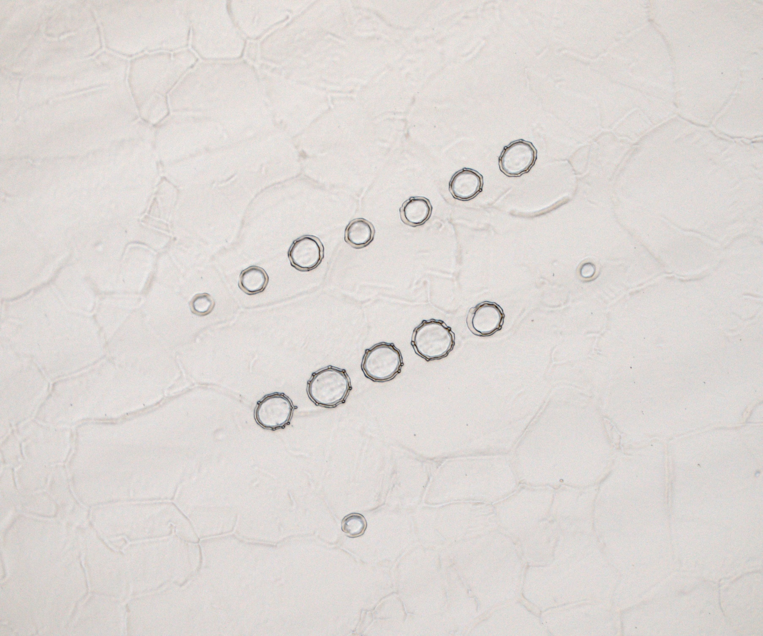
defect: number 2
Defect 2 found in the high RF field region:
Laser microscope view (5x):
Laser microscope view (20x):

Slide 25
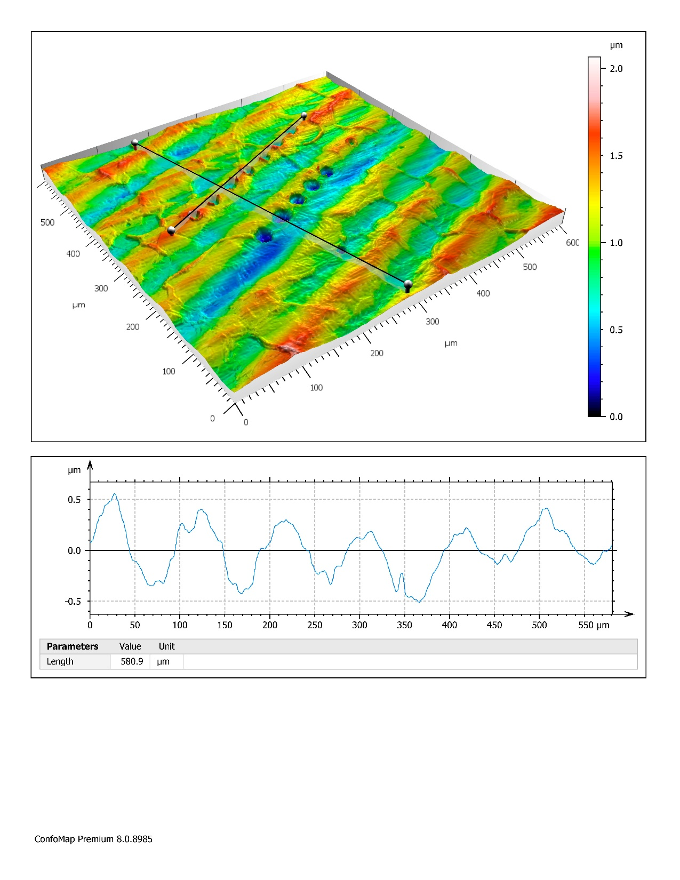
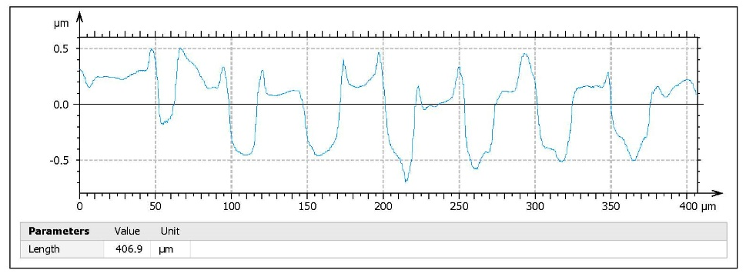
defect: number 2
Defect 2 found in the high RF field region:
Defect again looks like a crater (series of craters), deepness up to 1 mkm
Roughness from substrate shape (due to mechanical production) is about 1 mkm
Rings on Cu from mech. turning

Slide 26
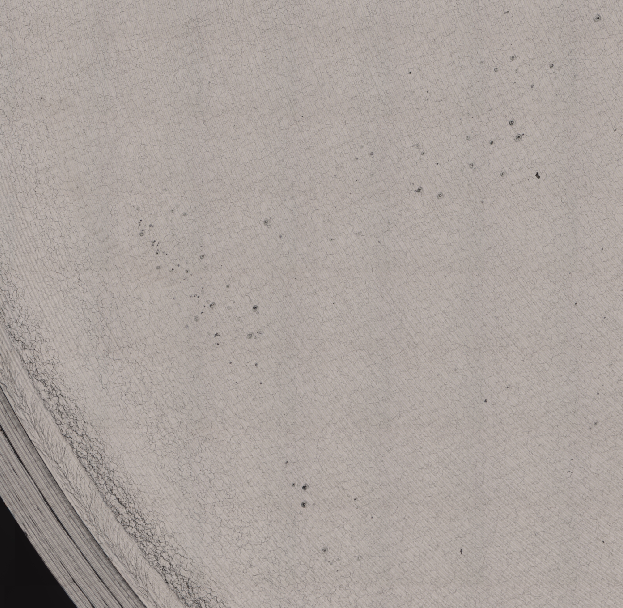
defect: number 3 & 4
Laser microscope view (5x):
Craters again?

Slide 27
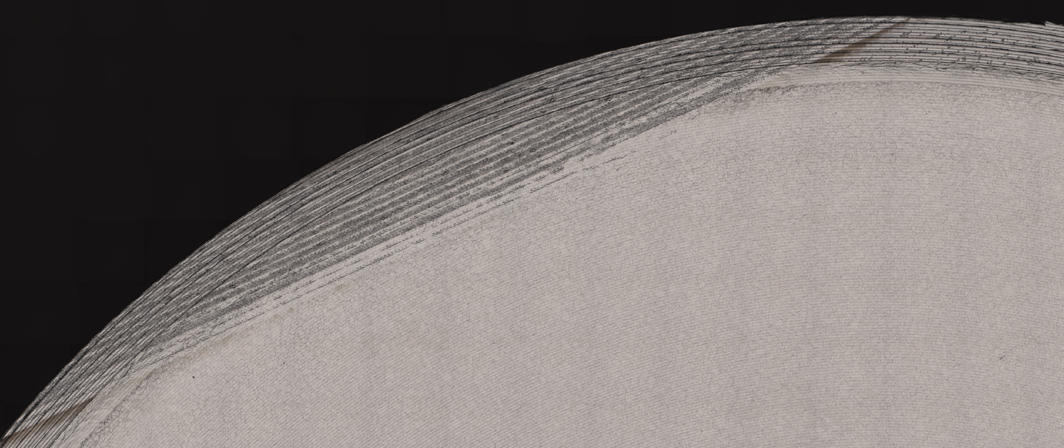
defect: number 3 & 4
Laser microscope view (5x):
Craters & overpowered region

Slide 28
Conclusions
Conclusions
Laser polishing practically can work
Minor improvements at Rs vs B behavior. The problem with the rough edges is still present, and % of contribution of it to the final result is not clear.
Film (probably) got some contaminations and defects during the process (conclusion from R_{BCS} and FvsT data).
The process needs to be adjusted and surface analyzed more carefully.

Slide 29
Now 25.01.2021
Next plan
Future plan
B-2 | CERN (HiPIMS Nb 7.3 micr.) | Rf test: 02.2021 CERN | ??? Nb Film INFN | ??? Rf test: 04.2021 HZB | ? | ?
B-3 | HZB (Siegen 1st SIS) | HOLD (for future test) | ? | ? | ? | ?
B-4 | HZB (Siegen 2nd SIS) | Nb Film strip. INFN | 3^{ed} SIS USiegen | Rf test: 02.2021 HZB | ? | ?
B-5 | HZB (RTU laser) | Rf test: 03.2021 HZB | Nb Film strip. INFN | SIS coat. STFC | Rf test: 04.2021 HZB | ?

Slide 30
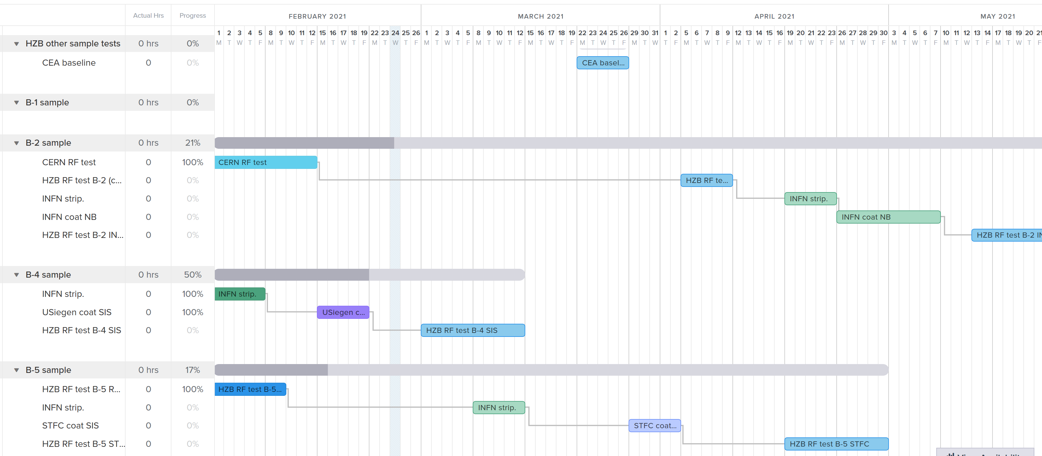

Slide 31
Conclusions
Suggested Next steps
If possible (not at HZB): Any analyses regarding molecular components of the film and/or SEM microscope scan
Suggestions: Stripping of the top layer of the film and retesting to see if the contaminations are removed?

