Slide 1
Field penetration experiment
Daniel Turner
Lancaster University
Daresbury Laboratory
Notes:
Working title

Slide 2
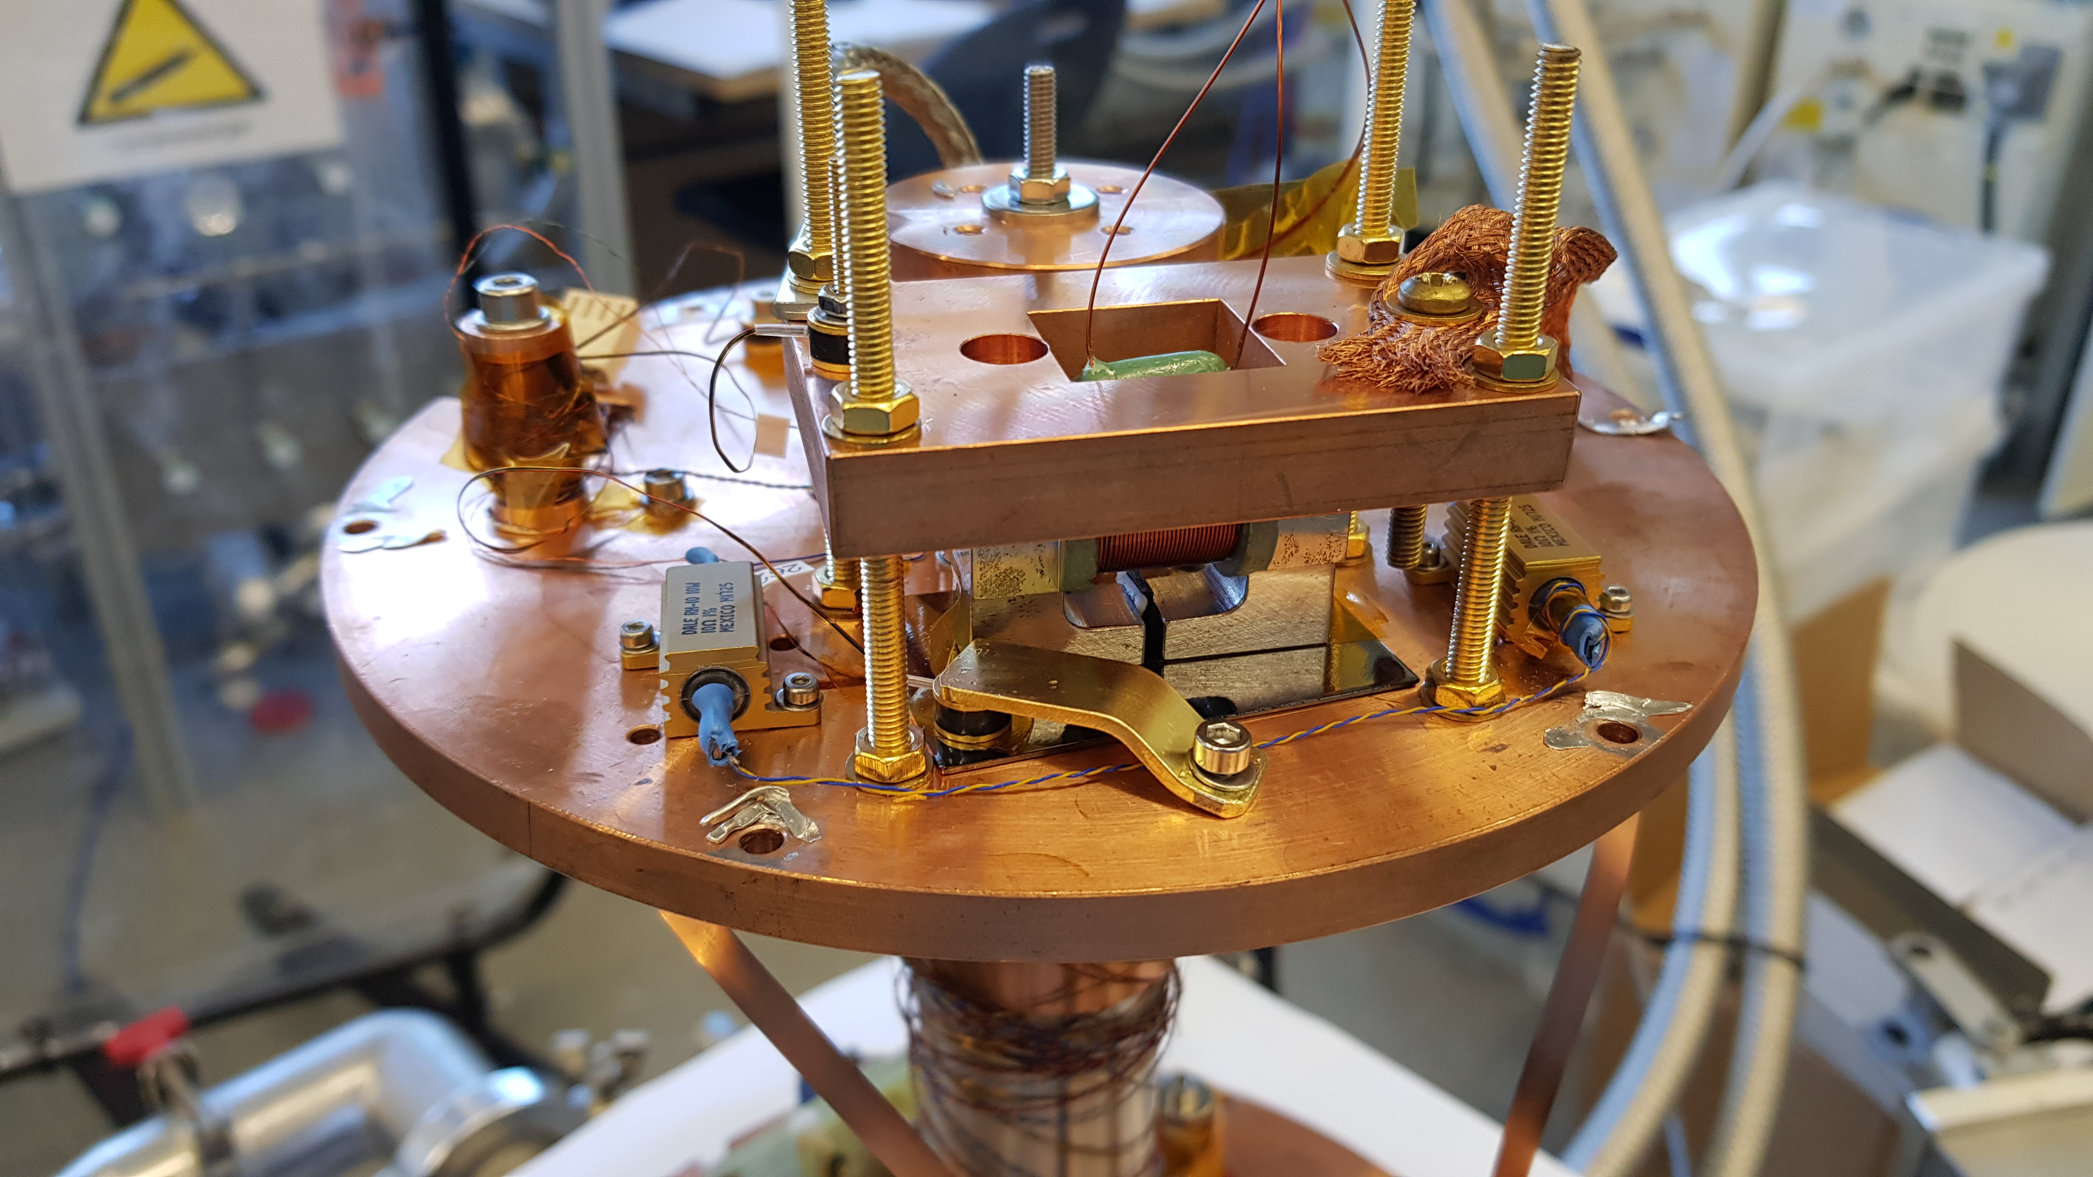
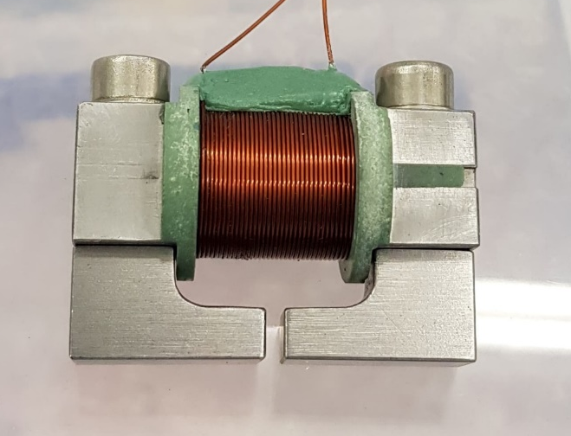

Field penetration concept
HP1
Sample
HP2
DC magnetic field parallel to the surface
Field local to the sample surface
  Avoid edge effect.
  Allow possibility if sample scanning.
Magnetic field applied from one side of the sample to the opposing side, similar to an SRF cavity.
Applied and penetrated field measured by Hall probe sensors

Slide 3
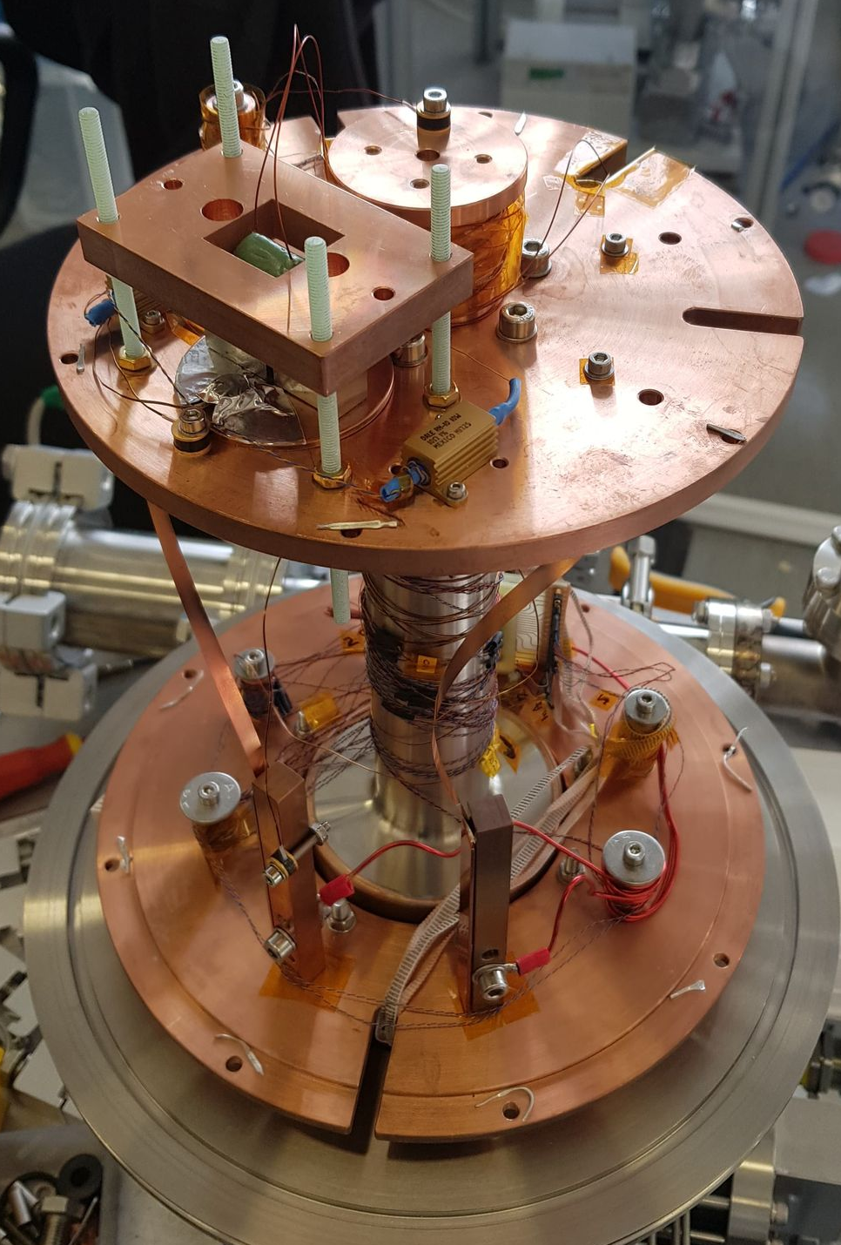
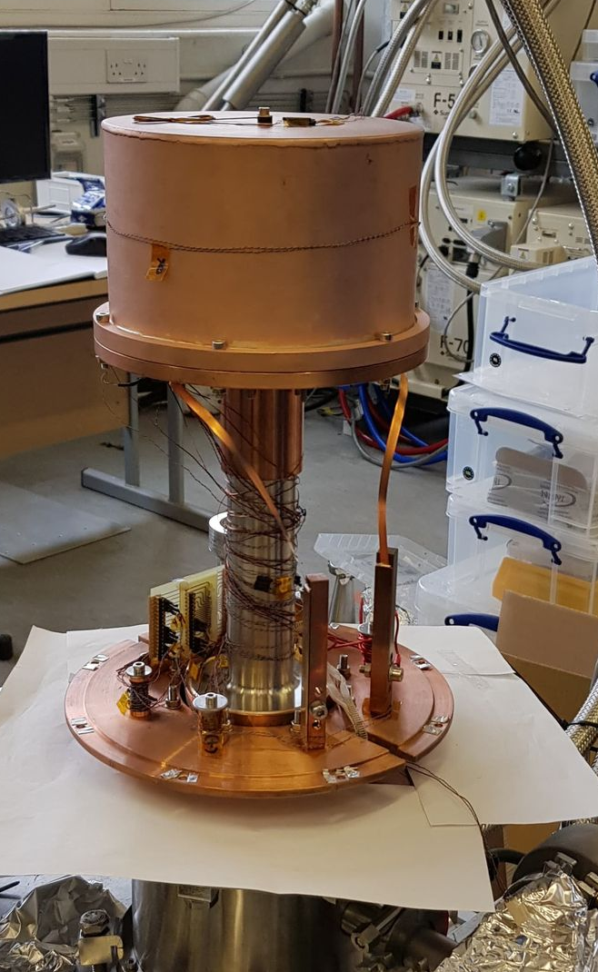
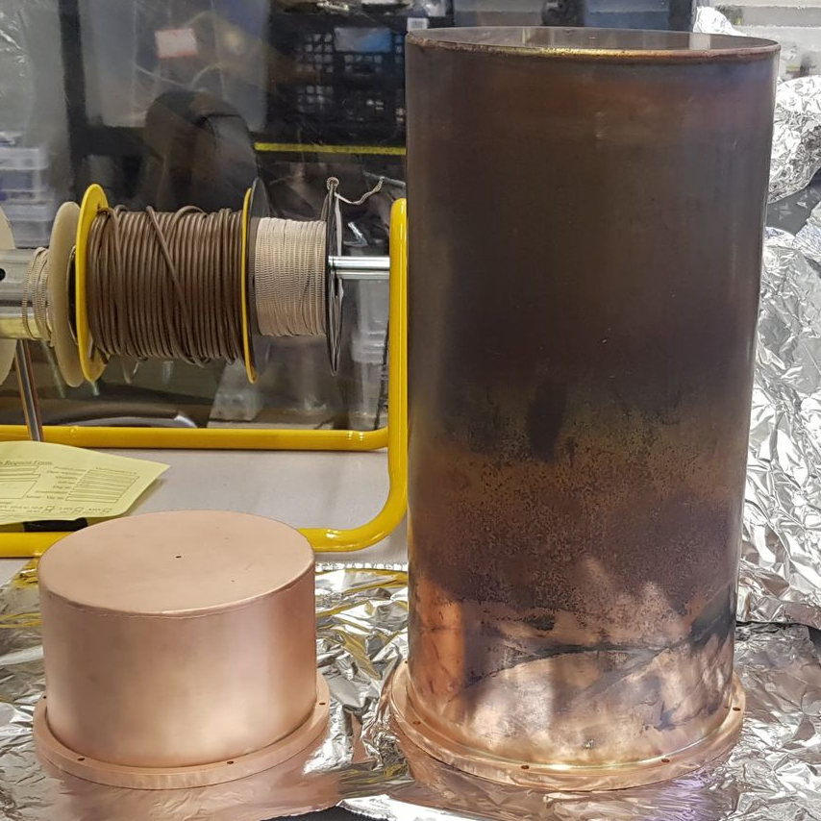
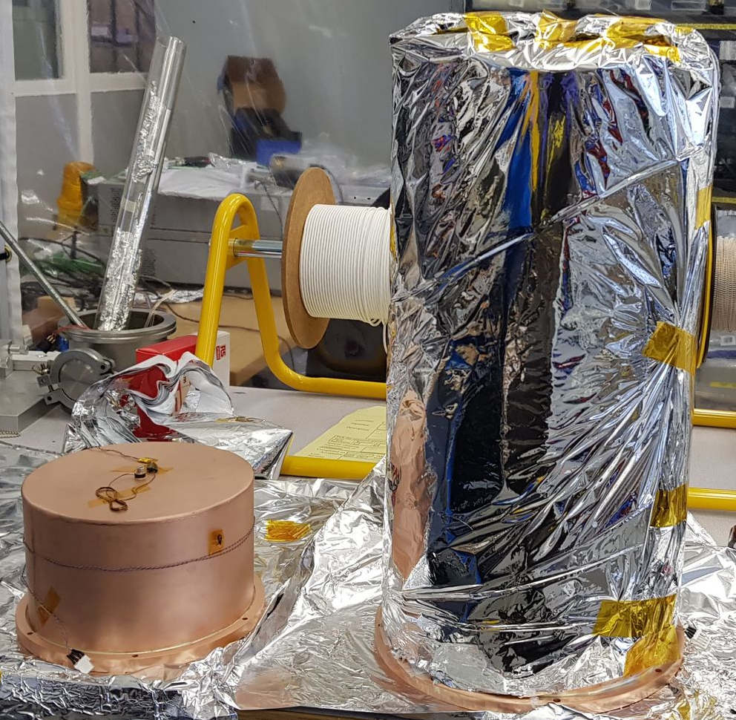
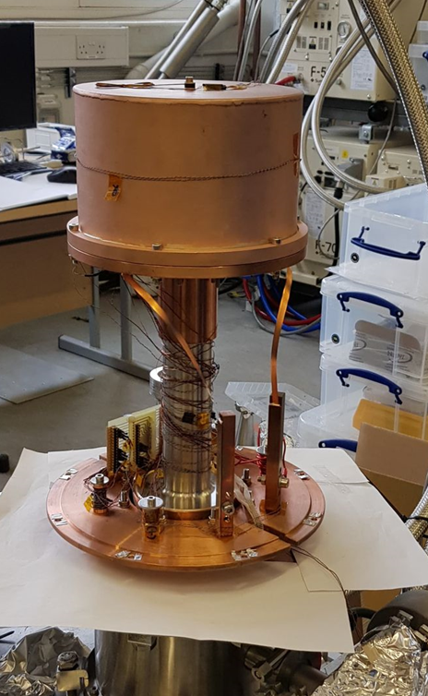
New Thermal radiation shields
Larger mass compared to Al radiation shields gives a better thermal stability.

Slide 4
Table
 |  |  |  |  |  | Bratislava VSM |  |  | Laser RTU |  | STFC Field penetration
 |  | Sample | Substrate Treatment |  |  | B Perp (mT) | B para (mT) | Tc (K) | B Perp (mT) | B para (mT) | Tc (K) | Hfp(0) (mT) | Hfp(4.2K) | Hfp(4.5K) (mT)
Code | Origin | Material
C7 | STFC | Nb | 10µm |  | SUBU CERN | 24.1 | 150.1 | 9.35 | 0 | 0 | 9.43 | 228.82 | 183.4291 | 186.405
L13 | STFC | Nb | 10µm |  | EP | 22 | 100.3 | 9.35 | 0 | 0 | 9.42 | 219.53 | 175.816 | 0
L18 | STFC | Nb | 10µm |  | EP + SUBU | 17.7 | 61 | 9.3 | 0 | 0 | 9.87 | 190.03 | 155.6199 | 154.606
L19 | STFC | Nb | 10µm |  | SUBU | 17.3 | 73.2 | 9.2 | 0 | 0 | 9.91 | 208.15 | 170.7624 | 164.562
C1 | Siegen | Nb | 3µm |  | SUBU CERN | 15.5 | 49.6 | 9.5 | 0 | 0 | 8.25 | 160.7 | 101.6734
L1 | Siegen | Nb | 3µm |  | SUBU INFN | 14.5 | 38 | 9.6 | 0 | 0 | 9.37 | 163.98 | 133.368 | 0
L9 | Siegen | Nb | 3µm |  | Tumbling | 16 | 38.6 | 9.38 | 0 | 0 | 9.03 | 148.04 | 113.059 | 0
L10 | Siegen | Nb | 3µm |  | EP | 15.5 | 32.7 | 9.38 | 0 | 0 | 8.97 | 154.55 | 122.007 | 0
L23 | Siegen | Nb | 3µm |  | EP + SUBU | 15 | 24.5 | 9.38 | 0 | 0 | 8.74 | 128.62 | 98.244 | 0
C10 | INFN | Nb | 3µm |  | SUBU5 CERN | 12 | 0 | 9.37 | 17 | 50.2 | 9.38 | 173.39 | 138.627 | 137.629
L8 | INFN | Nb | 3µm |  | Tumbling | 18 | 0 | 9.48 | 19.1 | 42.5 | 9.01 | 187.46 | 113.059 | 0
L16 | INFN | Nb | 3µm |  | EP + SUBU5 | 14 | 0 | 9.37 | 15.5 | 47.2 | 8.77 | 106.03 | 81.71198 | 72.332
L20 | INFN | Nb | 3µm |  | SUBU5 INFN | 20 | 0 | 9.58 | 23.7 | 45 | 10.36 | 179.65 | 150.1239 | 143.805
L21 | INFN | Nb | 3µm |  | EP | 18 | 0 | 9.28 | 18.8 | 45.2 | 0 | 0 | 0 | 0

Slide 5
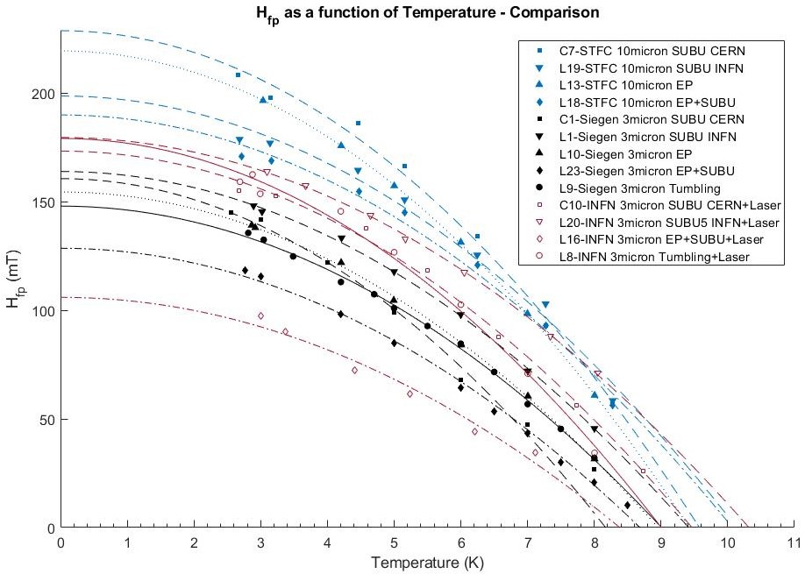
Notes:
All the samples, hard to distinguish data like this, but can see there is a difference between each institution

Slide 6
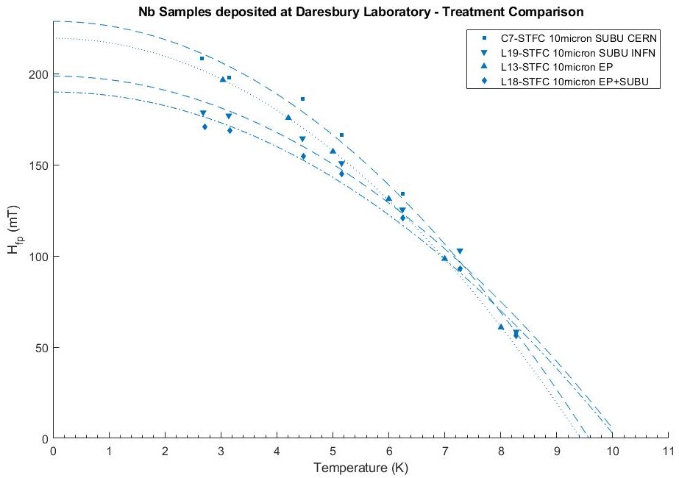

Slide 7
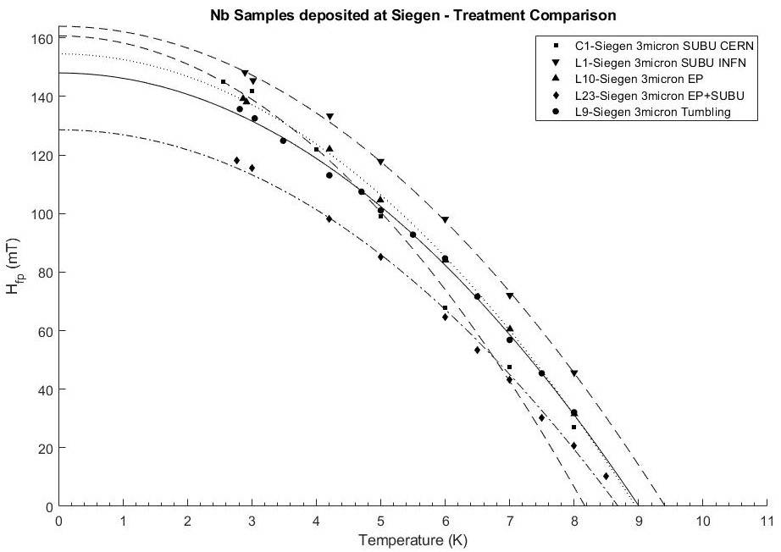

Slide 8
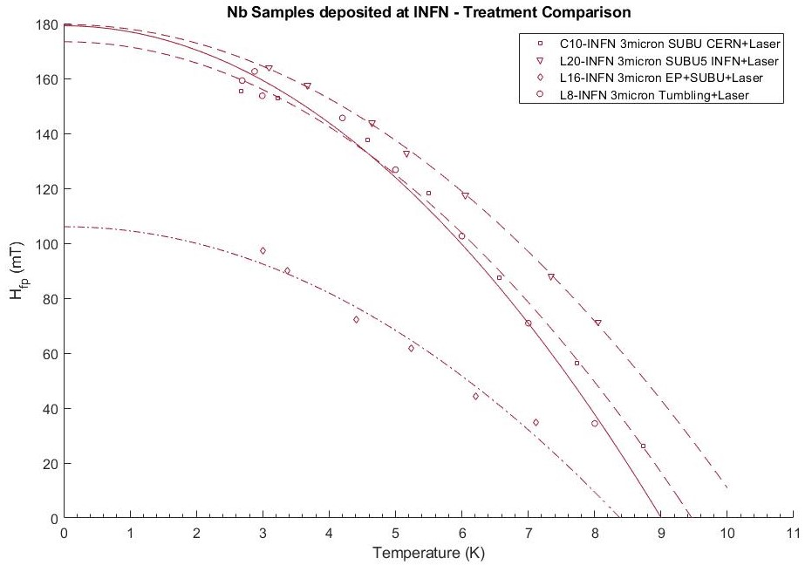

Slide 9
Best surface treatment determined by H_{vp}
STFC | Siegen | INFN with laser treatment
SUBU CERN | SUBU INFN | SUBU INFN
EP | SUBU CERN | Tumbling
SUBU INFN | EP | SUBU CERN
EP + SUBU | Tumbling | EP + SUBU
 | EP + SUBU
Notes:
SUBU seems to give the best results, outlier with the STFC SUBU from INFN. Same with INFN SUBU CERN. EP seems slightly worse than SUBU for Siegen, but is better than SUBU INFN for STFC?
EP+SUBU is the worst for each institution.

Slide 10
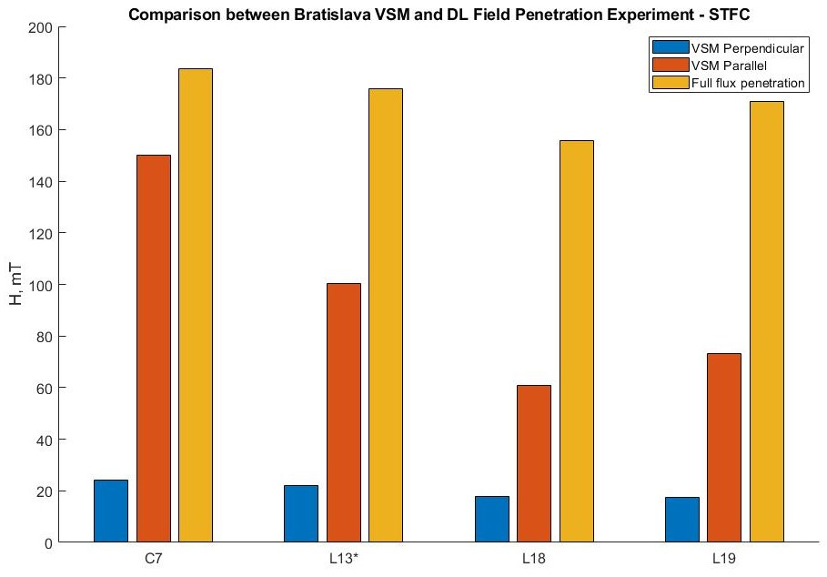

Slide 11
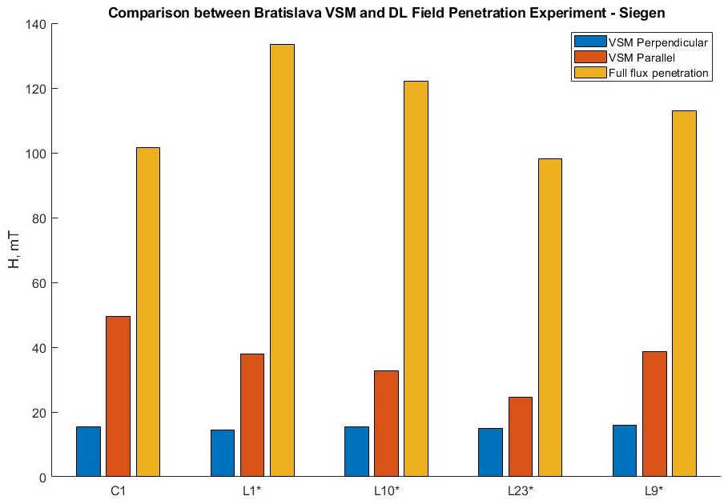

Slide 12
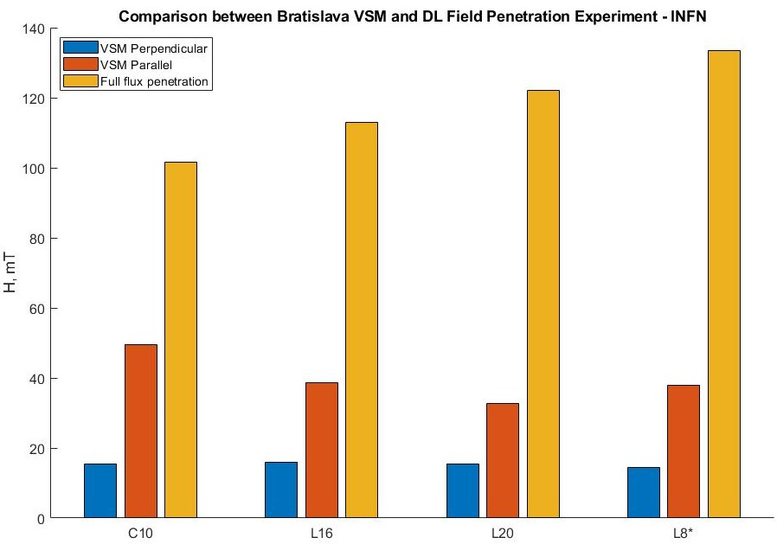
Notes:
Increasing H_{fp} for each sample, but not increasing H_{ll}

Slide 13
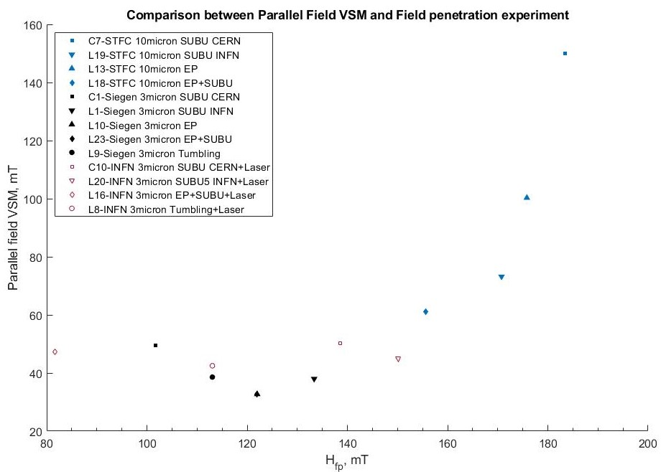
Notes:
Not a strong correlation between H_{FPE} and H_{ll} with a big jump in VSM for EP and SUBU CERN from STFC
But there is a clear correlation for thick STFC samples

Slide 14
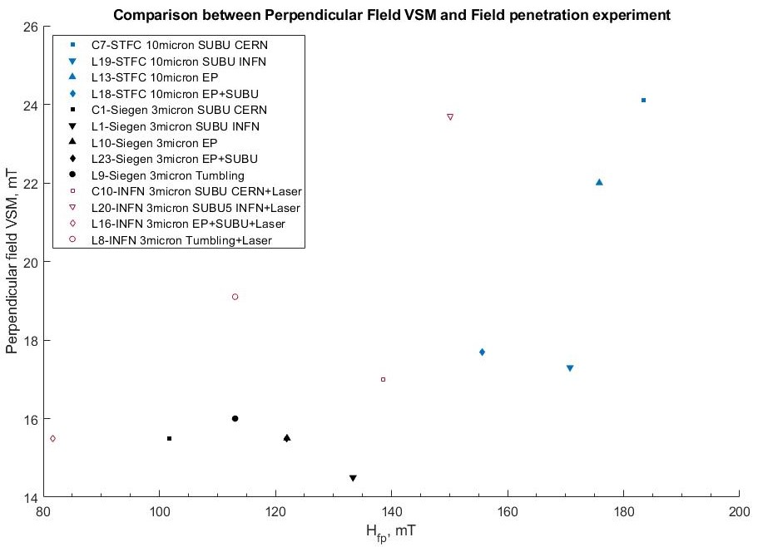
Notes:
Some kind of correlation with H_{perp} and H_{fp}

Slide 15
Next steps
Test how the field of full flux penetration varies with varying thickness’
Laser treated QPR disk
Move onto multilayer samples
Notes:
Should I mention that the system is now fully automated?

Slide 16
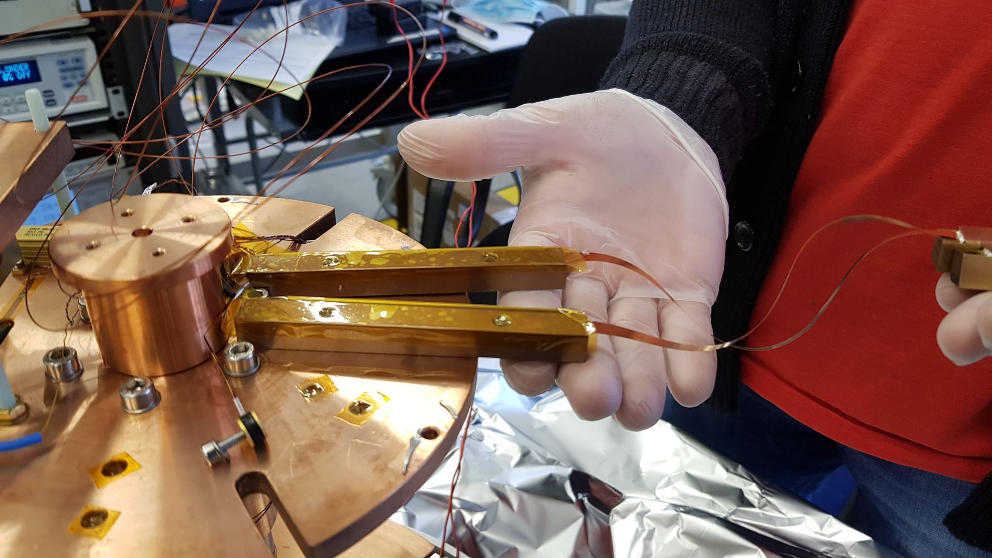
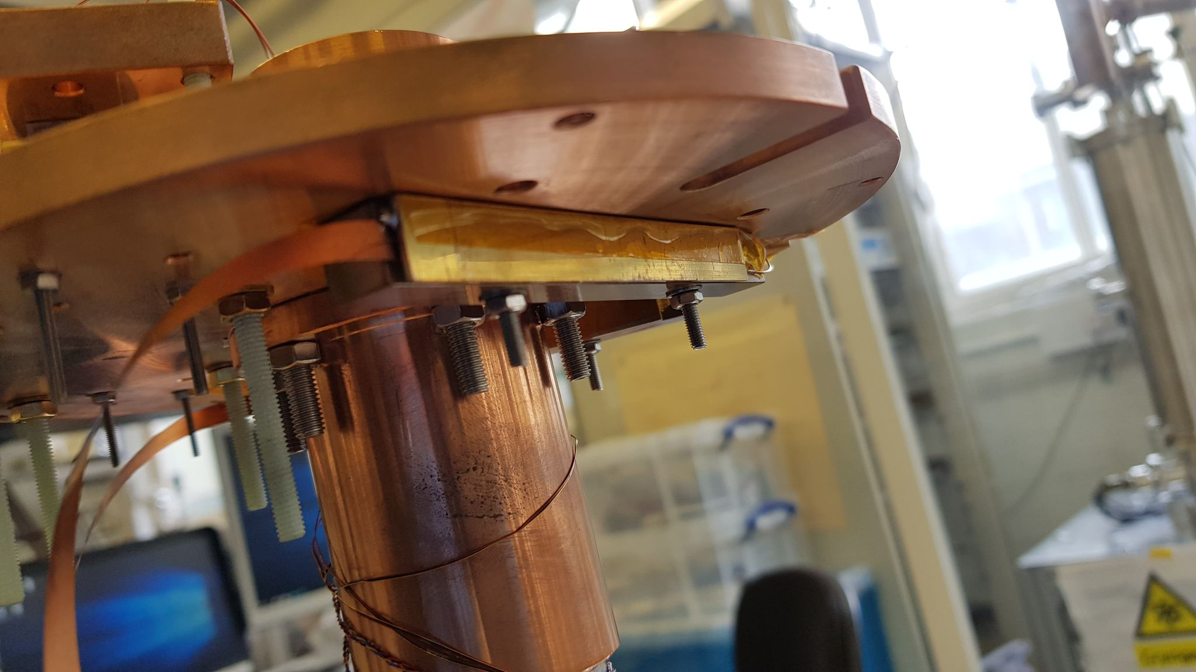
Superconducting joins

Slide 17
L14 – Nb₃Sn initial - 2µm
Hvp(0) = 250.37 mT
Tc = 12.76 K

Slide 18
Nb₃Sn – Repeat - 2µm
Hvp(0) = 232.2 mT
Tc = 12.72 K

Slide 19
L 15 Nb₃Sn - 2µm
Hvp(0) = 206.82 mT
Tc = 9.42 K

