Slide 1
2nd Technical Meeting on KE4738
February 24th, 2021
Radiation resistance
Davide Tommasini, CERN

Slide 2
Recall on the strategy
The strategy we are adopting is the following:
Identify candidate observables linked, by common sense, to the magnet performance
Characterize the physical properties of impregnation systems with large differences of these observables
Comparatively challenge these systems first at subscale level (impregnated cables, small coils) thereafter, depending on this first phase, on larger magnets
Develop new impregnation systems providing the best properties of the selected observables, in a compromise with the known required properties for an impregnation system (processing, radiation resistance …)
Presently we are exploring the fracture toughness as possible leading parameter:
At CERN we are starting a comparative small coils program impregnated with the four resins characterized so far
At ETHZ the work is presently focussed to understand the methods to measure and improve the fracture toughness

Slide 3
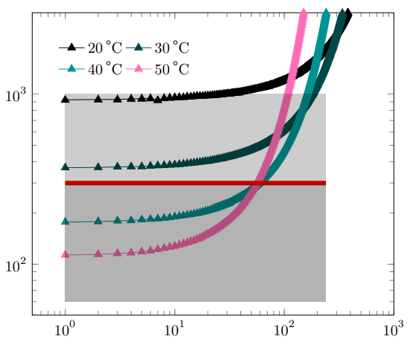
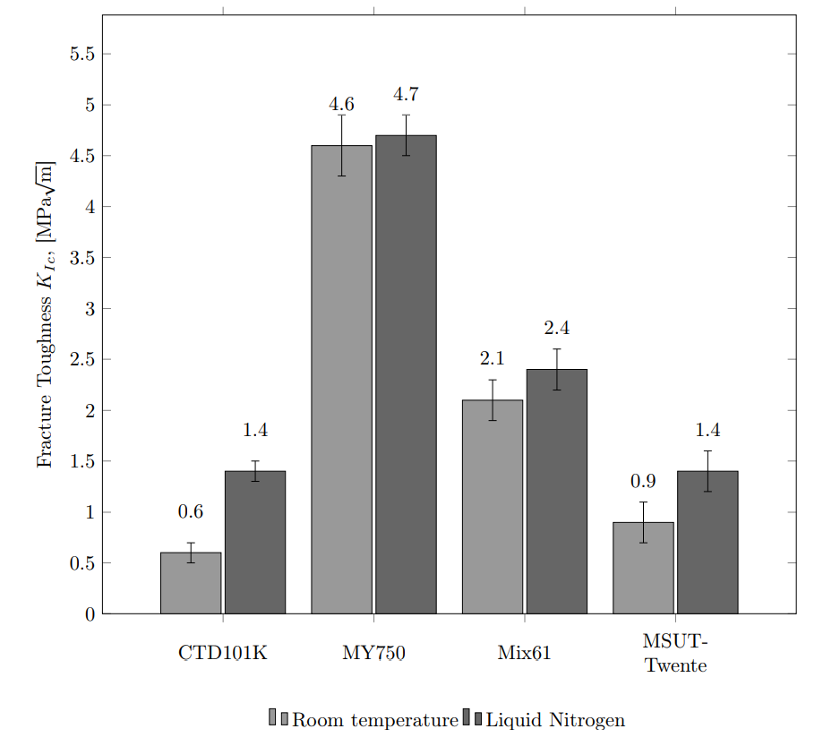

The MY750 (100 pbw) + HY5922 (55 pbw)
The MY750 with Aradur HY5922 was already used in the past at CERN to impregnate the MCBC/Y coils for the LHC corrector magnets. Among the four impregnation systems characterized at ETHZ so far, this is the one showing the highest fracture toughness.
The system is processed at 40°C and cured for 6 h at 40°C and thereafter 3 h at 80°C.
ETHZ, 2020

Slide 4
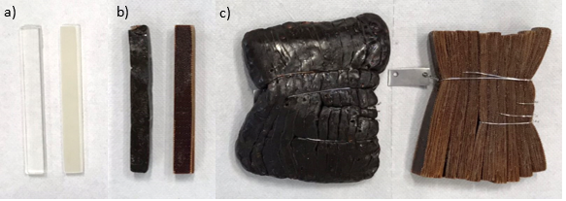
Proposal for a development around the MY750
The impregnation system MY750 (100) + HY5922 (55), cured 6h@40°C + 3h@80°C shows a degradation to radiations “already” below 10 MGy, confirmed by mechanical tests.
Resin (left) and laminate (right) irradiated at 0 MGy (a), 10 MGy (b), 20 MGy (c)
Are there directions to improve this performance without impacting on the fracture toughness ?

Slide 5
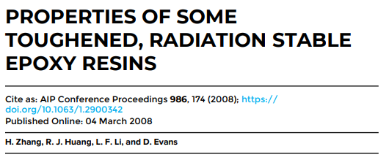
Some ideas about the parameters to play with
How much is the reticulation of the present system/procedure? What happens when adding for example a post-curing? Are there any options to introduce a third component to increase or toughen the links?
And, how much the fracture toughness would be influenced by these possible changes?
The HY5922 is an aliphatic polyamine hardener. Are there other hardeners, or possibly hardeners + catalyst, which still keeping a high fracture toughness may largely improve the radiation hardness?
For example the HY 5200, which is an aromatic amine, or an anhydride hardener?
ETHZ could perform the study and CERN organize the irradiation tests of a subset of promising systems

