Slide 1
Epoxy composites for application in superconducting magnets
Pascal Studer
Laboratory for Soft Materials

Slide 2
Structure of the presentation
  Motivation
  Engineering approaches
  Examples / research
  Experimental tools for preparing SENB samples
  Conclusion & Outlook

Slide 3
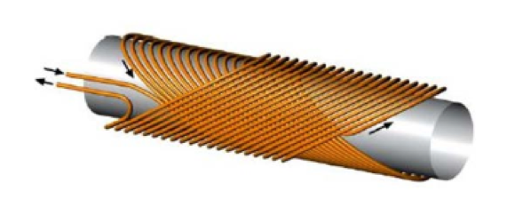
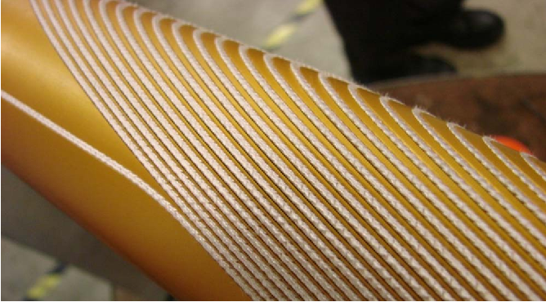
Superconducting electromagnets
1 Motivation
Particles guided by magnetic fields
  Electromagnets, Lorentz force
  Operated in the superconducting state at very low temperatures
  Superconductor: NbTi / Nb₃Sn
CHART
  CH-Accelerator Research & Technology
  Collaboration CERN,ETH, EPFL
resulting B-field direction
Particle trajectory

Slide 4
Requirements for epoxy application in superconducting magnets
1 Motivation
Function of the epoxy:
  Keeping the superconductors in place → high modulus, high fracture toughness
  Electrical insulation → Electrical insulator
Processing requirements
  No outgassing → Cross-linking without emission of volatiles & low volume change
  Long pot-life → Low initial viscosity, slow reaction
Other requirements
  Radiation stability
  Operation at cryogenic temp. (~4 K) → matching of thermal expansion coefficients
Epoxy (or other)
Aluminum bronze
Superconductor
T = 4.2 Kelvin

Slide 5
The causal chain of why research is needed
1 - Motivation
Cooling to cryogenic temperature leads to thermal stresses
Strong magnetic fields exert forces on conductors
Above a critical stress, the material releases elastic energy by cracking or localized yielding
The released energy is dissipated as heat
Approaching 0 K, heat capacity of almost all materials vanishses
Thus, cracks and yielding result in significant local temperature increases at 4 K
Superconductor becomes resistive above a critical temperature and given current density
Shutdown of the magnet
Significant cost factor

Slide 6
Possible approaches to solve the problem
2 – Engineering approach
Prevent thermal stresses
→ matching of thermal expansion coefficient to superconductor and metal (outside)
Increase K_{Ic}
→ prevention of cracking
Control yielding behaviour
Increase heat capacity
→ prevent temperature increase to above critical temperature
Increase thermal conductivity
→ reduce the peak temperature
Finding new superconductors with higher critical temperature
→ not part of my work

Slide 7
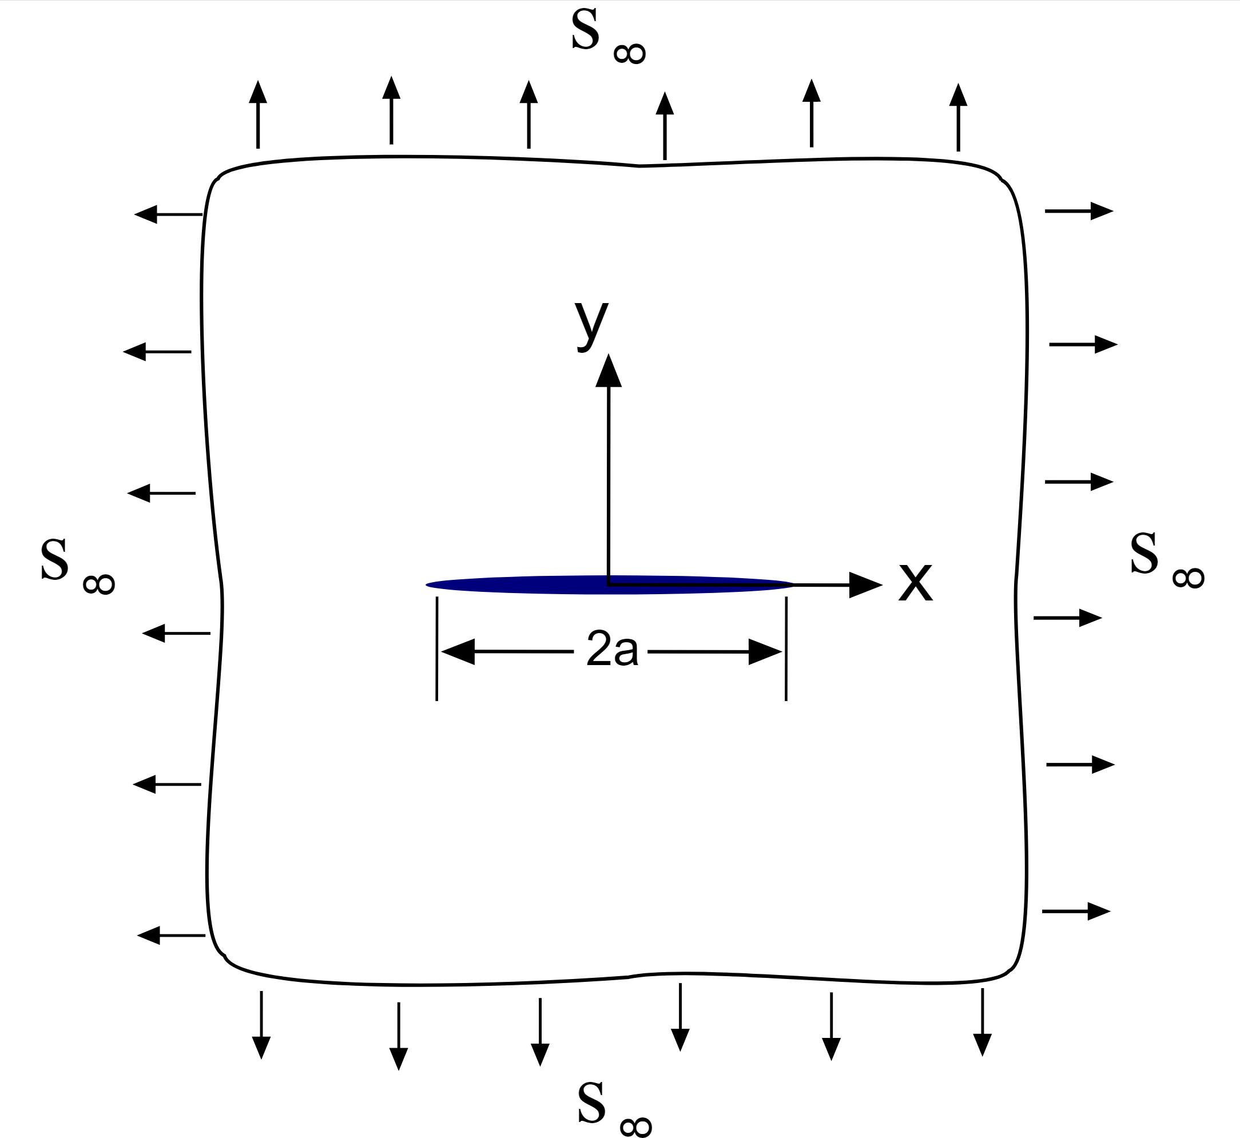
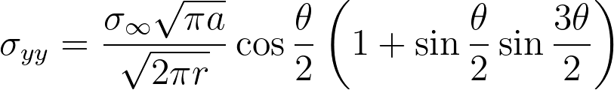
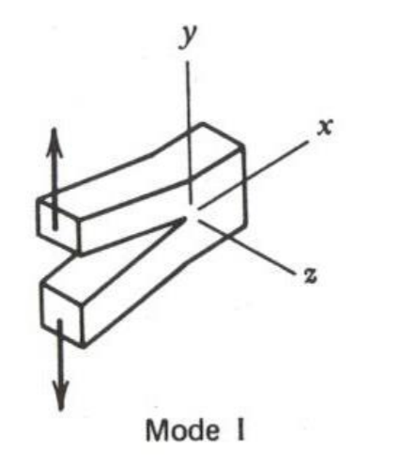


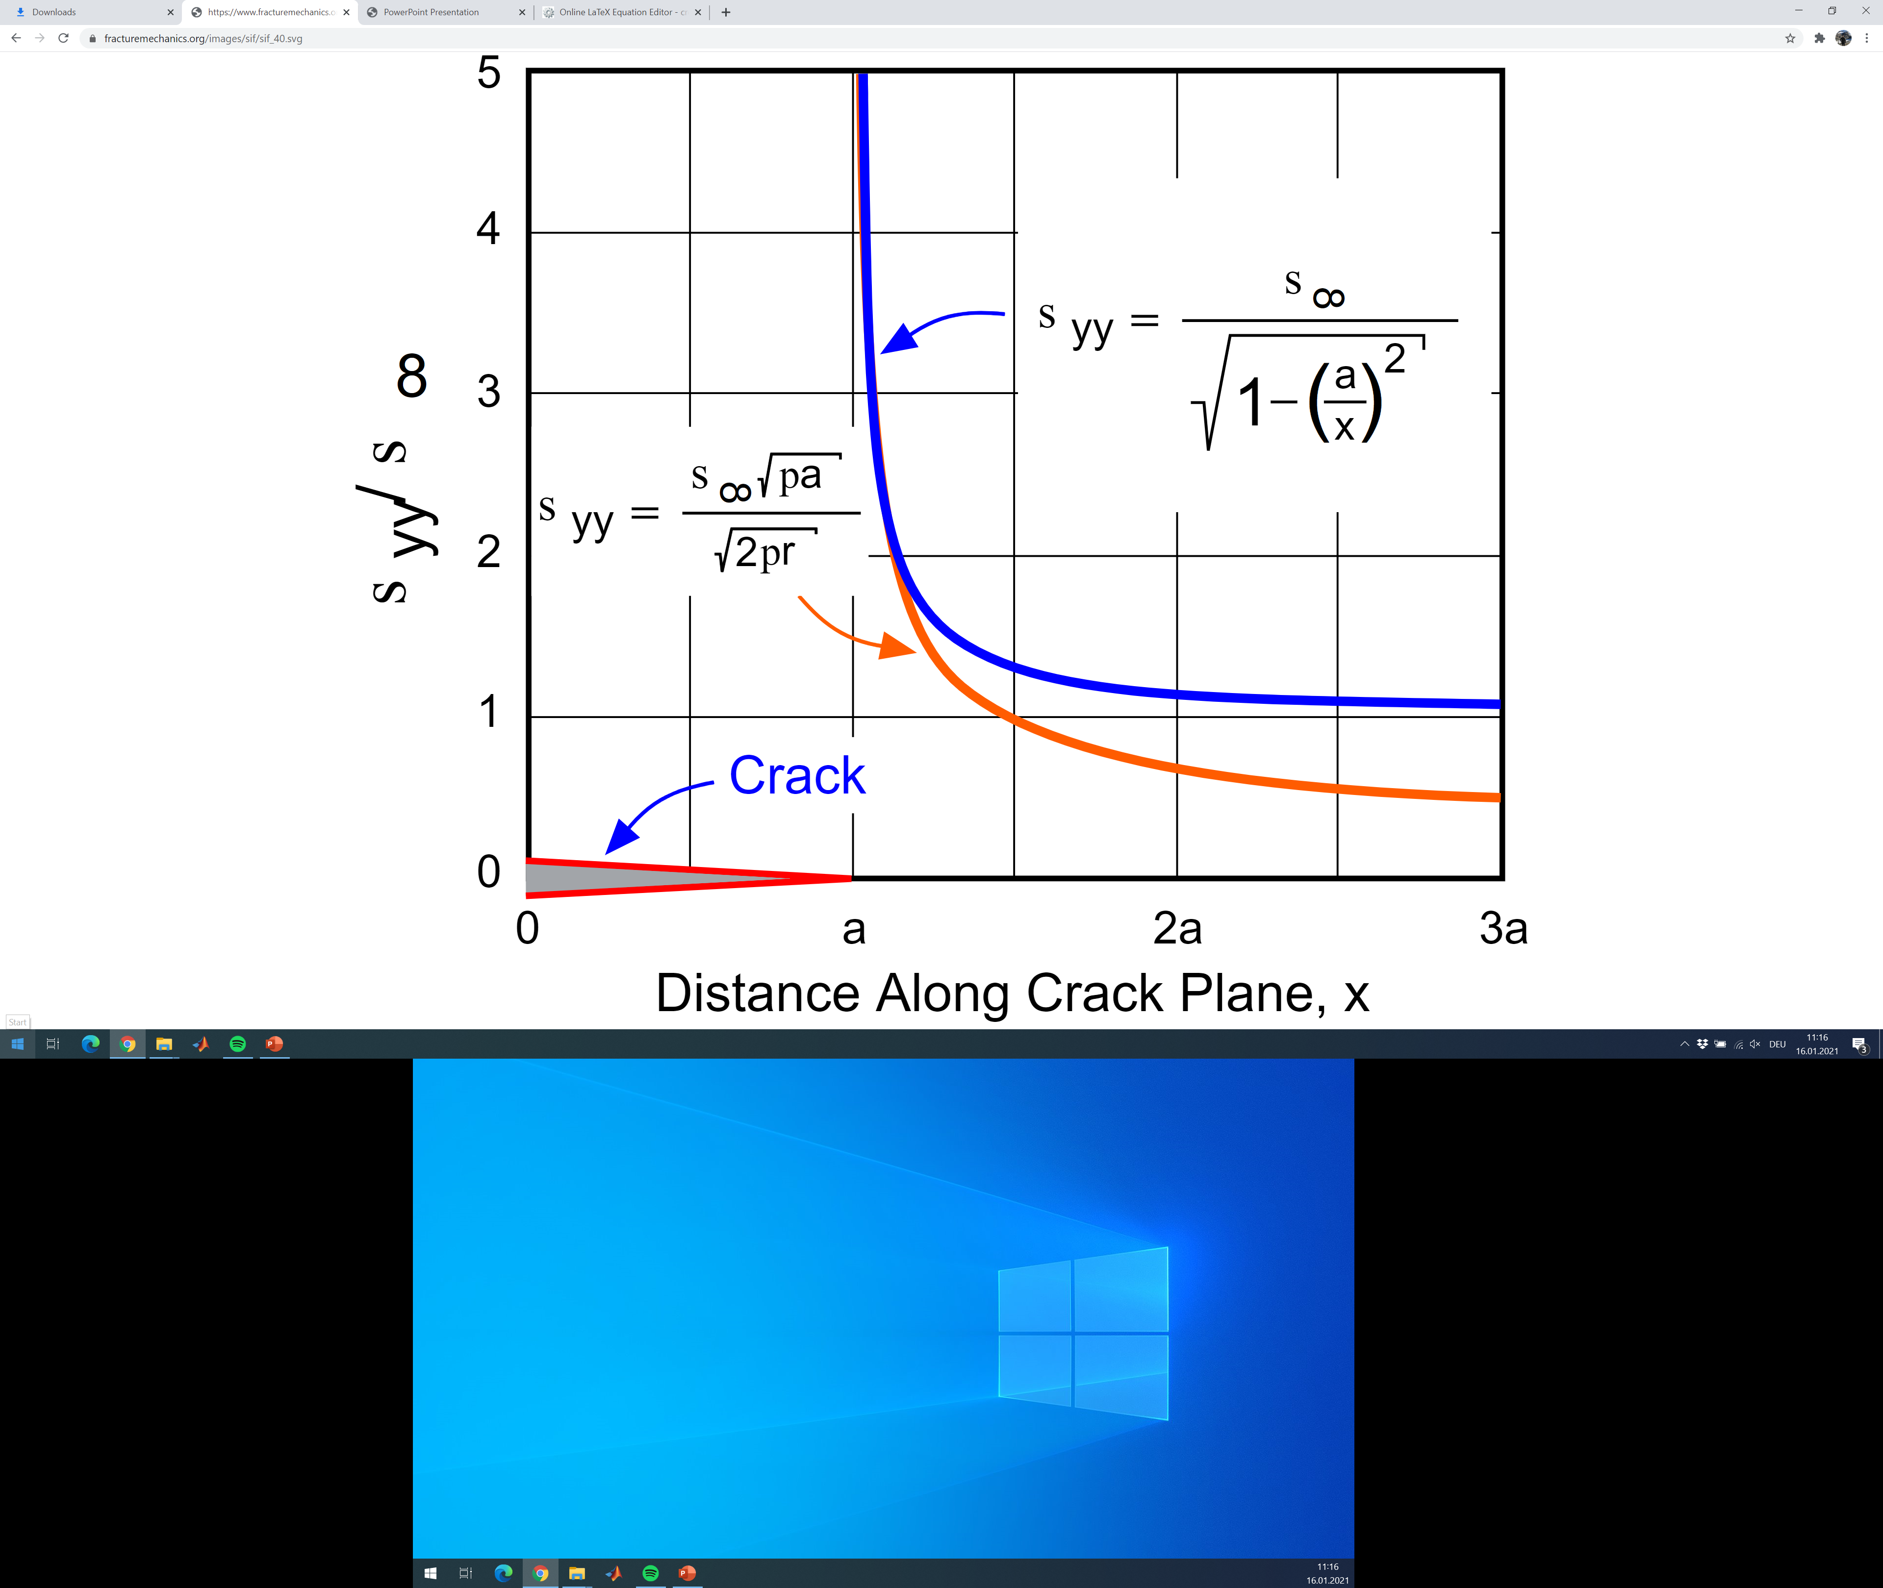
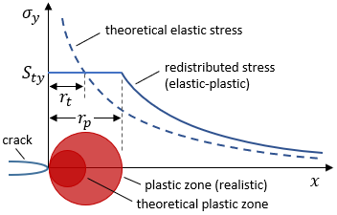
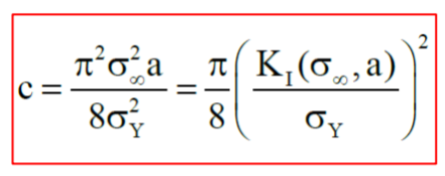
Definition of fracture thoughness
2 – Engineering handles
Many engineering materials fail well below their theoretical strength.
r
θ
Irwin found an approximation for the solution near the crack tip:
Thus, the stresses at a specific location near the crack tip defined by θ and r depend on the factor defined as the stress intensity K_{I}:
The singularity at r=0 suggests that all materials fail for a > 0 and σ_{ꝏ} > 0. However, every material some plasticity or microcracking at the crack tip.
The critical value of K_{I} at which failure occurs is an intrinsic material property, the so-called „fracture thoughness“ K_{IC}.
Plastic zone size, dugdale model
CTD-101K (LN2): 3.07 microns

Slide 8
Different ideas of epoxy composites for increasing K1c
3 Examples & Research
Particle toughening
Incorporate hard particles (micro/nano)
  Yielding of epoxy around particles
  Crack deflection → increase in crack surface area
Possible sedimentation (microfillers)
Possible aggregation (nanofillers/particles)
Rubber toughening
Incorporate soft but tough particles in epoxy matrix
Different mechanisms
  Matrix crazing (Formation of many small crazes increases energy-release rate, adhesion dependent, low modulus required to prevent debonding particle/matrix)
  Shear yielding: Interaction between stress fields around particles leads to shear bands, acting as an energy-dissipative mechanism, facilitated by cavitation of the rubber (increasing von Mises stress)
Not applicable! Below Tg, rubber is not soft anymore
Plane stress – tensile → yielding
Matrix crazing
Shear yielding
Ceramic
Epoxy
Rubber

Slide 9
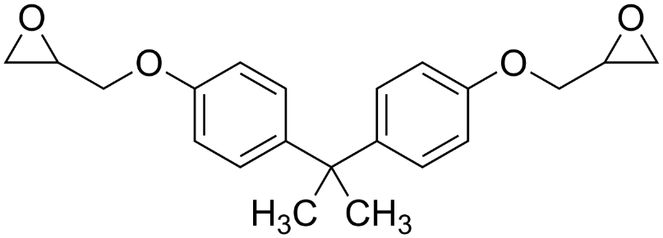
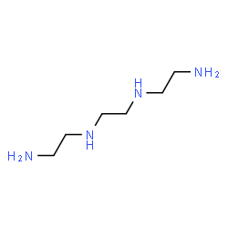
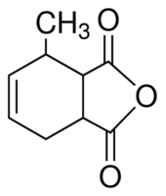
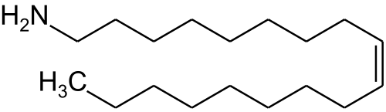
Epoxy with TiO₂ nanoparticles
3 Examples & Research
Preparation procedure
1. Nanoparticle suspension
2. Mix particle suspension with hardener or resin
Epoxy resin:
Some hardeners:
CHCl₃
TiO₂
HY 5922
CTD-101K Part B
3. Remove CHCl₃ with roto-evap
4. Mix hardener & resin → curing
Oleylamine

Slide 10
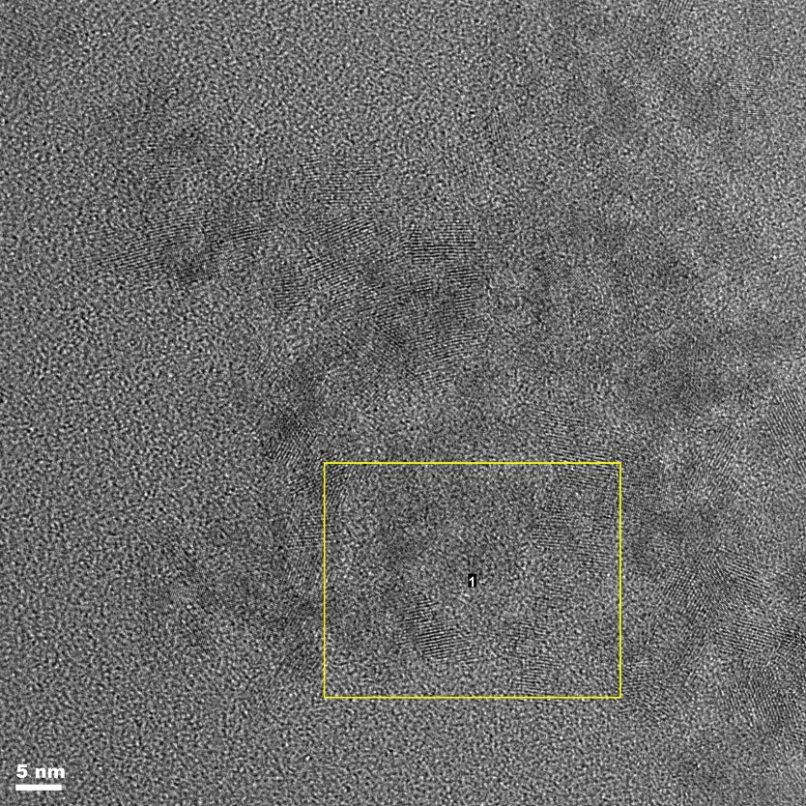
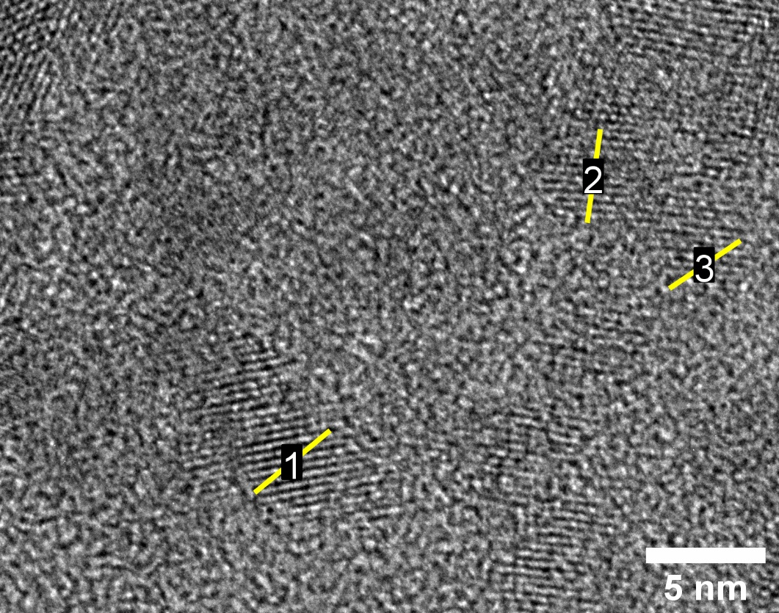
Epoxy with TiO₂ nanoparticles (MY750 resin)
3 Examples & Research
FFT of BF img
STEM images: Tecnai F30, FEG, 300 kV (ScopeM)
TEM samples prepared by ultramicrotomy
Agglomeration
Bright Field
Bright Field, zoom in
3.9, 3.7, 3.4 nm
STEM mode HAADF
Thanks to Fabian Gramm (ScopeM, ETHZ)

Slide 11
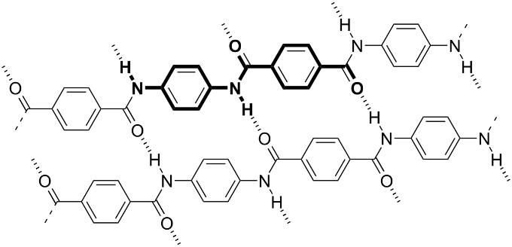
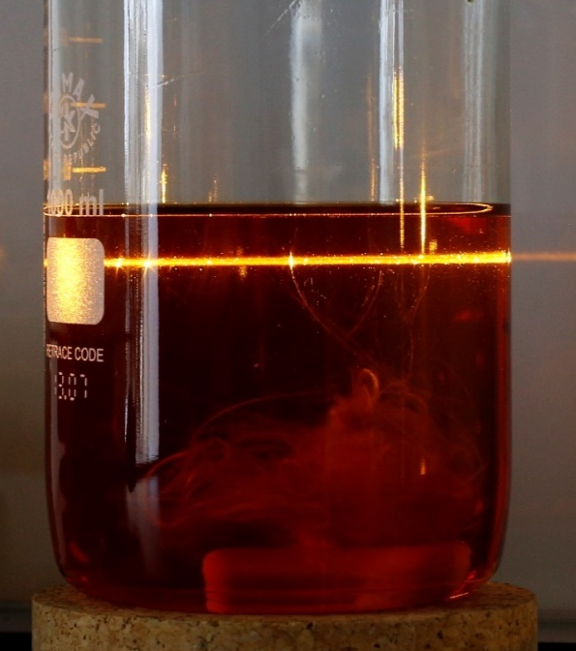
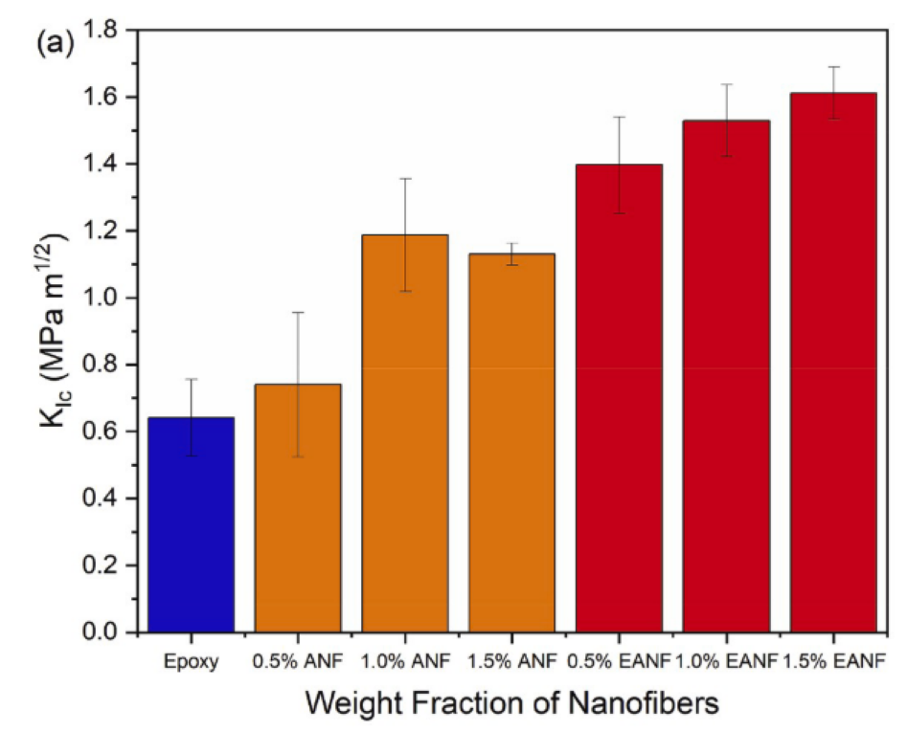
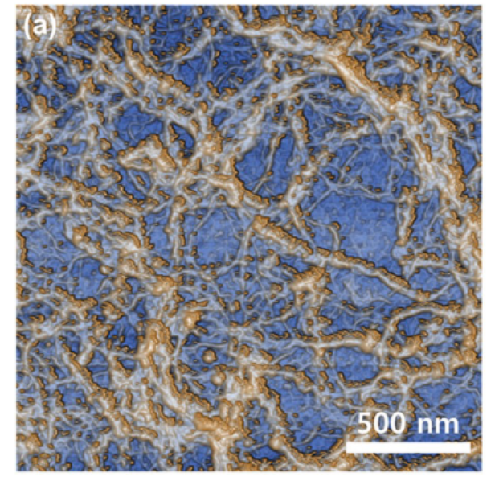
Different ideas of epoxy composites for increasing K1c
3 Examples & Research
Crack bridging
Epoxy-aramide nanofiber composite
Toughening by fiber bridging over crac
Process:
  1. Dissolution of aramide in DMSO/KOH/(H2O)→ polyanion solution
  2. Precipitation by adding proton donor (H2O
  3. Filtration / Drying / Characterization
  4. Incorporation into epoxy
OH⁻
OH⁻
1
OH⁻
Interactions:
Electrostatic
Van der Waals
Aromatic
H⁺
2
10 nm
Epoxy
1 um
Jung et al., 2020 (Polymer)
Aramide fiber / DMSO / KOH solution
After stirring for 5 days
Jung et al., 2020 (Polymer)
Notes:
Graph vergrössern

Slide 12
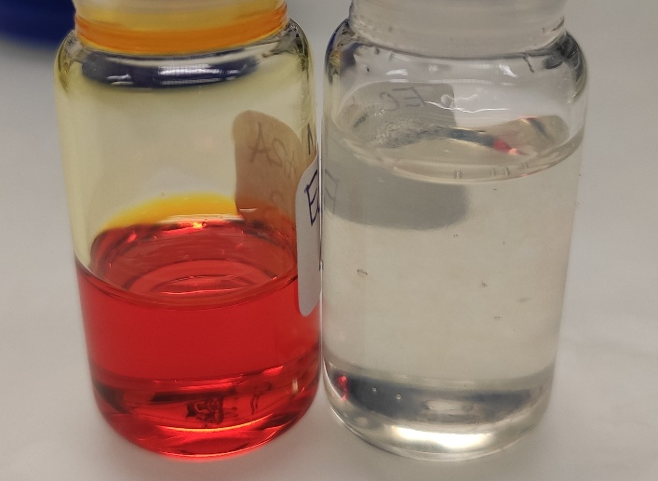
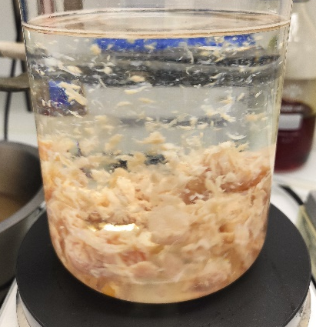
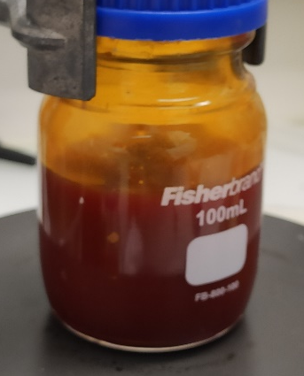
Results on preparing aramide nanofiber colloidal solutions
3 Examples & Research
0.2% solution
0.2% aramide in DMSO/KOH
KOH pellets
Stirred 7 days
Precipitated with proton donor H2O (added 0.5 mL/mg of aramide)
Formation of a colloidal gel
2% solution
2.3% aramide in DMSO/H2O (1:25)
KOH pellets crushed
Stirred 9 hours
Precipitated with proton donor H2O (added 0.5 mL/mg of aramide)
Forms clumps
Problem: Not fully dissolved (next slide) & concentration
Notes:
Graph vergrössern

Slide 13
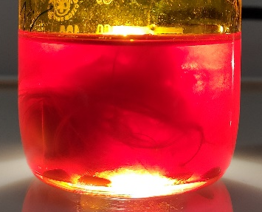
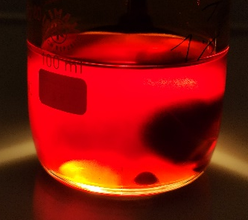
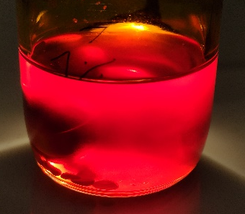
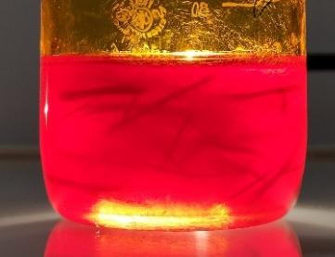
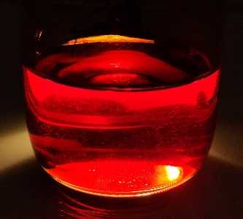
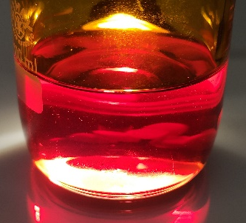
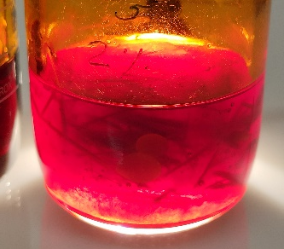
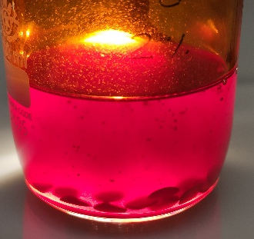
Preparation times for aramide polyanion solutions
3 Examples & Research
Composition (1:25 H2O/DMSO), KOH | Preparation method (RT) | 6h | 24h
1 % aramide sol. | Stirred, 400 rpm
1 % aramide sol. | Tumbler, ~80 rpm
2 % aramide sol. | Tumbler, ~50 rpm
Notes:
Graph vergrössern

Slide 14
Aramide nanofibers, open questions
3 Examples & Research
Preparation of dried nanofibers for application from higher concentrated solutions (1%, 2%, 4%,…)
  What happens when the concentration of proton donor is slowly increased instead of instantaneous mixing?
  Dilution necessary before precipitation? Influence on microstructure?
  What would be an appropriate diluent? (aprotic, polar, basic)
    Acetone, EtOH+KOH, H2O+KOH, ?
What is the influence of temperature on both aramide dissolution and precipitation?
Effect of nanofibers in epoxy on pot-life viscosity?
How do the fibers align during infusion of dense structures?
Notes:
Graph vergrössern

Slide 15
Different ideas of epoxy composites for increasing K_{Ic}
3 Examples & Research
Pre-stressing (internal pressure)
Idea: incorporate nascent UHMWPE (highly crystalline) particles into epoxy
After curing, melt the UHMWPE → lower crystallinity → specific volume goes up → pre-stress closes cracks
Chain explosion → improved adhesion?
UHMWPE
Epoxy
Melting
Pre-stressed
material
Notes:
Graph vergrössern

Slide 16
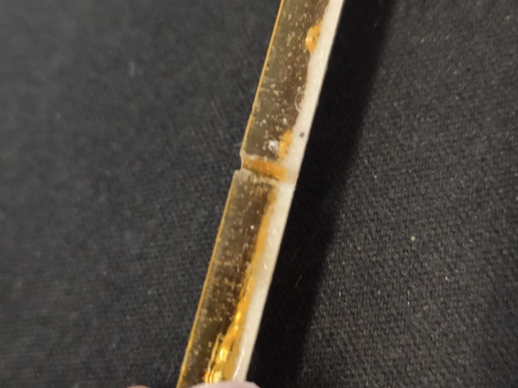
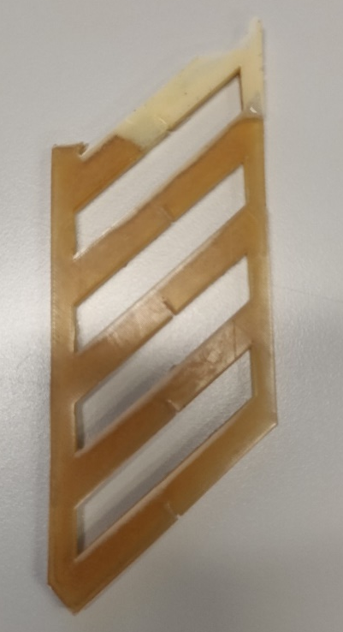
UHMWPE in Epoxy (CTD-101K)
3 Examples & Research
First trial
  Simply mixing GUR 4120 (commercial UHMWPE grade) with epoxy, degassing according to standard protocol & curing
    White layer on top
    Probably due to trapped air
Second trial
  Mixing GUR with liquid hardener (part B)
  Degassed 10 mBar, 60 °C, 30 min → bubbling
  Mixed with other components, degassed, cured, ultrasonic bath 2 min
  Similar result
  Air is entrapped since top level sank
Third trial
  Suspending GUR in ether (lower density → sediments)
  Centrifugated, tip sonicated & centrifugated again
  Now cured
Notes:
Bild einfügen

Slide 17
Possible approaches to solve the problem
3 – Examples & Research
Prevent thermal stresses
→ matching of thermal expansion coefficient to superconductor and metal (outside)
Increase K1c
→ prevention of cracking
Increase heat capacity
→ prevent temperature increase to above critical temperature
Increase thermal conductivity
→ reduce the peak temperature
Finding new superconductors with higher critical temperature
→ not part of my work

Slide 18
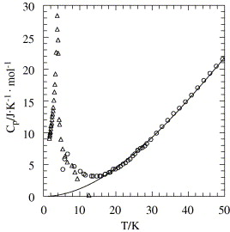
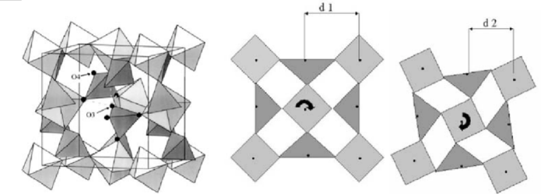
Combined approach: heat capacity & thermal expansion match.
3 Examples & Research
Zirconium tungstate (ZrW₂O₈)
negative coefficient of thermal expansion (α = ⎼7.2 * 10⁻⁶ K⁻¹) of ZRW₂O₈
→ overall reduction in thermal expansion coefficient
→ thermal stresses are distributed throughout epoxy rather than on interface superconductor/epoxy/metal
+ Gadolinium Oxide (Gd₂O₃) composite
Gadolinium oxide has anomaly in heat capacity at ~3K → where the magnet is operated
Cracking and yielding would result in lower local temperature rise
Schematics of Zirconium Tungstate and the
RUM mechanism
10.1007/s10853-009-3692-4
Heat capacity of GD₂O₃
10.1016/j.jct.2005.02.014

Slide 19
Measuring K_{Ic} for filled epoxy composites
4 – Experimental tools
Single-etch notch bend samples (SENB) → difficult preparation
Tapping on blade
Pressurized area
Controlled force
F
Sample
Sample
Sample
The test setup
Sample preparation
Stopping the crack

Slide 20
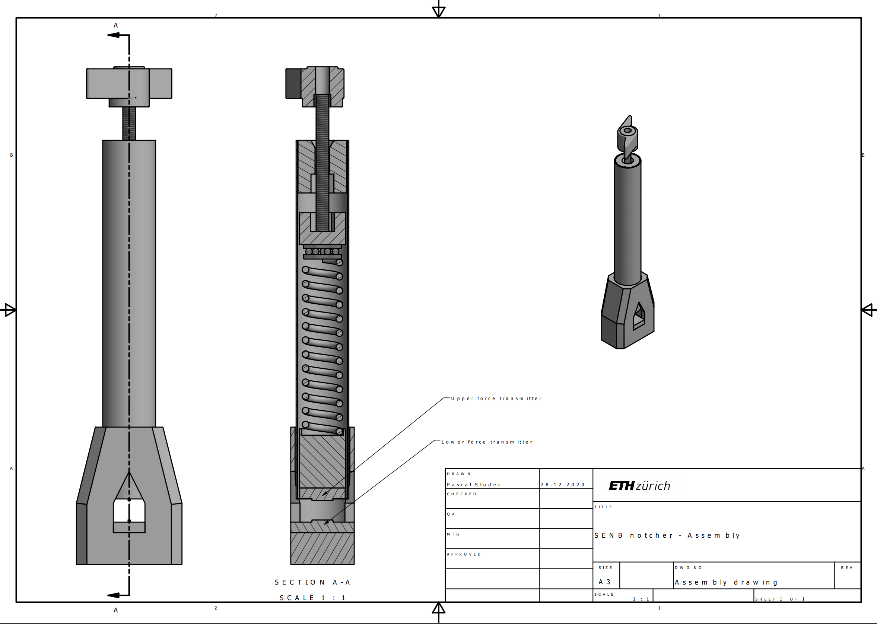
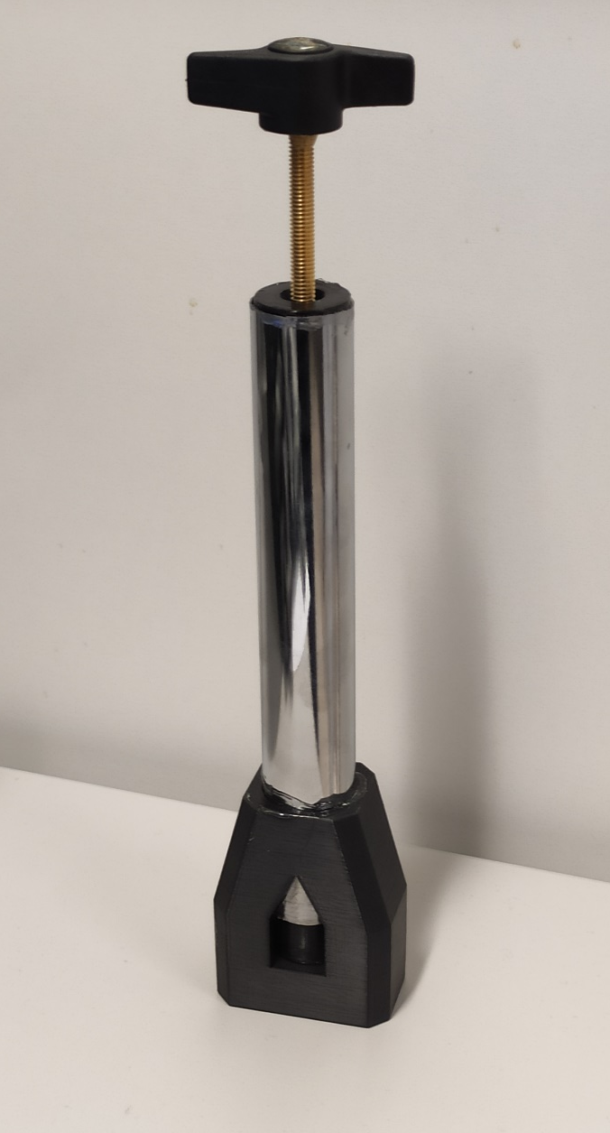
Measuring K_{Ic} for filled epoxy composites
4 – Experimental tools
Device design
  Controlled force
  Most parts 3D printed
  Except force transmitter (CNC)
In progress…

Slide 21

Conclusion & Outlook, questions
5 - Conclusion
Further research
  Explore toughening of epoxy composite with nascent UHMWPE and PTFE
  Fabricate aramide nanofiber epoxy composite
  Finish the sample notching device, obtain reliable K_{Ic} values
Thanks
  André Brem, Bernhard Auchmann and Theo Tervoort for their support
  Fabian Gramm (ScopeM) for support with TEM imaging
  Chris for helping with the design of the improved sample notcher

