Slide 1
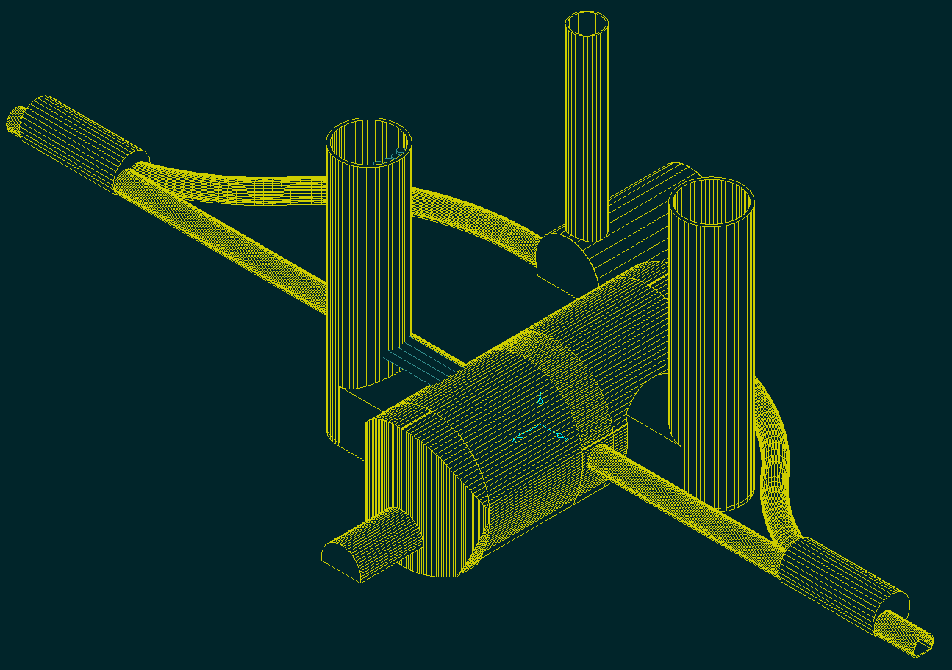
CLIC MDI STATUS REPORT
CLIC/ILC MDI+BDS meeting 19-7-2010
Lau Gatignon / EN-MEF
for the CLIC MDI team & related WG

Slide 2
MDI members
Robert Appleby, Armen Apyan, Marco Battaglias, Enrico Bravin,
Helmut Burkhardt, Phil Burrows, Francois Butin, Barbara Dalena,
Konrad Elsener, Arnaud Ferrari, Andrea Gaddi, Martin Gastal,
Lau Gatignon, Hubert Gerwig, Christian Grefe, Edda Gschwendtner,
Michel Guinchard, Alain Hervé, Andréa Jérémie, Thibaut Lefèvre,
Lucie Linssen, Helène Mainaud Durand, Sophie Mallows,
Michele Modena, John Osborne, Thomas Otto, Colin Perry,
Javier Resta Lopez, André Philippe Sailer, Hermann Schmickler, Daniel Schulte, Jochem Snuverink, Markus Sylte,
Rogelio Tomàs Garcia, Davide Tommasini, Raymond Veness,
Alexey Vorozhtsov, Volker Ziemann, Franck Zimmermann
And input from many others, e.g.
Michel Jonker, Giovanni Rumolo, Guillermo Zamudio Ascencio

Slide 3
Outline
Introduction
The QD0 magnet
Anti-solenoid
Detector layout
QD0 integration in detector
Pre-alignment of QD0
QD0 stabilisation
Fallback solution with QD0 in tunnel
IP feedback
Vacuum
Input for cavern layout with Push-pull
Summary and Outlook

Slide 4
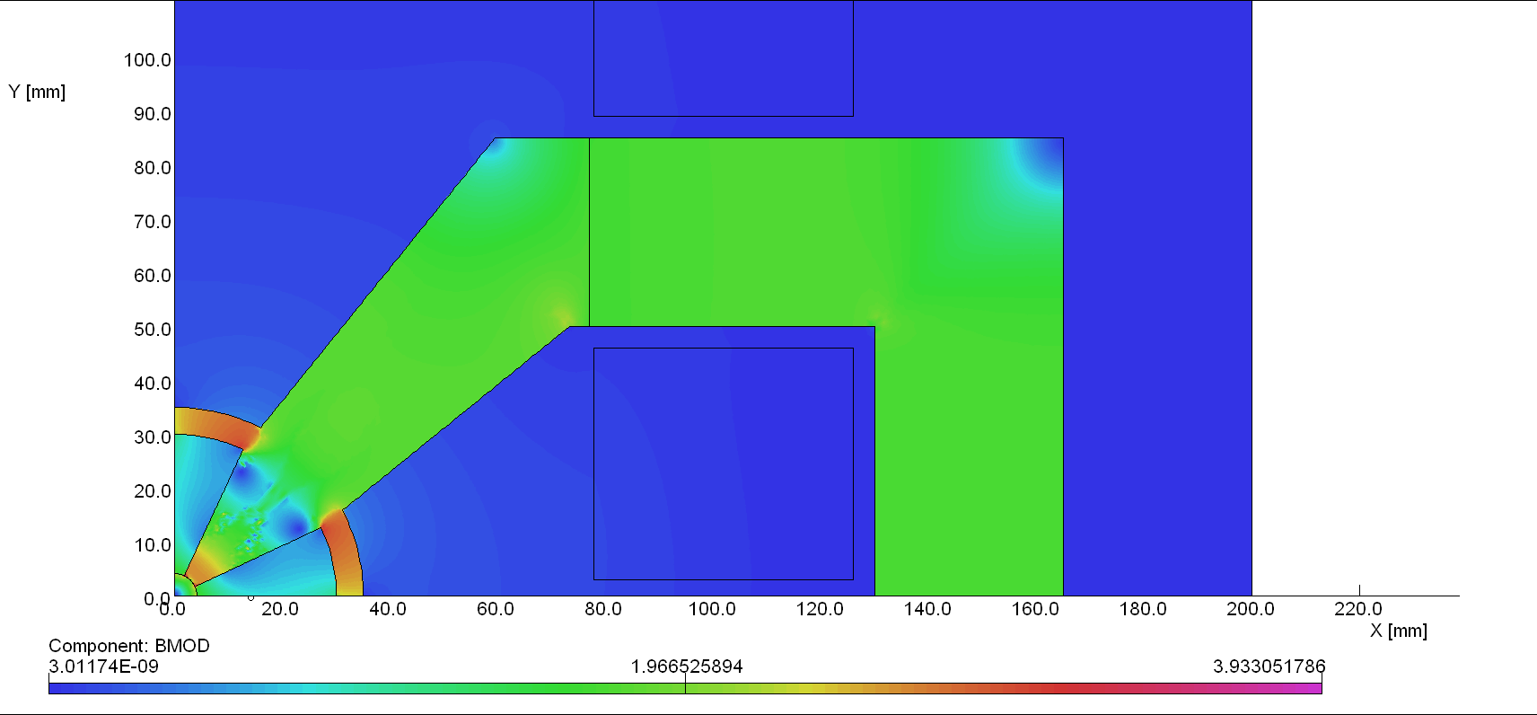
The QD0 MAGNET
“Hybrid” approach, Version 2:
 | Iw=5000 [A]
Grad [T/m] Sm₂Co₁₇ | 531
Grad [T/m] Nd₂Fe₁₄B | 599
The presence of the “ring” decrease slightly the Gradient (by 15-20 T/m) but will assure a more precise and stiff assembly
EM Coils design will permit wide operation conditions (with or without water cooling) that can be critical for performances (ex. stabilization)
“CLIC09 Workshop” 12-16 October 2009 , M. Modena

Slide 5
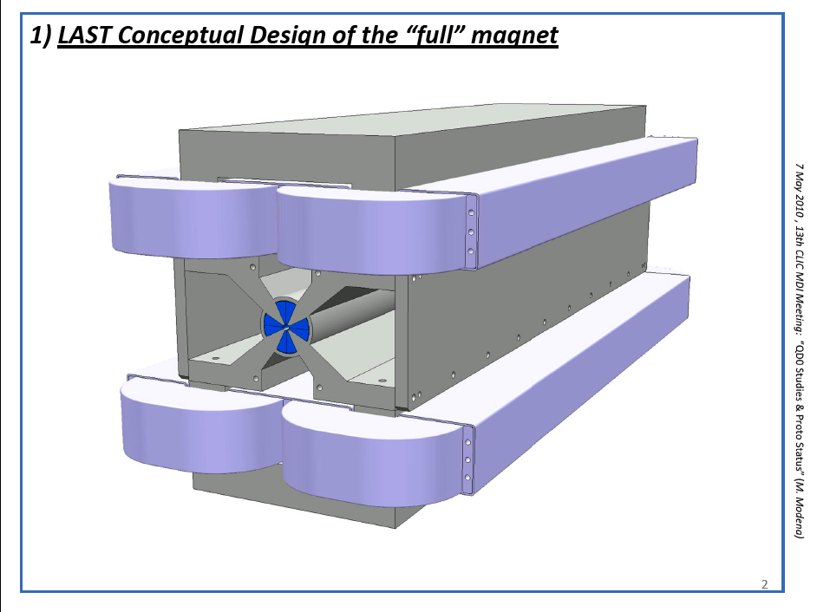

Slide 6
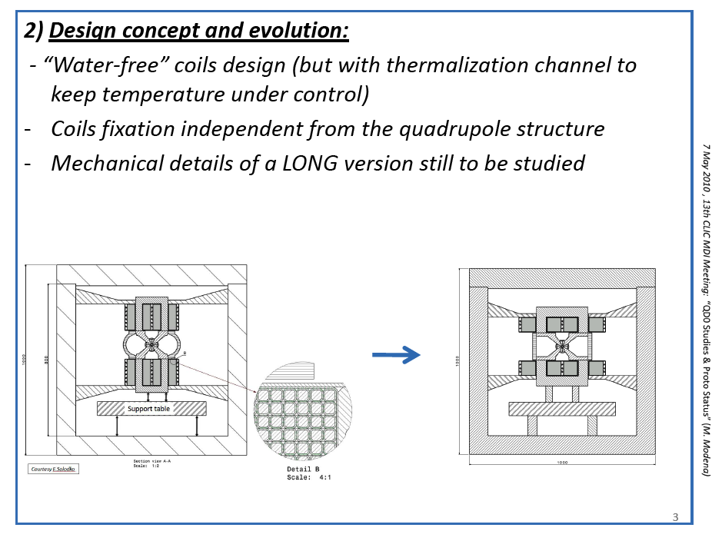
Define strategy to measure field in small aperture (→L.Walckiers)
Test tolerance of PM in external magnetic field

Slide 7
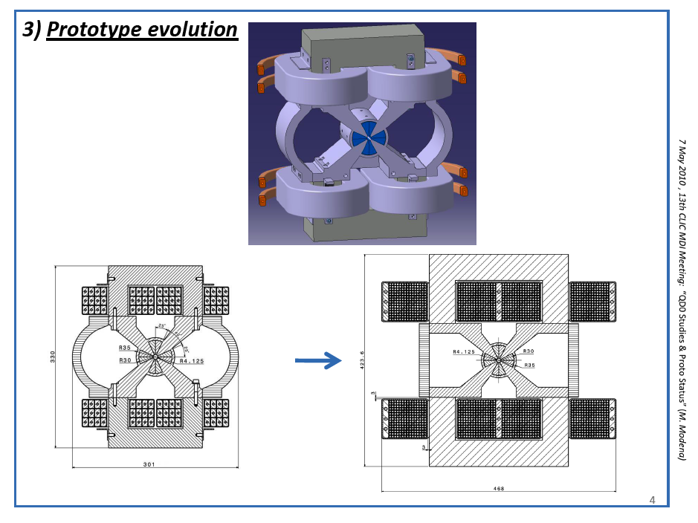
Building short prototype
Available by end 2010

Slide 8
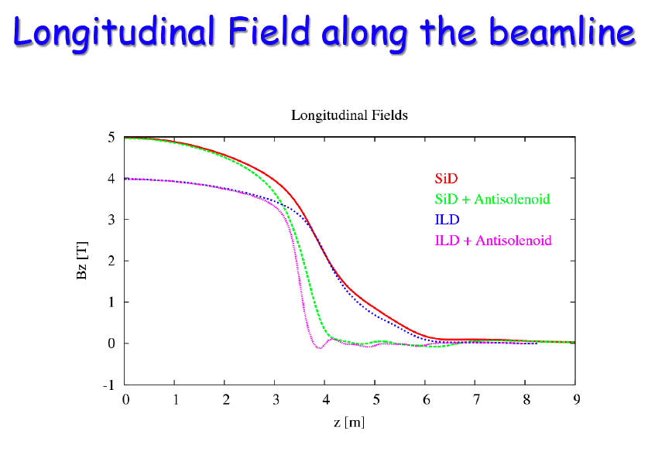
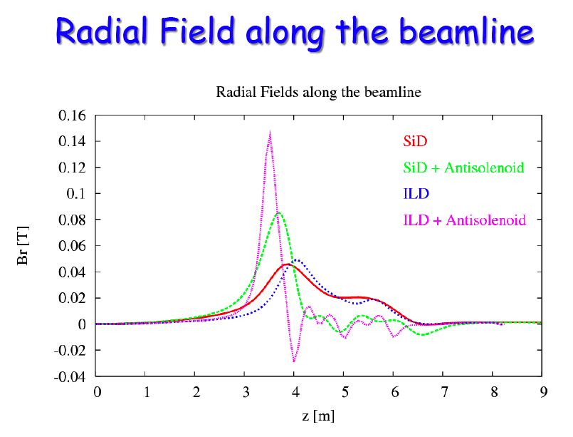
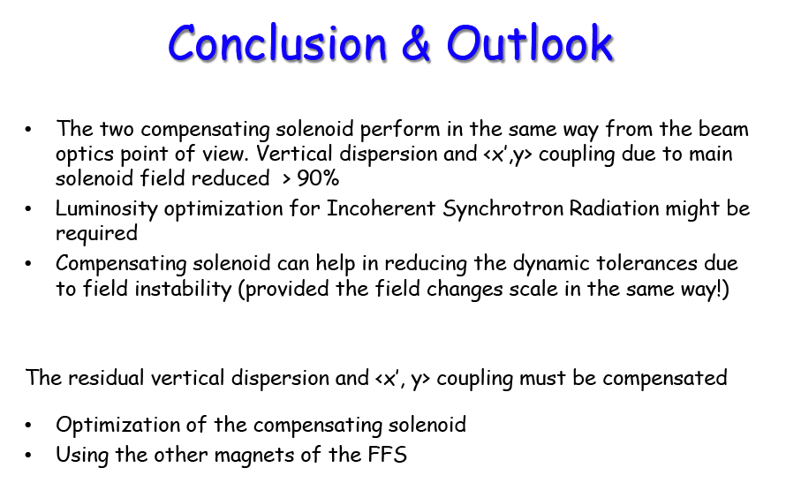

Slide 9
Latest CLIC-SiD detector

Slide 10
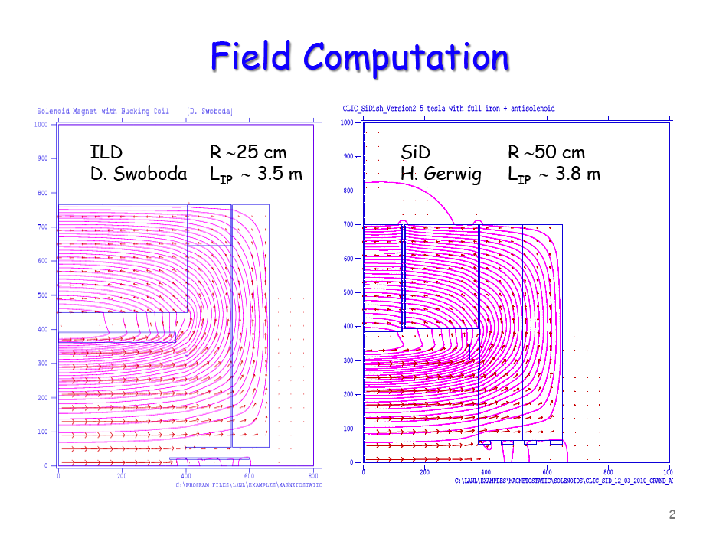
Anti-solenoid protects QD0 magnet:
B.Dalena
- Engineering design to be made
- Find way to protect QD0 even if one of the solenoids trips

Slide 11
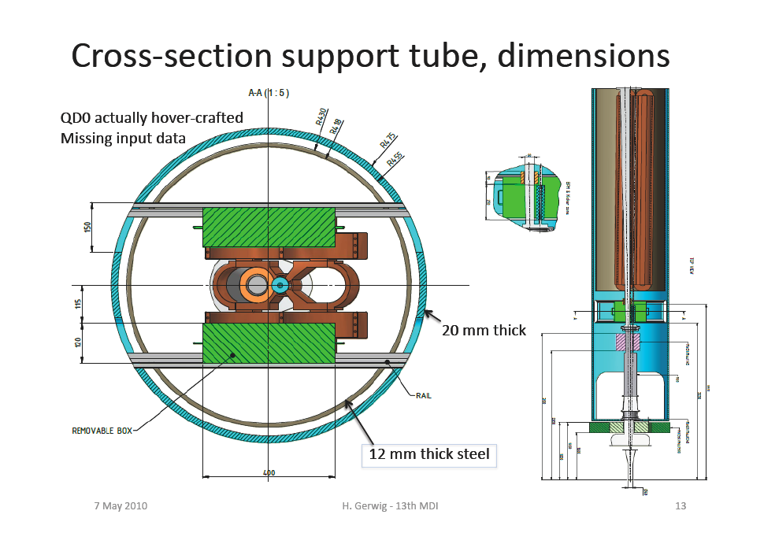

Slide 12
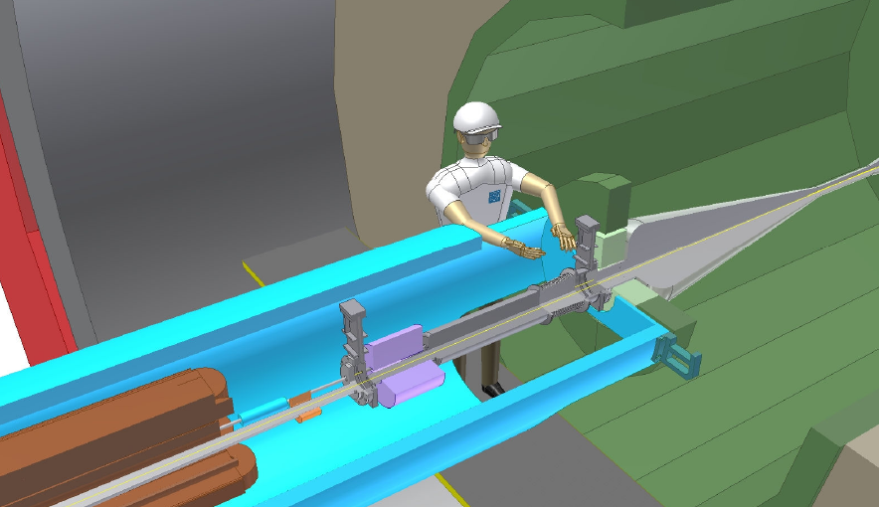
HCAL
Return yoke
LumiCal
BeamCal
Kicker
QD0
ECAL
BPM
Support tube

Slide 13
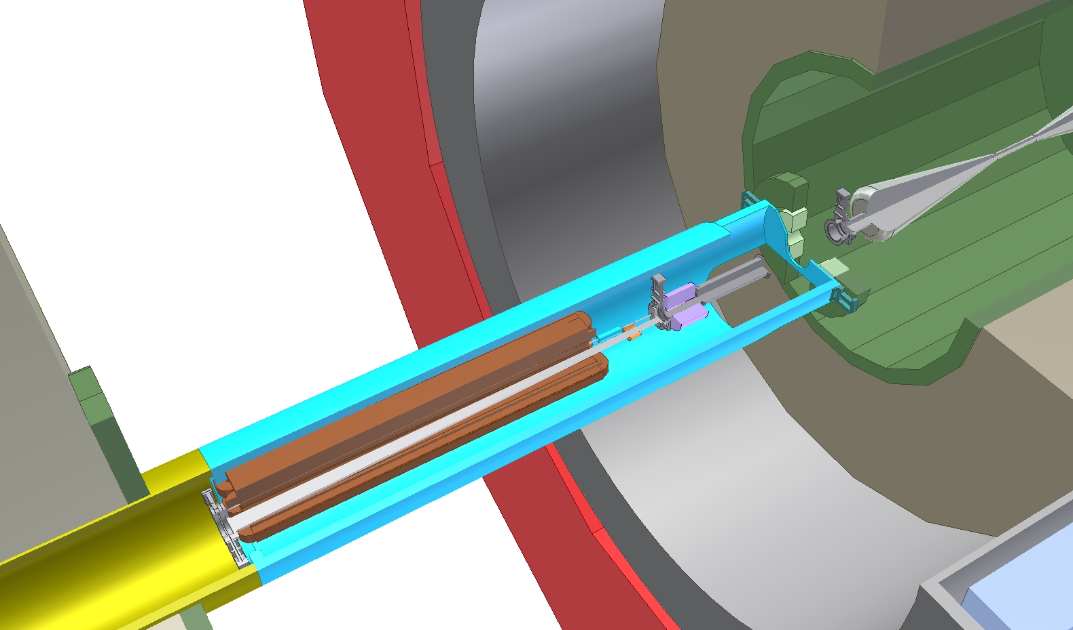
H.Gerwig, N.Siegrist
Return yoke
HCAL
Endcap retracted
Vacuum valve
ECAL
QD0
Support tube

Slide 14
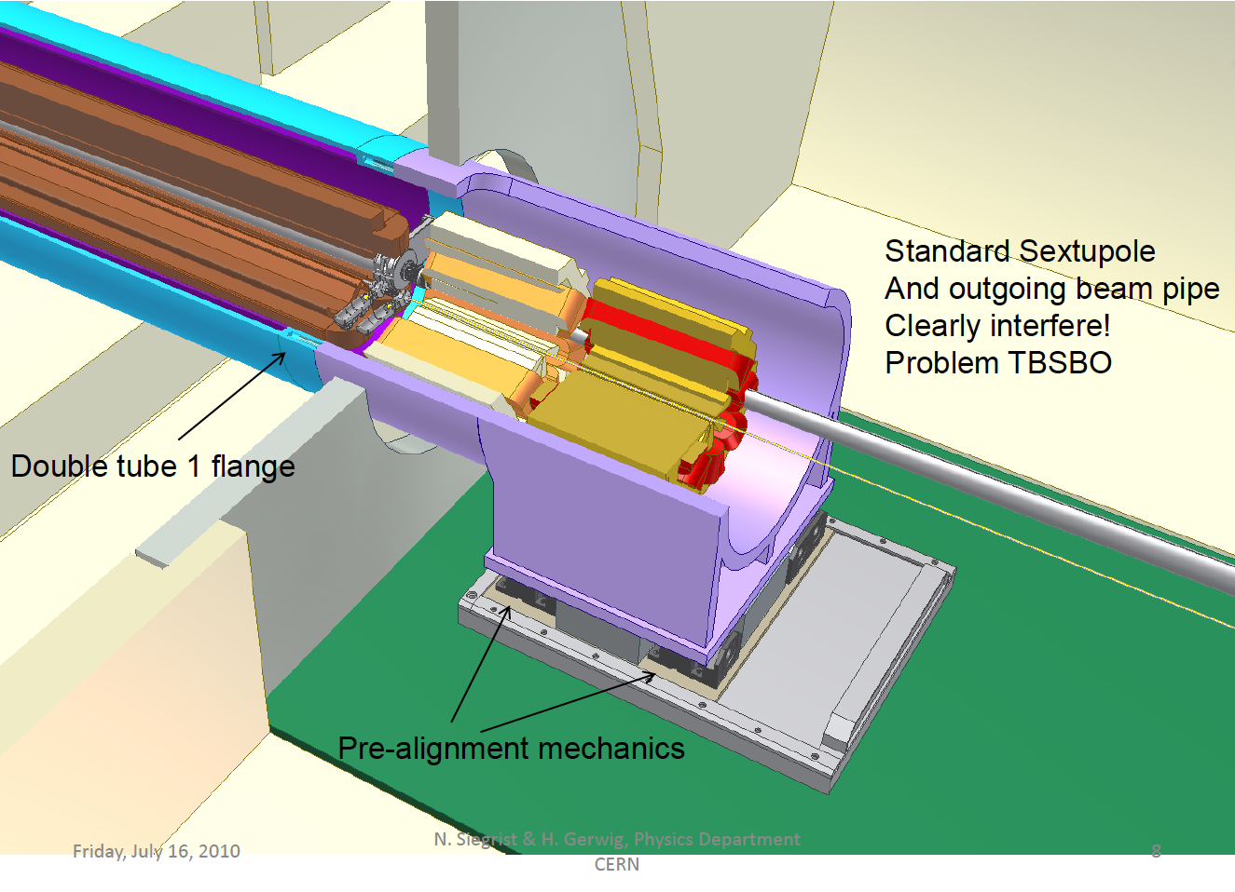
H.Gerwig, N.Siegrist

Slide 15
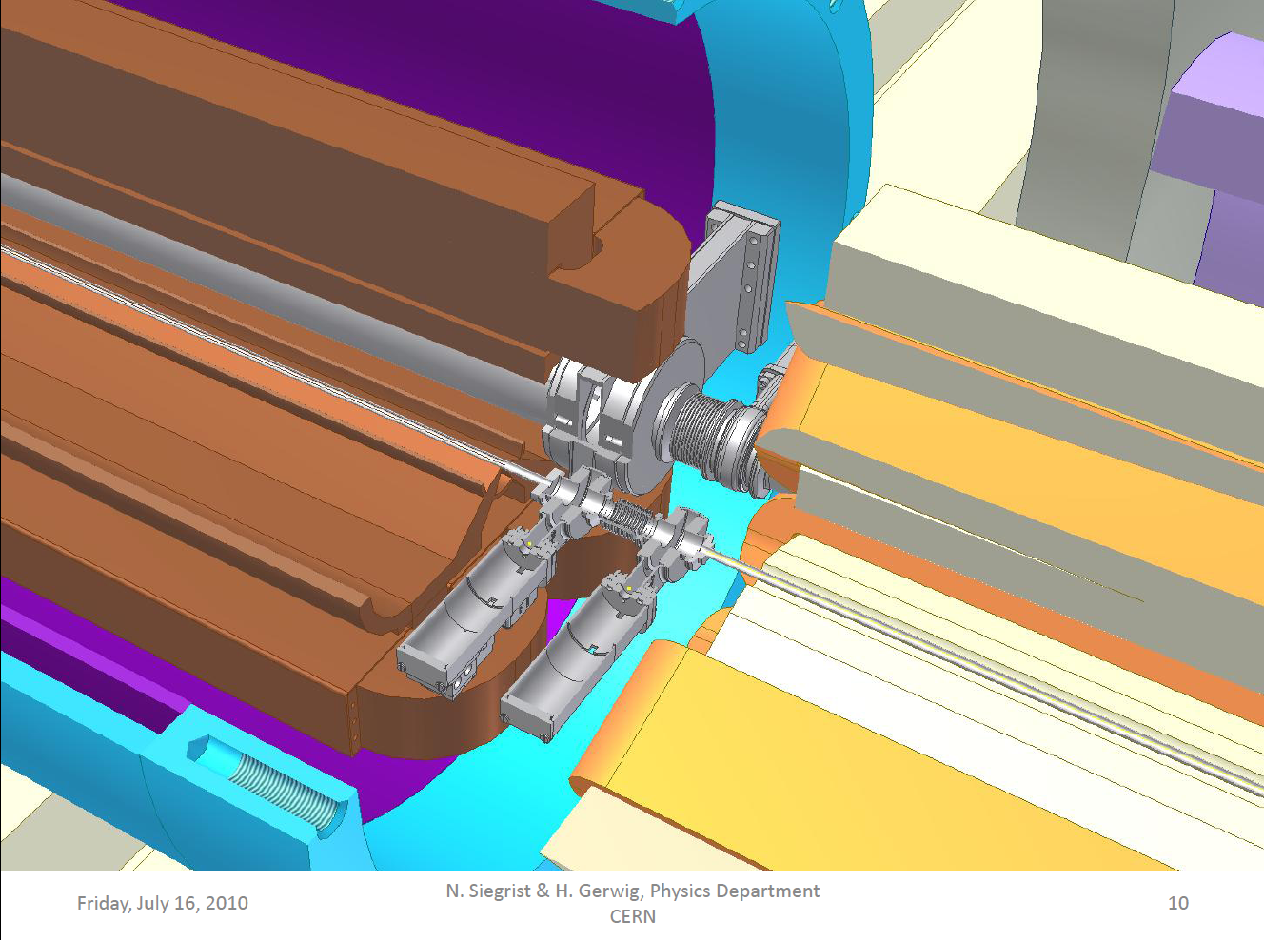
H.Gerwig, N.Siegrist

Slide 16
CLIC-ILD parameter drawing

Slide 17
Comparison between the two detectors

Slide 18
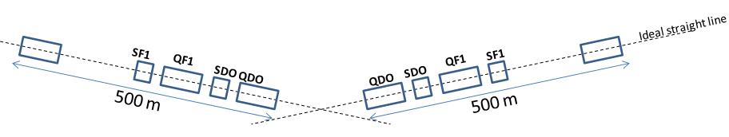
Helene Mainaud
Determination of the position of QD0 w.r.t other components of the BDS (500 last m)
Requirements:
  10 µm (for L*=3.5 m), rms value
  Position of the zero of the QDO w.r.t to the ideal straight line of the 500 m last meters of BDS
Solution proposed:
  Stretched wire + WPS sensors
  Same solution than for the main linac, except the length of wire (500 m instead of 200 m)
  500 m wire validated in TT83 tunnel in 2008.
Main remaining issues:
  Integration
  Fiducialisation

Slide 19
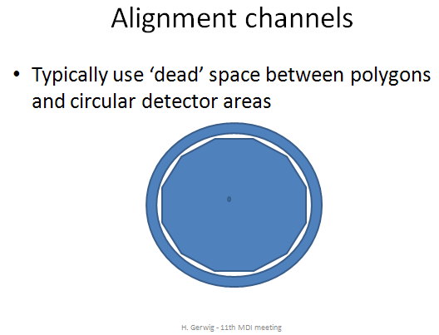
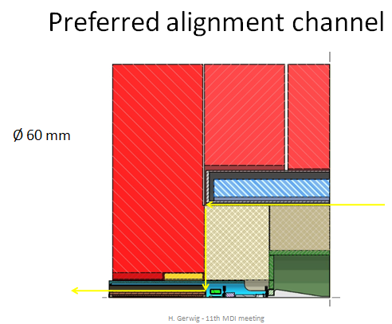
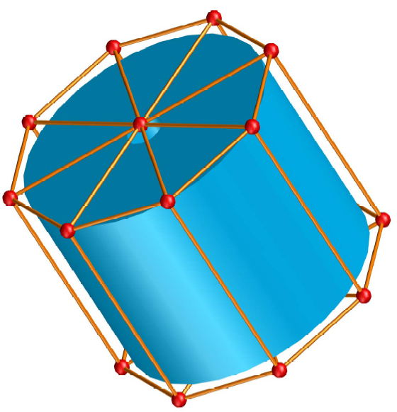
Helene Mainaud
Monitoring of the position of one QD0 w.r.t the other
Requirements:
  The best we can!
Solution proposed:
  Solution based on RASNIK system, through the detectors (using dead space between detector areas)

Slide 20
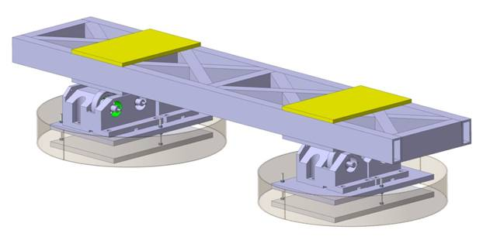
Helene Mainaud
Re-adjustment solution: cam movers for 5 DOF
Requirements:
  Sub-micrometric displacements
  Compatible with stabilization requirements
Solution proposed:
  Cam based system : same than for the MB quad of the linac
Remaining issues:
  Integration!

Slide 21
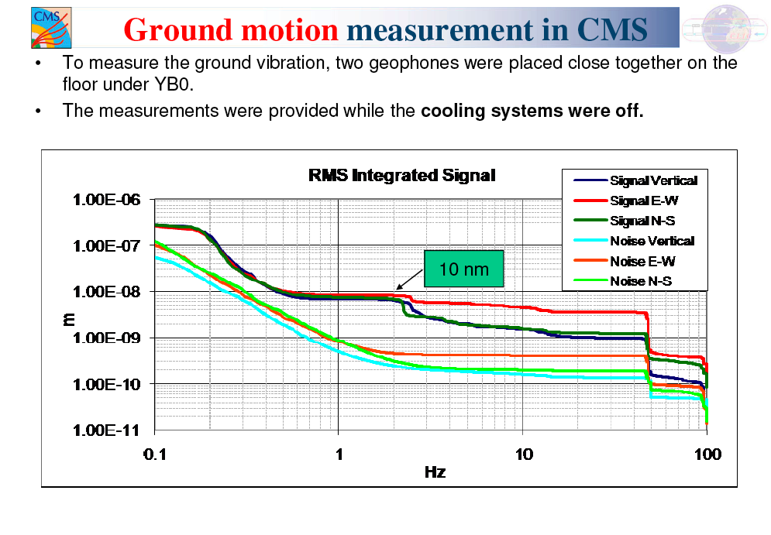
M.Guinchard and A.Kuzmin

Slide 22
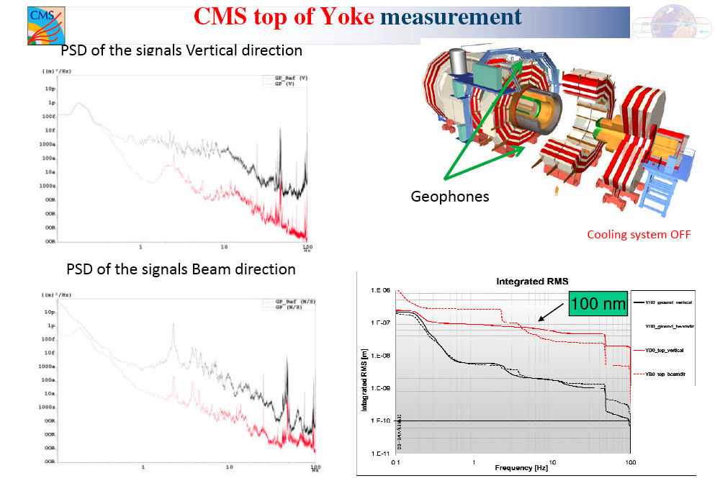
M.Guinchard and A.Kuzmin

Slide 23
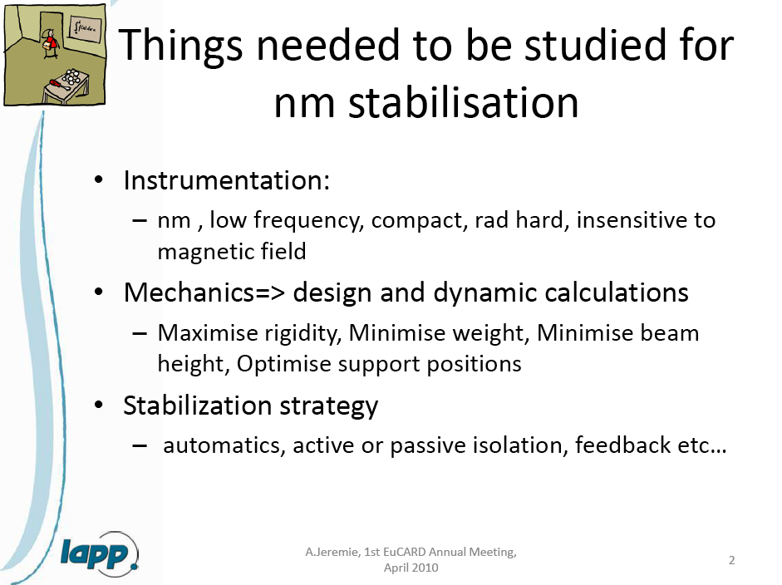
Specification: 0.15 nm for f > 4 Hz in vertical plane

Slide 24
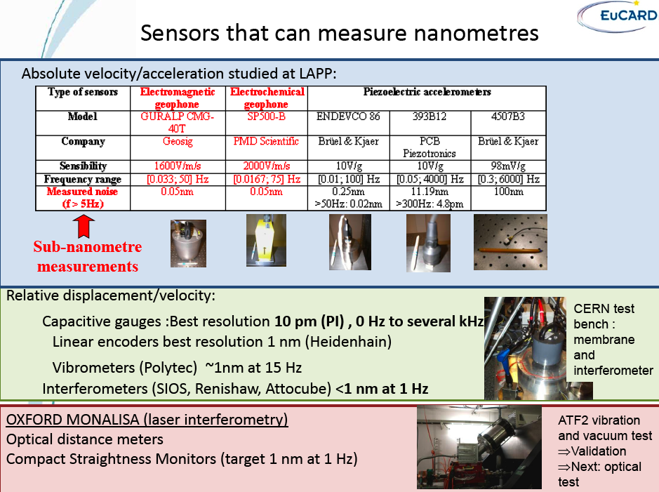
A.Jeremie, C.collette, K.Artoos

Slide 25
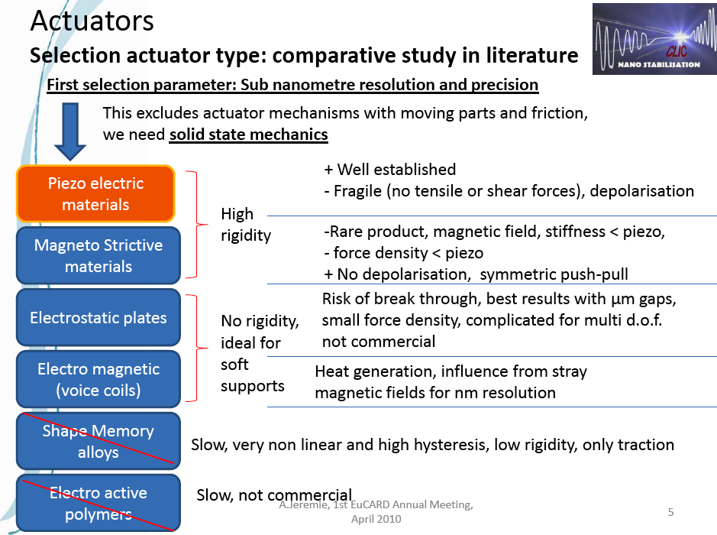
A.Jeremie, C.collette, K.Artoos

Slide 26
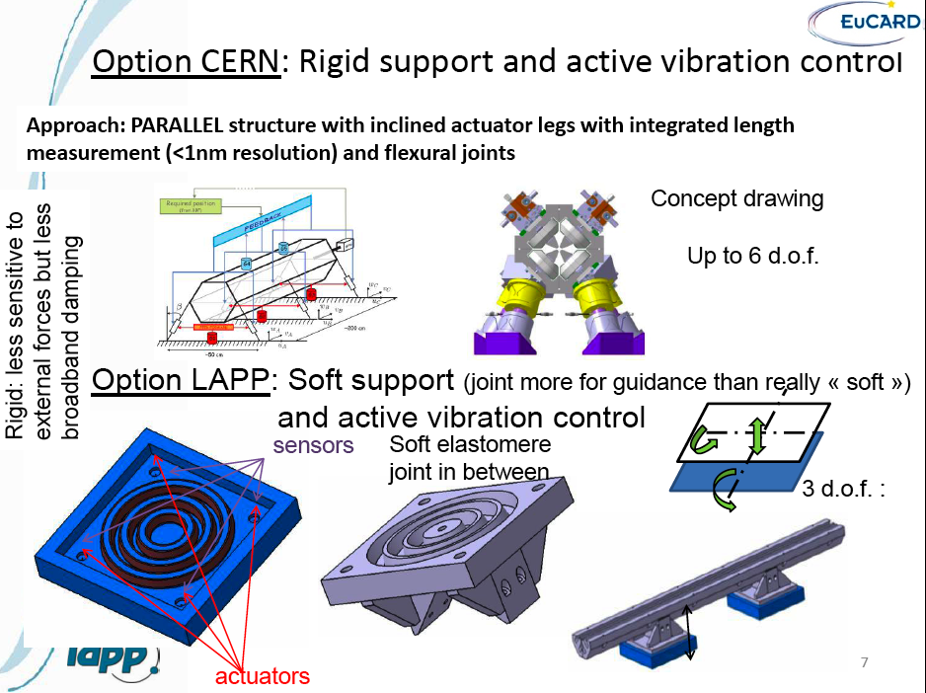

Slide 27
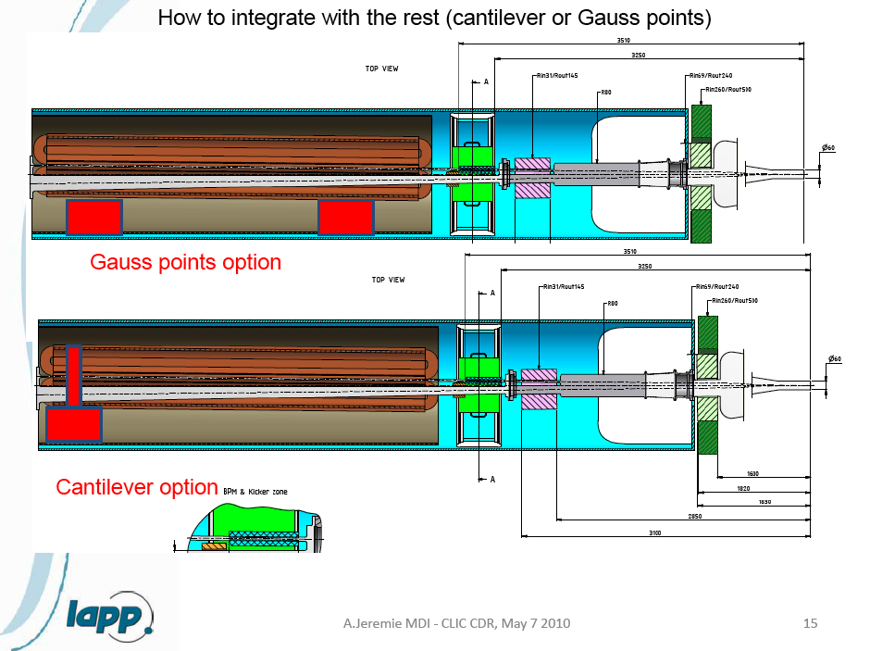

Slide 28
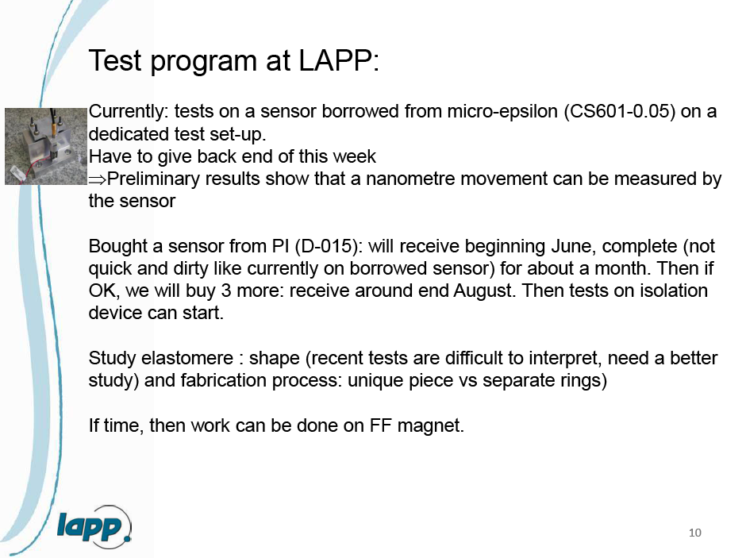

Slide 29
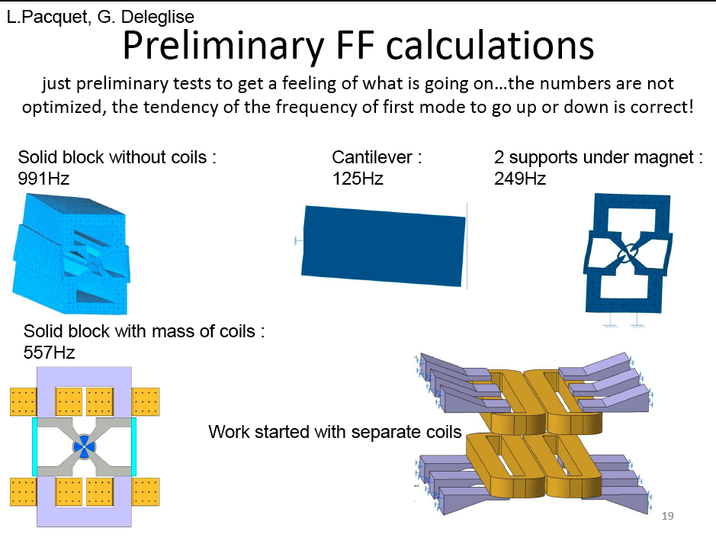

Slide 30
Pre-isolator – How does it work?
A.Gaddi, 7 May 2010
Low dynamic
stiffness mount
natural frequency around 1 Hz
Acts as a low-pass filter
for the ground motion (w)
+
Large mass
50 to 200 tons
Provides the inertia necessary to withstand the external disturbances (F_{a}), such as air flow, acoustic pressure, etc.)

Slide 31
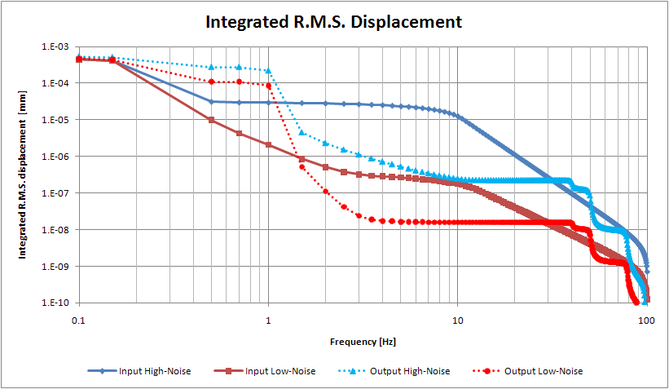
RMS vertical displacement reduced by a factor >10 from 4 Hz.
plots by F. Ramos

Slide 32
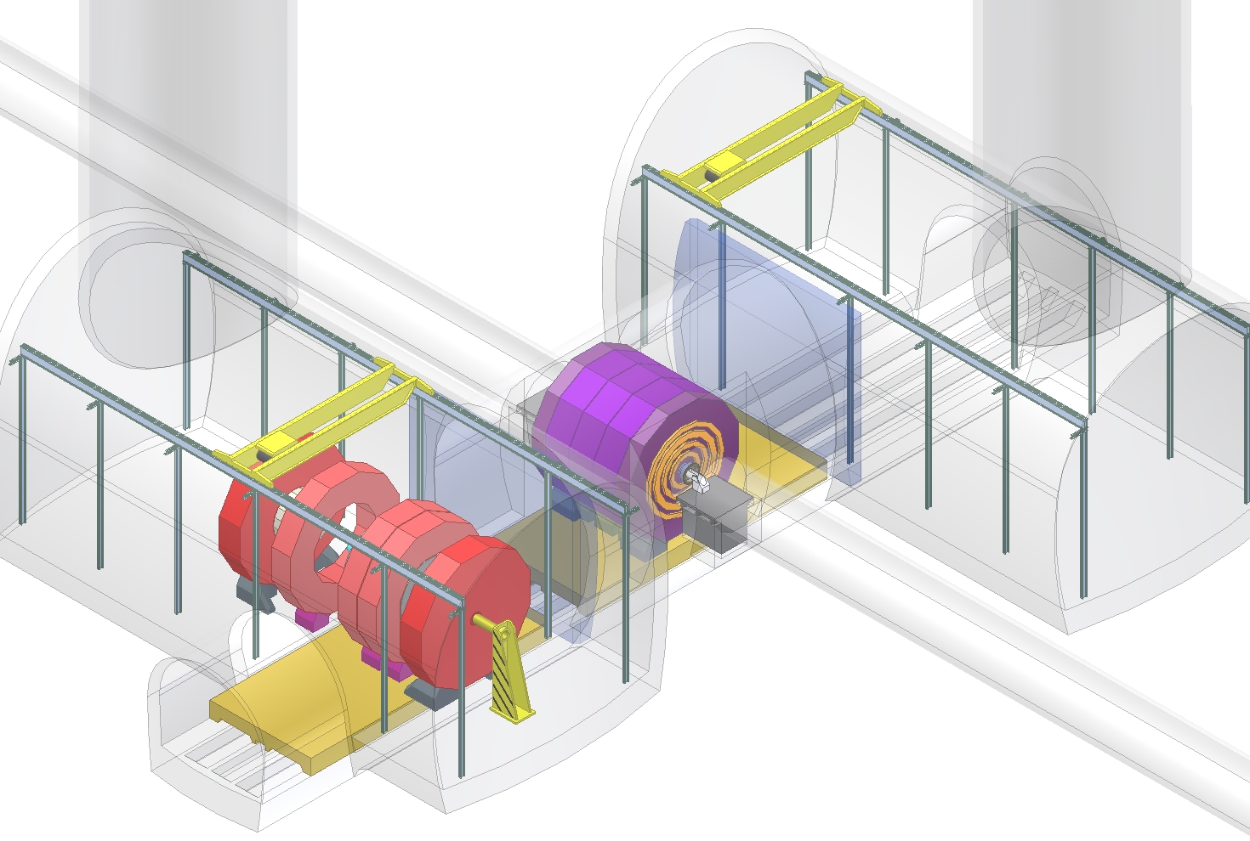
Where does it fit ?
H.Gerwig,A.Gaddi, N.Siegrist
Ideally located at the end of the machine tunnel,
just in front of the detector, on both sides.
drawing by N. Siegrist

Slide 33
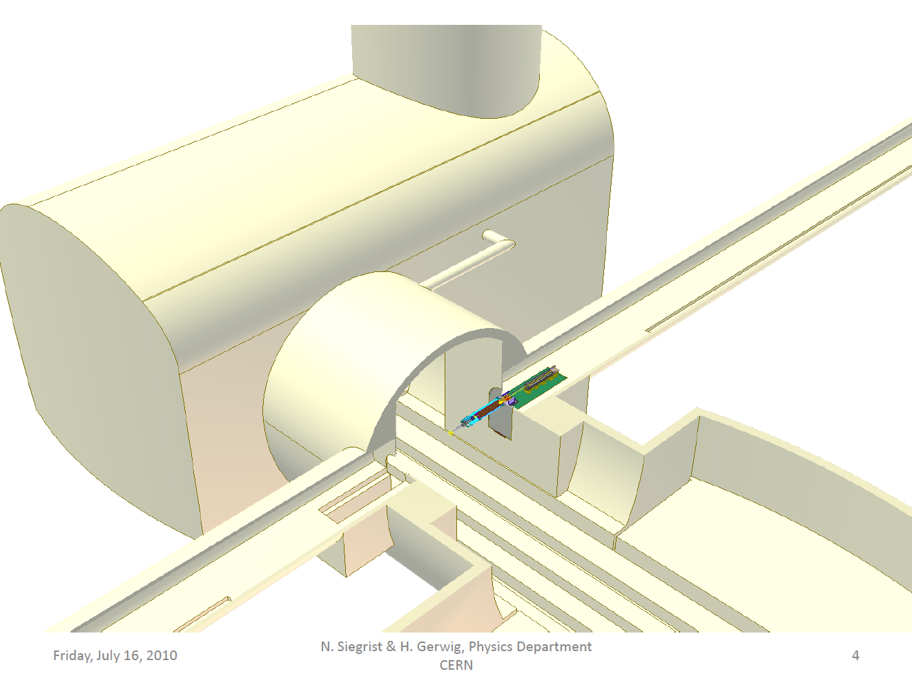
H.Gerwig, N.Siegrist

Slide 34
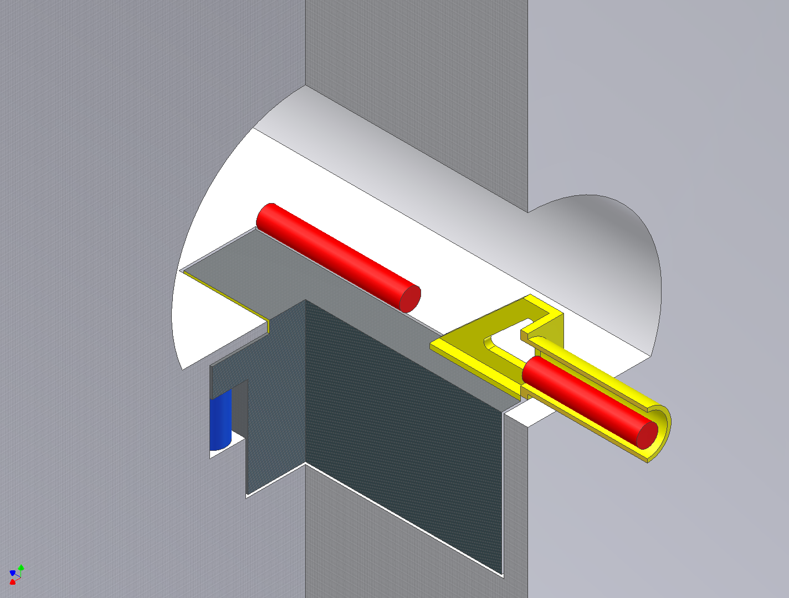
How can it be realized ?
A.Gaddi
QF1
Walk-on-floor
QD0
QD0 support tube
Mass
Elastic
support
conceptual design

Slide 35
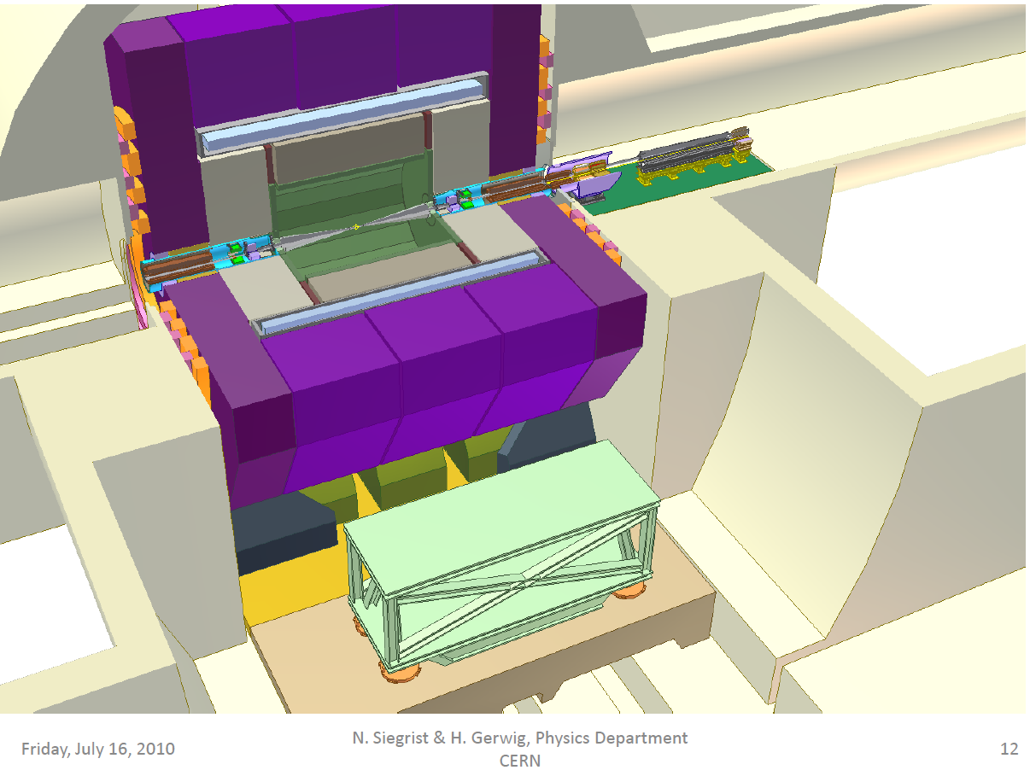
H.Gerwig, N.Siegrist

Slide 36
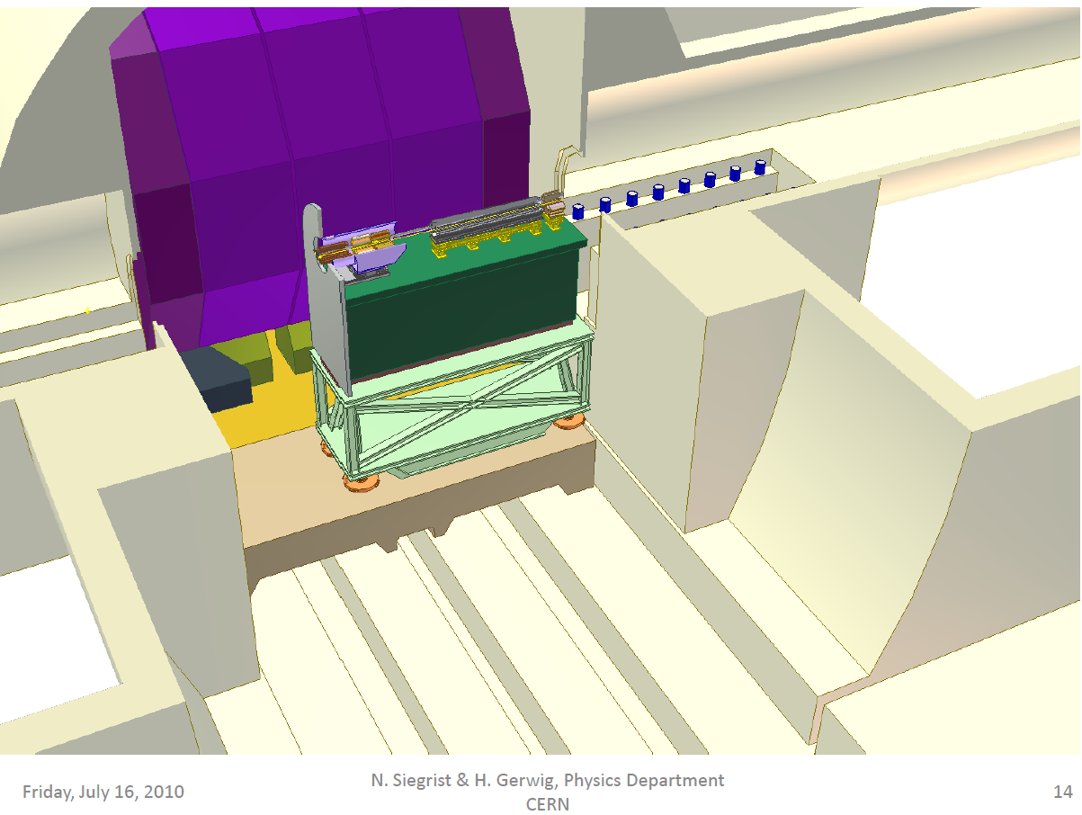
H.Gerwig, N.Siegrist

Slide 37
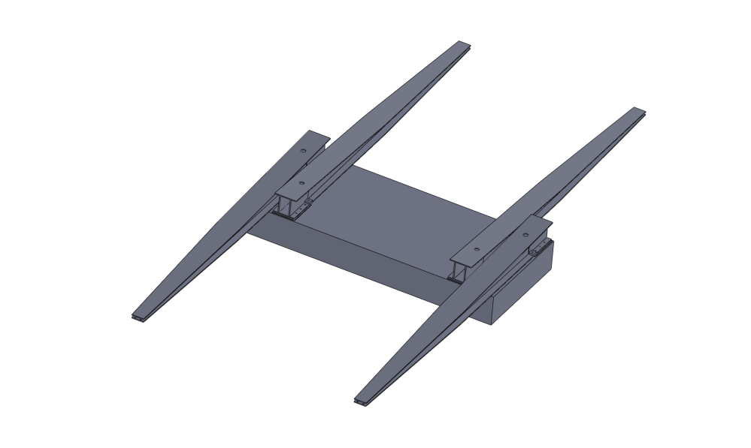
Experimental set-up – How ?
Small scale prototype test proposed:
The prototype needs to be:
Simple to design/build/assemble
Easy to “debug” & tune
Cheap
Displacement @Pre-isolator
Proposal:
40 ton mass supported by
4 structural beams acting as flexural springs

Slide 38
Only if unsuccessful: consider larger L*
In the past some studies were made for L* = 8 m, however not fully optimised
If L* = 8 m: QD0 would be in the tunnel, i.e. have a much more stable support (in principle)
But some heavy prices to pay (Luminosity, prealignment, …)
Would prefer intermediate value (e.g. 6 m)?
Parameters | L* = 3.5 m | L* = 8 m
Luminosity | L_{o} | 0.72 L_{o}
QD0 support | Detector | Ground
QD0 gradient | 575 T/m | 323 T/m
QD0 grad tolerances | 5 10⁻⁶ | 3 10⁻⁶
Final focus length | 400 m | 800 m
QD0 length | 2.73 m | 4.2 m
QD0 aperture radius | 3.8 mm | 6 mm
QD0 jitter | 0.15 nm | 0.18 nm
Prealignment | 10 μm | 2 μm
From Rogelio Tomas

Slide 39
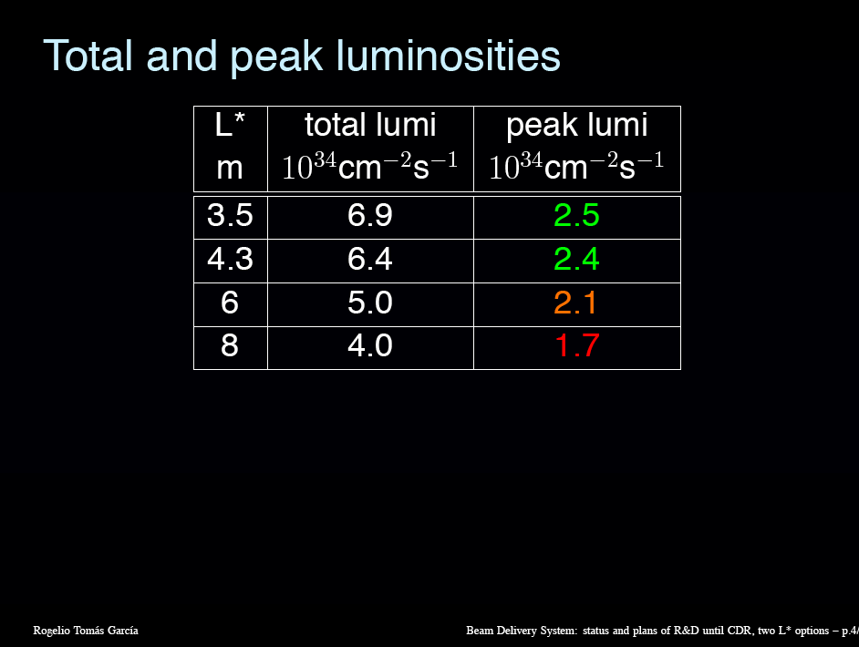

Slide 40
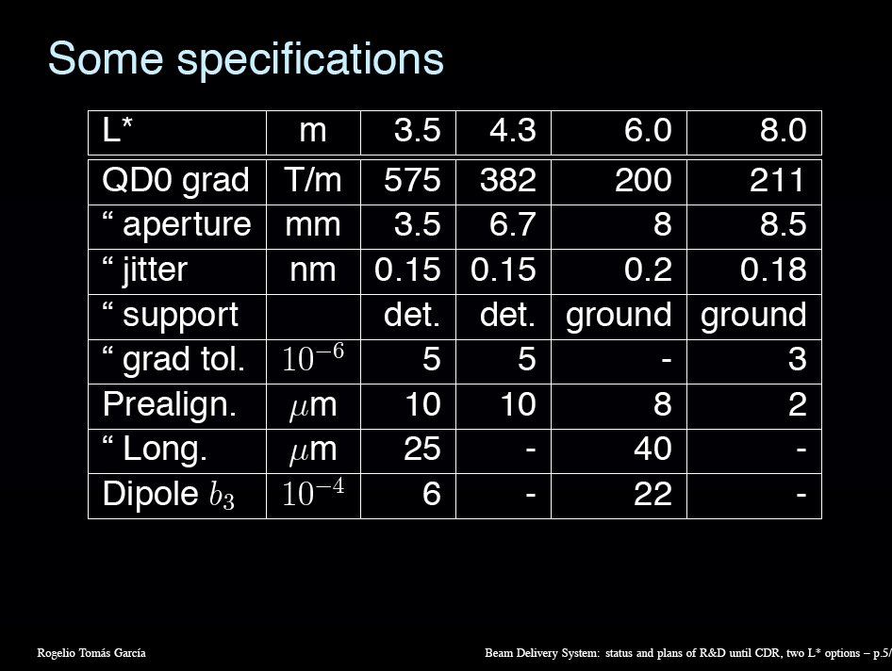
Lengths of QD0, what if split into 2 or more magnets?

Slide 41
Present choice of L*
For the CDR we concentrate of the SiD-like detector with L*=3.8 m
- most of the work so far has been done on L*=3.5 m (close to 3.8 m) BDS, QD0, ….
- L* = 3.8 m gives the higher luminosity (compared to 4.6 or even 6, resp 8 m)
The L*=4.6 m for the ILD like detector is not discarded, however.
An alternative solution with QD0 installed in the tunnel will be considered as well.
The expected L* will be around L* = 6 m, assuming we shorten the end-caps.
This will ease the stabilisation, but has an impact on the luminosity and
on the pre-alignment tolerance.
Latest studies have lead to a situation where the negative impact, in paticular
on the pre-alignment has been reduced significantly
L* = 6 m has become a plausible fallback solution

Slide 42
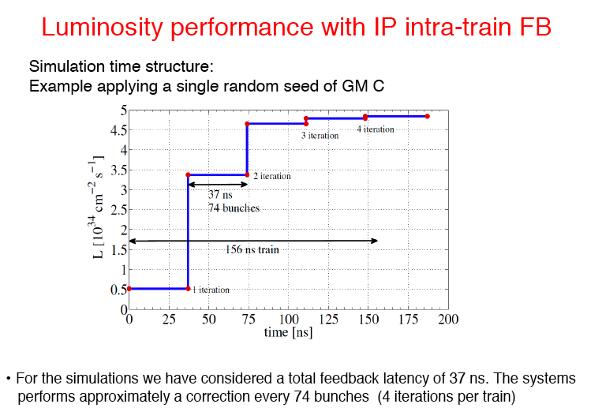

Slide 43
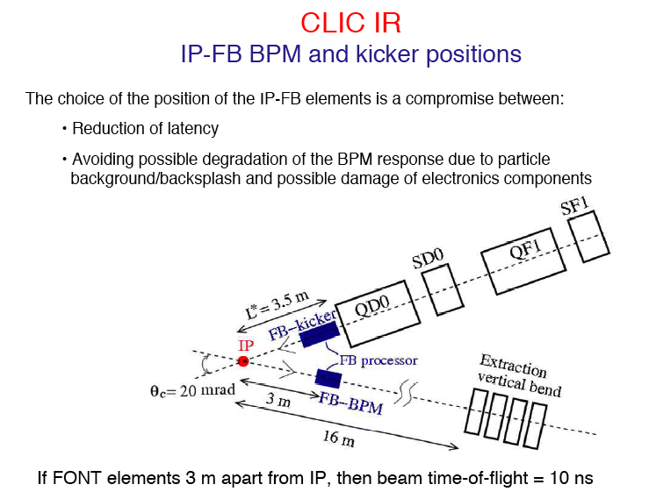
PRELIMINARY

Slide 44
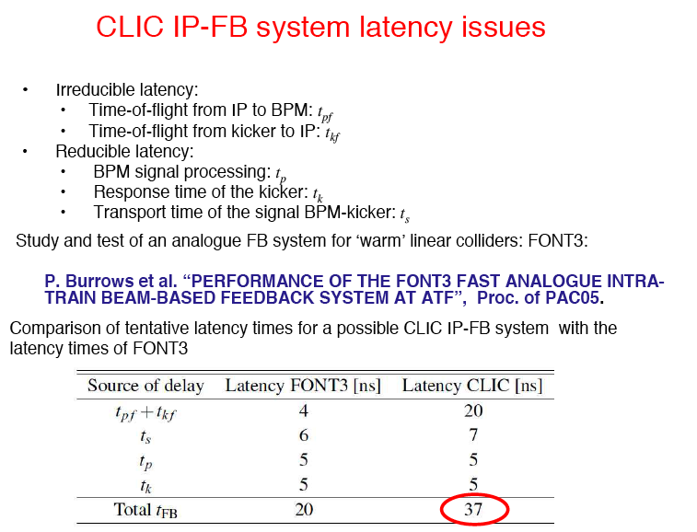
P.Burrows, J.Resta-Lopez
PRELIMINARY

Slide 45
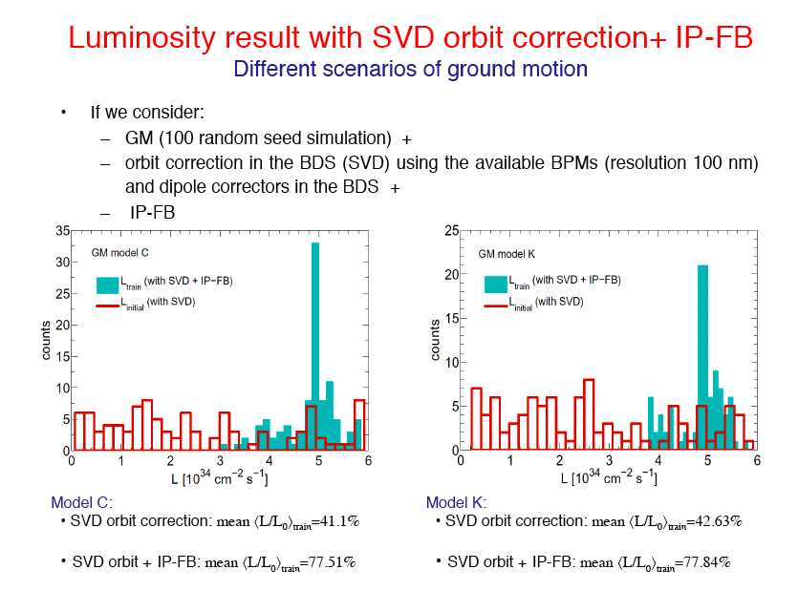
EXAMPLE:

Slide 46
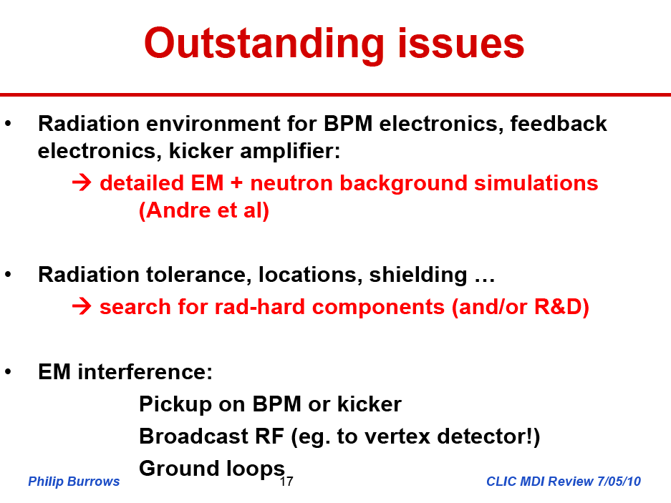

Slide 47
Overall integrated simulations of luminosity stability
The overall strategy of mechanical isolation and stabilisation combined with a number of
beam-based feedbacks and feed-forwards, both in the linac, BDS and final focus region
must be validated by an integrated simulation.
This simulation is done by Daniel Schulte with in put from all parties concerned.
The MDI input concerns the QD0 magnet vibration modes, the support structures, the
pre-isolation system ,the pre-alignment system, QD0 stabilisation and IP feedback.
Depending on the performance, the feedback controller must be programmed.
First results of such a simulation, based on preliminary and approximate inputs, was presented
by Daniel in the January MDI meeting. The results (see next slide) look promising.
Now an effort is being organised by Hermann to get more up-to-date inputs for the
simulation, hopefully in time for the CDR. MDI will try to review its inputs for this.

Slide 48
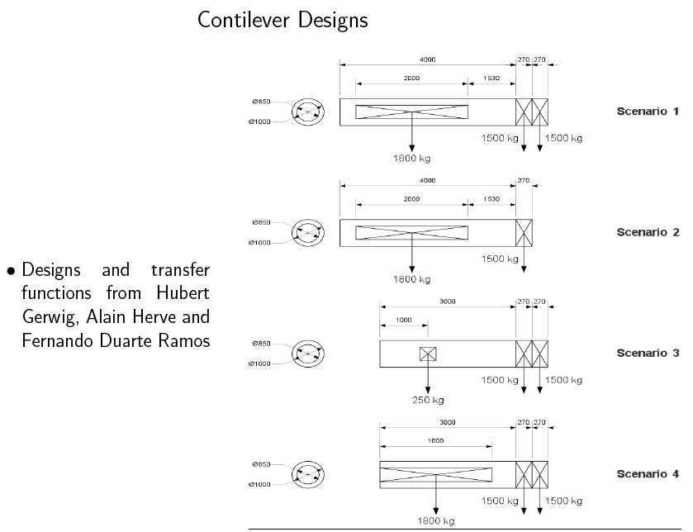

Slide 49
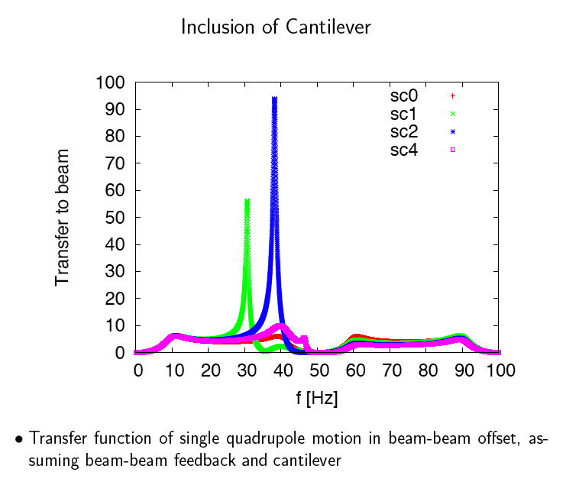

Slide 50
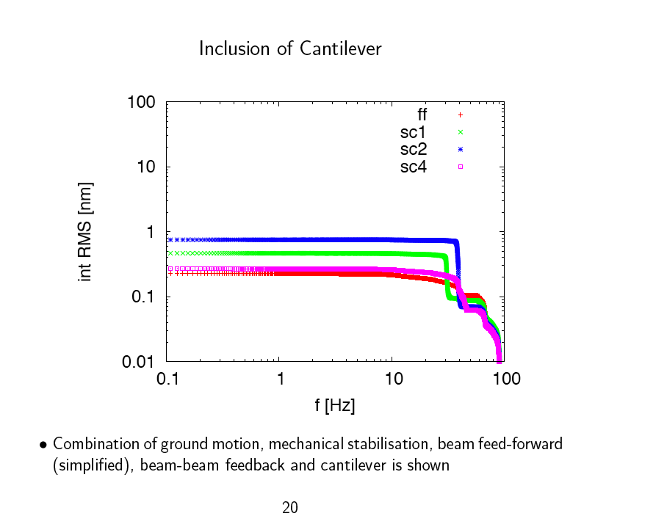
Daniel Schulte, Jan.2010
With preliminary assumptions
Presented in January 2010

Slide 51
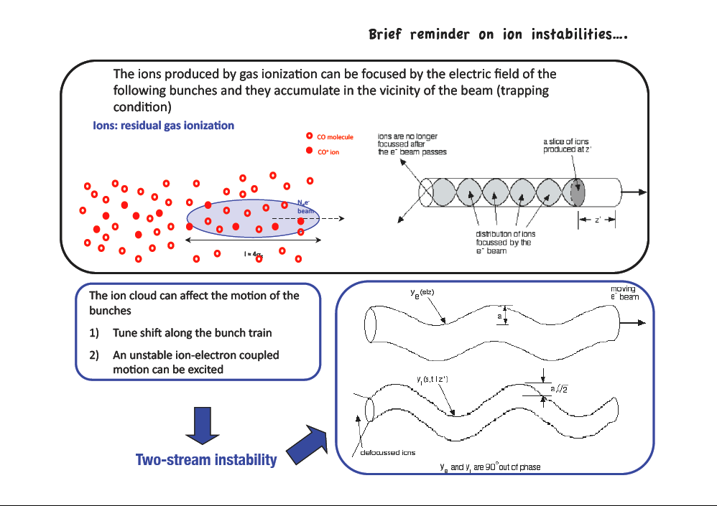
G.Rumolo, March 2010
Vacuum requirements

Slide 52
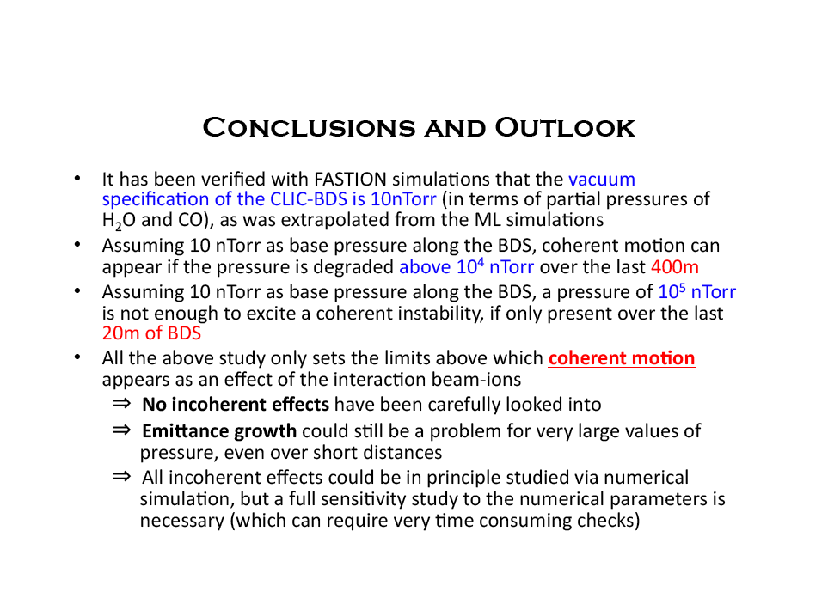
G.Rumolo, March 2010
VACUUM:

Slide 53
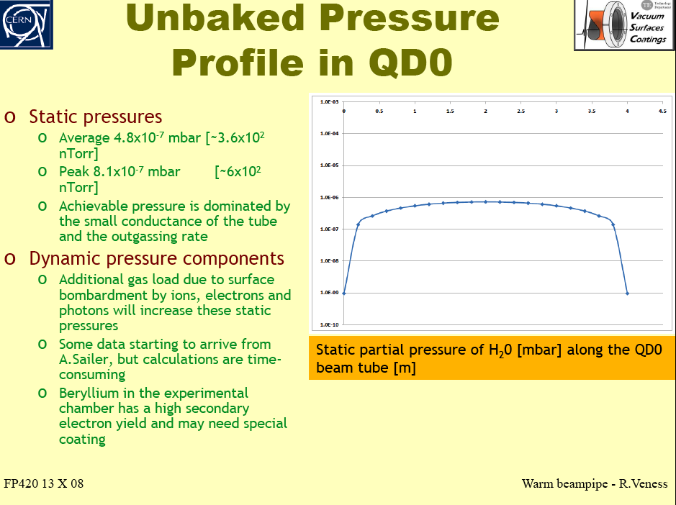

Slide 54
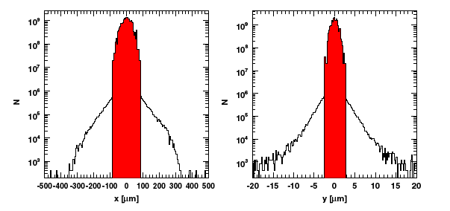
Courtesy: H.Burkhardt
A potential problem for CLIC: Muons from beam halo
Beam tails are scraped away by a collimation system in the BDS.
Below we show simulated profiles of the beam at the BDS entrance (core of beam in red)
From I.Agapov et al,
2009, to be published

Slide 55
SCRAPERS
(Magnetic Collimators)
B
Magnetic force
Have to get polarity right….

Slide 56
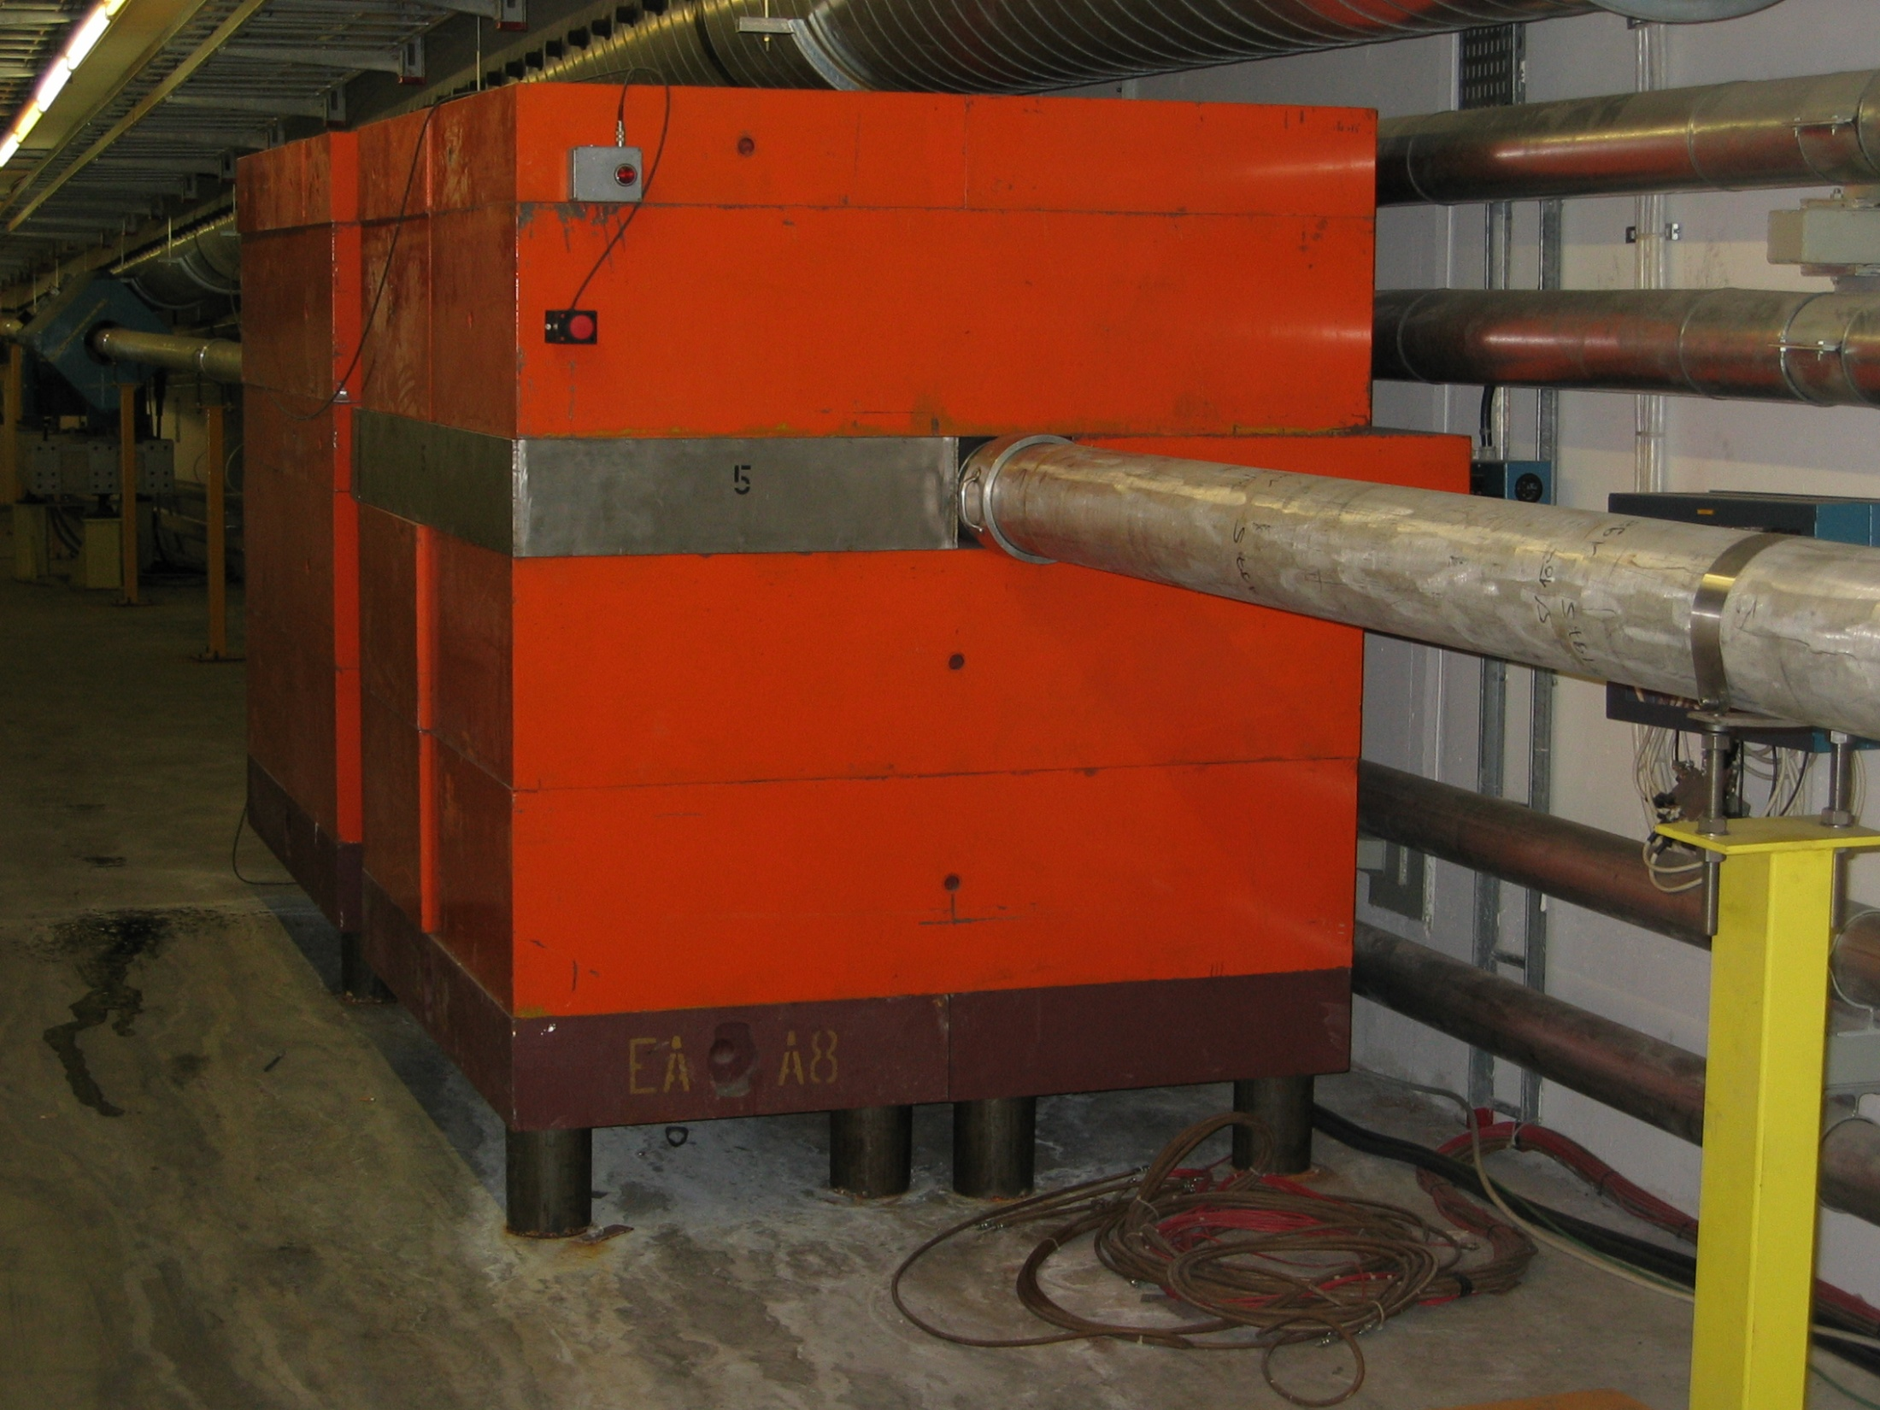
MIB = Magnetised Iron Block

Slide 57

The size of the Halo problem in M2 beam
Simulations based on the
HALO program by C.Iselin
(1974)
Flux (arbitrary units)
‘Good’ muons
Halo after π absorber
Halo after μ momentum
selection
Note: Halo / ‘Good’ μ ≈ 6
P (GeV/c)

Slide 58


Muons vs Halo in M2
Muons within 10 cm
Muons with r ∈ [10,200] cm
Muon flux (arb.units)
P (GeV/c)
P (GeV/c)
i.e. Halo (R=2 m) / Muons (R = 10 cm) ~ 5%,
i.e. Halo/Muons in same surface ~ 1.3 10⁻⁴
Excellent agreement
With data!
Gain > factor 100

Slide 59
Introduction.
A.Gaddi, H.Gerwig, A.Hervé, N.Siegrist, F.Ramos
New ideas for cavern layout:
The push-pull scenario and the coexistence of two detectors in the same experimental area sets some specific requirements to the civil engineering and to the design of underground infrastructures.
The most basic one being a fair sharing of the underground facilities between the two detectors → symmetric layout.
Then the possibility to move the detector form garage to beam in the fastest and safest way → detector platform, cable-chains.
Third, to guarantee, by an appropriate design, that the personnel safety is always assured → shielding of beam-area.
The detector assembly scenario plays a fundamental role in the design of the underground facilities → crane capacity, assembly space.
Finally, contribute to reduce the noise injected to the machine final focus magnets → integrate a passive isolator at the interface between machine and detector.

Slide 60


Slide 61


Slide 62


Slide 63


Slide 64
SUMMARY AND OUTLOOK
Over the last year we have made significant progress in the
design of the QD0 magnet and in its integration, including
the infrastructure and concepts for alignment and stabilisation
The next step is a full simulation of the expected performance
of stabilisation combined with the other feedbacks, as shown
but with the latest parameters
A prototype (short) QD0 magnet will be constructed and allow tests
in terms of field quality and mechanical behaviour.
Also a small prototype of a pre-isolator will be tested soon.
A MDI internal review has taken place on May 7th with 15 presentations.
Slides are all available on Indico.
Now we are preparing for writing the CDR chapter and estimating cost.
Soon we have to start thinking about the TDR.

