Slide 1

Test results of MCBXFBP2b
Salvador Ferradás, Jerome Feuvrier, Jean-Luc Guyon, Franco Mangiarotti, Juan Carlos Pérez, Guillaume Pichon, Gerard Willering
Test plan: EDMS #2466864
WP3 Meeting – 03 March 2021
https://indico.cern.ch/event/1012233/

Slide 2
Contents
Connection scheme
HV Tests
Protection scheme
Thermal transients
Cold powering
Conclusions

Slide 3
0. Intro
MCBXFBP2b vs 2a:
Inner and outer dipoles were recollared
  Ref: Coil geometry and shimming.
Inner dipole has instrumented collars
Targeted azimuthal pre-stress ~20 MPa higher at cold for both inner and outer dipoles:
  Ref: Mechanical measurements of MCBXFBP2b
The inner dipole was installed rotated 180 degrees.

Slide 4
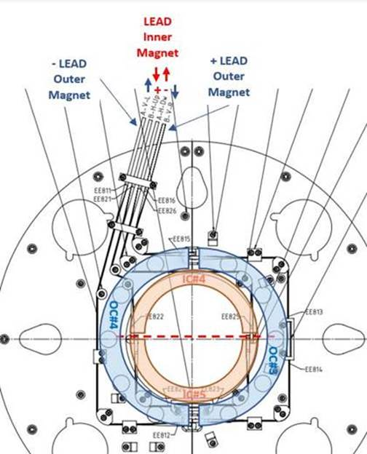
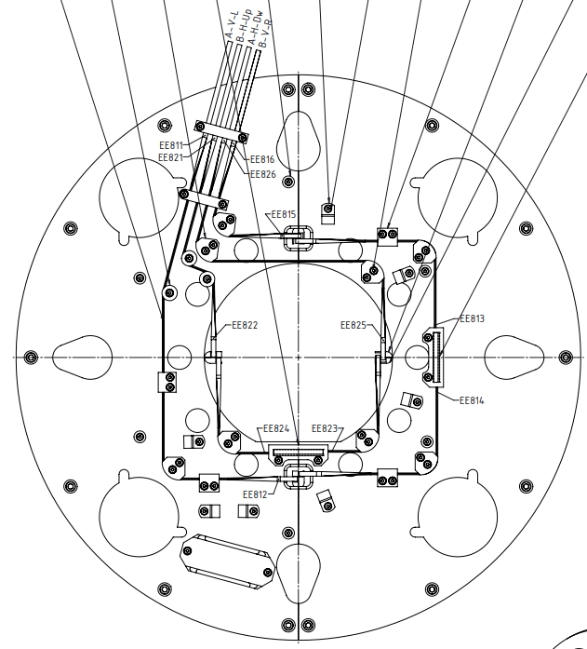
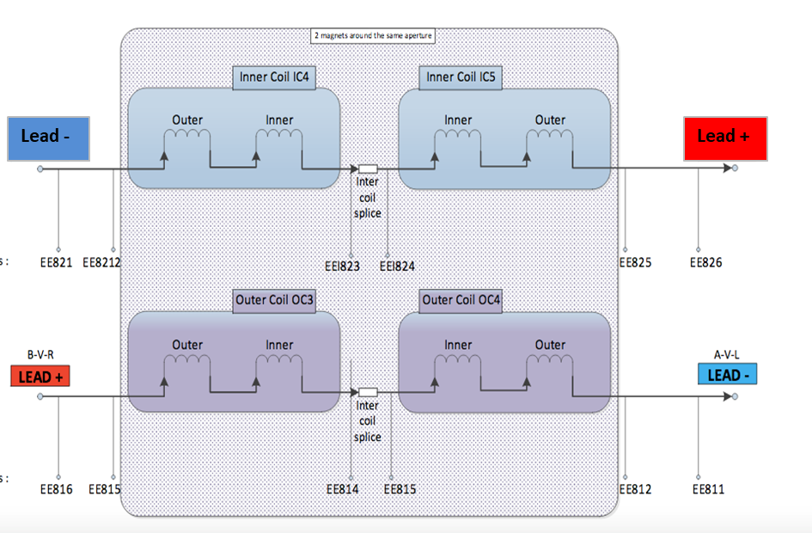
1. Connection scheme
MCBXFBP2a
EDMS 2413181
LEAD
Inner
Magnet
MCBXFBP2b
EDMS 2475766
- LEAD
Outer
Magnet
+ LEAD
Outer
Magnet
+
-
IC#4
OC#3
OC#4
IC#5

Slide 5
2. Electrical insulation test (I/II)
@Reception
SM18 Hall
293 K, Air
@Cryostat
Cluster D
293 K, Air
CD1 Before test
@Cryostat, Cluster D
4.5 K, He
CD1 Before test
Circuit | V [kV] | Time [s] | Resistance [GΩ]
Inner – GND | 0.4 | 60 | 379
Outer – GND | 0.4 | 60 | 373
Circuit | V [kV] | Time [s] | Resistance [GΩ]
Inner – GND | 1 | 60 | 34
Outer – GND | 1 | 60 | 25
Circuit | V [kV] | Time [s] | Resistance [GΩ]
Inner – GND | 0.4 | 60 | 378
Outer – GND | 0.4 | 60 | 398
MCBXFBP2b
MIT515
Voltage: 5 kV (+4%, -0%, ±10 V nominal test voltage at 1 GΩ load (0°C to 30°C)
Current: ±5% ±0.2 nA at all voltages (20 °C) [1].
[1] MIT515; 5 kV d.c. Insulation Resistance Testers; https://us.megger.com/5-kv-insulation-resistance-tester-mit525#technical

Slide 6
Electrical insulation test (II/II)
@Cryostat
Cluster D
293 K, Air
After test
@Cryostat
Cluster D
4.5 K, He
CD1 After test
Circuit | V [kV] | Time [s] | Resistance [GΩ]
Inner – GND | 1 | 60 | 63
Outer – GND | 1 | 60 | 34
Circuit | V [kV] | Time [s] | Resistance [GΩ]
Inner – GND | 0.4 | 60 | >500
Outer – GND | 0.4 | 60 | 341
MCBXFBP2b
MIT515
Voltage: 5 kV (+4%, -0%, ±10 V nominal test voltage at 1 GΩ load (0°C to 30°C)
Current: ±5% ±0.2 nA at all voltages (20 °C) [1].
[1] MIT515; 5 kV d.c. Insulation Resistance Testers; https://us.megger.com/5-kv-insulation-resistance-tester-mit525#technical

Slide 7
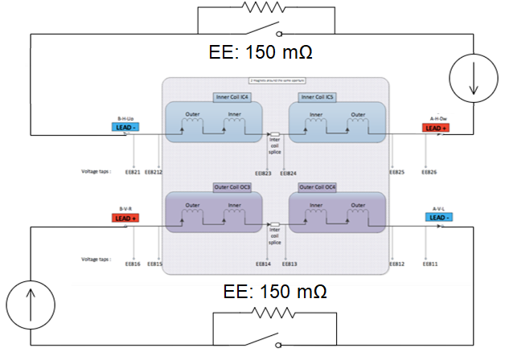
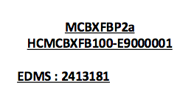
3. Protection scheme
Two quench detection systems:
  uQDS: Inductive cancellation of the total magnet voltage & diff signals
  PotAim cards (DAQ): Diff signals
2 kA PC 2
2 kA PC 1

Slide 8
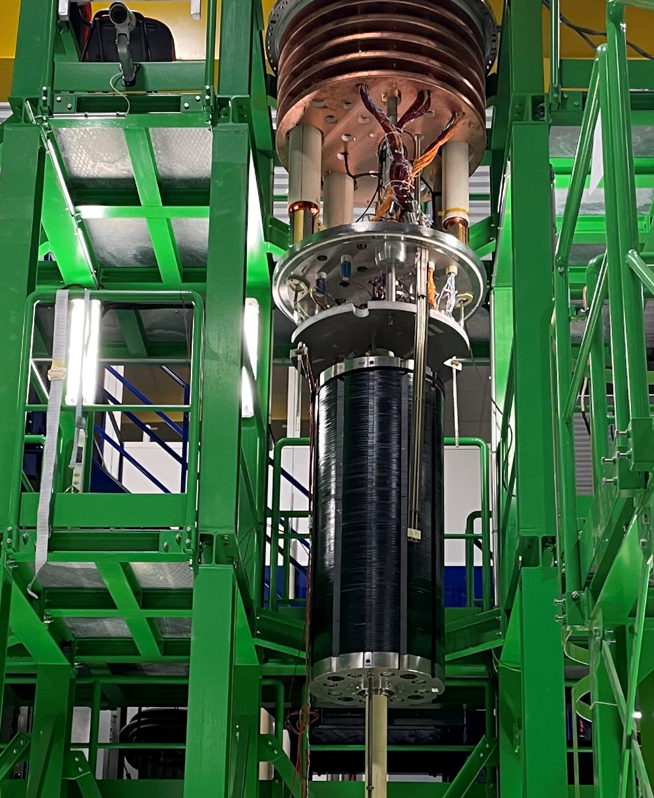
4. Cooldown 1
Warmup 1
Up A
Up
Middle
Down A
Down
Disclaimer: Approximate sensor positioning

Slide 9
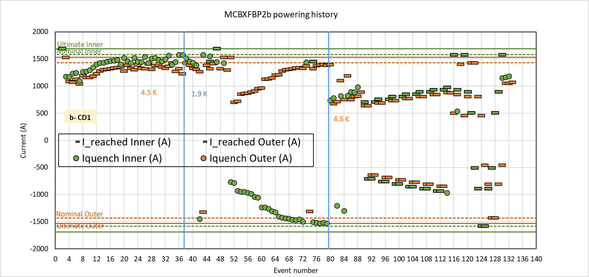
5. Summary of events
MCBXFBP2b:
Reached ultimate in both circuits, standalone
132 Events
Reached 99.9% + nominal torque. Proved unstable at high currents. Might point to a slightly decrease in performance
Reached 94.4% of -nominal torque
MCBXFBP2a:
Reached ultimate in both circuits standalone
Reached 1980 A Inner circuit stand alone
280 Events
Reached nominal + torque
Reached 97% of -nominal torque
 | Training quenches
 | IC4 | IC5 | OC3
 | 9 (10%) | 76 (90%) | 0
Total | 85
 | Training quenches
 | IC4 | IC5 | OC3
 | 91 (51%) | 83 (47%) | 4 (2%)
Total | 177

Slide 10
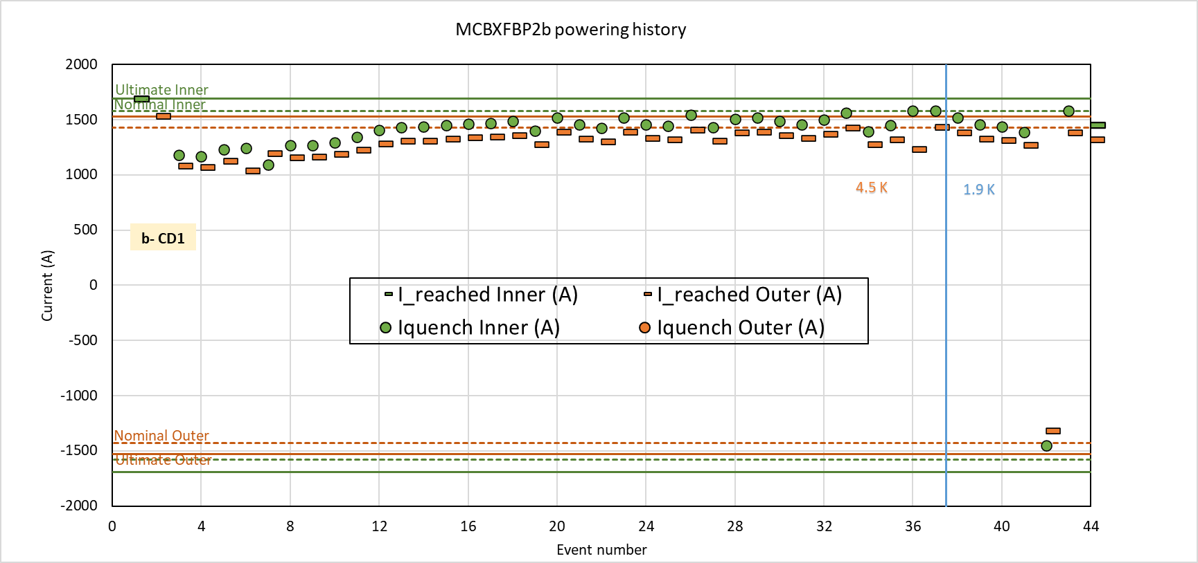
Training Q1 (from event 0)
MCBXFBP2b:
35 quenches to 99.9%
After 41 quenches nominal was not attained yet
 | Training quenches
 | IC4 | IC5 | OC3
Total 35 | 3 (8%) | 32 (92%) | 0
MCBXFBP2a:
32 quenches to nominal
 | Training quenches
 | IC4 | IC5 | OC3
Total 32 | 20 (62%) | 11 (34%) | 1 (2%)

Slide 11
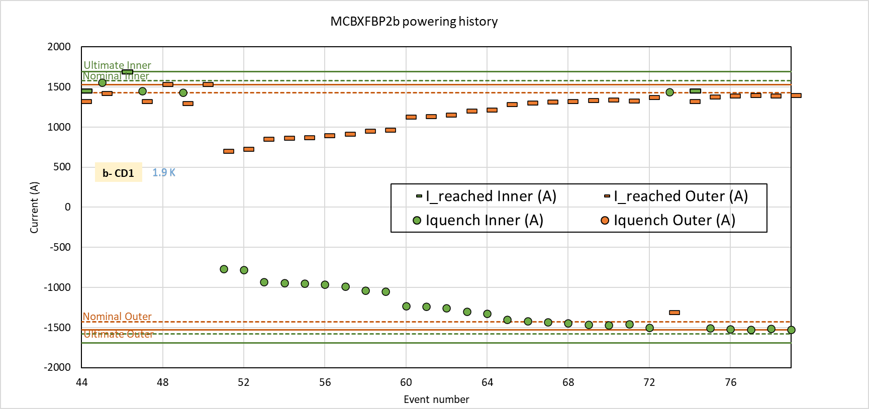
Training Q2 right after
MCBXFBP2b:
28 quenches
First quench at 23% of nominal torque
Reached 94% of nominal torque
Magnetic measurements
 | Training quenches
 | IC4 | IC5 | OC3
 | 4 (14%) | 24 (86%) | 0
MCBXFBP2a:
31 quenches
First quench at 23% of nominal torque
Reached 94% of nominal torque
 | Training quenches
 | IC4 | IC5 | OC3
 | 11 (36%) | 18 (58%) | 2 (6%)

Slide 12
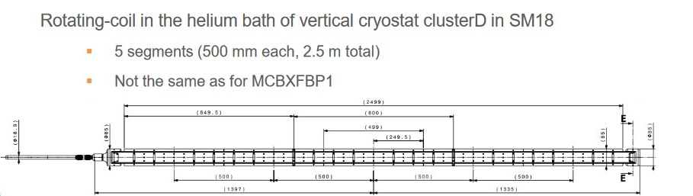
QA
The magnetic measurement shaft is installed as a quench antenna. There are 5 segments of 500 mm. Segment 3 should be centered with the magnet. Segment 1 and 5 stick out of the magnet. We use 2,3 and 4 to distinguish towards which coil end the quench happened.

Slide 13
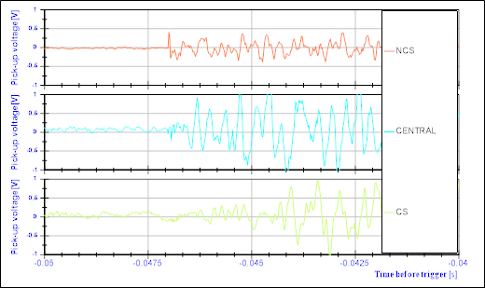
Note on quench localization
Case 1:
Clear onset on the NCS pick-up coil
The gain is under investigation, and the amplitude of the orange signal
Quench at 56% of nominal torque. Event na006.

Slide 14
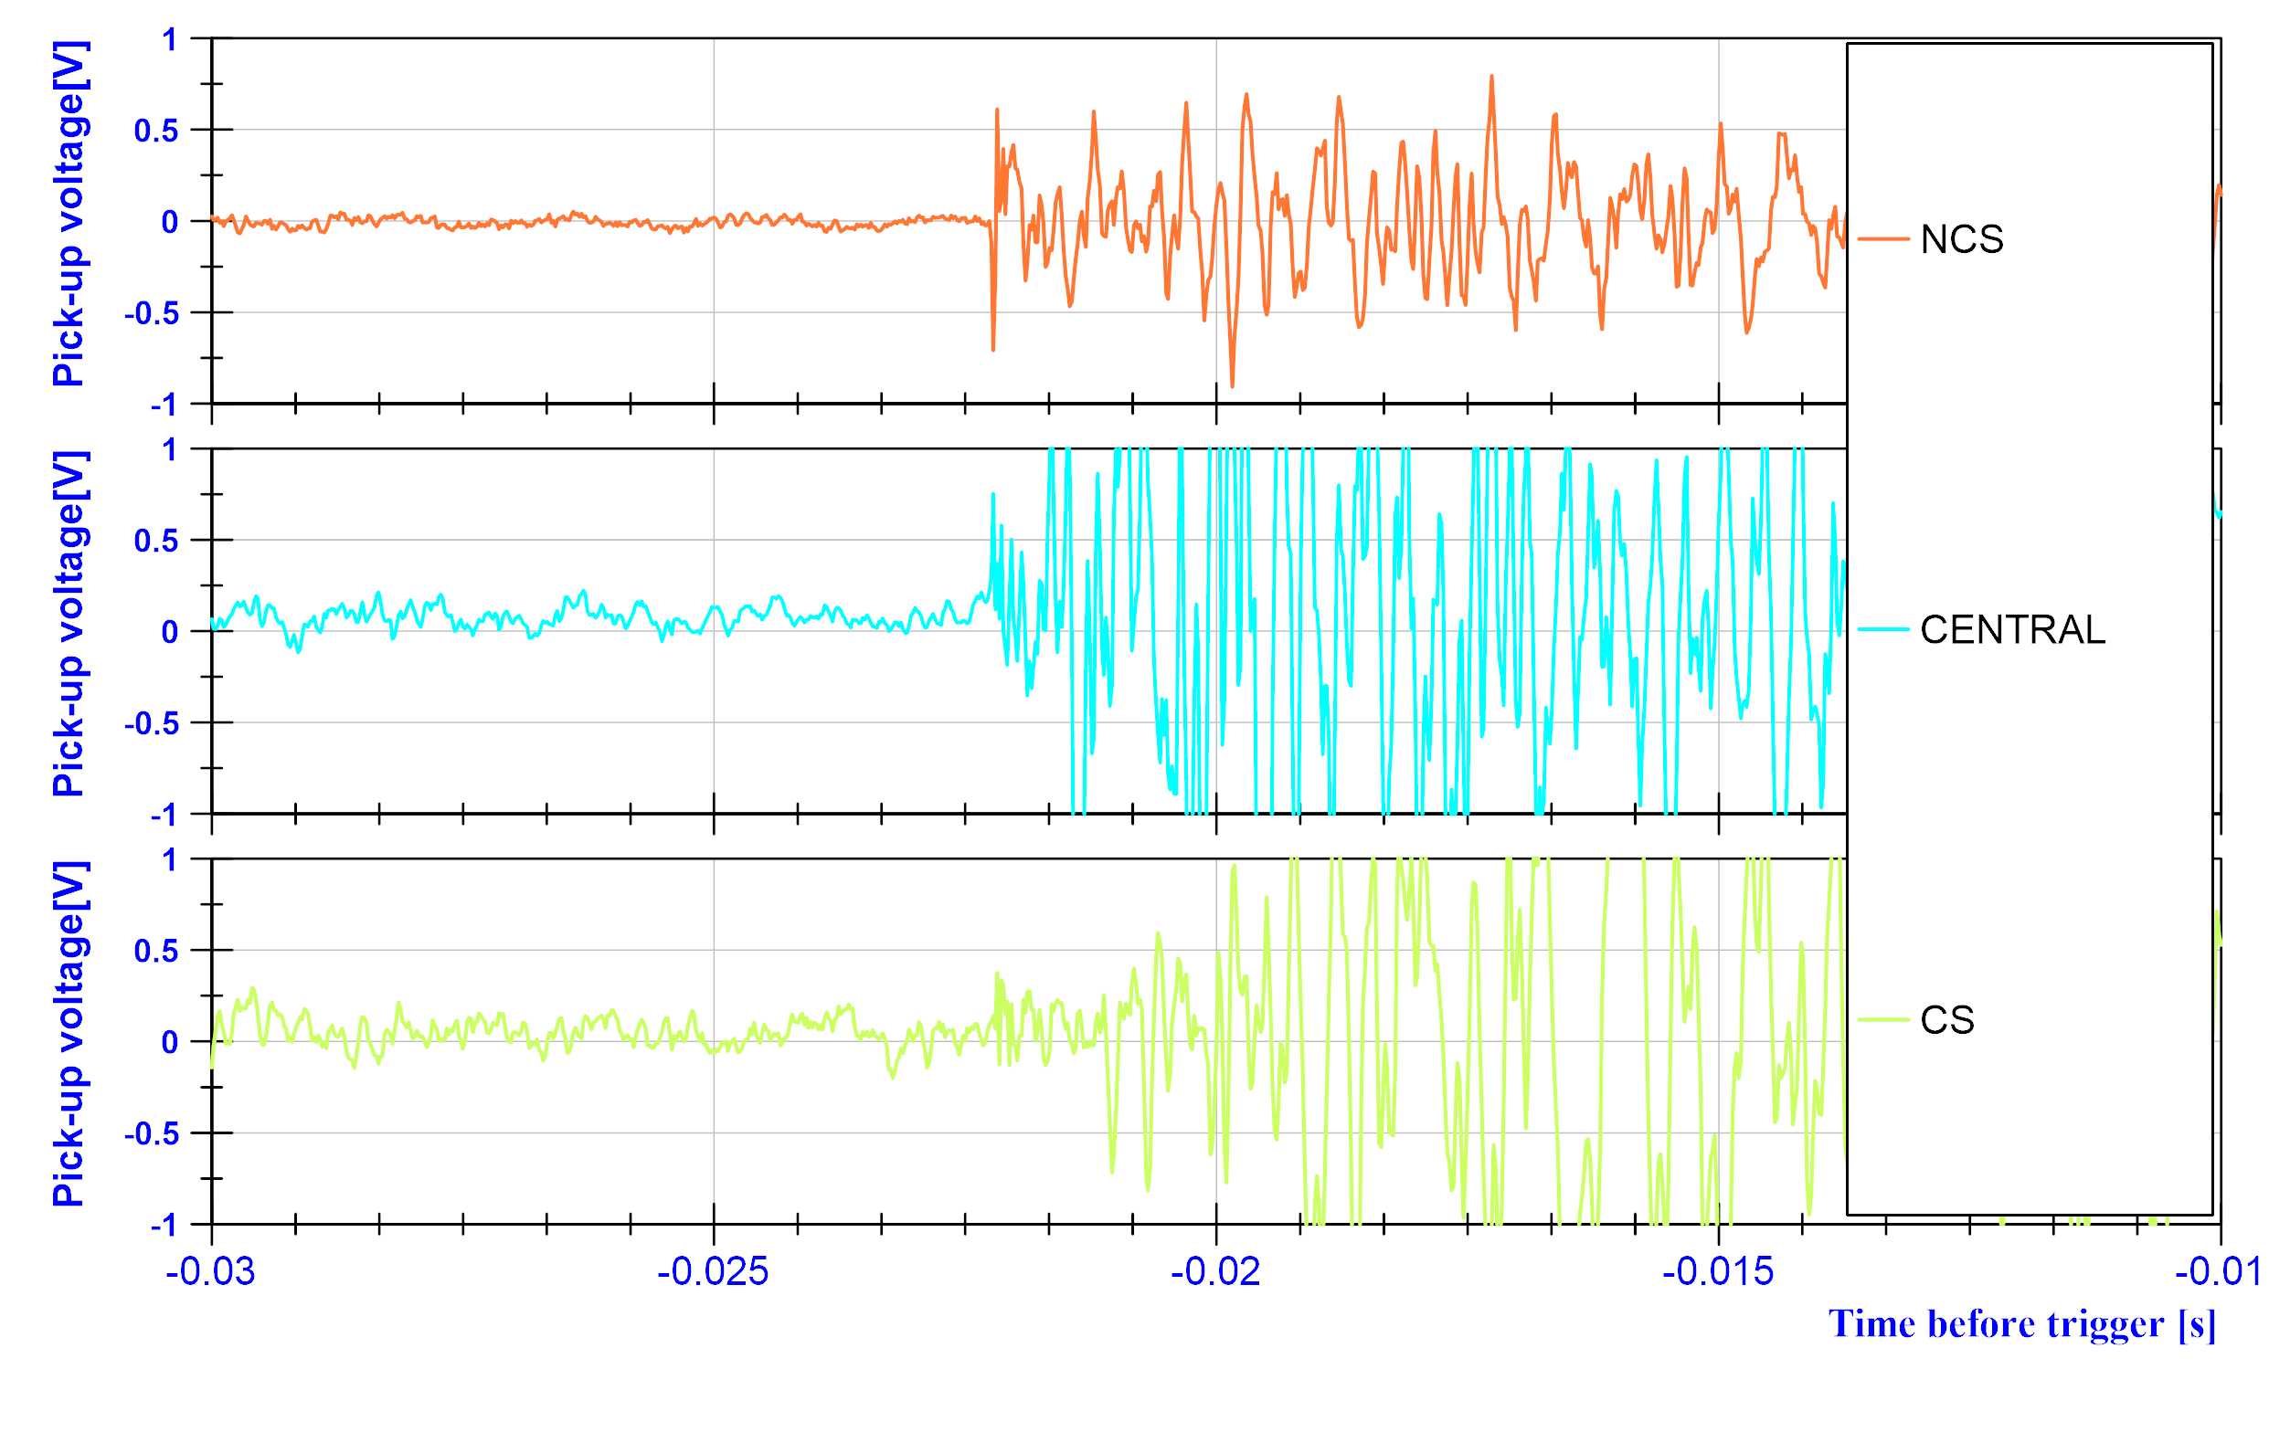
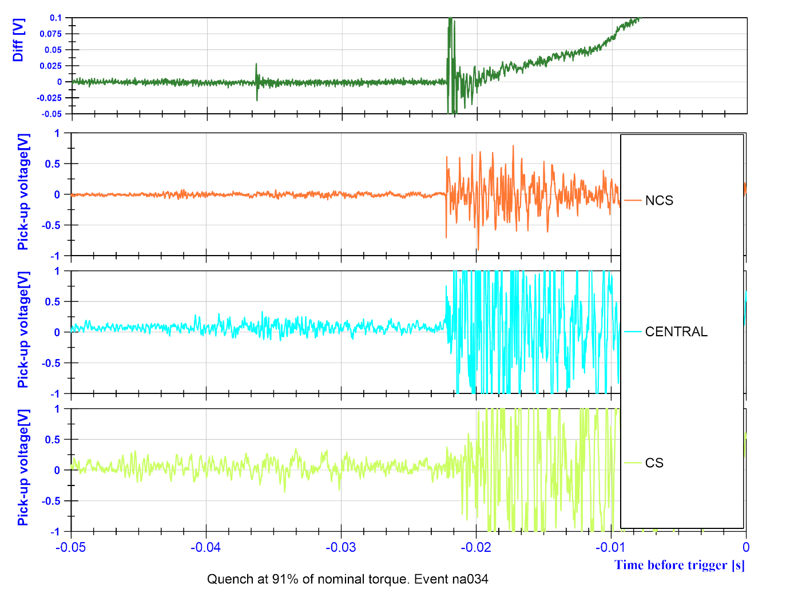
Note on quench localization
Quench at 91% of nominal torque. Event na034.
Case 1:
Clear onset on the NCS pick-up coil
The gain is under investigation, and the amplitude of the orange signal
As the current increases, central segment of the QA approaches in time to the onset of the NCS segment.

Slide 15
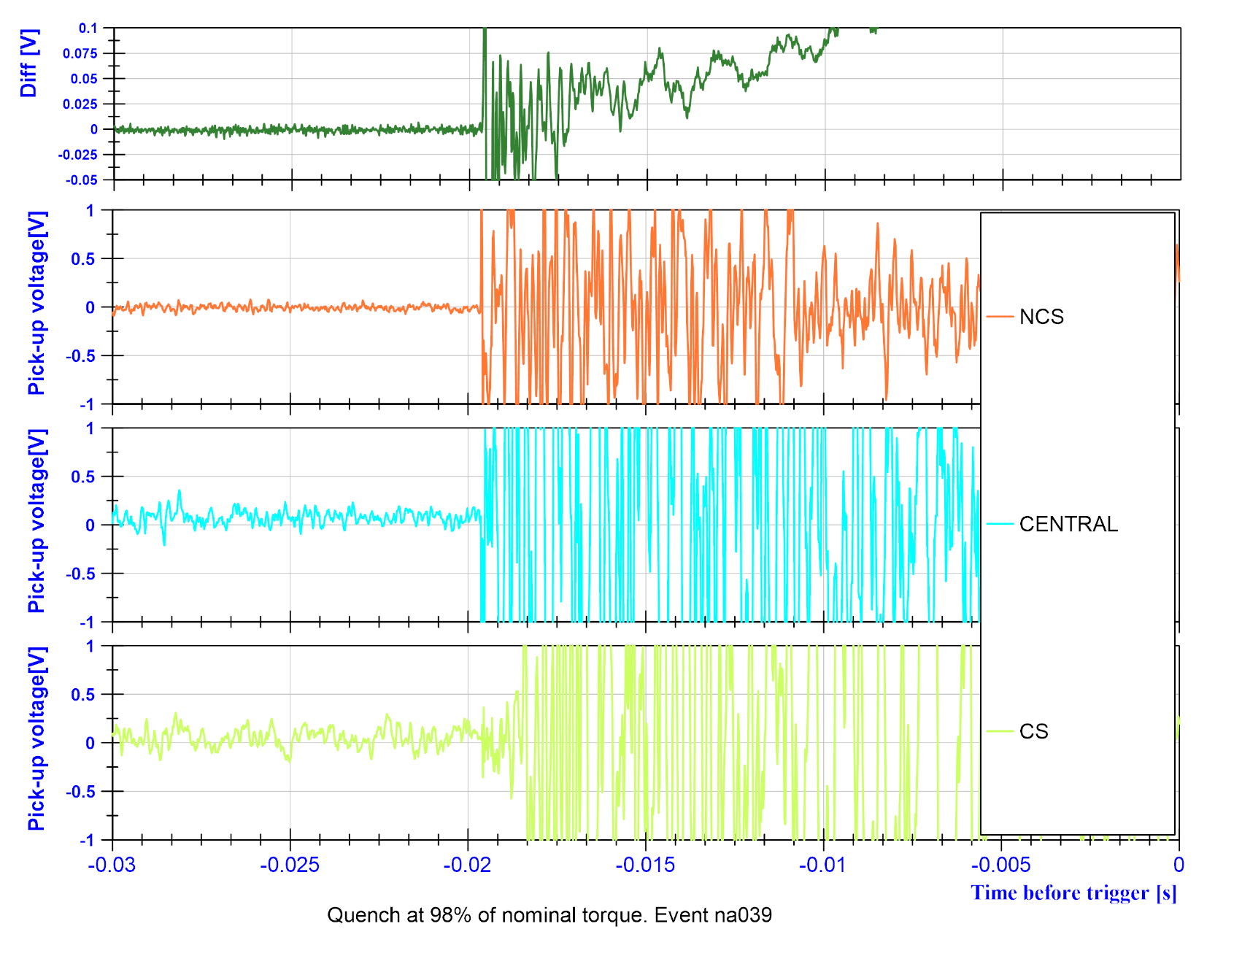
Note on quench localization
Case 1 high current:
Undistinguishable

Slide 16
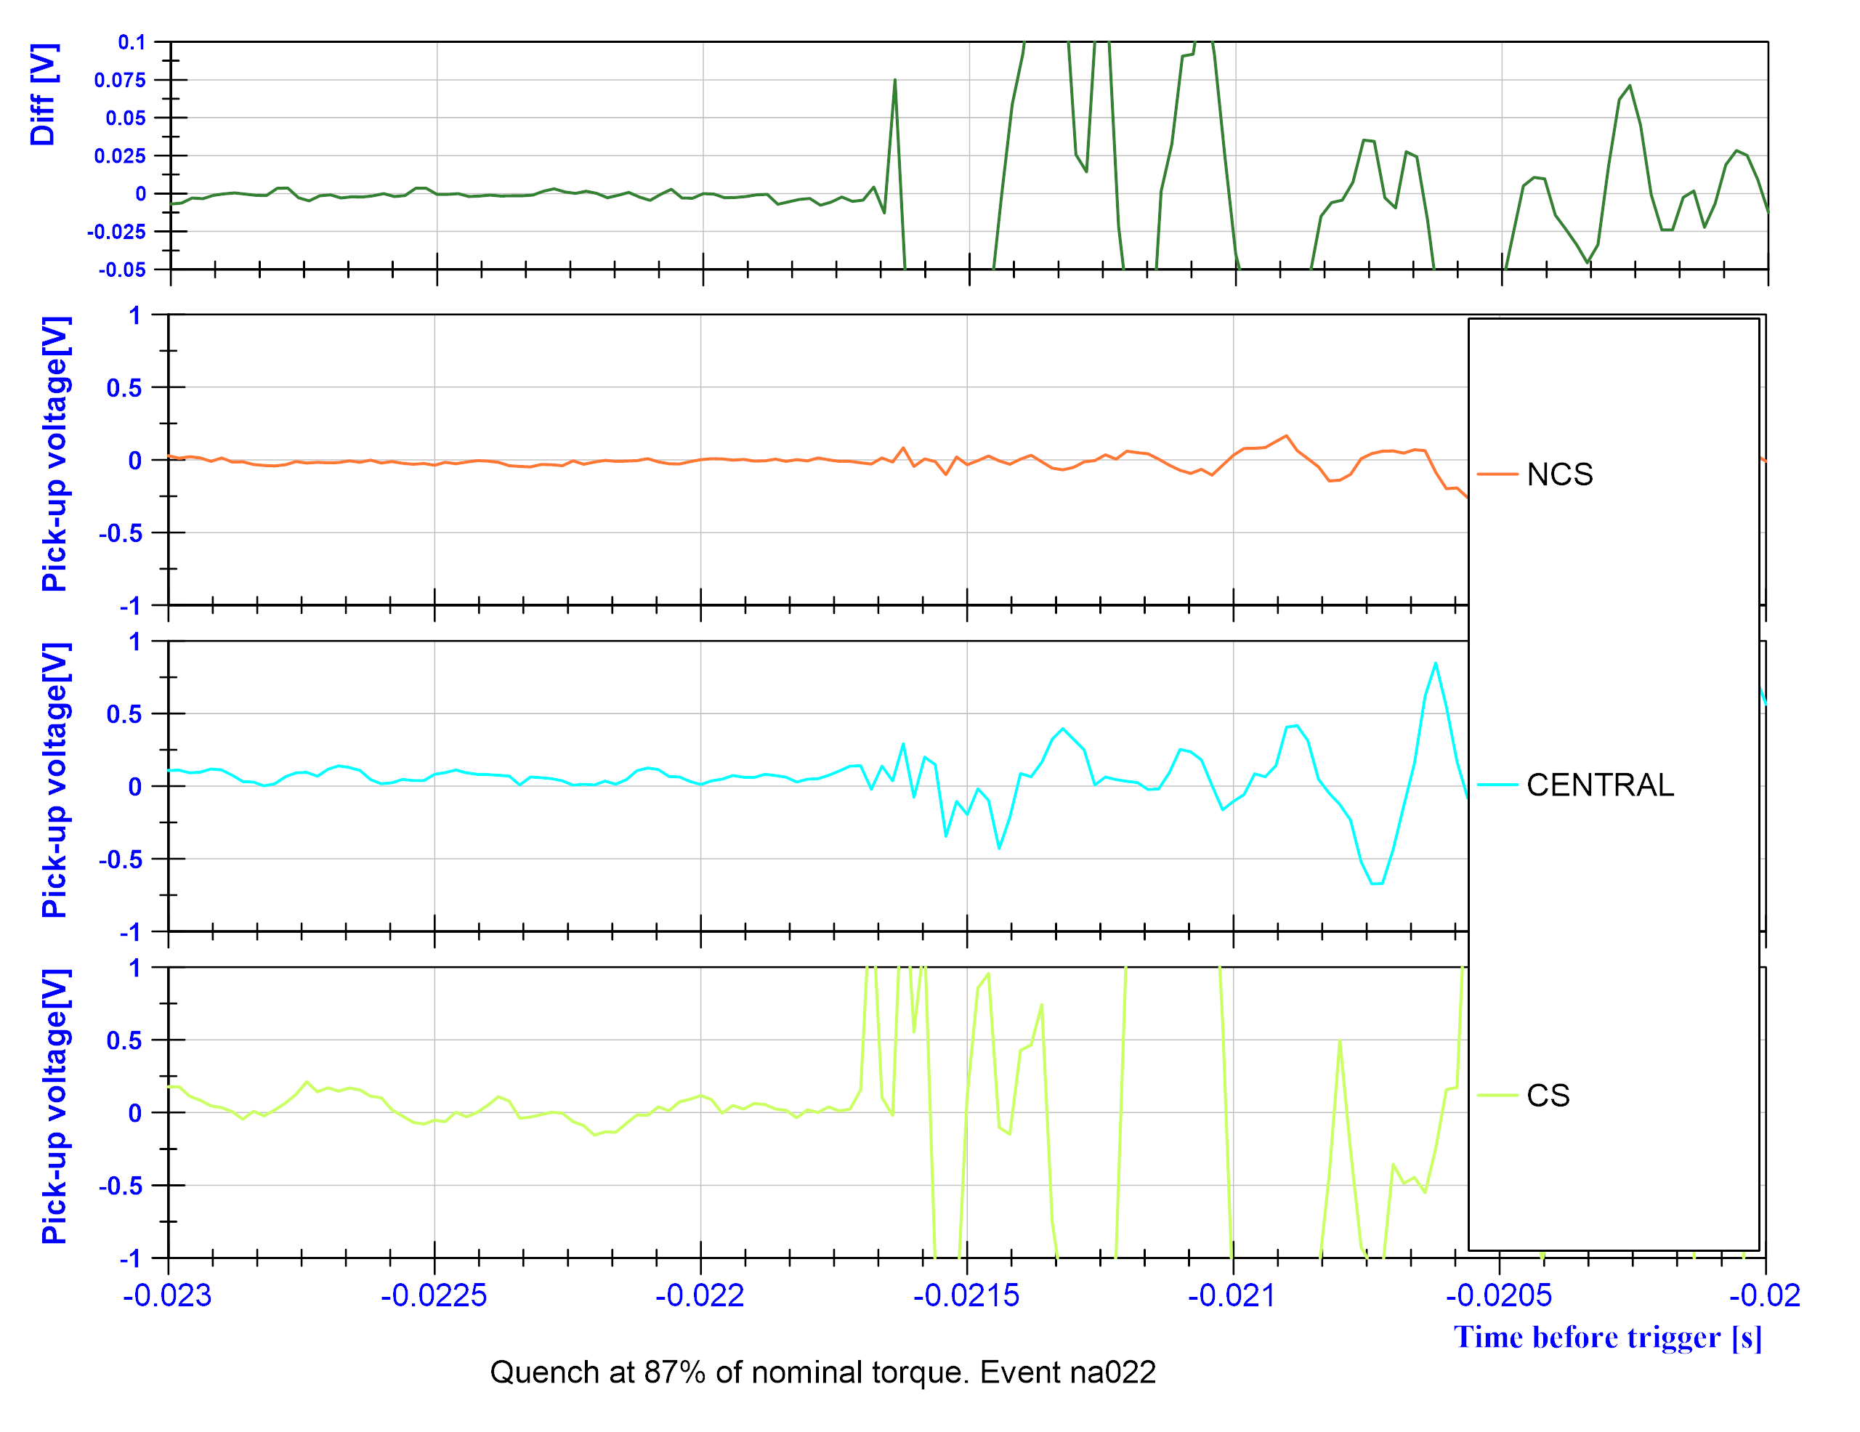
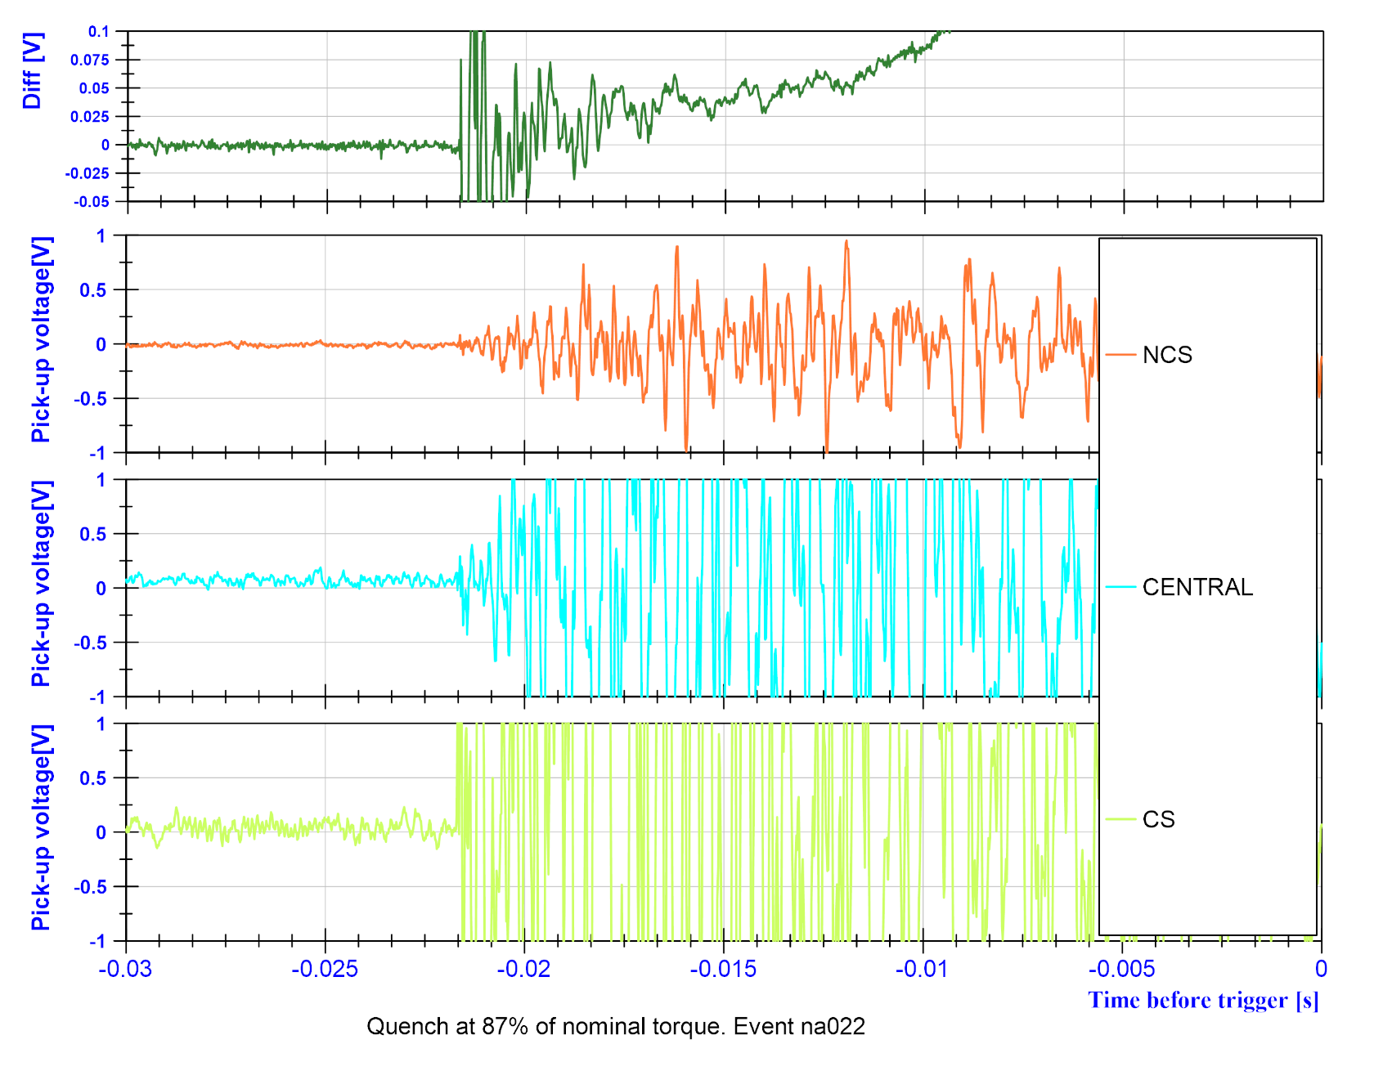
Note on quench localization
Case 2:
Clear detection in the CS side

Slide 17
Note on quench localization
Case Extra I:
Preceding vibrations do not decay, and it is difficult to assess the quenching segment

Slide 18
Note on quench localization
Case Extra II:
Preceding vibrations do not decay, Central segment gets most of the signal

Slide 19
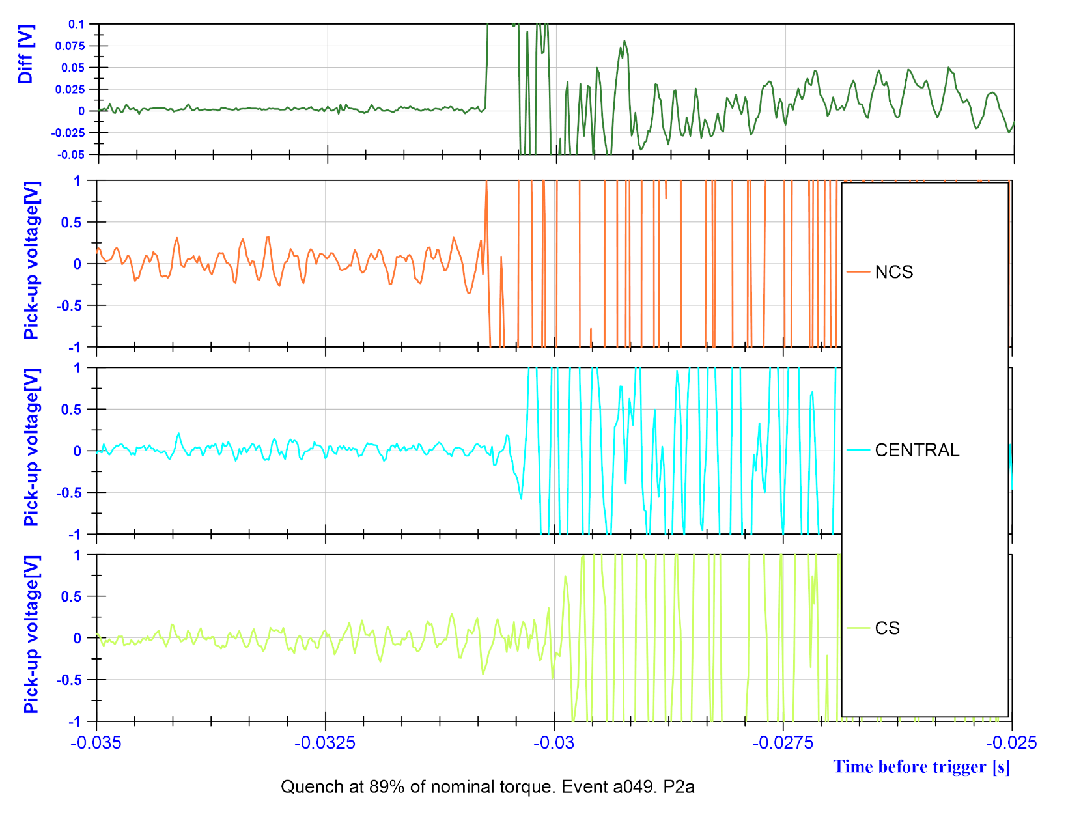
Note on quench localization
Summary:
During training in P2b Q1:
  NCS Onset: 47 %
  CS Clear: 22%
  Indistinguishable: 31%
Study case: training P2a Q1 in CD1 (Example ->)
  Not even 1 undistinguishable case
Case Extra III in 2a:

Slide 20
Recap… summary of events
MCBXFBP2b:
Reached ultimate in both circuits, standalone
132 Events
Reached 99.9% + nominal torque
Reached 94.4% of -nominal torque
MCBXFBP2a:
Reached ultimate in both circuits standalone
Reached 1980 A Inner circuit stand alone
280 Events
Reached nominal + torque
Reached 97% of -nominal torque
Retrain in Q1 to reposition the assembly again
 | Training quenches
 | IC4 | IC5 | OC3
 | 9 | 76 | 0
Total | 85
 | Training quenches
 | IC4 | IC5 | OC3
 | 91 | 83 | 4
Total | 177

Slide 21
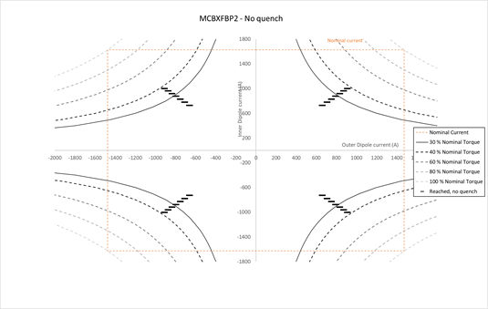
J. Verification of the quench free region (I/III)
MCBXFBP2a:
  Quench free cycle of 4 points (diagonals) 20, 23, 26, 29, 32, 35% of nominal torque
  Quench when attempting 38%
Quench at 38%

Slide 22
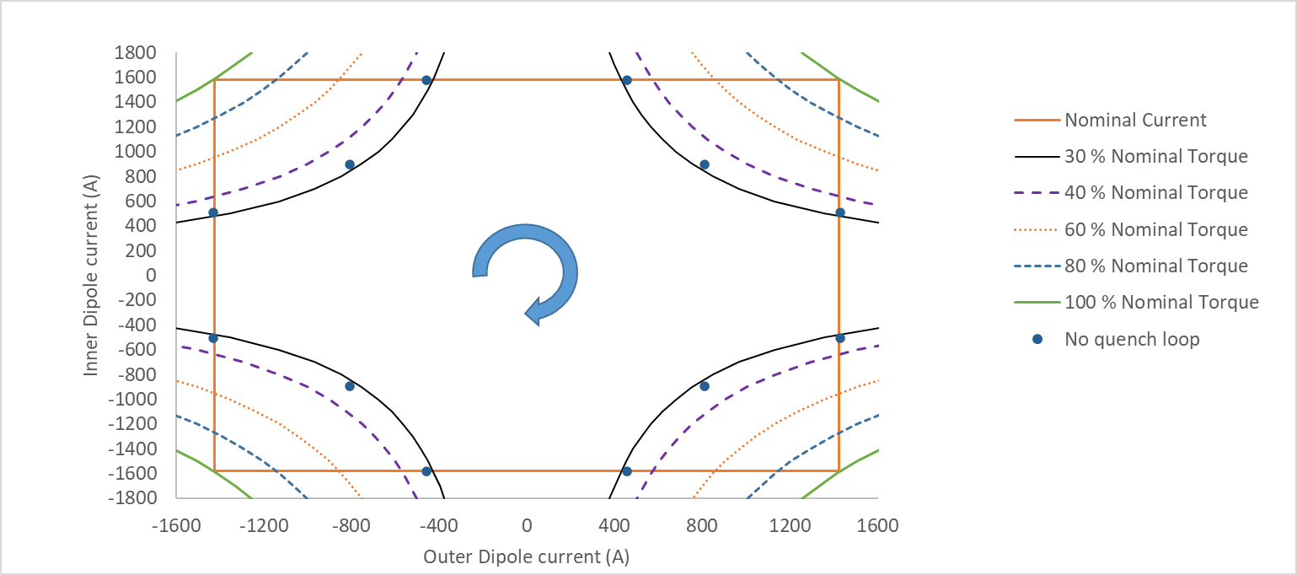
Verification of the free cycle (II/II)
MCBXFBP2a:
After the quench at 38% in the 4 point cycle:
  Quench free cycle attempt of 12 points at 35%, quench when ramping the outer to nominal current.
  Quench free cycle of 12 points at 32% OK
Quench at 35%

Slide 23
6. Conclusions
Similar to P2a:
  Good margin in standalone configuration
    No quench inner nor outer
  ~ same number of training quenches in both torque directions
  Quench free region:
    Q1/Q3: ~32% of nominal torque Q2/Q4: ~32% of nominal torque
Different from P2a:
  Unstable at high currents
  IC 5 quenching 90% of the time

Slide 24
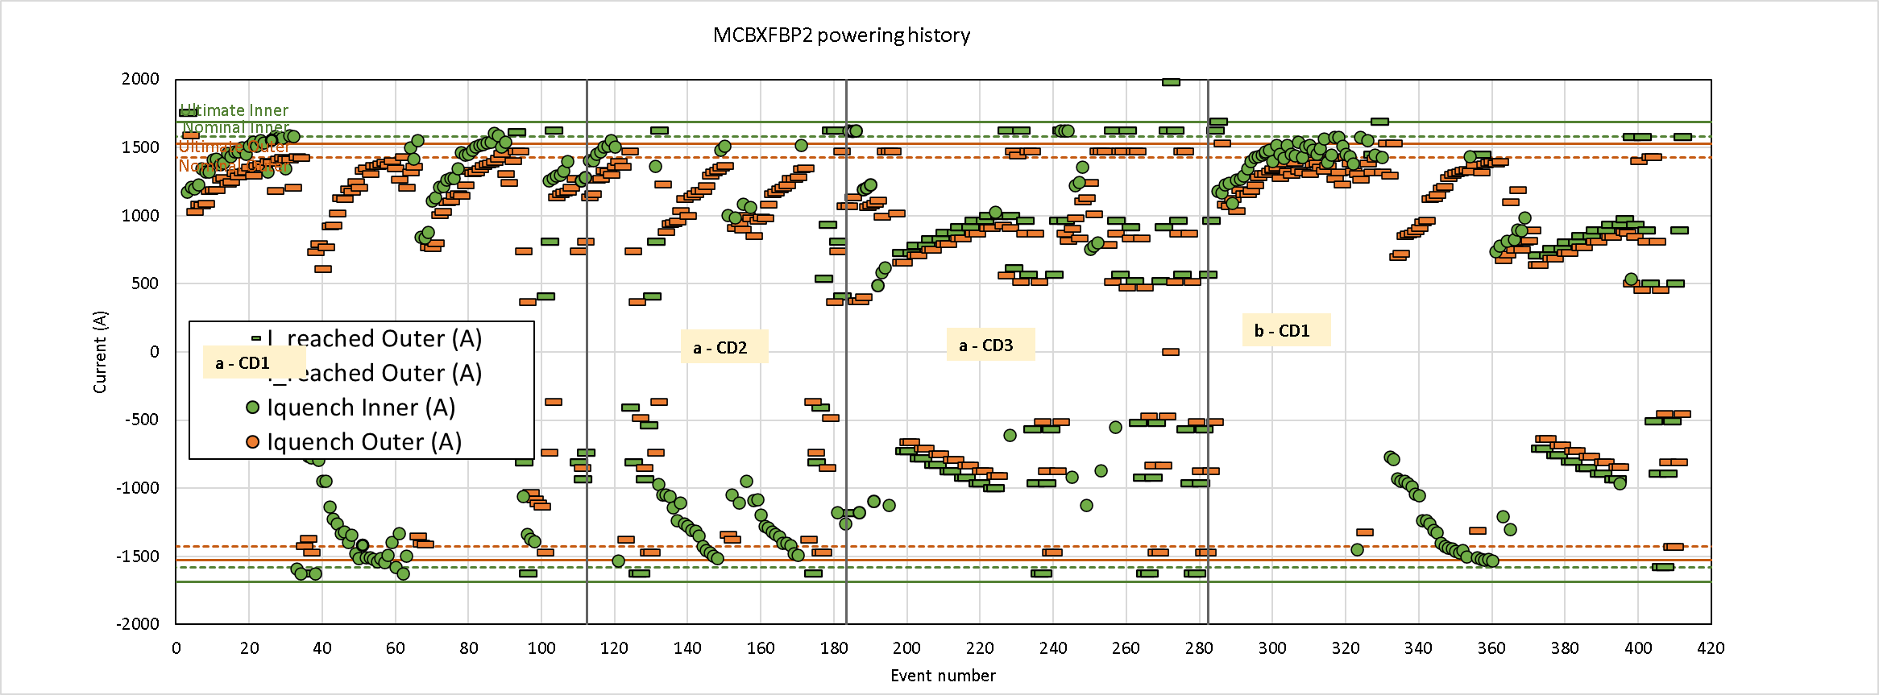
Summary of events, for completeness

