Slide 1
Magnetic Measurements on MCBXFBP2
Matthias Bonora
Lucio Fiscarelli
With the help of colleagues from TM and CIEMAT
Topical meeting on MCBXFB/A, 3rd March 2021

Slide 2
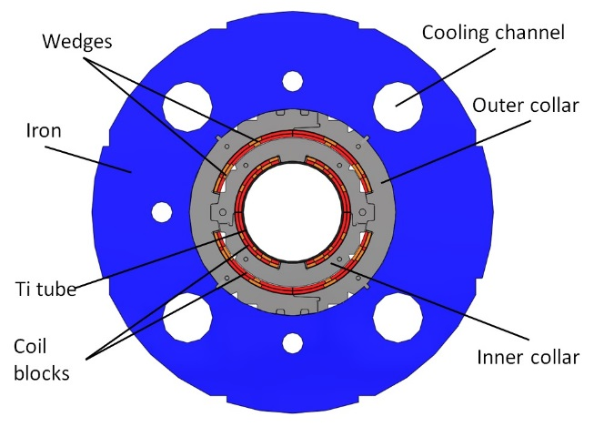
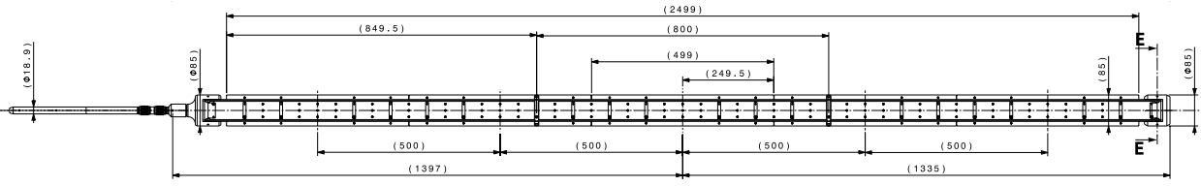
Introduction
Vertical field from the inner coils:
- main field B₁ (normal)
- first allowed b₃
Horizontal field from the outer coils:
- main field A₁ (skew)
- first allowed a₃
Rotating-coil in the helium bath of vertical cryostat clusterD in SM18
  5 segments (500 mm each, 2.5 m total)
Reference radius 50 mm
2

Slide 3
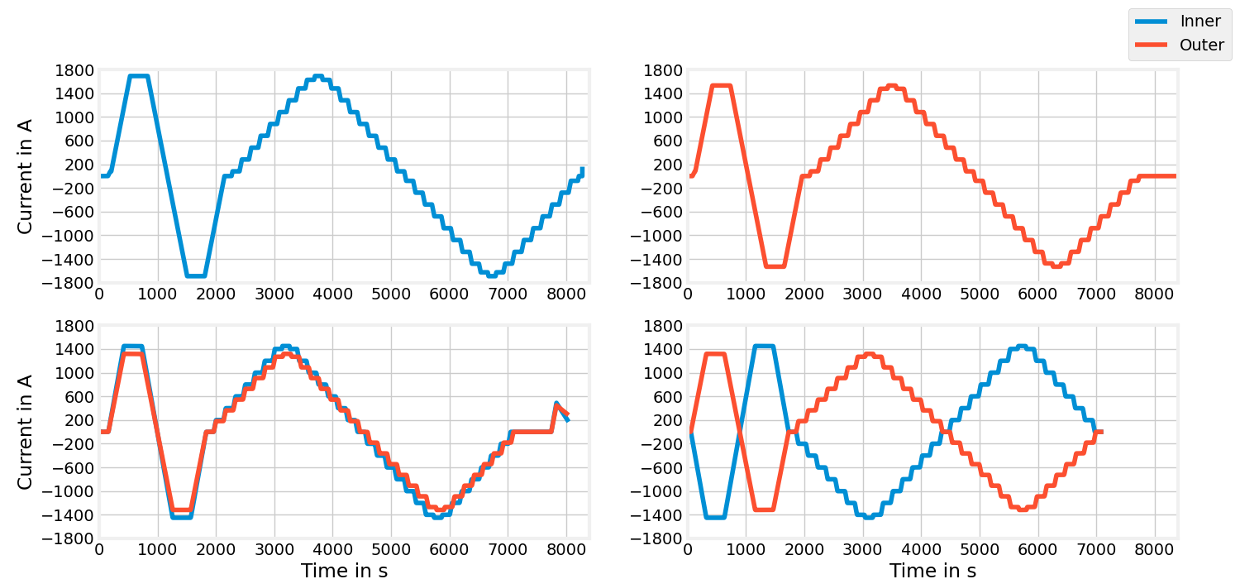
Powering cycles

Slide 4
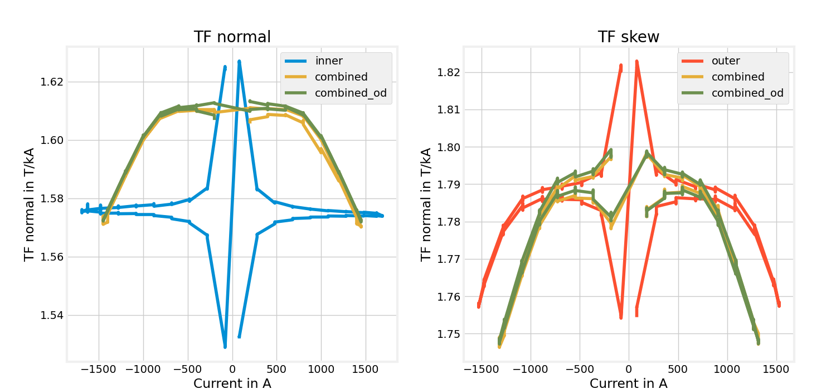
Transfer function
 | Unit | Inner Dipole | Outer Dipole
Nominal current | A | 1625 | 1474
Integrated field (model) | Tm | 2.62 | 2.59
Integrated field (measured) | Tm | 2.56 (-2.3% wrt. model) | 2.60 (+0.4% wrt. model)
Integrated field (previous measurement) | Tm | 2.64 (+0.8% wrt. model) | 2.62 (+1.2% wrt. model)

Slide 5
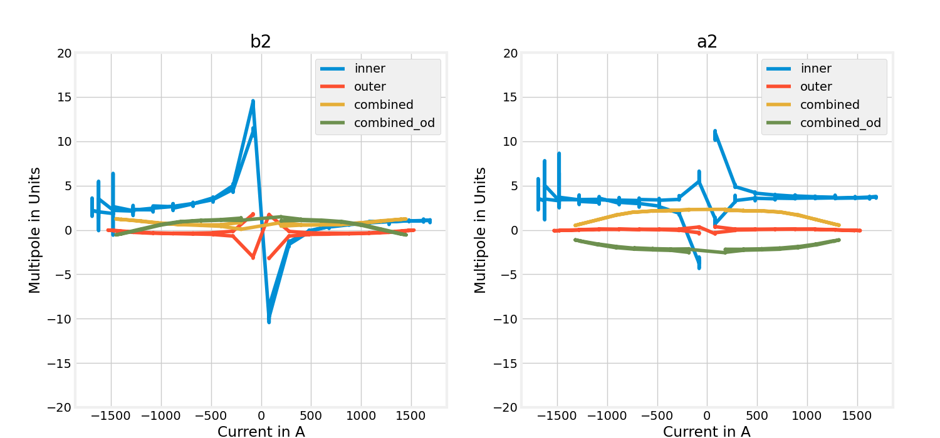
Multipoles vs current

Slide 6
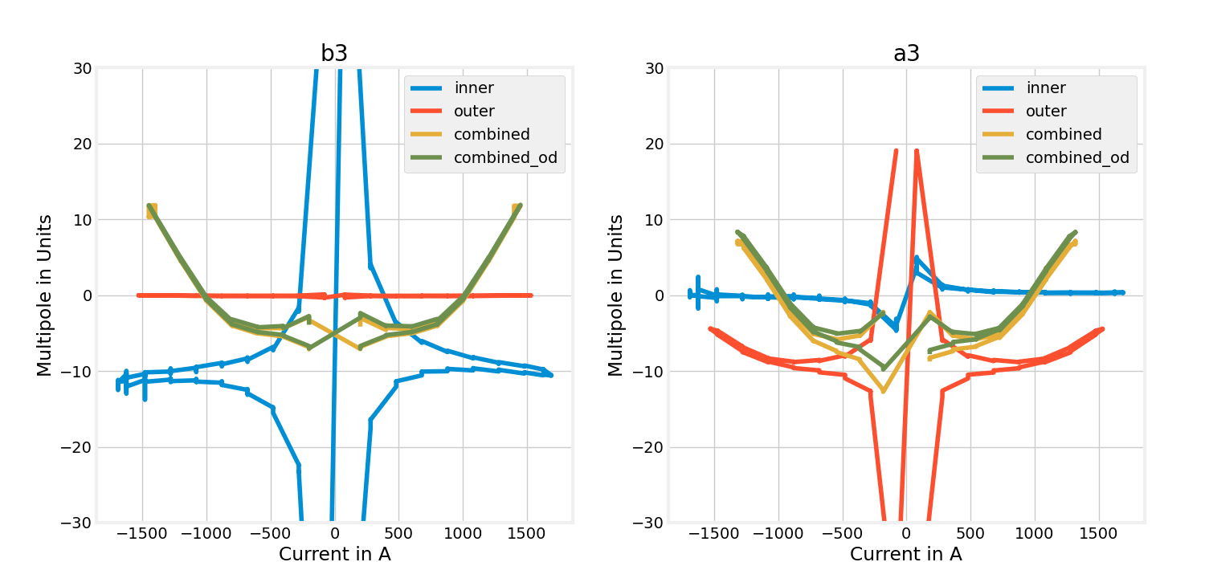
Multipoles vs current

Slide 7
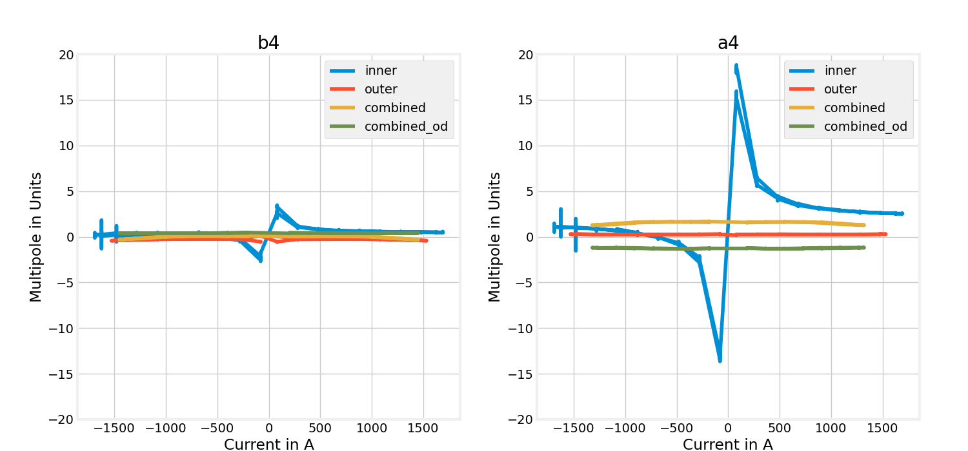
Multipoles vs current

Slide 8
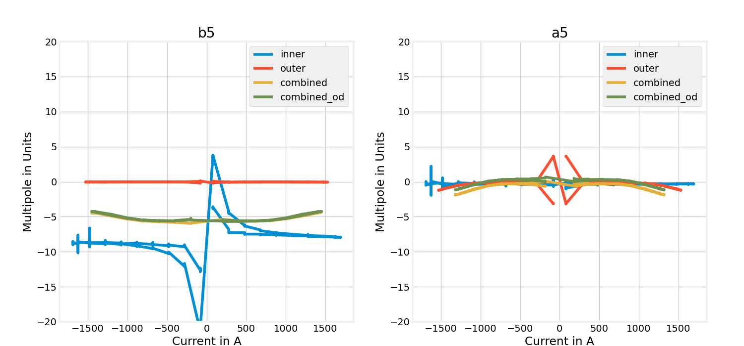
Multipoles vs current

Slide 9
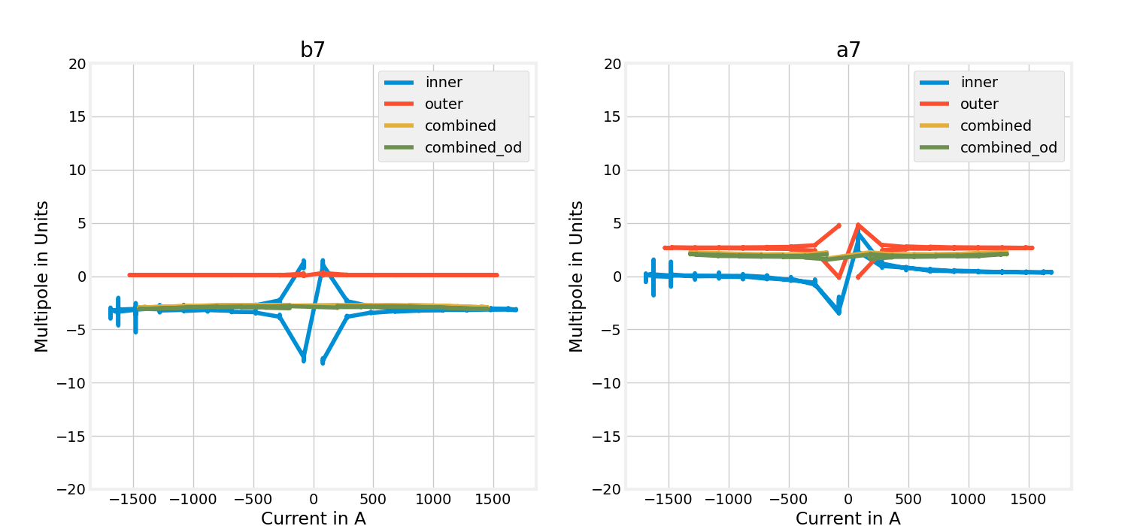
Multipoles vs current

Slide 10
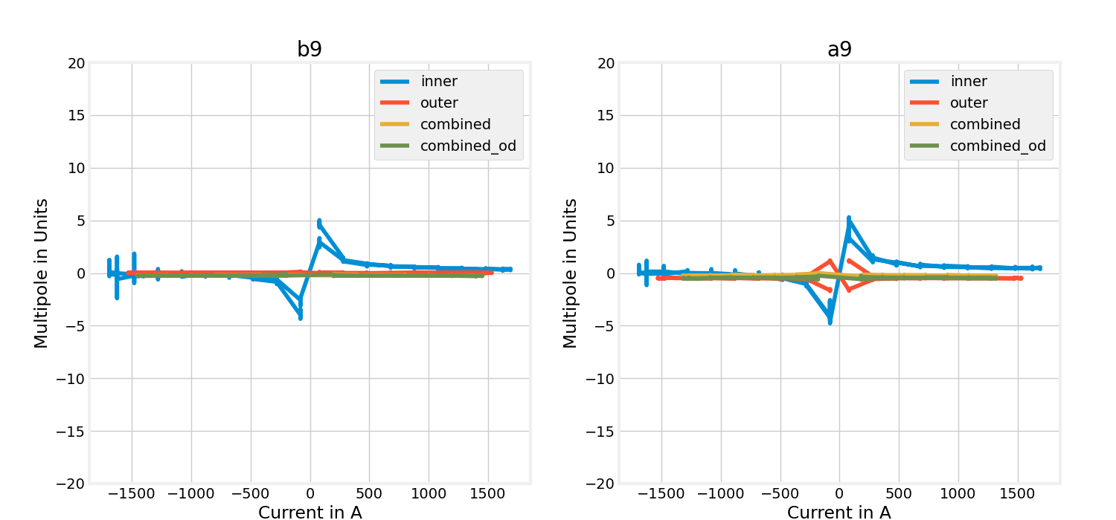
Multipoles vs current

Slide 11
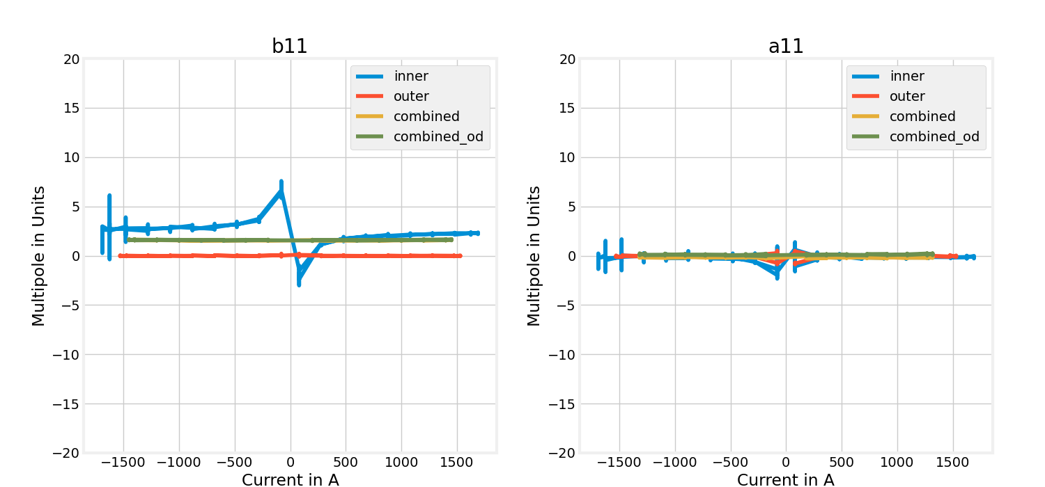
Multipoles vs current

Slide 12
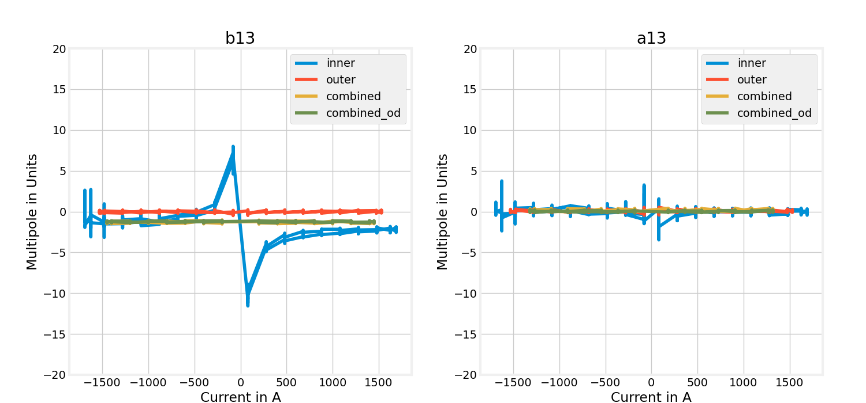
Multipoles vs current

Slide 13
Field-quality table
INNER at 1625A Outer at 0A |  |  | INNER at 0A OUTER at 1474A |  |  | INNER at 1200A OUTER at 1090A |  |  | INNER at 1200A OUTER at -1090A
n | bn | an | n | bn | an | n | bn | an | n | bn | an
2 | 1.06 | 3.65 | 2 | -0.06 | -0.05 | 2 | 1.01 | 1.18 | 2 | 0.07 | -1.64
3 | -10.15 | 0.32 | 3 | -0.06 | -4.97 | 3 | 4.63 | 2.26 | 3 | 4.74 | 3.35
4 | 0.49 | 2.55 | 4 | -0.41 | 0.28 | 4 | -0.13 | 1.43 | 4 | 0.39 | -1.22
5 | -7.90 | -0.32 | 5 | -0.07 | -1.03 | 5 | -4.85 | -1.09 | 5 | -4.74 | -0.44
6 | 0.19 | 0.89 | 6 | 0.67 | -0.23 | 6 | 0.75 | 0.70 | 6 | -0.24 | -1.00
7 | -3.10 | 0.36 | 7 | 0.10 | 2.66 | 7 | -2.83 | 2.10 | 7 | -3.00 | 1.95
8 | -0.25 | -0.07 | 8 | -0.15 | 0.02 | 8 | -0.09 | 0.10 | 8 | 0.13 | -0.07
9 | 0.34 | 0.47 | 9 | 0.01 | -0.50 | 9 | -0.24 | -0.25 | 9 | -0.26 | -0.48
10 | -0.22 | -0.95 | 10 | -0.04 | 0.01 | 10 | -0.25 | -0.64 | 10 | -0.20 | 0.63
11 | 2.26 | -0.15 | 11 | -0.02 | -0.05 | 11 | 1.57 | -0.19 | 11 | 1.60 | 0.11
12 | 0.19 | 0.88 | 12 | 0.02 | 0.02 | 12 | 0.25 | 0.64 | 12 | 0.15 | -0.61
13 | -2.21 | -0.02 | 13 | -0.03 | 0.06 | 13 | -1.31 | 0.17 | 13 | -1.25 | 0.04
14 | -0.05 | 0.02 | 14 | -0.00 | 0.08 | 14 | 0.00 | -0.01 | 14 | -0.02 | 0.15
15 | 0.66 | -0.17 | 15 | 0.02 | 0.03 | 15 | 0.16 | -0.06 | 15 | 0.17 | 0.11
Units of 10⁻⁴ at the reference radius of 50 mm

Slide 14
Comparison with previous measurement
INNER at 1625 A OUTER at 0A |  |  | previous measurement |  |  | difference
n | bn | an | n | bn | an | n | bn | an
2 | 1.06 | 3.65 | 2 | 1.75 | 2.81 | 2 | 0.69 | -0.84
3 | -10.15 | 0.32 | 3 | -6.91 | -0.07 | 3 | 3.24 | -0.39
4 | 0.49 | 2.55 | 4 | 1.78 | 0.81 | 4 | 1.29 | -1.74
5 | -7.9 | -0.32 | 5 | -7.45 | 0.67 | 5 | 0.45 | 0.99
6 | 0.19 | 0.89 | 6 | 1.33 | -0.18 | 6 | 1.14 | -1.07
7 | -3.1 | 0.36 | 7 | -3.77 | 0.76 | 7 | -0.67 | 0.4
8 | -0.25 | -0.07 | 8 | 0.11 | -0.08 | 8 | 0.36 | -0.01
9 | 0.34 | 0.47 | 9 | 0.00 | -0.06 | 9 | -0.34 | -0.53
10 | -0.22 | -0.95 | 10 | -0.8 | 0.38 | 10 | -0.58 | 1.33
11 | 2.26 | -0.15 | 11 | 1.45 | -0.64 | 11 | -0.81 | -0.49
12 | 0.19 | 0.88 | 12 | 0.89 | -0.24 | 12 | 0.7 | -1.12
13 | -2.21 | -0.02 | 13 | -1.47 | 0.77 | 13 | 0.74 | 0.79
14 | -0.05 | 0.02 | 14 | -0.06 | -0.13 | 14 | -0.01 | -0.15
15 | 0.66 | -0.17 | 15 | 0.12 | 0.06 | 15 | -0.54 | 0.23
INNER at 0 A OUTER at 1474 A |  |  | previous measurement |  |  | difference
n | bn | an | n | bn | an | n | bn | an
2 | -0.06 | -0.05 | 2 | 0.78 | 0.55 | 2 | 0.84 | 0.6
3 | -0.06 | -4.97 | 3 | -0.22 | -7.56 | 3 | -0.16 | -2.59
4 | -0.41 | 0.28 | 4 | -0.05 | -0.16 | 4 | 0.36 | -0.44
5 | -0.07 | -1.03 | 5 | 0.29 | 2.00 | 5 | 0.36 | 3.03
6 | 0.67 | -0.23 | 6 | 0.09 | 0.7 | 6 | -0.58 | 0.93
7 | 0.1 | 2.66 | 7 | -0.61 | -2.64 | 7 | -0.71 | -5.3
8 | -0.15 | 0.02 | 8 | 0.07 | -0.15 | 8 | 0.22 | -0.17
9 | 0.01 | -0.5 | 9 | 0.17 | 0.54 | 9 | 0.16 | 1.04
10 | -0.04 | 0.01 | 10 | -0.05 | -0.02 | 10 | -0.01 | -0.03
11 | -0.02 | -0.05 | 11 | -0.01 | 0.02 | 11 | 0.01 | 0.07
12 | 0.02 | 0.02 | 12 | 0.02 | 0.03 | 12 | 0 | 0.01
13 | -0.03 | 0.06 | 13 | -0.06 | -0.02 | 13 | -0.03 | -0.08
14 | 0 | 0.08 | 14 | 0 | 0 | 14 | 0 | -0.08
15 | 0.02 | 0.03 | 15 | -0.04 | 0.01 | 15 | -0.06 | -0.02
Units of 10⁻⁴ at the reference radius of 50 mm

Slide 15
Conclusions
Transfer function at nominal level
  Inner plane 2.558 Tm
  No saturation on inner plane with individual powering
  Outer plane 2.600 Tm
  Saturation on outer plane -1.3% with individual powering
Field quality at nominal level
  Inner plane
    b3 of -10.2 units with individual powering
    b5 of -7.9 units with individual powering
  Outer plane
    a3 of -5.0 units with individual powering

