Slide 1
MCBXFBP2b
Mechanical measurements
Mechanical Measurement Lab, EN/MME
M. Guinchard / S. Mugnier
3rd March 2021

Slide 2
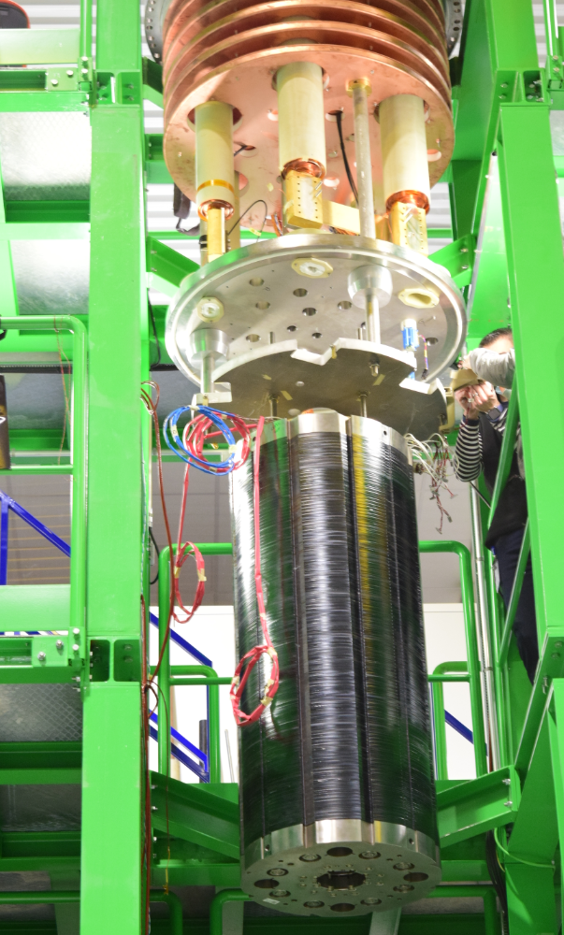
Outline
      Instrumentation overview
      Strain measurement during collaring
      Thermal cycle
      Powering tests
      Bath instability at 4.5 K
      Conclusion

Slide 3
1-Instrumentation overview

Slide 4
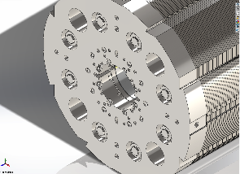
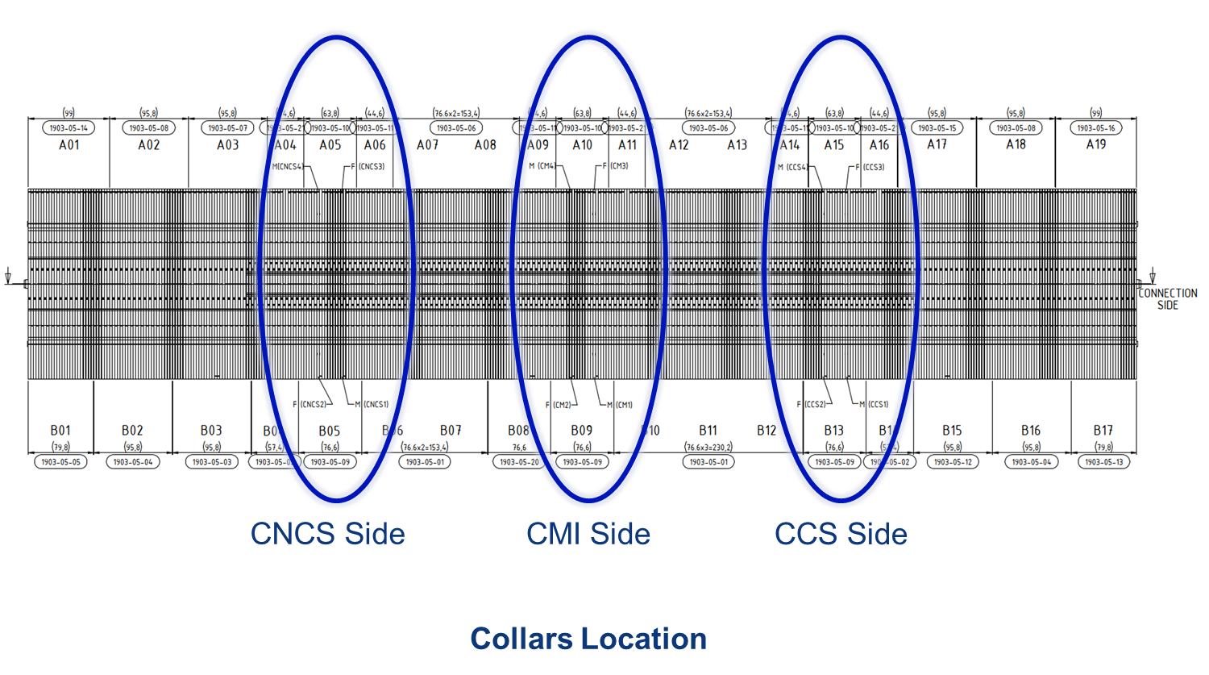
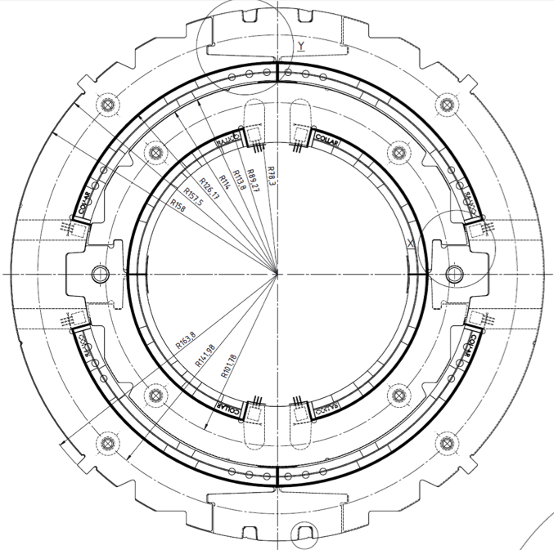
      Instrumentation overview
Azimuthal strain measurements on the inner coil :
12 instrumented collars in total :
    6 instrumented collars equipped for temperature and magnetic field compensation
    6 instrumented collars equipped only for temperature compensation (with external compensators)
Azimuthal strain measurements on the outer coil were performed only during initial collaring and removed for final assembly

Slide 5
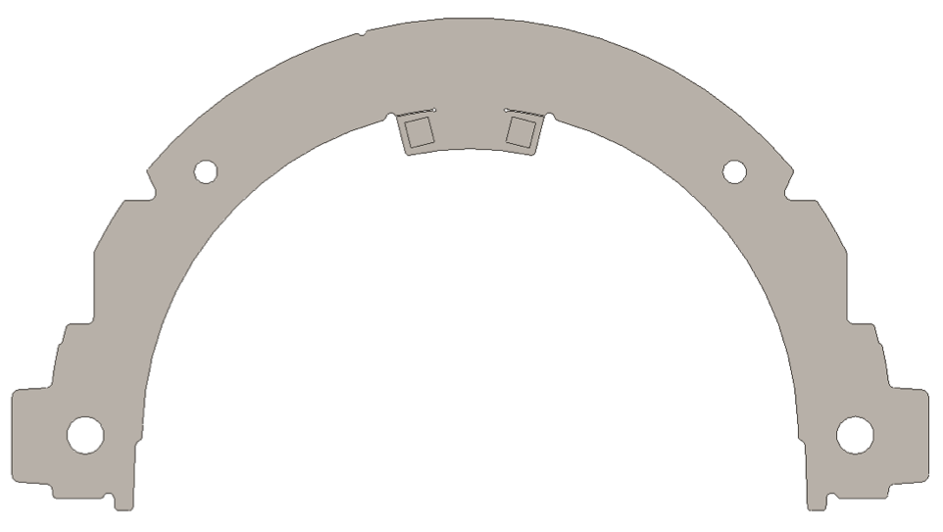

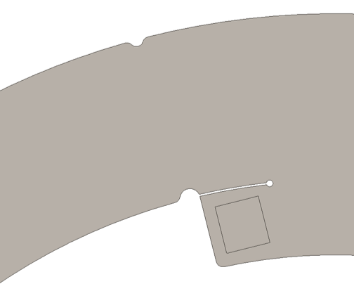
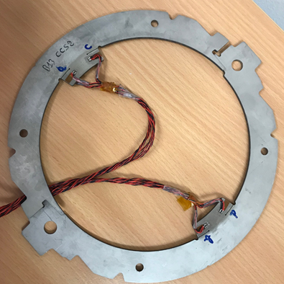


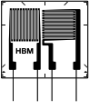
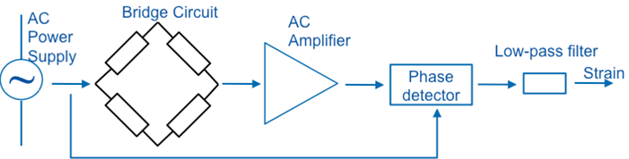
Instrumentation overview
Strain gauges a & c are on the same side of the collar, b & d are on the other side
Equipment | Reference
Strain gauges | HBM 1-XC11-1.5/350
Bridge power supply | 2.5 V @ 4.8 kHz
Bridge Configuration | Half bridge – Poisson compensation
Quantity | 6 collars / both sides
a/b
c/d

Slide 6

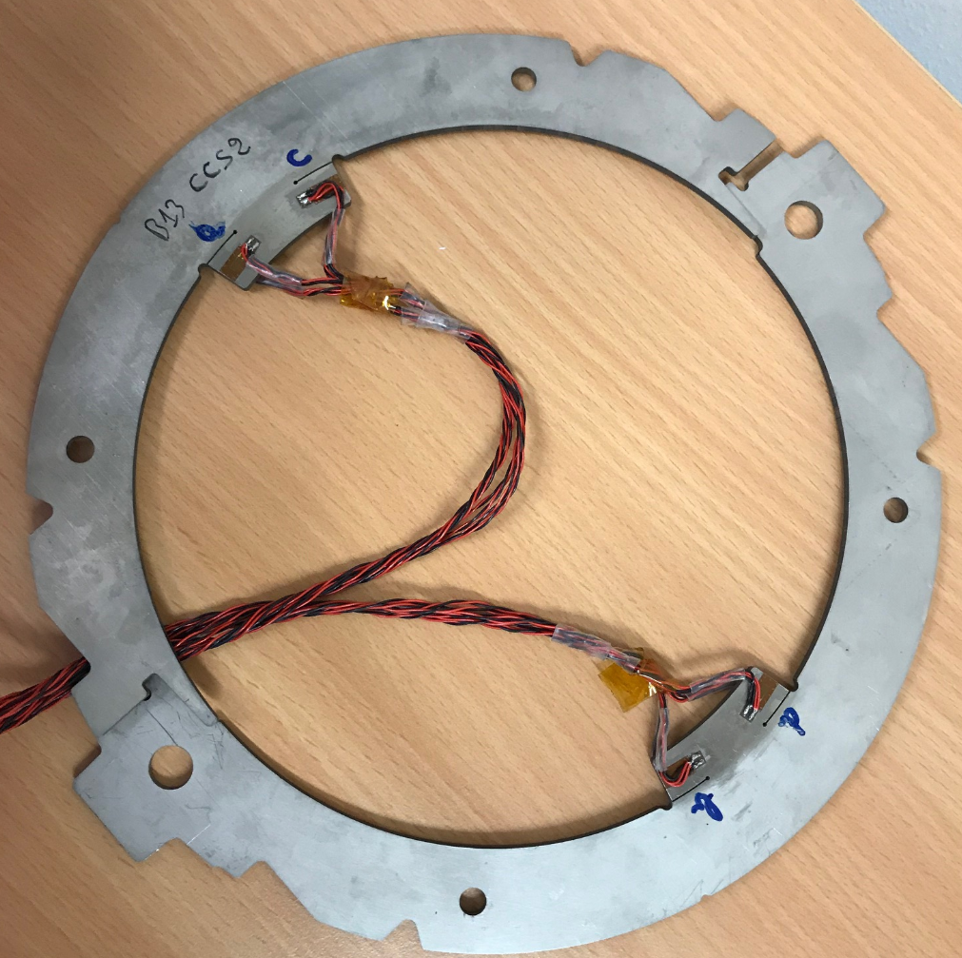

Instrumentation overview
Equipment | Reference
Strain gauges | HBM 1-LC11-1.5/350
Bridge power supply | 2.5 V @ 4.8 kHz
Bridge Configuration | Quarter bridge + compensators
Quantity | 6 collars / both sides
Strain gauges a & c are on the same side of the collar, b & d are on the other side
a/b
c/d

Slide 7

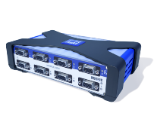






Instrumentation overview
Mechlab Server
Settings
MX840 for SG reading
Data
MX1615 for SG reading

Slide 8
2-Strain Measurement during collaring

Slide 9
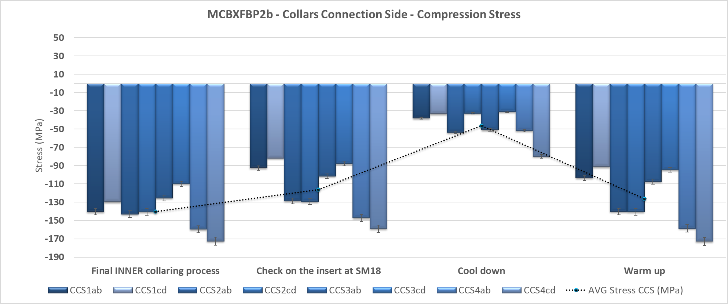
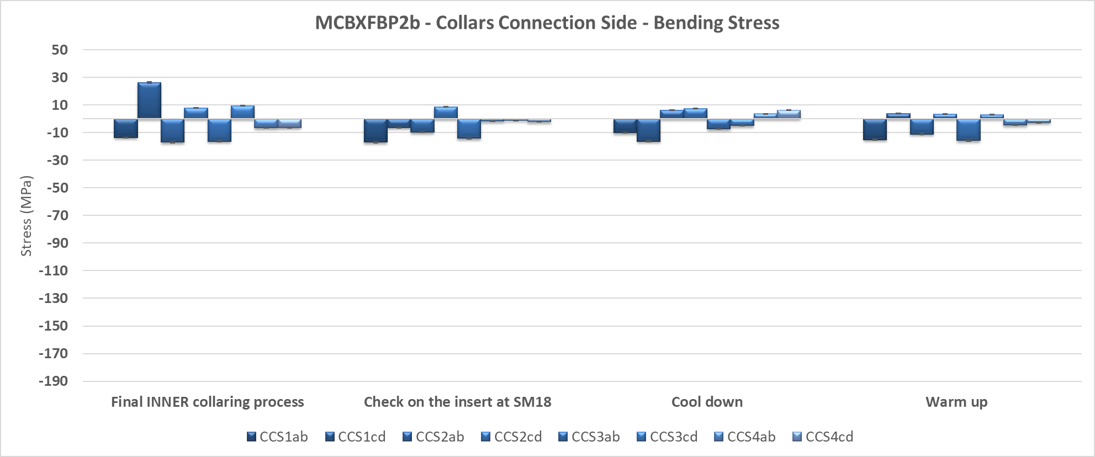
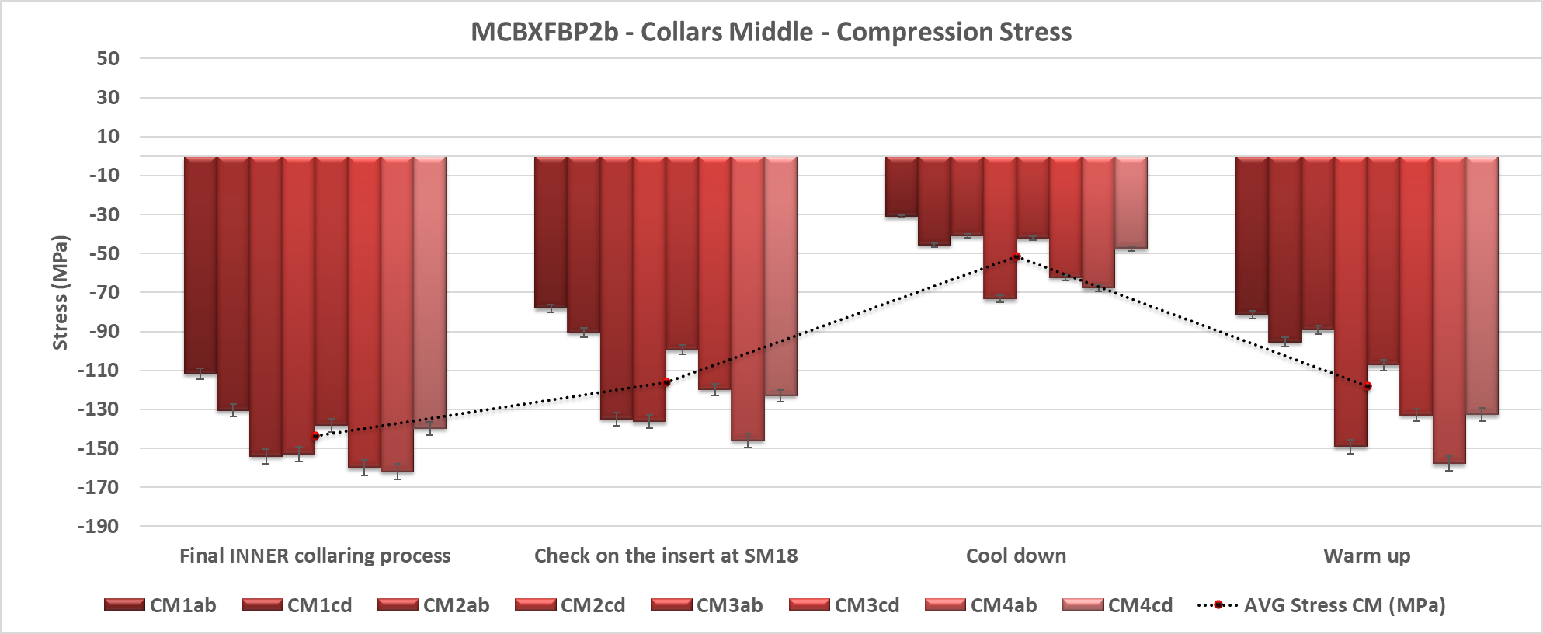
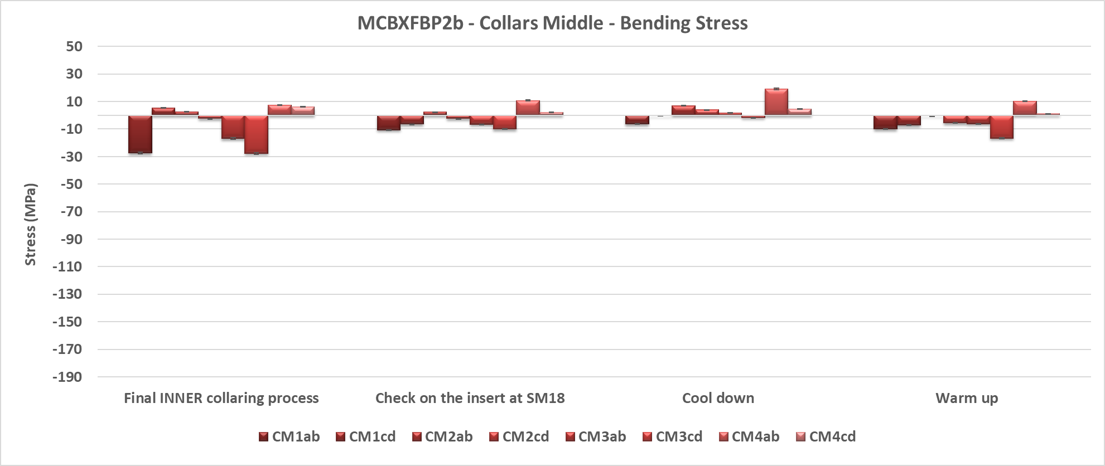
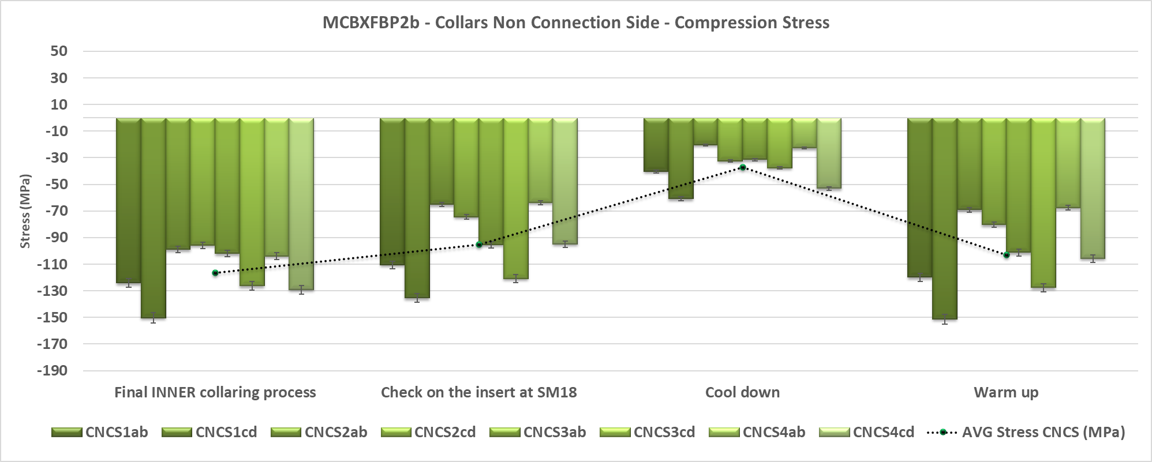
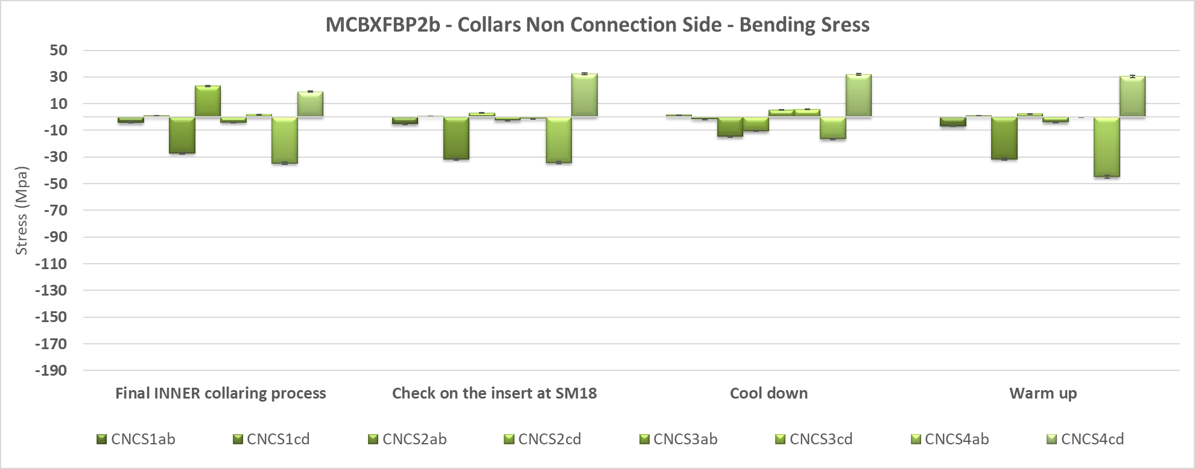
Stress measurement overview
MCBXFBP2a target value for inner collaring : 120 MPa at RT
MCBXFBP2b target value for inner collaring : 140 MPa at RT
→ Avg. Measured after collaring : 135 MPa
→ Avg. Measured before cooldown : 115 MPa
MCBXFBP2b target value for outer with a shim at 0,3 mm: +20 MPa more than MCBXFBP2a at RT
MCBXFBP2b target value at cold : 60 MPa at 4.5 K
→ Avg. Measured at cold : 45 Mpa

Slide 10
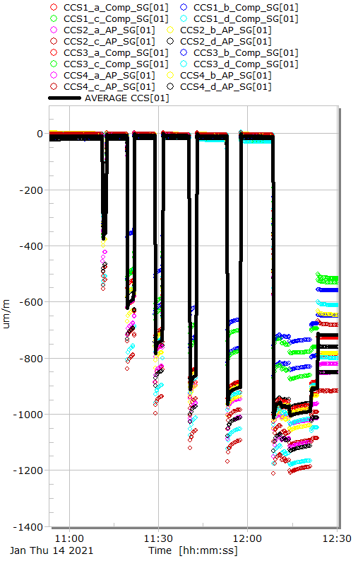
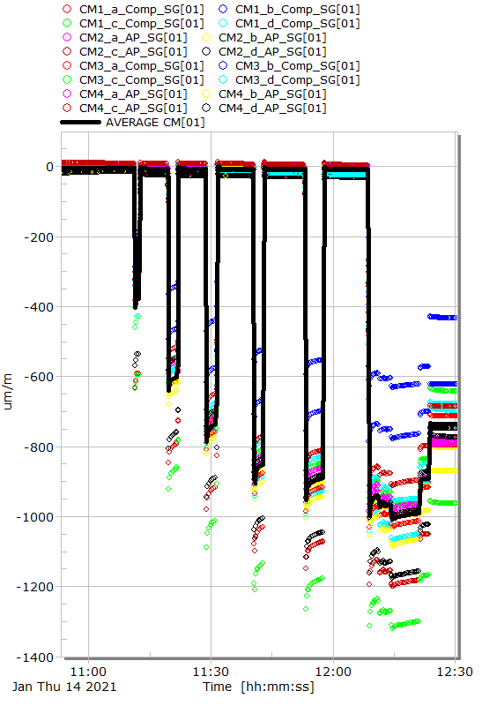
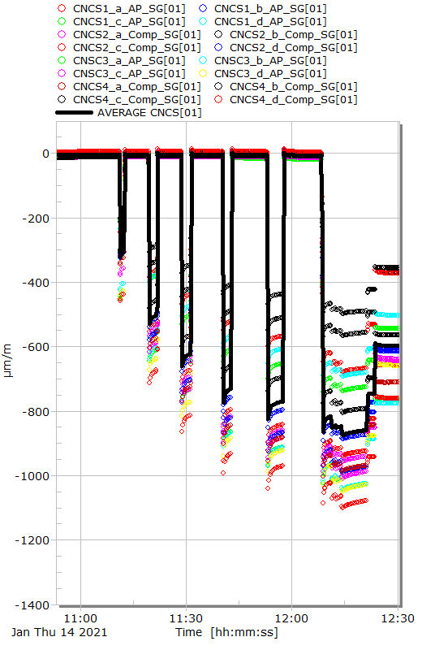
Last Inner collaring at 293 K in Building 927

Slide 11
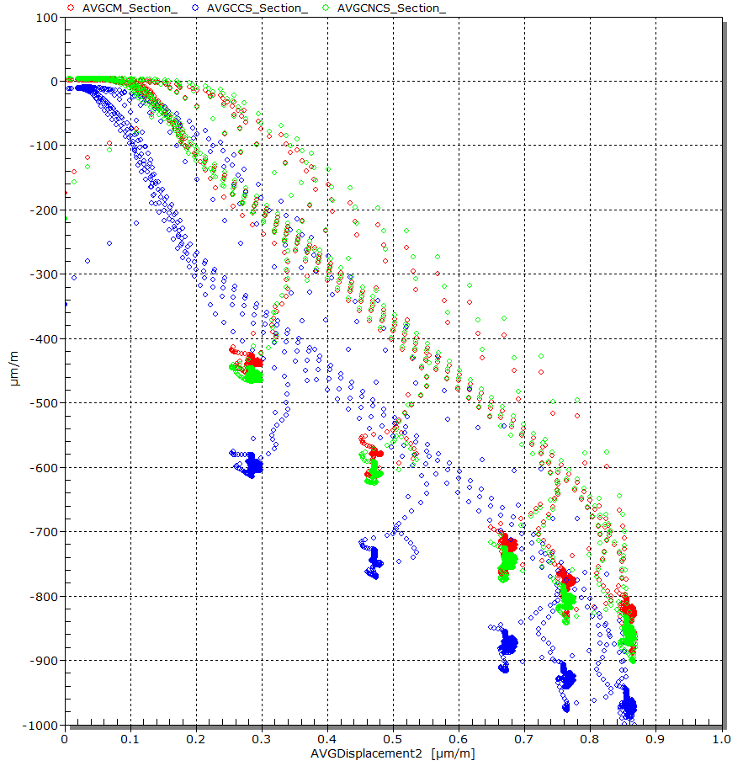
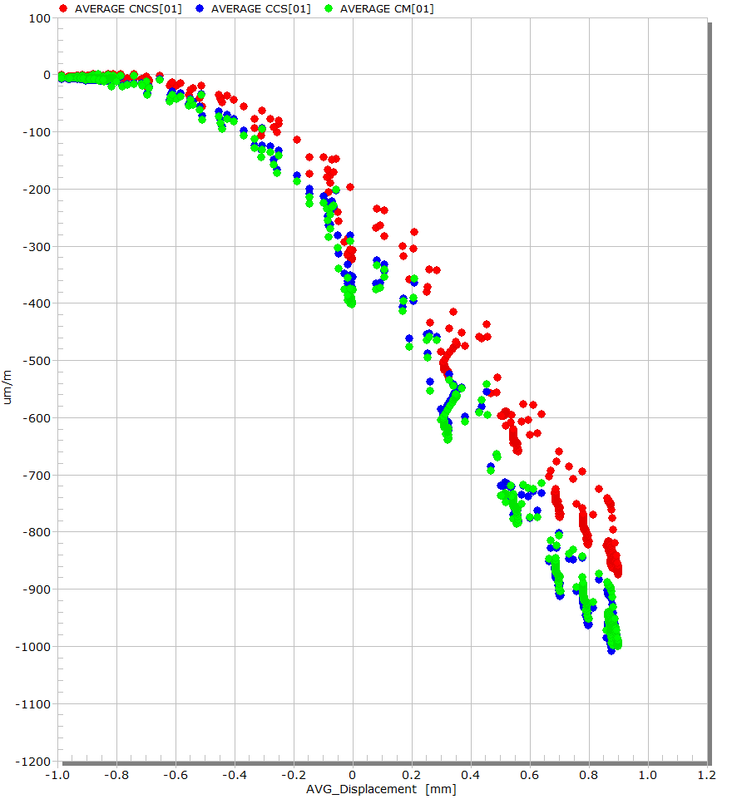
Last Inner collaring at 293 K in Building 927
Overall stiffness : 900 µm/m/mm
Overall stiffness : 650 µm/m/mm
MCBXFBP2a
MCBXFBP2b

Slide 12
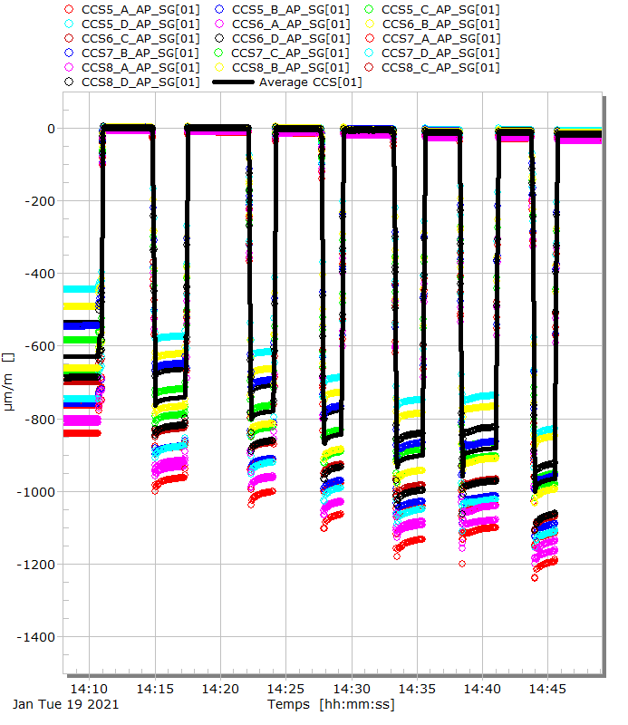
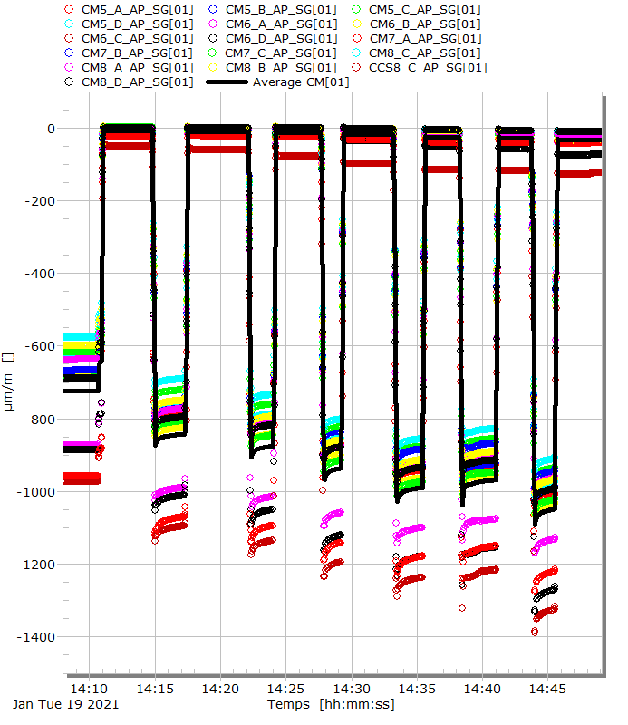
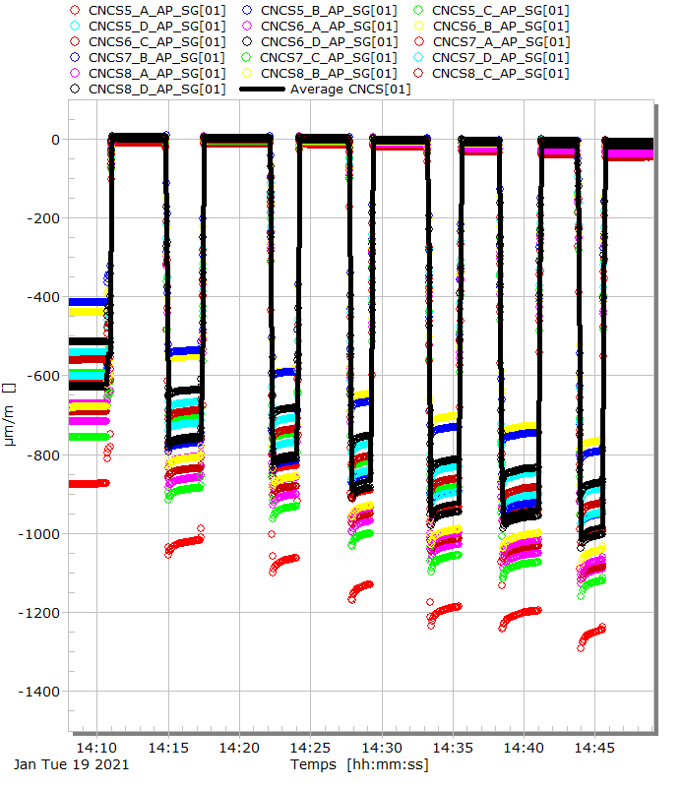
Outer comparison under press with shimming at 0.3 mm
The outers collars were removed for the final collaring phase before the cold tests.

Slide 13
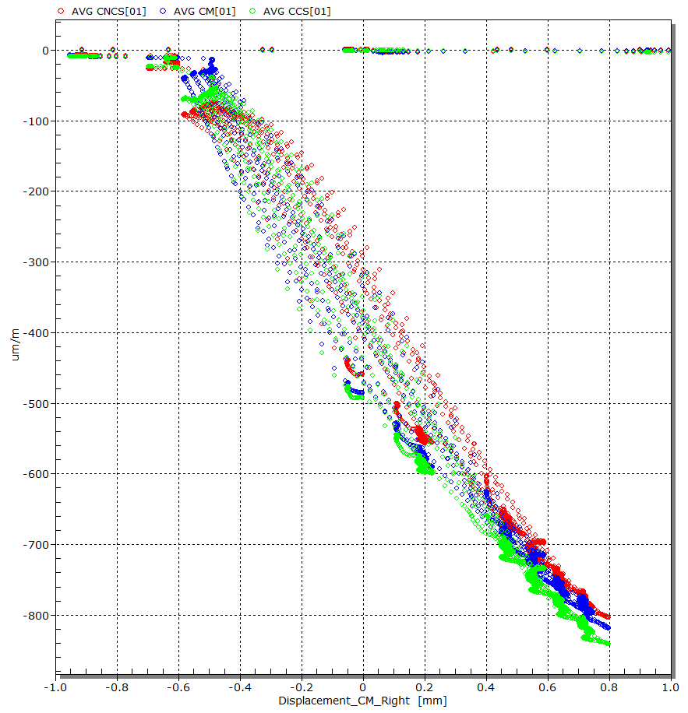
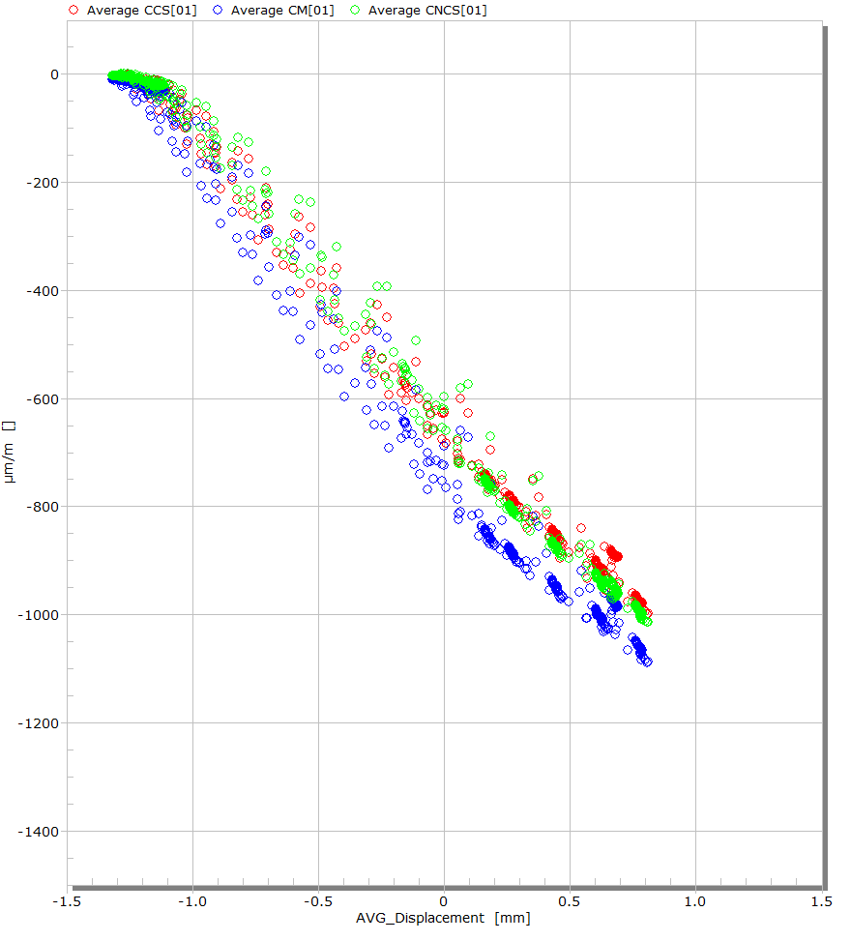
Outer comparison under press with shimming at 0.3 mm
Shimming at 0,3 mm
Shimming at 0,3 mm
180 MPa
At 0.3 mm of shimming: The target value was + 20 MPa (about 100 µm/m) more than for MCBXFBP2a
155 MPa
MCBXFBP2a
MCBXFBP2b

Slide 14
3-Thermal Cycle

Slide 15
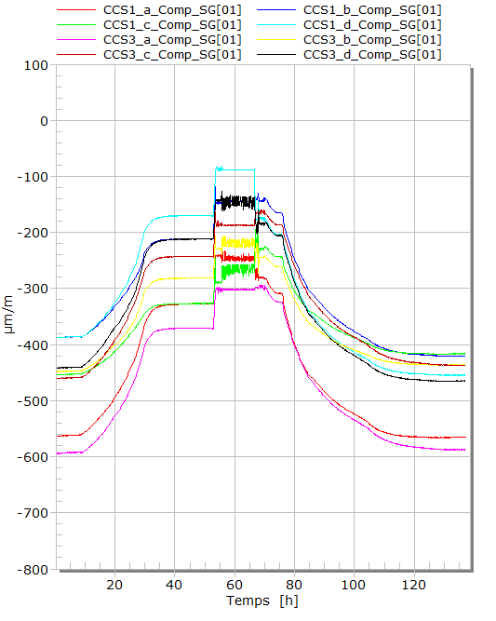
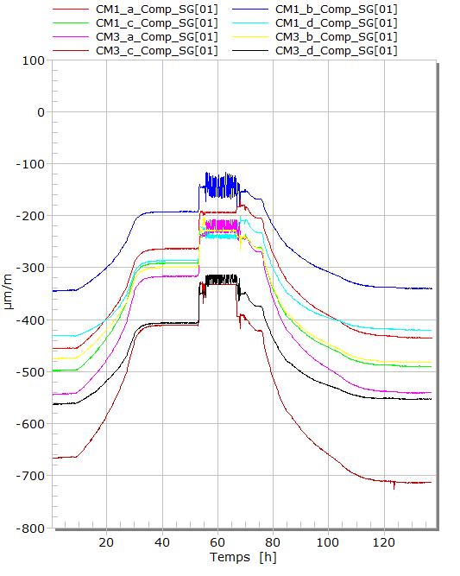
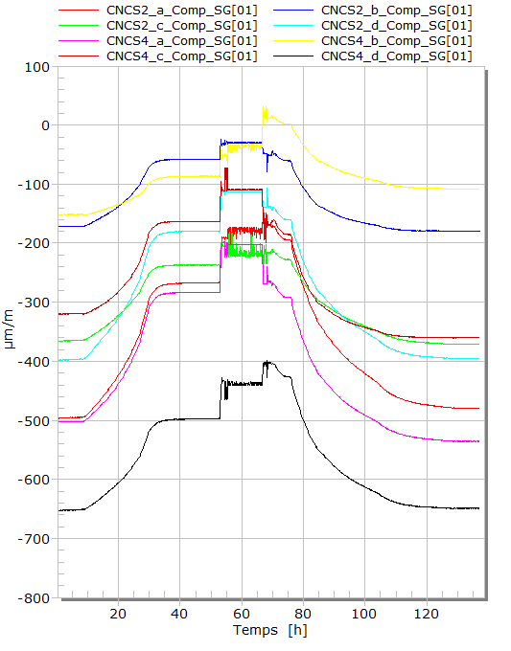
Thermal cycle
Cooldown
Warm-up
Cooldown
Warm-up
Cooldown
Warm-up
Raw values without K factor corrections.

Slide 16
4-Powering tests

Slide 17
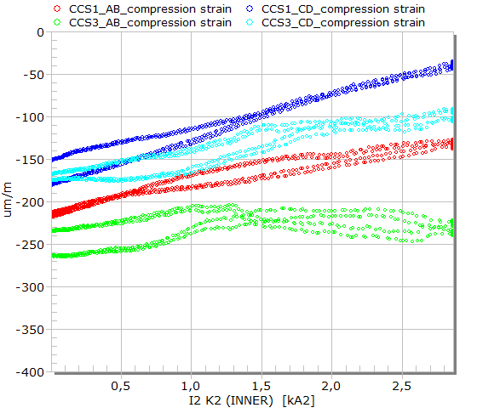
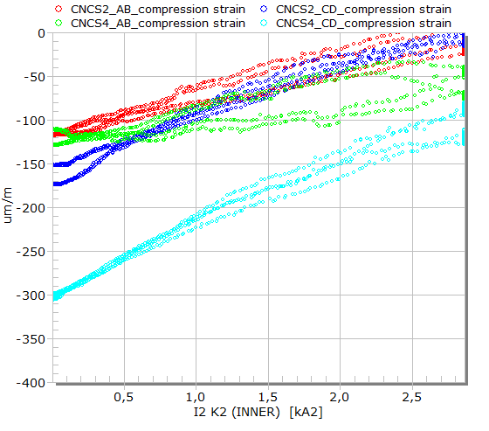
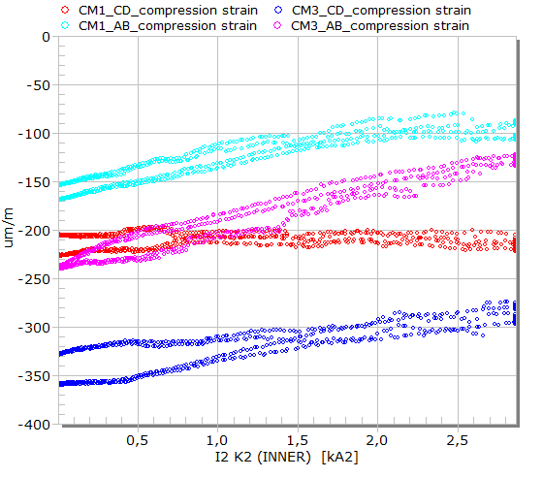
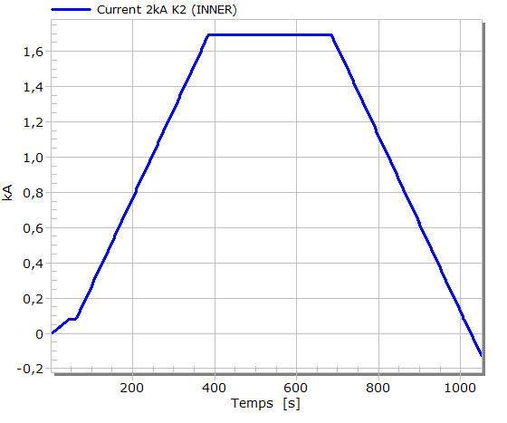
Inner dipole at ultimate current: 1690A
16 February 2021 at 02:00PM

Slide 18
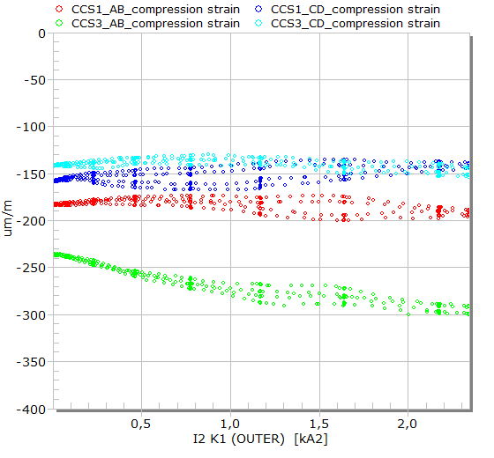
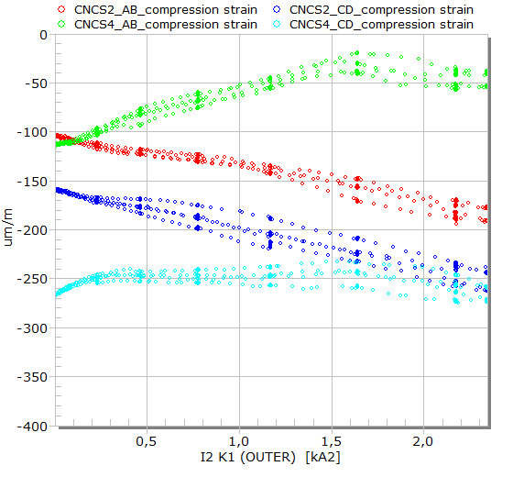
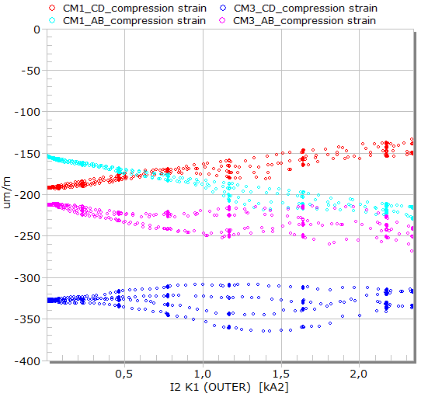
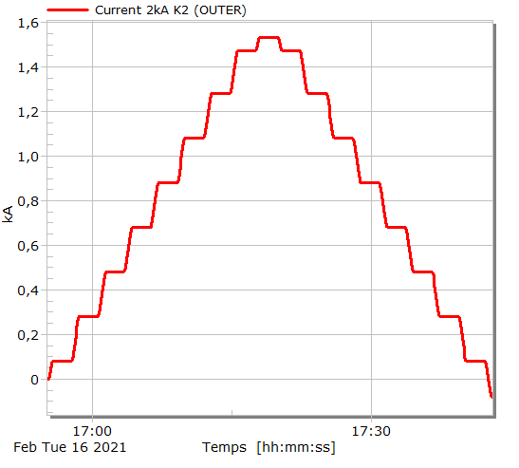
Outer dipole at ultimate current: 1580A
16 February 2021 at 05:30PM

Slide 19
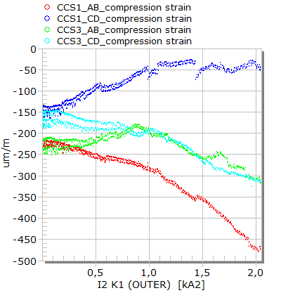
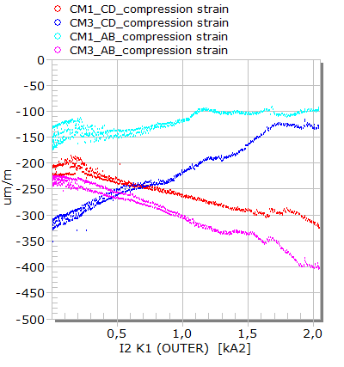
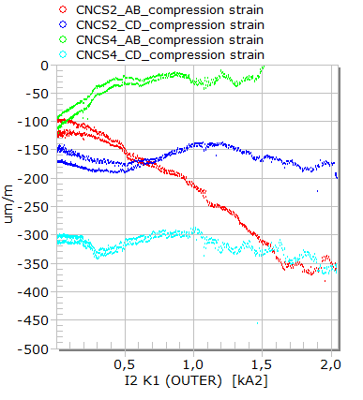
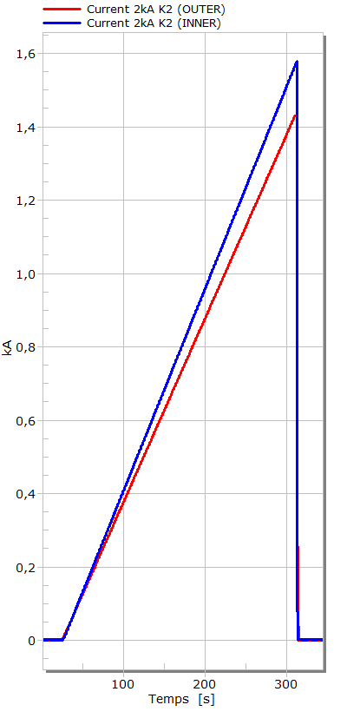
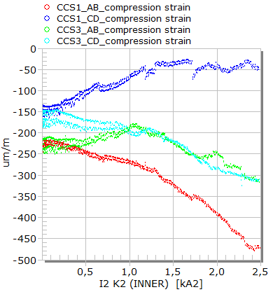
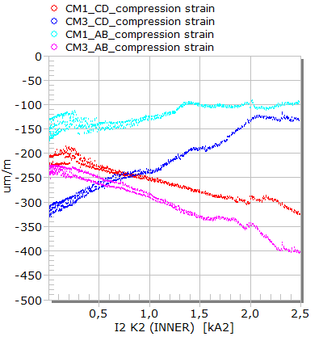
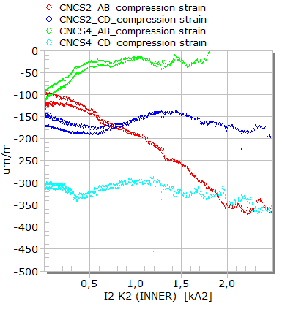
Training inner and outer dipole at nominal current, in Quadrant 1 (I Inner=1579A and I Outer=1430A)
15 February 2021 at 06:00PM

Slide 20
5-Bath instability at 4,5 K

Slide 21
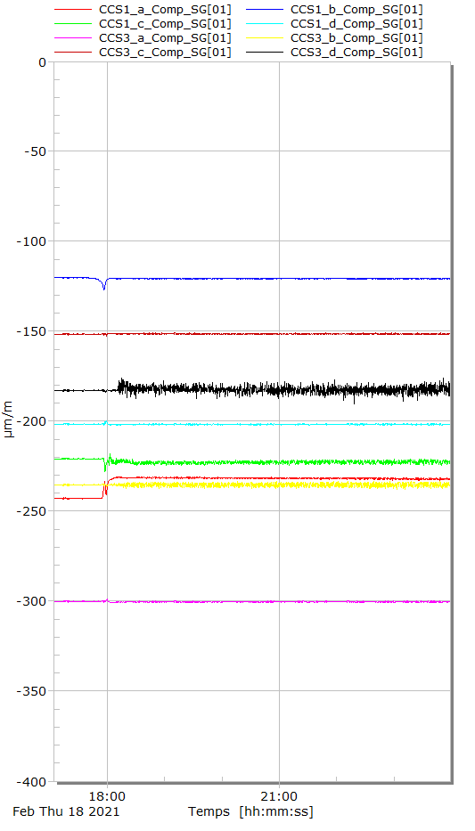
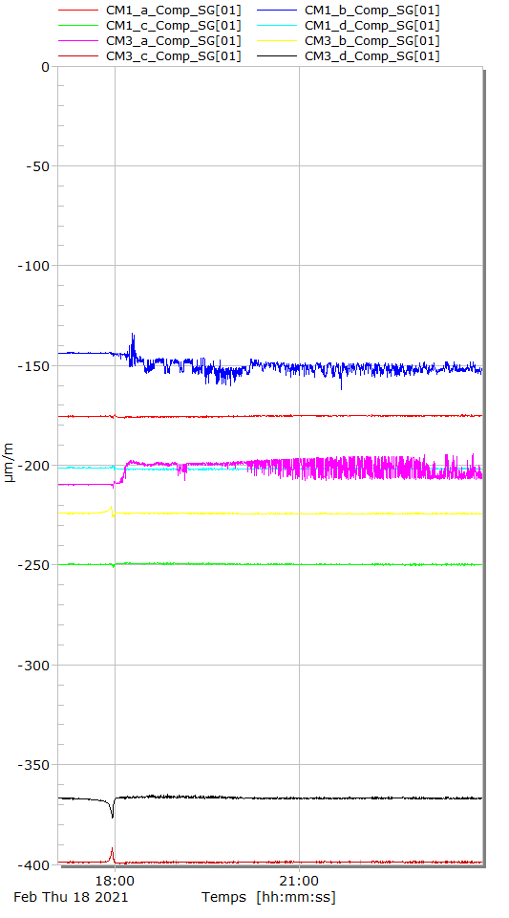
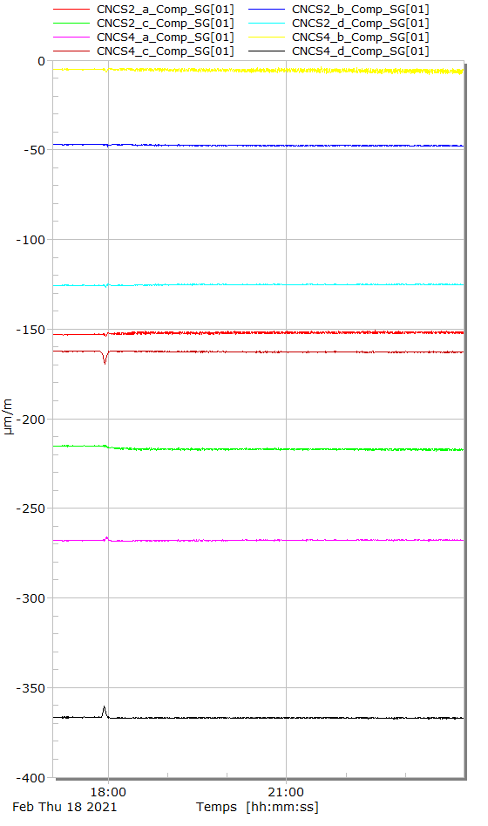
Bath instability at 4.5 K (Boiling)
2,2K
2,2K
2,2K
Change from 1.9 K to 4.5 K: Instability begins around 6:00 p.m. at a bath temperature of 2.2 K (Raw values without K factor corrections)

Slide 22
Conclusion
MCBXFBP2b was successfully monitored during the collaring process, thermal cycles and powering phases thanks to the 48 electrical strain gauges installed.
MCBXFBP2b was loaded with an additional stress of 20 MPa comparing to MCBXFBP2a.
A stress relaxation of 20 MPa was measured in 3 weeks.
Thermal cycles and powering phases do not affect the mechanical stresses of the structures.
During powering phases, a linear response of the inner coil strains was observed versus I² Inner. For the outer coil powering and both coils powering: additional investigation needs to be done to understand coupling effects: Data can be provided.
Some instability on the gauges was observed only at 4,5 K in the cryostat (circuit flowing from top to bottom inside the cryostat)

Slide 23
Thank you for your attention

Slide 24
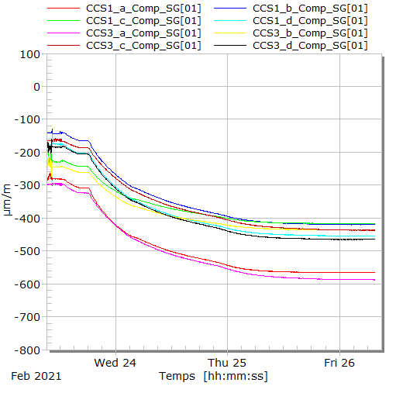
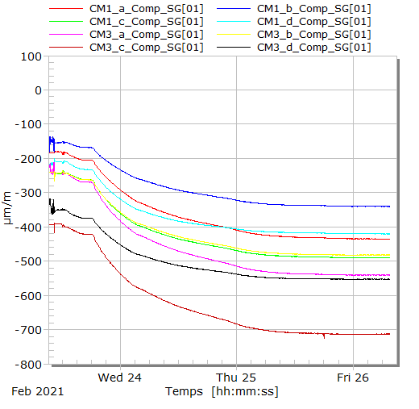




Warm up (raw values)
23 February 2021 to 26 February 2021

Slide 25







Ramp Inner at 1580A then Outer at 1384A
16 February 2021 at 10:05AM

Slide 26







Training inner and outer dipole at nominal current, in Quadrant 2 (I Inner=-1529A and I Outer=1395A)
18 February 2021 at 12:18PM

Slide 27







Quench free cycle – 12 ramps
19 February 2021 at 04:18PM to 06:06PM

