Slide 1
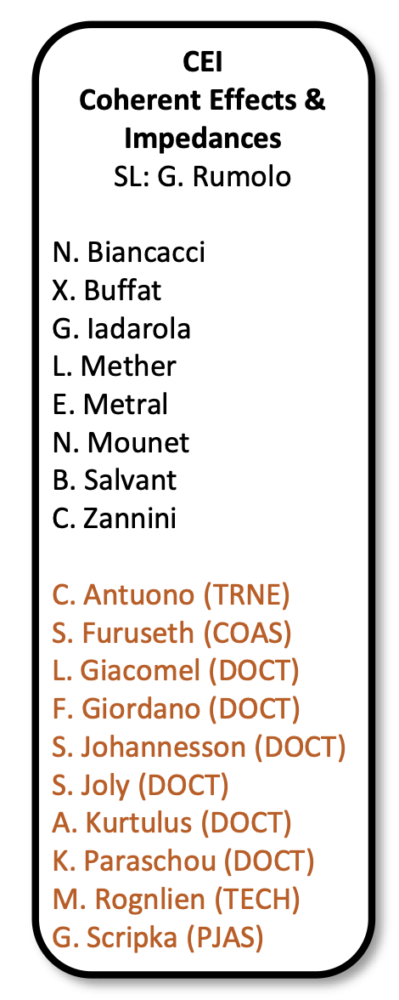
Coherent Effects and Impedances section (CEI) – general information
Giovanni Rumolo
CEI Section Meeting, 15/04/2020
https://indico.cern.ch/event/1012271/

Slide 2

General information from department/group/section
Covid-19 general info
  Current teleworking measures have been extended up to the 14 May 2021. Please keep your EDH leave status up to date.
  Relaxation of restrictions announced yesterday in Switzerland, like
    Reopening of outdoors meeting venues, e.g. bars and
    restaurants
    Reopening of gyms, cinemas and theaters at 1/3 capacity,
    access to stadiums up to 100 people
  Vaccination opened to all 45+ in the Geneva canton
Please take careful note of the information
  Found on the CERN Covid-19 info page
  (especially links recently updated)
  Spread through the weekly ‘Covid-19 updates’
  e-mail

Slide 3
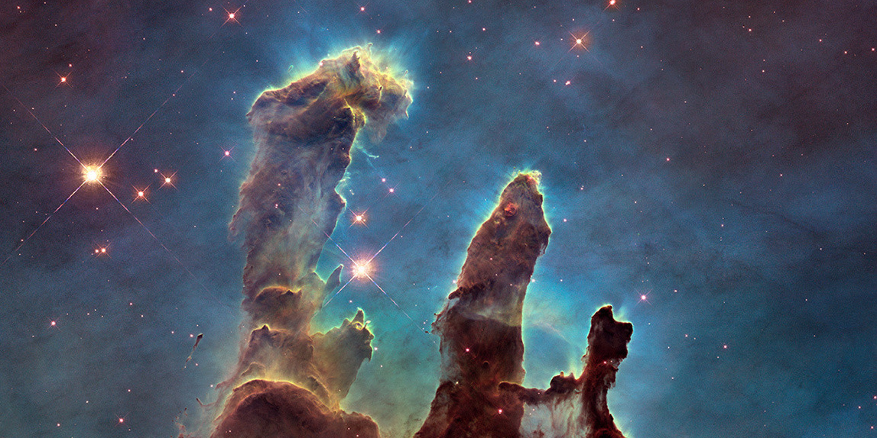
General information from department/group/section
New PBC organisation announced
by G. Arduini at IEFC:
FIP
Physics Centre
QCD
Working Group
BSM
Working Group
Conveners: H. Bartosik, G. Rumolo
  Exploration of performance possibilities and enhancements after LIU
  Provide expertise for analysis of beam requirements emerging from physics requests
  Update 2019 report based on commissioning and ramp-up experience
Beam Dump Facility
Accelerator Complex Capabilities
Conventional Beams
Forward Physics Facility
PBC-A&T
Committee
LHC – Fixed Target
Gamma Factory
Technology
Proto-EDM
Civil Eng., Integration, Radiation Protection (e.g. AION @ CERN)

Slide 4
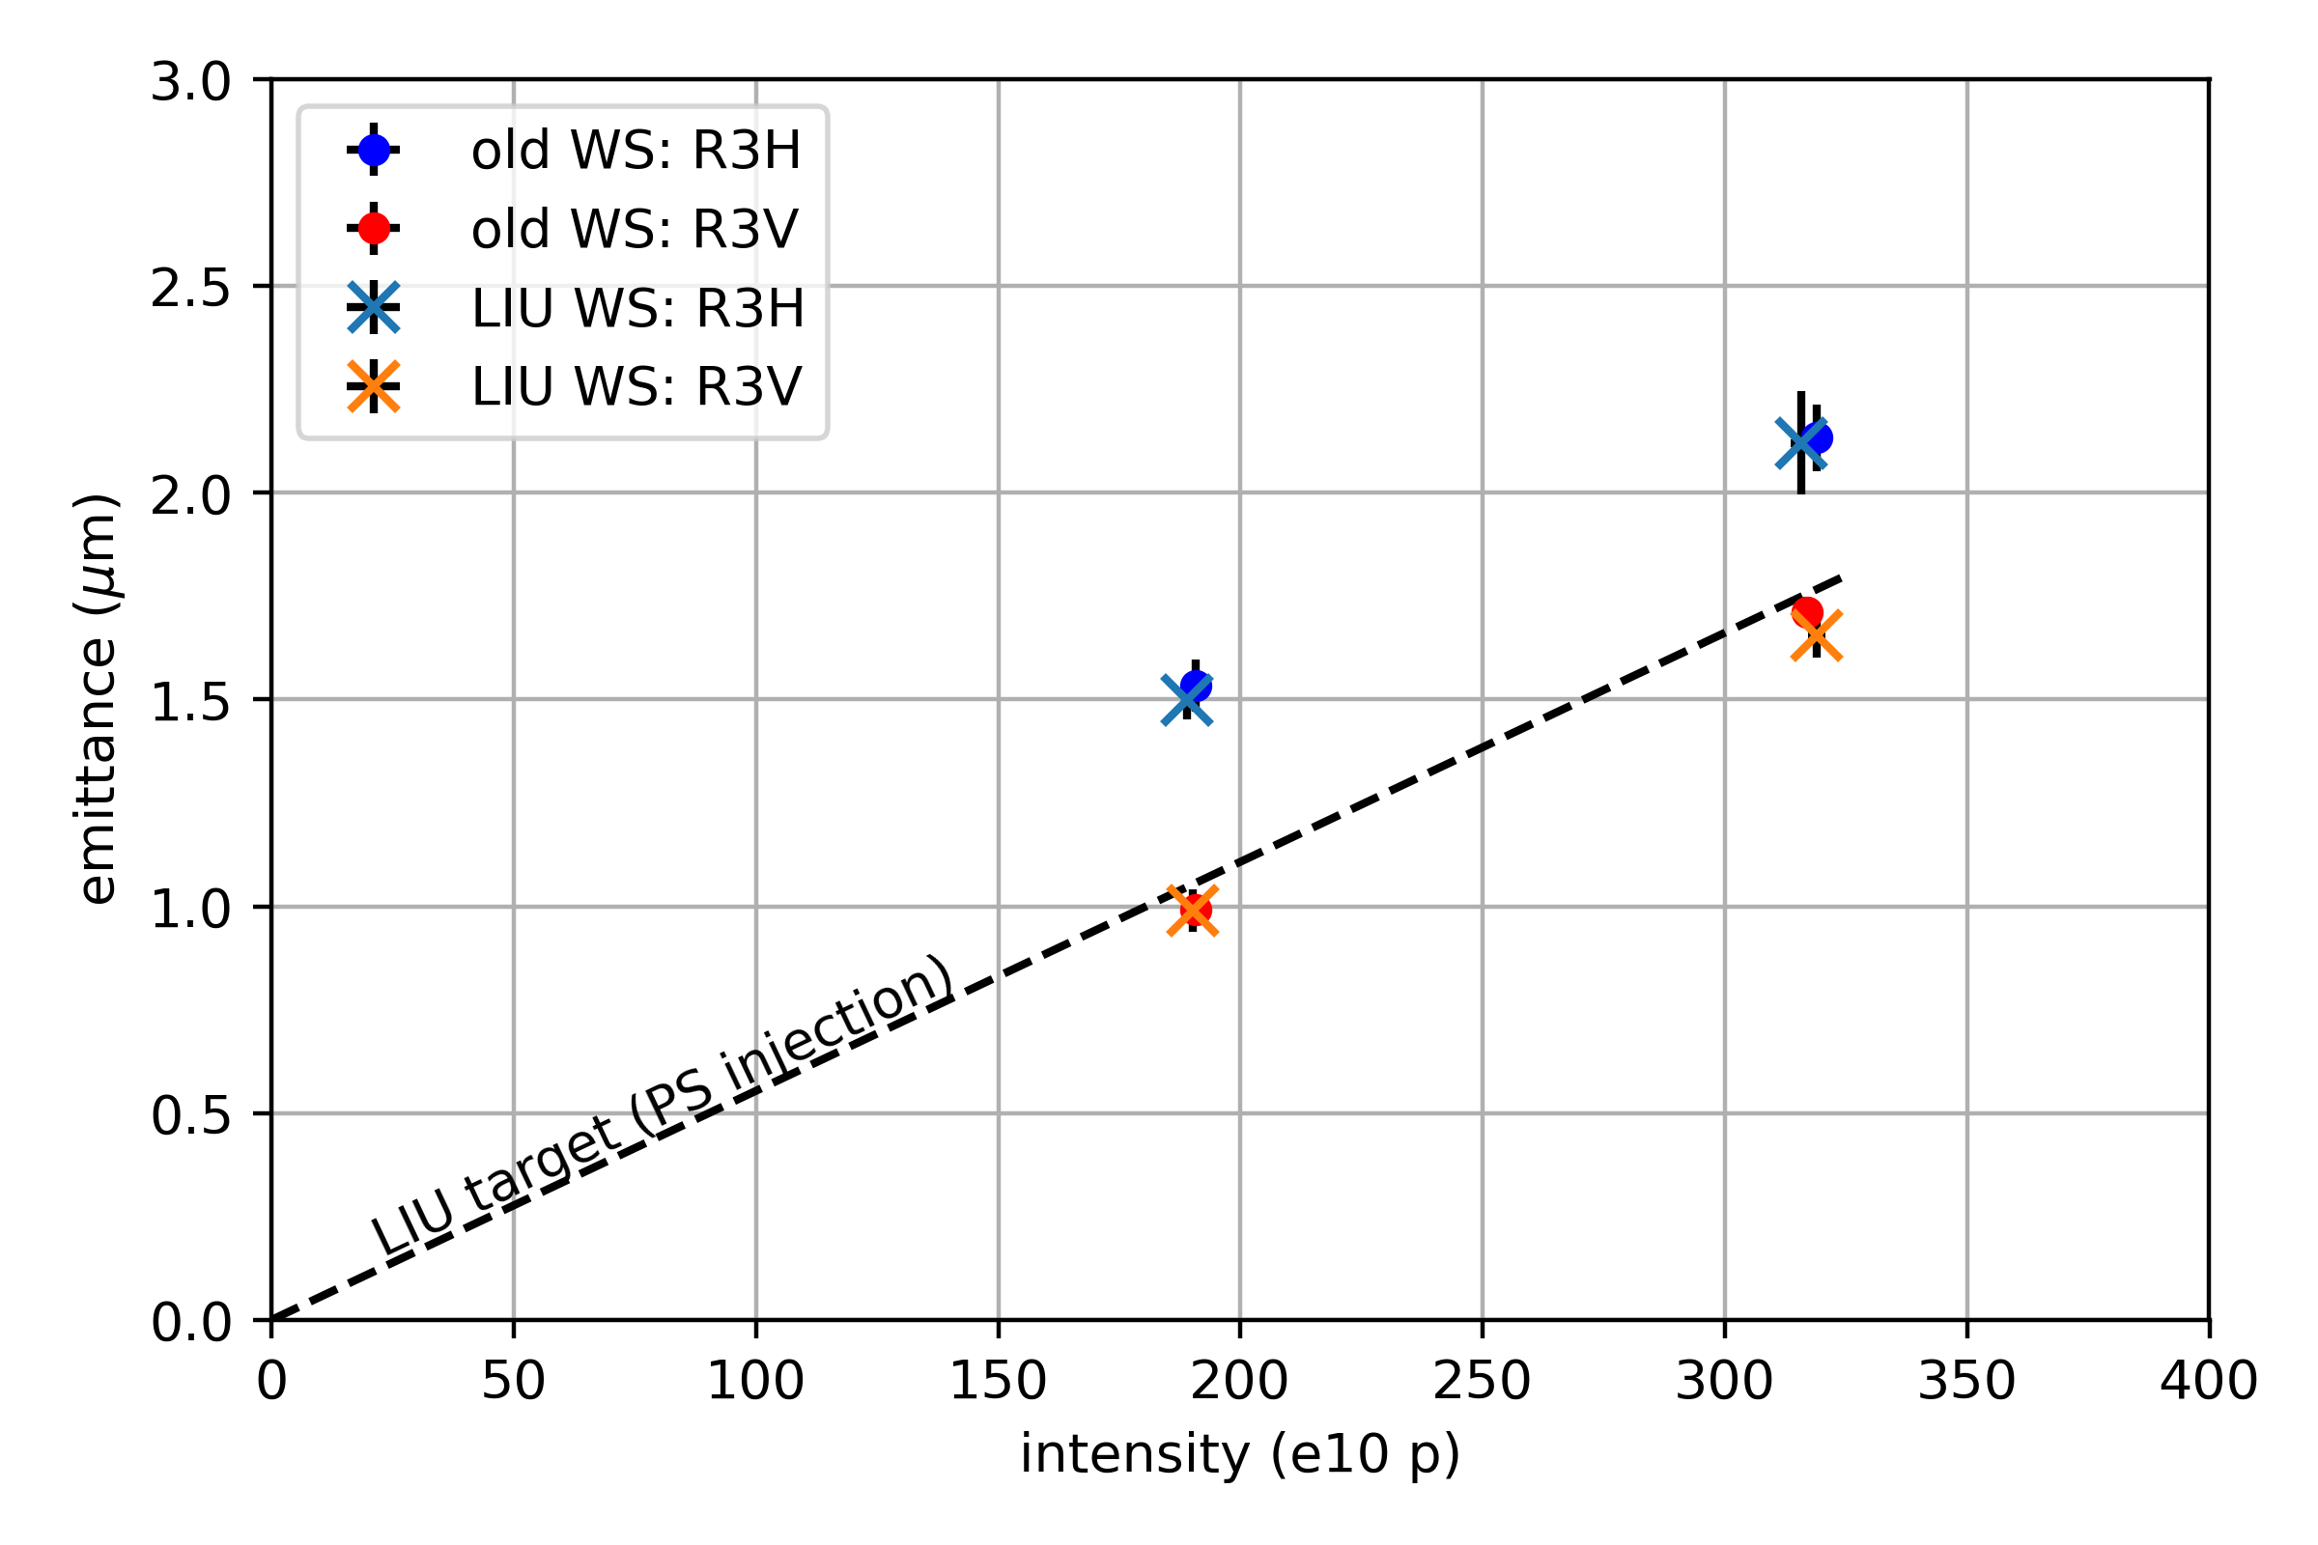
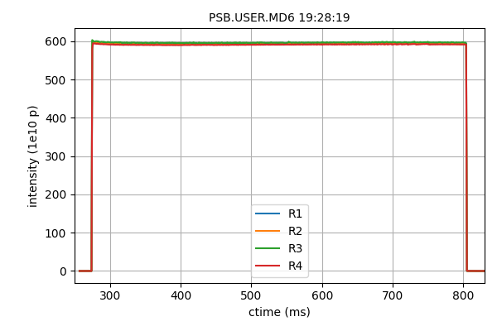
General information from department/group/section
My presentation on status of LIU beam commissioning at the IEFC:
MTE beam
60 turns injected
Pre-LS2
LHC beam: LIU brightness line
 | N [ppr] | ε_{x} [μm] | ε_{y} [μm]
Specs | <600e10 | >8 | <3
Achieved | 600e10 | 14 | 3.5

Slide 5
General information from department/group/section
Beam commissioning in the injectors
We are here

Slide 6
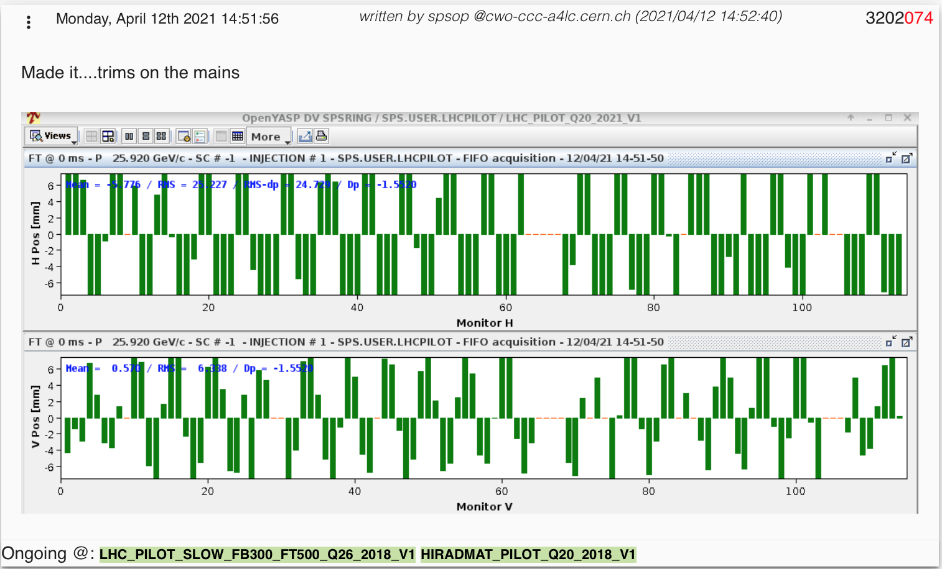
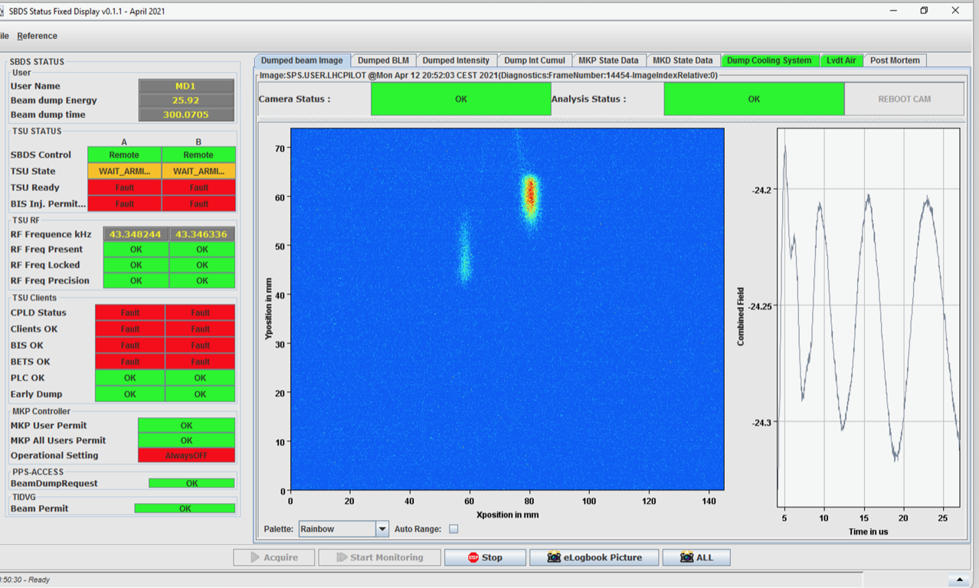
General information from department/group/section
Beam commissioning in the injectors
  There was beam in the SPS on 12 April
    Injection of LHCINDIV (nominal single bunch), uncaptured and coasting till start of the ramp
Beam sent to the new beam dump
New ALPS system tested with beam!
Notes:
LCH

Slide 7
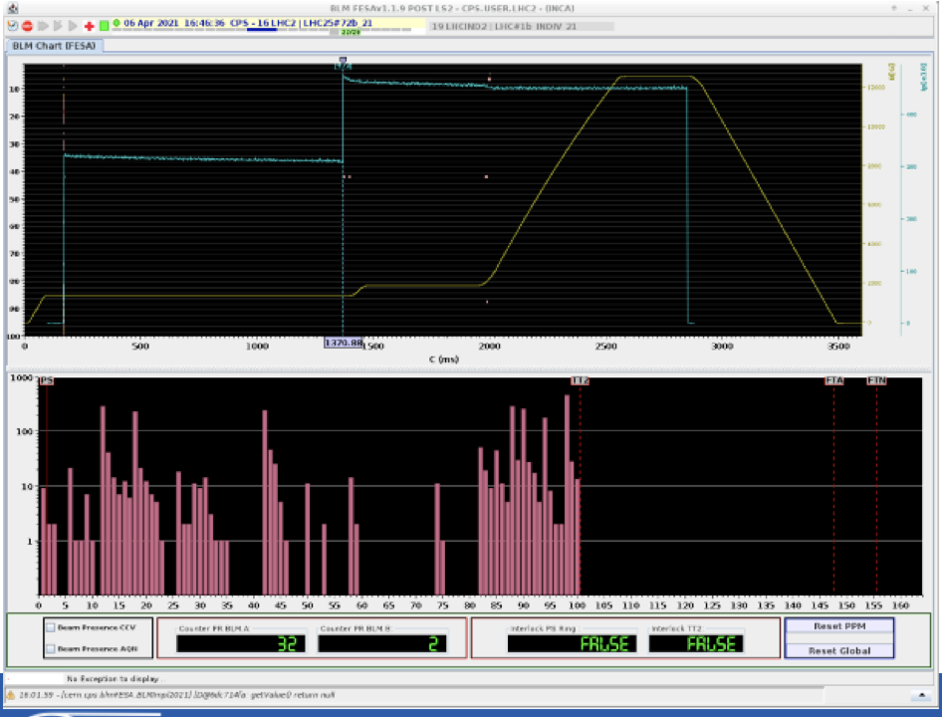
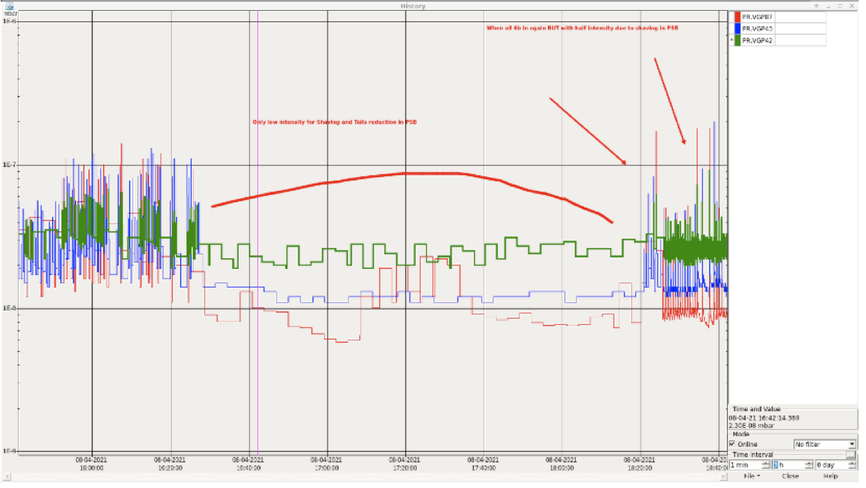
General information from department/group/section
Beam commissioning in the injectors
  There was beam in the SPS on 12 April
    Injection of LHCINDIV (nominal single bunch), uncaptured and coasting till start of the ramp
    Now two weeks to complete LLRF work and then real start of beam commissioning
  PS beam commissioning
    Still struggling with losses in SS88, probable vertical aperture restriction to be checked and possibly fixed during TS1
    Vacuum spikes and extraction losses seen with LHC25 could be due to electron cloud?
Notes:
LCH

Slide 8
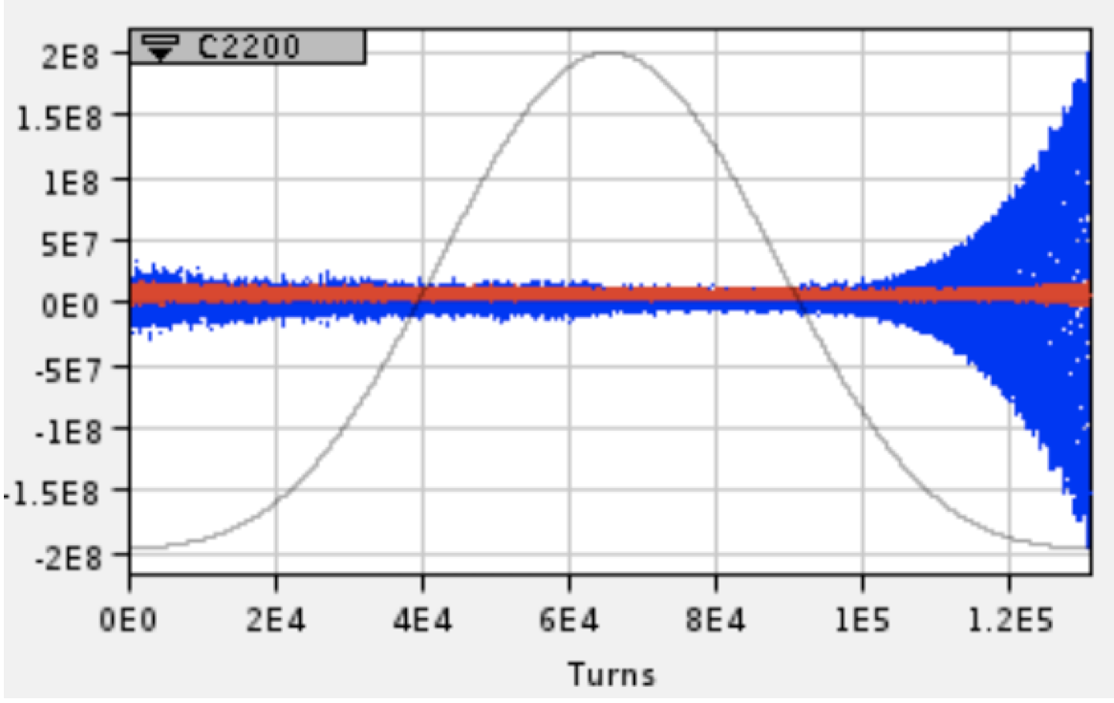
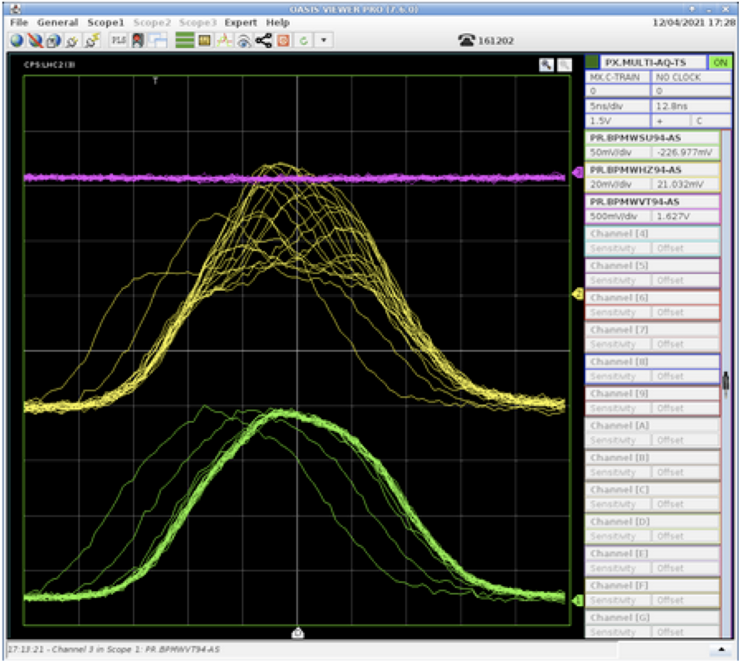
General information from department/group/section
Beam commissioning in the injectors
  There was beam in the SPS on 12 April
    Injection of LHCINDIV (nominal single bunch), uncaptured and coasting till start of the ramp
    Now two weeks to complete LLRF work and then real start of beam commissioning
  PS beam commissioning
    Still struggling with losses in SS88, probable vertical aperture restriction to be checked and possibly fixed during TS1
    Vacuum spikes and extraction losses seen with LHC25 could be due to electron cloud?
    Also observed horizontal instabilities at high energy due to negative chromaticity
      It could be interesting if our models of the PS predict this type of behaviour
Mode 0 ?
Notes:
LCH

