Slide 1


«STUDY OF DOSE TRANSMISSION IN A MULTILEAF COLLIMATOR ON A VARIAN HALCYON ACCELERATOR»
LOMONOSOV MOSCOW STATE UNIVERSITY
FACULTY OF PHYSICS
PHYSICS OF ACCELERATORS AND RADIATION MEDICINE
Morozova E.P. ^{2,1} , Lykova E.N.¹ , Petrova A.F.¹, Gromova N.V. ², Chernyaev A.P.¹
¹ LOMONOSOV MOSCOW STATE UNIVERSITY, Faculty of Physics, Physics of Accelerators and Radiation Medicine. Leninskie Gory, Moscow 119991, Russia
²Moscow International Oncology Center, st. Durov 26, Moscow, Russia
MOSCOW 2021

Slide 2
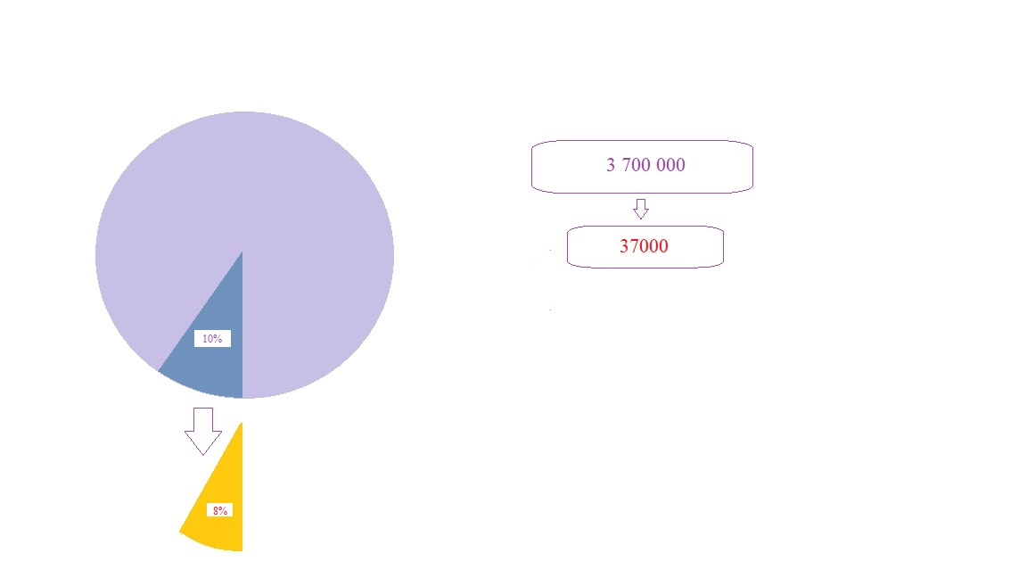
The relevance of research
The number of patients who show late radiation reactions is increasing every year. This trend can be traced, as, thanks to modern methods of treatment, a number of patients live long enough to show long-term reactions to radiation exposure.
In 10% of the occurrence of secondary cancer, 8% is due to the actual radiation exposure during radiation therapy.
That is, slightly less than 1% of those who survived for a long period of time developed secondary cancer as a result of radiation therapy, however, this number may increase with longer follow-up.
The single most important parameter that affects the overall leakage rate is the distance from the edge of the field.

Slide 3
Purpose of the study
Experimental study of dose leakage from the SX1 multi-leaf collimator at the Varian Halcyon medical linear accelerator.
Assessment of the dose outside the irradiated volume.
Varian Halcyon

Slide 4
MATERIALS AND METHODS
Design features of the MLC Varian Halcyon
The Halcyon MLC System features a unique stepped two-layer construction consisting of a distal and a proximal layer.
The primary and secondary collimators are fixed, there is no smoothing filter.
The petals are made from a natural mixture of tungsten and are staggered.
The MLC petals on Halcyon travel in a straight line and have rounded ends.
Halcyon delivers MLC speeds of up to 5.0 cm per second and a dose rate of 800 monitor units per minute.
Accelerator head Halcyon

Slide 5
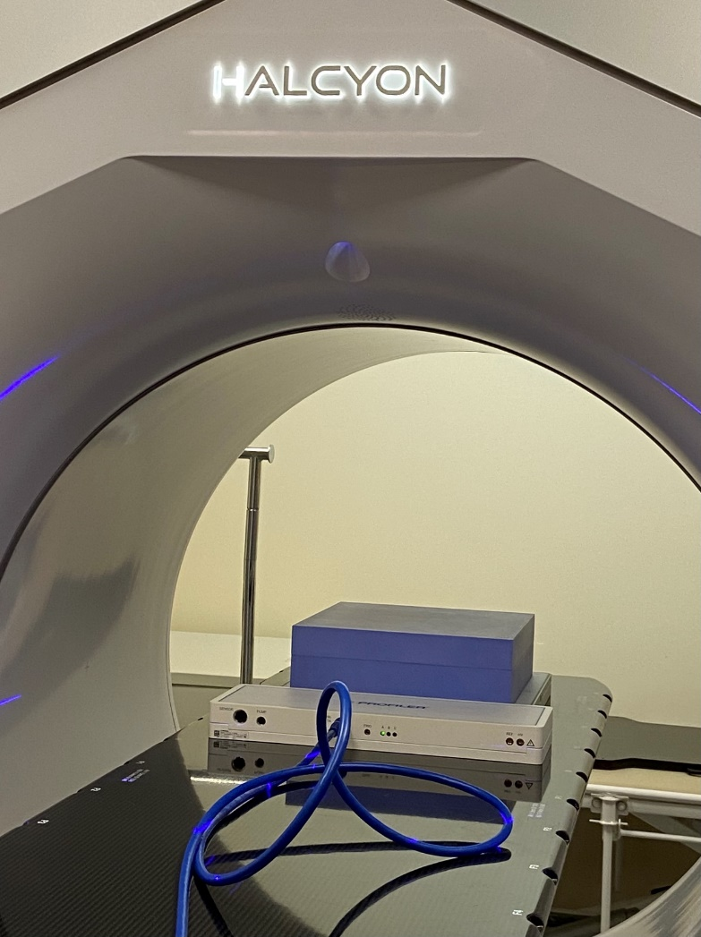
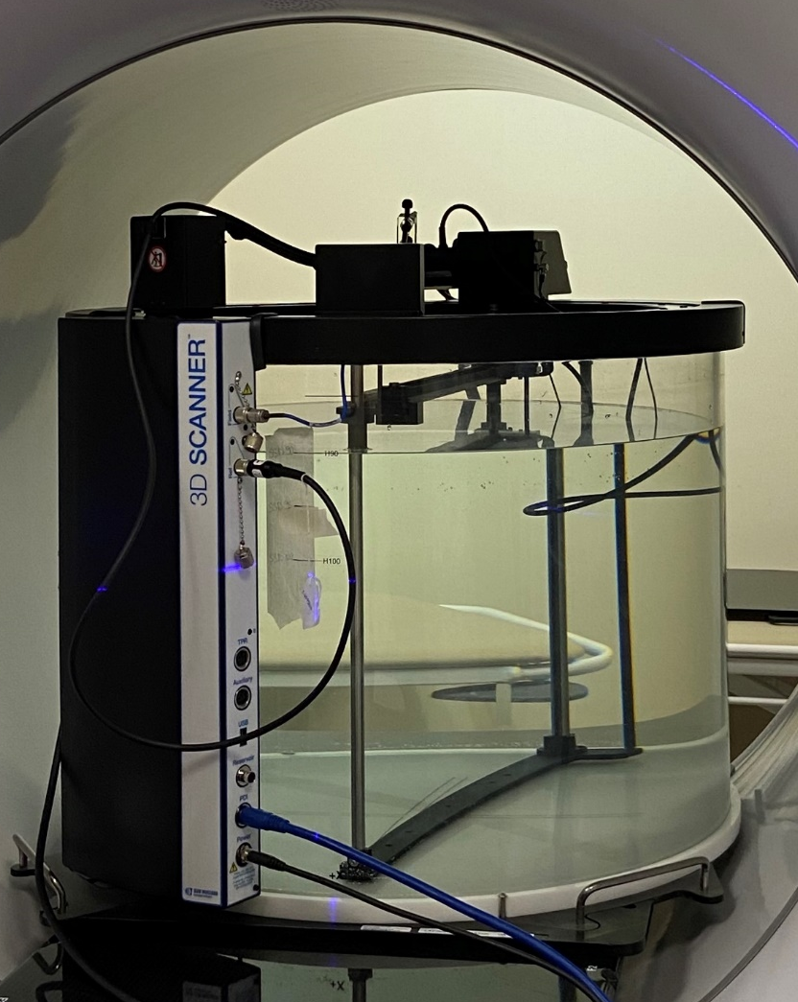
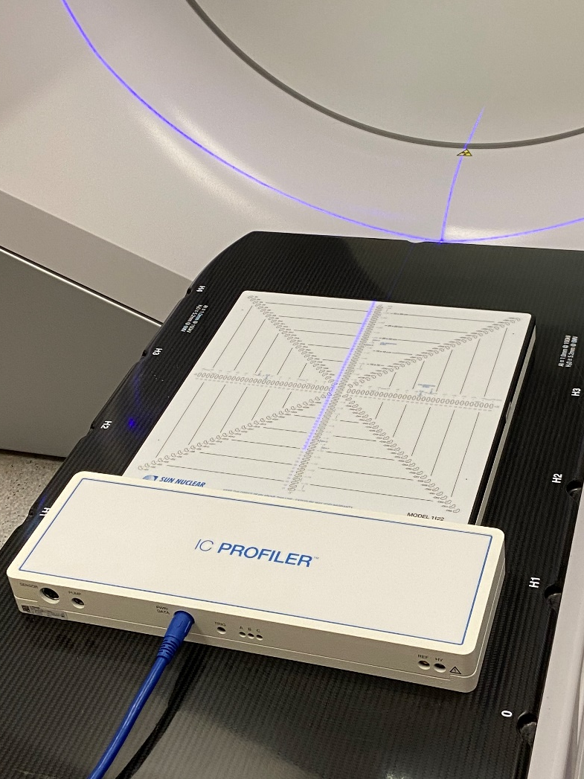
MATERIALS AND METHODS
Equipment
Matrix detector IC PROFILER Sun Nuclear
General view of the experiment with the Solid Water Gammex phantom
Water Phantom 3D Scanner Sun Nuclear

Slide 6
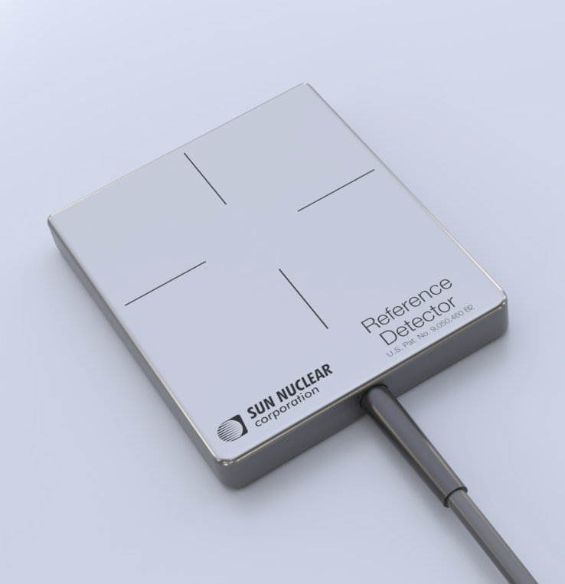
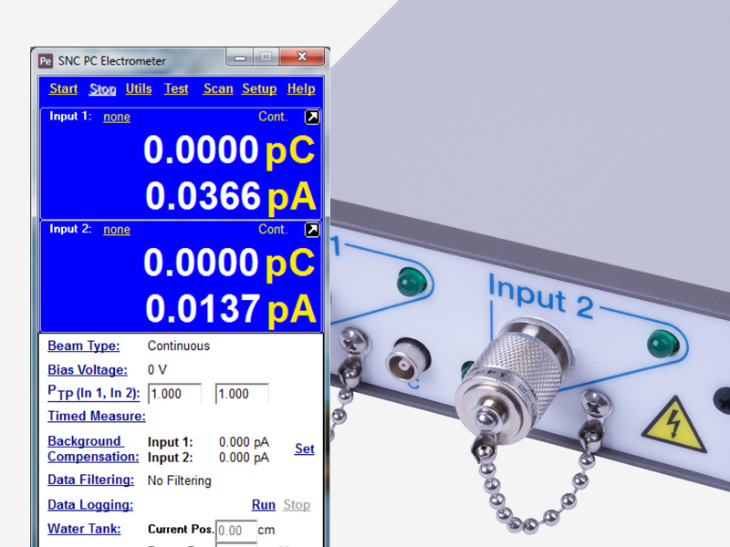
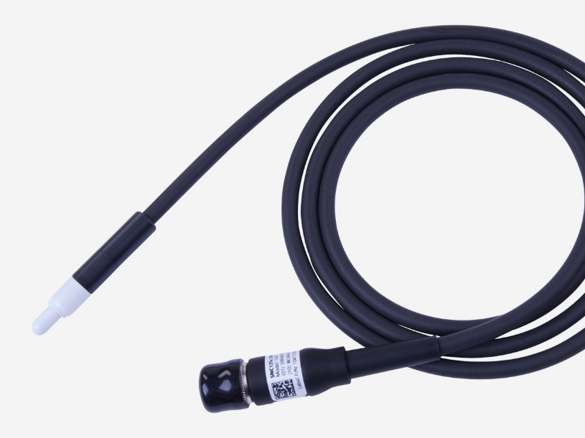
Equipment
MATERIALS AND METHODS
Ionization chamber SNC 125c
Sun Nuclear Reference Detector
PC Electrometer SNC Dosimetry

Slide 7
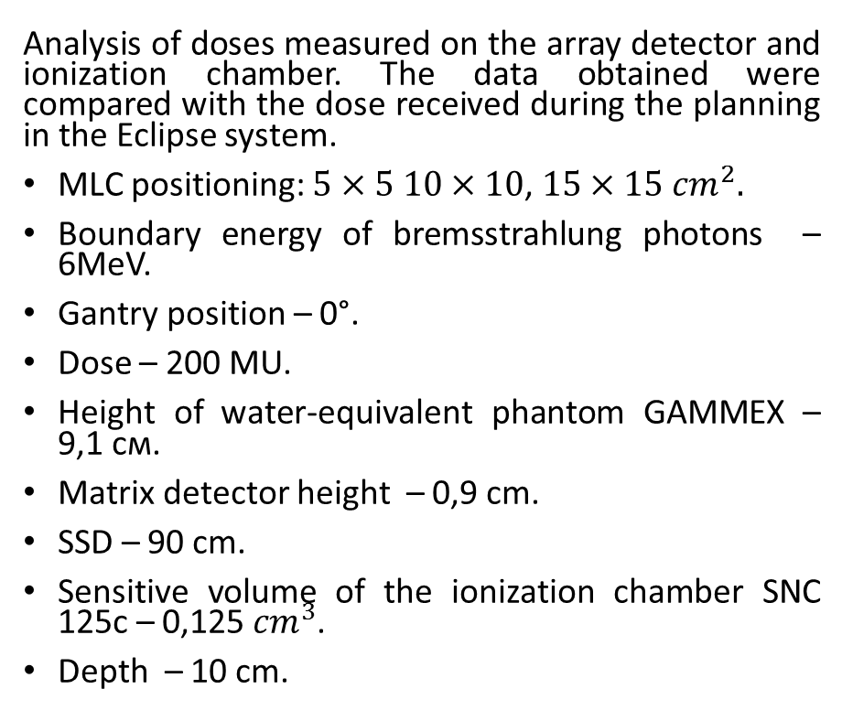
MATERIALS AND METHODS
Experimental data with different field sizes
Analysis of doses measured on the array detector and ionization chamber. The data obtained were compared with the dose received during the planning in the Eclipse system.
MLC positioning: $5×5$ $10×10$, $15×15 {cm}^{2}.$
Boundary energy of bremsstrahlung photons – 6MeV.
Gantry position – 0°.
Dose – 200 MU.
Height of water-equivalent phantom GAMMEX – 9,1 см.
Matrix detector height – 0,9 cm.
SSD – 90 cm.
Sensitive volume of the ionization chamber SNC 125c – 0,125 ${cm}^{3}$.
Depth – 10 cm.
Halcyon multilayer collimation system in cross section

Slide 8
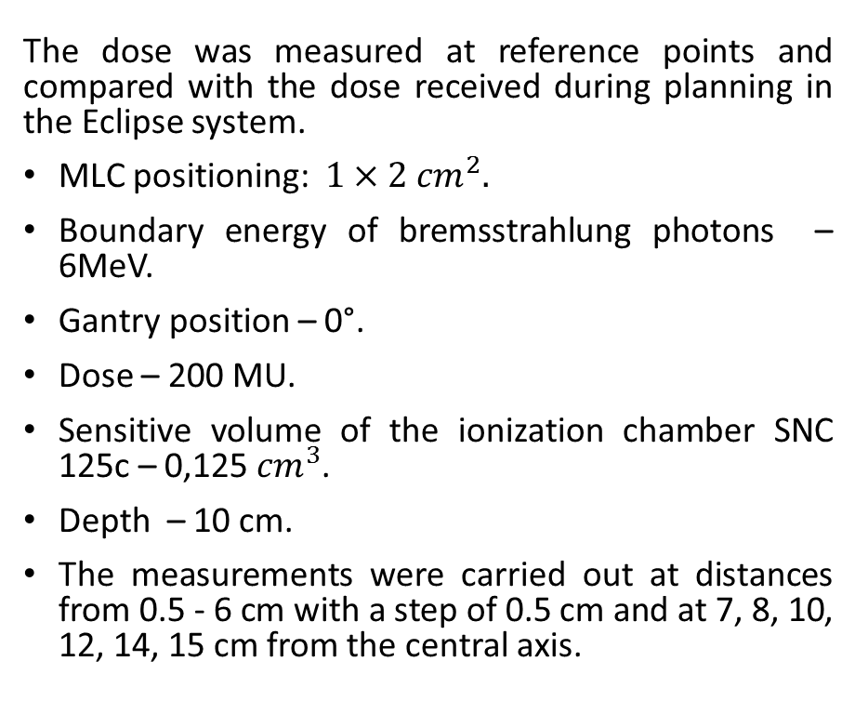
MATERIALS AND METHODS
Small field experiment data
The dose was measured at reference points and compared with the dose received during planning in the Eclipse system.
MLC positioning: $1×2 {cm}^{2}.$
Boundary energy of bremsstrahlung photons – 6MeV.
Gantry position – 0°.
Dose – 200 MU.
Sensitive volume of the ionization chamber SNC 125c – 0,125 ${cm}^{3}$.
Depth – 10 cm.
The measurements were carried out at distances from 0.5 - 6 cm with a step of 0.5 cm and at 7, 8, 10, 12, 14, 15 cm from the central axis.
Halcyon multilayer collimation system in cross section

Slide 9
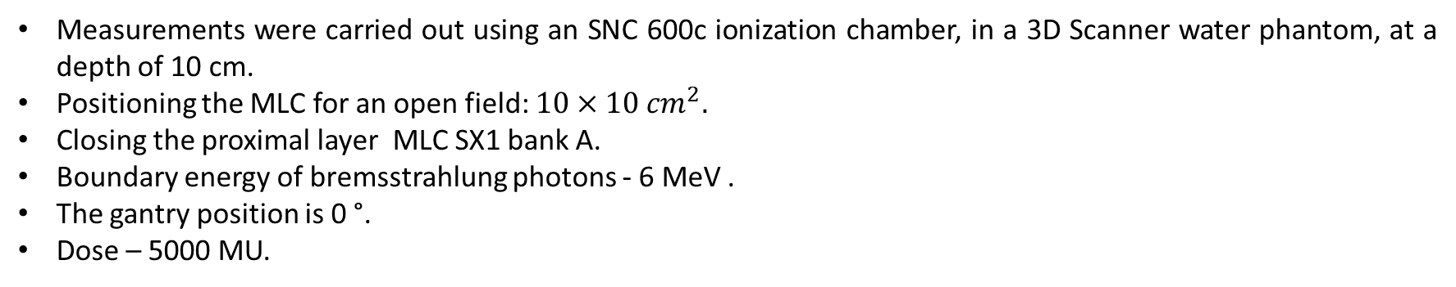
RESULTS
Measurements taken with closed MLC SX1
 | Charge, open field, nC | Average charge value, nC | Closed field, nC | The average value of the charge of the closed field , nC | Dose leakage, %
1 | 431,9511±5,6153 | 431,9368±5,6150 | 0,5125±0,0067 | 0,5126±0,0067 | 0,0119±1,705E-05
2 | 431,8129±5,6135 |  | 0,5131±0,0067
3 | 432,0245±5,6163 |  | 0,5121±0,0067
Measurements were carried out using an SNC 600c ionization chamber, in a 3D Scanner water phantom, at a depth of 10 cm.
Positioning the MLC for an open field: $10×10 {cm}^{2}.$
Closing the proximal layer MLC SX1 bank А.
Boundary energy of bremsstrahlung photons - 6 MeV .
The gantry position is 0 °.
Dose – 5000 MU.

Slide 10
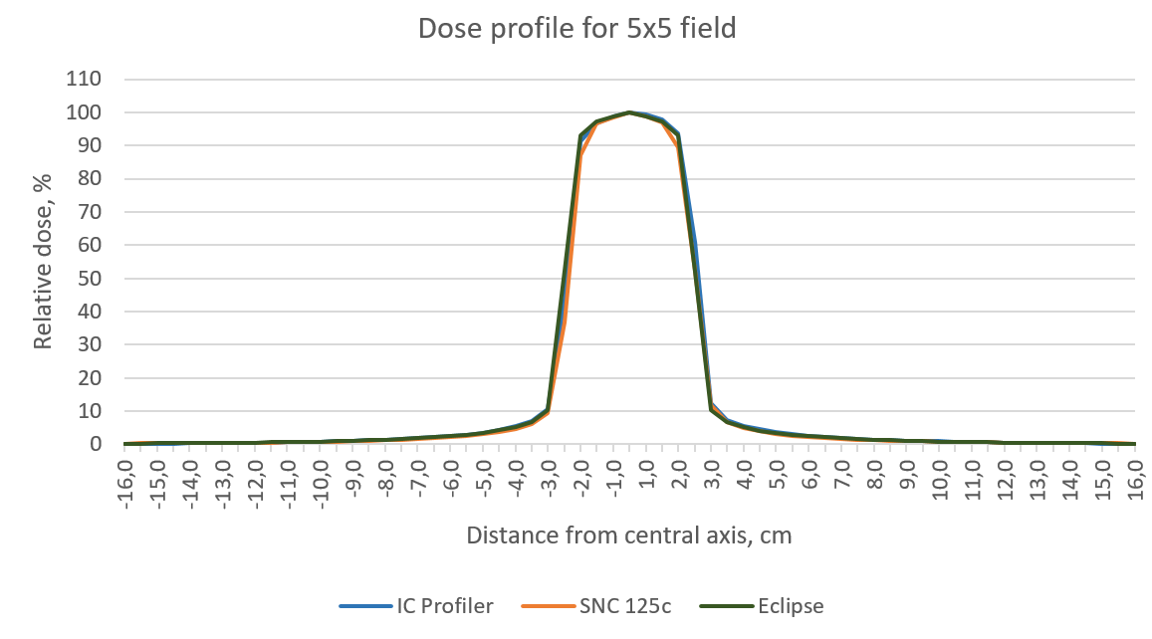
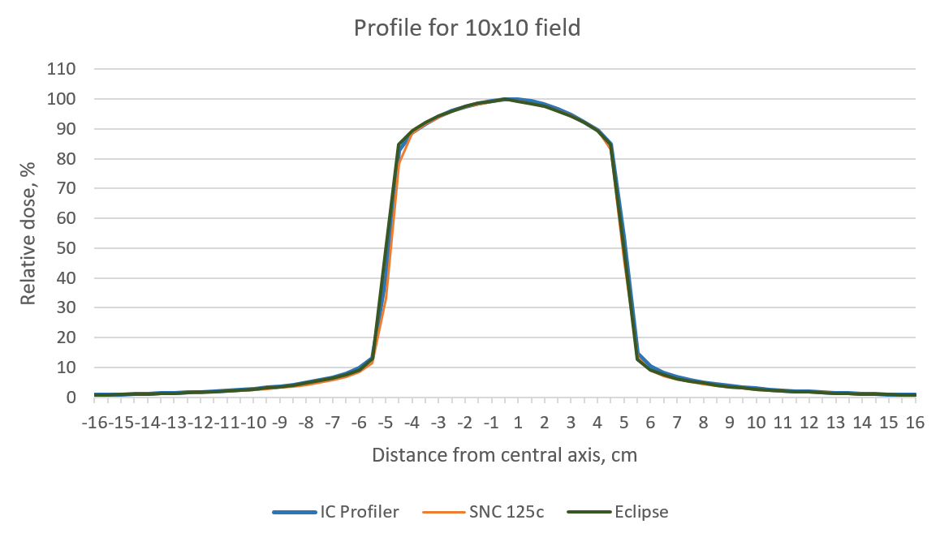
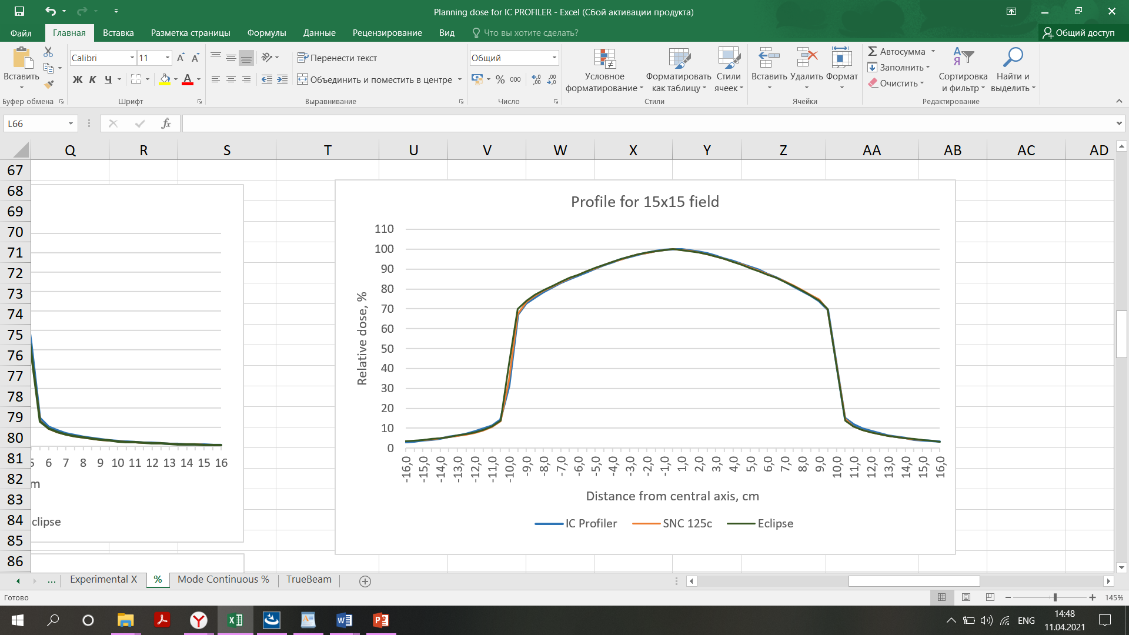
RESULTS
Obtained beam profiles for different field sizes

Slide 11
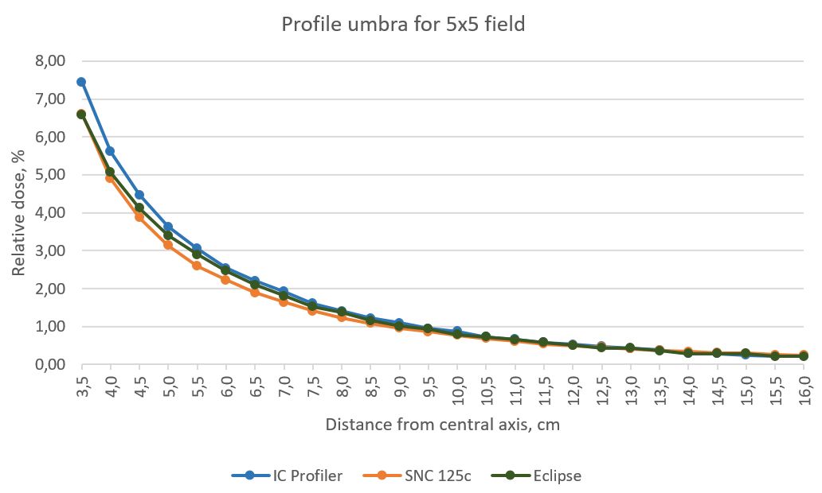
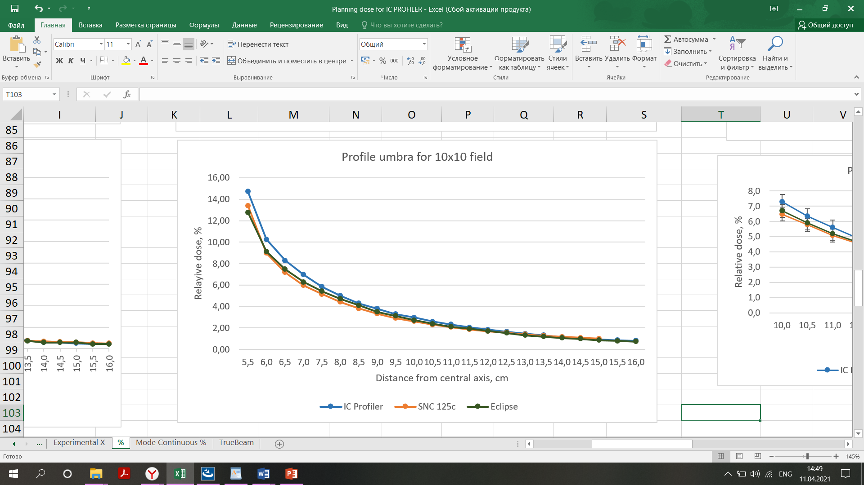
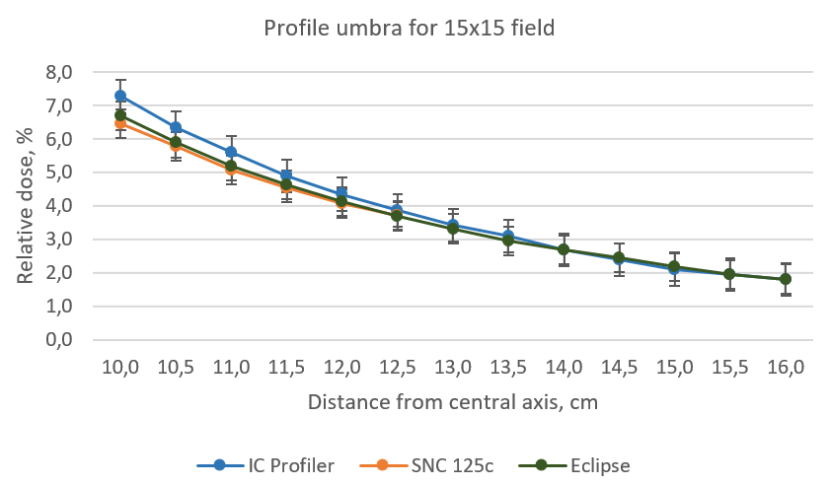
RESULTS
Shadow area plots for different field sizes

Slide 12
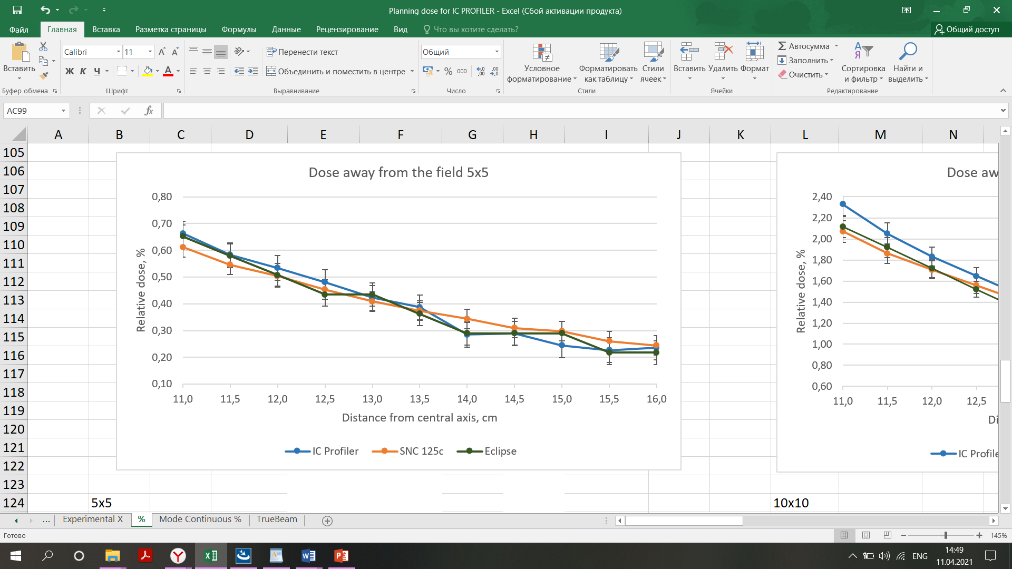
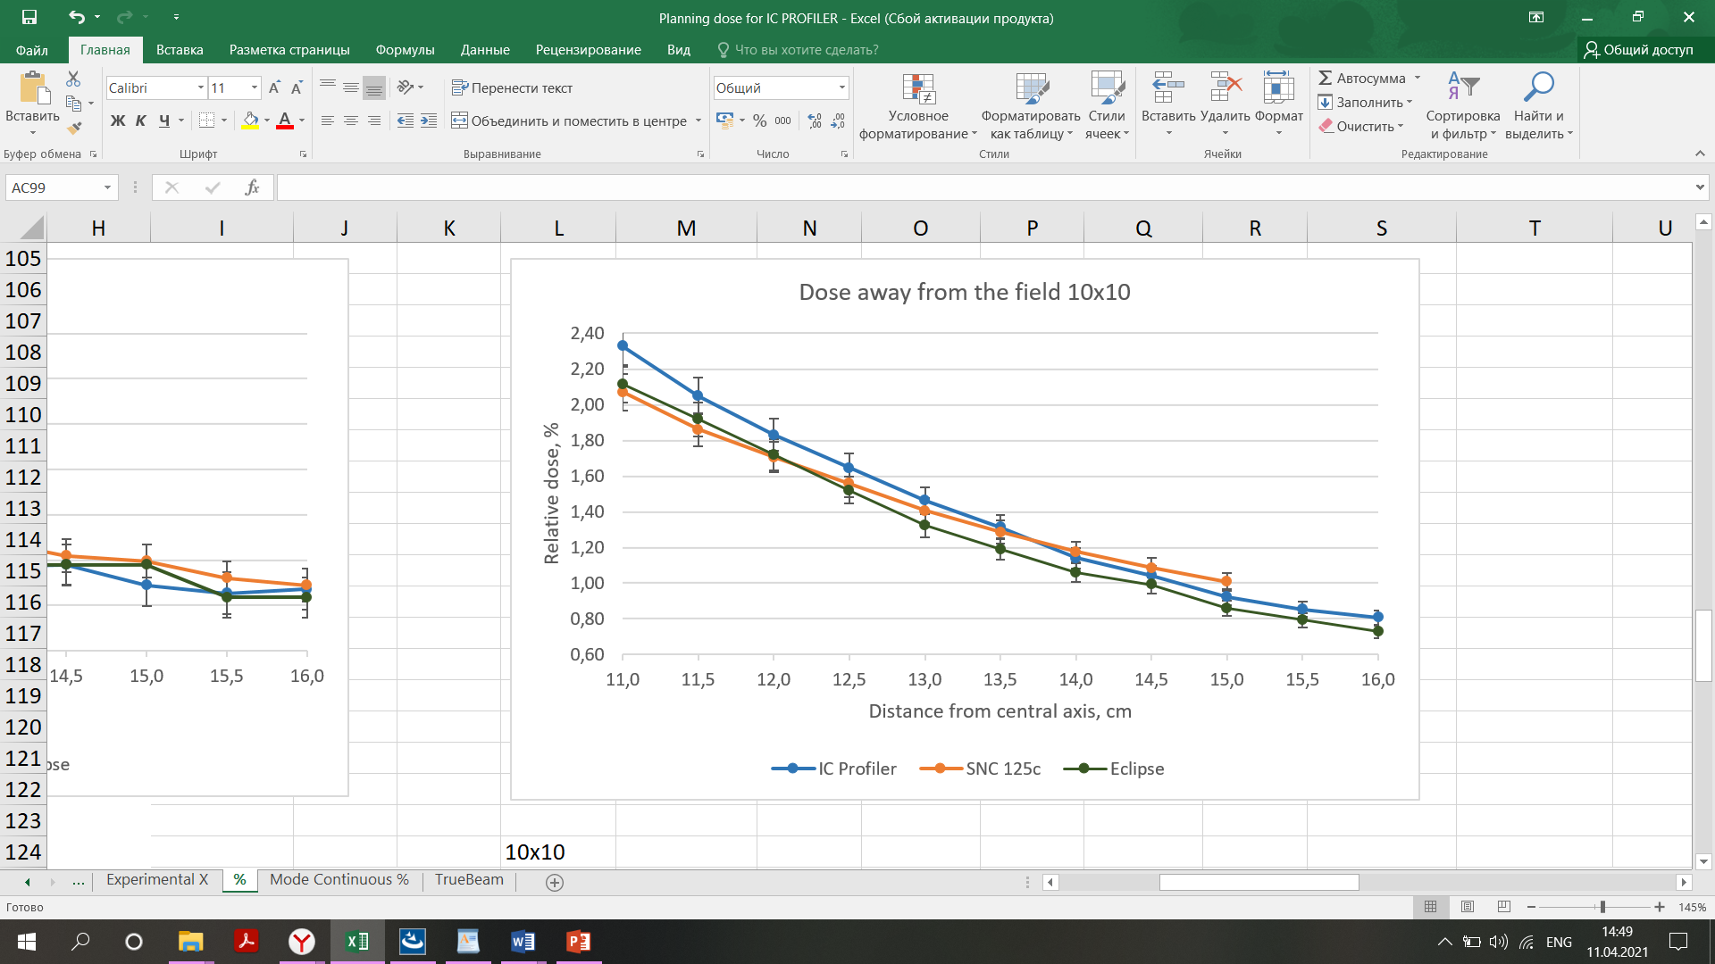
RESULTS
Profile plots away from the central axis

Slide 13
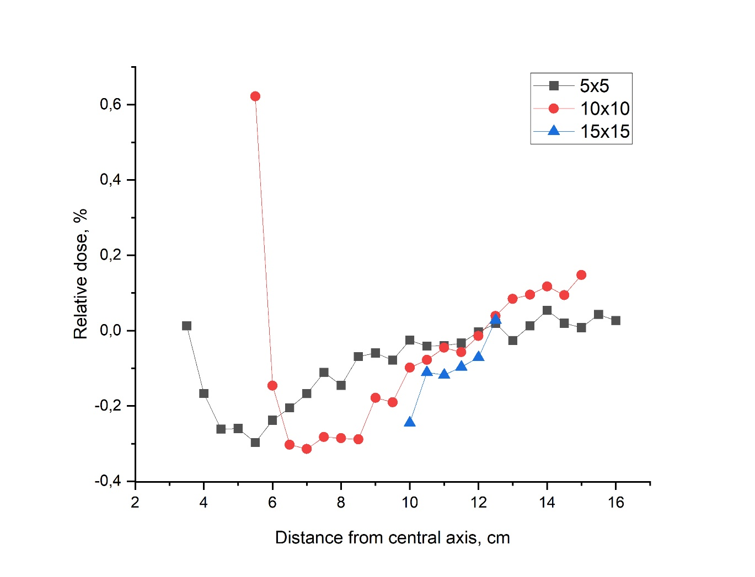
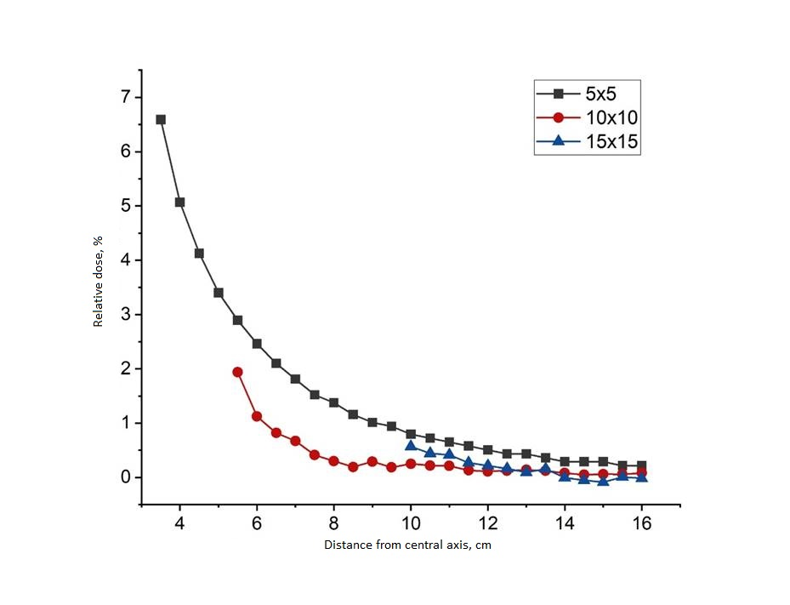
RESULTS
Difference between measured doses of SNC 125c and calculated doses in Eclipse
Dose difference between measured IC Profiler and calculated doses in Eclipse

Slide 14
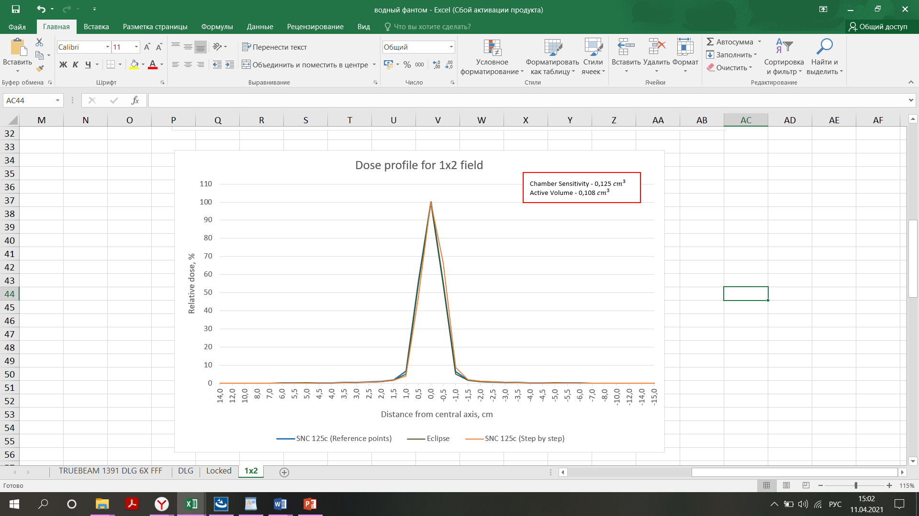
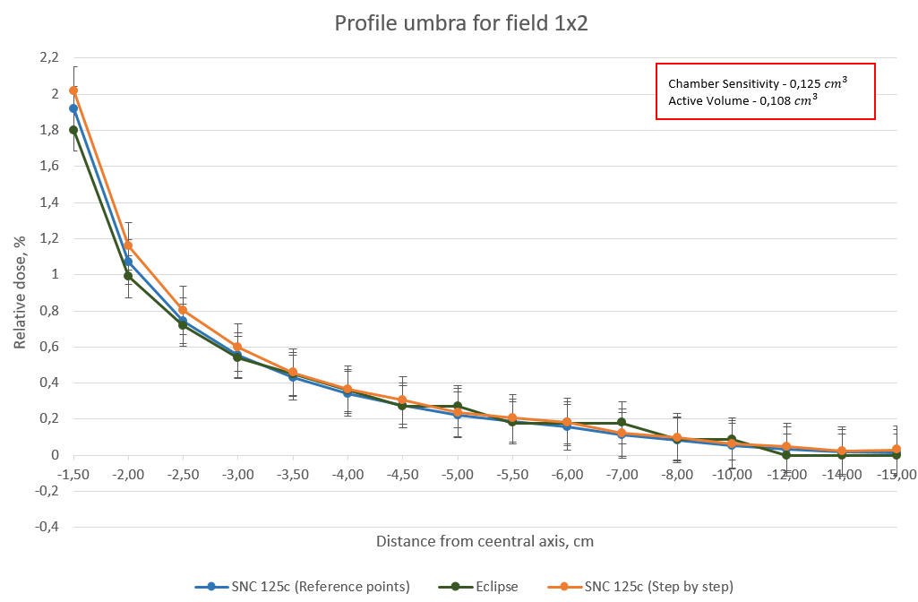
RESULTS
The data obtained in the experiment with a small field size

Slide 15
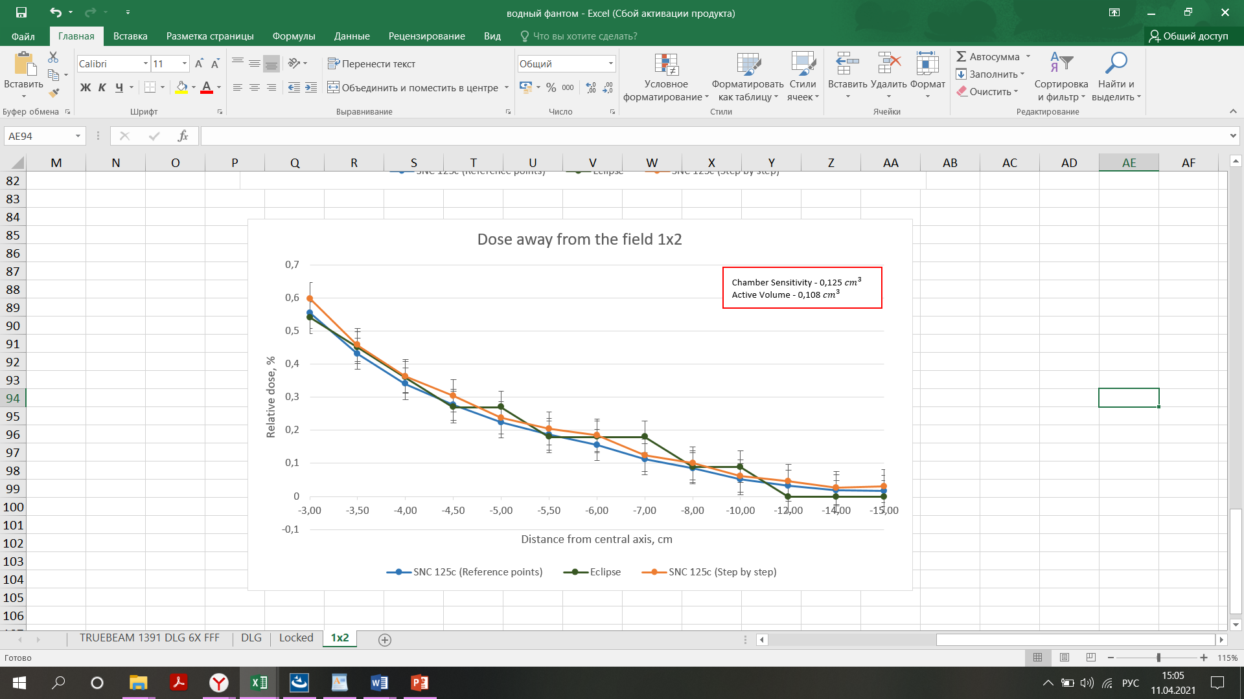
RESULTS
Data obtained for the experiment with a small field size
cm | Dose at reference points | Calculated dose | Dose measured in step by step mode
14 | 0,0213±0,0003 | 0,00 | 0,0374±0,0005
12 | 0,0341±0,0004 | 0,00 | 0,0527±0,0007
10 | 0,0524±0,0007 | 0,09 | 0,0639±0,0008
8 | 0,0886±0,0011 | 0,09 | 0,0994±0,0013
7 | 0,1174±0,0015 | 0,18 | 0,1258±0,0016
6 | 0,1593±0,0021 | 0,18 | 0,1780±0,0023
5,5 | 0,1896±0,0025 | 0,18 | 0,1873±0,0024
5 | 0,2258±0,0029 | 0,27 | 0,2462±0,0032
4,5 | 0,2780±0,0036 | 0,27 | 0,2755±0,0036
4 | 0,3445±0,0045 | 0,36 | 0,3579±0,0047
3,5 | 0,4343±0,0056 | 0,45 | 0,4372±0,0057
3 | 0,5579±0,0072 | 0,54 | 0,5371±0,0071

Slide 16
Conclusions
The dose leakage with the closed MLC SX1 was - 0,0119±1,705E-05%.
Experiments have shown that despite the fact that the same dose of 200 monitor units was guided in all experiments, the dose leakage increases with increasing field size. At a distance of 16 cm from the central axis, doses of 0.217, 0.727, 1.815% are observed for fields of 5 × 5, 10 × 10, 15 × 15, respectively.
For a field size of 1x2 at a distance of 14 cm from the central axis, a dose of 0.02% is observed, while the planning system sets 0% of the relative dose at the same distance.
The results of the current study are important for understanding how field size affects dose leakage.

Slide 17
THANKS FOR YOUR ATTENTION!

