Slide 1

Study of dose-enhancing agents on bremsstrahlung photons from SL75-5MT medical accelerator
LXXI International conference ”NUCLEUS – 2021. Nuclear physics andelementary particle physics. Nuclear physics technologies”
Skorkin V.M.
INR RAS
лекция

Slide 2
Contrast-enhanced radiotherapy allows to enhance the radiation dose absorbed by the tumor when using the hard elements for a photon absorption.
The dose-enhancing agents (I, Gd, Au, Bi, etc.) have a better absorption capacity, than biological tissues and thus sparing the surrounding healthy cells.

Slide 3
Normally, increase dose absorbed by dose-enhancing agent concentrations employ up to 15 mg/ml at using bremsstrahlung photons generated by the clinical linear electron accelerator SL75-5MT. .
Increase dose absorbed (on 13%) by iodinated water (for 50 mg/ml iodine concentrations) was obtained in a work (Vorobyeva E.S. at al, Bulletin of RSMU. 4, 57 (2017).

Slide 4
The study is aimed at studying the features of using metal-organic composites to increase the absorption of SL75-5MT bremsstrahlung photons.
In the work investigated the possibility of using dose increasing agents (Gd, Au, W, Bi, Pb, D2O)
to increase the absorption of SL75-5MT accelerator radiation. .

Slide 5
The SL75-5MT bremsstrahlung radiation created 2 Gray/min absorbed dose at a distance of 1 m.
The 80% of flux photon of the accelerator have 0.5-4.5 MeV energy.

Slide 6
The energy fluence distribution from SL75 accelerator

Slide 7
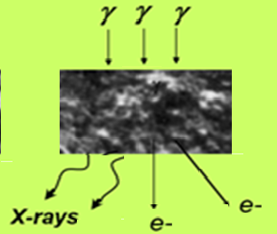
The photons of the linear electron accelerator create secondary X-ray and electrons in the dose-enhancing metallic agents.
This is enhanced the radiation dose absorbed by the tumor.

Slide 8
X-ray and electrons from dose-enhancing agents are enhanced the radiation dose absorbed by the tumor cells.
Radiation
DNA
Gd ion
e
electrons
Cell
e
X ray
≥ 50 μm
nucleus

Slide 9
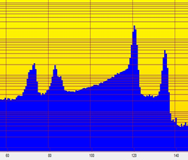
X-ray characteristic radiation for the lead material from lead composite material (energies 75 keV, 85 keV)
The intensity of the characteristic radiation for the Pb-composite, measured by a Ge detector was more than 15% from a attenuation radiation.

Slide 10
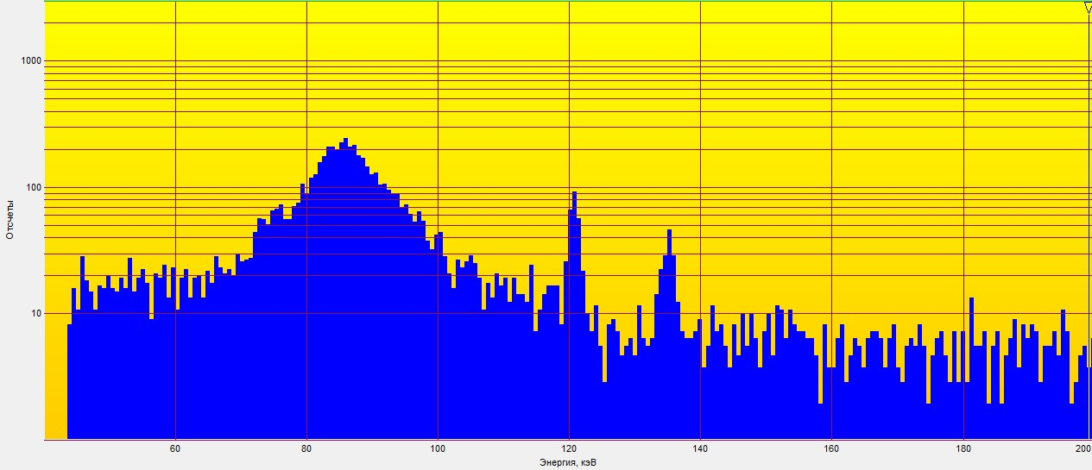
Spectrum of radiation from the bismuth material
The intensity of the characteristic radiation for the Bi-material (at large attenuation gamma raу). was about 50% from a attenuation radiation.

Slide 11
Bismuth dose-enhancing agent material

Slide 12
Spectrum of radiation from the bismuth material
The intensity of the characteristic radiation for the Bi-material (at large attenuation gamma raу). was about 50% from a attenuation radiation.

Slide 13
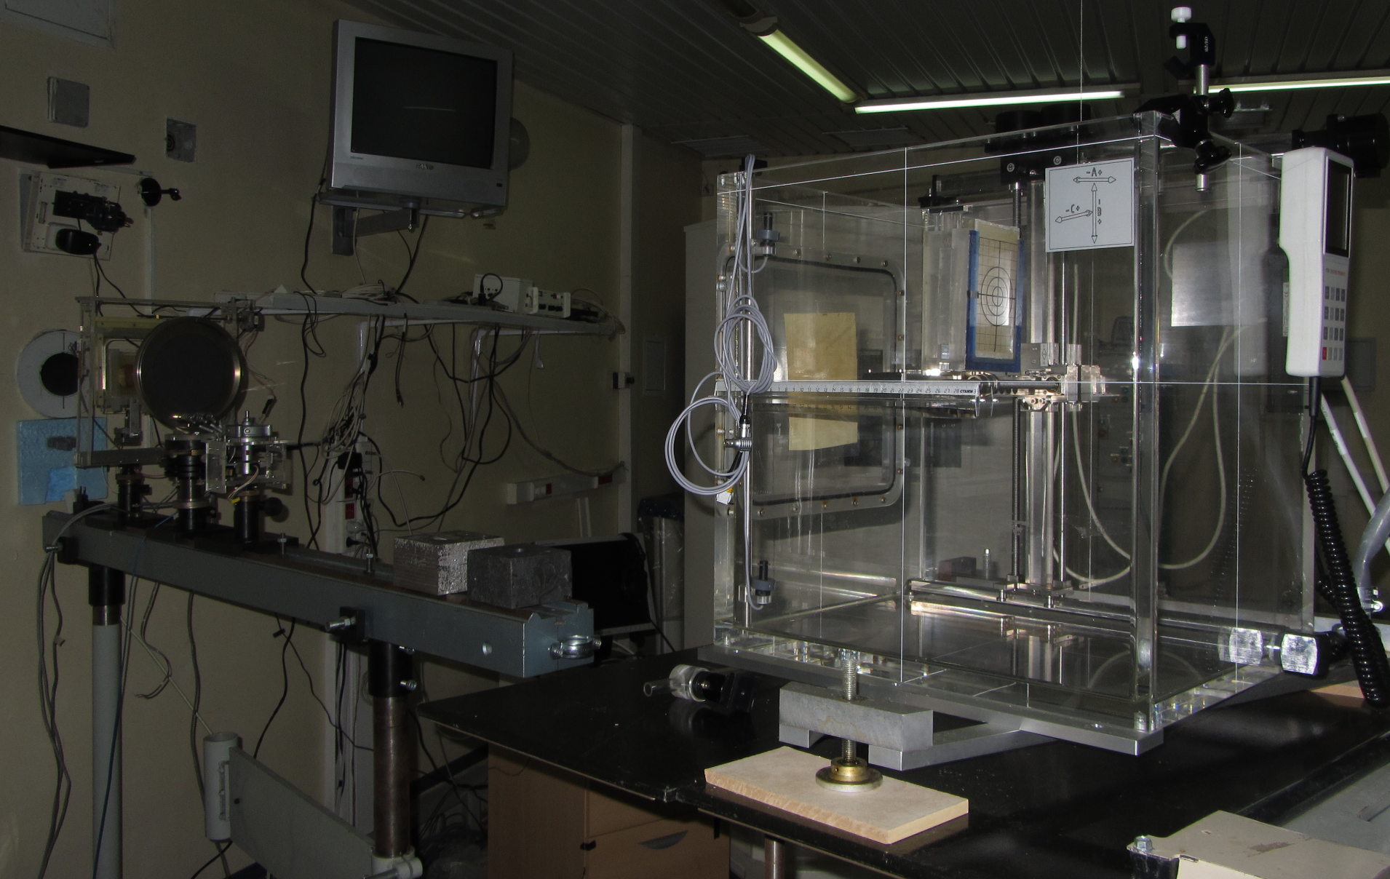
The photon absorbed dose measured by clinical ionization chambers in tissue-equivalent phantom and PTW MULTIDOS dosimetry chambers.
The dose measured using fantom with irradiated dose-enhancing metallic agents (Gd, Au, W, Bi, Pb)

Slide 14
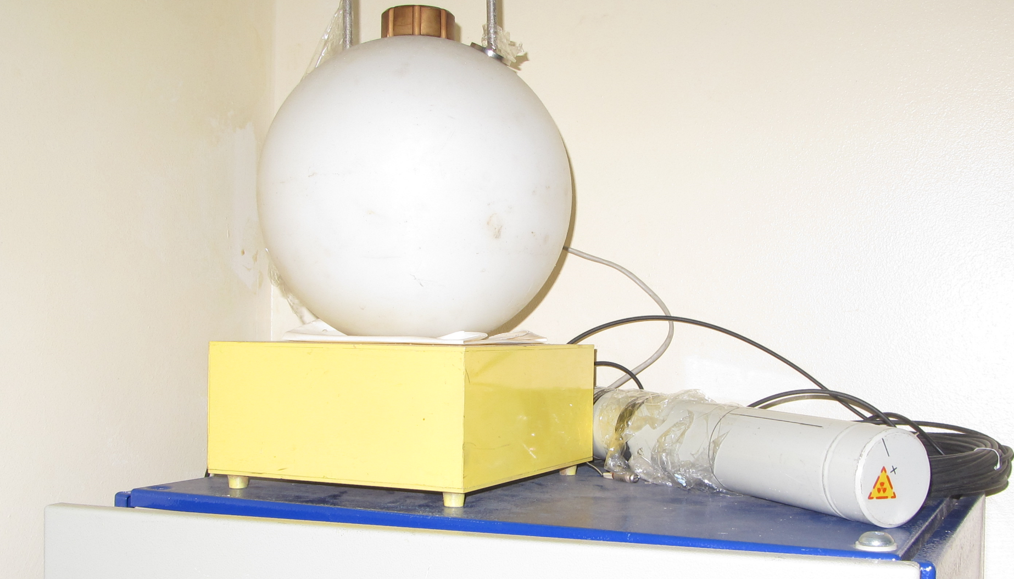
In addition, a gamma radiation from the phantom were measured using BDMG-08R gamma detectors.
γ
γ
Dose increasing agents (Gd, Au, W, Bi, Pb, D2O)
. .

Slide 15
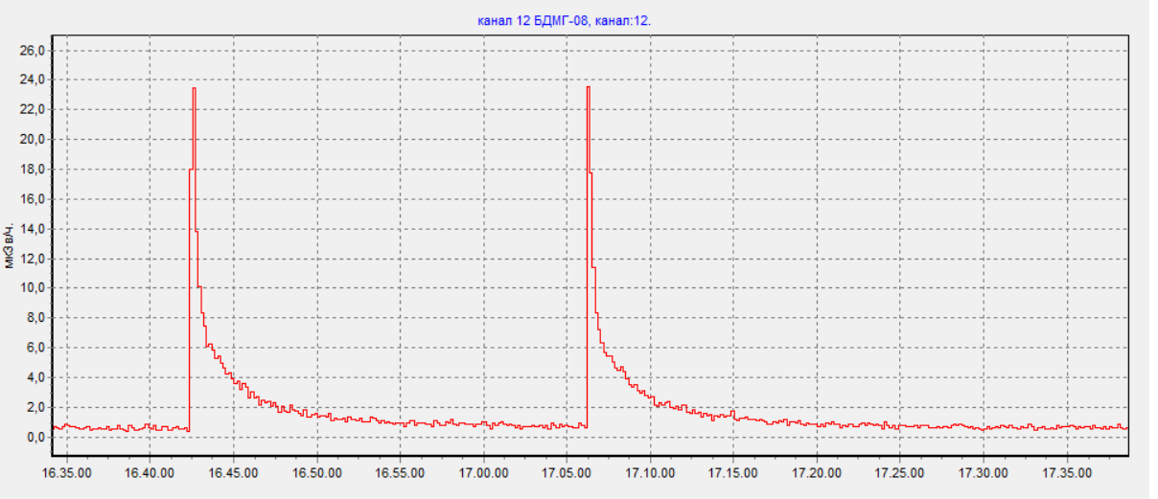
The proton irradiation of a metal and material creates γ –rays and radionucledes
The interaction of γ pulse with metallic agents create gamma, measured by the BDMG-08 gamma detector

Slide 16
A dose load from gamma emitting isotopes in a metal shell and organic material
A gamma dose load from long life ⁵⁴Mn, ^{56, 57}Co nuclides generated in steel protective shell (⁵⁴Fe, ⁵⁶Fe, ⁵⁷Fe)
The gamma dose load from ¹¹C, ¹⁴N, ¹⁵O short life positron isotopes
Tritium can be formed in containers with water under cosmic irradiation

Slide 17
For Au, Bi, Pb dose-enhancing agents the absorbed dose increased by 10-20%.
The significant increase in the absorbed dose (> 50%) was observed from d(γ,n)p reaction when using deuterated water instead of tissue-equivalent phantom.
About 30% of the bremsstrahlung photons have energies above the deuteron breakup threshold. As a result, the fast photons in D₂O target create protons and neutrons.

Slide 18
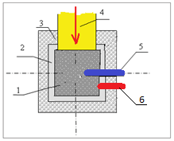
The irradiation facility consists of the heavy water target (30×30×30 cm), surrounded by a graphite reflector and lead absorber
1 - D₂O target; 2 - a graphite reflector; 3 – lead absorber; 4 – the bremsstrahlung photons; 5 - a neutron detector;
6 - a gamma detector.

Slide 19
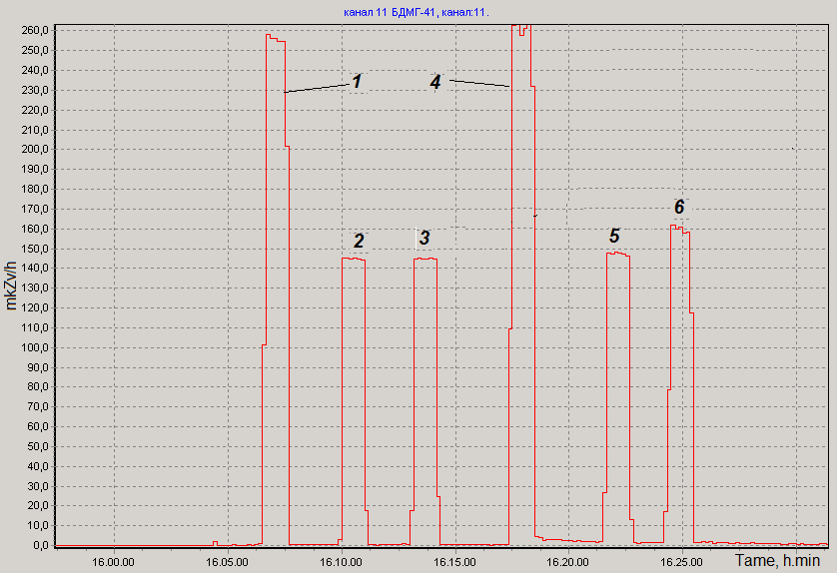
Diagram of the gamma radiation dose rate from photoneutron target
1, 4 - the gamma detector into D₂O target; 2, 3- the gamma detector into H₂O target; 5- the gamma detector out the water target; 6- the gamma detector out D₂O target. .

Slide 20
Diagram of the neutron dose rate from photoneutron target
1- neutron detector into D₂O target; 2, 3- the neutron detector into H₂O target; 4, 6- the neutron detector out D₂O target; 5- the neutron detector out the water target.
. .

Slide 21
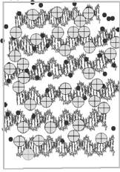
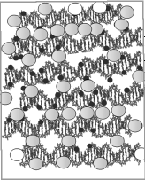
The particles of the cholesteric double-stranded DNA liquid-crystalline dispersions, containing Gd and Au ions have been obtained in Engelhardt Institute of Molecular Biology of the RAS.
ion Gd ion Au

Slide 22
Table.1. Energy, formation probability and maximum range of electrons in the 1 neutron capture by nanostructures.
Е_{e,} keV | 200 | 80 | 30 | 7 | 6 | 5 | 4 | 2 | 1
Р, % | 5.7 | 42.3 | 20.8 | 4.3 | 17.3 | 23.7 | 1 | 31.4 | 16
R_{м}, µm | 439 | 92 | 16 | 1.2 | 0.90 | 0.65 | 0.44 | 0.12 | 0.06
Approximately half of all electrons with energy less than 6 keV are absorbed in the microparticles themselves.

Slide 23
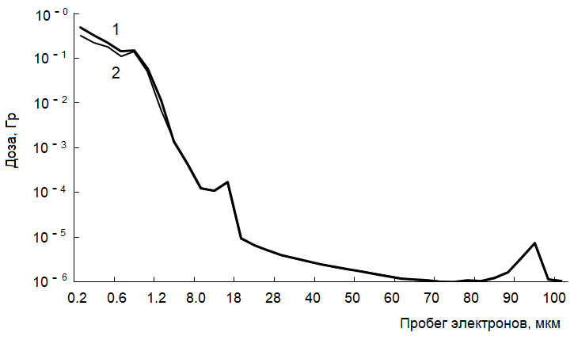
The absorbed dose of electrons from the reaction ¹⁵⁷Gd (n, γ) ¹⁵⁸Gd depending on the electrons range
1- dose taking into account Auger electron channeling effect
2- dose without the electron channeling.

Slide 24
High-energy conversion electrons (≥1 MeV) slowing down in DNA-Gd and DNA-Au microparticles, generate bremsstrahlung with a wide spectrum.
Channeled electrons traveling along DNA chains metal with metal ions can make periodic movements and emit photons in a narrow cone of angles (≤ 5°).
The wavelength of monochromatic X-ray radiation (λ_{m}) at zero angle is determined by the channel radius (r_{c}) and the relativistic factor (γ): λ_{m} ∼ r_{c} /2γ^{3/2}

Slide 25
Conclusion
An increase of the cell irradiation dose is due to Auger electrons channeling effect in DNA-Gd.
In liquid-crystalline DNA-Au nanostructures conversion electrons can emit photons with a wavelength ∼ 0.3 nm.
By changing the orientation of DNA-Gd using a magnetic field, one can increase the monitor the effectiveness of cancer therapy.

