Slide 1
DETERMINATION OF PHOTONEUTRON PRODUCTION FROM DIFFERENT TARGETS IRRADIATED BY ELECTRON BEAM
Elmira Melyan
23th June 2021

Slide 2
Contents
Introduction
Experiment
Methodology
Experimental results
Simulations
Results comparison
Conclusion

Slide 3
Introduction
neutron activation analysis
ADS
radioisotope production
nuclear waste assay
LINAC technology is attractive for ADS
Commercially available
Are in common use
Physically small

Slide 4

Experiment
A.I. Alikhanyan National Laboratory, YerPhi, Yerevan, Armenia
LUE-75 Linear Accelerator Facility
Energy: 70 MeV
Photoneutron converters: BeO, D2O
Samples were irradiated 3.8 h and 3.05 h respectively

Slide 5
Materials Irradiated
Thicknesses and weights of the sample
Material | Molar Mass | Thickness (mm) | Weight (g)
Al | 26.98 | 0.5 | 0.2150
Y | 88.91 | 0.25 | 0.1641
In | 114.82 | 0.1 | 0.1060
Co | 58.93 | 0.5 | 0.7174
Cu | 63.55 | 0.125 | 0.4019
Bi | 208.98 | 0.5 | 0.7276
Ta | 180.95 | 0.125 | 0.3069
Au | 196.97 | 0.0125 | 0.0401
Nb | 92.91 | 0.5 | 0.3341
Mn | 54.94 | 0.05 | 0.0982

Slide 6
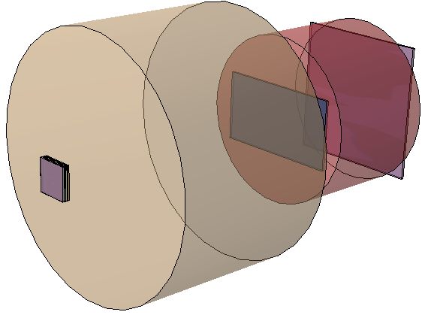
Experimental Setup
4.4 cm
0
W
Al-Cylinder
Al-Monitor
15.4 cm
Converter
Foils

Slide 7
Methodology
Induced activity method was used (Off-line analysis).
Advantages:
Lower boundary of the element recording, involves the activation of the material by n, γ or charged particles.
Allows to investigate the production mechanism of the residual nuclei in a wide mass range.
Characteristic γ ray spectra of emitted residual nuclei in the target are measured by HPGe detectors.
Obtained gamma ray spectra were analyzed by DEIMOS software

Slide 8
Experimental Results
Sample | Reaction | BeO | D2O
Nb | (n,2n) | 4.24E-28 | 2.12E-28
Ta | (n,a) | 9.77E-29 | 3.56E-30
 | (n,2n) | 9.49E-28 | 7.52E-28
Y | (n,a) | 1.12E-29 | 8.84E-30
 | (n,2n) | 8.90E-28 | 7.05E-28
 | (n,3n) | 7.32E-29 | 5.80E-29
Al | (n,a) | 1.11E-30 | 1.64E-30
Cu | (n,g) | 2.11E-30 | 1.67E-30
 | (n,3n) | 2.21E-29 | 6.24E-30
Mn | (n,g) | 6.01E-31 | 6.01E-31
 | (n,2n) | 6.42E-31 | 1.35E-30
Sample | Reaction | BeO | D2O
Co | (n,a) | 8.91E-31 | 9.39E-31
 | (n,2n) | 2.91E-28 | 3.84E-28
 | (n,3n) | 5.93E-29 | 6.97E-29
Bi | (n,a) | 7.36E-29 | 6.65E-29
In | (n,a) | 1.95E-30 | 1.62E-30
 | (n,p) | 1.67E-30 | 1.32E-30
 | (n,g) | 1.64E-29 | 2.88E-29
 | (n,3n) | 1.53E-29 | 1.21E-29
Au | (n,a) | 5.59E-29 | 6.63E-29
 | (n,g) | 1.97E-29 | 2.16E-29
 | (n,2n) | 2.27E-27 | 2.89E-27

Slide 9
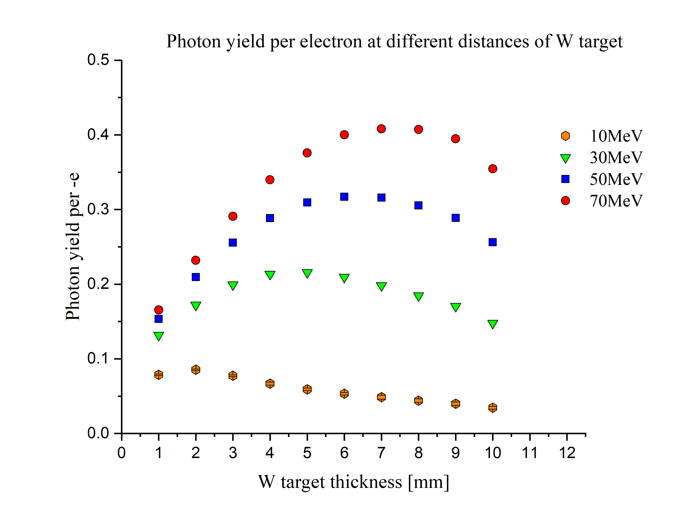
MCNP Simulation

Slide 10
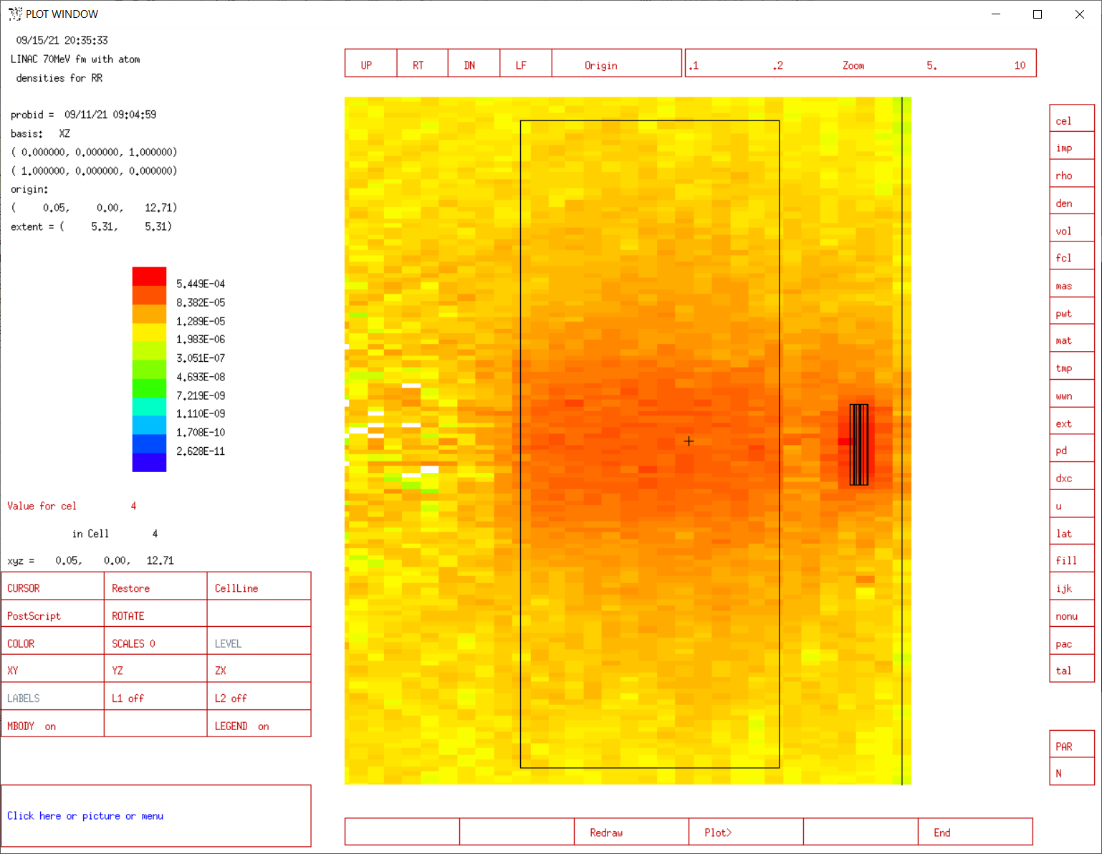
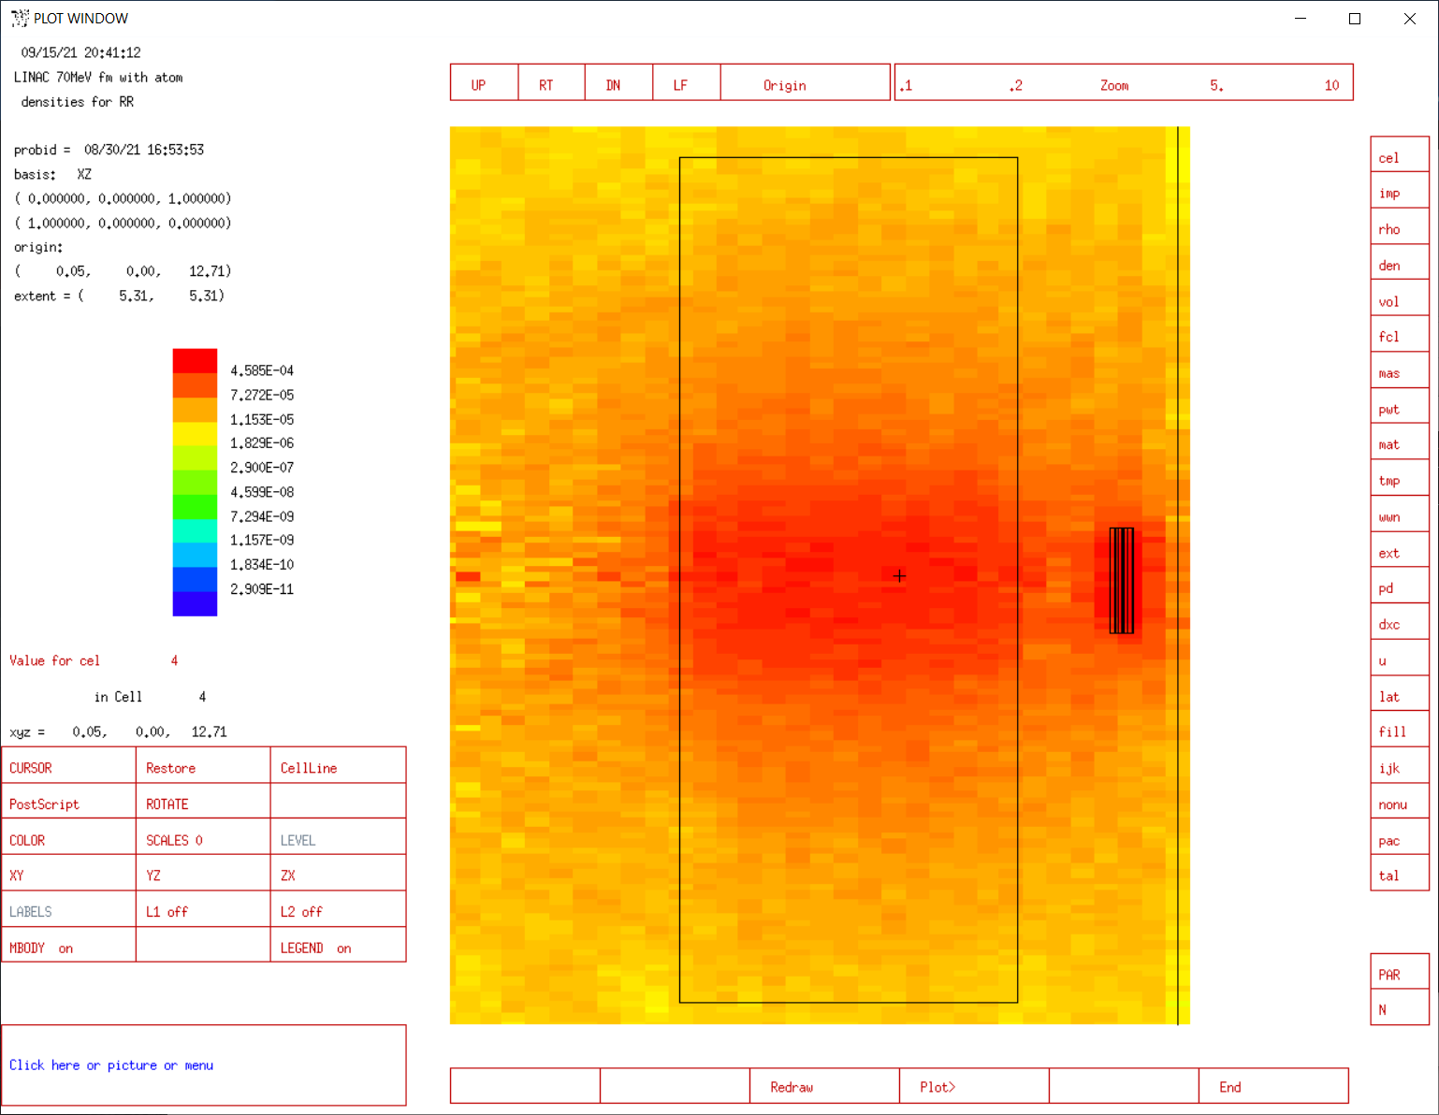


Neutron Flux Visualisation
$$D_{2}O$$
$$BeO$$

Slide 11
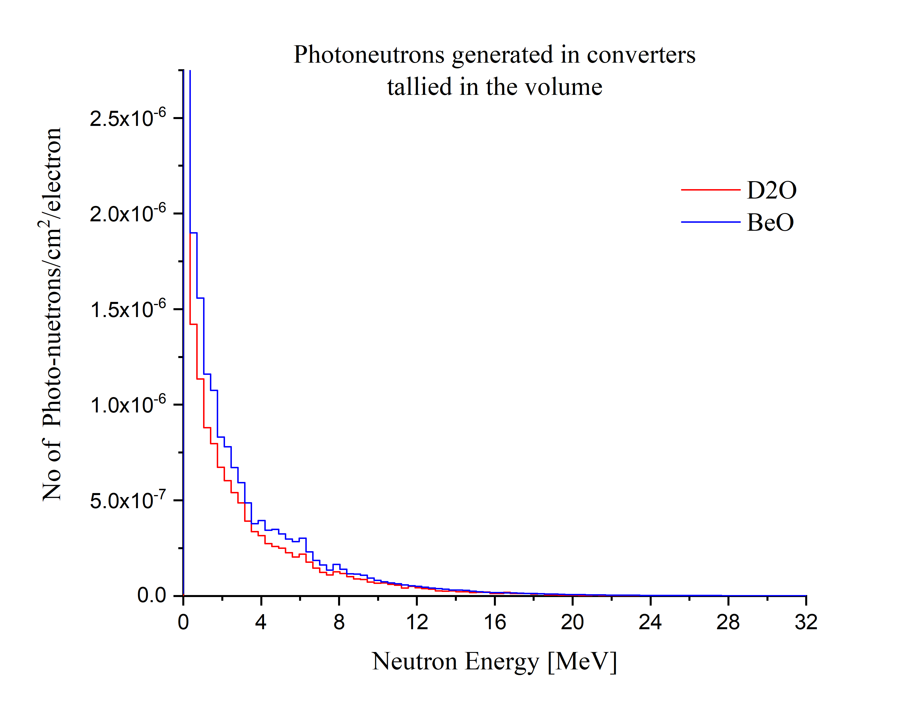
Photoneutron energy distribution

Slide 12
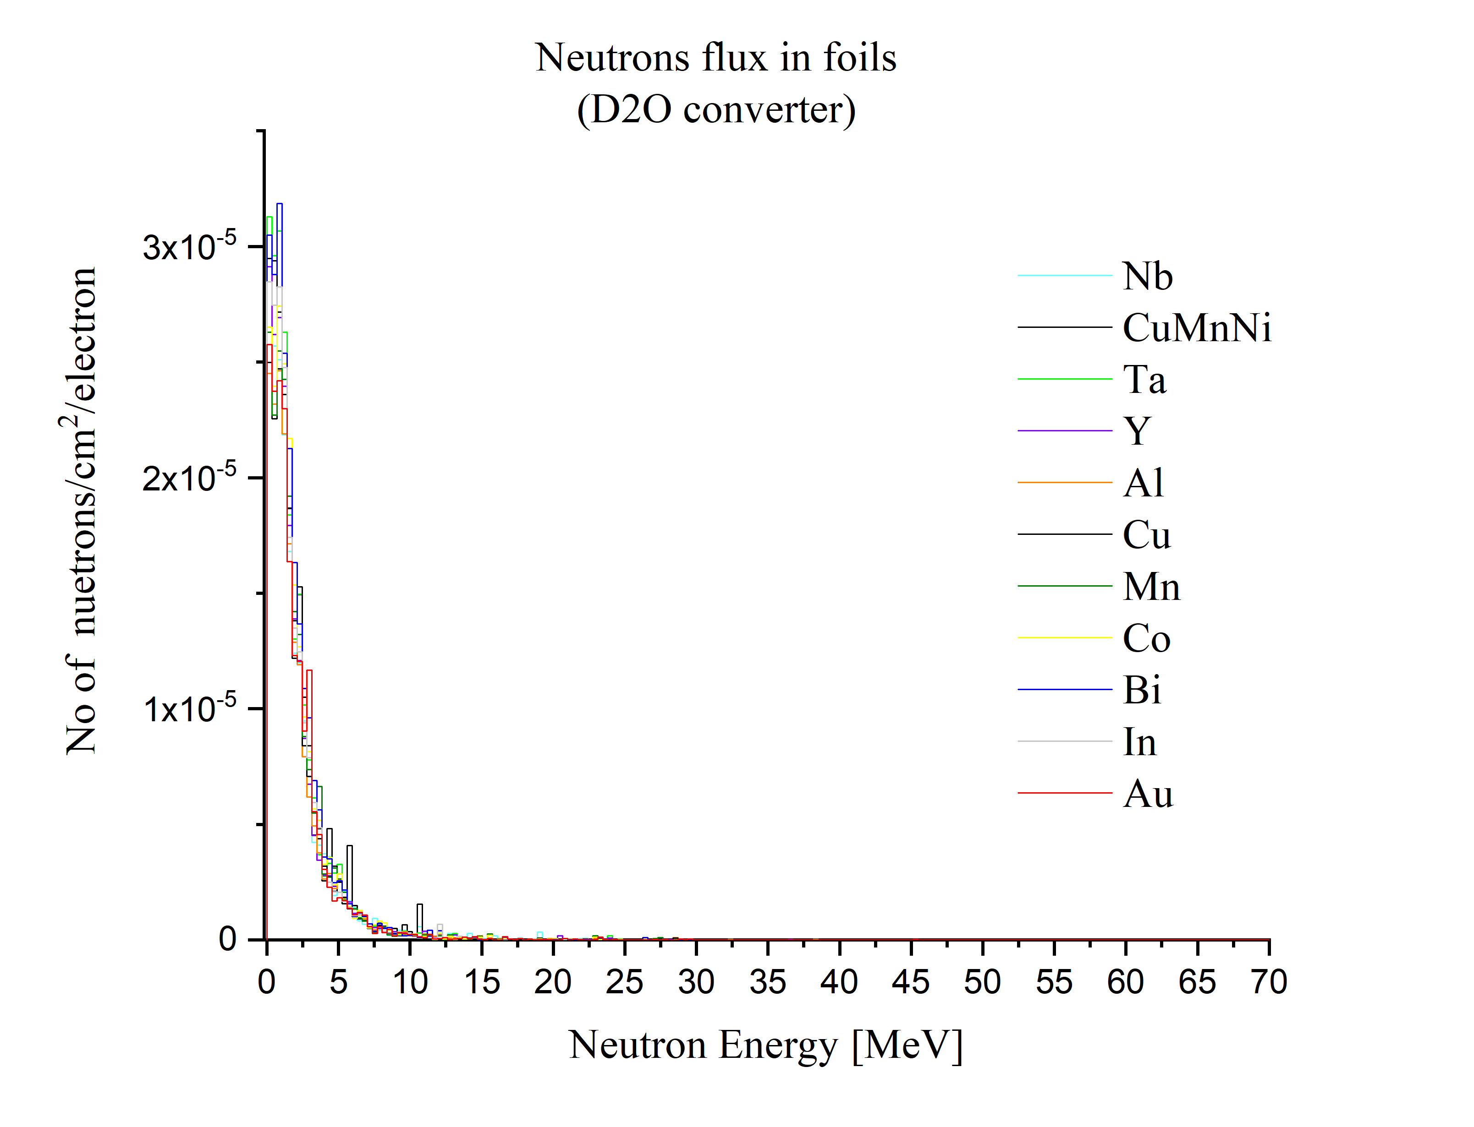
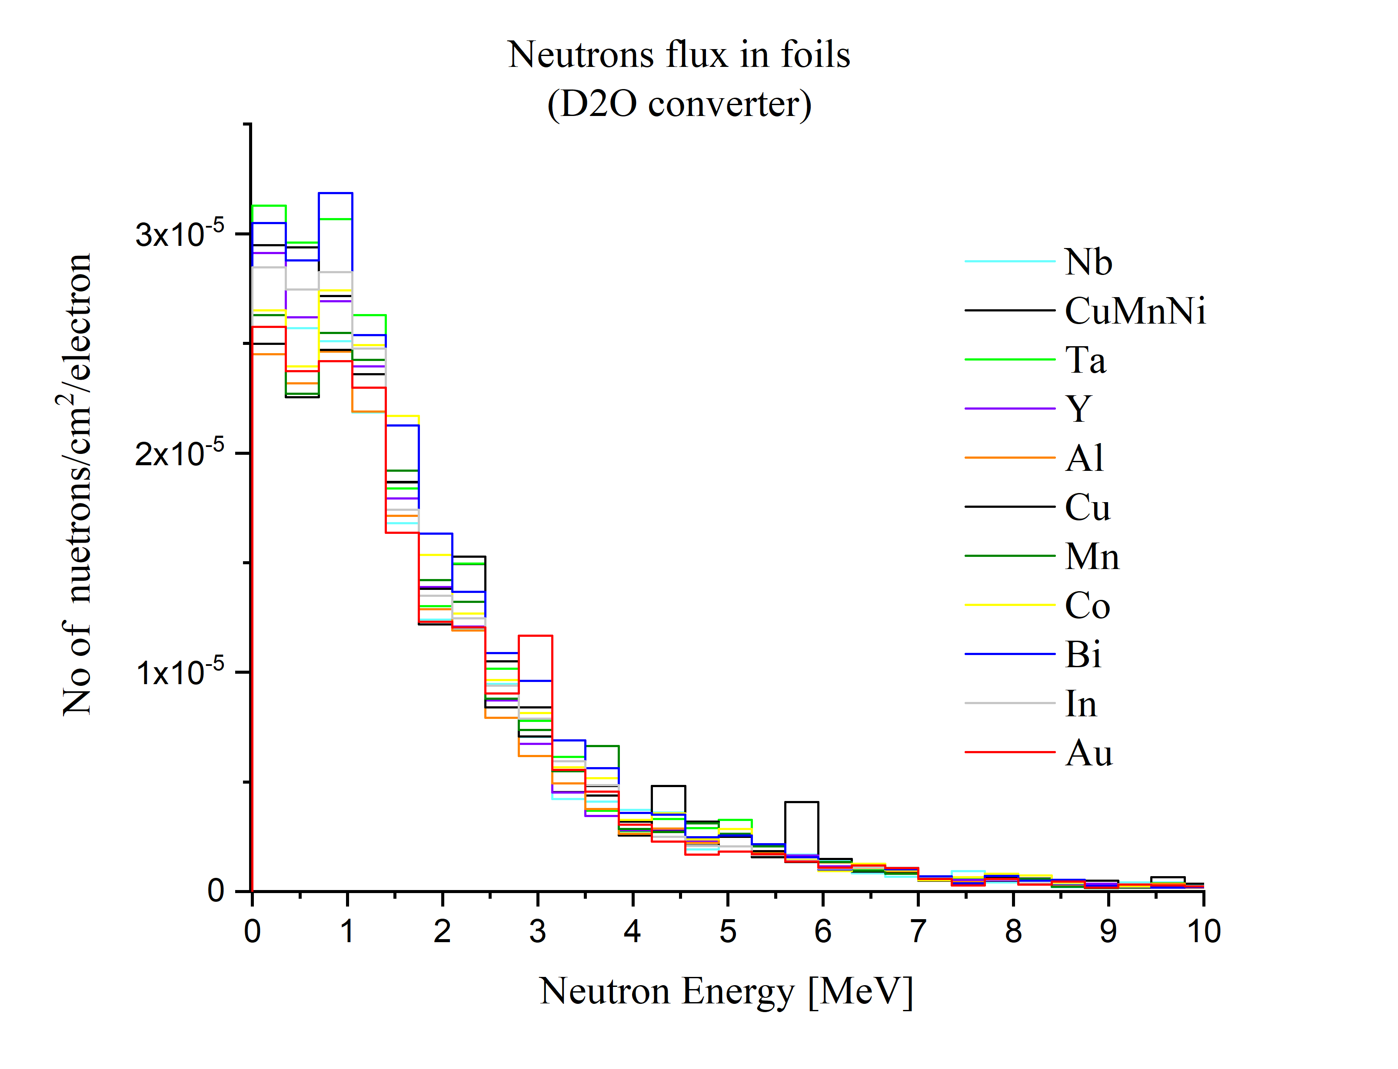
Neutron energy distribution

Slide 13
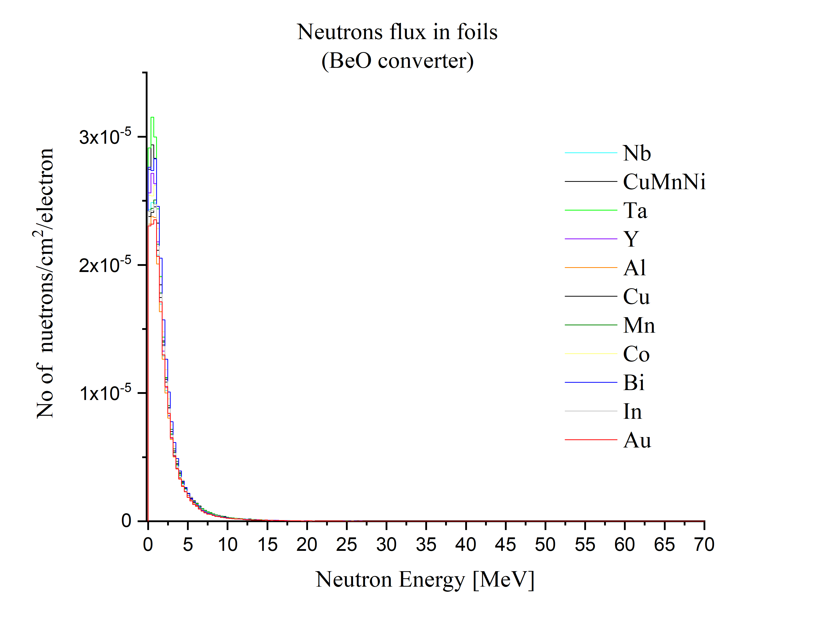
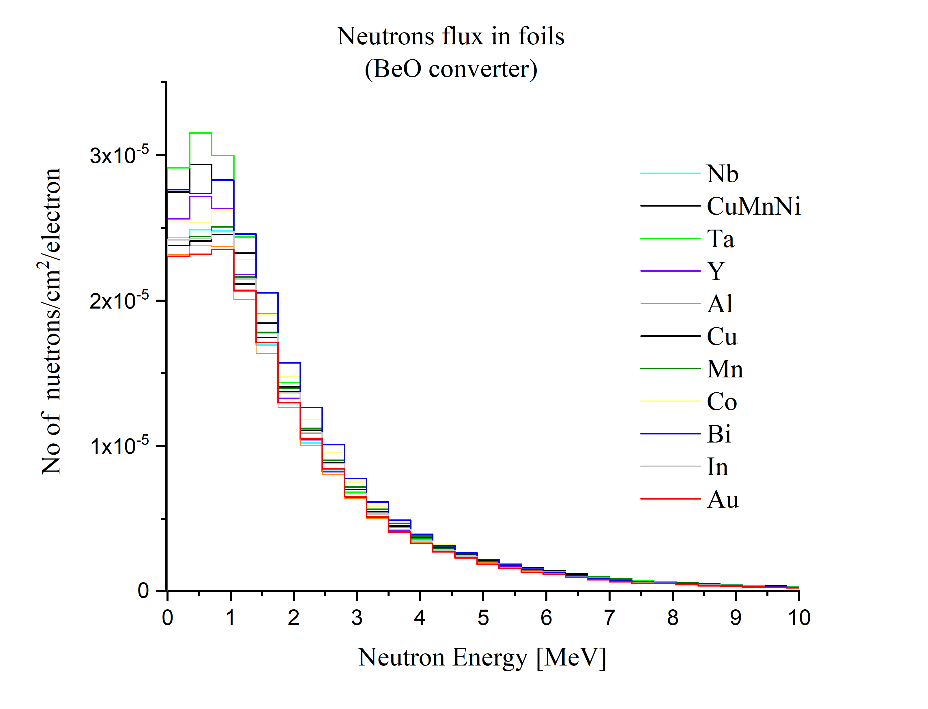
Neutron energy distribution

Slide 14
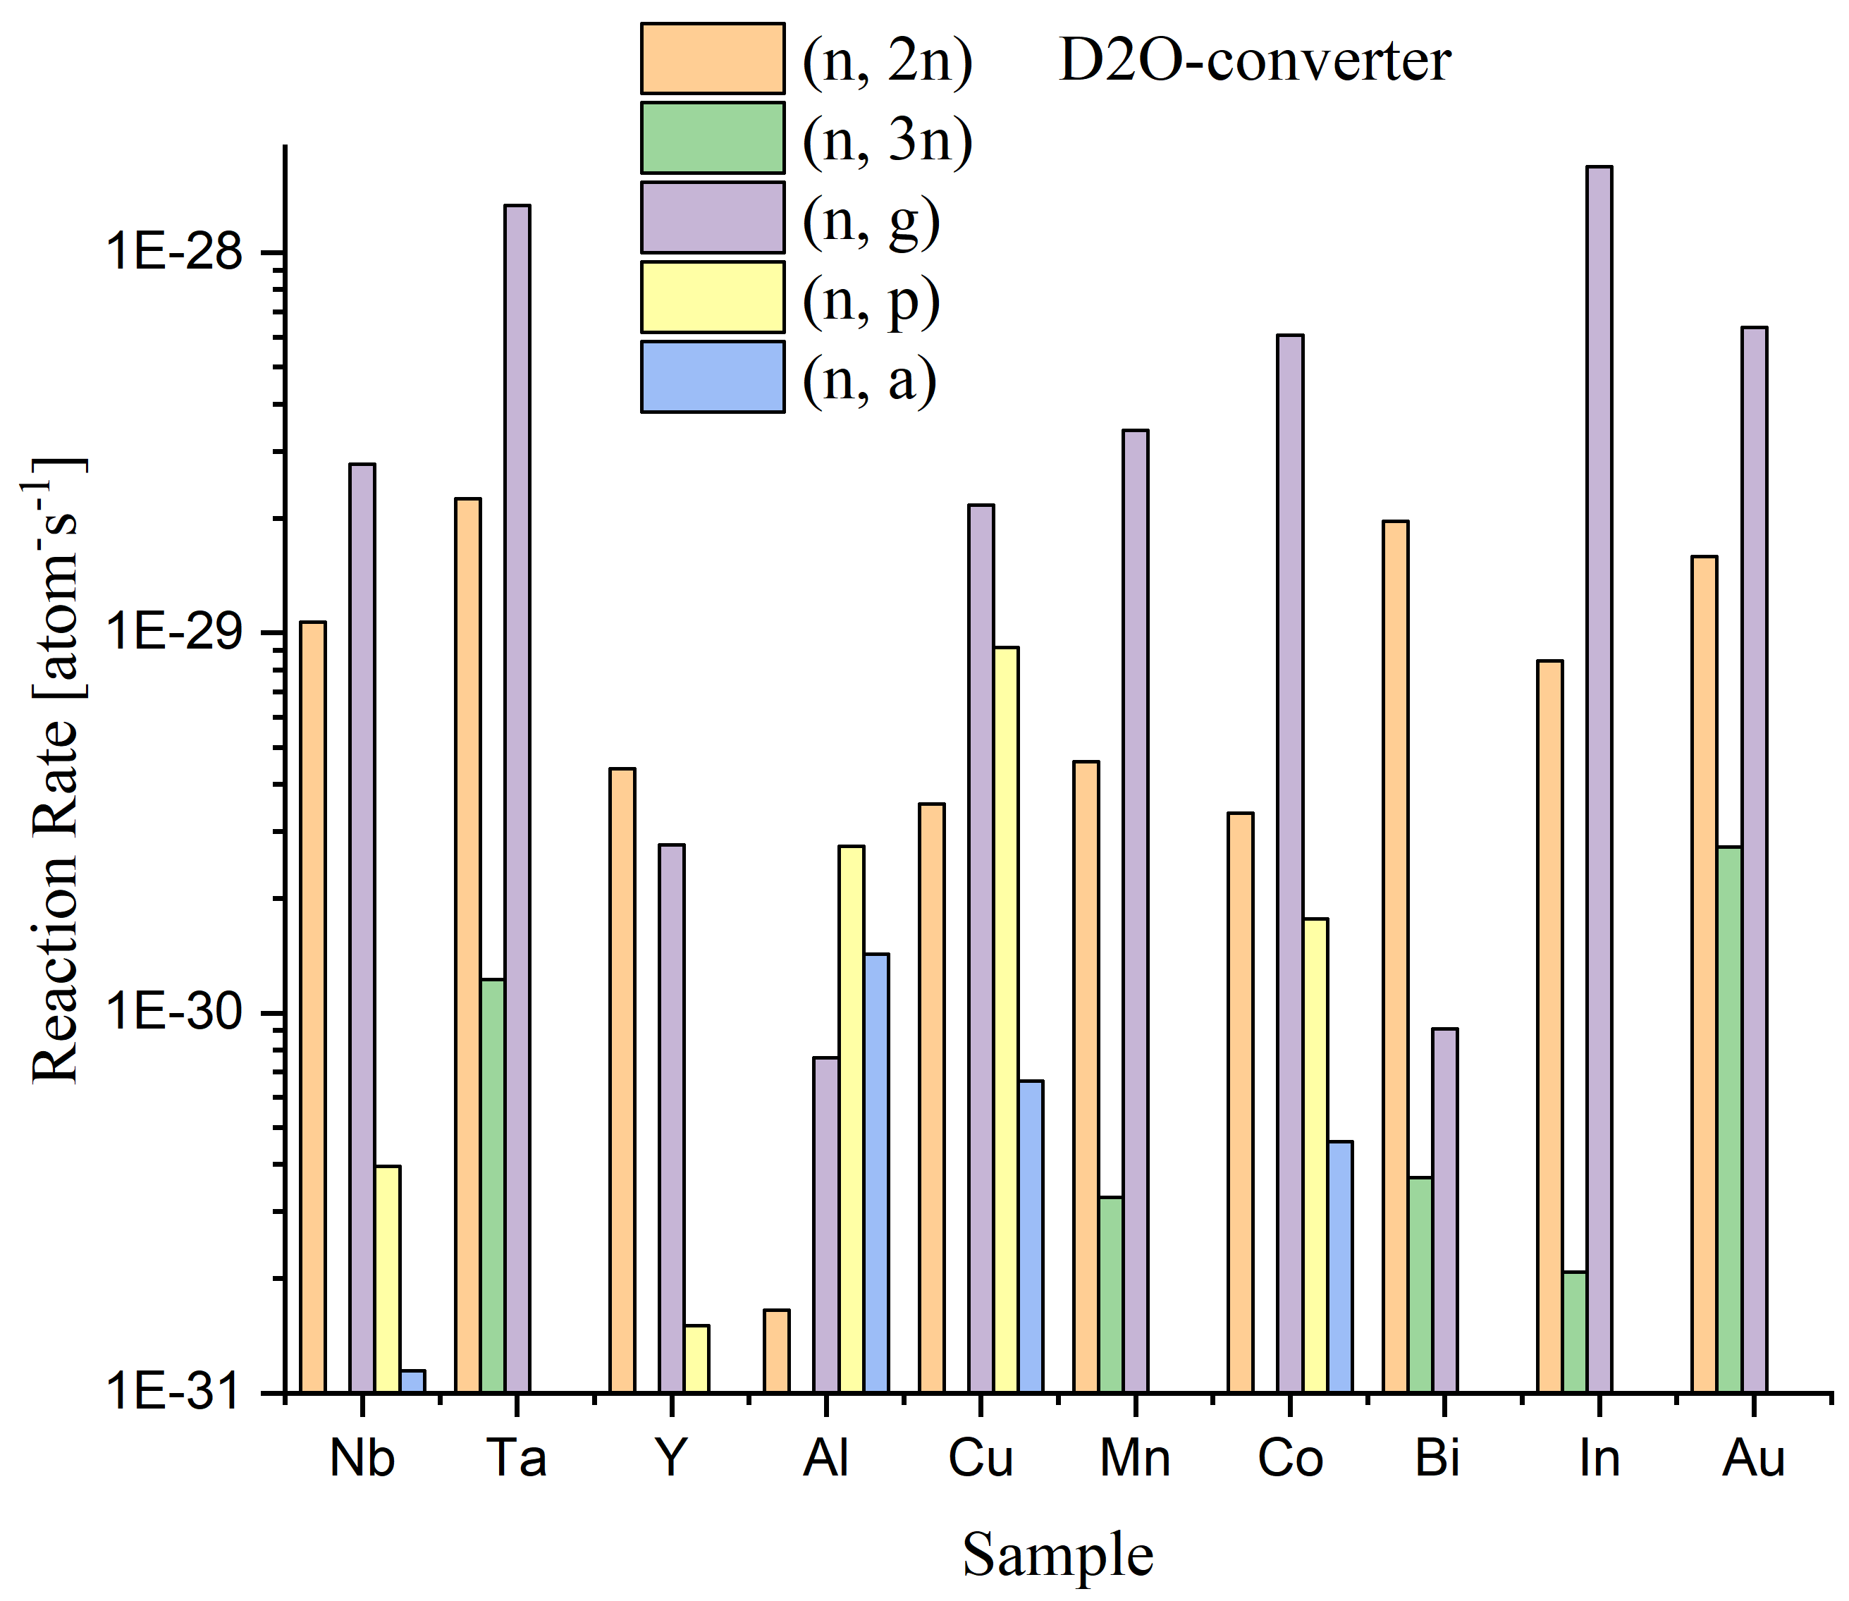
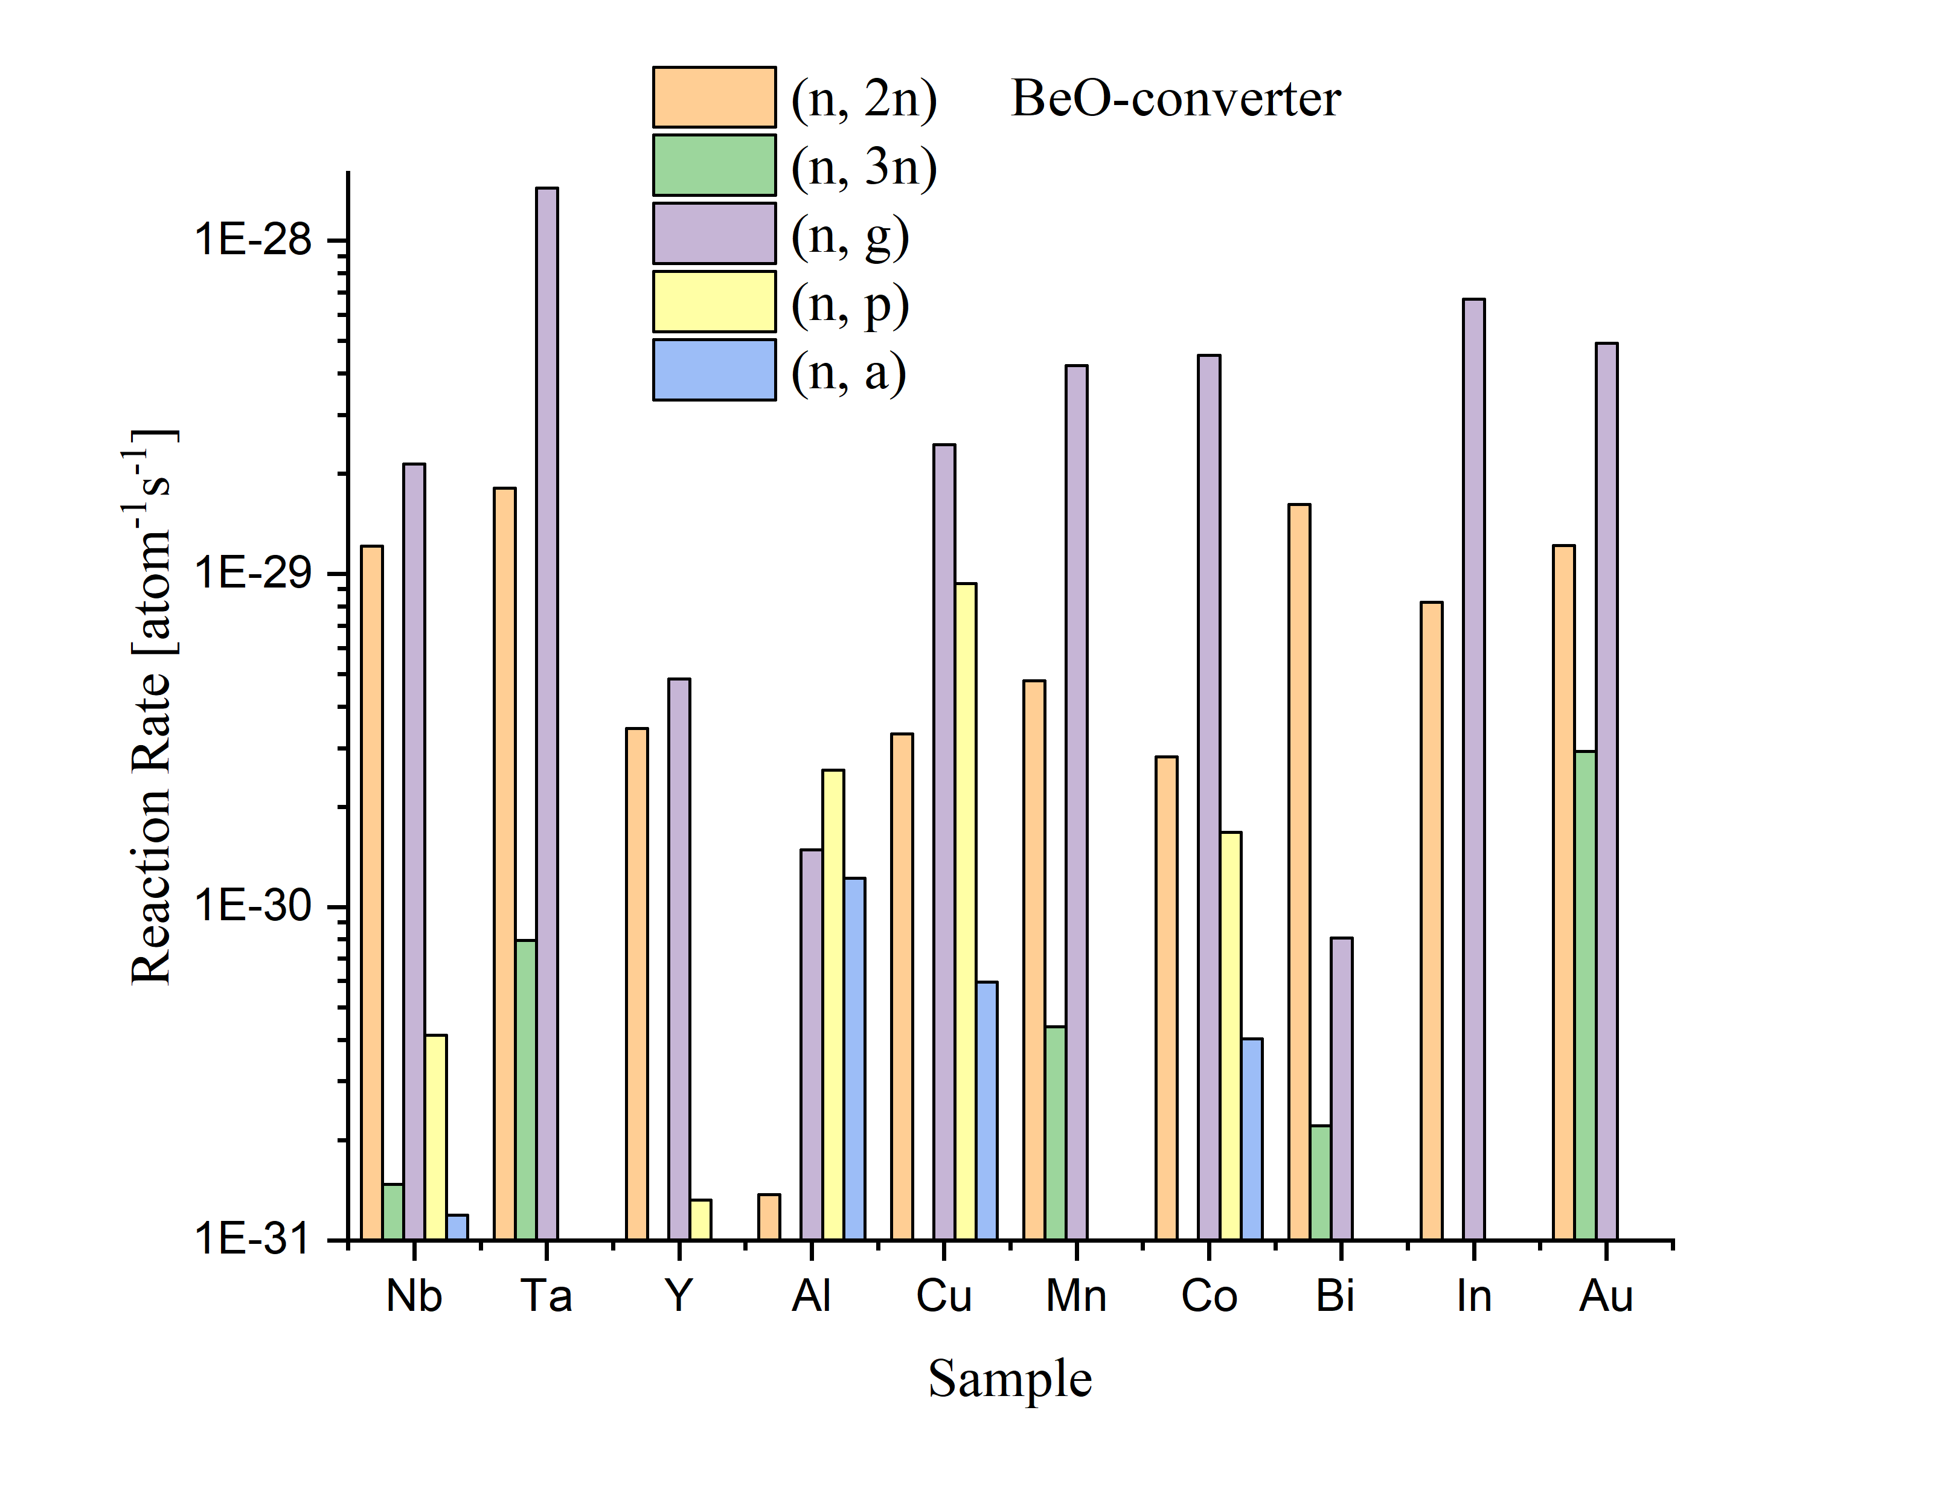
Reaction Rate

Slide 15
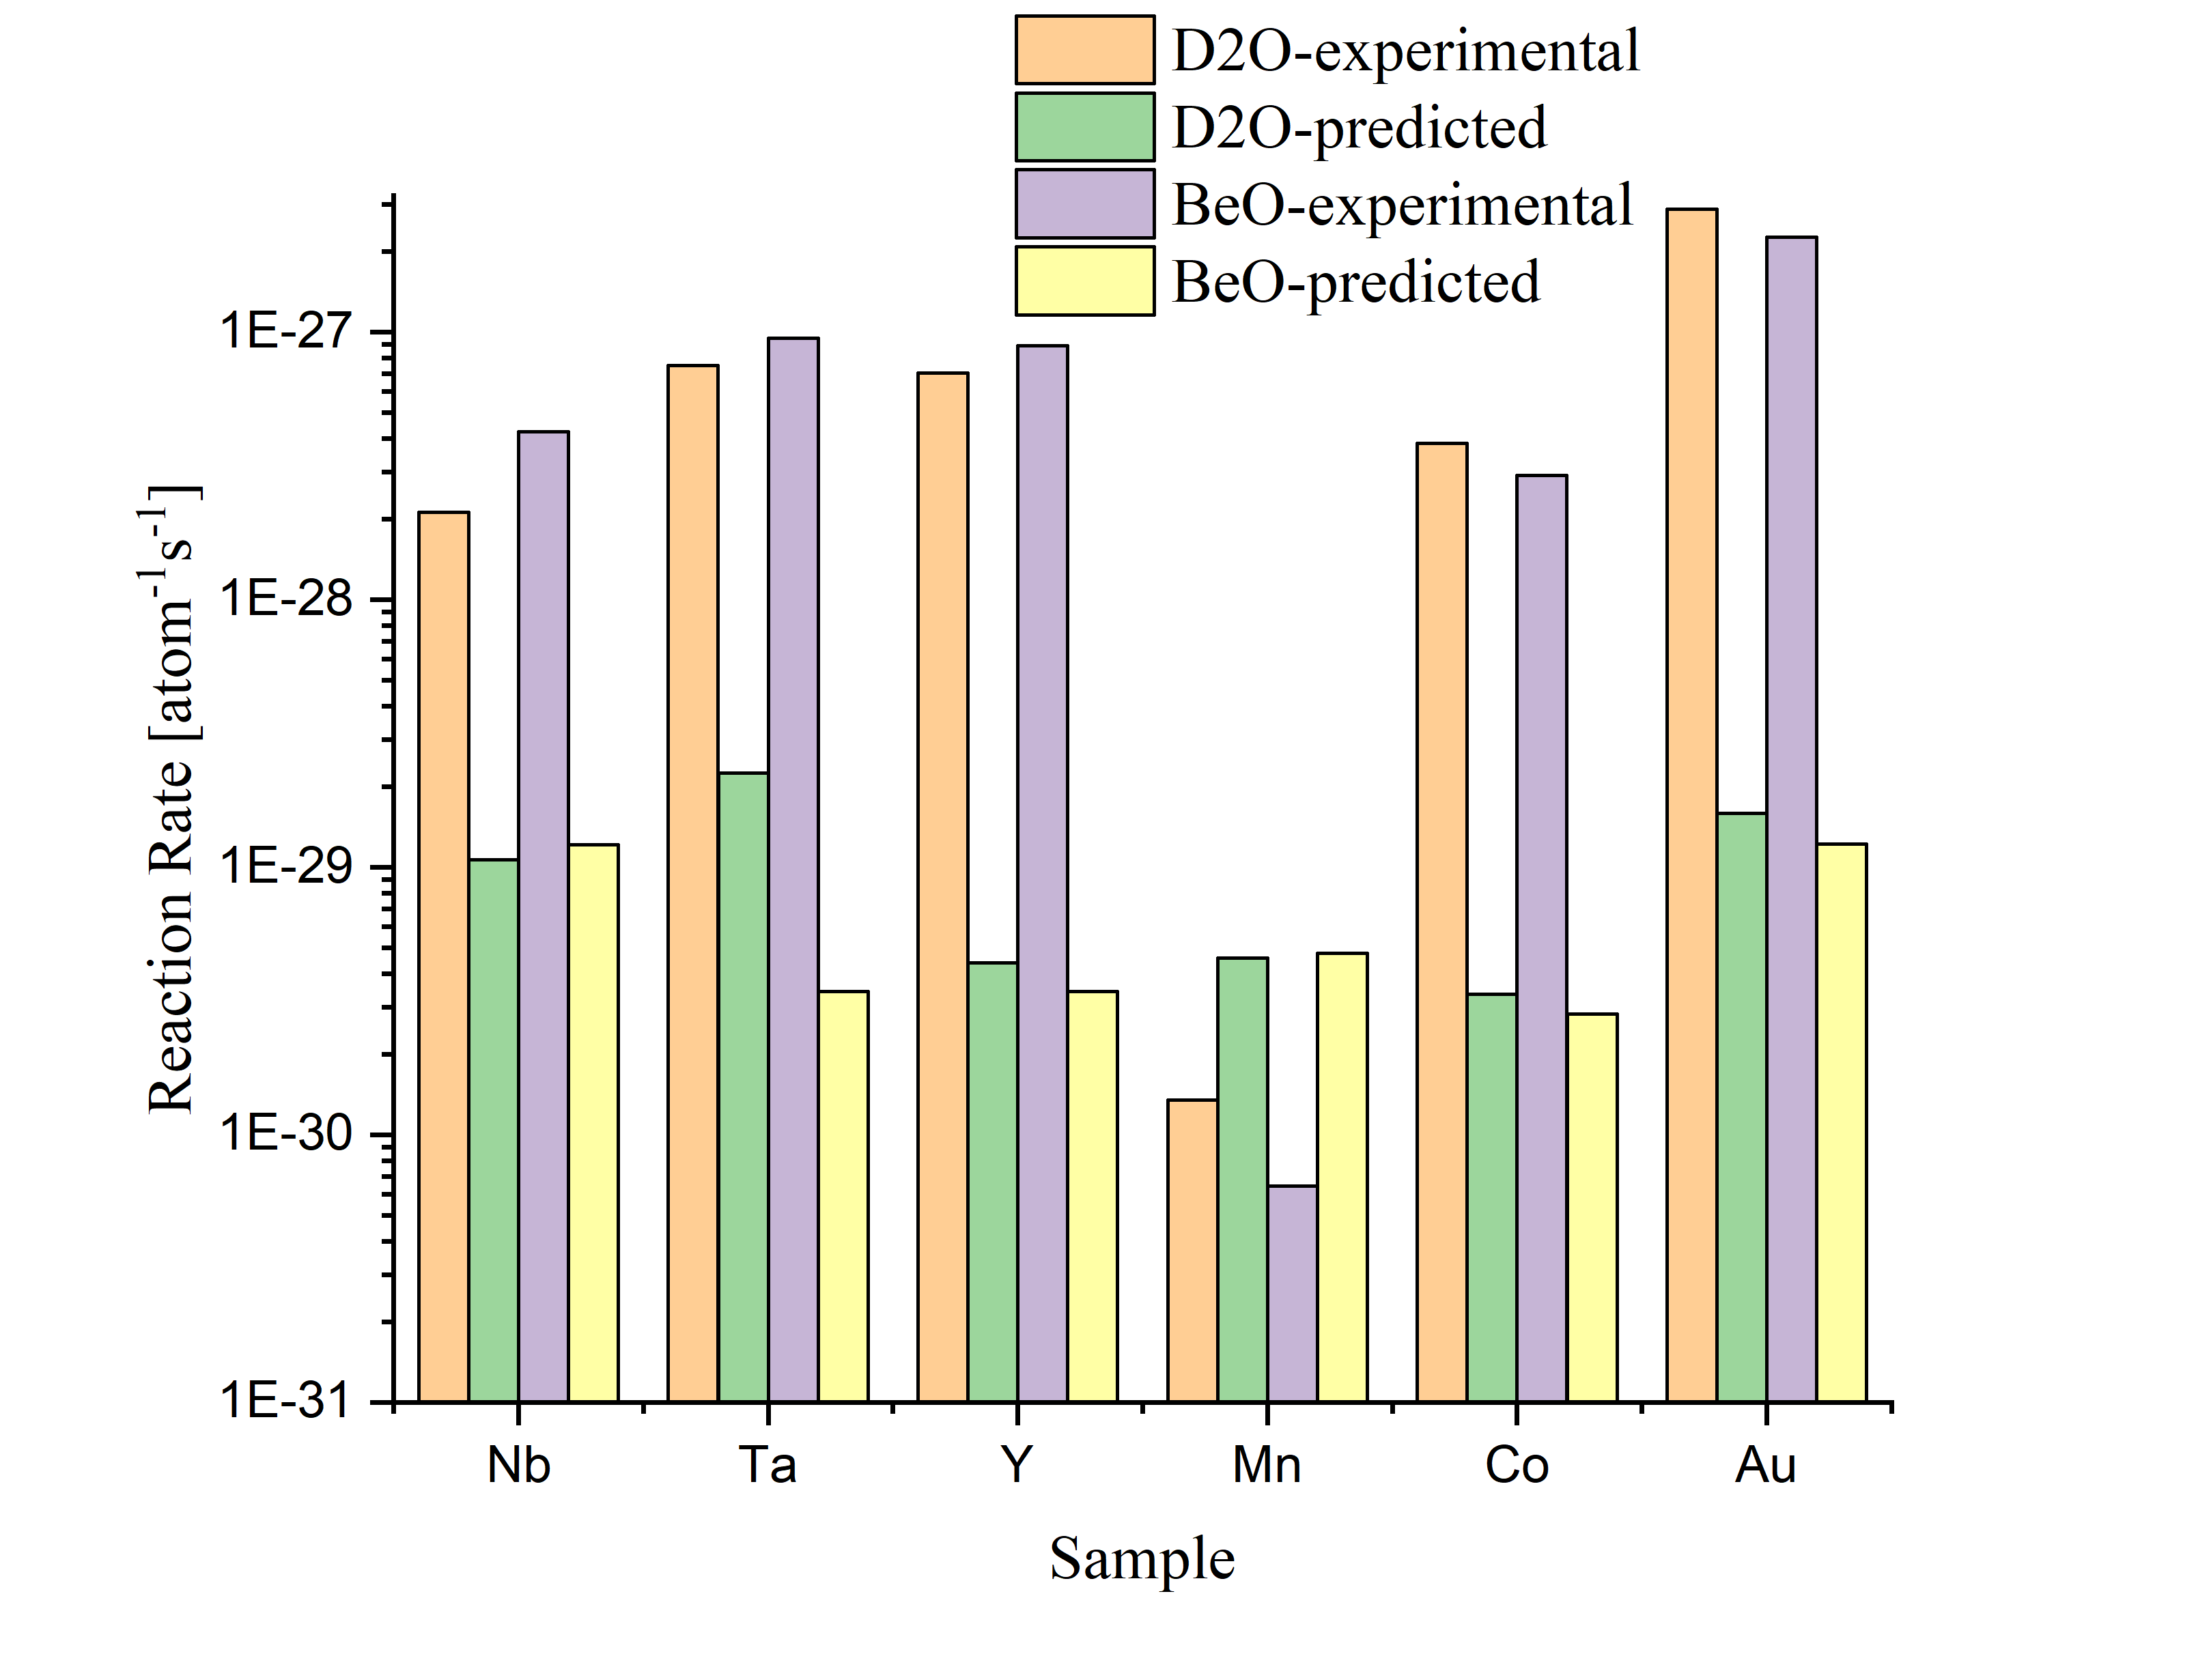
Comparison
(n, 2n)

Slide 16
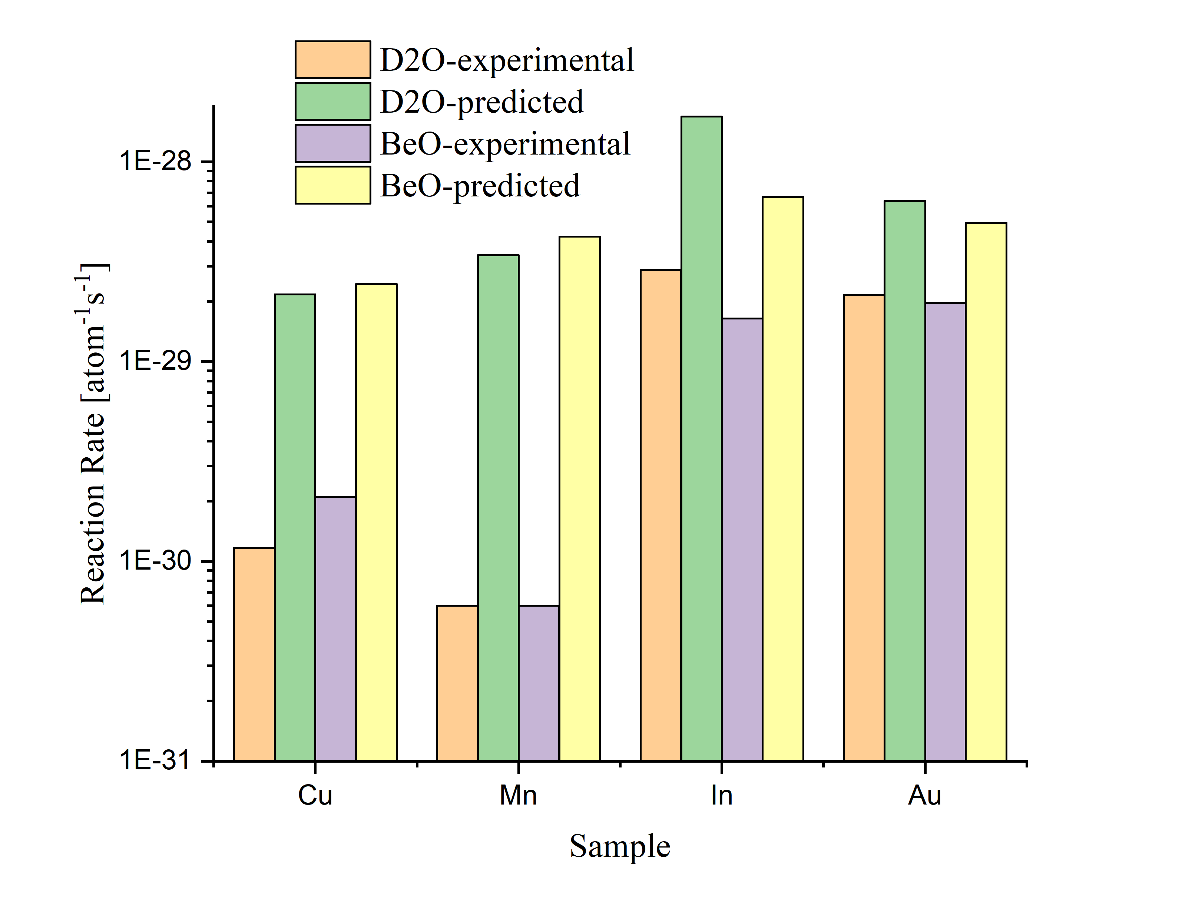
Comparison
(n, g)

Slide 17
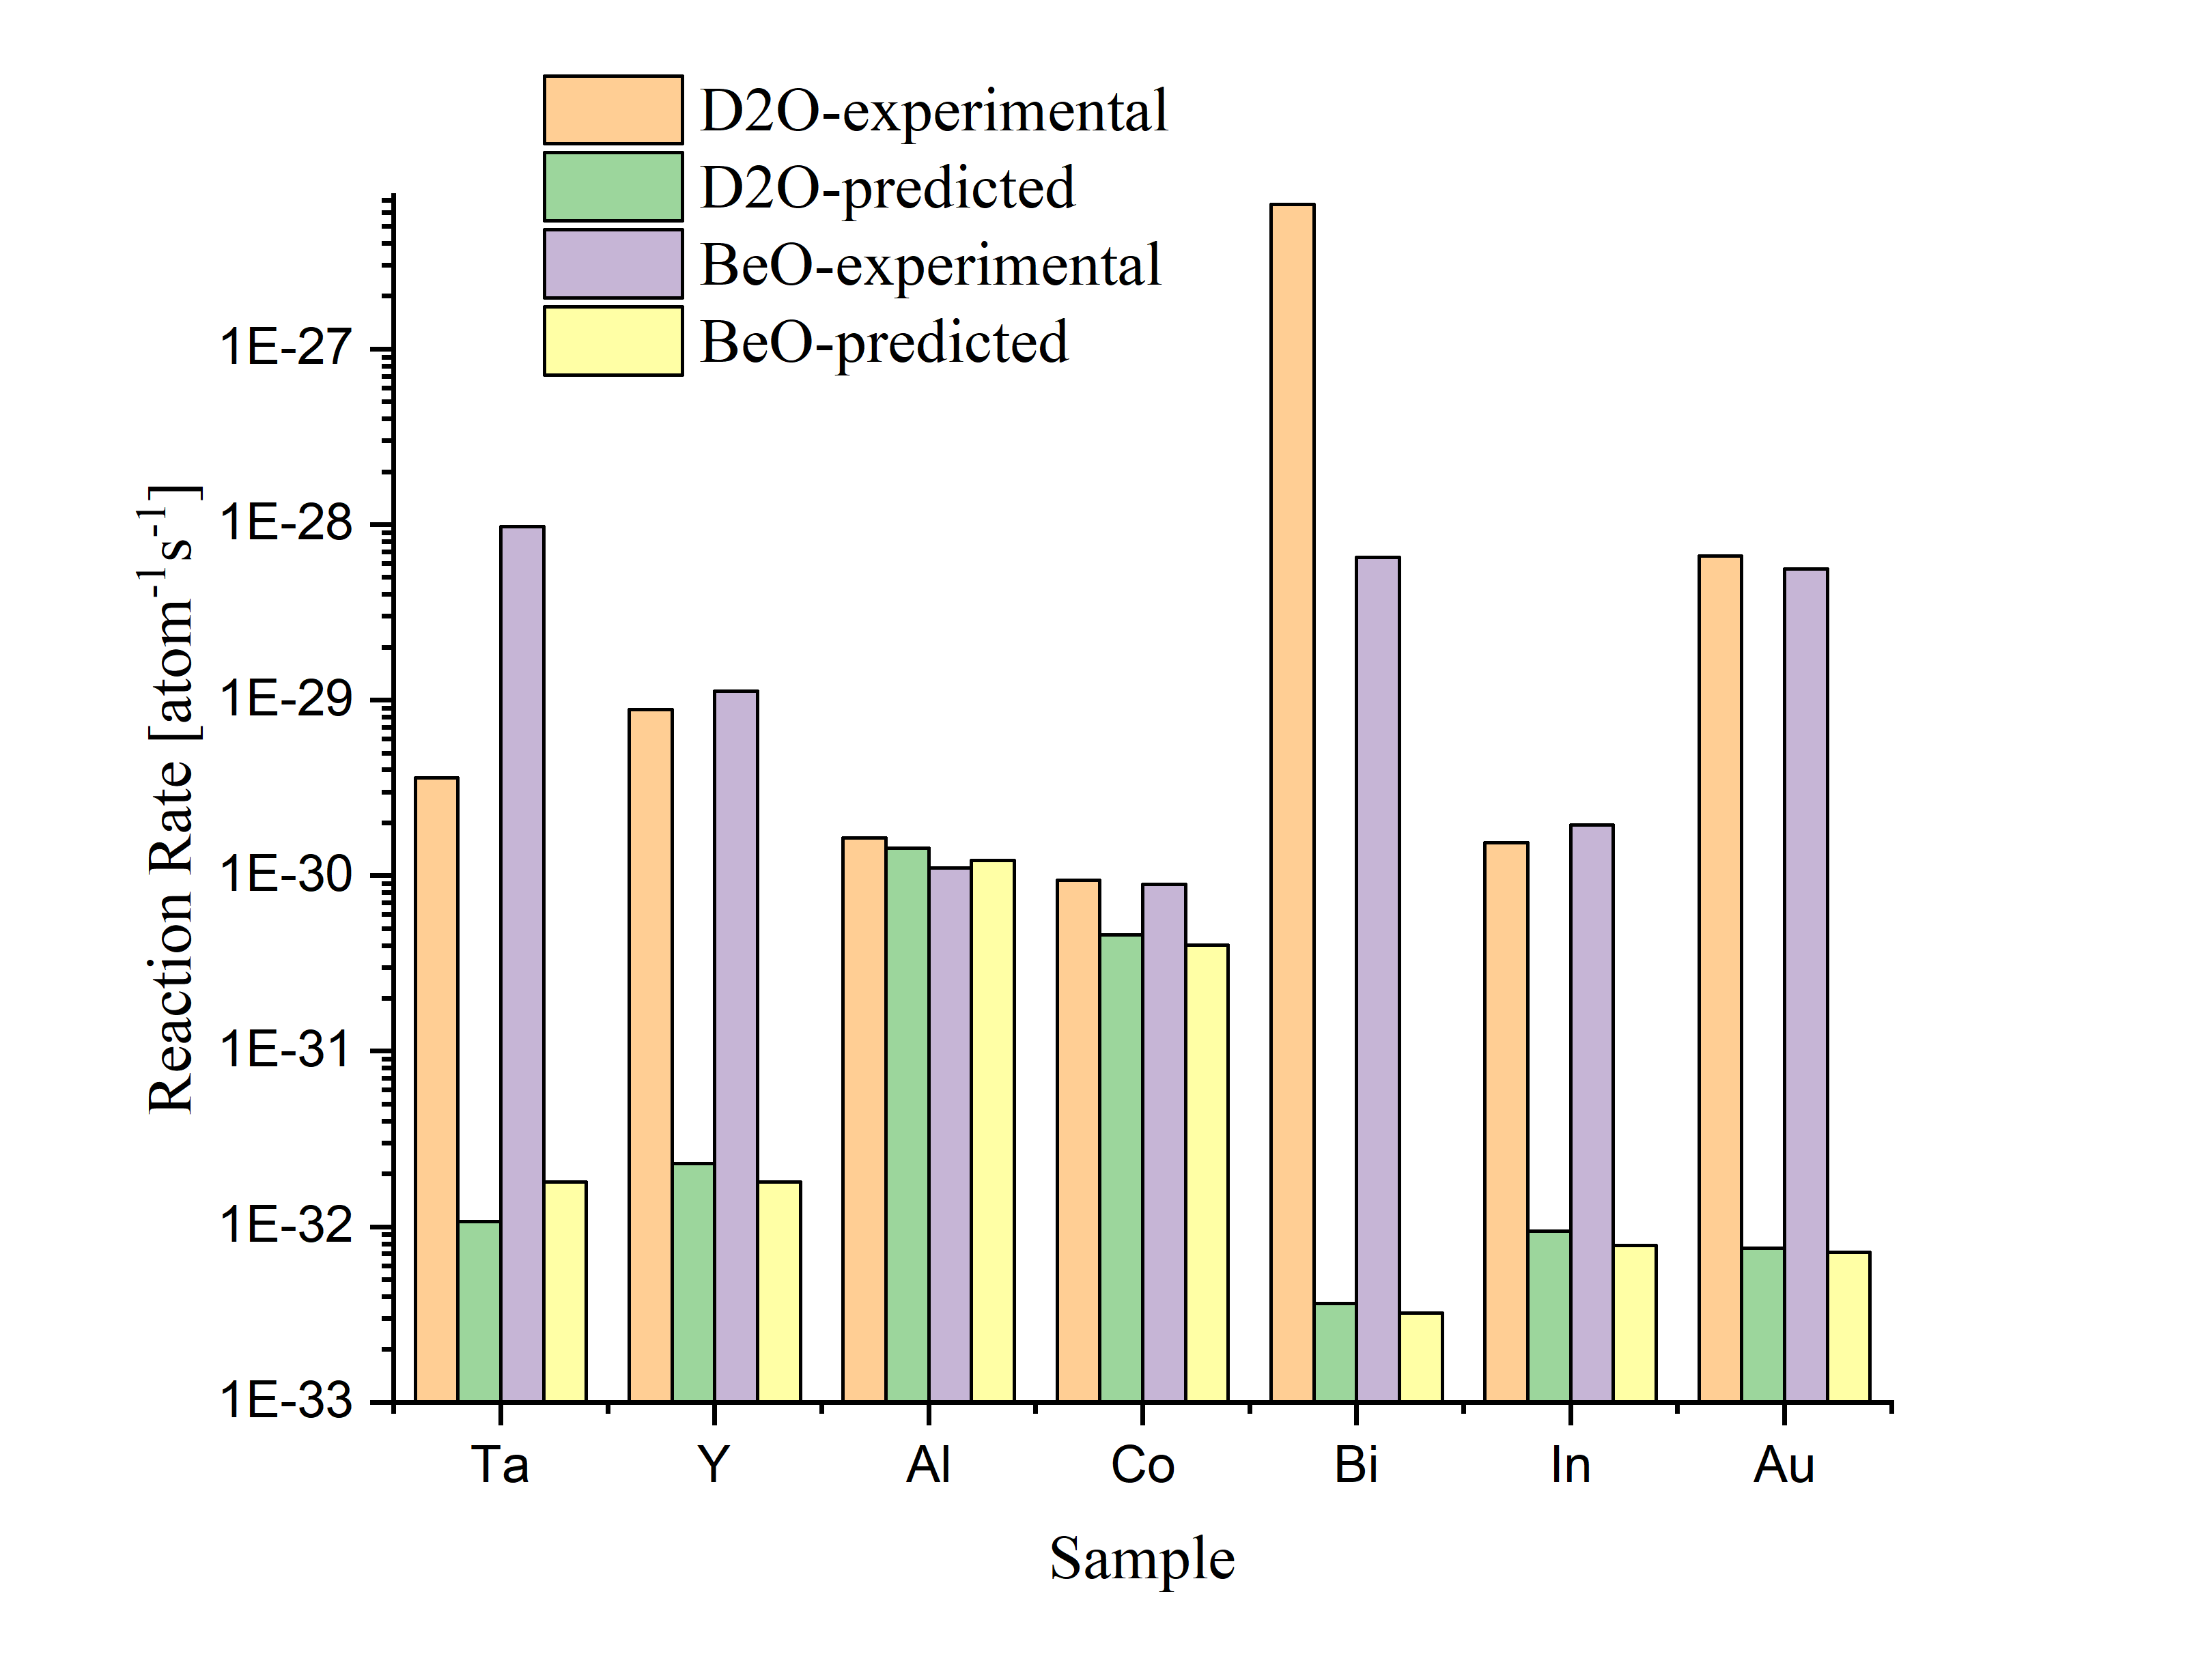
Comparison
(n, a)

Slide 18
Conclusion
A set of targets were irradiated by electron beam using two different neutron converters
Reaction Rates were calculated as a result of experiments
Simulations were done by MCNP software, where neutron fluxes and reaction rates were calculated for each sample. Both cases results were similar, however neutron fluxes for BeO-converter case are slightly higher
Reaction rates which are common for all cases were compared showing overall agreement between experimental and theoretical investigations

Slide 19
Thank You
for Your Attention

