Slide 1
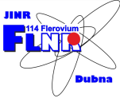
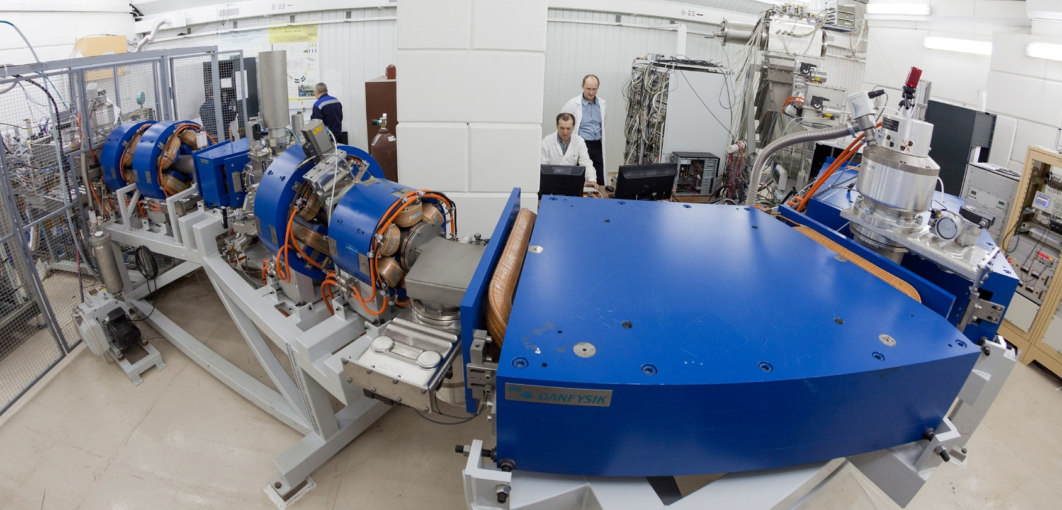
CARBON NANOMATERIALS APPLICATION FOR ISOL-METHOD OF HEAVY ION FUSION REACTION PRODUCTS
Joint Institute for Nuclear Research
Flerov Laboratory of Nuclear Reactions
Presenter: Viacheslav Vedeneev
LXXI International Conference «Nucleus-2021»

Slide 2
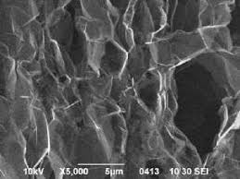
Separation of heavy ion fusion reaction products
Catchers: Solid Liquid Gas
Main requirements:
Enough separation efficiency;
Separation time – in order of SHE isotopes lifetime.
Catcher material characteristics:
1. High temperature stability (D=D₀⋅exp(-Q/RT)). D₀ – diffusion factor, Q – activation energy.
2. High porosity.
Porous graphite – polygraphene

Slide 3
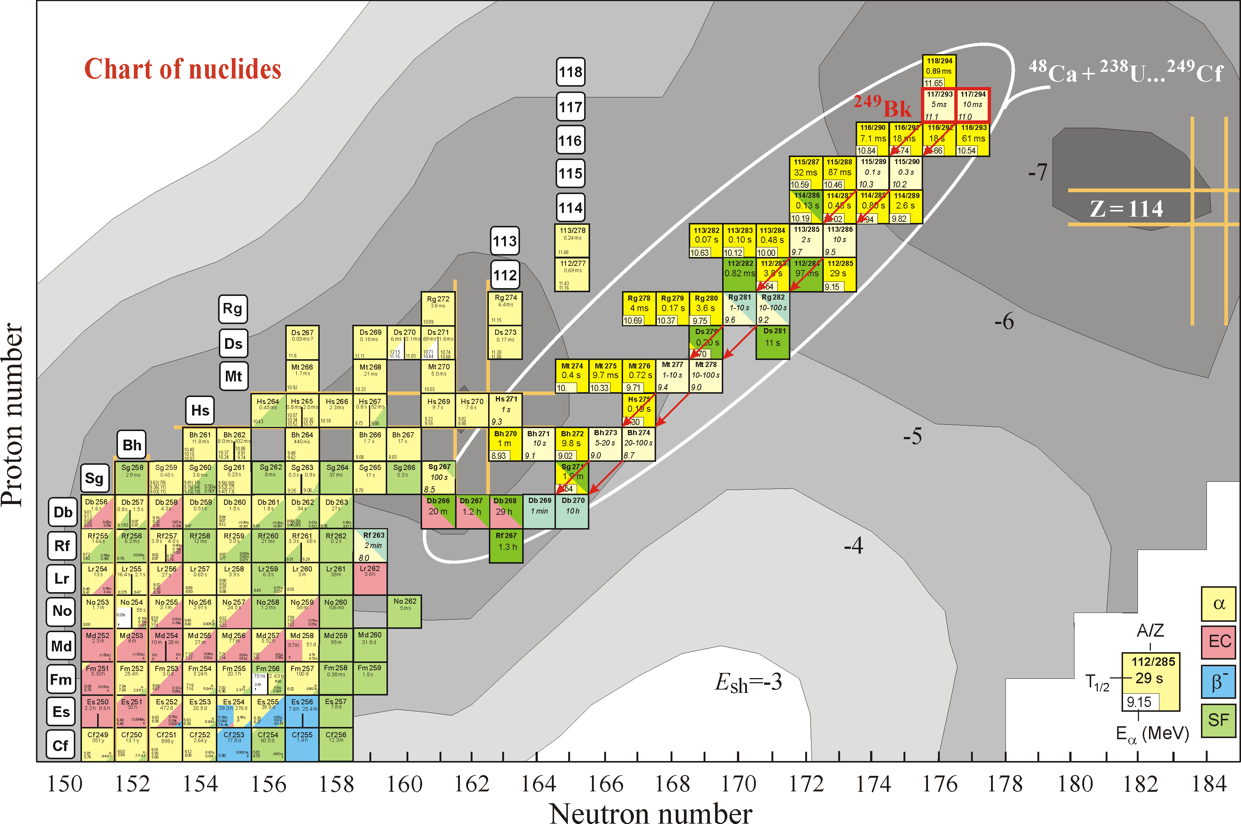
Solid ISOL method application for Superheavy nuclei
mass measurements
Two well-known volatile superheavy elements: Cn (Z=112) and Fl (Z=114).
Some isotopes have long enough decay time:
²⁸³Cn – 3.8 s, ²⁸⁵Cn – 29 s, ²⁸⁹Fl – 2.6 s.
Favorable reactions: ^{242, 244}Pu+⁴⁸Ca
Separation time –
order of seconds
Separation efficiency – quite enough
Notes:
The experiments performed at FLNR JINR showed that some of the nuclei with Z=112 and 114 have long enough half-lives, e.g., 3.8 s for ²⁸³Cn, 29 s for ²⁸⁵Cn, and 2.6 s for ²⁸⁹Fl.These elements are volatile. It means that the ISOL method can be applied for investigation of these elements
There are special requirements for the hot catcher in studies of short-lived superheavy nuclei that have low production cross-sections. The necessary separation time should be about ~ 1 s and the necessary efficiency must be higher than 10 %.

Slide 4
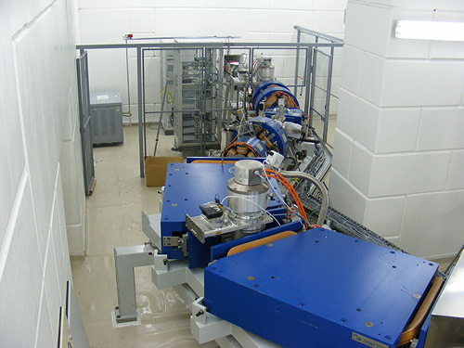
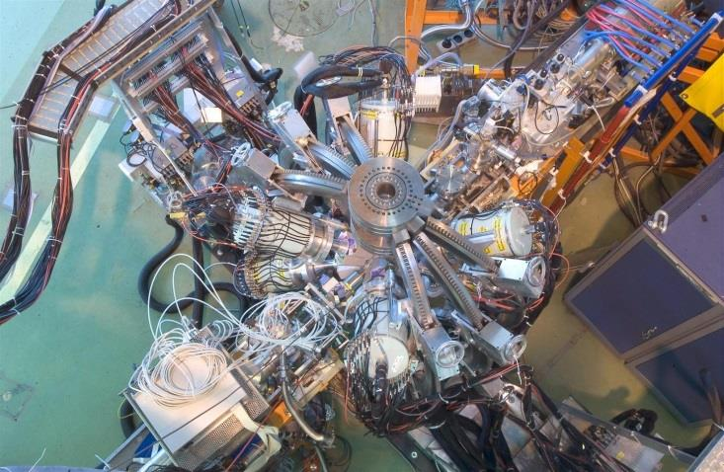
Application of ISOL method for heavy ion induced reaction
Main characteristics of ISOL systems are:
1. Separation efficiency;
2. Separation time.
Comparison of ISOL systems at ISOLDE-SC and MASHA
Setup | Catcher | Target thickness | Transport temperature | Separation time, s | Separation efficiency, %
ISOLDE-SC | Liquid lead | 170 g/cm² | ≤ 1000 K | 30 | 7.8
MASHA | Polygraphene paper | 0.06 g/cm² | 293 K | 1.8 | 0.07
MASHA: reaction ⁴⁰Ar+¹⁴⁴Sm
ISOLDE-SC: p⁺ + ^{nat}Pb
Notes:
Представлена твердотельная ИЗОЛ система, использующаяся на масс-сепараторе МАША для сепарации продуктов полного слияния под действием тяжелых ионов. В качестве горячего поглотителя продуктов реакций применяется полиграфеновая фольга.
The use of porous graphite as the hot catcher improves the time characteristics and the efficiency of extraction. At ISOLDE a liquid lead target is used as the hot catcher to provide a better diffusion of particles. At MASHA the extraction time was 1.8 s as compared with 30 s at ISOLDE. A separation time of 1.8 c of the MASHA setup seems to be a convenient value for the experiments on measuring the masses of superheavy elements. Since the production cross-sections of superheavy elements are of a few picobarns, the total efficiency of separation have to be more than 10 %.

Slide 5
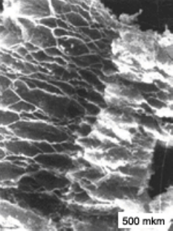
MASHA (Mass Analyser of Super Heavy Atoms)
MASHA setup is a combination of ISOL method of synthesis and separation of radioactive nuclei with the classical method of magnetic mass analysis, allowing identification of the synthesized nuclides in the wide mass range (A = 1 – 450 a.m.u.).
Middle
Operating temperature of hot catcher – 1800-2000^{о}С.
Delivery time of nuclides to the ECR ion source ~ 1.8 s.
ECR ion source: ionization efficiency – up to 90% for noble gas.
Operation pressure – 10⁻⁵ mbar
Poly-graphene paper, density of 0.5 g/cm³ (porosity – 75%). It is possible to produce as a paperboard with thickness 0.6 mm
Notes:
Установка MASHA представляет собой ..
В качестве горячего поглотителя продуктов реакций применяется полиграфеновая фольга.
The hot catcher is a very important component for the set-ups that use the ISOL method since the efficiencies of extraction of nuclides depend on its properties. The analysis of different materials shows that a good choice for the hot catcher is porous graphite due to its time characteristics and the efficiency of extraction.

Slide 6
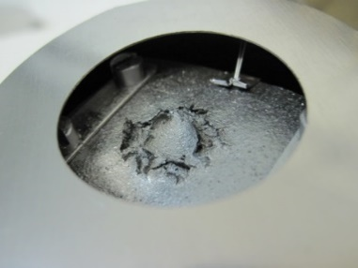
Limitations of the method for experiments with heavy ion beams
First attempt of determination of mass of Cn and Fl elements as daughter products of
the reaction ⁴⁸Ca+²⁴²Pu (2015)
Target: ²⁴²Pu (0.49 mg/cm²) with an admixture
of Nd isotopes (~ 1%).
Separation efficiency of MASHA setup as a function of measurement time.
Electrical volume power density – 2 kW/cm³
Ion irradiation power density – 8 kW/cm³
(ion beam intensity 0.5 pμA)
Poly-graphene paper after irradiation (300 h).
Beam current (⁴⁸Ca) ~ 0.5 pμA.
During the experiment, a detailed study of efficiency and reliability of all systems was carried out. It was observed that the separation efficiency of MASHA setup is not stable during the experiment in the case of high beam intensity (typically 10 mA of ⁴⁸Ca). The high beam intensity corrupts the Hot Catcher and the separation efficiency of the Hot Catcher decreases by almost ten times during a few days.
Notes:
Выполнены измерения зависимости эффективности от времени облучения при интенсивностях пучков тяжелых ионов вплоть до 0,5 pmkA.
Измерения эффективности проводились в реакции Ca+Nd благодаря специальной конструкции мишени.The target of ²⁴²Pu (0.49 mg/cm²) had an admixture of Nd isotopes (~ 1 %). During the experiment the yields of mercury isotopes produced in the reaction ⁴⁸Ca+^{nat}Nd were measured. The yield of ¹⁸⁵Hg was tested each day.
Обнаружено, что снижение эффективности сепарации связано с изменением структуры горячего поглотителя из полиграфена. Предложена новая конструкция горячего поглотителя.

Slide 7
Modernization of the MASHA setup
New design of the hot catcher: “Separated” graphite heater + catcher made of 1,1 mg/cm² graphene foil or carbon nanotube paper 6,4 mg/cm² thicknesses.
Installation of 16-strip silicon detector at the middle plane F1 (permanent control of the separation system by measurement of Hg yield).
New design ECR ion source and the vacuum chambers for ECR ion source, catcher and transport line: chemical inert covering of the inner part of the vacuum chambers; heating of the vacuum chamber at the temperature 300°C.
Notes:
Была выполнена модернизация установки MASHA которая включает в себя …

Slide 8
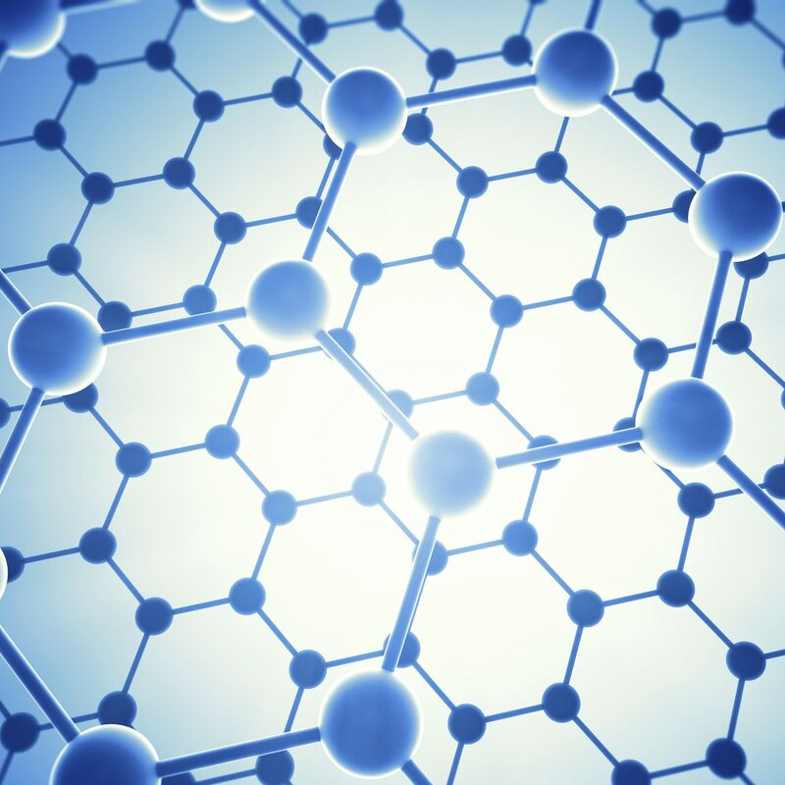
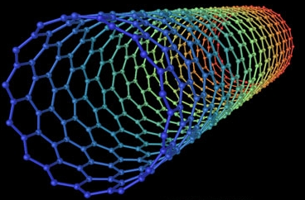
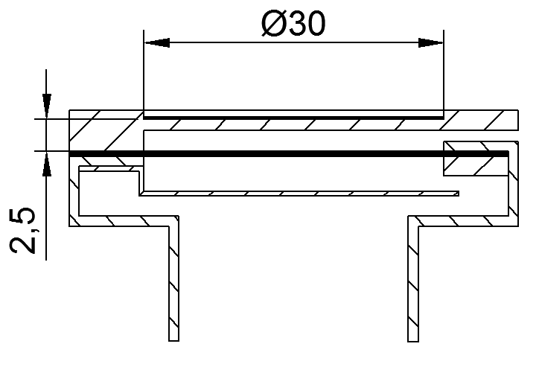
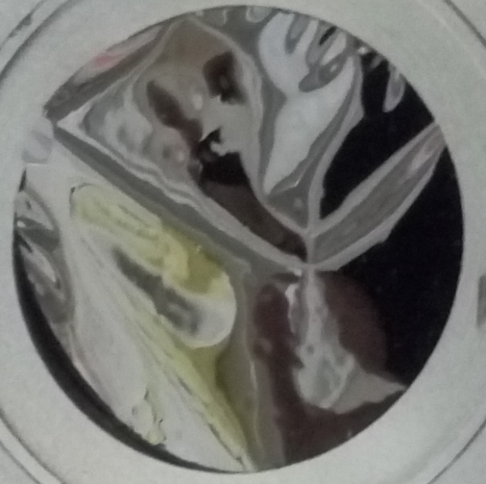
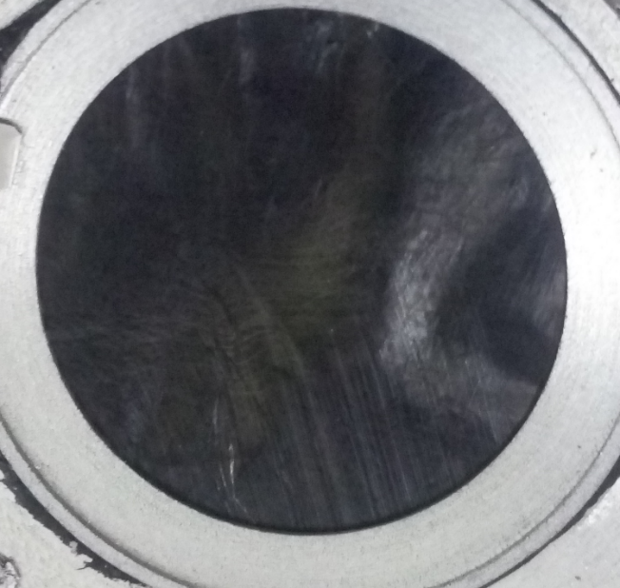
New materials: graphene and carbon nanotubes
Graphene/nanotube paper foil
Polygraphene heater
Shield

Slide 9
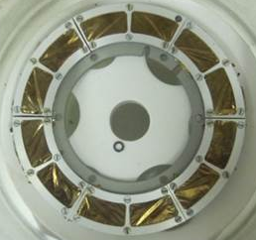
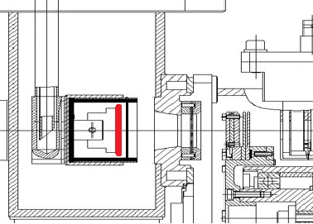
New arrangement of rotating target and separation system
Polygraphene Heater
Graphene/Carbon nanotube catcher foil
Target
To ECRIS
Ion
beam
¹⁶⁶Er
(6 sectors)
¹⁴⁴Sm
(6 sectors)
Rotating target wheel
Target for test experiment: irradiation stability of the new design hot catcher and synchronous measurement of products of the reactions ⁴⁰Ar+¹⁴⁴Sm and ⁴⁰Ar+¹⁶⁶Er
Notes:
The new version of the hot catcher was designed. It includes now a poly-graphene heater and a thin catcher made of 2 mg/cm² graphene foil or carbon nanotube paper. This construction has to prevent the catcher from heating and radiation destruction.
The ECR ion source with a special ceramic coating was developed and tested.
A special construction of a rotating target wheel was developed. The target wheel consists of the 6 identical sectors: 3 of ¹⁴⁴Sm and 3 of ¹⁶⁶Er. This target construction allows us to measure simultaneously in the test experiment the reaction ⁴⁰Ar+¹⁴⁴Sm at the intermediate plane F1 of spectrometer and the reaction ⁴⁰Ar+¹⁶⁶Er at the focal plane F2.

Slide 10
Strip detector at the intermediate focal plane F1
for control of the separation system
⁴⁰Ar + ¹⁴⁴Sm → ¹⁸⁴Hg
Middle
⁴⁰Ar + ¹⁶⁶Er → ²⁰⁶Rn
M/ΔM=1600-3000
M/ΔM=40-70
Test experiment:
F1: ⁴⁰Ar+¹⁴⁴Sm→¹⁸⁴Hg
F2: ⁴⁰Ar+¹⁶⁶Er→²⁰⁶Rn
Experiment with superheavy elements:
F1:⁴⁸Ca+¹⁴²Nd→¹⁸⁴Hg
F2:⁴⁸Ca+²⁴²Pu→²⁹⁰Fl
Notes:
The additional strip detector was placed at the intermediate focal plane F1 to control the separation efficiency during the experiment. It registers permanently the products of the complete fusion reaction ⁴⁸Ca+^{nat}Nd which takes place due to the admixture of Nd in the target, providing the Cn nuclei have to be detected in the focal plane detector.
In the test experiment we carried out simultaneously the reaction ⁴⁰Ar+¹⁴⁴Sm at the intermediate plane F1 and the reaction ⁴⁰Ar+¹⁶⁶Er at the focal plane F2.

Slide 11
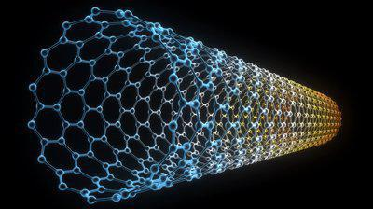
Efficiency stability of the hot catcher from carbon nanotubes
Separation efficiency of isotope ¹⁸⁵Hg as a function of time measured with polygraphene catcher in two different reactions. ¹⁸⁵Hg was measured at the middle plane of MASHA separator in the reaction ⁴⁸Ca with ^{nat}Nd admixture in both targets.
Separation efficiency of Rn and Hg isotopes as a function of time measured simultaneously with graphite nanotube catcher for beam energy in the middle of the target 218 MeV. Rn isotopes – at the focal plane (F2), Hg isotopes – at the middle plane (F1) of MASHA separator.

Slide 12
Time response of MASHA separator for two different solid hot catcher designs. Blue line – new design with nanotube paper. Green line – old design with polygraphene.

Slide 13
Conclusion: current status of modification of MASHA spectrometer
New design of the hot catcher: test on the ion beam shows the perspective of the new materials
Installation of the strip detector at the middle plane F1 gives the permanent control
New design ECR ion source and the vacuum chambers for ECR ion source, catcher and transport line
Chemical inert covering of the inner part of the vacuum chambers – test experiment started
Notes:
For the MASHA mass-spectrometer a series of improvements of setup parameters was performed…

Slide 14
Staff and the acknowledgements
A.M. Rodin, L. Krupa, E.V. Chernysheva, A.V. Gulyaev, A.V. Gulyaeva, M. Holik, J. Kliman, P. Kohout, A. Kohoutova, A.B. Komarov,
A.S. Novoselov, A. Opichal, J. Pechousek, A.V. Podshibyakin,
V.S. Salamatin, S.V. Stepantsov, V.Yu. Vedeneev, S.A. Yukhimchuk.
Sincere gratitude to:
FLNR U-400M acceleration complex for a qualitative ion beam;
FLNR engineering staff for the experiment support;
Saint-Petersburg University and NUCLEUS-2021 for organizing the online conference;
listeners – for your attention!
LXXI International Conference «Nucleus-2021».

