Slide 1
NEUTRON FLUX ESTIMATION IN THE SPALATION EXPERIMENT AT THE PNPI SYNCHROTRON
Authors: Alekseev I. E., Belov S. E., Ershov K. V.

Slide 2
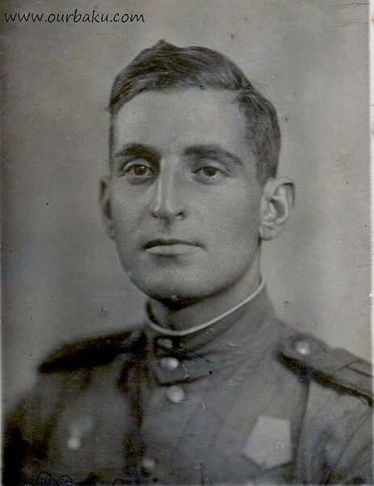
Michal Listengarten.
100 years since the birth.

Slide 3
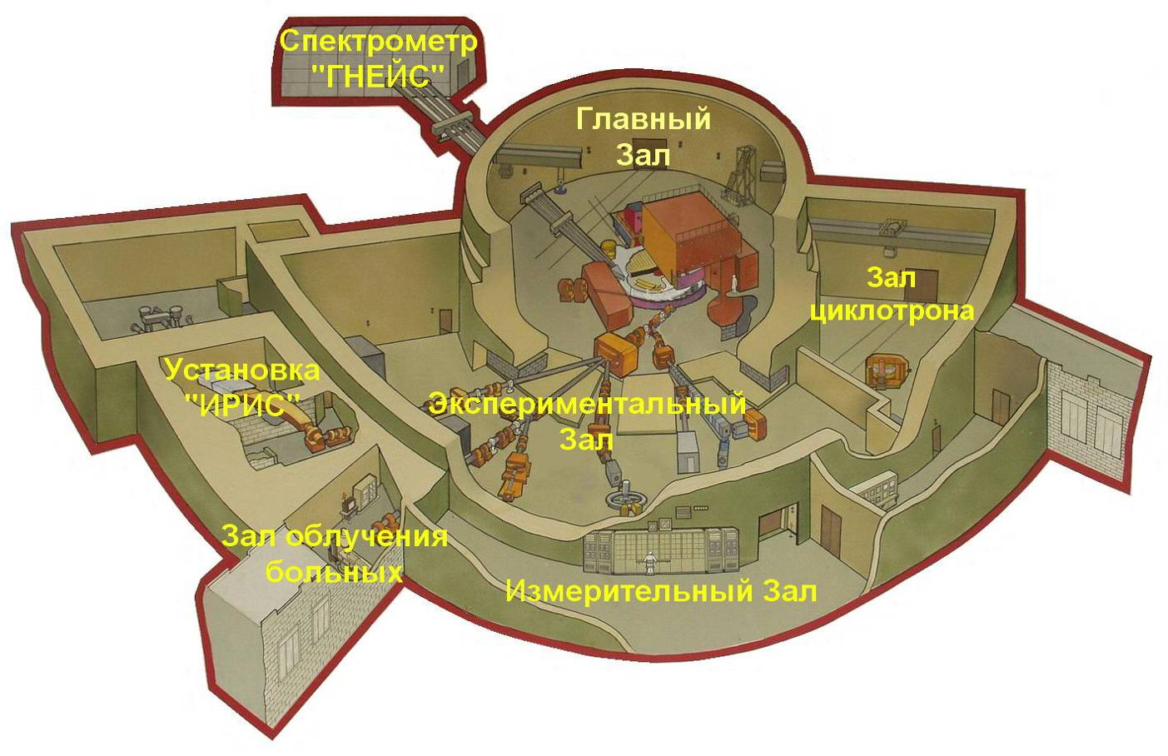
Figure from Russian journal Devices and Technic of the Experiment A, 2010, № 4, p. 5–12
NEUTRON TIME-OF-FLIGHT SPECTROMETER GNEIS
N.K. Abrosimov, O. A. Shcherbakov, A. S. Vorobyev, A. M. Gagarski, end etc.
place of this experiment

Slide 4
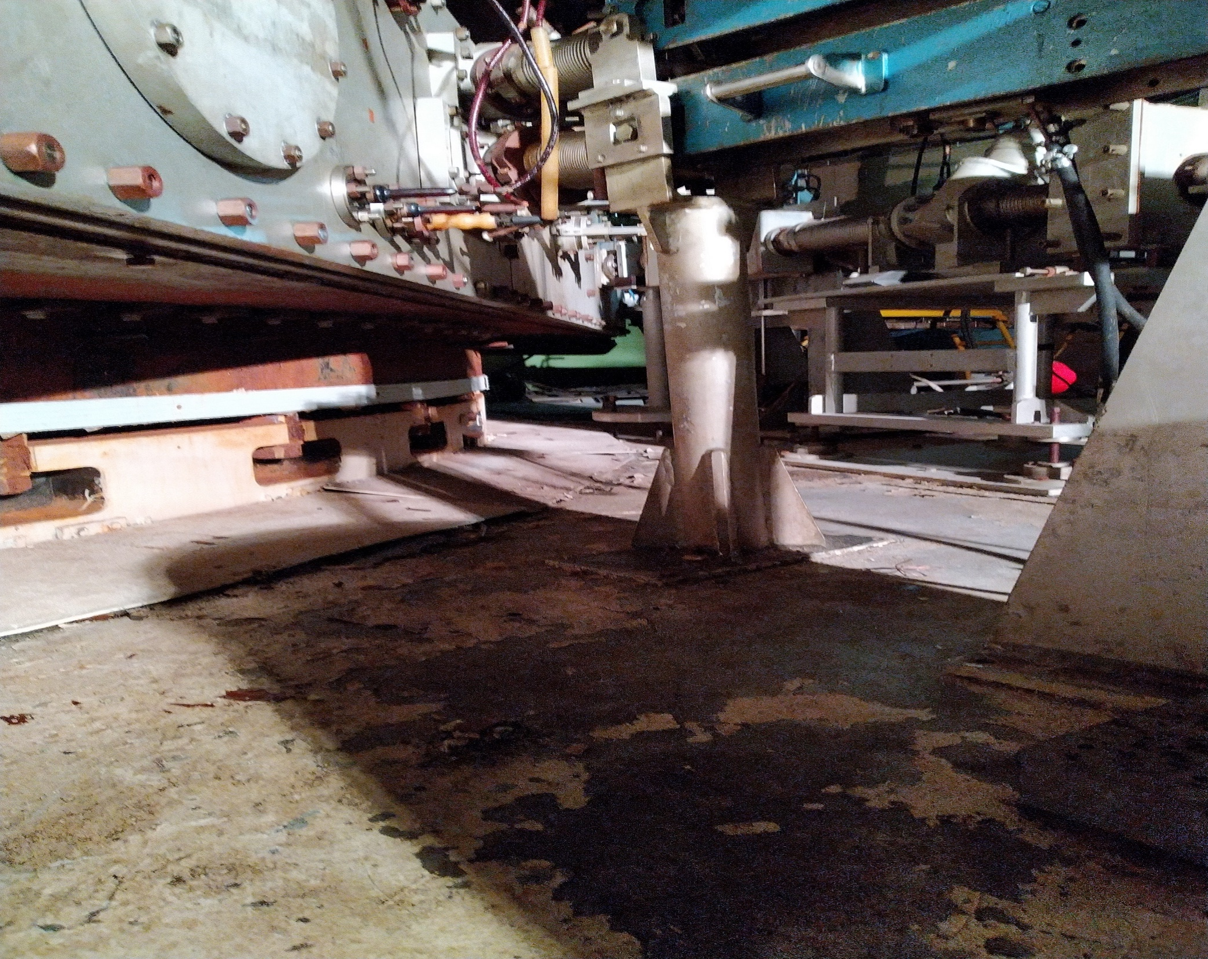
Place of this experiment

Slide 5
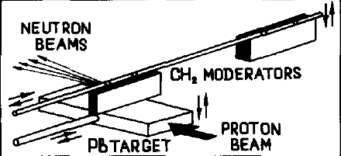
Spallation
Nuclear Instruments and Methods in Physics Research A242 (1985) 121-133
N.K. ABROSIMOV, etc.

Slide 6
Proton beam parameters and neutron flux
The duration of the entire deflected proton buch is – 10 ns at a repetition rate of ≤50 Hz.
The internal current – 2.3 μA (a maximum value - 3 .3 pA has been reached) and the number of accelerated protons is – 3 x 10¹¹ protons per pulse (1.5x10¹³ per second).
Neutron multiplicity ~20. Neutron flux ~3x10¹⁴ in 4π.

Slide 7
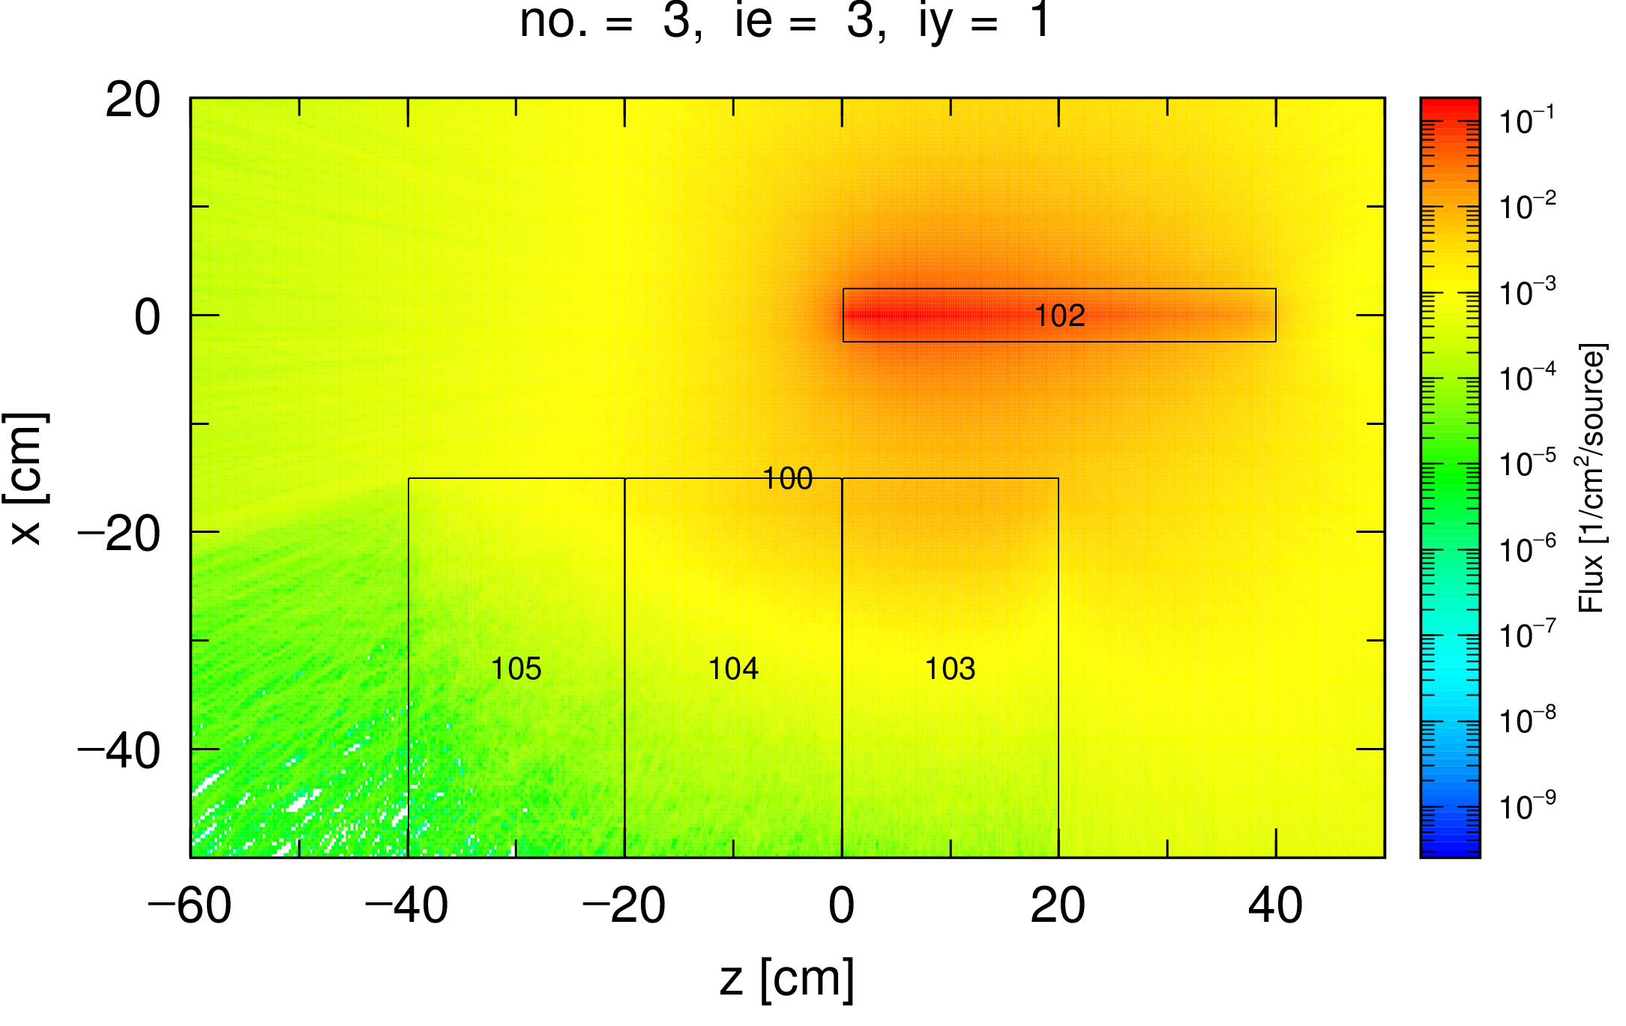
Calculation
lead brick
20 l canisters with water

Slide 8
Goals of experiment
The main goal of experiment is to determine fluxes for different energies for each moderator thickness.
Why is it important and interesting?
Time-dependent neutron experiment;
Neutron experiment with high energy.
Potential application:
Simulation of nuclear reactor;
Transmutation;
Exotic nuclear.

Slide 9
Methodology of experiment
Directly under the target is a set of rectangular 24-l canisters with light water;
Thin foils (monitors) are placed between them at the same height and on the same axis;
After irradiation, the foils are examined using a gamma spectrometer with a HPGE detector.

Slide 10
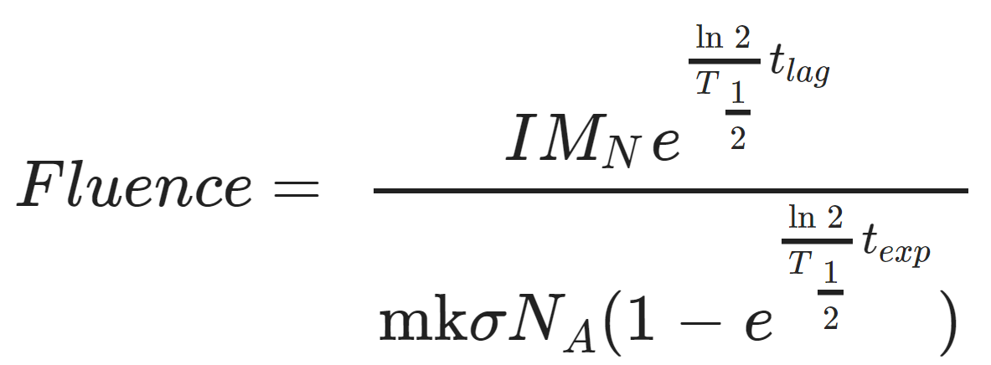
Fluence calculation by experimental data
I is the partial activity of the isotope in the monitor, M_{N} is the mass of the nucleus of the taget in atomic mass units, T_{1/2} – the half-life of the product, t_{lag} – the measurement delay time after the synchrotron stops, t_{exp} – the time of irradiation of the sample in the neutron flux, m—the mass of the sample, k – the product of the content of the corresponding element and the percentage of the parent isotope in it, σ – the cross section of the reaction, N_{A} – the Avogadro number.

Slide 11
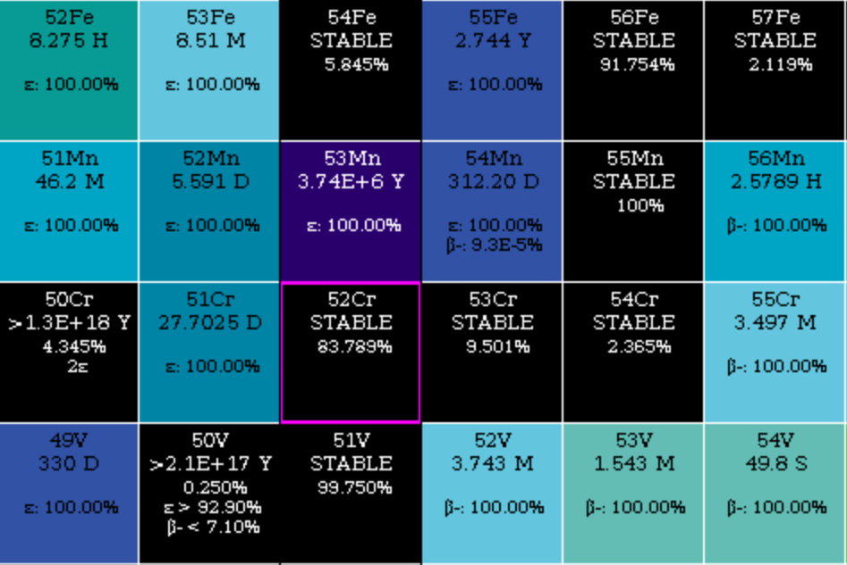
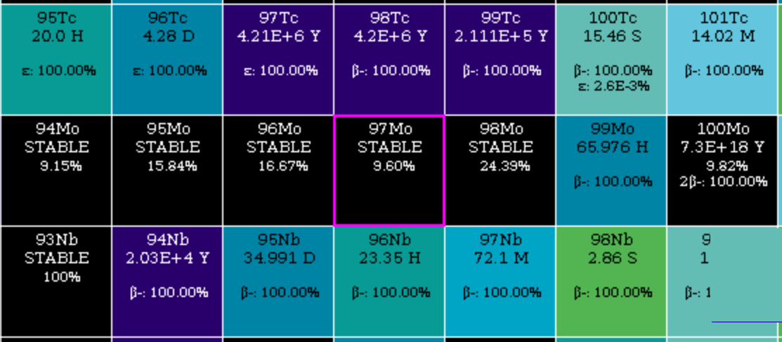
Foil content and reaction
Anealed Stainless steel 25μm
Fe — 61%;
Cr — 26%;
Ni — 7%;
Mo — 6%.

Slide 12
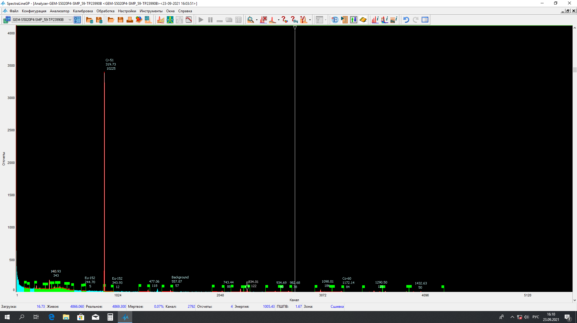
Example γ-spectrum of sample
Tc-99m

Slide 13
Results and conclusion
Since both reactions have a resonant fashion with an energy of several keV, we can only estimate qualitatively the ratio between high-energy and thermal neutrons (in this particular case) ;
For the last (fourth) sample, the value of the thermal neutron flux can be estimated ~10⁸ n/sec/sm².

Slide 14
Further research
The experiments with threshold nuclear reaction;
Transmutation of fission products and transuranic elements;
New reactions data search.

Slide 15
Thank you for attention

