Slide 1
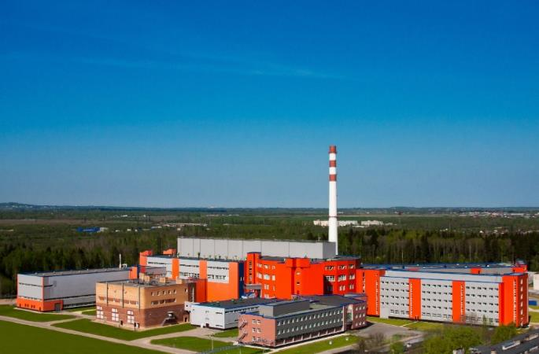
Reactor PIK status and
scientific program for elementary particle and nuclear physics
Vladimir Voronin
NRC “Kurchstov institute”-PNPI
Notes:
1
1

Slide 2
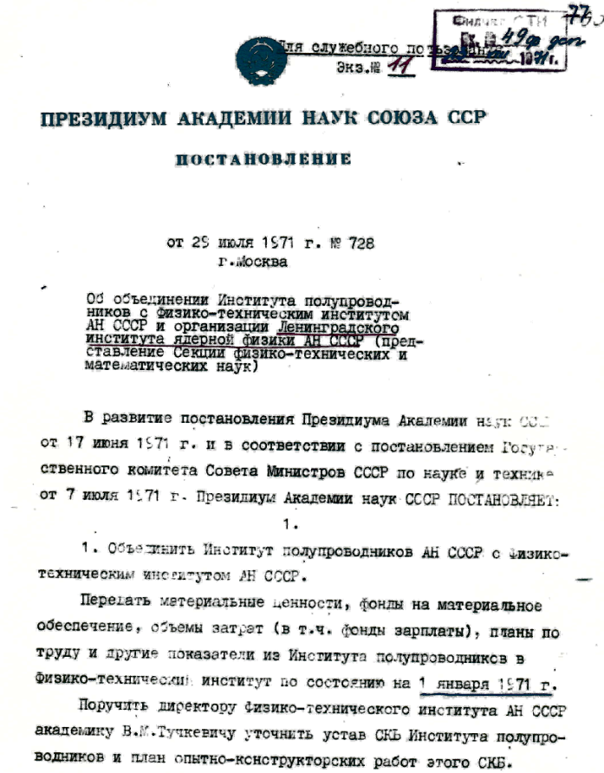
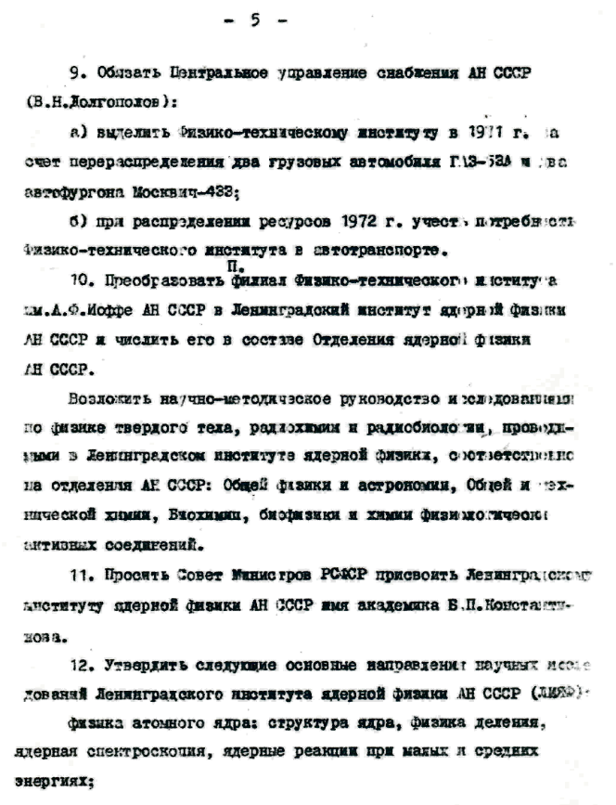
2021 – 50 years of PNPI

Slide 3
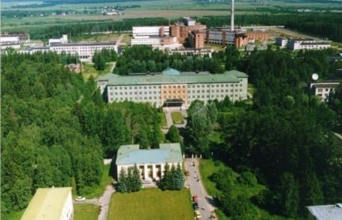
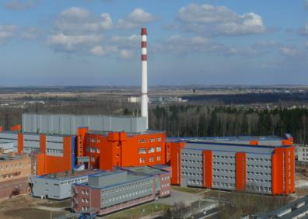
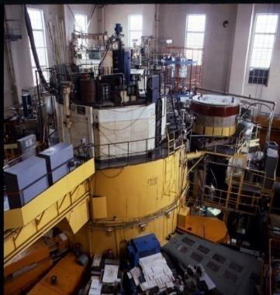
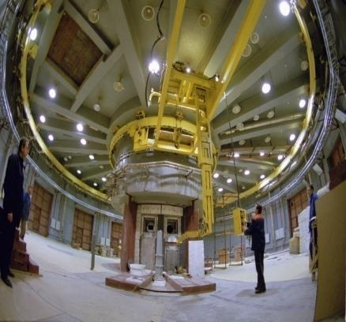
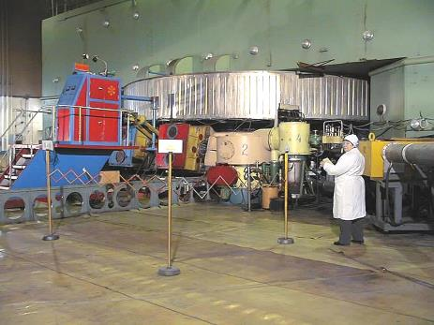
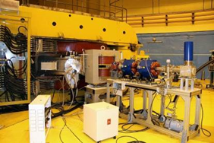
Член-корр. РАН - 2
Доктора наук – 75
Кандидаты наук – 260
Научные сотрудники - 530
Инженеры – >600
Всего в ПИЯФ – 2100 (+ 100 совм.)
Instrumental facilities Research nuclear reactor for 18 MW; Research nuclear reactor for 100 MW (commissioning stage); Proton accelerator at 1 GeV; Cyclotron 80 MeV. Main research direction: physics of elementary particles and fundamental interactions; physics of the atomic nucleus and nuclear reactions; neutron physics; physics of the condensed state of matter; molecular and radiation biophysics; theoretical physics; physics and technology of reactors and accelerators; radiation medicine; applied developments and instrumentation. Staff Total – 2100 Engineers - 600 Scientists - 530

Slide 4
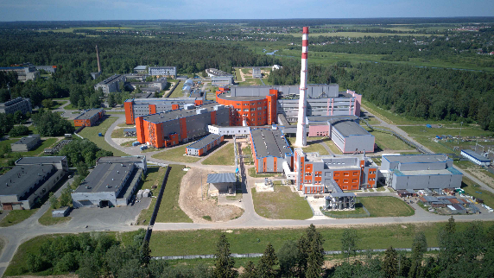
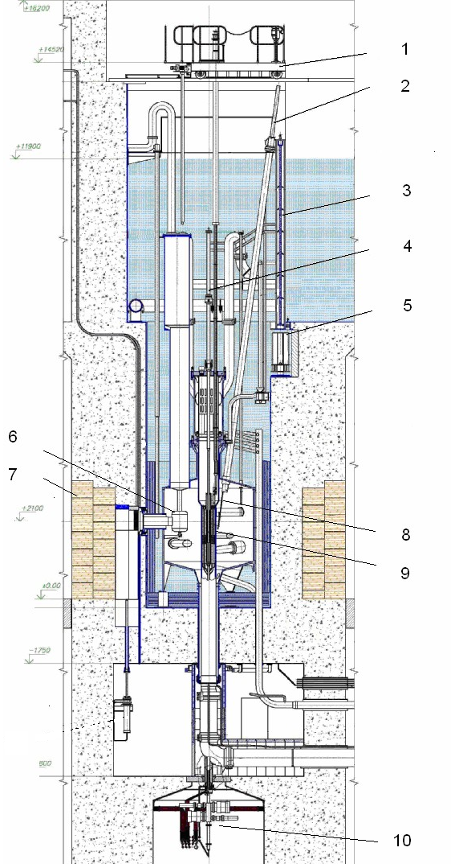
Reactor PIK as a neutron source

Slide 5
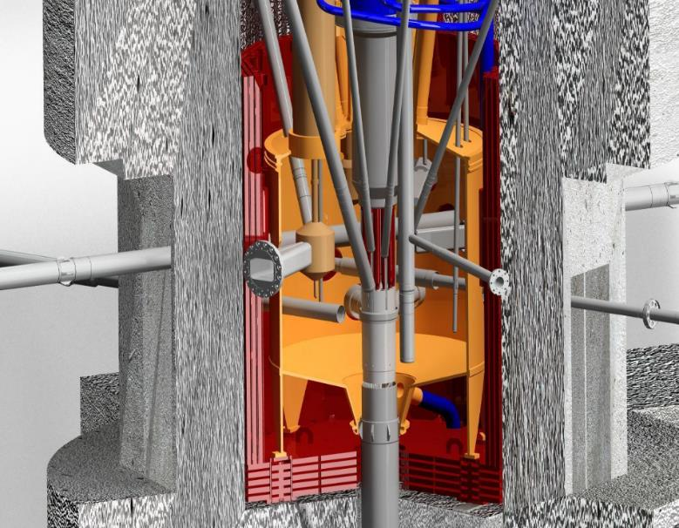
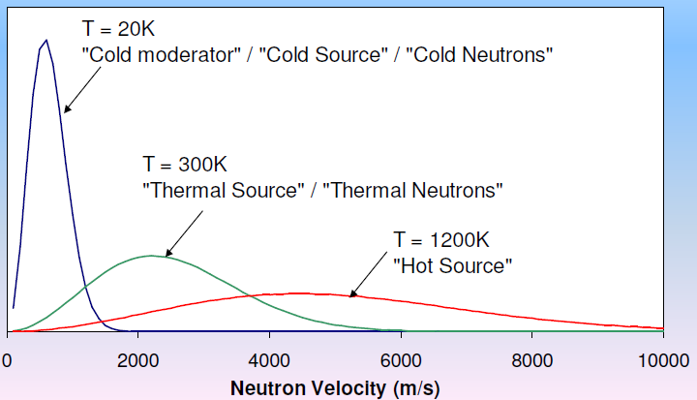
High flux research reactor PIK
PIK is aimed for production of neutron beams with the maximal possible fluxes.
Light water coolant
We need:
High neutron fluxes inside the reactor
Neutron thermalization system to provide required energy
Neutron transportation system
Neutron scattering station
Neutron beam
Reactor core
Heavy water moderator

Slide 6
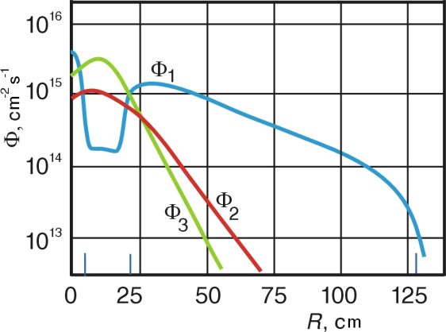
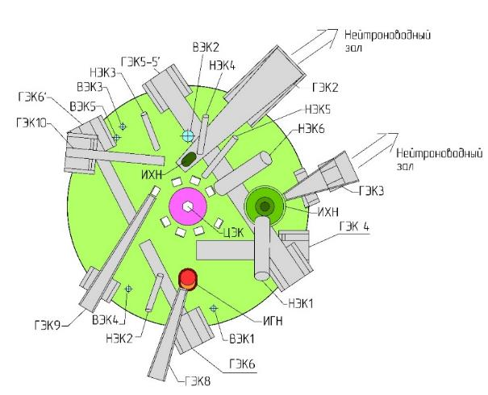
Reactor PIK parameters
 | Value
Power | 100 MW
Reactor core volume | 50 l
Core height | 500 mm
Coolant | Н₂О
Reflector | D₂О
Maximal neutron flux in moderator | 1.3х10¹⁵ n/cm²c
Maximal neutron flux in central trap | 5х10¹⁵ n/cm²c
Operation cycle | ~30 day
Experimental channels - Horizontal (HEC) - Vertical (VEC) Inclined (IEC) Central (CEC) | 10 6 6 1

Slide 7
Comparison of PIK with the best reactors
Europe without PIK
(from C.Carlile, NOP-2017, Nara, Japan)
Facility/ Location | Commissioning Date | Power | Maximum Flux Density | Number of Instruments on Beams
PIK Gatchina, Russia | 2021 (under commissioning) | 100 MW | 5×10¹⁵ n/сm²s | Up to 50
HFR Grenoble, France | 1971 | 58 MW | 1.5×10¹⁵ n/сm²s | 40
HFIR Oak Ridge, USA | 1965 (updated 2007) | 85 MW | 2.5×10¹⁵ n/сm²s | 12
FRM2 Munich, Germany | 2005 | 20 MW | 0.8×10¹⁵ n/сm²s | 27
BER2 Berlin, Germany | 1973 | 10 MW | 0.086×10¹⁵ n/сm²s | 25
OPAL Sydney, Australia | 2006 | 20 MW | 0.4×10¹⁵ n/сm²s | 7
CARR Beijing, China | 2010 | 60 MW | 0.8×10¹⁵ n/сm²s | 6
WWR-M Gatchina. Russia | 1959 | 18 MW | 0.45×10¹⁵ n/сm²s | 14

Slide 8
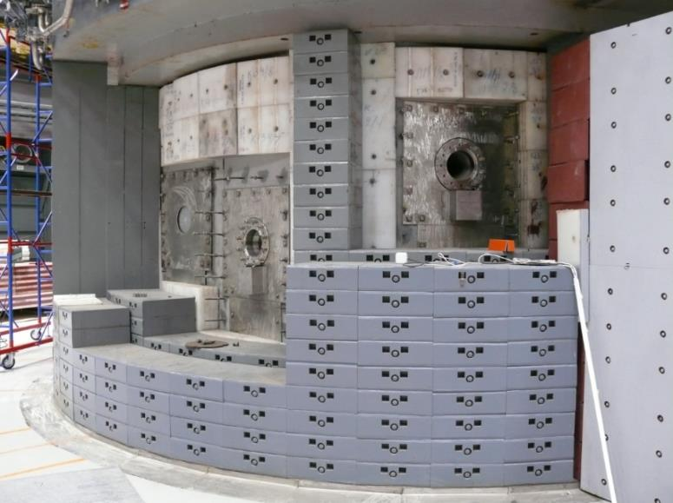
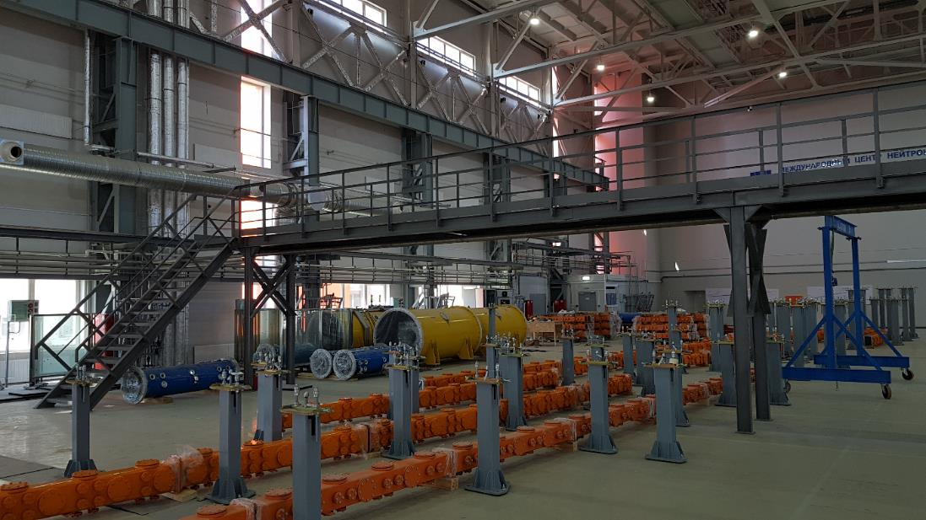
Current status of PIK commissioning

Slide 9
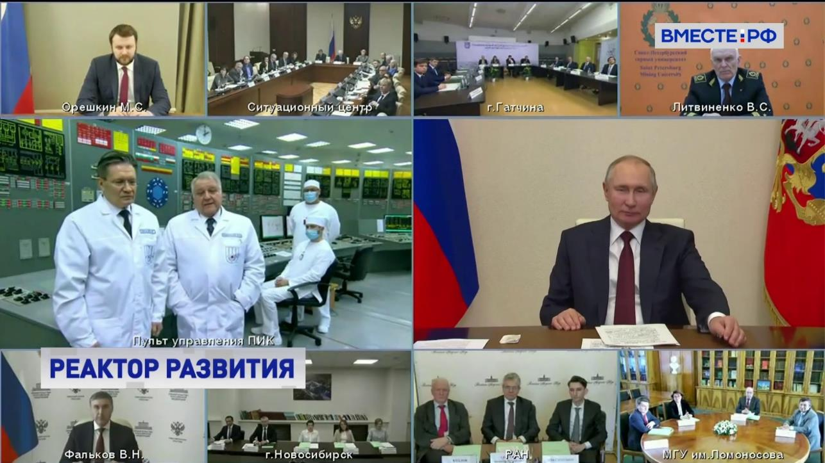
8 February 2021.
The energetic regime was started by Russia president Vladimir Putin
2019 – 100 kW
2021 – 10 MW
2023 – 100 MW

Slide 10
Roadmap of PIK commissioning
5 stations
for CM
5+20 stations
First neutron beam
experiment
We are here

Slide 11
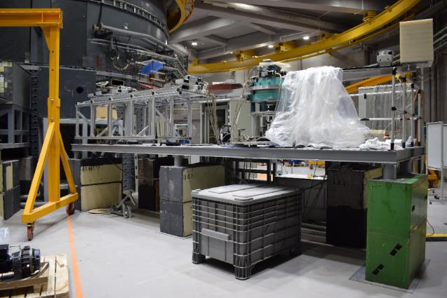
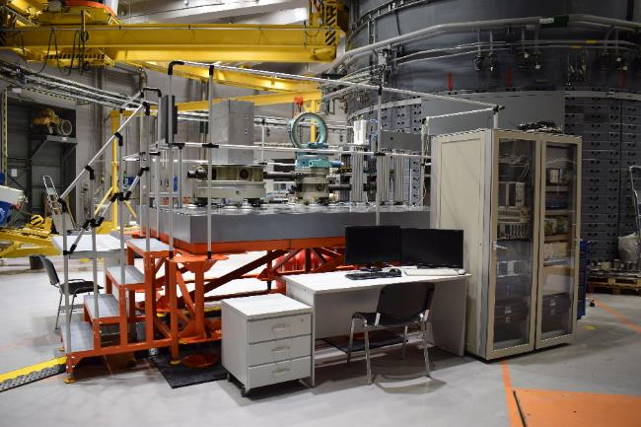
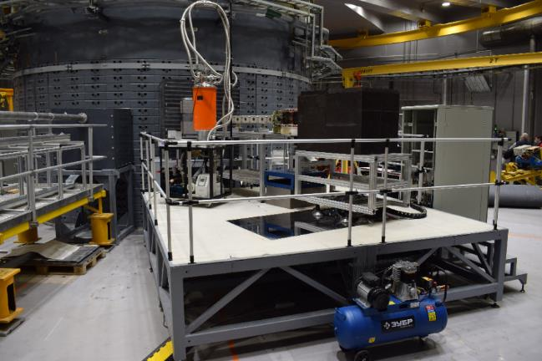
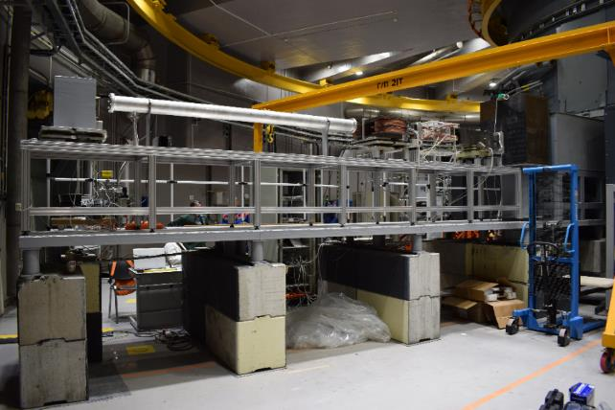
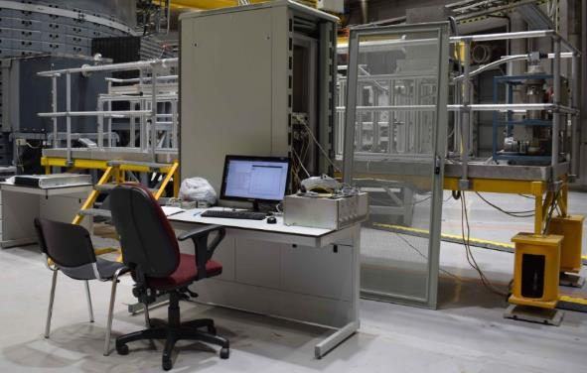
5 “first day” stations
NERO-2
TEX-3
Test neutron reflectometer
DPN
Tspectrum

Slide 12
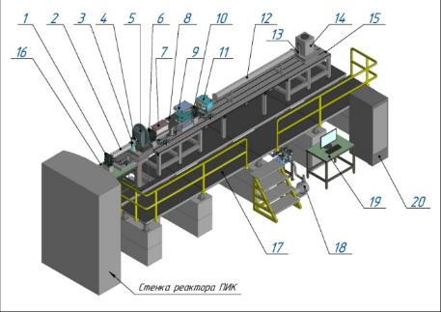
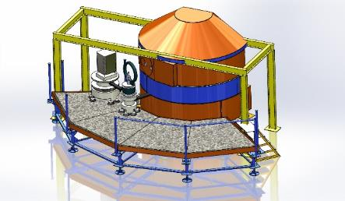
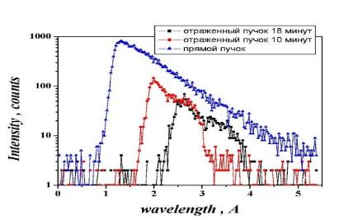
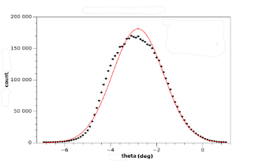
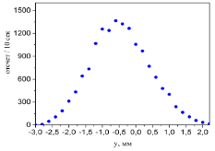
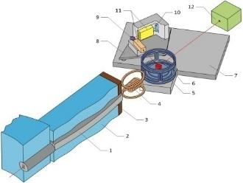
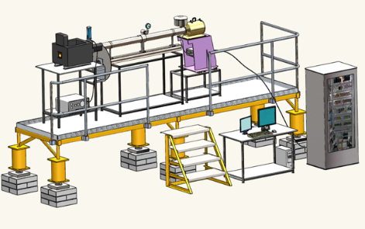
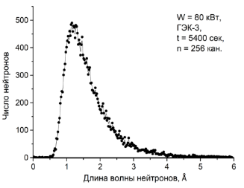
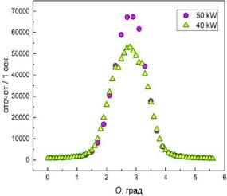
Status of the “first day” stations
1
4
TNR test neutron reflectometer
NERO Polarized Neutron Reflectometer (GKSS)
DPN polarized neutron diffractometer
Texture Diffractometer TEX-2 (GKSS)
Test neutron spectrometer
Commissioned at the December 2020
First “demonstration” experiments at 100kW power were carried out
All results coincide with the theoretical predictions
Program for updates of these stations to the power of 100 MW is developed
2
3
5

Slide 13
Instrumental program status
The design of the project obtained a positive state expertise decision in September 2020
Construction of the first phase instruments started January 2021
Second phase instruments started June 2021
The third phase will start at the beginning of 2022

Slide 14
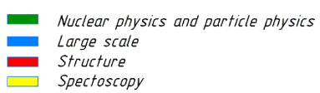
Road map of instrumental program
# |  |  | 2019 |  | 2020 |  |  |  | 2021 |  |  |  | 2022 |  |  |  | 2023 |  |  |  | 2024
 |  |  | III | IV | I | II | III | IV | I | II | III | IV | I | II | III | IV | I | II | III | IV | I | II | III | IV
0 |  | Reactor PIK commissioning | 100 kW |  |  |  |  |  | 10MW |  |  |  |  |  |  |  | 10-100MW |  |  |  | ~100MW
1 |  | Project of instruments
2 |  | Experimental channel
3 |  | HNC HEC-8
4 |  | UCNS HEC-4
5 |  | CNS HEC-2
6 |  | CNS HEC-3
7 |  | Neutronguide system
 |  | Neutron stations
2 |  | SESANS |  |  |  |  |  |  |  |  |  |  |  |  |  |  |  |  |  |  |  |  |  | Commissioning
4 |  | INAA |  |  |  |  |  |  |  | Phase 1
5 |  | «Нейтрино» (Neutrino)
6 |  | D1
8 |  | DC-1
3 |  | D3
1 |  | IN-1
9 |  | IN-2 |  |  |  |  |  |  |  |  |  |  | Phase 2
10 |  | ИРИНА (IRINA)
11 |  | DEDM
12 |  | FISCO
13 |  | Tenzor
7 |  | Мембрана – 2 (Membrane – 2)
14 |  | IN-3
15 |  | IN-4
16 |  | SONATA
17 |  | SEM |  |  |  |  |  |  |  |  |  |  |  |  |  |  | Phase 3
18 |  | Harmony
19 |  | PROGRAS
20 |  | «Бета-распад нейтрона» (neutron beta decay)

Slide 15
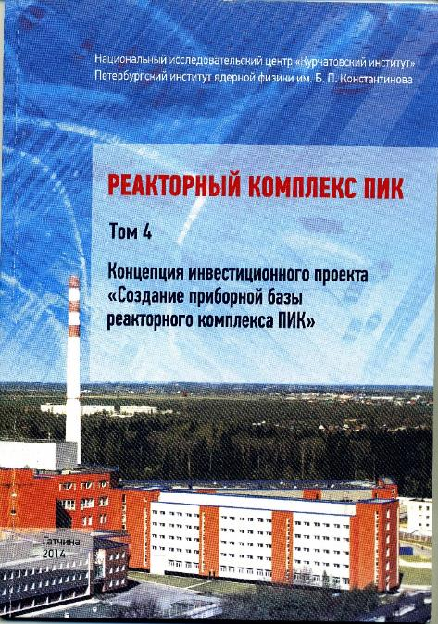
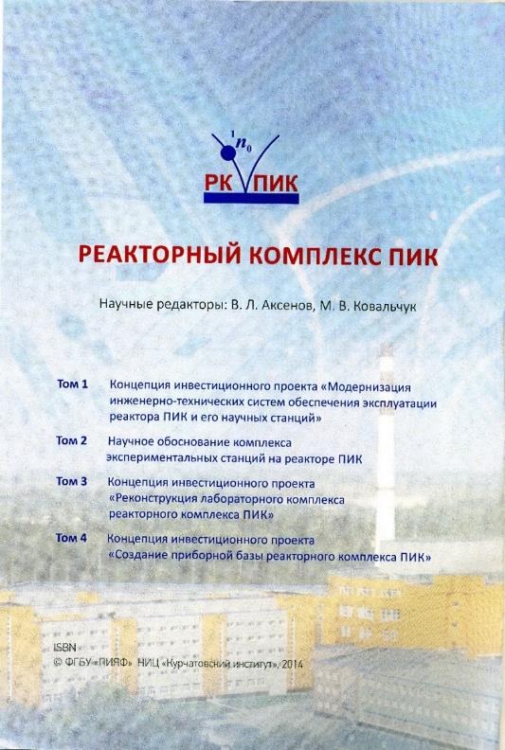
The scientific case was published in 2015. (v.3 and v.4) There are not serious changes for 2021.

Slide 16
What do we get for particle and nuclear physics?

Slide 17
National Instrument Program
5 “first day” stations (2020)
Main program (2020-2024)
Neutron sources –
Two cold neutron source (HEC 2 and HEC 3)
Hot neutron source – HEC 8
Ultra cold neutron source – HEC 4
Instrumentation base (20 stations)
Experimental stations for condensed matter (13)
• Diffractometers (3)
• Spectrometers of inelastic scattering (5)
• SANS machines (3)
• Reflectometers (2)
Experimental stations for nuclear and particle physics (7)
  Stations with CN (2)
  Neutrino physics facility (1)
  Stations for nuclear spectroscopy (3)
  Fission physics (1)
Realized at the the framework of national program of the development of neutron and synchrotron research in Russia (2020-2027)

Slide 18
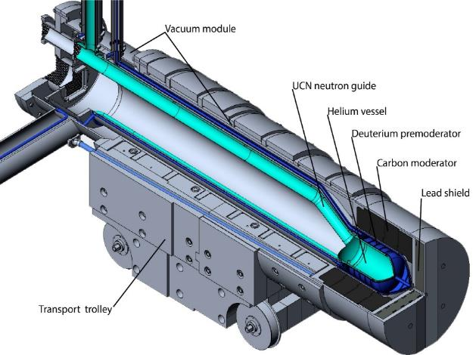
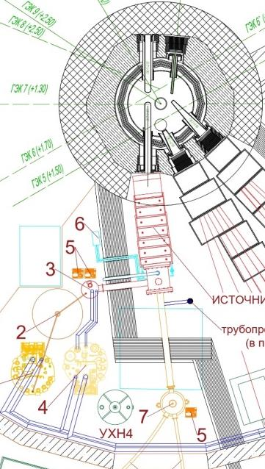
ULTRACOLD NEUTRON SOURCE
UCN source parameters:
Parameter | Value
UCN converter temperature, K | 1,15
Thermal neutron flux, cm⁻²s⁻¹ | 2,8∙10¹⁰
9Å flux density, cm⁻²s⁻¹Å⁻¹ | 5∙10⁸
UCN density in UCN source, cm⁻³ | 1,3∙10³
UCN density in the EDM trap, cm⁻³ | 3,5∙10²
Energy release in the helium chamber, W | 3,85
Energy release in the pre-moderator chamber, W | 10,7
Energy release in the lead shield, W | 267
Superfluid ⁴Не convertor at HEC-4
Т-1.15К
V~35 litre

Slide 19
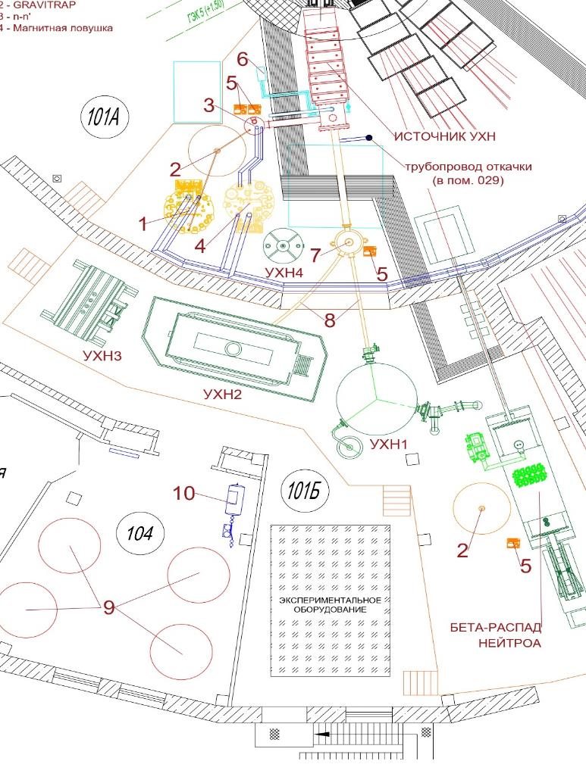
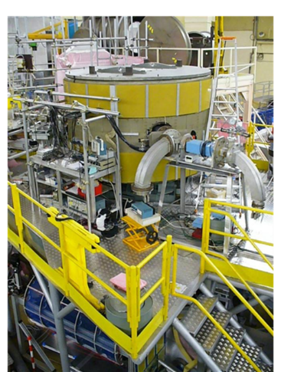
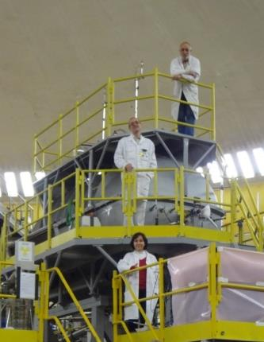
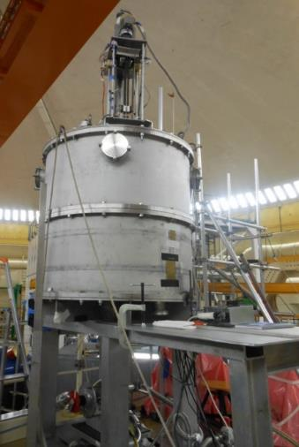
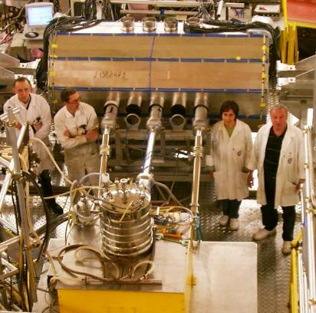
UCN source on PIK reactor and the program of research of fundamental interactions
UCN source
UCN gravitational
trap
UCN
magnetic trap
n-n’ oscillations
EDM spectrometer
UCN
gravitational
trap
EDM spectrometer
asymmetry of β-decay
UCN magnetic trap
n-n’ oscillations

Slide 20
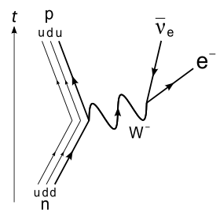
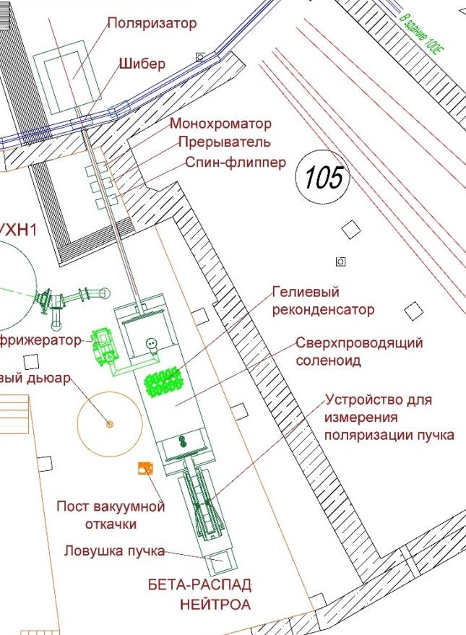
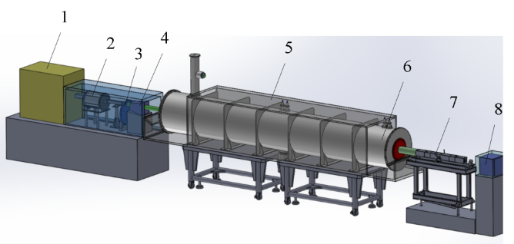
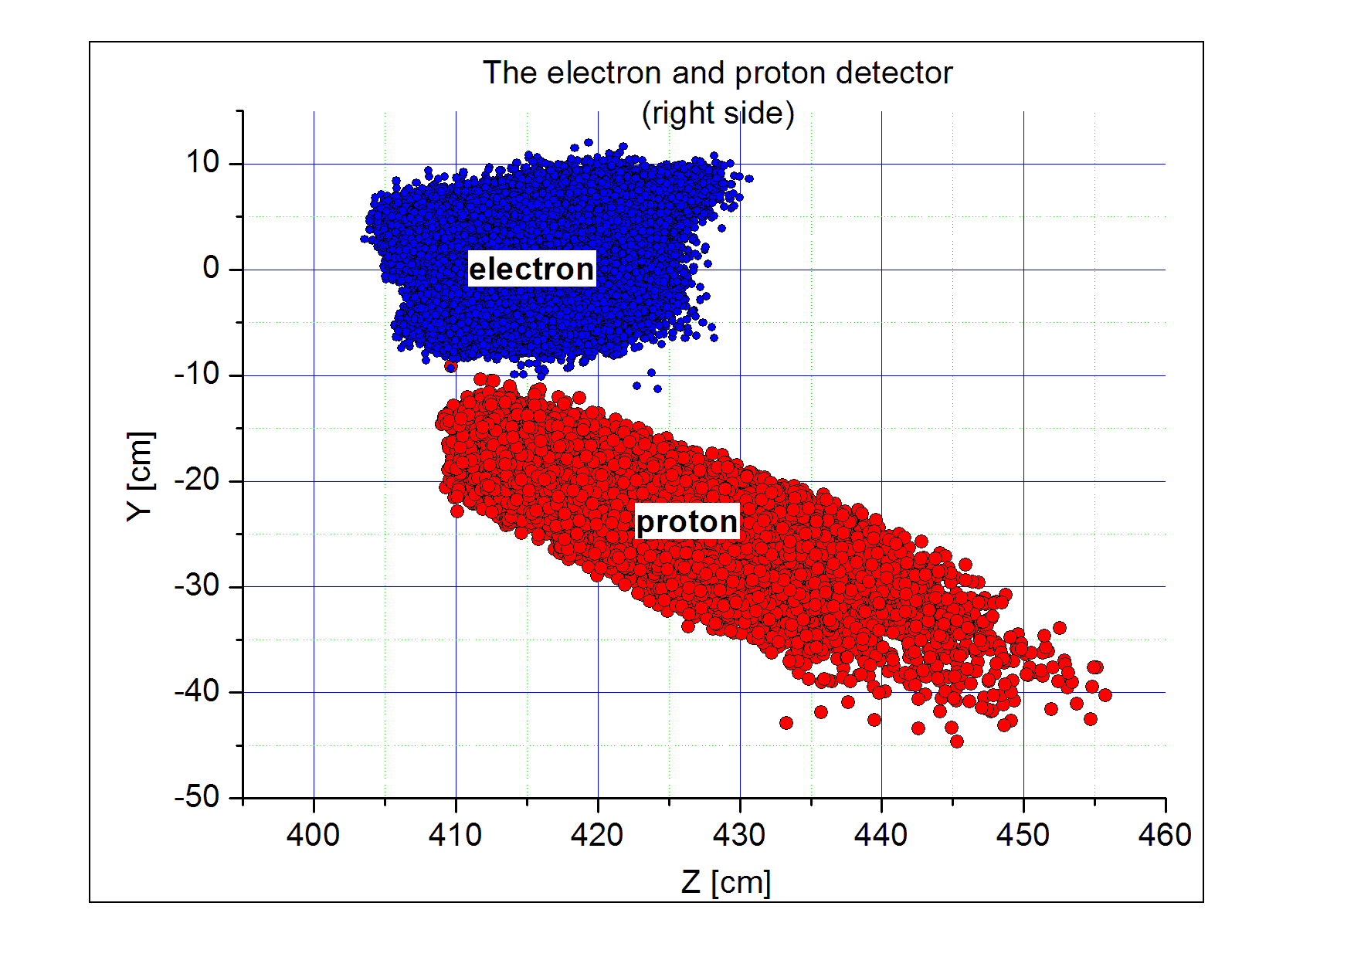

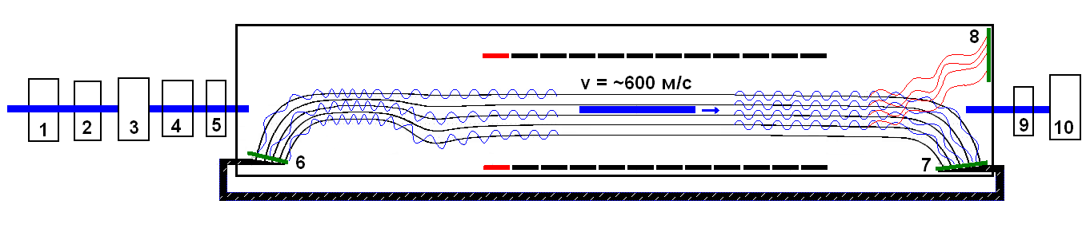
Neutron beta-decay
Supermirror Polarizer
Shutter
Monochromator
Breaker
Spin Flipper
Helium refrigerator
Superconducting solenoid
Study the correlation in neutron decay with accuracy about 10⁻³
Helium Dewar
Beam polarization measuring device
Vacuum pump
Beam stop
NEUTROM BETA DECAY

Slide 21
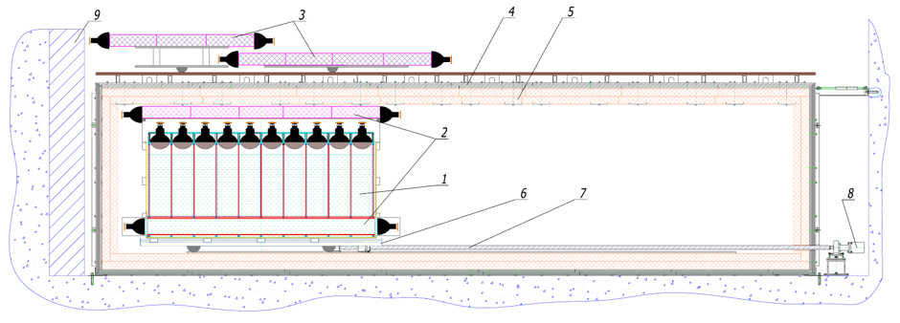
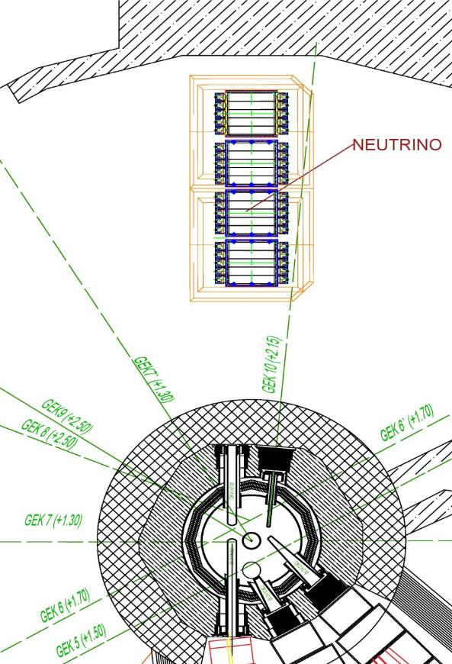
NEUTRINO
Study the short range neutrino oscillations
NEUTRINO parameters:
Parameter | Value
Detector section size, cm | 22х22
Energy resolution | 20% for 1 MeV
Fast neutron background inside the detector shielding | less then 6·10⁻⁵ s⁻¹cm⁻²
Thermal neutron background inside the detector shielding | less then 4·10⁻⁵ s⁻¹cm⁻²
The ratio of the neutrino level signal to the correlated background | more then 1
The ratio of the neutrino level signal to the background of random coincidences | more then 0,6

Slide 22
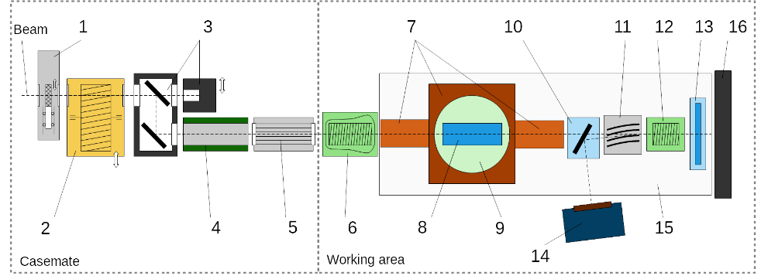
DEDM Setup for Crystal Diffraction Experiments at PIK Reactor Complex
1. Beam shutter
2. Velocity selector
3. Double-crystal monochromator
4. Neutron guide
5. SM polarizer
6. Spin-flipper
7. CRYOPAD (3D polarization analyze)
8. Working crystal (sample)
9. Non magnetic hexapod positioner
10. Monochromator
11. Transparent SM analyzer
12. Spin-rotating coil
13. Crystal-reflector
14. PSD detector
15. Granite plate
16. Beam stop
• Velocity selector: transmission ~ 95%, Δλ/λ ~ 10%.
• Monochromator: Dual pyrolytic graphite (PG), size 100 × 100 mm², mosaicity ~1°.
• Detector: 2D position-sensitive, 250 × 250 mm², resolution ~ 1-2 mm, efficiency > 90%.
• Hexapod Positioner: non magnetic, not heat.
• Spin-flipper: radio frequency, f ~ 99.9%
• Working mode: wavelength 3-5 Å or white spectrum, polarized/non-polarized beam.
• Polarizer/analyzer: super-mirror multi-slit, P ~ 98-99%.
• CRYOPAD: system with a double superconducting magnetic shield and rotating coils for 3D polarization analysis. Max sample size is 100 × 100 × 500 mm³.
DEDM

Slide 23




DEDM Setup for Crystal Diffraction Experiments at PIK Reactor Complex
Large tested composite working crystal (15 items with 35×100×100 mm³).
Interplanar space dispersion is
Δ d/d= ± 2 ⋅ 10⁻⁶ over the all crystal.
3D model of the DEDM setup
Project of DEDM-CRYOPAD
(3D polarization analysis)collaboration with ILL (Grenoble, France) for large composite crystal.
A high-priority task is to conduct an experiment on the neutron EDM search using the diffraction in a noncentrosymmetric quartz crystal. The sensitivity can reach about 2.5×10⁻²⁵ e∙cm/day for the full scale experiment.

Slide 24


Исследование Радиоактивных Изотопов на НейтронАх (ИРИНА)
Investigation Radioactive Isotopes with Neutron (IRINA) facility project at the PIK reactor
Calculated yields of isotopes expected at the IRINA facility
Target is a high density uranium carbide of highly enriched ²³⁵U.
The neutron flux through the target is (3-5)х10¹³ n/сm²s.
Power dissipated on the target about 2,5 кW,
The target temperature up to 2200 °С.
The IRIN goal:
to investigate neutron-rich isotopes with neutron number close to the magic number N=82 in the region of border of neutron stability;
isotopes in the valley of nuclei with the proton magic number Z=28 and neutron magic number N=50 to establish the influence the shell effect on the nucleus form;
to develop new methods of radioisotopes production for medicine;
production radioisotope for research in solid state physics
Target – ion optic system
1–heat shield; 2-insulator; 3-niobium support disk; 4-niobium frame;
5-tantalum target body; 6-UC target inside graphite container;
7,8-pyrolytic graphite plugs; 9-tantalum target shield;10-tantalum
target holder; 11-plate from pyrolytic graphite; 12-extraction electrode;
13,14,15- focusing lens electrodes; 16,17-insulators;18-flange of lens
electrode; 19- the rod-holder.

Slide 25



Laser ion source and ²³⁸UC target material tested at the IRIS facility
The target of ²³⁸UC of
of a high density
Method of laser resonance spectroscopy in the laser ion source firstly developed and used at IRIS facility in PNPI will be used.

Slide 26





FISCO facility (FISsion COrrelations) – Detectors
(B) The multi-section detector of fission neutron and γ-quanta
Studies of the angular correlations of light charged particles in ternary fission induced by cold polarized neutrons (ROT, TRI and PNC effects).
Studies of the angular correlations in γ -quanta and neutrons emission in fission induced by polarized neutrons with resonance energies (ROT effect).
Study of the angular correlations in the prompt neutron emission in the spontaneous fission of ²⁵²Cf.
Measurements of the Fission Neutron Multiplicity Distribution in Spontaneous Fission and in Fission by Thermal and Low Energy Neutrons.
(A) Detector of the fission neutrons multiplicity
The fission fragment detector

Slide 27


INAA setup (Instrumental Neutron Activation Analysis)
General view of the pneumatic transport installation and container for irradiation.
Automation of instrumental neutron activation analysis using a pneumatic transport unit. The reduced transport time of the sample and to avoid contact of personnel with radioactive samples.
The installation will allow determining the content of Li, B, N, O, F, Ne, Al, V, and Pb in samples by their short-lived isotopes and will increase the number of elements determined by neutron activation analysis. This opens up a unique opportunity to determine these elements in superhard and heat-resistant alloys on the content of which their properties depend, to study geological samples and biological objects.
Nuclear spectroscopic studies are supplemented by x-ray fluorescence analysis of the elemental composition of samples. Development of technology for the production of isotopes ⁷⁵Se and ¹⁹²Ir, which are used in the production of non-destructive gamma-ray flaw detectors. Development of technology for the production of radiopharmaceuticals ³²P, ⁶⁴Cu, ^{66.67}Ga, ⁹⁰Y.

Slide 28

PROGRAS
5, 6
Hall of IEC
Study the nucleus structure with (n,γ)-reaction by thermal neutron in (γ-γ) coincidence.
4
INAA
2
3
1
General layout
of semiconductor gamma-ray spectrometers on the inclined channel of the PIK (b) reactor and experimental equipment:
1-neutron polarizer, 2-flipper, 3- collimator, 4 – trap, 5, 6 –radiation detectors.
A unique opportunity to identify and quantify light elements in (n,g) reactions, prompt gamma analysis, studies of nuclear reactions in gamma-gamma coincidences.
PROGRAS

Slide 29





Thanks

