Slide 1

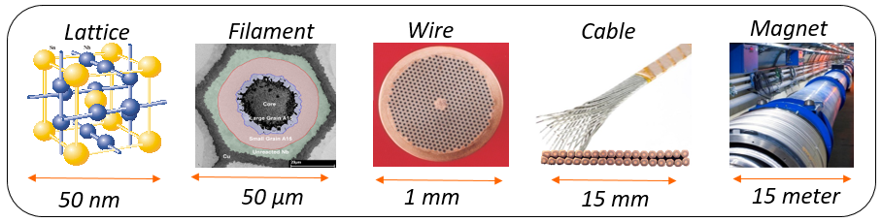
Nb₃Sn Conductor Characterization
- a selection of critical issues -
Workshop State-of-the-Art in High Field Accelerator Magnets, April 14-16, 2021
Marc Dhalle & Herman ten Kate,
University of Twente
Focus on most critical issues…..
Critical current density, filaments, AC Loss
Strain effects on wires and cables
Stability, degradation, training
Conclusion

Slide 2
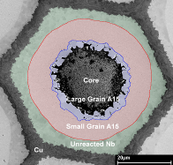
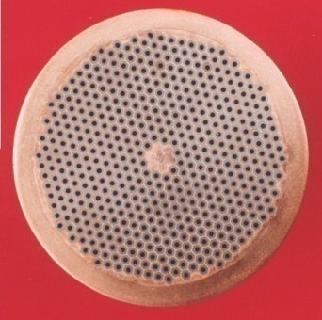
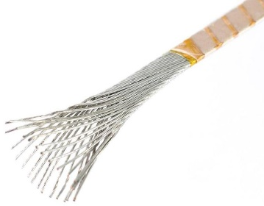
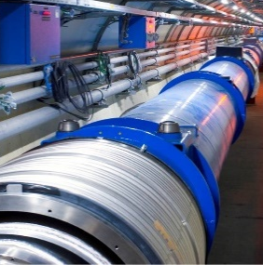

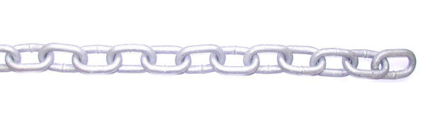
1. From material to a successful magnet
How to make cables that guarantee the accelerator magnet not to quench or degrade ?
Key physics
phenomena:
Critical current density – Magnetization & Ramp loss – Stress & Strain – Stability & Training
Magnet
Performance
Manufacturability
Robustness
Reliability
Availability
Cost
Lattice
Filament
Wire
Cable
50 nm
50 µm
1 mm
15 mm
15 meter
Few key parameters:
J_{c} - D_{eff} - Interfilament resistance - Interstrand resistance - Wire architecture - Cooling - Specific Heat
We need to understand and control the entire chain, but emphasis is on cable level….
2

Slide 3
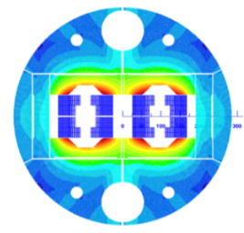
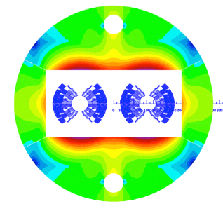
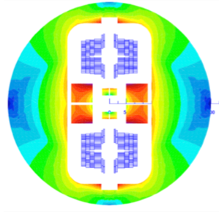
2. J_{c} - D_{eff} - AC loss - status in Nb₃Sn Rutherford cables
J_{c} & D_{eff}: for efficiency-cost-volume reasons the engineering current density in accelerator windings have to be at least some 400 A/mm² at the requested field:
  8 T at LHC, 11-12 T for HL-LHC, 15-16 T for FCC, 20+T for FCC+
  Non-Cu Jc increase well underway for achieving 1500 A/mm² in ˂20 µm filaments at 16T@4.2K, reached in km long wires (see previous talks)
  Next: further increase to some 1800 A/mm², for achieving margin and robustness, reduction of D_{eff} to 20 µm, and making long lengths
  A great success made possible by CERN’s drive towards affordable 15-16 T.
Ramp Losses: in strands and cables sufficiently predictable provided inter-filament and inter-strand resistances are under control and filament shape is known.
Hottest issues for cables, and thus for magnet performances are:
  Sustaining Transverse Pressure on cable wide face,
  Achieving no (or little) training and stable long term performance.
  So, we will focus on this in the next slides….
Three 16T FCC designs

Slide 4
2. J_{c} - D_{eff} - AC loss - status in Nb₃Sn Rutherford cables
Literature survey 2015-2021^{(*)}
Wang 2015
Collings 2017
Magnetization loops RRP strands
Sextupole moment HQ02 magnet
Coupling losses several Rutherford cables US program
Magnetization and ramp losses well-understood when strand magnetization, R_{a} & R_{c} are known
  For Nb₃Sn no major research issue last ~ 5 years.
(*) The extensive body of work < 2015 is not included in this presentation.

Slide 5
3.1 Strain effect - Single strands
Literature survey 2015-2021^{(*)}
Internal stress/strain -distribution well-charted with local probes:
n-diffraction reveals strain distribution on filament level (Scheuerlein 2017, Osamura 2019), role of thermal pre-strain (Suwa 2018), bending strain (Hemmi 2017), pre-bending (Takahashi 2015)
X-rays reveal strain distribution matrix (Scheuerlein 2017, Jin 2017)
Related T_{c} distribution evolves with mechanical / thermal cycling (Wesche 2020).
Modelling has refined to a local filament level:
Multi-level modelling from coil all the way down to filament (Daly 2018)
Influence of imperfections on transverse-stress concentration (Zhai 2016) and thermal pre-strain (D’Hauthuille 2017)
Role of plastic matrix deformation (Ta 2015, Barzi 2019)
Role of filament cracking on σ(ε) (Wang 2016) and on J_{c} (Liu 2018).
Wesche 2020
Evolution T_{c} distribution with cycling
Stress distribution magnet strand
Daly 2018
(*) The extensive body of work < 2015 is not included in this presentation.

Slide 6
3.1 Strain effect - Single strands
Literature survey 2015-2021^{(*)}
Single-strand strain response experiments have refined ....
Axial strain response well-documented (Liu 2015), including role of factors such as voids (Barth 2018) and filament twist (Seeber 2019)
Transverse strain response measured under magnet-relevant conditions no J_{c} degradation up to ~ 150 – 180 Mpa (Troitino 2021).
… and are well-understood:
Strain response is well-described and quite predictable (Ekin 2016)
It is intrinsically related to the interplay between lattice disorder (Mentink 2017) and the electronic DOS (Godeke 2018, Qiao 2019)
It can, if needed, be further ‘engineered’ with internal reinforcements (Sugitomo 2020, Barzi 2019, Hishinuma 2018).
Troitino 2021
Transv. stress response RRP strand
Conclusion: “The overwhelming lesson from the 30 years of Nb₃Sn development for ITER is that the issue is not the strand production, but the strand use” (Mitchell 2020)
Godeke 2018
A-priori axial strain response vs. data

Slide 7
3.2 Transverse pressure - Rutherford cables
Literature survey 2015-2021^{(*)}
Important body of data collected mechanical behavior cable stacks ...
Overall stiffness impregnated stacks (Wolf 2019a); evolution geometry during HT (Durante 2016, Rochepault 2016)
Local probes: n-diffraction loaded stacks (Wolf 2019b); X-ray tomography & contact imaging (Wolf2018)
Effect of RT pre-loading (Ebermann 2018) and of cable uniformity (Fleiter 2018) on critical current;
… and applied in coil modelling
Strain distribution in impregnated stacks (Nunio 2019) and winding pack (Martins Araujo 2020)
I_{c} & thermal margin prediction (Vallone 2021);
Strain development during quench (Troitino 2020).
Wolf 2019a
Impregnated stack for RT testing
FEM modelling
stack response
Nunio 2019
(*) The extensive body of work < 2015 is not included in this presentation.

Slide 8
3.2 Transverse pressure - Rutherford cables
Critical current cables vs field and transverse pressure in FRESCA (Duvauchelle 2018)
Long-sample;
Precise B_{c2}(σ) analysis;
RT stress-adjustment.
FRESCA
transverse compression holder
I_{c} response RRP cable
B_{c2} response RRP cable

Slide 9
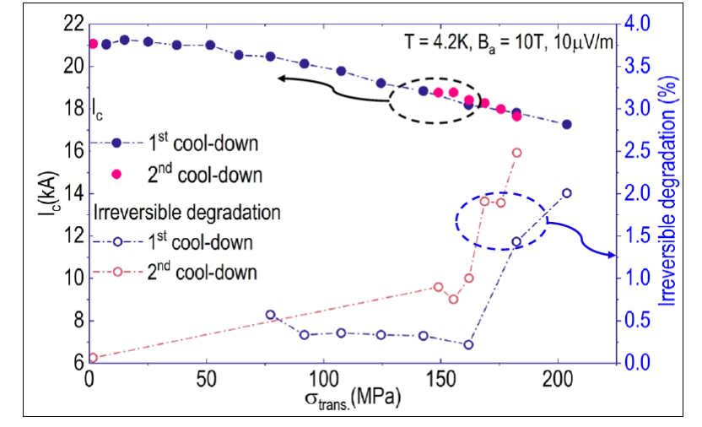

3.2 Transverse pressure - Rutherford cables
Critical current cables vs field and transverse pressure in UT press / transformer
(Gao 2018)
In-situ stress variation;
Ease of mechanical and/or thermal cycling;
Short sample.
UTwente
Cryopress /
transformer
B_{c2} response RRP cable
I_{c} response RRP cable

Slide 10
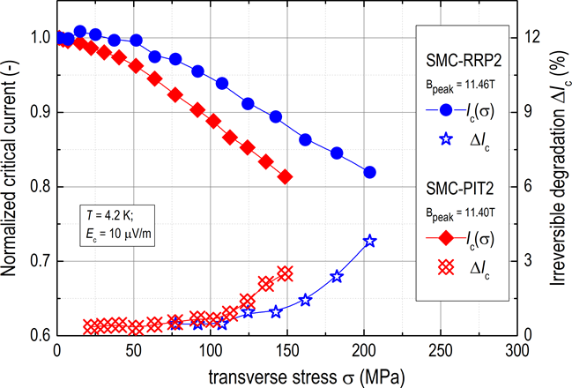
3.2 Transverse pressure - Rutherford cables
Critical current affected by pressure
Reversible reduction due to lattice deflection, some 10-20% at 150 MPa!
Irreversible reduction due to copper yielding, changing Nb₃Sn pre-stress state, significant > 100 MPa
Irreversible damage, filament cracking
Starts at some 150-200 MPa.
Note: measured with pressure uniformly applied, in real coil not the case, thus worse to expect.
Benchmarking I_{c} response
Gao 2020
Transverse pressure of some 150 MPa OK in perfectly impregnated cables, but I_{c} then some 20% less, eating from the margin, thus reduced stability!
Strand and cable mechanical optimization possible to some extend, not more, hitting a principle limit for non-reinforced Rutherford cables !
Duvauchelle 2018
Benchmarking I_{c} response

Slide 11
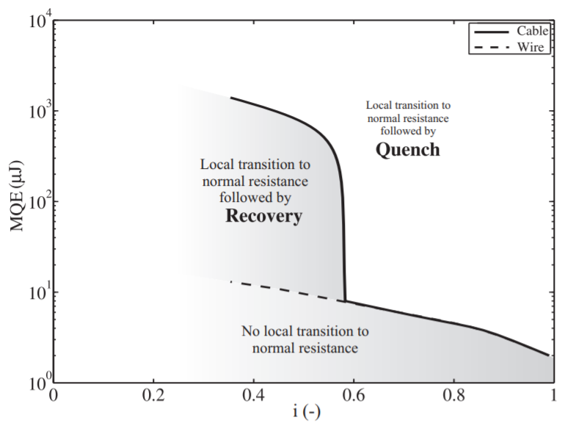
Human resources slide 4
4.1 Stability versus I/I_{c} - Nb₃Sn Rutherford
Operate cable at operating point I/I_{c} not too high.
I_{c} is of the cable after manufacturing (cabling degradation, may be -5%) and fully loaded at 150-200 MPa (-10 to 20%); so effectively at some 75 to 80% of the wire I_{c} (only).
To profit from collective strand stability, be on left side of the kink, to get robustness and be less susceptible to wire motion and resin cracking!
The transition is characterized mainly by single strand level (heat capacity) and the “kink value” of I/I_{c}.
Systematically all factors determining i_{kink} were investigated experimentally and verified by simulation (CUDI).
Key factors are C_{p} (added high C_{p} material or sf He in cable); cooling with sf He and inter-strand contact resistances!
I_{c} (B,T,Ɛ) cable under load !
I_{c}(A)
I_{c} (B,T) virgin wire
B α I_{o}
B(T)
We probably can’t base a large series production of long magnets on a design relying on single strand stability… have to accept the consequences.
11

Slide 12
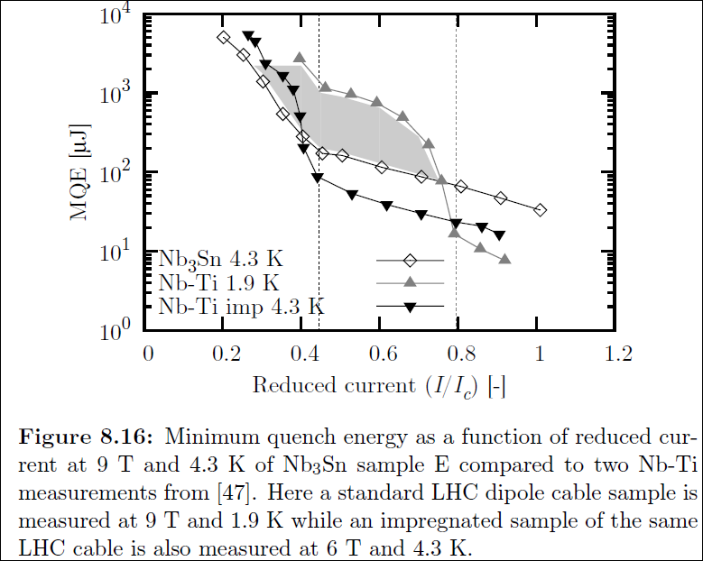
4.1 Stability versus I/I_{c} – The ‘stability cliff’
Using collective cable stability yields a factor 10 to 50 in MQE!
For NbTi@1.9 K, sf-He inside, needs margin to profit from collective strand stability, ---> I/I_{c}<0.75.
Impregnated Nb₃Sn is in “single strand regime” when at some > 75% on load line! Need to reduce I/Ic down to < 0.45 to profit again, and this cost €€€€.
Convincingly, we see the same in impregnated NbTi 1.9 K, “lost” stability, need I/I_{c} less than some 0.45!
Willering, PhD thesis 2009
Nb₃Sn, no He, impregnated
NbTi impregnated
NbTi with He in cable
Cure? what to do!
Keep impregnated cables, but reduce I/I_{c} to some 0.45; cost a lot to buy this robustness, but what else?
Increase heat capacity of the conductor by adding high C_{p} material (brings something, but not enough).
Bring sf He heat sink and cooling back in the conductor, make a porous cable or use a Cable-in-Conduit.
Drastically reduce inter-strand contact resistance, strand coating, porous metal filler, solder.
A well-balanced combination of 1 to 4!
Much more cable stability tests and simulations needed to master this key problem.

Slide 13
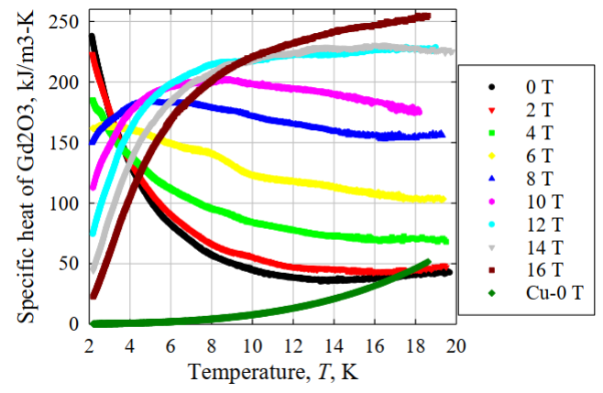
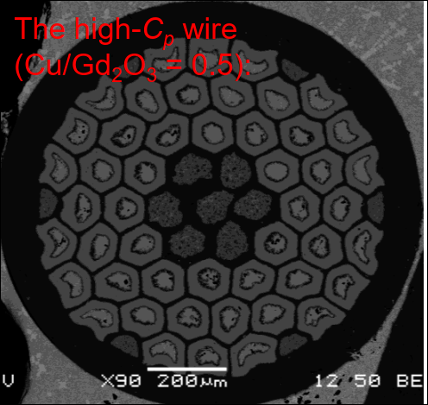

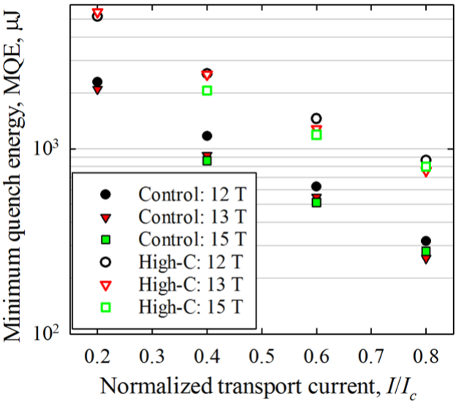
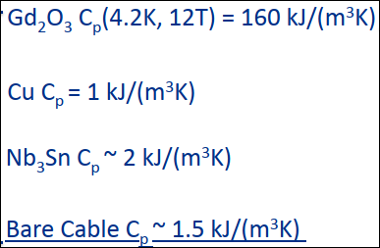

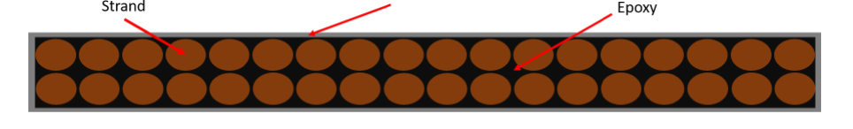
4.2 Example of enhancing stability – boosting C_{p}
High C_{p} material (e.g. Gd₂O₃ or Gd₂O₂S) can be added to:
  strand (replacing filaments) or as a coating
  in the cable (core strip, wrap, replacing strands)
  in winding blocks (wedges)
  as interface to coil structure (cover sheets)
  as nm-powder filler in resins for impregnation.
Wire with GdO filaments, cable with wrap, GdO tape
MQE gain with loaded wire, FNAL.
Xu and Barzi, FNAL, 2020-21
Proof of principle delivered, worth to develop and do extensive MQE stability tests on range of cables.
13

Slide 14
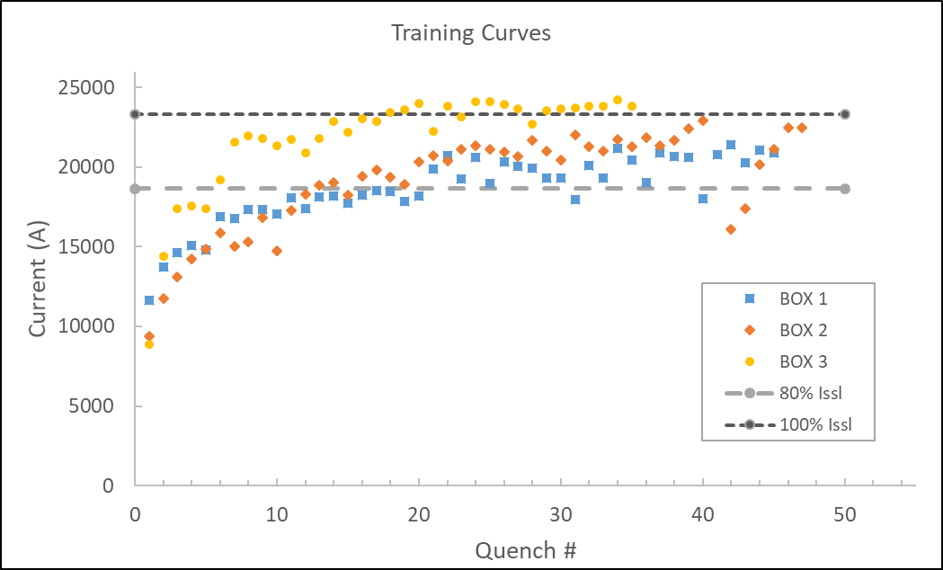
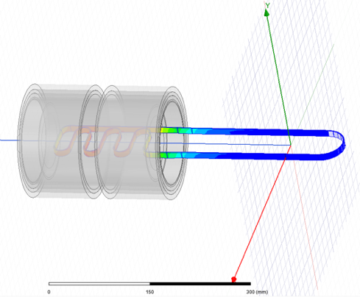



4.3 Reducing training – BOX, a new benchmark
Extensive studies required to understand training vs bonding (surfaces - resin - insulation - cable)
Building small R&D magnets too expensive and time consuming, looking for a smarter way
PSI developed with UTwente a facility called BOX for fast turn-around testing of samples at representative stress and strain conditions
Serpentine with 7 straight section in high field (B x Ic)_{max}, pulling/pushing on cable, VI taps, acoustic sensors
First 3 Boxes recently done, “magnet-like” training curves seen, improvements visible, promising technique!
BOX serpentine sample in 11 T solenoid, 50 kA max
Seems to work very nicely
Some 20 BOX samples with variations waiting……
14

Slide 15
5. Conclusion
Key issues for Nb₃Sn in high-field accelerator magnets are proper J_{c}, robust stability and no/little training.
For allowing series of full-size magnets, the stability & training issue must be solved to get robustness, allowing practical production tolerances and sufficient yield.
Accepting comfortable margin seems hard, but is an investment.
Critical current reduction by transverse stress is understood in terms of lattice deformation (reversible), changing pre-strain state (not reversible), and filament cracking (degradation), determined by wire layout and composition.
When assessing magnet performance, the loaded strand I_{c} must be taken into account (some 70-85% of virgin wire I_{c} at 150-200 MPa).
15

