Slide 1
Nb₃Sn Rutherford Cables for High Field Magnets
State of the Art, Lessons Learned, and Key Challenges
Ian Pong (ipong@lbl.gov)
Staff Scientist
Lawrence Berkeley National Laboratory

Slide 2
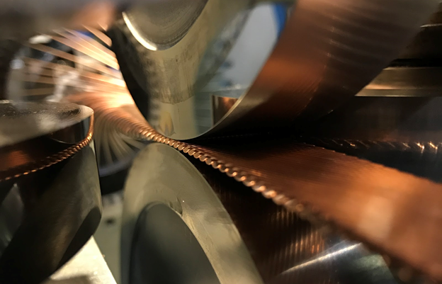
Outline
State of the Art
  Facilities
  Cable Performance
    Series Production
    R&D
  Cable Characterizations
    Modeling
    Experiments
    Techniques
  Cable Designs
Lessons Learned
    Series Production
    R&D
Key Challenges

Slide 3
State of the Art Cabling Facilities

Slide 4
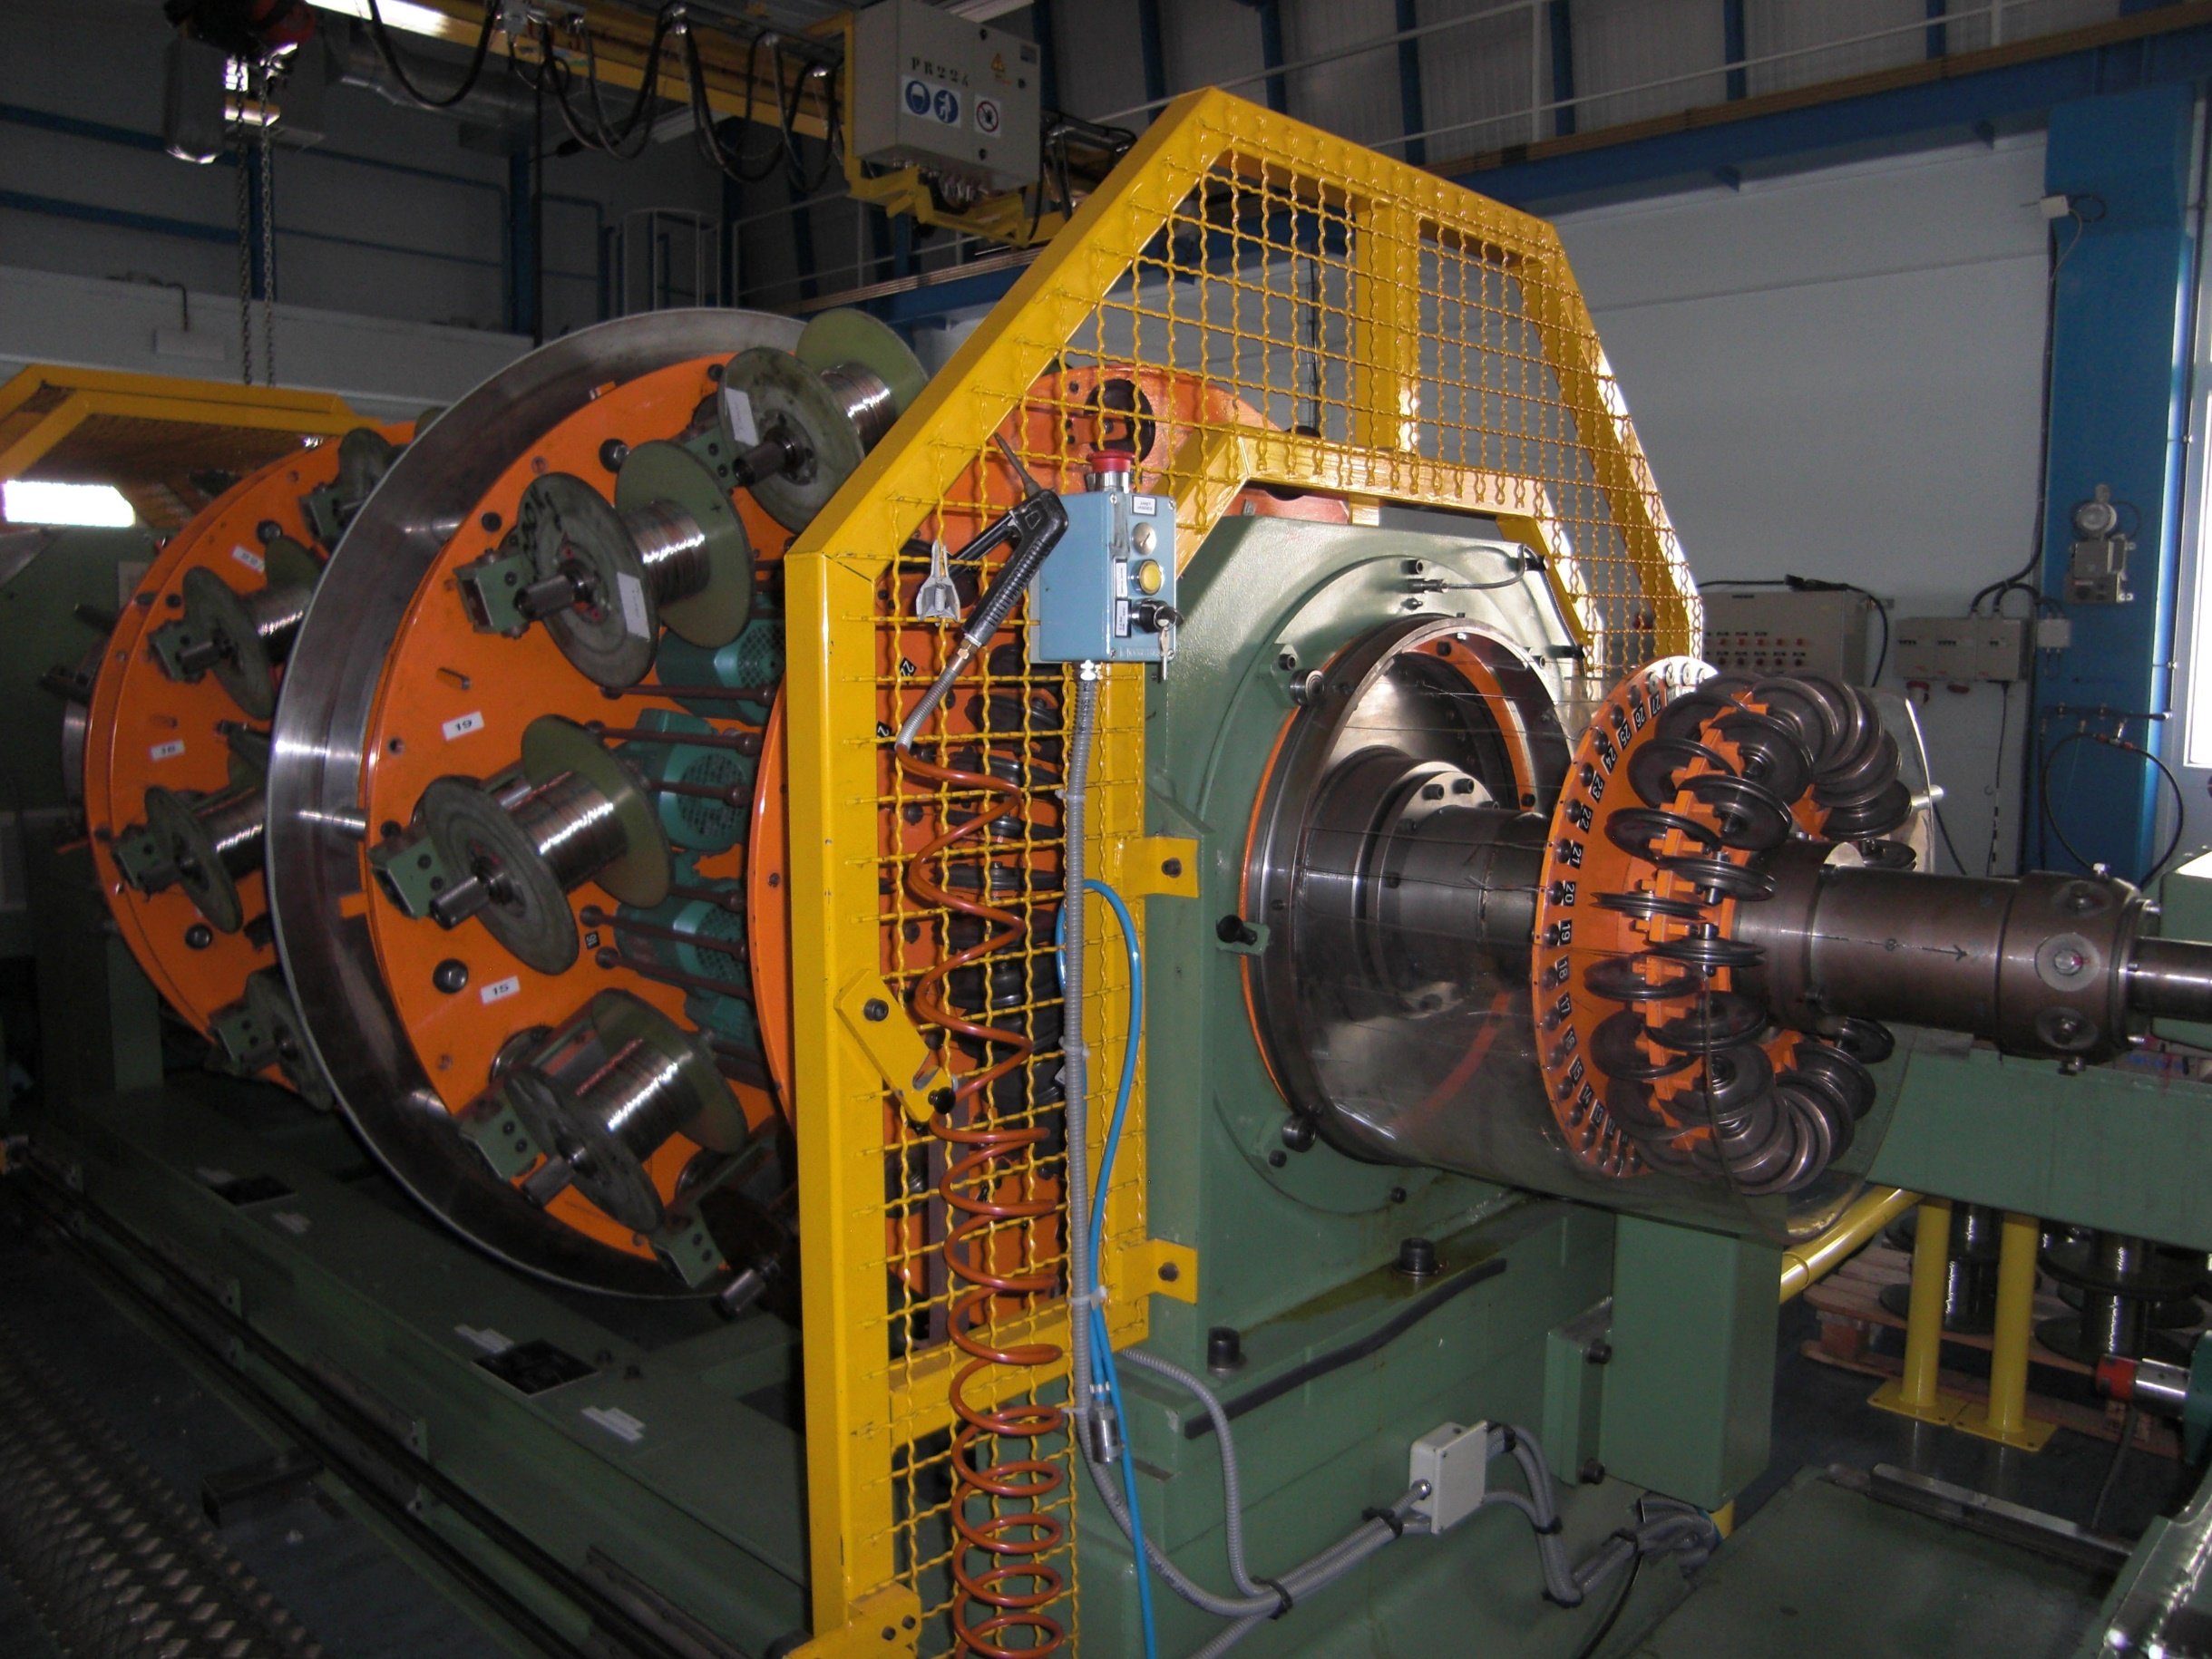
State of the Art Cabling Facilities
CERN
  Up to 40 strands
  Real-time tension recording
Features
  High load (1200 kg)
Experience
  Nb₃Sn
    MQXFB, DS 11T, Fresca2, SMC…
  Nb-Ti
    LHC MB, MQ, MCBX
With help from Angelo Bonasia
Notes:
Wire diameter: 0.48 mm to 1.25 mm

Slide 5
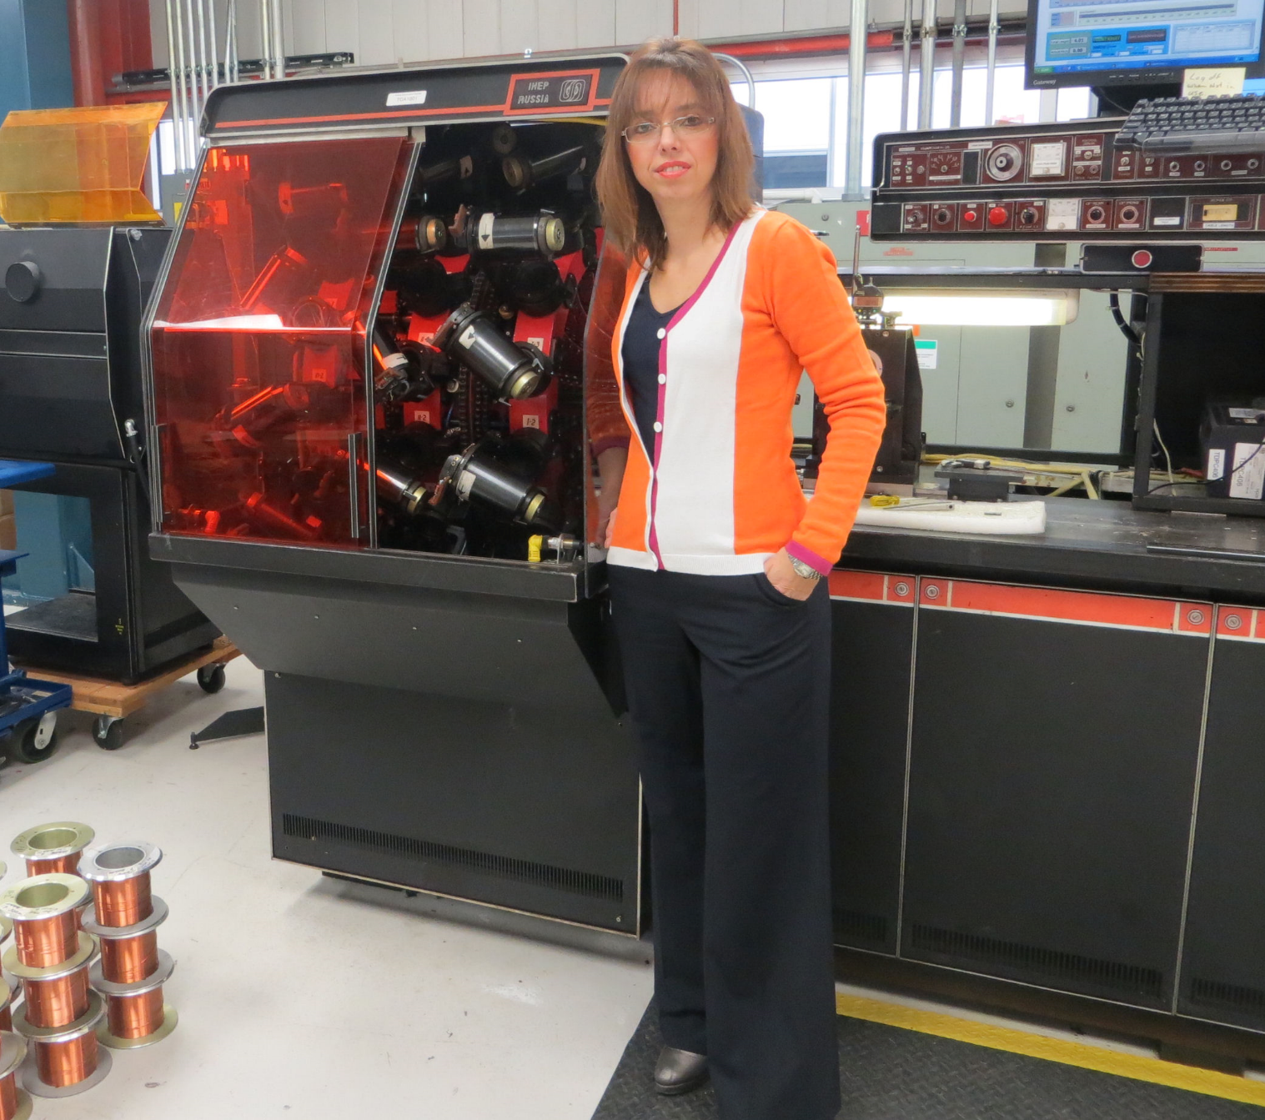
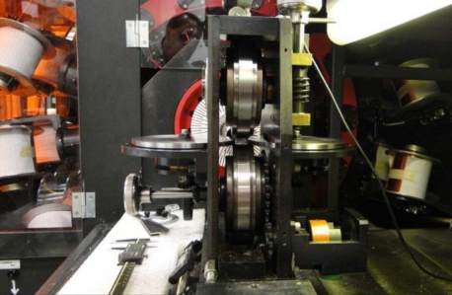
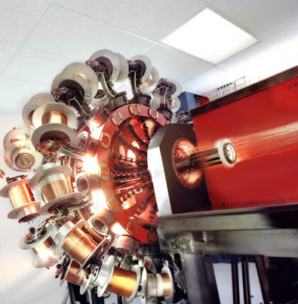
State of the Art Cabling Facilities
FNAL
  Up to 42 strands
  Typically 1 km spools
Features
  Turkshead not powered
  Rollers with grooves
Experience
  Many R&D cables, including 15 T MDPCT1
Photo by courtesy of Emanuela Barzi

Slide 6
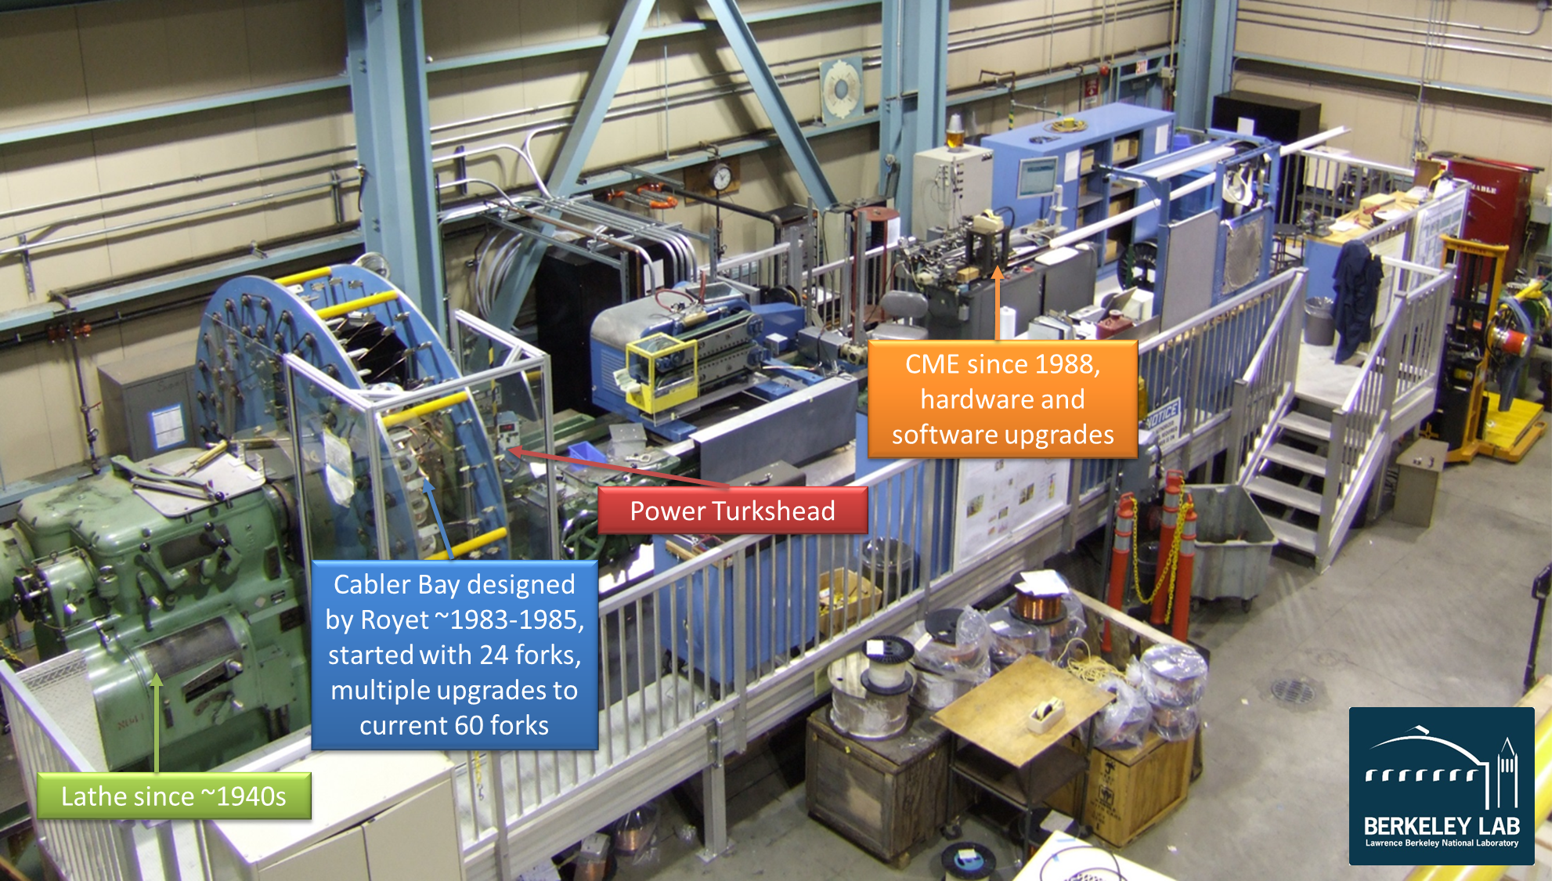
State of the Art Cabling Facilities
LBNL
  Up to 60 strands
Features
  Single bay (efficient stringing)
  Max wire mass ~200 kg
  Max cable width ~30 mm
  ~350 kg steady state pulling
  force (Turkshead alone)
Experience
  LARP, AUP
  TFD, USMDP CCT

Slide 7
Other State of the Art Cabling Facilities
TRATOS Cavi (Italy)
  Up to 66 strands
  MgB₂ for the Superconducting Link
Bilfinger Noell (Germany)
  Up to 40 strands
NEWT (USA)
  Up to 36 strands
  Nb-Ti Rutherford cables and CICC
Furukawa (Japan)
  Rutherford cables, multiplex cables
All those involved in ITER, DTT, future DEMO…(CICC)
Notes:
NEWT: ITER, RHIC
Furukawa: HERA, RHIC, SSC, Mu2e, ITER, JT-60SA, HFM

Slide 8
State of the Art Cable Performance

Slide 9
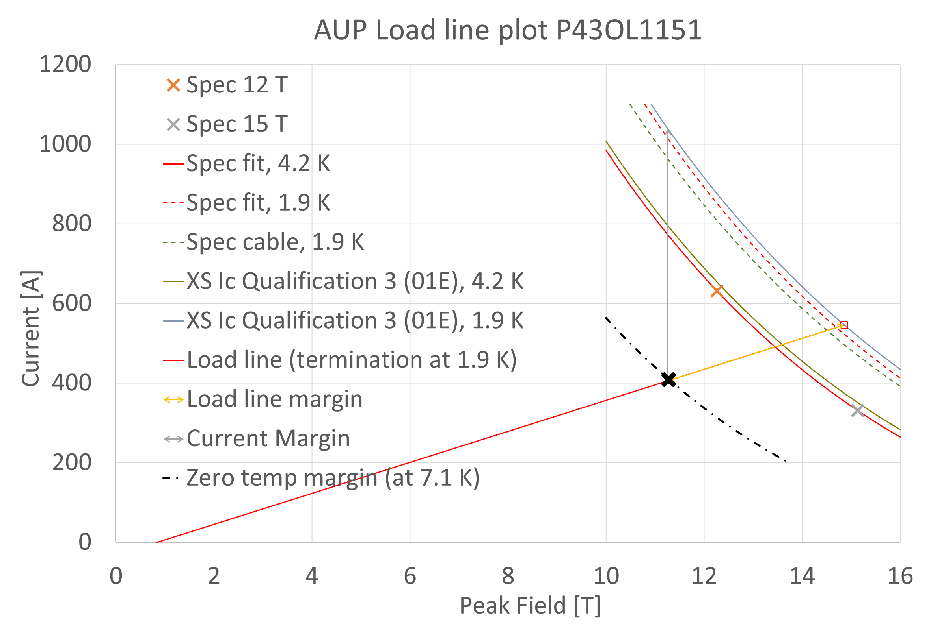
Series Production Cable SoftA Performance
Example HL-LHC AUP
40 strands φ 0.85 mm
RRP® 108/127
Wire spec: 632 A (12 T)
Residual twist 150°/m (one-pass, no annealing)
Margins | Margin | Operating Point (X)
Load line margin | 25.7% | 74.3%
Current margin | 60.9% | 39.1%
Temperature margin [K] | 5.2 | 7.1

Slide 10
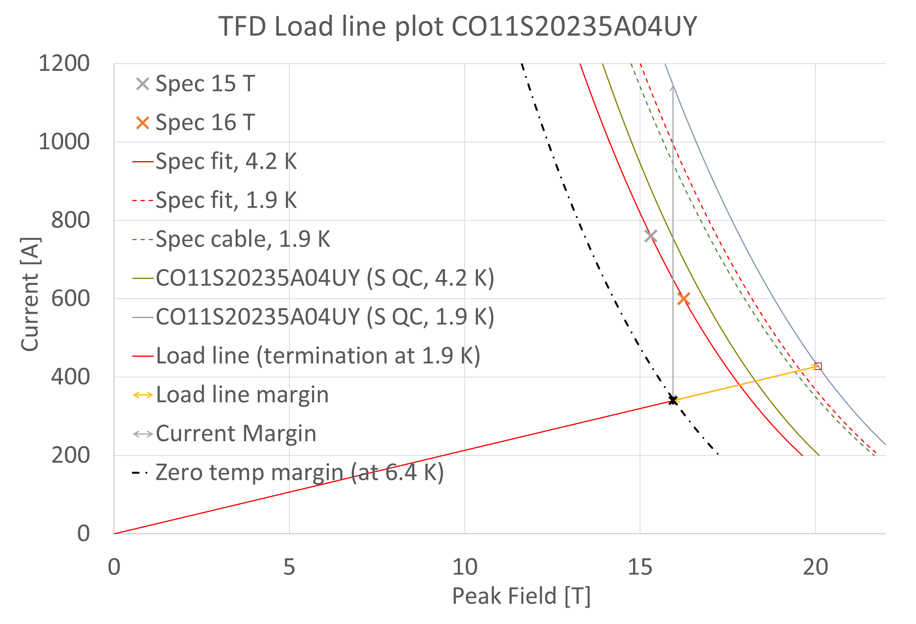
R&D Cable SoftA Performance
Example TFD / HEPdipo
44 strands φ 1.1 mm
RRP® 162/169
Wire spec: 760 A (15 T)
Residual twist 15°/m (one-pass, pre annealing)
Limited gain by I_{C} improvement (marginal return)
Margins | Margin | Operating Point (X)
Load line margin | 20.6 | 79.4
Current margin | 70.4 | 29.6
Temperature margin [K] | 4.5 | 6.4
Notes:
Critical surface steeper because Ic is higher. Terminates at 0 A at similar B ~30 T.
Field margin ~4 T

Slide 11
State of the Art Cable Characterizations

Slide 12
Nb₃Sn Cable SoftA Simulations and Models
Rutherford Cables:
  CERN, FNAL, CEA Saclay, …
  Examples: Fabrication, design models, current distribution, geometry, damage
Also CICC
  Ecole Centrale Paris, CEA Cadarache, PSI
  Twente, Bolognia
  PSI

Slide 13
Nb₃Sn Cable SoftA Experiments
Cable testing under transverse load in field [1] [2]
Cable expansion [3], [4]
Cable MQE [5]
AC losses [6]
Defects [7]
Cable stability at self-field using an SC Transformer [8]

Slide 14
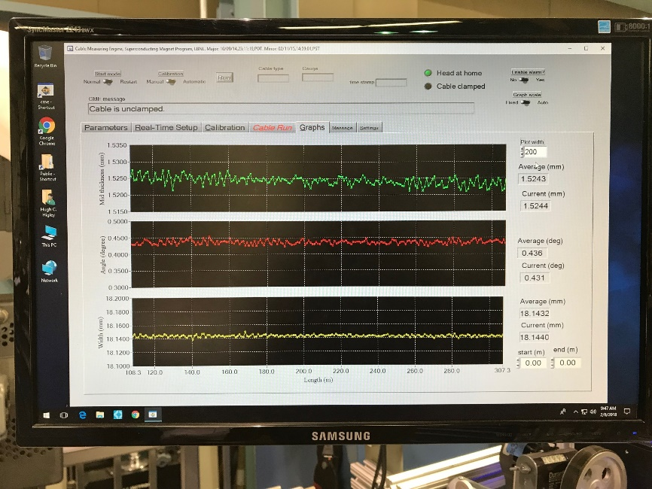
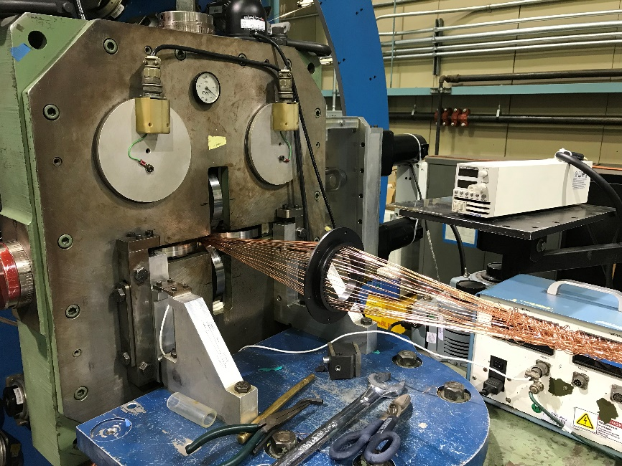
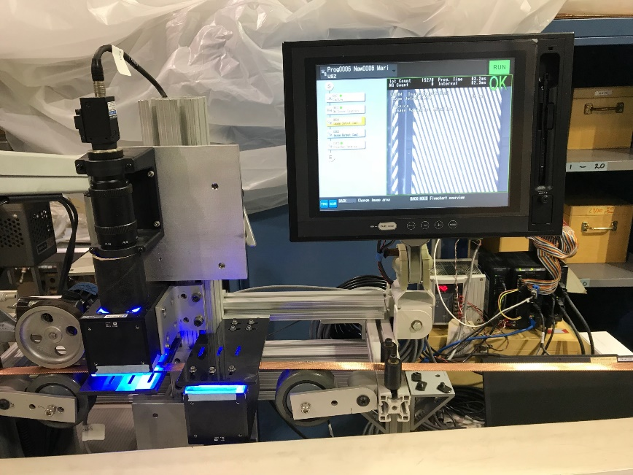
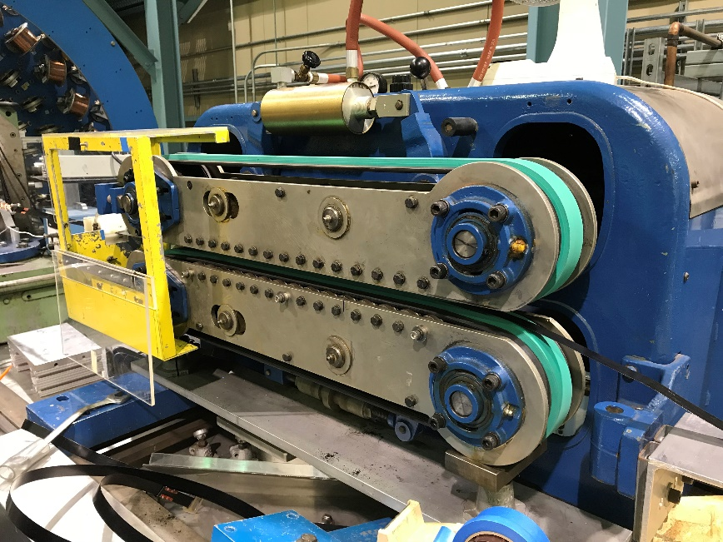

SoftA Production Characterization Techniques
SoftA QC / Characterization Techniques are a combination of:
  CME (a.k.a. CMM – Cable Measurement Machine)
  Image analysis with custom FIJI / imageJ scripts
  Metallography – sheared subelement counting in transverse cross section
  RRR – on extracted strands
  I_{C} – on extracted strands
Upgraded CME Computer and Software
New and Spare Rollers for the Turkshead
Upgraded Power Supply
New Motors
New Diagnostics System (Motor Voltage
Recording and Strain Gauge Recording)
Keyence Vision System
Analysing Twist Pitch, Wire Distance,
Facet Sizes, etc.
New Caterpuller Belt

Slide 15

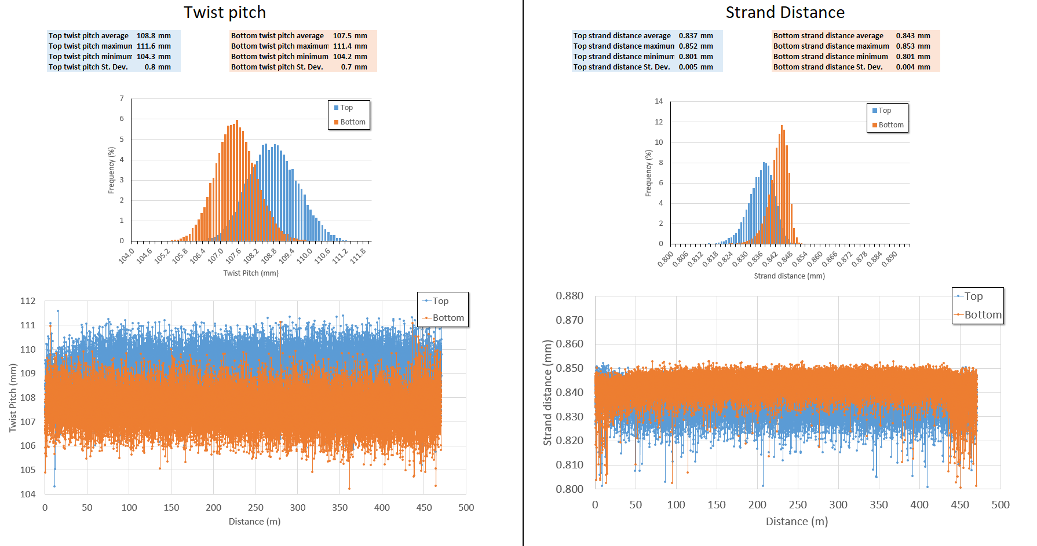
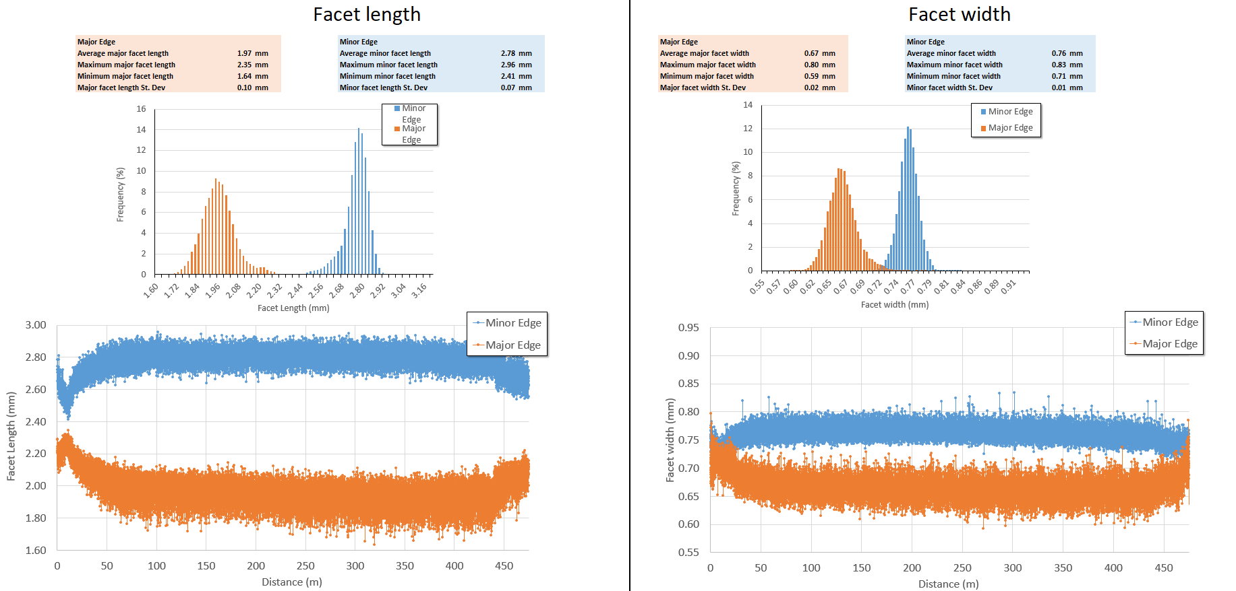
Image Analysis
Length (z)
Captures the entire cable run
Top and bottom broad faces
Minor and major edges
Image analysis for:
  Defect check
  Wire-to-wire distance
  Facet length and width
  Twist pitch
  Irregularities
Width
Length

Slide 16
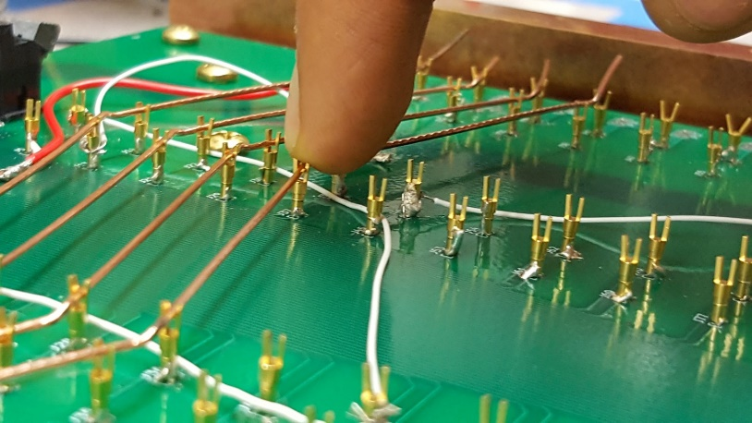

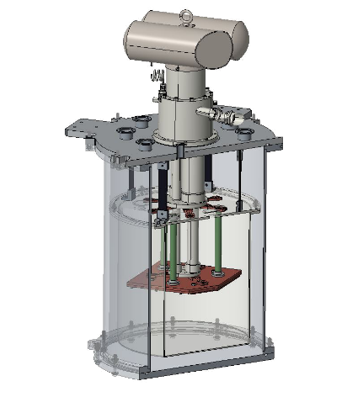
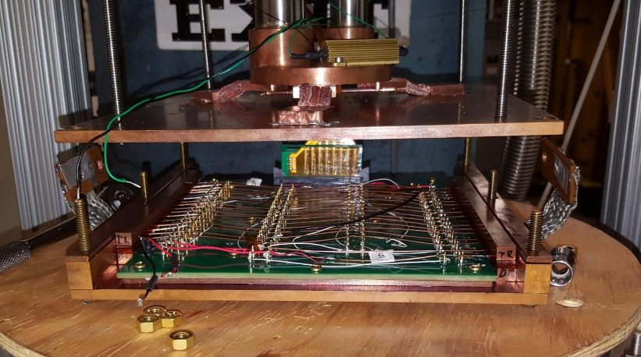
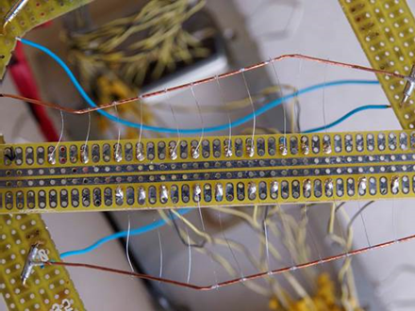
Residual Resistance Ratio of Extracted Strands
QXF cable
Major edge
Major edge
“kink”
Minor edge
“straight”
“straight”
Minor edge
“kink”
Extracted wire
V₁
Voltage taps
V₂
V₃
Cabled (extracted)
wire
V₄
Cryocooler system
(2nd stage ~3.9 K @ full power)
Printed circuit board
(up to 18 cabled samples)

Slide 17
State of the Art Cable Designs

Slide 18
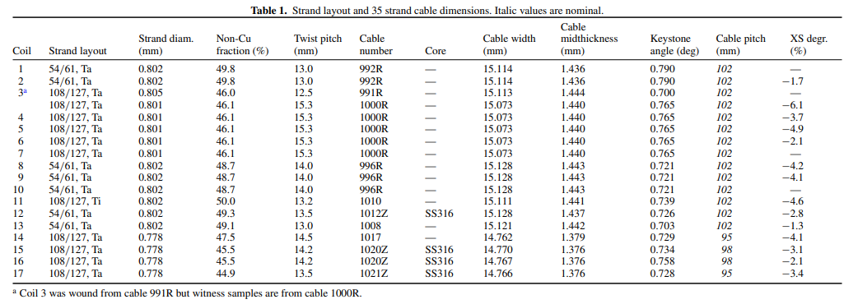
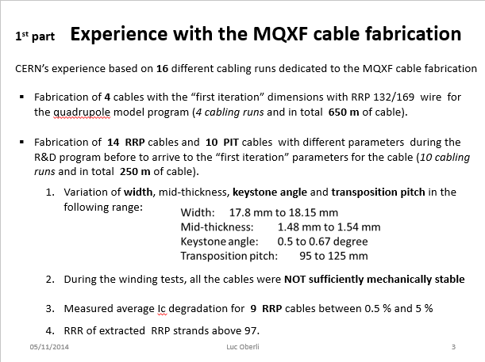
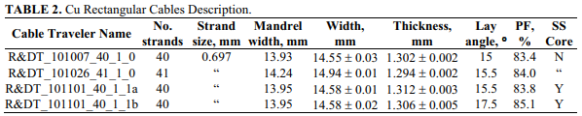
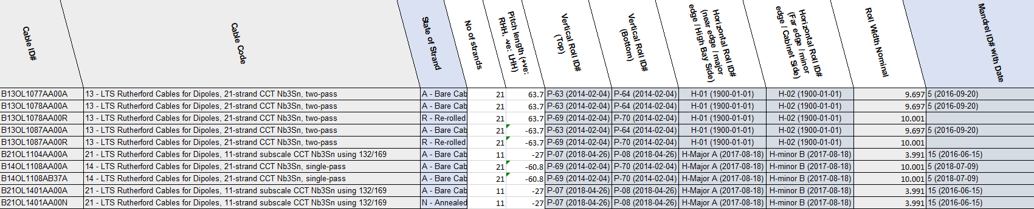
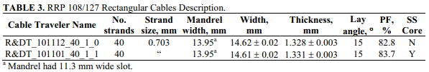
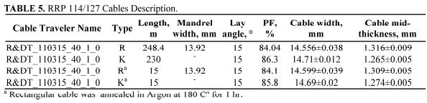
Examples on R&D Cables Designs – a wide range
LARP: HQ cables
FNAL: 11 T DS
CERN: MQXF
LBNL: CCT

Slide 19
Cable Design – General
Very wide range of design is possible
Many experienced players
The number of strands is probably the most inflexible hardware limitation among different facilities, but should not dictate magnet design
Turkshead design upgrade (e.g. powering) and characterization improvement will require some investment
Component modifications (e.g. roller, mandrel…) relatively easy
Some general rules on cabling parameters, but correlation with performance depends strongly on the wire design

Slide 20
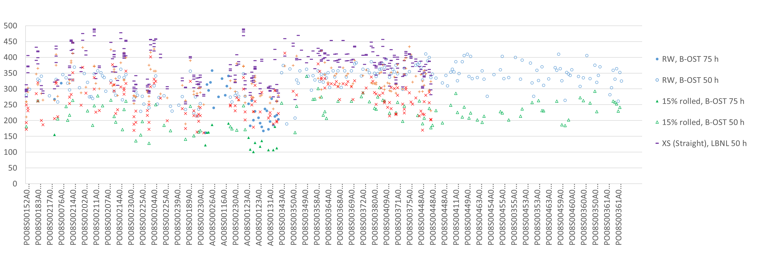
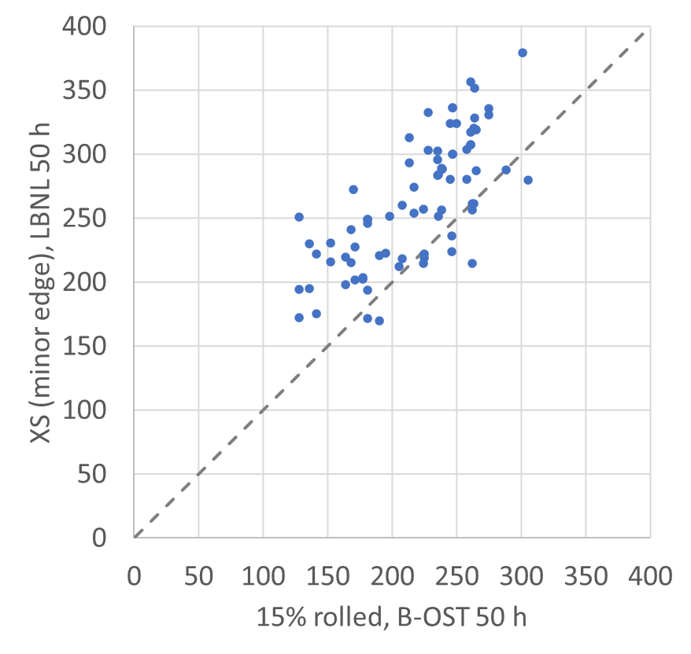
Cable Design –AUP Experience with RRP®
XS RRR can be predicted by 15% rolled
XS I_{C} RRP® not much affected: 5% degradation is a good guide
Keystone angle does not necessarily translate to facet size
Facet size – Sheared subelement scoring – RRR can be associated
HL-LHC AUP DocDB Doc 3337

Slide 21
Lessons Learned

Slide 22
Lessons Learned – AUP Series Production
  Series Production Yield: 90% assumption is reasonable, >95% may be achievable
  Length: strand UL required ~ 1.05 x (cable length in coil + 50 m)
  Cost:
    Cable + braiding – labour to materials ratio ~3:1
    Wire procurement to cable fabrication ratio ~4:1
  Schedule
    Wire delivery should not be just in time. Conductor is an upstream task and procurement is an external dependency. RFQ to delivery ~1 year. Cable to coil free float >> 3 months
    Wire acceptance is a substantial but worthwhile effort*
    Preventive maintenance and spare parts should be planned in
  Ensure maintenance/parts subcontractors are in business!
  Case of braiding issues causing cable failure – this cost has to be absorbed by the project
Notes:
* LHC Lynn Evans story on collaboration partnership

Slide 23
Lessons Learned – R&D (from LARP to AUP)
R&D
  Equipment upgrade requires engineering support – plan for the time
    Roller and mandrel; CME, 10-stack, and Keyence; RRR
  Strand properties affect cable properties and manufacturability – plan R&D runs years ahead of series production. Consider:
    QXF R&D in 2012,
    International review of conductors in 2014,
    AUP CD-0 in 2015,
    MQXF International Review in 2016,
    first AUP cable in 2018,
    last AUP cable in 2022
  Plan sufficient percentage of prototype:
    LARP made nearly 40 cables ~3 tonnes, ~20+20 QXFS-QXFA, 2012-2018
    AUP 104 cables ~10 tonnes, ~20+80 pre-series vs. series, 2018-2022

Slide 24
A comparison with LHC
LHC required ~1265 tonnes of Nb-Ti cables
R&D phase: 1988-1994, ~16 tonnes
Pre-qualifications: 1995-1996, ~19 tonnes
Production contracts: 1998-2005
~3% R&D
~3% sent back / declassified

Slide 25
Key Challenges

Slide 26
Key Challenges
Technical:
  Design
    A good design is job half done
  Experiments, diagnostics, characterization, performance prediction
    AI/ML?
    Need materials to make prototypes and need timely coil/magnet feedback
    Strong R&D must go before—and can take longer than—production
  R&D Facility Upgrade
  Production Facility Setup

Slide 27
Key Challenges
Management during planning and integration
  Schedule (cables only)
    LHC R&D ~8 years; production ~7 years
    HL-LHC LARP ~6 years; AUP ~4 years
    FCC h-h: production ~15 years?? → R&D ~10-15 years??
  Cost (by material volume)
    LHC R&D ~3%; quality rejection ~3%
    FCC h-h: production wire only ~10BCHF??, given AUP wire:cable cost ~4:1 →
    FCC h-h conductor R&D ~400M over 10-15 years???
  People, people, people
    In project, contractors, maintenance and parts

Slide 28
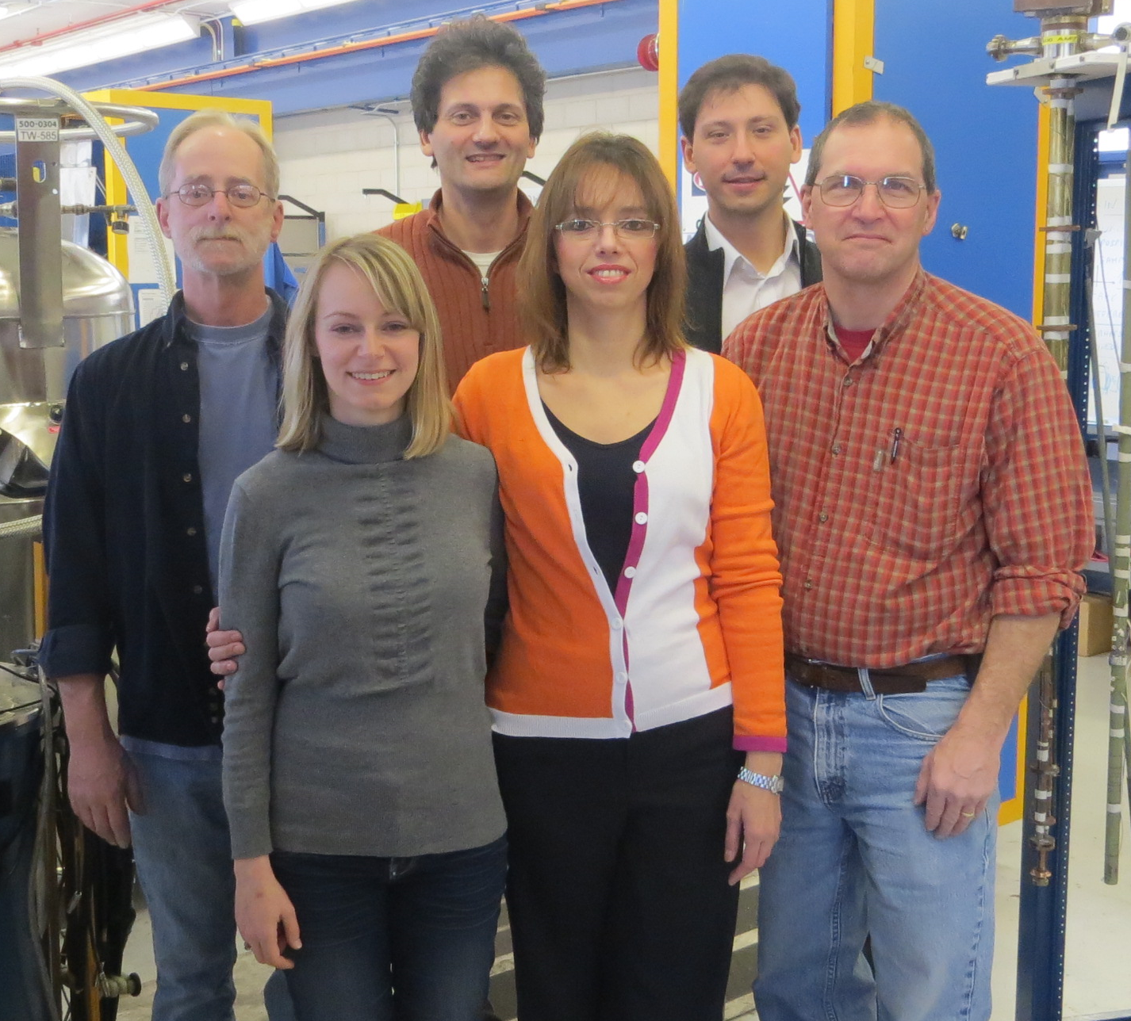
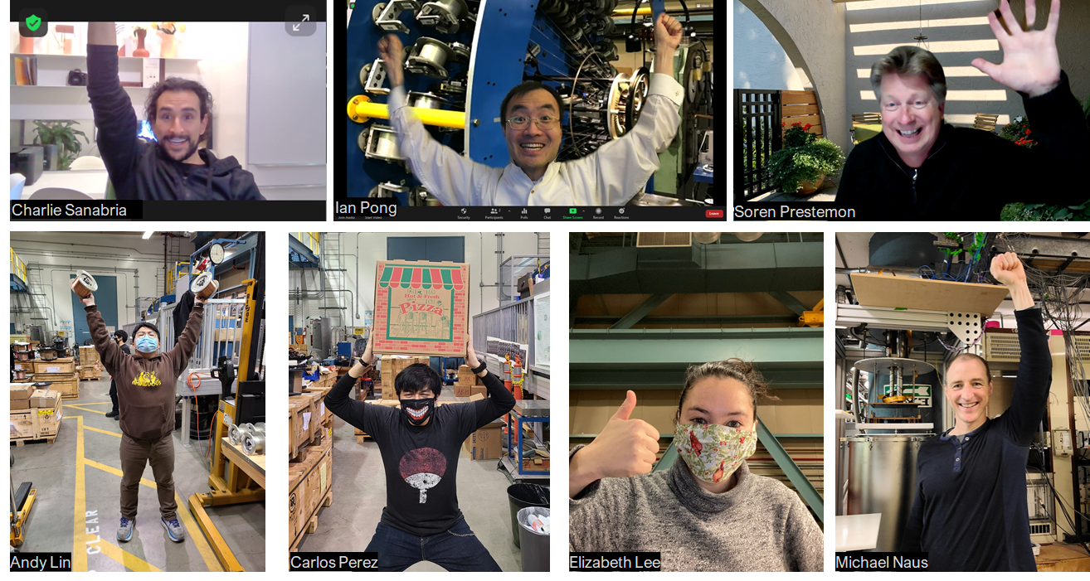
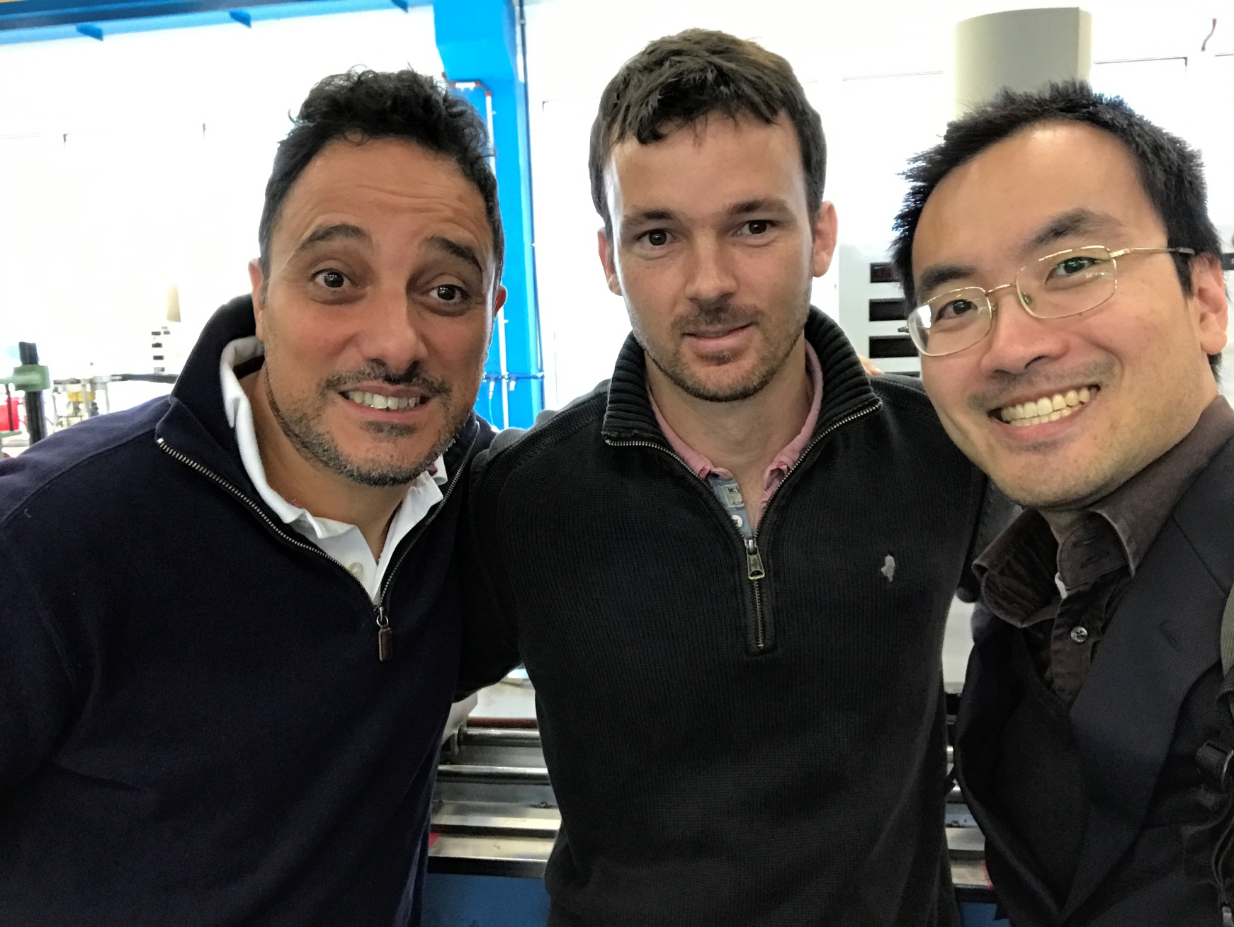
Team Power

