Slide 1
Status of coated conductor cables for high field magnets
D. Uglietti
Ecole Polytechnique Fédérale de Lausanne (EPFL), Swiss Plasma Center (SPC), CH-5232 Villigen PSI, Switzerland
Background – magnets and HTS materials
Cables: fusion magnets and dipoles
Achievements
Non-twisted stack concepts
Summary
Based on:
2019 A review of commercial high temperature superconducting materials for large magnets: from wires and tapes to cables and conductors https://dx.doi.org/10.1088/1361-6668/ab06a2
2020 Non-twisted stacks of coated conductors for magnets: Analysis of inductance and AC losses https://doi.org/10.1016/j.cryogenics.2020.103118

Slide 2
Background – magnets
Magnet type influences the cable design
Fusion magnets
R/r ~ 1
r
Thin winding
Large bore
Operating current
about 30–100 kA
(50-300 tapes)
B₀
⇒ J_{e} is not so important
R
B_{peak}
B_{peak}/B₀ > 1
High field dipoles (and solenoids)
R/r >> 1
r
Thick winding
About 5–30 kA
(10-50 tapes)
B₀
B_{peak}
⇒ J_{e} must be high
R
Small bore
B_{peak}/B₀ ~ 1
High field and/or large size ⇒ large stresses

Slide 3
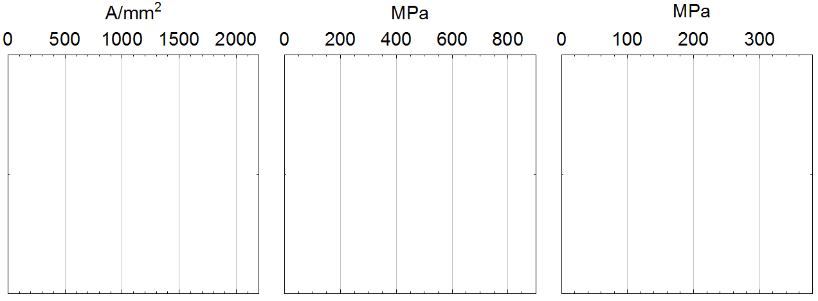


Background – technical HTS
N. of manufacturers
J_{e}(4.2 K, 15 T) Long. ten. stress Trans. comp. stress
Bi2212
1
1
>5
Bi2223
REBCO
Table 1 in https://dx.doi.org/10.1088/1361-6668/ab06a2
REBCO is the weakest in some directions (peeling, …)
REBCO is the youngest ⇒ largest margin of improvement
Production capacity and J_{e} are still growing fast
What will be the commercial application? MRI for NbTi (3000 t/y), NMR for Nb₃Sn (50 t/y?)
REBCO: wind turbines, NMR, compact high-field tokamak?
https://doi.org/10.1038/s41598-021-81559-z
Round, twisted, fine filaments are not requirements.
In fact, the first HTS commercial magnets (NMR) was made with coated conductor (non-round, non-multifil., non-twisted).

Slide 4
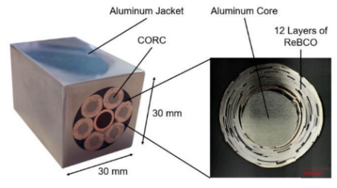
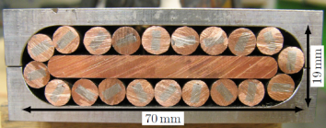
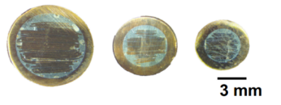
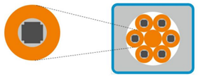
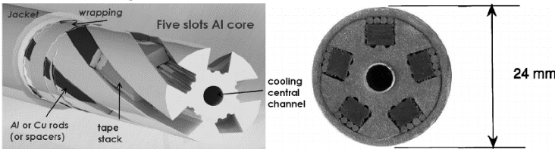
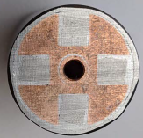
Cables for fusion magnets
Operating current: 30–100 kA
Two cabling stages
CORC multi-stage (CERN)
Twisted stacked, round or flat (SPC)
Twisted stacked, round (KIT)
Stacked slotted matrix (ENEA)
VIPER (Commonwealth Fusion)

Slide 5
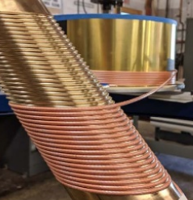
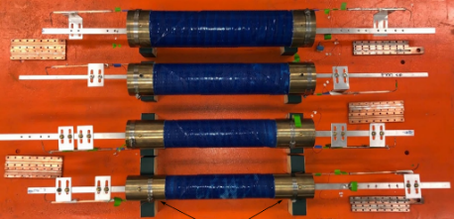
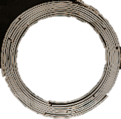
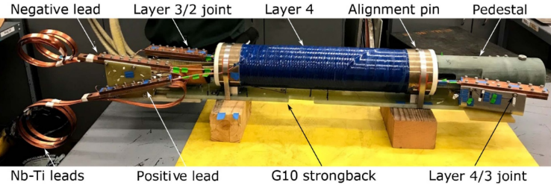
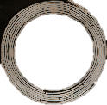
Cables for high field dipoles
Operating current: 5–30 kA
One cabling stages
CORC cable – Canted Cosine Theta (Berkeley)
https://doi.org/10.1088/1361-6668/abc2a5
2.9 T at 4.2 K, 6290 A, 100 m of CORC
CORC: 30 tapes (2 mm wide),
3.8 mm ∅, Cu/nonCu=1
∅4
∅2.5
45%
CORC ha relatively low J_{e} (0.55 x tape J_{e})
Stress concentration (CCT avoid it)
Tapes in layer 4 had not homogeneous properties.
I_{c} reduction in layer 4 (too tight bending); more flexible cable in development
Field quality affected by screening current (as usual)
Quench detection is not an issue, but one cable was damaged after thermal runaway (perhaps too high contact resistance between tapes?)

Slide 6

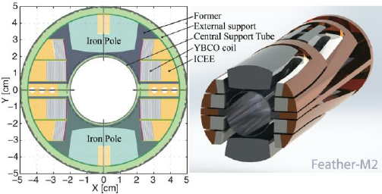
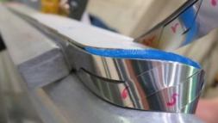
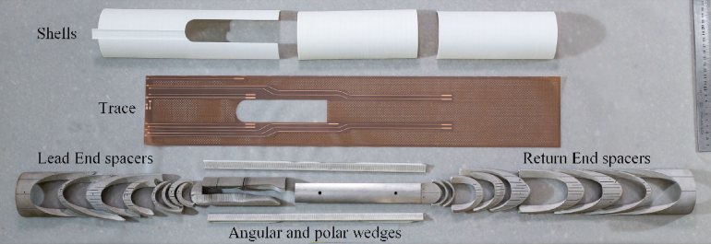

Cables for high field dipoles
Roebel J_{e}>0.9 tape J_{e}
Large critical compressive stress
REBCO Roebel cable - aligned block (CERN)
https://doi.org/10.1088/1361-6668/aab887
https://doi.org/10.1109/TASC.2018.2820177
Ends were re-designed to account for Roebel cable characteristics
Magnetic field almost aligned to the wide face of the tape: I_{c} increment and lower magnetization
REBCO Roebel cable - Cos theta (CEA)
https://doi.org/10.1109/TASC.2020.2978788
Roebel cable trajectories are different from Rutherford cable ones
Insulated with glass sleeve

Slide 7
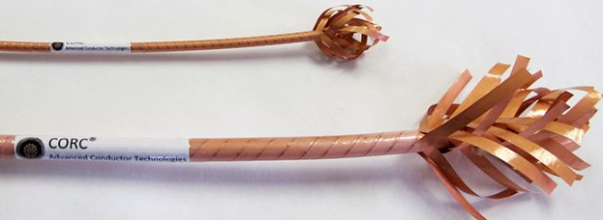
Achievements
Roebel and CORC were intensively investigated.
Both are very flexible.
Both can be produced in long length (hundreds of meters).
Roebel J_{e}>0.9 tape J_{e}
Large critical compressive stress
Material waste during punching (could be avoided)
CORC ha relatively low J_{e} (0.4–0.6 x tape J_{e})
Stress concentration (CCT avoid it)
Various tests have shown that quench detection in coated conductor cables is not critical: non-inductive voltage taps are sensitive enough to detect early voltage development (current sharing among tapes).

Slide 8
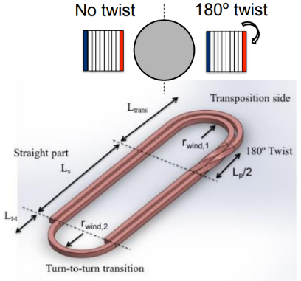
Achievements
Roebel and CORC are the best way to assemble tapes in cables?
Anything else?
REBCO Twisted stacked – block coil (University of Grenoble/NEEL/Ge2LAB)
https://doi.org/10.1109/TASC.2017.2677470
Why twisting once per turn?
How much twisting needs a stack?

Slide 9
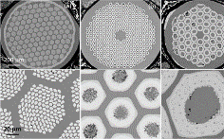
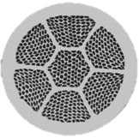

Achievements
Coated conductor cable designs were mostly copied from LTS cables.
LTS strand and cable requirements and designs (1960-1980) based on physics.
J_{c}
J_{c}
LTS
HTS
T
T
Strand microstructure and cable design driven by stability
Tapes and wire characteristics are driven by manufacturability and maximising J_{c}
HTS can withstand large transient perturbations (flux jumps, AC losses, current redistribution, …)
Twisting a stack has modest impact on stability, losses and inductance mismatch among tapes. https://doi.org/10.1016/j.cryogenics.2020.103118
How much twisting needs a stack? Probably no twisting is fine.

Slide 10
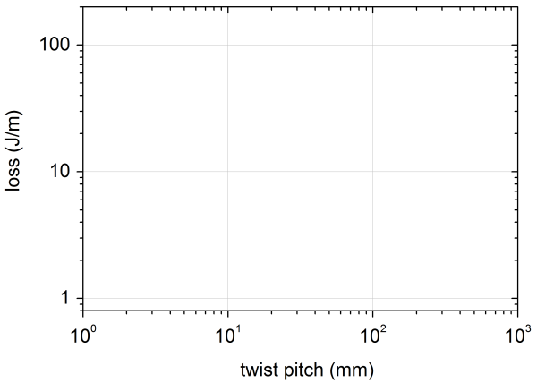

AC losses background
D
Saturated coupling loss
B_{ac}>>B_{p}
d
D/d∼100
Large loss means large magnetization loops, affecting field quality.
Coupling loss
Hysteretic loss
dB/dt
D
D/d∼3
d
dB/dt
π/2∼1.6
B_{ac}>>B_{p} , for a given dB/dt
dB/dt
Twisting a stack provides a modest (<35%) reduction of losses.

Slide 11


AC losses background
Three necessary conditions to achieve loss reduction (needed for LTS stability):
Twisting √
Twist pitch < √
Fine filaments (50–200 smaller than wire/cable size) √
$L_{c}=4\sqrt{\frac{aρJ_{c}}{\dot{B}}}$
In coated conductors stacks and cables :
Twisting √
Twist pitch < Usually not investigated ?
Fine filaments (tapes and stack have roughly the same size) X
$L_{c}=4\sqrt{\frac{aρJ_{c}}{\dot{B}}}$
Only twisting was copied. Why?
Twisting has advantages:
twisting provides cable flexibility (CORC, VIPER)
In multistage cable, twisting the stacks (1st stage elements) could provide a moderate AC loss reduction

Slide 12
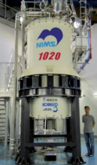
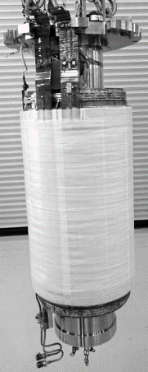
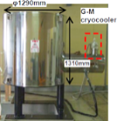
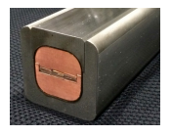

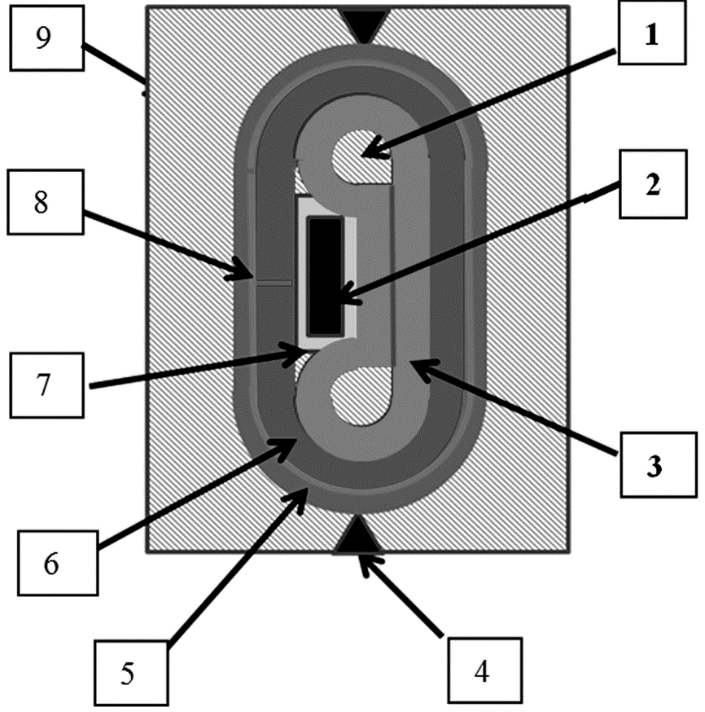

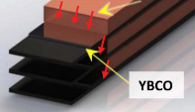

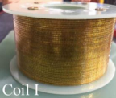
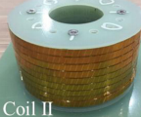
Non-twisted concepts
Of course, any Bi2223 magnet: …
10 T + 25 T LTS
https://doi.org/10.1109/TASC.2017.2657689
https://doi.org/10.1088/1361-6668/aa6676
https://doi.org/10.1109/TASC.2016.2524466
Any significate difference?
3.6 T +21 T NMR
3 T MRI
https://doi.org/10.1109/TASC.2013.2239342
Stacked, non twisted
Y. Yanagi,NIFS, 2014
S. Lelekov
ASC2014 and ASC2020
Short piece length, originally proposed to simplify construction of helical coils. It can works also on long length
https://doi.org/10.1016/j.cryogenics.2016.06.011
Brookhaven Technology Group Inc. ExoCable™
Department of Electrical Engineering Shanghai Jiao Tong University
https://doi.org/10.1088/1361-6668/ab0b9c
https://doi.org/10.1109/TASC.2019.2902420
1.2 mm
8 REBCO layers
2.4 mm

Slide 13
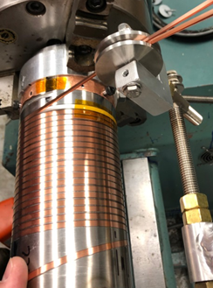
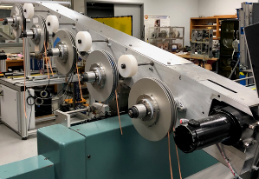
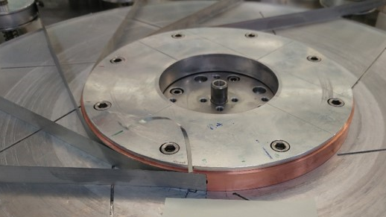

Non-twisted concepts
Perhaps better suited for dipoles:
T. Painter, NHFML
Co-wound tapes
Non-insulated (turn-to-turn)
Coaxial formers
Formers reinforce previous layer (no-gap insertion)
O1B.2-1 Thomas Painter, First test results of the integrated coil form technology, TOFE 2020
Co-wound tapes
Non-insulated
Paul Scherrer Institute (PSI) has acquired Tokamak Energy’s proprietary magnet technology for use in PSI’s accelerator and beam line applications.
https://www.tokamakenergy.co.uk/tokamak-energy-and-switzerlands-paul-scherrer-institute-sign-collaboration-and-license-agreement-for-magnet-technology/

Slide 14
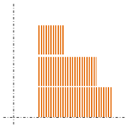
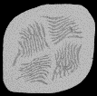
Non-twisted stack for dipole
CEA dipole, 2016
https://doi.org/10.1109/TASC.2018.2796063
https://doi.org/10.1109/TASC.2018.2809780
2 tapes per stack
Screening currents deteriorate field quality
CuBe tape, 100 μm
12 mm
It is allowed to stack more than 2 tapes…
Block dipole with non-twisted stack https://doi.org/10.1016/j.cryogenics.2020.103118 section 5.2
8 tapes per stack
Perhaps magnetisation is reduced
4 tapes per stack
2 tapes per stack
Campbell, 1982: “… a thin conductor … in the direction perpendicular to the field”.
https://doi.org/10.1016/0011-2275(82)90015-7
Applied to Bi-2223:
https://doi.org/10.1109/TASC.2003.812398
https://doi.org/10.1016/S0921-4534(02)01133-4

Slide 15
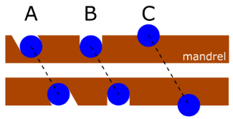
Non-twisted stack for dipole
CORC cable – Canted Cosine Theta (Berkeley)
How to generate higher field?
https://doi.org/10.1088/1361-6668/abc2a5
Perhaps replacing CORC with a stack?
from 2.9 T to >6 T
22%
35%
∼100%
43%
I_{op}
2.3 x I_{op}
Relaxing twisting/transposition requirements enlarge the design space.
Non-twisted concept opportunities:
Simple geometries and manufacturing
The highest current density (same as tape J_{e})
Critical transverse stress similar to the tape value
Sometimes, moderate increase in J_{c} (field almost paralle to ab plane)

Slide 16


Summary
Status and
achievements
Roebel cables and CORC have been used successfully for prototype dipoles.
LTS have completely different requirements and characteristics than HTS.
Why copying technical solutions from LTS to HTS?
Make a difference?
Non-twisted concepts enlarge the space design, simplify manufacturing and have outstanding electrical and mechanical performances.
About project management: requirements and design choices (twisting, impregnation, …) for HTS should be based on rigorous physical analysis and motivations.

