Slide 1
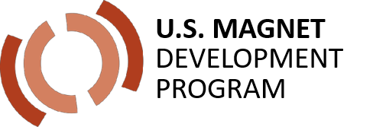



Bi-2212 – A round wire conductor for high-field magnets
Eric Hellstrom
S. Barua, E. Bosque, J. Cooper, D. Davis, L. English, I. Hossain, J. Jiang, F. Kametani, Y. Kim, J. Kvitkovic, D. Larbalestier, E. Martin, E. Miller, G. Miller, A. Oloye, Y. Oz, U. Trociewitz
Applied Superconductivity Center – National High Magnetic Field Laboratory – Florida State University
Collaborators: LBNL, BOST, Engi-Mat, Cryomagnetics, Solid Materials Solutions
Funded by DOE-HEP DE-SC0010421, NSF DMR-1644779, and the State of Florida

Slide 2
Achievements that have produced long-length high-J_{E} Bi-2212 round wire
Powder: Use Engi-Mat Bi-2212 powder, which replaced Nexans powder. Composition is close to Nexans 521 powder.
Wire fabrication: BOST packs billets and fabricates as-drawn wire.
Overpressure heat treatment: ASC-developed 50 bar Bi-2212 overpressure (OP) heat treatment
ASC working with collaborators to develop technologies for Bi-2212 in coils
  Insulation, winding, strengthening, impregnation

Slide 3
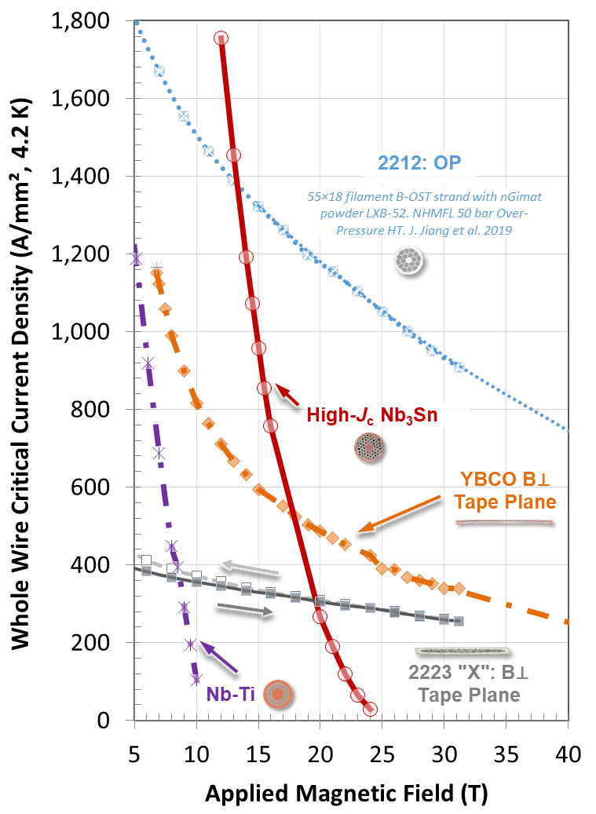
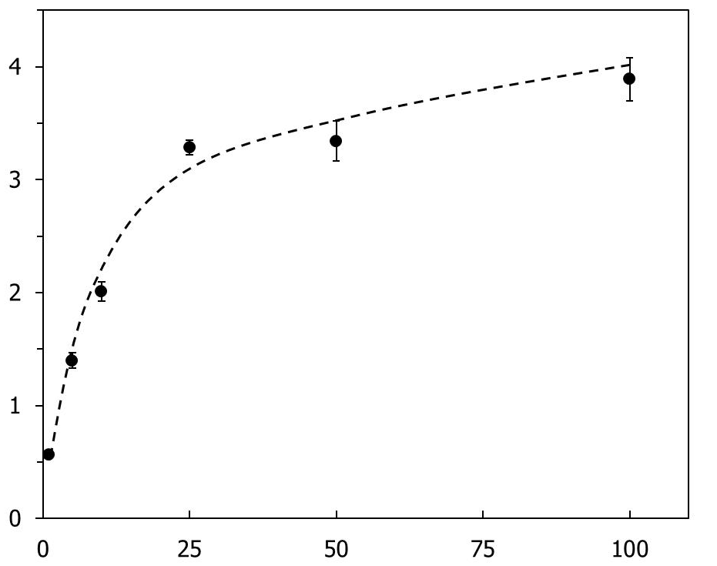
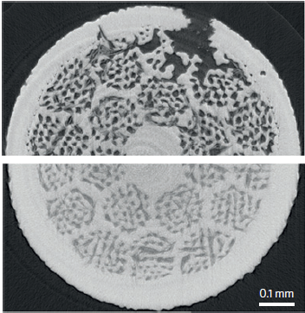
Overpressure (OP) processing made Bi-2212 round wire a reliable high-J_{E} conductor suitable for high-field magnets
After OP HT
100 bar
800 %
J_{C} (kA/mm²)
Bi-2212
1 bar
Pressure (bar)
100 bar OP HT
1 bar HT
P. Lee - ASC
Larbalestier et al.

Slide 4
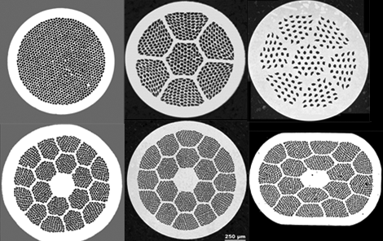
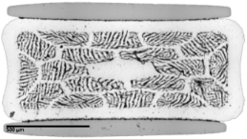
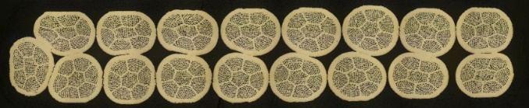
• Engi-Mat powder is significantly better than Nexans powder
A wide variety of wire architectures available with Bi-2212
Flexible wire architectures with Bi-2212
Top right by Supercon, all others by BOST, strengthened by Alex Otto SMS
Engi-Mat LXB-52
Twisted
Strengthened
Nexans lot 87
17-strand Rutherford cable

Slide 5
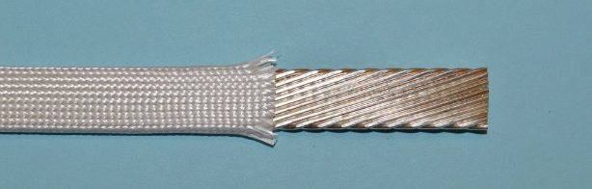
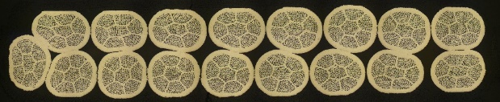
OP heat treatment significantly improves subscale race track coil performance
Shen presentation: Thurs. Apr. 15, 15:00-15:25
RC5 – 3.4 T, J_{cable} = 740 A/mm², J_{wire} = 940 A/mm².
Made possible by OPHT at FSU, wire by BOST, and powder by Engi-Mat.
LBNL 17-strand Rutherford cable
Mullite braided insulation
2212
Subscale coils allow fast-turnaround test of cable and magnet-relevant technologies.
Tengming Shen, Ernesto Bosque and Lamar English

Slide 6
Ten 10 kg and three 2 kg billets produced by BOST in 2017-2020 from Engi-Mat powder
Maximum piece lengths
2.0 km at 0.8 mm diam.
1.3 km at 1.0 mm diam.

Slide 7
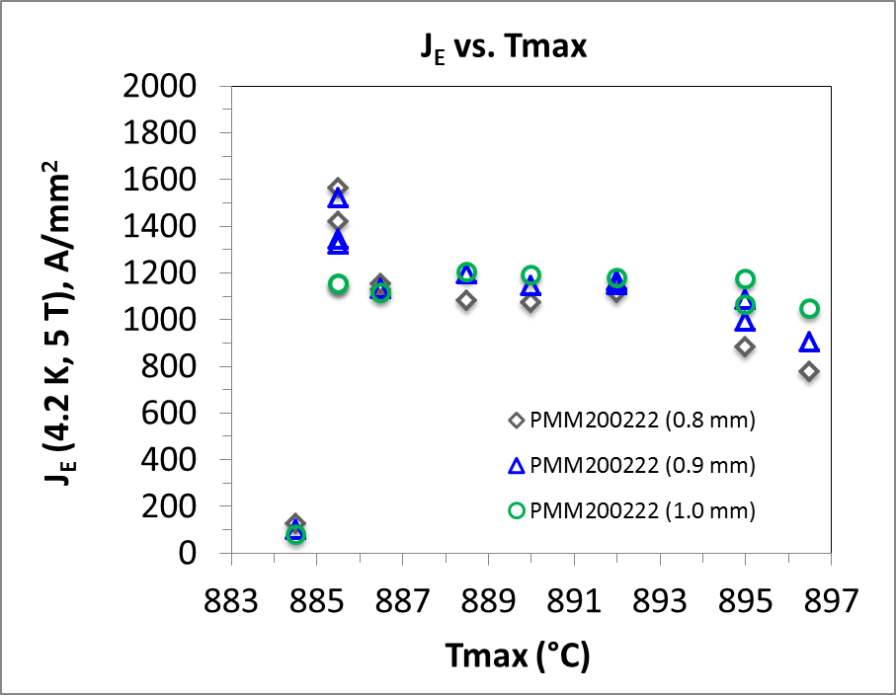
J_{E} for Bi-2212 plateau corresponds to 770 A/mm² at 16 T
J_{E} - 1100 A/mm² at 5 T = 770 A/mm² at 16 T
J_{C} > 3600 A/mm² at 16 T

Slide 8
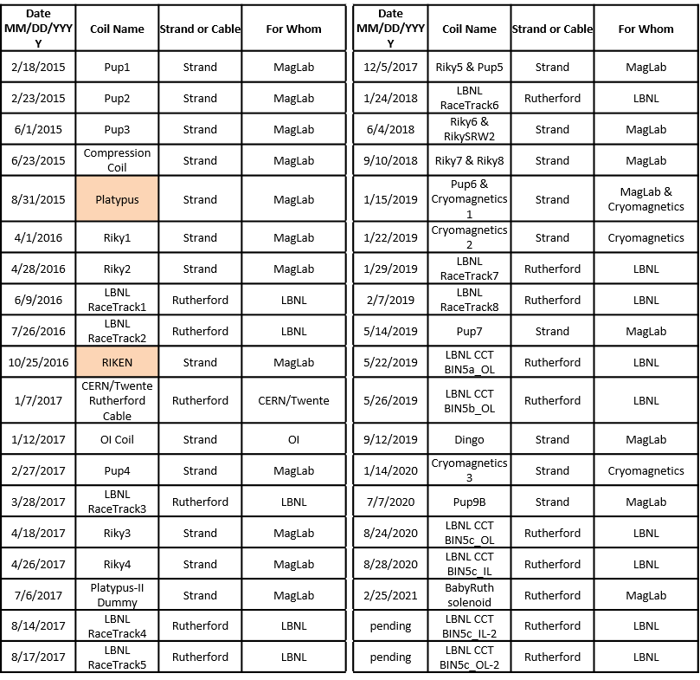
40 coils OP heat treated in Deltech furnace for MagLab and collaborators – all but 2 were successful
Coils OPed for
• LBNL
• Cryomagnetics
• CERN/Twente
• Oxford Instruments
• MagLab

Slide 9
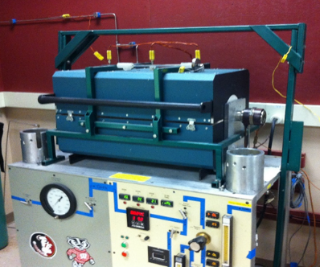
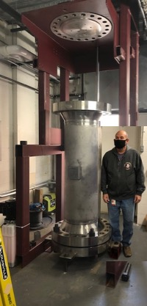
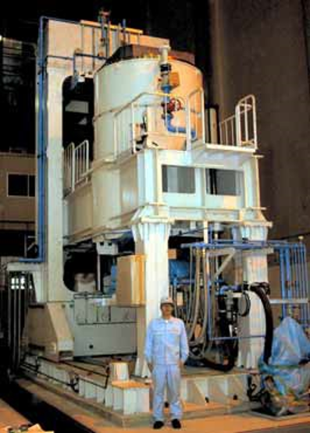
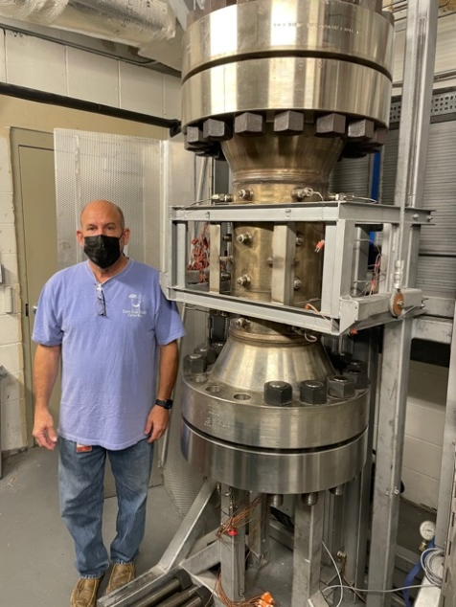
Building progressively larger OP furnaces – new furnace will have 1 m x 0.25 m diam. hot zone
Research furnace - 100 bar hot wall
Deltech
50 bar cold wall
Renegade (new) 50 bar cold wall
Sumitomo Electric OP furnace for Bi-2223 - 200 bar cold wall – in use for 15 years

Slide 10
ASC and collaborators are addressing issues for Bi-2212 coils

Slide 11
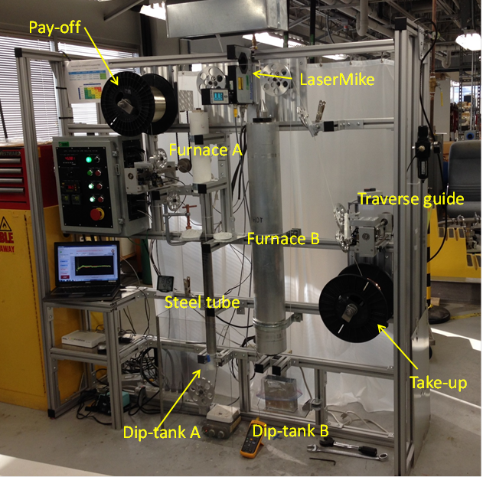
Coil technology requires insulation, compatible support materials, stability through reaction, and stress management
Insulation
FSU insulation scheme is mullite braid around TiO₂ coating: prevents Ag shorts and reaction between Ag and mullite
MagLab TiO₂ dip-coat system

Slide 12
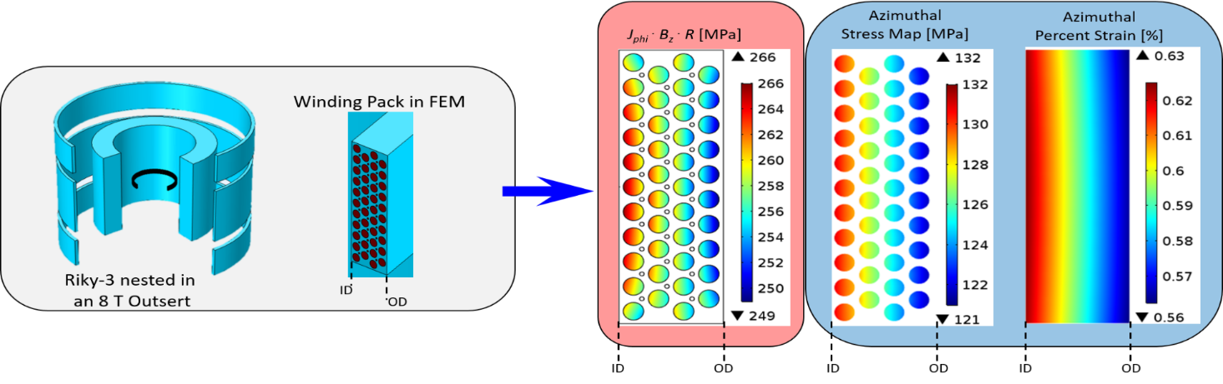
Model stress and strain when designing coil – include reinforcement
Model a series of coils that have different construction and reinforcements.
Calculations shown are for a prototype coil (Riky-3) at 350 A nested in an 8 T outsert field.
Notes: J x B x R is the Lorentz stress (red insert). In real coils, this stress couples to all the materials in the winding pack (epoxy, etc.), yielding a coupled stress and strain (blue inset).

Slide 13
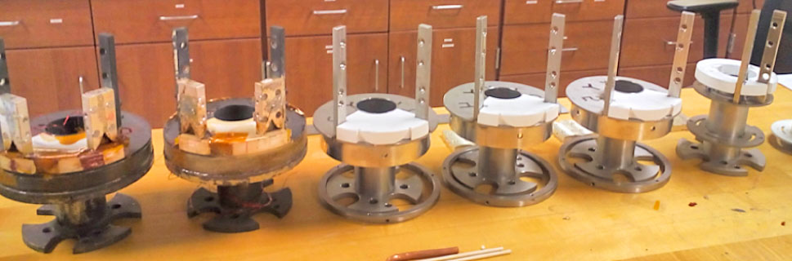
Designing and testing many small solenoids to incorporate reinforcement into the windings to allow > 30 T use in solenoids
Prototype coils with 20 – 200 m of wire are tested in 160 mm bore 8 T and 14 T magnets to probe safe reinforcement techniques
Safe operation at almost twice the wire breaking stress is now demonstrated: JBr stresses of 290 MPa at 0.4% 2212 strain without damage

Slide 14
Present status: Bi-2212 round wire
The conductor technology is mature at present scale
  Single 10 kg piece lengths:
    2.0 km at 0.8 mm
    1.3 km at 1 mm
  Twisted, multifilament, isotropic, low loss conductor with high RRR (> 100) and no need for diffusion barrier
Insulation technology for single wires is good
Reaction under 50 bar to 13 cm diam. x 40 cm length – new furnace to 25 cm diam. x 1 m length
Successfully replaced powder producer Nexans with Engi-Mat and MetaMateria

Slide 15
What would truly make a difference for Bi-2212 coil technology?
Design, build, and test more Bi-2212 coils
  Increase production of Bi-2212 powder
  Fabricate more Bi-2212 wire
  Find, understand, and overcome challenges using Bi-2212 in coils

