Slide 1
Coil Insulation for High Field Magnets
Steve Krave
Workshop on State-of-the-Art in High Field Accelerator Magnets
15 April 2021

Slide 2
Outline
Functions of insulation
Training Behavior
Resin Properties
An overview of some knobs
On interfacial behavior
New Resins
Other Observations

Slide 3
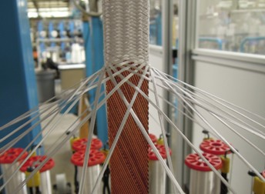
The Role of Magnet Insulation
Obviously to prevent unwanted and potentially destructive currents from flowing where they shouldn’t.
Designed to be high dielectric system, good for a few hundred volts turn to turn and higher coil to ground.
In Nb₃Sn and other wind and react systems, fiberglass braid and epoxy are used to provide the dielectric strength, while simultaneously providing mechanical integrity to magnet coils.

Slide 4
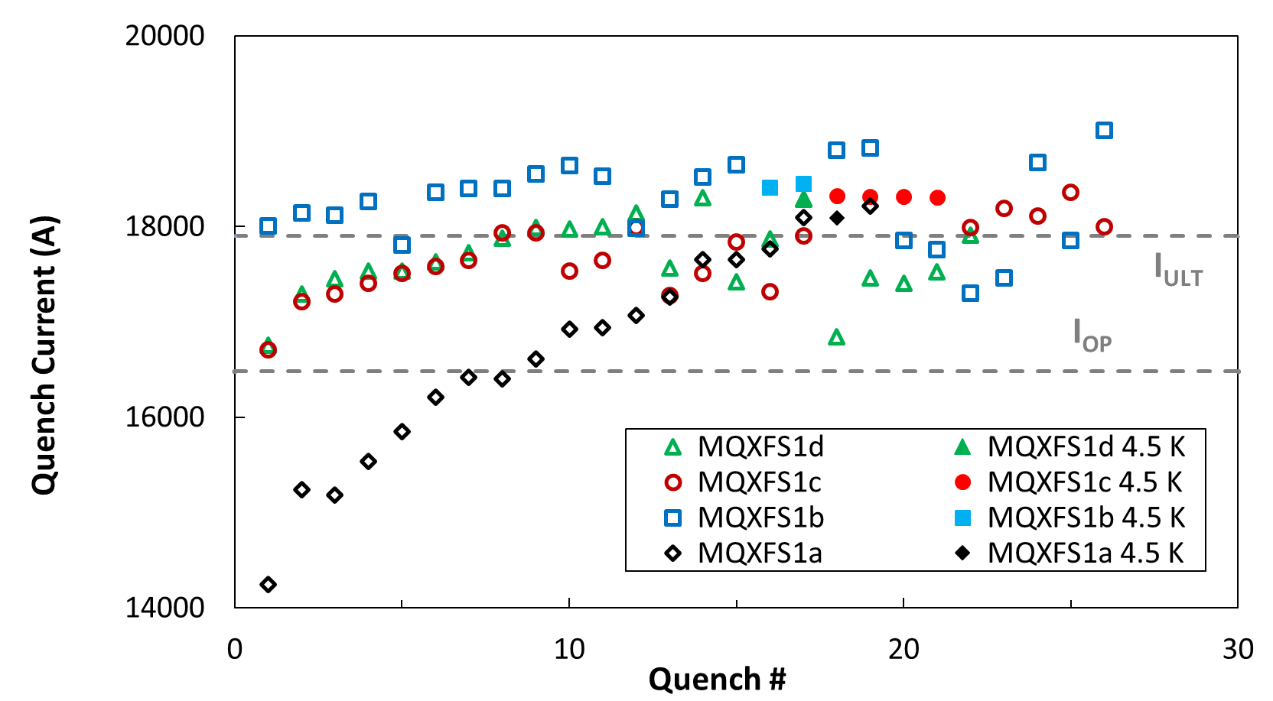
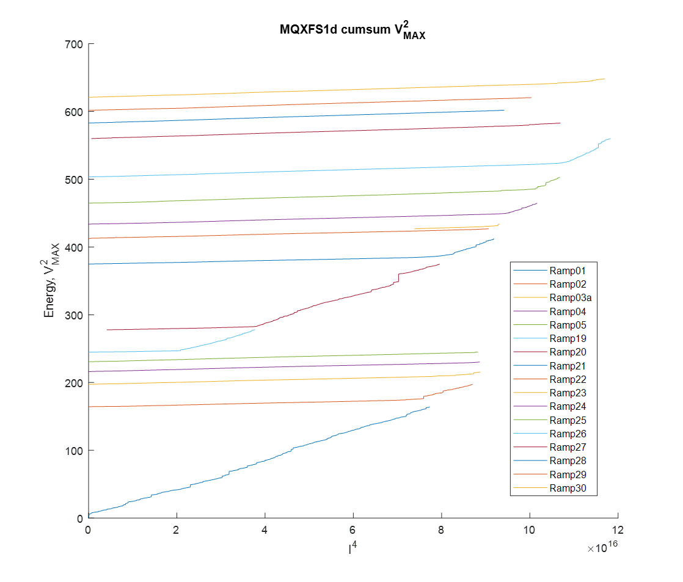
Insulation systems and impact on training
Typical Magnet Training
While powering a magnet, the insulation system undergoes small scale cracking and/or debonding as a result of loading
Cracking releases energy into the magnet
If conditions are right (wrong?) the energy release can trigger a quench
The conditions at the point of a quench are highly multifaceted, the magnet mechanics must be working well, the conductor must be behaving etc.
Conductor is essentially under control
Mechanics are based on composite behavior, as well as pre-stress thermal stresses etc.
How bad is cracking for electrical properties?
Kaiser effect, illustrating energy released as a function of cracking

Slide 5
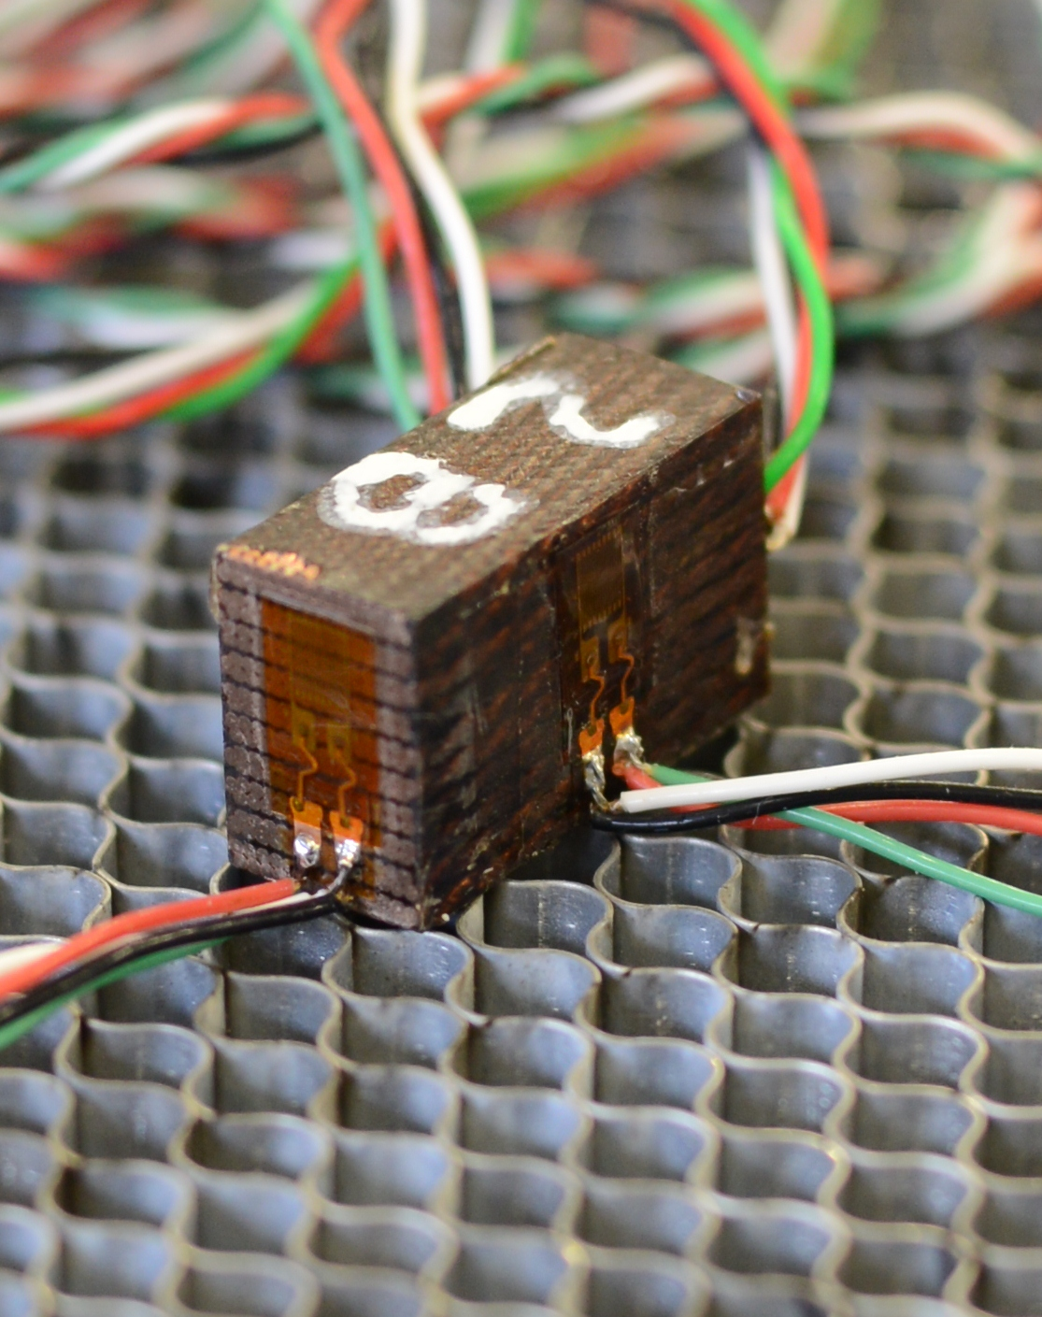
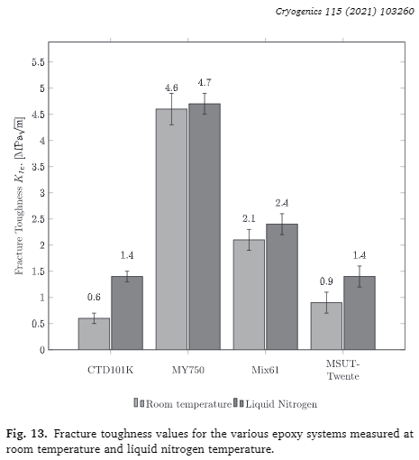
Resin Properties
The overall properties of a composite are dominated by the epoxy behavior
Generally, While different near room temperature, properties of epoxies are very similar at cryogenic temperatures – Except fracture toughness (A. Brem- Elasticity, plasticity and fracture toughness at ambient and cryogenic temperatures of epoxy systems used for the impregnation of high-field superconducting magnets)
We can build lots of stacks and measure things like modulus, and CTE, Which is important, but these properties should be predictable, roughly by rule of mixtures approaches or more accurately by FEM
We should look into failure modes and available knobs to tune performance as desired

Slide 6
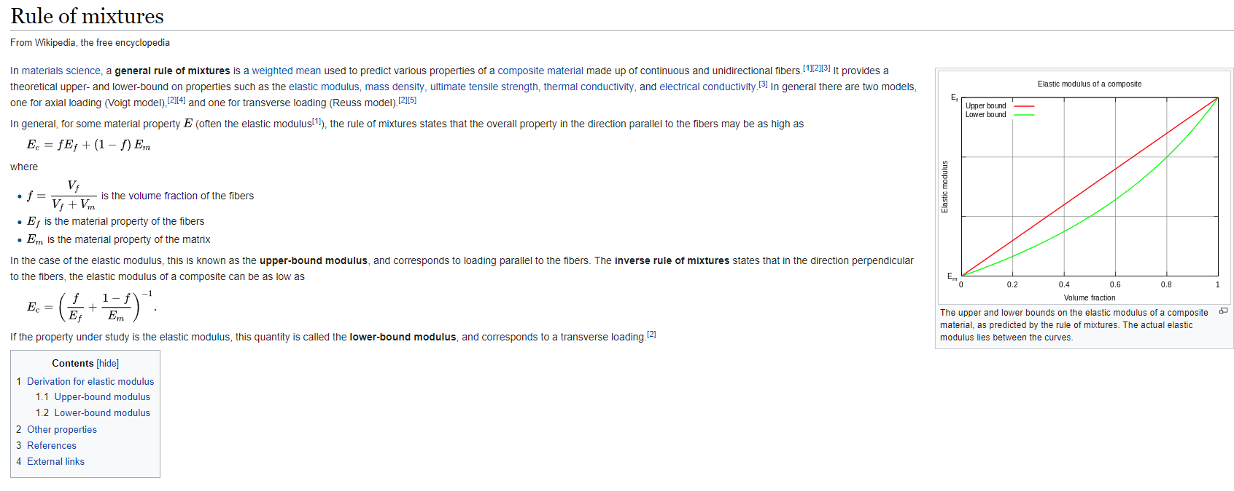
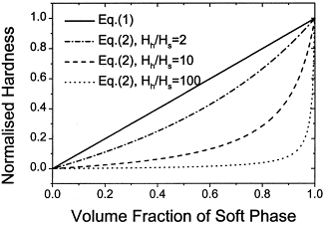
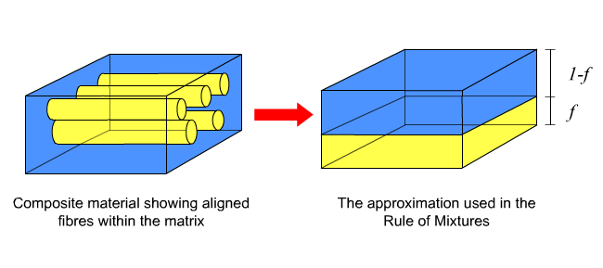
Rule of Mixtures: Insulation Dominates Coil Stiffness
2 forms:
Parallel, isostrain, Voight model (|| fiber)
Series, isostress, Reuss model (ꓕ Fiber)
In the upper bound (parallel) condition, the hard material dominates
In the lower bound (series) condition the soft material dominates
This becomes evident as the modulus ratio of the mixtures becomes larger
For S-glass to epoxy the ratio is ~30

Slide 7
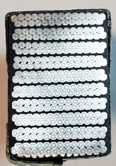
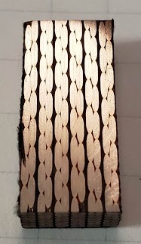
3 cable coordinate systems show preferences to different models
Longitudinal: Clearly columns of conductor and columns of insulation.
Radial: Clearly columns of conductor and columns of insulation. Somewhat less then longitudinal.
Azimuthal: Clearly conductor and insulation in series.

Slide 8


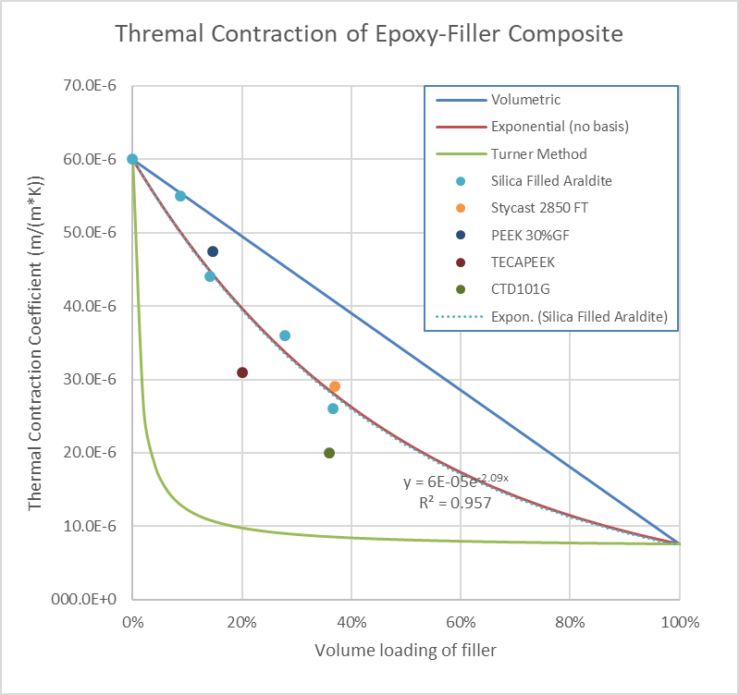
Thermal Contraction Matching
One of the most apparent issues with using epoxy resins in a cryogenic application is the large thermal strains induced in the composite.
  Thermal stresses are certainly large in a lot of cases to cause fracture without loading
  We have 2.5 knobs: Fracture toughness and differential thermal expansion, modulus
Thermal contraction of a mixture can be estimated in several fashions, none of which gives a good estimation of the bulk material behavior. The popular ones are below:
  Volumetric: overall thermal contraction is equal to the cube root of change in volume of the constituents. This is the upper bound for CTE.
  Turner: stress normalization in the composite: CTE depends on bulk modulus of materials. This is the lower bound for CTE.
  Exponential: In the middle…
Note: High aspect ratio fillers have substantially larger impact on CTE, but may be anisotropic e.g. PEEK 30%GF is 11^10^-6 at 15% VF
From D. Evans, cracks and more
?
?
?

Slide 9
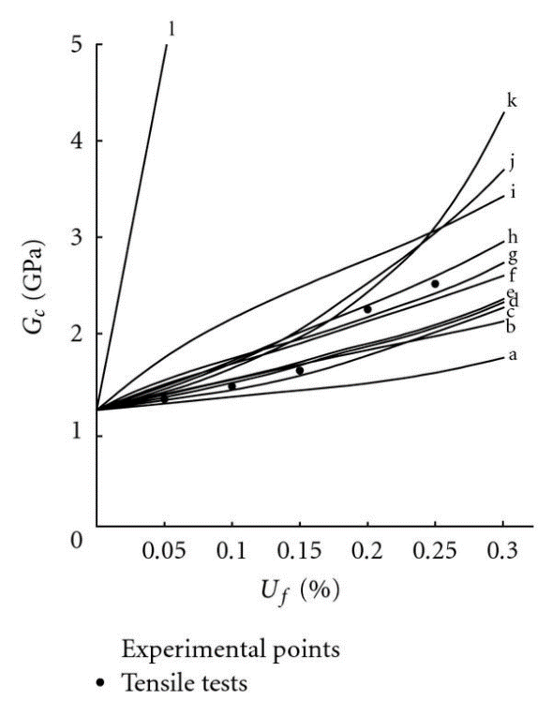
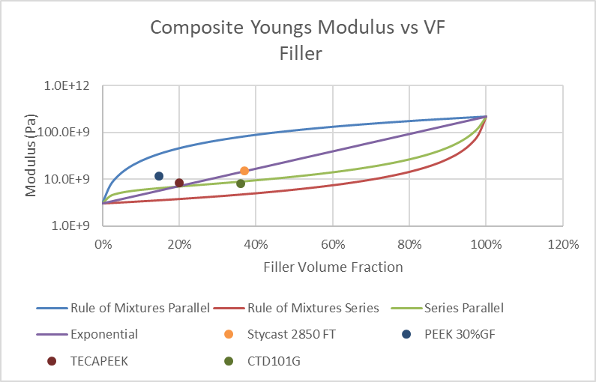
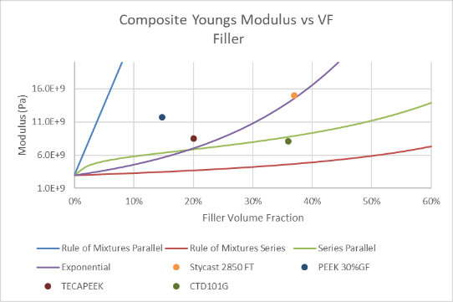
Modulus modification
Increased modulus results in lower strain energy by Hooke’s law
Less energy, less chance of quench?
Hard to work with but nanofillers are a workable solution
Semi-log Y
From G. Bourkas Estimation of Elastic Moduli of Particulate Composites by New Models and Comparison with Moduli Measured by Tension, Dynamic, and Ultrasonic Tests

Slide 10
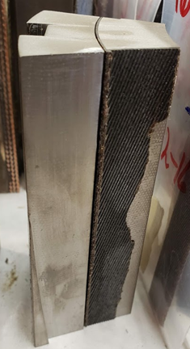
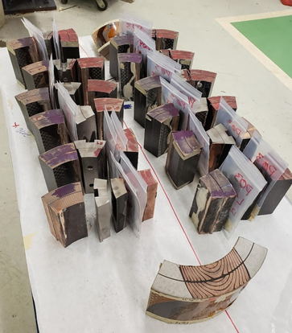
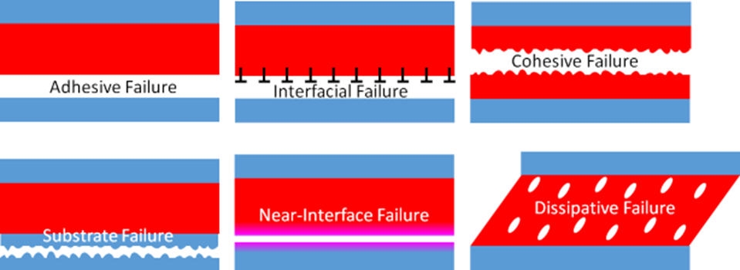
Adhesion
A comparison was made between good performing and poor performing coils from an AUP magnet.
During destructive disassembly of coils the first thing you notice if that everything delaminates
  Some function of adhesive properties
Interfaces in magnet composites are all a function of adhesion characteristics of the resin and surface properties
Magnet interfaces are so weak that seems unlikely that they directly cause conductor degradation

Slide 11
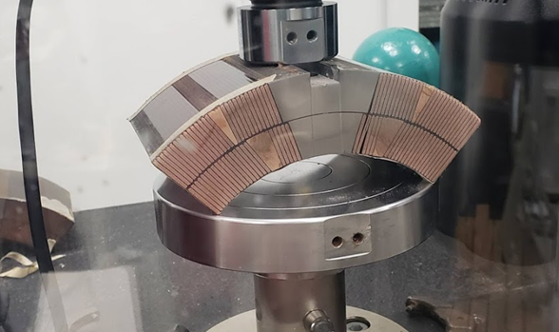
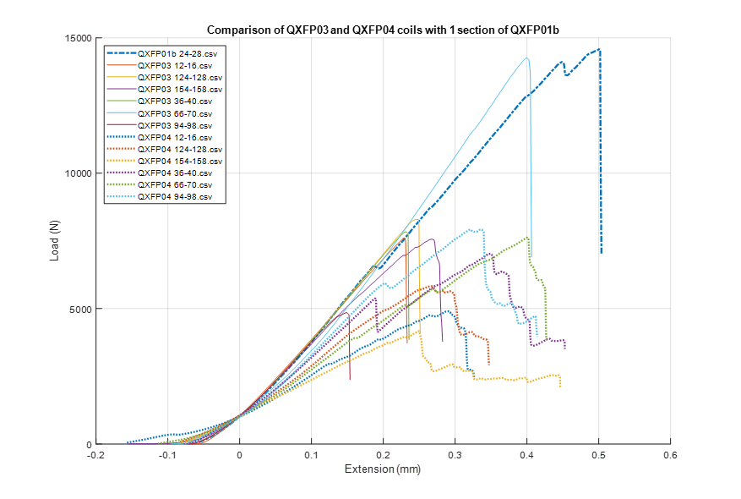
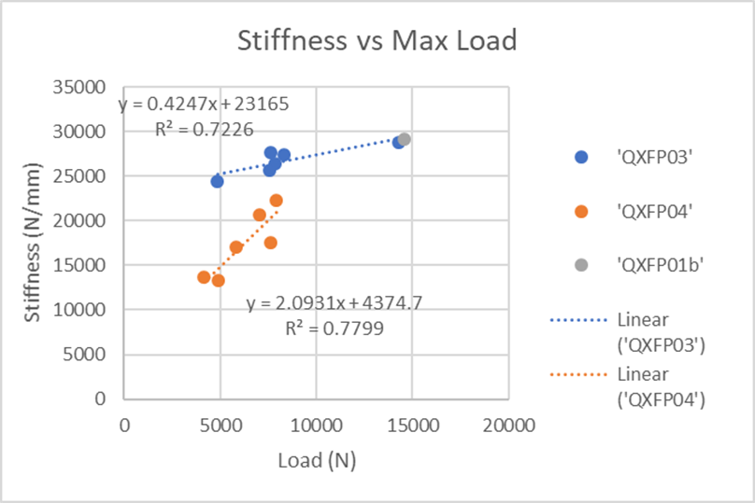
Observations during coil autopsy
To put a long story short, we have observed some indication that between 2 coils with very different performance in a magnet, there appears to be an inverse correlation between adhesion and training performance
Adhesion is a function of surface properties and rather difficult to control
When adhered, energy can be stored at the interface

Slide 12
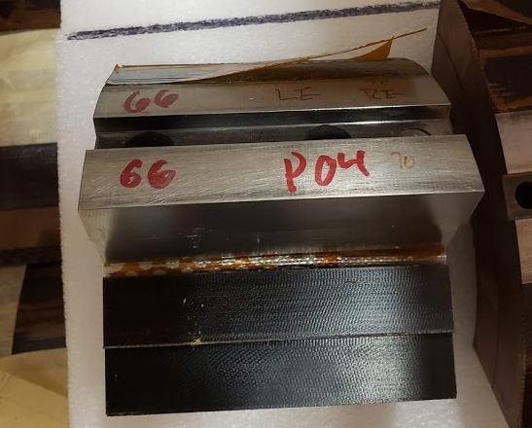
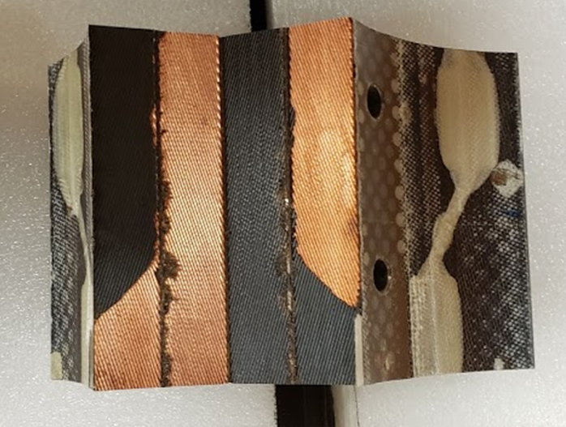
Typical P04 Failure
Typical P03 Failure
Adhesive failure between pole and fiberglass insulation
Typical of bonds with surface contaminates or preparation issues.
Generally less preferred failure mode with adhesive systems
Single sample as a low strength outlier
Delaminated between cable insulation and cable
  Typical with all P03 coils
More along the lines of a cohesive failure, but still mostly adhesive
  “Preferred” failure mode as typically indicated good bonding and system performance.
Failure between turns

Slide 13
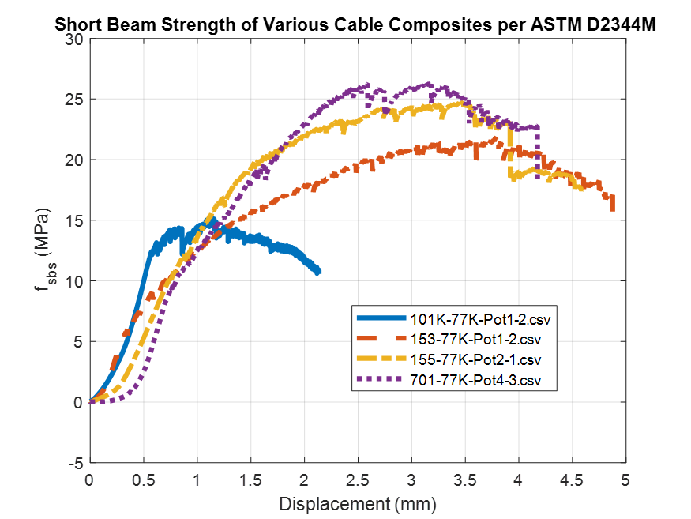
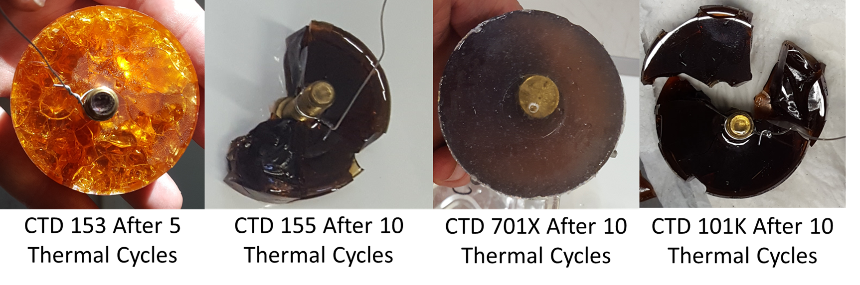
New Resins Under Investigation (CTD, FNAL, and LBNL)
CTD-155 GN
  A toughened epoxy system with nano-filler.
CTD-701X
  A thermoset polyolefin system with high elongation and extreme toughness.
    Were working on a compatible range of fillers
    Extremely low viscosity
    Very interesting

Slide 14
Future plans for magnet materials testing
Subscale composite Testing
  New filled CTD-701 resin
  Filled CTD-155 resin
Magnet Testing
  Subscale CCT with 701x
  Subscale CCT with filled 155

Slide 15
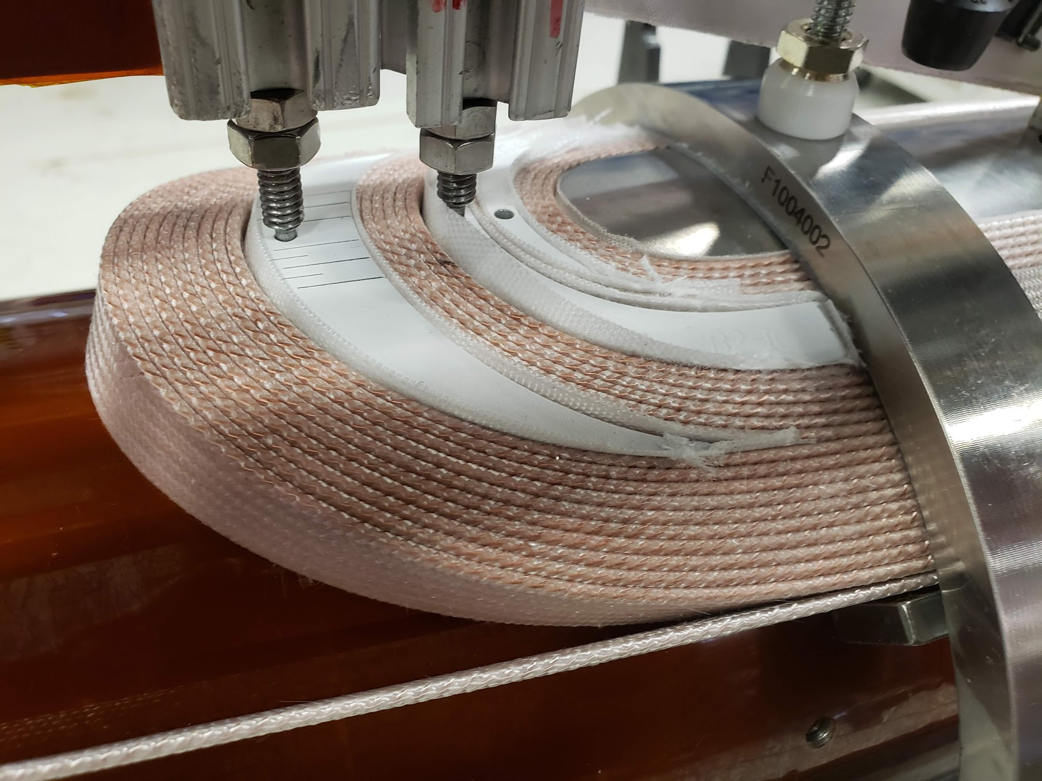
Honorable mention End Parts: Plasma Coating
Plasma coating is being used in AUP and other projects with good success at reducing coil to part shorts.
Thickness ~250µm
Good adhesion through reaction
Easy to chip at corners

