Slide 1


Results from the EU HTS program
Lucio Rossi (CERN, now INFN-Milano) on behalf of
EU FP7-EuCARD2 & H2020-ARIES
L. Bottura, G. de Rijk, G. Kirby J. van Nugteren, J. Murtomaki, A. Ballarino, J. Fleiter, H. Bajas, G. Willering (CERN)
M. Durante, C. Lorin, Ph, Fazilleau, Th. Lecrevisse (CEA), A. Kario, W. Goldacker (KIT),
A. Usoskin and U. Betz (BHTS), C. Senatore, M Bonurs (UniGE), M. Dhallé, P. Gao (U Twente), T. Salmi (U.Tampere)

Slide 2











The Partners
BHTS: A. Usoskin
CEA: M Durante, Ph. Fazilleau, C. Lorin (F. Borgnolutti)
CERN: A. Ballarino, M. Bajko, L. Bottura, J. Fleiter, G. Kirby, J. van Nugteren, L. Rossi
DTI: N. Zangenberg
INFN: G. Volpini (M. Sorbi)
INPG: A. Badel, P. Tixador
KIT: W. Goldacker, A. Kario
SOTON: Y. Yang
TUT: E. Härö, T. Salmi, A. Stenvall
UniGE: C. Senatore
UT: M. Dhallé

Slide 3
Scope of FP7-Eucard2
CONDUCTOR
Demonstrator MAGNET – accelerator type
5-20 kA cable @4.2K 5-20T
ten kAmps-class cable
For accelerator dipoles:
J_{overall} ≥ 400 A/mm2
  80-85% filling factor
  J_{eng} strand ≥ 400 A/mm² min.
  J_{eng} strand ≥ 600 A/mm² enhan.
Accelerator type
  Transposed
Not too many joints ⇒ high current – 100 m long tape
Aperture ∼ 40 mm
(R_{min} cable ⇒ 20 mm!)
5 T standalone with 20% margin (> 6 T ss limit)
Insertable in High Field
⇒ outer Diam < 100 mm (including mech. structure)
Length < 1m (L_{straight} ≥ 200mm)
Must reach 16-17 T in 13 T background (Fresca2)

Slide 4

Selection of HTS: REBCO → cable type: ROEBEL
Choice in favor of REBCO tapes assembled in Roebel cable
  REBCO: continuing the route of EuCARD
  EU Industry. Other EU programs (FP7-Eurotapes)
  High current density (use// orientation) & Transposition!
  “Easy” start: conductor in final form, no need high temperature heat treatment of whole coil.
Other types of cable like stacked tape cable with twist on the curvature ends have been investigated. Eyes on CORC®!
Activity on Bi-2212 have been pursued in the collaboration CERN-ASC(Fl) on advanced powder from Nexans with mesurements by Univ. of Geneva on strand and in future U.Twente on cable
W. Goldacker et al., 2006 J Phys. Conf. Ser. 43 901

Slide 5
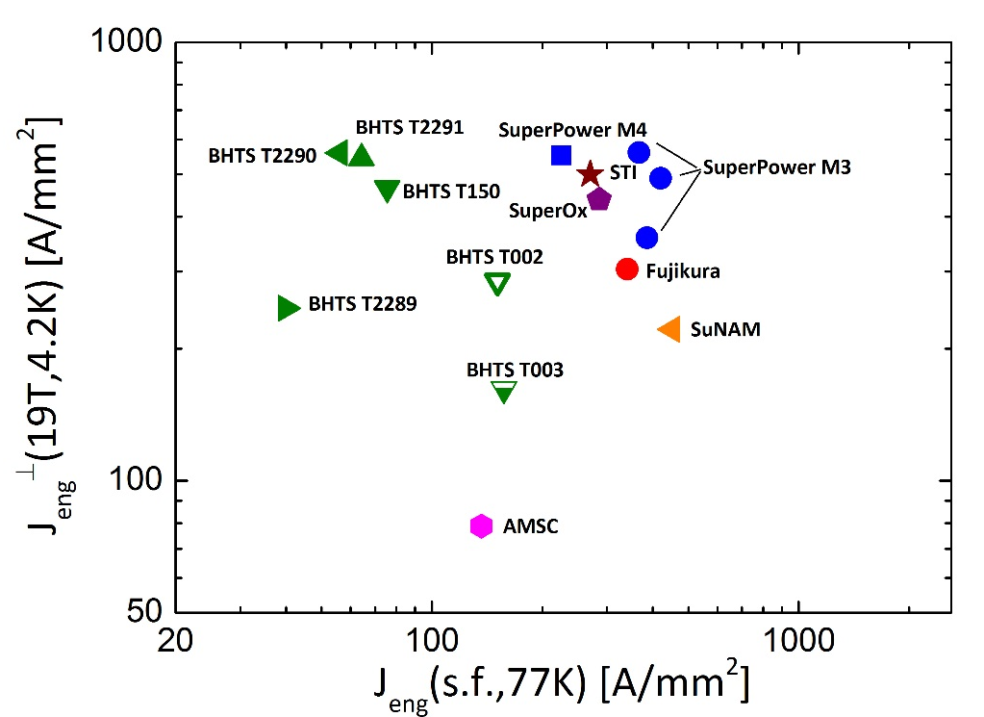
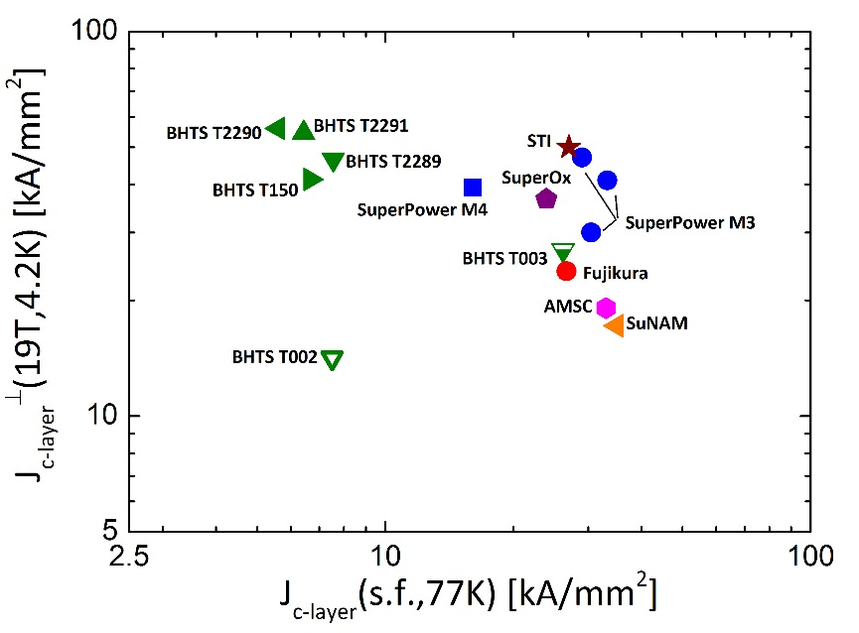
EuCARD2 conductor
C. Senatore
Good in term of Je
Even better in terms of J_{layer YBCO}

Slide 6
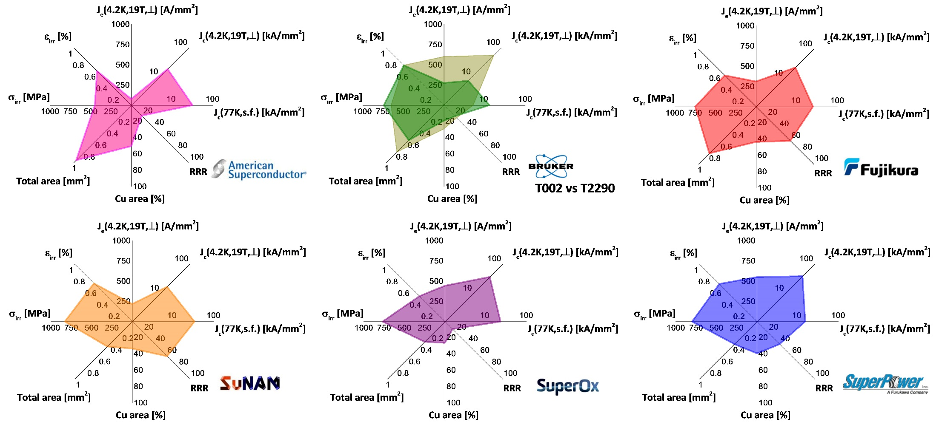
We procured and tested tapes form various suppliers
C. Senatore

Slide 7
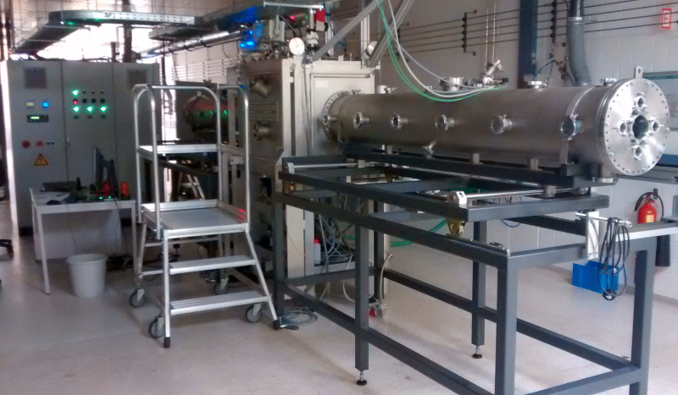
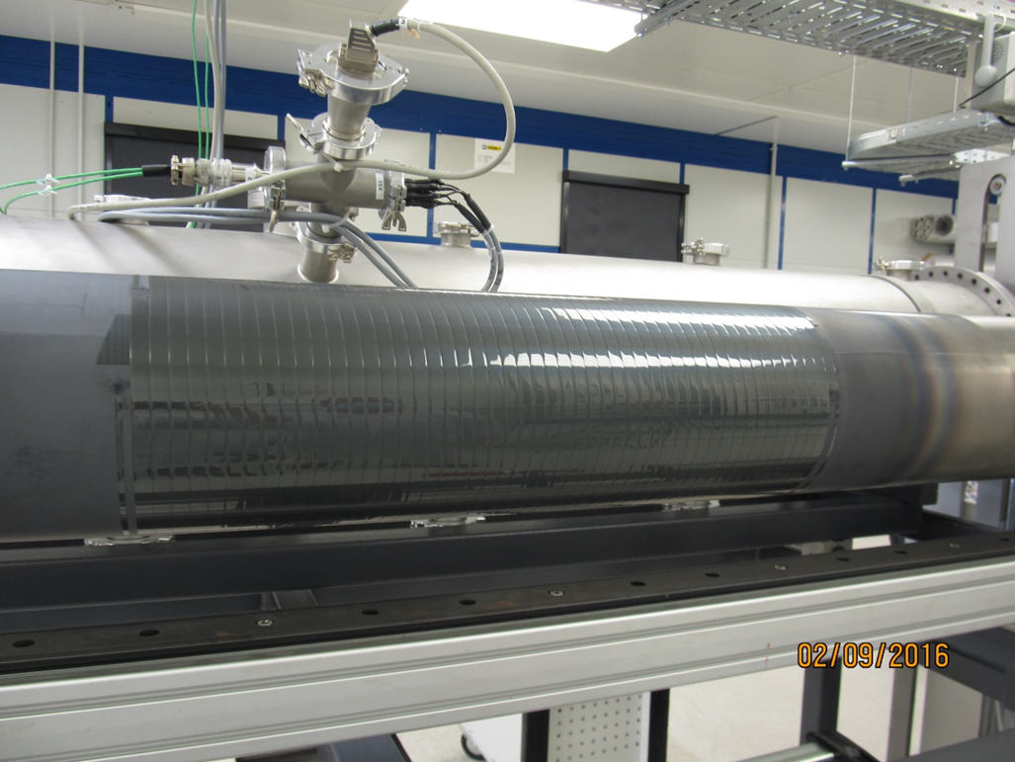
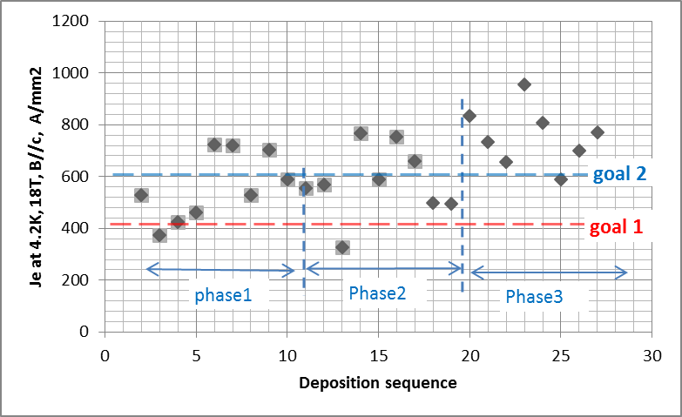
New line for CERN (w=12mm) at Bruker
2014
2015
2016
A.Usoskin & U. Betz - BHTS

Slide 8

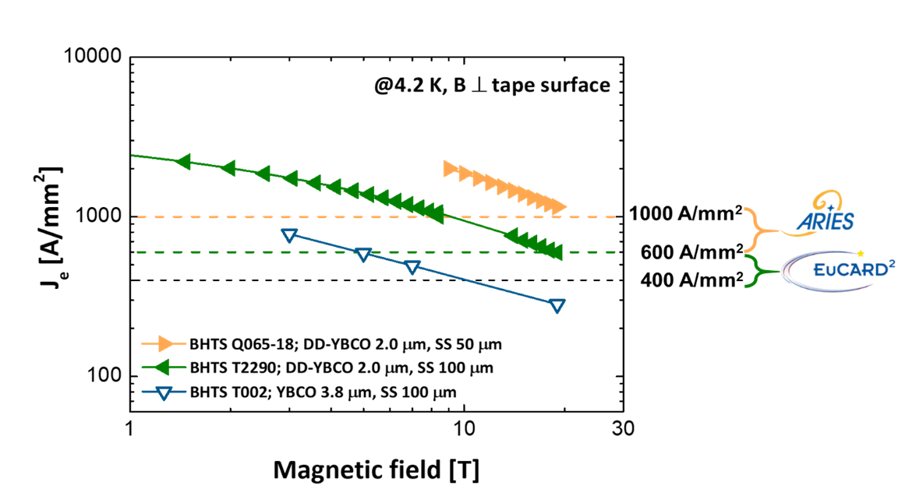
H2020-ARIES
C. Senatore
Scope: reduce substrate
100 µm →50 µm
To – almost – double Je
Idea behind:
Reduce cost of kA-m
Possible use of extra current density to increase Cu stabilizer
2018
After a successful start … →

Slide 9
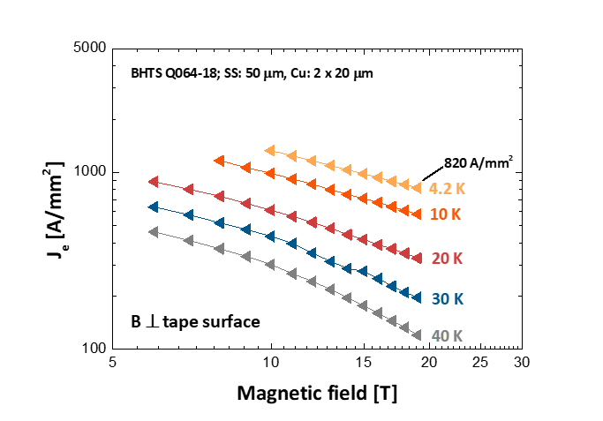
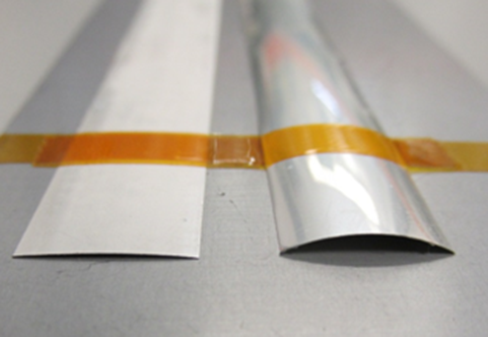
…did not work at all; low yield; severe bow of the tape. attempt to correct the bow decreased Je

Slide 10
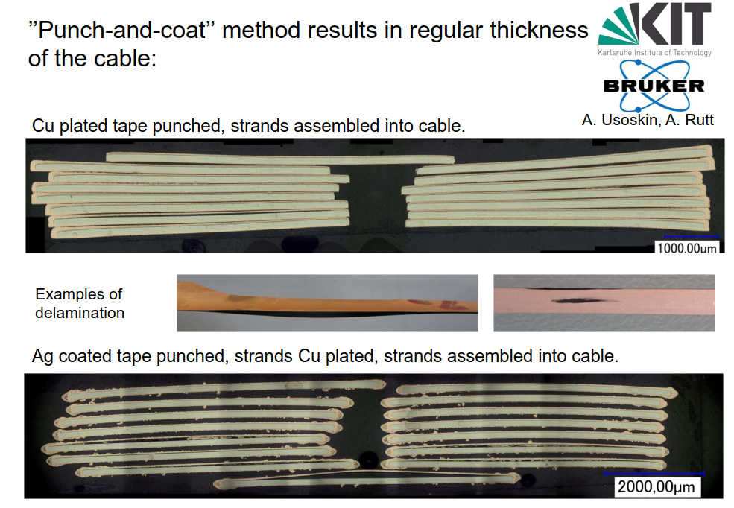
Roebel cable - cont.

Slide 11
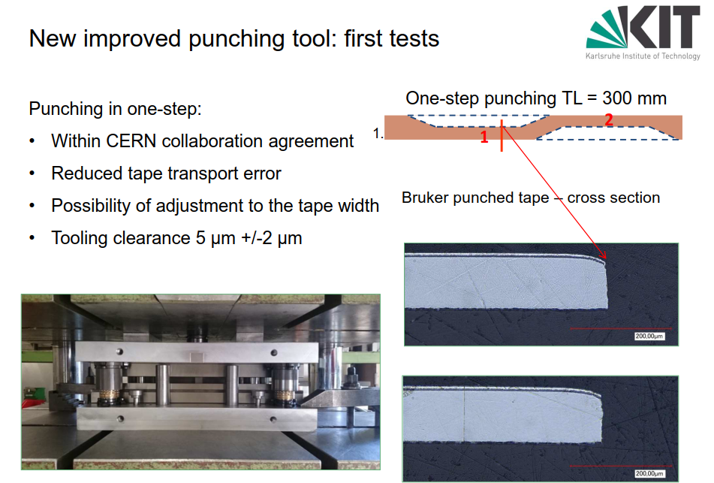
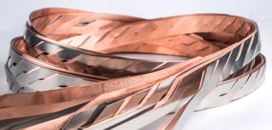
New line for the Roebel
Anna Kario, Simon Otten, Andrea Kling, et al.

Slide 12
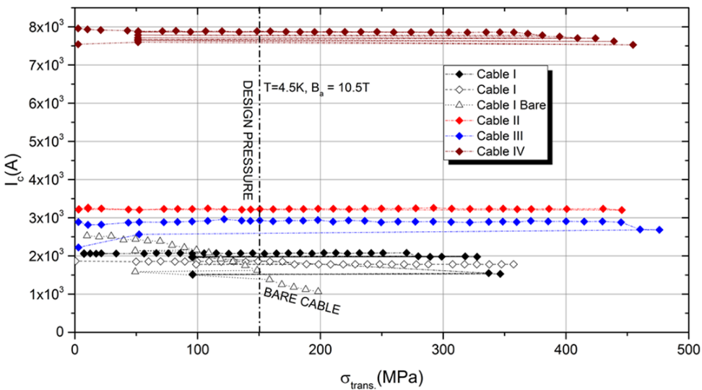

Ic vs. transv. stress
J. Fleiter et al. SUST 26.6 (2013)
Demonstrated that above 100 MPa bare cable is severely damaged: but we will work at 150-200 MPa...
P. Gao and M. Dhallé
showed that impregnated cable works at 400 MPa

Slide 13
Achievements (closing on 31 April 2017)
L. Bottura, CERN
parameter | units | target
J_{E} (20 T, 4.2 K) | (A/mm²) | 600
σ (I_{C}) within a unit length | (%) | 10
M(1.5 T, 10 mT/s) | (mT) | 300
Range of σ_{transverse} | (MPa) | 100
Range of ε_{longitudinal} | (%) | ±0.3
Unit length | (m) | 100
✔
✔
Tape
✔
✔
parameter | units | target
I_{C} (20T, 4.2 K) | (kA) | 10
Width | (mm) | 12 ± 0.1
Thickness | (mm) | 1.0 ± 0.1
Effective contact resistance | (μΩ) | 5
✔
Cable
✔
Plus direct order form CERN (about 500 kE) doubling the Eucard finacing to BHTS and other purchase

Slide 14
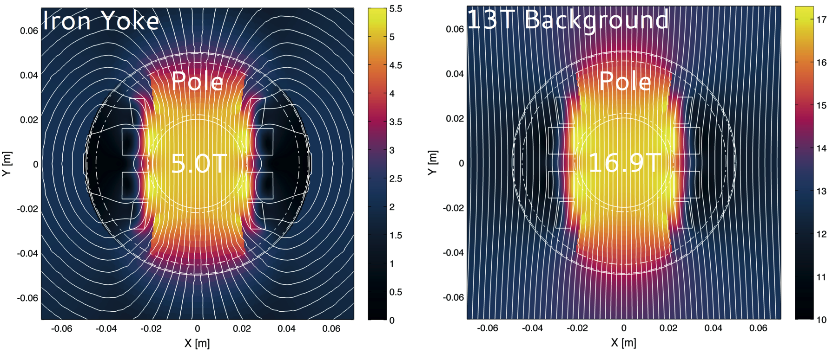
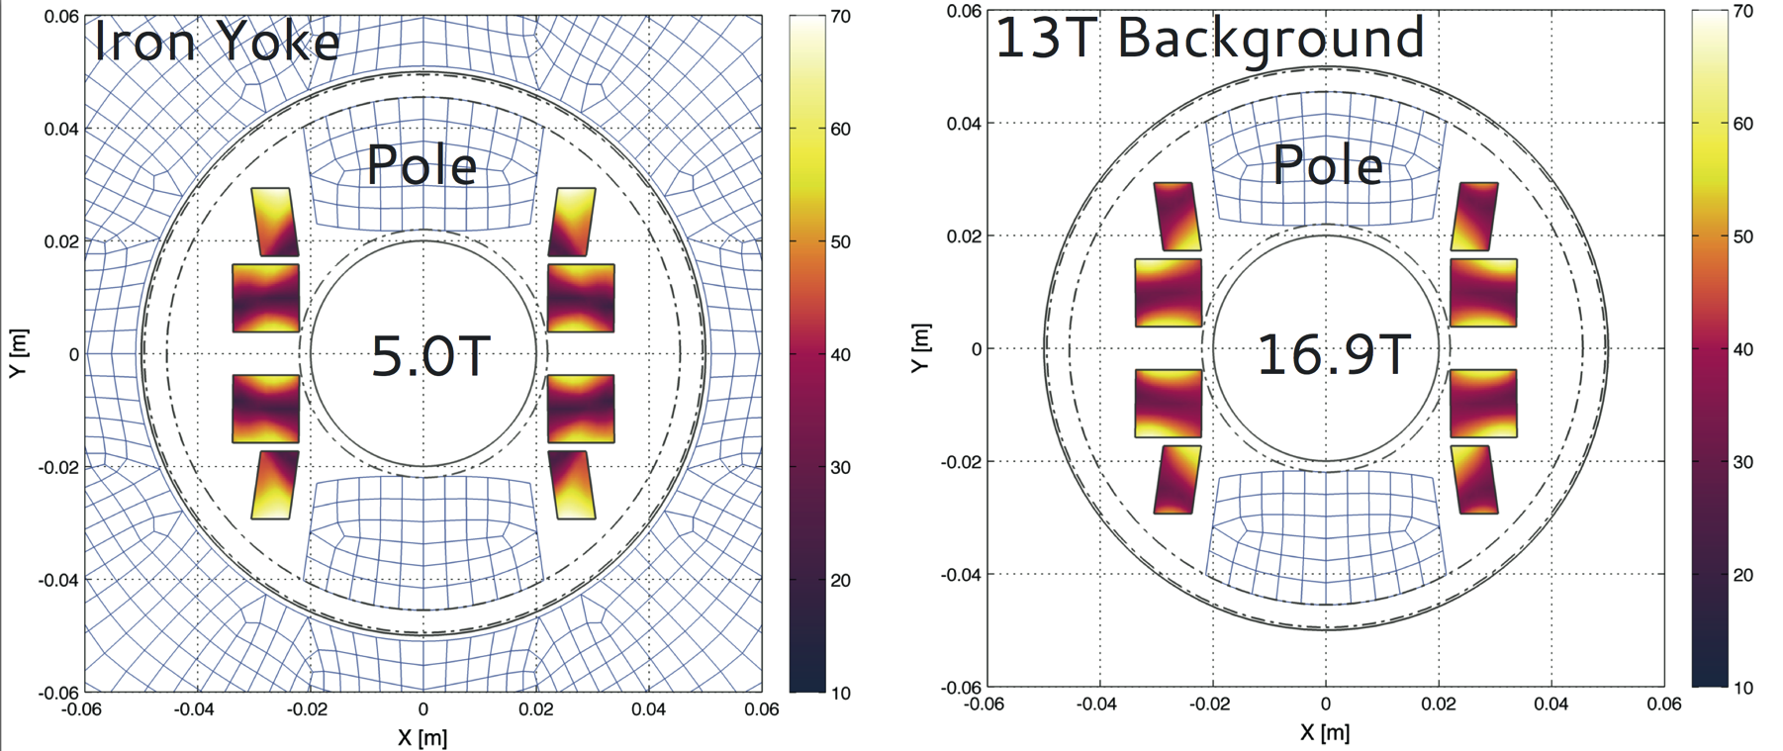
Aligned Block lay-out by J. van Nugteren
The two plots present flux path variation for insert magnet:
(left) standalone in Iron ,
(right) in 13T ideal background field
Magnetic Field [T]
e.m. model and e.m. design by J. Van Nugteren @ CERN
Yellow area is the region more near to short sample.
Very different from std. LTS magnets.
Percentage on Loadline [%]

Slide 15
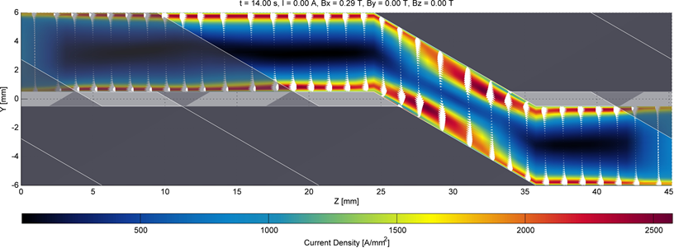
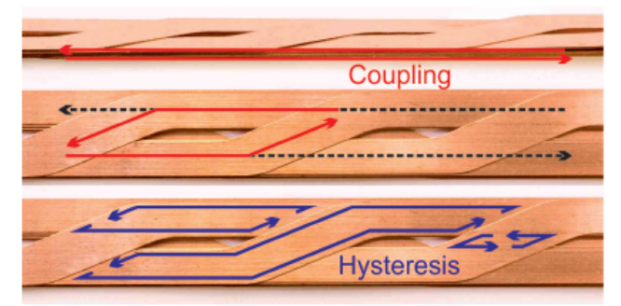
e.m. model by J. van Nugteren (CERN& U.T.)
Measurements at U. Twente have validated the e.m. model with a contact resistance in the orders of 10 μΩ;
These values are not too different to measurements done in KIT (A. Kario): 20-30 μΩ
Good news: we expect current sharing in our cable.
Dynamic E.M. cable model J. van Nugteren, EUCAS 2015
Hysteretic losses are dominant but how much coupling do we have in impr. Roeble?
Courtesy of M. Dhallé, U.T.

Slide 16
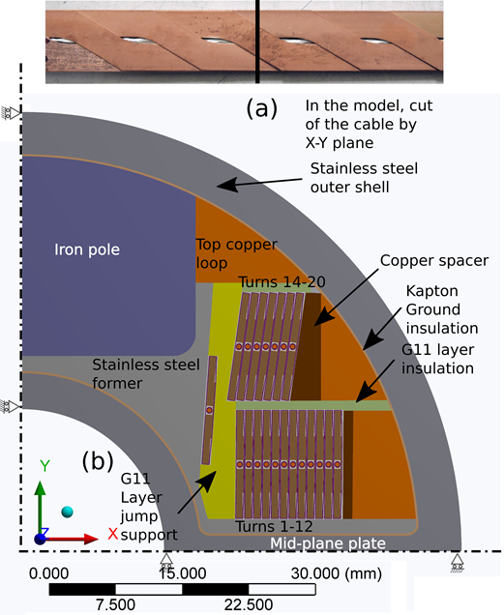
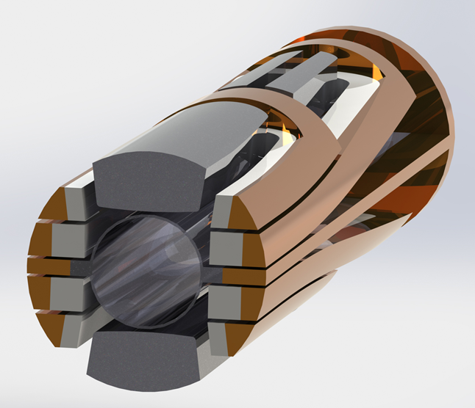
AB dipole magnet (FeatherM2)
Quench CU bars
G. Kirby, CERN
Design: minimal precompression: the coil are leaning against a rigid wall
J. Murtomaki, CERN

Slide 17
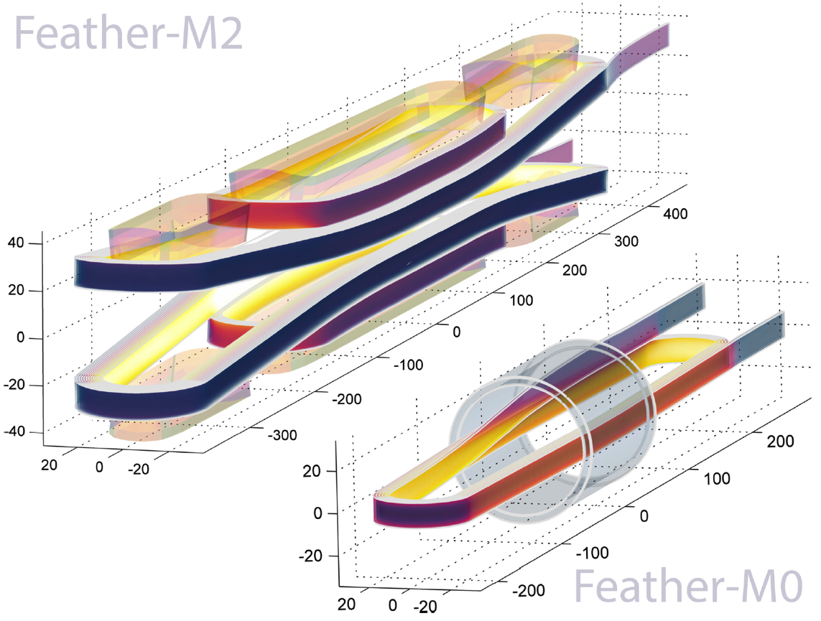
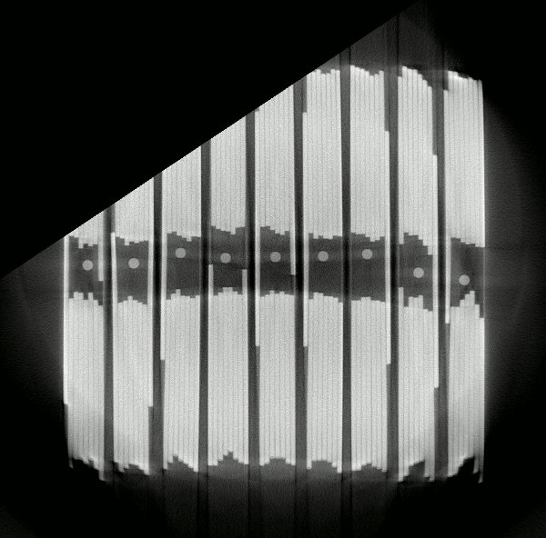
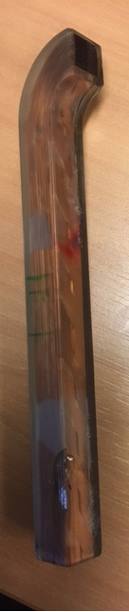
Going in steps:FeatherM0 flat racetrack,
5 m cable
G. Kirby, J. van Nugteren, CERN

Slide 18
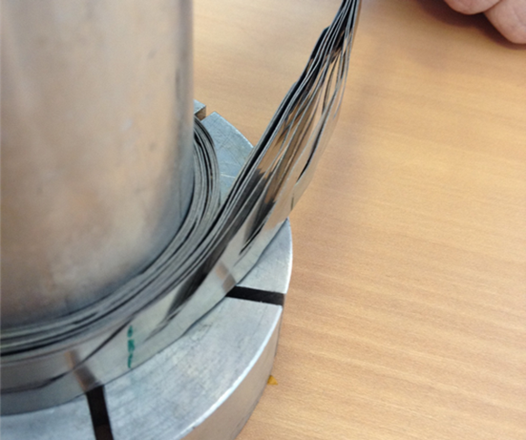
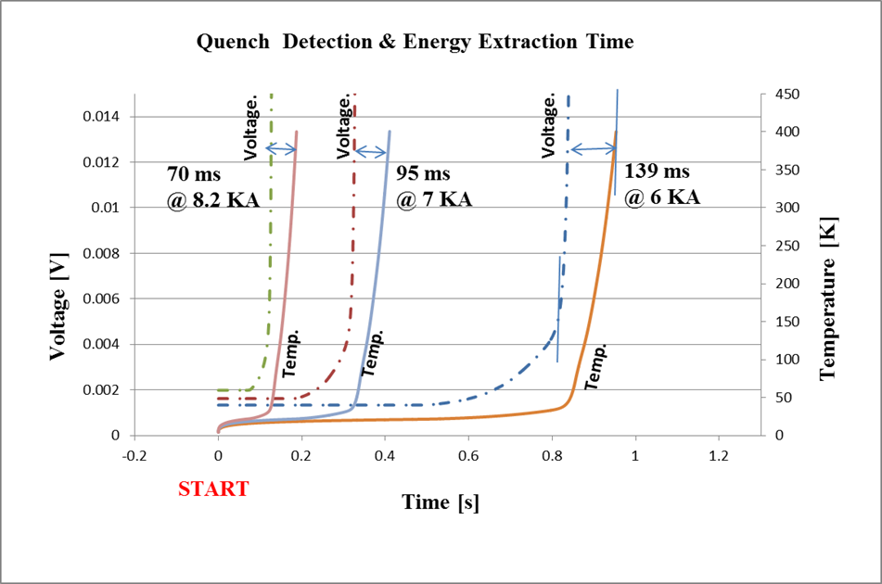
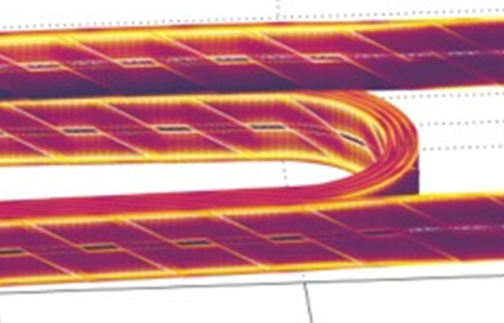

Magnet technology issues… design & protection issues…
Winding (un)stability : small tension
Impregnation → delamination
QD & QP Studies with strongly anistotropic th. Cond.
and with strong TCS variation inside tape/cable
Current redistribution
Tampere TUT. J. Ruuskannen
e.m. model of J. Van Nugteren, U.T. & CERN

Slide 19
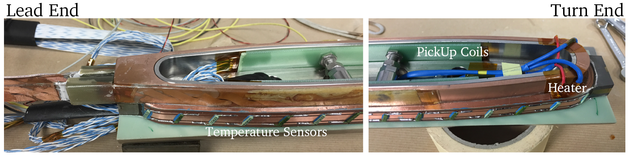
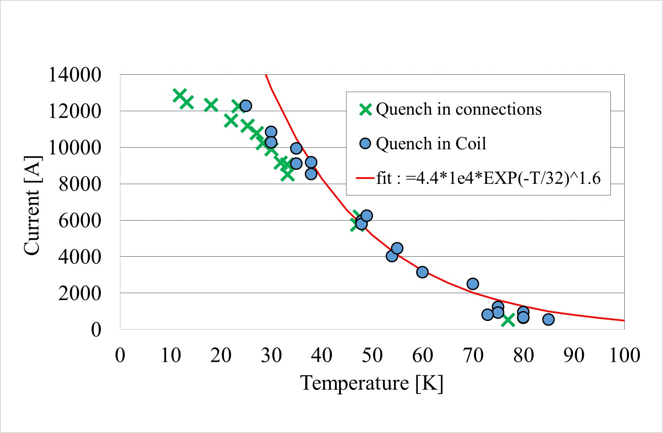
FeatherM0.4 – cable behaved as “expected”
Computation showed little time to react to a quench: 20-30 ms:
Quench detection.
Improved voltage taps
(≈ 1 mV)
Array of temp. sensors
Pick-up coil array
Fiberglass in Bragg grating
12.8 kA, cable qualified
Way too much diagnostics
Too many wires!

Slide 20
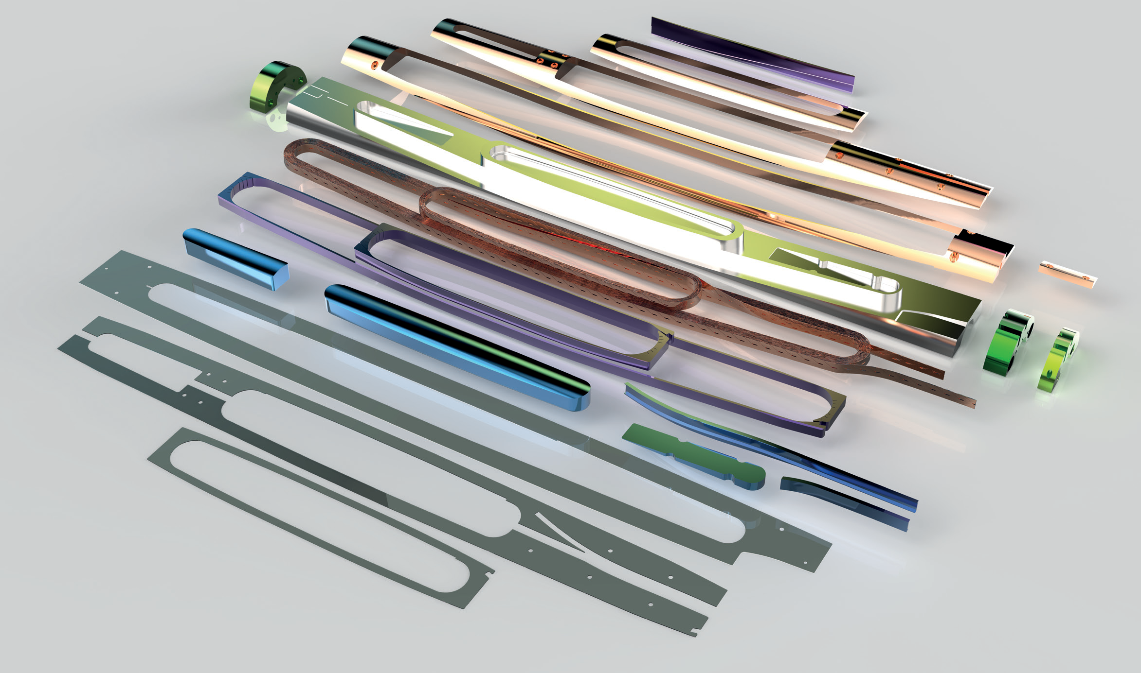
FeatherM2 construction: a complex assembly

Slide 21
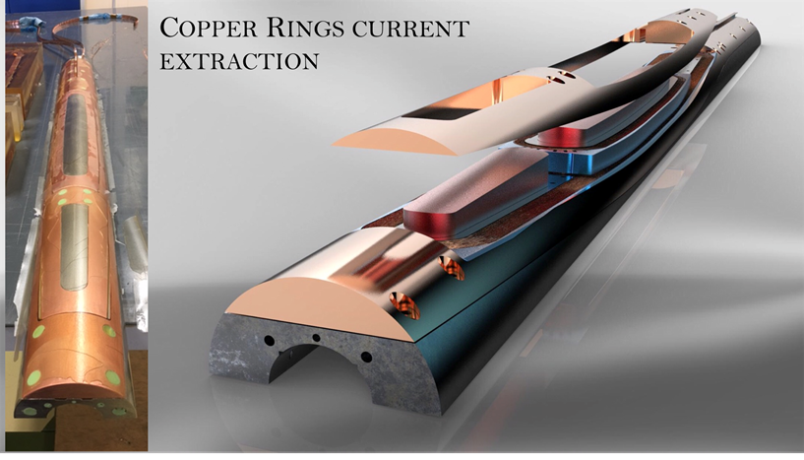
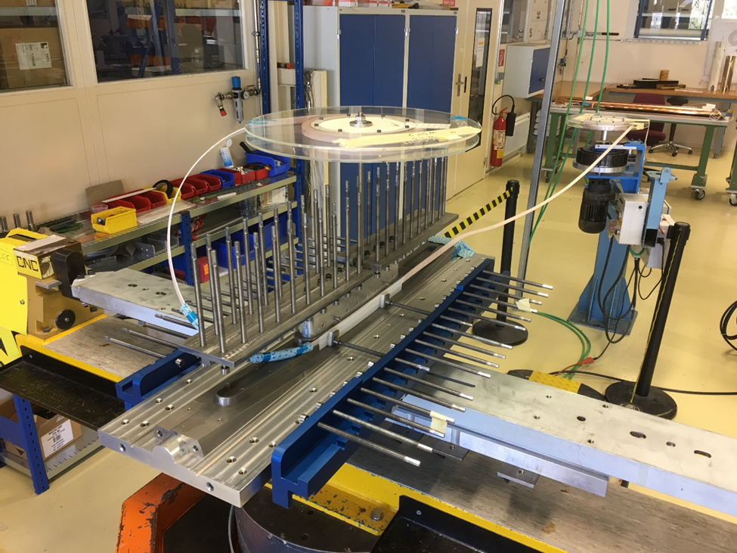
Manufacturing the Eucard2 first AB dipole FeatherM2
Courtesy of Glyn Kirby

Slide 22
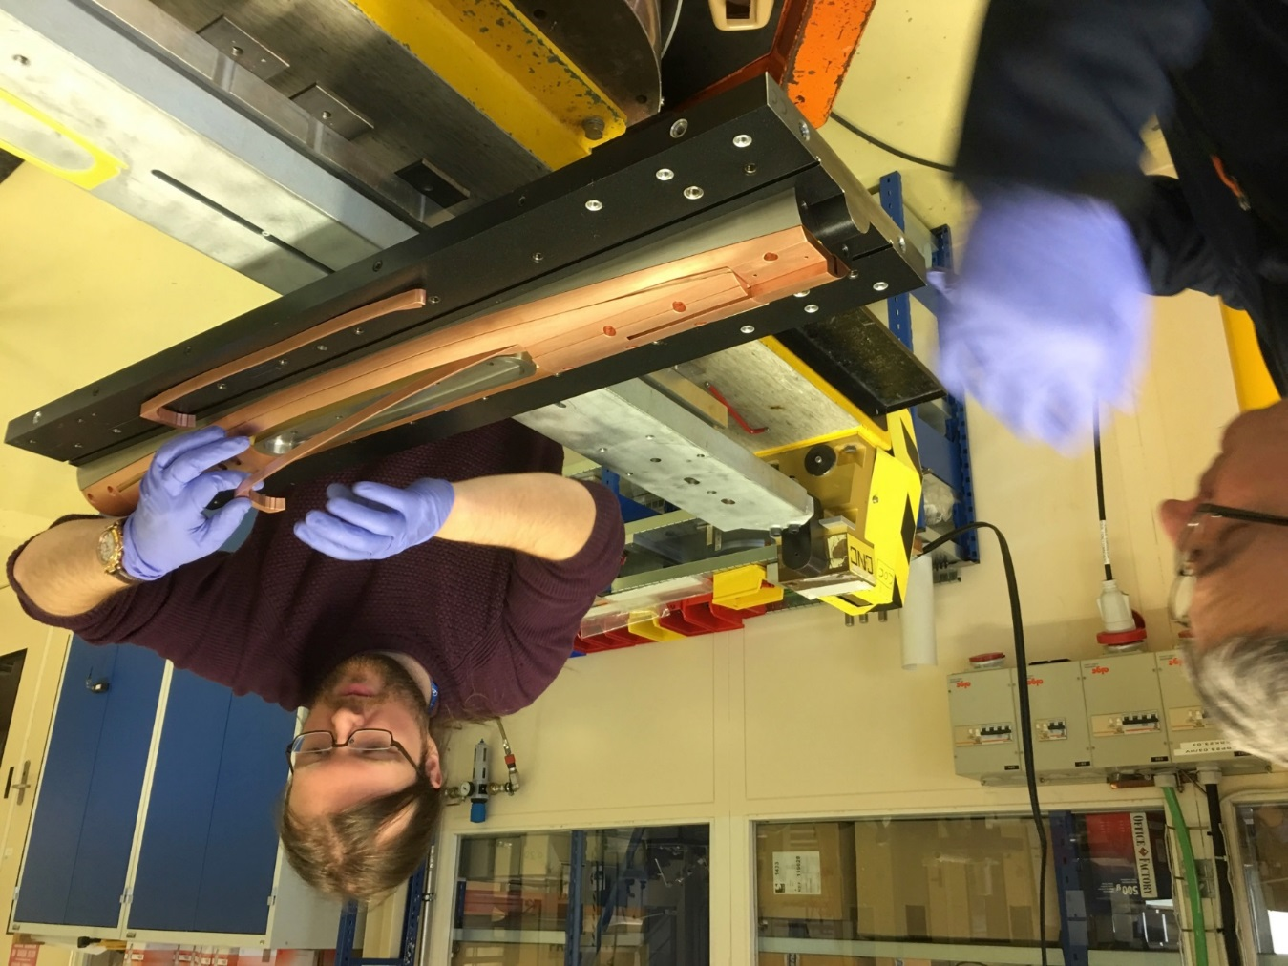
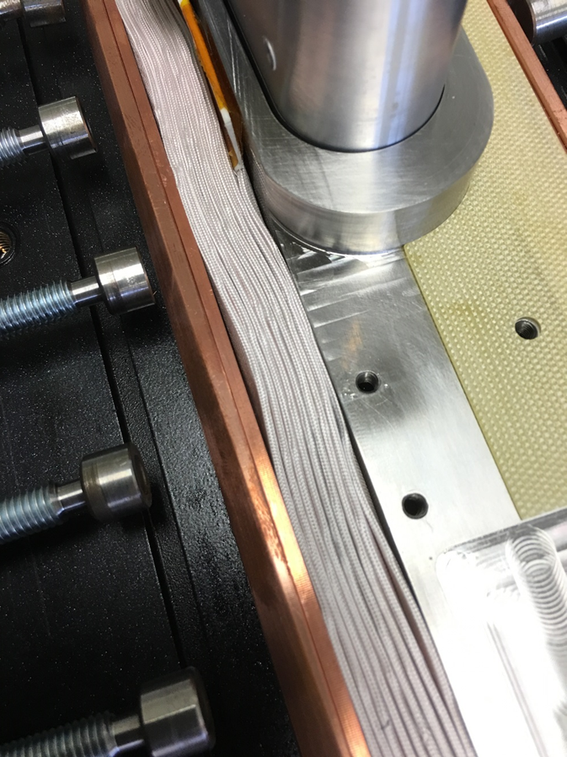
FeatherM2 AB block dipole construction

Slide 23
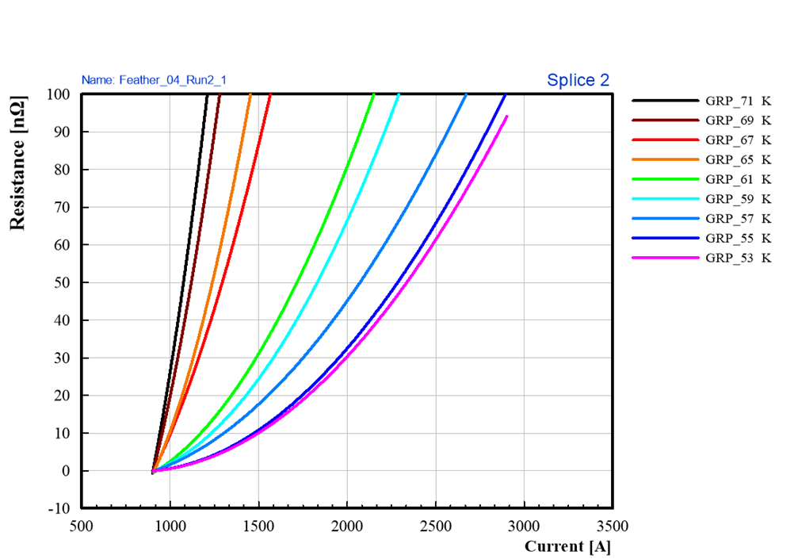
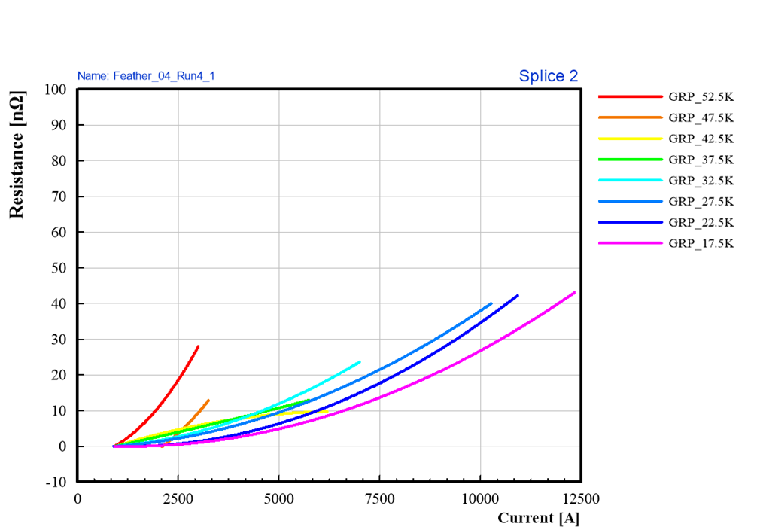
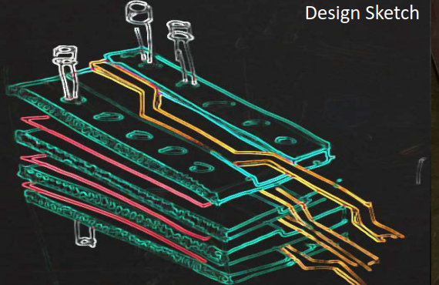
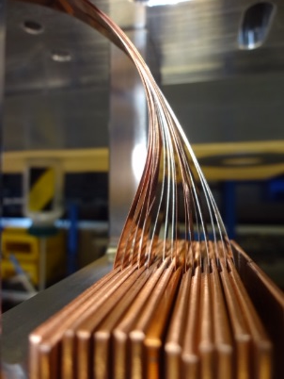
Fin Joints by G. Kirby
Classical butlap joint in FM0.4:
>100 nΩ! ⇒ 40 nΩ
New design, called Fin block joint
(G. Kirby).
Improvement by a factor 2, no need of overcooling: do we need it? Certainly it helps to transfer current more uniformly…

Slide 24
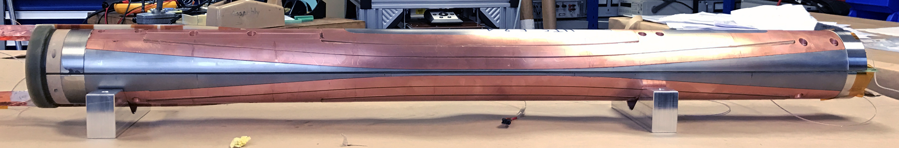
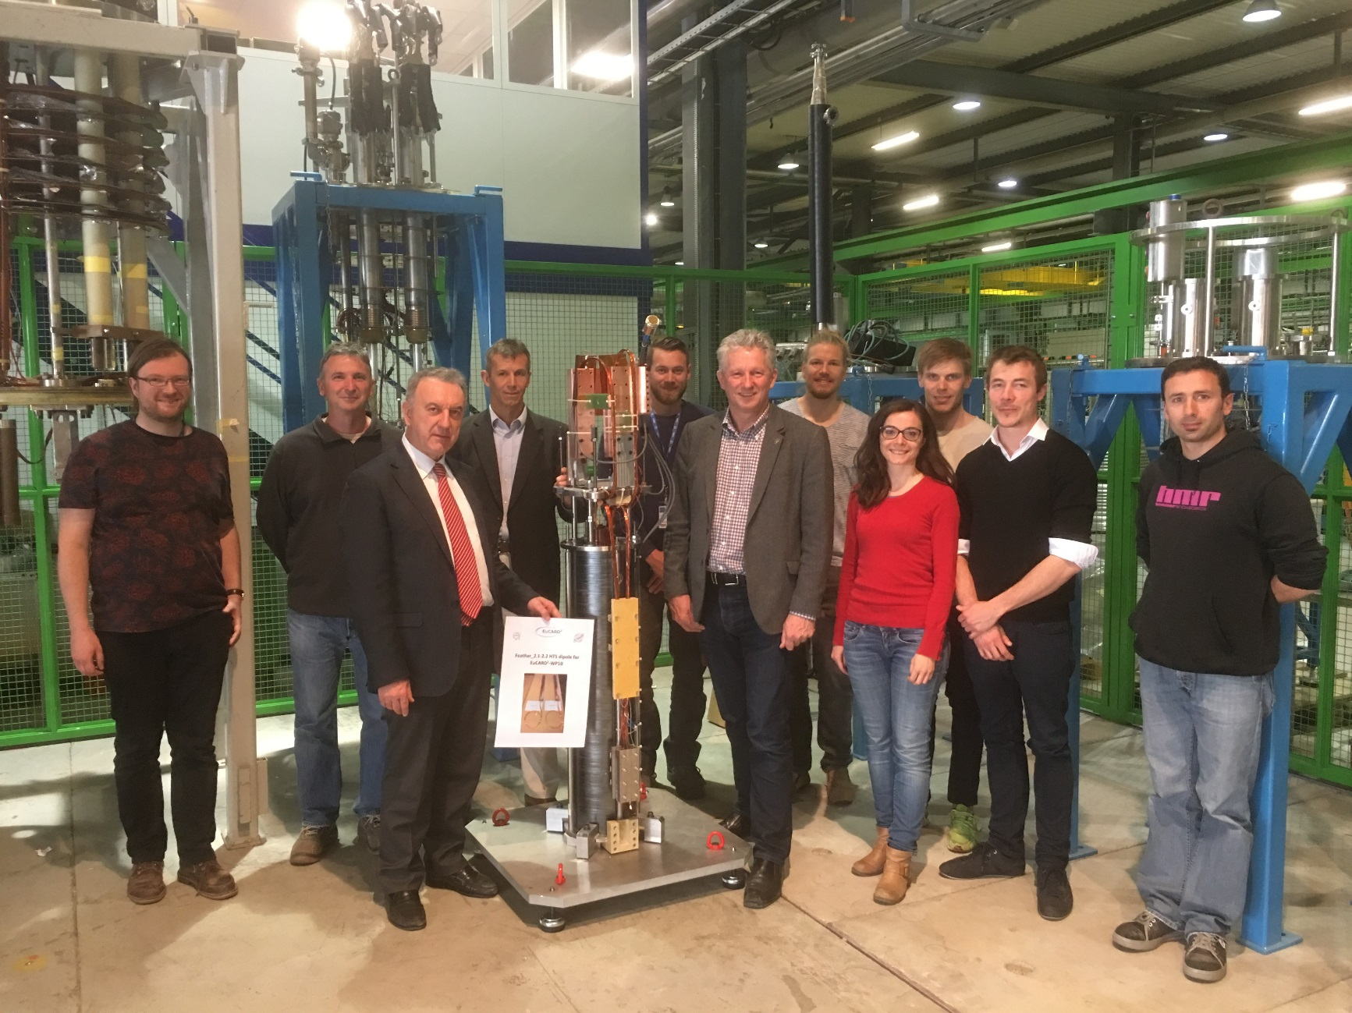
First accelerator-type magnet before going to test:
The Eucard2 FeatherM2.1-2 dipole
April 2017.
FeatherM2.1-2
Is special cable:
Tape from SUNAM
Cable by SuperOx
Low current

Slide 25
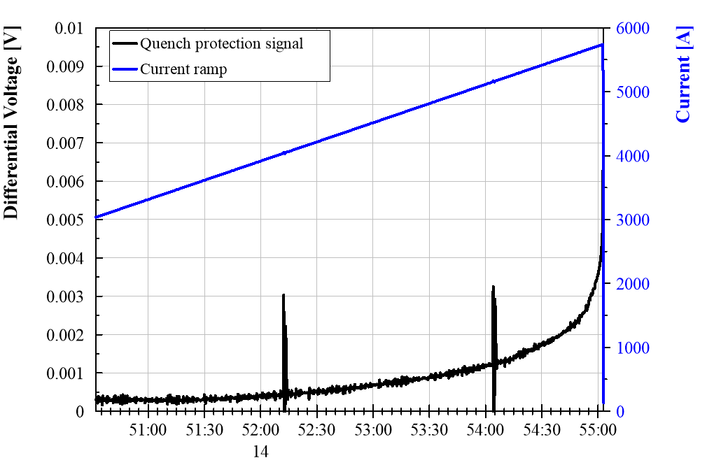
High resolution low frequency acquisition
Quench detected
by protection
Minute to react
3 mV
1 mV

Slide 26
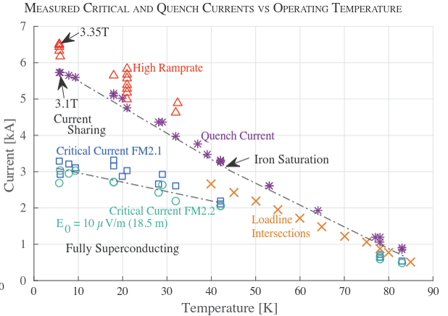
FeatherM2 first excitation cycle
The copper ring works
The transition is soft, Contact resistance is in the 10 µΩ range!!
Coupling current decay in 80 s
But very little persistent current!
Courtesy H.Bajas and J. van Nugteren, CERN
Only 60 unit of b3 foreseen
(model with no iron).
Measured about 20 unit!
Recalculated wth iron (L. Bortot et al.): agreement with 20 units!

Slide 27
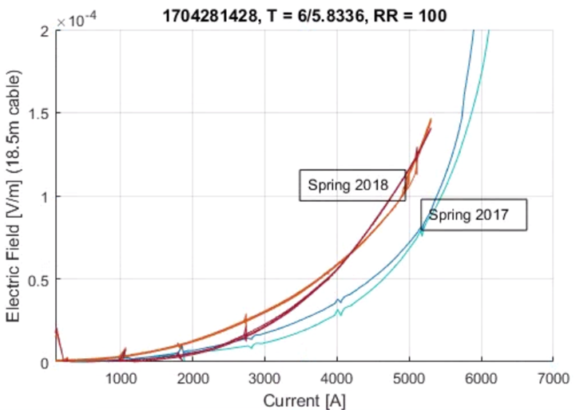
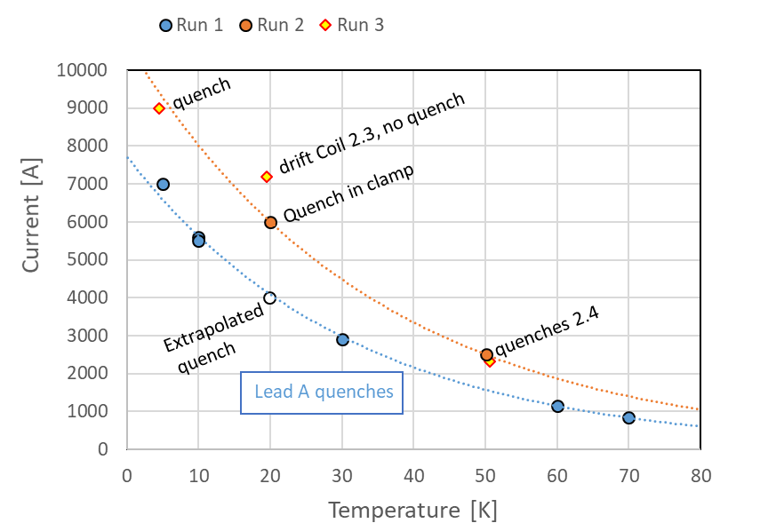
Degradation due to the cycle? Cold down also a little suspicious. But happened other times
G. Willering, CERN
FeatherM2_1-2
3.1 T
FeatherM2_3-4
(Eucard2 cable) 4.5 T (expected > 5 T)

Slide 28

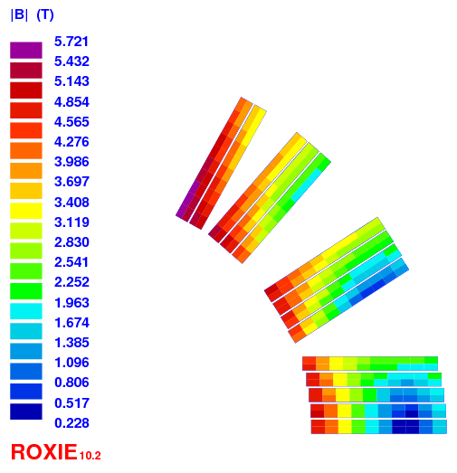
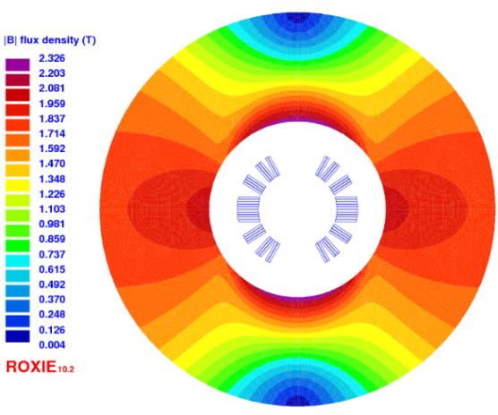
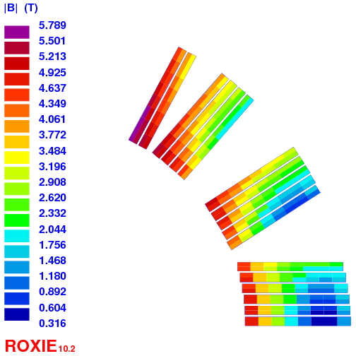
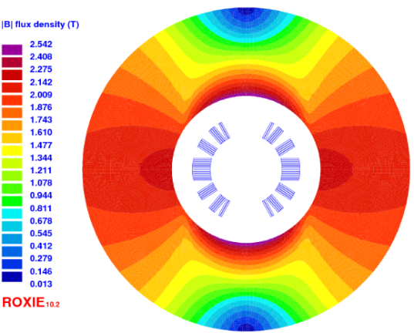
Cosϑ design with Roebel at CEA-Saclay
C. Lorin, M. Durante & Ph. Fazilleau
Design A - « thick » cable : 12 x 1.2 mm² bare, 13 tapes 140-µm thick
Design B - « thin » cable : 12 x 1.0 mm² bare, 15 tapes 100 µm-thick
Cos-θ A : 1.2 mm + 2x100µm insulation, 14 turns
Layout | Unit | Cosϑ A | Cosϑ B
Iop | kA | 11.68 | 10.06
Bop | T | 5 | 5
Bpeak | T | 5.7 | 5.8
Ic | kA | 14.4 | 15.2
LL margin | (%) | 20 | 34
T margin | K | 20 | 30
Sd. inductance | mH/m | 0.49 | 0.73
coil inner radius | mm | 22 | 24
yoke inner raidus | mm | 50 | 50
yoke outer raidus | mm | 112 | 110
Nb. of turns | - | 14 | 17
Unit len. of cond. | m | 20 | 24
Cos-θ B : 1.0 mm + 2x125µm insulation, 17 turns

Slide 29
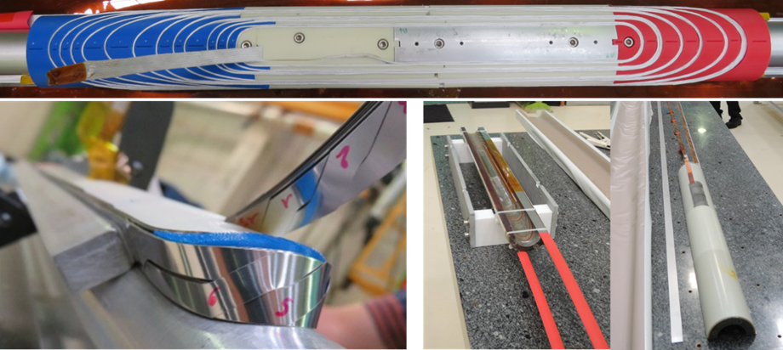
Cos Theta coil at CEA: one layer;
Technological test to compare with Ruth. cable
C. Lorin, M. Durante & Ph. Fazilleau, CEA
Very good quality winding and careful control of all process
Finished. At CEA
To be tested

Slide 30
(some) Technical lessons
Working with tape and Roebel is difficult but possible. But do we need transpostition?
  Relatively smooth process in the period when effort was sufficient
  Too many uncertainty open. Main is the degradation. Is it intrinsic? Due to resin-induced delamination ? (CT101K is already suspected for NbSn…). Compatibility with resin is to be assessed more systematically. Or need to avoid liquid?
Persistent Currents are reasonable for FQ, not as bad as one could expect (b3 about 20 units).
  This point need more study. Could be canceled by intrinsic correction (magix magnet? See experiment of L. Bortot , C. Petrone et al. on a SC shield).
  Because of current anisotropy in the tape, and – see presentation of D. Uglietti, we do not need transposition. Simple stacked tape can do the job? WHAT IS IMPORTANT IS TO HAVE GOOD CURRENT SHARING. Robel even impregnated shows that current sharing is there.
The large enthalpy margin really pays off but must be coupled with a current sharing mechanism. Defect needs to be “bypassed”. Current sharing plays the role of “stabilizer” to shunt defects. The large enthalpy margin allows for the small inherent dissipation.
We had about 3.5 km of tapes and 150 of Roebel. → Luca Bottura excel file
Some unit lengths is still there. It is possible to have a final FeatherM2_5-6 built in more controlled condition.

Slide 31
General lesson learnt
Knowledge of tape behaviour is of course the first thing
Knowledge of the cable, i.e of the “conductor” is as well critical and is much more difficult. Depends also on the coil technology.
Taking more steps with intermediate mock-up is important
But a program cannot be done all in series: some parallelism must be introduced, otherwise you risk to see certain problem too late.
Foresee test and multiple retesting.
Difficult to do the program if has not some stable priority (which it had in 2016-17).
Long term program with company (HTS manufacturer) may suffer form company change of strategy.
We spent in Eucard2 (plus conductor and tooling) about 4 M€ (1.4 from EU) including salary and 0.5 M€ in ARIES (all from EU).

Slide 32
Spares

Slide 33
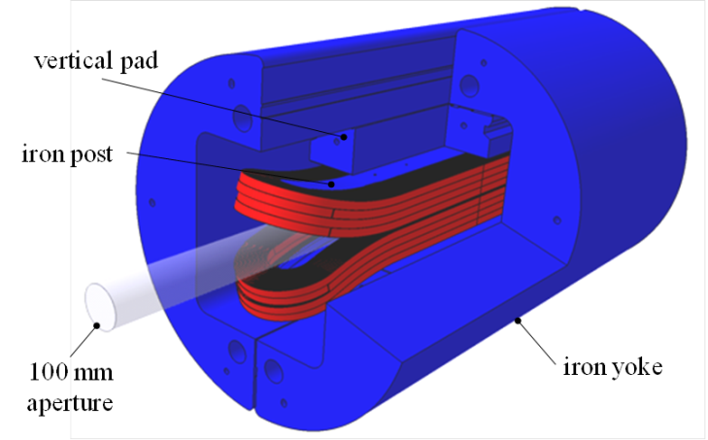
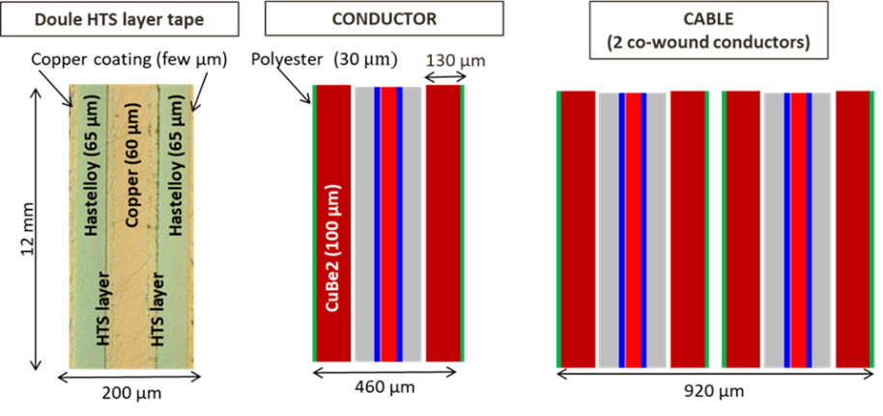
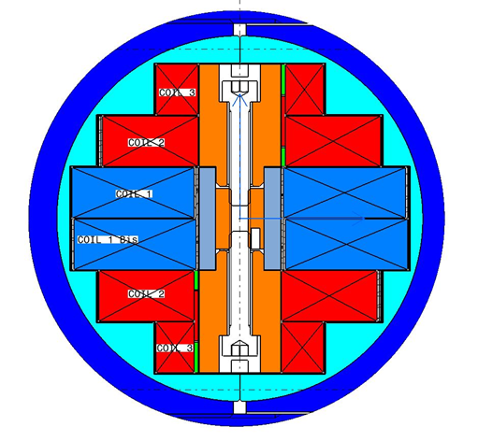


Situation in 2011-12
FP7 EuCARD – WP7
technology R&D 2008-2013
  FRESCA2 dipole
  13 T, ∅ 100 mm facility
  Tested in July 2017: 13 T!
  HTS insert + 6 T (no bore)
  Tested in Juy 2017: 4.52 T @4.2K (power supply limit, no quench)
Forming the EU strategy aiming at 80-100 km VLHC, then FCC.
Dipoles of 15-16 T, ultimate 20T
Noticing the activity in USA (stimulus program, NHMFL/ASC Bi-2212 performance jump)
Decision to use EuCARD2 (2013-2017) to explore accelerator quality HTS.
Application aimed at Bi-2212 Rutherford, but open to consider also YBCO based conductor(s)
Fresca2
EuCARD HTS Insert
Conductor procured by CERN
Magnet designed and manufatcured by CEA

Slide 34


Choice of Supercondutor: REBCO
REBCO | characteristics | Bi-2212
High, steadily improving | Critical current | High, more stagnant
Roebel cable (waste), ready to use, 50-200 m unit length | Cabling and general | Easy Rutherford cable, but need special H.T., very long length possible
Very bad (tape). | Magnetization | Worst than NbSn but manageable
Excellent, better than Nb₃Sn | Mechanical prop. | Weak vs. transv. stress
Difficult bend in non-easy way, joints not easy, good insulation and handling | Coil technology | Very complex HT, large scale coils may be difficult. Easy joints
Various suppliers and projects everywhere | Supply | Limited number

Slide 35


Δ = ± 10%
This corresponds to 800 A/mm2
Test in Tallahasse NHMFL

Slide 36




Conductor characterization at CERN (MSC-SCD)
Elaboration of J_{c}(B,T,θ) scaling for REBCO materials
Magnetization measurements with VSM +/-10.5 T, 1.9-100 K
Residual Resistivity Ratio (RRR) measurements of the copper stabilizer
Splice resistance measurements at 4 K in the field range 0-12 T and at 77 K
  Type 0: Lowest resistance (13-40 nΩ⋅ cm² )
  Type 1: High resistance (98-570 nΩ⋅ cm² )
  Type 2: Very High resistance (150-884 nΩ⋅cm²)
J. Fleiter
Geometrical rules for Roebel; stacking factor important

Slide 37

Measurements of losses in Univ. of Twente (NL) and Univ. of Southampton (UK)
Losses are dominated by the hysteresis of superconductor assemblies in Roebel.
Simple assemblies of isolated tapes are coupled, i.e. as a monolithic conductor, but not quite fully.
The 15 tape Roebel samples with/without epoxy impregnation behave as two in-line coupled stacks, each stack of 7-8 tapes. The saturation fields of the stacks increases linearly with the number of tapes, as expected.
Epoxy impregnated Roebel is less coupled and the strand in transposition seemed uncoupled.

Slide 38



Back to Eucard2 : from tape to cable
A. Kario & W. Goldacker

Slide 39





F_M0.1,2,3,4
StSt dummy ctd101K
test instrumentation tests, electrical short
Test dummy filled resin CTD101G test failed
Fiber optics development for temperature onset detection
HTS , 1st real test coil FeatherM0.4 Bruker tape , KIT cable
G. Kirby, CERN

Slide 40


Low resolution high frequency acquisition
Quench detection
> 1 s
Zoom of the last 50 ms
Protection 10 mV, 20 ms

Slide 41

Soft transition and easy detection: FeatherM0.4 coil
Quench detection
Stability is huge: hundred of Joules to quench
Heater pulse:
I_SH=30 A, U_SH= 40 V, t_pulse= 1.3 s

Slide 42

FeatherM2.1-2
Current sharing
Runaway above 3 mV
Sc until here
Courtesy H.Bajas, CERN

Slide 43


Slide 44


Slide 45


Slide 46



Not so easy but almost ready to wind (Nov 2018)
Courtesy of C. Lorin

Slide 47



Stacked cable based magnet design (Grenoble)
Mechanics at the ends is difficult but probably manageable….
To avoid huge redistribuition: partial insulated tape inside the cable
But very high Filling factor easy cable to do, no waste…
P. Tixador, A. Badel & J. Himbele

