Slide 1










The Japanese HTS (High Field Magnet) programs for accelerators
T. Ogitsu, M. Sugano, T. Nakamoto, K. Suzuki, M. Iio, M. Dhakarwal; KEK,
N. Amemiya, Y. Sogabe, X. Luo; Kyoto U.
T. Shen, X. Wang, L.G. Fajardo, C. Myers; LBNL, C. Reis; UC Berkeley,
R. Gupta, P. Joshi, J. Schmalzle, G. Jochen, S. Joshi; BNL
S. Awaji; Tohoku Univ., H. Oguro; Tokai Univ., N. Banno; NIMS
A. Ballarino, S. Hopkins; CERN, D. Larbalestier; NHMFL, G.Velev, X. Xu; FNAL
S. Kawashima, T. Kawarada, Y. Murakami, K. Saito; Kobe Steel and JASTEC
Asami, H. Ii, H. Sakamoto, T. Kato; Furukawa Electric

Slide 2
R&D for High Field Magnet for Accelerator in Japan
Based on international collaboration
  HTS: US-Japan collaboration framework
    KEK, Kyoto U., LBNL, BNL, UC Berkeley
  Nb3Sn: CERN-KEK collaboration
    KEK, Tohoku U., Tokai U., NIMS, JASTEC, Furukawa, CERN, NHFML, FNAL

Slide 3
R&D for High Field Magnet for Accelerator in Japan
Based on international collaboration
  HTS: US-Japan collaboration framework
    KEK, Kyoto U., LBNL, BNL, UC Berkeley
  Nb3Sn: CERN-KEK collaboration
    KEK, Tohoku U., Tokai U., NIMS, JASTEC, Furukawa, CERN, NHFML, FNAL

Slide 4

Kyoto Univ.
Graduate School of Engineering Department of Electrical Engineering
Advanced Technologies on
AC-Loss and Field Quality Analysis on HTS magnets
UC Berkeley
Dept of Nuclear Engineering
Experimental material science for nuclear applications
Advanced
HTS Magnet
Technologies
for
Future
Accelerator
Sciences
BNL
Member of US-MDP
Developing Various HTS Magnets
Advanced Technologies for
HTS Magnet
LBNL
Member of US-MDP
Developing 20 T HTS Accelerator Magnets
Advanced Technologies for
High Field Accelerator Magnet
KEK
Developing HTS Magnets for High Radiation Environments
Advanced Technologies for HTS Magnet with Radiation Hardness
US-Japan
Framework

Slide 5
Task and Target
Task1: HTS magnet technologies for high-radiation environment
  Gamma ray irradiation to organic materials
  Neutron irradiation at the IMR Oarai and preform Ic test.
  Microscopic analysis of irradiation damage.
Task 2: Stability, quench protection, and magnet safety
Quench experiments of various spiral conductors.
Task 3: Measuring and modeling AC loss and field quality of HTS accelerator magnets
  Analyses of mechanical effect of shielding current, and CCT wound with CORC wires.
Field measurement of various HTS magnets.
Task 4: HTS/LTS high field hybrid accelerator dipole technology
Non-organic insulation technology R&D for HTS and Nb₃Sn conductor.
Develop rad-hard racetrack coils that can be tested at BNL 10T test stand.
Prepare test stand, complete quench protection system design. Device a detailed test program including magnetization measurement.
FCC Interaction Region Magnets
Muon Collider Production Solenoid
J-PARC 2nd Target

Slide 6
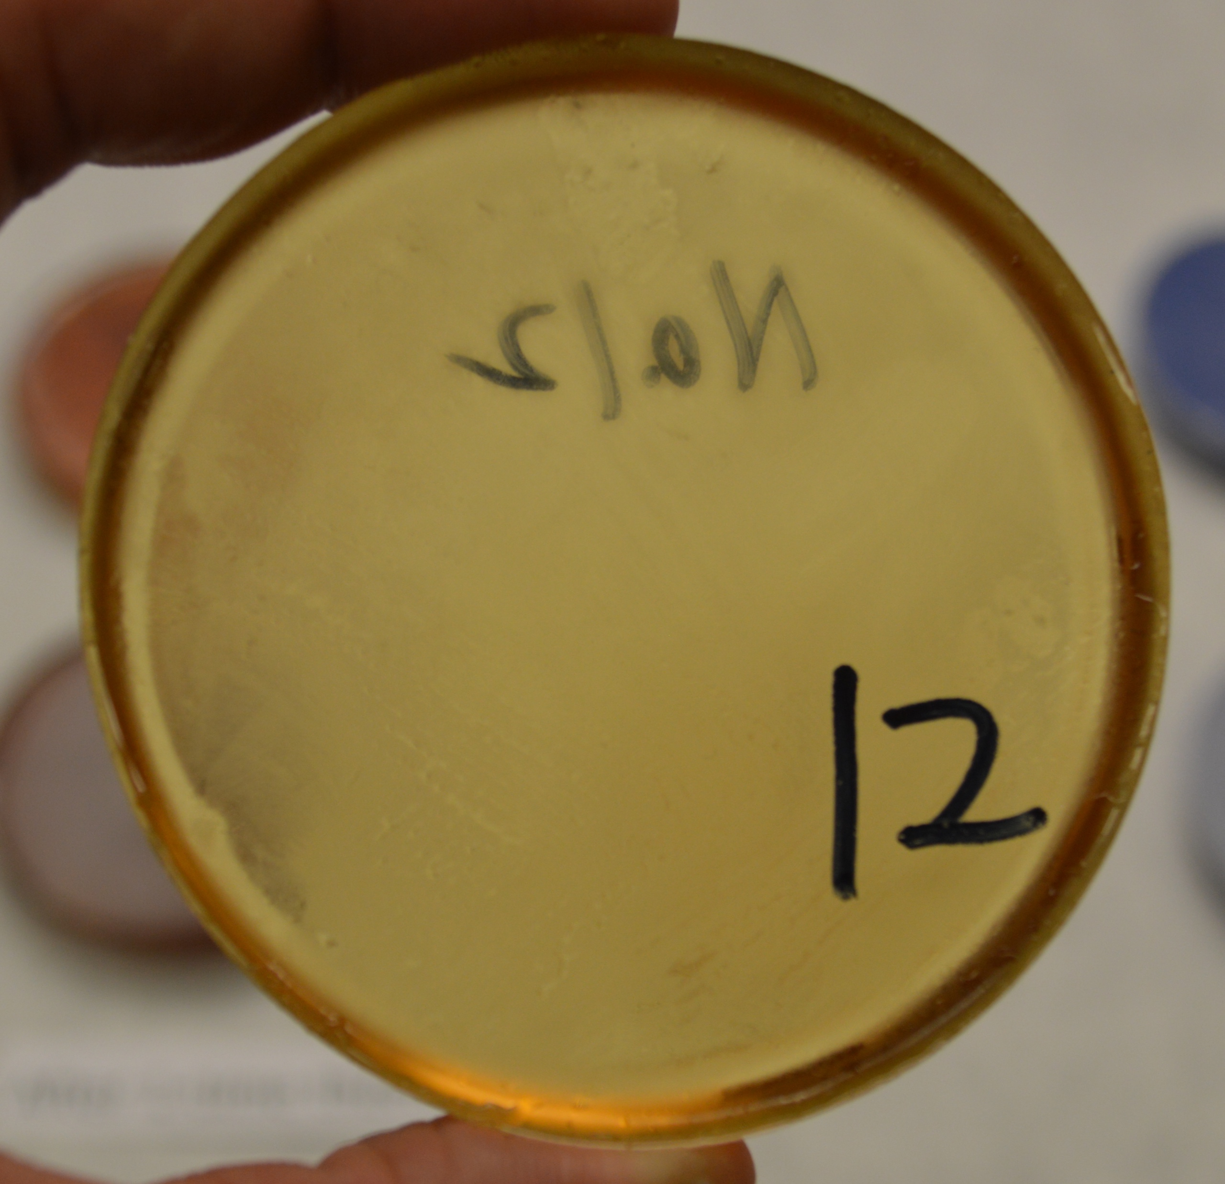
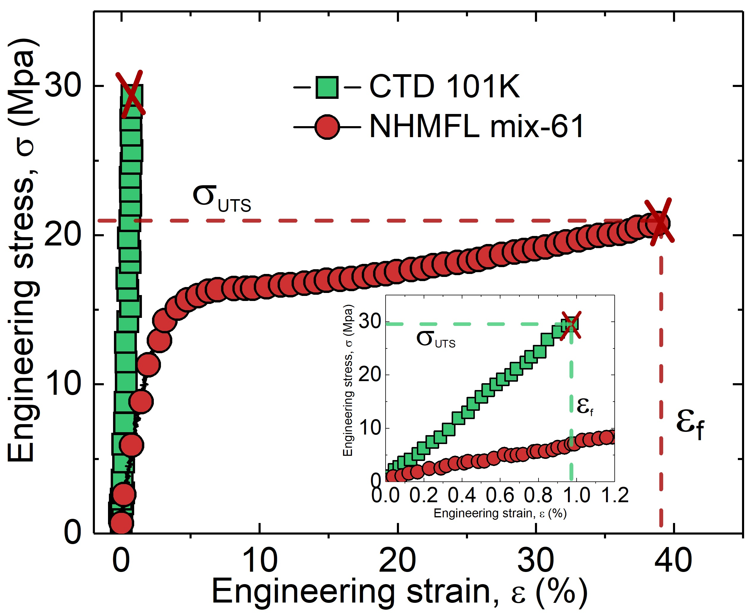
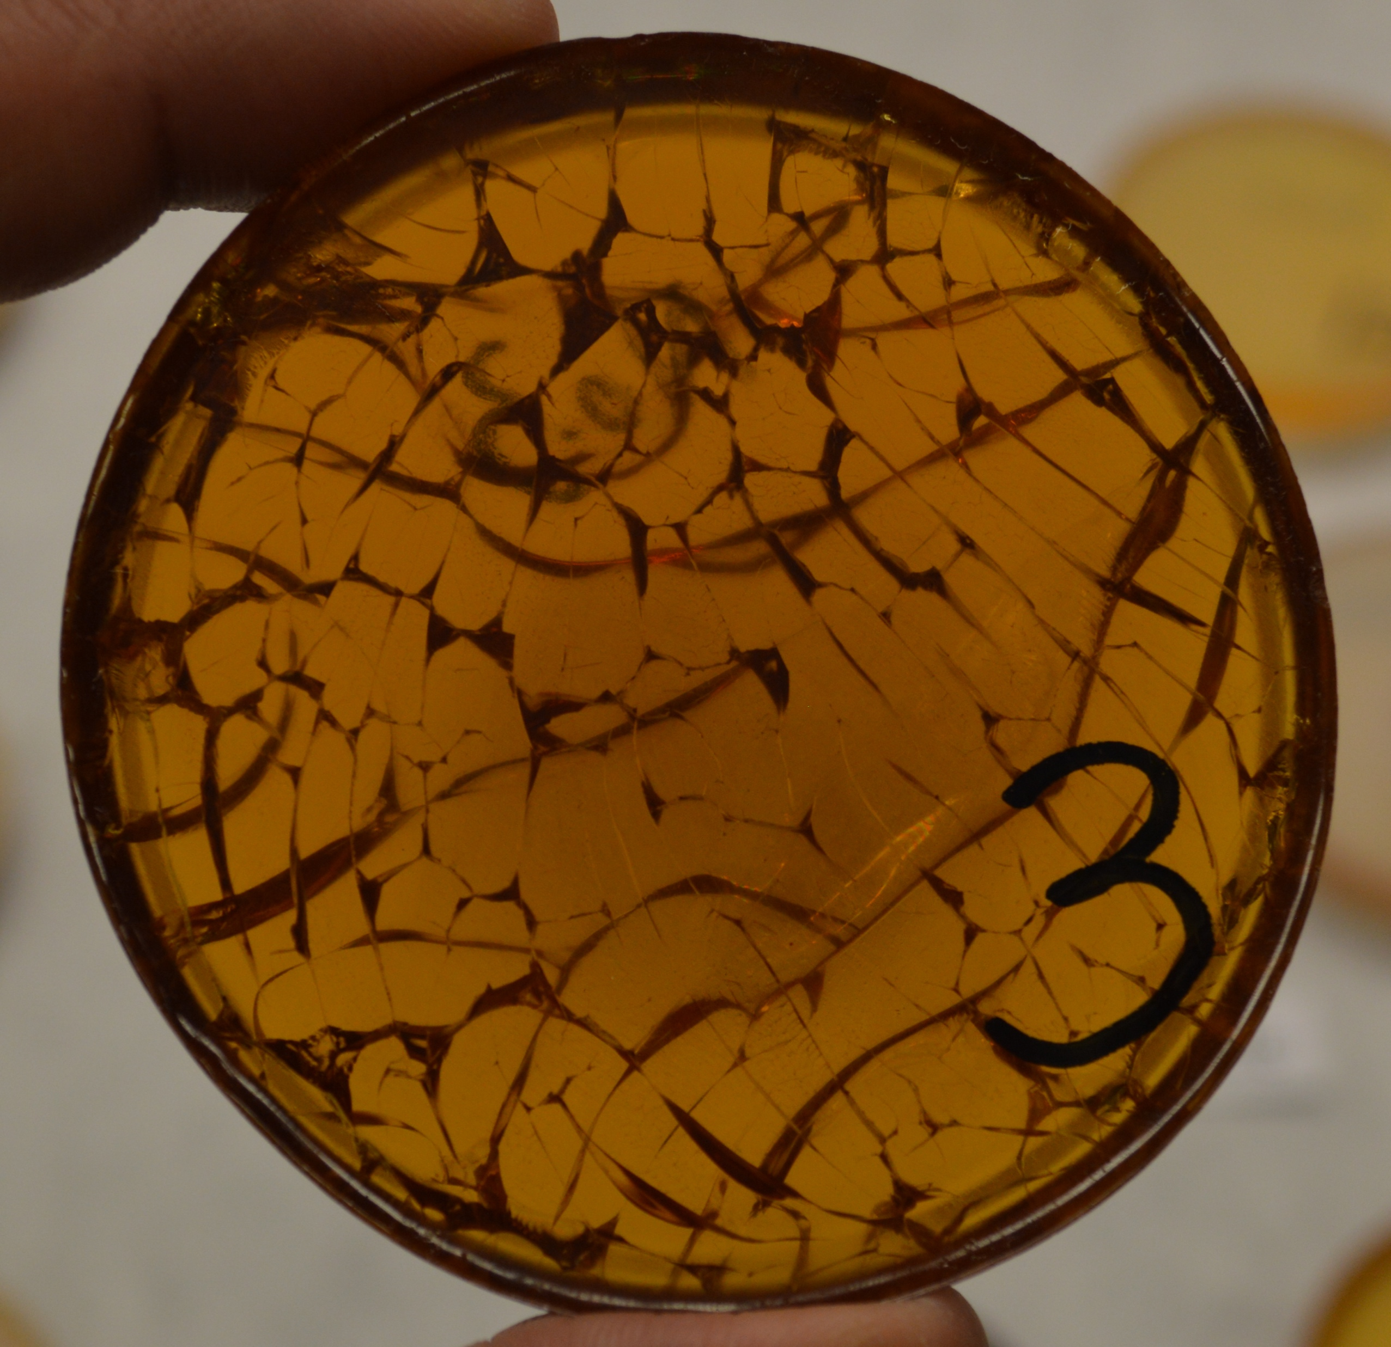
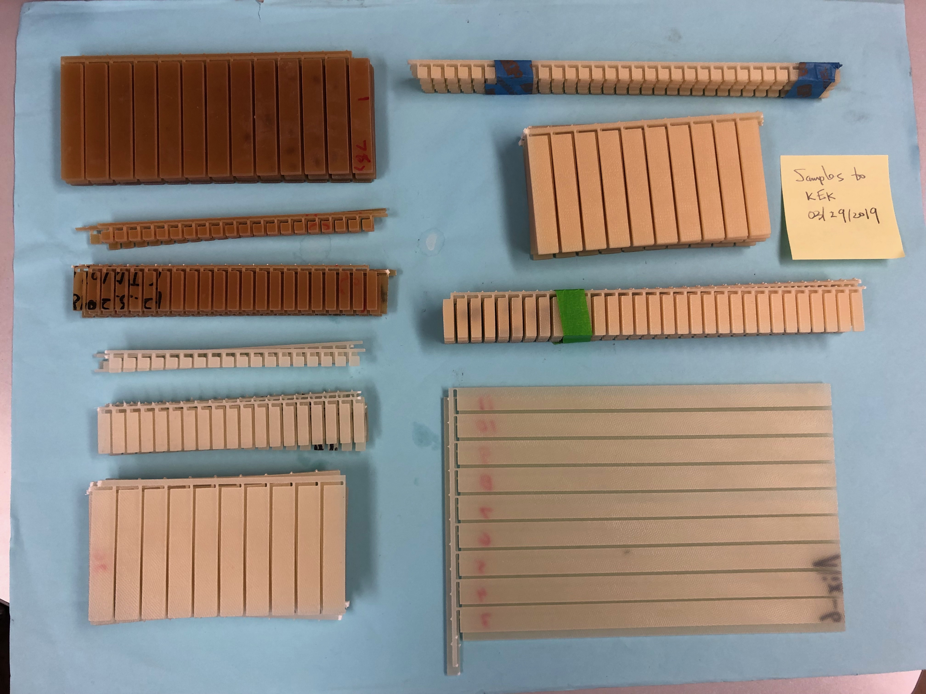
Task 1: Irradiation of a novel epoxy developed at QST gamma-ray facility (KEK + LBNL)
CTD-101 k, used by US LARP, after one thermal cycle to 77 K
NHMFL-mix61, an amine-based epoxy after one thermal cycle to 77 K
RT tensile test
Extensive cracks
No crack
25 MGy, 50 MGy, 100 MGy irradiated
  Samples shipped to LBNL.
  Mechanical tests pending.
Yin, Shen et al., IEEE Trans. Appl. Supercond., 2019
CTD 101K
ATLAS ECT
NHMFL mix61

Slide 7
Current status of neutron irradiation
Task 1 Neutron irradiation to HTS conductors
PIE of GdBCO samples with neutron flux of 1.80, 2.58x10²² n/m²
Neutron irradiation effect on Tc
*influence of Cd foil for SuperPower SCS4050
D. X. Fischer, et al., Supercond. Sci. Technol. 31 (2018) 044006
No significant degradation in shielded HTS tape at 0.6 x 10²² n/m².
But, reduction of Tc by 5 K in unshielded sample.
Vanishment of superconductivity is confirmed
X-ray diffraction patterns of the unirradiated GdBCO tape as a preliminary study.
Further study
PIE of GdBCO samples of target fluence 1x10²¹, 5x10²¹ n/m²
Fast neutron irradiation by shielding of samples with Cd foil
Irradiation of EuBCO samples to confirm the contribution of Gd
Materials analysis of irradiated samples by X-ray diffraction

Slide 8
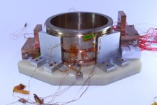
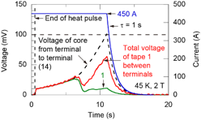

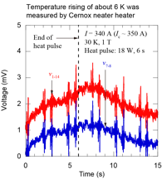

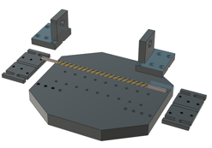
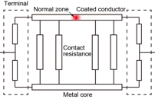
Task 2: Quench experiments of CORC and other spiral conductors
Quench experiments using CORC samples provided by LBL
Quench experiments using
short “home-made” spiral samples
Normal voltage appeared but not quenched
Copper core looks helping protection.
As of January 27, 2021

Slide 9
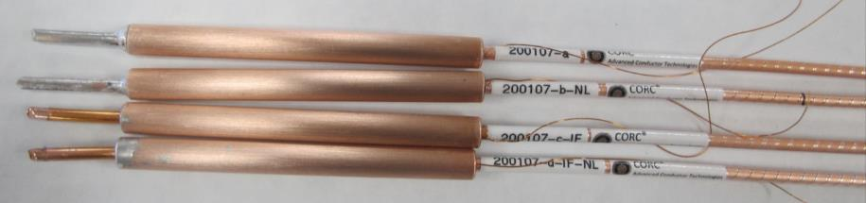
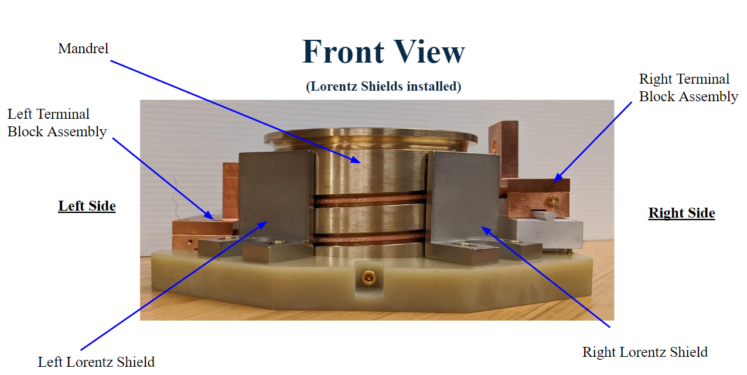
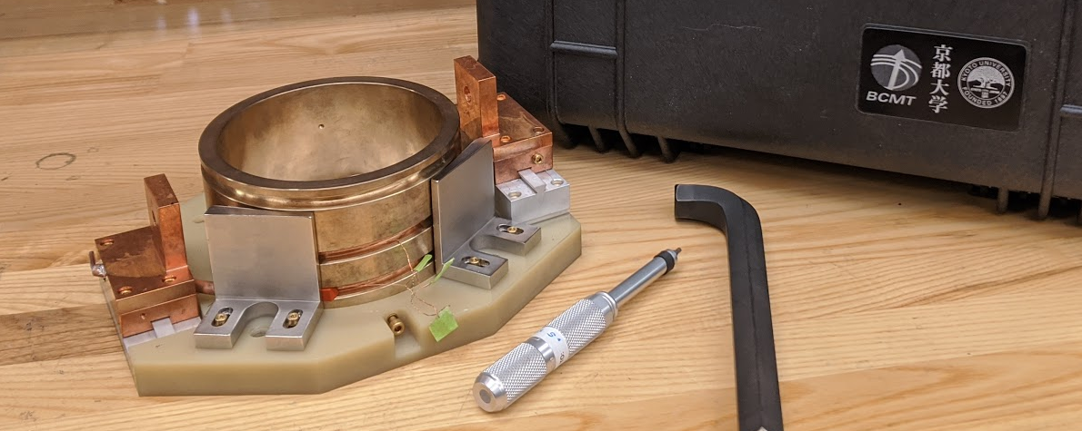
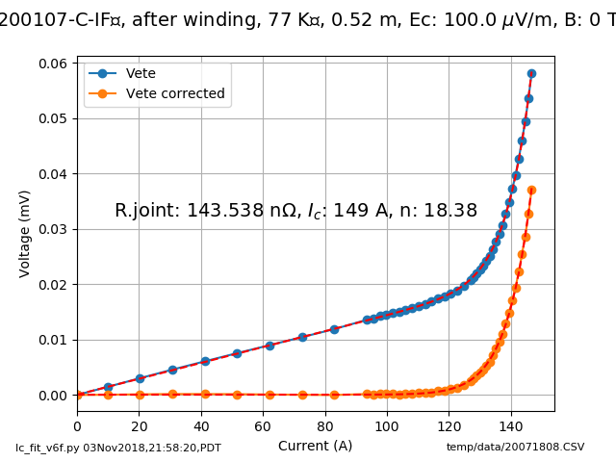
Task 2. Stability and quench protection of HTS magnets – LBNL delivered samples and sample holder for quench experiment at Kyoto Uni.
The multi-REBCO-tape CORC® wire is promising for HEP magnet applications
The collaboration under US-Japan will enable us to fully understand the stability and quench behavior of CORC® wires in conditions relevant for applications
Samples provided by Advanced Conductor Technologies
The multi-REBCO-tape CORC® wire is promising for HEP magnet applications
The collaboration under US-Japan will enable us to fully understand the stability and quench behavior of CORC® wires in conditions relevant for applications
I_{c} 149 A at 1 µV/cm criterion, 91% of expected I_{c}
After multiple times of winding and unwinding during the development of sample holder
Reproducible VI transition

Slide 10
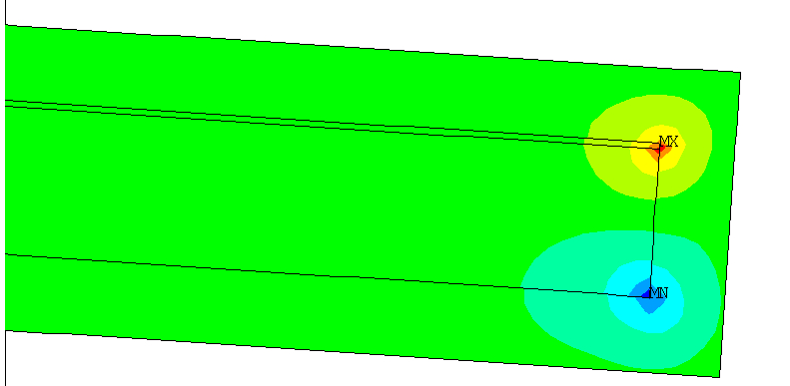
Task 2. Stability and quench protection of HTS magnets: LBNL developed a method to minimize damages during a quench of REBCO tapes
Ag + REBCO
Cu
C276
4 K to 300 K,
shear stress >23 MPa
Removal of damages using a simple and scalable method.
Delamination by thermal stress.
Methods to determine peeling and shear stress during a quench established. Simple analytical model also cross-checked with FEM models.

Slide 11
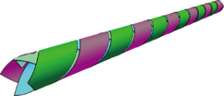
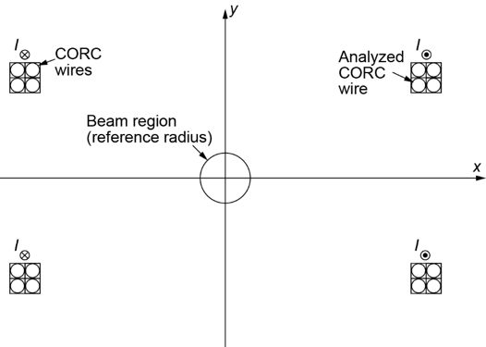
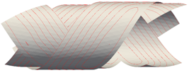
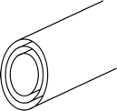
Task 3: Simple calculation and analyses of field quality of CORC magnets
Simple field calculation
(quasi-3D model for RTC)
Calculated current distribution
A simple calculation method was developed in order to
evaluate influence of CORC wires’ geometry and
shielding currents on field distribution along z-axis.
Coaxial three layers with
uniform current distribution
As of January 27, 2021

Slide 12
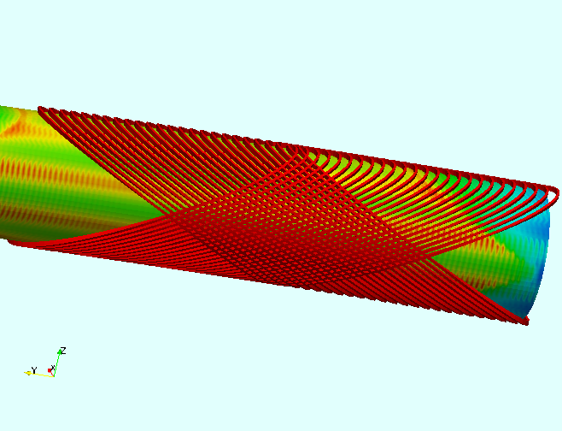
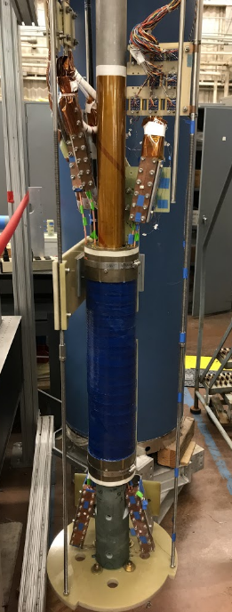
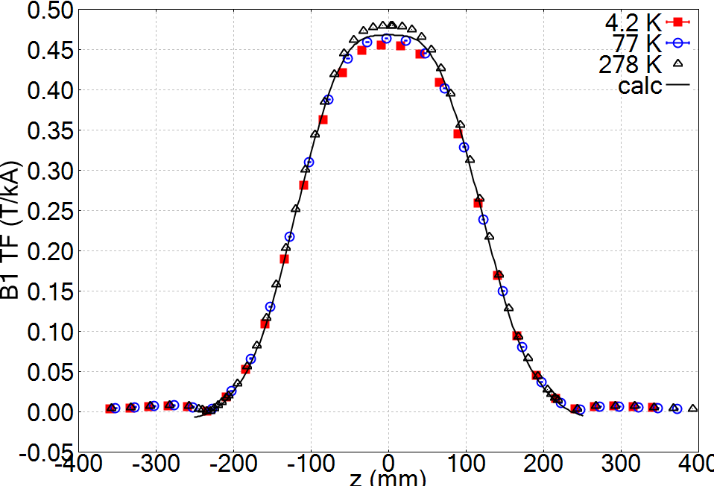
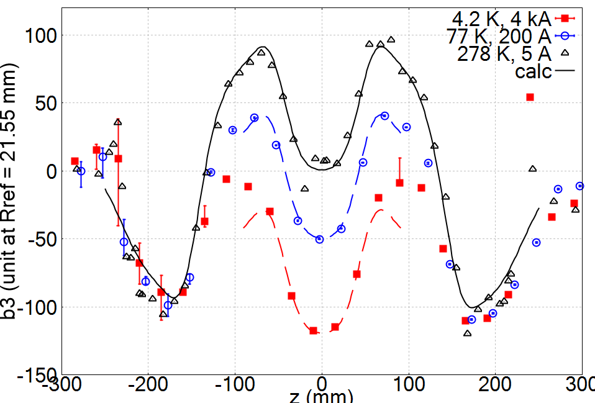
Task 3. Field quality of LBNL C2 magnet based on a new round REBCO CORC wire (65 mm aperture, 2.9 T dipole field at 4 K) accessed at LBNL and provided to Kyoto University for analysis.
Dipole field
current
The 65 mm-aperture C2 magnet generated a dipole field of 2.9 T at 4.2 K, providing the unique opportunity to measure and understand the field quality of a REBCO dipole magnet using CORC® wires
Measurements agree with the calculation for the dipole field
Strong magnetization effects in b₃ – too large due to the high J_{c} and tape width
C2
magnet

Slide 13
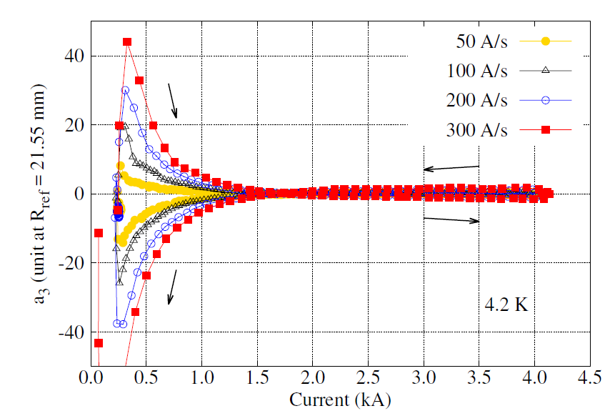
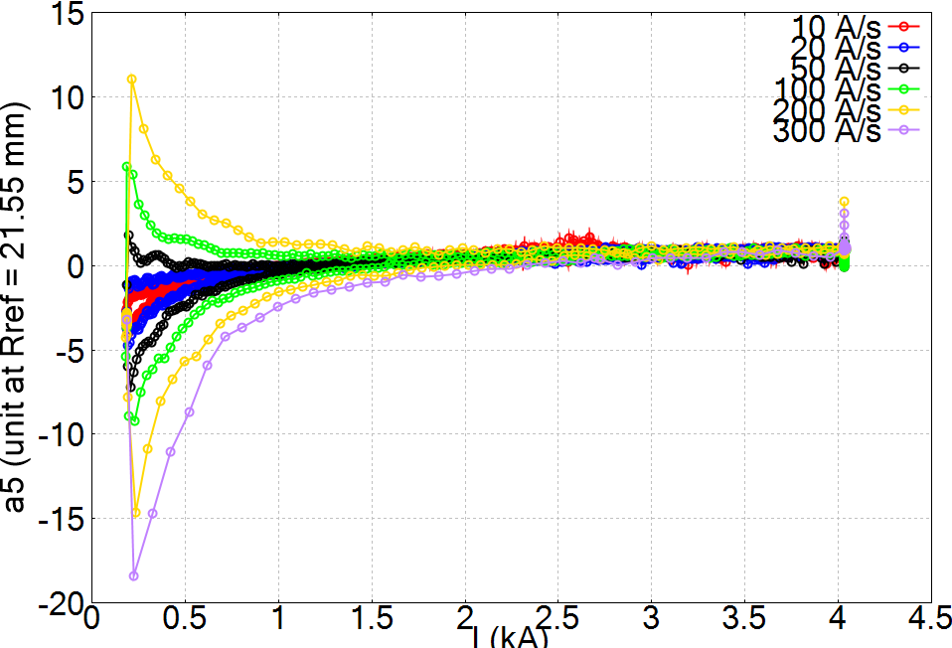
Task 3. Field quality of LBNL C2 magnet. A ramp-rate dependence was observed in non-allowed skew terms. A similar behavior was seen in C1 with the plastic printed mandrel
C2 (aperture 65 mm)
on aluminum bronze mandrel
C1 (aperture – 70 mm) on
bluestone mandrel
Xiaorong Wang et al 2021 Supercond. Sci. Technol. 34 015012
Xiaorong Wang et al 2019 Supercond. Sci. Technol. 32 075002
3.8 mm diameter CORC wire that contains
30 REBCO tapes in 12 layers.
3.1 mm diameter CORC wire that contains
16 REBCO tapes in 8 layers.
C2 before
assembly
C1 before assembly

Slide 14
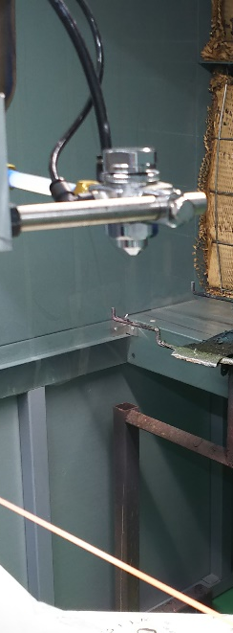
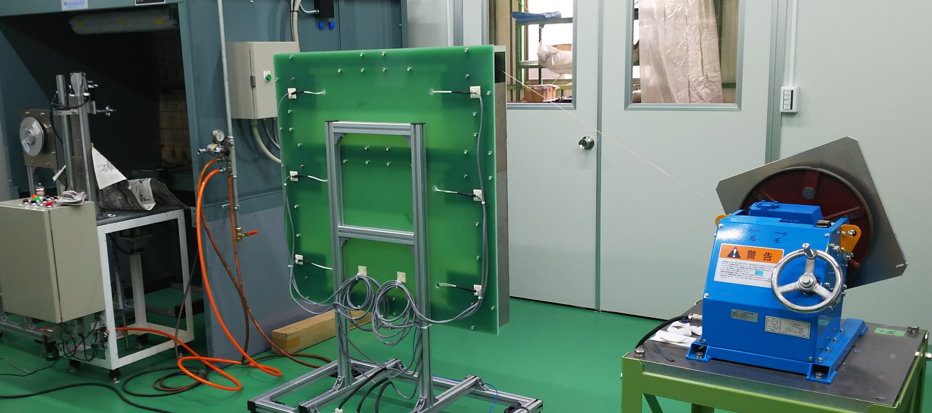
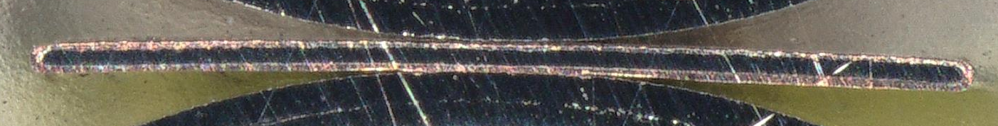
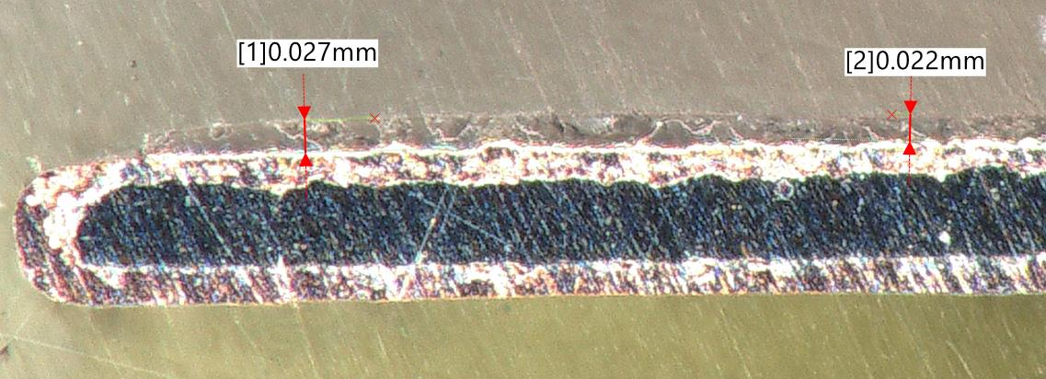
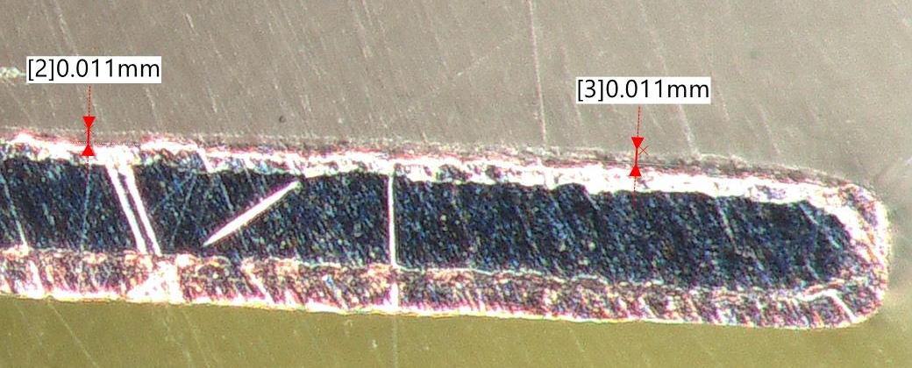
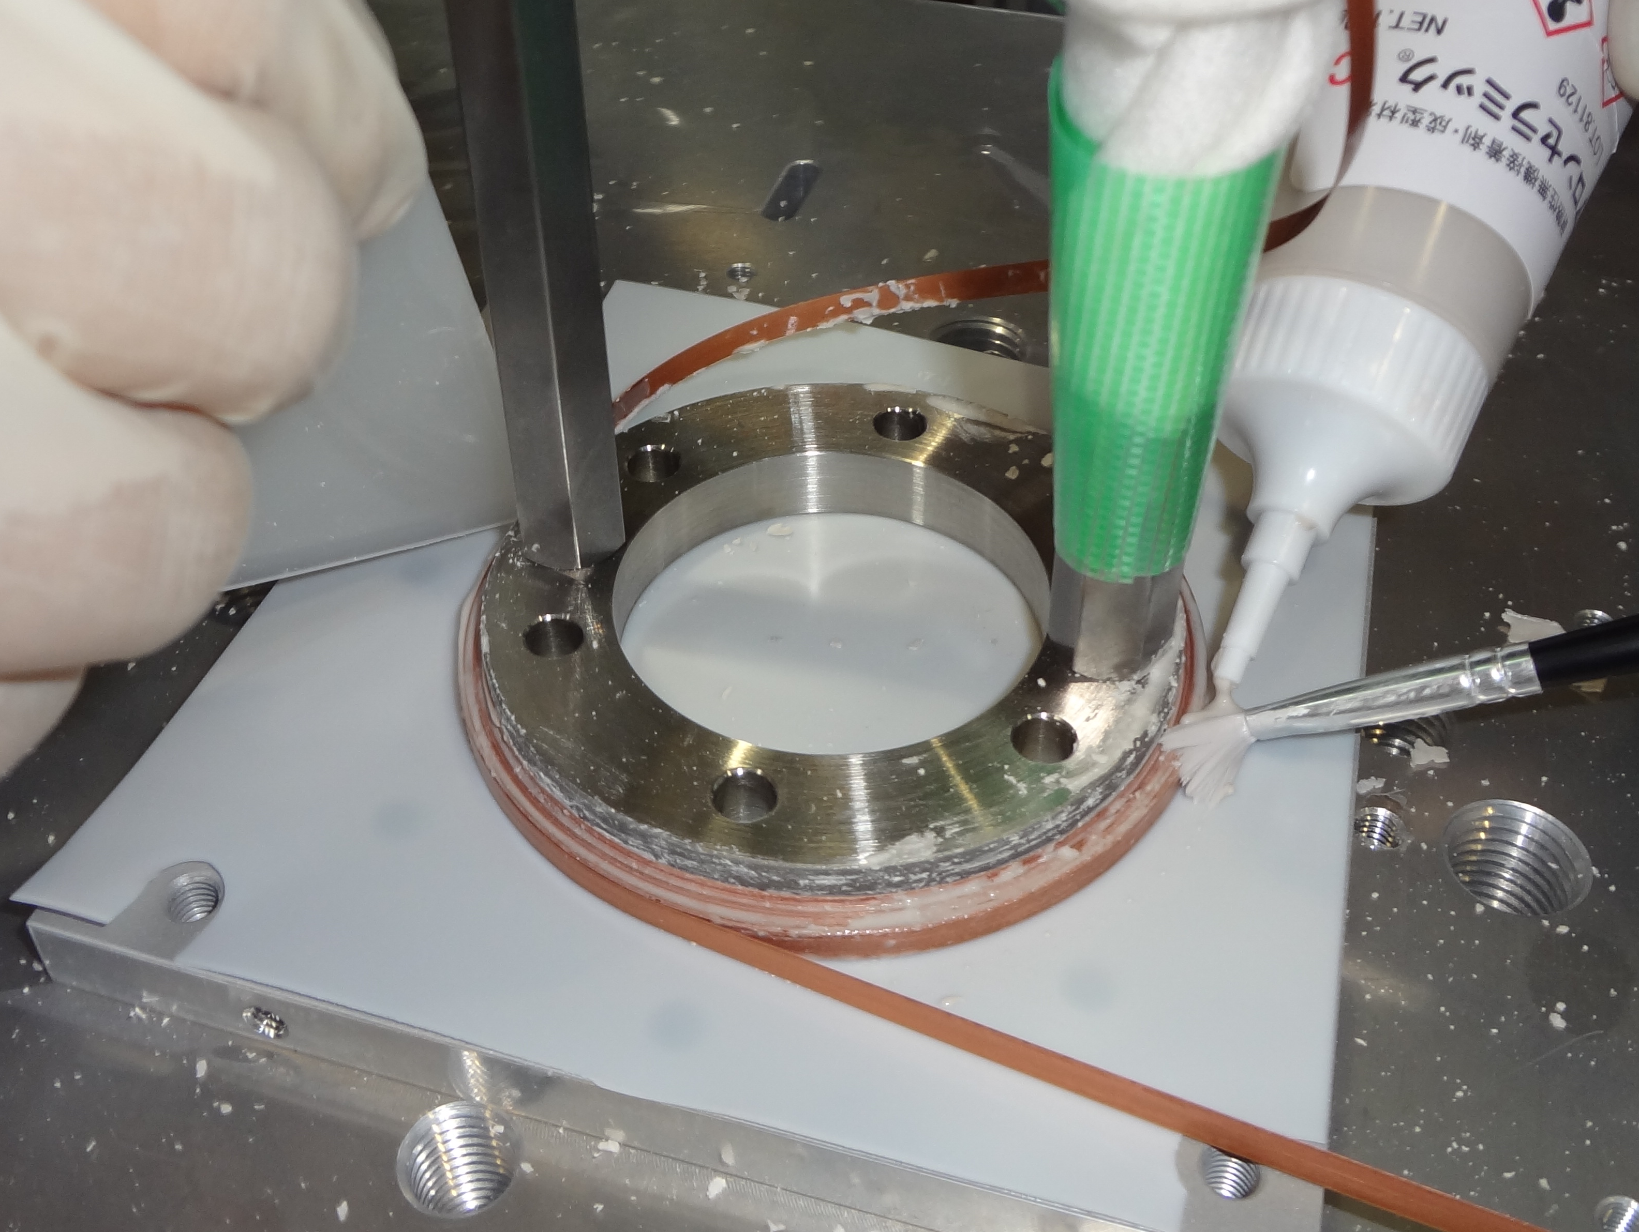
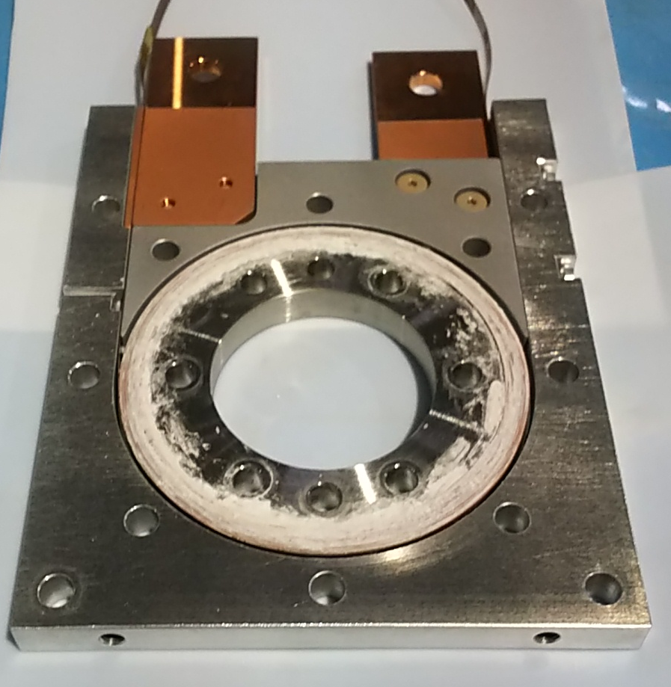
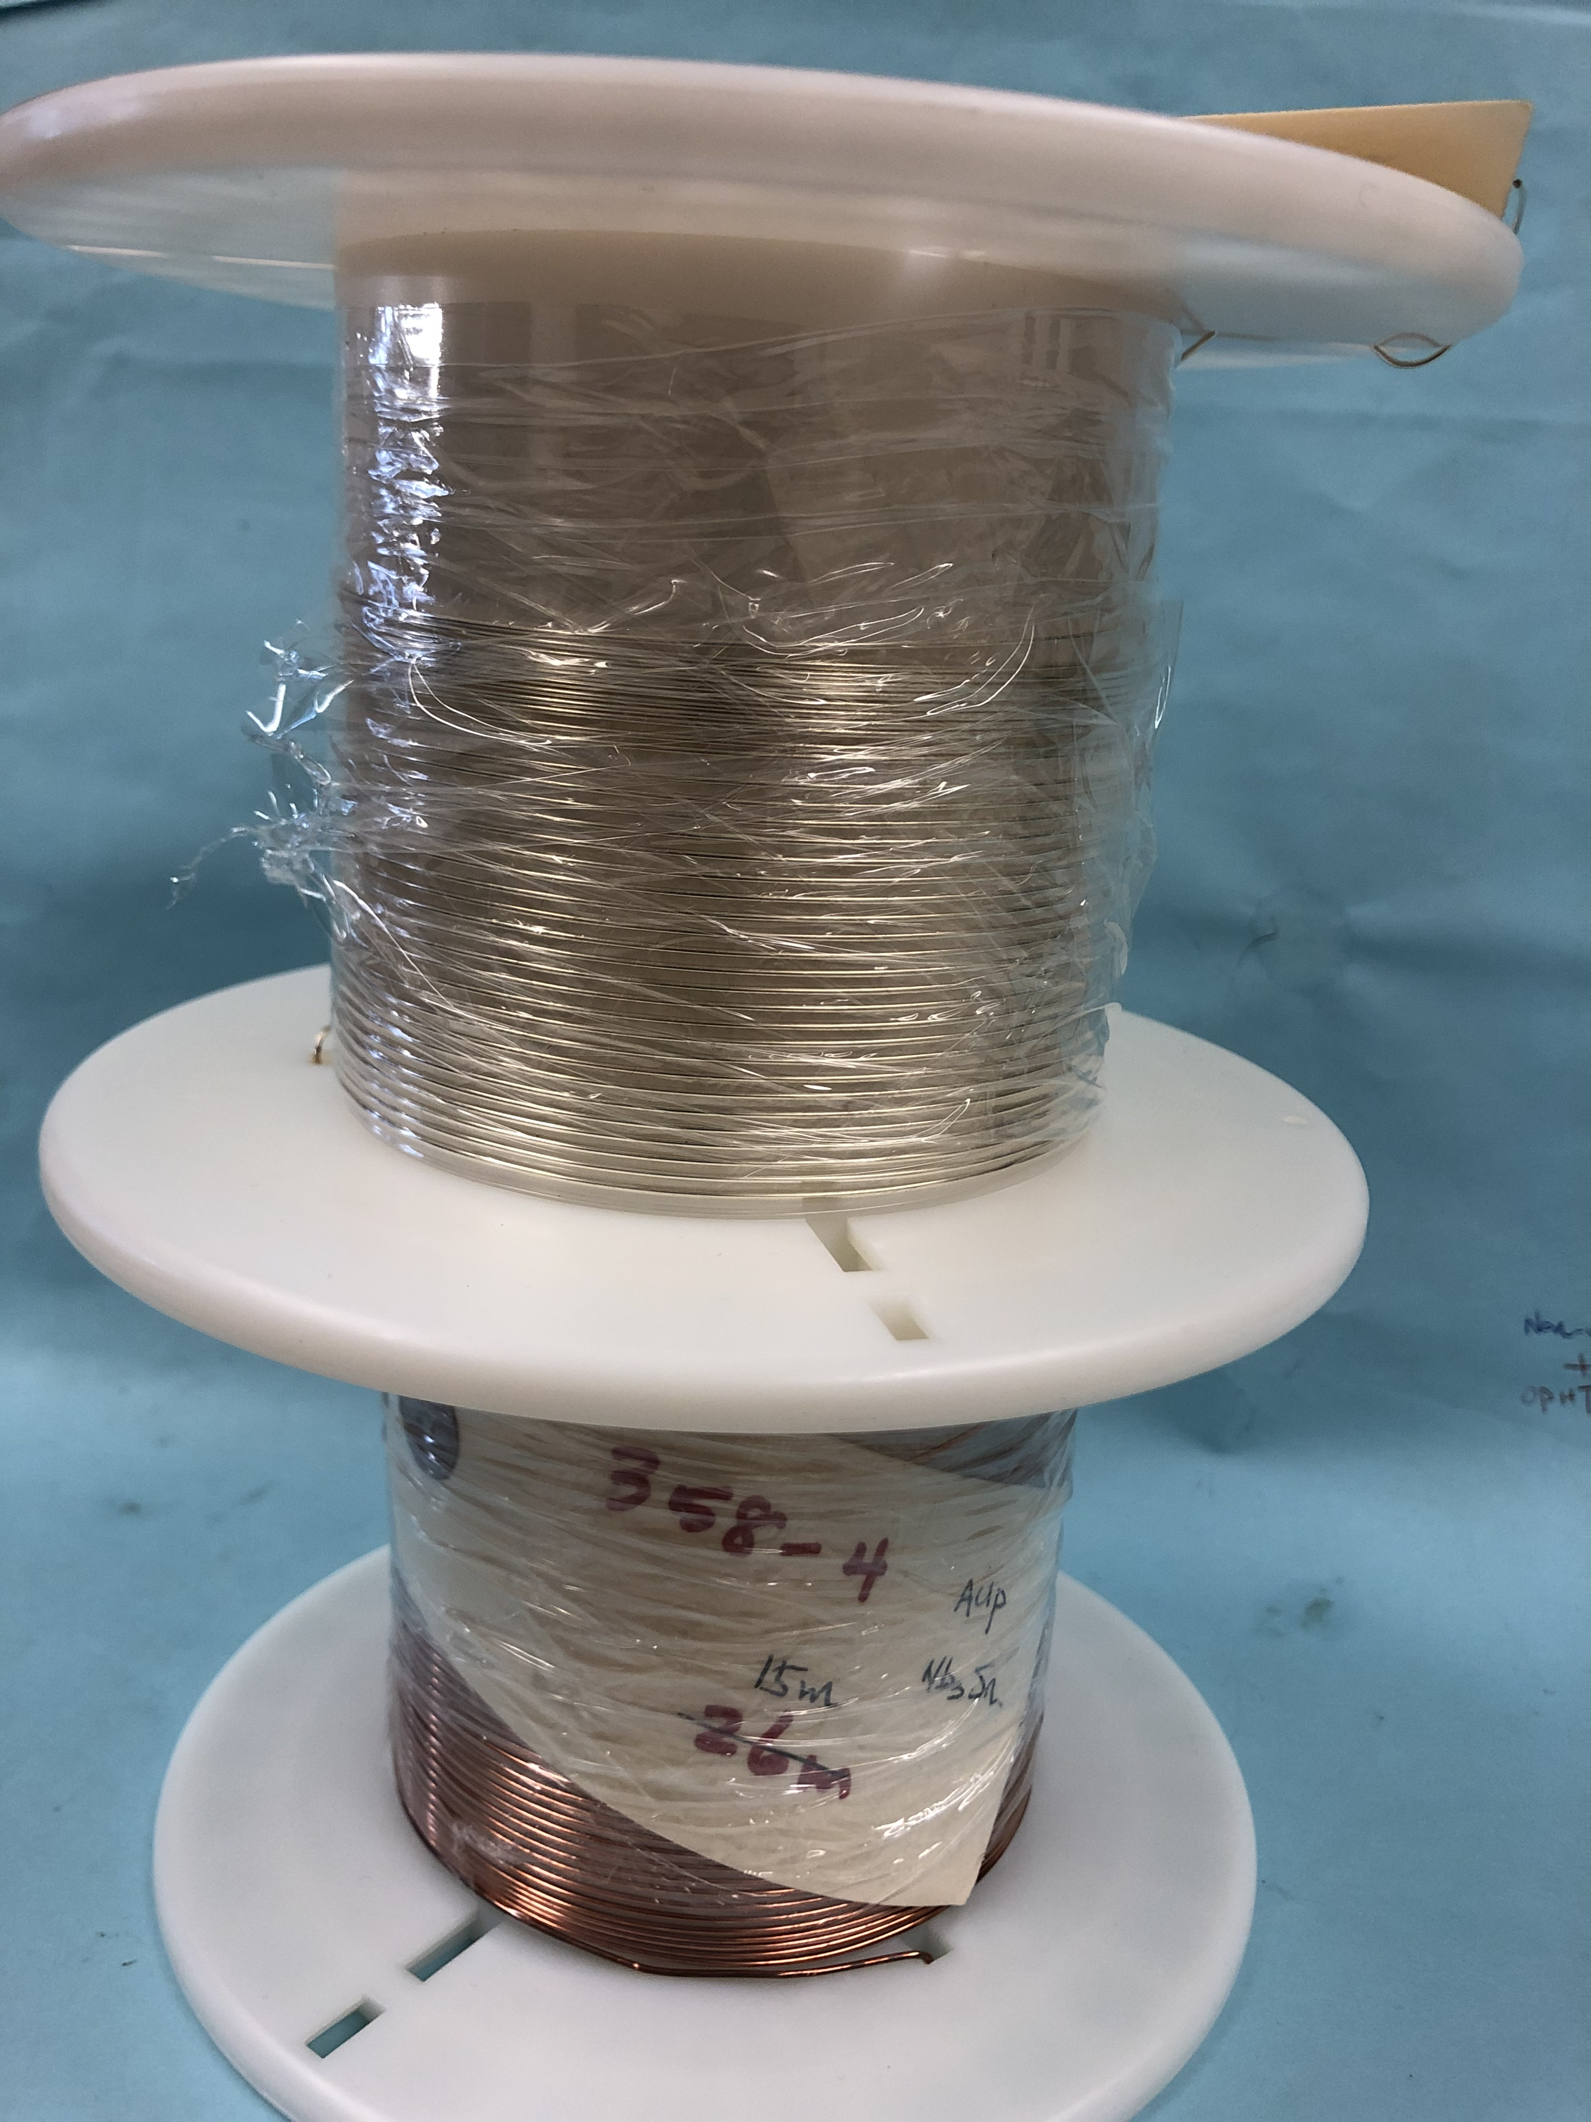
Task 4 Inorganic Insulation HTS coil
R&D of continuous coating on long tapes by real to real insulation machine is in progress.
Although continuous coating is successful, difference in thickness of ~16 μm in the width direction is confirmed.
Preparing the winding of the circular test coil #2 with co-winding 2 REBCO and Cu tape
(same shape as Test coil #1)
Coated Layer
Cu-Stabilizer
Substrate
Superconductor
Cu-Stabilizer
REBCO #1
Cu tape (t=0.1mm)
Cu-Stabilizer
Superconductor
Substrate
Cu-Stabilizer
Coated Layer
REBCO #2
  Wires identified and shipped from LBNL to KEK for testing KEK’s new ceramic coating insulation on Nb₃Sn and Bi-2212 wires.

Slide 15
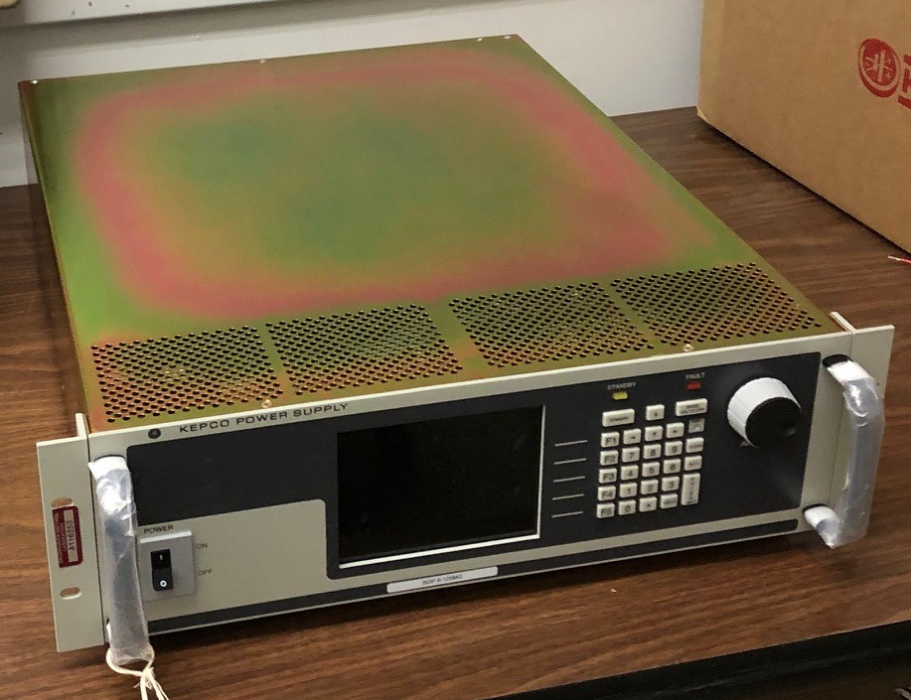
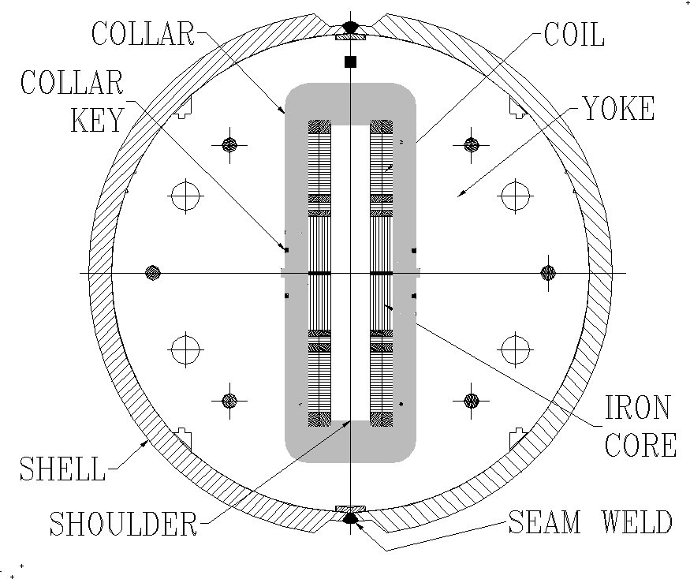
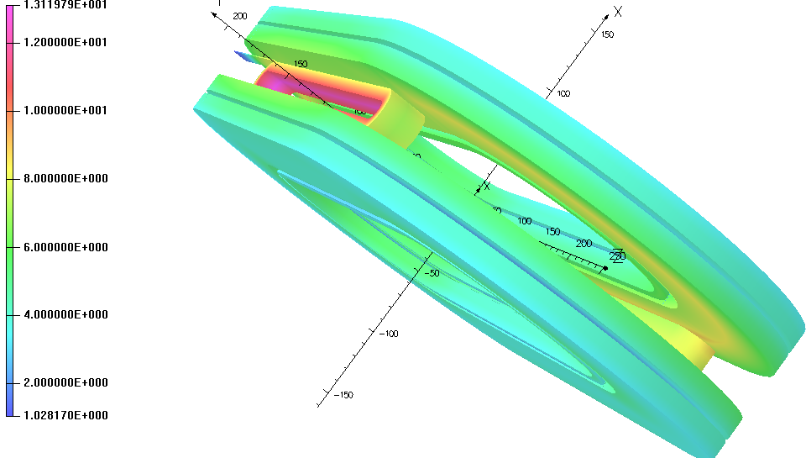
Task 4. High Field Test with Common Coil Configuration @BNL
R&D on High Field Accelerator Dipole
(Highest Field and Field Quality Studies)
Power Supply Acquired
Design study in progress
30
31
30
323.2
R5.5
Background
field :~10 T
335
Two tests in one go:
Two HTS insert coils in two apertures of the common coil dipole:
Upper Bore: field primarily parallel
Lower bore: field primarily perpendicular

Slide 16
Achievement so far
Task1: HTS magnet technologies for high-radiation environment
Gamma ray irradiation at QST Takasaki up to 100 MGy: DONE, preparing for mechanical testing.
Initial PIE performed, For GdBCO complete degradation confirmed with 1.8x10²² n/m².
X-ray diffraction study on non-irradiated GdBCO, prepare for irradiated GdBCO
Task 2: Stability, quench protection, and magnet safety
Initial quench experiments using CORC sample and short spiral sample.
Task 3: Measuring and modeling AC loss and field quality of HTS accelerator magnets
Development of calculation method to evaluate field quality of CORC magnets.
  Field measurement of C1 and C2 including ramp rate dependence.
Task 4: HTS/LTS high field hybrid accelerator dipole technology
R&D of continuous coating on long tapes by real to real insulation machine is in progress.
Testing inorganic insulation with Nb3Sn and Bi-2212 conductors is in progress.
Design study of racetrack coil in progress.
Preparing test stand, acquired power supply.

Slide 17
R&D for High Field Magnet for Accelerator in Japan
Based on international collaboration
  HTS: US-Japan collaboration framework
    KEK, Kyoto U., LBNL, BNL, UC Berkeley
  Nb3Sn: CERN-KEK collaboration
    KEK, Tohoku U., Tokai U., NIMS, JASTEC, Furukawa, CERN, NHFML, FNAL

Slide 18

Conductor Development Programme
The programme now includes 10 active partners and 3 new agreements awaiting signature
First workshop held 5-6 March 2018 at CERN
MOU btw KEK and CERN

Slide 19
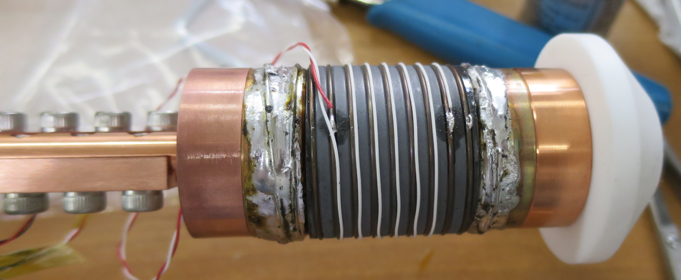
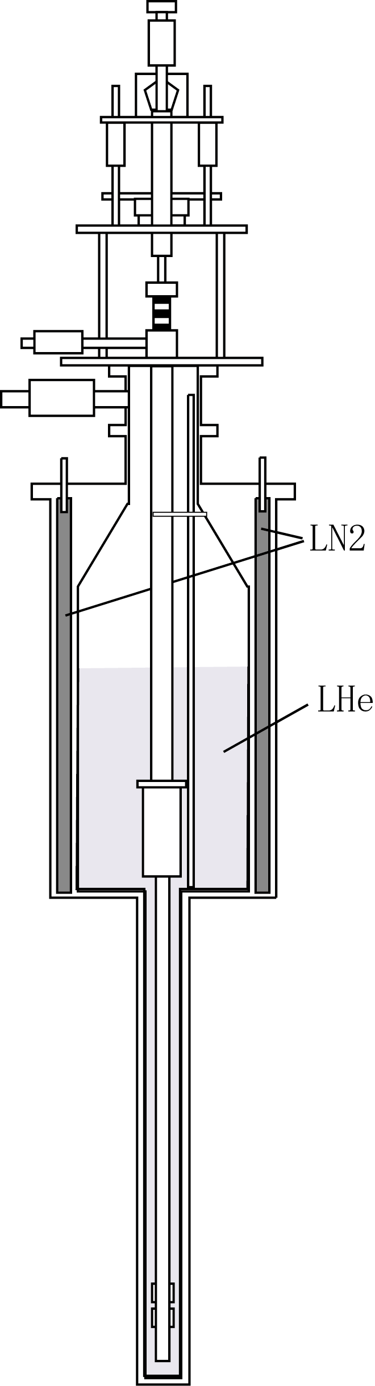
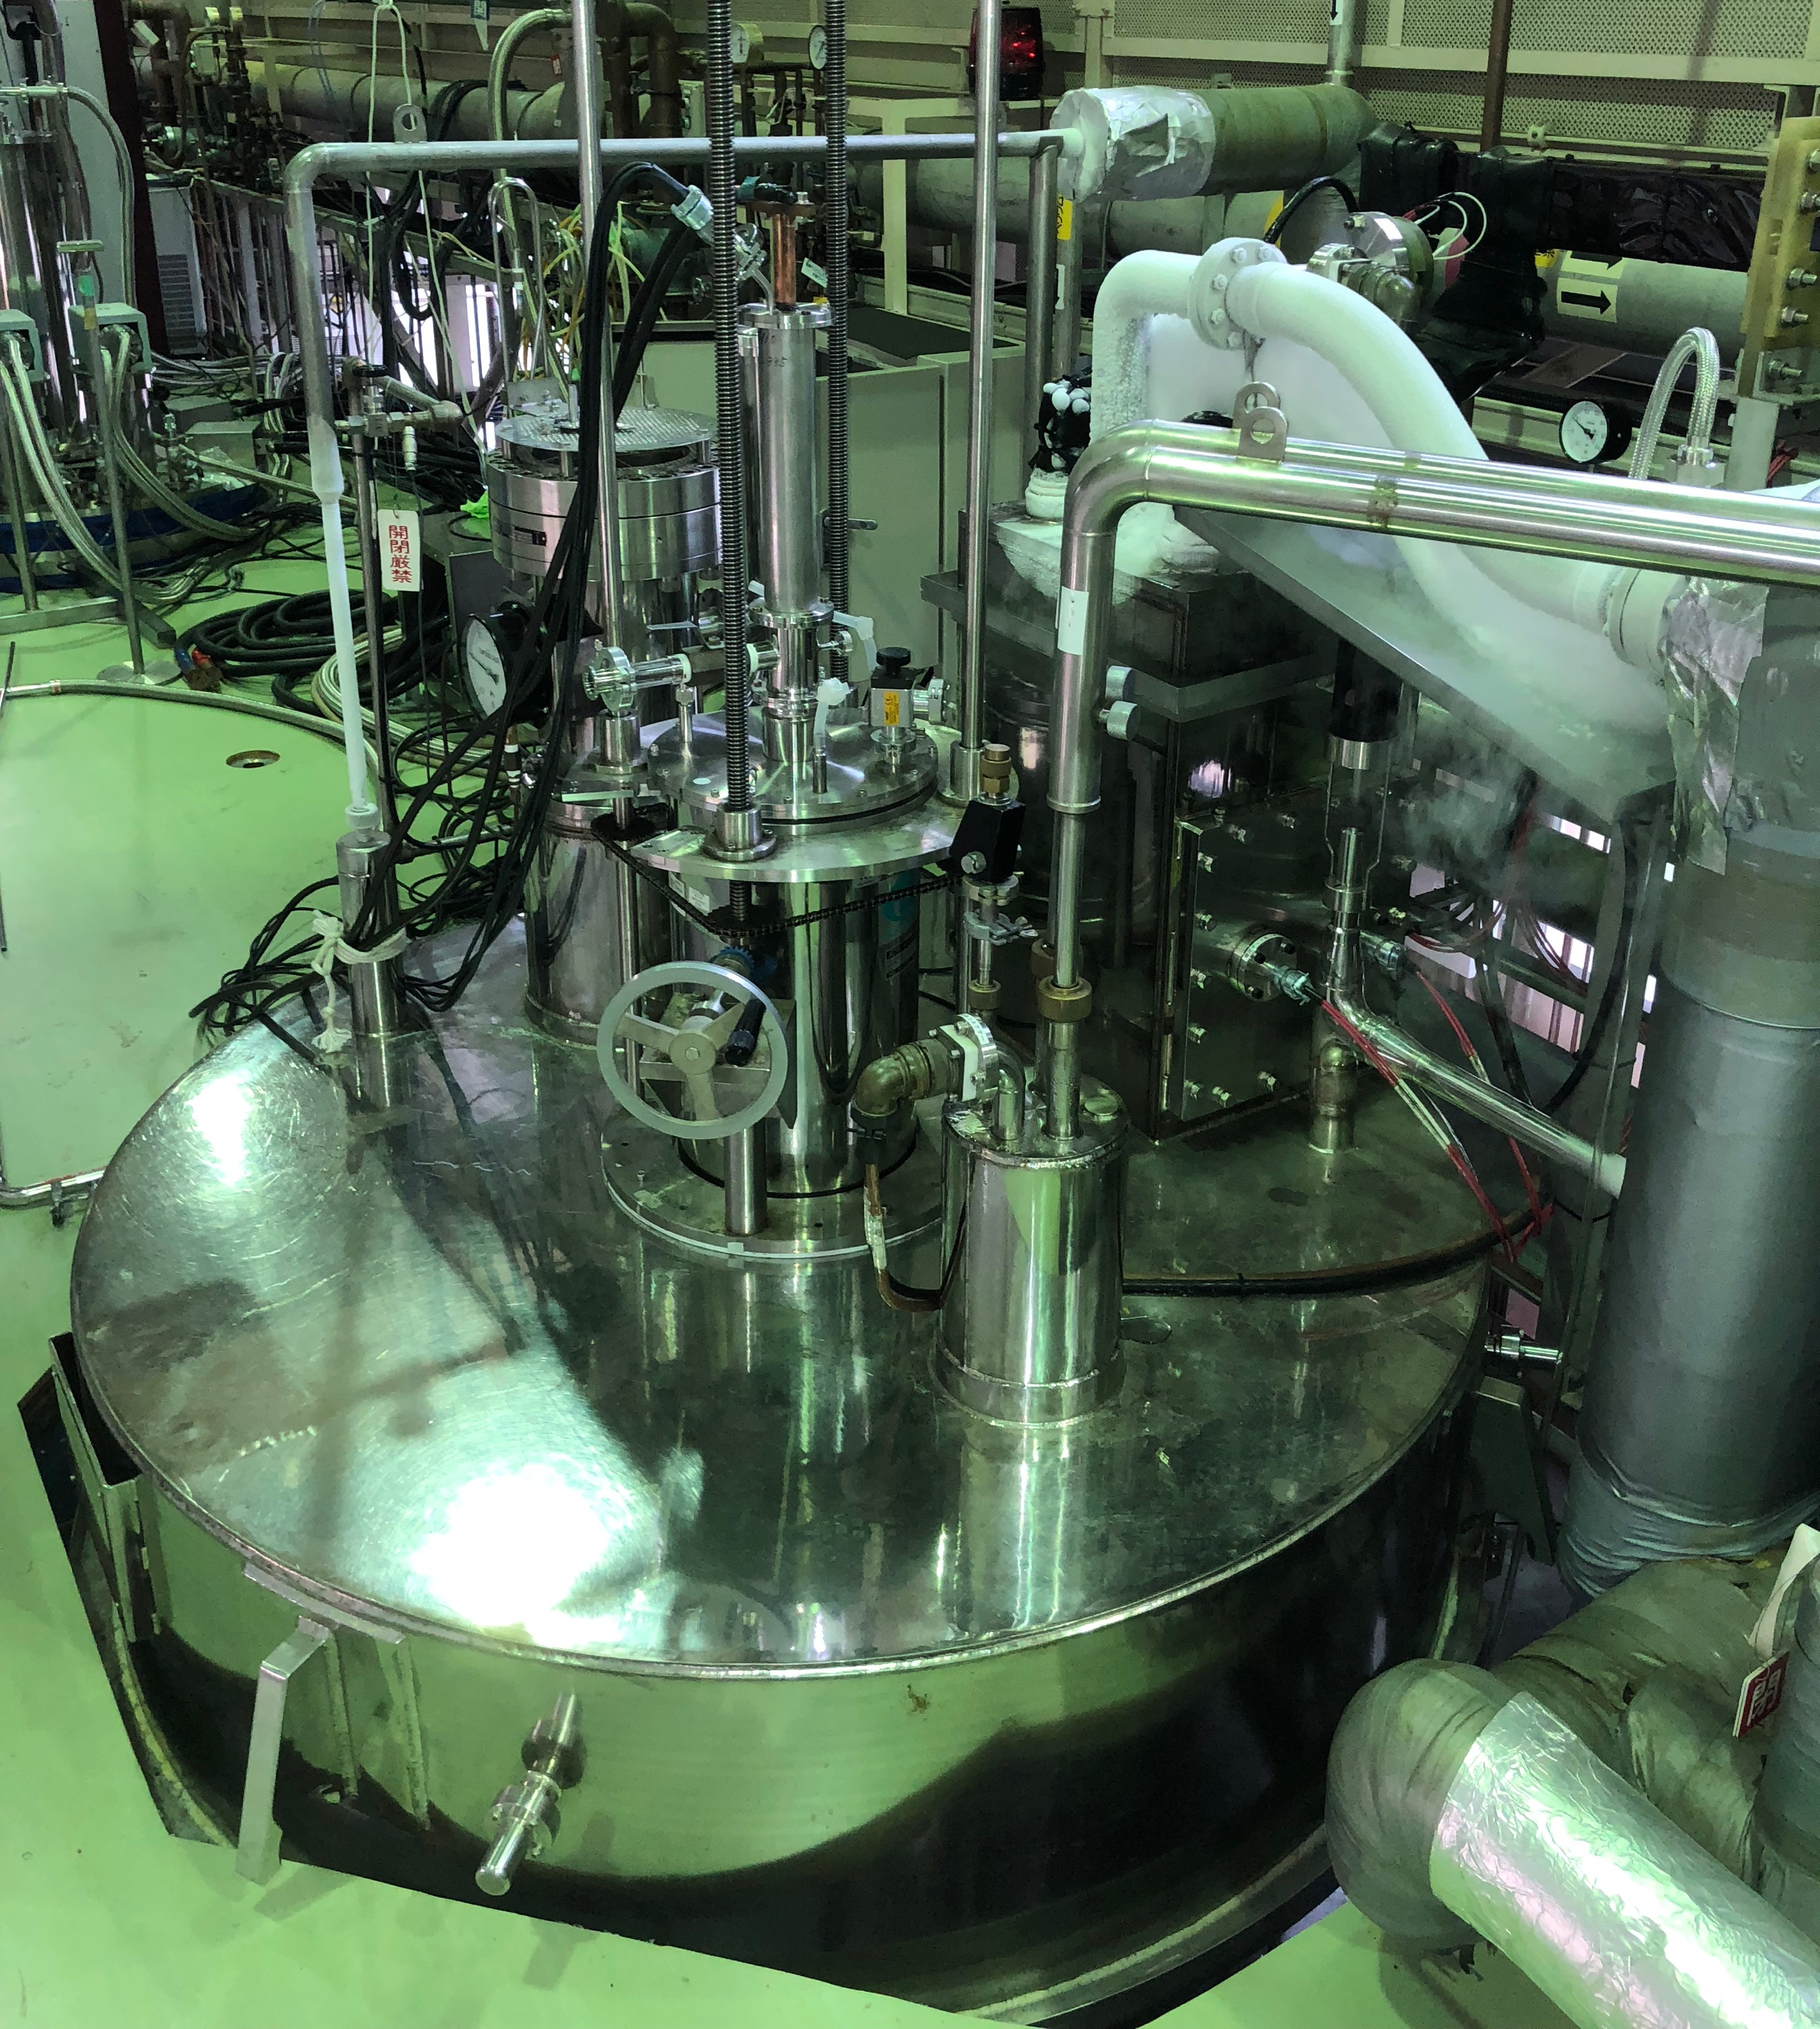
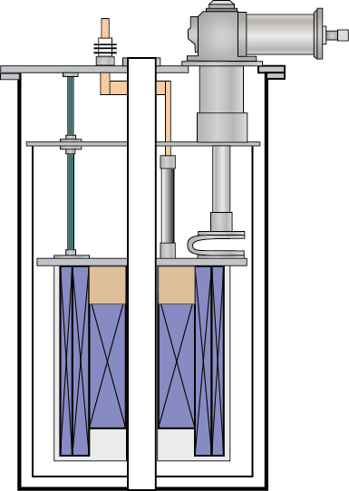
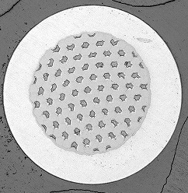
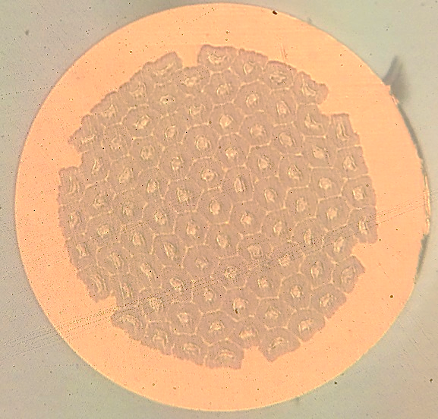
R&D structure
Design and Characterization
KEK
CERN
• In-depth characterization
HT, J_{c}, composition, d_{eff} ...
• Program coordination
• Defining specification
• Conceptual design
• Evaluation of J_{c}, B_{c2}
• Mechanical property
Tokai University
Tohoku University
• Optimization of HT condition
• Microstructure observation
• Compositional analysis
• High field magnet facility
• Evaluation of d_{eff}
Spec,
design
R&D billets
Fabrication
Kobe Steel / JASTEC
28 T HM
Furukawa Electric

Slide 20
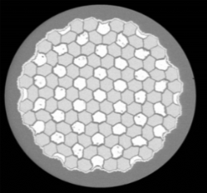
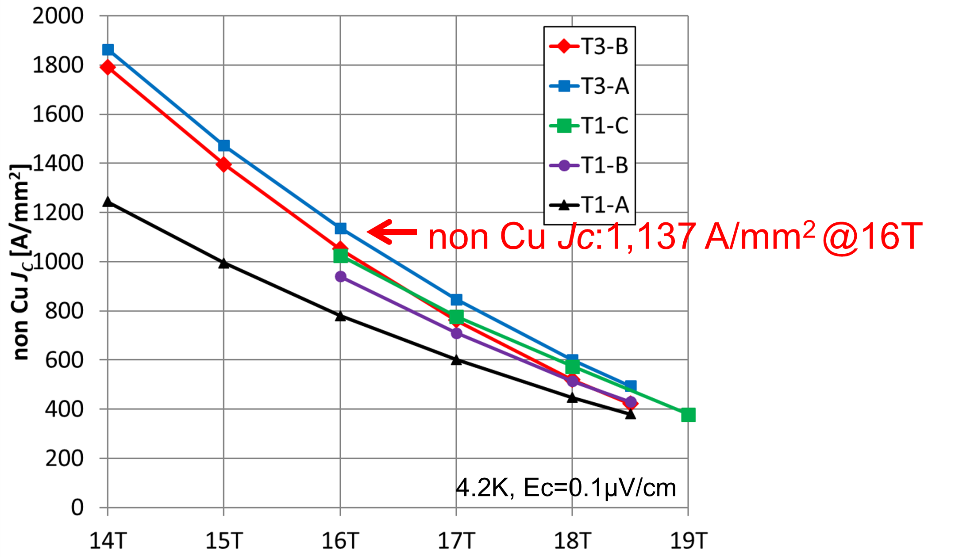
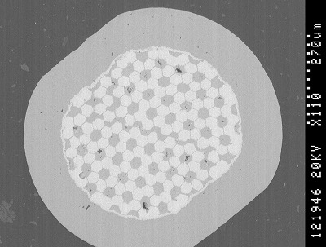
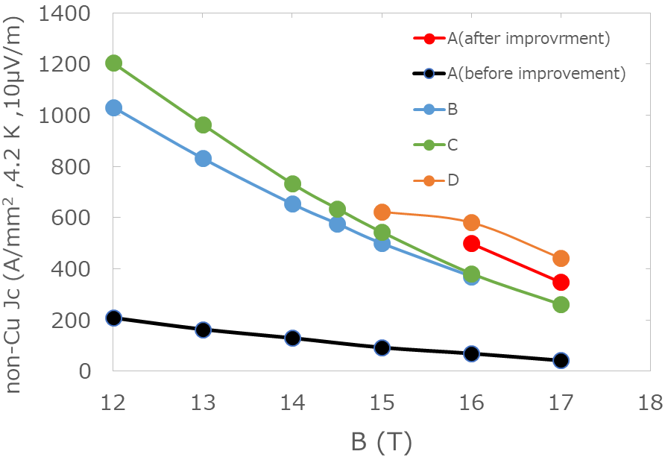
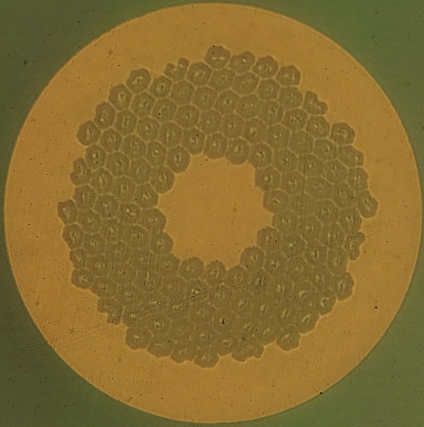
Status of Nb3Sn conductor R&D
DT wire
  non Cu J_{c} @16T 1,100 A/mm²
  reasonable results in d_{eff} (~50µm)
  and rolling test (Ic/Ic0>95%, RRR>100 @ 10% roll)
  Further improvement and mass production R&D in progress
Nb tube wire
  Non-Cu Jc of 580 A/mm² @16 T
  Further improvement in progress

Slide 21
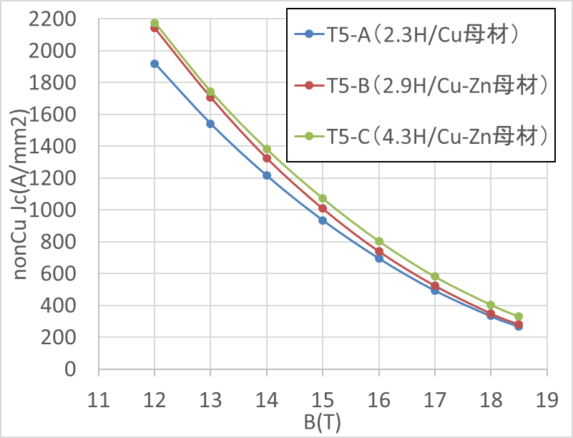
R&D Plan modified
Task2
Design wire layout and composition
Procure material (possible trial billets)
5 Years Plan
Task1
Review past technologies and select.
First review meeting in Feb. 2016
Task 4
Production of R&D billets with Advanced Technologies
W; 1~5kg * N=8
Task 5
Select candidate
Produce 2*5km wire
Heat treatment study
Task3
Production of R&D billets
W; 1~5kg * N=8
Change Task 4 and 5 to accommodate further R&D with Nb-Ta-Hf: collaboration with NHFML (2020-2022 within CERN-KEK Collaboration)
Also
Collaboration with NIMS for Cu-Zn matrix technology for possible enhancement of J_{c} and mechanical strength
MOU btw KEK and CERN
Collaborator
Prof. Larbalestier
(NHMFL; FSU)
Collaborator
Dr. Banno
(NIMS)
preliminary

Slide 22
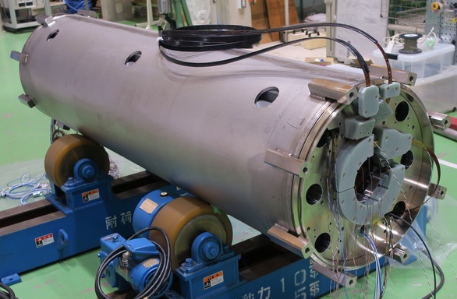
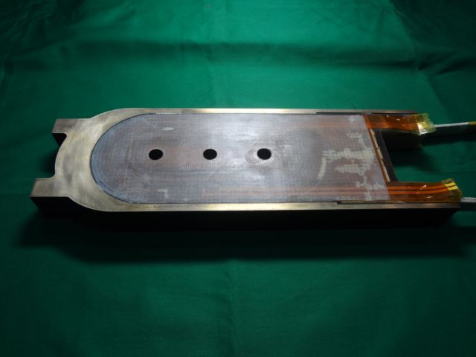
Magnet Development (Dream)
2016-2025
HL-LHC D1 Magnet Development
  Ongoing project
  1 Prototype: 2020-2021
  6 Production 2022-2025
    ↓
FCC D1 magnet design study (2018-2020 done)
  FCC Collaboration
  ↓
  Development of high strength Nb₃Sn conductors (2021-2023)
  ↓
Nb₃Sn subscale coil R&D (2022-2024)
  Establish Coil fabrication technology
↓
12 T Large Aperture Dipole (2024-2026)
  Model of FCC D1 with the bore of φ100 mm (Nb₃Sn)
  Can be used as Test stand
  ↓
16-20 T Dipole Magnet (2026-2028)
  Nb₃Sn 4 T insert
  HTS 8 T insert?
HL-LHC D1
2018-2020
FCC D1
Design study
Subscale coil
2022-2024 EXF
12T model magnet
2024-2026 EXF
16-20T magnet R&D
2026-2028 EXF

