Slide 1


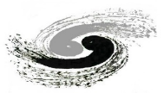
Progress of the High Field Magnet R&D
with IBS
Qingjin Xu
(IHEP, CAS)
In collaboration with Yanwei Ma’s group at IEE-CAS
Team members: Zhan Zhang, Chunyan Li, Ershuai Kong, Yingzhe Wang, Chengtao Wang (IHEP)
Dongliang Wang, Xianping Zhang,… (IEE)
中国科学院电工研究所
Institute of Electrical Engineering, CAS
中国科学院高能物理研究所
Institute of High Energy Physics, CAS

Slide 2

J_{e} of Practical Superconductors Presently
500A/mm²
IBS
100-m tape
IBS 2016
(short sample)

Slide 3
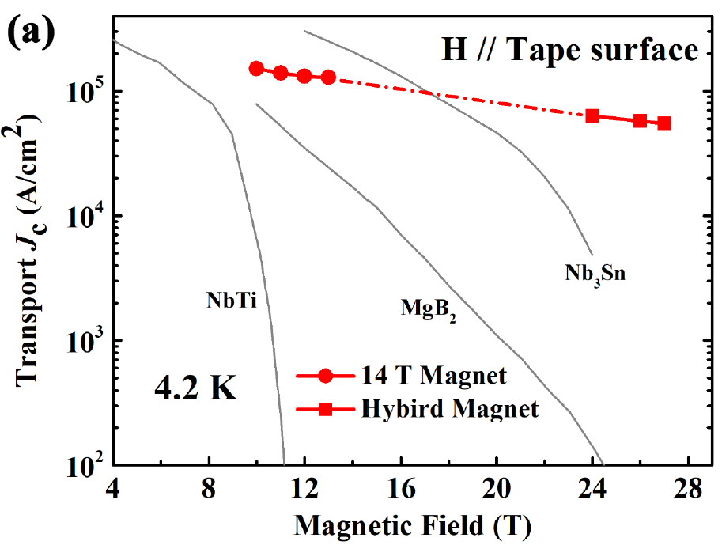
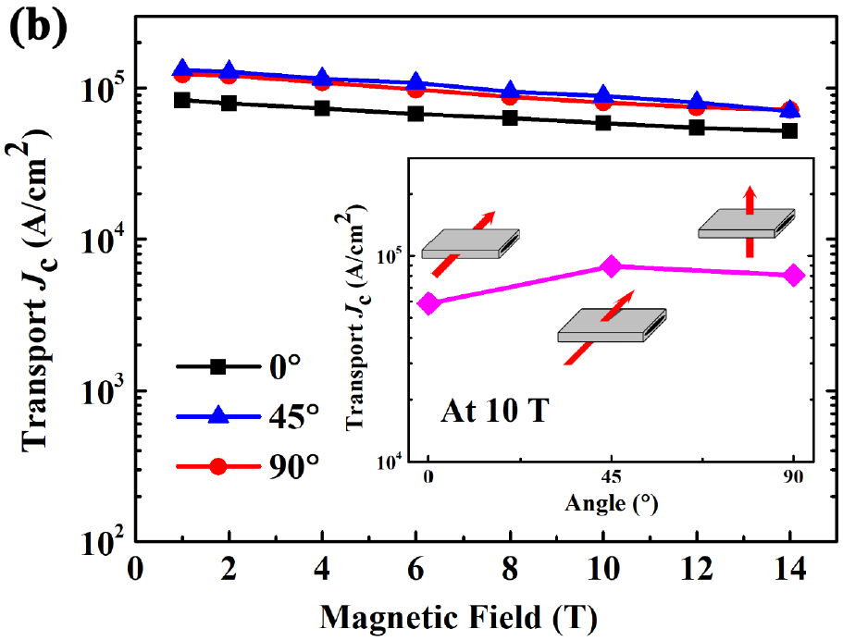
Performance of Hot-Pressed Ba122/Ag Tapes
At 4.2K, 10 T, J_{c}~1500A/mm²，I=437 A
At 4.2K, 14 T, J_{c}~1400A/mm²
At 4.2K, 27 T, J_{c}~550A/mm²
The anisotropy of J_{c} at 10T is 1.37
He Huang, et al., SuST, 31 (2018) 015017

Slide 4
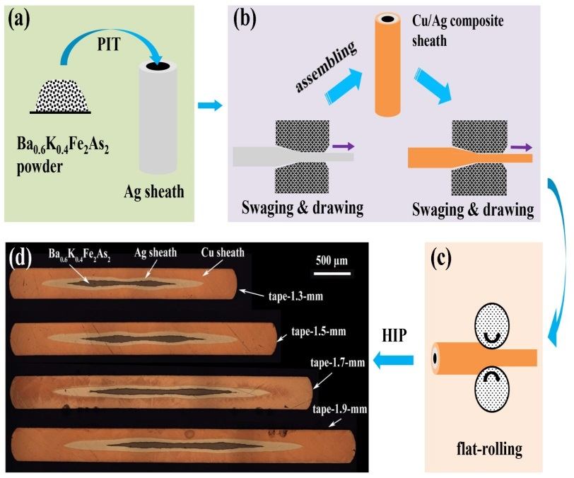
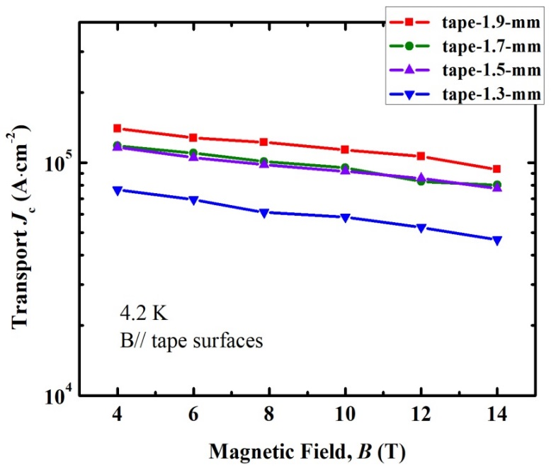
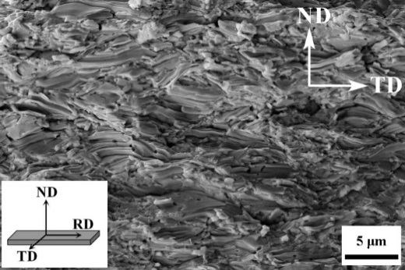
Performance of HIP Ba122 Tapes with Cu/Ag Sheath
4.2 K, 10 T: J_{c}=1100 A/mm²
Size of the grains was around 0.5 um, smaller than that in the Hot-pressed samples.
The J_{c} may be improved with the increase the grain size.
Science China-Materials, Accepted

Slide 5
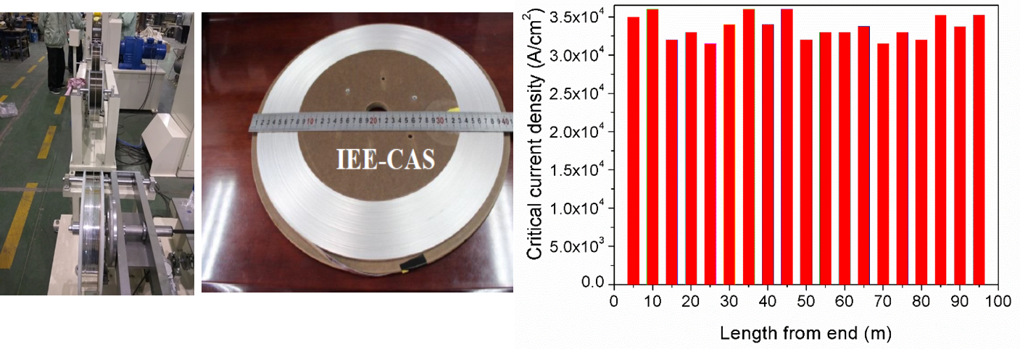
100-m Long Ba122 Tapes by Rolling Process
In 2020, J_{c} of a 100-m 7-core tape using the new fabrication technique reached 500 A/mm² @ 4.2 K, 10 T.
Tape width 4.8 mm, tape thickness 0.3 mm. I_{c} > 200 A.
In 2018, J_{c} of such tape is 300 A/mm² @ 4.2 K, 10 T.

Slide 6
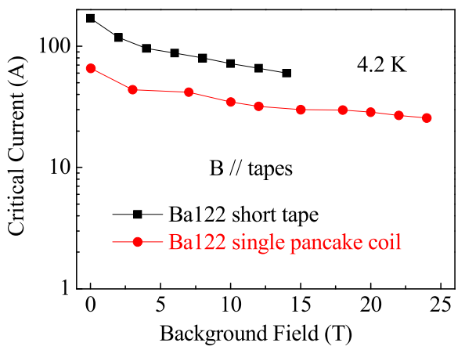
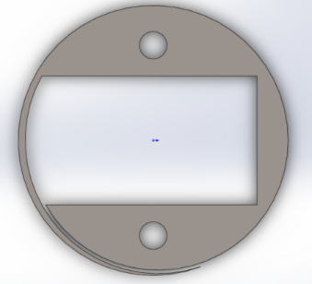
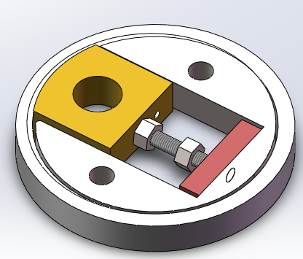
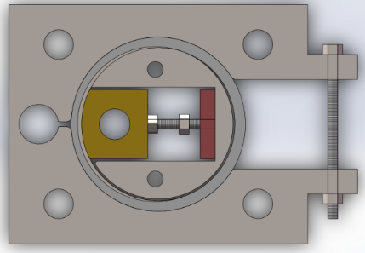
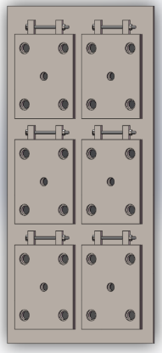
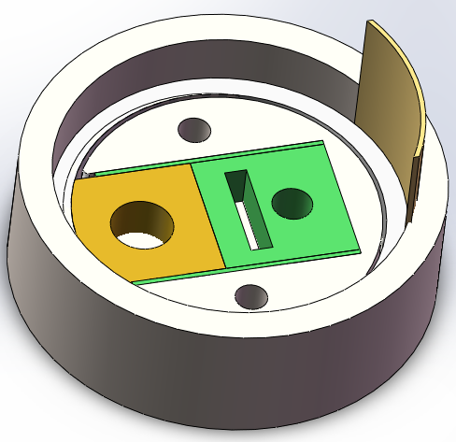
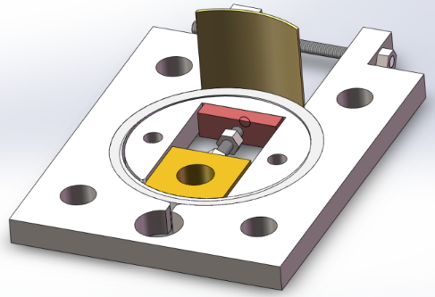
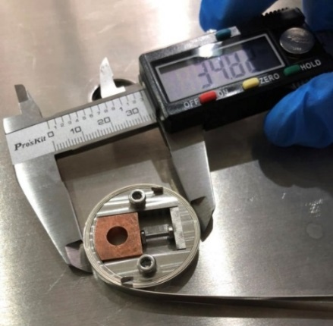
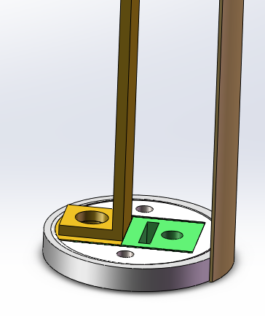
First Performance Test of IBS Solenoid Coil under 24 T
The transport I_{c} of the single pancake IBS coil reach 40% of that at zero external magnetic field.
Wang, et al., SuST,. 2019(32) 04LT01
Hoop
Fixed on the winding plane
Thickness
0.8mm
Φ30mm
Fake
Leader
Φ2mm Screw & nuts
Leader A Leader B
YBCO
Cu
YBCO
Heat
treatment
Epoxy impregnating
Current leader soldering

Slide 7
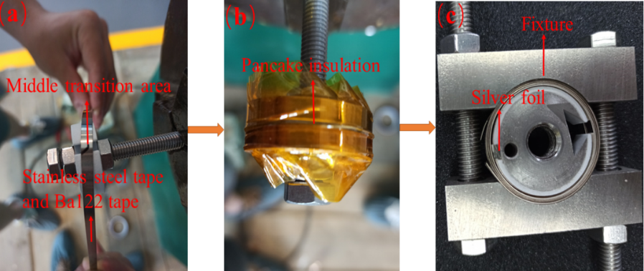
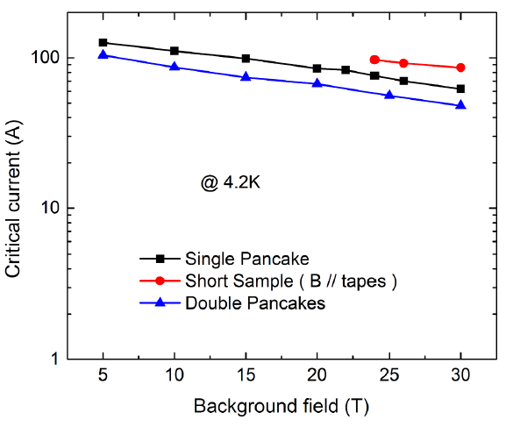

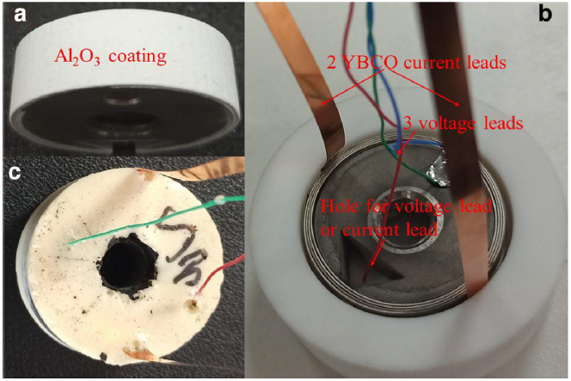
Performance Test of IBS Solenoid Coil under 30 T
At 30 T @ 4.2 K, the Ic of the double pancake IBS coil was reached 48A (56% of short sample)
D30 coil :
inner diameter: 30mm
Qian, et al., Physica C 580 (2021) 1353787

Slide 8
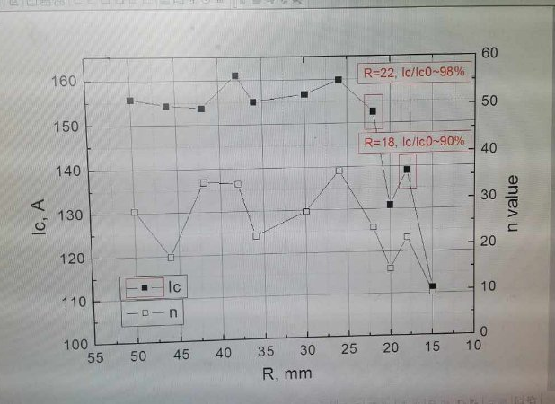
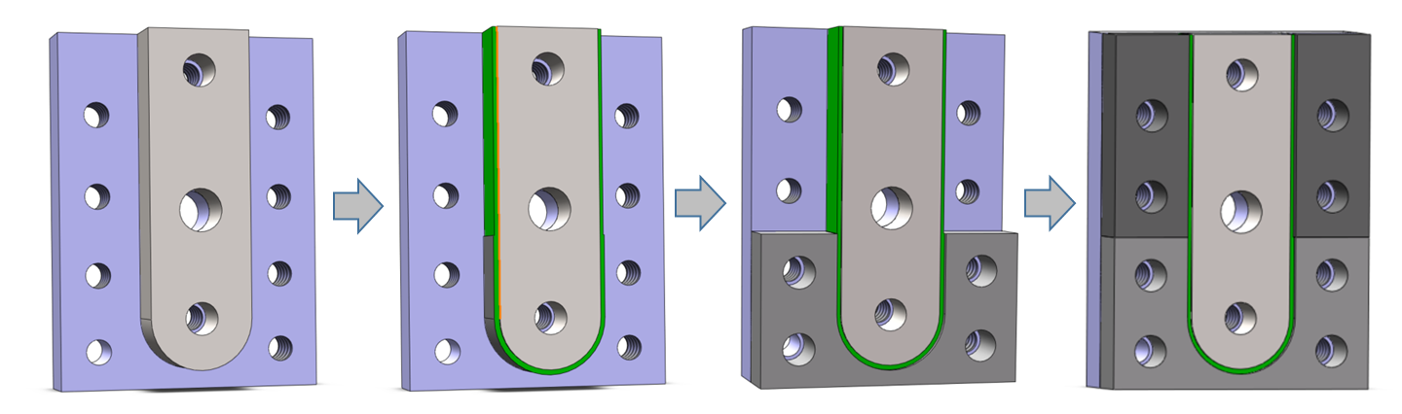
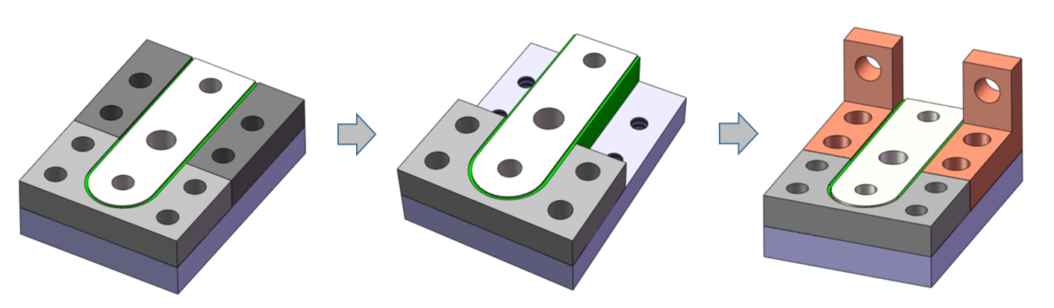
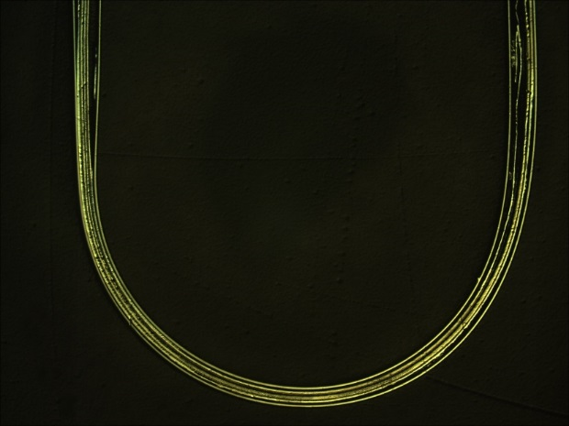
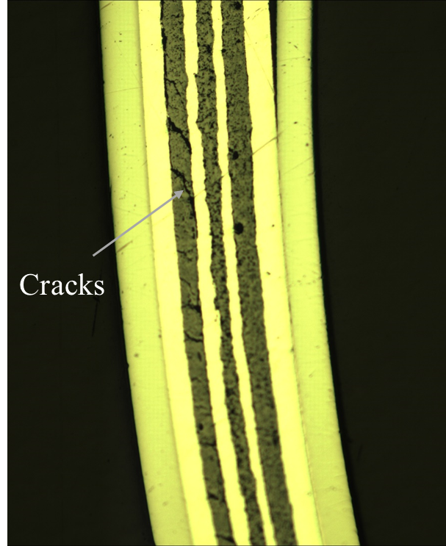
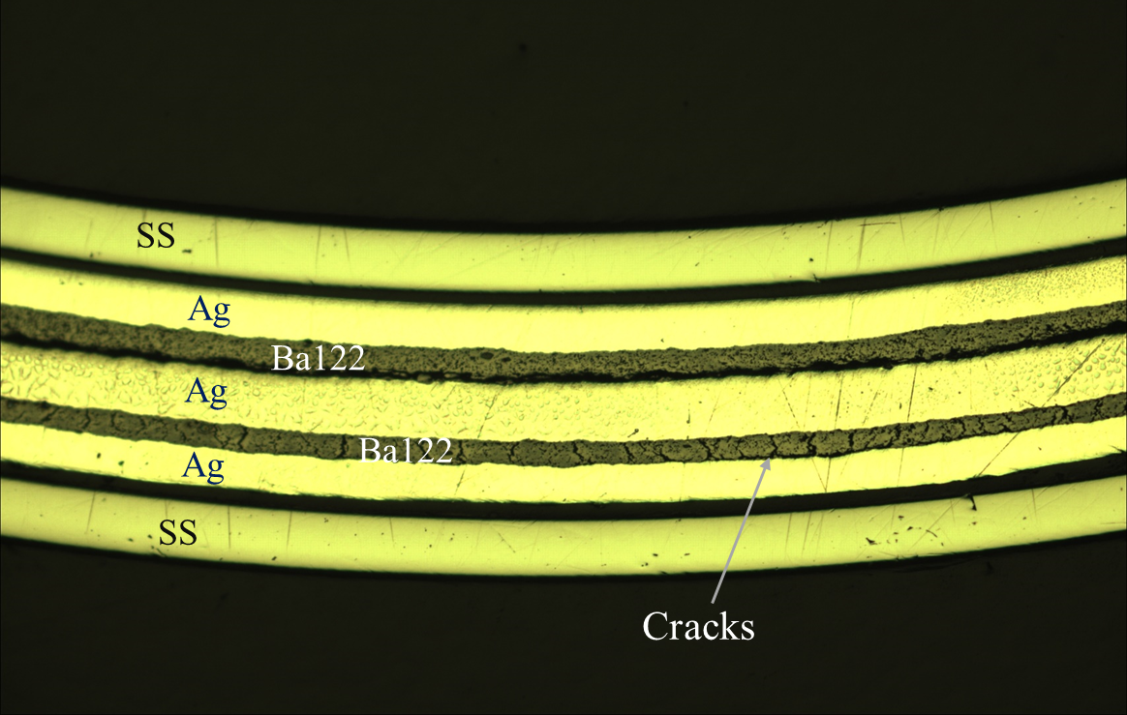
J_{c} of Bent IBS Tapes
Preparition of bent IBS tape
Sample results by ASIPP in 2018
Sample results by IHEP in 2021
OMI of D10 bent tape
Cracks appear regularly in part of the superconducting cores under tensile stress !
I_{c} of bent IBS tapes decreases with smaller bending diameters.

Slide 9
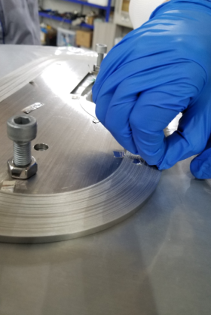
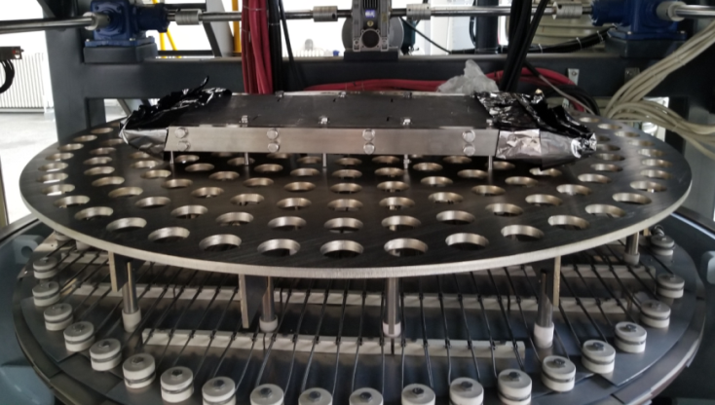
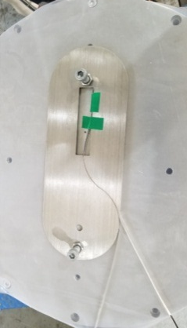
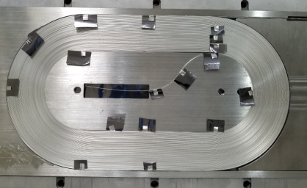
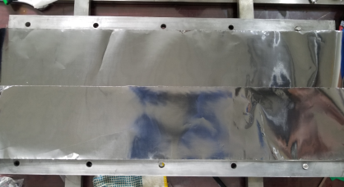
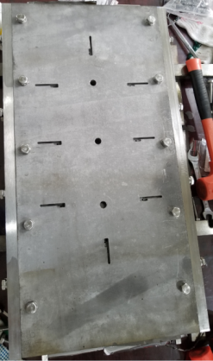
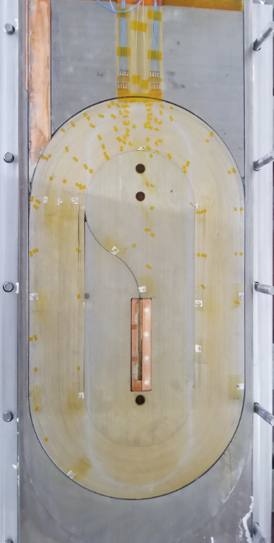
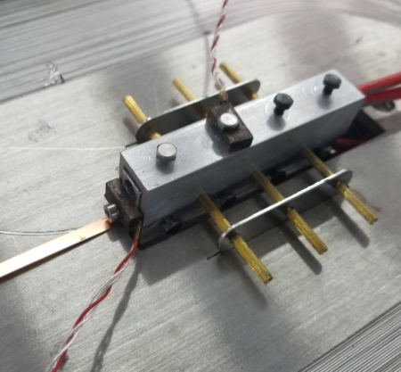
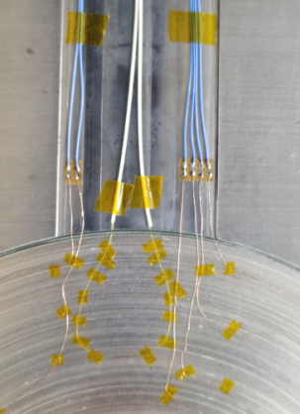
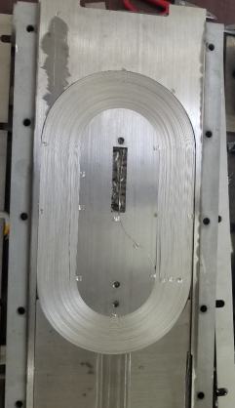
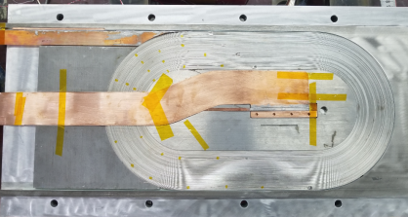
Development of Racetrack Coils with 100-m Long IBS Tapes
< 绕制线圈 > < 布置抽头 > < 绕制完毕 > <组装钽箔> < 组装热处理> < 热处理>
< 热处理后> < 内侧接头> <外侧接头> < 光栅与抽头 > <环氧浸渍后制备完成>

Slide 10
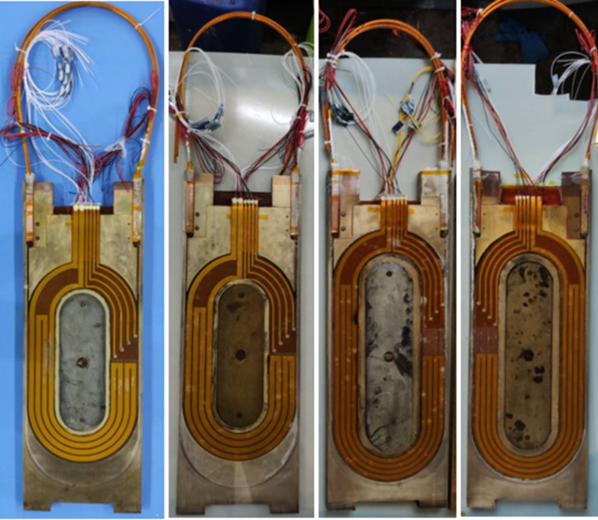
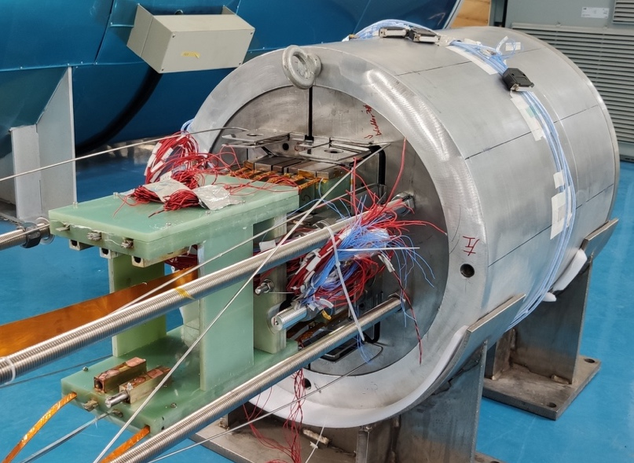
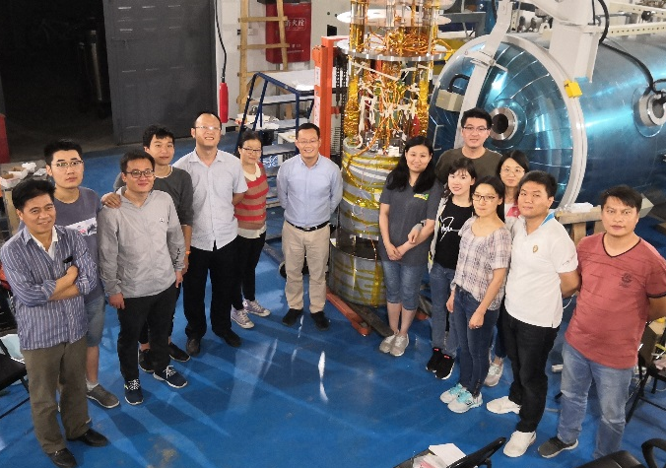
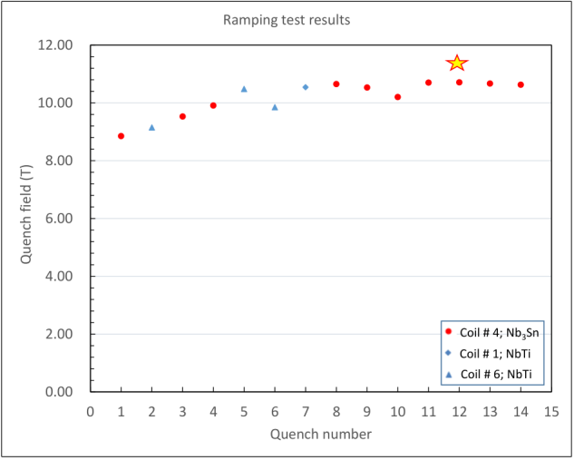
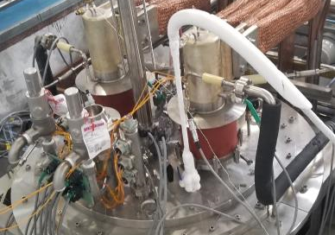
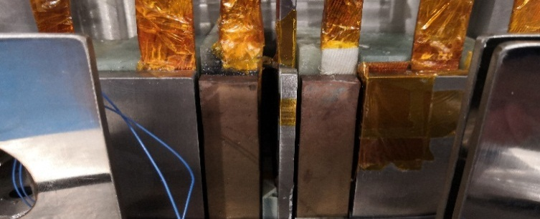
Development of Racetrack Coils with 100-m Long IBS Tapes
NbTi and Nb₃Sn background coils
10-T background mode dipole
Assembly completed and ready for test
Performance of the model dipole
IBS
Nb₃Sn
NbTi
IBS coil was inserted in the center
and assembled together with
the 10-T model dipole magnet
Under test at 4.2 K

Slide 11
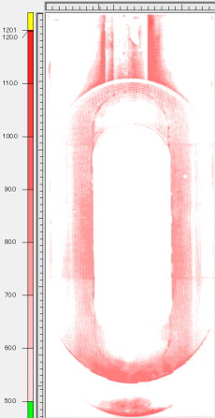
Development of Racetrack Coils with 100-m Long IBS Tapes
Parameter | Value
Background field | 0-10 T
Rate | 1 A/s
Maximum pressure on IBS | 120 MPa

Slide 12
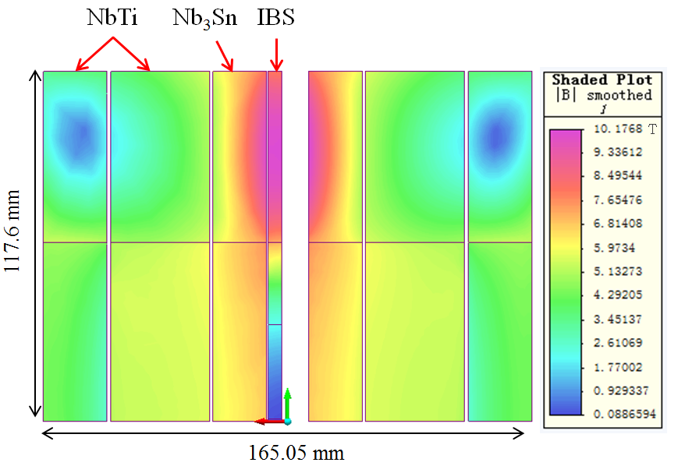
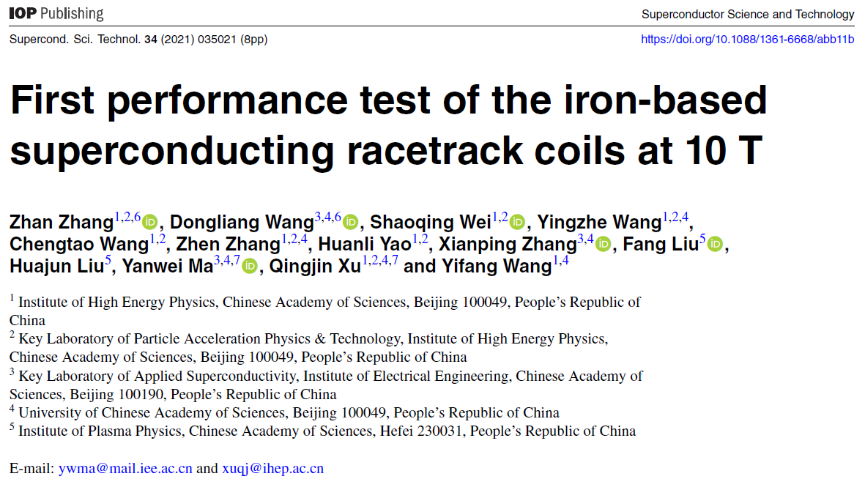
Development of Racetrack Coils with 100-m Long IBS Tapes
Two racetrack coils have been made using the 100 m length IBS tapes.
The coils reached 86.7% of critical current of the short sample at 4.2 K and 10 T, and 81.25% of the quench current under self-field,
with highest compressive stess over 100 MPa.
Zhang, et al., SuST,. 34 (2021) 035021

Slide 13
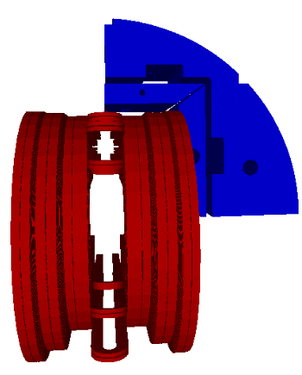
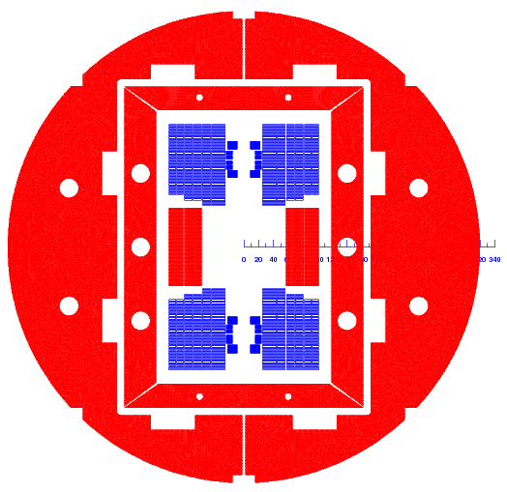
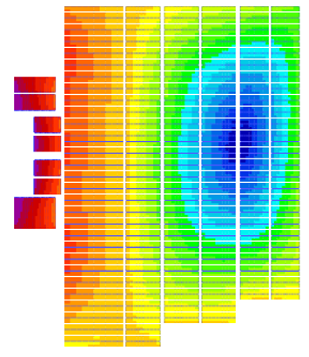
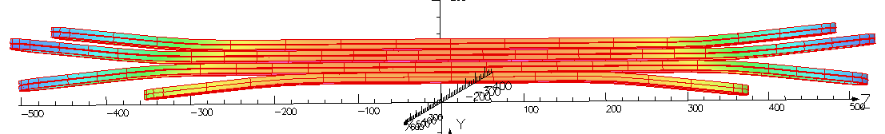
Ongoing: Development of the 16-T Hybrid Dipole Magnet
Nb₃Sn 12~13 T + HTS 3~4 T
ReBCOor
IBS
Nb₃Sn
OD 640 mm
AP 2*30 mm
Nb₃Sn
ReBCO
Or
IBS
Nb₃Sn

Slide 14
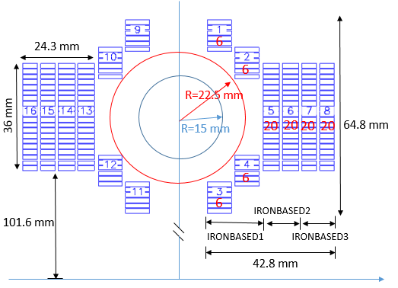



Next in future: the 12-T IBS Dipole Magnet
Yoke OD
500mm
Target cost of IBS: 20 RMB /kAm @12 T
Strand | diam. | cu/sc | RRR | Tref | Bref | Jc@ BrTr | dJc/dB
IBS | 0.802 | 1 | 200 | 4.2 | 10 | 4000 | 111

Slide 15
Challenges and Outlook
100-m 7-core IBS tape fabricated
T_{c} reached 55K
2nd IBS Racetrack at 10 T
2008.02
2008.04
2008.09
2016
2018
2020
Discovery of IBS
Discovery of
122 phase IBS
1st IBS solenoid at 24 T
1st IBS Racetrack at 8 T
The engineering current density of the long-length IBS still needs a significant improvement, to reach the similar level as ReBCO or Bi-2212 conductors.
The materials of stabilizer should be shifted to copper or any other low-cost metals to realize the low cost of IBS.
Structure and fabrication methods of IBS and corresponding coils should be further optimized to minimize the J_{c} degradation at high field and high stress.
And many other issues like detailed magnetic and mechanical properties study of IBS, quench detection and protection of the IBS coils / magnets and etc.
We are expecting a IBS-only 12-T dipole magnet in 10 years…

Slide 16
Thanks for your attention!

