Slide 1
Results from the U.S. REBCO HTS Program
X. Wang for the USMDP/REBCO WG
Workshop on State-of-the-Art in High Field Accelerator Magnets, 15 April 2021

Slide 2







The US-MDP is collaborating with industry to address several key questions for REBCO accelerator magnet technology
How to make high-field REBCO dipole magnets?
What field level and field quality can REBCO magnets achieve? What factors limit the performance? How can we improve?
How to detect the transition in REBCO magnets and protect the magnets?
What is the required conductor and cable performance?

Slide 3
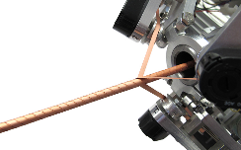
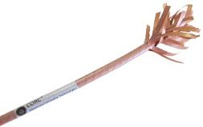
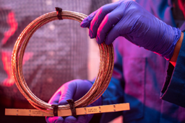

Our current focus is round REBCO cables: CORC® and STAR™
Macroscopic round conductor → isotropic in bending direction and magnetics
Partial transposition
Lower J_{e} compared to rectangular cable due to the additional former
Tape degradation due to cabling and bending
CORC®: ~ 30 commercial tapes, 30 micron thick substrate; 3 – 4 mm diameter, > 30 mm bending radius;
10 kA class transport current at 4.2 K
STAR™: ~ 10 customized tapes; 1 – 2 mm diameter; 15 mm bending radius; excellent candidate for cable

Slide 4
All four collaborating labs under MDP have started making and testing magnets using round REBCO cables
Lab | Magnet design | Main drivers
ASC/NHMFL | Solenoid | Performance in high field, stress limit
BNL | Common coil dipole | Leverage large bending radius for conductor
FNAL | Conductor on Molded Barrel dipole | Concept for stand-alone and insert dipole magnets with higher magnetic efficiency
LBNL | Canted cosθ dipole | Magnet technology based on the CCT concept

Slide 5

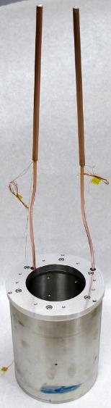

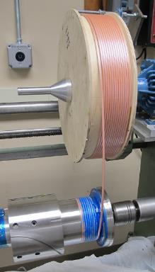
ACT and ASC/NHMFL successfully tested the first CORC® solenoid in 14 T background field
ACT, ASC/NHMFL HEP Phase II SBIR
The insert coil containing 19 meters of 28-tape CORC® cable
Central field at I_{c} (4.4 kA) of 15.86 T, peak field on conductor of 16.8 T
J_{w} (169 A mm⁻²) and JBr (275 MPa)
https://doi.org/10.1088/1361-6668/ab7fbe

Slide 6
No degradation in CORC® performance after full measurement campaign and stable operation into flux-flow regime
No significant degradation in I_{c} was measured after 16 high-current tests in high magnetic field
  Demonstrating the robustness of the CORC® cable in high-field magnet applications
Highly stable operation into flux flow regime, likely due to current sharing between tapes in the CORC® cable

Slide 7
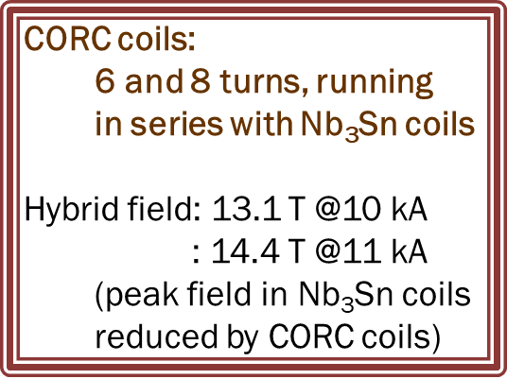
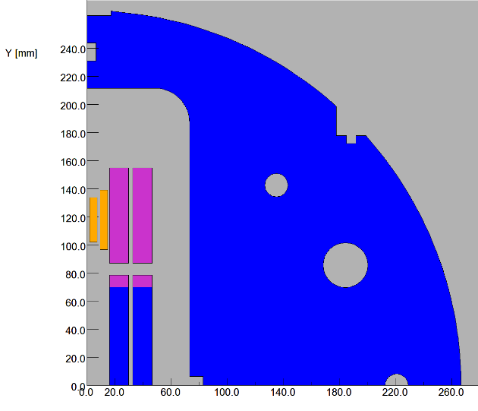
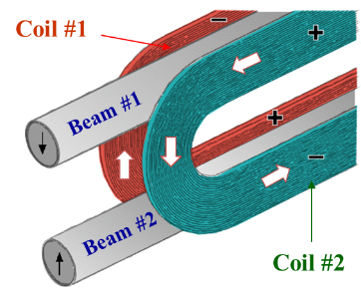
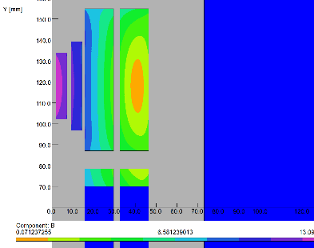

CORC® based HTS/LTS Hybrid common coil to leverage large bending radii to generate a 14 T total dipole field (DOE HEP STTR program)
High current CORC® coils in series with the Nb₃Sn coils
Desired for quench protection
Large radii of common coil allows high J_{e} CORC® cables
2-d model
Nb₃Sn Coils
CORC Coils

Slide 8
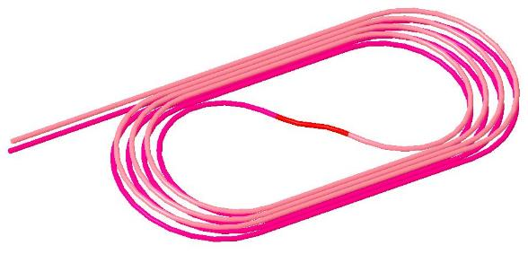
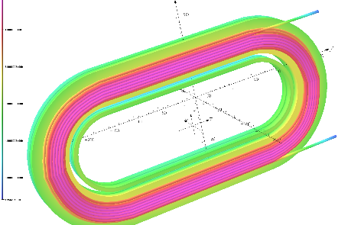
Subscale common coil to allow quench studies and technology demonstration
MDP Coil:
4+4 turns with an S-turn
STTR Coils two sets:
Each with 6 and 8 turns
MDP: Quench studies and technology demo
STTR: High field Demo
All drawings made. Parts ordered. Test expected in 2021

Slide 9

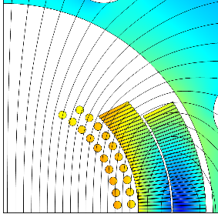
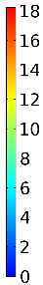
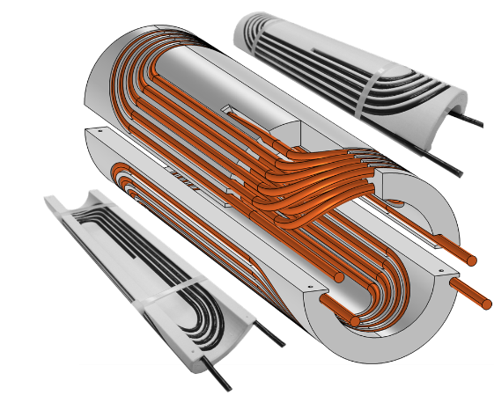
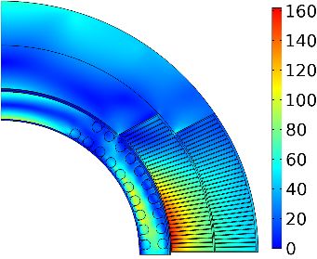
The COMB concept features both stress management and efficient dipole field generation for REBCO dipole magnet
Straight section generates 100% transverse fields
Magnetic field (T)
Nb₃Sn coil
HTS coil
Grooves to manage stress
120-mm OD coil for the first superconducting model
+1.25 T in Nb₃Sn 4.4 T standalone
Equivalent stress (MPa)
60-mm OD mock-up coil built to demonstrate manufacturability
http://dx.doi.org/10.18429/JACoW-IPAC2019-THPTS084
110 MPa
160 MPa
Within safe limits

Slide 10
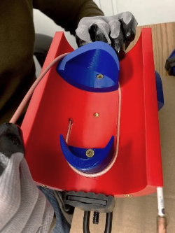
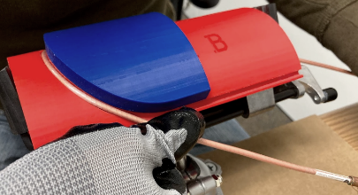
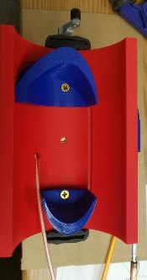
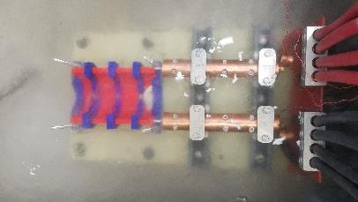
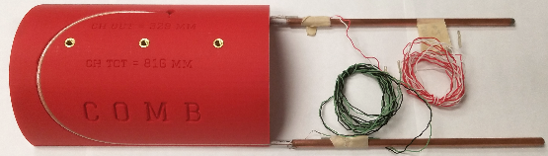
Test winding with a 30-tape CORC® wire and measure I_{c} at 77 K before and after winding
26 mm minimum bending radius

Slide 11
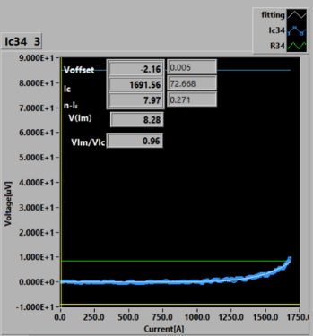
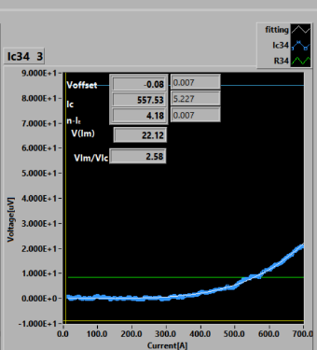
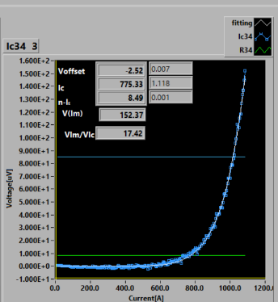
Test winding provided critical feedback for the magnet design
Before winding
I_{c} = 1691 A, n = 8.3
In the structure
I_{c} = 558 A, n = 4.2
Extracted from the structure
I_{c} = 775 A, n = 8.5
Based on the test results, mandrel design is modified to reduce I_{c} reduction
More flexible conductors will be critical

Slide 12
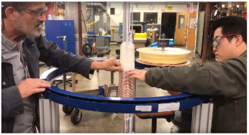
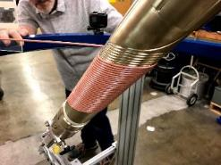
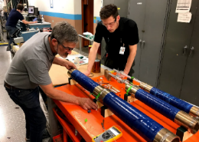
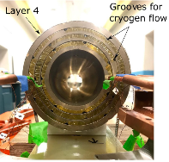

CCT design provides another vehicle for MDP to develop the REBCO magnet technology
The design intercepts stress accumulation on conductor, eyeing high fields
Simple and beautiful geometry, but less efficient at a first look
Two magnets were made so far with commercial CORC® wires
  C1: 1.2 T, 30 m wires
  C2: 2.9 T, 100 m wires, 6 km SuperPower tapes (2 mm wide, 30 micron thick substrate)
Wound with a winding table towards minimum and reproducible handling
C2 used aluminum bronze mandrels and was applied Stycast after winding
Co-wound voltage tap wires for quench detection

Slide 13
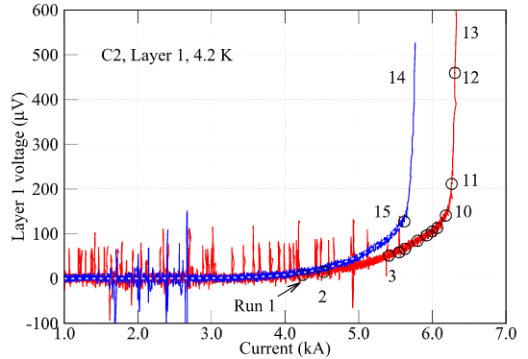
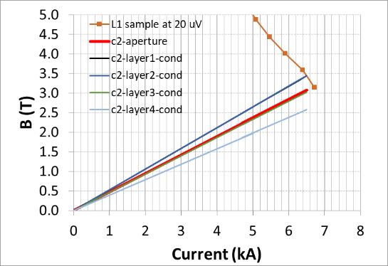
The magnets showed encouraging behavior and open more questions to address
Reproducible transition; thermal runaway should be avoided
Layer 1 started transitioning at 73% of the short-sample prediction. Why?
Field quality measurements with FNAL-developed rotating coil showed strong magnetization effects and ramp-rate dependence

Slide 14
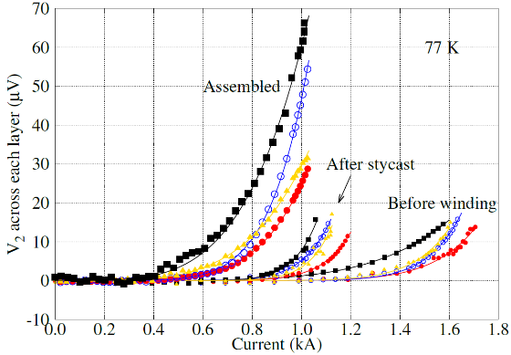
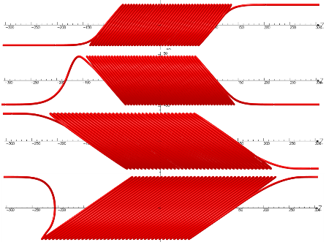
Test results suggest that we need more flexible conductors with higher J_{e} to achieve higher dipole fields
30 mm bending radius resulted in inefficient inner layers
Lose ~ 50% I_{c} at 77 K after being assembled into magnet
Layer 1
50°
2
3
4
35°
To address these issues, we need thinner (≤ 20 µm substrate) and narrower
(≤ 1.5 mm) tapes with higher transport current (pinning)

Slide 15
Although we obtained encouraging results, magnet performance-limiting factors are yet to be determined and serious fields are yet to be achieved
We do not know for sure the performance-limiting factors in the existing CORC® CCT dipole magnets
  The locations of first flux-flow voltage along conductors are unknown
  Cannot improve without knowing what is not working
Need insights from advanced diagnostics and analysis capabilities to identify and understand the resistive transition regions along conductors
  Voltage across the entire CORC wire does not help much
  See talks from Maxim and Lucas on Friday
Need to demonstrate at least 5 T to pass the laughing-test of program director

Slide 16
Although a critical mass is forming, a strong feedback loop between conductors and magnets is yet to be established
CORC® conductors are being wound into magnets and gaining stronger interest from MDP and collaborating programs
  STAR wires are coming next
A strong feedback loop with fast responses from both magnet and conductor sides will benefit everyone
  The current development pace of magnets and conductors is slow (lead time approaching 24 months)
  Are the desired conductor performances achievable?
  Does the new conductor work in magnets?
What is an optimal mechanism to enable such a feedback loop?

Slide 17
Push the field and fail fast
REBCO is an exciting material in an exciting time
  Strong potential and many unknowns…
  … Do we know enough about what we do not know?
  Need to move fast
Push for higher dipole fields, sooner
  What really matters for the outside world?
  8 – 10 T by 2024 and 16 – 20 T by 2030
Strive for a faster feedback loop between conductors and magnets
  Access to conductors and support manufacturers to experiment (require ¥ ₿ € $)
Notes:
What is the field limit a REBCO dipole magnet can achieve? What drives the limit? Conductor architecture? Magnet design, fabrication and operation?
What can obsolete the assumptions for conductor cost?

