Slide 1
Overview of HTS magnet developments and technical challenges
Gijs de Rijk
CERN
15th April 2021
Workshop on State-of-the-Art in High Field Accelerator Magnets

Slide 2
contents
timeline
First generation: EUCARD1 CEA insert
Insulated cable models: Feather and EuCARD-CosTh- CEA
Non-Insulated coils
  Winding tooling development
  Small solenoid coils
  Cloverleaf models
Synergy projects
  HDMS space spectrometer
  Gatoroid HTS Gantry toroid
  HTS undulator
Lessons learned

Slide 3
Timeline
2009-2013 (-2018) EuCARD WP7 HFM, task 4 HTS insert (CNRS-CEA)
2013 - 2017 EuCARD2
  Conductor development ReBCO conductor (Bruker) and Roebel ReBCO cable (KIT)
  Roebel ReBCO cable magnets (block coil @CERN (Feather); CosΘ @CEA)
2017 - 2020 ARIES
  ReBCO conductor (Bruker)
2017 - 2020 CERN HTS Program
  Continuation of Roebel ReBCO cable magnets (CEA and CERN): test as inserts
  Non-Insulated tape stack magnets
  HDMS
  Gatoroid
  Undulator

Slide 4

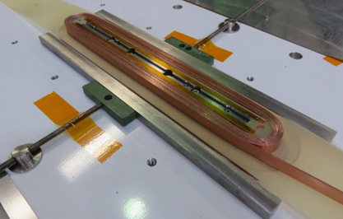
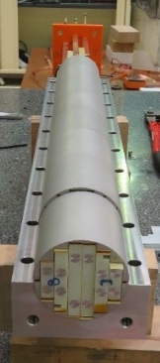
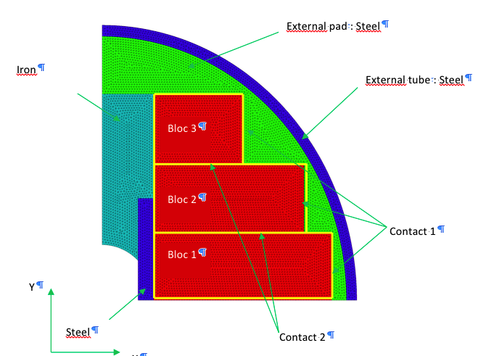
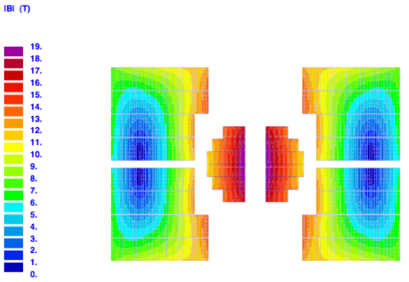
HTS: First attempt towards 20 T: EuCARD1 CEA insert
aim: 6 T HTS (YBCO) insert for test in Fresca2 , to get to 19 T
But without bore
Conductor 2 x 2 4 mm tapes
19 T
CEA + CRNS Grenoble
J.M. Rey, F. Borgnolutti, M. Durante, CEA-Saclay

Slide 5
EuCARD1 CEA HTS insert
Stand alone tested Sept 2017: Reached 5.37 T @ 4.2K (I=3200A)
After the stand-alone test, during the structure update for test as an insert in a background field, damage was discovered. The magnet “burned” several truns on a top coil due to an insulation problem. No obvious signals had been seen during the stand-alone test.

Slide 6
2020 CERN HTS program
Daniel Schoerling, MSC SLM-PRO 16-03-20
https://indico.cern.ch/event/885059/

Slide 7
2020 CERN HTS program, updated
1st priority of the program (80+% of resources)
References:
Daniel Schoerling, MSC SLM-PRO 16-03-20, https://indico.cern.ch/event/885059/
HTS Program website: https://hts.web.cern.ch/
L. Bottura et al., High Field Magnet Development for HEP in Europe – A Proposal, Letter of Intent to the Particle Physics Community Planning Exercise (a.k.a. “Snowmass”), https://www.snowmass21.org/docs/files/summaries/AF/SNOWMASS21-AF7_AF0_Luca_Bottura-249.pdf.

Slide 8
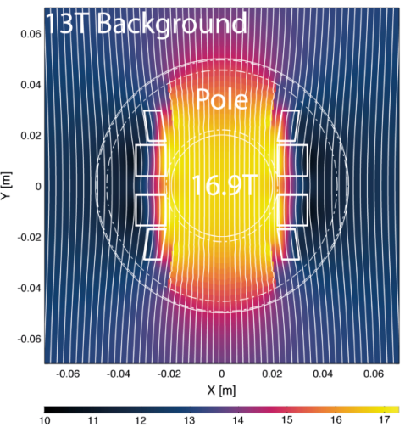
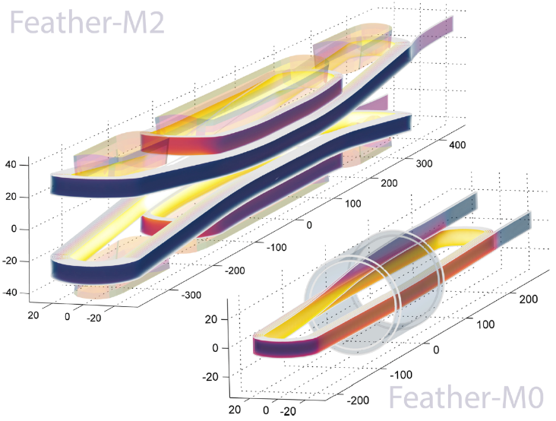
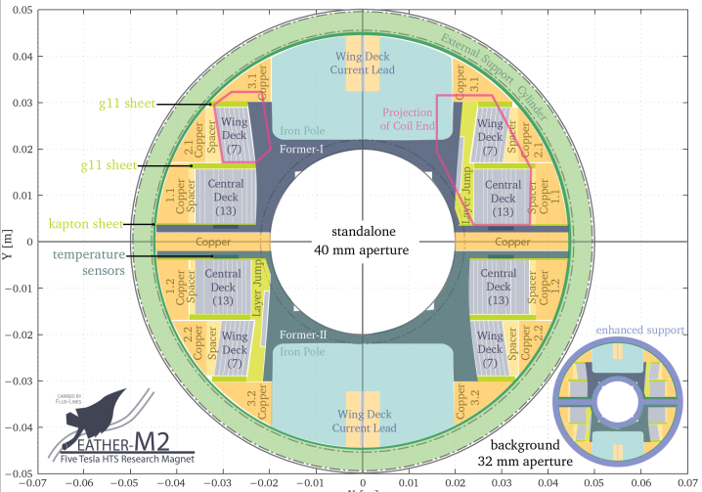
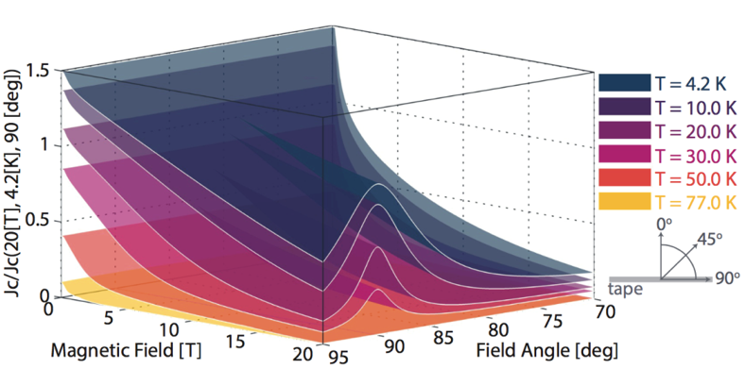
Feather magnets

Slide 9
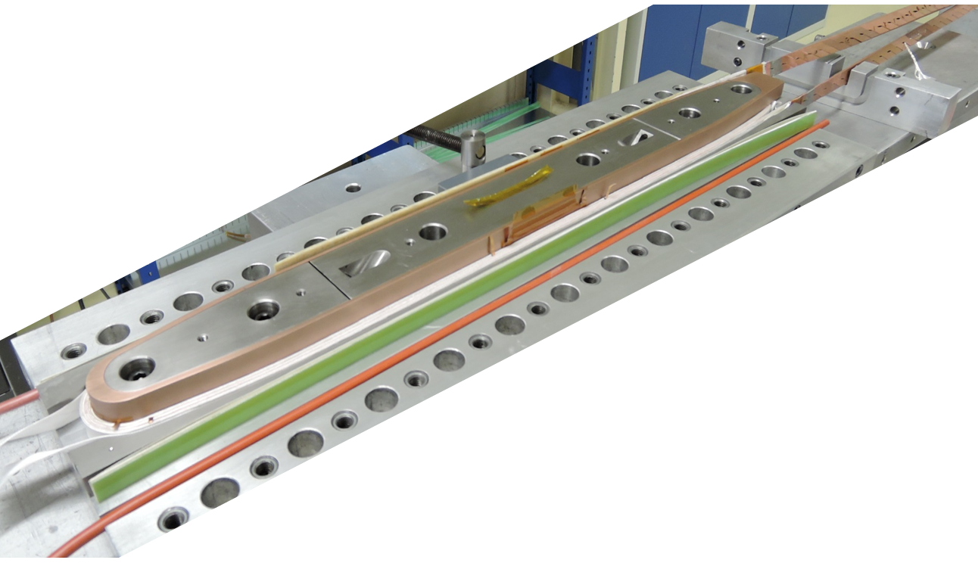
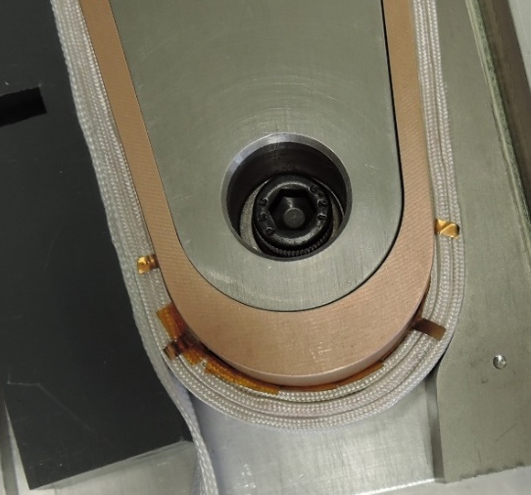
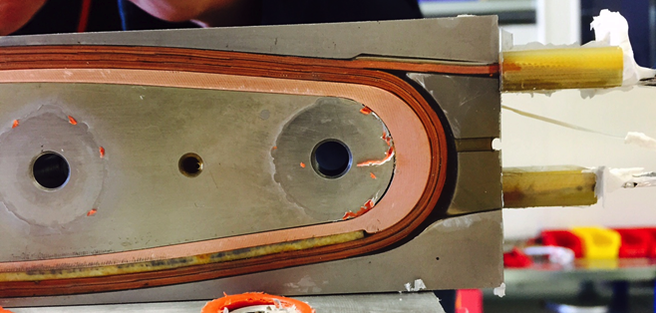
FeatherM0
A simple 4 turns racetrack coil to test usability of Roebel cable.
Return end
Lead end

Slide 10
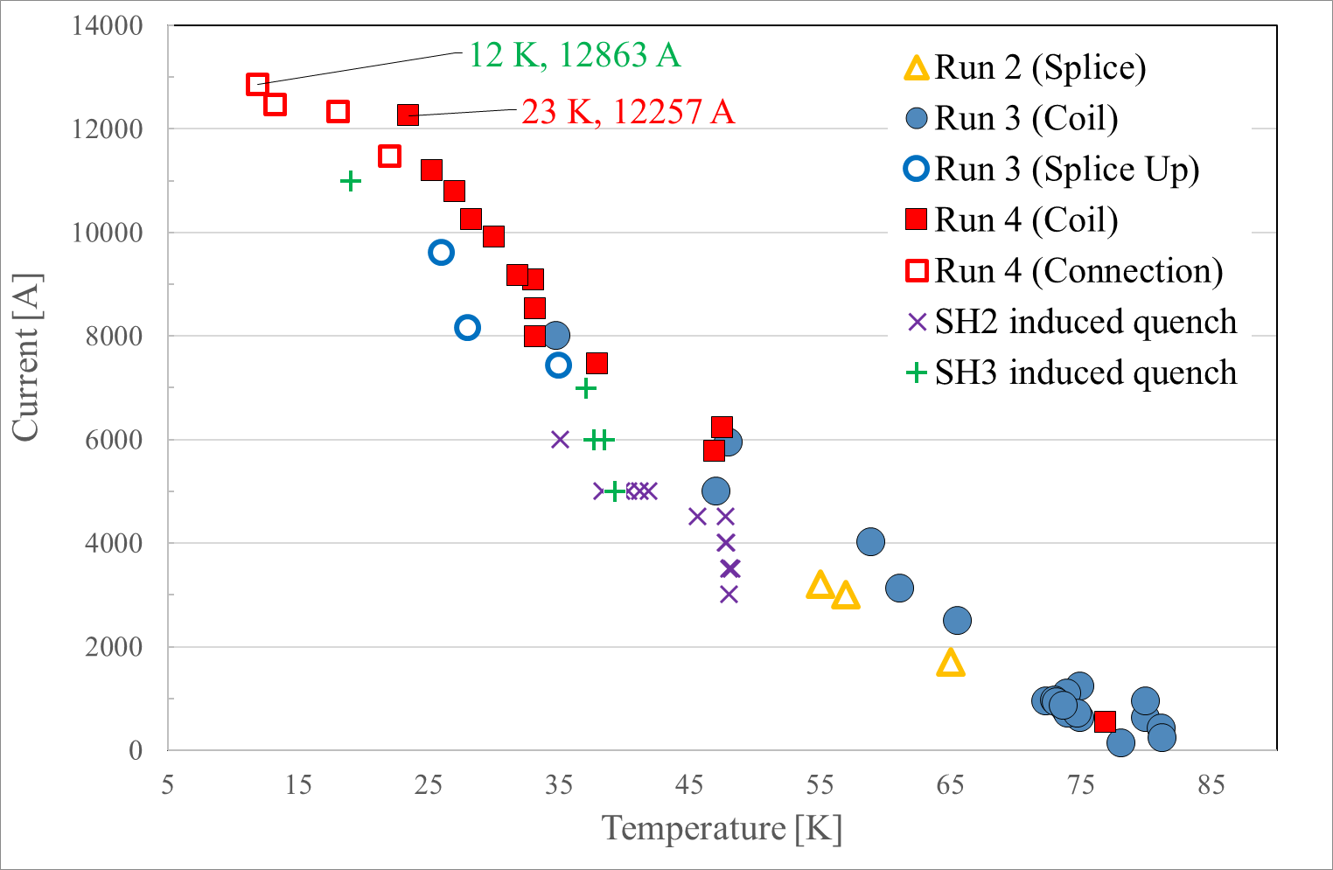
Feather_M0.4, run 3 & 4 results
Connection temperature lower than coil
Quenches in the coil
Reached 12.9 kA
Magnet reached 12.9 kA at 12 K, 12.2 kA at 23 K
  We don’t have Ic(B,T,α,σ), so difficult to assess how good this result is
Magnet reached same current level after a thermal cycle → no degradation
Courtesy H. Bajas and F. Margiarotti

Slide 11
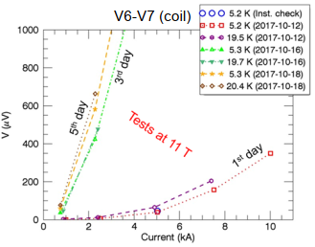
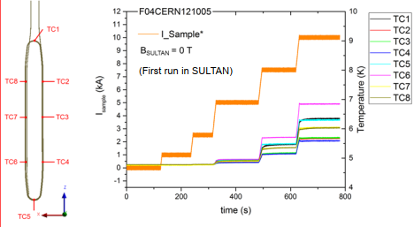
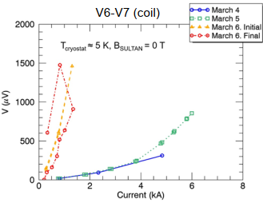
Feather_M0-4 and -5 in Sultan results
M0.4 reached 10 kA in 11 T background field
“Both tests were limited by the apparent resistance across the coil, which increased dramatically after the tests at high field.”
Heat generation observed in the coils
Feather_M0.4
Feather_M0.5
Courtesy X.Sarasola (EPFL/SPS)

Slide 12
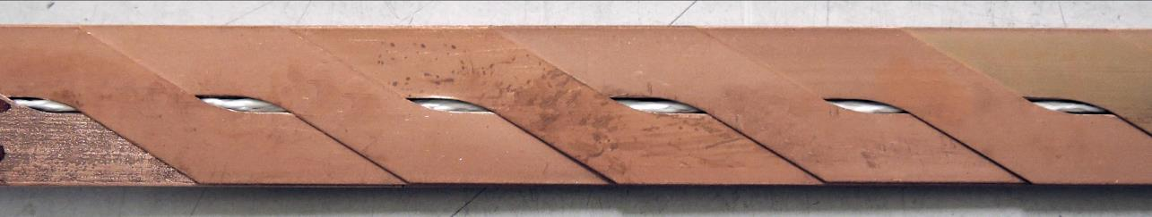
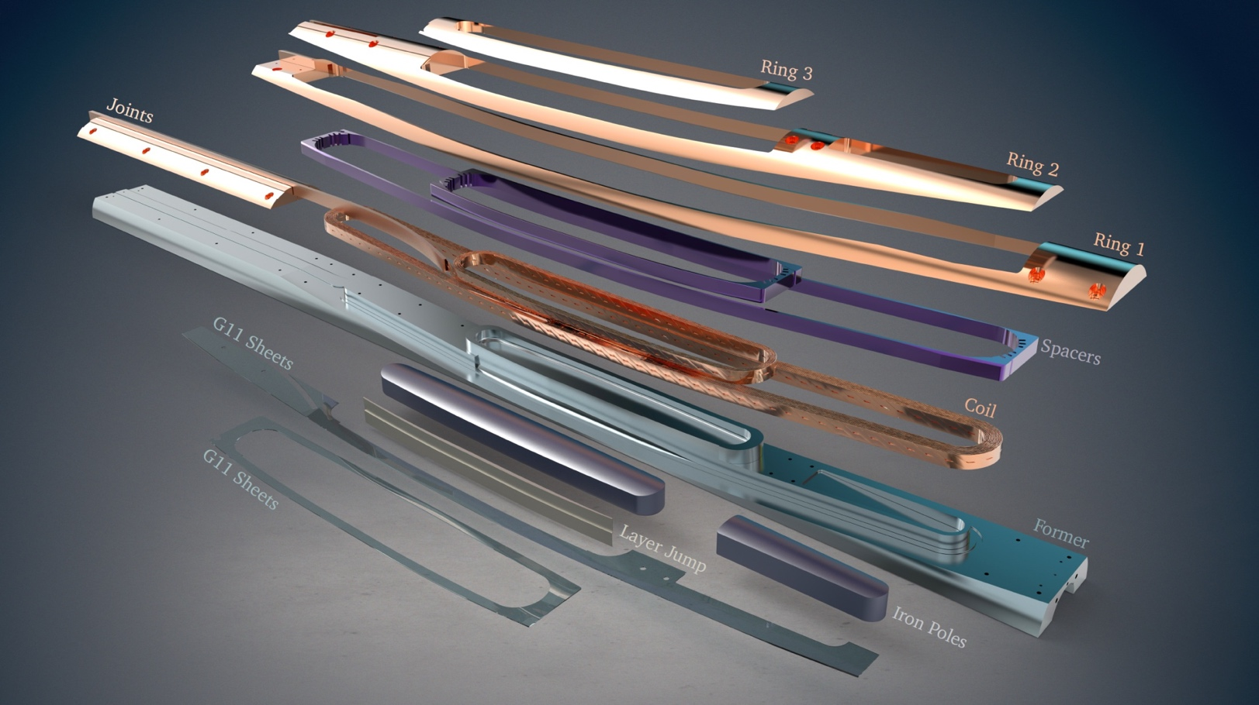

Roebel cable magnets: FeatherM2
5 Tesla stand alone, @ 4.5K and 18 Tesla in 13 Tesla background (potentially the highest dipole field in an aperture)
40 mm (real) aperture
10 kA class Roebel cable
Accelerator Field quality
J. van Nugteren, G. Kirby, J. Mazet, et al

Slide 13
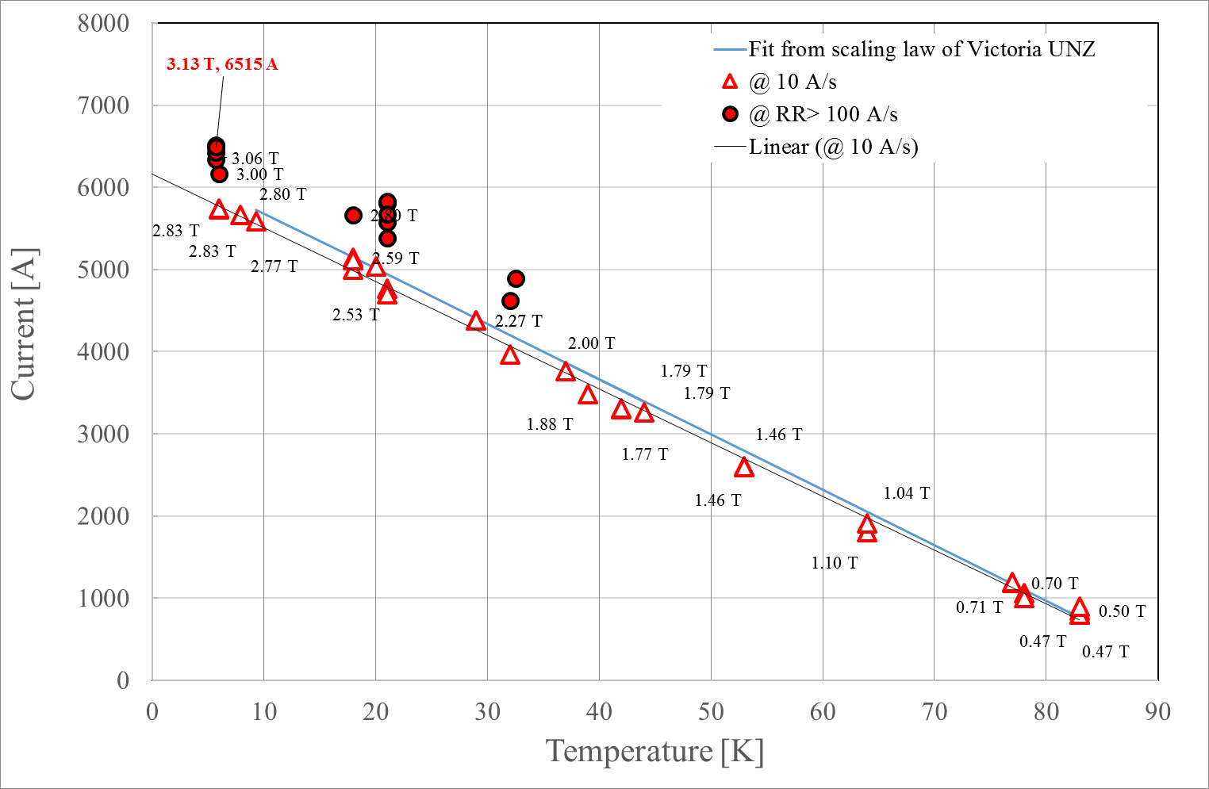
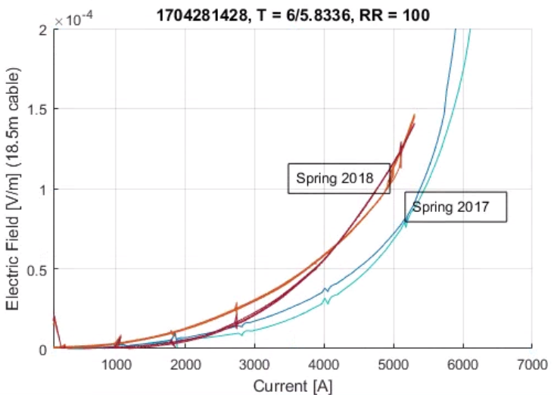
FeatherM2_1-2 magnet test results, stand alone
FeatherM2_1-2. Suman tape - SuperOx Roebel cable
3.13 T reached, but it degrades over succesive cooldowns.

Slide 14
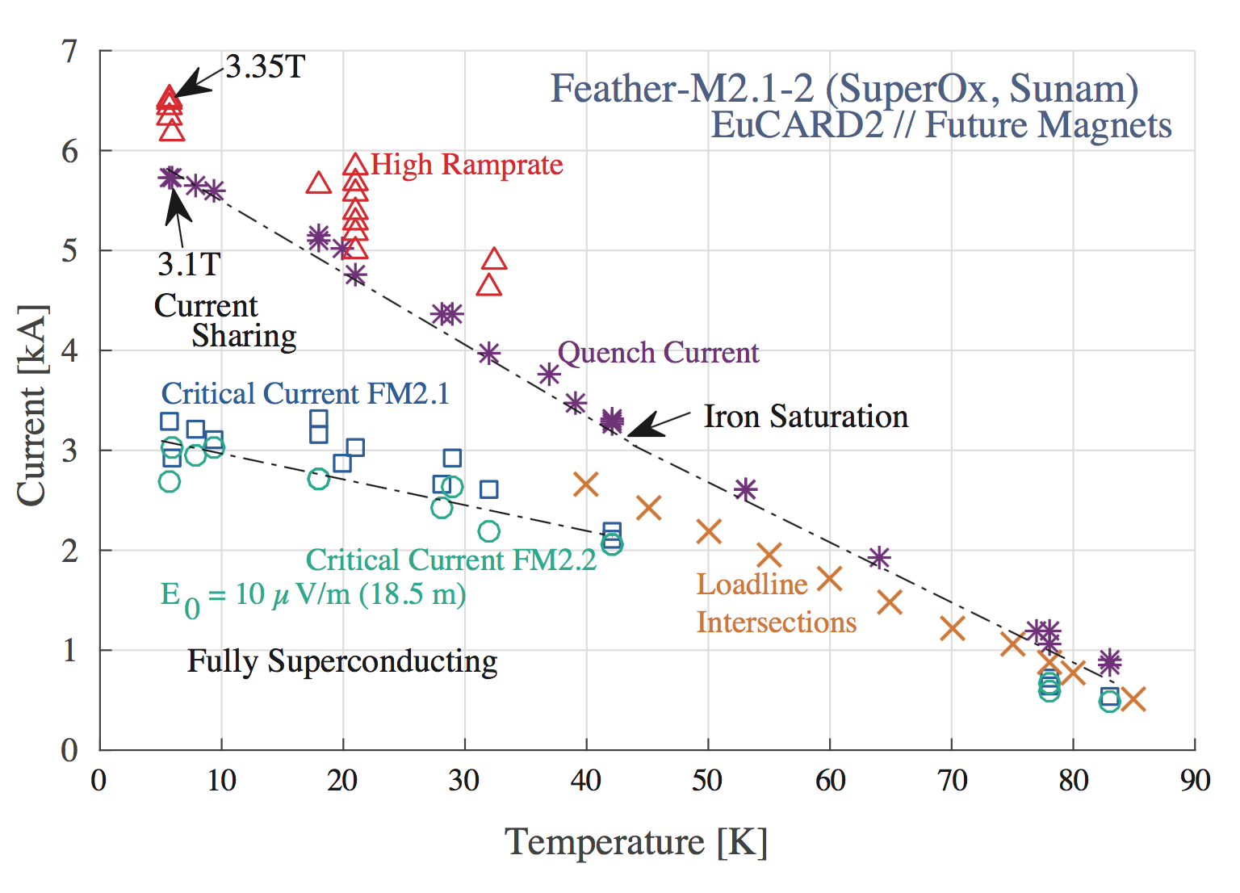
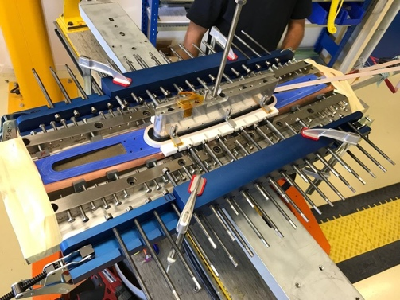
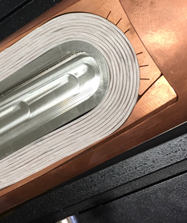
Feather-M2.0 test results
HTS magnets work differently than LTS magnets due to a larger enthalpy margin.

Slide 15
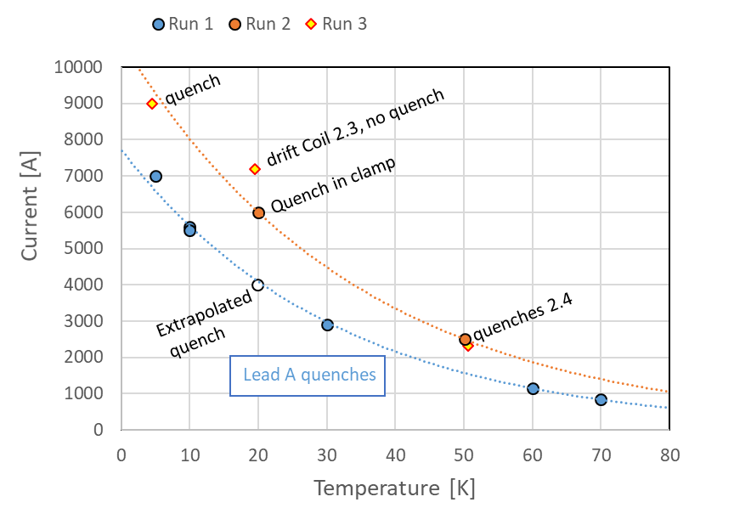
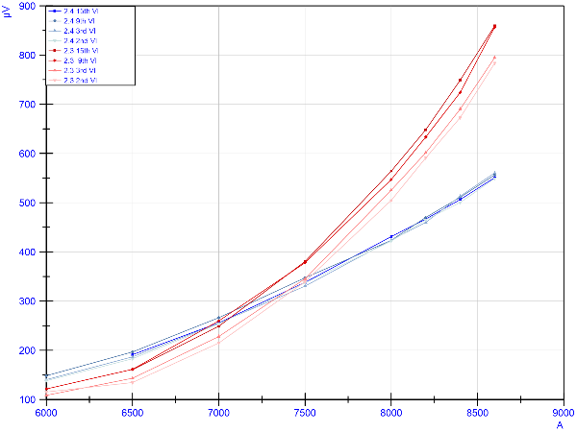
FeatherM2_3-4 magnet test results, stand alone
Coil 3, successive ramps
Coil 4
FeatherM2_3-4. Bruker tape – KIT Roebel cable
4.3 T reached (9000 A),
Serious problems with the leads, ReBCO Roebel cable is mechanically less robust as initially thought
Some degradation on (only) one coil

Slide 16
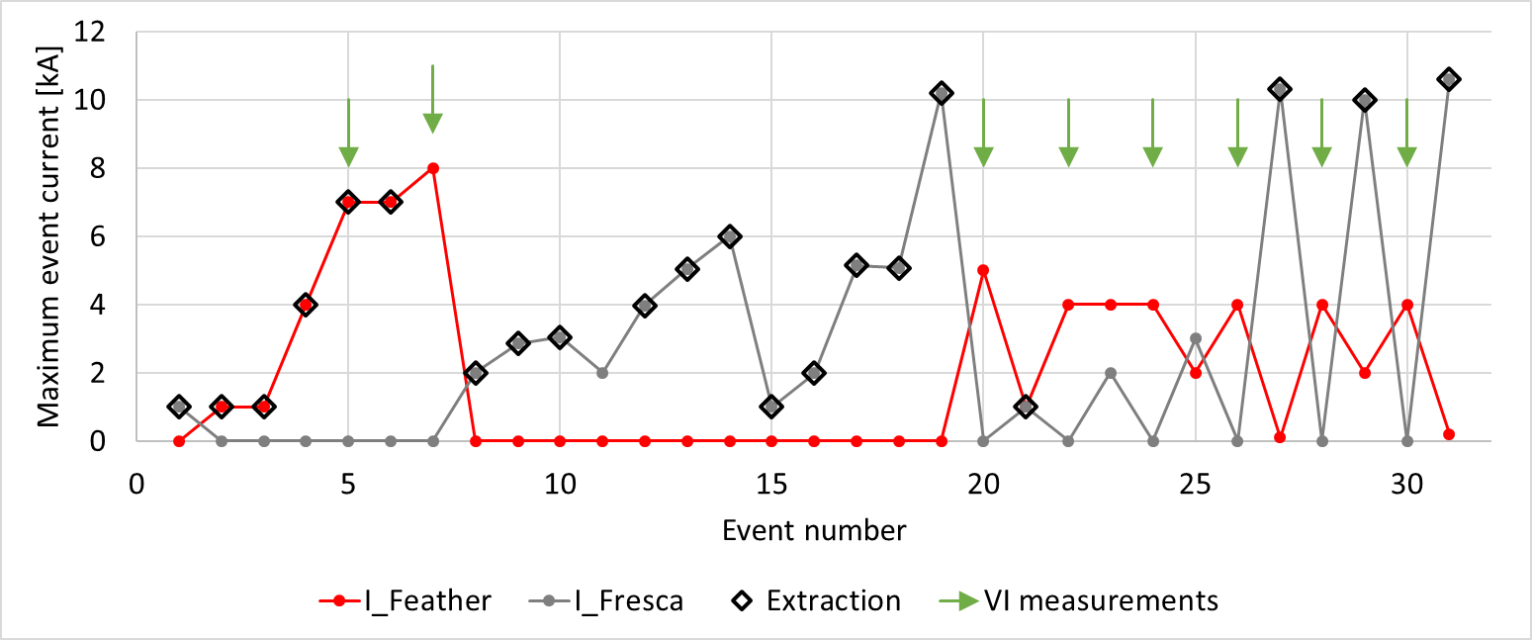
FeatherM2_3-4 magnet test results, as insert in Fresca2
FeatherM2_3-4 4.2K (no superfluid)
At start:
know stand-alone degradatiopn on one coil
mechanical damage issues with the leads
strong degradation in background field
1
2
3
4
5
6
7
8
F. Mangiarotti, G. Kirby, D. Martins Araujo, et al

Slide 17
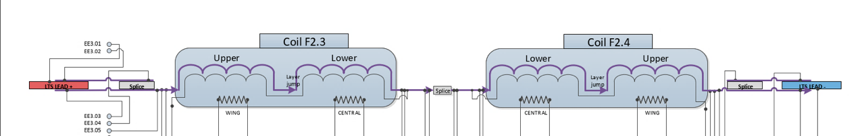
FeatherM2_3-4 magnet test results, as insert in Fresca2
V-I in Coil 2.3
V-I in Coil 2.4

Slide 18
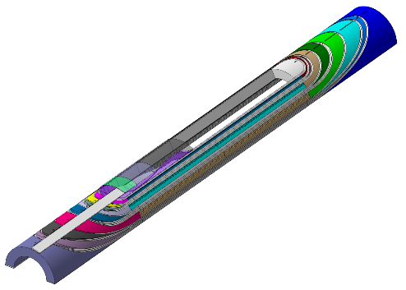
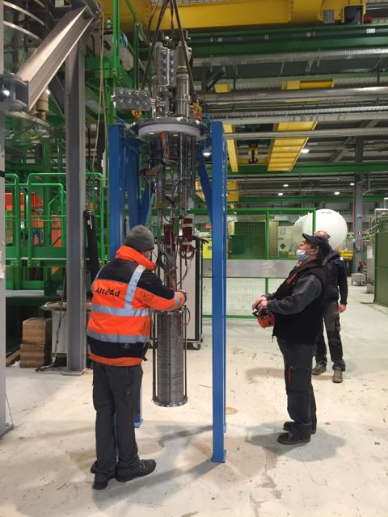
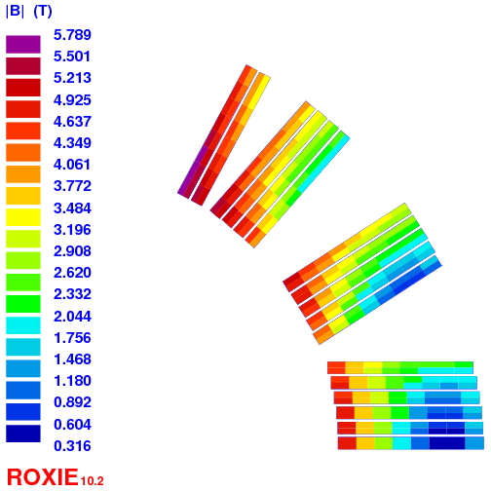
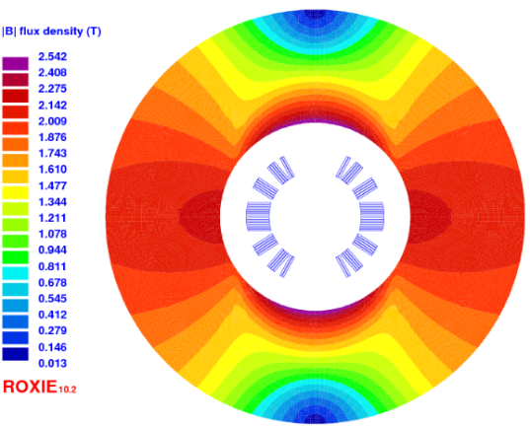
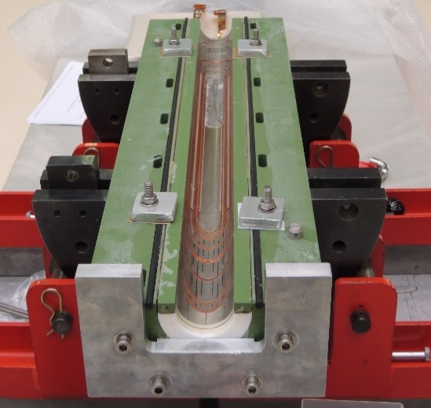
EuCARD2 Cos-θ CEA
Design B - « thin » cable : 12 x 1.0 mm² bare, 15 tapes 100 µm-thick
EuCARD2 Roebel « thin » cable :
  12 x 1.0 mm²
  15 tapes 100 µm
  12.0 mm total width
  300 mm twist pitch
2x125µm insulation
Layout | Unit | Cosϑ B
Iop | kA | 10.06
Bop | T | 5
Bpeak | T | 5.8
Ic | kA | 15.2
LL margin | (%) | 34
T margin | K | 30
Sd. inductance | mH/m | 0.73
coil inner radius | mm | 24
yoke inner raidus | mm | 50
yoke outer raidus | mm | 110
Nb. of turns | - | 17
Unit len. of cond. | m | 24
Cos-θ B : 1.0 mm + 2x125µm insulation, 17 turns
Notes:
Inner radius A : 22 mm B : 24 mm
Nb turns A: 14 B : 17
LL margin A : 20% B : 34%

Slide 19
Non-Insulated magnets: controlled interturn resistance
In case of a quench the current has an alternative path to the usual axial tape/cable direction
This alternative path is resistive : ~<μΩ per turn: to be costumised
Time constant to ramp the magnet: design the appropriate R _{interturn} to have ~10 mins ramp-up but a save fast rampdown.
Interturn medium possibilities: stainless steel tape, coatings, kapton with holes, “diode paint”
Coil structure: dry wound, soldered ( tin solders, Indium solders, etc)
Question: do we need full transposition cables ? Answer: probably not, but to be studied and tried out.
First aims:
  Can we build soldered coils ?
  Can we have controlled ramp-up, ramp-down and transitions (quench) ?
  Can we have a sufficient dynamic field quality for accelerators ?

Slide 20
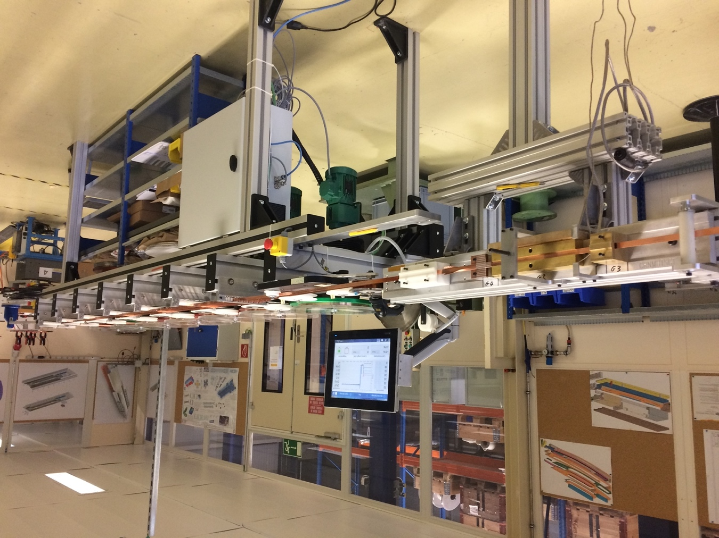
New winding tooling: 7 tape (co-) winding bench
927 lab “home development”
7 tapes (max), individual tension feedback controlled
compatible with coating stages on tape or on tape-stack

Slide 21
NI coil technology: Small solenoid coils
Study Non or partially insulated coils with small (cheap) solenoids.
Conductor Shanghai 10mm, The assembly is compatible with the full range of 4 – 12 mm tapes
ID 52mm, OD 102mm about 250 turns: ~64 m of tape per coil
T. Nes, J. Mazet, F-O. Pincot, D. Standen
single tape dry wound (done)
single tape soldered
2 tapes f2f soldered
2 tapes f2f, ss insulation, soldered
2 tapes f2f, ss insulation (thick), soldered
2 tapes f2b, ss insulation, soldered
2 tapes b2b, ss insulation, soldered
…

Slide 22
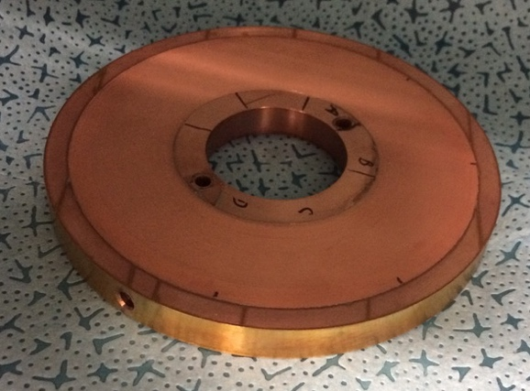
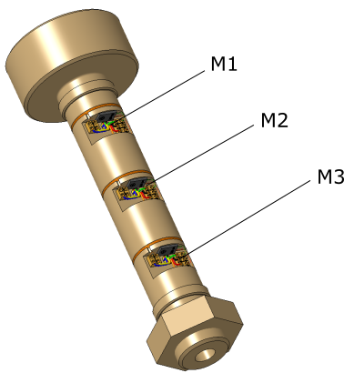
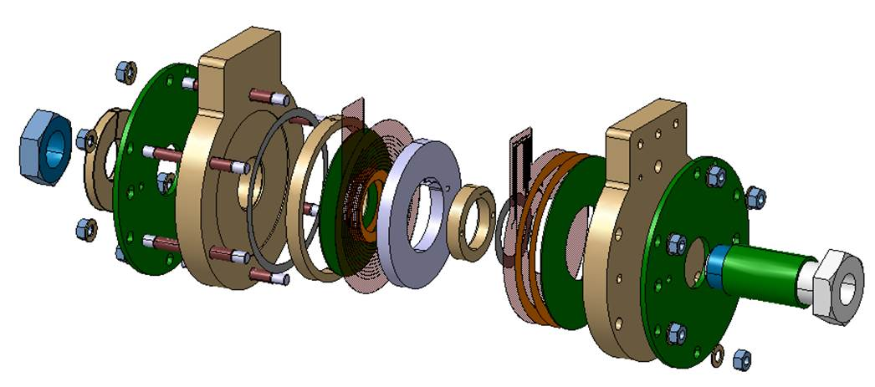
NI coil technology: Small solenoid coils
First coil wound
magnet assembled
Magnetic measremet probes installed
setting up DAQ system
preparing test

Slide 23
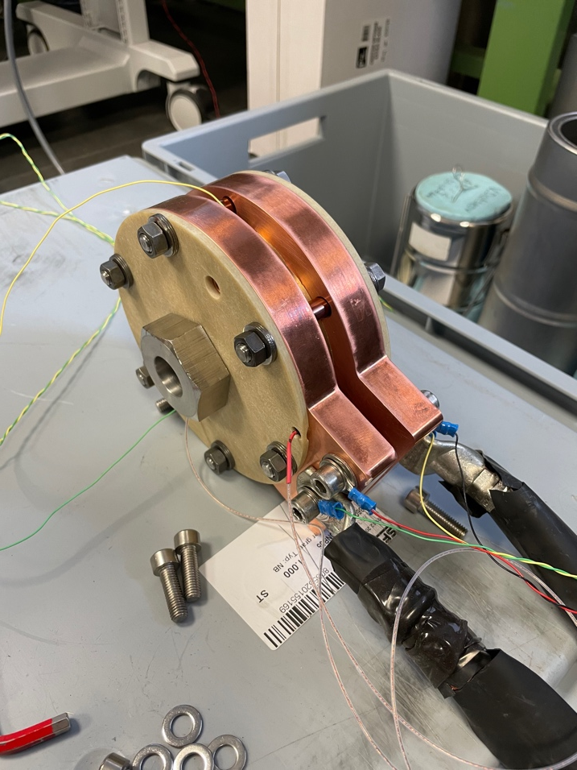
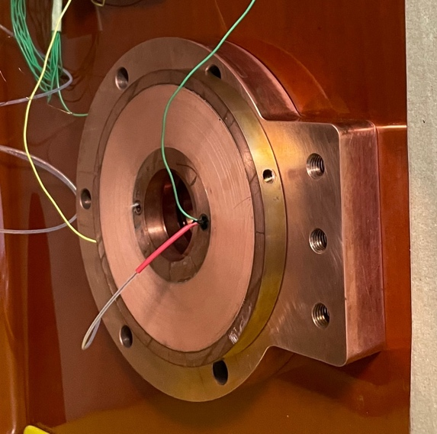
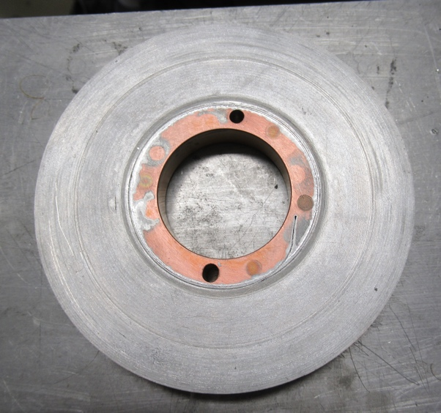
NI coil technology: Small solenoid coils
Test in Cryolab: variable T (20-80K), gass flow cooled setup
Test: look at the effect of the radial currents.
Magnet is self protecting, can potentially run at 110% Ic !
(have been shown in other labs)
First coil made
commissioning DAQ system
first LN2 tests soon
to be tested 20 < T < 77 K
Cryolab setup
To be tested also in: bld288, SM18, Twente, LASA…
dry wound, HTS tape
winding test, soldered, Cu tape

Slide 24
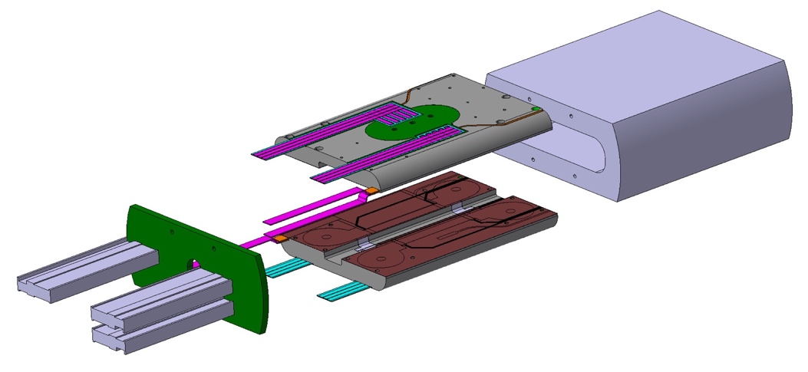
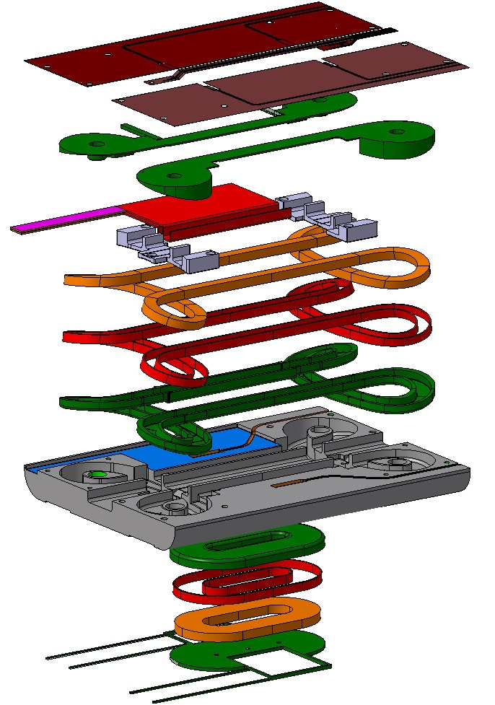
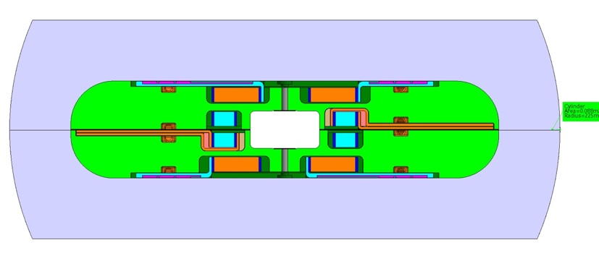
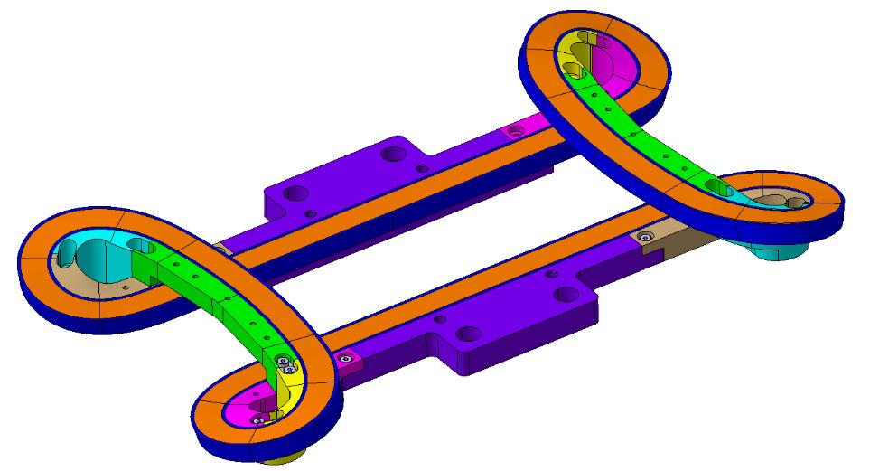
Small solenoid coils and cloverleaf model
3D model (Catia) of magnet (nearly finished) and hot-winding tooling exists, winding mandrel ordered
Design review in May, first model end of the year
Length | 495 mm
Width | 450 mm
Height | 180 mm
Aperture width | 56.815 mm
Aperture height | 30 mm
Operating current | 2 kA
Operating temperature | 20 K
Center Field Magnetic field strength | 8.3 T
Maximum Field on conductor | 12.2 T
Stored Energy | 73.16 kJ
Length cable per cloverleaf | 143 m
Length cable per racetrack | 80 m
Number of turns cloverleaf | 82
Number of turns racetrack | 183
Number of tapes per cable | 2
Insulation thickness | 0 mm
Cloverleaf Coil pack thickness | 16.4 mm
Racetrack Coil pack thickness | 36.6 mm
Total tape length 1 Cloverleaf | 286 m
Total tape length 1 Racetrack | 160 m
Total tape length | 894 m
T. Nes, G. Kirby, M. Canale, J. Mazet
hot winding tooling

Slide 25
HDMS “HTS Demonstrator Magnet for Space”
Aim: Study a successor satellite spectrometer for AMS-02 to lift the acceptance for detection of cosmic ray particles from 2TeV to around 100TeV
Participants: CERN, the Italian Space Agency (ASI), the Department of Physics at the University of Trento, and Trento Institute for Fundamental Physics and Applications
Financing: ASI 600k€, CERN 600kCHF (50% KT)
M. Dam, L. Rossi, J. Mazet, J-C. Perez, at al.
References:
edms CERN-0000191204
M. Dam et al, Supercond. Sci. Technol.33(2020)044012
M. Dam, MSC seminar 28.01.21, https://indico.cern.ch/event/999643/

Slide 26
HDMS
.

Slide 27
HDMS demonstrator

Slide 28
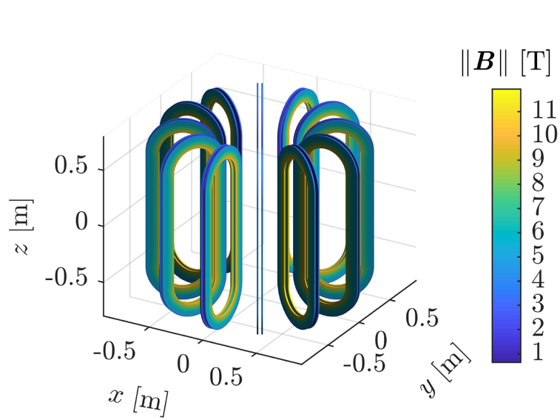
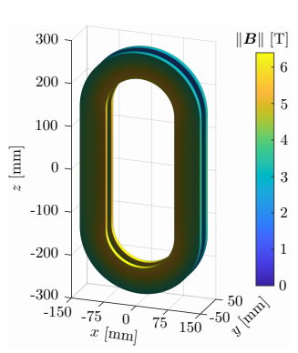
Magnet for space spectrometer
HTS Demonstrator Magnet Space (funded through ASI)
  One dummy coil and one full coil to be built until Spring 2021 to show the feasibility
  Final demonstrator summer 2021
Sub-scale coil (no HTS)
single Sub-scale coil (HTS)
double Sub-scale HTS coil

Slide 29
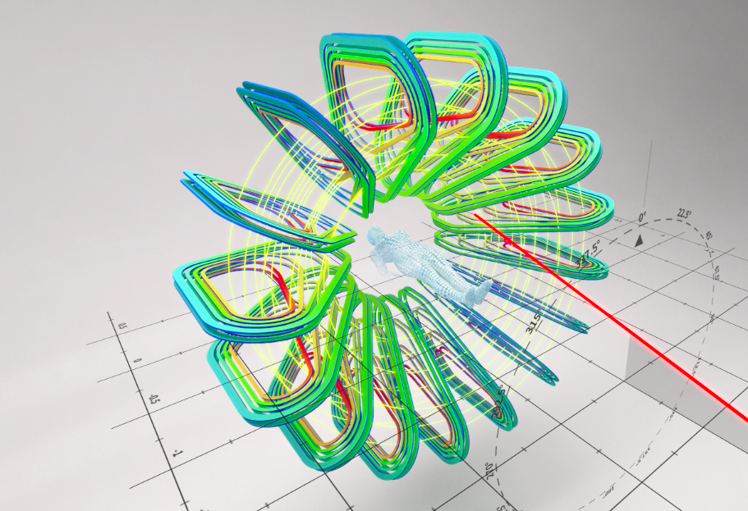
GATOROID: Toroid gantry magnet (HTS version)
Thesis of E. Felcini
Design for the HTS version done
Dummy coil wound (single tape)
demonstrator coil construction: tbd. where and when
L. Bottura, E. Felcini, J-C. Perez, A. Haziot, J. Mazet, T. Lehtinen, et al

Slide 30

GaToroid: Flowchart
Small coil program
Sub-scale HTS coil, 1/3, 600 mm
Dummy1, single SS, no insulation
Dummy2
2020

Slide 31
HTS Undulator
S. Richter, D. Schoerling

Slide 32
The HTS program: Undulators/Wigglers Flowchart
Small coil program
Horizontal Wiggler, Test coil
Coil 1-#n
Vertical Wiggler, Test coil
Wiggler/undulator, short model (0.1 m)
Wiggler/undulator, long model (0.5 m)
Coil 1-#n
Helical Wiggler, Test coil(s)
Coil 1-#n
2022
2027
Depends on the results of the coils currently under construction

Slide 33
Lessons learned-1
General technical
“Go in steps” , build intermediate models which target specific features.
HTS behaves differently than LTS
  Can operate in current sharing mode: you can run it I > I_{short-sample}
  Low, slowly developing quench voltages: need sensitive detection ( buckling, poles or wire )
Connections and splices are not (yet) obvious: need extra attention
  Recurrent problem
    Splices need a large surface (each tape ~10 cm²) (ReBCO layer to Cu resistance)
    ReBCO Roebel cable is mechanically less robust as initially thought: leads need to be redesigned
We need detailed and complete conductor characterisation, (stand, tape and cable).
Using new cable concepts: construct small models early on to see what the issues are and to give feedback (Feather2 does this for Roebel, Cloverleaf does this for NI tape stack).
Interaction between tape and impregnation need to be understood (delamination)
Tape robustness in high fields needs to be investigated.
Do we need prestress or is “leaning against the wall” sufficient ?

Slide 34
Lessons learned-2
General organizational
To address the HTS challenge, sufficient engineering and technical workforce needs to be deployed. One senior engineer doing everything does not work here.
Real collaboration is key
  No lab has for long periods of time all the know-how and key resources available all the time. You have to be complementary and supportive (examples: the 2 CEA inserts where they were mostly alone, CERN lacking conductor characterisation due to HL-LHC overload).
  As you cannot predict where all the difficulties are, you cannot define rigid “black box” contributions to the project at the beginning.
You need the discipline to step back and study a difficulty when you hit one. You need to be strong enough to decide not to follow the planning.
Doing R&D in the same organizational unit as serving the running machines leads to significant delays and limits possibilities to study detailed effects.
HFM development takes time: resist to management trying to squeeze the planning. The same holds for the budget.

Slide 35
Lessons learned-3
Feather magnet line
Leads need to be redesigned (full length support)
Splices need to be redesigned (e.g. fin-block)
For stand alone:
  quench protection with buckling coil works well
  quench protection with differential pole signal works well
For insert tests:
  quench protection with delayed outsert dump works well
More instrumentation needed to see the detailed behaviour and degradation (Feather2: 3 out of 4 coils degraded in stand alone, both coils degraded in insert mode)
Up to now all Feather magnets degraded : need a thorough post-mortem to find the cause for this.

