Slide 1


The 32 T superconducting magnet at the NHMFL
Presented by Hubertus (Huub) Weijers
Formerly 32 T project leader at the NHMFL, Tallahassee, Florida, USA
(2010-2020)
Now Senior Principal Engineer – Magnet System and
Chief Engineer for Space and Magnets
Piehau / Robinson Research Institute, Victoria University of Wellington
Wellington, New Zealand

Slide 2

Outline
(2009)
Introduction
  The 32 T magnet
  Recent activity (& team)
First run to full field and subsequent results
Recap of Lessons learned
  Quite a few
Key challenges
  SCIF affecting strain state, lifetime
  I_{c} margins & Protection
  Defect tolerance: 2-in-hand or cable?
This work was supported in part by the U.S. National Science Foundation under Grants No. DMR-0654118, DMR-1157490, DMR-0923070 and the State of Florida.

Slide 3
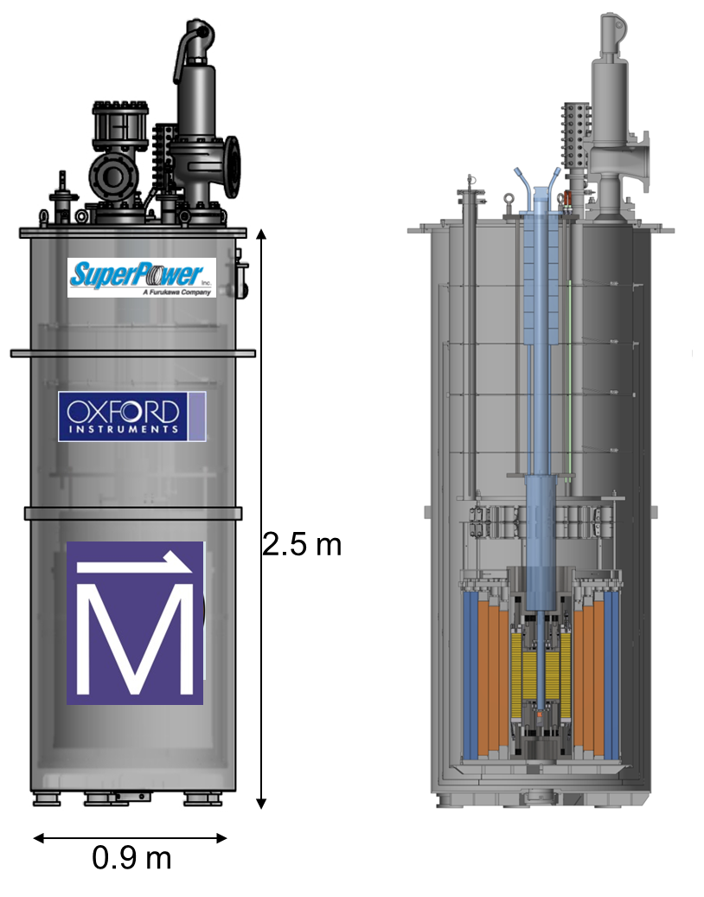
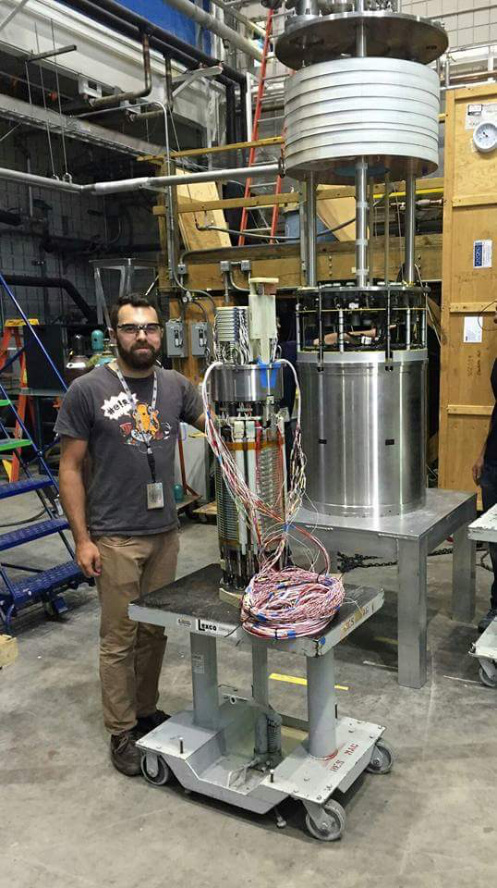
The 32 T magnet
(2009)
Key parameters:
Center field 32 T
Clear bore 34 mm
Ramp time 1 hour
Uniformity 1 cm DSV 125 ppm
Operating temperature 4.2 K
Intended cycles/20 years 50,000
Time between LHe fill (spec) ≥ 1 day
Stored energy 8.3 MJ
System weight 2.6 ton
15 T / 250 mm bore LTS magnet
17 T / 34 mm bore REBCO coils
Separately powered (268 & 174 A), ramped synchronos
REBCO: 2 double pancake coils
INSULATED TURNS
Nb₃Sn coils
NbTi coils
Dil. fridge or VTI
Just before the union of HTS and LTS coils

Slide 4
Recent activity
(2009)
Date | Key activity
Nov 2017 | Deliberate 28 T / 6 MJ quench
Dec 2017 | Successfully reached 32 T & demonstrated all specs (except lifetime cycles)
1Q-2Q 2018 | Warm-up and partial disassembly for inspection, flange issue found
2Q 2018-1Q 2019 | Re-design HTS terminals, testing, installation, magnet re-assembly. SCIF-strain calculations
1Q-4Q 2019 | Move to final site, commissioning / conversion to user facility, electronics re-build, cool down
1Q 2020 | Operated stepwise to 16 T, comparing B_{z}(z) maps with SCIF calculations (HW leaves)
2Q 2020 & beyond | Covid slows everything down
Throughout 2020 | Improved understanding of SCIF-strain & feasible explanation of observed hysteresis
Aug-Oct 2020 | First (~internal) user: material science with NMR data to 26 T
March 8, 2021 | Operated to 32 T in user configuration
May 2021 | Intended start of user operations

Slide 5
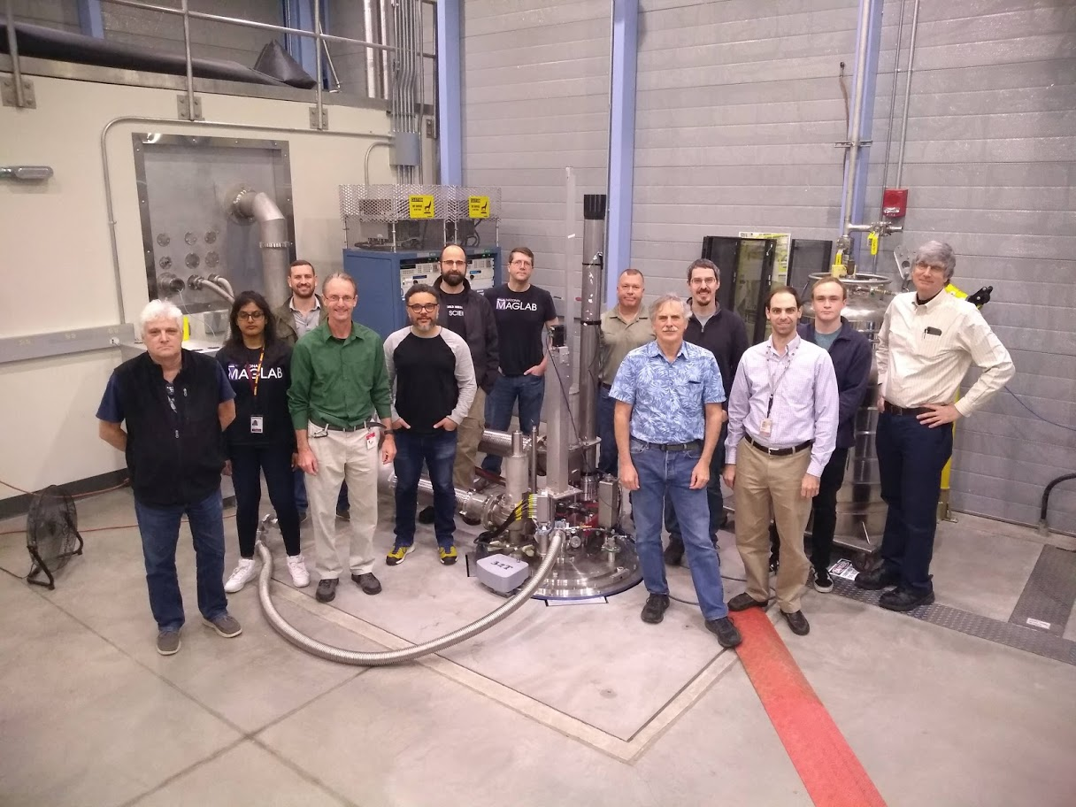
Commissioning core team
(2009)
Youri Viouchkov – designer
Sujana Uppalapati- Electronics
Brent Jarvis – technician
Huub Weijers – project lead
Ali Bangura - user support
Robert Nowell - user support
Eric Stiers - Electronics
Tim Murphy- Director user operations
Scott Hannahs - instrumentation
Bert Green - instrumentation
William Coniglio- instrumentation
Dylan Kolb-Bond – SCIF calculations
Mark Bird – MS&T director

Slide 6
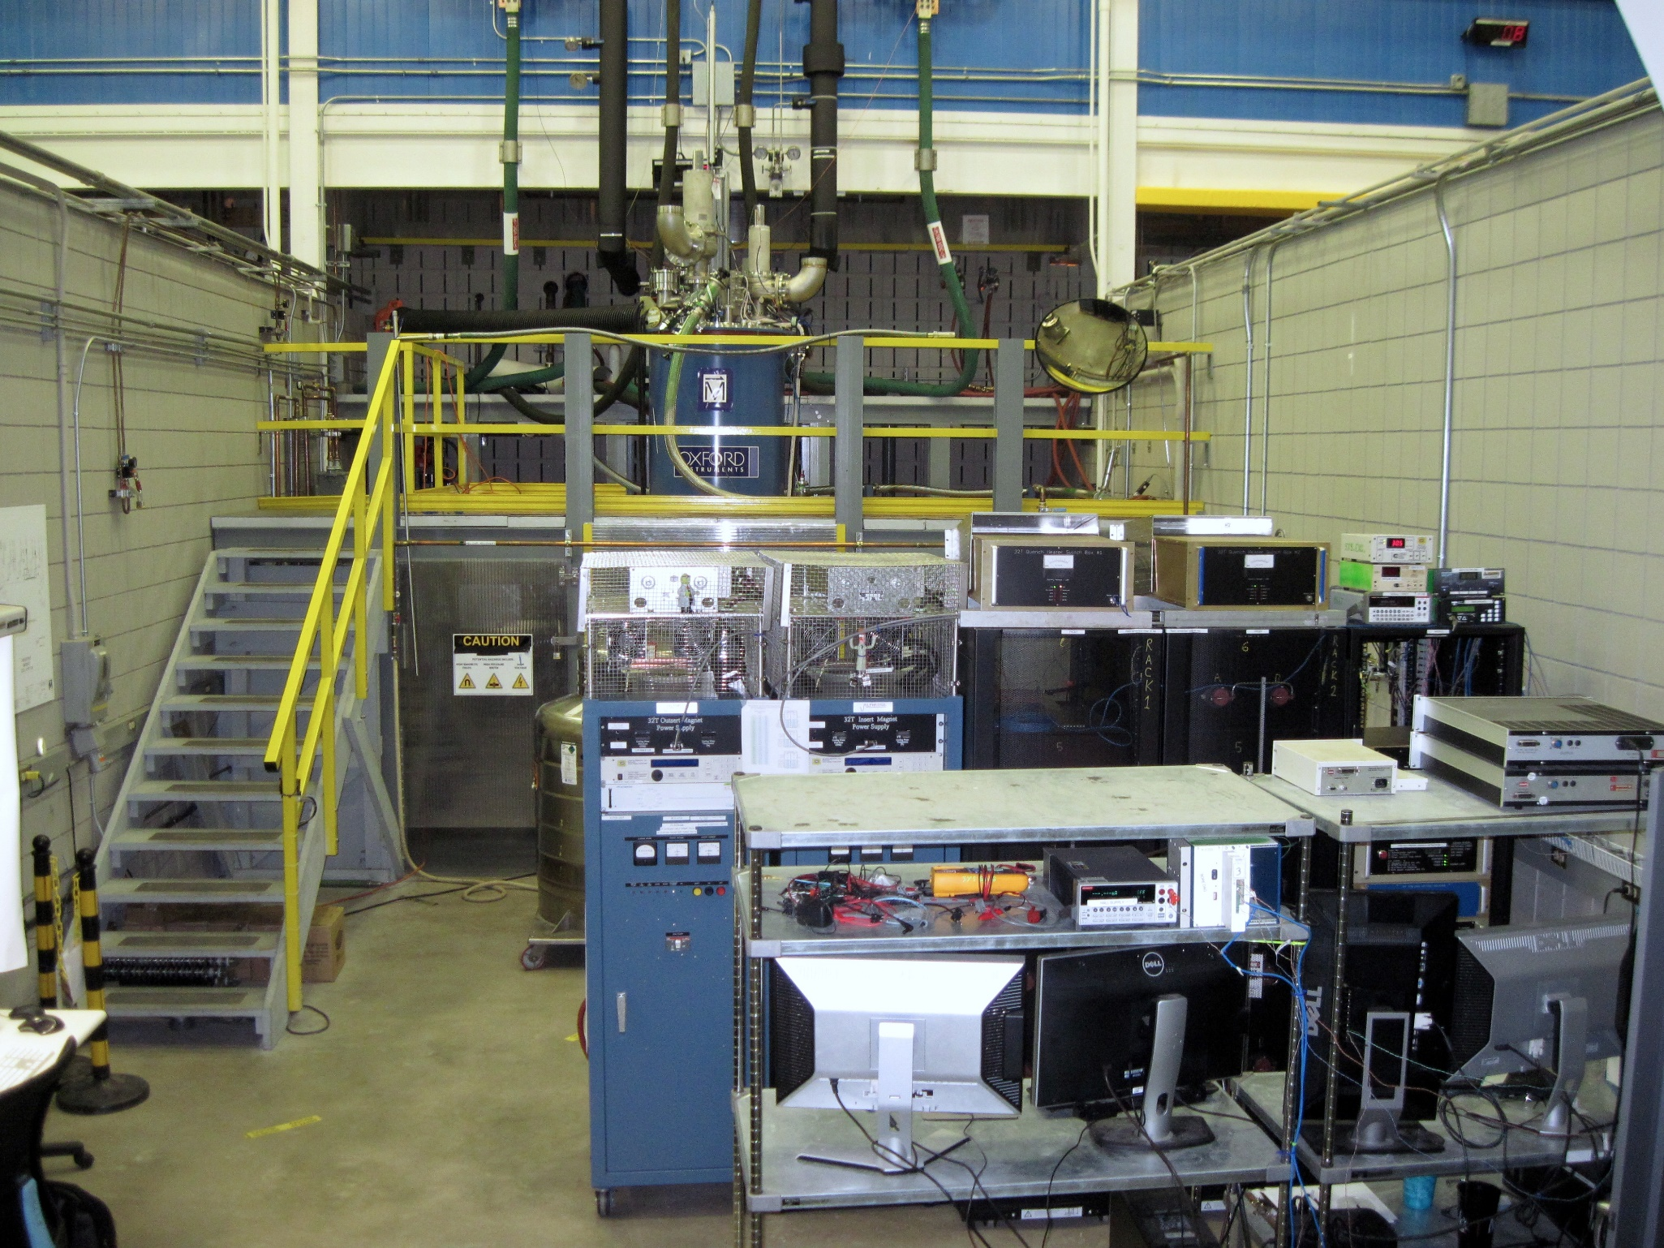
The 32 T system under test (2017)
(2009)
Top of cryostat
Data Acquisition

Slide 7
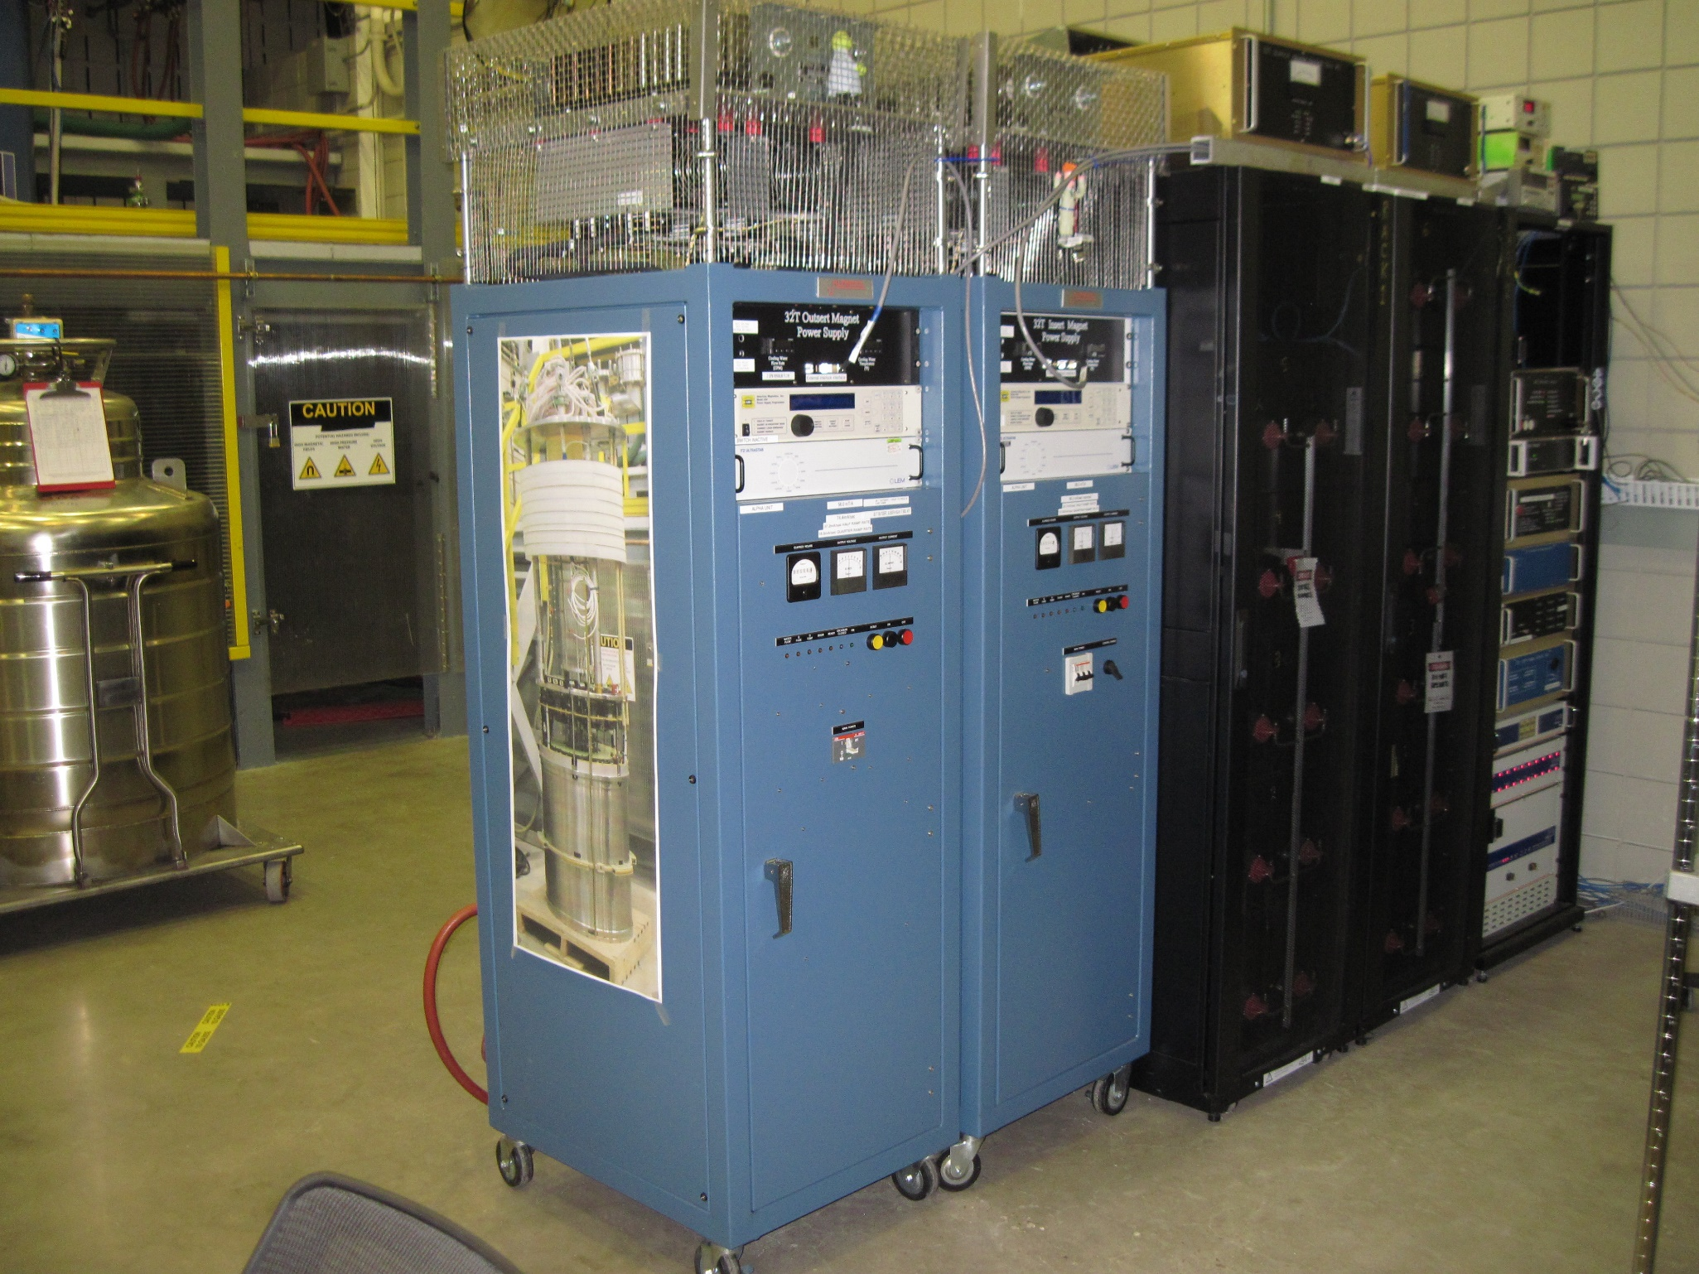
The 32 T system under test (2017)
(2009)
Switch Box 1 & 2
Crowbar resistor
Interlock
HTS Quench management
LTS Quench management
LTS magnet PS
HTS magnet PS
Battery bank

Slide 8
The NHMFL 32 T system under test in Cell 4 of NHMFL (2017)
(2009)
Switch Box 1 & 2
Crowbar resistor
All this stuff is protection equipment
Interlock
HTS Quench management
LTS Quench management
LTS magnet PS
HTS magnet PS
Battery bank
Notes:
The two blue boxes power the magnet. The rest is protection.

Slide 9
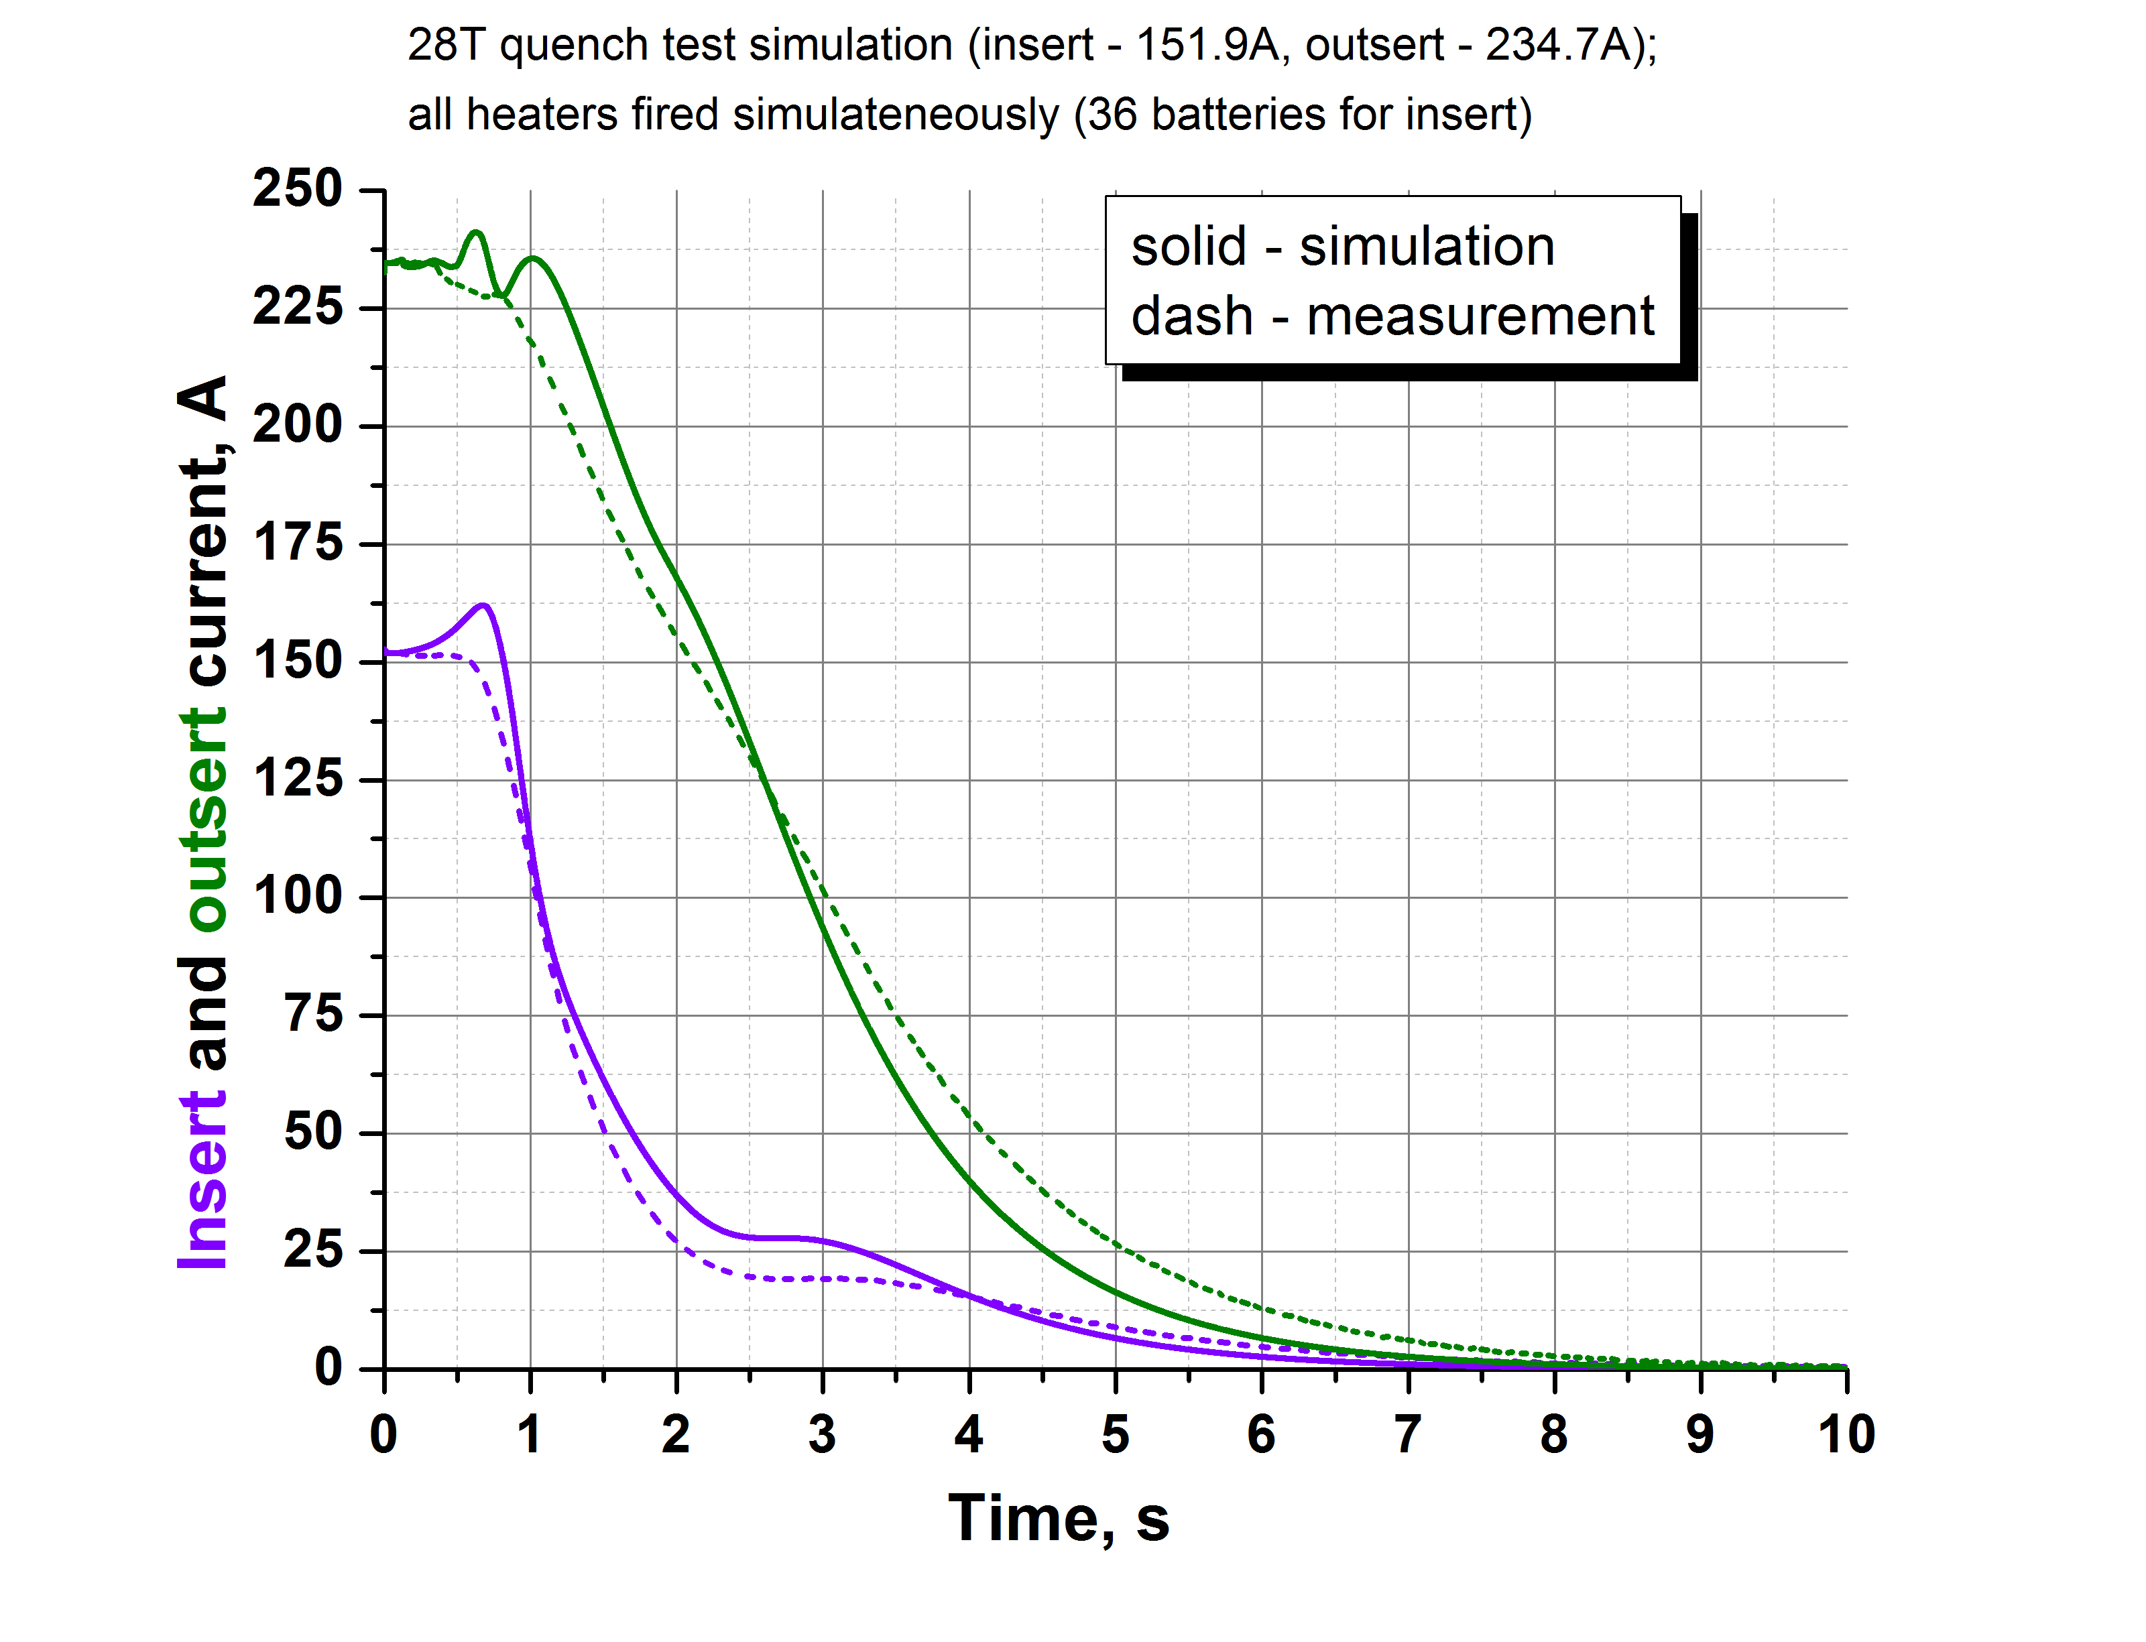
28 T quench data and simulation
(2009)
This is unique quench data:
High-value high-field HTS coils
The HTS coils survived
Actual behavior slightly more favorable than simulation
Simulation output is sensitive to variations within known variability range of conductor properties:
Having data on few short samples from ends of each spool is not good enough
Get end-end data
Quench model had to be tweaked based on experimental data
(at lower field)

Slide 10
Quench history of assembled 32 T
(2009)
 | HTS-only operation, or LTS < 1 T | HTS + LTS series operation
Spontaneous HTS quenches | None | None
Spontaneous LTS quenches | None | None
False positive in quench detection | 9 trips*, all below 9 T central field | 2 trips*, -18.5 T, -11 T
Deliberately induced quenches | None | 16 T: half field, quarter energy 22.5 T: half energy 28 T: 7/8 field, ¾ energy
*: Reduced quench detection sensitivity at lower fields to address this.

Slide 11
Actual performance versus specifications
(2009)
Key specifications:
Center field 32 T
Clear bore 34 mm √
Ramp time 1 hour
Uniformity 1 cm DSV 5×10⁻⁴
Operating temperature 4.2 K √
Time between LHe fill ≥ 1 day
Peak field (32.1 T) later confirmed
with ⁶³Cu NMR measurement
√
√
√
Dec 8, 2017
Used 32 liters helium for this run
~ 6 liter/hour versus 11.3 liter/hour max in heat load budget
➔130 liter/day with 24/7 operation (ramping)
➔~50 liter/day at constant current
> 300 l useable volume

Slide 12
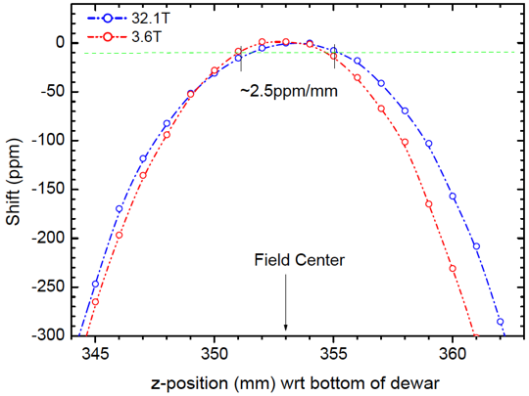
Observed behavior: Uniformity over +/- 5 mm
(2009)
Key specifications:
Center field 32 T √
Clear bore 34 mm √
Ramp time 1 hour √
Uniformity 1 cm DSV <500 ppm √
Operating temperature 4.2 K √
Time between LHe fill ≥ 1 day √
  Uniformity is ~ 125 ppm in 1 cm DSV ~independent of B
  Well within spec of 500 PPM
  Hall sensor mapping shows consistent z² term |B| > 1 T
  z² term can be adjusted by modifying Coil 1 mid-plane gap
NMR mapping at 3.6 and 32 T
125 ppm in 1 cm DSV
B_{fit} = B_{peak}(1-a×z²) with z in mm
z² term a is 5±2×10⁻⁶ for |B| > 1 T
Determined with Hall sensor, which contributes to error bars
(raw data in spare slide)

Slide 13
Observed behavior: drift
(2009)
  Central magnetic field drifts
  Worst case: 10 ppm/minute in direction of ramp immediately after reaching a set point at full ramp rate
  0.5 ppm/minute after > 1 hour (level of power supply drift)
  <0.5 ppm/minute immediately after reaching a set point at full ramp rate after slight overshoot
  At zero current: 2 mT drift of remanent field overnight (14 hours)
>1 hour wait results in
power-supply level drift
Slight overshoot immediately results in
power-supply level drift
lunch break
10 ppm
10 ppm

Slide 14
Actual performance versus specifications
Flux Jumps
Mostly happen ramping at low field (B_{CF}< 10 T)
Central field disturbance is small (few mT over few ms)
Power supply response is not
  Improvements via controller modification needed
Low-field flux jump related clusters of events:
LTS power supply response
32 T
HTS Coil 1
HTS Coil 2
HTS power supply (over-)reaction to
single flux jump event
PS limit
0 T
0 T
0 T
HTS power supply output
Event
- 32 T
1 Hz data over 5.5 hours
500 Hz data over 20 seconds

Slide 15
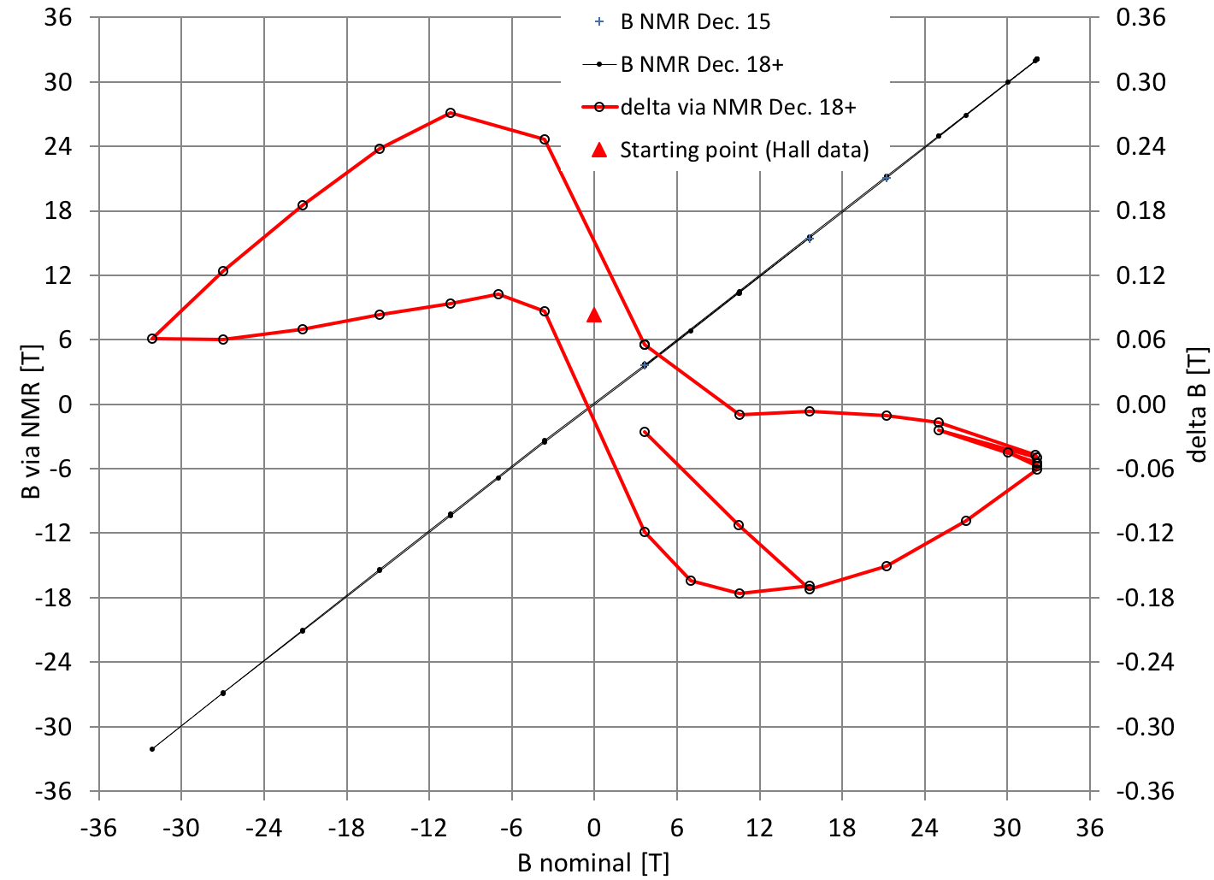
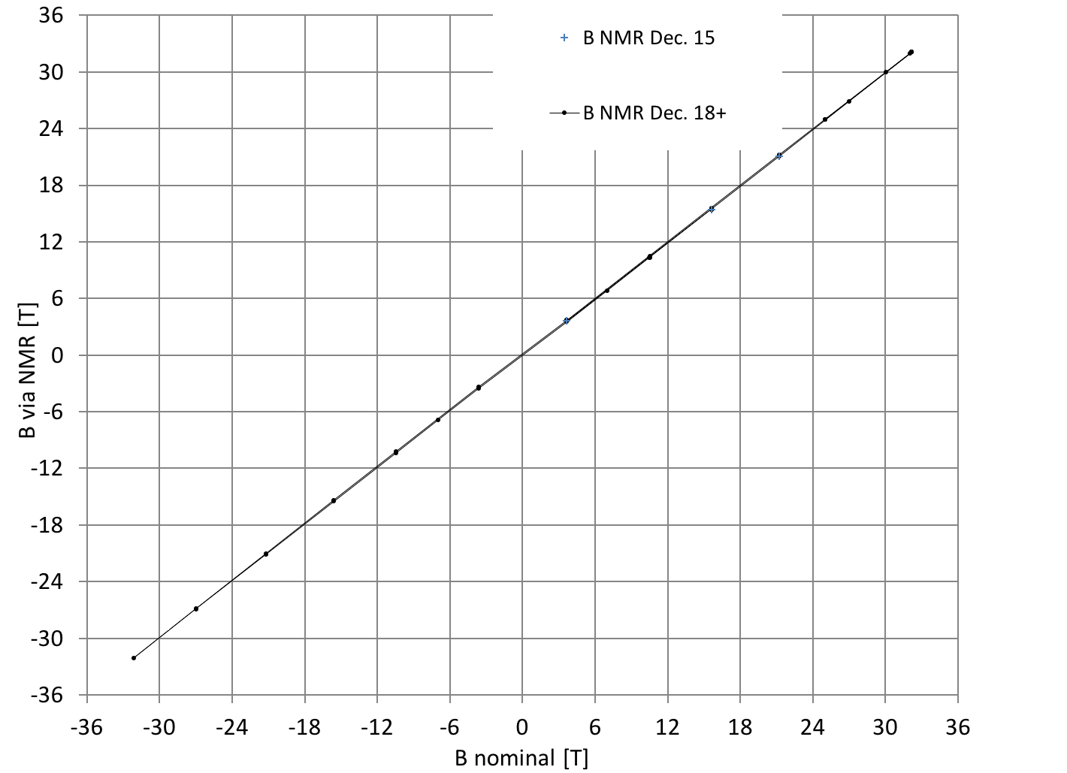
Observed behavior: Hysteresis at field center
(2009)
60 mT below nominal at ±32 T
FAR smaller than expected from SCIF models (~900 mT)
Different shape expected
Why?
What does that mean?
Large HTS I_{c} margin expected
Large I_{c} margin→ big SCIF
Small SCIF → I_{c} margin lost?
But nothing else points to I_{c} loss (degradation)
SCIF models are ~correct at Low B, so ?????
Coming back to this
NMR mapping 0➔32➔0➔-32➔0➔ 14 tesla

Slide 16
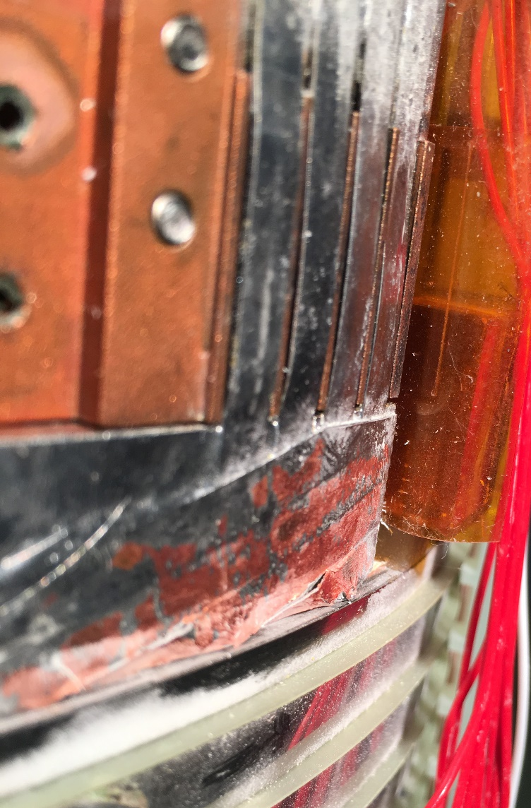
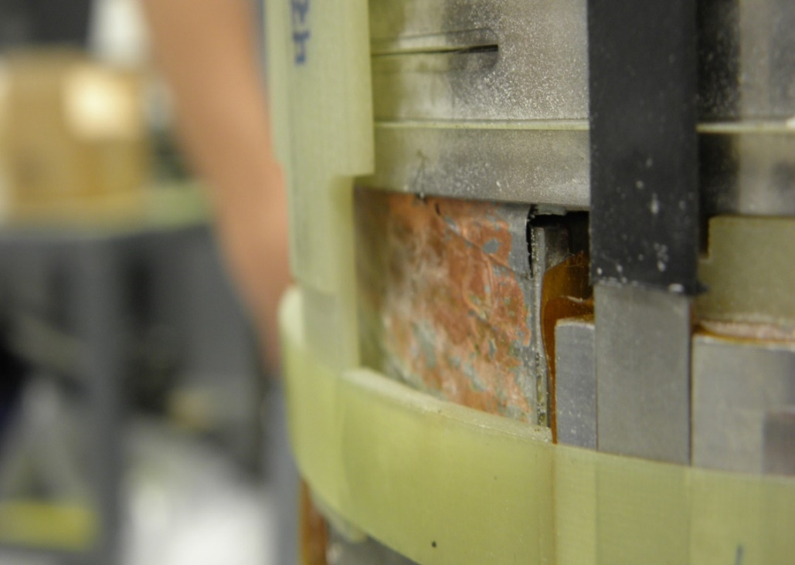
Inspection after first test (as planned) (2018)
(2009)
  Final conclusion: Spring loaded HTS top & bottom flanges didn’t move properly with coil
    Terminal damage was not measurable (yet), hardly visible
  Redesign of terminal to accept this deemed the least painful solution
    Were not 100% confident that “easy” flange mods would suffice
HTS Top electrical terminal with first pancake overbanding removed
HTS Bottom electrical terminal with final pancake overbanding in place
Double pancake (~9 mm)
Terminal
overbanding
Damaged scarf
(multiple 4 mm wide tapes)
Terminal scarf
Bottom flange
Scarf over top pancake without overbanding

Slide 17
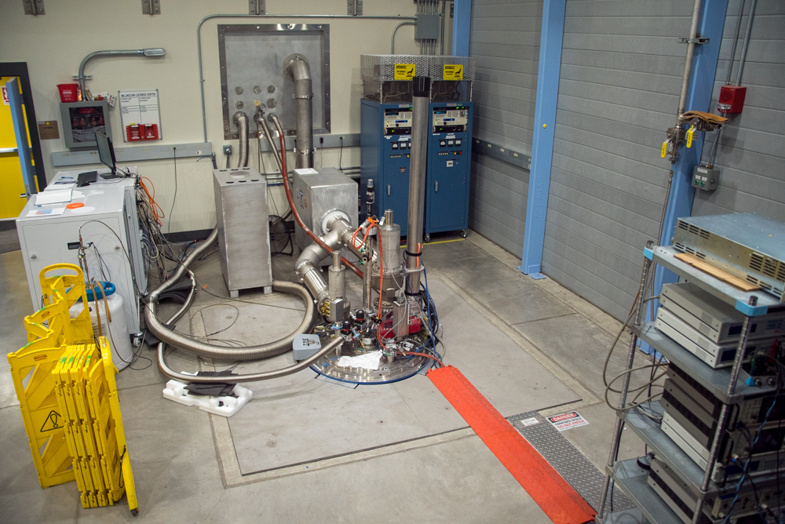
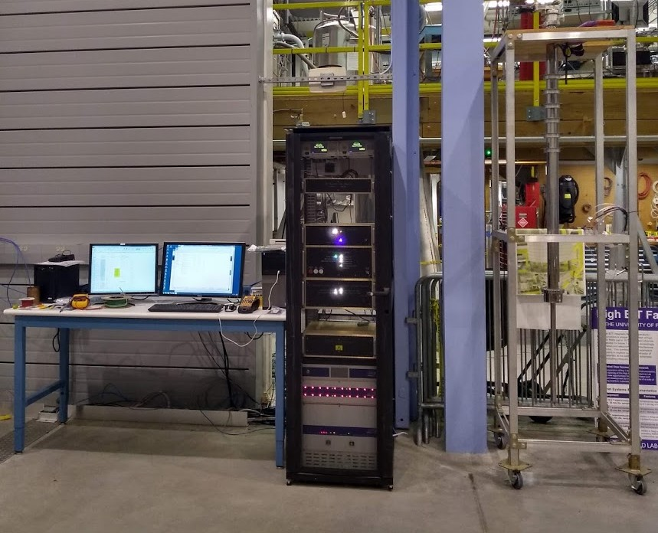
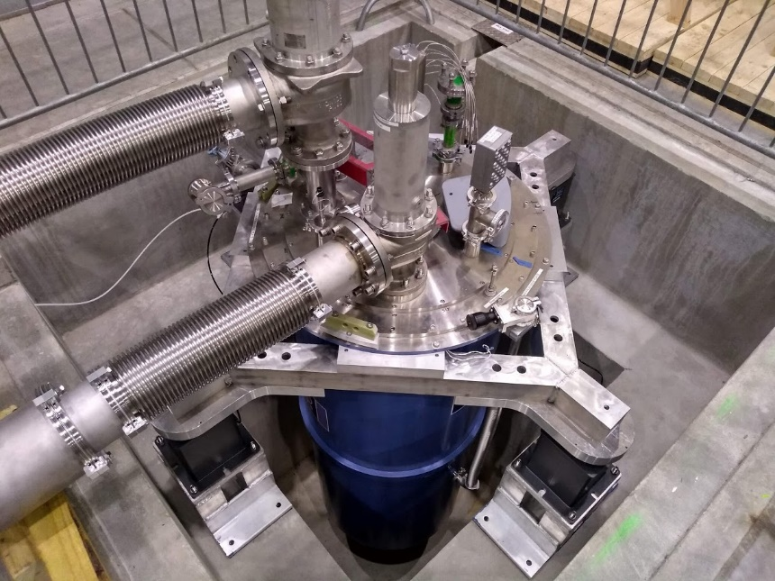
Superconducting 32 T magnet set up as user facility (2019)
(2009)
Overview
Temporary (?) Magnet DAQ and protection monitoring
VTI
Protection electronics
Pit with cryostat on vibration isolation (cover temporarily off)

Slide 18
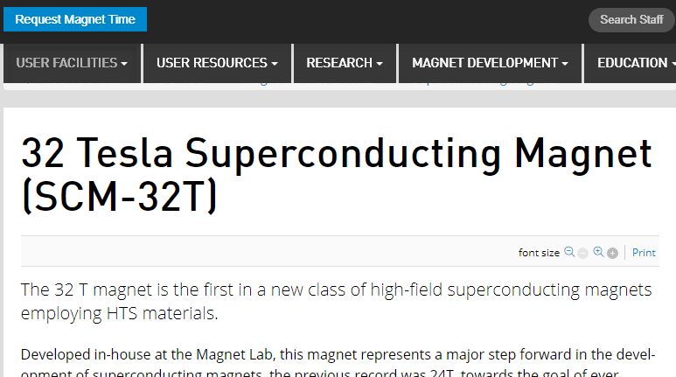
Superconducting 32 T magnet user facility (2020-2021)
(2009)
The magnet is used as scientific instrument
  Including NMR
Access can now be requested as user
First scientific experiment up to 26 T Q2-Q3 2020)
https://nationalmaglab.org/user-facilities/dc-field/instruments-dcfield/dc-field-superconducting-magnets
https://nationalmaglab.org/images/users/dc_field/searchable_docs/science_highlights/jan2021_dc_field_probing_spin_nematic_state.pdf

Slide 19
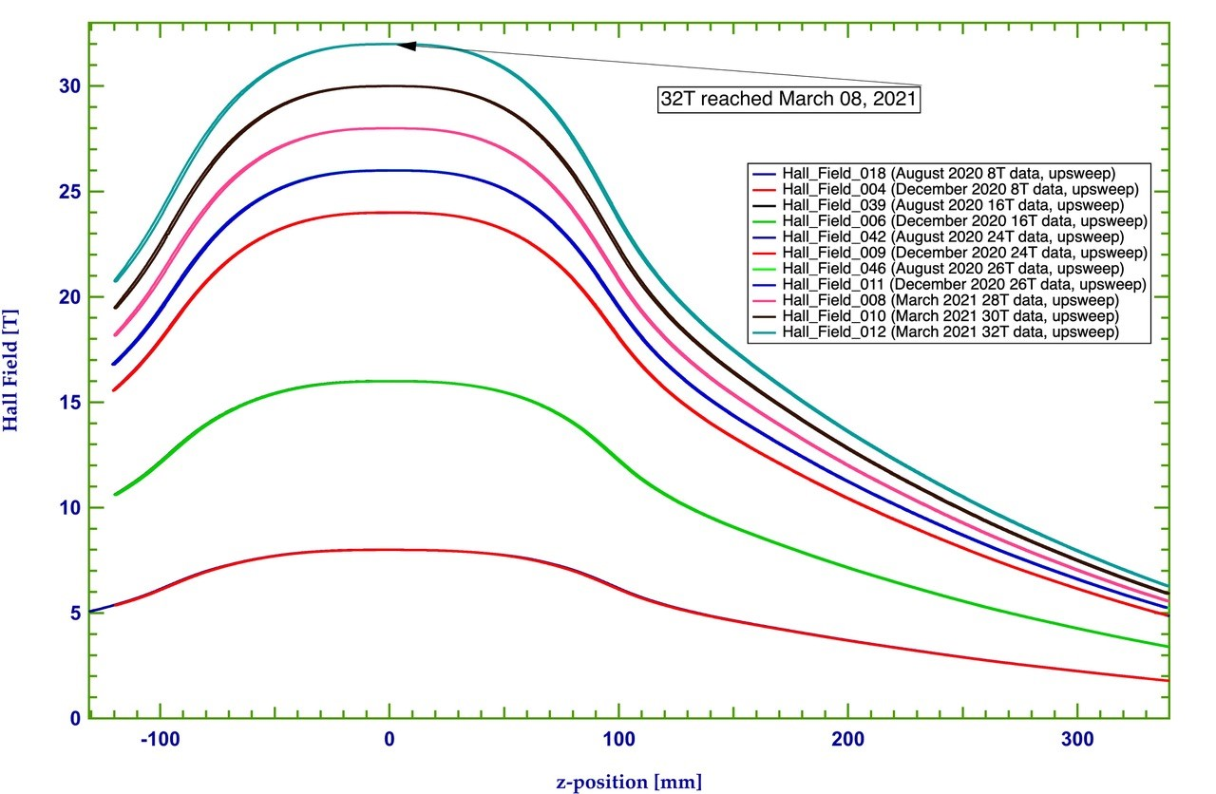
Superconducting 32 T magnet user facility (2020-2021)
(2009)
Magnet returned to full field in March 2021
Center Field

Slide 20
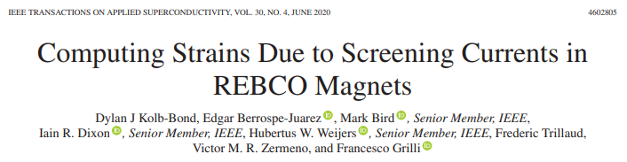
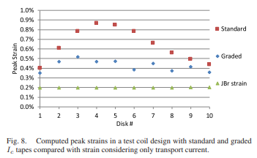
Recent SCIF work at NHMFL (not 32 T)
(2009)
I_{c} margin matters
Keep it small
Suggest deliberate grading in I_{c} spec in design & purchase of conductor
Personal communication, unpublished
32 T observed hysteresis falls in range of recent simulations if the relevant geometric factors are taken into account
Not necessary to assume the I_{c} margin has been reduced to explain narrow hysteresis loop
Peak strain [%]
https://ieeexplore.ieee.org/document/9031297

Slide 21
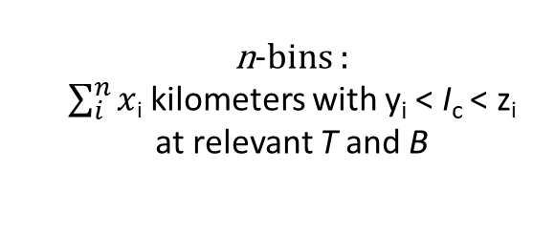
Conductor as delivered (2013-2014)
(2009)
Short sample I_{c} varies within piece length
Average I_{c} generally increased with time
Most of this is too good leading to excessive margins
Lower grades ideally tailor made, not failed attempt at higher grade
What we would have wanted in retrospect
Spec not feasible then and work in progress now
specification
Data on 175 lengths, ordered in sequence of increasing average I_{c}
n-bins :
$\sum_{i}^{n}{x}$_{i} kilometers with y_{i} < I_{c} < z_{i}
at relevant T and B

Slide 22
Lessons learned (condensed), 32 T insulated HTS + LTS magnet
(2009)
One-off NHMFL 32 T & Sendai 25 T insulated HTS+LTS magnets meet or exceed specs and generate scientific data, TRL 8-9
HTS Conductor (2013-2014 production) not as mature as desired, vendor collaboration essential
Quench management works ($$$) and spontaneous HTS quenches have not occurred
Commercial LTS magnet is stable (no spontaneous LTS quenches) but flux jumps at low field
Partial disassembly and visual inspection after first test worthwhile
HTS SCIF has effect on both B and strain, hard to get models to match data
Custom Electronics for test & user setup take a much larger effort than anticipated

Slide 23
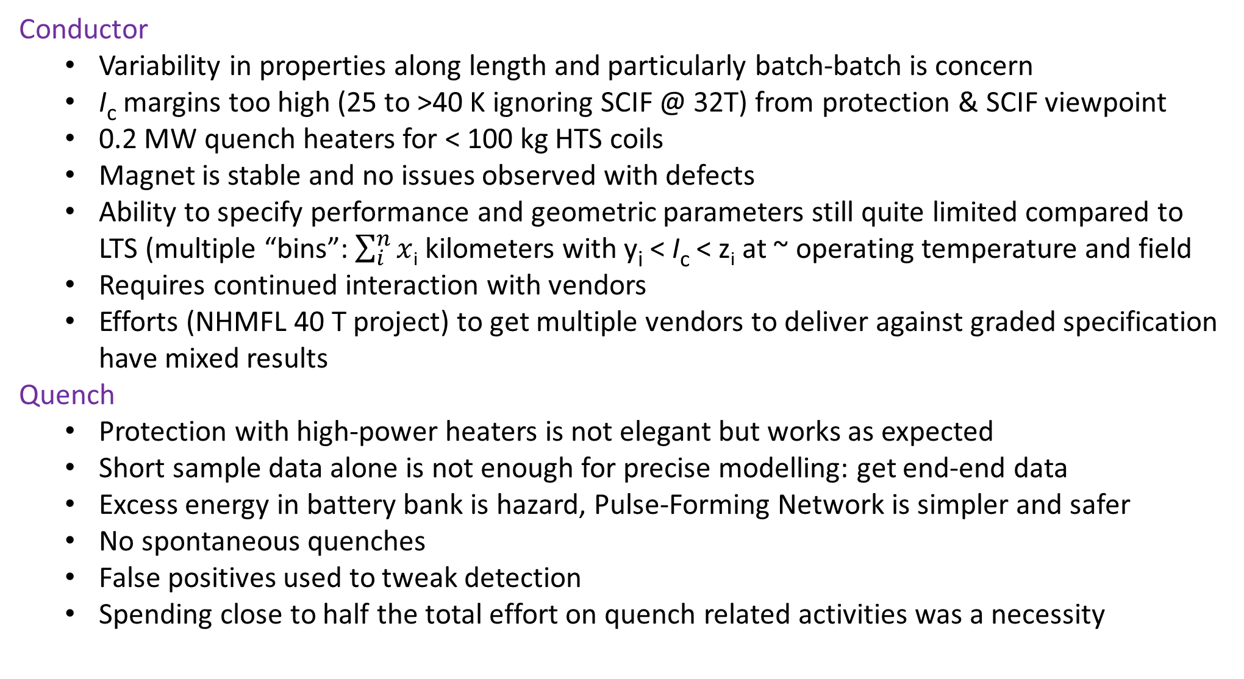
Lessons learned 32 T insulated HTS + LTS magnet
(2009)
Conductor
  Variability in properties along length and particularly batch-batch is concern
  I_{c} margins too high (25 to >40 K ignoring SCIF @ 32T) from protection & SCIF viewpoint
  0.2 MW quench heaters for < 100 kg HTS coils
  Magnet is stable and no issues observed with defects
  Ability to specify performance and geometric parameters still quite limited compared to LTS (multiple “bins”: $\sum_{i}^{n}{x}$_{i} kilometers with y_{i} < I_{c} < z_{i} at ~ operating temperature and field
  Requires continued interaction with vendors
  Efforts (NHMFL 40 T project) to get multiple vendors to deliver against graded specification have mixed results
Quench
  Protection with high-power heaters is not elegant but works as expected
  Short sample data alone is not enough for precise modelling: get end-end data
  Excess energy in battery bank is hazard, Pulse-Forming Network is simpler and safer
  No spontaneous quenches
  False positives used to tweak detection
  Spending close to half the total effort on quench related activities was a necessity

Slide 24
Lessons learned 32 T insulated HTS + LTS magnet
(2009)
SCIF
  Impact on strain should have been explicitly considered during design and development
  Early simulations of SCIF by multiple scientist from several institutions agree with each other but overestimate observed hysteresis by > factor 10 at high field (OK at low field)
  Early simulations suggested severe overstrain and implored careful low-field operation of magnet until SCIF in 32 T sufficiently understood and matching observations
  Improved models taking various geometric effects into account can explain hysteresis
  Uncertainty in strain state (imperfect SCIF input) put fatigue life of 50k cycles in doubt
  Drift small and manageable: Magnetic field quality generally better than expected
LTS flux jumps require custom changes to power supply controllers
Custom Electronics for test & user setup took a much larger effort than anticipated
Partial disassembly for inspection after first test revealed damage before it affected magnet
  Investing the time and effort to inspect likely avoided premature and sudden failure
Helium use lower than budgeted

Slide 25
Challenges, what would make a difference
(2009)
Engineered temperature margin across the coil
  Aim at operation at say 40-60% of I_{c}
  Would improve Quench management and SCIF
  Puts limits on allowable I_{c} variability, must make sure vendors can deliver
  May require two-in-hand to reduce sensitivity to defects/variability in superconducting properties
Small cable (1 kA) would simplify design a lot, allow dump resistor
  TRL levels not quite there yet it seems
Really need to understand SCIF
Simulation models must be benchmarked against relevant data

Slide 26
End of presentation
(2009)
Thank you for your attention
Questions

Slide 27
Electrical schematic
(2009)

Slide 28
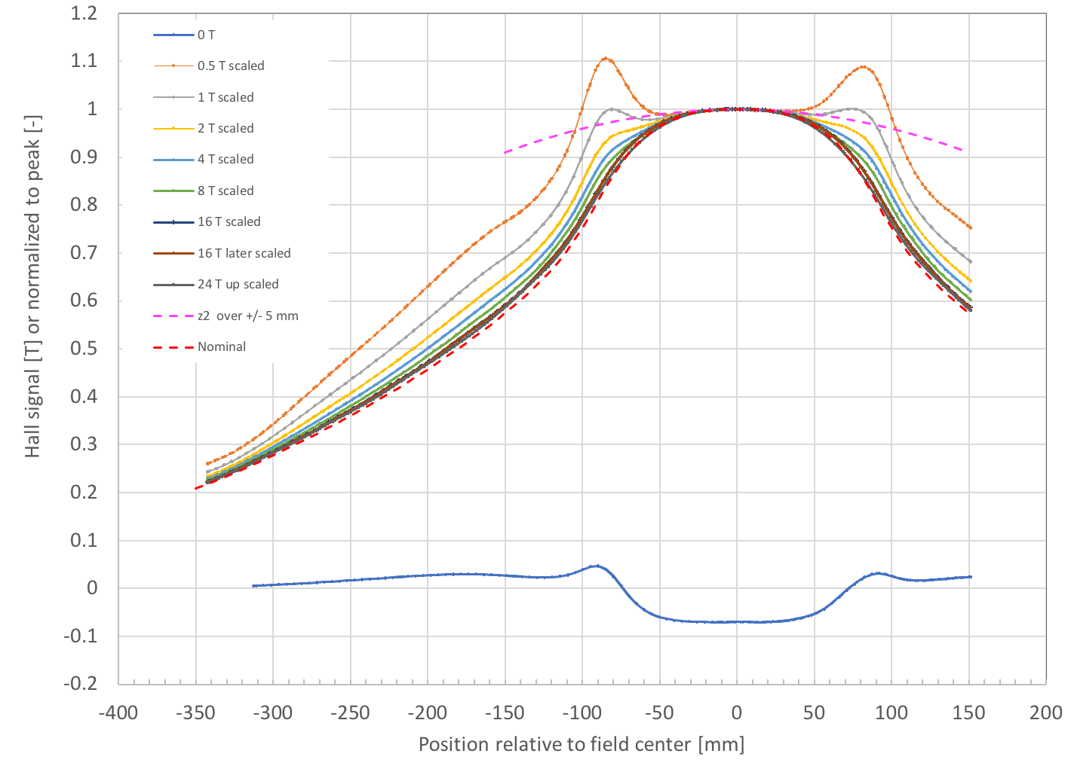
Observed behavior: B_{z} behavior along z-axis
(2009)
Extrapolation of z² term for |z| < 5 mm
Mid-plane split in Coil 1 reduces z² term at midplane
  Optimization can improve uniformity to well below 100 ppm in 1 cm DSV
Screening currents distort B_{z} profile at lower fields for |z| >> 5 mm
  Slightly asymmetric but reproducible
mid plane [-]
Normalized field, increasing current
Remnant field (in tesla) after ramp down
Position is relative to field center

Slide 29
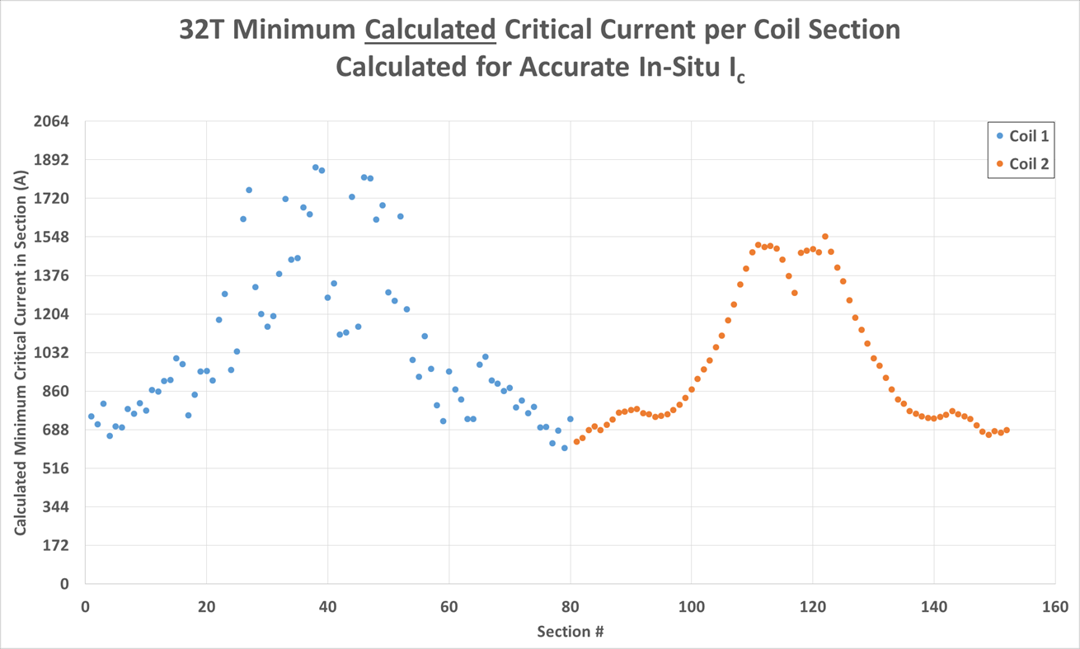
Critical current margin versus quench protection
(2009)
Temperature margin goes up during quench as field and current decay
  Once current decay starts, it becomes harder to drive rest of HTS to normal state
  Desirable to have large fraction of coil volume with ~ same temperature margin
placeholder
~35-40 K margin
(T_{cs} = 40-45 K)
Margins are much larger in low field conditions
Calculated critical current in coil [A]
~ 25-30 K margin
256 A = ~10 K margin
174 A = 0 K margin
Operating at 70% of I_{c} would give > 10 K initial temperature margin
32 T operates at 33-10% of I_{c}
Operating current
HTS Coil 1

