Slide 1
Coil Composite and Interface Engineering
G. Vallone
Workshop on State-of-the-Art in High Field Accelerator Magnets
15 April 2021

Slide 2
Acknowledgments
BNL
  M. Anerella, J. Cozzolino
CERN
  B. Bordini, N. Bourcey, J. Ferradas, C. Fichera, P. Grosclaude, M. Guinchard, S. Izquierdo Bermudez, J. C. Perez, O. Sacristan De Frutos
FNAL
  G. Ambrosio
LBNL
  D. Cheng, E. Anderssen, D. Arbelaez, L. Brouwer, P. Ferracin, H. Pan, I. Pong, S. Prestemon, GL. Sabbi, T. Shen
PSI
  B. Auchmann, M. Daly

Slide 3
Outline
Introduction
Coil composite models
Debonding in superconducting magnets
Conclusion

Slide 4
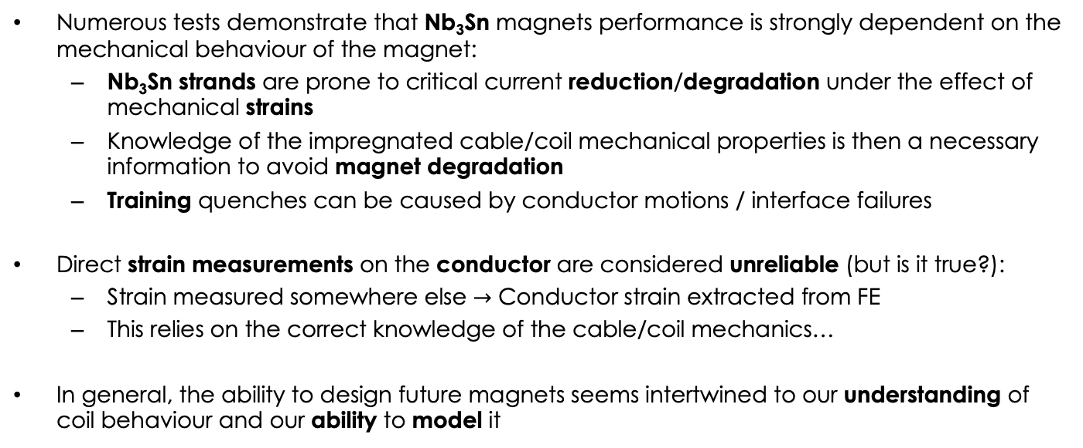
Introduction - Nb₃Sn Coils
Numerous tests demonstrate that Nb₃Sn magnets performance is strongly dependent on the mechanical behaviour of the magnet:
  Nb₃Sn strands are prone to critical current reduction/degradation under the effect of mechanical strains
  Knowledge of the impregnated cable/coil mechanical properties is then a necessary information to avoid magnet degradation
  Training quenches can be caused by conductor motions / interface failures
Direct strain measurements on the conductor are considered unreliable (but is it true?):
  Strain measured somewhere else $→$ Conductor strain extracted from FE
  This relies on the correct knowledge of the cable/coil mechanics…
In general, the ability to design future magnets seems intertwined to our understanding of coil behaviour and our ability to model it

Slide 5
Outline
Introduction
Coil composite models
Debonding in superconducting magnets
Conclusion

Slide 6
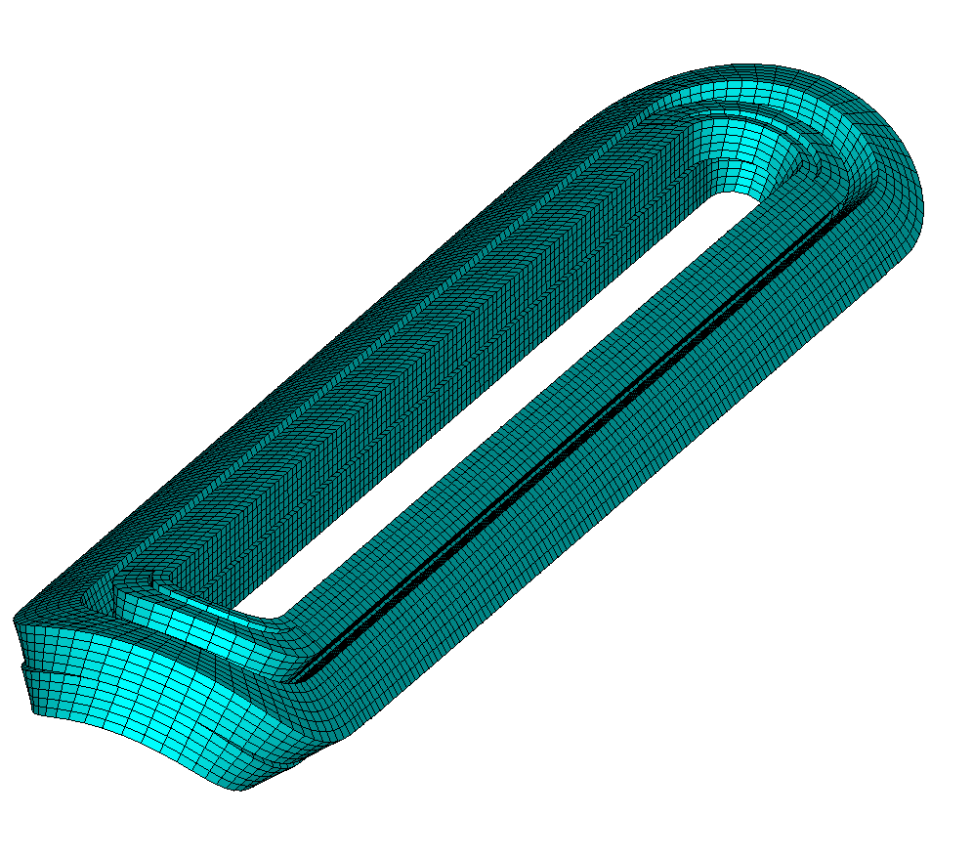
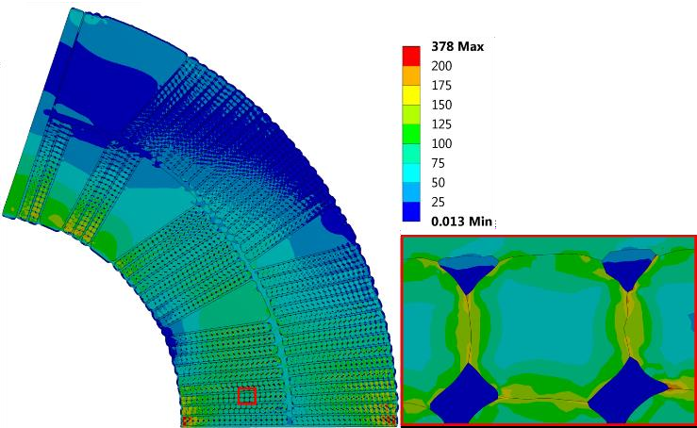
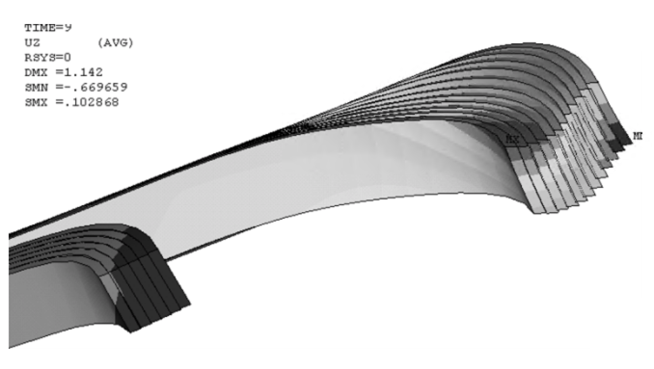
Introduction - Modelling Strategies
Block Model
Cable Model
S. Caspi et al., IEEE Trans 2006
Strand Model
M. Daly et al., IEEE Trans 2018
Block model is the current standard approach:
  Coil approximated as an uniform block with uniform mechanical properties
  Properties were measured in the past on impregnated coil stacks
  Orthotropic in 2D, isotropic in 3D
This consistent way of modelling also allowed to define an empirical limit on the coil equivalent stress (150:200 MPa - H. Felice et al., IEEE TAS, 2011)
New modelling strategies are currently under development

Slide 7
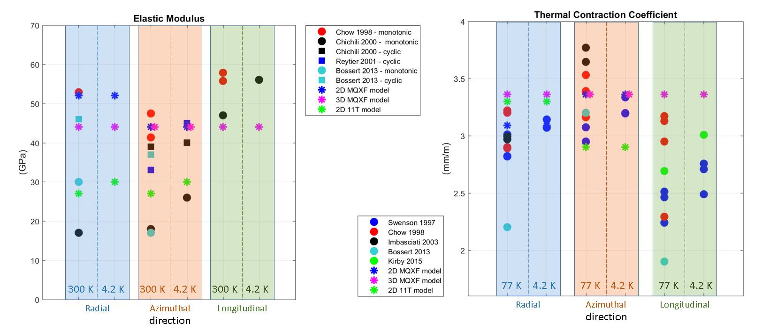
Coil Properties – Literature Review
Y – azimuthal
Z – longitudinal
X – radial
Available coil properties measures highly dispersed
  Indication that there is no ‘correct’ value, and that the modulus and the contraction depend on the coil design?
Measured Young modulus: 15-60 GPa. Also depends upon cyclic/monotonic loading phase
Measured thermal contraction: 2-4 mm/m

Slide 8
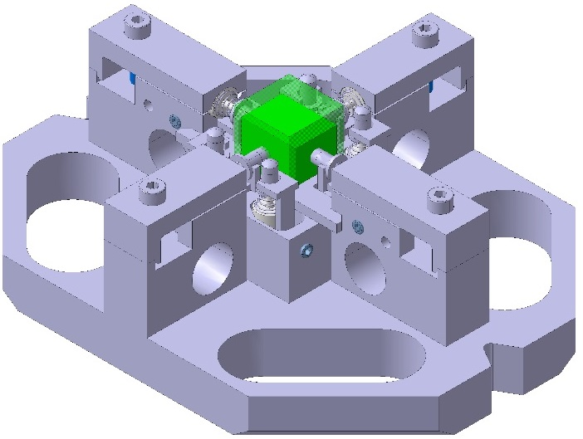
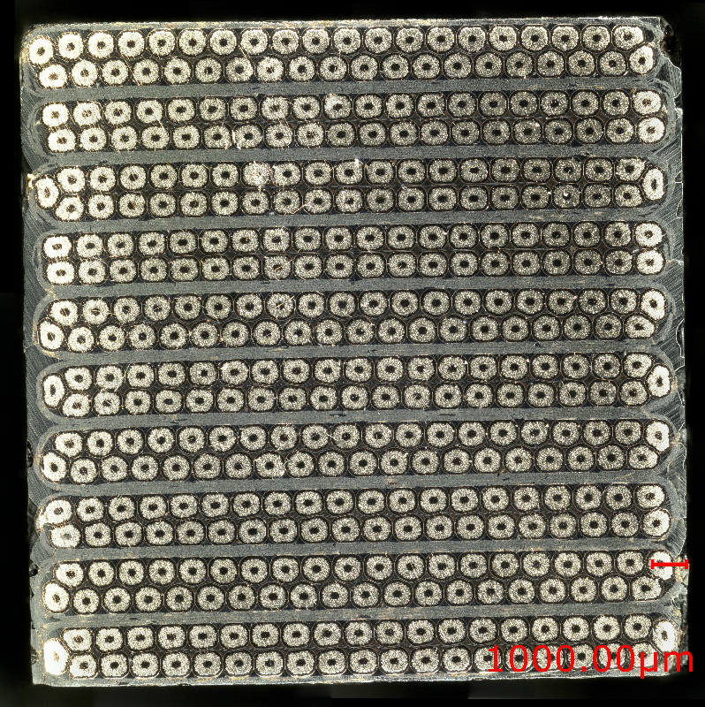
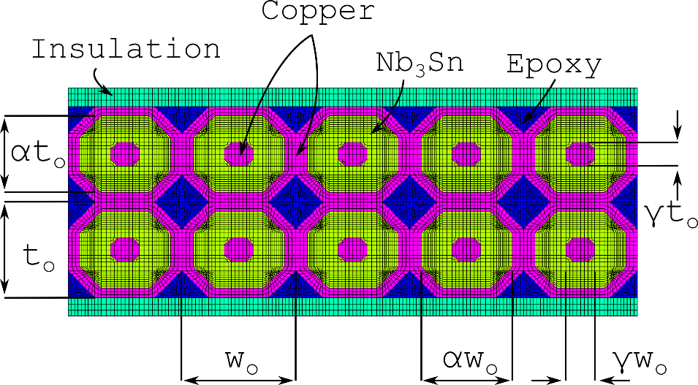
MQXF – Experiments & Models
Measurements on stacks of impregnated cables have always been used as a reference for coil elastic modulus measurements
  But were they ever part of the design process?
An extensive testing campaign was launched almost 2 years ago
2D FE model of the cable stack
Material properties from literature
Geometry from a mix of image analysis and simple geometric formulas to match the filling factor, copper-non copper etc.
See C. Fichera et al., IEEE Trans. (2019)
See G. Vallone et al., IEEE Trans. (2019)

Slide 9
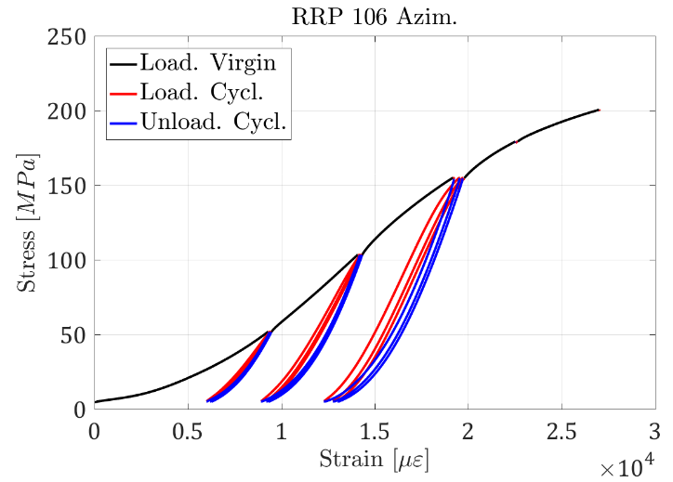
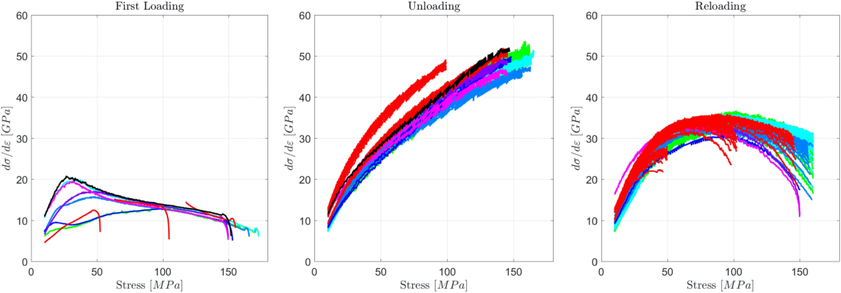
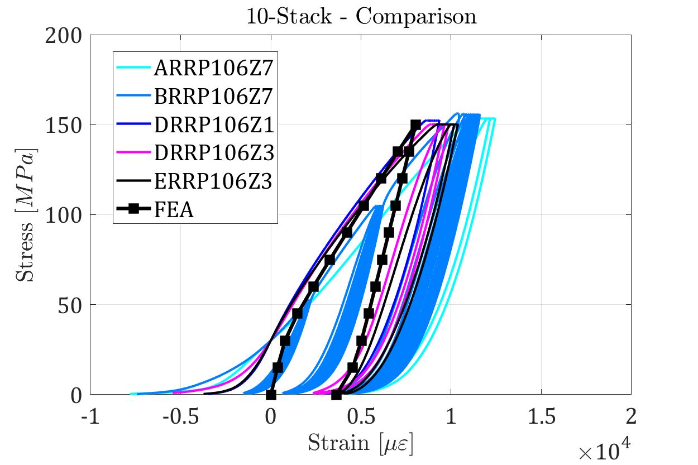
Cable Stacks – Result Summary
Very different behaviour in the three phases
The slope varies continuously during the test
  Difficult to condensate the coil ‘elastic’ properties in a single number (elastic modulus)
Virgin/cyclic behaviour explained by copper plasticization
FE results reasonably good especially considering that no model calibration was necessary

Slide 10
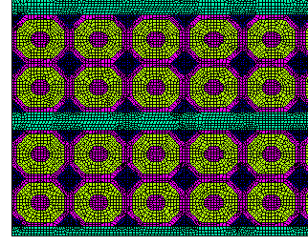
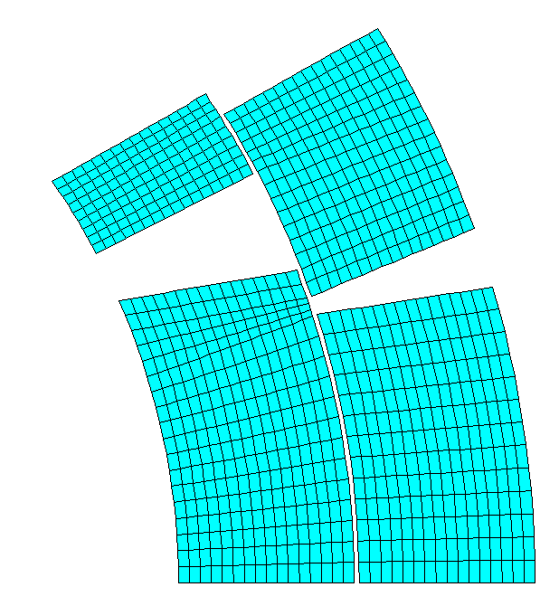
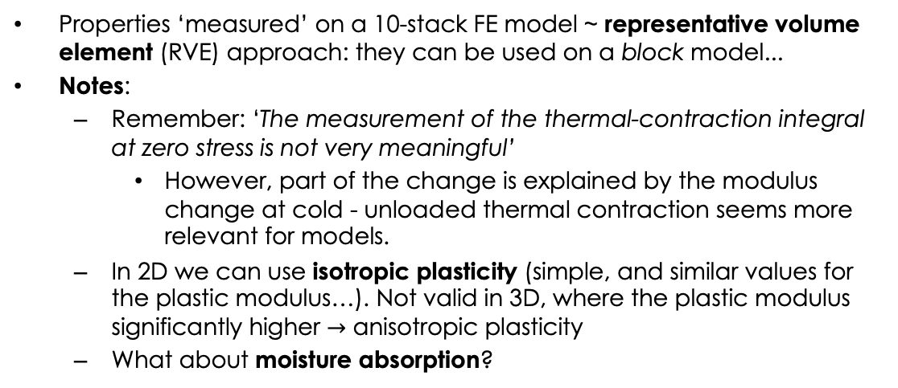
Cable Stacks – RVE Model
 | Unit | R.T. |  | 4.5 K
 |  | Elastic | Plastic | Elastic | Plastic
Ex | GPa | 52.6 | 11.3 | 48 | 12
Ey | GPa | 37.4 | 11.6 | 40.2 | 12
Gxy | GPa | 18.8 |  | 17.7
nu12 | / | 0.195 | 0.298 | 0.245 | 0.299
alpha_x | mm/m | 4.438 | 4.45
alpha_y | mm/m | 4.03 | 4.2
Strand Model
Properties ‘measured’ on a 10-stack FE model ~ representative volume element (RVE) approach: they can be used on a block model...
Notes:
  Remember: ‘The measurement of the thermal-contraction integral at zero stress is not very meaningful’
    However, part of the change is explained by the modulus change at cold - unloaded thermal contraction seems more relevant for models.
  In 2D we can use isotropic plasticity (simple, and similar values for the plastic modulus…). Not valid in 3D, where the plastic modulus significantly higher $→$ anisotropic plasticity
  What about moisture absorption?
Block ‘RVE’ Model

Slide 11
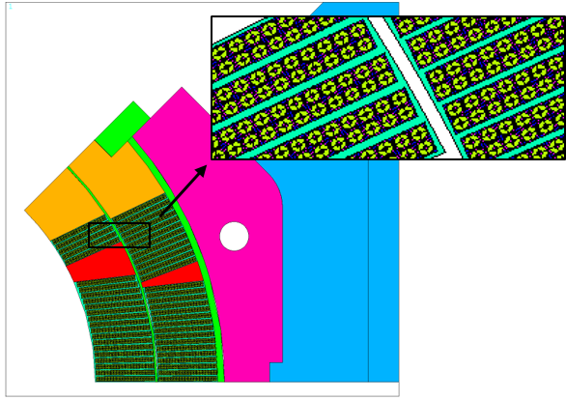
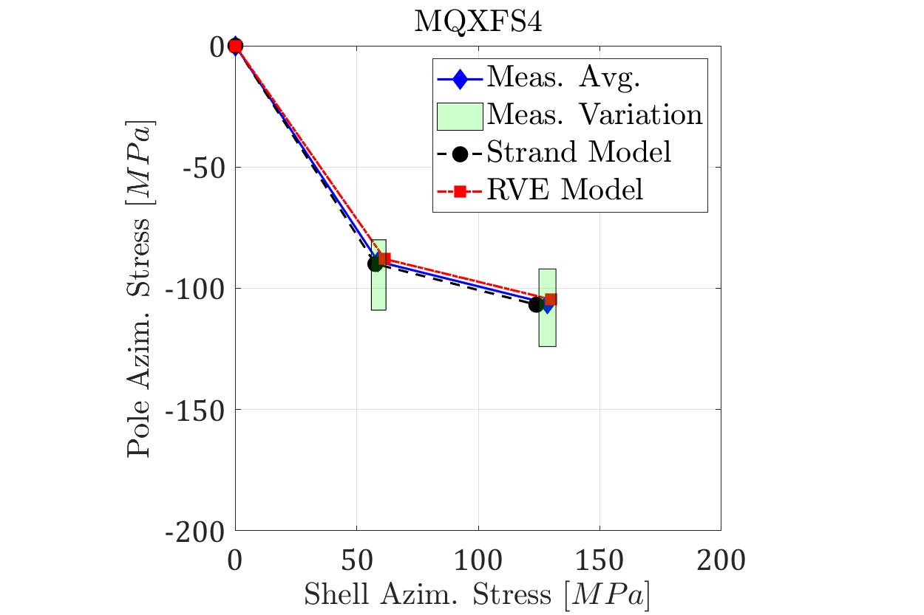
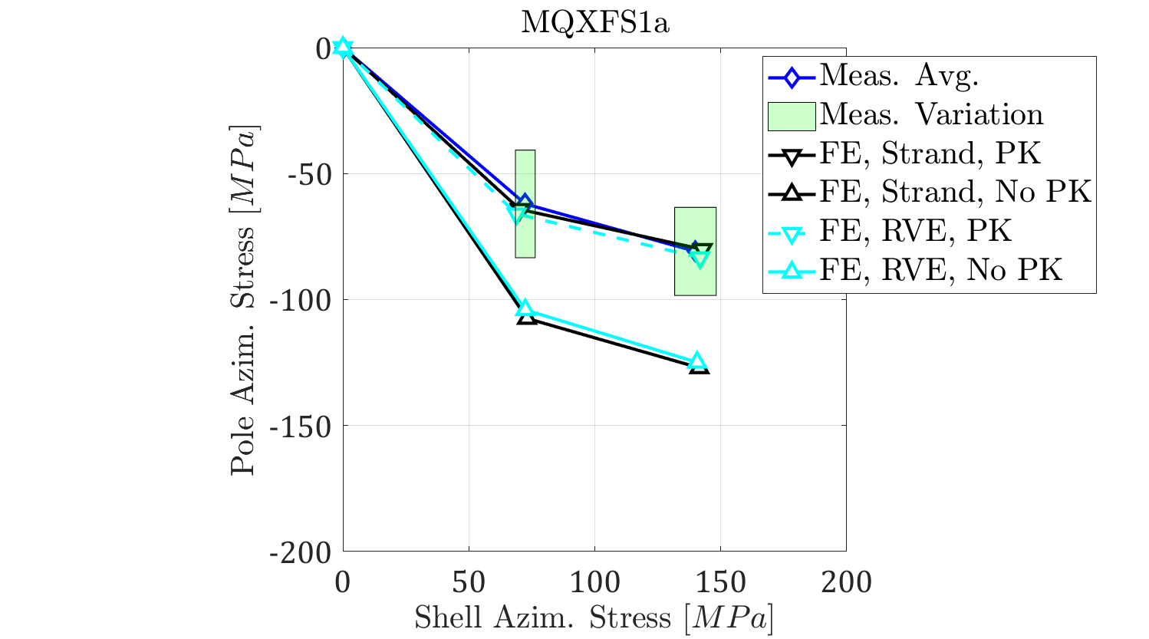
Magnet Simulation
Strand Model
‘RVE’ Model
MQXF magnet: current reference models use a model ‘calibrated’ on top of the available mechanical measurements – not feasible during design
Both the strand model and RVE model match the mechanical measurements, with no calibration
Properties from the RVE strand model agrees reasonably with the maximum slopes measured on cable stacks!
  Suggestion on how to extract properties from these experiments?
  10-stack measurements are effective! But extracting just 1 number (coil modulus?) is just not enough
What is the material limit now? Lost connection to the empiric 150-200 MPa!

Slide 12
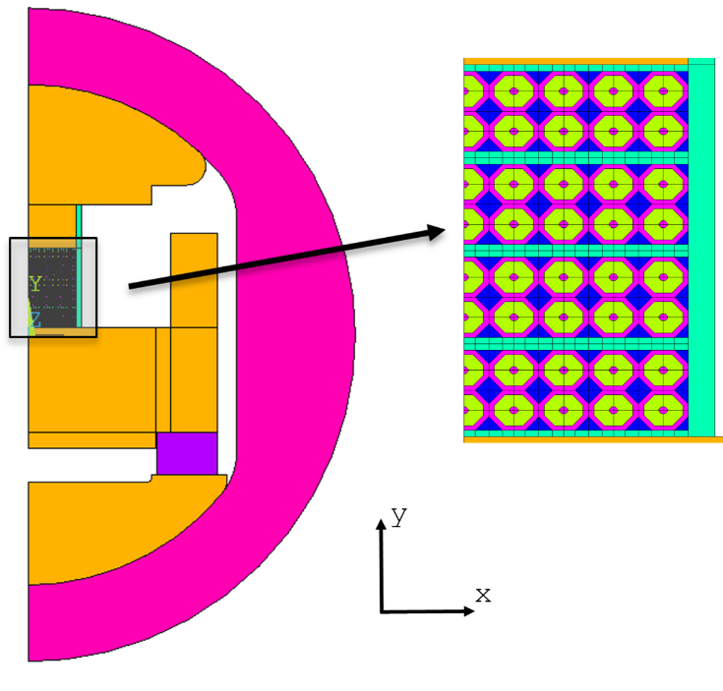
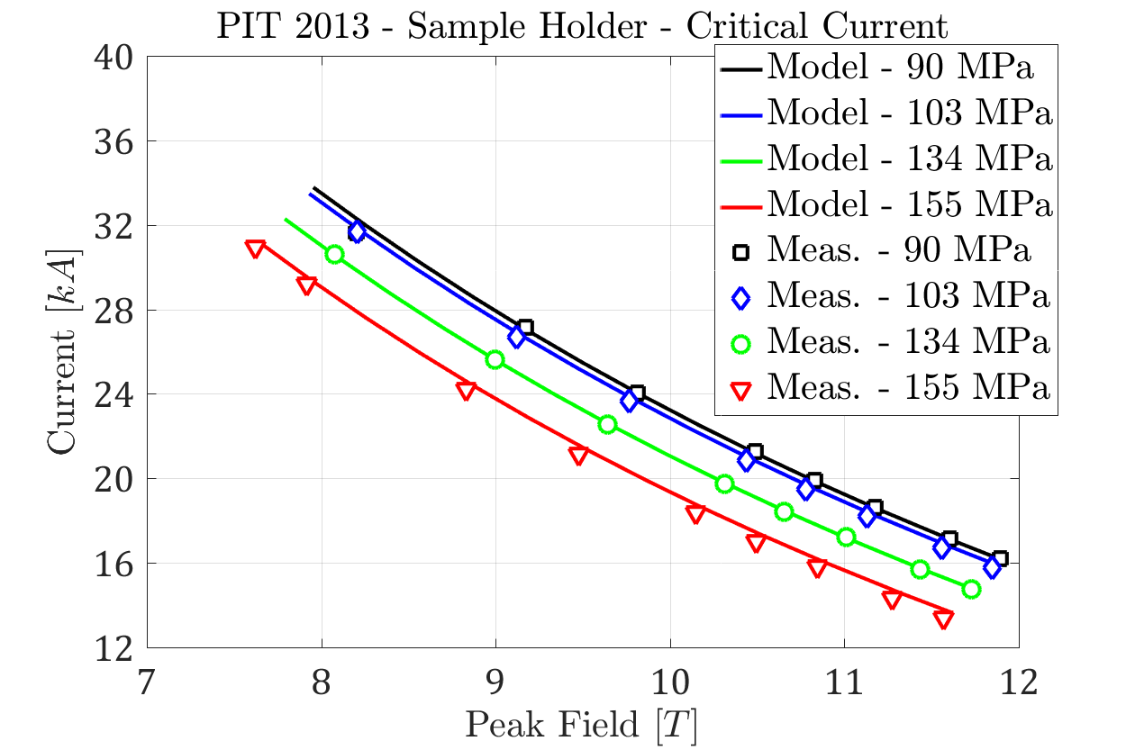
I_{c} Reduction – Sample Holder
See B. Bodrini et al., IEEE Trans. (2013)
Electro-magnetic-mechanical model of the sample holder
  Cable stack modelled with the mechanical approach validated from 10-stack measurements
  The ’strand’ model allows to extract the strain in the Nb₃Sn region
  The exponential scaling law allows to connect this strain to the critical surface
Quench currents are matched reasonably well
  At 155 MPa there was some irreversible degradation – not modelled…
See G. Vallone et al., IEEE Trans. (2018)

Slide 13
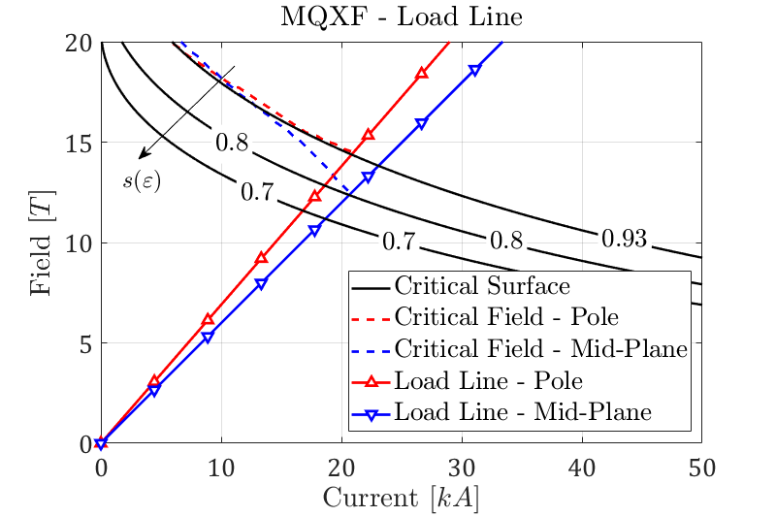
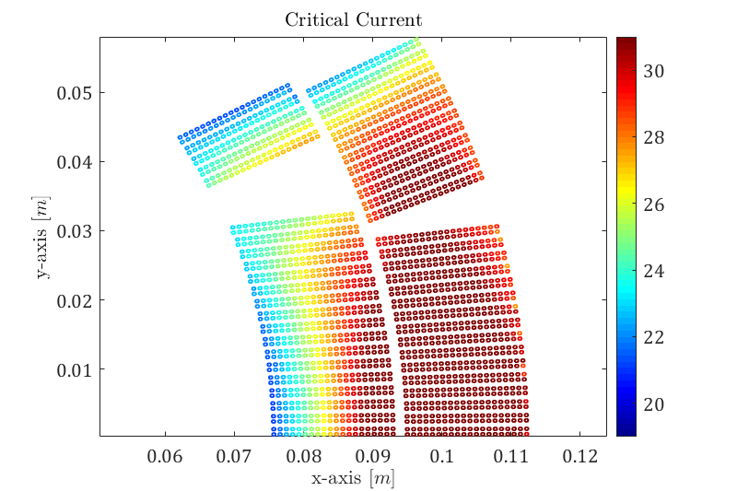
I_{c} Reduction - MQXF
MQXF strand model, powering results:
  Approach validated on the 10 stacks + sample holder
  Refined short sample estimation (critical strands at the the mid-plane)
  Inner layer, 2nd turn: local strain concentration reduces the available margin
    The impact of local effects was difficult to evaluate with block models
  Model allows to extract an updated temperature margin map (not shown)
    Significant margin reduction on the strained regions
See G. Vallone et al., SUST (2020)

Slide 14
Outline
Introduction
Coil composite models
Debonding in superconducting magnets
Conclusion

Slide 15
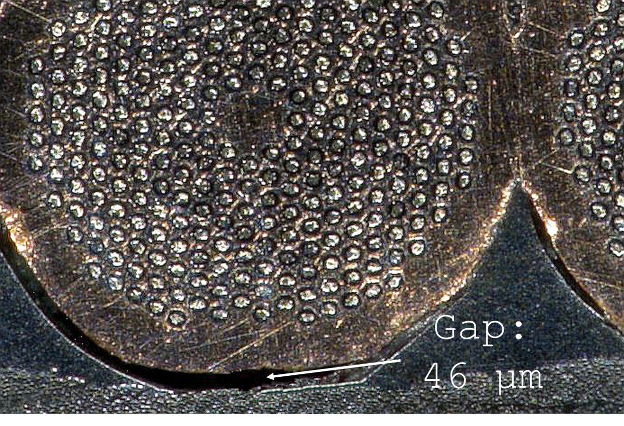
Introduction – Coils Interfaces
Bonded joints (interfaces) are commonly used in superconducting magnets coils
  Pole/coil, pole/wedges in cos(𝜗) designs
  Pole/coil in block coils
  Even more used in certain ‘stress-managed’ designs: e.g. spar/cable and rib/cable in CCT magnets
  But also cable/cable…
These interfaces can fail:
  Their failure is considered a possible cause of training
  Our failure criteria are often empiric
  Shear stress rarely considered as possible source of failure
In FE models we often consider only 2 cases: perfectly bonded, and completely debonded (with or without friction)
  Reality can be in between… The interface may be failed only partially
  As often happens on supercond. magnets, almost impossible to measure during a magnet test…

Slide 16
Commonly Used Interface Limits
Traditional Prestress/Failure ‘Criteria’, generally applied on pole/coil interfaces:
    ​No tension (bonded model) / no detachment (friction model)
    ​Average pressure >0 (friction model)
    20 MPa avg. tension (bonded model)
      Results might not be representative of the real coil condition, especially if the tension ‘region’ is ‘wide’
      Not clear if there is any empirical evidence that this works
    20 MPa max. tension (bonded model)
      Failure criteria for the epoxy bonding
      Generally, the ‘corner spikes’ (~1 contact element, 1 mm) were neglected
    50 um max. normal displacement on non-bonded interfaces
Why no limits on shear stresses? And interaction (mixed mode failure)?

Slide 17
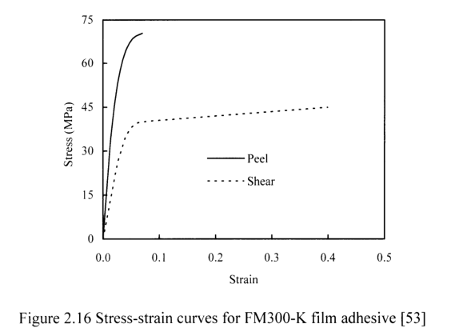
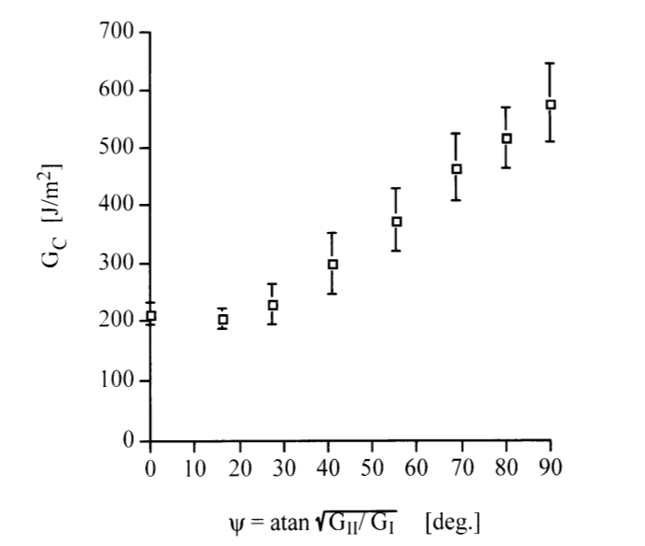
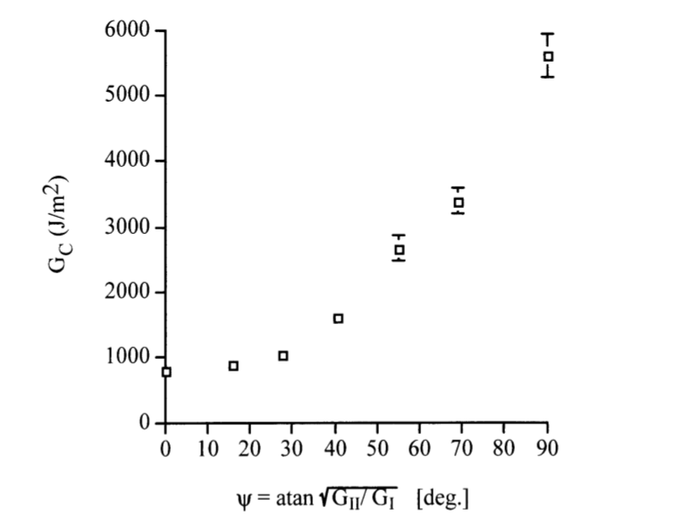
How strong can adhesive joints be?
Tensile strength of bonded joints is usually lower than 100 MPa (50 MPa for shear)
Common values around 70 MPa tensile, 35 MPa shear
  Tresca criterion seems to apply on most adhesives (shear = ½ tensile)
  Much more than 20 MPa… A reliable 70 MPa bonding strength would allow to significantly decrease stresses on the conductor in many designs… But can the coil handle it?
  This would also require a glue layer ‘thicker’ than what we normally consider
G_{c}(Ψ) curves measured on different adhesive systems (Cybond 4523GB, Permabond ESP 310) suggest that roughly: G_{IIc}~3G_{Ic}

Slide 18
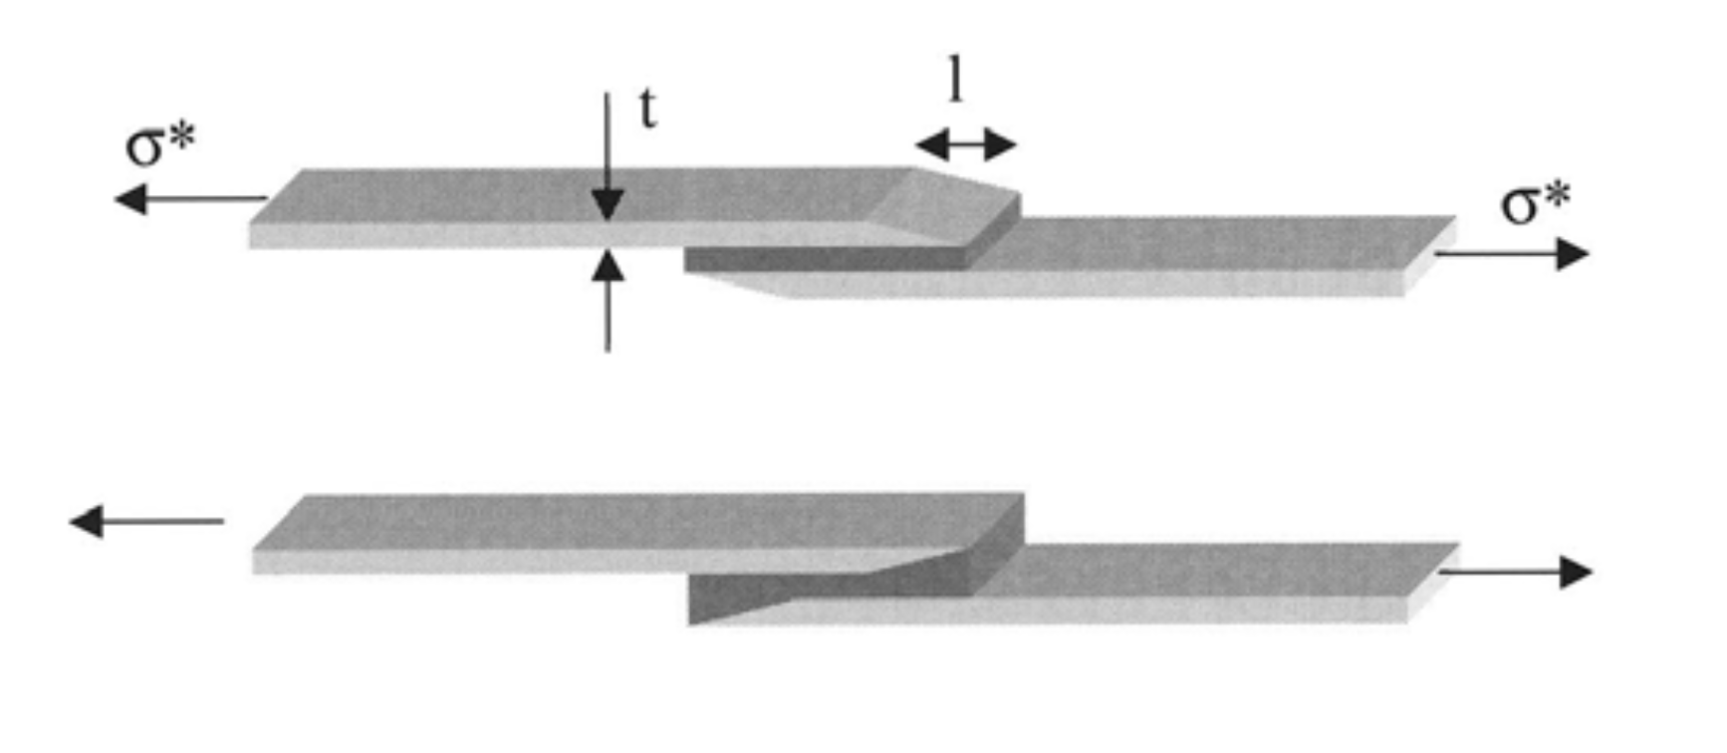
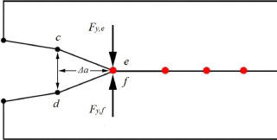
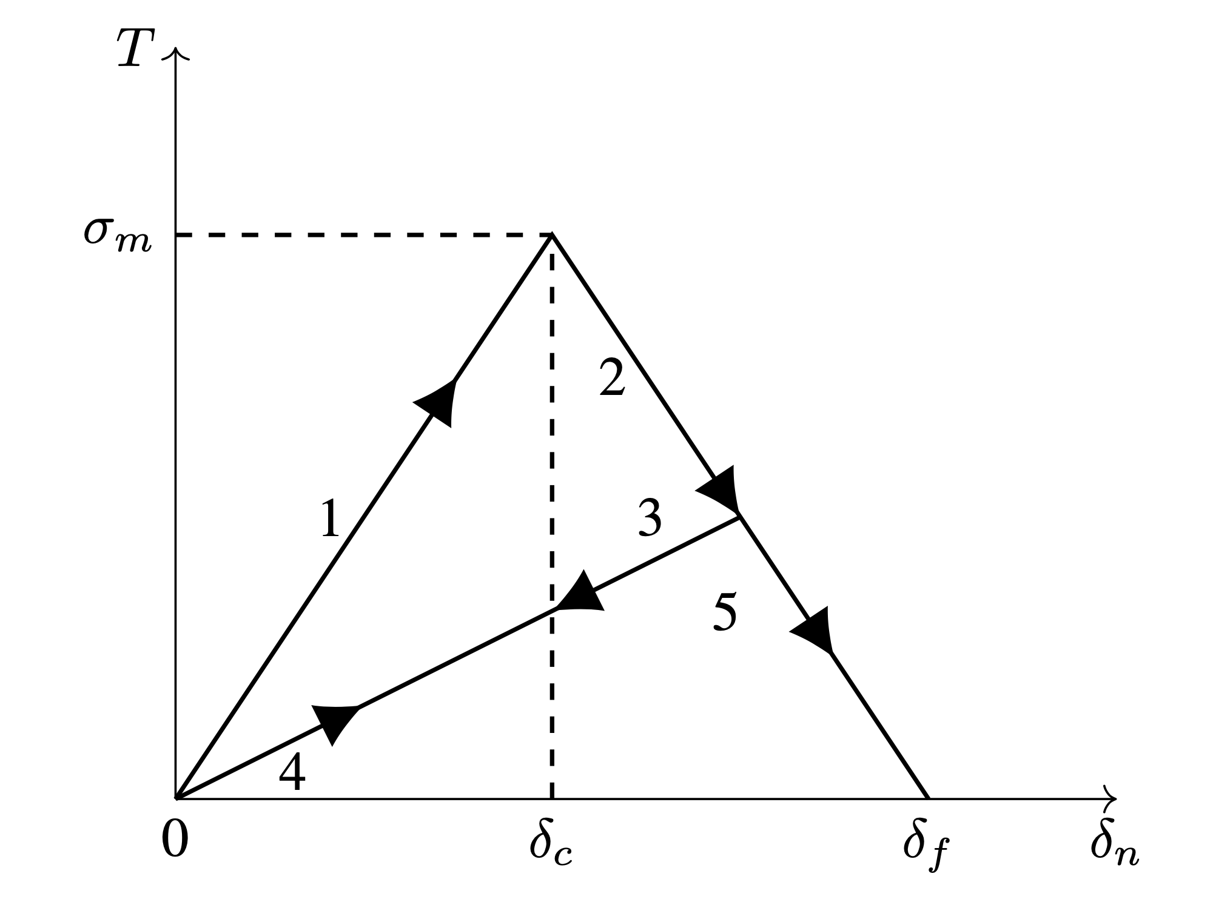
Debonding Material Models
Many methodologies available to simulate debonding:
  ‘Manually’ kill contact elements – needs a failure criteria (e.g. max tension/shear, VCCT). Does not allow to ‘degrade’ the contact stiffness during failure.
  VCCT (Virtual Crack Closure Technique, used as fracture criteria)
  Plastic glue models – with/without killing the underlying contact
  Cohesive zone model (CZM)
  SMART crack growth (K_{I}/J-integral + adaptive re-meshing)
  XFEM – special elements that allow the crack propagation inside. More useful when the crack propagation path is unknown.
CZM seems particularly suited to our needs:
  We already know the potential failure locations (interfaces…)
  Allows to simulate mixed mode failure, glue plasticity
  No need for:
    Special meshes near the crack (and remesh after propagation)
    Explicitly model the glue – easy to extend available models
Material properties required:
  Glue elastic properties (E, nu) and thickness (important!)
  Elastic and shear strength
  Fracture energy release rate for different modes (G_{Ic}, G_{IIc})

Slide 19
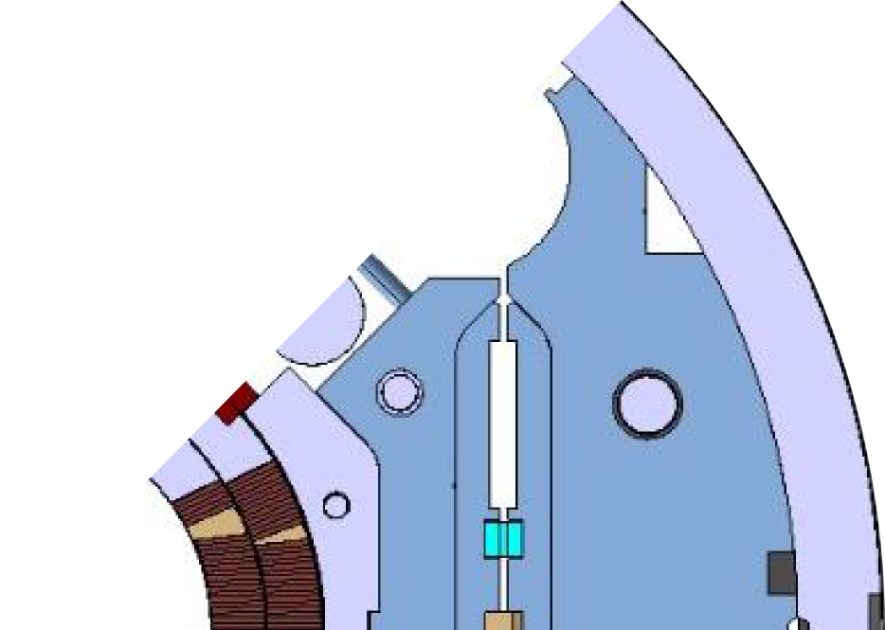

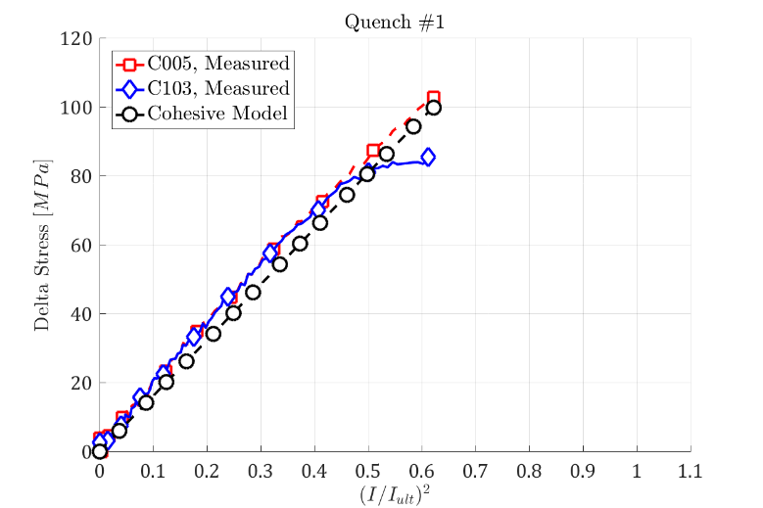
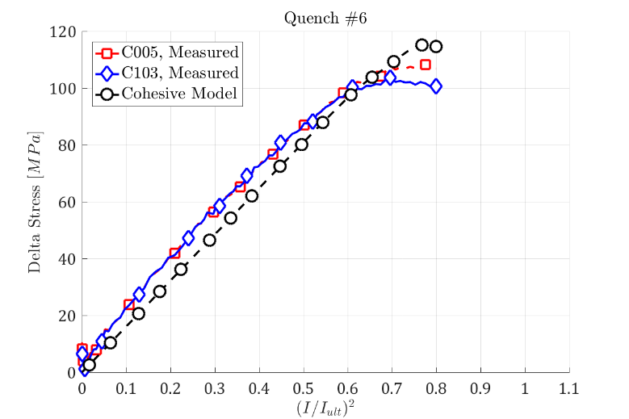
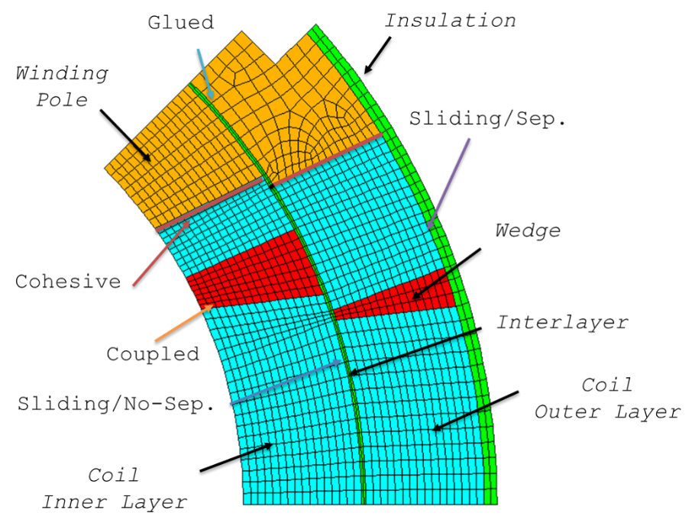
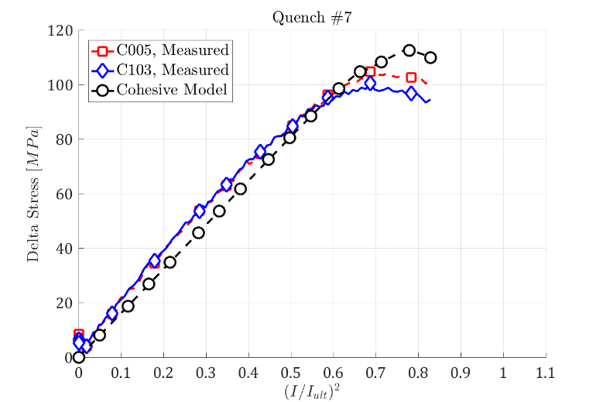
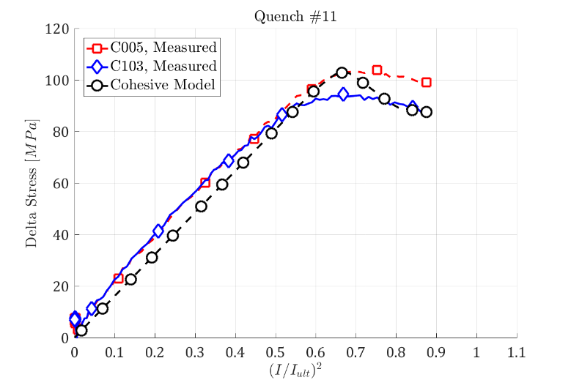
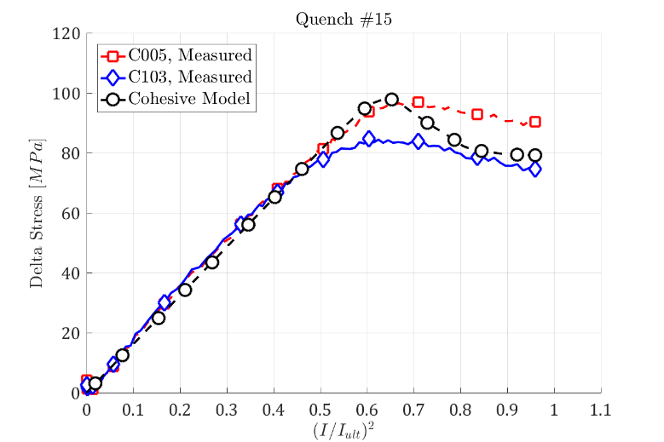
Coil-Pole Debonding in MQXF
Progressive failure of the coil/pole interface during training - only mode I failure

Slide 20
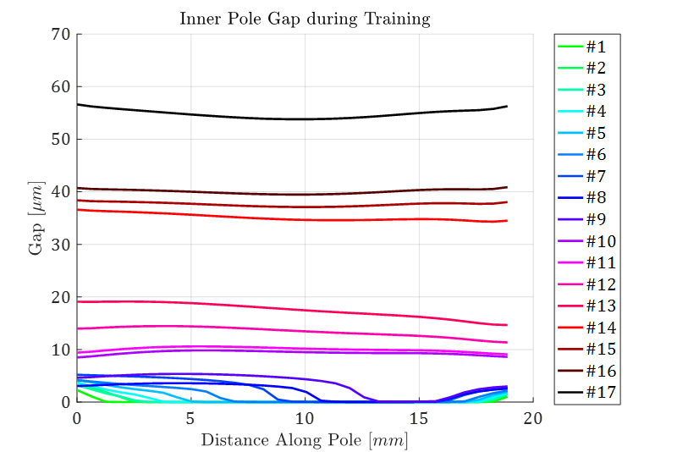
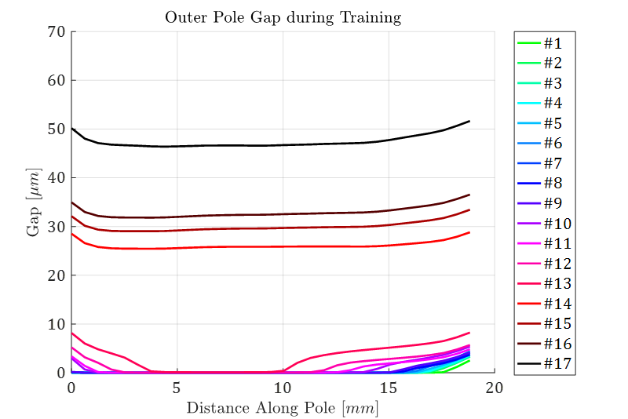
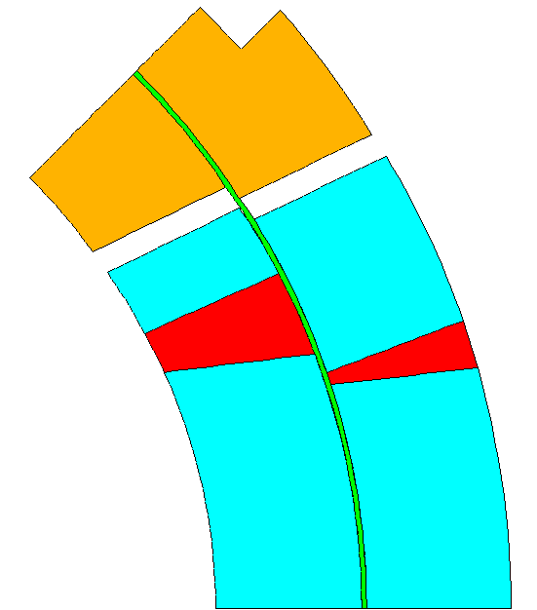
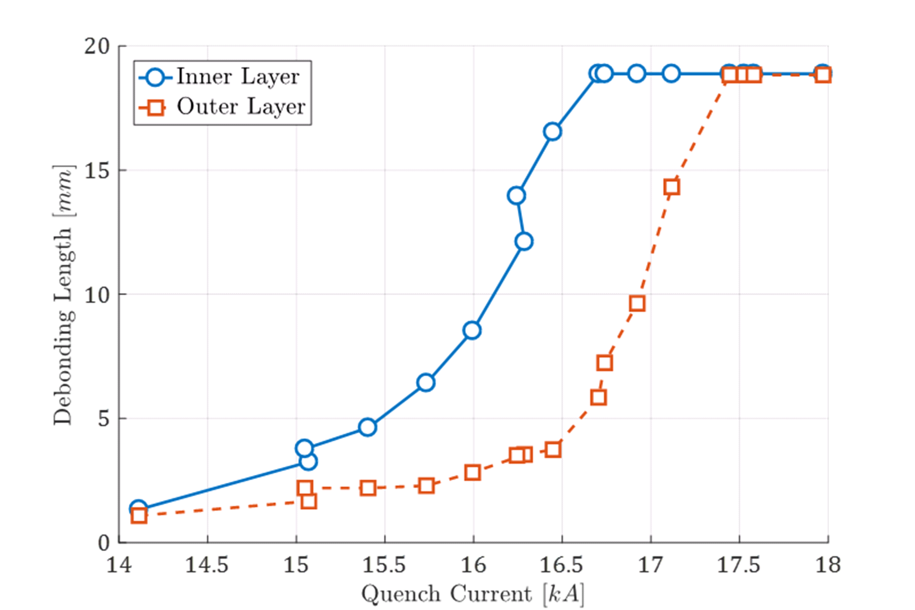
Coil-Pole Debonding in MQXF (2)
Coil/Pole motion at the interface:
The crack propagation starts from the inner/outer radius of the inner layer and from the outer radius of the outer layer
The central part of the outer layer is the last to break
See G. Vallone, P. Ferracin, SUST (2017)

Slide 21
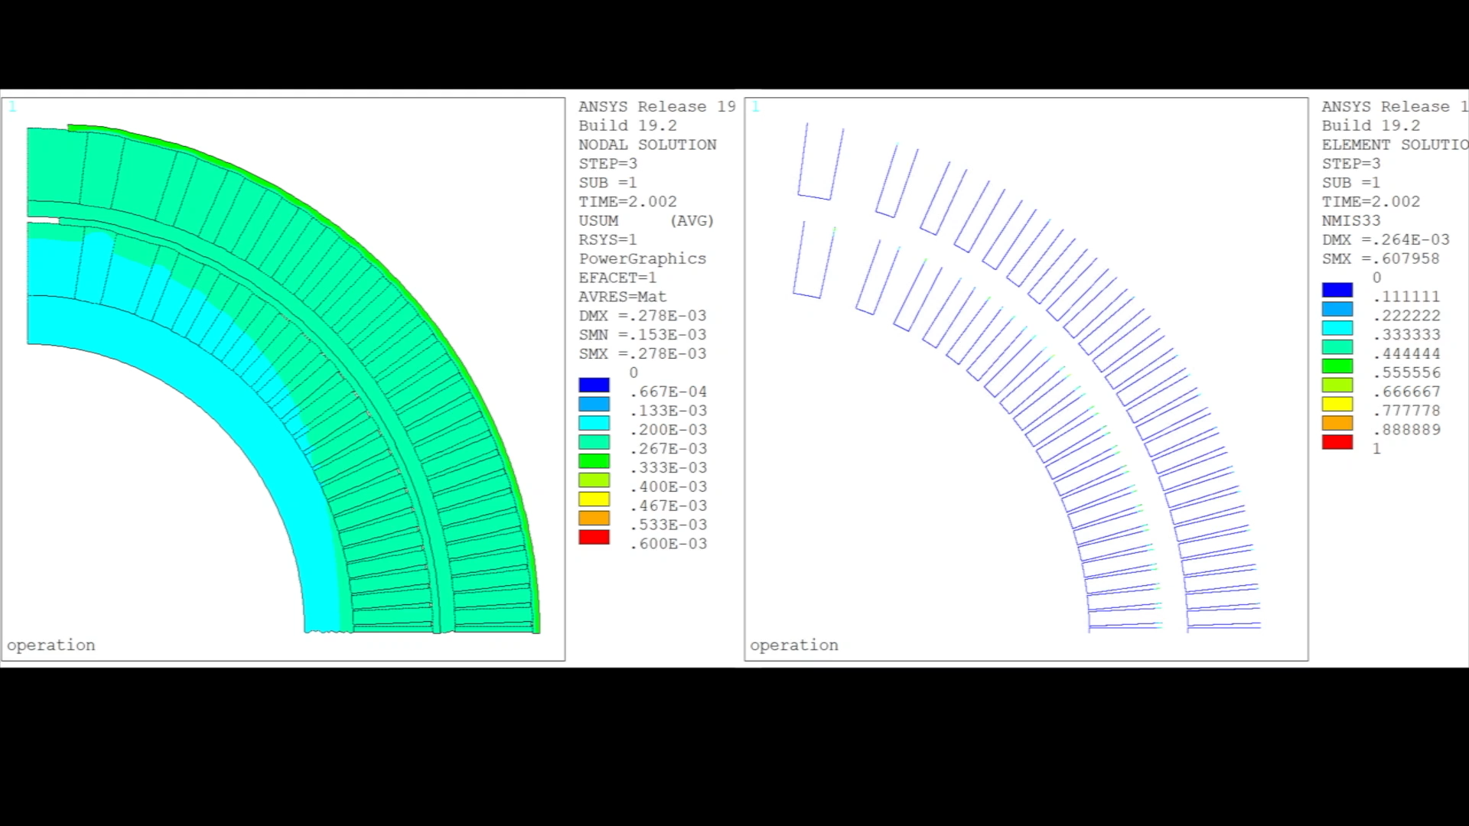
CCT – Interface Failure During Powering

Slide 22
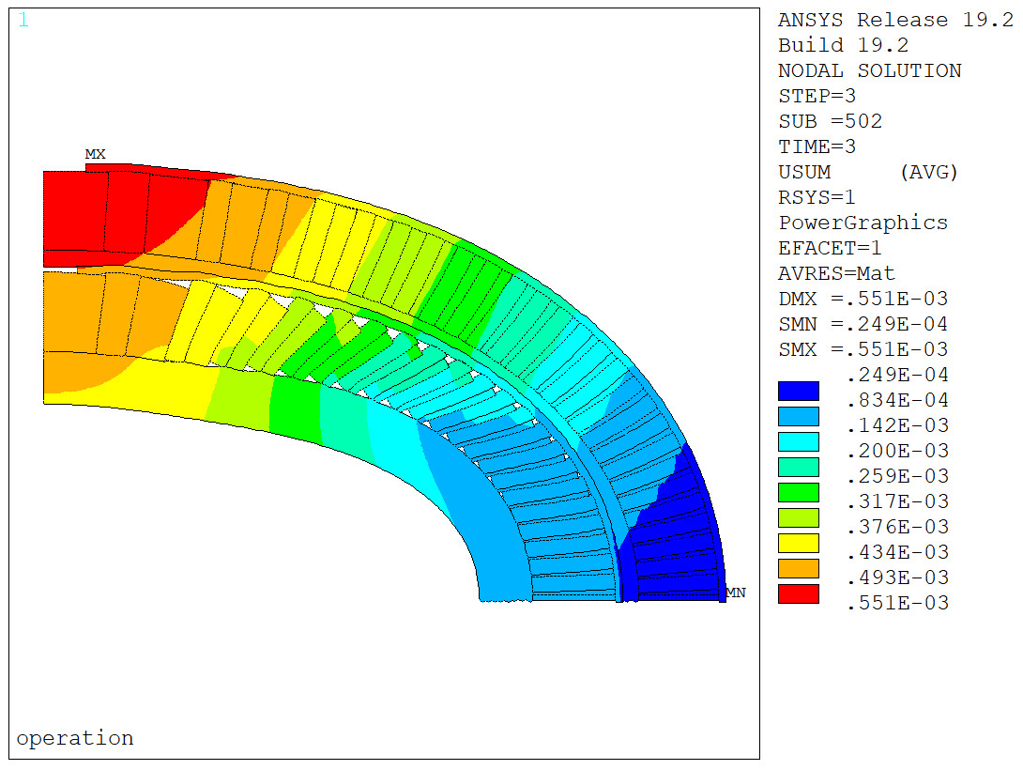
CCT – Interface Failure During Powering
Some ‘small’ detachment after cooldown at the outer radius
  This is what you might see looking at the coil after a test…
  Almost no damage inside!
Significant damage on the inner layer – negligible on the outer layer
  Most of the spar/cable interface failed (from ~20 to 75 deg approx.)
  The rib/cable interface fails on both sides (completely on the side in tension)
Failure propagates slowly from the outer edge, then suddenly propagates at around 12 kA
  Impossible to say if this would be one or multiple events in a real magnet
  This is quite close to where most CCT5 quenches were… (more later)

Slide 23
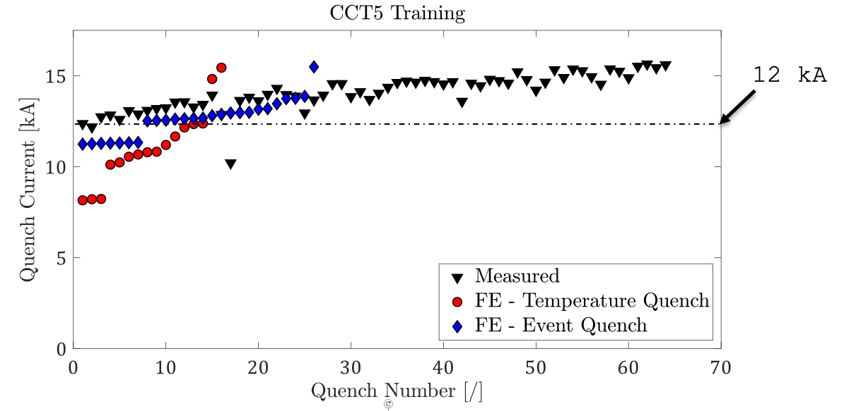
CCT5 – Training Simulation
CCT5 training curve – real and simulated. Numerical quench mechanisms:
  A: Crack release energy compared with the available margin. B: Event magnitude
  Quench threshold calibrated in both cases – we do not know how much energy is released by crack propagation events!
Results suggest that the ‘event quench’ mechanism (B) might be predominant. Notes:
  I am assuming that these events cause quenches, but this result does not prove it
  We should compare the ‘crack propagation currents’ with measured AE events
  Quenches could be distributed along the length –3D model!
  Difficult to say if one ‘quench’ does not represent ‘multiple quenches’ in reality

Slide 24
Outline
Introduction
Coil composite models
Debonding in superconducting magnets
Conclusion

Slide 25
Conclusion
Coil composite mechanical properties:
  Strongly non-linear behaviour
  Part of this behaviour can be explained by the copper plasticization
  Stack strand model looks reasonably close to reality.
  But is still very far from a perfect match! There is a lot we do not understand at the moment…
  Refined models (strand and RVE) ‘perform well’ on MQXF
  Why not integrate a stack model in the magnet design phase?
    There is no universal value, as each coil is different!
Interfaces:
  Properly designed interfaces (at room temperature) can reach 70 MPa of tension – we assume 20 MPa, and probably are closer to 0 MPa…
  Interface design is often overlooked in the design process – the design tries to limit the tension but not to increase the bonding strength
  We do not know what is the tensile strength of the coil
  Advanced models allow for a more realistic understanding of what is happening inside the magnet during operation
APDL cable stack macro available online:
https://github.com/giorgiovallone/Nb3Sn

Slide 26
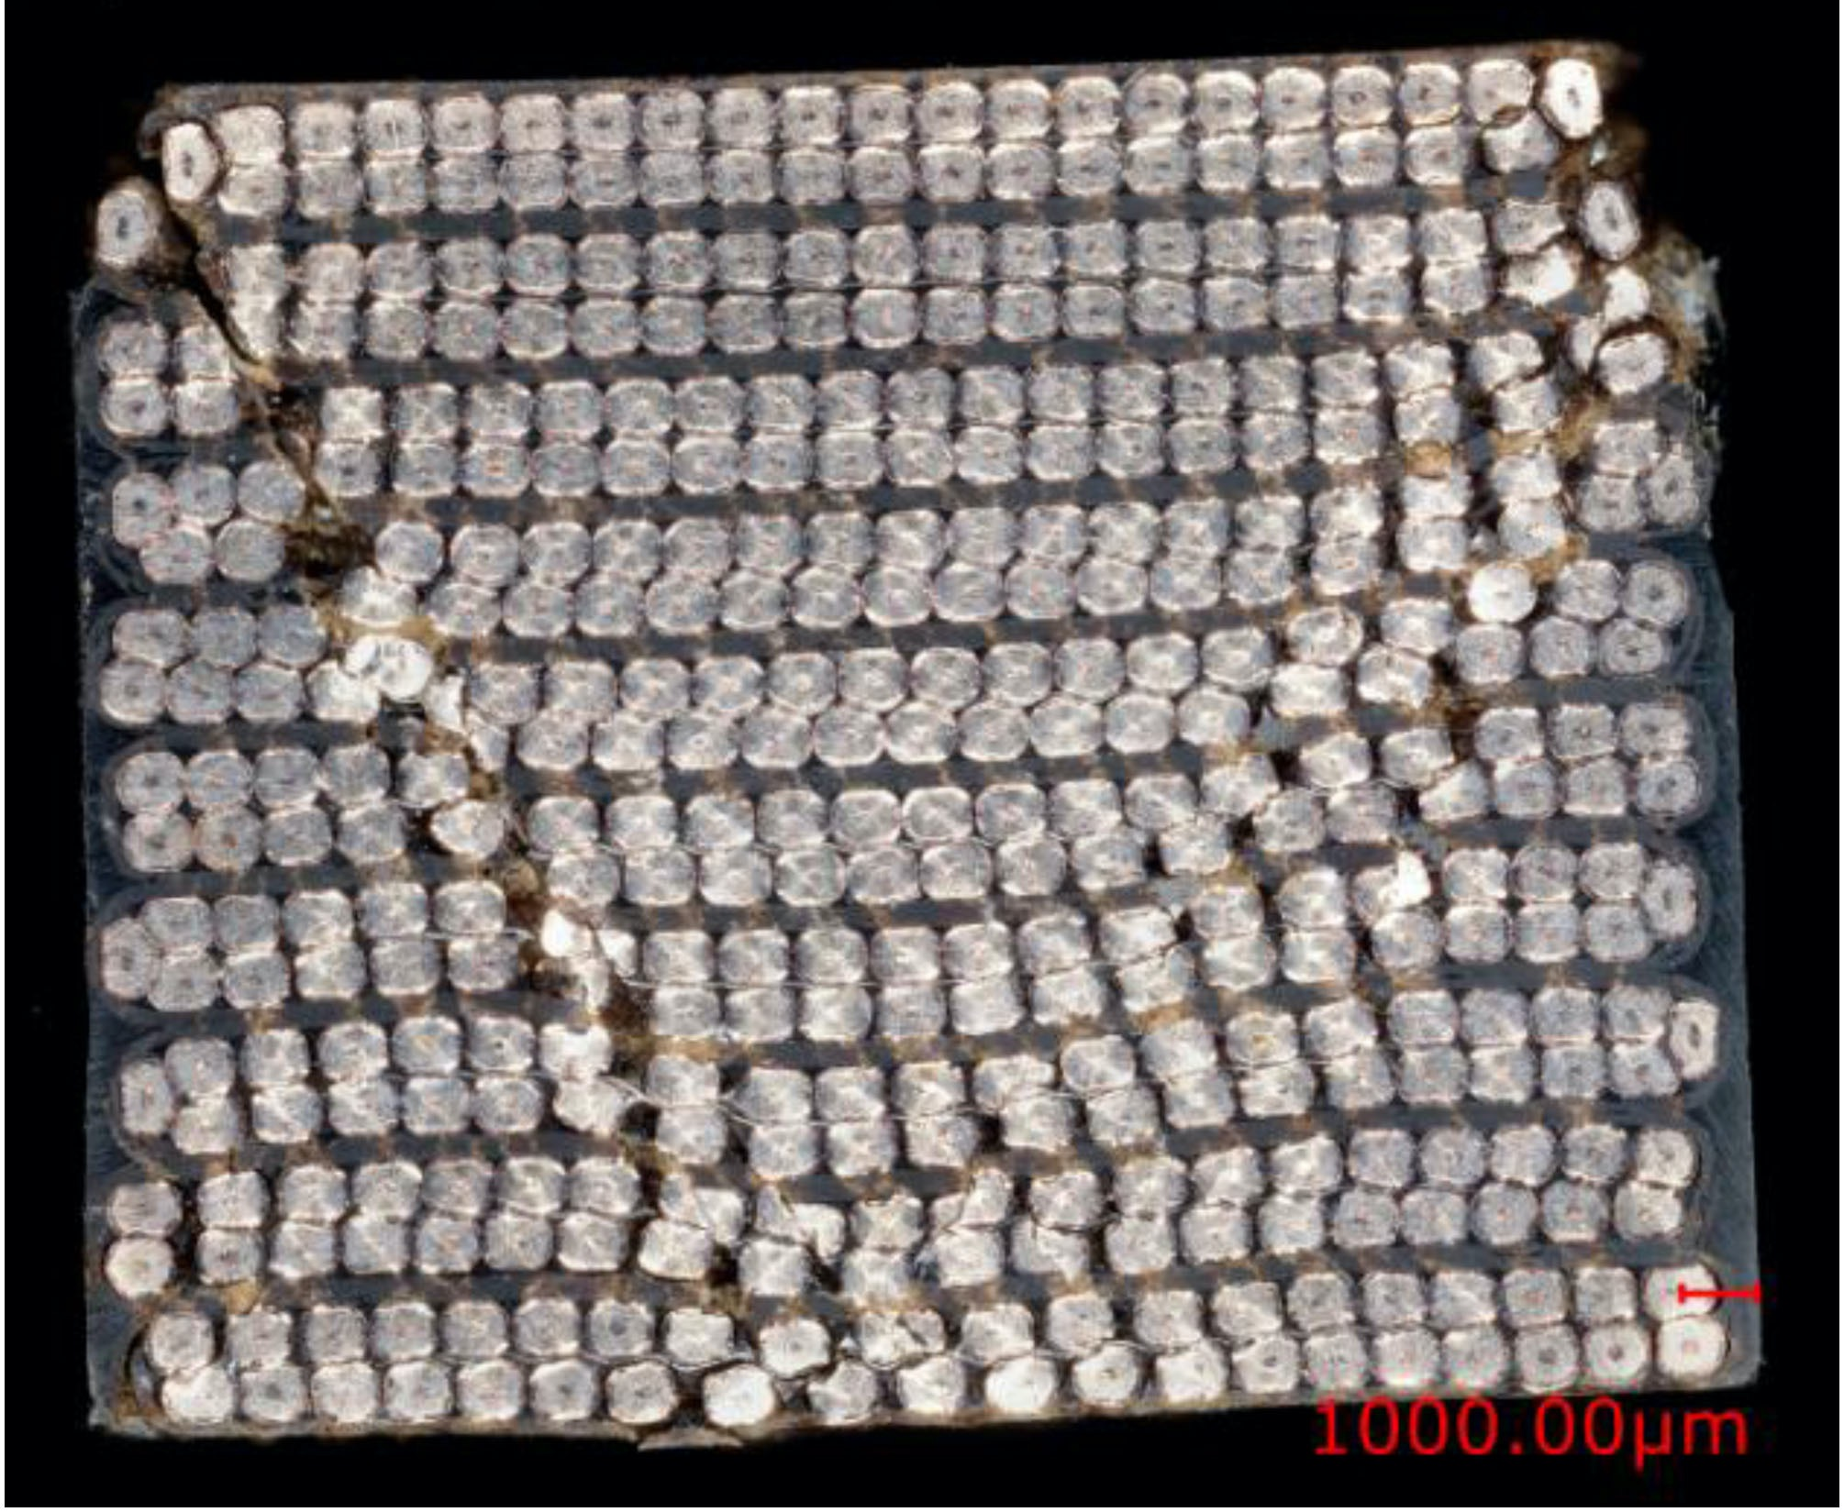
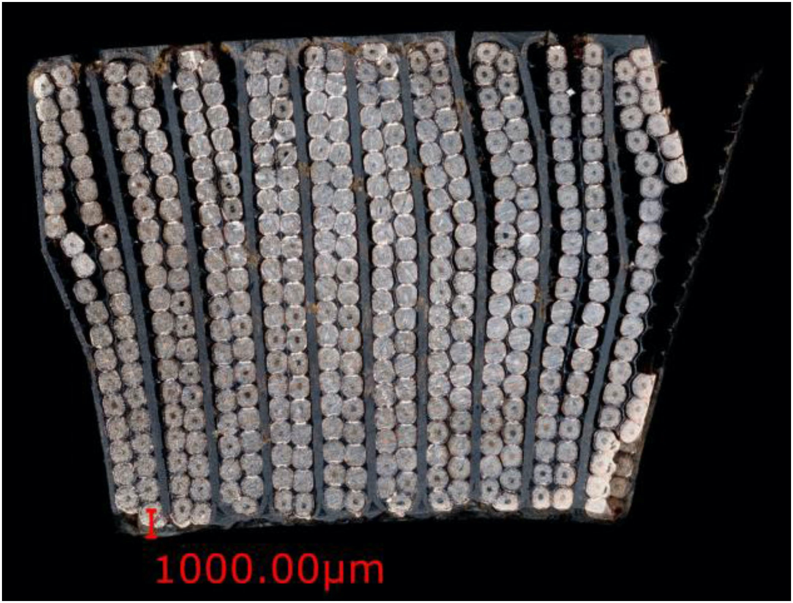
What are we missing?
Coil mechanics:
Advanced material models:
  Creep/strain relaxation
  Non-linear anisotropic hardening
Clear failure criteria for the coil missing (!):
  Detailed models and exponential scaling law can help, but do we have enough experimental knowledge of 3D failure modes? E.g. interaction between longitudinal and in-plane loads?
  What about interfacial failure between cables/strands?
Interfaces:
Conclusive measurements of properties of coil interfaces at cryogenic temperatures:
  Reaction impact on bonding?
  Effect of temperature, insulation thickness, etc.?
  Released energy with plastic deformation and crack propagation? (for training)

Slide 27
Extra

Slide 28
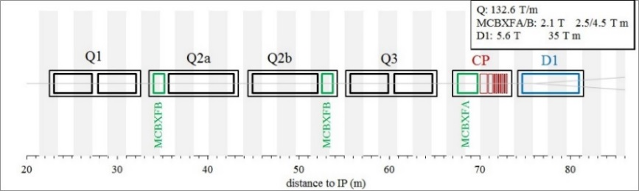
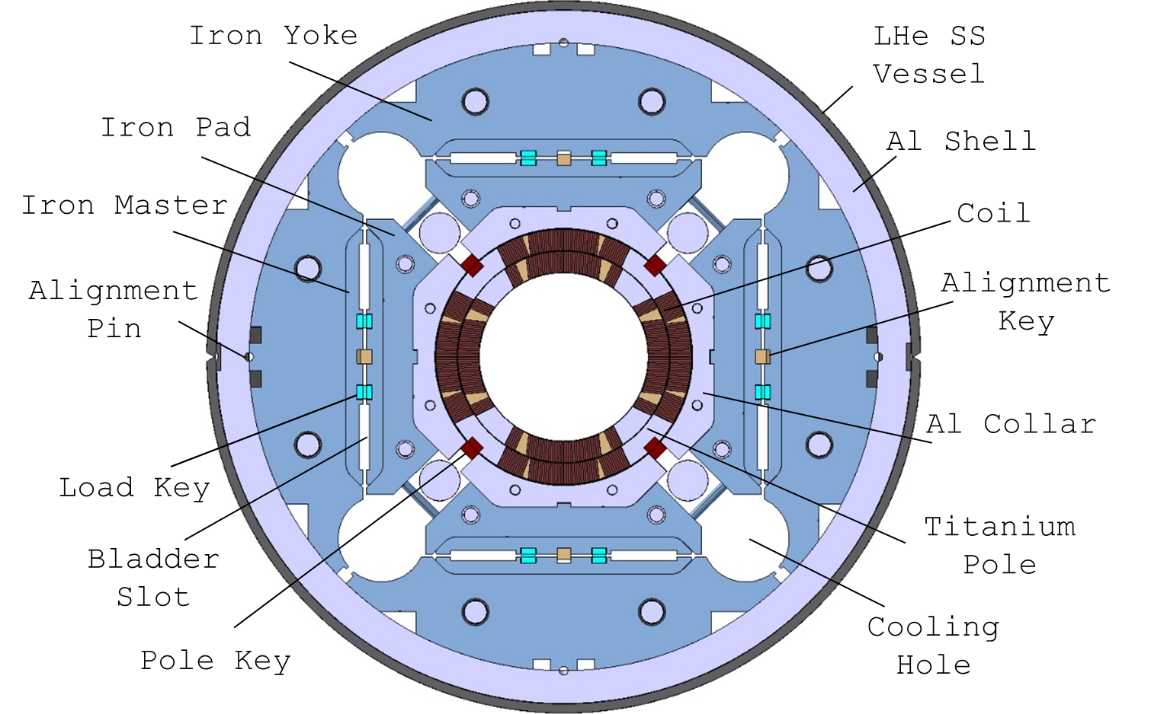
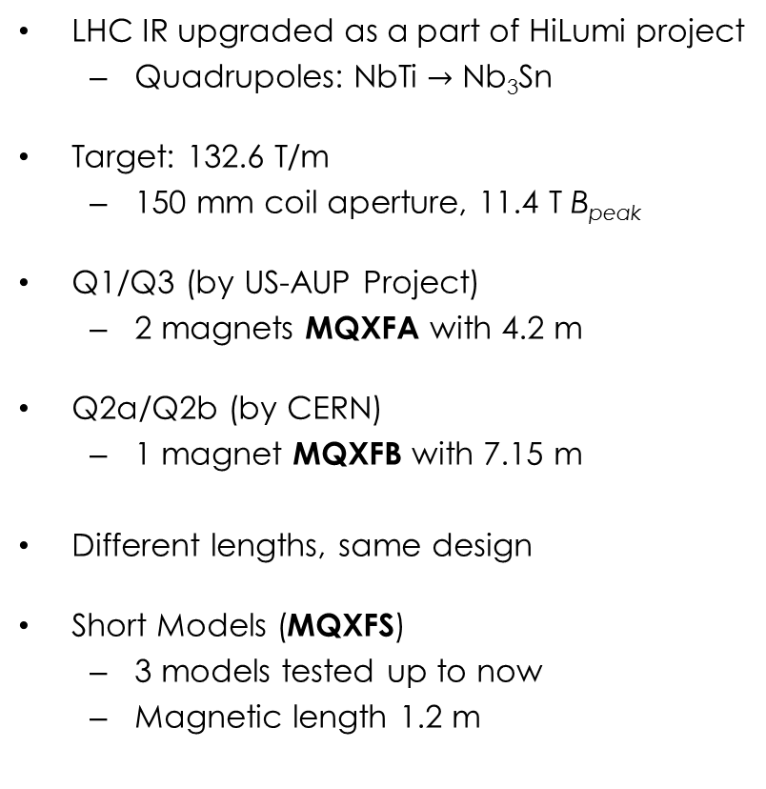
MQXF Design
LHC IR upgraded as a part of HiLumi project
  Quadrupoles: NbTi $→$ Nb₃Sn
Target: 132.6 T/m
  150 mm coil aperture, 11.4 T B_{peak}
Q1/Q3 (by US-AUP Project)
  2 magnets MQXFA with 4.2 m
Q2a/Q2b (by CERN)
  1 magnet MQXFB with 7.15 m
Different lengths, same design
Short Models (MQXFS)
  3 models tested up to now
  Magnetic length 1.2 m

Slide 29
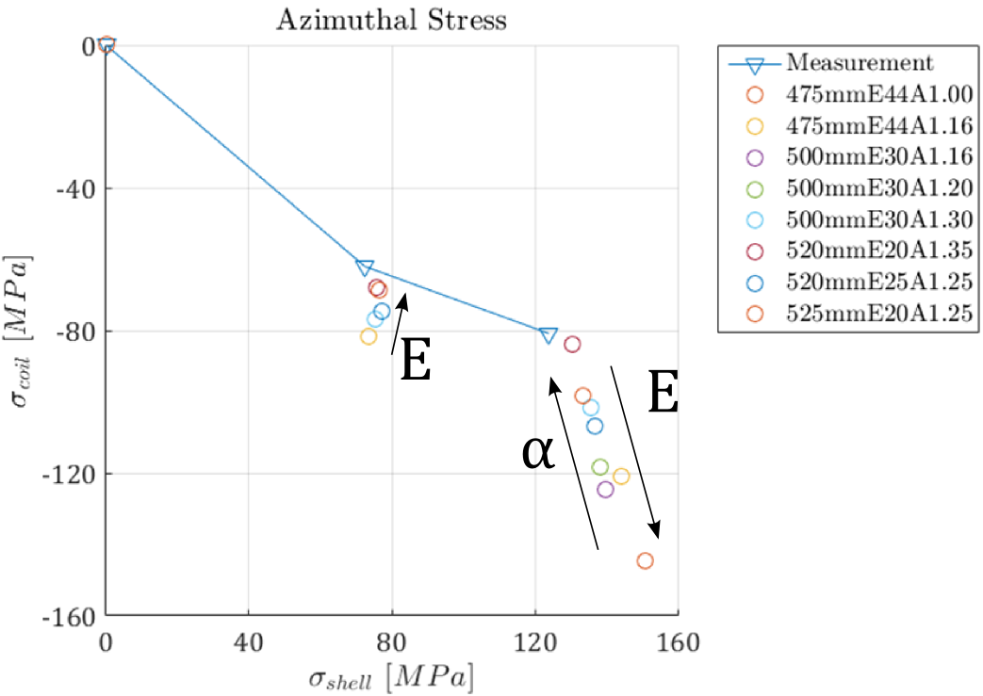
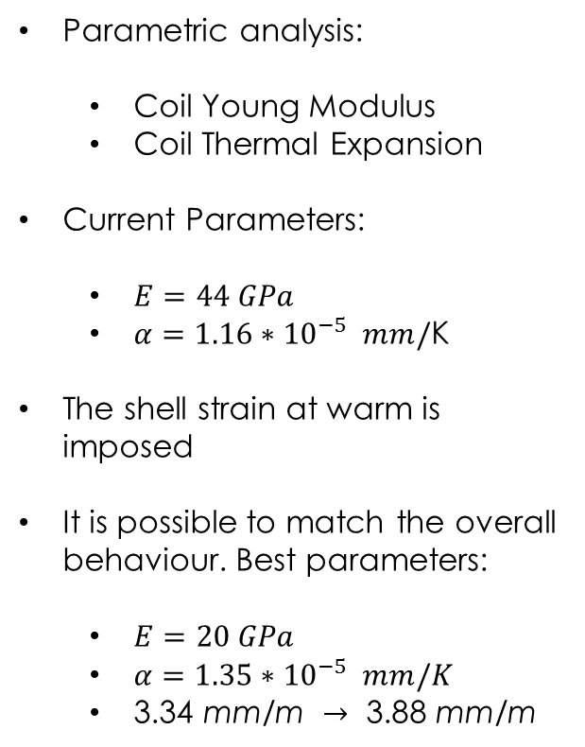
MQXFS1 – Material Calibration
Parametric analysis:
  Coil Young Modulus
  Coil Thermal Expansion
Current Parameters:
  $E=44 GPa$
  $α=1.16{∗10}^{−5} mm/$K
The shell strain at warm is imposed
It is possible to match the overall behaviour. Best parameters:
  $E=20 GPa$
  $α=1.35{∗10}^{−5} mm/K$
  $\text{3.34 }\text{mm}\text{/}\text{m} →\text{ 3.88 }\text{mm}\text{/}\text{m}$

Slide 30
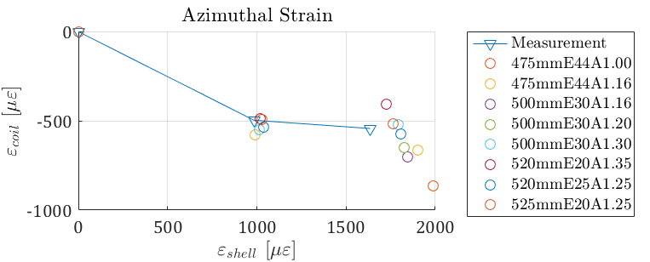
AT1 – Material Calibration
Best stress calibration parameters does not coincide with strain ones.
Possible improvement:
  Orthotropic Coil behaviour
  Friction parametric study

Slide 31


Mechanical Model Validation
Shell
Cool-Down
Loading
Pole

Slide 32



Short Model - Strain Gauge Locations
Shell
Pole

Slide 33


MQXF Mechanical Model
Coil modelled as a block. Simulations in 2D and 3D.
Coil properties from LARP experience:
  Elastic modulus (linear elastic): 44 GPa (azimuthal), 52 GPa (radial)
  Thermal contraction: 3.35 mm/m

Slide 34

MQXF – Mechanical Structure
Azimuthal preload at R.T. applied with bladders & keys
  Al shell compresses the coils. Part of the force is absorbed by the pole key
Longitudinal preload at r.t. applied pre-tensioning the rods
Both increased by the differential thermal contraction during cool-down

Slide 35


MQXFS1 – Transfer Function
Shell
  Prestress analysis:
  Prestress variation: $±17 MPa$
    Does this set a threshold on expected model precision?
Model result is out of the meas. uniformity
  Pole stress at warm lower
  Lower prestress increase during CD
  Stress after CD lower than expected on both shell and coil
The mechanical models experience suggests that the distance between model and measurements is due to the coil properties used.
Pole
Loading
Cool-Down

Slide 36

Mechanical Model
Cool-Down
Loading
Mechanical structure was tested with aluminium dummy coils
Transfer Function: force provided by the structure vs coil prestress
  Very good agreement with the numerical model results
  No calibration was performed

Slide 37



Interfaces – Measurements
Preliminary measurements on single lap and double lap shear samples
  Single lap useful for mixed mode (tension+shear) failure (likely to occur in magnets)
  Double lap useful for verification of shear failure
These tests tried to reproduce as close as possible the coil/structure interfaces
  Copper/copper (single-lap), impregnated insulation/Aluminum bronze (double-lap)
Still missing some effects:
  Reaction impact on bonding
  Effect of temperature, insulation thickness, etc.
Released energy during crack propagation?

Slide 38

Material Model Calibration
DOUBLE LAP JOINT TEST
smax | Gcn | tmax | Gct | Fmax | Stress
MPa | J/m2 | MPa | J/m2 | N/m | N/mm2
10 | 200 | 10 | 600 | 97612 | 9.76
20 | 200 | 10 | 600 | 98746 | 9.87
20 | 200 | 20 | 600 | 193175 | 19.32
20 | 200000 | 10 | 600000 | 99584 | 9.96
70 | 200 | 35 | 600 | 312706 | 31.27
SINGLE LAP JOINT TEST
smax | Gcn | tmax | Gct | Fmax | Stress
MPa | J/m2 | MPa | J/m2 | N/m | N/mm2
20 | 200 | 10 | 600 | 92750 | 9.28
20 | 100 | 10 | 300 | 90749 | 9.07
20 | 50 | 20 | 150 | 87933 | 8.79
20 | 25 | 10 | 75 | 73215 | 7.32
24 | 50 | 12 | 150 | 100081 | 10.01
24 | 25 | 12 | 75 | 74081 | 7.41
24 | 30 | 12 | 90 | 81397 | 8.14
Assumptions: 1. $τ_{R}=\frac{1}{2}σ_{R}$ 2. $G_{n_{c}}=\frac{1}{3}G_{t_{c}}$ 3. $E=5 GPa$
Double lap joint used to calibrate the material strength
  tensile strength: 24 MPa, shear strength: 12 MPa
Single lap joint results used to calibrate the fracture toughness
  Fracture toughness, mode I: 30 J/m² mode II: 90 J/ m²
Preliminary values, more exp. data needed
  E.g. the disp./force curve might allow for a better toughness calibration
    Available data not clean enough
  Measurements at room temperature - no data at cold
G…

Slide 39



Cohesive Zone Material Model
Cohesive zone model for single-mode failure:
  Initial slope dictated by the glue modulus and thickness $→$ Glue thickness can change the joint strength…
  $δ_{c}$ is the displacement at the damage ‘start’
    Degraded stiffness for damaged interfaces
  $δ_{f}$ is the displacement at the debonding completion
  Damage defined as: $λ= \frac{δ−δ_{c}}{δ_{f}}$ for $δ>δ_{c}$, 0 otherwise
  Total area below the curve equal to the energy release rate G
Mixed-mode failure:
  Quadratic sum for mixed mode debonding (beta assumed equal to 1 here)
Some issues:
  Standard ANSYS allows only for bilinear laws with mixed mode failure(more can be added with subroutines)
  Post-debonding friction does not work (should work, seems a bug. Can still activated manually during solution)

Slide 40


CCT Model Description
CZM elements
Contact elements with CZM properties around the cable (cable/spar, cable/rib)
Shim ‘angle’ increased w.r.t reality – otherwise some of the conductor ‘blocks’ fly away after detachment
  This region is not realistic in 2D anyway
Elasto-plastic material model for the conductor
  Extracted from RVE models of the cable
‘Single ramp’ simulation – cooldown, then current is increased - no powering/quench/powering simulation

Slide 41




Powering - Stresses
Does the stress distribution change because of the interface failure?
Yes, higher stresses – neglecting the corner spikes:
  Radial: 100 MPa vs ~60 MPa
  Azim.: 90 MPa vs 70 MPa
The CZM model shows significant stress gradients
Note: stresses on an elasto-plastic model are not ‘what we are used to’ and should not be compared with the empirical limit of 150/200 MPa.
Radial
Azim.
Radial
Azim.
Bonded
CZM

Slide 42

Quench Simulation
Released energy
$$dE∝dω(1−dω)$$
$$dω∝{d(δ}_{n}−δ_{n}^{∗})$$
Compare to fixed threshold
Compare to local T margin
Can we correlate the crack propagation to energy releases?
  Crack energy released should be related (proportional) to the heat released (minus elastic waves…)
    Difficult to say how much heat goes trough the conductor and how much trough the mandrel
    Add temperature measurements in the future? Challenging at cryogenic temperature
A couple of simplified approaches:
  Derivative of damage vs time proportional to the released energy?
    Compute the local temperature margin
    Compute the contact element energy change
    Assume that the change in temperature is proportional (ok this would have been better with the enthalpy margin)
  Event magnitude approach
    The energy released by the crack is propagating to every location in the magnet (shocks?)
    The limit should not be constant but decrease with the margin…
This study is only qualitative, and useful for comparison purposes

