Slide 1
Modeling tools for HFM R&D
Lucas Brouwer
Accelerator Technology and Applied Physics Division
Lawrence Berkeley National Laboratory
4/15/2021

Slide 2
Scope of the Presentation
Mechanical modeling
modeling strain induced margin reduction (strand to magnet level)
improved modeling of interfaces
high performance computing for efficient solution of large 3D models
Multiphysics codes for magnets
diverse set of codes for simulating strongly coupled (EM-thermal-circuit) behavior of magnets enable accurate modeling of CLIQ and other challenging scenarios
HTS cable and magnets
Focus on recent advances (representative examples) and key challenges for each
mechanical and electromagnetic models guiding cable design
evaluation of screening induced fields in HTS accelerator magnets

Slide 3
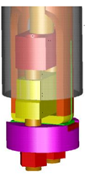


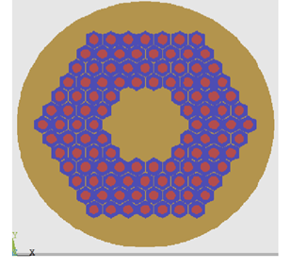
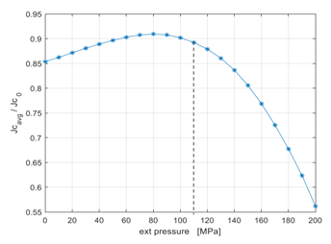
Modeling critical current degradation of Nb₃Sn at the strand and cable level
Simulation of Ic sensitivity to uniaxial transverse pressure
FEM Modelling reproduces Ic degradation as a function of transverse pressure for 10-stack cable compression test
Structural FEM analysis in Ansys APDL
Pre-stress evaluation from heat treatment (950K to 300K)
Cool down of sample from 300K to 4.2K + Ramped external load
𝐉_{𝐜} evaluation for each element using Ekin’s law
Numerical integration on the strand cross section → I_{c} degradation for the entire strand
as a function of external load
Ic measurement on wire inside cable
I_{c} Reduction @15 T vs. Pressure
Rutherford cable stack
Strand sub-modeling
(includes insulation and resin)
G. Vallone, et al., IEEE Trans. Appl. Supercond., 28, 4, 2018
B. Bordini et al., IEEE Trans. Appl. Supercond., 20, 3, 2010
Courtesy of Emanuela Barzi

Slide 4
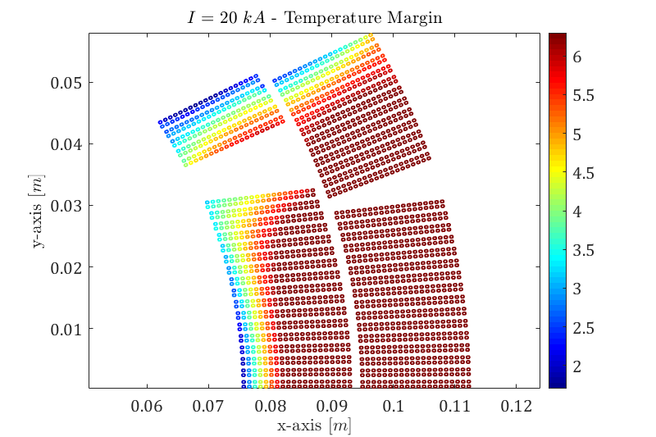
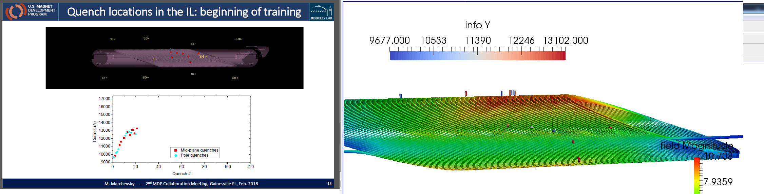
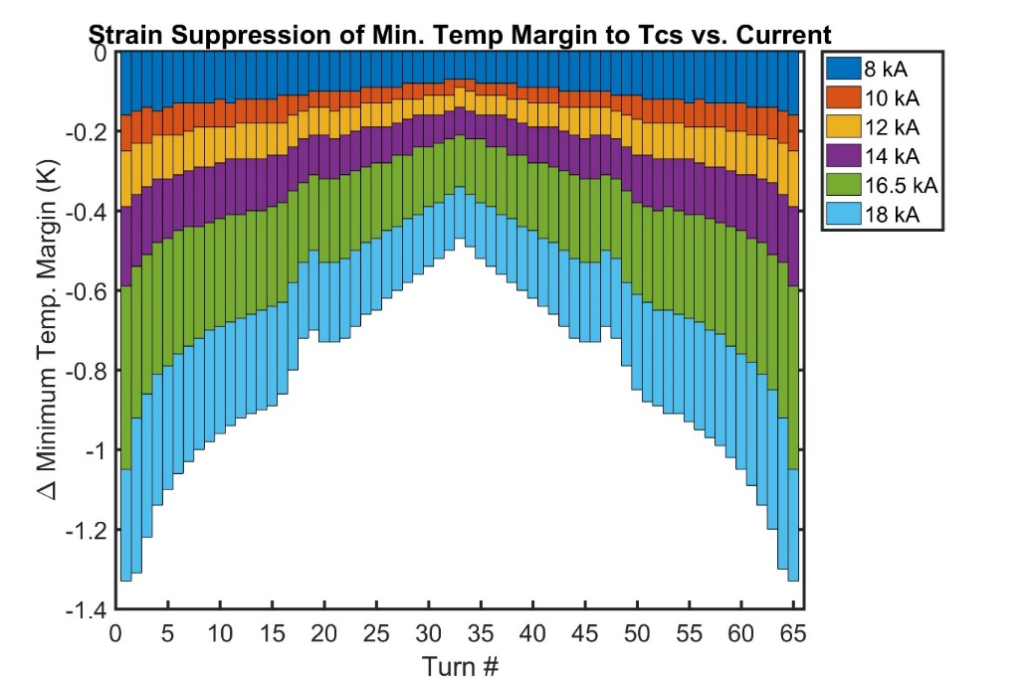
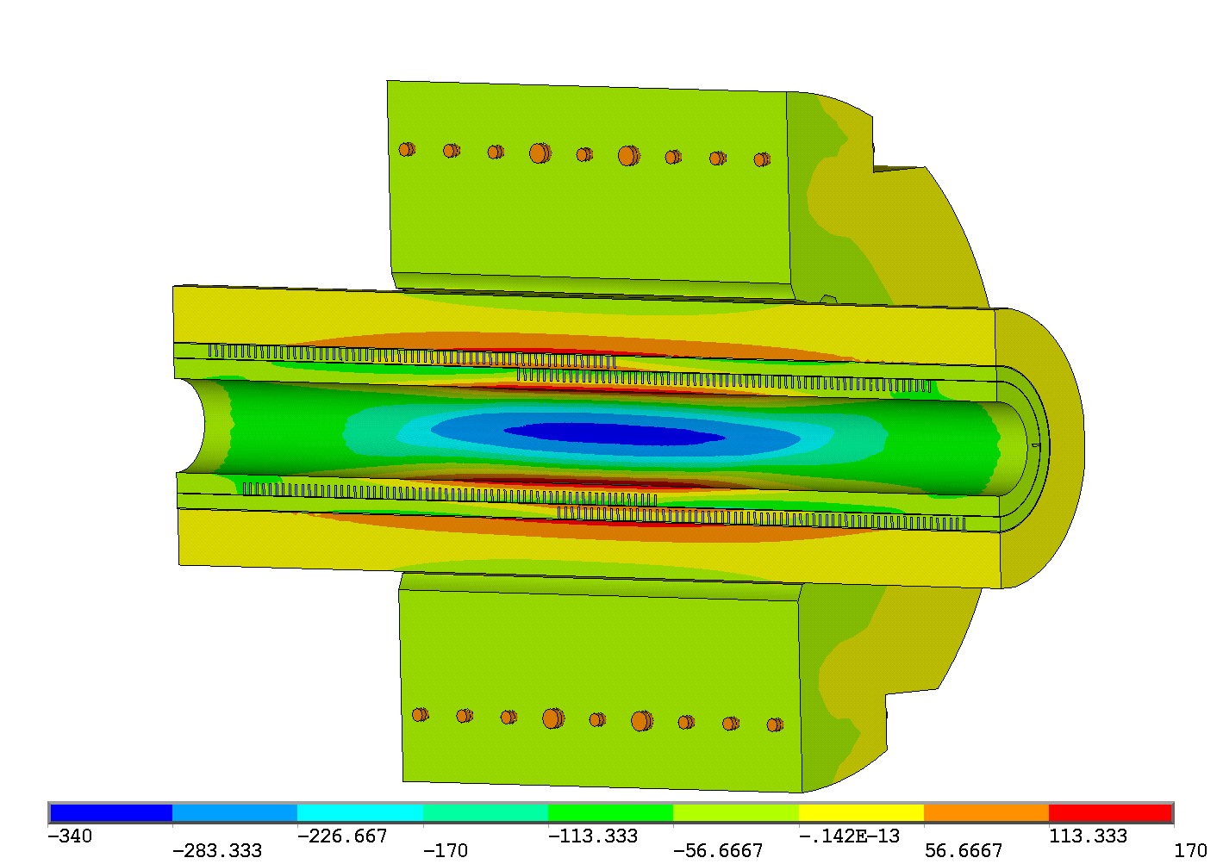
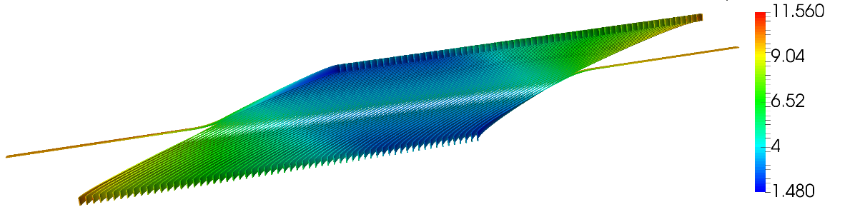
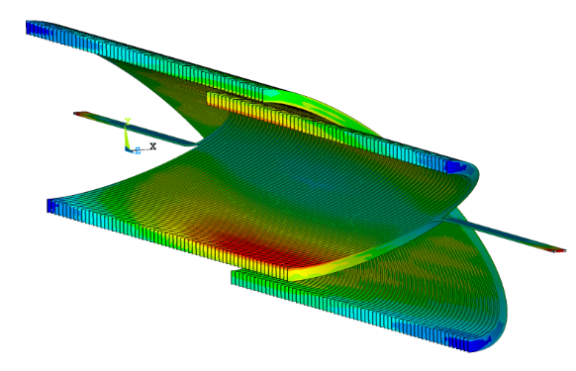
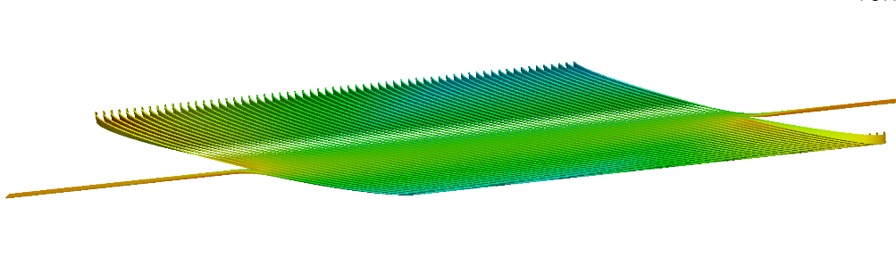
Margin maps including stress at the magnet level
Example 1: Individual strands and insulation included in 2D (MQXF)
Many uncertainties, but is proving to be a valuable tool for comparison with test diagnostics
G Vallone et al 2021 Supercond. Sci. Technol. 34 025002
Ic(B,T,strain) calculated on mesh using (B, strain) from FEM models gives margin as a function of position and evolution vs. magnet current (min. margin can move)
Example 2: blended cable properties in 3D (CCT)
Overlay of margin and quench location from acoustic sensors

Slide 5
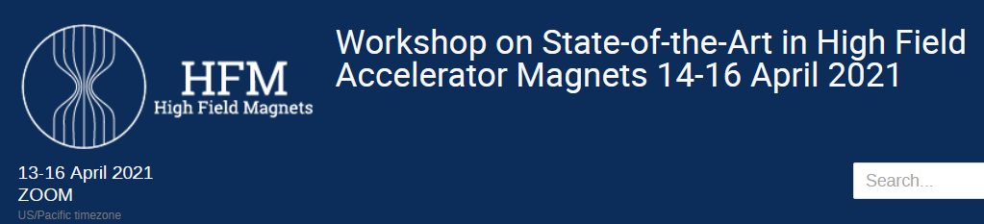
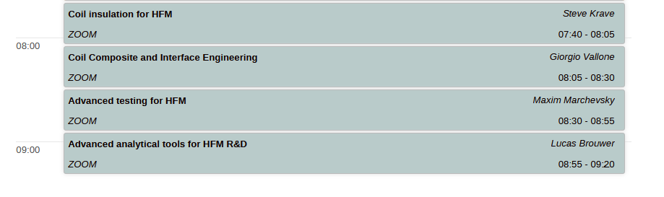
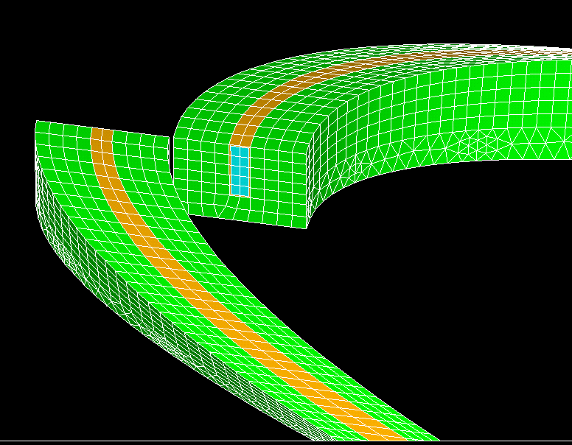
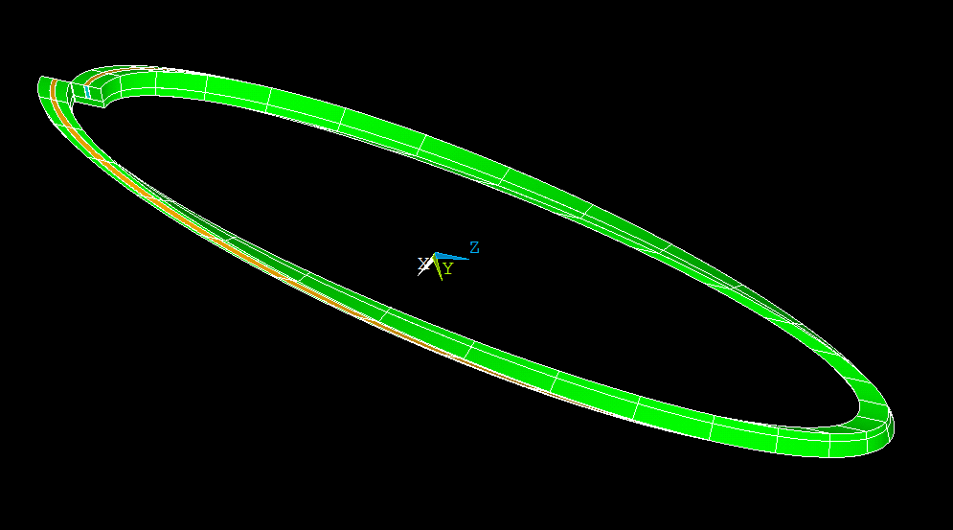
Improved Modeling of Interfaces
See detailed talk on interface modeling from Giorgio Vallone
Strong non-linearity of interface contact models are computationally challenging in 2D and 3D
Summary of recent developments
pole debonding modeled for MQXF
implementation on 2D CCT models shows initial debonding location and evolution
quantitative results are challenged by uncertainty in interface material properties

Slide 6
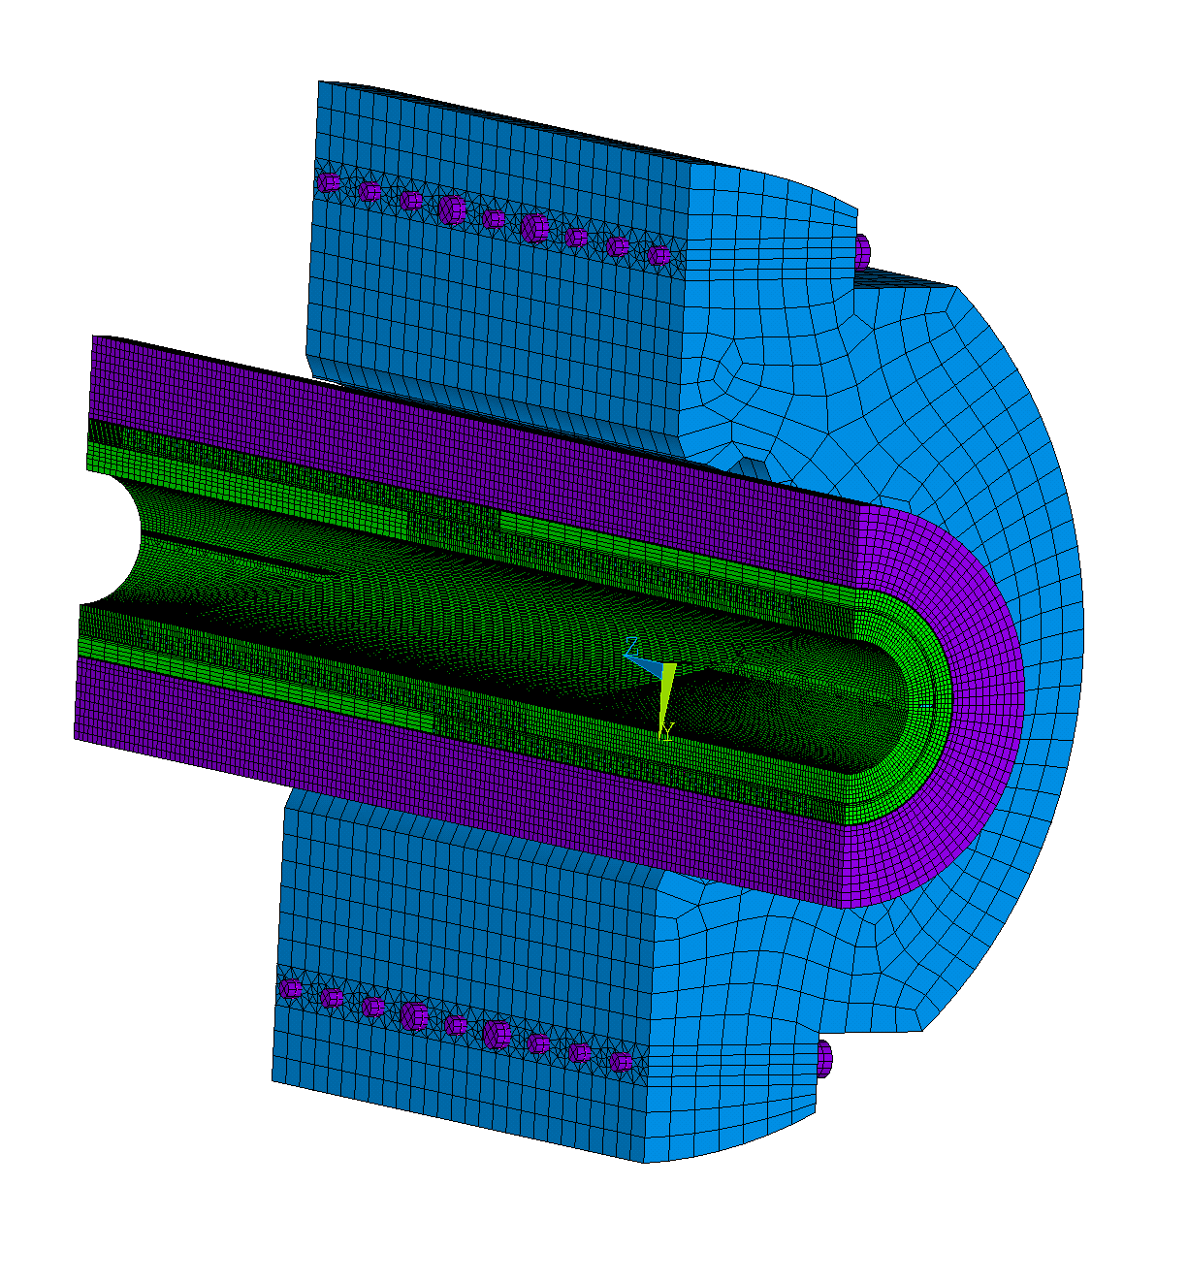
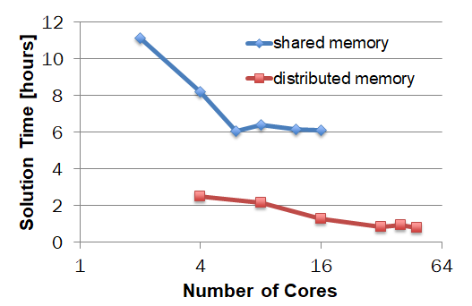
Use of high performance computing reduces run times for large 3D mechanical models, allowing for 3D design and optimization
Example: CCT4 3D ANSYS mechanical model
Solution time is reduced from overnight to less than one hour
using the Lawrencium cluster*
Solid186, 7M DOFs
3 load steps: assembly, cooldown, Lorentz forces
PCG (iterative) solver
Not yet implemented for multiphysics or interface de-bonding models
L. Brouwer et al. IEEE Trans. Appl. Supercond. 4001006, 28.3, 2017
*http://scs.lbl.gov/

Slide 7
Summary of Mechanical Modeling
Recent advances
  sub-strand and cable level modeling predicts Ic reduction
  magnet-level margin maps show distribution and evolution of margin during powering
  development of interface debonding models and their initial application to Nb3Sn accelerator magnets
  high performance computing (HPC) resources enable efficient solution of large 3D mechanical models
Key challenges
  uncertainty in material properties of conductor and interfaces
  implementing energy release and thermal effects leading to quench for debonding models
  extending the use of HPC resources as needed (for highly non-linear interface debonding, margin analysis, etc.)
7

Slide 8
Mechanical modeling
modeling strain induced margin reduction (strand to magnet level)
improved modeling of interfaces
high performance computing for efficient solution of large 3D models
Multiphysics codes for magnets
diverse set of codes for simulating strongly coupled (EM-thermal-circuit) behavior of magnets enable accurate modeling of CLIQ and other challenging scenarios
HTS cable and magnets
mechanical and electromagnetic models guiding cable design
evaluation of screening induced fields in HTS accelerator magnets

Slide 9
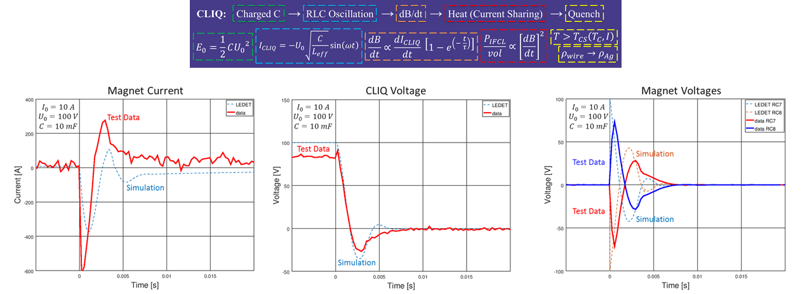

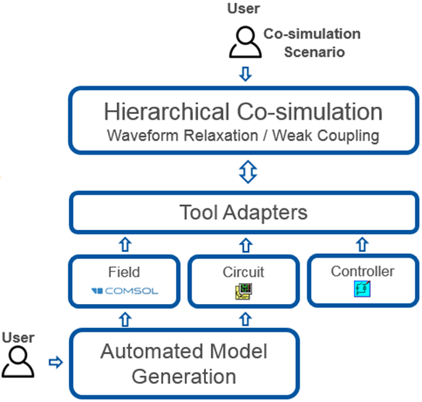
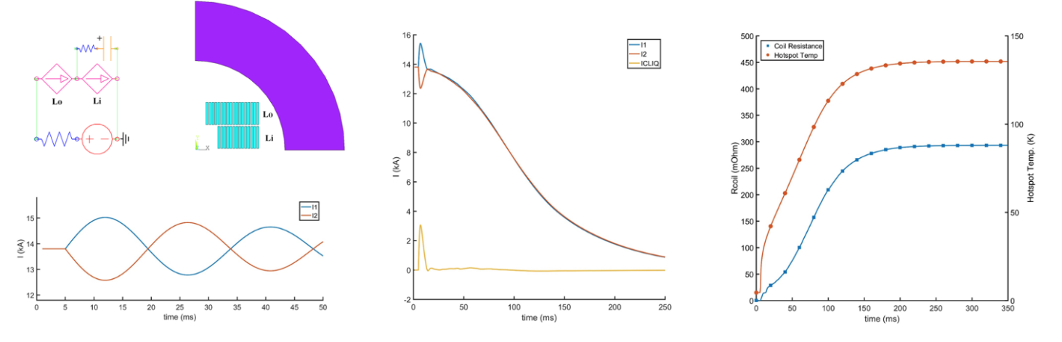
A diverse set of codes are now available for simulating strongly coupled, multiphysics behavior of magnets
Challenge: multiphysics coupling of EM, thermal, and circuit effects in magnets over large variations in time and length (for CLIQ[1] etc.)
[1] E. Ravaioli, PhD thesis, 2015
STEAM: co-simulation approach (FEM, network models, …)
ANSYS user elements (self-contained FEM)
Supported simulation tools
In-house developed: LEDET, ProteCCT, SIGMA, BBQ
Developed in other institutions: QLASA
Commercial: PSPICE, LTSpice, COMSOL, ANSYS, PSIM
Automated model generators (supported for PSPICE, SIGMA, LEDET, COSIM)
“Meta-methods” (requiring tool adapter APIs), i.e. cooperative simulation
“Front-ends”: Jupyter notebooks and scripts to make it easier to use the above-mentioned and run simulations
STEAM References
For BBQ: M. Mentink, et al., IEEE Trans. on Appl. Supercond., 28, 4004806, 2018
For COSIM: L. Bortot, et al., IEEE Trans. on Appl. Supercond., 28.3, 1-6, 2017
For ProteCCT: M. Mentink et al., IEEE Trans. on Appl. Supercond., 28, 4004806, 2018
For SIGMA: L. Bortot, et al., IEEE Transactions on Magnetics, 54.3, 7000404, 2017
For LEDET: E. Ravaioli, et al., Cryogenics, 80.3, 346-356, 2016.
For any software [in addition]: https://espace.cern.ch/steam/
L. Brouwer et al 2019 SUST 32 095011

Slide 10
These codes are benchmarked and are now routinely used for high-field Nb₃Sn accelerator magnet studies
Quench Protection of the First 4-m-Long Prototype of the HL-LHC Nb₃Sn Quadrupole Magnet
Quench protection of the Nb₃Sn CCT magnet CD1
STEAM-LEDET simulations of CLIQ, energy extraction, and heaters show good agreement with test results
CLIQ and EE simulated with ANSYS UDE’s, including eddy current effects in CCT structure (FEM)
E. Ravaioli, et al. IEEE Trans. Appl. Supercond. 29.5 (2019). 4701405
J. Gao, et al. IEEE Trans. Appl. Supercond. 30.4 (2020). 4701505

Slide 11
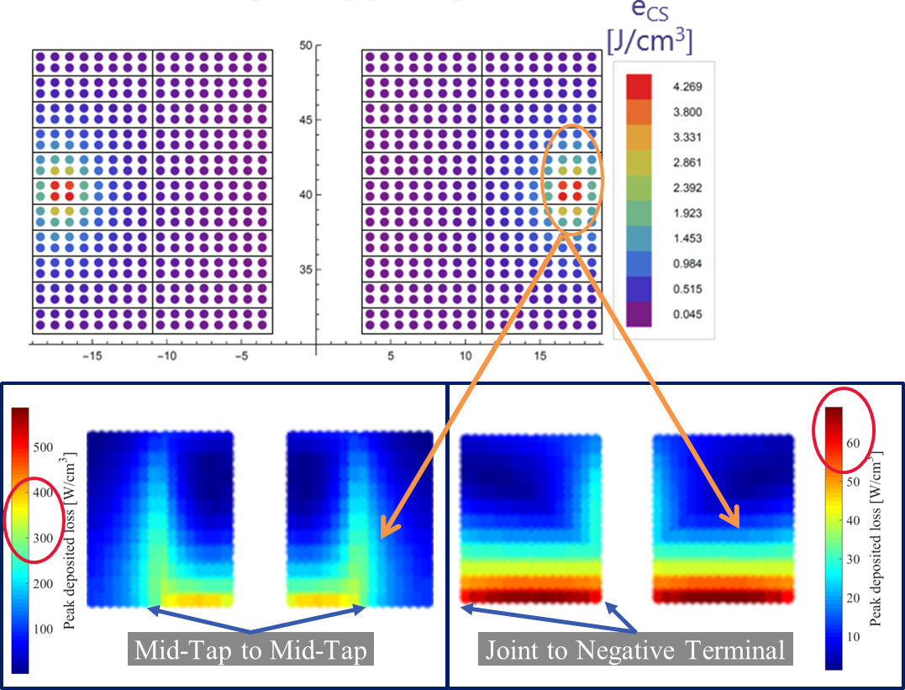
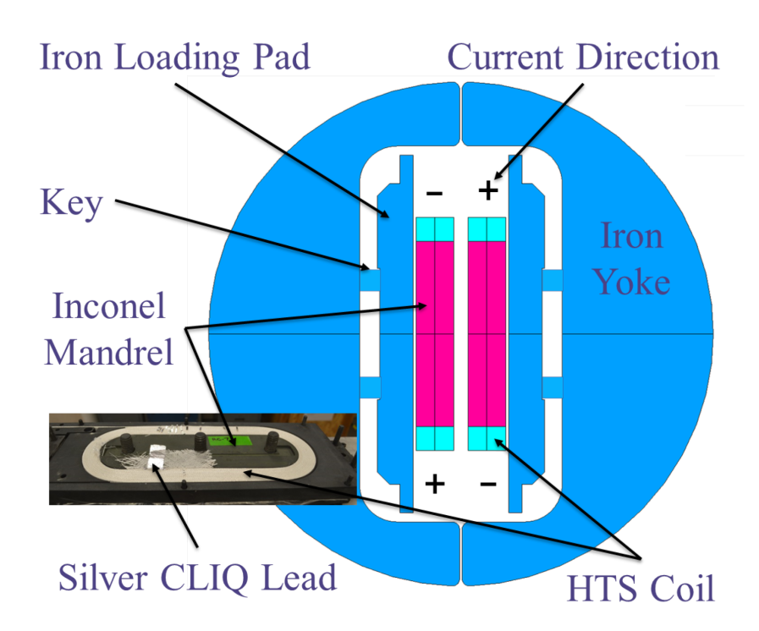
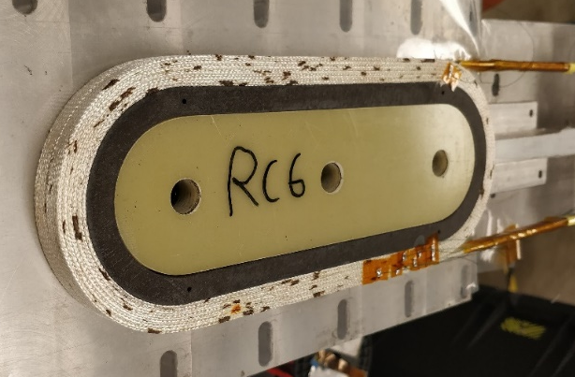
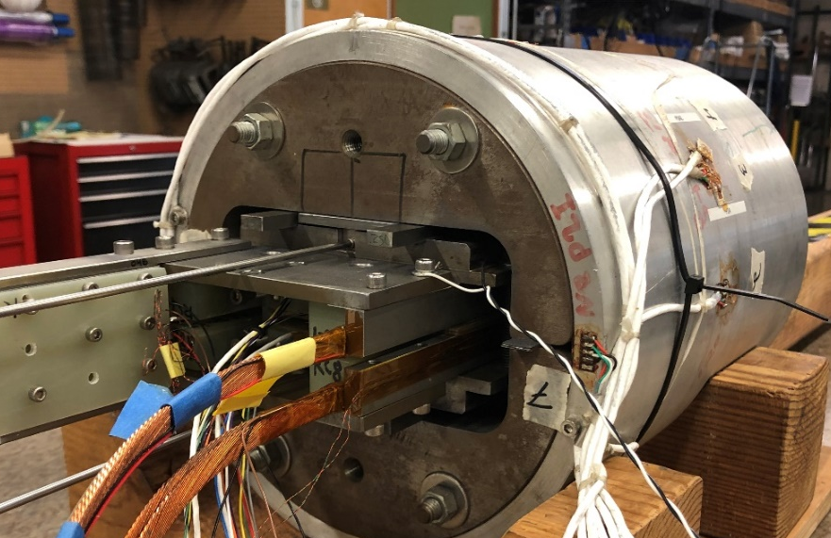
STEAM tools applied to quench protection of multi-filamentary Bi-2212 HTS accelerator magnets
~5 T, Bi-2212 common coil magnet
CLIQ design optimized using STEAM-LEDET modeling, 1st low current test at 77 K
Double Pancake Windings
Silver Mid-Tap
Common Coil RC7+RC8
Joint
Key
Bladder
Strain
Gauges

Slide 12
Summary of Multiphysics Magnet Modeling
Recent advances
  a diverse set of tools can model CLIQ and other strongly coupled EM, thermal, and circuit behavior of magnets
  these codes are being extended to multi-filamentary HTS (important for future hybrid LTS/HTS testing)
Key challenges
  extension to REBCO and HTS cables (magnetization models/approaches)
  extension to 3D
  management and sharing of codes

Slide 13
Mechanical modeling
modeling strain induced margin reduction (strand to magnet level)
improved modeling of interfaces
high performance computing for efficient solution of large 3D models
Multiphysics codes for magnets
diverse set of codes for simulating strongly coupled (EM-thermal-circuit) behavior of magnets enable accurate modeling of CLIQ and other challenging scenarios
HTS cable and magnets
mechanical and electromagnetic models guiding cable design
evaluation of screening induced fields in HTS accelerator magnets

Slide 14

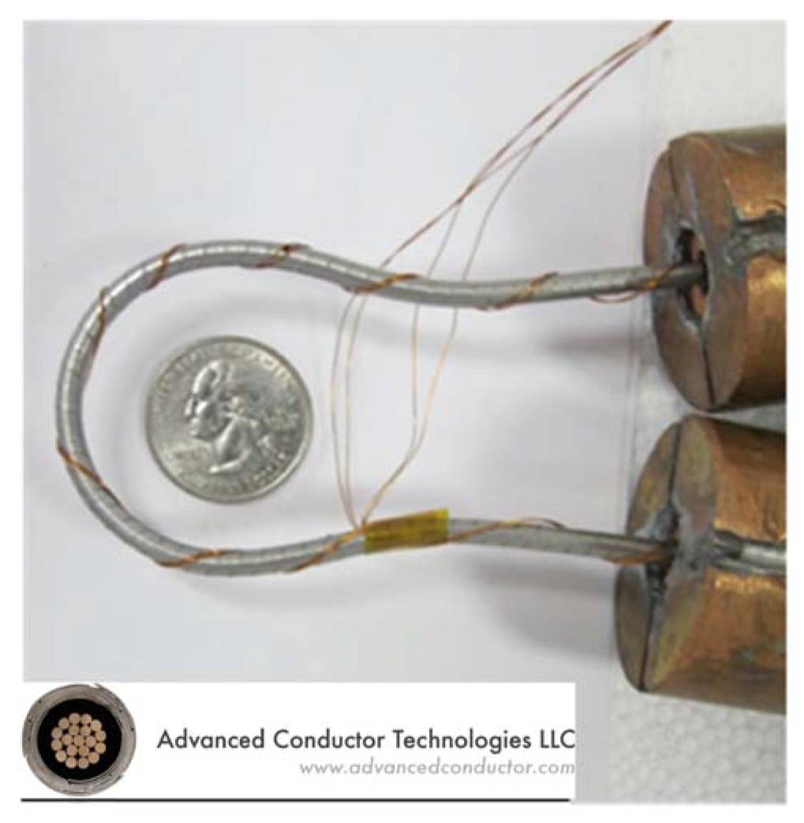

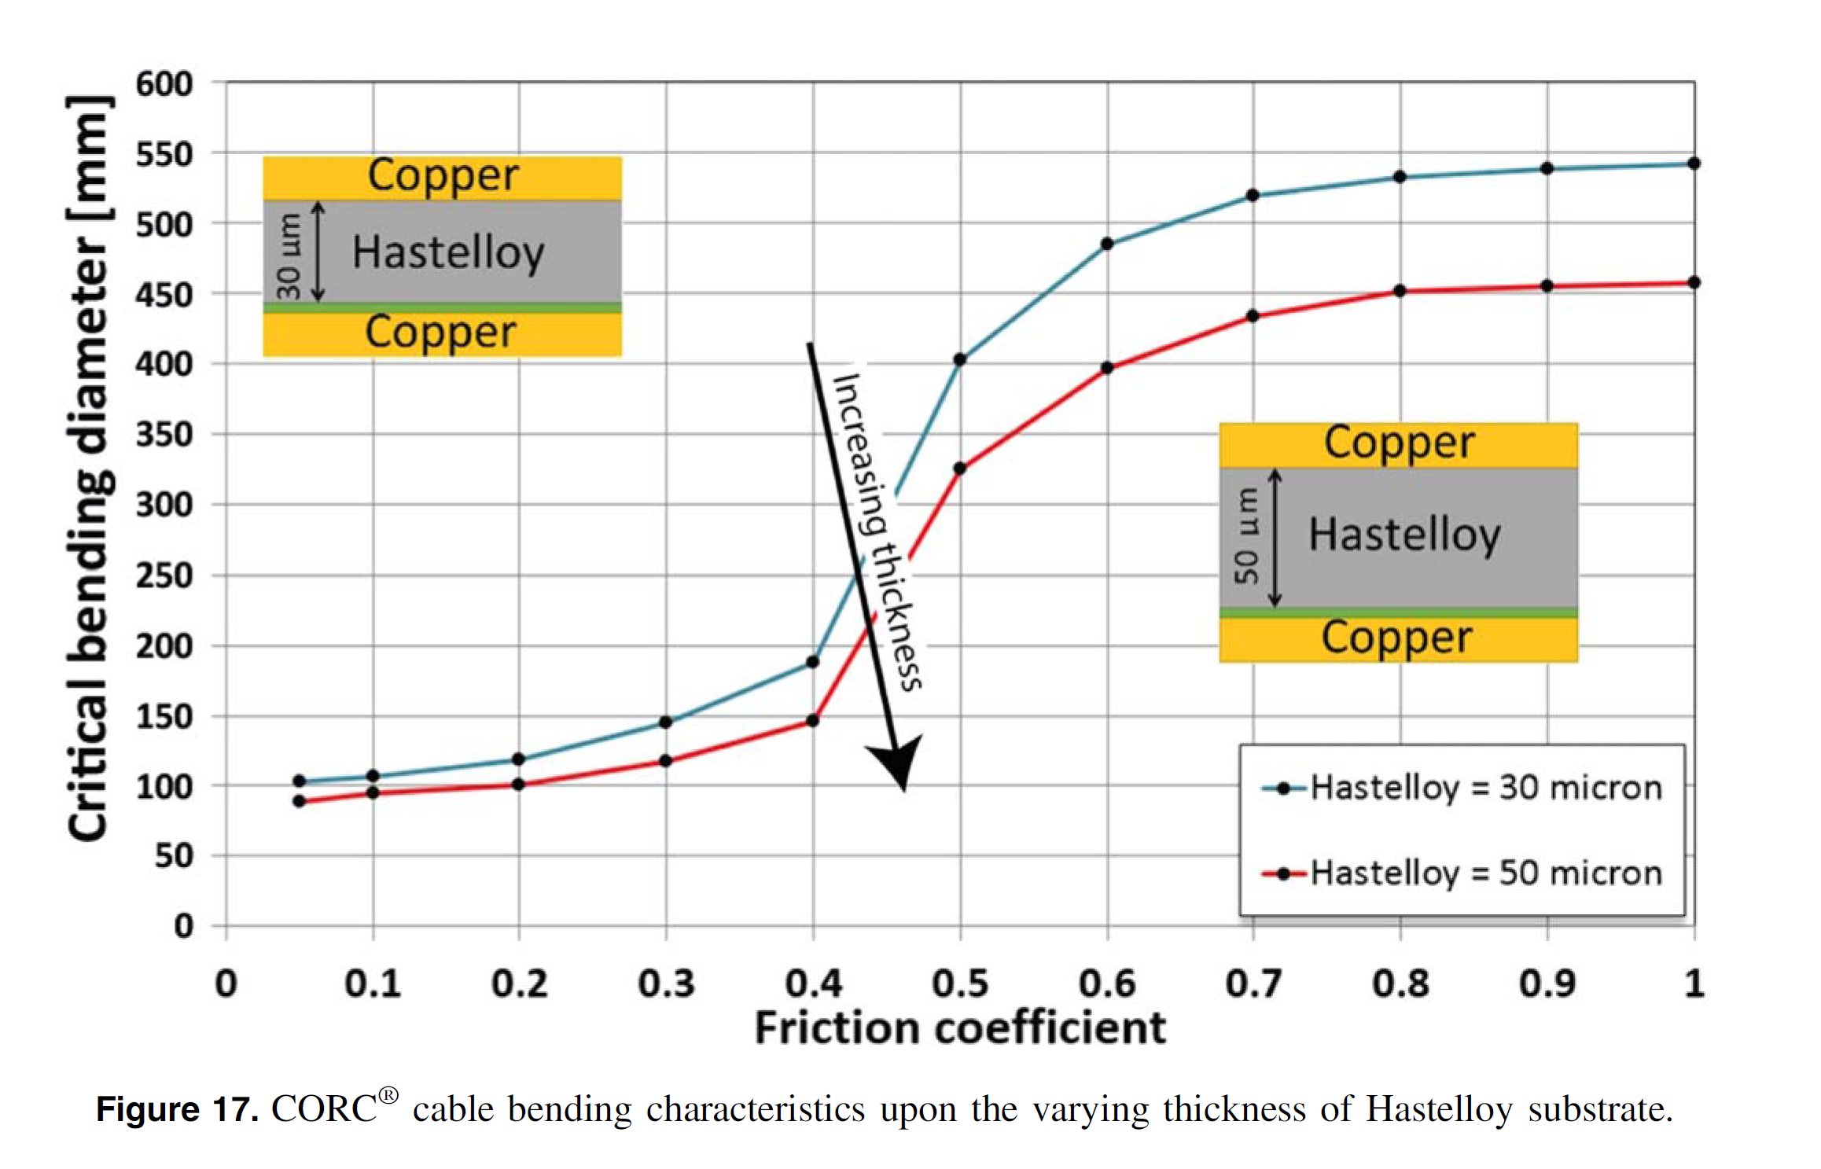
3D mechanical modeling of HTS cables guiding design (representative example for CORC)
FEM models predict degree of Ic degradation during bending of CORC cable as a function of: winding angle, tape width, friction, copper thickness, substrate thickness, # of layers, and core diameter
V A Anvar et al 2018 Supercond. Sci. Technol. 31 115006

Slide 15

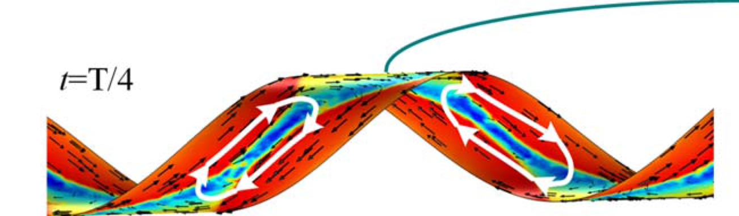
Different approaches to 3D modeling of HTS cables can relate cable design parameters to magnetization and AC loss
EM-thermal network models
3D T-A formulation (FEM)
Current vector potential with thin-strip approximation
Yawei Wang et al, SUST, 33, 025003, 2019
Y. Sogabe, et. al., SUST, 33, 055008, 2020
J. van Nugteren, HTS accelerator magnets, PhD thesis, 2016
Magnetization, hysteresis, and loss for Roebel, CORC, and twisted stack cables
Magnetization loss as a function of CORC cable parameters: winding direction, layer structure, and striation
AC loss and coupling time constants evaluated for SCSC cable concept

Slide 16
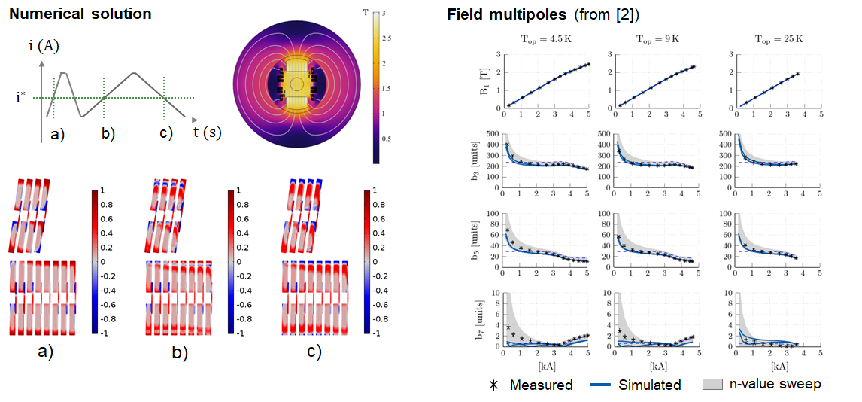

Simulated screening currents for the Feather-M2 HTS Magnet
A coupled A-H, 2D FEM formulation allows for numerical modeling of REBCO screen currents in accelerator magnets [1]
Field multipoles compared to measurements at different temp [2]
[1] Bortot, L., et al. "A Coupled A–H Formulation for Magneto-Thermal Transients in High-Temperature Superconducting Magnets." IEEE Transactions on Applied Superconductivity 30.5 (2020): 1-11.
[2] Bortot, L,, et al. "Numerical analysis of the screening current-induced magnetic field in the HTS insert dipole magnet Feather-M2. 1-2." Superconductor Science and Technology 33.12 (2020): 125008.
Backup slide contains details on the A-H FEM formulation

Slide 17
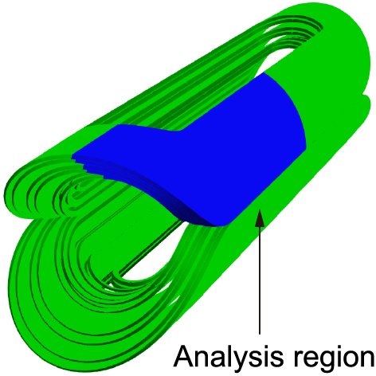
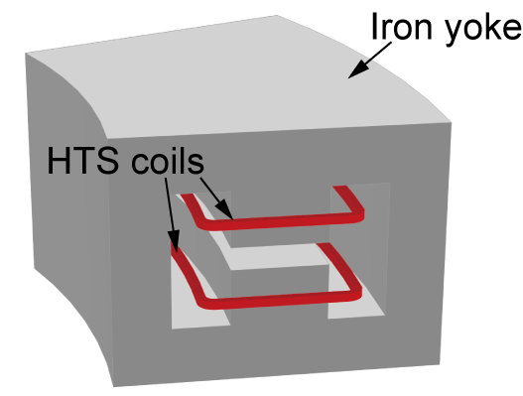
AC losses and shielding current induced fields can be evaluated in 3D for accelerator magnets wound with single coated conductors
Large-scale electromagnetic field analysis tool for HTS magnets [1-2] using T-formulation and thin-strip approximation with applying hierarchical matrices and preconditioning by Algebraic Multi-Grid method
1.5 M of degree of freedoms or more, enabling us to model almost whole part of a magnet wound with single coated conductor.
17
[1] T. Mifune, et. al., SUST, 32, 094002, 2019
[2] Y. Sogabe, et. al., IEEE-TAS, 29, 5900505, 2019
Achieved: evaluation of ac losses and shielding current induced fields (SCIFs) of magnets wound with single HTS tape
Not achieved: detailed analysis of ac losses and SCIFs of magnets wound with cables, considering their detailed structures
Courtesy of Dr. Amemiya and Dr. Gosabe of Kyoto University

Slide 18
Summary of HTS Cable and Accelerator Magnet Modeling
Recent advances
several different 3D numerical approaches can relate HTS cable design parameters to bending limits, magnetization, and AC loss
large-scale electromagnetic field analysis tools enable modeling of screening current induced fields and AC loss in HTS accelerator magnets (2D and 3D)
Key challenges
  current sharing around defects in detailed cable geometries
  including effects due to detailed cable structure in magnet models
  increase in the degrees of freedom (tens of million?)
  more parallel computation

Slide 19
Thank you for your attention
Acknowledgements
LBNL: Giorgio Vallone, Xiaorong Wang, Qing Ji, Zoe Webb-Mack, Tengming Shen
FSU-MAGLAB: Daniel Davis
CERN: Emmanuele Ravaioli, Lorenzo Bortot, Mariusz Wozniak, Glyn Kirby, Jeroen van Nugteren
FNAL: Emanuela Barzi
Kyoto University: Yasuke Sogabe, Naoyuki Amemiya

Slide 20

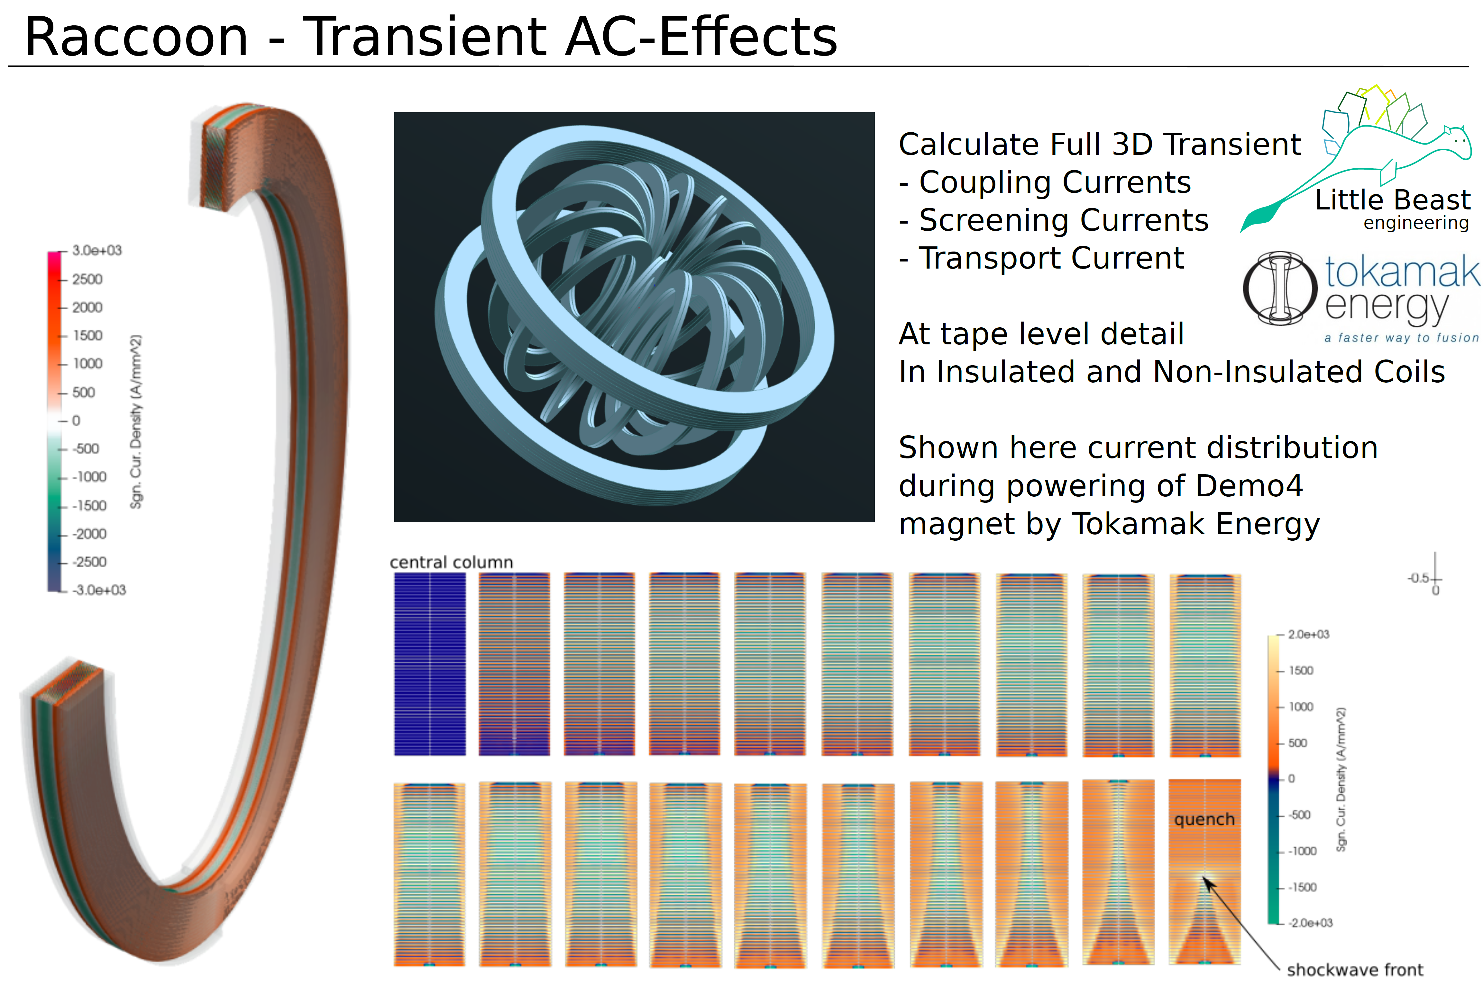
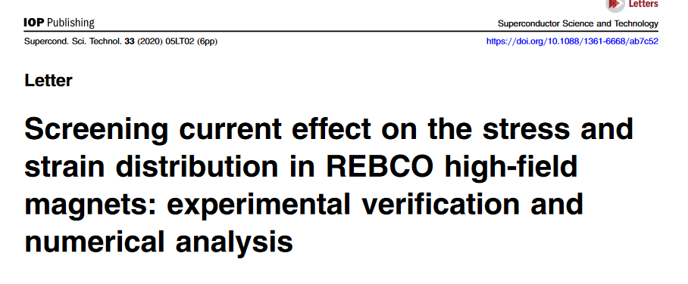
There is a large HTS modeling community worldwide, many relevant developments for power, fusion, NMR, and other applications not included in this presentation
http://www.htsmodelling.com/
20

Slide 21
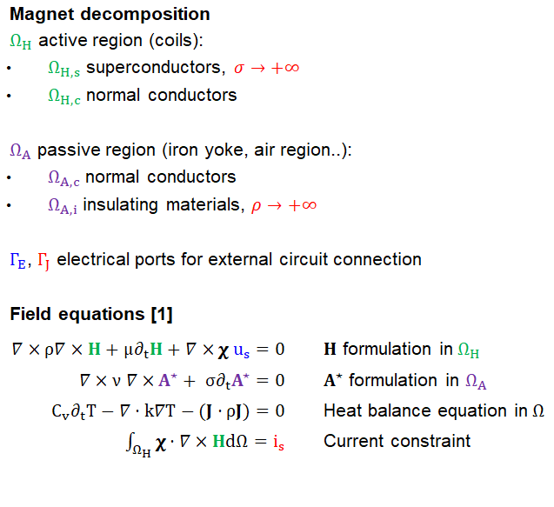
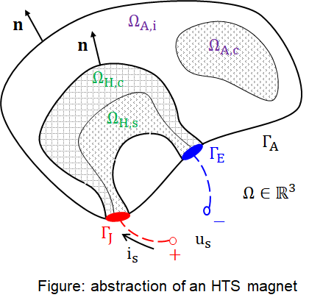
A coupled field formulation for HTS Magnets [1]
[1] Bortot, L., et al. "A Coupled A–H Formulation for Magneto-Thermal Transients in High-Temperature Superconducting Magnets." IEEE Transactions on Applied Superconductivity 30.5 (2020): 1-11.

Slide 22
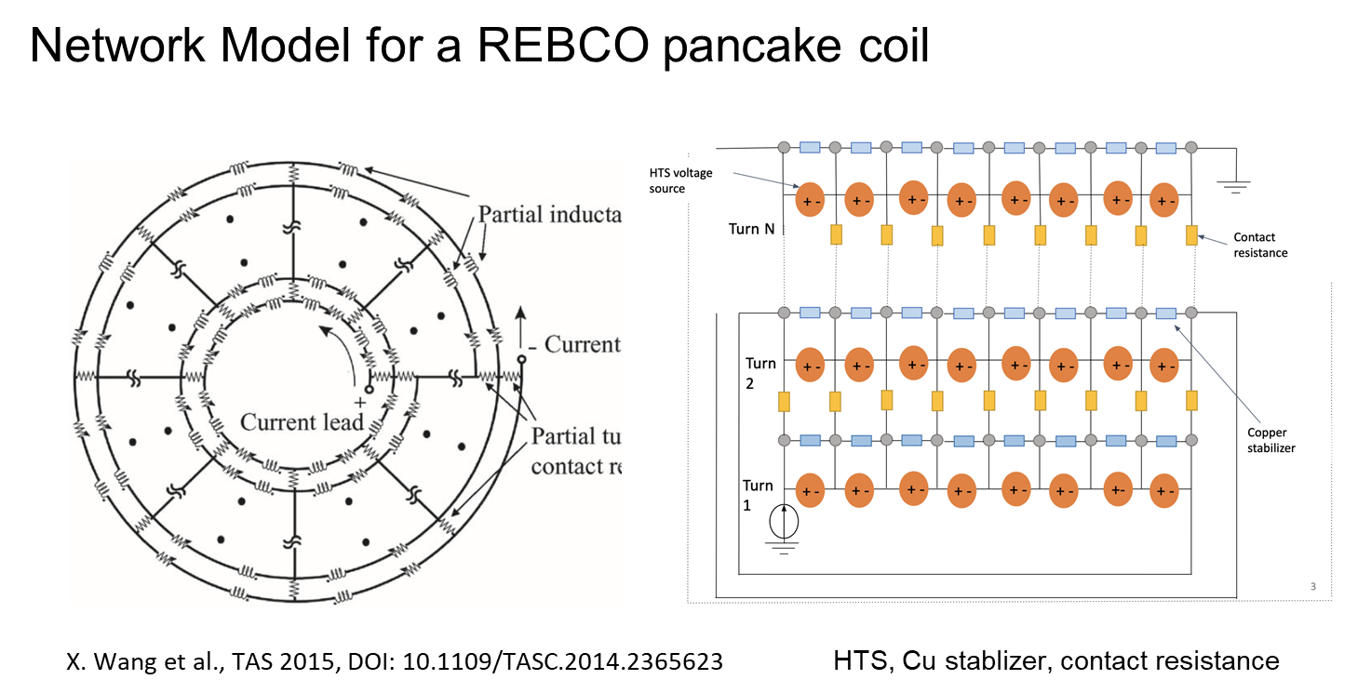
Network Model for RECBO Pancakes with Heat Transfer
Courtesy of Zoe Webb-Mack, Qing Ji, and Xiaorong Wang

Slide 23
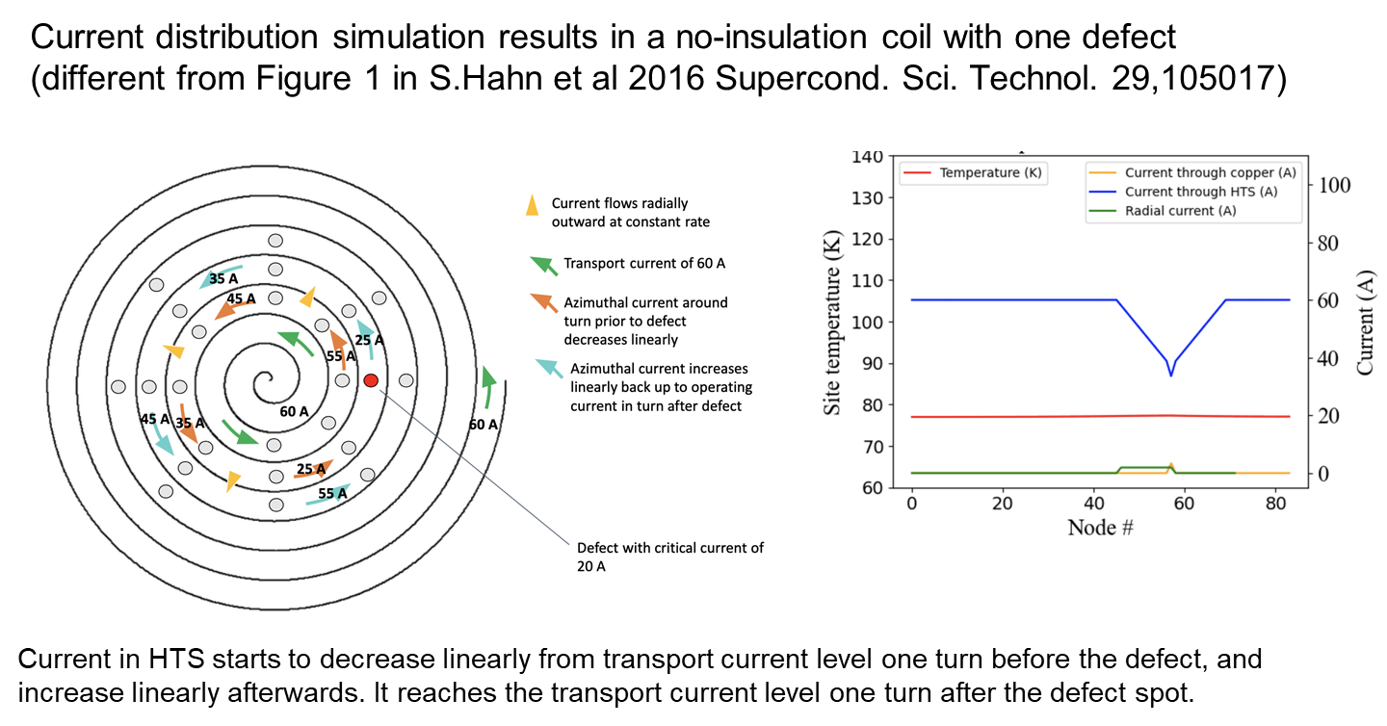
Network Model for RECBO Pancakes with Heat Transfer
Courtesy of Zoe Webb-Mack, Qing Ji, and Xiaorong Wang

Slide 24
Network Model for RECBO Pancakes with Heat Transfer
State of the art:
- Experimental results on current sharing between stacks of tapes and NI pancake coil can be reproduced with a ngspice network model. Current sharing in NI pancake coils can be counter-intuitive.
Lessons learned:
- Simple electrical network model can explain the observed experimental results.
- Electrical and thermal aspects need to be coupled to fully understand the current sharing behavior.
Key challenges:
- More high-quality experimental results
- Improved modeling
Courtesy of Zoe Webb-Mack, Qing Ji, and Xiaorong Wang

Slide 25
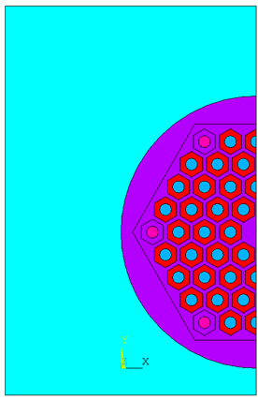
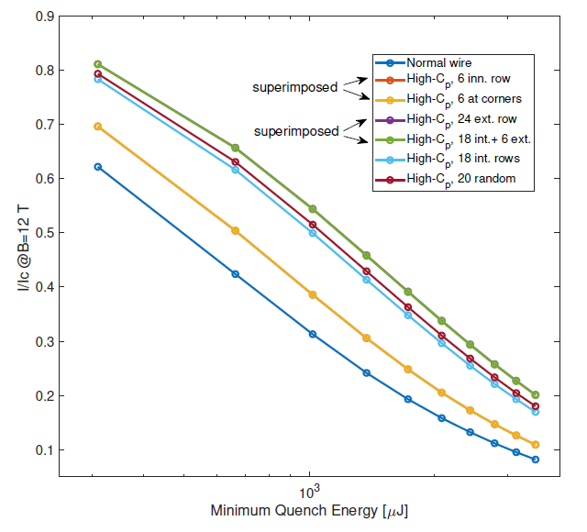
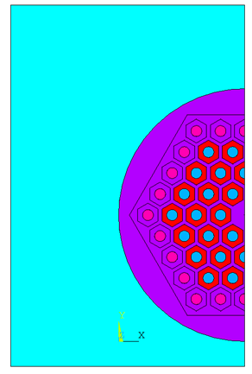
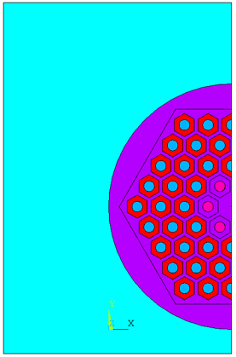
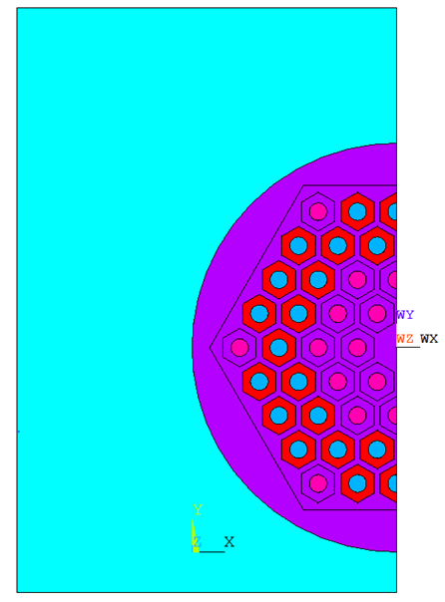
RESULTS: There are no preferred locations for the high-C_{p} subelements for thermal efficiency, i.e. the Gd₂O₃ tubes DO NOT HAVE TO BE EXTERNAL to the superconducting elements. It is the total cross sectional area of the high-C_{p} tubes that matters.
MQE Thermal Modeling of Nb₃Sn Wires with N High-C_{p} subelements
6 at corners
24 external
Standard
60/61 RRP wire
6 central
24 (w/18 central)
Courtesy of Emanuela Barzi
“Heat Diffusion in high-C_{p} Nb₃Sn Composite Superconducting Wires”, Invited paper, Instruments 2020, 4, 28

