Slide 1

The experience from 11 T and MQXF at CERN in view of High Field Magnets program
E. Todesco
For the 11 T part, relying on presentations of F. Savary, A. Devred, L. Bottura (in particular A. Devred at FNAL meeting, October 2019)
Special thanks to S. Izquierdo Bermudez and S. Farinon
State of the art in High Field Magnets, 16th April 2021

Slide 2

Contributors
11 T: M. Karppinen, F. Savary, D. Smekens, B. Auchmann, S. Izquierdo Bermudez, J. Carlos Perez, M. Bajko, G. Willering, J. L. Rudeiros Fernandez, A. Foussat, E. Gautheron, J. Petrik, D. Pulikowski, M. Bednarek, H. Prin, A. Milanese, R. Principe, A. Ballarino, B. Bordini, J. Fleiter, D. Duarte Ramos, L. Fiscarelli, S. Russenschuck, C. Petrone, D. Schoerling, L. Bottura, A. Devred, L. Rossi, et al.,
MQXF - CERN: P. Ferracin, S. Izquierdo Bermudez, J. Carlos Perez, J. Ferradas Troitino, E. Takala, G. Vallone, F. Mangiarotti, M. Bajko, G. Willering, H. Prin, H. Bajas, A. Milanese, R. Principe, A. Ballarino, B. Bordini, J. Fleiter, V. Parma, D. Duarte Ramos, Y. Leclercq, E. Ravaioli, G. Kirby, L. Fiscarelli, S. Russenschuck, C. Petrone, G. de Rijk, M. Bednarek, L. Bottura, A. Devred, L. Rossi, et al.,
MQXF – AUP: G. Ambrosio, S. Feher, J. Muratore, P. Joshi, K. Amm, M. Yu, A. Nobrega, J,. Schmalzle, M. Anarella, A Vouris, G. Chlachidze, S. Stoynev, R. Bossert, M. Baldini, P. Ferracin, D. Cheng, S. Prestemon, L. Cooley, V. Lombardo, R. Carcagno, G. Apollinari, et al.,
A page of references in WP3 web site: https://espace.cern.ch/HiLumi/WP3/SitePages/References.aspx also including previous work on Nb₃Sn

Slide 3
CONTENTS
Elements of 11 T design
Elements of MQXF design
11 T performance
MQXF performance

Slide 4
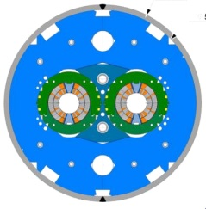
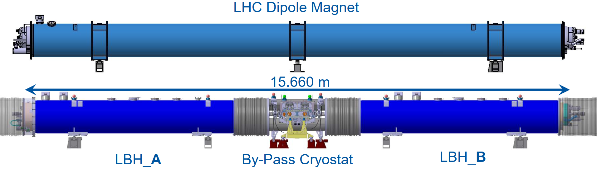
11 T SCOPE
The 11 T dipole is a part of the HL-LHC project
  Double aperture dipoles compatible with LHC dipoles (current, aperture), 35% larger field (11.2 T) to make space for additional collimators
    Initially 8 units (16 magnets), in 2011, 4+2 units (total 12 magnets) in HL-LHC baseline, descoped in 2016 to 2+1 units (total 6 magnets)
The 11 T unit, including the collimator, and the LHC dipole (F. Savary)
The 11 T cross-section (M. Karppinen)

Slide 5
11 T TIMELINE
Project start in July 2010, to be installed in 2019 (Long Shutdown 2)
Lead by M. Karppinen 2011-2014
  Design (B. Auchmann, D. Smekens, et al.), first double aperture short models (927, J. C. Perez et al.)
  Fall 2014 (T₀+4.2 years) test first model
  June 2015 (T₀+5 years) succesful test of second model, and of double aperture
Lead by F. Savary since 2015
  Completion of short model program, scaling to 5.5 m-long-magnets (prototypes and series)
    Task force starts in November 2017 to review different aspects, among them collaring parameters (P. Ferracin et al.)
  June 2018 (T₀+8 years) test of first prototype
  First succesful 5.5-m-long Nb₃Sn magnet in July 2019
  Installation in LS2 has been canceled in November 2020, due to performance degradation with time observed in 3 series magnets
Thanks to L. Bottura for the careful reconstruction of timeline

Slide 6
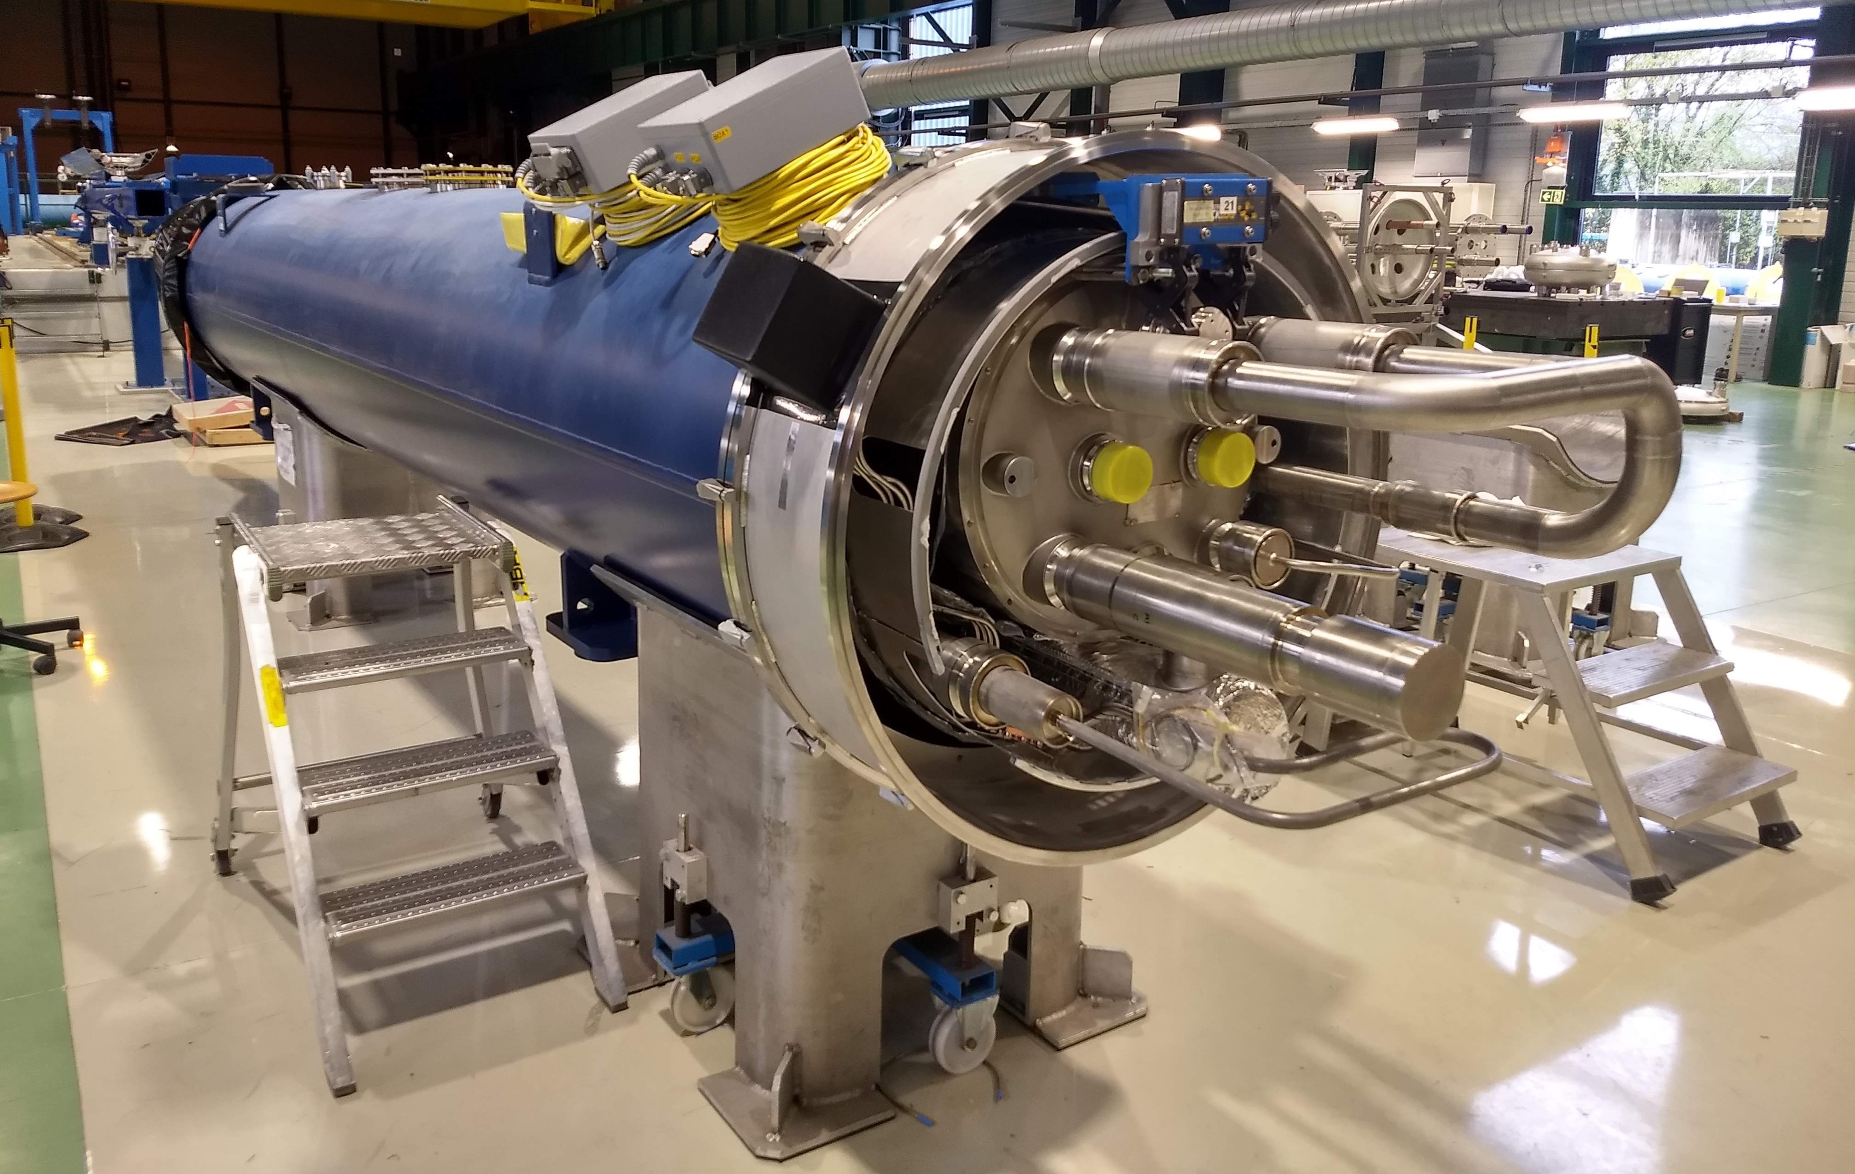
11 T TIMELINE
Short model program (more than 20 coils)
  8 single aperture, partly assembled in 2 double aperture with RRP conductor
  2 single aperture, assembled in one double aperture with PIT conductor
1 Prototype and 4 series magnets
Yoked 11 T magnet
11 T magnet in the cryostat

Slide 7
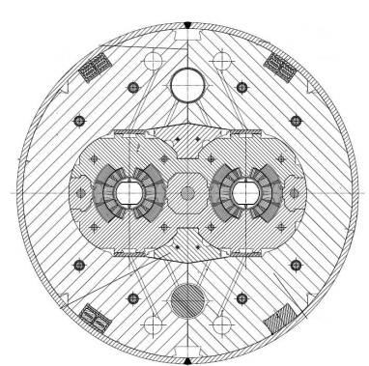

11 T DESIGN CONTRAINTS
In a dipole at first order field is given by coil width times overall current density
  With 450 A/mm², 10 mm of coil width make 2.8 T
    LHC dipole coil width: 2 times ~15 mm (with grading)
With respect to the LHC dipole, the increase in field is all given by current density
  11 T dipole coil width: 2 times ~15 mm (no grading)
  Since collars are thinner, iron helps more but we end up with 520 A/mm² overall (including insulation)
  A larger coil widthcould not be used without breaking the constraint of the 12 kA current or of having a cable with no more than 40 strands
$$B\sim 0.66×{10}^{−4}j\left[\text{A}\text{/}{\text{mm}}^{\text{2}}\right]w[\text{mm}]$$

Slide 8
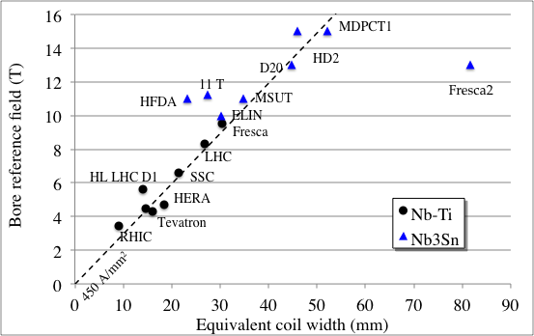
FIELD VS COIL WIDTH
This large current density makes it sticking out of the 450 A/mm² line of current density where we find most of the accelerator magnets
  Did we dare too much in current density ? i.e. did we imagine a too effective magnet?
Higher current density
More efficient
Protection limit
Lower current density
Less efficient
(see https://indico.cern.ch/event/926968/
for a parade of magnet designs)
Operational field versus coil width for several dipoles

Slide 9
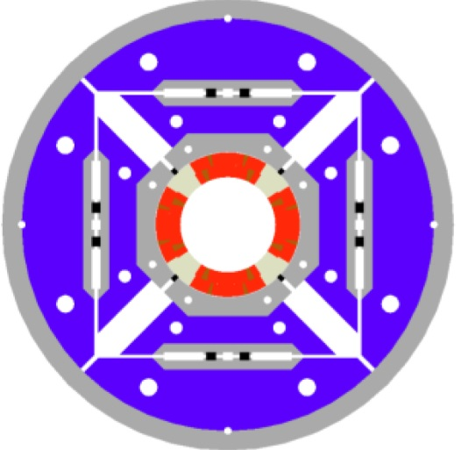
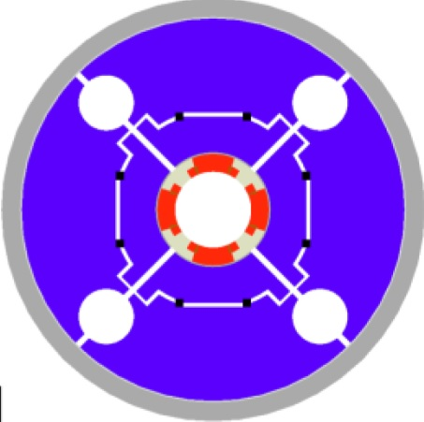
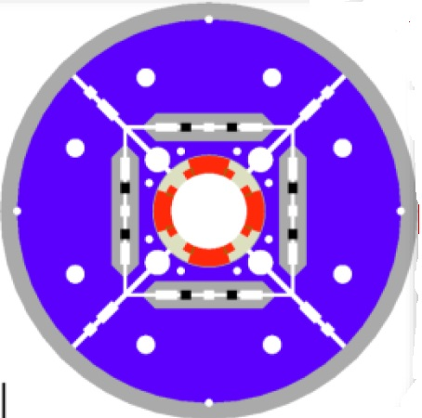
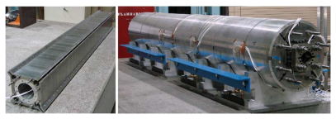
FIELD VS CURRENT DENSITY
However, succesful quadrupoles with current densities >500 A/mm² have been built in LARP (see G. Ambrosio talk)
  TQ at 200 T/m: more than 700 A/mm² overall current density
  LQ, the first 3.4 long Nb₃Sn magnet: more than 700 A/mm² overall current density
  HQ at ~160 T/m: more than 600 A/mm² overall current density
  Ok, these are quadrupoles but they worked well
TQS
LQS
HQ

Slide 10
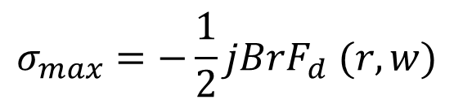
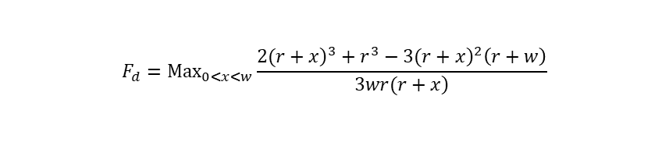
STRESS DUE TO E.M. FORCES
The transverse stress in the midplane provoked by the accumulation of the electromagnetic forces can be estimated via the equation
  This excludes the two dimensional aspects, and deformations of the structure, but it is a good to compare different magnets – in any case it cannot be lower than this
With respect to the LHC dipole we double from ~55 MPa to ~116 MPa
  The management of this stress, already in this approximation not far from the limit of 150 MPa of conductor degradation is the main challenge of the magnet
$$σ_{max}=−\frac{1}{2}jBrF_{d} (r,w)$$
$$F_{d}={Max}_{0<x<w}\frac{2({\left.r+x\right)}^{3}+r^{3}−3({\left.r+x\right)}^{2}\left(r+w\right)}{\left.3wr(r+x\right)}$$
Shape factor for sector coil from F. Regis, P. Fessia IEEE TAS 19 (2009)
is the same estimated by Meuser for cos theta coils used by S. Caspi, P. Ferracin in PAC 2005

Slide 11
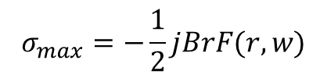
DIGRESSION ON 12+ T FOR HFM
A 12+ T dipole, being under consideration in HFM, can have lower levels of stress w.r.t. the 11 T
  Transverse stress is not proportional to magnetic pressure (B²), otherwise we would get 20% more stress than in the 11 T
Analytical guidelines:
  A 50 mm aperture (w.r.t. the 11 T 60 mm) already gives a 17% reduction
  Try to reduce as much as possible the current density – how?
  Maximum cable width, as considered in the Falcon design (1 mm strand, 22 mm width cable)
  A. Pampaloni, S. Farinon, et al, IEEE TAS 31 (2021)
  Place the iron as close as possible to the coil
In this way, even a 12 T magnet can have lower stress than the 11 T, gaining precious margin w.r.t. the 150 MPa cliff
$$σ_{max}=−\frac{1}{2}jBrF(r,w)$$

Slide 12
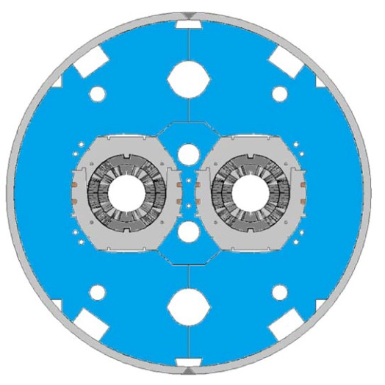
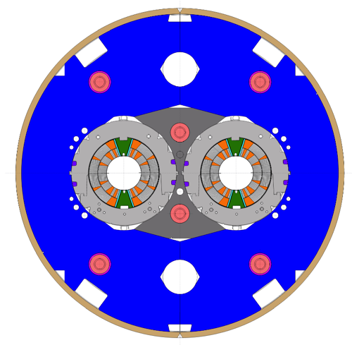
THE US FNAL CONTRIBUTION
11 T program had a collaboration with FNAL in its initial phase (2011-2015) A. Zlobin, et al, IEEE TAS 25 (2015)
  FNAL design based on same coil
  Mechanical structure also based on collars but with impregnated pole following the LARP TQC experience (see G. Ambrosio talk)
  3 single aperture short models built and tested, first one in June 2012, one double aperture made with second and third
The 11 T FNAL cross-section
(A. Zlobin, et al.)
The 11 T CERN cross-section
(M. Karppinen, B. Auchmann, et al.)

Slide 13
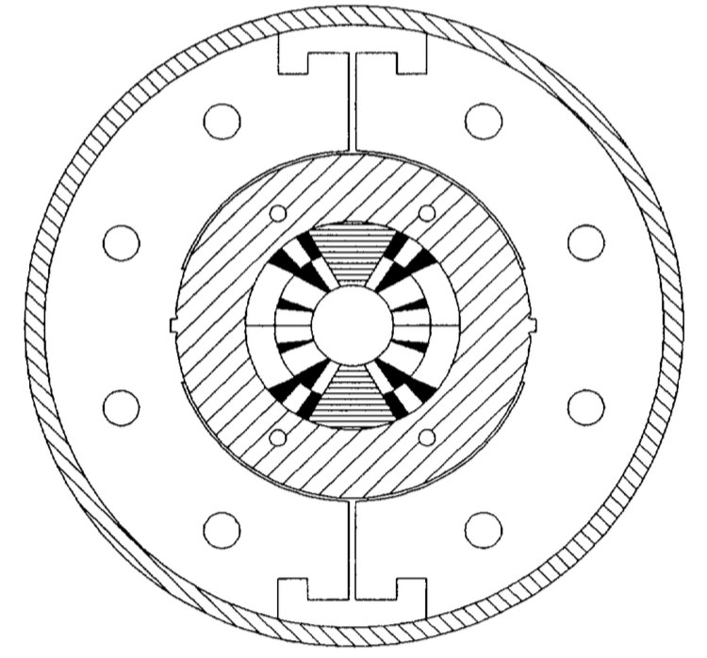
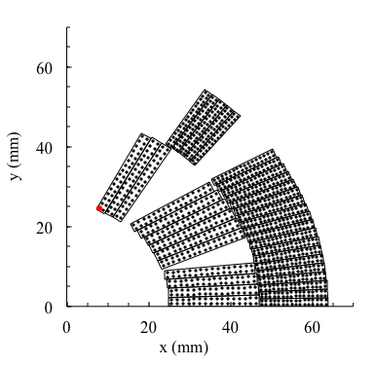
PREVIOUS PROJECTS
A 11 T Nb₃Sn dipole was built in the mid 90s in University of Twente (MSUT) [A. de Ouden, H. ten Kate et al, IEEE TAS 7 (1997)]
  Reached 11 T at 4.2 K, using a much lower current density strand available at the time (1850 A/mm² at 10 T, 4.2 K, instead of 2400 A/mm² at 12 T, 4.2 K)...
  .. thanks to more coil (21.7 mm and 17.4 mm cables)
  Current density: 340 A/mm² (inner) 540 A/mm² (outer)
  Removable pole (taken in 11 T)
  Mica insulation (taken in 11 T)
  Al ring structure and Al clamp (not taken)
  Graded coils (not taken)
The MSUT dipole
(H. ten Kate, A. den Ouden, et al.)

Slide 14
11 T DESIGN CHOICES
    M. Karppinen, et al. IEEE TAS 22 (2012)
Management of the transverse stress
  Structure similar to the LHC dipole (separate collar variant), with 30 mm-thick stainless steel collars giving most of containment and preload
    Partial contribution of the iron
  Removable pole (non impregnated) to allow a shimming also from coil pole (as in the LHC dipole) to have additional parameters to manage the bending
  Separate apertures (not mechanically coupled as in the LHC dipole)
  Insulation based on braided fiberglass and mica sheet
Management of the axial stress
  Structure similar to the LHC dipole, with axial forces
  on the coil kept by the stainless steel shell
  Note: for conductor refer to talk by A. Ballarino

Slide 15
CONTENTS
Elements of 11 T design
Elements of MQXF design
11 T performance
MQXF performance

Slide 16
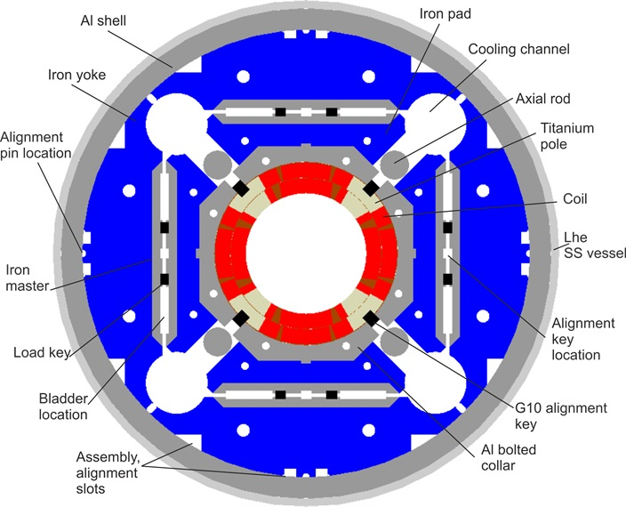
MQXF SCOPE
The MQXF dipole is a part of the HL-LHC project
  Quadrupole for interaction regions to replace the present triplet (MQXA and MQXB) in Long Shutdown 3
  Twice larger aperture with respect to present MQXFA/B (150 mm vs 70 mm) to allow a smaller β* and to have space for thick W absorbers
    Change of technology (Nb-Ti to Nb₃Sn) needed to keep compact triplet fitting the LHC tunnel constraint
  Peak field from 8.6 T (MQXFA/B) to 11.4 T
  4 triplets to be installed in LS3, total of
    20 magnets 4.2-m-long (MQXFA)
    10 magnets 7.15-m-long (MQXFB)
    Together with prototypes, this makes 170 m of Nb₃Sn magnets

Slide 17
MQXF TIMELINE
Project start in 2012, four triplets (24 magnets) to be installed in 2025
Lead by E. Todesco since 2011 – time zero is the selection of magnet aperture in July 2013 [E. Todesco, et al., SUST 34 (2021) 053001]
  P. Ferracin WPE 2014-2019
  S. Izquierdo Bermudez WPE since 2019
Short model program (more than 20 coils) in 927, (J. C. Perez) in synergy with LARP
  6 models completed, first two with coils from LARP
  Baseline is RRP conductor, 1 model and a half made with PIT conductor
  First model tested in March 2016 (T₀+2.6 years) in FNAL – about one new model per year in 2016-2021

Slide 18
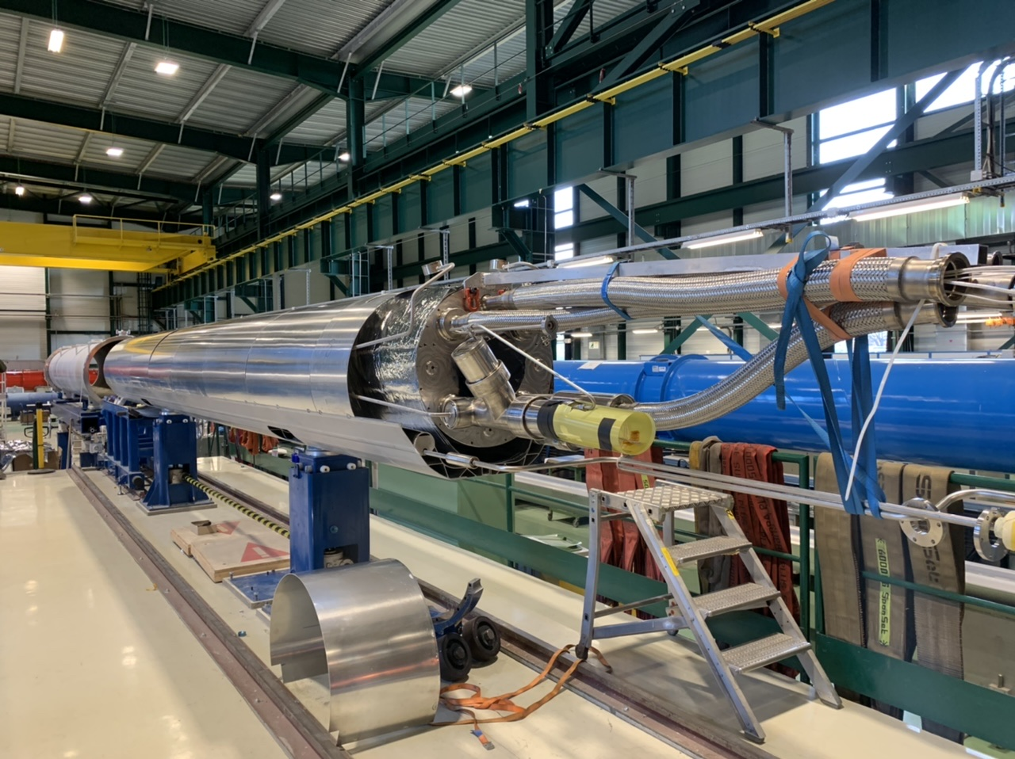
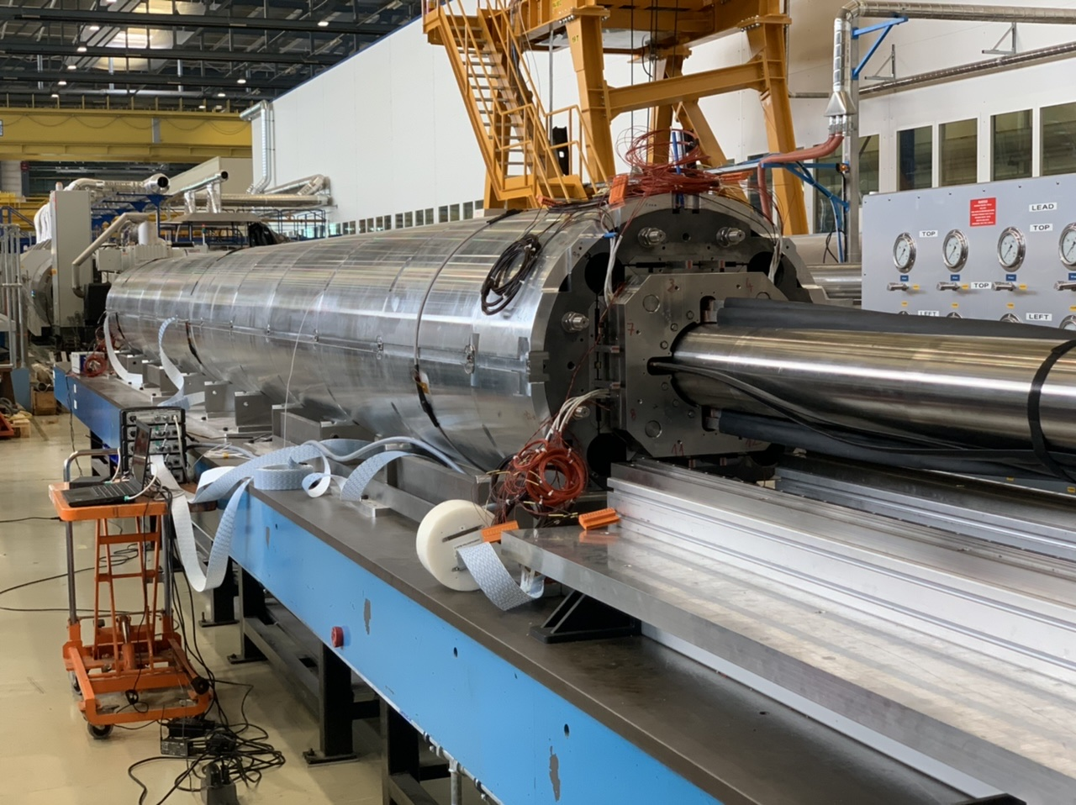
MQXF TIMELINE
MQXFB: 2 prototypes (completed and tested) and 10 series magnets
  Activities started in 2017 in 180, first led by F. Savary, with F. Lackner in charge of coils, and since 2019 by A. Milanese
  First 7.15-m-long prototype tested in August ’20 (T₀+7.0 years), second in March ’21
  In the US, first prototype tested in September ’18 (T₀+5.0 years)
  Note: this magnet proved CLIQ (G. Kirby et al.), major advancement in protection strategy, not discussed in this talk

Slide 19

MQXF DESIGN CHOICES
  P. Ferracin, et al, IEEE TAS 26 (2016)
  Only design constraint is the transverse size of the magnet: 630 mm
MQXF is the last stage of a 15 year developments of Nb₃Sn quadrupole for LHC upgrade (see talk of G. Ambrosio)
  Initially 90 mm (TQ), then 120 mm (HQ)
    From TQ to HQ, and to MQXF: increase cable width to reduce the current density (more conductor, less efficient magnet) – TQ: 27 strands, 0.7 mm HQ: 35 strands, 0.8 mm MQXF: 40 strands, 0.85 mm
$$G\sim 0.66×j\left[\text{A}\text{/}{\text{mm}}^{\text{2}}\right]\ln\left(1+\frac{w}{r}\right)$$
TQS
LQS
HQ
MQXF

Slide 20
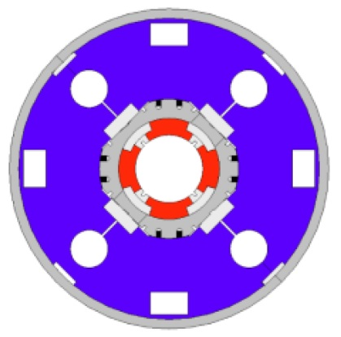
MQXF DESIGN CHOICES
MQXF is the last stage of a 15 year developments of Nb₃Sn quadrupole for LHC upgrade (see talk of G. Ambrosio)
  LARP developed two structures for the 90 mm (collar TQC and AL shell TQS) – both worked, but the Al shell showed better control and reproducibility of results
  LARP proved with LQS the scale up of Al shell structure to 3.4 m long coils – not trivial step [see G. Ambrosio talk, and P. Ferracin, IEEE TAS 18 (2008)]
MQXF kept the Al shell structure, and very similar coil to HQ
  MQXFA opted for split 4.2-m-long magnets, MQXFB went for 7.15-m-long coil
TQS
TQC
LQS

Slide 21
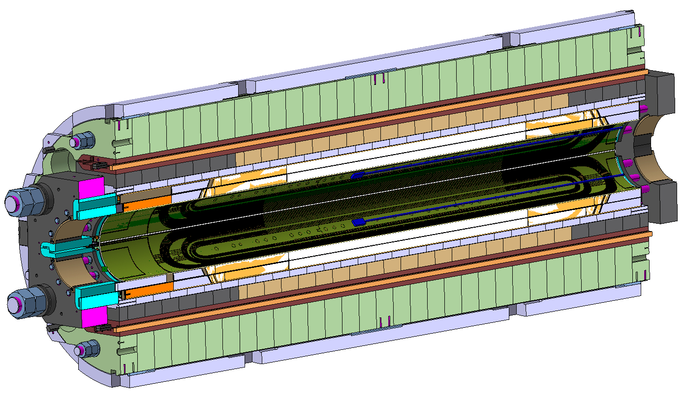
MQXF DESIGN CHOICES
    (more on this in the P. Ferracin talk)
Management of the transverse stress
  Al shell structure as in LARP
  Insulation based on braided fiberglass as in LARP
  Impregnated pole as in LARP
Management of the axial stress
  Tie rods providing axial preload as in LARP

Slide 22
MQXF vs 11 T
Similar features
  Similar arc length of the coil – relevant for influence of tolerances
  The coil manufacturing, including impregnation with CTD-101K
Aspects for which MQXF is a bit easier
  Peak field: 11 T has 11.8 T, MQXF has 11.4 T
  Current density: 11 T has 520 A/mm², MQXF has 460 A/mm²
  Stress*: 11 T has 116 MPa, MQXF has 110 MPa
  Loadline fraction 11 T has 81%, MQXF has 77%
    Note that MQXF margin was increased in 2015 when it became
    clear that the initial loadline fraction was sliding towards 82%
  Aperture of MQXF is much larger, and is a quadrupole:
  aspects related to bending are much less critical in MQXF
*Analytical estimate previously discussed

Slide 23
MQXF vs 11 T
Different features - 1
  Collar structures with loading via a press impose a displacement
  Al shell with loading via bladder and keys impose a stress
    Much concern for this solution about field quality: if stress is imposed one risks to have good loading but wrong positioning of coils, affecting field quality
    A quadrupole has a much easier field quality than a dipole, but the control of skew multipoles in MQXF does not show field quality issues
Different features - 2
  SS collar have a significant prestress loss during cool-down
  Al shell have a significant prestress increase during cool-down
    For SS collars the difference 1.9 K – 300 K is systematically underestimated in models : SS collars lose much more preload at 1.9 K than expected, see also the experience of the LHC dipole (more on P. Ferracin talk)
Different features - 3
  Axial support based on SS shell provide rigid support (to limit axial displacements)
  Axial support based on tie rods provide rigid support and preload

Slide 24
MQXF vs 11 T
Different features - 4
  MQXF profited of the LARP feedback (HQ program) on the requirement of having a comfortable space for the coil in the manufacturing tooling
    During HQ program it was found that the space was too tight (insulation failure)
    To avoid major modifications in the design, the easier option was to reduce the strand diameter from 0.8 to 0.788 mm [HQ01 to HQ02, see H. Felice, et al. IEEE TAS 22 (2012) ]
  11 T suffered from a very tight space in the manufacturing tooling
    This made aspects related to insulation more difficult, and impregnated QH more fragile

Slide 25
CONTENTS
Elements of 11 T design
Elements of MQXF design
Feedback from 11 T performance
Feedback from MQXF performance

Slide 26
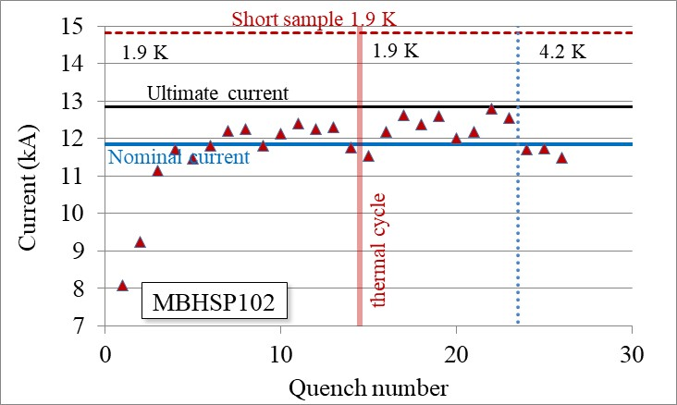
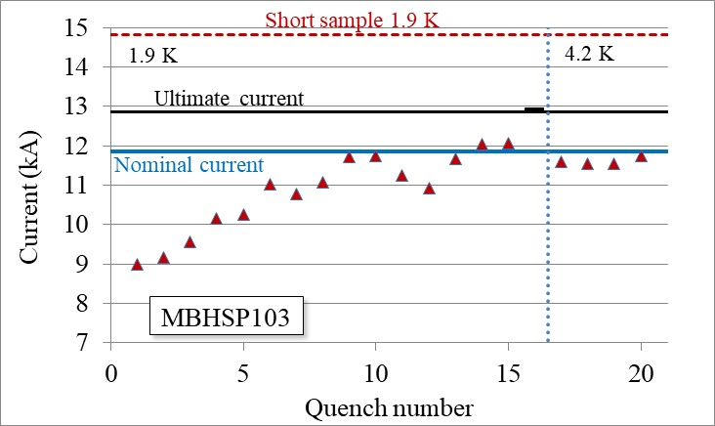
Training, memory, margin
Second and third single aperture short models reach nominal/ultimate
Reassembly in double aperture configuration, ultimate reached
  4.2 K maximum level just below nominal shows the presence of some margin
Major milestone, first Nb₃Sn double aperture, reaching field values not far from the D20 record (13.4 T at 4.2 K), with much smaller and simpler coil
  11 T using a two-layer, non-graded coil and higher performance conductor
Second and third short model single aperture training [M. Karppinen, et al., test eng. G. Willering]

Slide 27
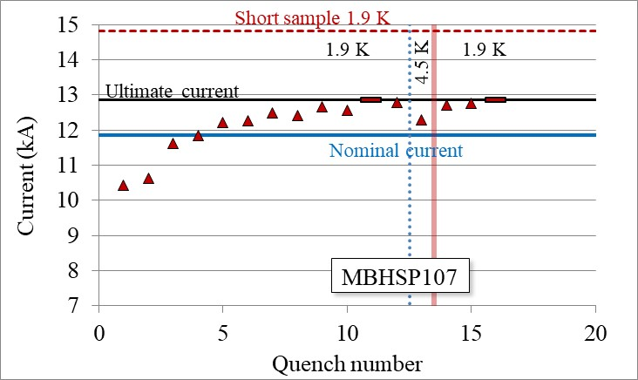
Training, memory, margin
4 out of 8 short models based on RRP conductor reached ultimate performance (SP102, SP103, SP106, SP107)
  Two apertures made with PIT conductor reached nominal field, limited below ultimate due to midplane stress
  First quench between 9-10 kA (60%-65% of loadline fraction), initial fast training
  Perfect memory after thermal cycle
106 and 107 training [F. Savary, et al., test eng. G. Willering]

Slide 28
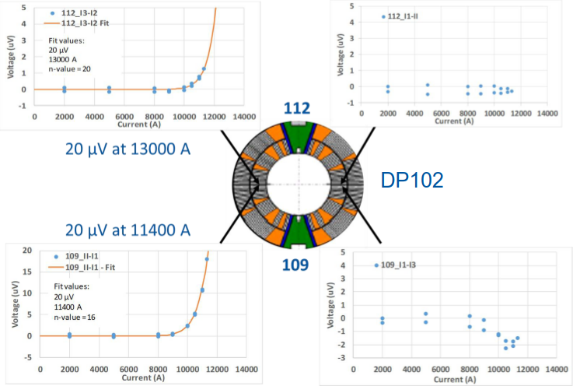
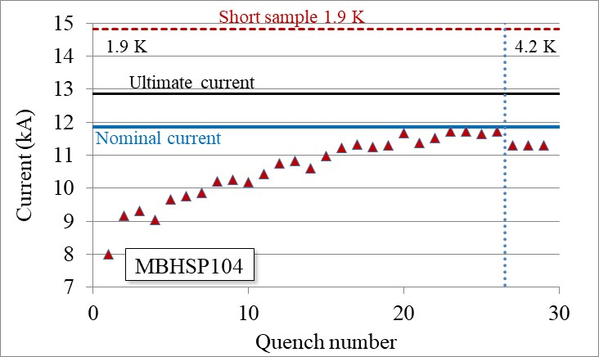
Limitation due to excess of transverse stress
In SP104 and SP105 first evidence of limitations due to local concentrations of stress in the coil midplane – assembled in DP102
  New technique of VI developed by G. Willering and co., very useful early indicator of resistance build up well below the quench level
VI curves giving early indication of degradation [G. Willering]

Slide 29
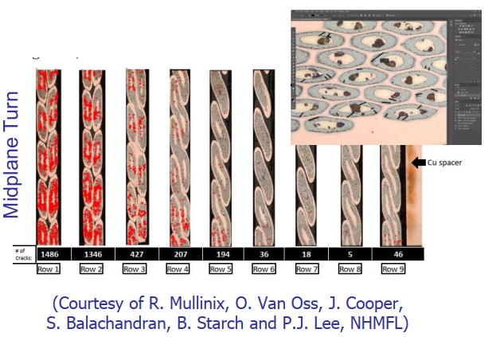
Limitation due to excess of transverse stress
In SP104 and SP105 first evidence of limitations due to local concentrations of stress in the coil midplane – assembled in DP102
  Evidence of strand cracking (see also talk by S. Sgobba, this workshop)
  A task force reviews the collaring parameters, applying a lower level of preload for magnet 107

Slide 30
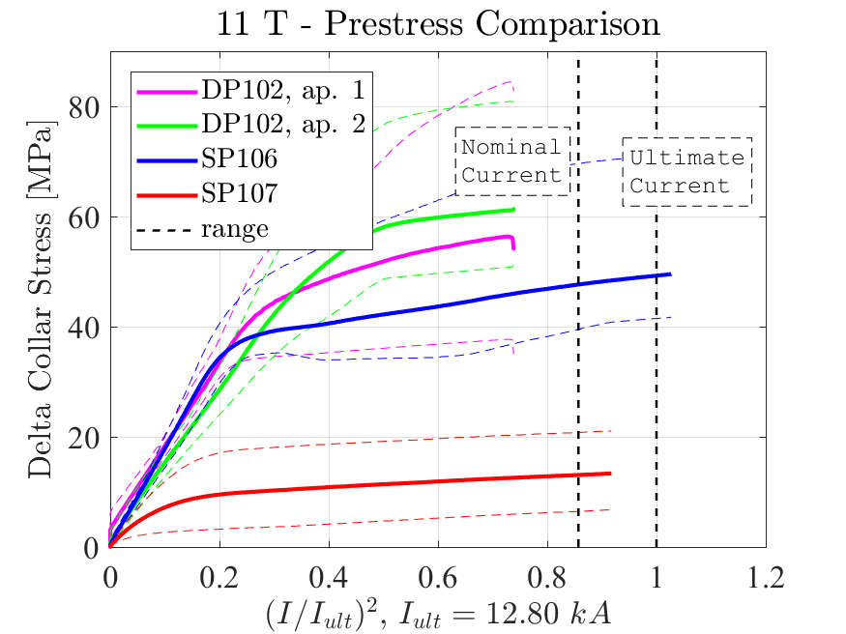
Preload
A very low level of preload does
not prevent reaching performance
  Unloading also visible in b₃ change
  proportional to I²
Unloading
Unloading
106 and 107 training [F. Savary, et al., test eng. G. Willering]

Slide 31
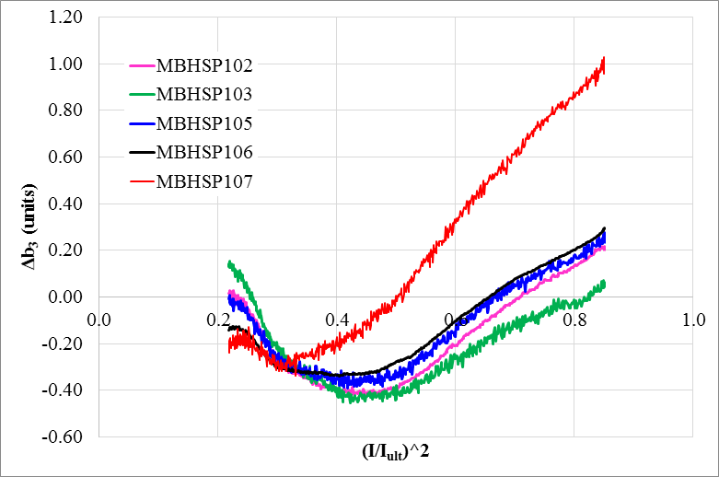
Preload
Unloading also visible in b₃ change proportional to I², larger in magnet with lower preload
  This is a powerful indication that the removable pole is doing its work: avoid that coil works in tension
Pole unloading and variation of b₃ with current [S. Izquierdo Bermudez, et al.]

Slide 32
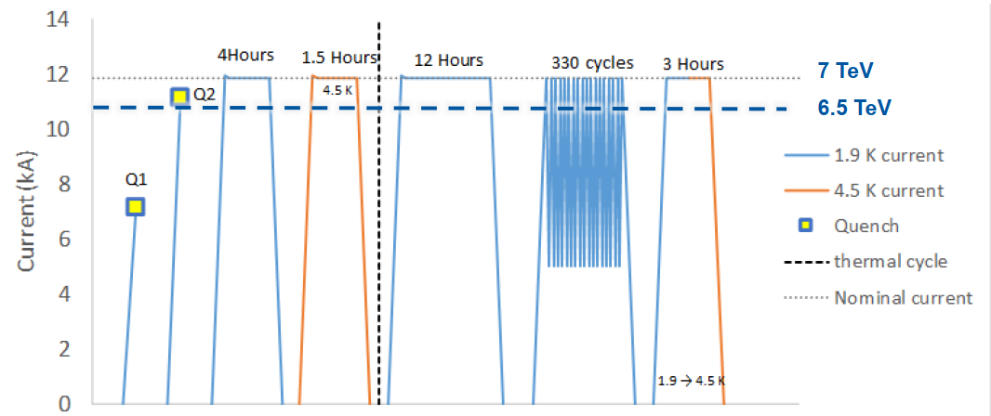
Magnet scaling to 5.5 m
S1 reached performance – first double aperture Nb₃Sn dipole 5.5-m-long
  A major milestone – world record in Nb₃Sn lenght
Powering of 11 first series magnet [F. Savary, et al., test engineer G. Willering ]

Slide 33
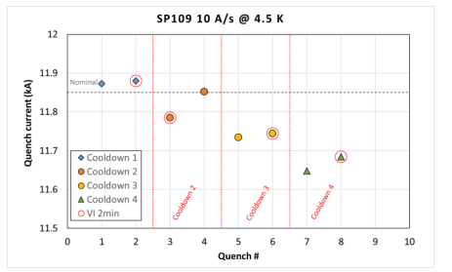
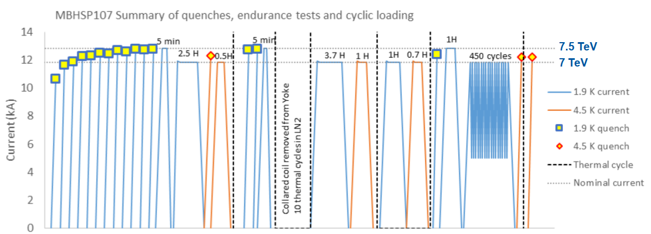
Magnet degradation with time
Evidence of minor degradation with successive thermal cycles was found in short model SP109
  A complete endurance test in SP107 showed the absence of degradation
107 endurance test [F. Savary, et al., test engineer G. Willering ]
A minor degradation in 109
[F. Savary, et al., test engineer G. Willering ]
Please note the enlarged scale

Slide 34
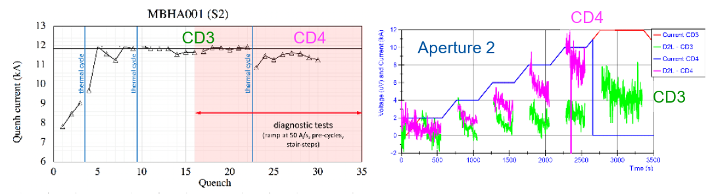
Magnet degradation with time
When moving to long magnets, the degradation after successive thermal cycles become more relevant (order of kA) – hybrid, S2 and S4
    Is this related to the same phenomena seen in the short models ?
  This is the most worrying phenomenon for the community
    The problem could be in the coil end mechanics – reports to CERN Machine Advisory Committee and task force led by M. Jimenez and A. Devred – ongoing work
    Larger degradation was recently seen in the MDPCT1 dipole (see talk from S. Prestemon)
Degradation in S2 performance, and VI signals [F. Savary, et al., test engineer G. Willering ]

Slide 35
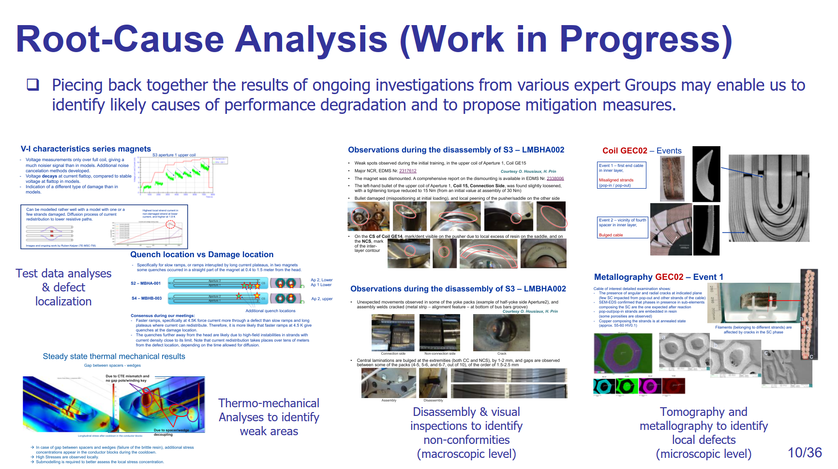
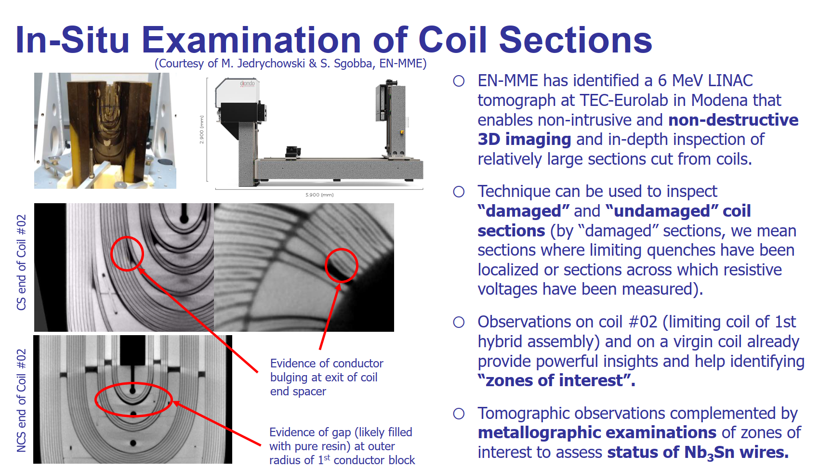
Magnet degradation with time
Large efforts to better understand the degradation with time are ongoing
  This is a ongoing work, not yet concluded, but it is relevent for HFM
Degradation in S2 performance, and VI signals [F. Savary, et al., test engineer G. Willering ]

Slide 36
CONTENTS
Elements of 11 T design
Elements of MQXF design
Feedback from 11 T performance
Feedback from MQXF performance

Slide 37
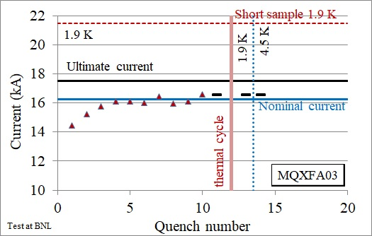
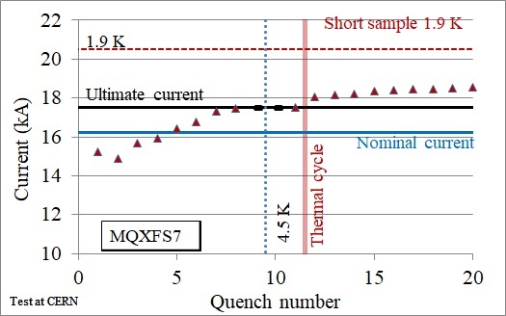
Training, memory, margin
5 out of 6 short models reached ultimate performance
  Plus 2.5 out of four MQXFA (see talk from G. Ambrosio)
  First quench between 14-16 kA (65%-75% of loadline fraction)
  Perfect memory after thermal cycle
  Able to operate well above nominal also at 4.5 K
Training of MQXFA03
[G. Ambrosio, S. Feher et al., test engineer J. Muratore]
Training of MQXFS7
[S. Izquierdo Bermudez et al., test engineer S. Ferradas Troitino]

Slide 38
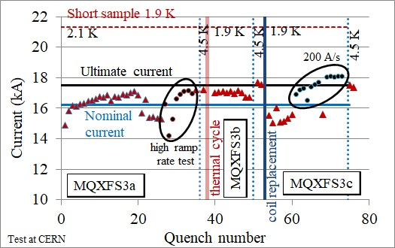
Reverse behaviour
2 magnets exhibited reverse behaviour, limiting performance
  Magnet performs better at high ramp rate and higher temperature
  Reasons not yet understood
Training of MQXFS3
[S. Izquierdo Bermudez et al., test engineer S. Ferradas Troitino]

Slide 39
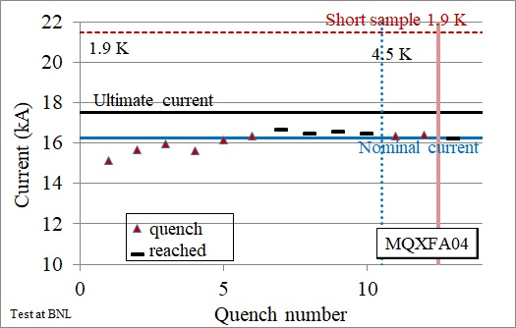
Training, memory, margin
Scaling to 4.2-m-long proved on two magnets (without SS shell, and tested vertical)
    Training does not increase with magnet length
  Similar features of short:
    First quench between 14-16 kA (65%-75% of loadline fraction)
    Perfect memory after thermal cycle
    Able to operate at nominal also at 4.5 K
Training of MQXFA03 and MQXFA04
[G. Ambrosio, S. Feher et al., test engineer J. Muratore]

Slide 40
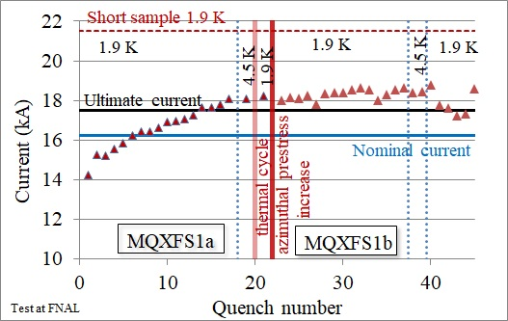
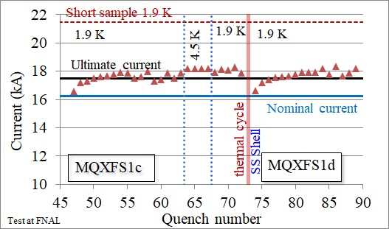
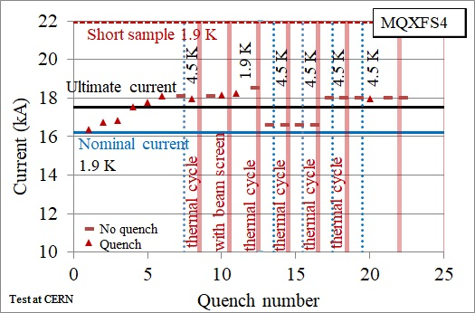
Magnet degradation with time
Concerns from 11 T (and later MDPCT1) triggered a careful analysis of possible degradations with time (successive thermal cycles)
  Intensive program carried out on two short models –no trace of degradation were found
  100s of quenches, up to 8 thermal cycles and 1000 powering cycles
Endurance test of MQXFS1 and MQXFS4
[G. Ambrosio, P. Ferracin, S. Feher, et al., test engineer H. Bajas and S. Stoynev]

Slide 41
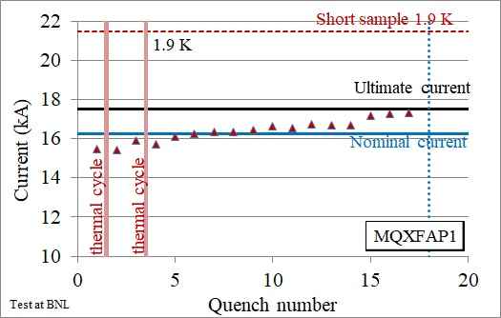
Magnet degradation with time
Concerns from 11 T (and later MDPCT1) triggered a careful analysis of possible degradations with time (successive thermal cycles)
  Much less statistics and experience from long magnets, but no trace of degradation – more statistics coming in 2021
Training of MQXFP1
[G. Ambrosio, S. Feher et al., test engineer J. Muratore]
Training of MQXFA04
[G. Ambrosio, S. Feher et al., test engineer J. Muratore]

Slide 42
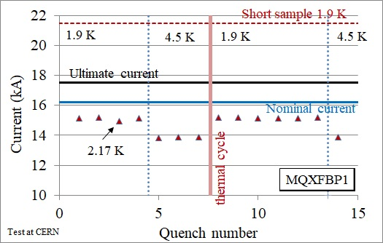
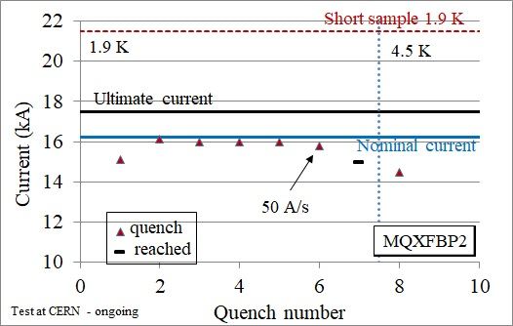
Scaling to long magnets and horizontal test
The scaling to 4.2 m long magnet looks very promising, but needs more statistics
  Proved on two magnets tested vertically (see talk by G. Ambrosio), two more coming soon
The scaling to 7.15 long magnets, including cold mass (SS shell around Al cylinder) requires understanding of prototype results, showing performance limitations
  First prototype has very reproducible limitations at 15 kA, losing accordingly at 4.5 K, no degradation after thermal cycle
  Second prototype has similar phenomenology at 16 kA – thermal cyle will be done soon
Training of MQXFBP1 and MQXFBP2
[S. Izquierdo Bermudez et al., test engineers F. Mangiarotti and G. Willering]

Slide 43
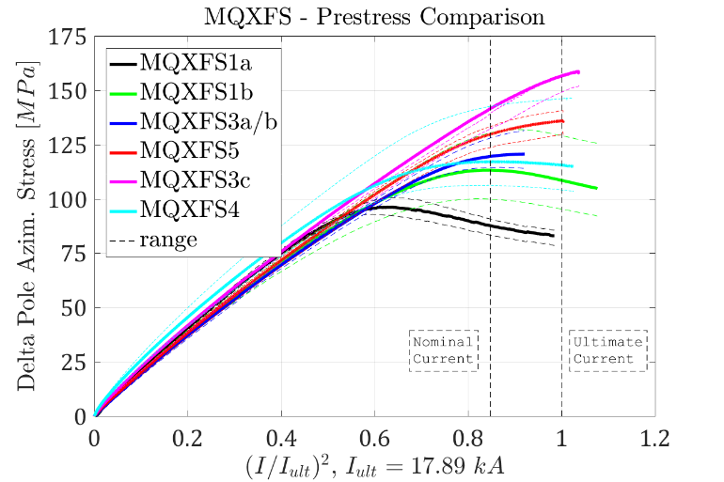
Preload
Main results
  There is a large preload window allowing magnets to reach performance
  Training continues after unloading (as in 11 T) – but highly unloaded magnets were not explored
  Al structure allows preload up to ultimate current
Unloading
Test of MQXFS1 [G. Ambrosio, S. Feher, et al., test engineer S. Stoynev]

Slide 44
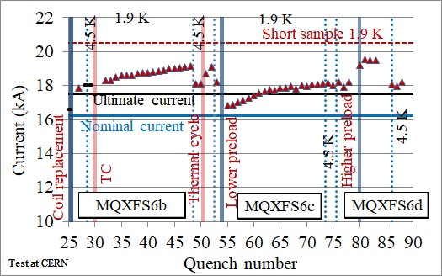
Preload
To reach the 90% loadline fraction preload is beneficial
  MQXFS6 lost 2 kA (but always above nominal) when preload was released
  Indication from one magnet (no statistics), it would be interesting for HFM /ultimate magnet to test on more MQXF short models (see P. Ferracin talk)
Test of MQXFS6 [S. Izquierdo Bermudez, et al., test engineers F. Mangiarotti and S. Ferradas Troitino]

Slide 45
Conclusions
In Nb₃Sn, the structure needed to manage the stress induced by e.m. forces is the dominating factor – two HL-LHC results for HFM:
  Training continues after preload levels – is the full preload paradigm necessary ?
  For Al shell structure, full preload is relevant to achieve the 85-90% zone
    This region is instrumental for the HFM part exploring the Nb₃Sn limits – i.e. going towards the 16 T target of FCC
Solutions working for Nb-Ti are not automatically working for Nb₃Sn
The HL-LHC Nb₃Sn program achieved significant milestones
  MQXF has slighlty easier design parameters
  Both 11 T and MQXF designs proved to reach performance on short models
    11 T statistics is much less rich, and margin at 4.5 K in MQXF is bit better
  Both 11 T and MQXF able to reach >13 T peak field (2 T more than needed)
  No indication that training is longer in longer magnets
  The scaling to 4.2-m-long of Al shell proved on two magnets
    But not yet on 7.15-m-long MQXF (performance limitation)
    And not proved on the collar/SS shell structure for 5.5-m-long 11 T (performance degradation)

Slide 46
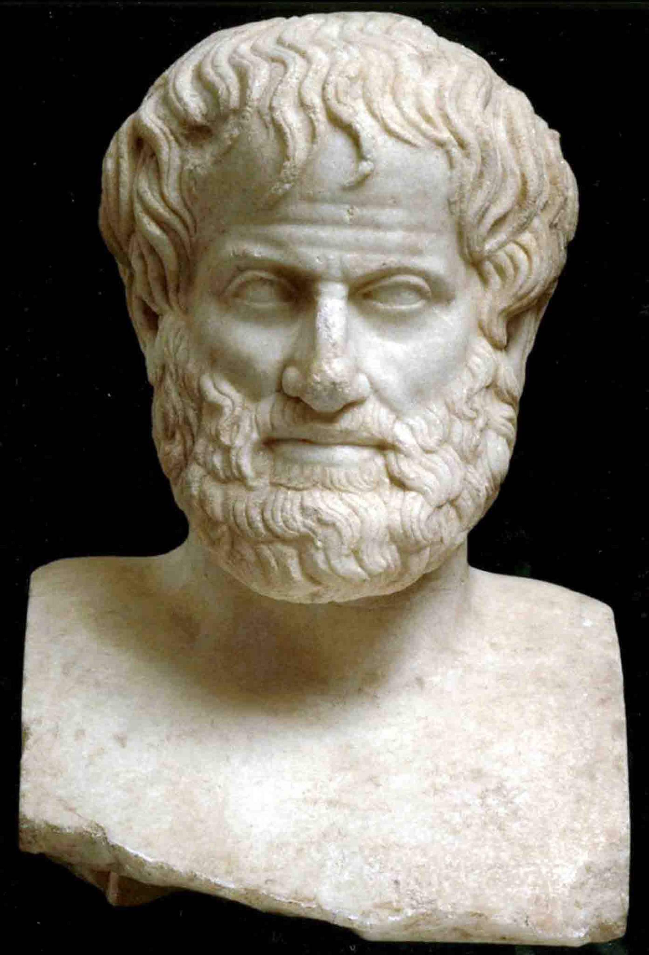
Conclusions
When you squeeze too much, you lose performance
  The conductor degradation due to trasverse strain is well visible in the 11 T
  Novel methods have been developed to characterize performance degradation
  A 12 T magnet will not have 20% larger stress than 11 T – reduce current density as much as possible
The degradation in successive thermal cycles observed in 11 T and in MDPCT1 is a source of concern
  Until now this has never been observed in MQXF
  Investigations are ongoing – results will be instrumental for HFM
Short model program has to be based on an good statistics of similar magnets
  «One swallow does not make summer» (Aristotle)
  11 T: 10 short models MQXF: 6 short models
  MQXA: 8 short models MQXB: 5 short models
  LHC MB: ~30 short models
Beware of the timeline
  Allow proper time for a intense short model program, and for the scaling to longer lenghts
  However, with LARP and HL-LHC experience, we do not start from scratch …

