Slide 1
MDP introduction, overview and research
Presentation to the HFM SoftA Workshop
Soren Prestemon
Director, US Magnet Development Program
Lawrence Berkeley National Laboratory
For the US MDP Team

Slide 2


Outline
The US Magnet Development Program: Vision and Goals
How we are organized
Technical progress highlights
Current focus areas and key challenges
Lessons learned
Summary

Slide 3
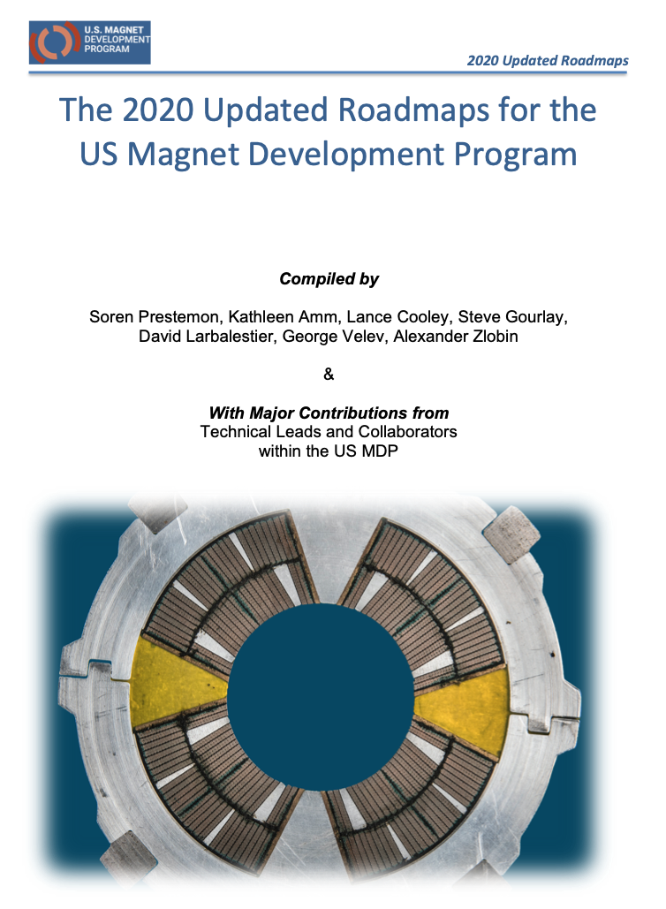
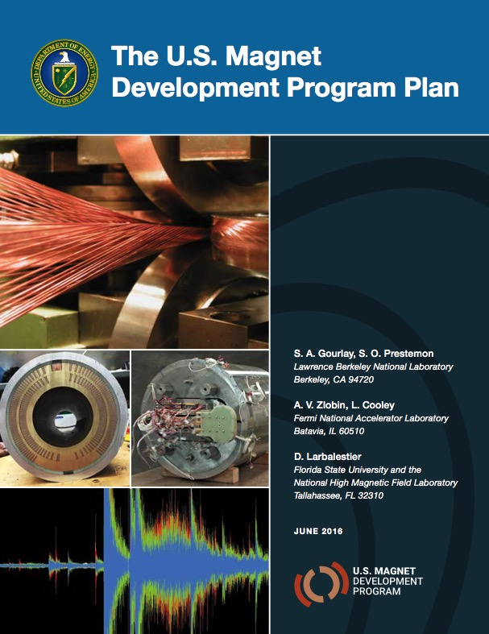
US MDP vision
Maintain and strengthen US Leadership in high-field accelerator magnet technology for future colliders
Focus on the four primary goals identified in the the original MDP Plan
  Explore the performance limits of Nb₃Sn accelerator magnets…
  Develop and demonstrate an HTS accelerator magnet with a self-field of 5T or greater…
  Investigate fundamental aspects of magnet design and technology…
  Pursue Nb₃Sn and HTS conductor R&D …
Further develop and integrate the teams across the partner laboratories and Universities for maximum value and effectiveness to the program
Identify and nurture cross-cutting / synergistic activities with other programs to more rapidly advance progress towards our goals
https://arxiv.org/abs/2011.09539
Time for an update!
We have refreshed the Program Roadmap this year,
but the vision and primary goals remains unchanged

Slide 4
General management structure of the US MDP
Integrates the teams from LBNL, FNAL, BNL and the ASC/NHMFL
A “G7” Management Team meets weekly and provides oversight of the day-to-day progress of the MDP technical Areas
Bi-weekly “General” meetings of the overall MDP
Teams associated with technical Areas meet regularly
  Report back at Bi-weekly General meetings on rotation
G7 members
Kathleen Amm BNL
Lance Cooley ASC/NHMFL
Steve Gourlay LBNL
David Larbalestier ASC/NHMFL
Soren Prestemon LBNL
George Velev FNAL
Sasha Zlobin FNAL

Slide 5
Guidance and Oversight of the US MDP
A strong Technical Advisory Committee (TAC) advises us on strategy and technical performance – constant since MDP formation
Oversight is provided by a Steering Council
Technical Advisory Committee
Andrew Lankford (Chair) | University of California, Irvine
Giorgio Apollinari | Fermi National Accelerator Laboratory
Joseph Minervini | Massachusetts Institute of Tech. (retired)
Mark Palmer | Brookhaven National Laboratory
Davide Tommasini | CERN
Akira Yamamoto | KEK & CERN
Steering Council
Harry Weerts (Chair; DOE representative) | Argonne National Laboratory (retired)
Tor Raubenheimer (DOE representative) | SLAC National Accelerator Laboratory
Michael Witherall (or designee) | Lawrence Berkeley National Laboratory
Nigel Lockyer (or designee) | Fermi National Accelerator Laboratory
Gregory Boebinger (or designee) | Florida State University / NHMFL
Doon Gibbs (or designee) | Brookhaven National Laboratory

Slide 6
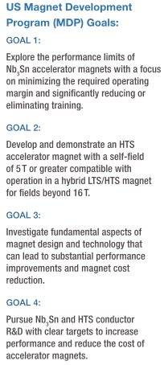
We have made significant progress on multiple fronts
  Steady development of “CCT” concept
  Record accelerator magnet Cos(t) result!
  Development of Bi2212 into a competitive high-field technology
  Development of REBCO/CORC towards a magnet conductor
  Significant new insight into the disturbance spectrum
  New modeling techniques, and access to computing clusters
  Introduction/development of new impreg. materials and dopants
  Impressive new developments that breathe new life into Nb₃Sn
  Dramatic performance increase in Bi2212 performance
  REBCO performance being customized for HEP

Slide 7
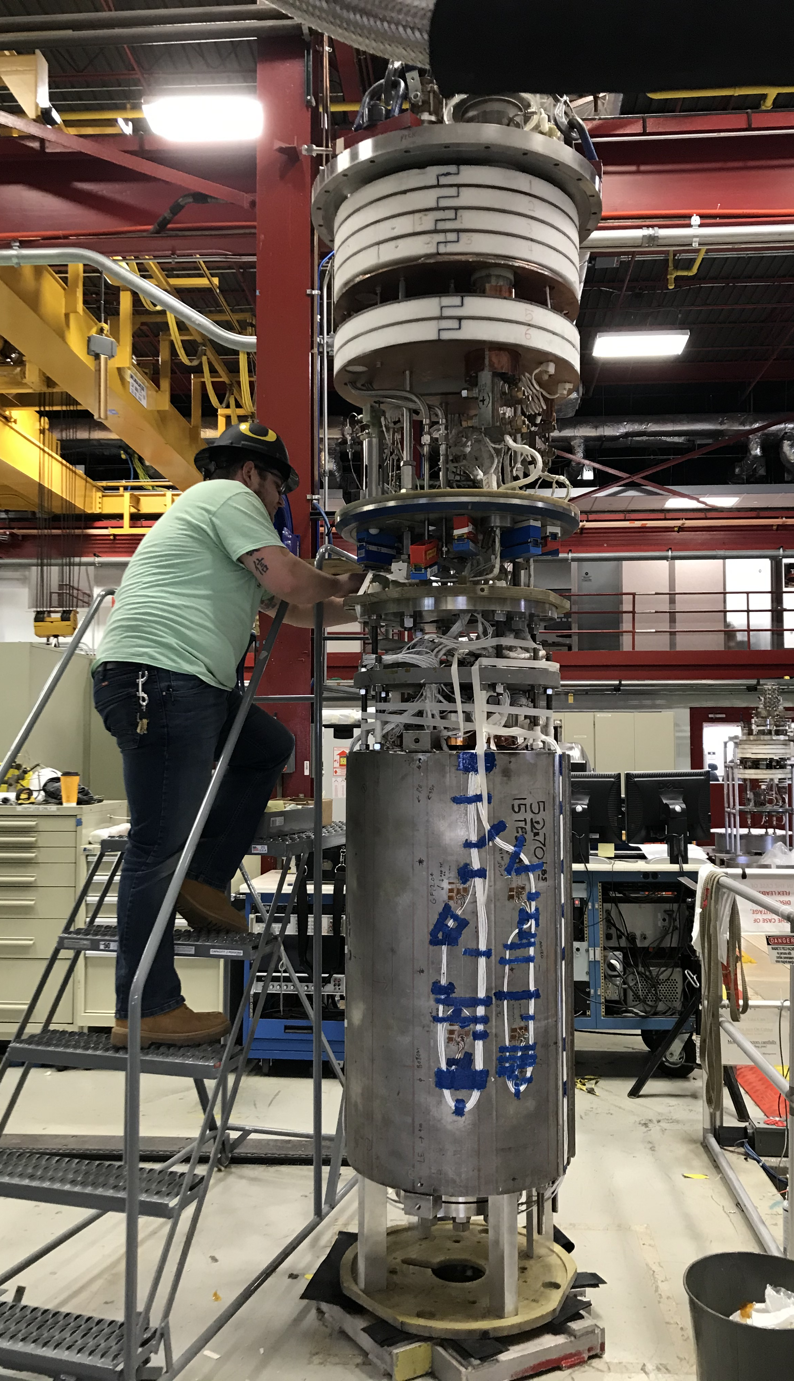
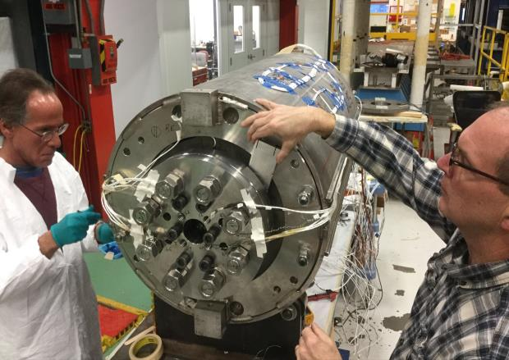
Example of major successes:
MDPCT1 - 15 T dipole demonstrator
Towards the limit of Nb₃Sn accelerator magnet technology
MDPCT1 design features:
60 mm aperture, 1 m long graded 4-layer Nb₃Sn dipole coil
600 mm diameter innovative support structure
Zlobin et al., TAS Vol 30, (4), 2020

Slide 8
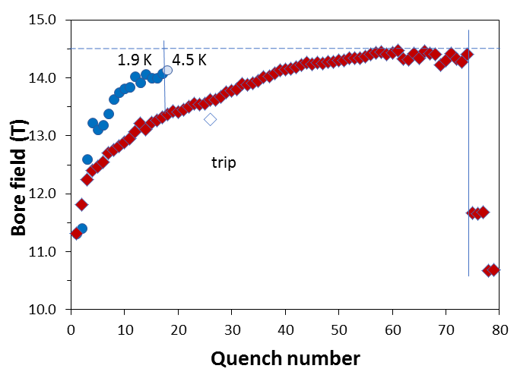
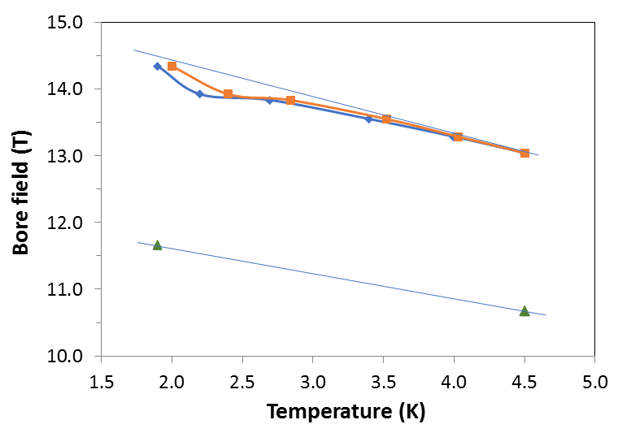
MDPCT1 Training summary
Magnet test sequence:
1. 1st test – May-July 2019
Test target: B_{max}=14 T
B_{max} =14.1 T @4.5K – the world record field for accelerator magnets!
2. August 2019-February 2020
magnet re-assembly with improved coil axial support and higher pre-stress
3. 2nd test – May-July 2020
Test target 15 T. Magnet reached the conductor limit.
B_{max}=14.5 T @1.9K – the new world record field for accelerator magnets!
4. 3rd test after thermal cycle – August 2020
B_{max}=11.7 T @1.9K - large performance degradation
the causes are being investigated
Timely result for FCC Week in Brussels June 2019!

Slide 9
The MDPCT1 test motivates critical elements of our MDP Plan
[I]: Highest priority issue: degradation
  Mechanisms; design mitigation
[II]: Second priority: Initial quench current
and memory after thermal cycle
[III]: Third priority: Training rate
II
III
I
Our updated roadmaps include a focus on “stress-management”:
Strives to mitigate the usual scaling of coil stress with field and aperture
Unfortunate consequence:
  More interfaces and shear-stress considerations

Slide 10
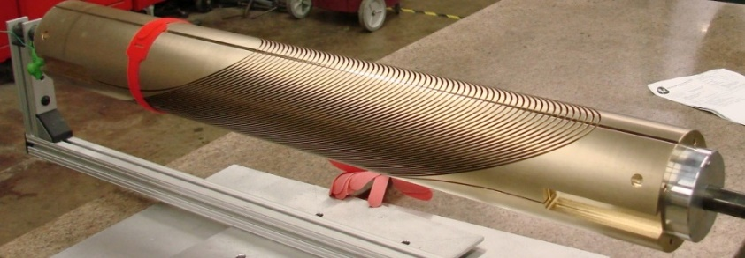
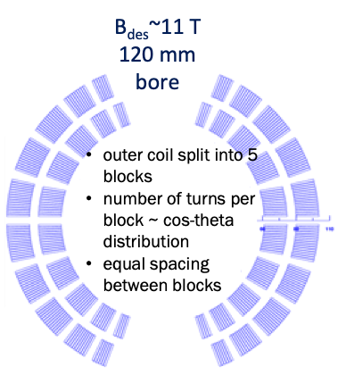
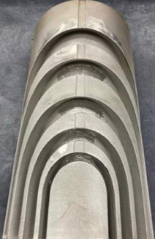
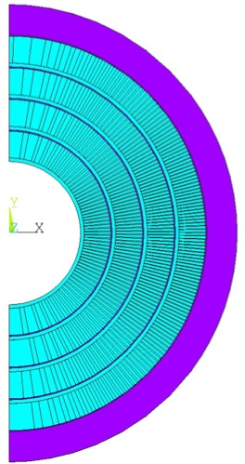
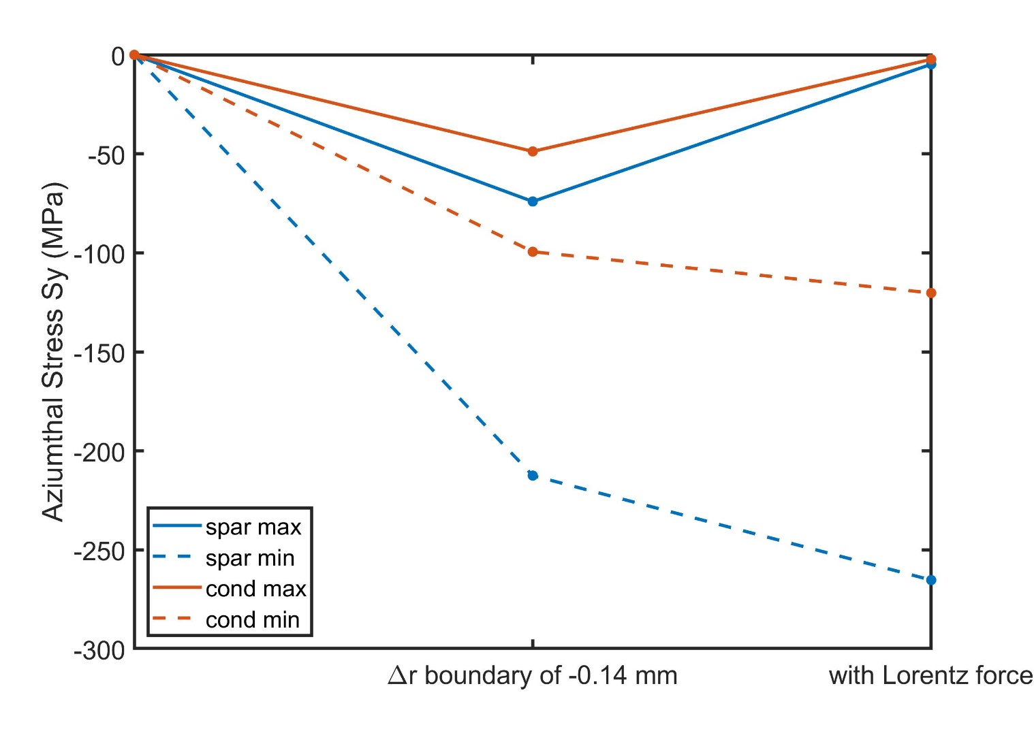
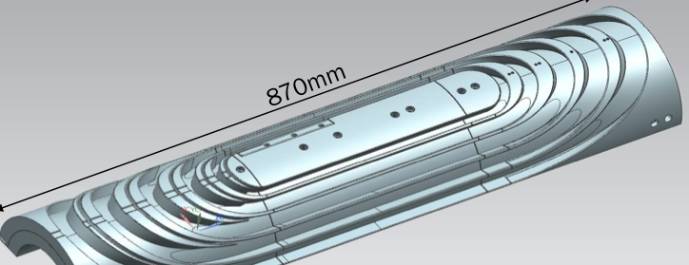
MDP stress management concepts target high fields and large bores for hybrid magnet needs
Canted Cosine-theta
Share utility structure
Shared modeling approaches
Similar instrumentation approaches to be used
Same aperture for HTS inserts
Stress-managed Cosine-theta

Slide 11
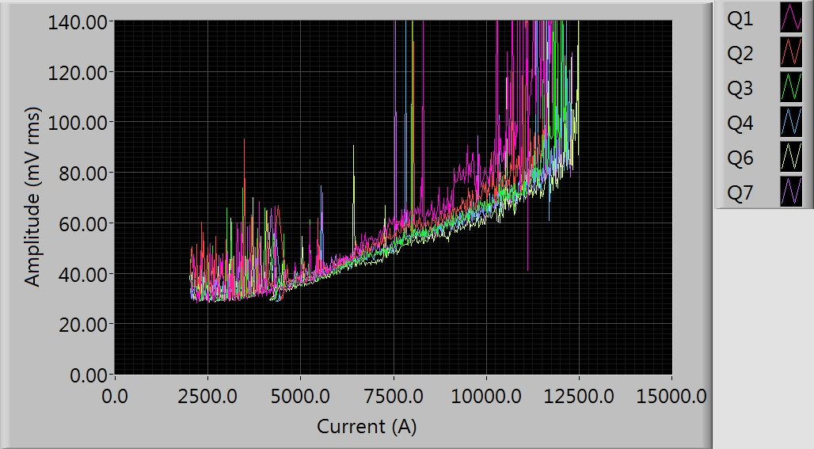
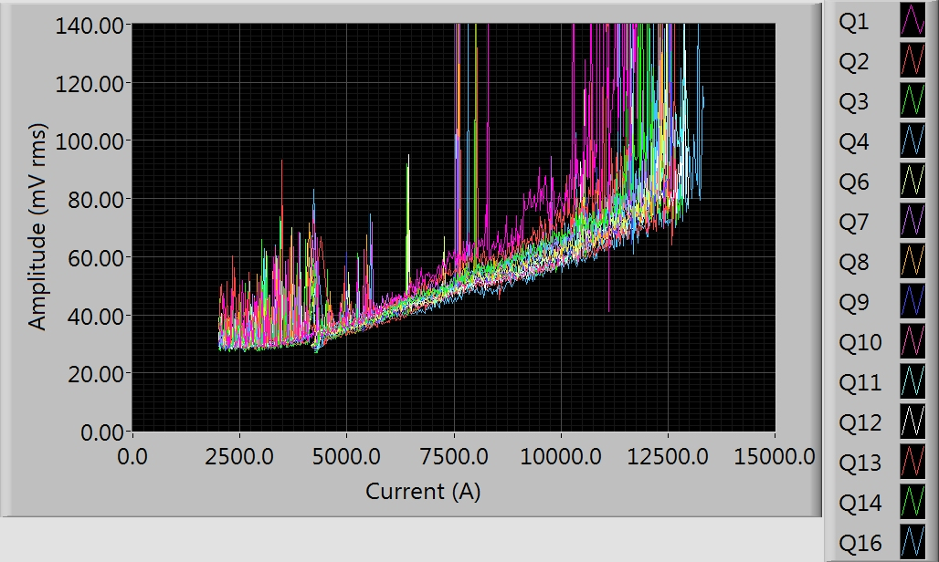
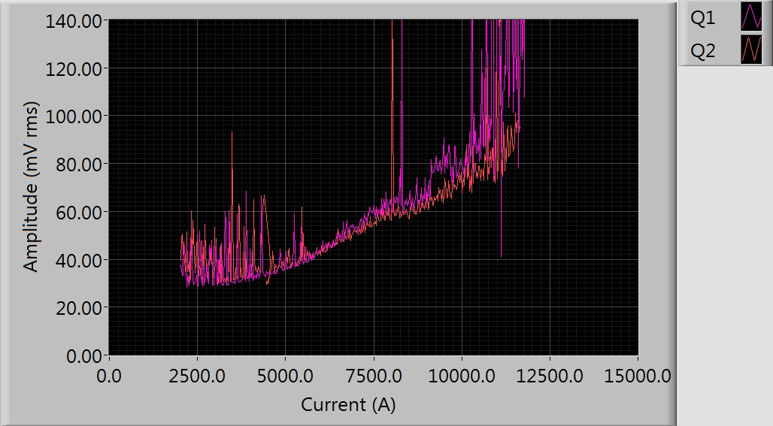
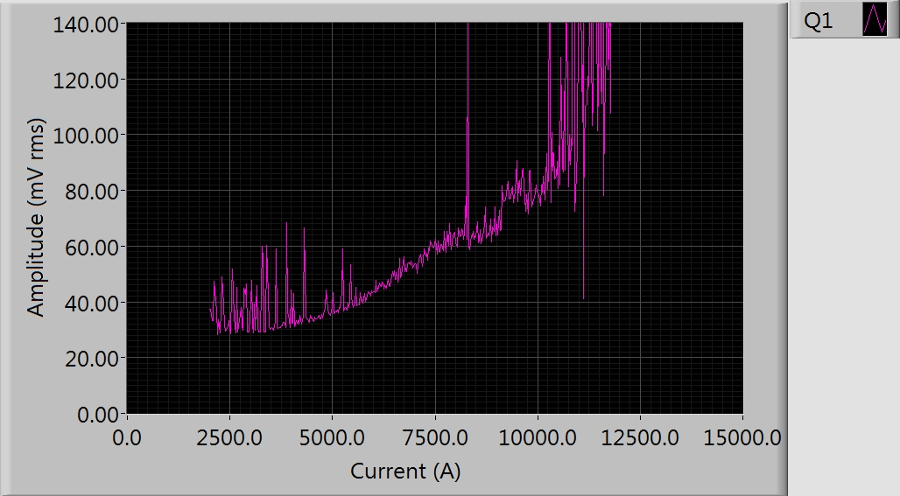
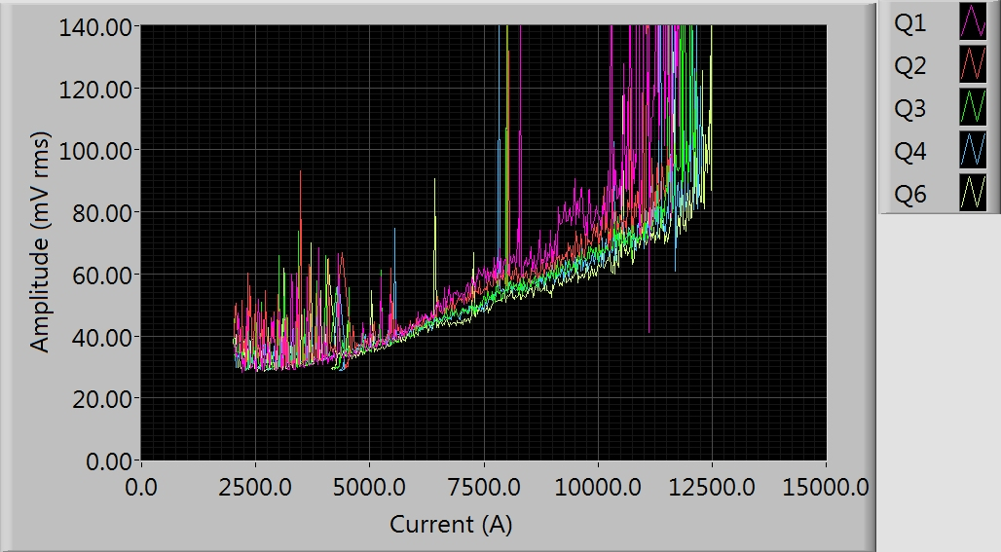
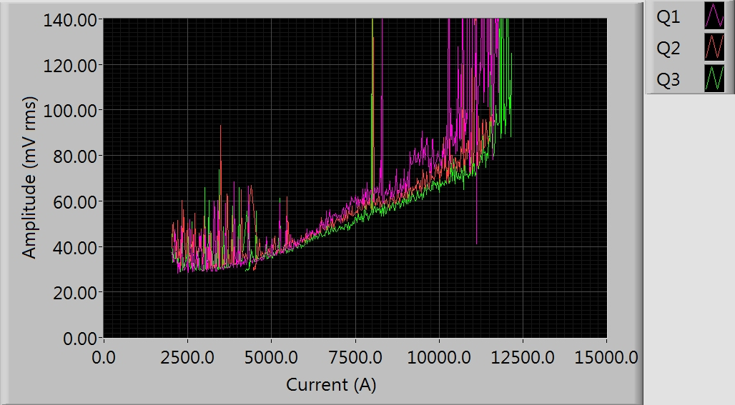
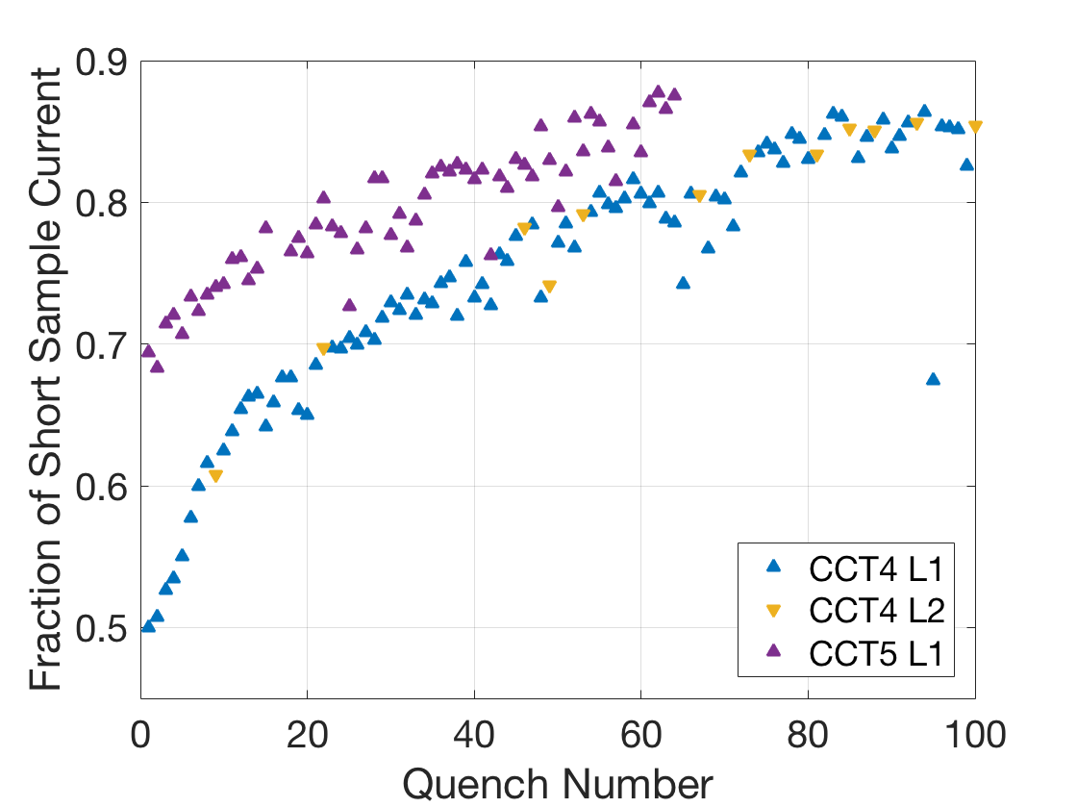
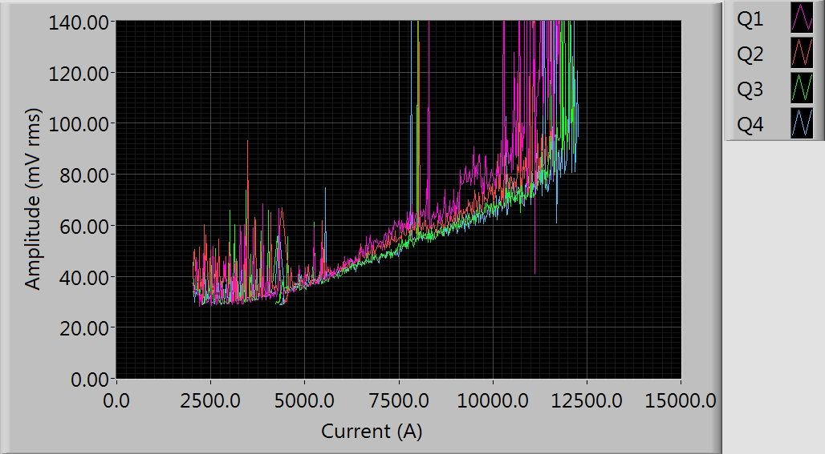
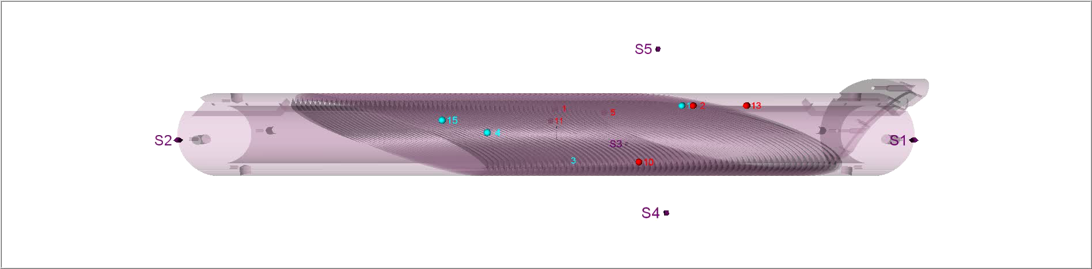
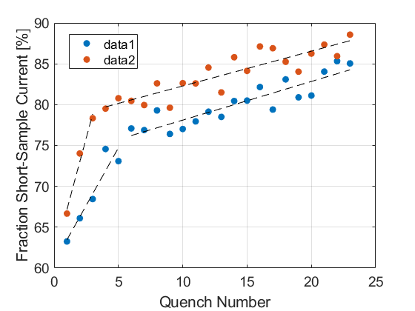
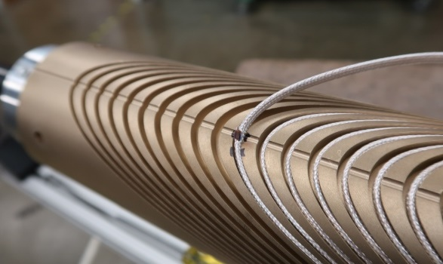
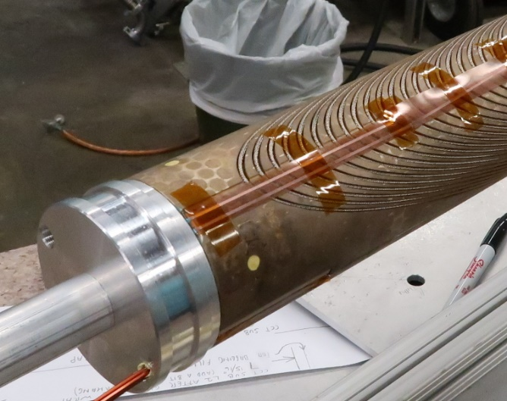
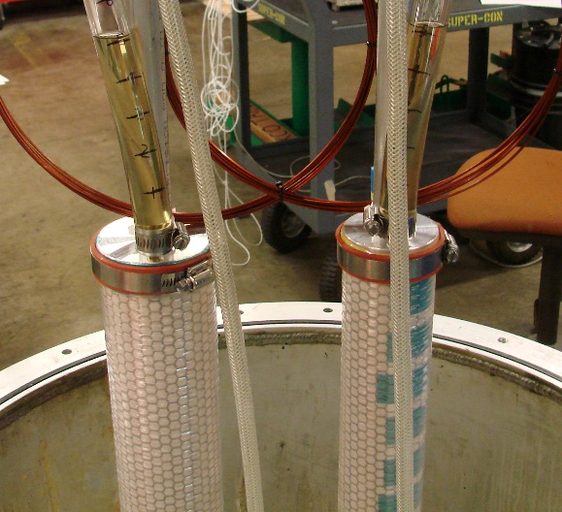
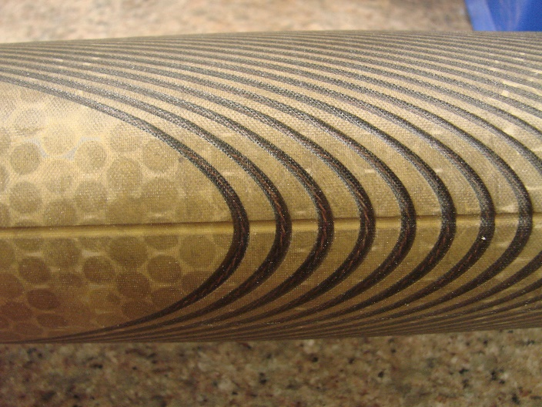
Canted Cosine Theta efforts are focused on subscale versions to probe training mechanisms and their mitigation
Quench Current Relative to SSL
CCT5 training: AE rms voltages
Acoustic Sensor Localization
Test 2
Test 1
Thermal Cycle
Subscale 3
CCT Subscales
Subscale 2
Coil Winding with Vtap Flag
Potting Tooling & process
Impregnated Coil
Notes:
conductor 54/61 to 108/127 with reduced Jc

Slide 12
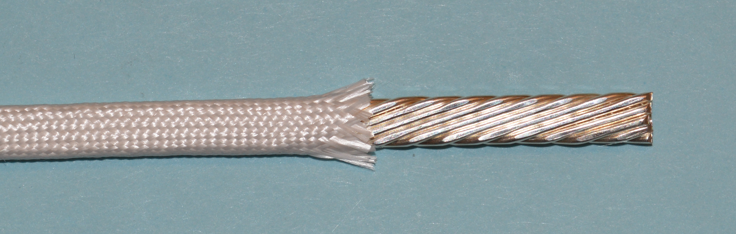
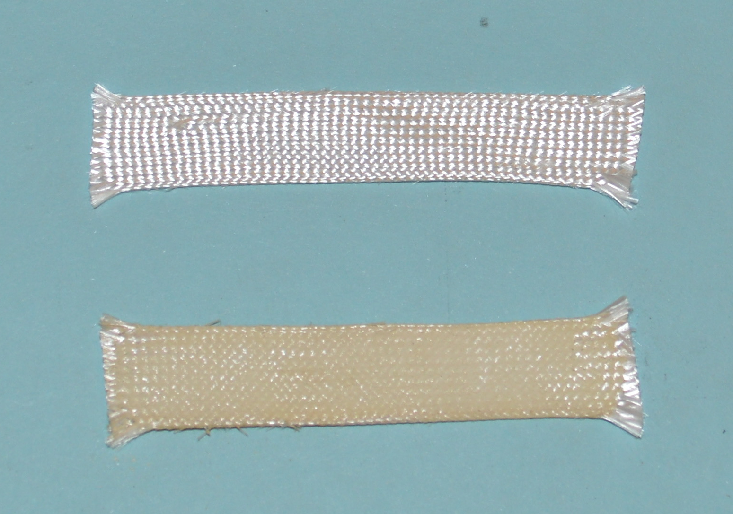
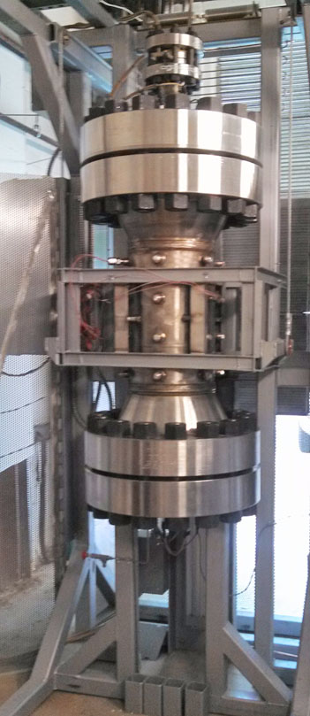
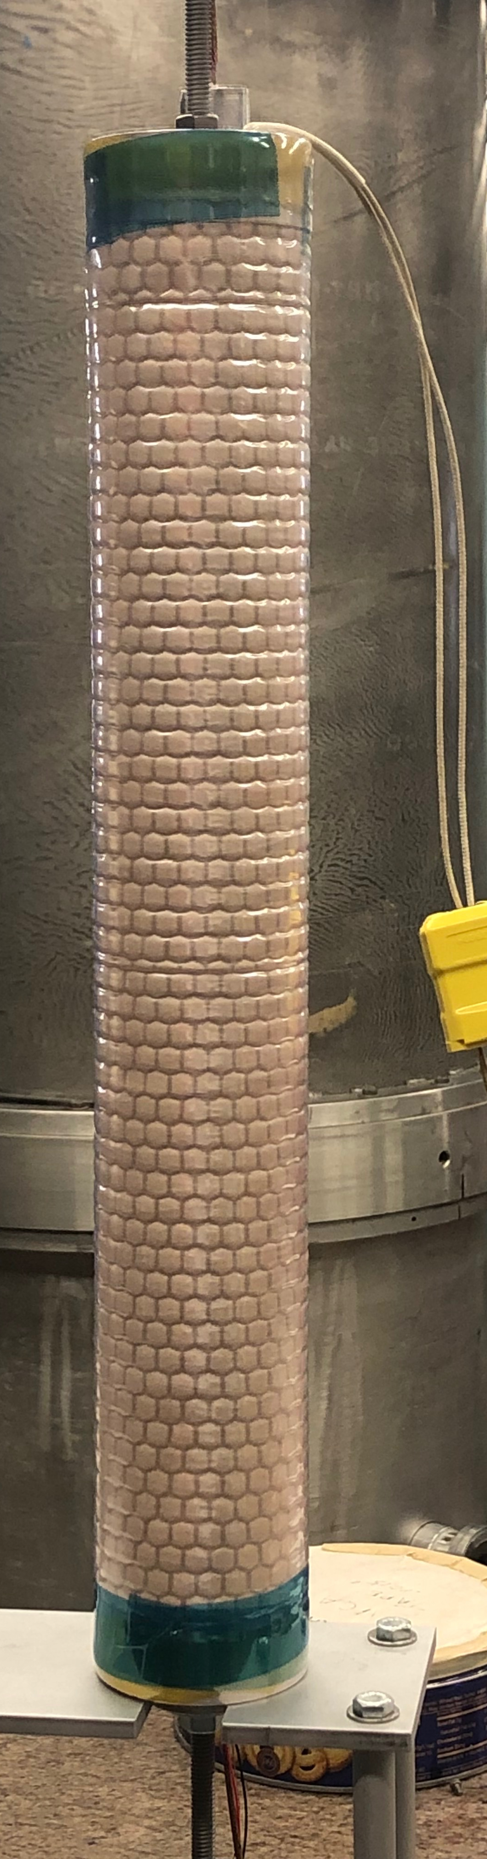
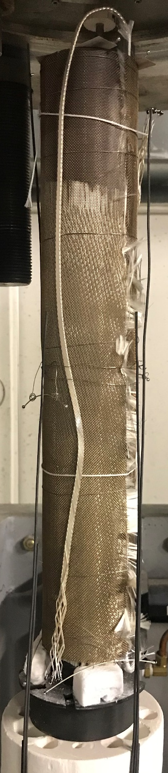
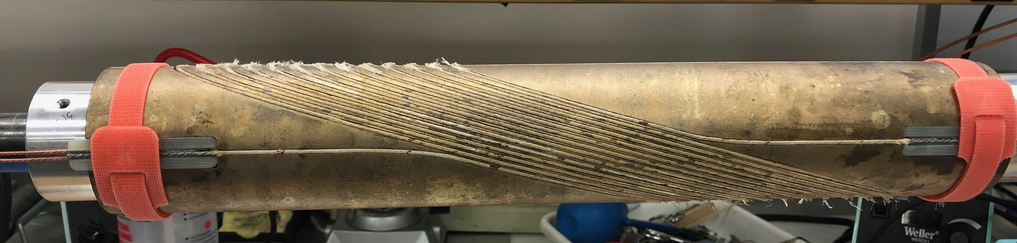
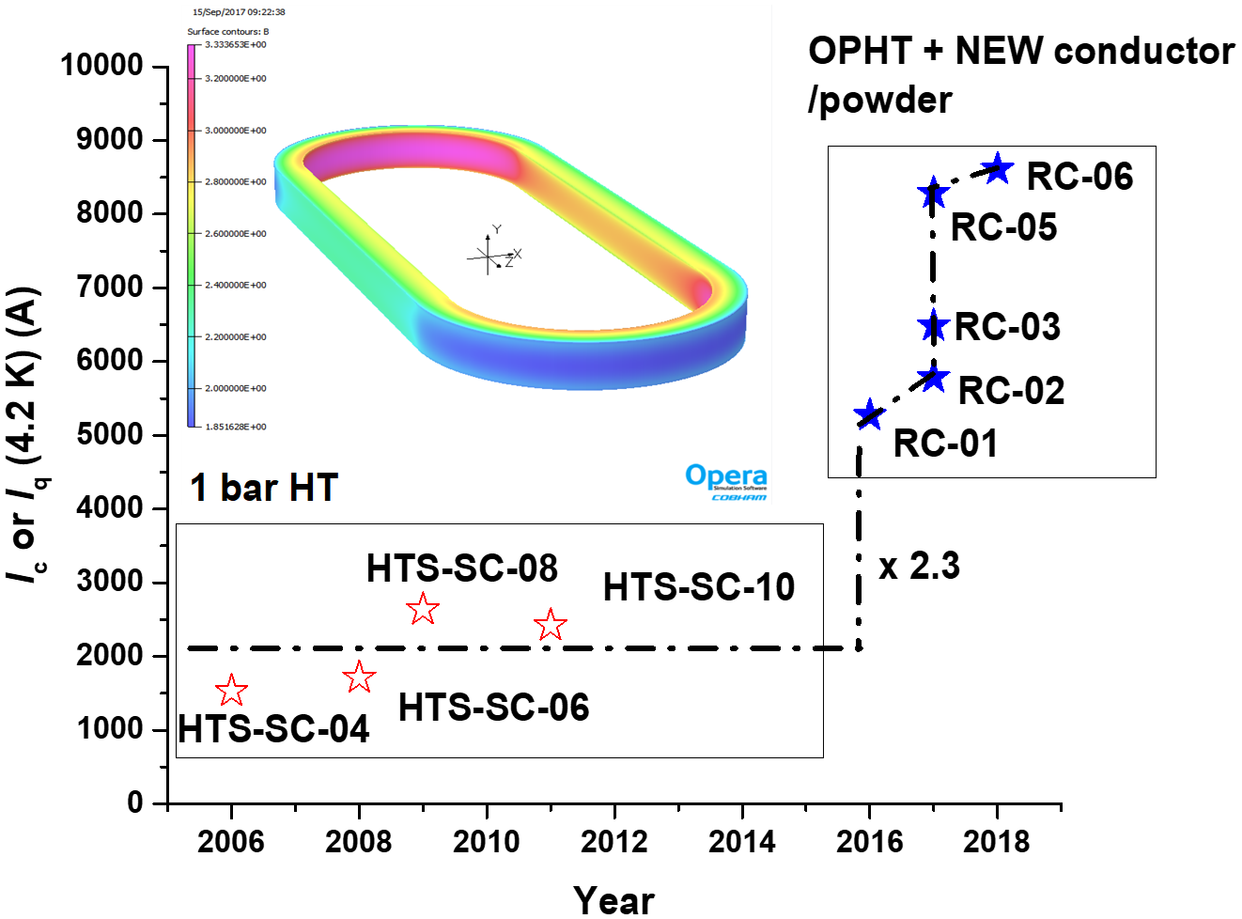
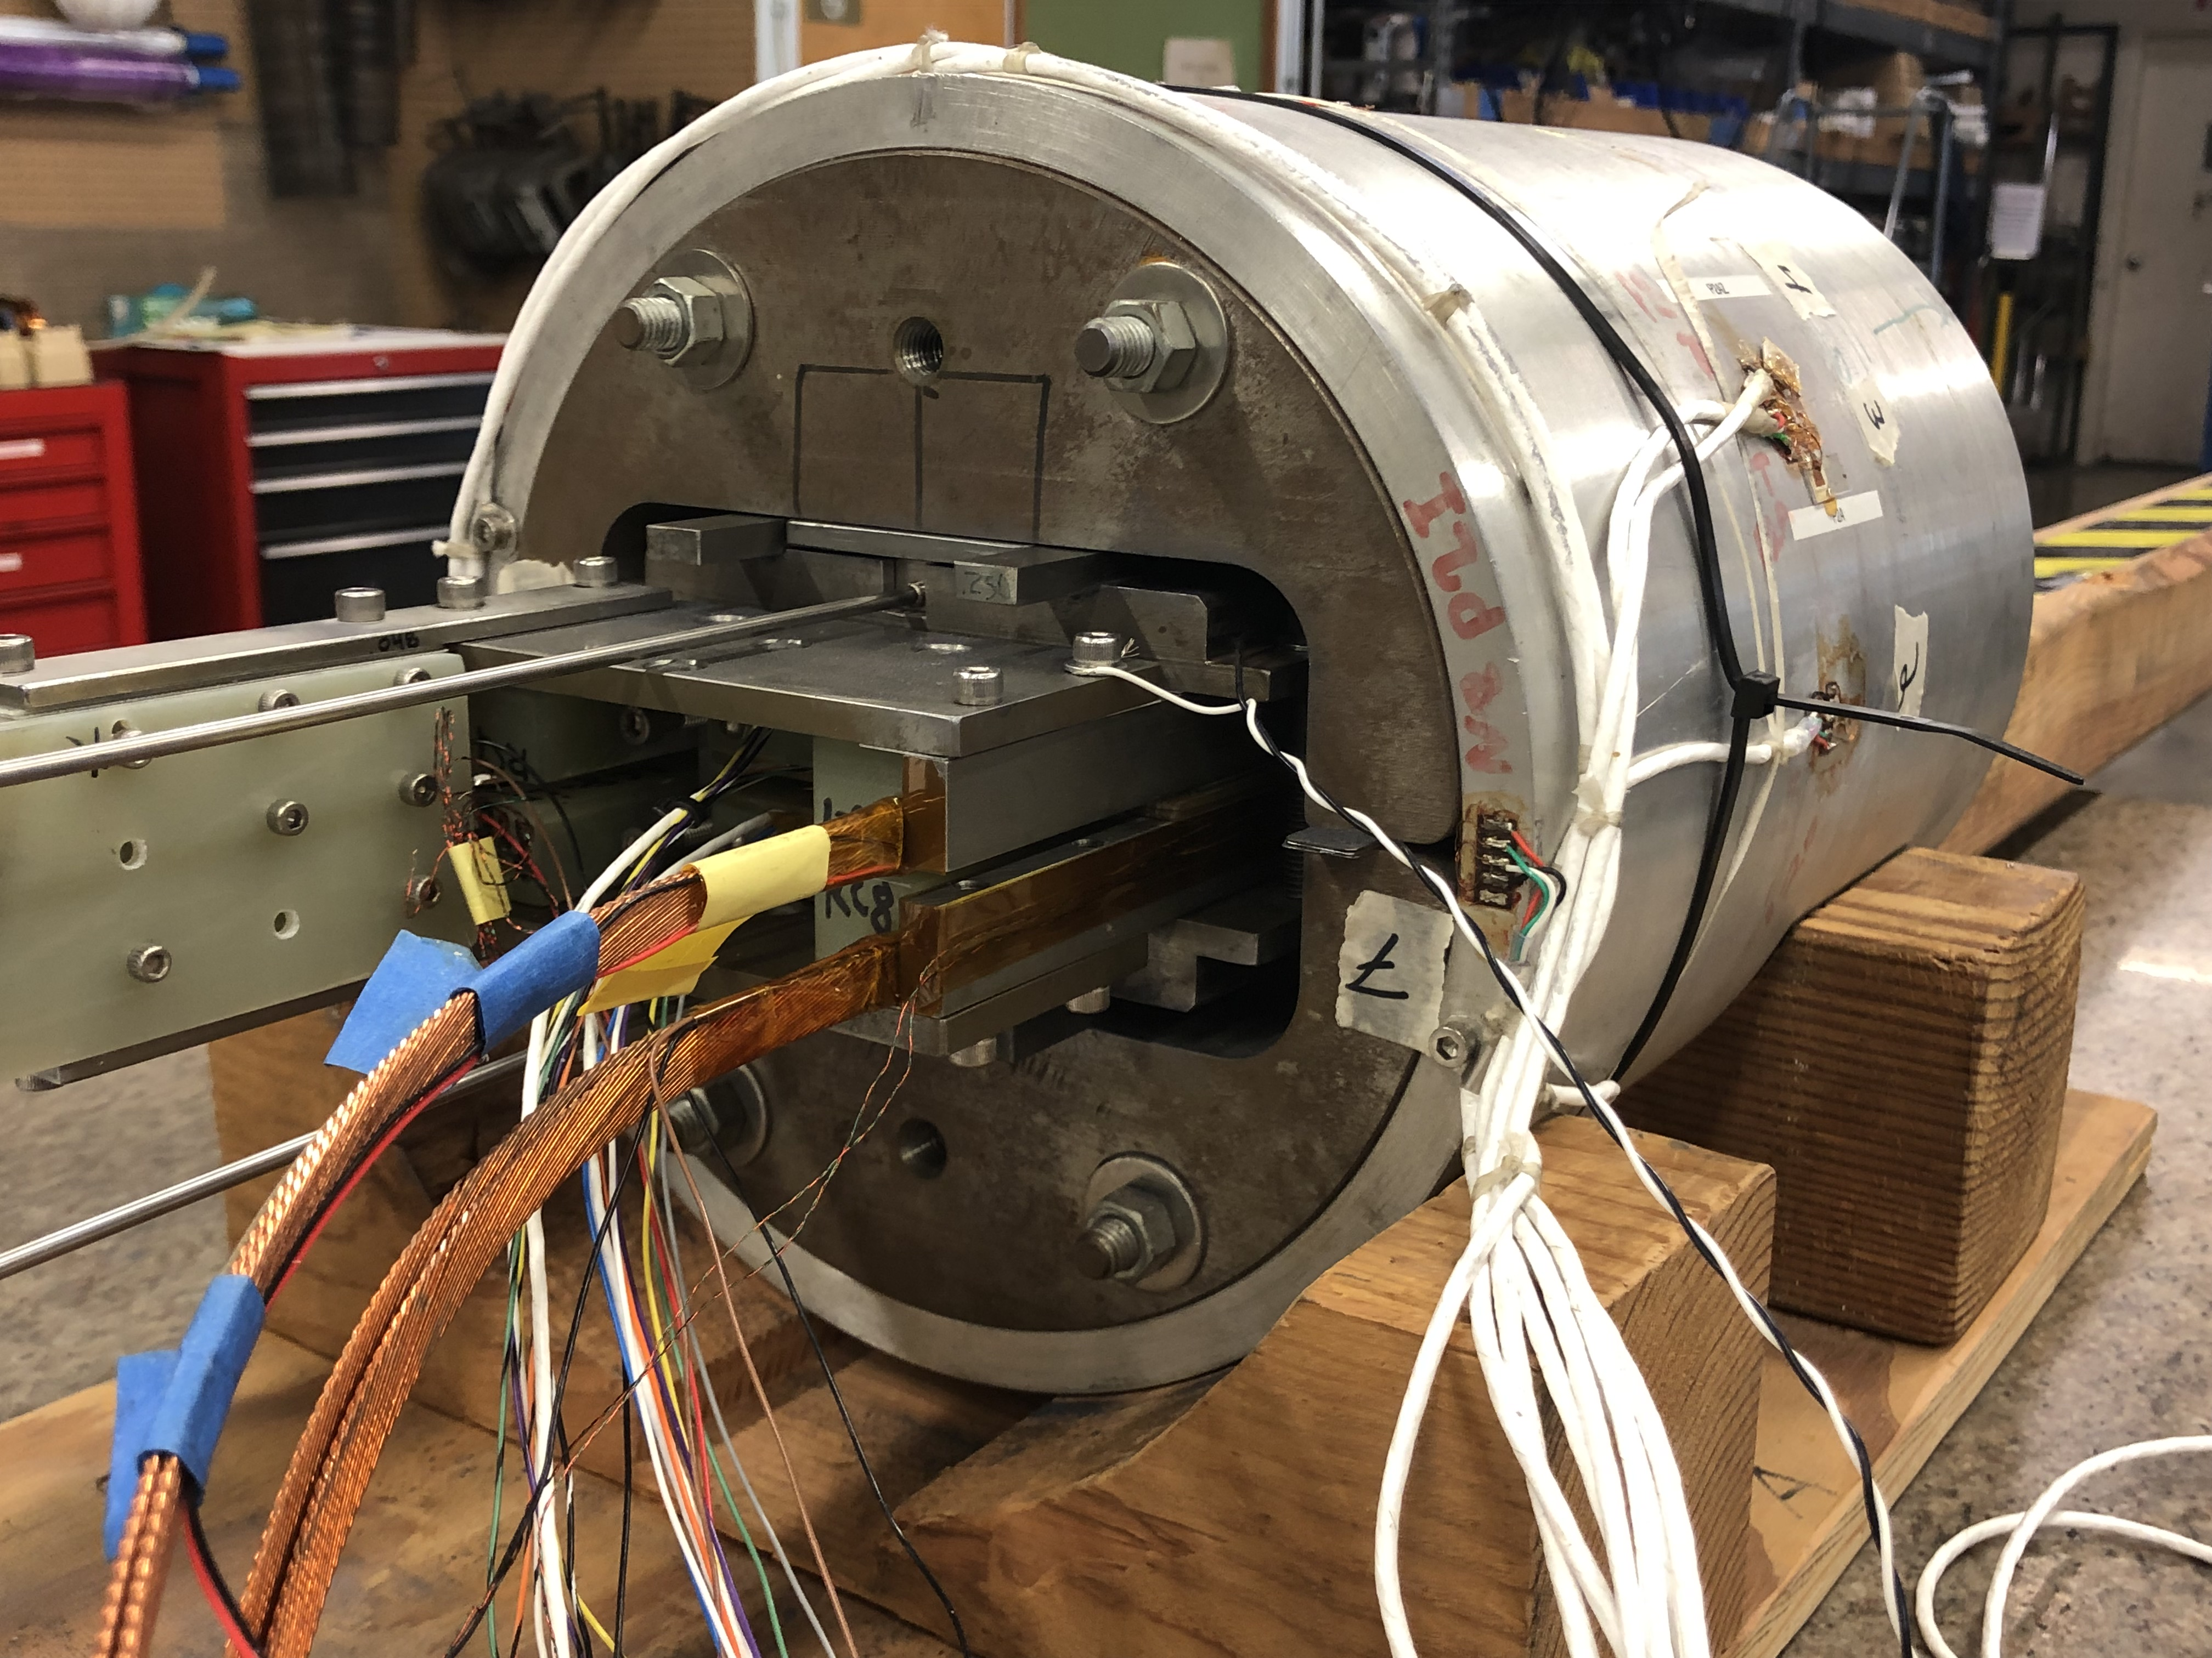
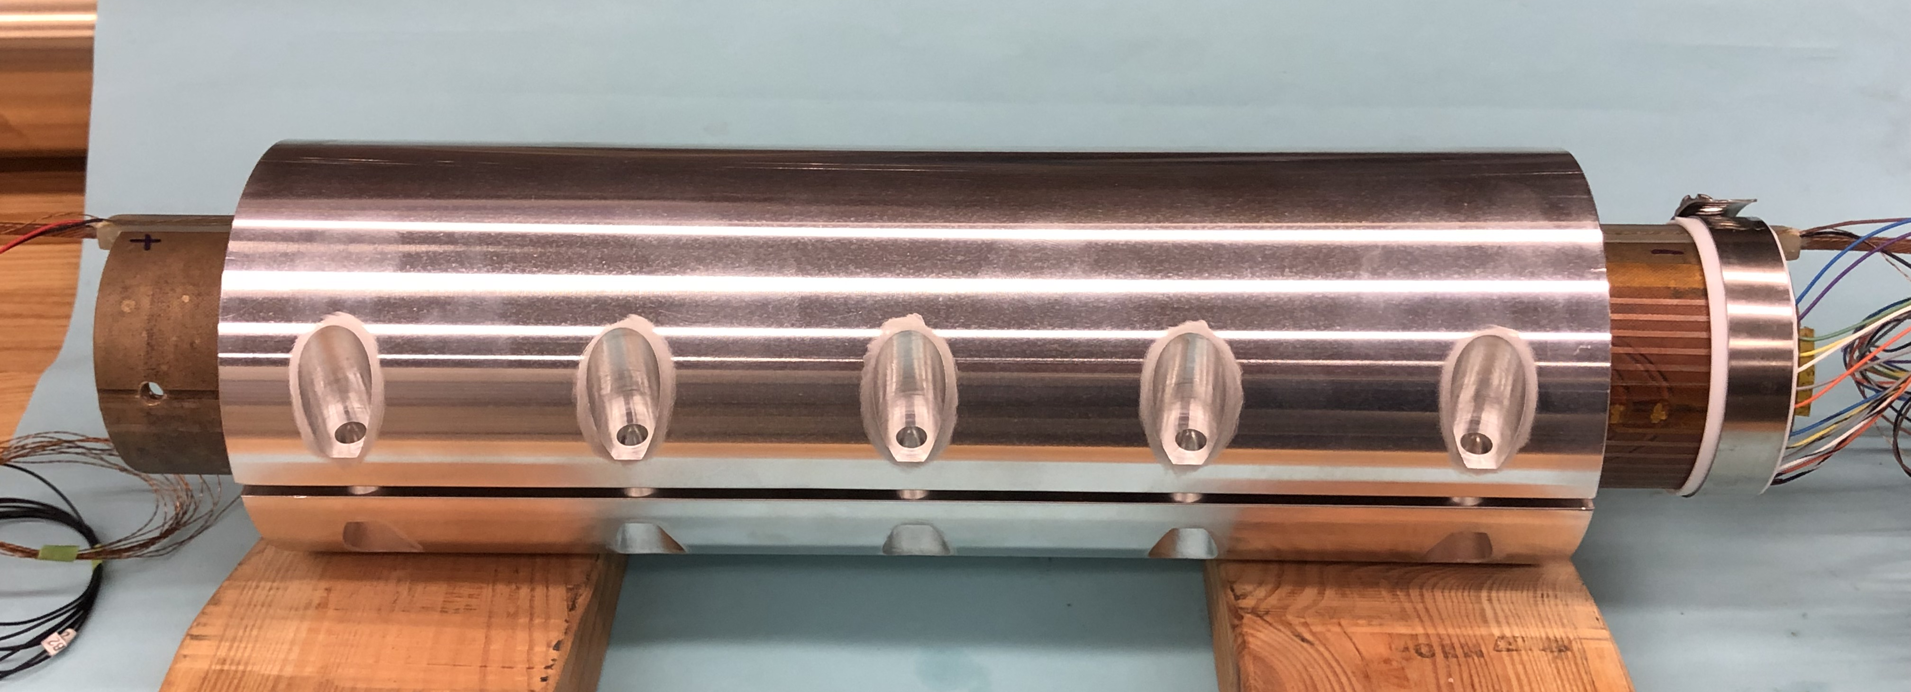
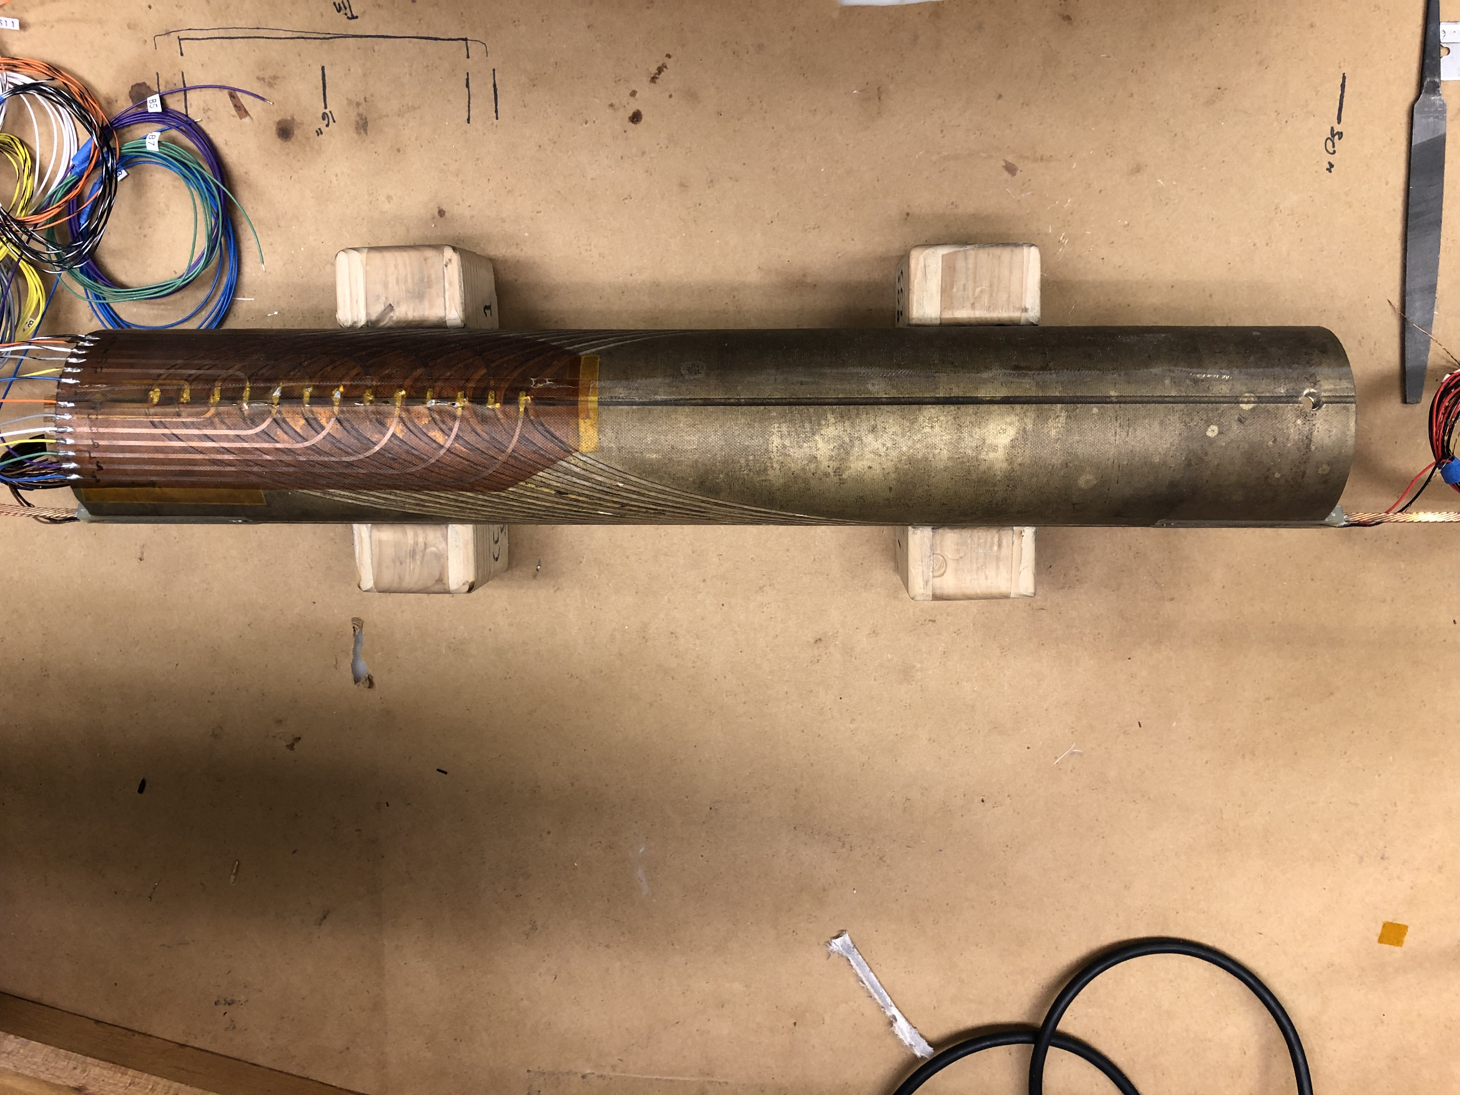
Bi2212 magnet technology is developing rapidly, and we are preparing infrastructure for hybrid magnet development
1. Insulation for minimizing electric shorts
2. OPHT in
FSU
DELTECH
4. Getting ready for VPI
LBNL 9-strand Bi-2212 Rutherford cable
Mullite only
Mullite braided insulation
Bi-2212
Mullite + TiO₂ slurry
3. After reaction and before VPI – nearly no deformation; still many leakages.
After heat treatment
HEP has invested in a larger furnace at ASC – “Renegade” is just about ready!
L. English, E. Bosque
Overall – easy winding and robust fabrication
No electrical shorts after winding, VPI, and tests.
VPI using vacuum bag techniques established for CCT Nb₃Sn.
Heat treatment technology at FSU.
5. After VPI (NHMFL mix 61), with voltage traces shown
6. Getting ready for tests – inside a Al collar
4.7 T @ 5.7 kA
TiO₂ slurry provided by Jun Lu, NHMFL.

Slide 13
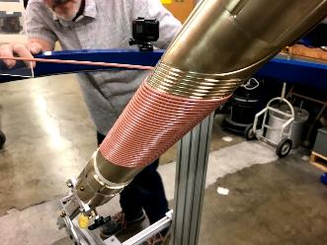
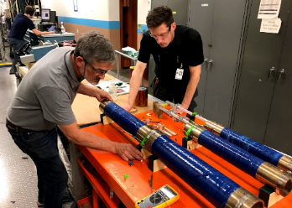
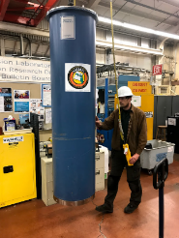
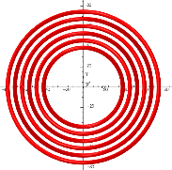
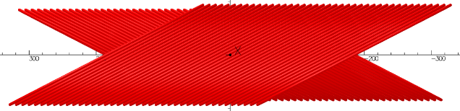
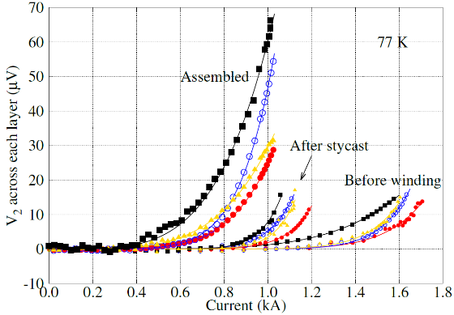
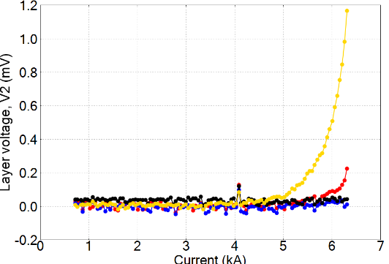
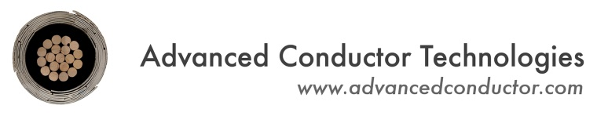

REBCO accelerator magnet technology is progressing in close coordination with industry
“C3” will use tapes with 30 µm thick substrate
  ID 70 mm, OD approaching 160 mm, produce 5T
ACT fabricated a record length of 100 m 30-tape CORC® wire for “C2”, consuming 6 km of SuperPower tapes with 30-µm thick substrate
Alternative concept under development – improved efficiency

Slide 14
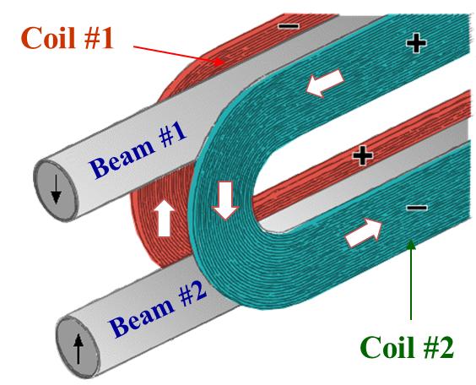
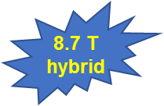
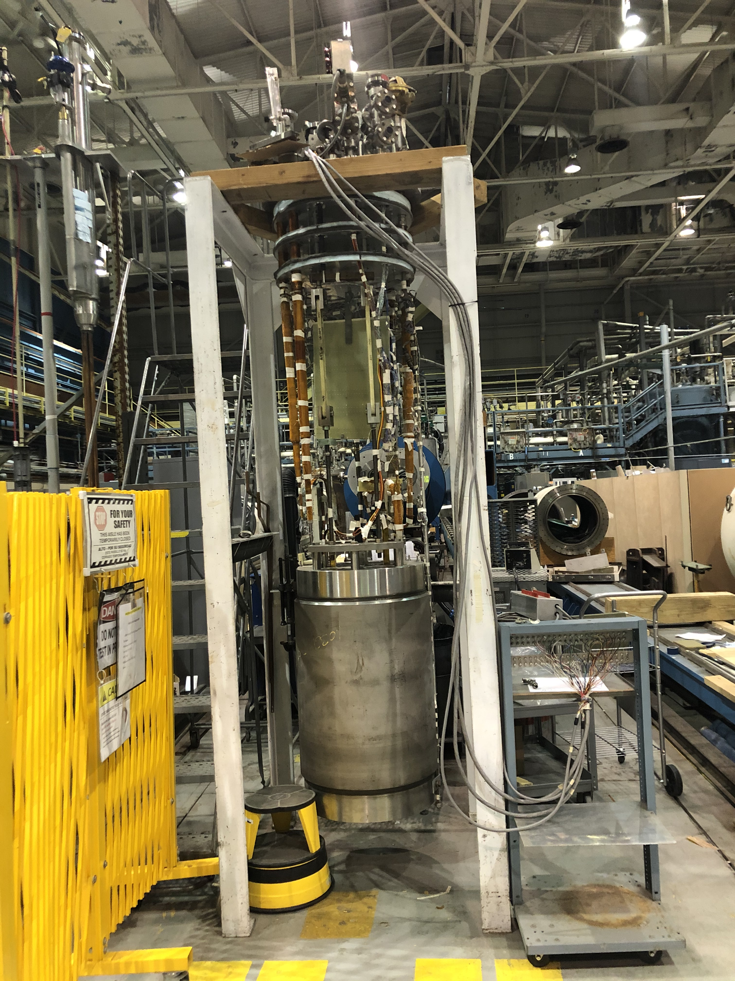
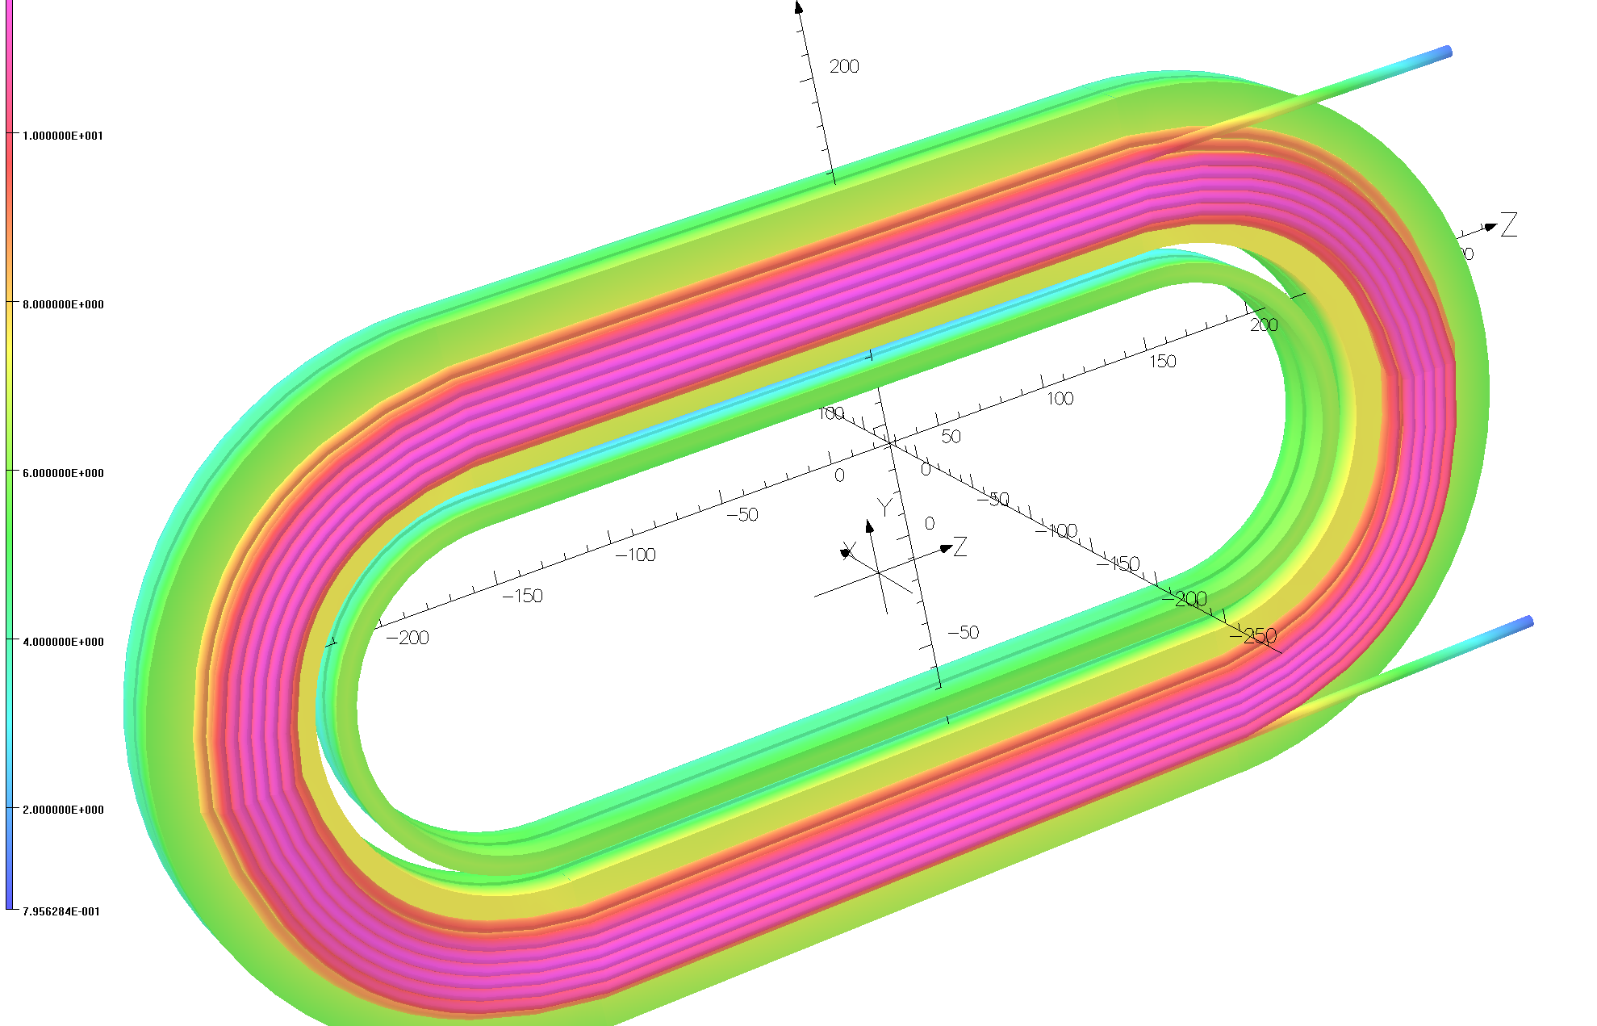
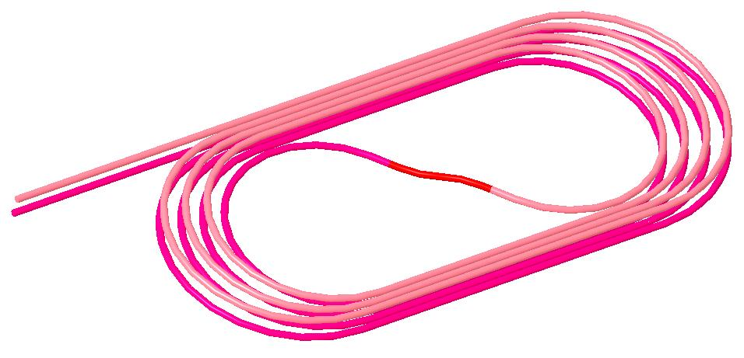
BNL experience and facilities are being applied to MDP research goals
2019-2020
Longstanding experience and interest in REBCO magnet technology
Existing ~10T common-coil magnet provides a platform for experiments to support MDP
A first experiment has been performed to explore magnetization effects in tape-wound REBCO coils and get first insights into hybrid HTS/LTS magnet testing in ”dipole” configuration
2020-2021
MDP HTS/LTS Hybrid Dipole

Slide 15



A sampling of diagnostics developments – driven by MDP needs, but with broad impact to DOE-SC and beyond
Machine Learning
Active acoustics
Goal: Use unsupervised learning to investigate physics (cracking vs. stick-slip) in magnet quench dataset
Stretch goal: Develop method to predict the quench in real-time
FPGA board
YBCO coil instrumented with
pulser and receiver piezos
Amplifier
First successful cryogenic (LHe) test of an FPGA digitizer with analog front end
CRYODAQ
Integration
Signal
Conditioning
Digitization
Communication
Processing
Experiment at 4.2 K. Current ramp stopped at 6100 A (stable) and then increased by 30 A (quenching)
Acoustic thermometry

Slide 16














Wide array of modeling advances underway to support diagnostics feedback and to optimize magnet systems
Magnet Protection
Strain impact on operation
Mechanics and thermal processes in conductors
4.2 K, 12 T
Nb₃Sn
+
Stycast
Gd₂O₃+Cu
Heater
Cu
Bronze
6 at corners
24 external
First test of CLIQ on Bi-2212 common coil, 77 K: comparing simulation and measurement
6 central
Standard
60/61 RRP wire
24 (w/18 central)
“Heat diffusion in Nb₃Sn strands”, E. Barzi, to be published.

Slide 17

Progress in conductors – Nb3Sn, Bi2212, and REBCO
Significant advances – both in performance obtained, and in identifying issues to be addressed
  Doping of Nb₃Sn promises dramatic increase in high-field transport => higher field, more compact magnets
    But comes with concerns of stability, drawability, protection etc
  High Cp wire holds promise of increased stability => reduce margin => more efficient use of conductor
    But needs progress in drawability, scale-up, and proof of performance
  Bi2212 wire exceeds Nb₃Sn now at ~11-12T, with high uniformity => magnet ready!
    But need to reproduce the reliable, quench-free magnet behavior at higher field, e.g. in a background dipole field
  REBCO tapes & cables continue to improve - higher J_{c}, higher J_{E}, tighter bend radius
    But uncertainties in current sharing, tape homogeneity, and mechanical performance remain
Most critically, we need ample supplies of all conductors to explore their performance in magnets => critical feedback to Universities and to the conductor industry
  This is the single most important driver of the timescale for HTS magnet development
Opportunity for a strong collaborative International approach

Slide 18

Current focus areas and key challenges
Can stress-management provide a viable means of accessing high-field and/or large bore dipole magnets without risk of conductor degradation?
Can hybrid LTS/HTS magnets deliver on the promise of efficient high-field dipoles
  Will they inherit the “best of both” or the “worst of both”
Advance HTS magnet technology to a respectable level of maturity
=> make it “real”
Advance diagnostics and modeling to further enhance our insight into magnet performance and issues
Overcome the advanced Nb₃Sn architecture issues and mature them to industrial levels
Provide a substantial and timely quantity of conductor for magnet research and feedback to conductor development

Slide 19
Lessons-learned: programmatic
R&D thrives on a combination of innovation and focus
  Innovation is at its heart: willingness to try new ideas, to question the status-quo, to take risks
  Focus provides strength to persevere – try, fail, and try again (quickly!) – while keeping an “eye on the prize”
Facilities are critical – and costly; leverage the community's capabilities to advance the field, and invest in unique capabilities early to get full benefit
The most critical asset for research: the people!
  Diversity – of culture, background, education, expertise, experience, thought – is central to a vibrant and productive R&D team

Slide 20
Summary
We are a mature and vibrant integrated multi-lab research program focused on developing accelerator magnet technology for the next energy frontier collider
This is an international endeavor, and we are eager to collaborate and join forces to rapidly advance the field
High field accelerator magnets are essential for the next collider – the onus is on us to deliver!
We strive to…
  provide a clear vision for magnet development & conductor properties/performance we would like to see
be open with our results and progress so others can benefit from our advances
  identify and benefit from the achievements and progress of others
  be good collaborators – we recognize the strengths and enthusiasm residing in the broader community!

