Slide 1
Racetrack and Block Coils
Gijs de Rijk
CERN
16th April 2021
Workshop on State-of-the-Art in High Field Accelerator Magnets

Slide 2
Contents
The state of the art
The Fresca2 line: SMC-RMC-Fresca2
The FCC line: eRMC-RMM-DEMO
Lessons learned
2

Slide 3
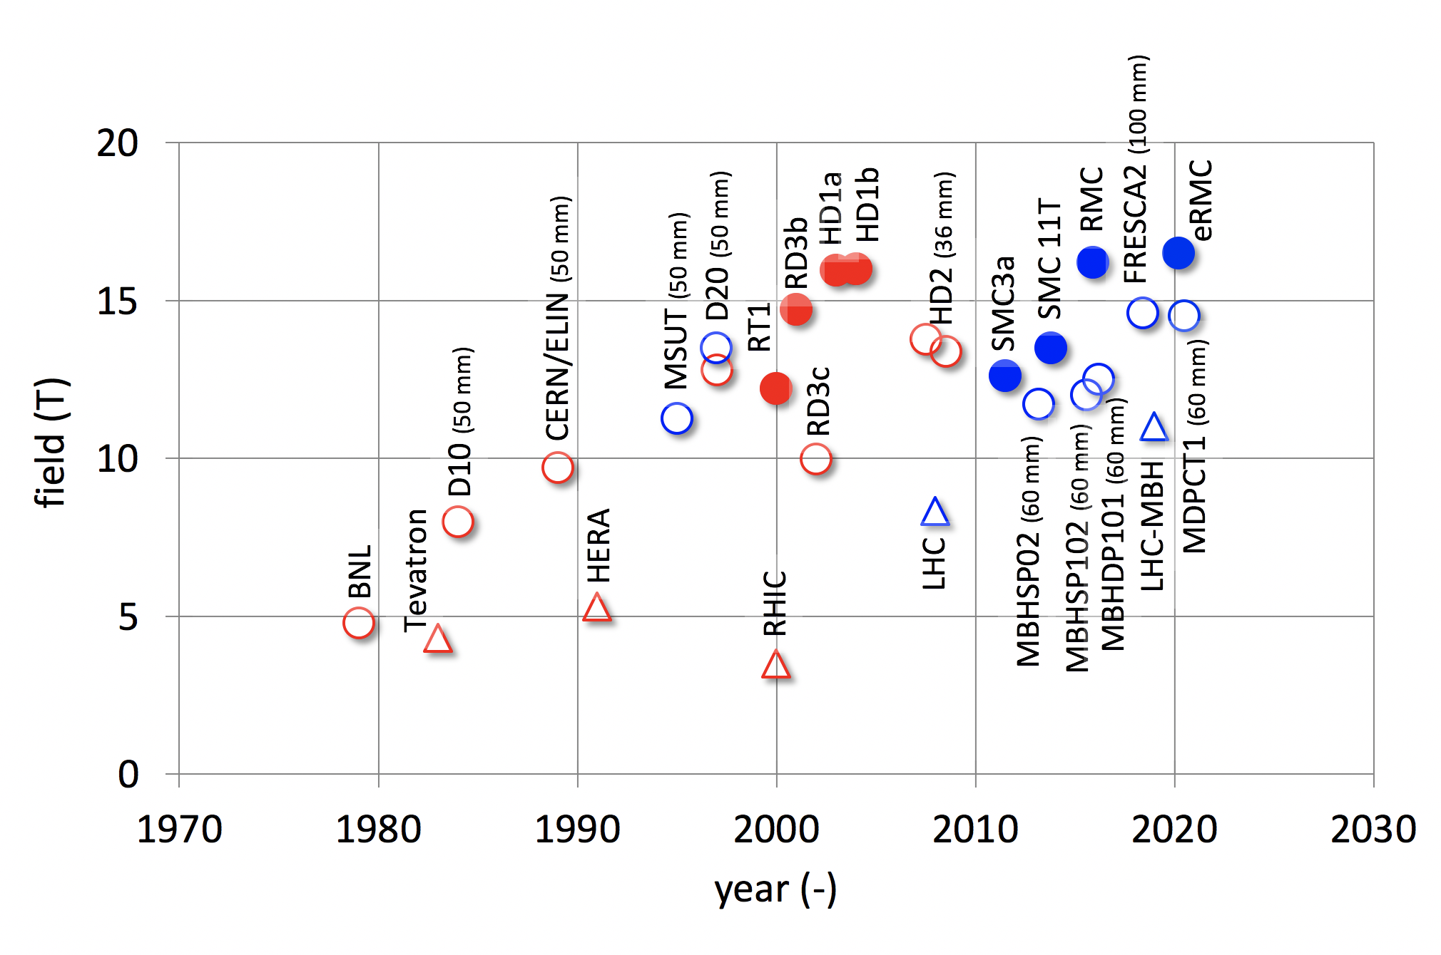




Superconducting accelerators magnets; the state of the art
Maximum attainable field, in a usable aperture, slowly approaches 16 T
Courtesy: L. Bottura

Slide 4
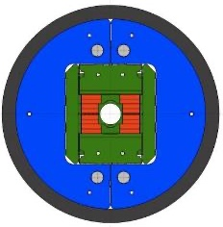
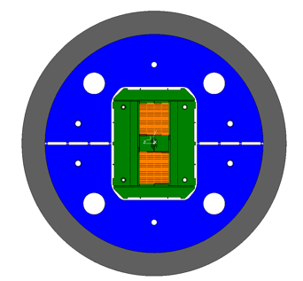
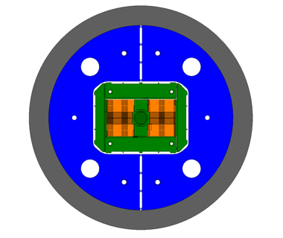
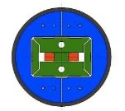
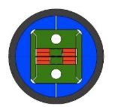
Nb₃Sn HFM development @ CERN
SMC
RMC
eRMC
RMM
FRESCA2
OD = 530 mm
L = 500 mm
No Ap.
B_{op}= n.a.
B_{ult} = 14 T
OD = 570 mm
L = 820 mm
No Ap.
B_{op}= n.a.
B_{ult} = 16 T
OD = 800 mm
L = 1.2-1.4 m
No Ap.
B_{op}= 16 T
B_{ult} = 18 T
OD = 800 mm
L = 1.2-1.4 m
50 mm closed Ap.
B_{op}= 16 T
B_{ult} = 18 T
OD = 1.03 m
L = 1.6 m
100 mm Ap.
B_{op}= 13 T
B_{ult} = 15 T
Hi-Lumi R&D
FCC R&D
No aperture
No aperture
No aperture
cavity
Large aperture
OD = Outer diameter
L = Magnet length
AP = Aperture
B_{ult}= Ultimate field, defined as the maximum design field for the magnet structure
Courtesy S. Izquierdo, P. Ferracin, J-C. Perez

Slide 5
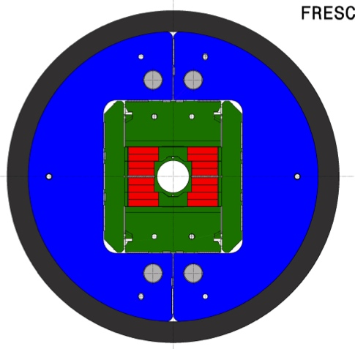
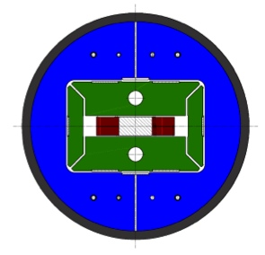
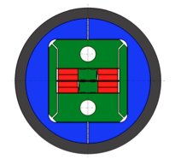
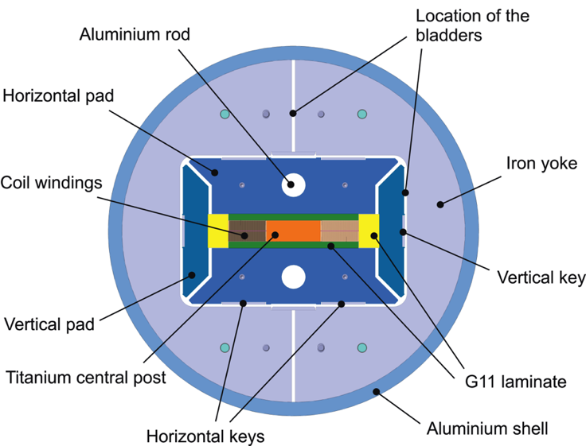
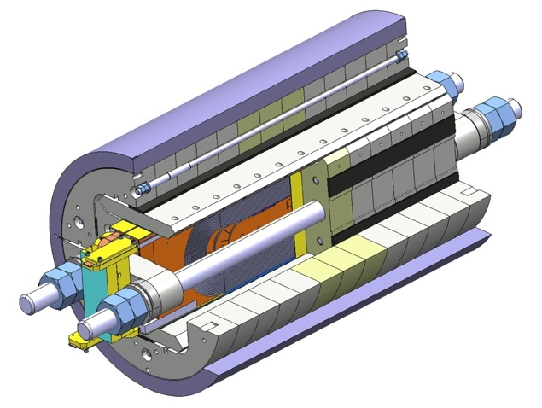
CERN-European development evolution on dipoles
FReSCa2 13T
Nb₃Sn Dipole
Short Model Coil
Race-track
Model Coil
RMC (Racetrack Model Coil)
SMC (Short Model Coil)
FReSCa2
Horizontal Pad
Nb₃Sn Coil
Vertical Pad
Electrical connexion box
Laminated Yoke
Aluminium Shell
Longitudinal Rods

Slide 6
SMC & RMC in a nutshell
SMC, Small Model Coil
initially 1.25 mm in a 14 stand cable followed by 1 mm strand in a 18 strand cable (11T version 0.7 mm stand in a 40 strand cable)
2 racetrack coils (28 turn/layer) (1 racetrack coil for the 11T version, 35 t/l )
Test basic layout: racetrack coils in a S-B-K structure. Coil technology test (glass-fibre braiding, Inpregnation with CTD101, traces, instrumentation. Look at: prestress scan, quench mechanisms, MIITs, ramp rates, go close to Ic, degradation after pushing it a bit)
RMC, Racetrack Model coil
1 mm strand in a 40 strand cable: same as Fresca2 (33 or 35 t/l) (+ MQXF version: 0.85 mm strand in a 40 strand cable)
2 racetrack coils
Test full cable in a racetrack model: Layer jump, prestress scan, quench mechanisms, MIITs, ramp rates, go to the same field level as Fresca2. Final check of all technologies before making the full magnet (except for the flared ends)

Slide 7
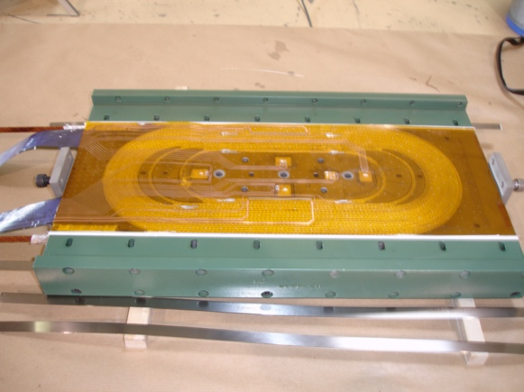
SMC & RMC
Shell bladder and keys
Axial: Al rods & end plate
glass fibre braided sleeve, Impreg: CTD101
Trace with V taps and Quench heaters
pole strain gauges

Slide 8
SMC test results - 1

Slide 9
SMC test results - 2

Slide 10
RMC test results
95% - 97% of strand I_{c} @ 4.2K and 1.9K
I_{op} = 18.5 kA and B_{peak}= 16.2 T

Slide 11
SMC – RMC -- some worries
epoxy cracking was evident on nearly all coils after extensive testing (quenching)

Slide 12
Nb₃Sn HFM development @ CERN
SMC
RMC
eRMC
RMM
FRESCA2
OD = 530 mm
L = 500 mm
No Ap.
B_{op}= n.a.
B_{ult} = 14 T
OD = 570 mm
L = 820 mm
No Ap.
B_{op}= n.a.
B_{ult} = 16 T
OD = 800 mm
L = 1.2-1.4 m
No Ap.
B_{op}= 16 T
B_{ult} = 18 T
OD = 800 mm
L = 1.2-1.4 m
50 mm closed Ap.
B_{op}= 16 T
B_{ult} = 18 T
OD = 1.03 m
L = 1.6 m
100 mm Ap.
B_{op}= 13 T
B_{ult} = 15 T
Hi-Lumi R&D
FCC R&D
No aperture
No aperture
No aperture
cavity
Large aperture
OD = Outer diameter
L = Magnet length
AP = Aperture
B_{ult}= Ultimate field, defined as the maximum design field for the magnet structure
Courtesy S. Izquierdo, P. Ferracin, J-C. Perez

Slide 13
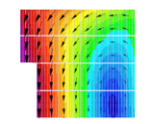
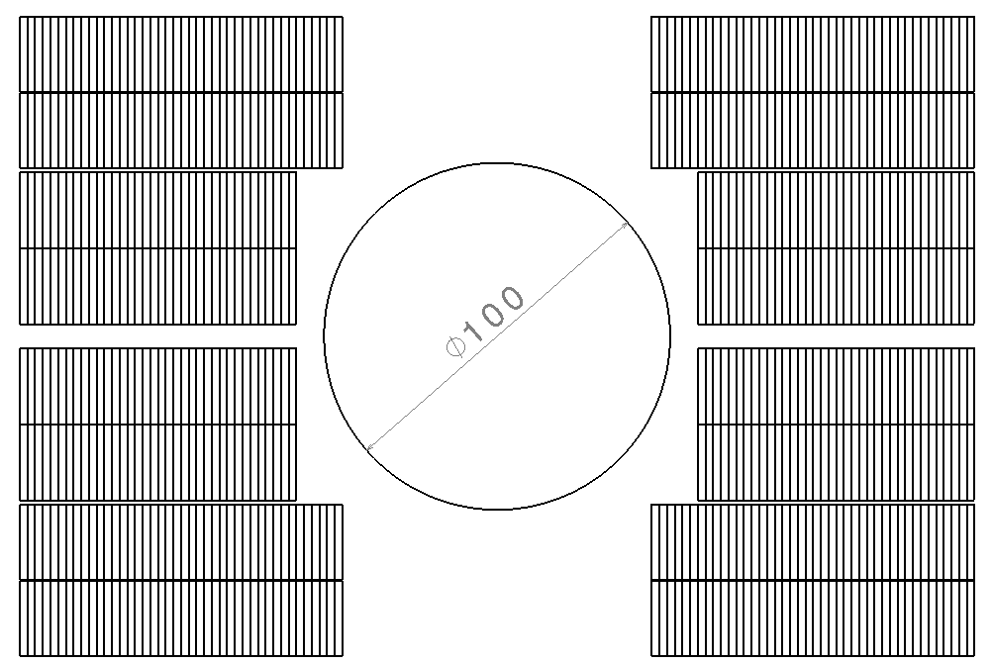
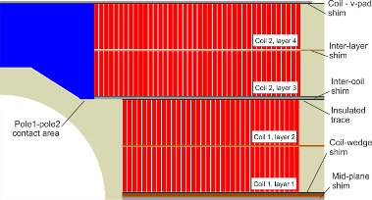
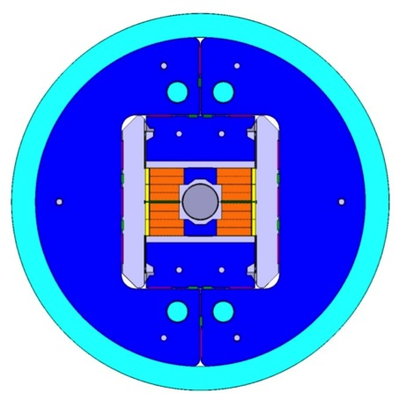
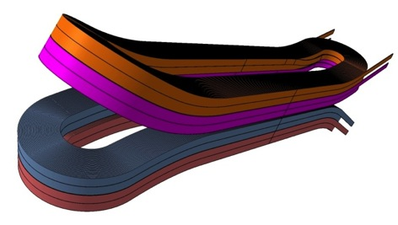
Fresca2 design
Fresca2 : CERN, CEA construction phase
First tests 2014
156 turns per pole
Iron post
B_{center} = 13.0 T
I_{13T} = 10.7 kA
B_{peak} = 13.2 T
E_{mag} = 3.6 MJ/m
L = 47mH/m
Diameter Aperture = 100 mm
L coils = 1.5 m
L straight section = 700 mm
L yoke = 1.6 m
Diameter magnet = 1.03 m
42
42
36
36
Courtesy: A. Milanese, P. Manil, J-C Perez, P. Ferracin, F. Rondeaux, M. Durante

Slide 14
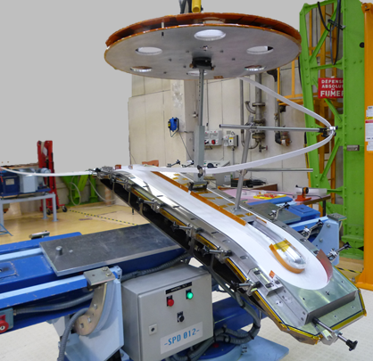
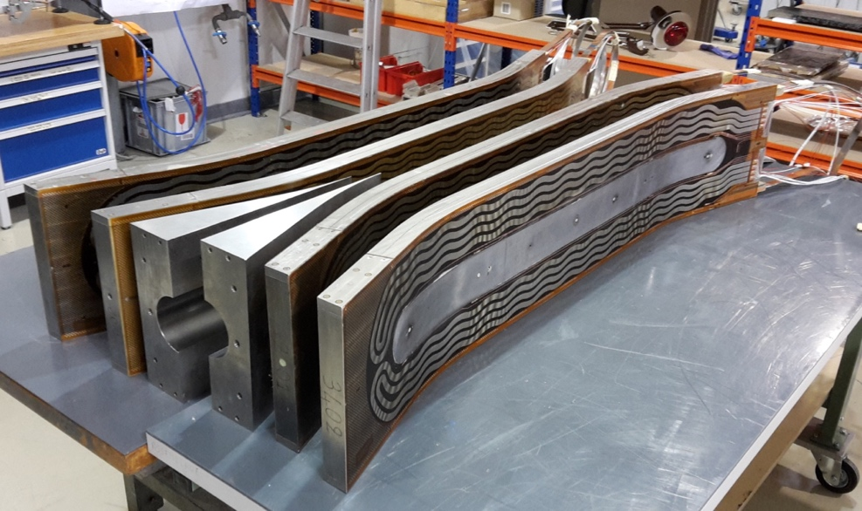
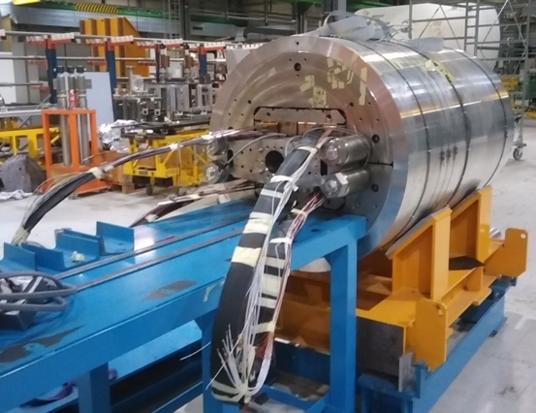
Fabrication of Fresca2
Straightforward technology to wind block coils with flared ends:
Cable volume changes during reaction: took long to get a grip on this
Tailored shim in between coils for perfect mechanical contact

Slide 15
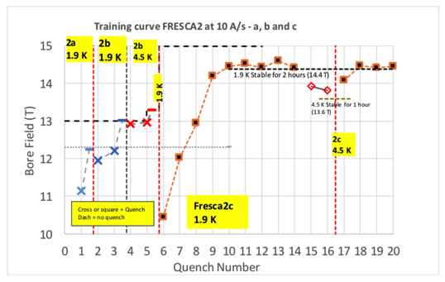
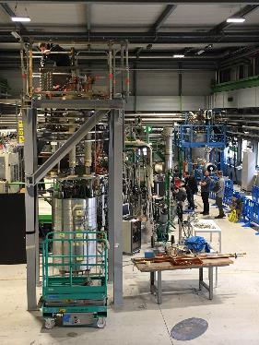
Cold test of the Fresca2
Only short training to 13T@1.9K
Record field 14.6T at higher pre-stress
DC ops at 14.4T possible
Still some optimisations to do on coil manufacturing: where to slip and where not…

Slide 16
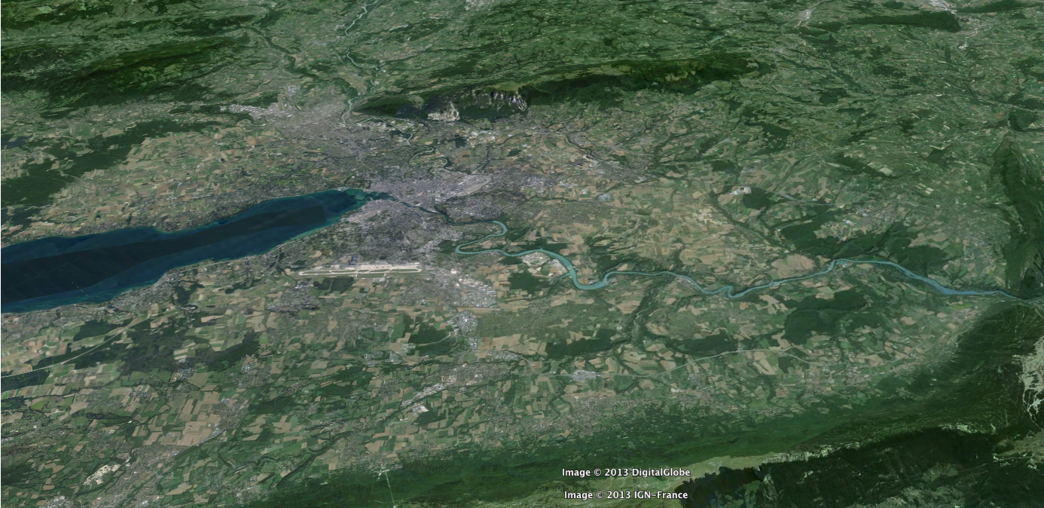
FCC development (2014 - ... )
Geneva
PS
SPS
LHC
LHC
27 km, 8.33 T
14 TeV (c.o.m.)
HE-LHC
27 km, 20 T
33 TeV (c.o.m.)
FCC-hh
80 km, 20 T
100 TeV (c.o.m.)
FCC-hh
100 km, 16 T
100 TeV (c.o.m.)i

Slide 17
Nb₃Sn HFM development @ CERN
SMC
RMC
eRMC
RMM
FRESCA2
OD = 530 mm
L = 500 mm
No Ap.
B_{op}= n.a.
B_{ult} = 14 T
OD = 570 mm
L = 820 mm
No Ap.
B_{op}= n.a.
B_{ult} = 16 T
OD = 800 mm
L = 1.2-1.4 m
No Ap.
B_{op}= 16 T
B_{ult} = 18 T
OD = 800 mm
L = 1.2-1.4 m
50 mm closed Ap.
B_{op}= 16 T
B_{ult} = 18 T
OD = 1.03 m
L = 1.6 m
100 mm Ap.
B_{op}= 13 T
B_{ult} = 15 T
Hi-Lumi R&D
FCC R&D
No aperture
No aperture
No aperture
cavity
Large aperture
OD = Outer diameter
L = Magnet length
AP = Aperture
B_{ult}= Ultimate field, defined as the maximum design field for the magnet structure
Courtesy S. Izquierdo, P. Ferracin, J-C. Perez

Slide 18
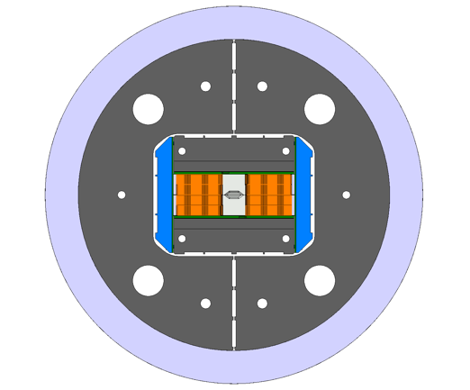
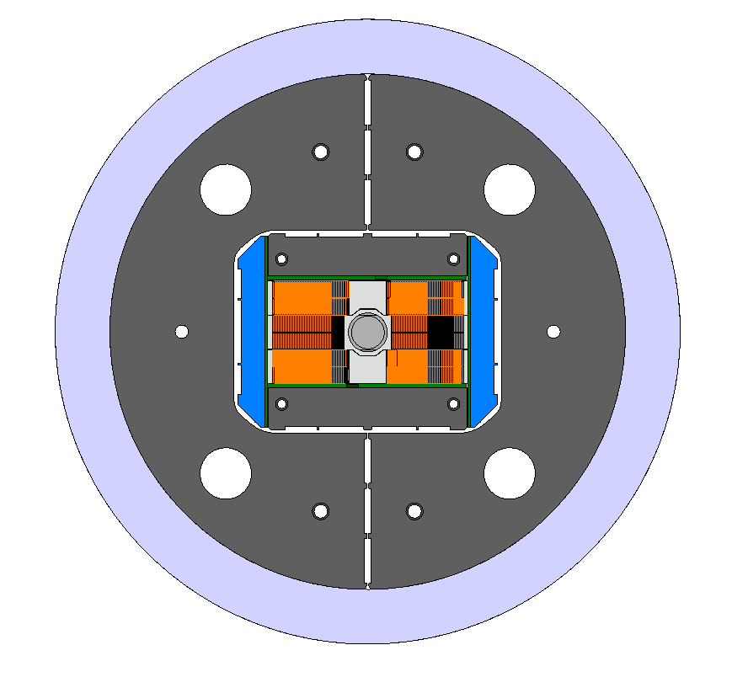
16 T , CERN approach , go in steps
1 Extended Racetrack Model Coil , ERMC
2 Racetrack Model Magnet, RMM
3 Demonstrator, DEMO
First with one conductor , then with 2 different ones to optimise the coil: Grading
ERMC
RMM
DEMO
Real aperture Flared ends
coil: 2 x 45 t/l
middle coil: 2 x 42 t/l

Slide 19
Comparison RMC-eRMC
courtesy S. Izquierdo

Slide 20
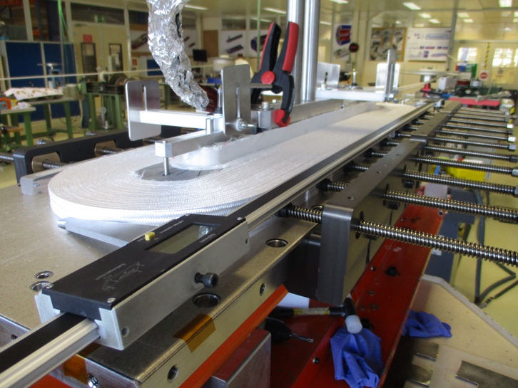
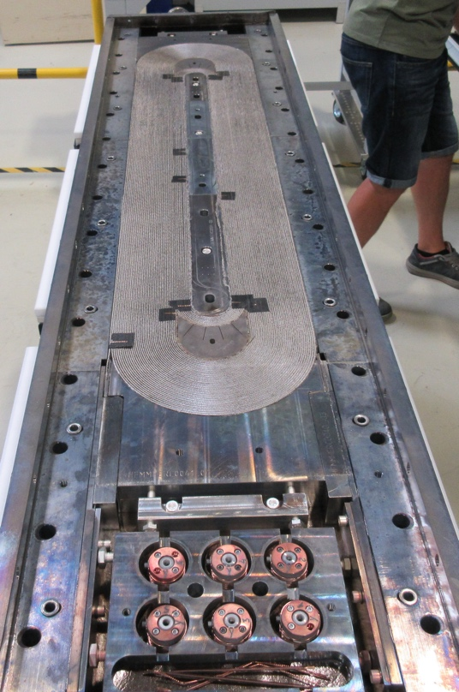
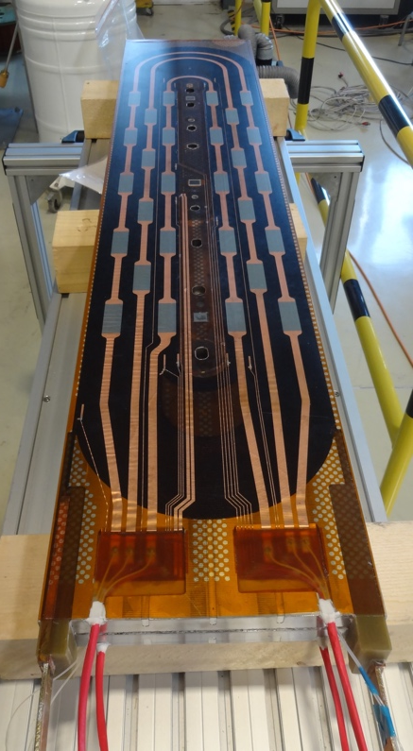
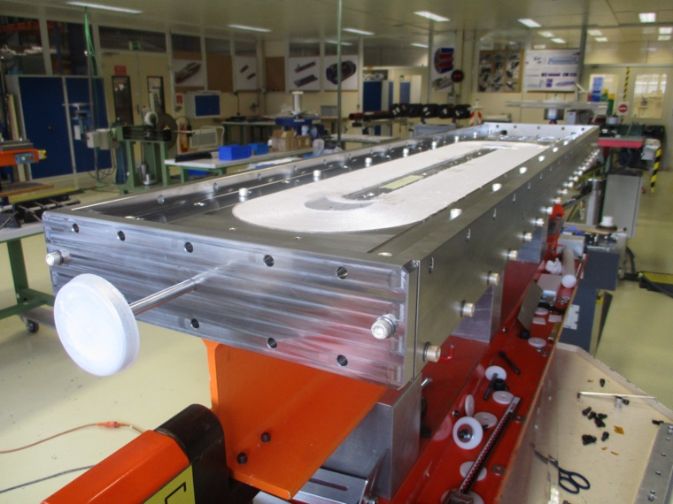
ERMC
winding
Coil after reaction
Coil completed
Coil before reaction
Courtesy: S. Izquierdo

Slide 21
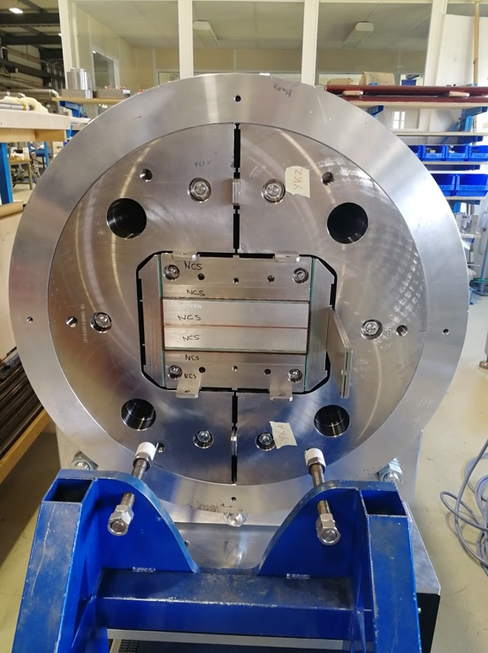
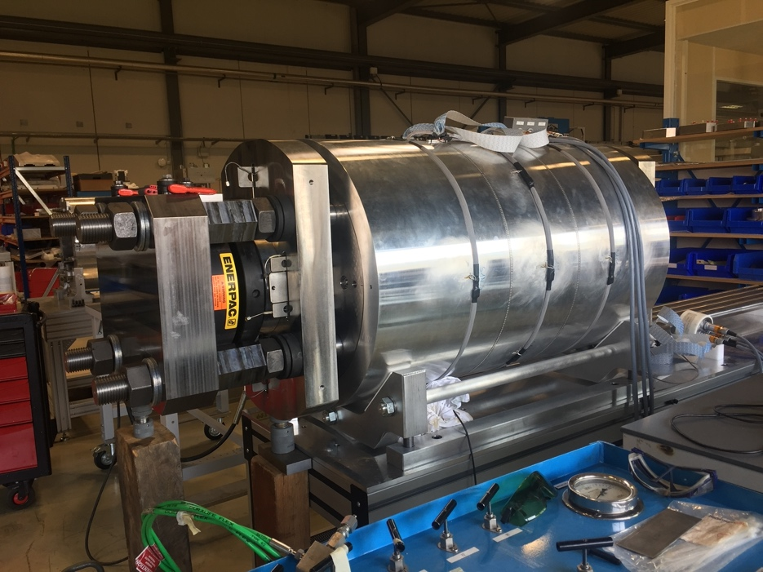
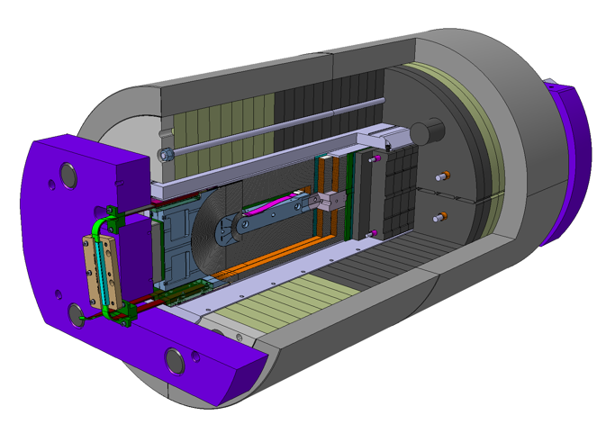
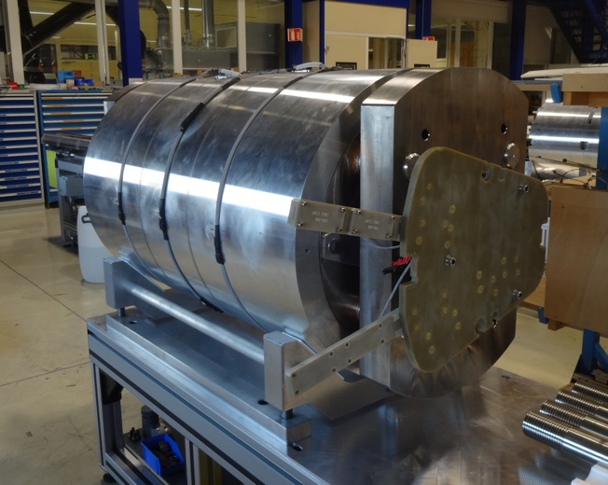
ERMC (dummy) assembly
Assembly with dummy coils
Structure with dummy coils now in SM18 for mechanical validation tests at cold
Courtesy: S. Izquierdo

Slide 22
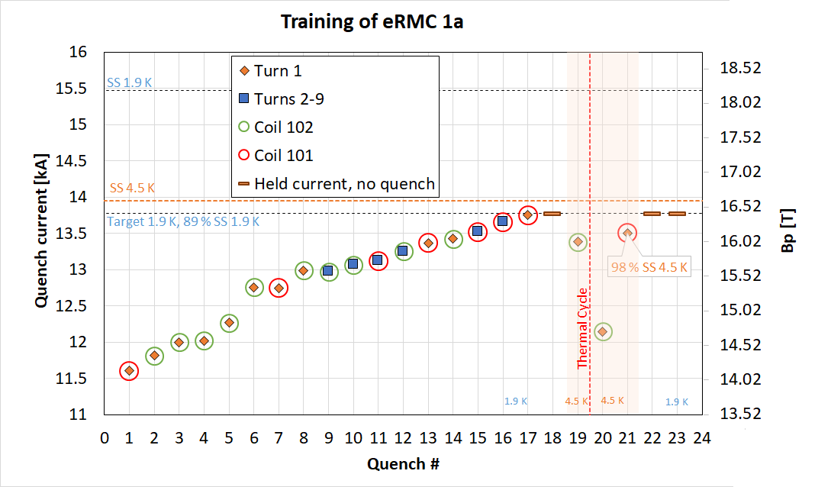
ERMC test results
courtesy S. Ferradas & G. Willering
The training dI/dt was reduced after quench 17. Then, it reached 13.77 kA (Bp 16.5 T)
The magnet reached 98% of SS at 4.5 K
Good memory after the thermal cycle: Only one training quench

Slide 23
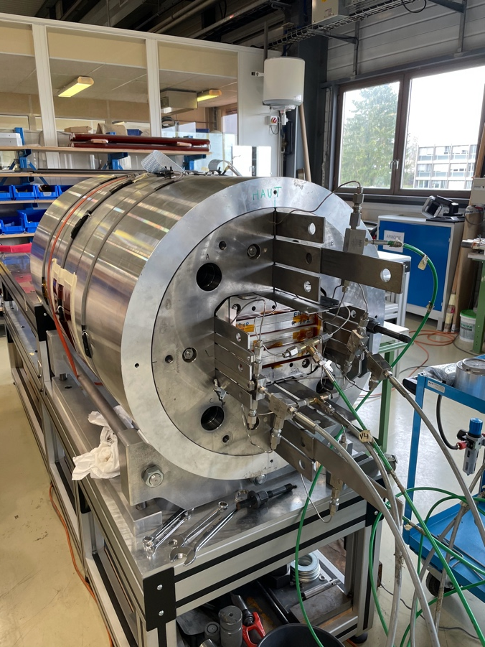
RMM assembly
RMM
coil manufacturing hit by ~1 year delay
  HL-LHC priorities in the lab
  FCC budget issues
  COVID delays
Assembly started only in 2021
Test planned for May 2021

Slide 24
Lessons learned-1 SMC-RMC-Fresca2
Technical
“Go in steps” , build intermediate models which target specific features. This philosophy (inspired by LBNL) works out very nicely.
The insulation system is designed for 20kV but barely holds 2kV, it needs to be redesigned (Fresca2 lost a coil on this problem).
CTD101 epoxy is bad, but it is the best we have. (cracking under loads: seen on all SMC & RMC coils). We need a new epoxy system.
We need to have sliding or detaching surfaces in and on the coils (we learned from commercial solenoids).
  Material development is needed on how to do this (linked to impregnation).
  One needs to figure out where to put them: FE studies and practical tests.
Quench heaters are the Achilles heel of any SC magnet: need more robust protection (Fresca2 lost a coil on this problem), in the end we only used a dump.
Shell-bladder-and-key structures are great for flexibility : changing coils is now (nearly) a routine job.
Conductor stability needs to be evaluated beforehand. We stepped back from 1.25 mm to 1 mm and gave us a stability and a windable cable.

Slide 25
Lessons learned-2 SMC-RMC-Fresca2
Use the flat coil intermediate steps to (among others):
  study pre-stress dependence of the degradation
  study the MIITs, quench velocity etc.
  Reach Ic and observe quench behaviour and potential degradation
After winding trails with the cable the magnet design must be adapted to the geometry that fits.
Conductor volume changes during reaction need to be known, and the reaction mould has to be adapted for this. Doing this, cost us a > 1 year extra in the schedule and it is still not fully understood.
Cooldown and warmup need to be studied in detail to define the procedures. (we did that and did not see any degradation during T-cycling).
Don’t try to immediately design a maximum conductor efficient magnet, take margins on all parameters (done on Fresca2).
Flared end geometries are working but need to be further optimised to gain the last %s on the loadline. Especially, the sliding surfaces, where to block, and who much and how to to the axial support and prestress need to be fine-tuned.

Slide 26
Lessons learned-3
Organizational
Real collaboration is key
  No lab has for long periods of time all the know-how and key resources available all the time. You have to be complementary and supportive.
  The project was managed by both CERN and CEA (no conflicts, well argued decisions).
  As you cannot predict where all the difficulties are, you cannot define rigid “black box” contributions to the project at the beginning.
  For Fresca2:
    The combined CERN-CEA team did the design.
    CEA made the CATIA model and the drawings.
    CEA wound the coils.
    CERN did the coil reaction-Impregnation and the assembly.
    CERN tested the magnet.
    Funding came from 4 budget sources, partly overlapping in time.

Slide 27
Lessons learned-4
You need the discipline to step back and study a difficulty when you hit one. You need to be strong enough to decide not to follow the planning. (Done several times with good results).
HFM development takes time: resist to management trying to squeeze the planning. The same holds for the budget.

