Slide 1
Overview of FCC Nb₃Sn magnet development and technical challenges
Daniel Schoerling
on behalf of the FCC collaboration with material from the collaboration
16th April 2021

Slide 2
Outline
Introduction: what is the scope of the presentation ?
State of the art: what results were obtained during the last (few) years (i.e. no need for a complete historical review) ?
Lessons learned: what was achieved, what was not (yet) achieved ?
Key challenges: what is crucial and would truly make a difference ?

Slide 3
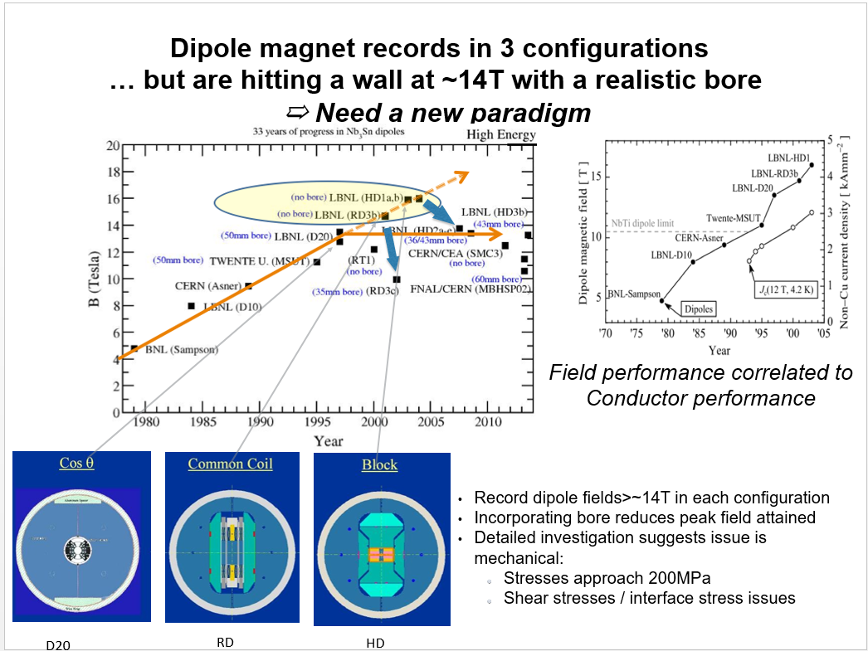
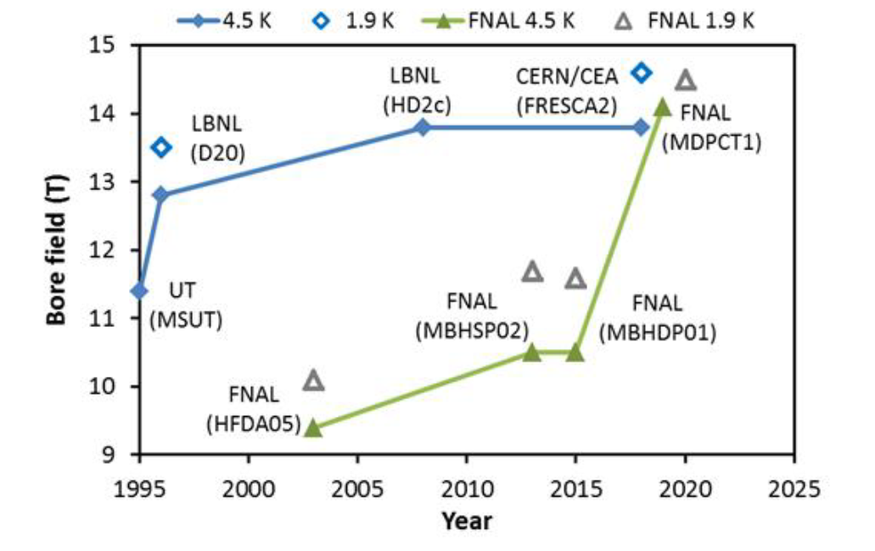
FCC and EuroCirCol: A view back
Kick-off meeting was on 12 to 15 February 2014 at the University of Geneva
CERN defined a FCC technology development plan with the following WP:
  Wound conductor facility
  ERMC & RMM
  DEMO
  EuroCirCol WP5
Courtesy: S. Gourlay. His proposal: CCT
D. Schoerling et al., Strategy for SMD for a FCC-hh, http://dx.doi.org/10.22323/1.234.0517

Slide 4
Rationale of the program
In the initial phase explore all design options (coils and structures)
  Use identical field target (16 T), design margins (e.g. 14 % along the loadline) and material properties (as much as possible…)
  Allow a direct comparison of results (e.g. coil mass, peak stress, …)
Build demonstrator model magnets of all variants to identify engineering and performance issues
  Designed for target conductor performance, but built with best available wire
  Go through a progression of complexity (and design field) – start at intermediate field levels of 12 to 14 T
Down-select and define a baseline magnet design and alternatives, as well as nominal and ultimate field level that can be reached
done
In progress
future

Slide 5




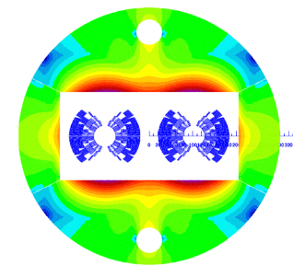
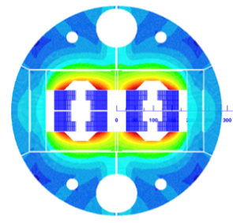
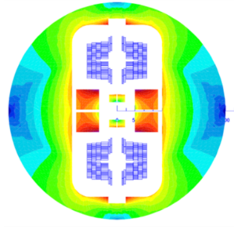
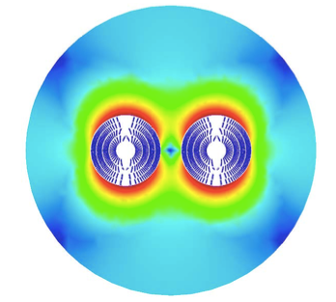
Main Results Design: FCC Dipoles
OD = 600 mm
L = 2 m
50 mm aperture
B_{ultimate} = 16 T
W_{strand} ≈ 350 kg (700 kCHF)
 |  | cos(θ) | block | common coil | CCT
Current | (A) | 10000 | 11230 | 16100 | 18055
Inductance | (mH/m) | 50 | 40 | 19.2 | 19.2
Stored energy | (kJ/m) | 2500 | 2520 | 2490 | 3200
Coil mass | (tons) | 7400 | 7400 | 9200 | 9770

Slide 6
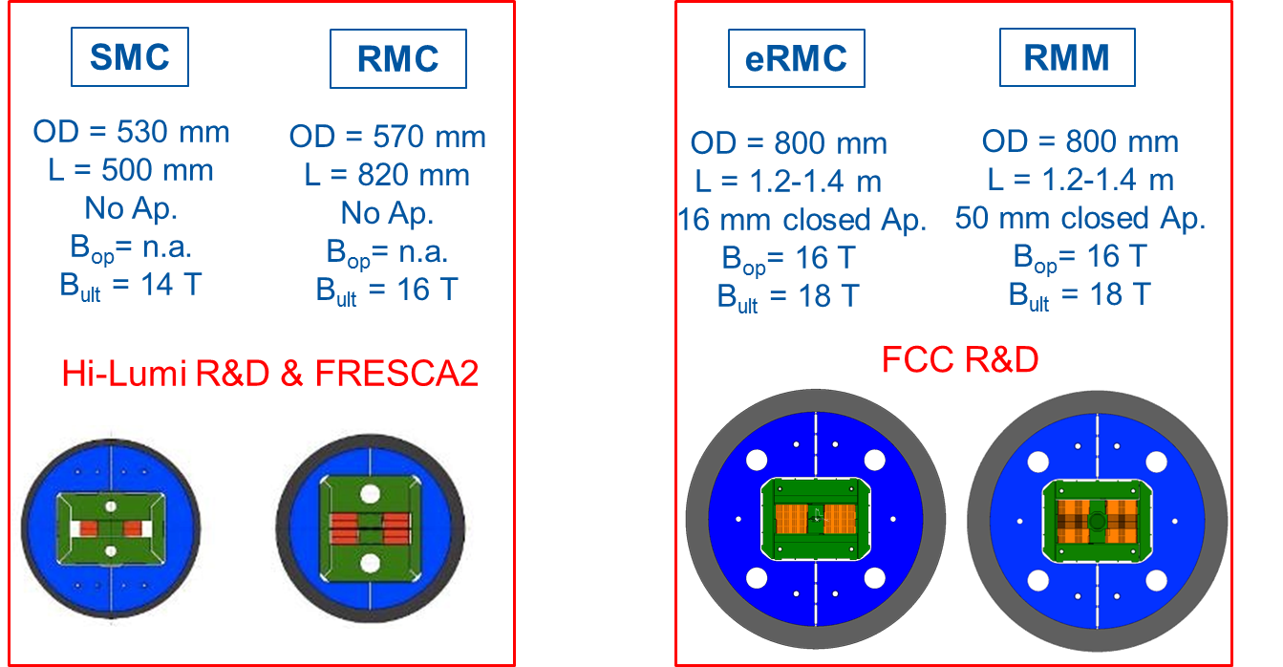
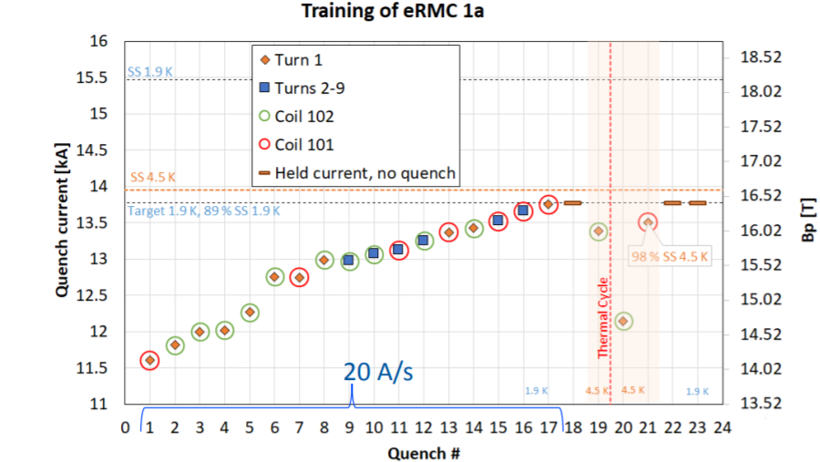
Main Results Hardware: eRMC
The training dI/dt was reduced after quench 17. Then, it reached 13.77 kA (B_{p} 16.5 T)
  The magnet reached 98% of SS at 4.5 K
  Good memory after the thermal cycle: Only one training quench
Test of eRMC planned for mid 2017, test performed beginning of 2020

Slide 7
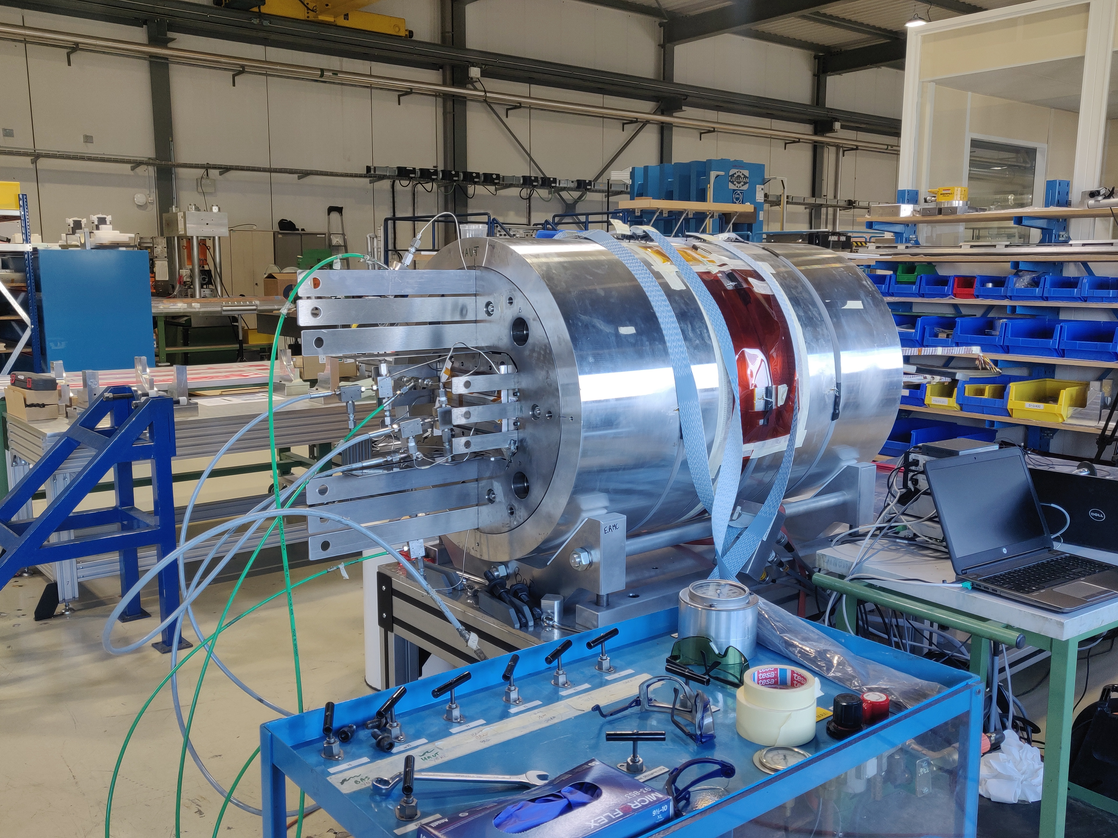
RMM status
Coil mechanical instrumentation is currently finalized
Final loading is foreseen early May

Slide 8
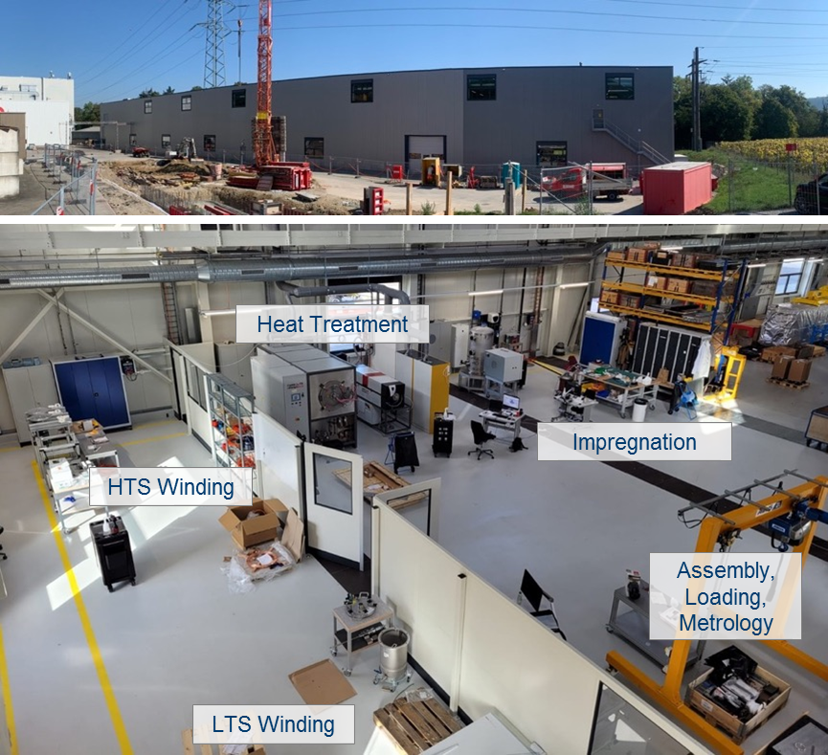
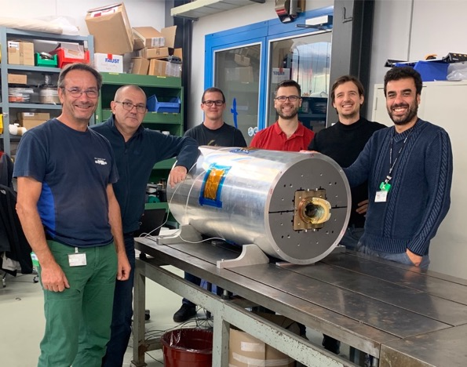
CCT development
Initial idea: stress managed coils, easy to produce (small amount of components), cost effective
First prototypes have shown long training
Subscale CCT Magnets have been developed and a first one has been tested at LBNL, which reproduced training behavior
‘Box’ is used to study training

Slide 9
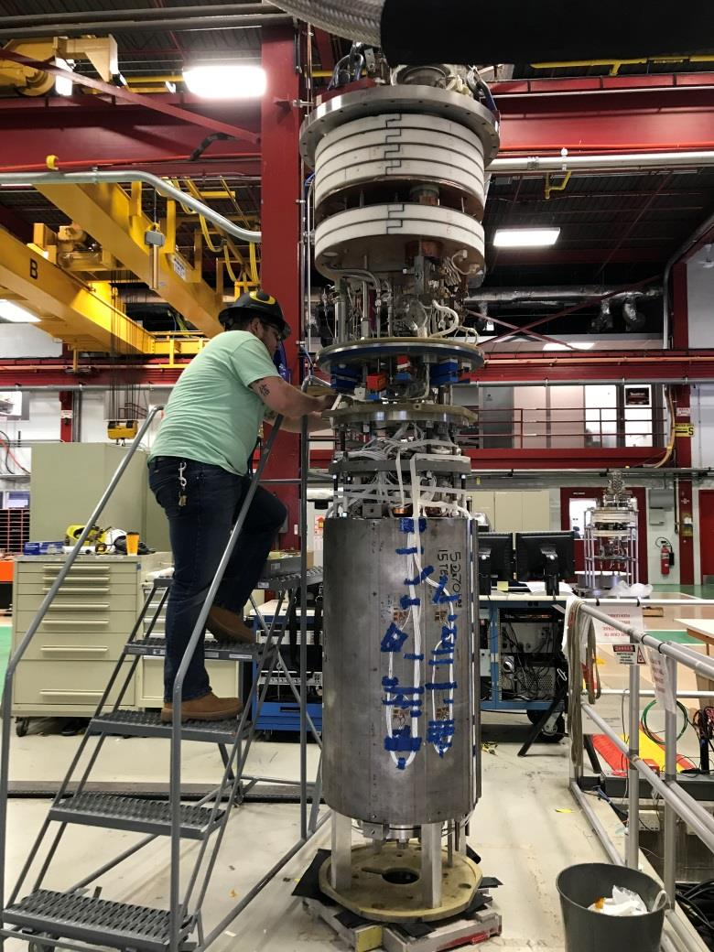
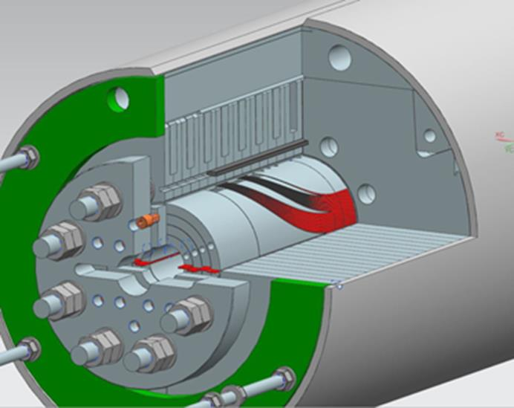
MDPCT1
In the 1st test the magnet has reached 14.1 T at 4.5 K and in the 2nd test 14.5 T at 1.9 K.
At the 3rd test, after a TC, stable reproducible quench currents indicate that the magnet reached its conductor limit at both temperatures with a degradation of 18% with respect to the 2nd test.

Slide 10


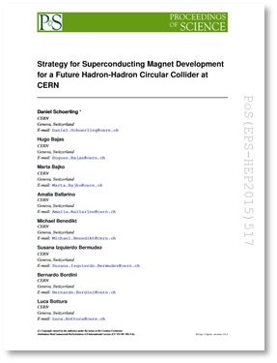
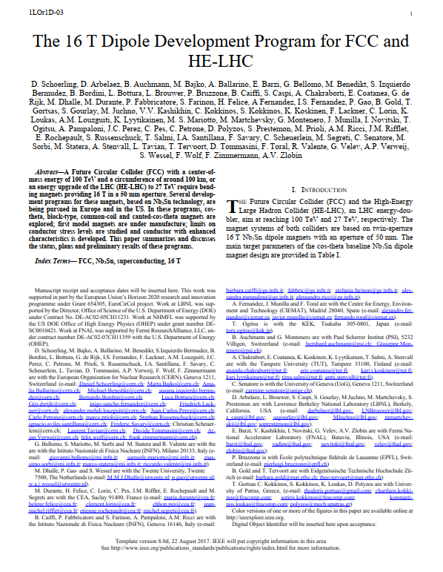
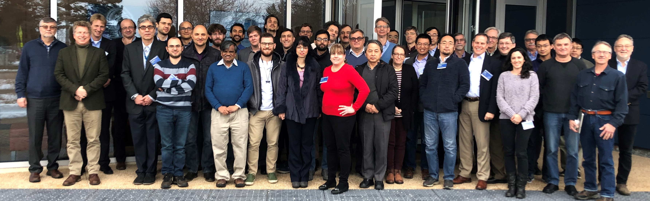

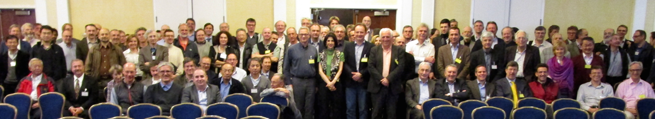



FCC and EuroCirCol (2015 – 2019)
Design efforts for magnets required for FCC-hh were performed in an collaborative effort (D1, D2, triplets, correctors) and defining the parameters together with beam dynamics colleagues (inside and outside CERN) with at least monthly meetings with strong participation from European institutes, US and Japanese colleagues over the entire time span
Wound conductor tests to establish electro-mechanical properties and irreversible degradation limits of Nb₃Sn coils (several publications, PhDs)
Several joint publications (e.g., strategy (2015), cost model (2017), program overview (2019))
Book on all so-far built Nb₃Sn accelerator dipole magnets
KEK

Slide 11
Rationale of the program
In the initial phase explore all design options (coils and structures)
  Use identical field target (16 T), design margins (e.g. 14 % along the loadline) and material properties (as much as possible…)
  Allow a direct comparison of results (e.g. coil mass, peak stress, …)
Build demonstrator model magnets of all variants to identify engineering and performance issues
  Designed for target conductor performance, but built with best available wire
  Go through a progression of complexity (and design field) – start at intermediate field levels of 12 to 14 T
Down-select and define a baseline magnet design and alternatives, as well as nominal and ultimate field level that can be reached
done
In progress
future

Slide 12
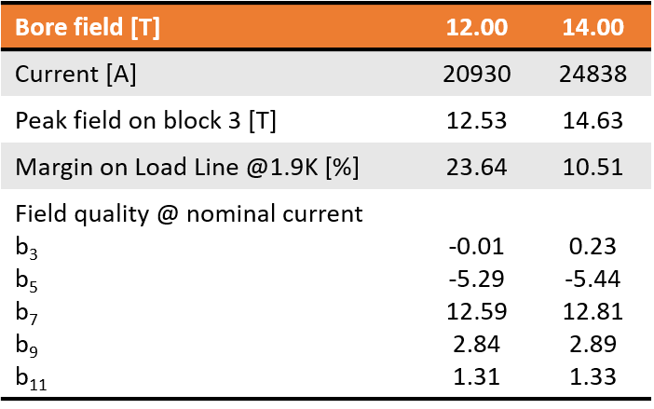
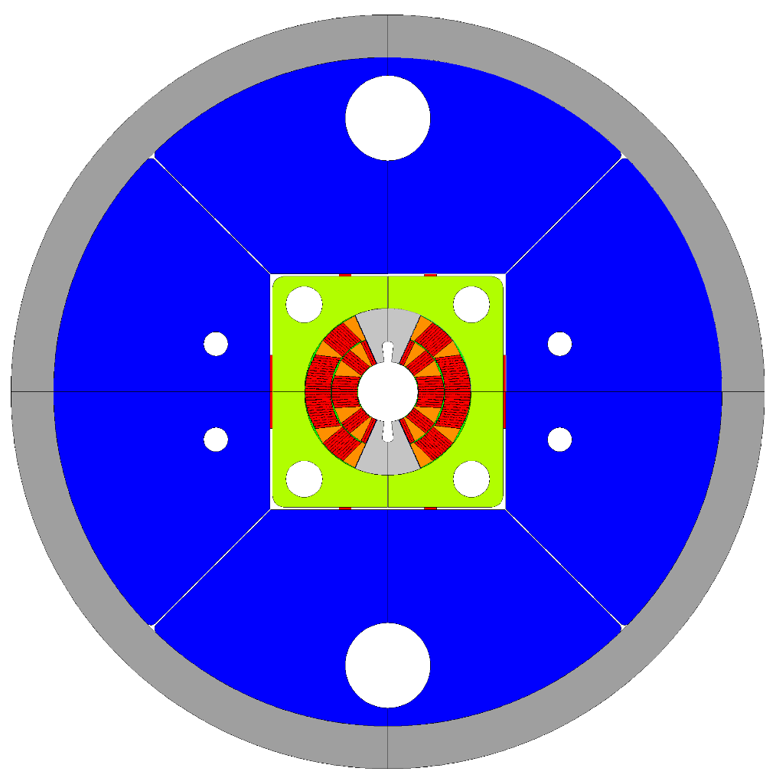
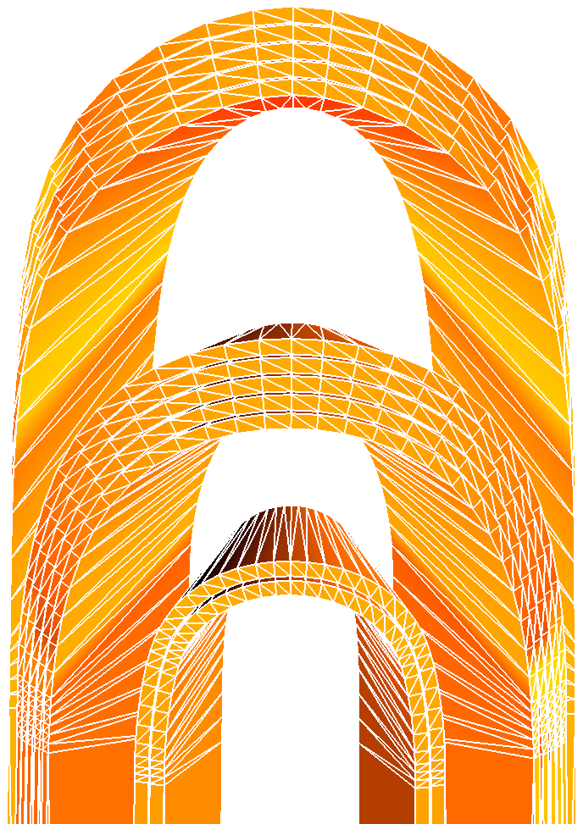

INFN: FalconD
Design at LASA
A total of 6 coils is planned to be manufactured in industry
Assembly at LASA
Test at CERN
650 mm

Slide 13
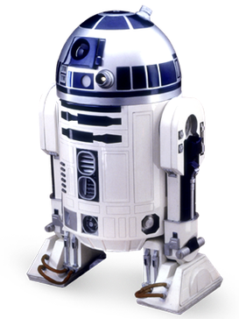
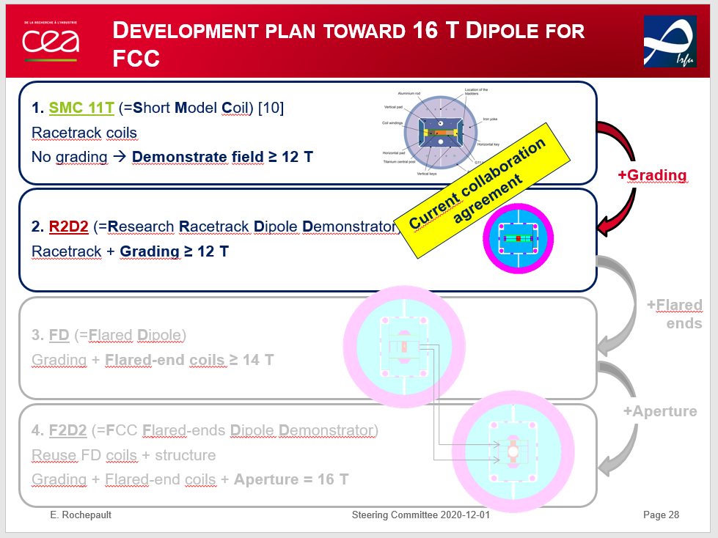
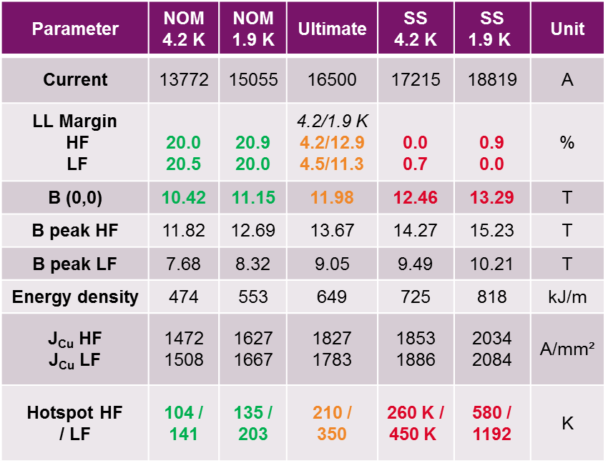
CEA: R2D2 the Research Racetrack Dipole Demonstrator

Slide 14
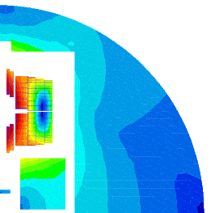
CIEMAT
Magnet Laboratory at CIEMAT
Manufacturing and assembly of ERMC and RMM magnets
Manufacturing of a CIEMAT FCC-hh short dipole model magnet (to be re-discussed)
Conceptual design of a 16 T common coil dipole model for FCC

Slide 15
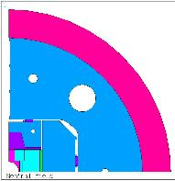
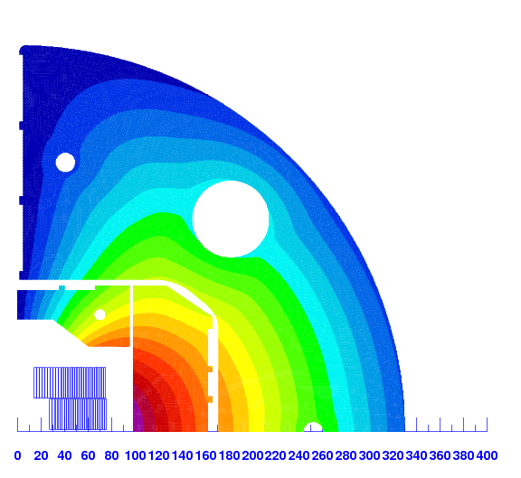
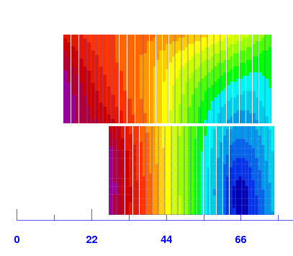
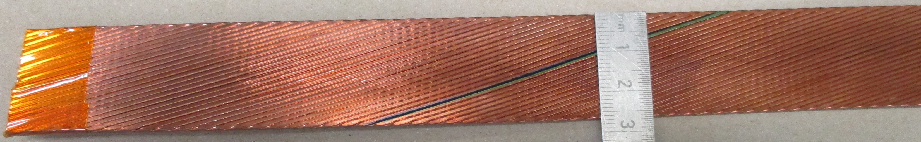
CERN-DEMO16
R= 13.5 mm
R= 34 mm
 |  | Strands | Dstrand | CU/SC | Width | Thickness
 |  | (-) | (mm) | - | (mm) | (mm)
Cable geometry | DEMO HF | 44 | 1.10 | 0.8 | 25.700 | 2.002
 | DEMO LF | 56 | 0.85 | 1.2 | 25.700 | 1.547
DEMO-HF prototype
Courtesy of I. Pong LBNL
S. Izquierdo Bermudez, D. Tommasini
https://indico.cern.ch/event/744064/contributions/3073981/attachments/1686053/2711269/180712_16T_DEMO_LBNLDiscussion.pdf

Slide 16
What was achieved with FCC?
A vibrant collaboration was set-up preforming designs of 16 T magnets
It was the first time, that all design options for Nb3Sn 16 T magnets were compared on paper to each other. It was found that they all have their strengths and weakness. Based on a paper study no decision can be taken, which magnet design is best.
A detailed conceptual design report for FCC-hh was prepared which includes conceptual designs for the main FCC magnets (dipoles, quadrupoles, lattice sextupoles, octupoles and interaction region magnets)
Collaboration agreements for building up the infrastructure and for building 12-16 T magnets at 4 national labs have been signed:
  Start-up phase of this collaboration agreements is slow
  The scope of the agreements has been realigned, mainly to ~12 T magnets
  Lab build up and knowledge transfer from CERN has started for some of the collaboration agreements
  According to the current plan, in my estimate earliest in 3-7+ years, ~12 T, 1 m long prototypes (CCT, cos-theta, block, and common coil will be manufactured)
The activity performed within the FCC framework has also given important inputs to the HL-LHC projects, for example in the understanding of the importance of the transversal pressure, both at warm and at cold
Important achievements on the conductor program (CERN FCC program to qualify more companies, FCC J_{c} target reached by MDP)

Slide 17



Some quotes: still true today?

Slide 18
What is crucial and would truly make a difference ?
Resources for building magnet coils (~1 m long) are limited to a few coils/institute. Therefore, the technology has to be developed and tested with appropriate small tests/mock-up tests before the construction of these coils. Development is needed
Initiatives like the PSI ‘box’ for studying interfaces, dedicated joint testing and also the mechanical tests on cable samples and 10-stacks, and mock-up tests currently performed at CERN are important. Making best use of available testing infrastructure
To continue direction, establishing test beds with reduced turnaround times, to investigate observed limitations in processing Nb₃Sn magnets
Review all production steps and procedures (winding, curing, heat-treatment, impregnation, cold mass assembly) and optimizing these steps towards robustness is crucial
Conductor optimization (like for example the initiative to increase c_{p}) are important, mechanical optimization might be also possible
A revival of a platform allowing to exchange ideas on expert level and to disseminate knowledge is key for success (this workshop is a great first step!)

Slide 19
Future of HFM Development
Functional Specification
Push Nb₃Sn magnet technology to its practical limit, both in terms of maximum performance as well as production scale
  1. Develop Nb₃Sn magnets for collider-scale production, through robust design, industrial processes and cost reduction
  2. Demonstrate Nb₃Sn full potential in terms of ultimate performance
Provide a proof-of-principle for HTS magnet technology beyond the reach of Nb₃Sn, and sufficient field quality for accelerator application
Concrete applications provide the opportunity to refine the functional specification for high-field magnets, including concerns around field quality requirements, ramping time and aperture form and diameter.
System Engineering
Magnet project
Conductor & Cabling
Insulation System
Splicing &
Instrumentation
Production process optimizat.
Material character-ization
Electro-magnetic analysis
Engi-neering design
Mech. analysis

