Slide 1
Solenoids in MADX and SAD
Leon van Riesen-Haupt, Rogelio Tomas, Katsunobu Oide, Helmut Burkhardt, Tobias Persson

Slide 2
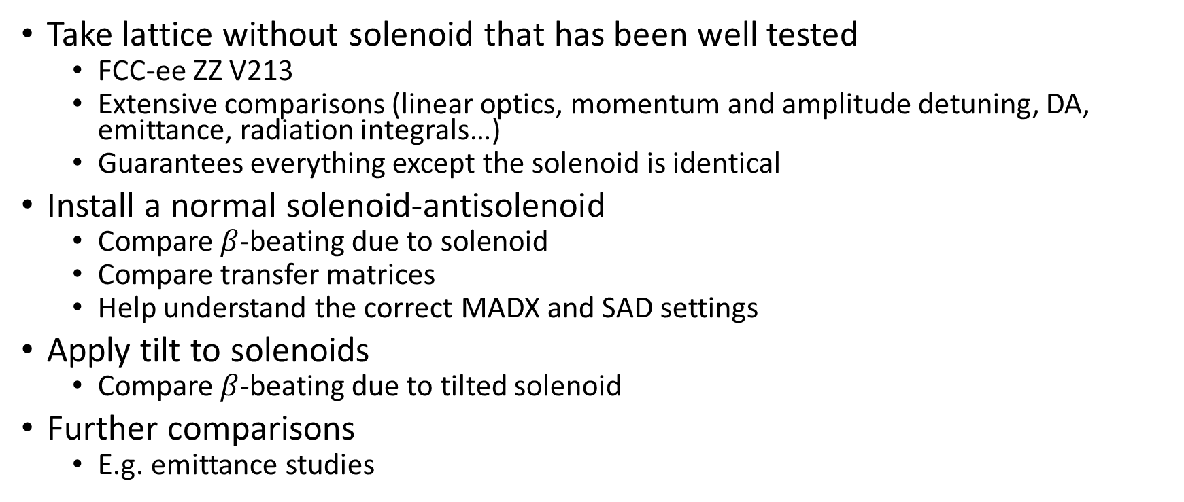
Strategy
Take lattice without solenoid that has been well tested
  FCC-ee ZZ V213
  Extensive comparisons (linear optics, momentum and amplitude detuning, DA, emittance, radiation integrals…)
  Guarantees everything except the solenoid is identical
Install a normal solenoid-antisolenoid
  Compare $β$-beating due to solenoid
  Compare transfer matrices
  Help understand the correct MADX and SAD settings
Apply tilt to solenoids
  Compare $β$-beating due to tilted solenoid
Further comparisons
  E.g. emittance studies

Slide 3
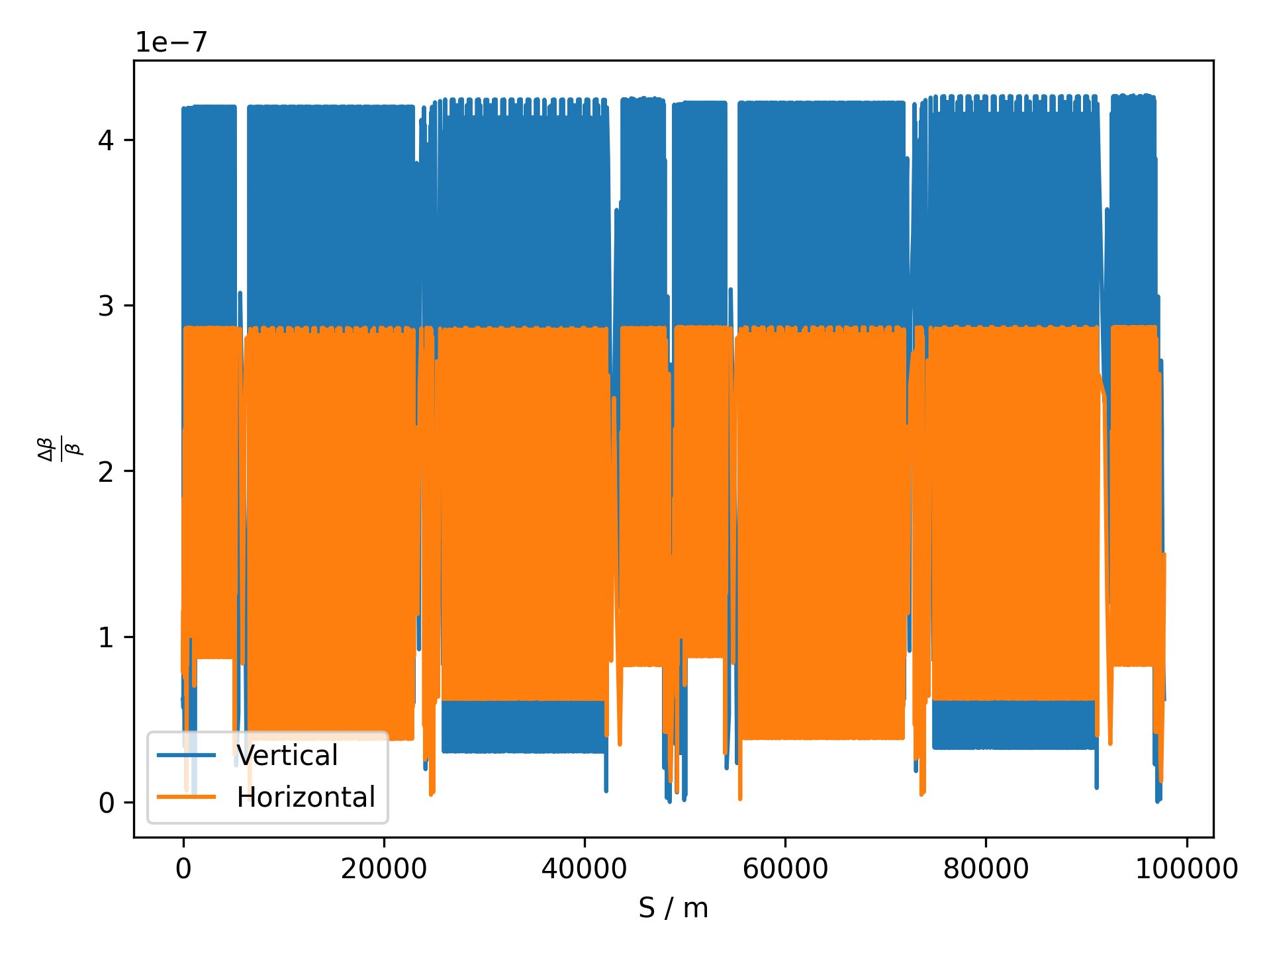
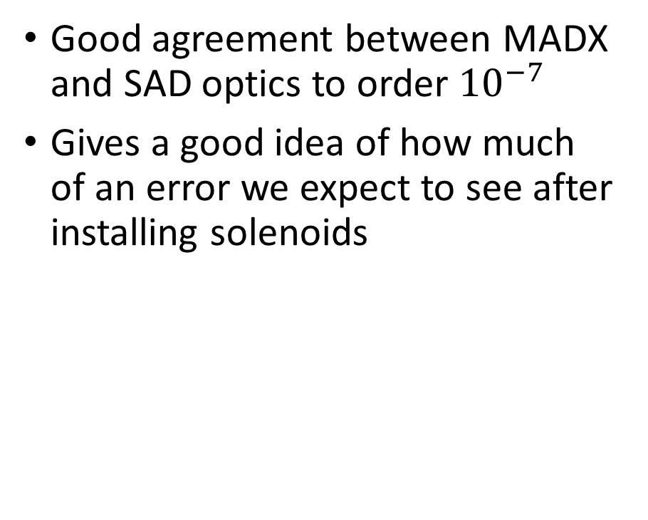

Baseline Lattice
Difference in $β$-functions in MADX and SAD
Good agreement between MADX and SAD optics to order ${10}^{−7}$
Gives a good idea of how much of an error we expect to see after installing solenoids

Slide 4
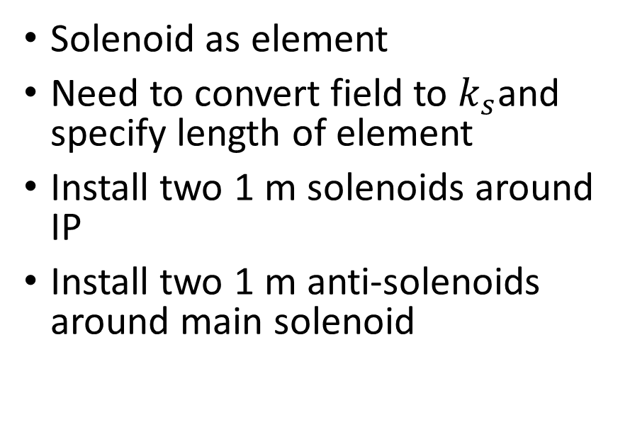
Installing Solenoids
MADX
SAD
Solenoid as element
Need to convert field to $k_{s}$and specify length of element
Install two 1 m solenoids around IP
Install two 1 m anti-solenoids around main solenoid
Solenoid markers define where longitudinal field changes
Specify absolute field (in T)
One marker at the IP defining solenoid field
Next marker at interface of solenoid/anti-solenoid
Final marker at exit of antisolenoid

Slide 5
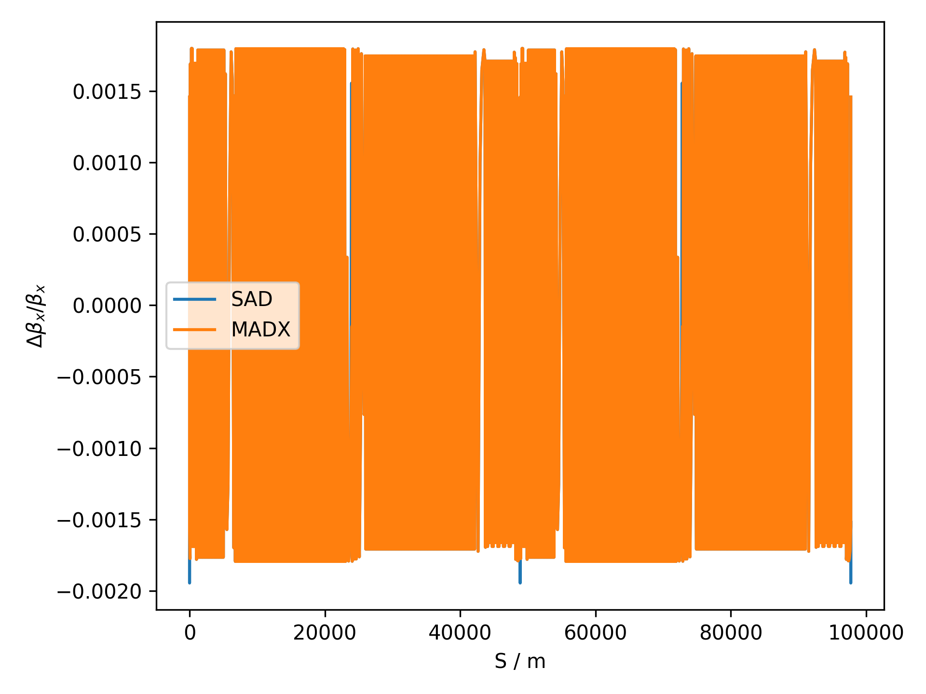
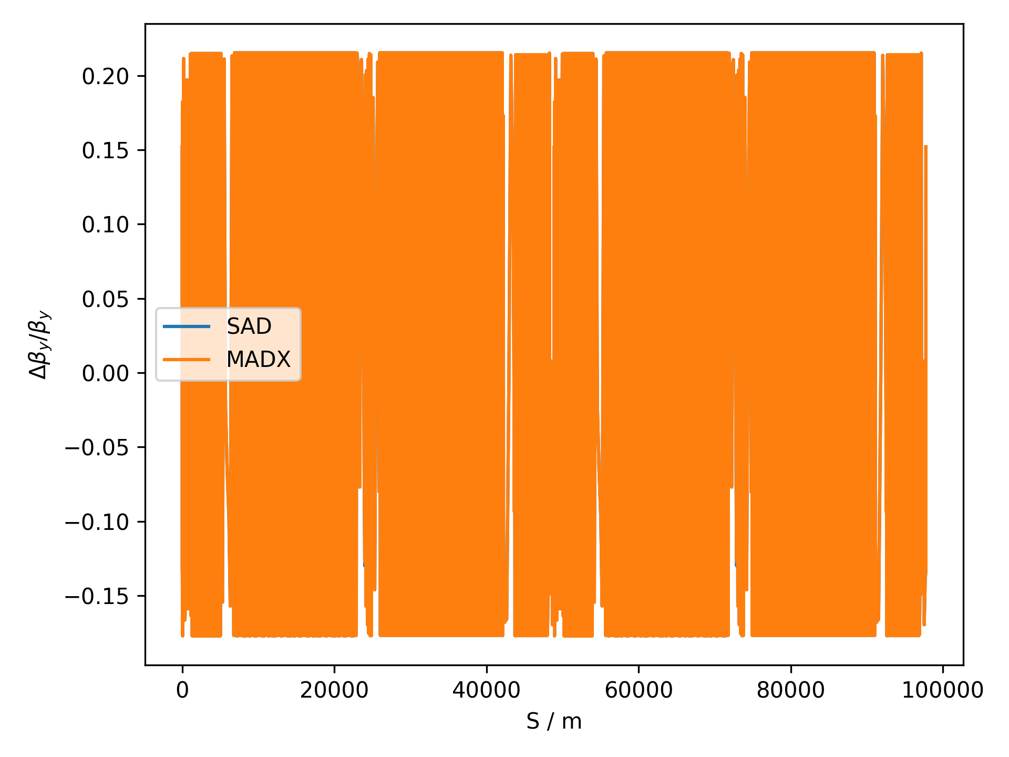

Change in $β$-functions due to Solenoid

Slide 6
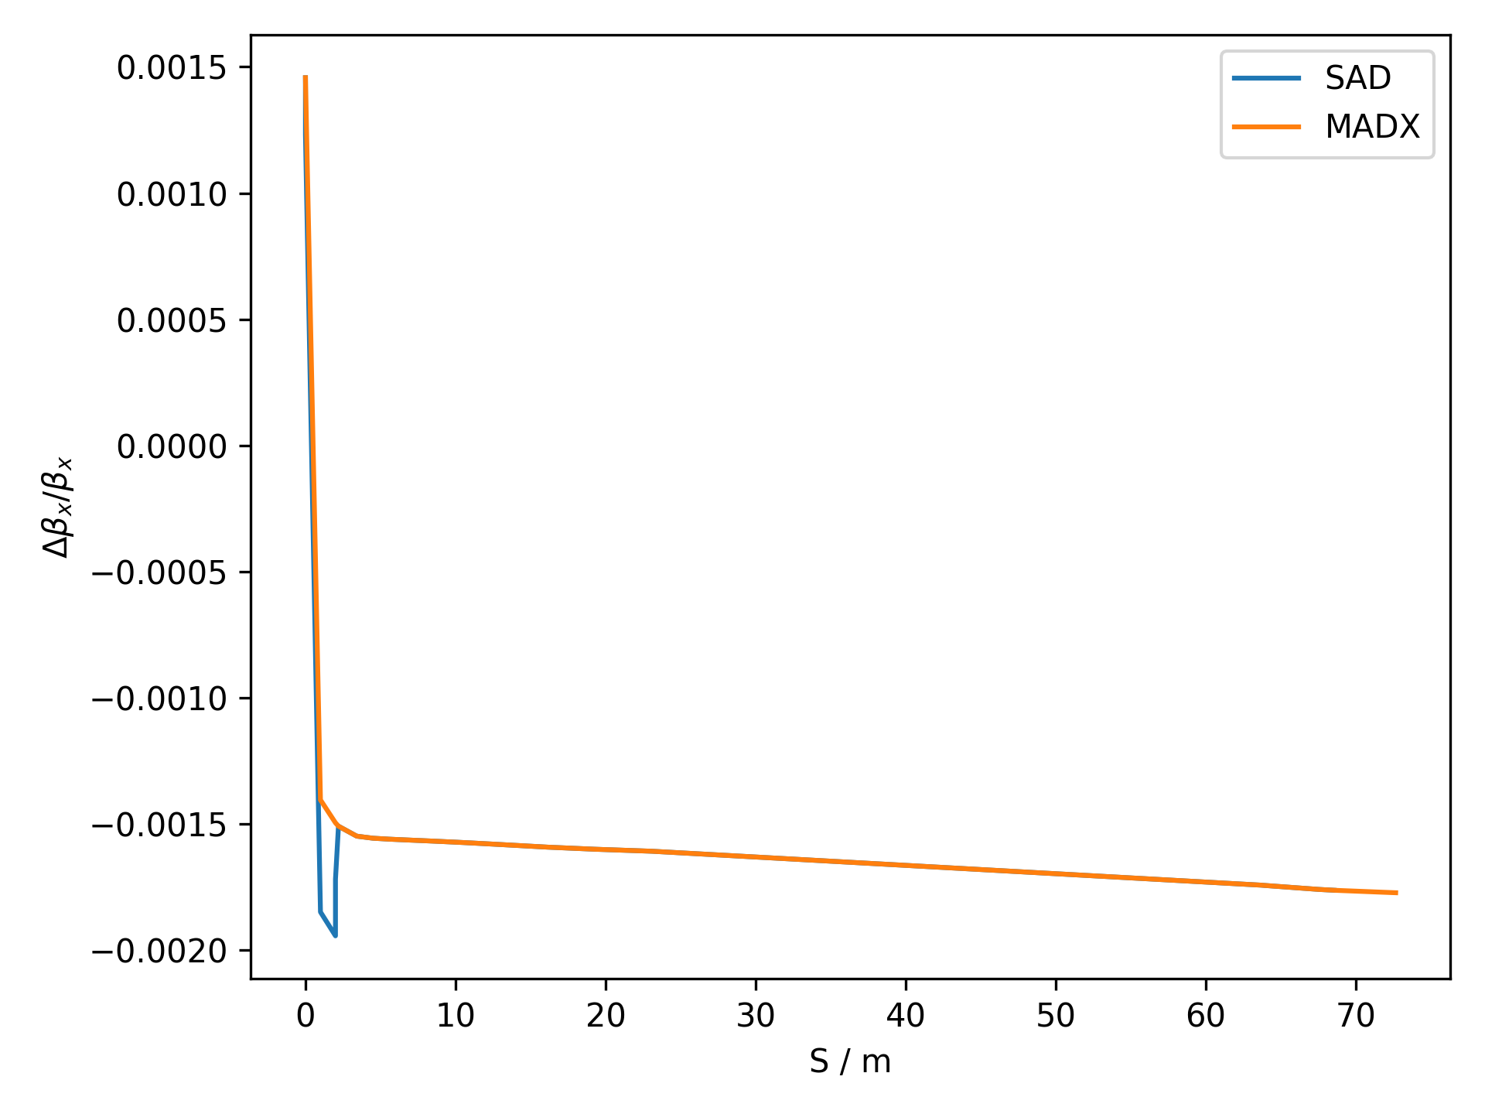
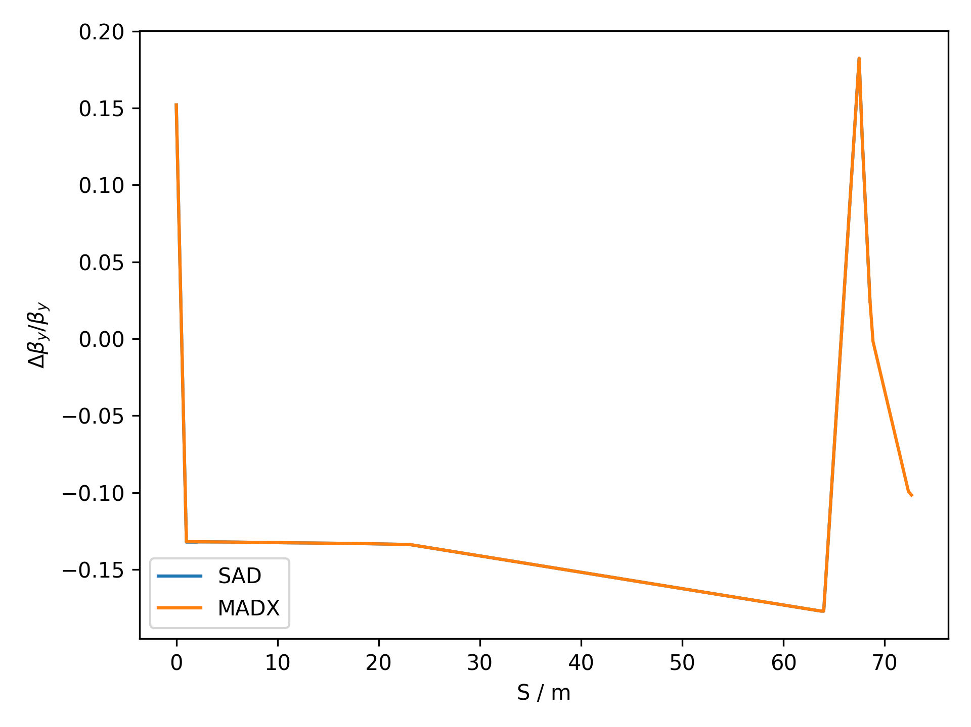
Zoomed In
Small geometry difference to reference lattice (see next slide)

Slide 7
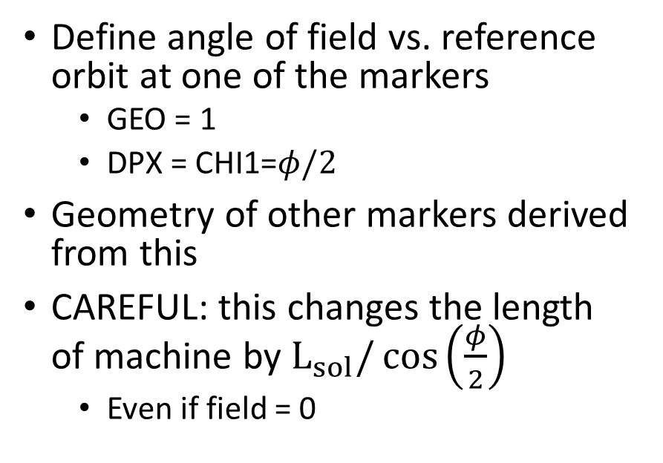
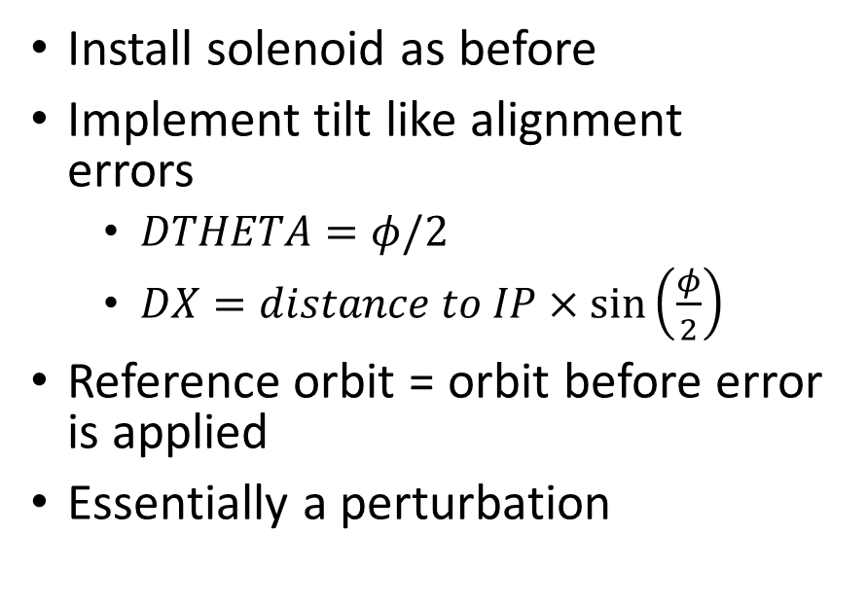
Tilting the Solenoid
MADX
SAD
Install solenoid as before
Implement tilt like alignment errors
  $DTHETA=φ/2$
  $DX=distance to IP×\sin\left(\frac{φ}{2}\right)$
Reference orbit = orbit before error is applied
Essentially a perturbation
Define angle of field vs. reference orbit at one of the markers
  GEO = 1
  $\text{DPX}\text{ = }\text{CHI}\text{1=}φ/2$
Geometry of other markers derived from this
CAREFUL: this changes the length of machine by $L_{sol}{/\cos\left(\frac{φ}{2}\right)}$
  Even if field = 0

Slide 8
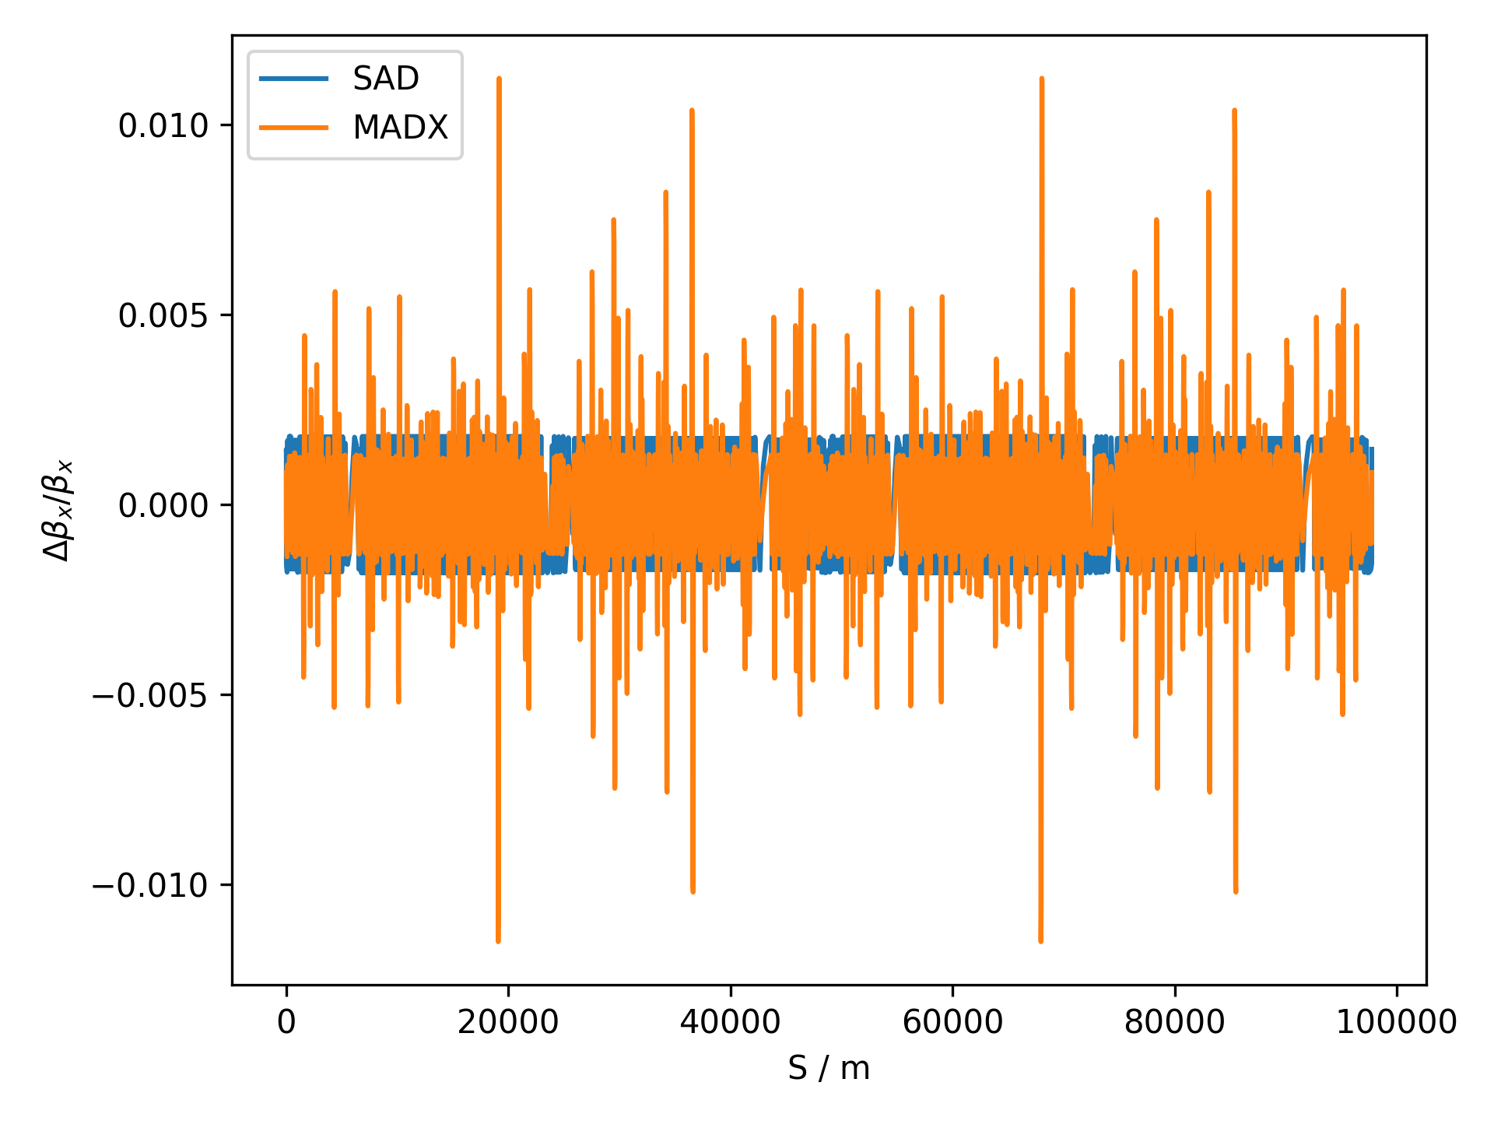
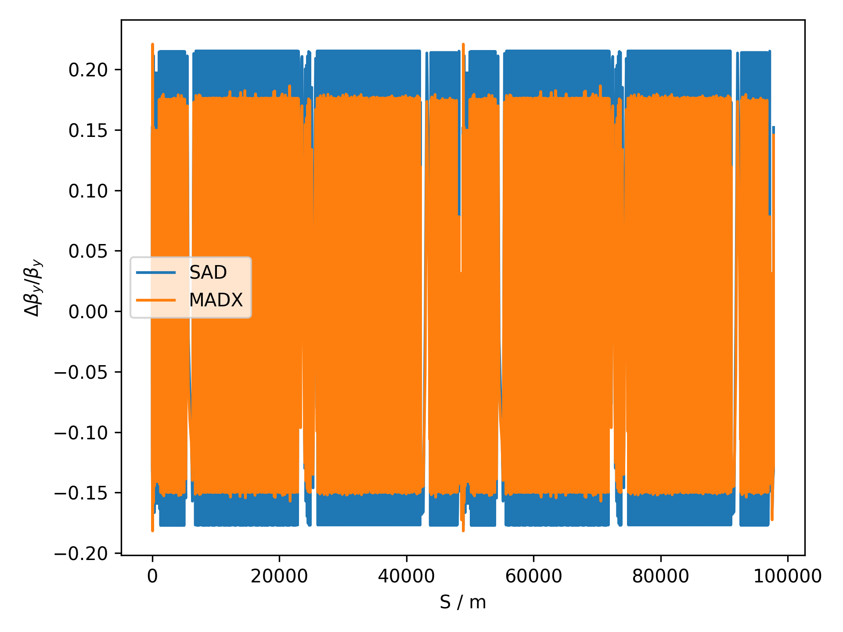

Change in $β$-functions due to tilted Solenoid

Slide 9
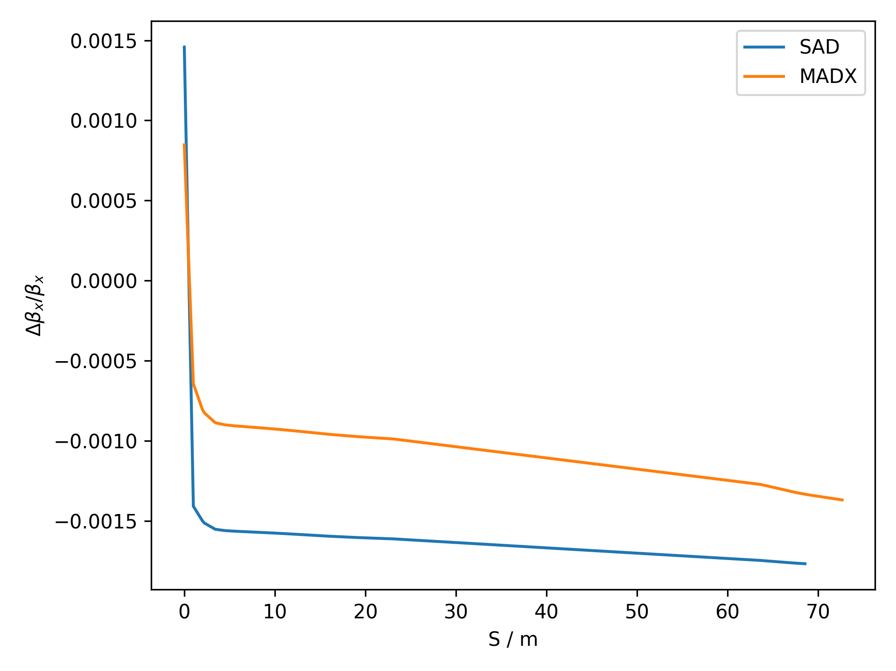
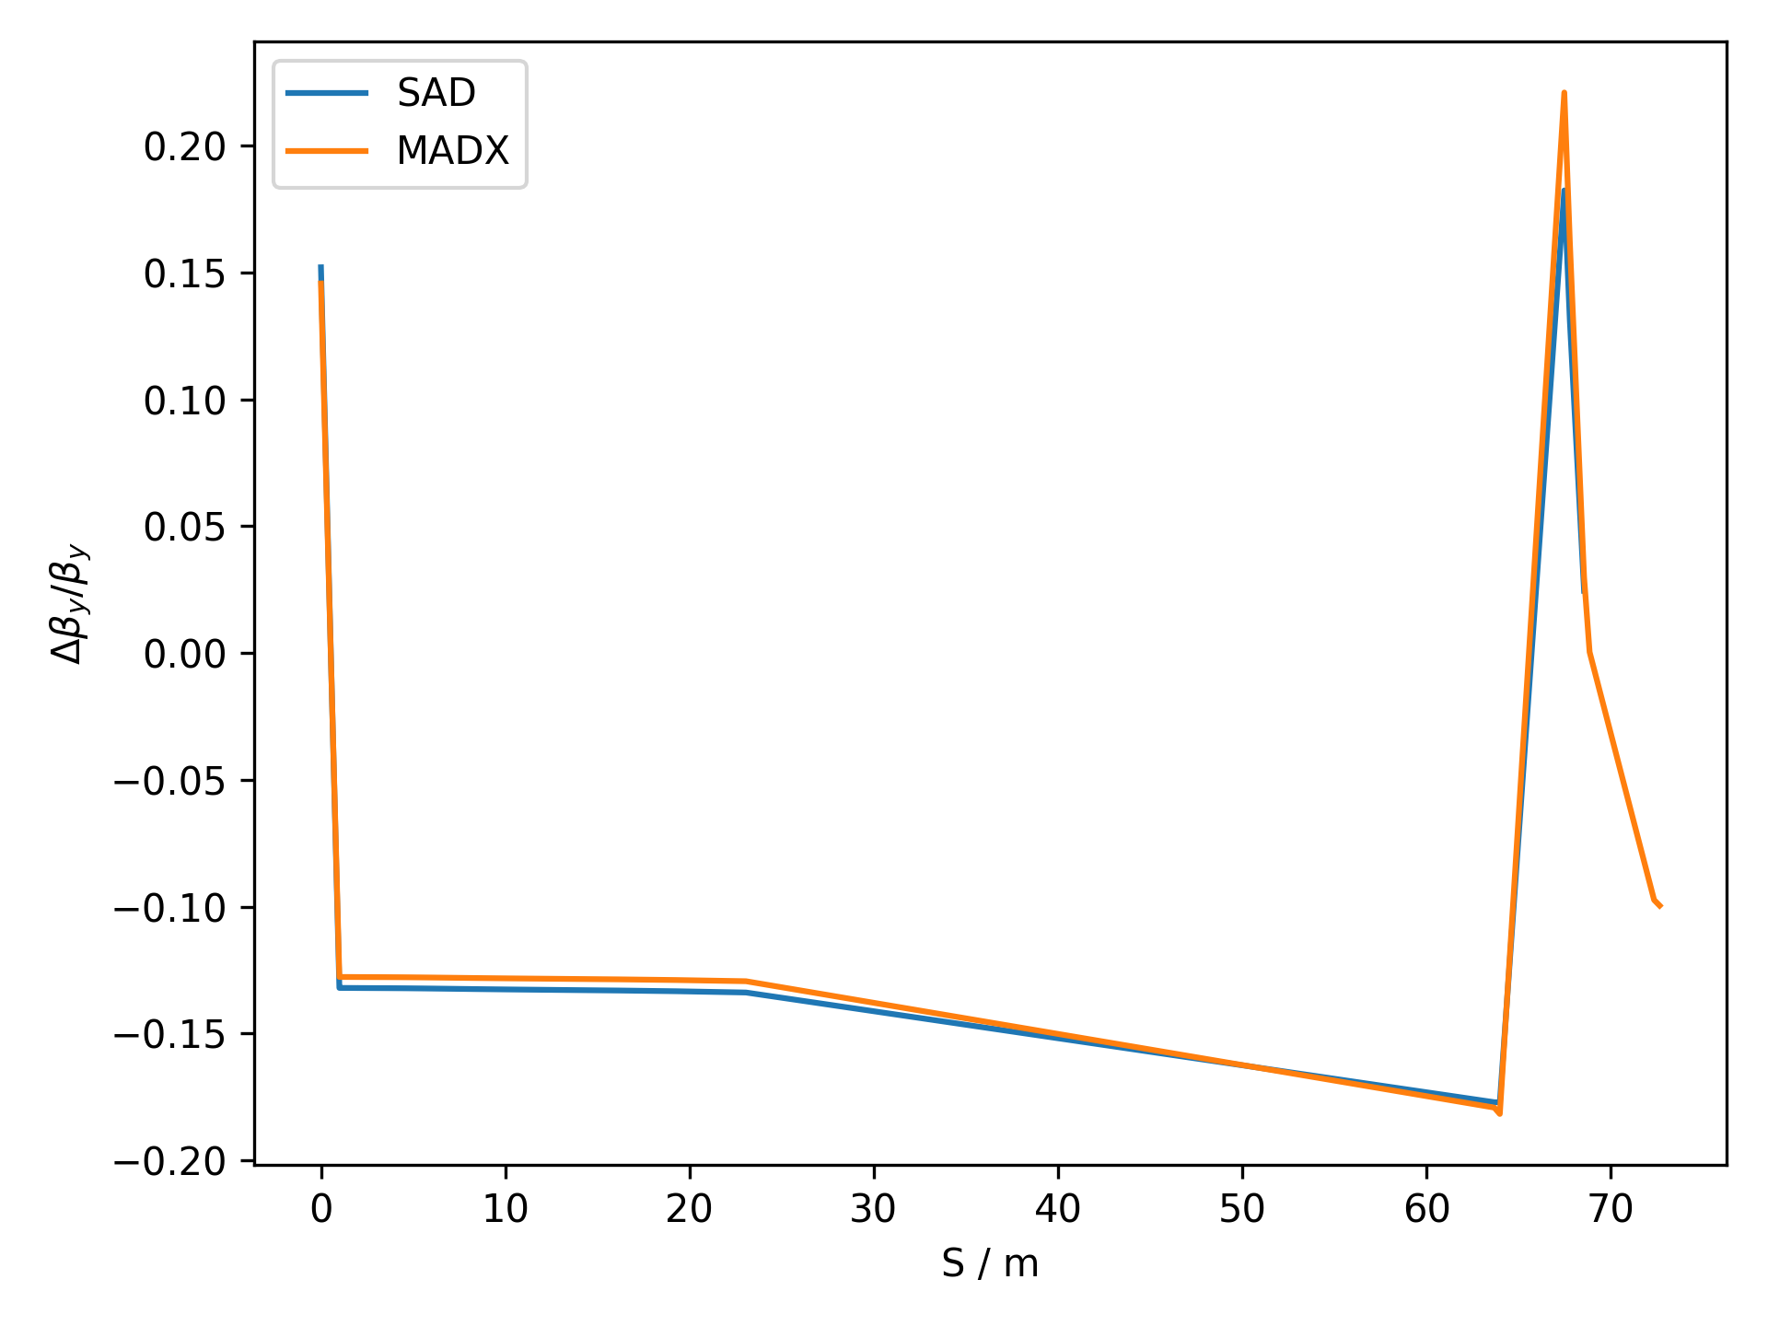
Zoomed In

Slide 10
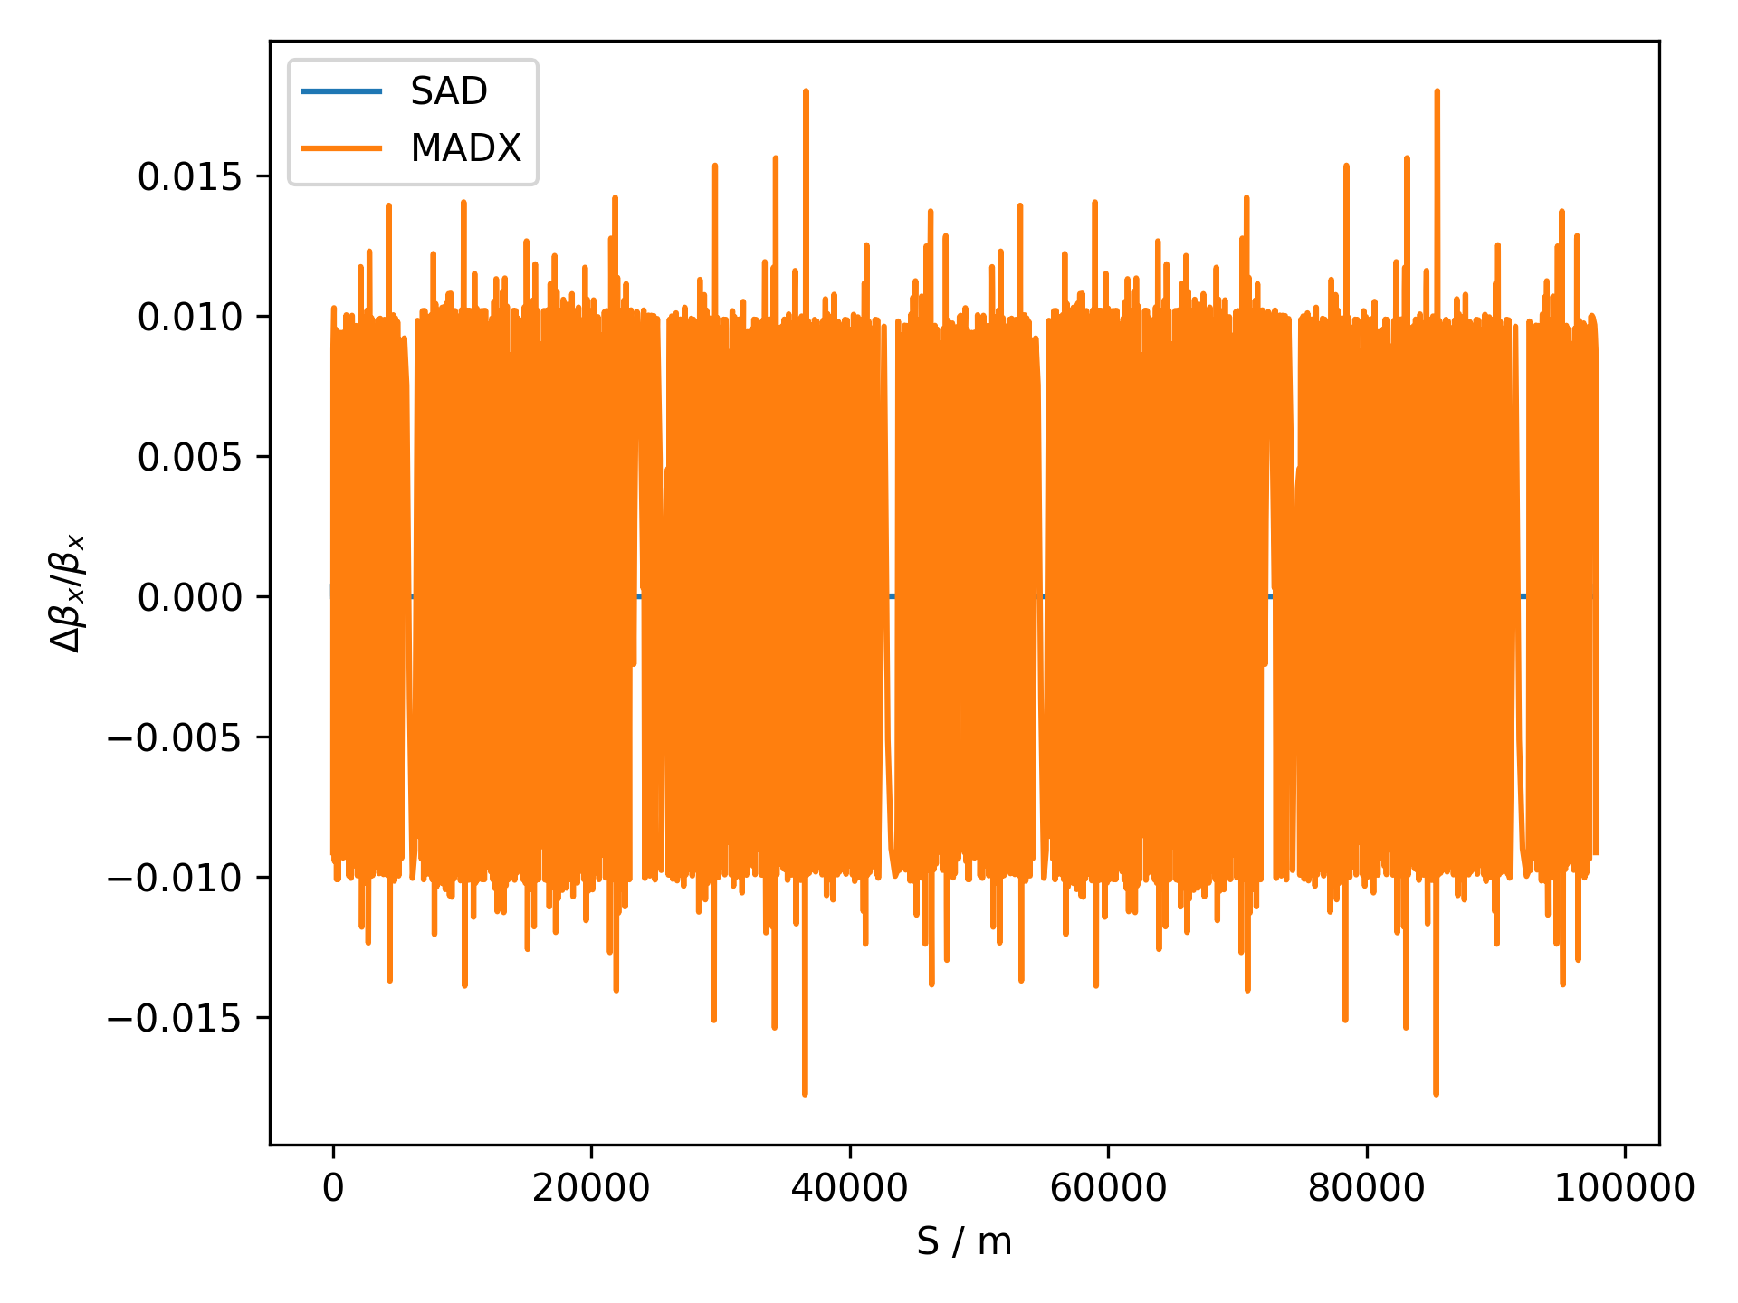
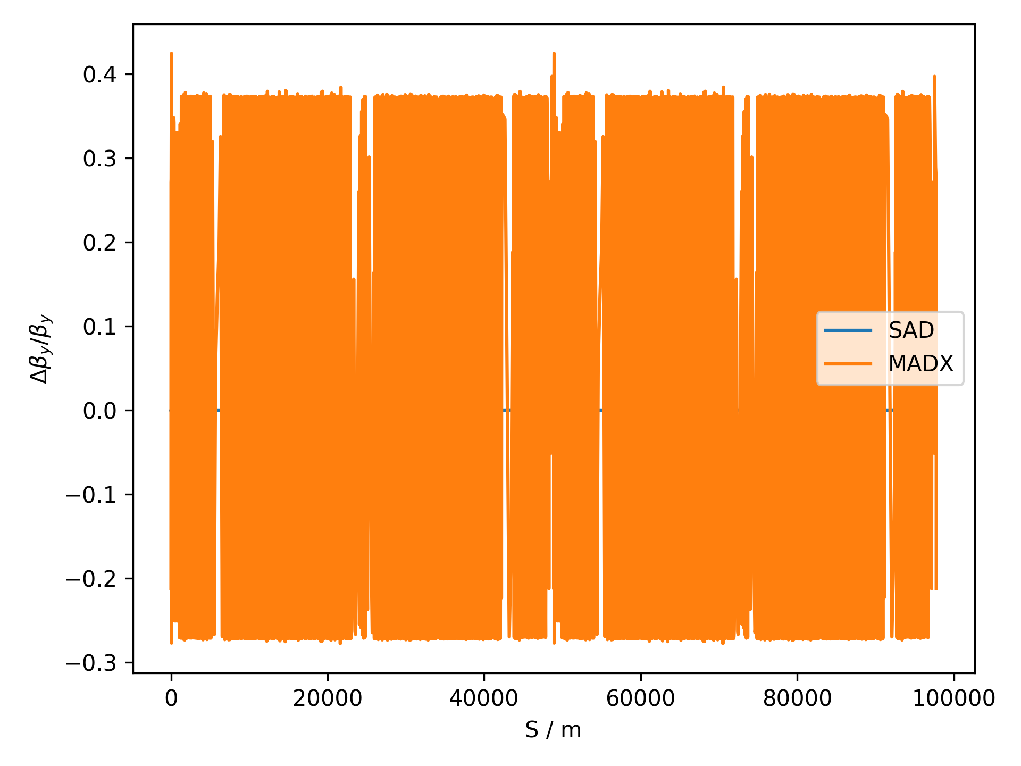
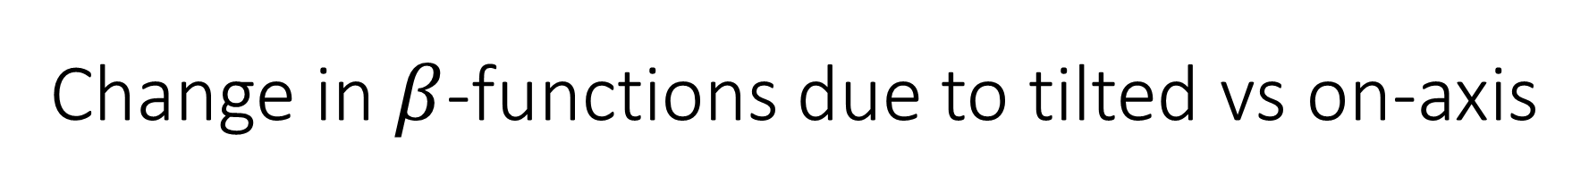
Change in $β$-functions due to tilted vs on-axis

Slide 11
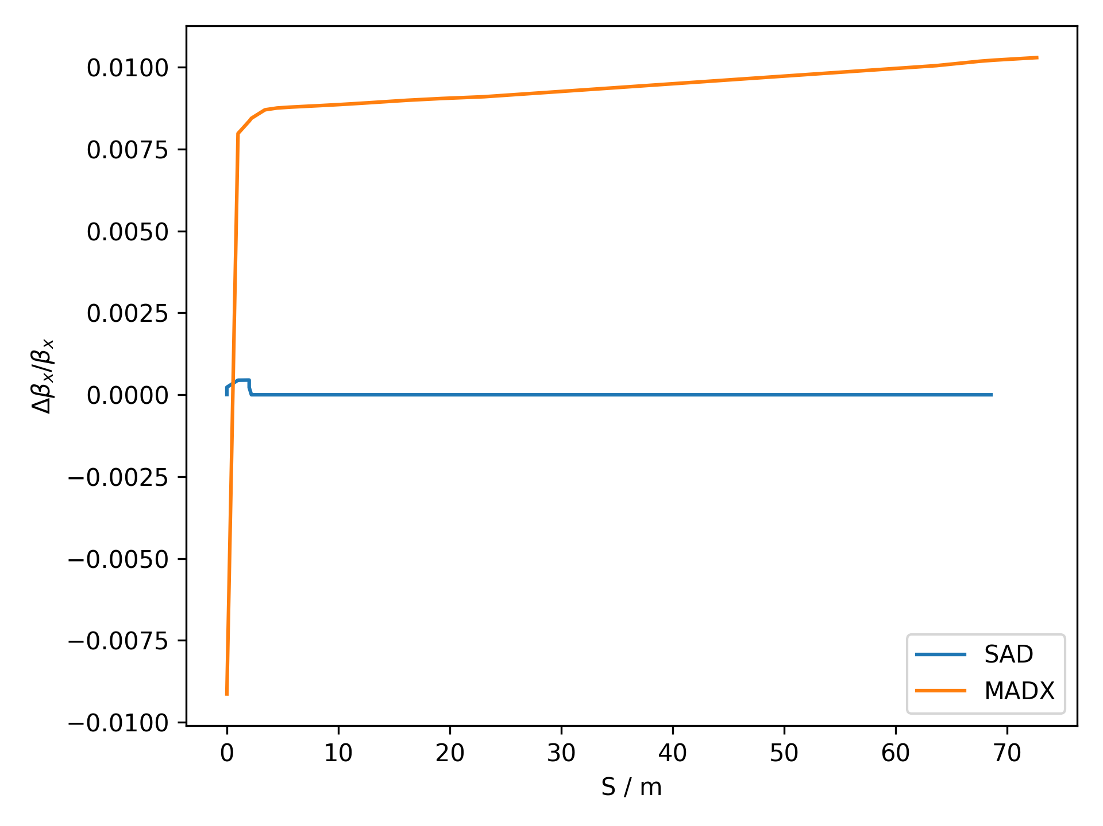
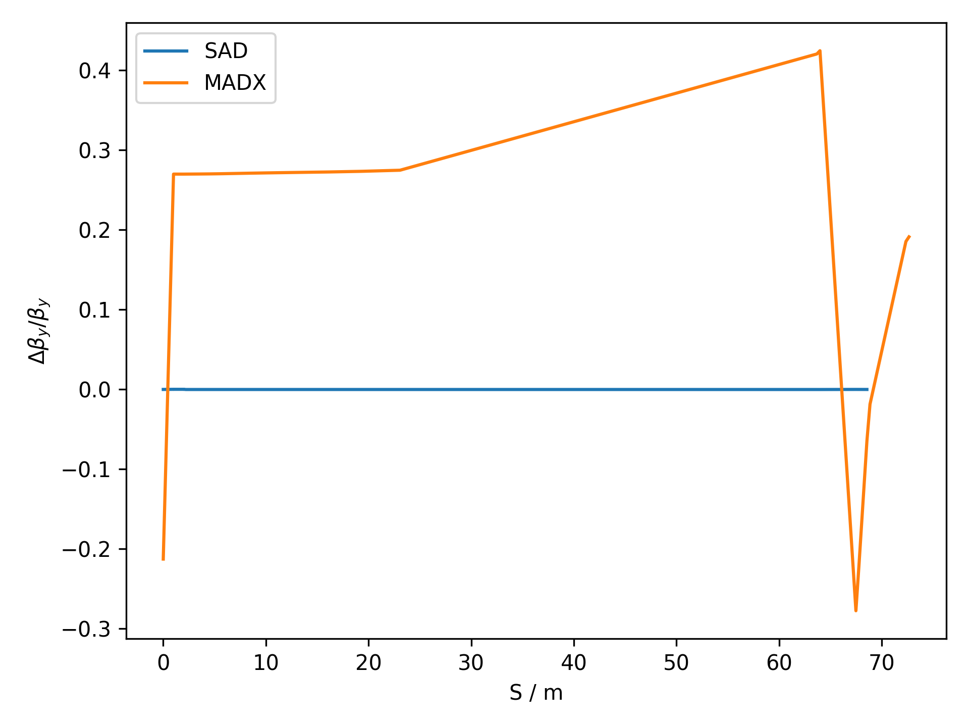
Zoomed In

Slide 12
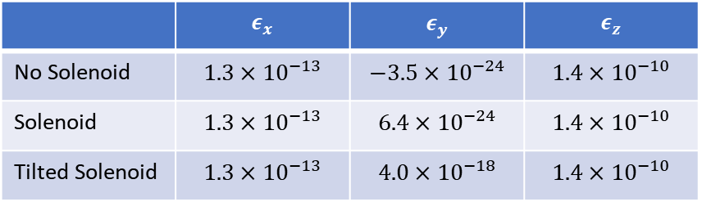
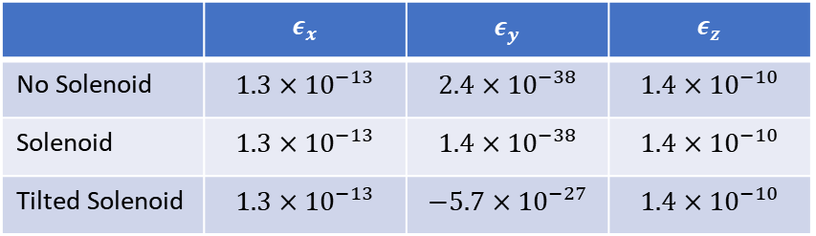
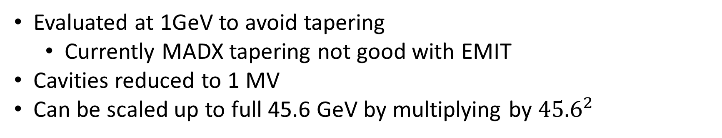
Emittance
Evaluated at 1GeV to avoid tapering
  Currently MADX tapering not good with EMIT
Cavities reduced to 1 MV
Can be scaled up to full 45.6 GeV by multiplying by ${45.6}^{2}$
MADX
SAD
 | $$ε_{x}$$ | $$ε_{y}$$ | $$ε_{z}$$
No Solenoid | $$1.3×{10}^{−13}$$ | $$2.4×{10}^{−38}$$ | $$1.4×{10}^{−10}$$
Solenoid | $$1.3×{10}^{−13}$$ | $$1.4×{10}^{−38}$$ | $$1.4×{10}^{−10}$$
Tilted Solenoid | $$1.3×{10}^{−13}$$ | $$−5.7×{10}^{−27}$$ | $$1.4×{10}^{−10}$$
 | $$ε_{x}$$ | $$ε_{y}$$ | $$ε_{z}$$
No Solenoid | $$1.3×{10}^{−13}$$ | $$−3.5×{10}^{−24}$$ | $$1.4×{10}^{−10}$$
Solenoid | $$1.3×{10}^{−13}$$ | $$6.4×{10}^{−24}$$ | $$1.4×{10}^{−10}$$
Tilted Solenoid | $$1.3×{10}^{−13}$$ | $$4.0×{10}^{−18}$$ | $$1.4×{10}^{−10}$$

Slide 13
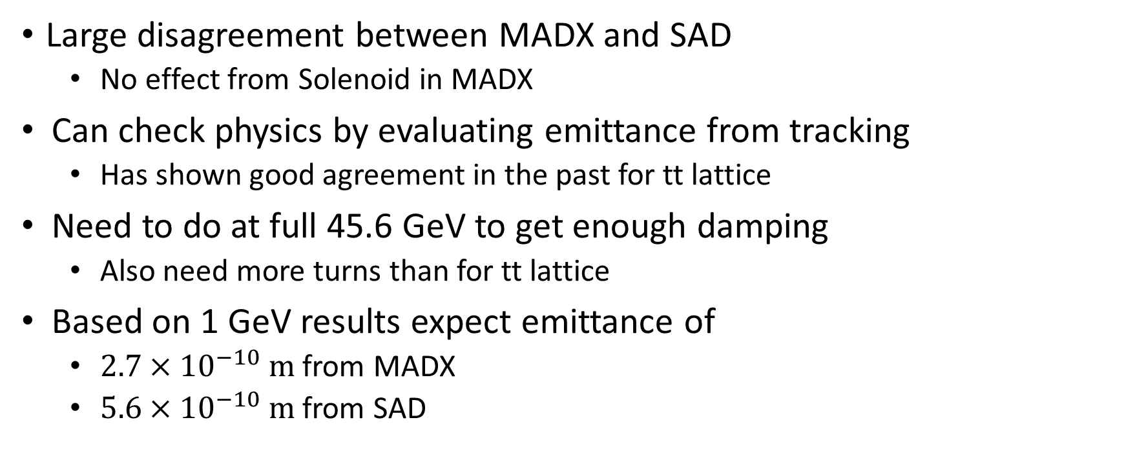
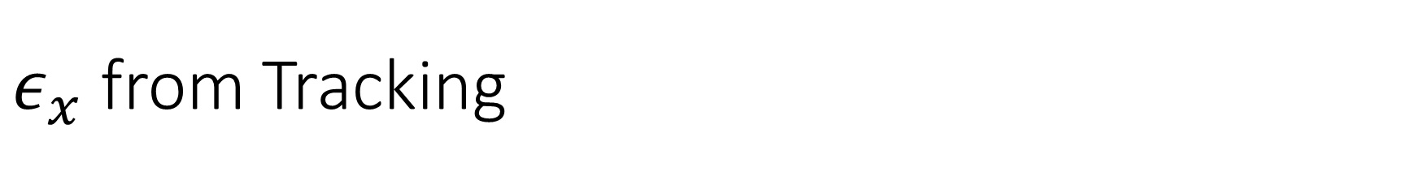
$ε_{x}$ from Tracking
Large disagreement between MADX and SAD
  No effect from Solenoid in MADX
Can check physics by evaluating emittance from tracking
  Has shown good agreement in the past for tt lattice
Need to do at full 45.6 GeV to get enough damping
  Also need more turns than for tt lattice
Based on 1 GeV results expect emittance of
  $2.7×{10}^{−10} m$ from MADX
  $5.6×{10}^{−10} m$ from SAD

Slide 14
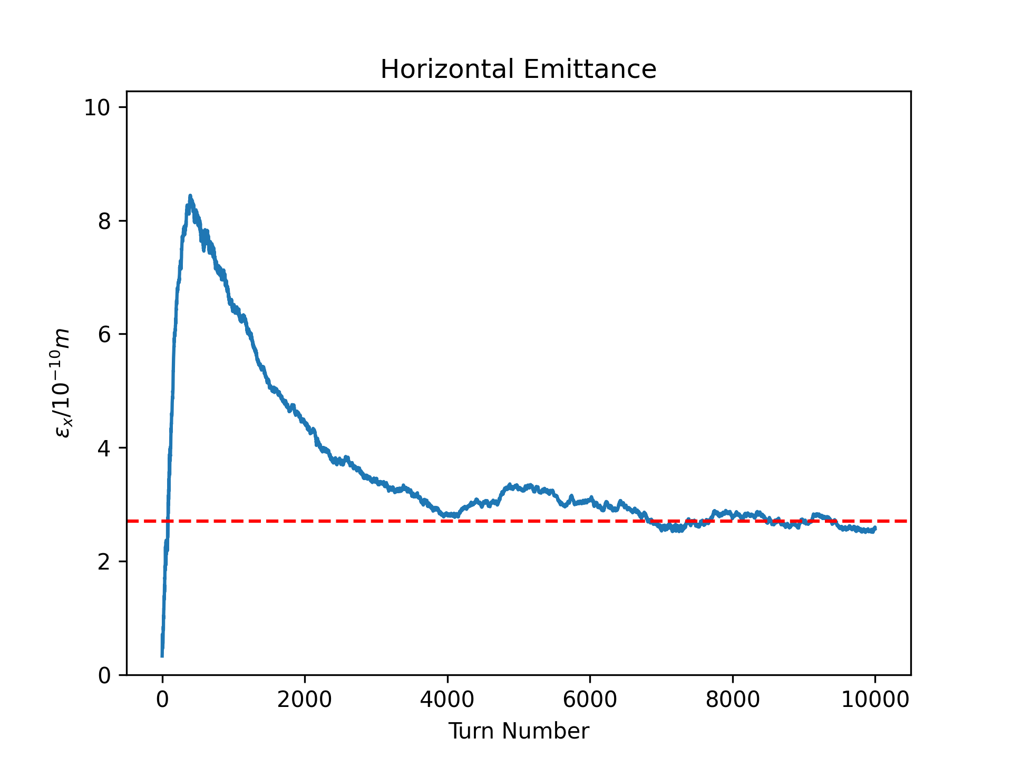
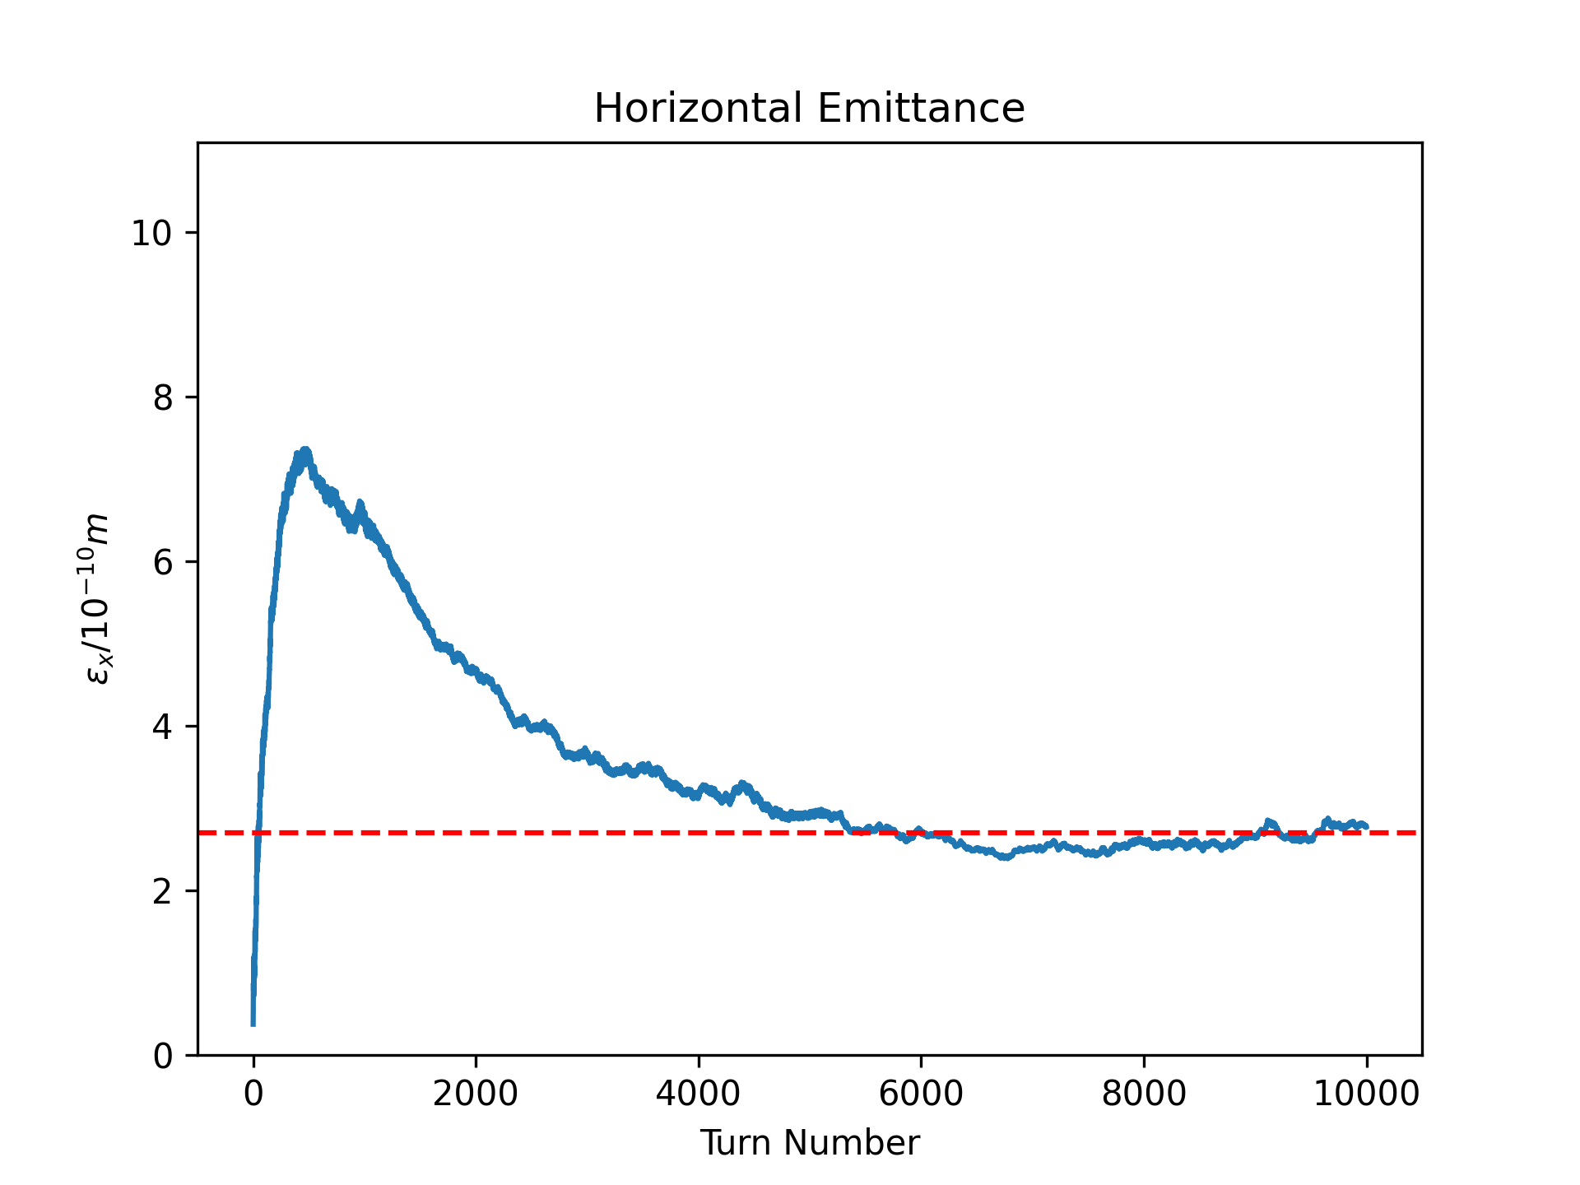
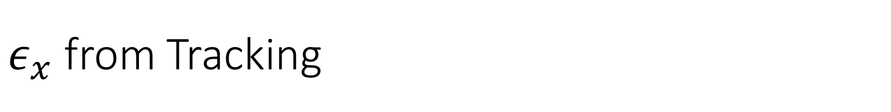
$ε_{x}$ from Tracking
MADX
SAD

Slide 15
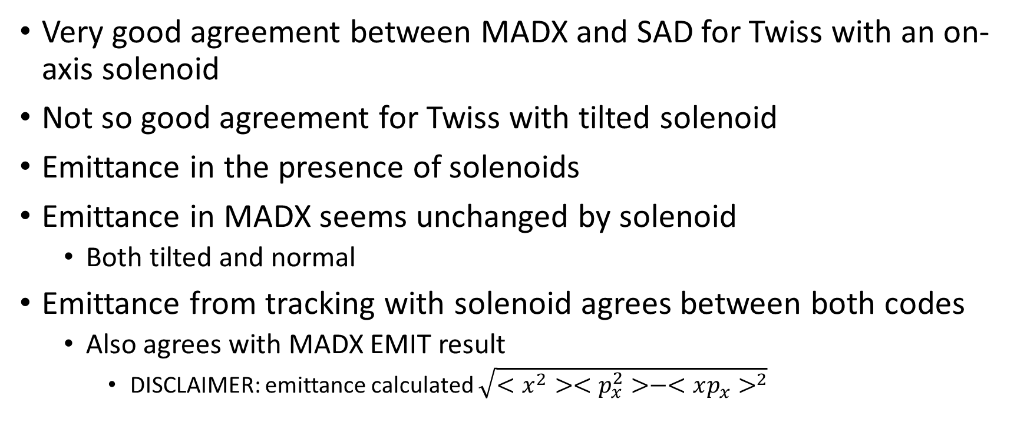
Conclusions
Very good agreement between MADX and SAD for Twiss with an on-axis solenoid
Not so good agreement for Twiss with tilted solenoid
Emittance in the presence of solenoids
Emittance in MADX seems unchanged by solenoid
  Both tilted and normal
Emittance from tracking with solenoid agrees between both codes
  Also agrees with MADX EMIT result
    DISCLAIMER: emittance calculated $\sqrt{<x^{2}><p_{x}^{2}>−<xp_{x}>^{2}}$

