Slide 1

FFIELD for non linear fringe field of Detector Solenoids ?
March 2021
B. Dalena¹, T. Pugnat¹, A. Simona², L. Bonaventura² (¹IRFU/DACM,²MOX) Thanks to: R. De Maria, V. Olsen and R. Tomas

Slide 2
Goal
Extend the FFIELD module of SixTrack to study the impact of the Detector Solenoid on beam dynamics
Consider the “realistic” 3D field distribution (decay of the field + high order field harmonics)
Possibility to overlap field of different elements
Implies the knowledge of the linear part of the field element, which is computed using usual SixTrack maps

Slide 3
FFIELD in SixTrack
FFIELD------------------------------------------------------------------
FFQNORMAL mqxfa.a1l5..1 5 10
FFQNORMAL mqxfa.b1l5..1 4 12
FFQNORMAL mqxfb.a2l5..1 3 8
FFQNORMAL mqxfb.b2l5..1 1 7
FFQNORMAL mqxfa.a3l5..1 5 10
FFQNORMAL mqxfa.b3l5..1 4 12
FFQNORMAL mqxfa.a3r5..1 3 9
….
FFMSKIP mqxfa.b3l5..fl
FFFILE "/afs/cern.ch/user/d/dalena/hllhc/coeff_in_HFC_C2-6-10-14_ND2_Ran50mm_BmR_dz0.020m.out" 5.91783358704972118e-01 1.420
FFFILE "/afs/cern.ch/user/d/dalena/hllhc/coeff_in_HFC_C2-6-10-14_ND2_Ran50mm_BmR_dz0.020m_mid.out" 5.91783358704972118e-01 1.420
FFFILE "/afs/cern.ch/user/d/dalena/hllhc/coeff_in_HFC_C2-6-10-14_ND2_Ran50mm_BmR_dz0.020m_inv.out" 6.29915713814027667e-01 1.620
….
K
Lq
$$D_{in}^{−1}I_{in}Q_{in}^{−1}Q_{SixTrack}Q_{out}^{−1}I_{out}D_{out}^{−1}$$
Only normal quadrupole implemented so far:
anti-skew-quad to do
To extend it to other straight elements (sextupoles, octupoles, solenoid) anti-sext, anti-oct, antisol to be added
Full 6D to be done (longitudinal canonical pair not updated)
I_{in} I_{out} Integrator (Lie map of 2nd order)
Thomas Pugnat PhD thesis
T. Pugnat et al. NIMA 978 2020

Slide 4
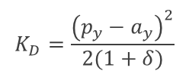



Integrator (Lie map of 2nd order)
$$K_{A}=p_{z}−δ$$
$$K_{B}={−a}_{z}$$
$$K_{C}=\frac{{\left(p_{x}−a_{x}\right)}^{2}}{2(1+δ)}$$
$$K_{D}=\frac{{\left(p_{y}−a_{y}\right)}^{2}}{2(1+δ)}$$
For the Solenoid:
we can use same Hamiltonian
transformation for s and δ required

Slide 5
Choice of the Integrator
Find the best compromise between accuracy and computational time
HL-LHC MQXFs
CLIC Detector Solenoid
A. Simona et al. CPC 239, 32-52 (2019)
Y. Levinsen et al. Phys. Rev. ST AB 17, 051002 (2014)
Benchmarked between them and with others tracking codes
I think both of them are
good for FCC-ee, but fine
tuning of z-step, etc…
to be done
Seven steps in the 4th order symplectic integrator

Slide 6
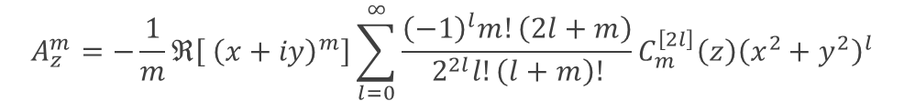

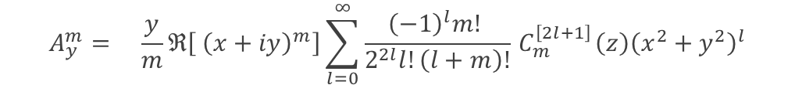
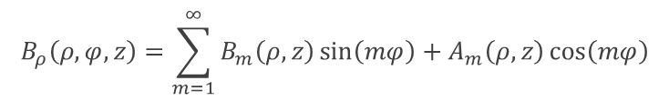

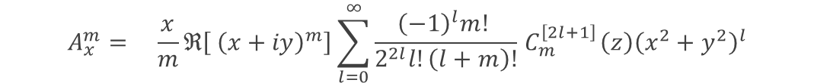
FFIELD Inputs files
Harmonics
$$B_{ρ}\left(ρ,φ,z\right)=\sum_{m=1}^{∞}{B_{m}\left(ρ,z\right)\sin\left(mφ\right)+A_{m}\left(ρ,z\right)\cos\left(mφ\right)}$$
Generalized Gradient for normal multipole
$$C_{m}^{\left[l\right]}\left(z\right)=\frac{i^{l}}{2^{m}m!\sqrt{2π}}\int_{−∞}^{∞}{\frac{e^{ikz}k^{m+l−1}}{I_{m}^{′}\left(kρ\right)}}{\tilde{B}}_{m}\left(ρ,k\right)dk$$
Functions which depend only on longitudinal coordinate
$$A_{x}^{m}= \frac{x}{m}ℜ\left[{ \left(x+iy\right)}^{m}\right]\sum_{l=0}^{∞}{\frac{{\left(−1\right)}^{l}m! }{2^{2l}l!\left(l+m\right)!}{ C}_{m}^{\left[2l+1\right]}\left(z\right){\left(x^{2}+y^{2}\right)}^{l}}$$
3D Vector Potential for normal multipole
$$A_{y}^{m}= \frac{y}{m}ℜ\left[{ \left(x+iy\right)}^{m}\right]\sum_{l=0}^{∞}{\frac{{\left(−1\right)}^{l}m! }{2^{2l}l!\left(l+m\right)!}{ C}_{m}^{\left[2l+1\right]}\left(z\right){\left(x^{2}+y^{2}\right)}^{l}}$$
$$A_{z}^{m}=−\frac{1}{m}ℜ\left[{ \left(x+iy\right)}^{m}\right]\sum_{l=0}^{∞}{\frac{{\left(−1\right)}^{l}m!\left(2l+m\right)}{2^{2l}l!\left(l+m\right)!}C_{m}^{\left[2l\right]}\left(z\right){\left(x^{2}+y^{2}\right)}^{l}}$$
$$\vec{A}=\sum_{i,j}{\vec{c_{i,j}}\left(z\right) x^{i}y^{j}}$$
Colum unit Comment
z (m) Longitudinal position of the kick.
i – Exponent of x in the Horner polynomial representation of the vector potential.
j – Exponent of y in the Horner polynomial representation of the vector potential.
k – Exponent of z in the Horner polynomial representation of the vector potential.
Ax m^{−(1+i+j)} Coefficient of the Horner polynomial of the x component of the vector potential.
Ay m^{−(1+i+j)} Coefficient of the Horner polynomial of the y component of the vector potential.
Az m^{−(1+i+j)} Coefficient of the Horner polynomial of the z component of the vector potential.

Slide 7
Computation of the generalized gradient from the magnetic field harmonics
B_{ρ} for quadrupole ⇒ B_{z} for solenoid

Slide 8

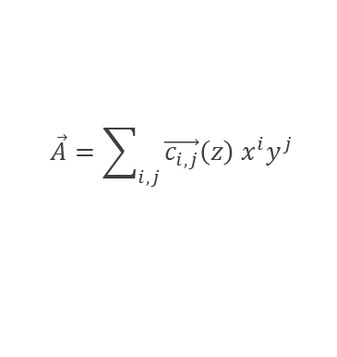
Reference systems and overlap with other elements
At each step of the integrator:
1. Rotate particle canonical pairs in the Solenoid reference system
2. Get Vector potential in Solenoid reference system
3. Transform the solenoid vector potential from the solenoid reference system back to the beam reference system
4. Add the quadrupole vector potential (if full 3D not know just the A_{z} can be added)
5. Perform integration step
N.B. Incoherent Synchrotron Radiation emission is not considered in the present Integrator, in case it is needed, to be added
$$\vec{A}=\sum_{i,j}{\vec{c_{i,j}}\left(z\right) x^{i}y^{j}}$$
$$A_{z}^{2}=\frac{1}{2}B_{2}ℜ[{ (x+iy)}^{2}]$$

Slide 9
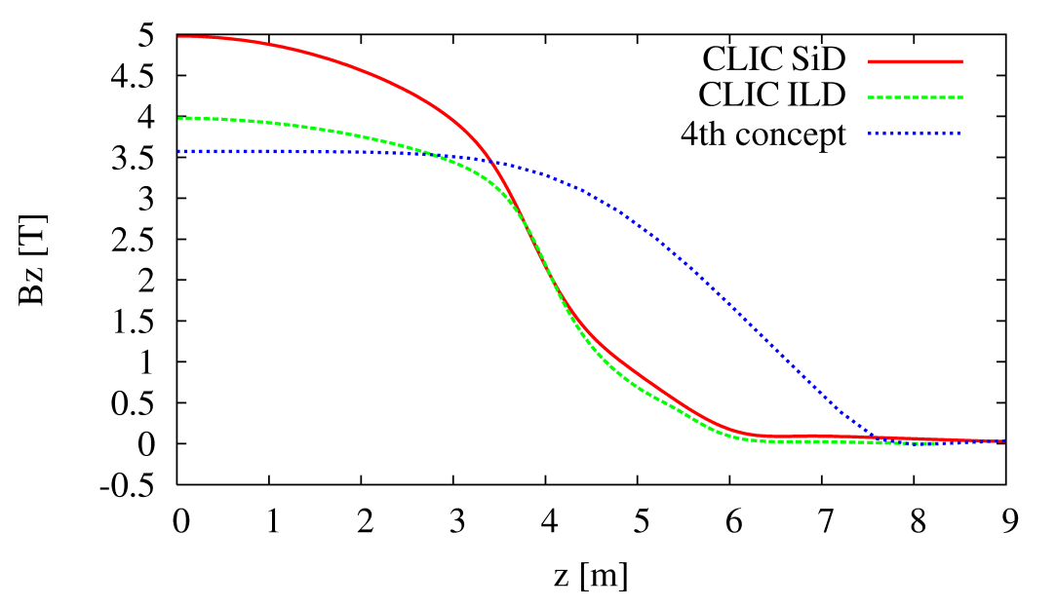
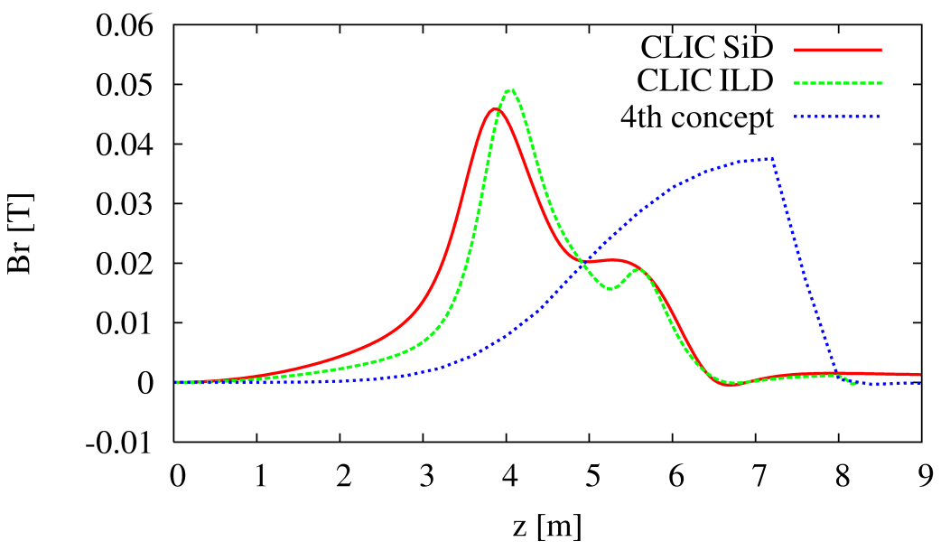
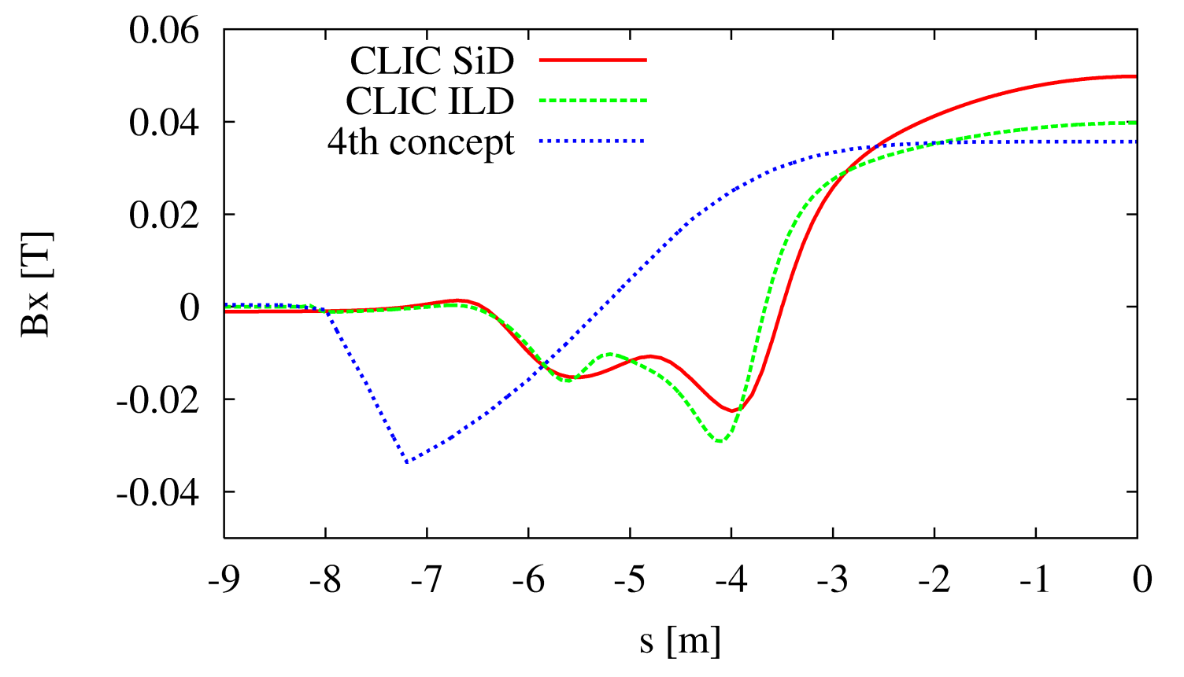

Example: CLIC Detector solenoid magnetic field
In the Solenoid Reference System
$$\vec{B}=(B_{x},B_{y},B_{z})$$
In the Beam Reference System
x
X
θ_{c}/2
s
0
z
x, z solenoid axes
X, s beam line longitudinal axis

Slide 10
Conclusions and perspectives
Generalized Gradients and Lie2 maps can be extended to other accelerators elements
This technique is suitable to study impact of 3D field non-linearities on beam dynamics of rings, also in combinations with other effects
Several details needs to be workout yet for the Detector Solenoid
For dedicated machine detector interface studies and for linear accelerators I still prefer full tracking in the 3D magnetic field maps, as we have done for CLIC

Slide 11
Spares

