Slide 1


1. Crash course particle therapy
Slides by:
Viridiana Badillo (FI-UNAM)
Enrique Sánchez (FI-UNAM)
Aris Mamaras (AUTh)
Martina Palkowitsch (DKFZ)
Niklas Wahl (DKFZ)
Yiota Foka (IPPOG, CERN)
Benjamin Dedić (PMF-Sarajevo)

Slide 2
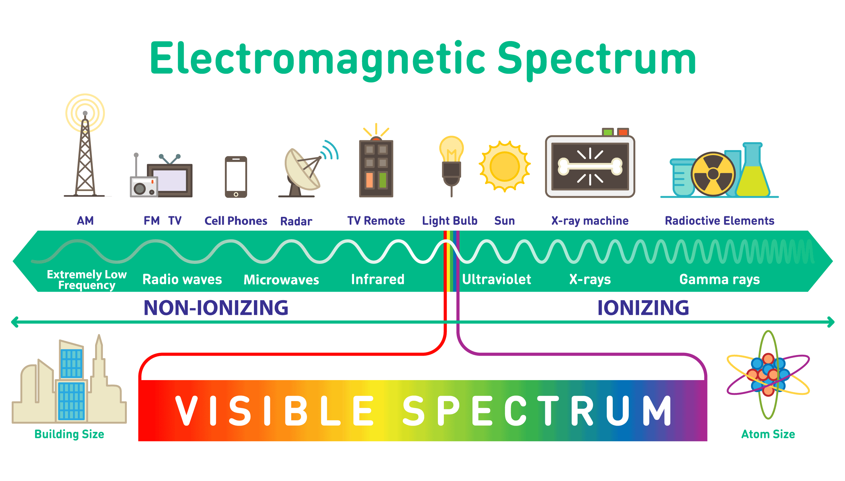
1. What is Radiation Therapy?
uses ionizing radiation to produce DNA damage to cancer cells
its goal is to kill or “control” the cancer cells and at the same time spare healthy cells
different modalities are in use:
  conventional radiation therapy
  electrons
  photons
  particle therapy
  hadrons: mainly protons, neutrons also possible
  Ions: mainly carbon ions
ɣ
e⁻
n⁰
p⁺
C
[1]
[1] Medium – Electromagnetic spectrum. Accessed from https://medium.com/@tajamulfayaz621/electromagnetic-spectrum-b80002a65665.

Slide 3
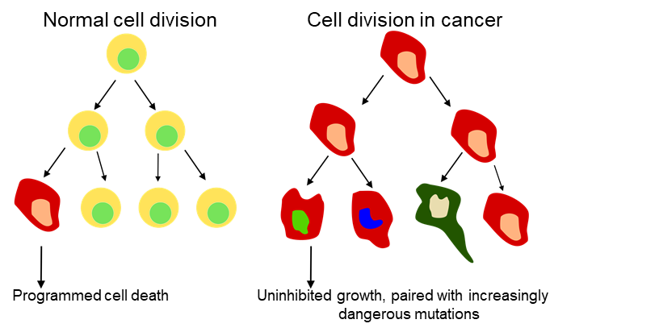
2. Cancer
[2]
is uncontrolled cell proliferation and cell rampant growth
cancer may spread to other parts of the body
over 100 different types, individual
Cancer cell of a lung tumor
during cell proliferation
healthy cells vs. cancer cells
Theory of cancer formation:
(random) mutation levers out normal programmed cell death
→ cells need to be removed / killed “manually” for treatment
[1]
[1] Garak76, Suhadi Jorhaa'ir (https://commons.wikimedia.org/wiki/File:Zellteilung_normal_im_Gegensatz_zu_Krebs.svg), „Zellteilung normal im Gegensatz zu Krebs“
[2] fineartamerica - Lung Cancer Cell Division. - Accessed from https://fineartamerica.com/featured/lung-cancer-cell-division-sem-steve-gschmeissner.html?product=metal-print on 12.02.2021. Lettering was adapted.

Slide 4
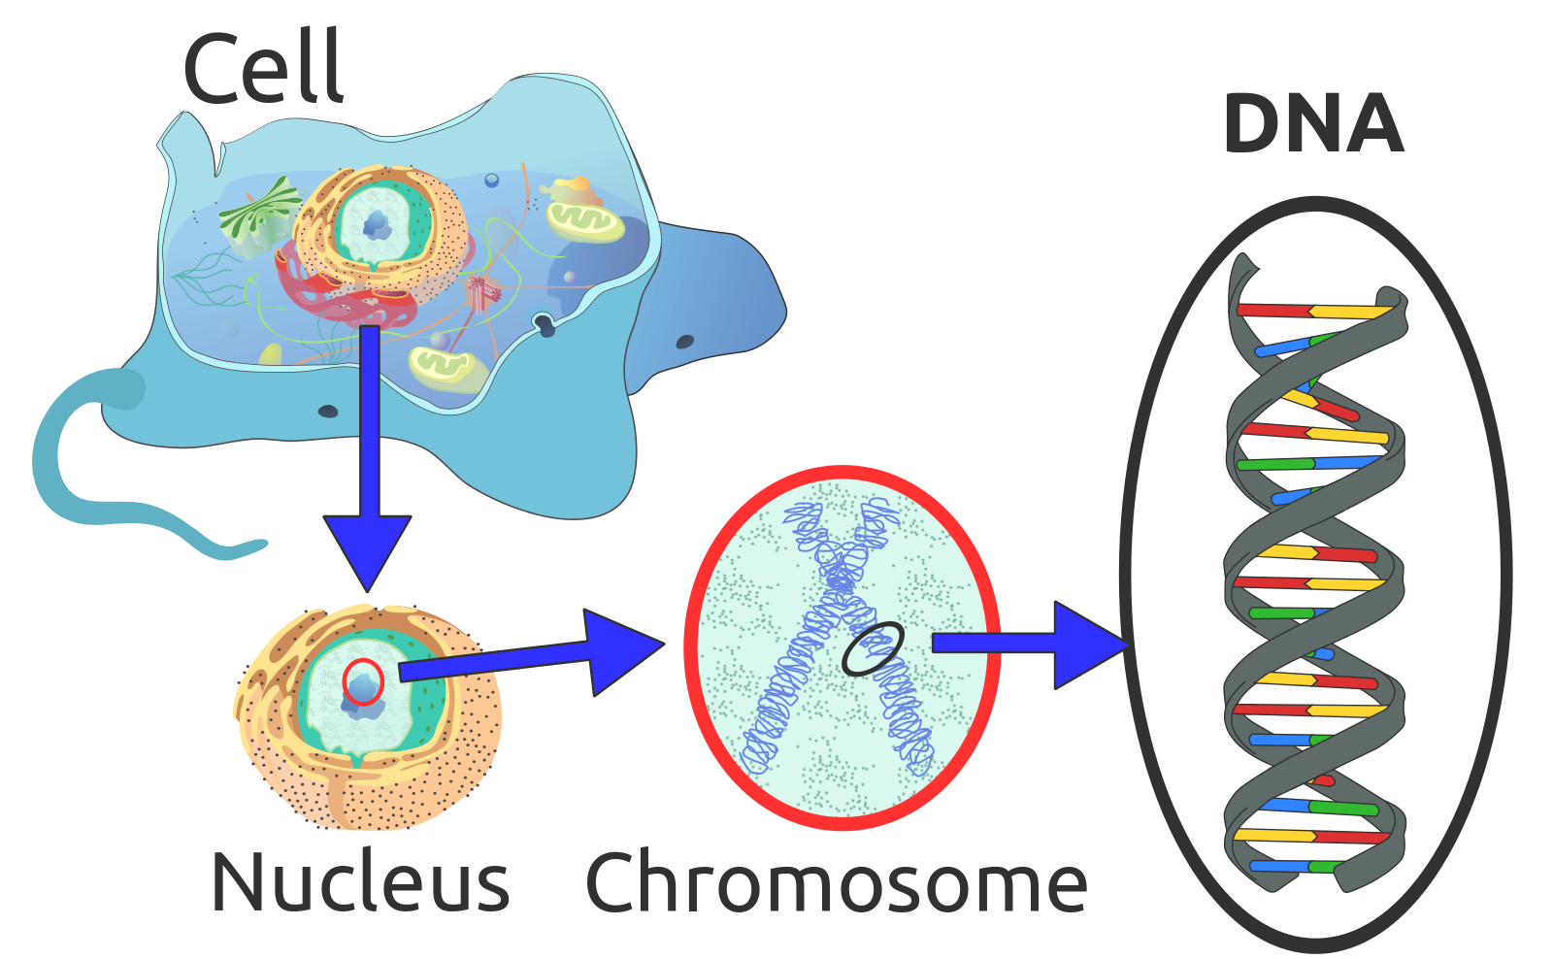
3. Radiotherapy - Biology
> 50% of all cancer patients receive radiotherapy [1]
Physical phase: 10⁻¹⁸ to 10⁻¹⁴ s
Elementary physical interactions between ionizing radiation and atom
Chemical phase: 1ms to ~ min
Reactive radicals react with molecules of the cell and change their chemical composition
Biological phase: after 1s to years
Cell death, loss of function of the organism
Serial organs: e.g. spinal cord
Parallel organs: e.g. lung
[2]
[1] Atun R. Jaffray et. al, Expanding global access to radiotherapy. Lancet Oncol., 2015
[2] Sponk, Tryphon, Magnus Manske, User:Dietzel65, LadyofHats (Mariana Ruiz), Radio89 (https://commons.wikimedia.org/wiki/File:Eukaryote_DNA-en.svg), „Eukaryote DNA-en“, https://creativecommons.org/licenses/by-sa/3.0/legalcode

Slide 5
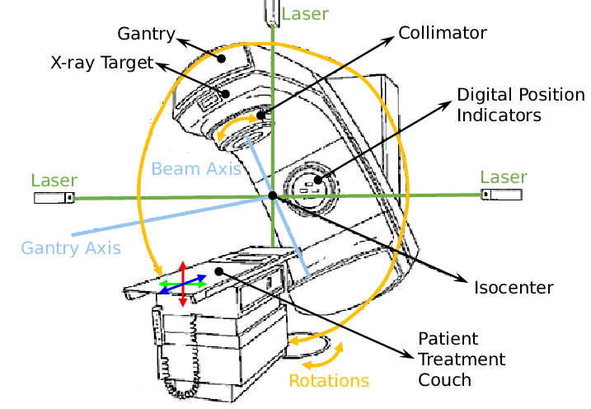
4. Conventional radiation therapy
Uses photons: massless, no electric charge and
travel always at the speed of light
no “acceleration”, but frequency dependent energy
How to generate? We can accelerate electrons!
accelerated electrons hit a target
electrons loose energy due to “bremsstrahlung
high-energy photons
gantry: moves the radiation source around the patient
coach: rotates the patient
[1]
[1] ResearchGate – Schematic depiction of a linear accelerator (LINAC) used in External Beam Radiation. Accessed from https://www.researchgate.net/figure/Schematic-depiction-of-a-linear-accelerator-LINAC-used-in-External-Beam-Radiation_fig1_334378462.

Slide 6
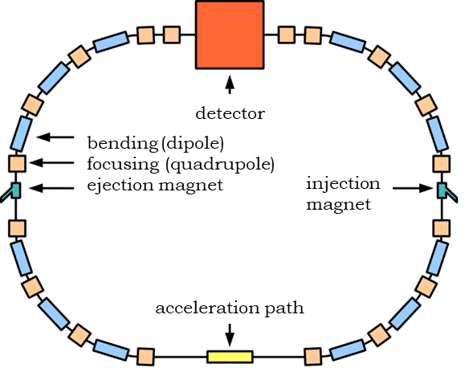
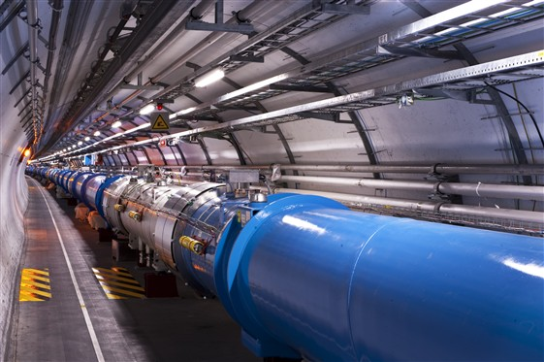
5. Particle therapy – particle accelerator
How do we generate high energy protons or ions?
acceleration with electric fields
linear or circular accelerator
(depending on the required energy)
→ e.g. Large Hadron Collider LHC (CERN)
the bigger the particle‘s mass,
the more energy, power and size is needed
for its acceleration
big and expensive accelerators are needed
[2]
[1]
[1] Maximilien Brice (https://commons.wikimedia.org/wiki/File:CERN_LHC.jpg), https://creativecommons.org/licenses/by-sa/4.0/legalcode
[2] No machine-readable author provided. Florian DO assumed (based on copyright claims). (https://commons.wikimedia.org/wiki/File:Storage_ring_de.svg), „Storage ring de“, lettering was adapted, https://creativecommons.org/licenses/by-sa/3.0/legalcode

Slide 7
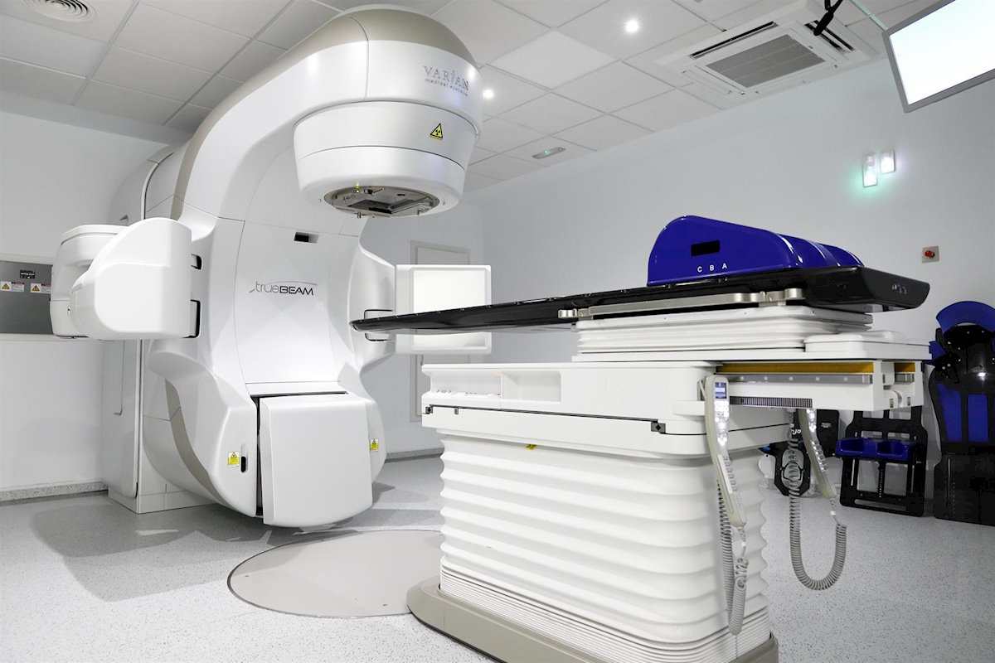
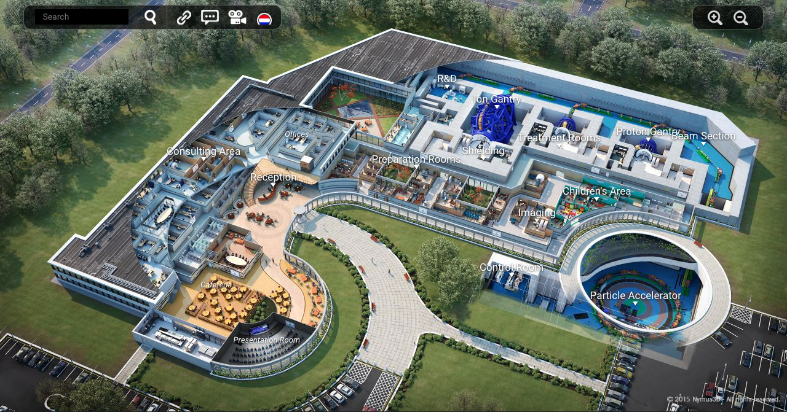
6. Machines
heavy ion
C
p⁺
e⁻
ɣ
LINAC - Linear accelerator
Circular accelerator
$$$
$$$$$$

Slide 8
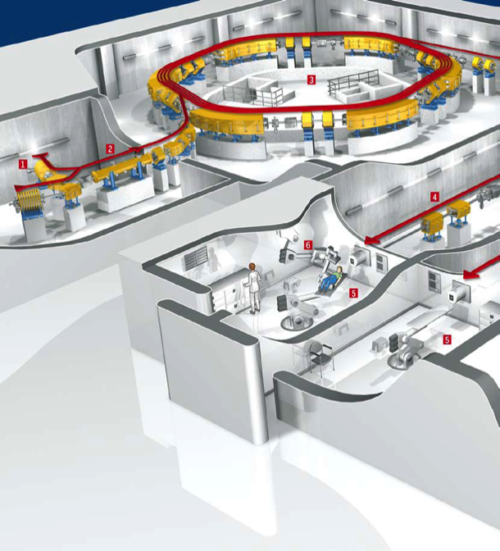
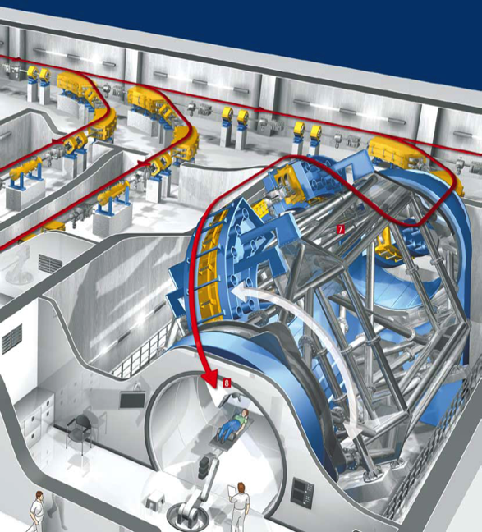
6. Machines
Heidelberg Ion-Beam Therapy Center (HIT)
All particle treatment centers have
static beam lines
Some of them have rotating gantries
(common for protons, but only 2 in the world
that work with carbon ions).
The system of reference or “center” is usually placed in the tumour (in the isocenter).
We will work with the rotating gantry.
Synchrotron
Beam transport line
Ion source
LINAC
Gantry
Treatment rooms Siemens Medical
[1]
[1] Universitätsklinikum Heidelberg – HIT Broschüre - HIT Ionentherapieanlage. Accessed from https://www.klinikum.uni-heidelberg.de/fileadmin/hit/dokumente/HIT_Broschuere.pdf on 12.02.2021

Slide 9
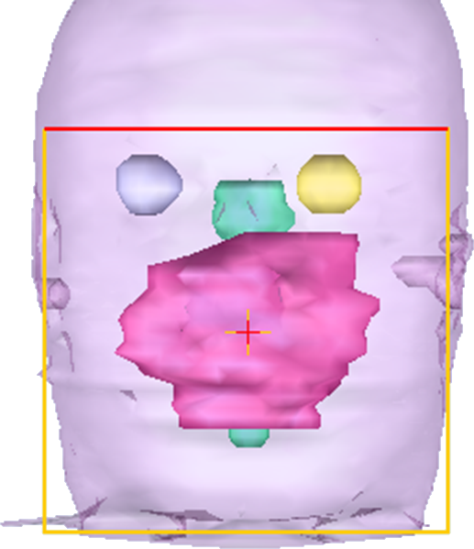
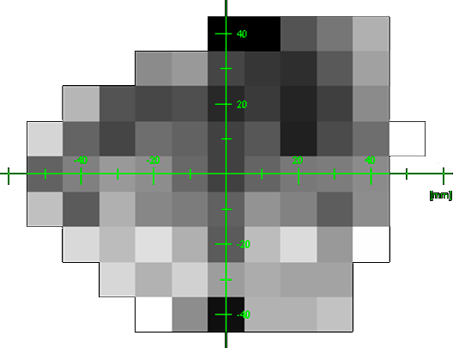
7. Important concepts
Absorbed dose: ionizing energy absorbed per mass unit.
It is measured in Gray (1 J/kg = 1 Gy).
Intensity modulation for photons with pencil beams:
Pencil beams form “pixel” in the beam cross-section
(or the fluence, respectively)
= “bixel” (Beam + Pixel)
We weight all pencil beams
(more/less photons) differently
Bixel j

Slide 10
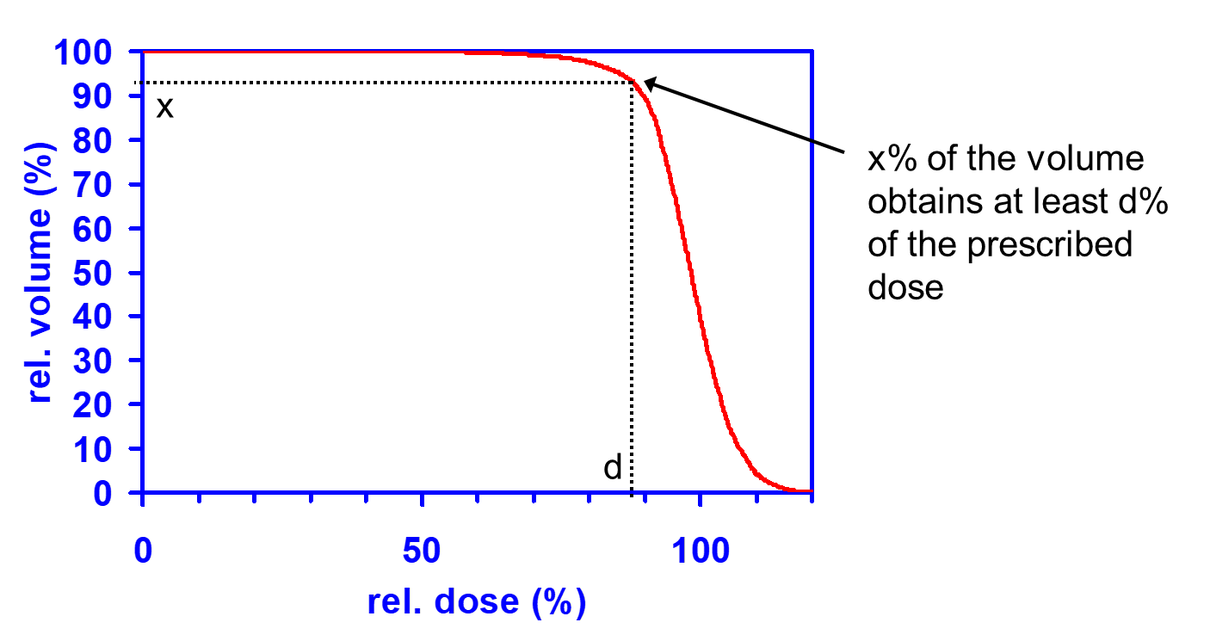
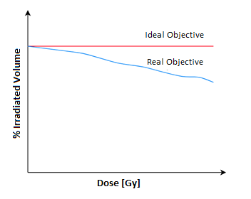
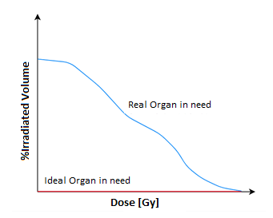
7. Important concepts
DVH: dose-volume histogram.
In the ideal case, only the tumor is irradiated without affecting other (healthy) tissues.
Notes:
“Values taken from Wu & Mohan (2000 Medical Physics).” was deleted.

Slide 11

7. Important concepts
RBE: Relative biological effectiveness. Factor that compares the biological effectiveness of (the biological damage caused by) one type of ionizing radiation (e.g. particle radiation) to the biological effectiveness of a reference radiation (e.g. photon radiation) .
Voxel: volume pixel. A voxel is a volume element. It is the basic building block of a volumetric description of an object.
VOI: volume of interest.
OAR: organ at risk.

Slide 12
7. Important concepts
Gross Tumour Volume (GTV).
  Tumour volume that is visible on the images.
Clinical Target Volume (CTV).
  Volume of the tissue including the GTV and regions where invisible tumour tissue is expected.
Planning Target Volume (PTV).
  Includes the GTV and CTV as well as a safety margin to take uncertainties into account.
PTV
CTV
GTV

Slide 13
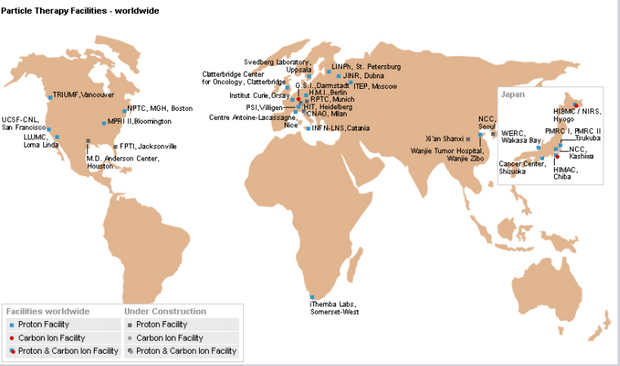
8. Particle therapy centers
All around the world
  In Europe – England (1), France (2), Germany (6), Italy (3), Austria (1),...
  In Asia – South Korea (2), Japan (11), Taiwan (1)
  In America – USA (24), Canada (1)
  In Africa – South Africa (1)
  On the Balkans?
[1]
[1] Particle Therapy, worldwide – Particle Therapy Fighting Cancer with Ion-Beams. Accessed from https://www.desy.de/f/seminar/MBraeuer.pdf on 10.03.2021

Slide 14
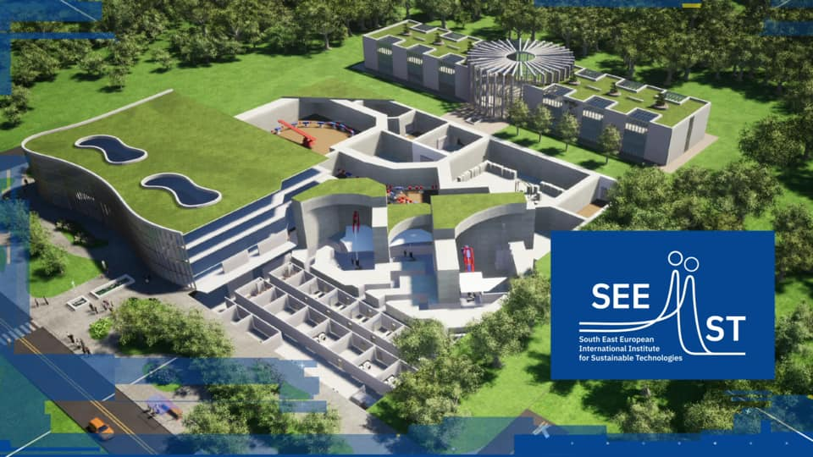

8. SEEIIST
[2]
[1]
[1] SEEIIST building proposal. Accessed from https://www.facebook.com/SEEIIST/photos/a.2834764259883608/4414393698587315/ on 10.03.2021
[2] SEEIIST logo. Accessed from https://seeiist.eu/seeiist-project-is-getting-its-logo/ on 10.03.2021.

Slide 15
THANK YOU FOR YOUR ATTENTION

