Slide 1



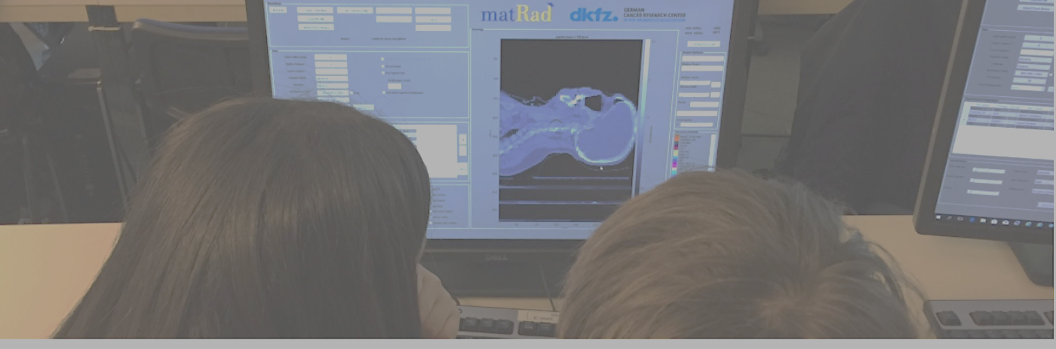



Particle Therapy MasterClass
Albana Topi, PhD (a.topi@gsi.de)
GSI Helmholtz Center for Heavy Ion Research (gsi.de)
on behalf of IPPOG and IMC

Slide 2
Before we start
Please keep your camera on (It is nice to see each other :-)
Do you agree to record or to take pictures of you?
Do you agree to post photos or videos of you in IPPOG website?
During the Hands-on session there will be CT of different body part, are you ok with seeing this images?
If you disagree with any of these points, please email me: a.topi@gsi.de

Slide 3

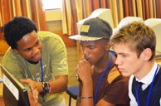
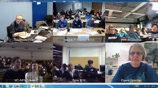
PTMC Agenda
09:00 – 09:20
09:20 – 10:20
10:20 – 10:30
10:30 – 11:20
11:20 – 11:30
11:30 – 12:00
12:00 – 13:00
13:00 – 15:15
15:15 – 16:00
16:00 – 17:00
Welcome and introduction
Introductory lectures I
Coffee break
Introductory lectures II
Short break
Virtual lab visit
Lunch break
Hands-on session
Locally - results discussion
Video conference
Let’s have fun 😃 while learning about Particle therapy & matRad 👩‍🎓🧑‍🎓👩🏻‍💻🧑🏻‍💻

Slide 4
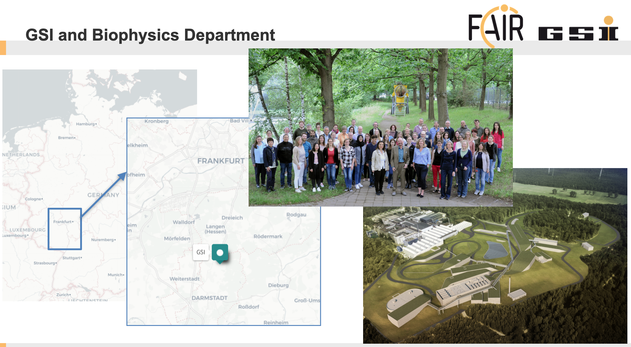


Slide 5
PTMC Agenda
09:00 – 09:20
09:20 – 10:25
10:25 – 10:35
10:35 – 11:20
11:20 – 11:30
11:30 – 12:00
12:00 – 13:00
13:00 – 15:15
15:15 – 16:00
16:00 – 17:00
Welcome and introduction
Introductory lectures I
Coffee break
Introductory lectures II
Short break
Virtual lab visit
Lunch break
Hands-on session
Locally - results discussion
Video conference

Slide 6
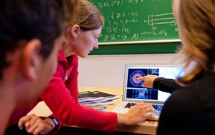
International MasterClasses
The aim is to get insight into topics and methods of research
PTMC is integrated into the International MasterClasses project
The IMC project is an educational
outreach activity that brings the
excitement of cutting-edge research
methods into the classroom.
Offers to pupils hands-on experience with real data
https://physicsmasterclasses.org/index.php
Normalisht organizohet me nxënës të gjimnazit për ti inkurajuar që të studjojnë fizikë

Slide 7

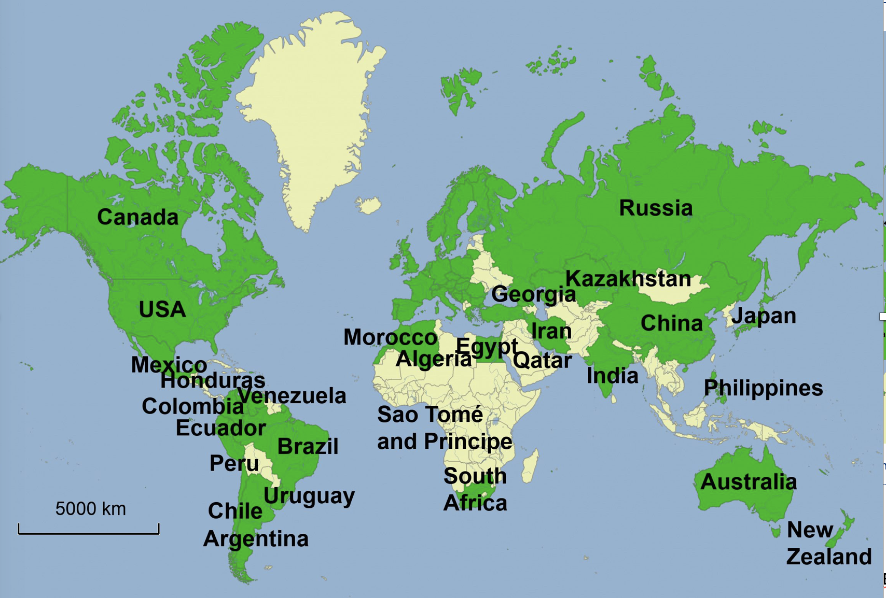
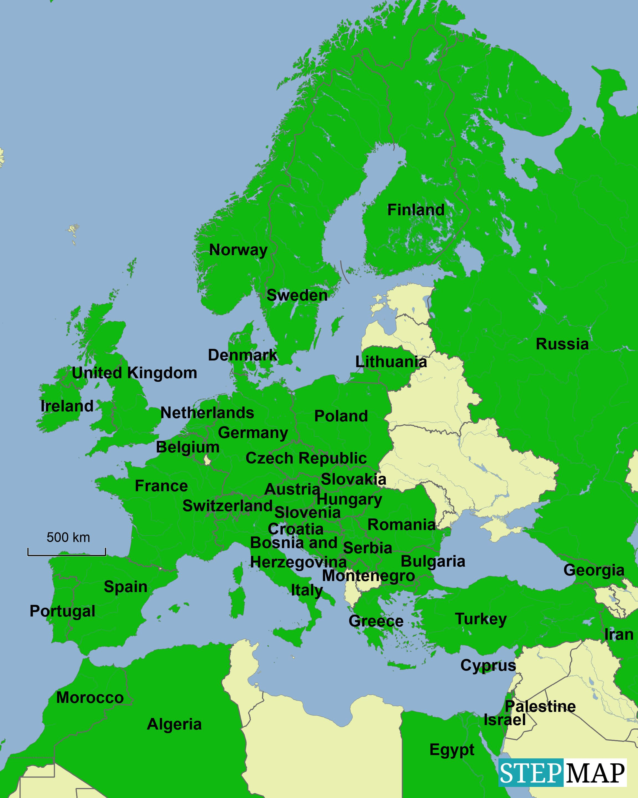
IMC Statistics 2019
07.03. - 16.04.2019
255 Institutes
54 countries involved
~ 15000 students
Flagship project of IPPOG (https://ippog.org )
International Particle Physics Outreach Group
Coord.: QuarkNet / TU Dresden
188 institutes (177)
266 LHC Masterclasses (257)
  30 ATLAS W (35)
  101 ATLAS Z (104)
  64 CMS (58)
  41 LHCb (39)
  27 ALICE SP (18)
  3 ALICE R_AA (3)
51 institutes (48)
54 LHC Masterclasses (50)
  22 ATLAS (19)
  32 CMS (31)
(Incl. TRIUMF program)
12 MINERvA Masterclasses

Slide 8
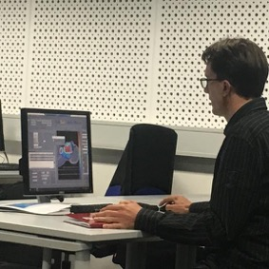
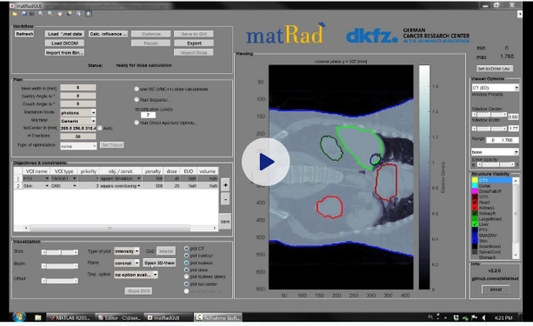
PTMC and Treatment Planning
matRad - open source treatment planning: developed by Heidelberg DKFZ www.matrad.org
Christian

Slide 9
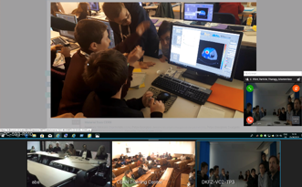
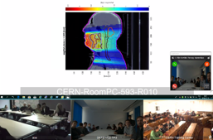
PTMC pilots in 2019
Common discussion: intuitive, visual comparisons of photons, protons, ions
First test: GSI on 7th February 2019
~ Participation of CURIEosity Team from Crete
First pilot: CERN, DKFZ Heidelberg, GSI, 05.04.2019
Survey: positive results from students
Hope and motivation
to contribute to the
fight against cancer

Slide 10
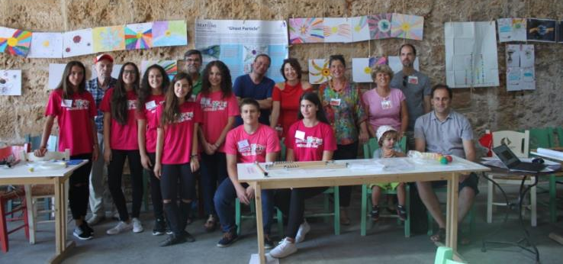
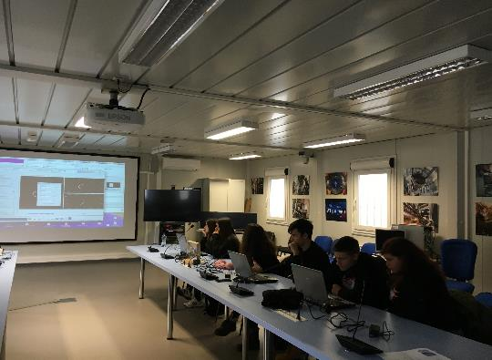
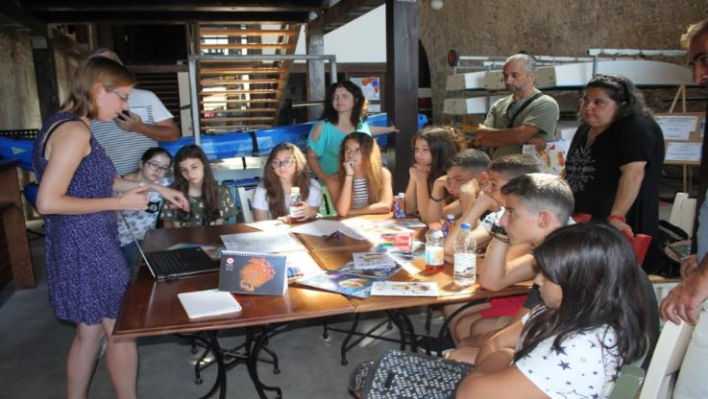
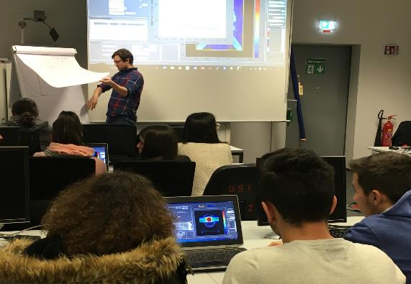
The CURIEocity team from Crete
CERN
GSI
From Crete

Slide 11
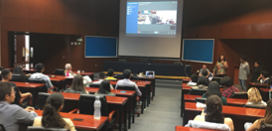
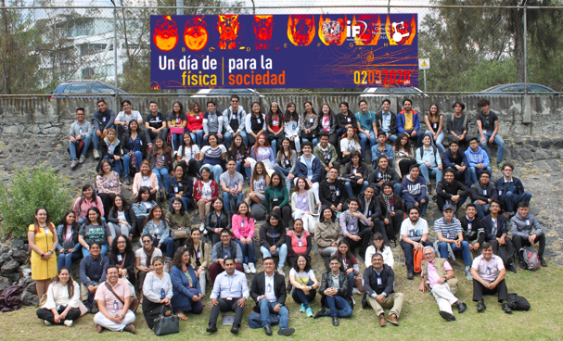

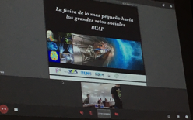



PTMC in IMC 2020
The first & the only one
in 2020

Slide 12
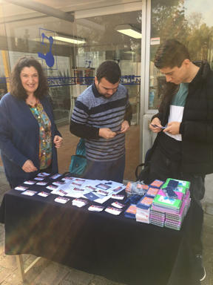
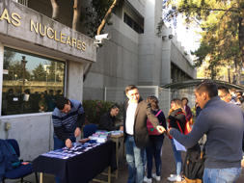
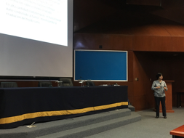
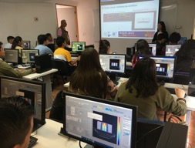
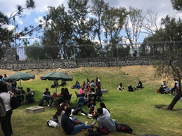


Yiota

Slide 13
PTMC in IMC 2021
Dates IMC2021: 11.02 – 27.03.2021
  06.03 Greece, GSI, Heidelberg, Skopje, Portugal
  08.03 CERN
  11.03 Prague, Teheran, Mexico, Sarajevo, Dortmund
  23.03 Munich, Milan, Riga, Egypt
  24.03 Tuzla, Kaunas, Vilnius, Saint-Petersburg, Egypt, Montenegro
  26.03 Tirana, Pristina, Tetovo, Novi Sad, Sofia

Slide 14
PTMC Agenda
09:00 – 09:20
09:20 – 10:25
10:25 – 10:35
10:35 – 11:20
11:20 – 11:30
11:30 – 12:00
12:00 – 13:00
13:00 – 15:15
15:15 – 16:00
16:00 – 17:00
Welcome and introduction
Introductory lectures I
Coffee break
Introductory lectures II
Short break
Virtual lab visit
Lunch break
Hands-on session
Locally - results discussion
Video conference

Slide 15
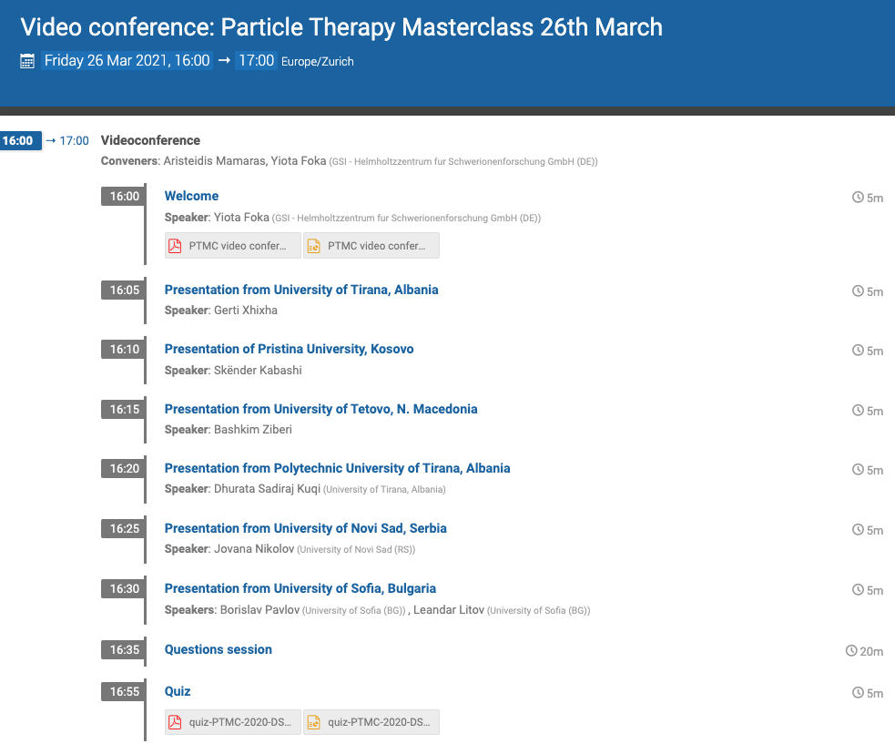
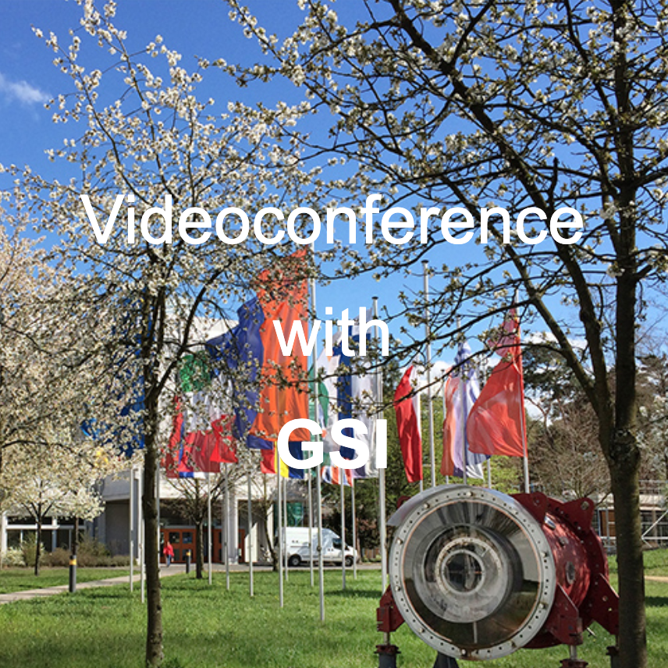
https://indico.cern.ch/event/999560

Slide 16
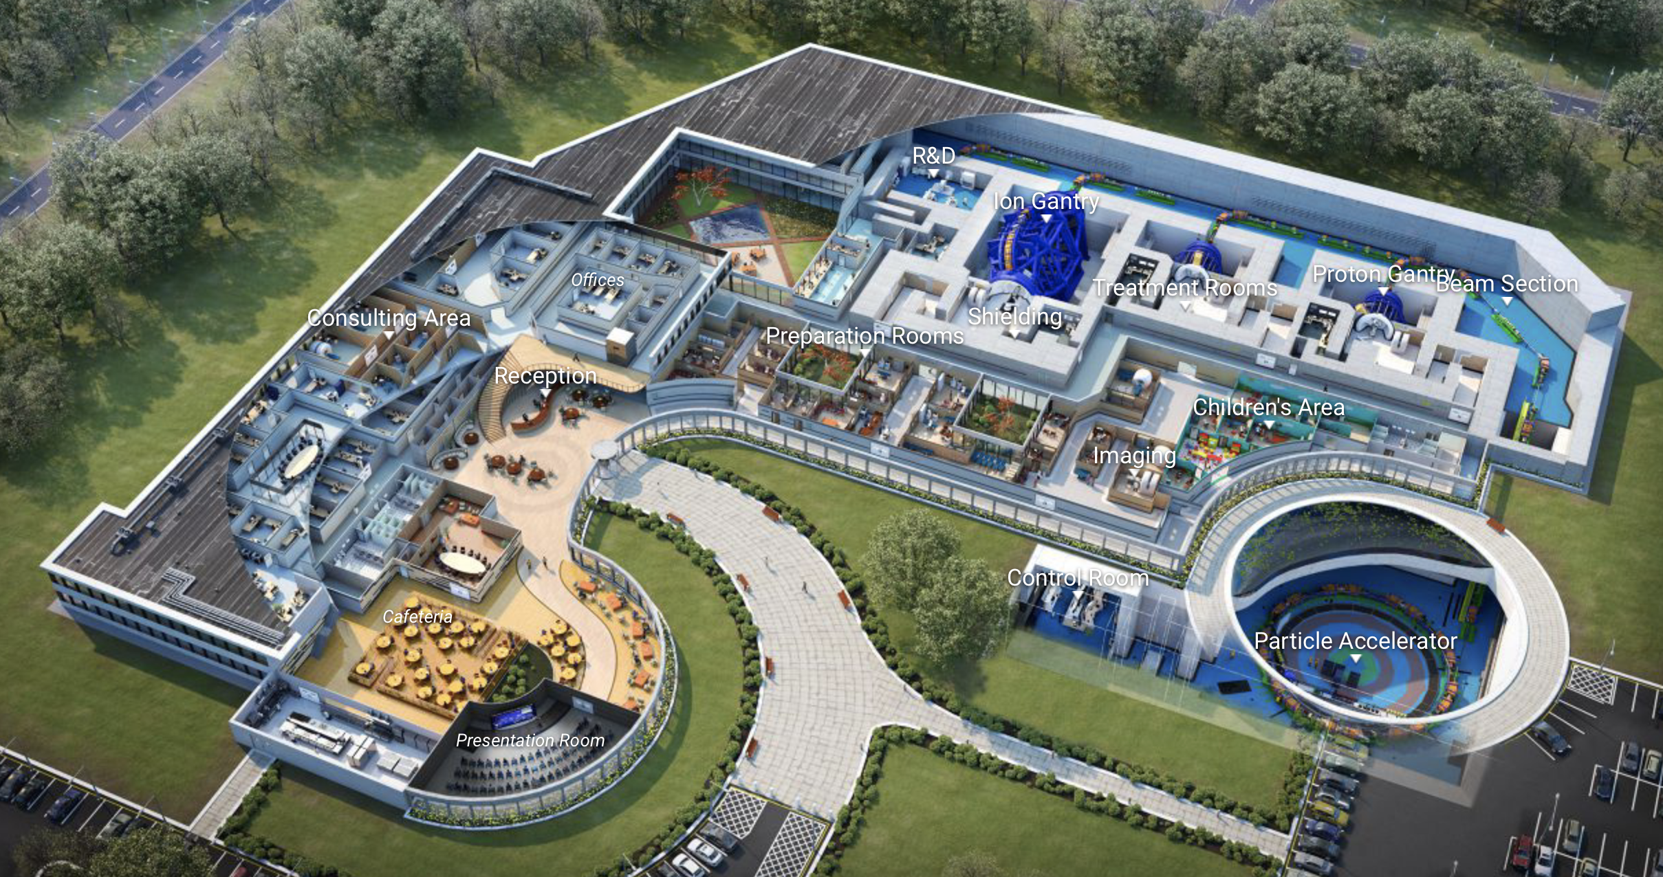
Virtual Particle Therapy Centre
https://cern.nymus3d.nl/maps

