Slide 1
Particle Physics Technology Advisory Panel
Paula Chadwick, Durham University – PPTAP Chair

Slide 2
Why a PPTAP?
The European Strategy for Particle Physics Update identified an immediate need for active R&D programmes for future detectors and accelerators
The European Committee for Future Accelerators (ECFA) called on to establish an R&D roadmap for detectors
The European Laboratory Directors Group (ELDG) called on to establish an R&D roadmap for accelerators
Work started in autumn 2020 and expected to report to CERN Council in December 2021
UK input needed for these processes and to inform UK direction

Slide 3
PPTAP
Aims
  overview of the emerging R&D roadmaps
  understand the case for investment in R&D
Need to look at current programme and landscape
Gather evidence
Look for strengths and synergies
Explore routes forward
Output - report autumn 2021

Slide 4
Roadmap activities
+ +

Slide 5

Detector R&D Roadmap
European Particle Physics Strategy Update
“Organised by ECFA, a roadmap should be developed by the community to balance the detector R&D efforts in Europe, taking into account progress with emerging technologies in adjacent fields.”
“The roadmap should identify and describe a diversified detector R&D portfolio that has the largest potential to enhance the performance of the particle physics programme in the near and long term.”
“Detector R&D activities require specialised infrastructures, tools and access to test facilities.”
“The community should define a global detector R&D roadmap that should be used to support proposals at the European and national levels.”
Extracted from the documents of 2020 EPPSU, https://europeanstrategyupdate.web.cern.ch/
For previous presentations on the Detector R&D Roadmap see Plenary ECFA: Jorgen D’Hondt (13/7/20) & Susanne Kuehn (20/11/20) (https://indico.cern.ch/event/933318/ & https://indico.cern.ch/event/966397/)
More roadmap process details at:
https://indico.cern.ch/e/ECFADetectorRDRoadmap
March to May 2021
5
ECFA Detector R&D Roadmap

Slide 6

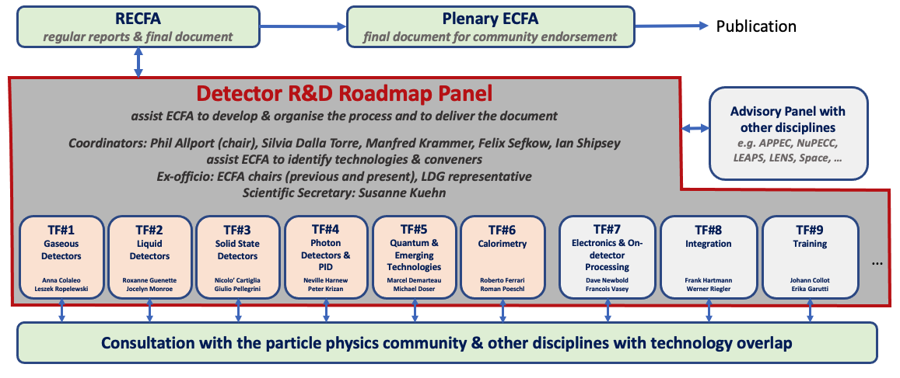
Detector R&D Roadmap
Organization for Consultation of Relevant Communities
https://indico.cern.ch/e/ECFADetectorRDRoadmap
6

Slide 7
Process and Timeline
Organisation
Expert & Community Consultation
Drafting Roadmap & Feedback
May 2020
EPPSU mandate to ECFA to develop a roadmap for detector R&D efforts in Europe
May 2021
Task Forces collate input from symposia
Feb 2021
Collection of requirements of future facilities & projects
25-28 May 2021 Drafting sessions
opening session with all experts involved
plenary & parallel sessions with Task Force members
final session of Roadmap Panel
Feb/March 2021
Questionnaires of Task Forces to national contacts
Sep 2020
Structure in place with Detector R&D Roadmap Panel
July 2021
Near final draft shared with RECFA*
30 July 2021
Presentation at Joint ECFA-EPS session
Until Sep 2021 Collect final community feedback*
Task Forces liaise with experts in
ECFA countries
adjacent disciplines
industry
Dec 2020
Task Forces active
Website: https://indico.cern.ch/e/ECFADetectorRDRoadmap
Oct 2021
Detector R&D Roadmap Document submission to RECFA and afterwards to PECFA and Council
March-May 2021
Open Symposia
*community feedback via RECFA delegates and National Contacts
*community feedback via RECFA delegates and National Contacts
March to May 2021
7
ECFA Detector R&D Roadmap

Slide 8
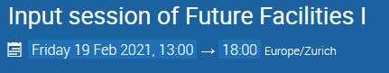
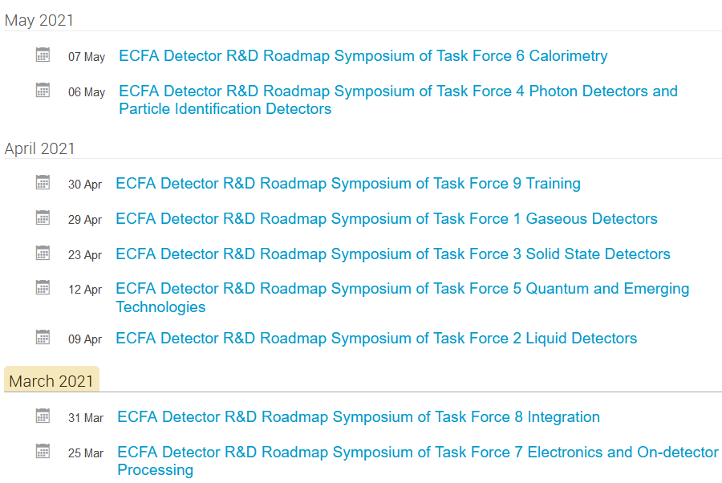
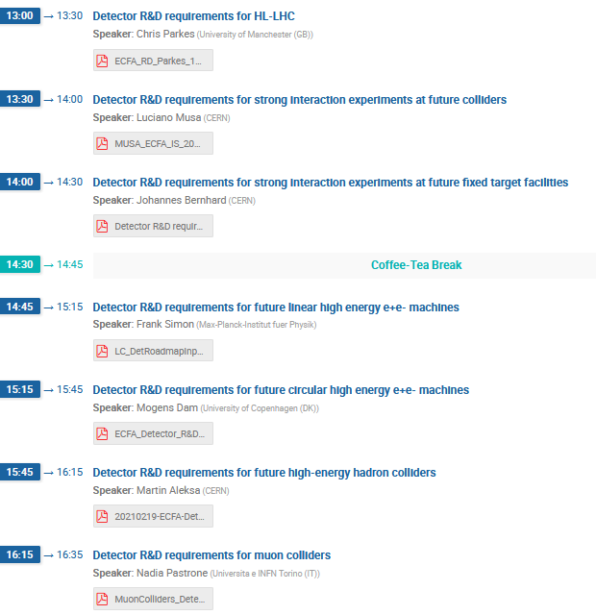
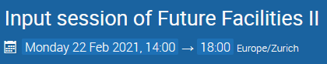
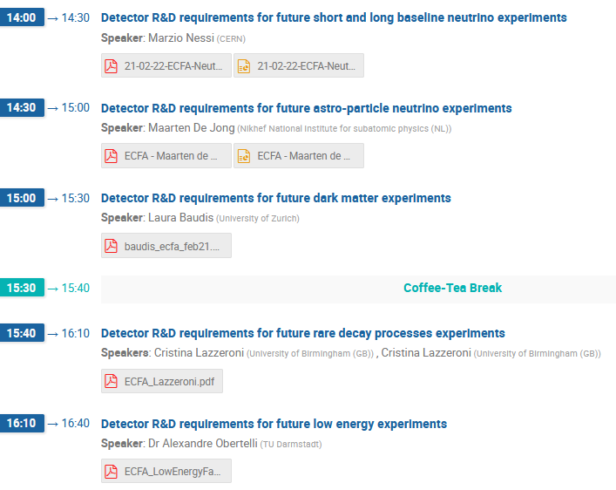
Process and Timeline
Expert & Community Consultation
Feb 2021
Collection of requirements of future facilities & projects
Feb/March 2021
Questionnaires of Task Forces to national contacts
Task Forces liaise with experts in
ECFA countries
adjacent disciplines
industry
Materials from past Symposia, Input Sessions and other components of the ECFA Detector R&D Roadmap Process can be found at https://indico.cern.ch/e/ECFADetectorRDRoadmap
March-May 2021
Open Symposia
*community feedback via RECFA delegates and National Contacts
March to May 2021
8
ECFA Detector R&D Roadmap

Slide 9
LDG Roadmap Requirements
Provide an agreed structure for a coordinated and intensified programme of particle accelerator R&D, including into new technologies, to be coordinated across national laboratories
Be compatible and commensurate with corresponding roadmaps in detectors, computing and other developments, with a compatible timeline and deliverables
Be based on the goals of the European Strategy, but defined in its implementation through consultation with the community and, where appropriate, through the work of expert panels
Take into account, and coordinate with, international activities and work being carried out in other related scientific fields, including development of new large-scale facilities
Specify a series of concrete deliverables, including demonstrators, over the next decade
Be designed to inform, through its outcomes, subsequent updates to the European Strategy.

Slide 10
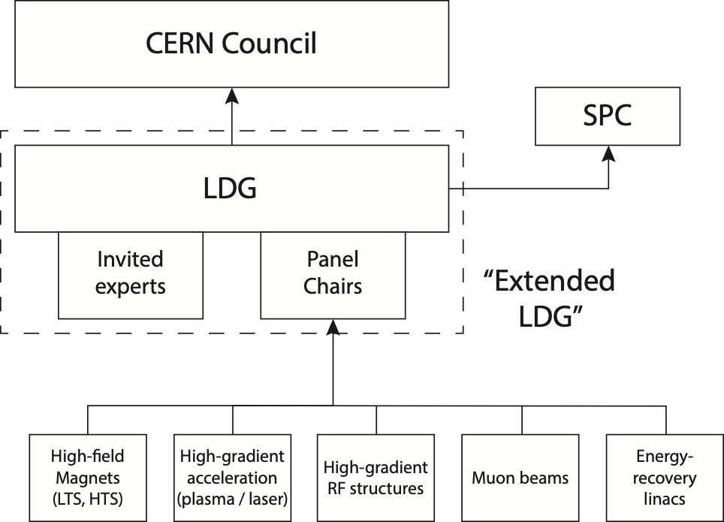
LDG Roadmap Process
Five expert panels appointed:
  High-field magnets, including use of high-temperature superconductors
  High-gradient acceleration (plasma / laser)
  High-gradient RF structures and systems
  Bright muon beams and muon colliders
  Energy-recovery linacs
Panel chairs
  Magnets: P. Vedrine (IRFU)
  Plasma: R. Assmann (DESY)
  RF: S. Bousson (IJCLab)
  Muons: D. Schulte (CERN)
  ERL: M. Klein (Liverpool)
  Diverse and international
  set of panel members now
  in place and starting work

Slide 11
Status, Timeline and Outcome
Process is really now starting in earnest
  Panels are now fully populated, initial meetings have taken place
  List of workshops and input sessions being populated:
    https://indico.cern.ch/category/13700/
  Key questions and issues being identified
Timeline
  March: Council confirmation of roadmap scope and process
    Emphasis on ‘inclusivity across the community’
  June: SPC update
  June: proposed public workshop for HEP community (NEW)
  July: Presentation of progress at EPS-HEP conference for feedback
  September: Present interim findings to SPC / Council (facts, not priorities or plan)
  December: Council approval of final report, definition of next steps
Outcome
  Yellow report summarising work of the panels and synthetic conclusions
    We may wish to include additional thoughts / material on ‘cross-cutting’ issues, e.g. training
    Clear that ‘preparatory documents’ may be of publishable quality
  SPC / Council recommendations on priorities and next steps

Slide 12
PPTAP Membership
Accelerators
Prof Deepa Angal-Kalinin, ASTeC STFC
Prof Robert Appleby, Manchester
Dr Chris Rogers, ISIS STFC
Ben Shepherd, ASTeC STFC
Prof Matthew Wing, UCL
Detectors
Prof Adrian Bevan, Queen Mary
Prof Kai Bongs, Birmingham
Rob Halsall, Technology STFC
Dr Kimberley Palladino, Oxford
Dr Angela Romano, Birmingham Dr Craig Sawyer Dr Eva Vilella-Figueras, Liverpool
Prof Iacopo Vivarelli, Sussex
Computing
Dr Neil Chue Hong, Edinburgh
Dr Tim Scanlon, UCL
Observers
Prof Phil Burrows, JAI
Prof Jim Clarke, ASTeC STFC
Charlotte Jamieson, PD, STFC
Prof Max Klein, Liverpool, RECFA
Prof Dave Newbold, PPD, STFC
Prof Peter Ratoff, CI

Slide 13
PPTAP
Webpage
Meetings: monthly since December
Gathering information
  Community survey closed 12th March
    Circulated via PPAP, PAAP and other professional networks
  Circulating ECFA and ELG questionnaires
  Subject area community meetings/workshops

Slide 14
Community Survey
21 questions in total – included the option for respondents to agree to further contact – we had 63 detailed responses

Slide 15
Community Workshops/Meetings
Envisaged over the couple of months
Focus on specific sub-areas e.g. accelerators, calorimetry etc.
Some sub-areas have already held preliminary meetings
These aim to fill in any gaps, provide context to questionnaire responses etc.

Slide 16
Community Meetings (so far)
Accelerators
  Preliminary meeting on March 31st
  Further meetings in due course
Computing
  Specific community survey next month
  Workshop in June
Detectors
  Likely a preliminary meeting soon, workshop in June
Particle Astrophysics
  Series of short, informal meetings (mostly) next week – DM, GWs, neutrino astrophysics, gamma-ray astrophysics

Slide 17
The Timetable

Slide 18

Thank you
PPTAP Contacts:
Paula Chadwick p.m.chadwick@durham.ac.uk
Charlotte Jamieson Charlotte.Jamieson@stfc.ukri.org
Dave Newbold dave.newbold@stfc.ac.uk
Facebook: Science and Technology Facilities Council
Twitter:@STFC_matters
YouTube: Science and Technology Facilities Council

Slide 19
Backup slides

Slide 20
Broad Topic Areas
Organization for Consultation of Relevant Communities
Focus on the technical aspects of detector R&D requirements given the EPPSU deliberation document listed “High-priority future initiatives” and “Other essential scientific activities for particle physics” as input and organise material by Task Force.
Task Forces start from the future science programmes to identify main detector technology challenges to be met (both mandatory and highly desirable to optimise physics returns) to estimate the period over which the required detector R&D programmes may be expected to extend.
Within each Task Force create a time-ordered technology requirements driven R&D roadmap in terms of capabilities not currently achievable.
Grouped targeted facilities/areas emerging from the EPPSU
Detector requirements for full exploitation of the HL-LHC (R&D still needed for LS3 upgrades and for experiment upgrades beyond then) including studies of flavour physics and quark-gluon plasma (where the latter topic also interfaces with nuclear physics).
R&D for long baseline neutrino physics detectors (including aspects targeting astro-particle physics measurements) and supporting experiments such as those at the CERN Neutrino Platform.
Technology developments needed for detectors at e⁺e⁻ EW-Higgs-Top factories in all possible accelerator manifestations including instantaneous luminosities at 91.2GeV of up to 5×10³⁶cm⁻²s⁻¹.
The long-term R&D programme for detectors at a future 100 TeV hadron collider with integrated luminosities targeted up to 30ab⁻¹ and 1000 pile-up for 25ns BCO.
Specific long-term detector technology R&D requirements of a muon collider operating at 10 TeV and with a luminosity of the order of 10³⁵ cm^{–2} s^{–1}.
20

Slide 21
Broad Topic Areas
Grouped targeted facilities/areas emerging from the EPPSU
Detector developments for accelerator-based studies of rare processes, DM candidates and high precision measurements (including strong interaction physics) at both storage rings and fixed target facilities, interfacing also with atomic and nuclear physics.
R&D for optimal exploitation of dedicated collider experiments studying the partonic structure of the proton and nuclei as well as interface areas with nuclear physics.
The very broad detector R&D areas for non-accelerator-based experiments, including dark matter searches (including axion searches), reactor neutrino experiments, rare decay processes, neutrino observatories and other interface areas with astro-particle physics.
Facilities needed for detector evaluation, including test-beams and different types of irradiation sources, along with the advanced instrumentation required for these.
Infrastructures facilitating detector developments, including technological workshops and laboratories, as well as tools for the development of software and electronics.
Networking structures in order to ensure collaborative environments, to help in the education and training, for cross-fertilization between different technologically communities, and in view of relations with industry.
Overlaps with neighbouring fields and key specifications required for exploitation in other application areas
Opportunities for industrial partnership and technical developments needed for potential commercialisation
21

