Slide 1
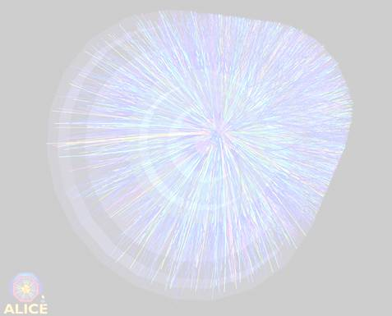
Quark-Gluon Plasma (QGP) Physics with ALICE at the CERN LHC
David Evans
The University of Birmingham
IoP Joint APP, HEPP and NP Conference
15th April 2021

Slide 2
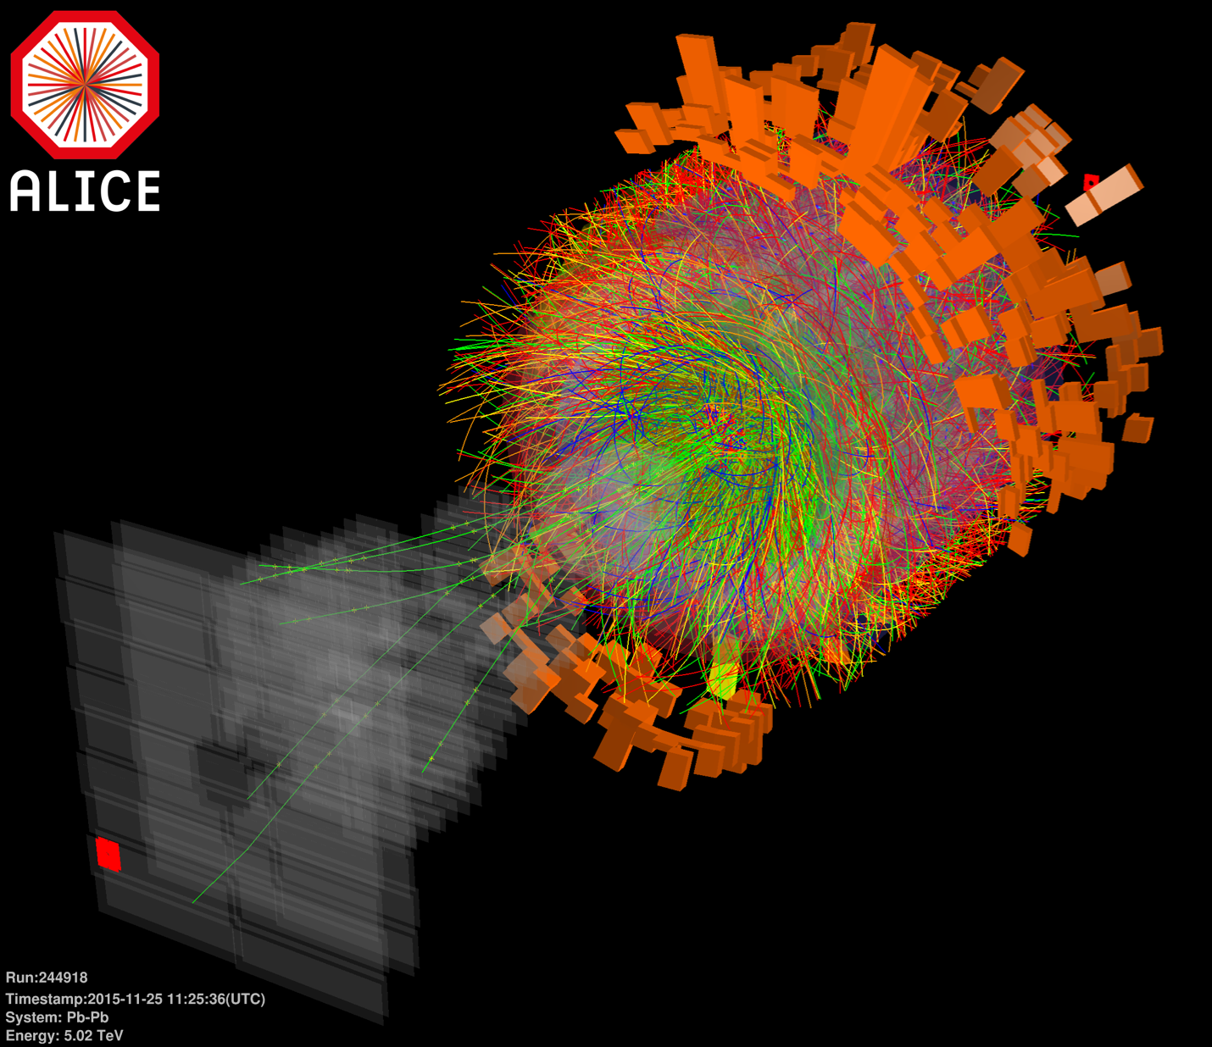
Outline Of Talk
Motivation
ALICE detector
Global features e.g Temperature
Is QGP a gas or liquid?
Strange particles
Ultra-peripheral collisions
Non-QGP physics example
ALICE Upgrade (1 slide)
Summary
A central Pb-Pb collision
at √s_{NN} = 5.02 TeV

Slide 3
Aims of ALICE
Study strongly interacting matter at extreme energy densities over large volumes and long time-scales.
Study the role of chiral symmetry in the generation of mass in hadrons (accounts for vast majority of the mass of nuclear matter).
Study the nature of quark confinement.
Study the QCD phase transition from hadronic matter to a deconfined state of quarks and gluons - The Quark-Gluon Plasma (QGP).
Study the physics of the Quark-Gluon Plasma (QCD under extreme conditions).
  Early Universe would have been a QGP until ~ 10μs after the Big Bang

Slide 4
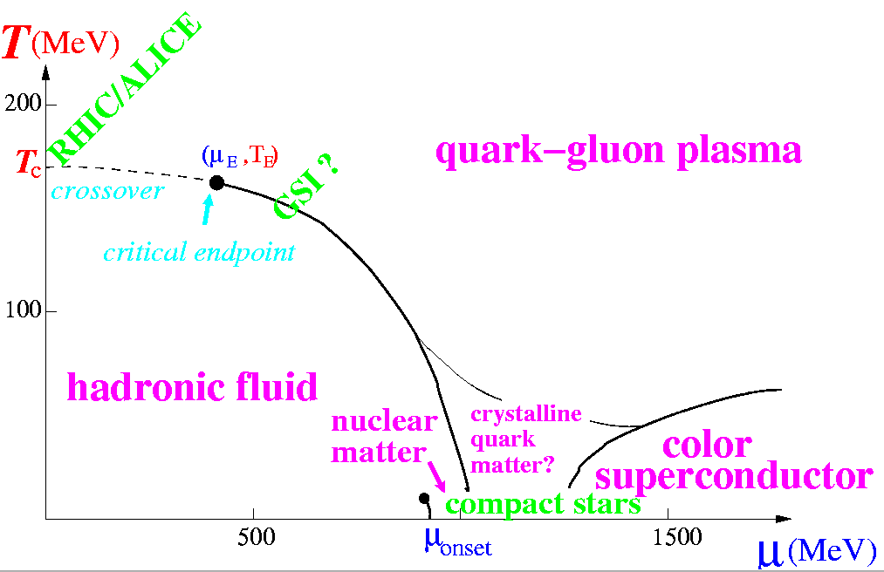
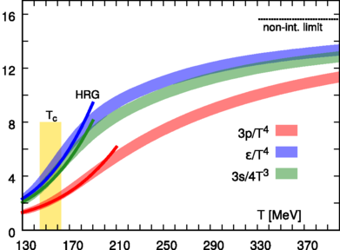
Phases of Strongly Interacting Matter
Both statistical and lattice QCD predict that nuclear matter will undergo a phase transition at high energy densities (ε ~ 0.5 -1 GeV/fm³)
T_{crit} ≈ 155 MeV
ε_{crit} ≈ 0.5 GeV/fm³
colour
HotQCD Collaboration: Phys. Rev. D90 (2014) 094503
At high temperature or high baryon density, nuclear matter undergoes a phase transition into an unbound state of quarks, anti-quarks, and gluons - a quark-gluon plasma (QGP)

Slide 5
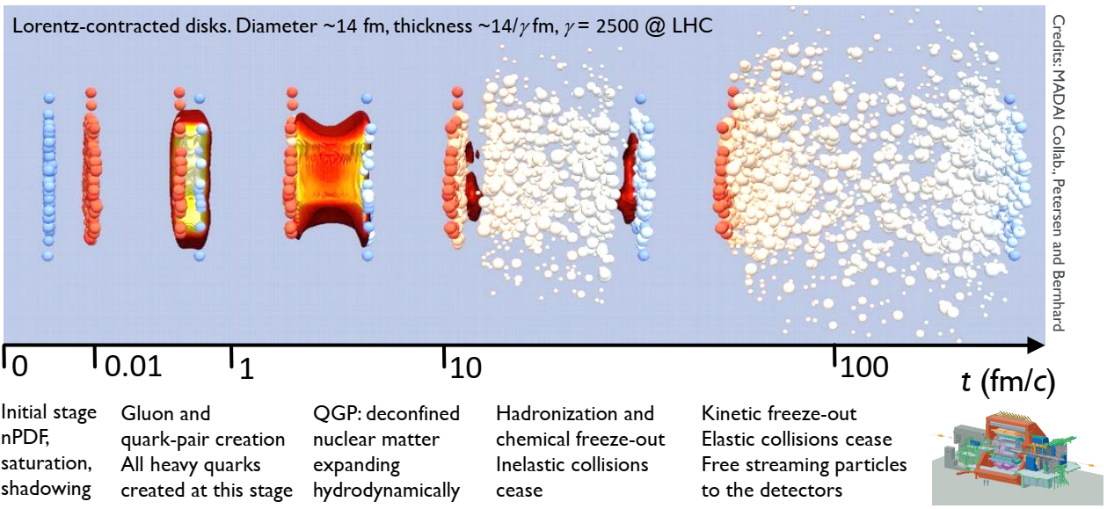
Heavy Ion Collisions
Create QGP by colliding ultra-relativistic heavy ions (at the LHC)

Slide 6
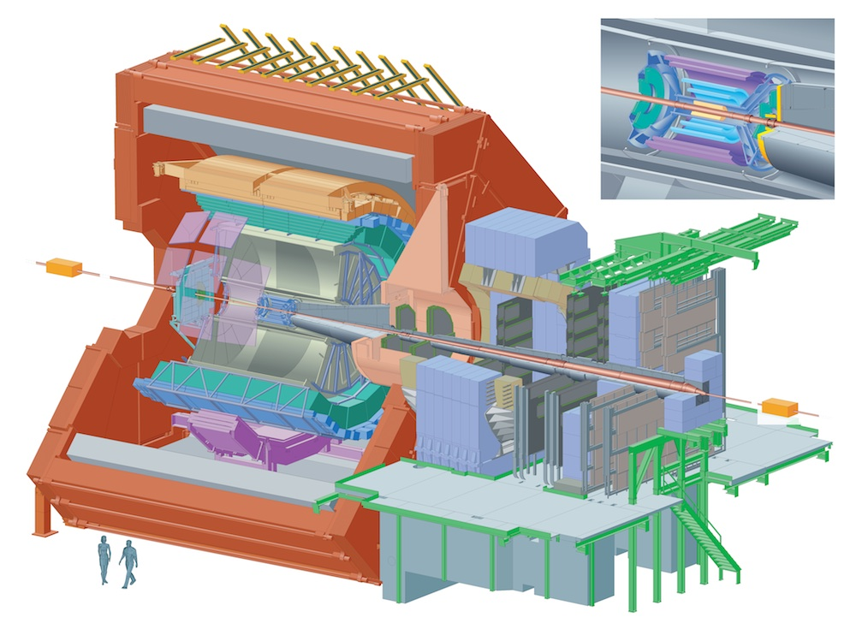






ALICE (A Large Ion Collider Experiment)
Central barrel
Tracking detectors
Particle identification
Calorimetry
B = 0.5 T
Acceptance
φ = {0,2π}
|η| < 0.9
η = 0.9
η = 0
η = –0.9
θ
Forward region
Muon spectrometer
ALICE-UK
Central Trigger Processor
Inner Tracking System
Definition:
Pseudorapidity
$$η=−\ln{\tan\left(θ/2\right)}$$

Slide 7
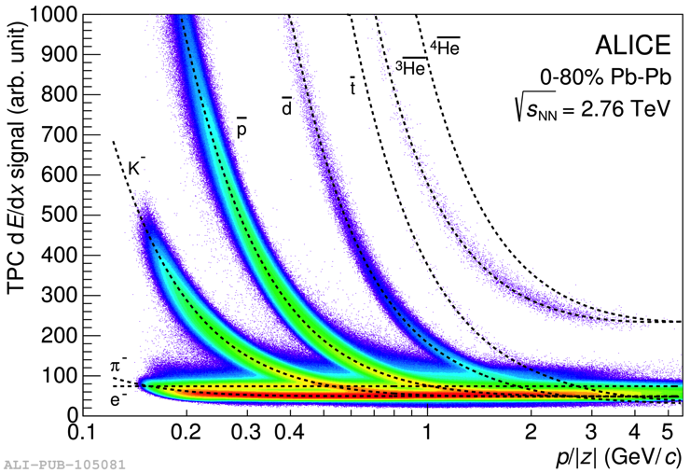
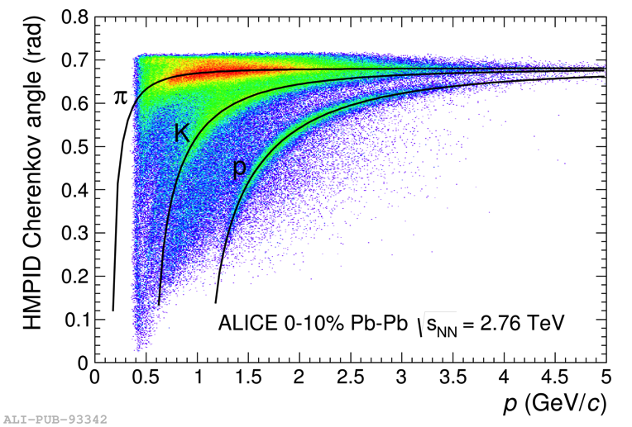
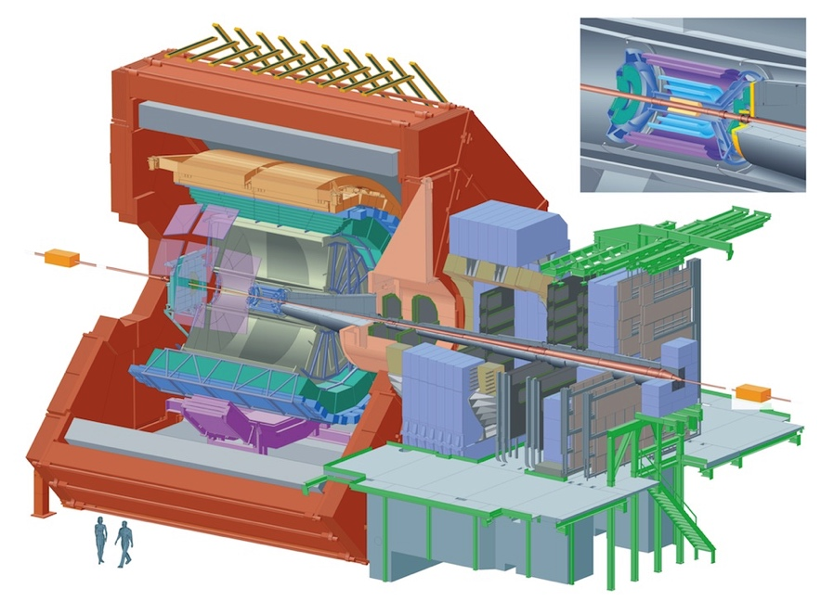
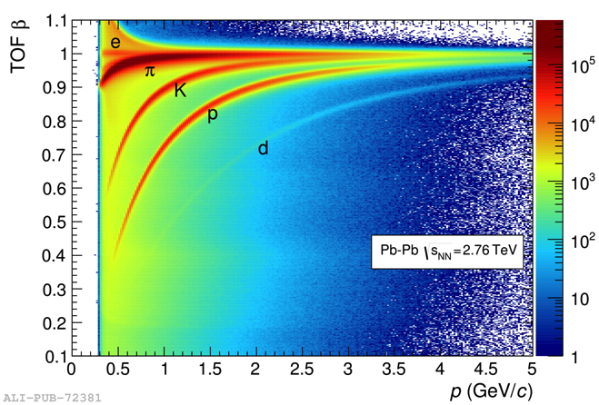
Particle Identification
TPC (+ ITS) dE/dx
HMPID – Cherenkov radiation
EMCAL
HMPID
TRD
TPC
ITS
TOF
PHOS
Barrel Time of Flight (TOF)
plus Transition radiation detector (TRD)
Photon spectrometer (PHOS), EM calorimeter (EMCAL)

Slide 8
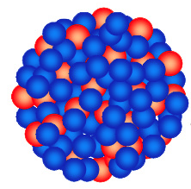
Collision Systems
Run 1: 2010-2013
Run 2: 2015-2018
Pb
Pb
b
Pb-Pb collisions
Hot QCD matter studies
√s_{NN} = 2.76, 5.02 TeV
Pb
p
b
p-Pb collisions
Cold nuclear matter effects
Are
QGP
effects
really
absent
here?
√s_{NN} = 5.02, 8.16 TeV
p
p
pp collisions
Standard QCD reference
√s = 0.9, 2.76, 5.02, 7, 13 TeV

Slide 9
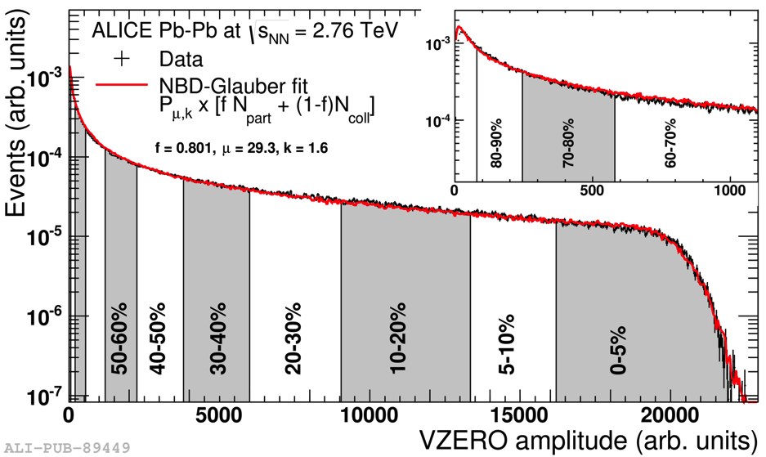
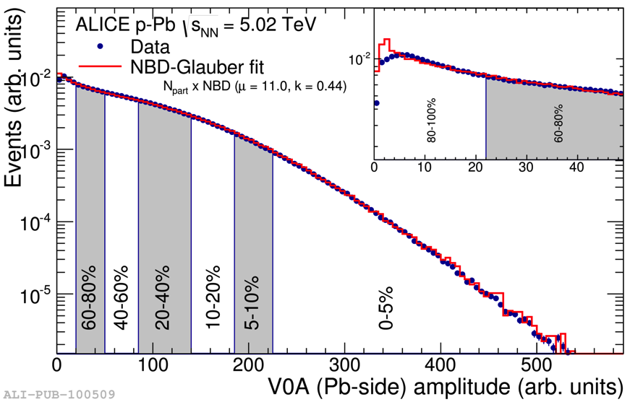
Measuring Centrality
Pb
Pb
Pb
b
p
b
Phys. Rev. C 88 (2013) 044909
Phys. Rev. C 91 (2015) 064905
Events are classified by dividing the multiplicity distribution into percentiles. Central collisions typically top 5% or 10% highest multiplicity.

Slide 10
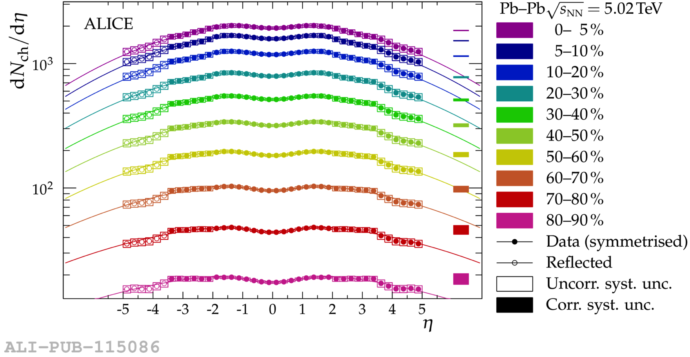
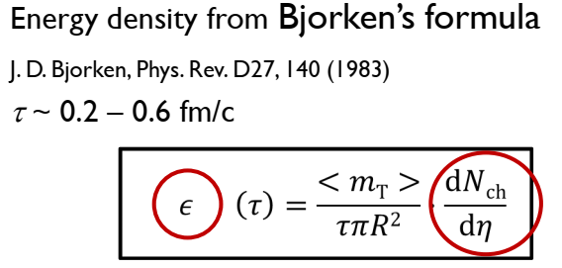
Charged particle multiplicity
TPC
SPD = Silicon Pixel Detector
FMD = Forward Multiplicity Detector
FMD
SPD
FMD
Total number of charged particles ≈ 21,500 in 0-5% central collisions
90º
40º
15º
6º
2º
dN_{ch}/dη |_{η=0} = 1943 ± 54 equivalent to ε ~ 18 GeV/fm³

Slide 11
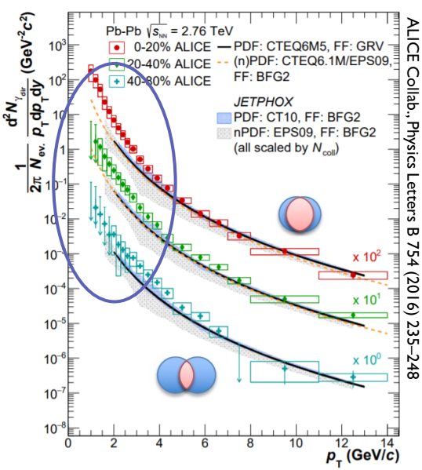
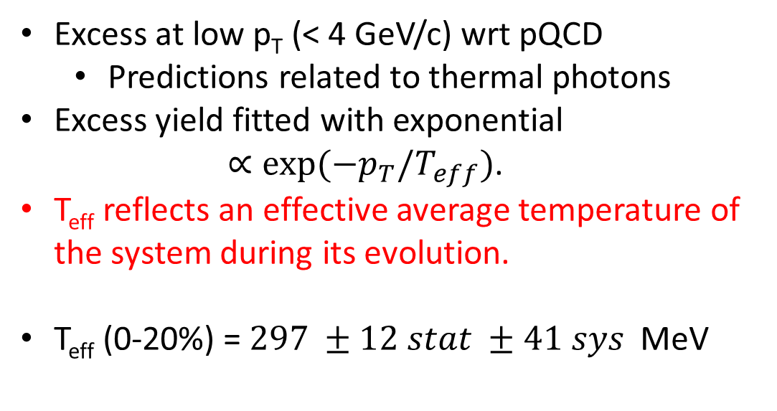
QGP Temperature from Direct Photons
Excess at low p_{T} (< 4 GeV/c) wrt pQCD
  Predictions related to thermal photons
Excess yield fitted with exponential $∝exp⁡(−p_{T}/T_{eff})$.
T_{eff} reflects an effective average temperature of the system during its evolution.
T_{eff} (0-20%) = $297 ±12 stat ±41 sys$ MeV
“Temperature” ≈ 300 MeV ( → highest man-made temperature)

Slide 12
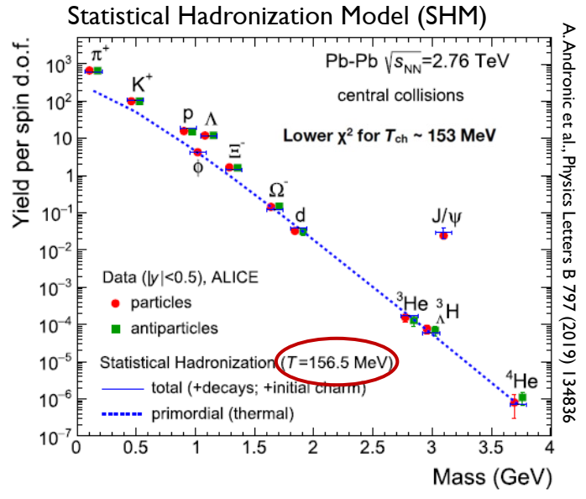
Temperature at Hadronization
At hadronization, system is close to thermal equilibrium.
A rapid freeze-out takes place at the phase boundary
Hadron yields described well by thermal model over 9 orders of magnitude.
Even loosely bound objects (light nuclei etc) are well described.

Slide 13
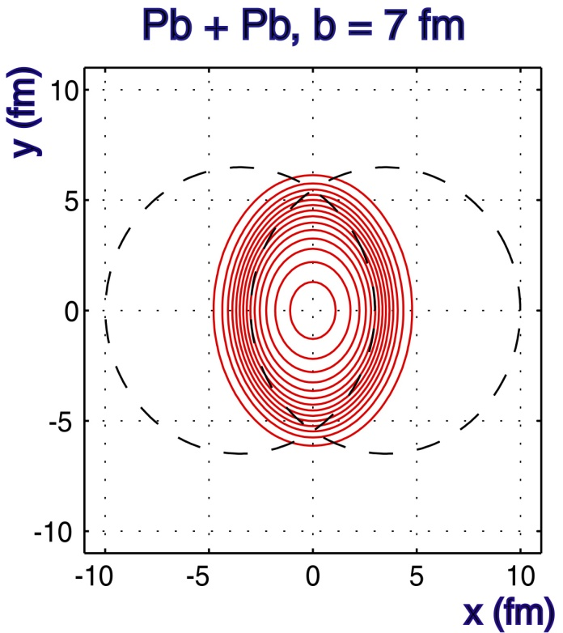
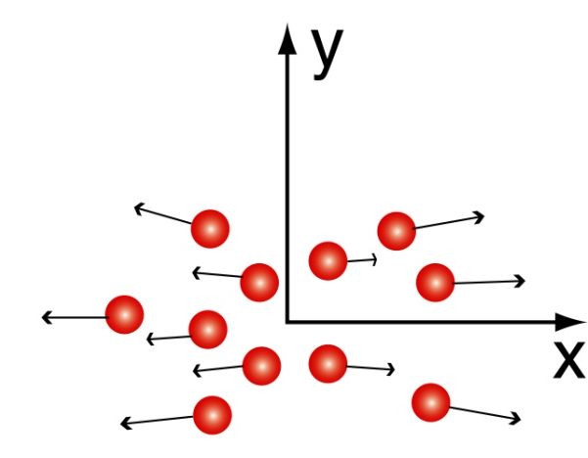
Is QGP a Liquid or Gas?
Study angular dependence of emitted particles
Equal energy density contours
y
z
x
P
p_{T}
v₂
φ
Fourier coefficient
Angle of reaction plane
V₁ = directed flow. V₂ = elliptic flow.

Slide 14
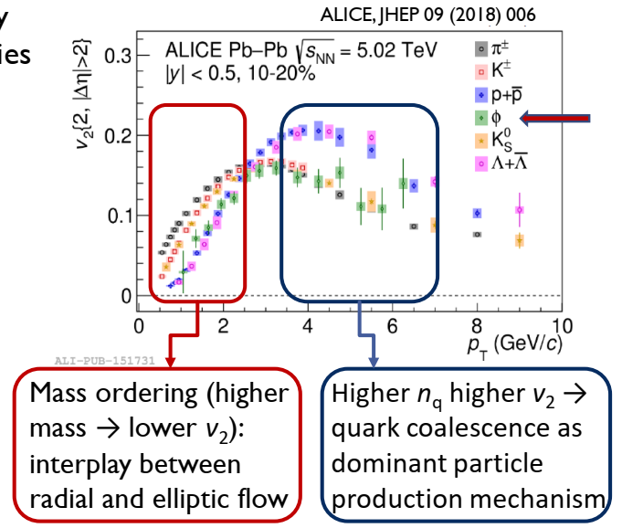
Elliptic Flow of System
Viscosity/Entropy density (η/S dimensionless number in natural units)
Theory prediction η/S > 1/4π ≈ 0.08
Result: The QGP is a (almost) perfect liquid
  QGP almost ideal fluid, η/S ≤ 0.2

Slide 15
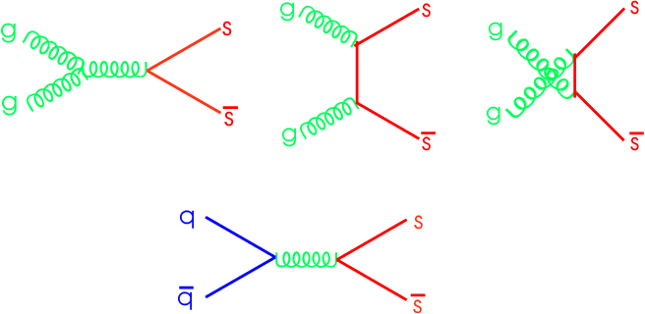
Strangeness Enhancement in QGP
Gluon-rich QGP:
Energy needed to produce ss pair = 2m_{s} ~ 200 MeV due to partial chiral symmetry restoration.
QGP temperature ~ 200 MeV ∴ easy to produce ss pairs.
Much more difficult to produce strange particles in hadronic interactions (esp. multi-strange).
Originally proposed as a signature of QGP formation in heavy-ion collisions
  Rafelski and Muller, PRL 48, (1982) 1066
Enhancement of strange particles expected, increasing with strangeness content for QGP

Slide 16
Multi-strange particle enhancement
Phys. Lett. B 728 (2014) 216–227
Multi-strange particle yields in Pb-Pb collsions are enhanced with respect to those in pp collisions
Enhancement increases with strangeness content
But at LHC energies, multiplicity in p-Pb collisions almost reaches that in peripheral Pb-Pb.
?
?
Is there evidence of an onset of strangeness enhancement going from small to large systems?

Slide 17
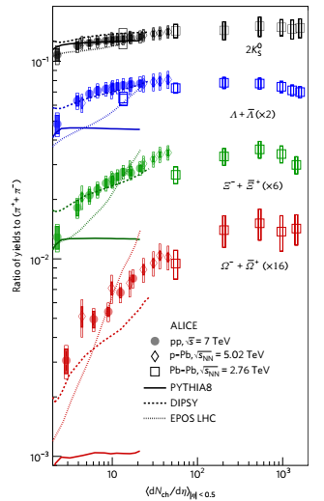
Enhancement of Strange Particles
Nature Physics 13, 535-539 (2017)
Smooth evolution of particle production from small to large systems (vs multiplicity)
Strangeness enhancement increasing with multiplicity until saturation in Pb-Pb
The higher the strangeness content, the steeper the enhancement
Depends on multiplicity only – not system size or energy
Common mechanism for all systems?
Will enhancement saturate in p-Pb and p-p at the same level as Pb-Pb?

Slide 18

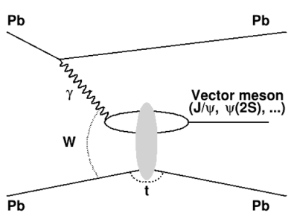
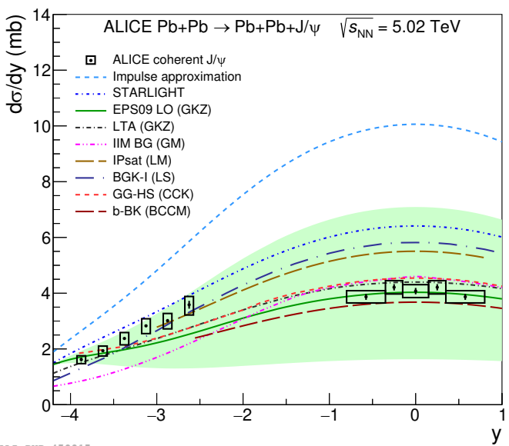
Ultra-Peripheral Collisions (UPC)
Pb
Pb
b
Provides source of ~1 TeV (quasi-real) photons to probe nuclear Generalised Parton Distribution functions
(UPC Pb-Pb) and proton structure functions (UPC Pb-p).
Coherent J/ψ cross-section
Favours models where colliding nuclei are partially concealed by gluon field (nuclear shadowing)

Slide 19
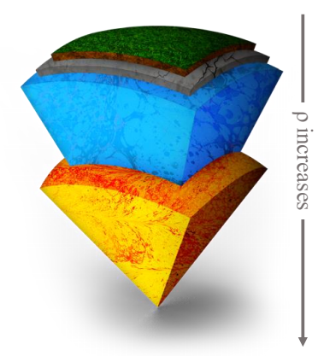
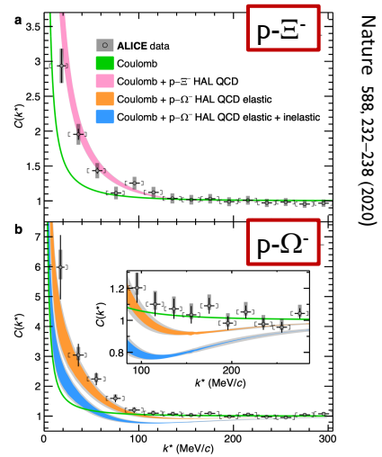
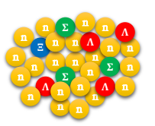
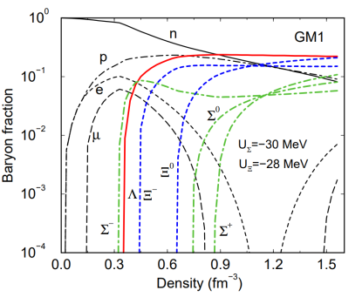
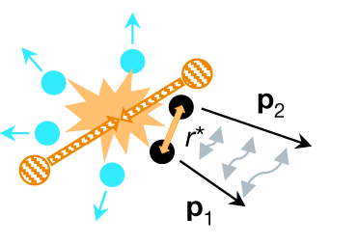
Non-QGP Physics: Hadron-Hyperon Interactions
Neutron star inner core
Composition still unknown (neutrons, protons, hyperons, quark matter?)
Depends on constituent interactions and couplings
First precise observation of attractive strong interaction between p and Ξ⁻ or Ω⁻

Slide 20
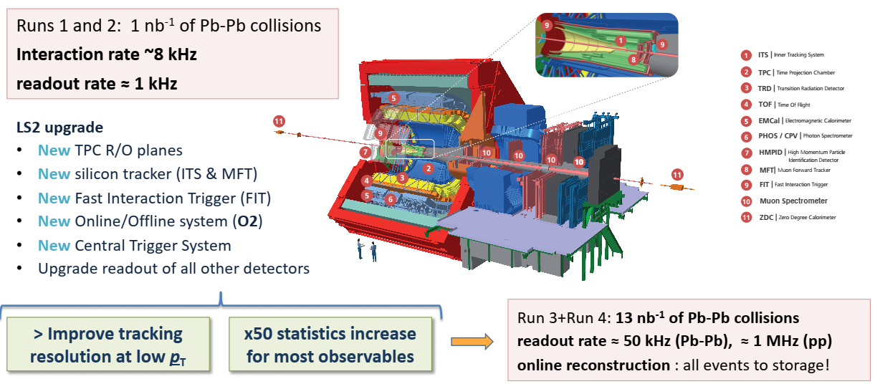
ALICE Upgrade for LHC Runs 3 & 4
Derby – Software innovations AI, ML etc.
Birmingham – sole responsibility for Trigger System
Liverpool and Daresbury Lab – built large part of outer two barrels of 12.5 G-pixel ITS

Slide 21
Summary
Energy density >> critical value
Flow consistent with perfect liquid
Particle yields appear to be frozen-in close to hadronisation
Strangeness enhancement observed in pp and p-Pb collisions
Ultra-peripheral collisions help to constrain initial state
Rich programme of non-QGP physics also available
…
ALICE is being upgraded ready for LHC Run 3 (2022+)
Readout rate for Pb-Pb will increase from 1 kHz to 50 kHz
New ITS will improve measurements of heavy flavour hadrons
UK playing leading roles in both the upgrade and in the physics.
Looking forward to a lot of exciting results from Run 3
Thank you for listening

Slide 22
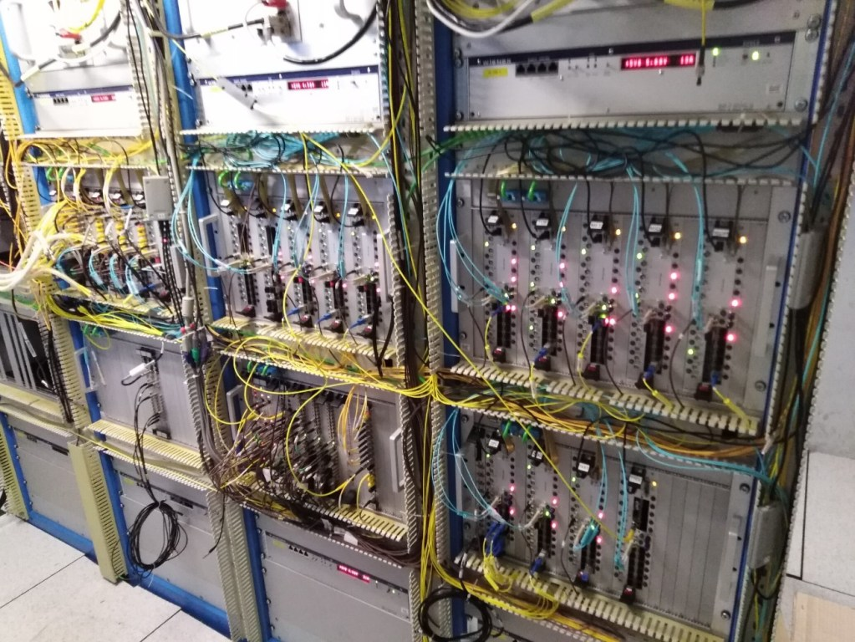
New Trigger System
Completely new ALICE trigger system designed and built by the UK (Birmingham).
Consists of a Central Trigger Processor (CTP) and 14 Local Trigger Units (LTUs), one for each subdetector.
  LTUs have built-in CTP emulator for stand-alone running.
CTP has zero dead-time
  i.e. can receive inputs and deliver triggers every 25ns bunch-crossing,
In addition, CTP monitors and controls all (>500) Common Readout Units (CRUs) of upgraded detectors.
  Can slow down readout rate if CRU buffers become full.

Slide 23
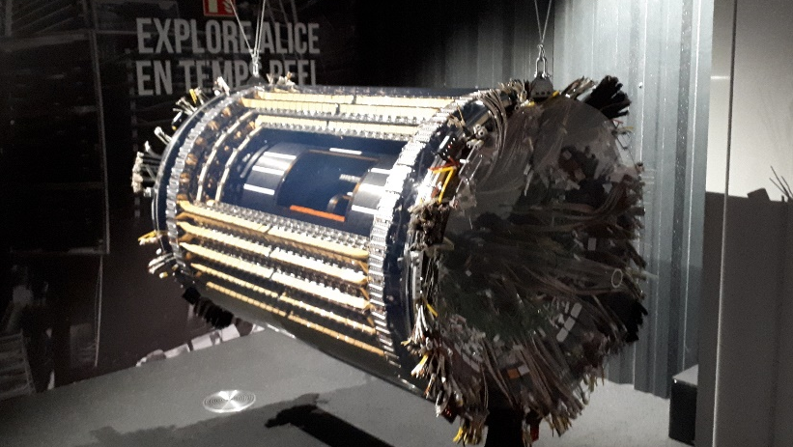
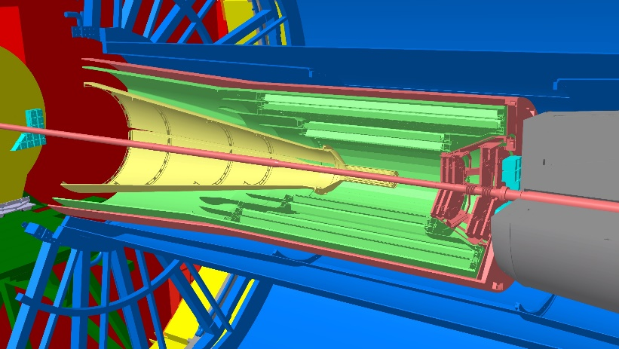
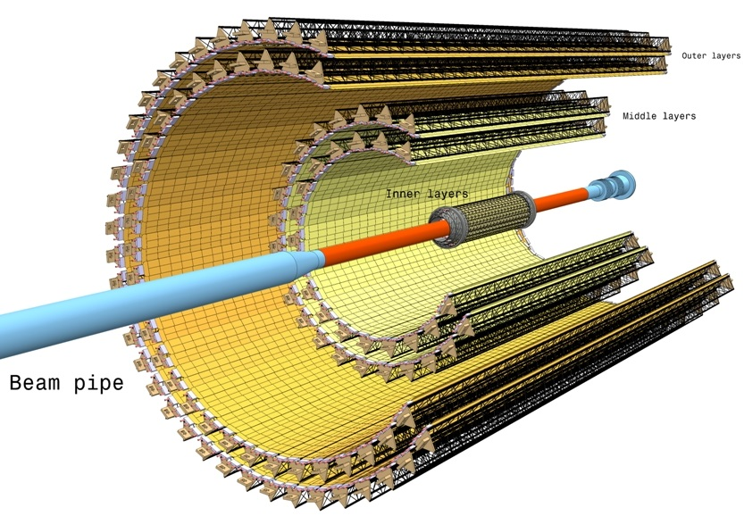
Inner Tracking System Upgrade
Liverpool and Daresbury
ITS11
ITS2
ITS2
12.5 G-pixel camera
taking 50000 pictures/s
(~10 m²)
40 cm
ITS2 has a barrel geometry:
- 7 layers; 3 (IL), 2 (ML), 2(OL)
- 192 staves; 48 (IL), 54 (ML), 90 (OL)
147 cm

Slide 24

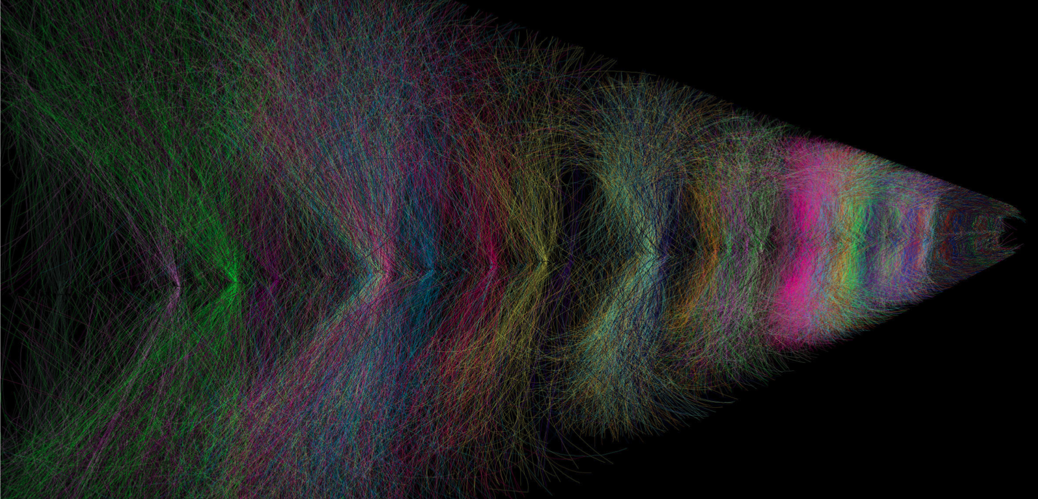
Contribution to Upgrade Software
The ALICE upgrade requirements include
  increased (~50x) data-taking rate
  switch to continuous readout
  prompt reconstruction of data
Many software developments are required. The University of Derby’s current and recent contributions, under the O² umbrella, include:
  An AI-based approach to detector monitoring,
  C. Bower “Adversarial thresholding semi-bandits for online monitoring of ALICE detector controls”, PhD Thesis (2020)
  Developments in machine learning, Graph-based Neural Network, for charm decay recognition (PhD ongoing)
  Reconstruction algorithms for weakly decaying strange particles in the continuous readout environment (PhD ongoing)
Overlapping events in ALICE Time Projection Chamber
Examples of charmed baryon decays with weakly decaying strange particles in decay chain

