Slide 1


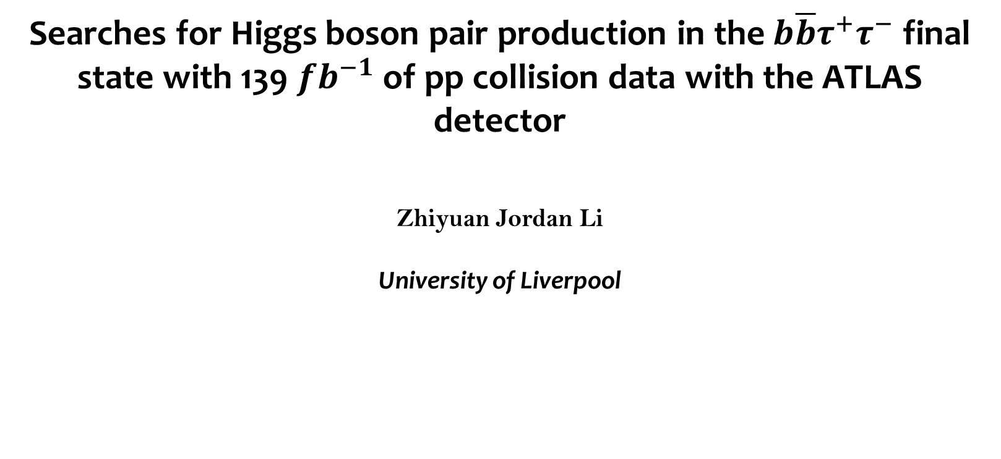
Searches for Higgs boson pair production in the $b\overline{b}τ^{+}τ^{−}$ final state with 139 $fb^{−1}$ of pp collision data with the ATLAS detector
Zhiyuan Jordan Li
University of Liverpool

Slide 2
Overview
List of contents:
Motivation of di-Higgs searches (p3-p4)
Signal and background (p5-p6)
Object reconstruction and event selection (p7-p8)
MVA classification (p9)
Uncertainties (p10)
Limit setting (p11)

Slide 3
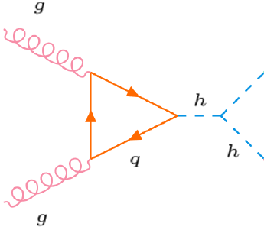
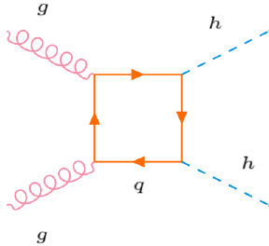
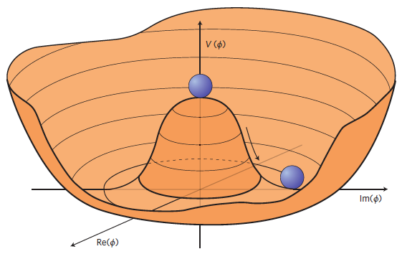
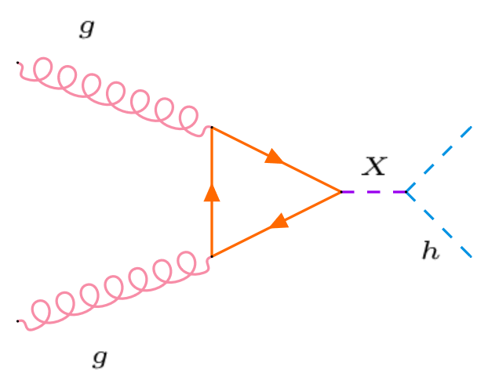




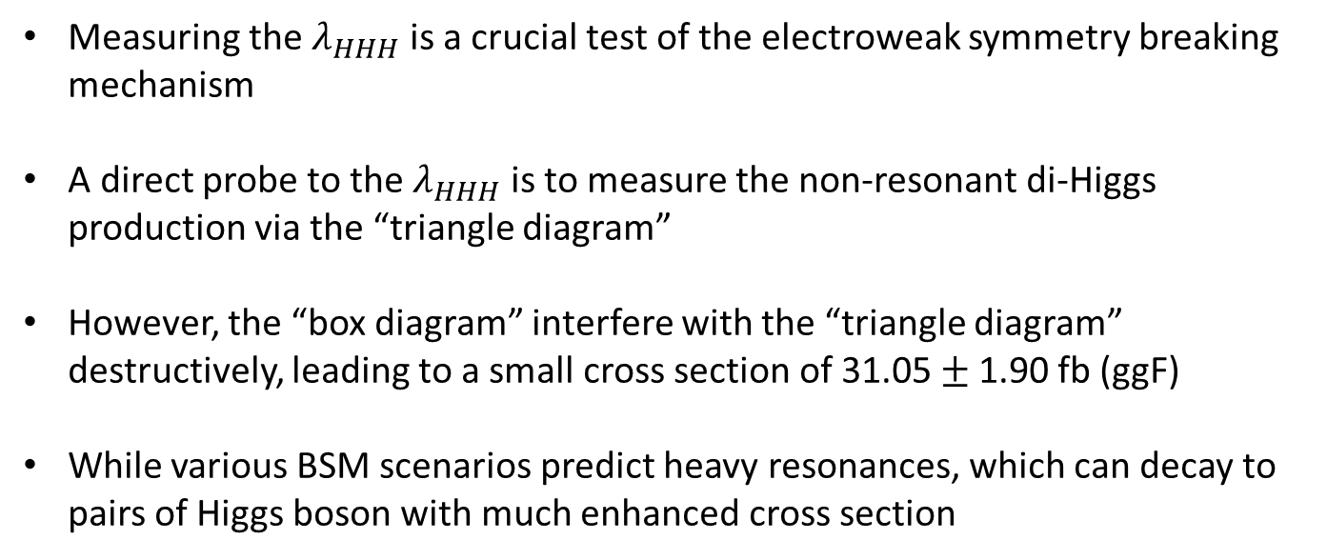
Motivation
Measuring the $λ_{HHH}$ is a crucial test of the electroweak symmetry breaking mechanism
A direct probe to the $λ_{HHH}$ is to measure the non-resonant di-Higgs production via the “triangle diagram”
However, the “box diagram” interfere with the “triangle diagram” destructively, leading to a small cross section of 31.05$±$1.90 fb (ggF)
While various BSM scenarios predict heavy resonances, which can decay to pairs of Higgs boson with much enhanced cross section
Non-resonant production
$$λ_{HHH}$$
$$y_{t}$$
$$y_{t}$$
$$y_{t}$$
resonant production
$$V\left(φ\right)=\frac{1}{2}m_{h}^{2}h^{2}+λvh^{3}+\frac{λ}{4}h^{4}=m_{h}^{2}\frac{h^{2}}{2}+λ_{HHH}\frac{h^{3}}{3!}+λ_{HHHH}\frac{{ h}^{4}}{4!}$$
Higgs potential:

Slide 4
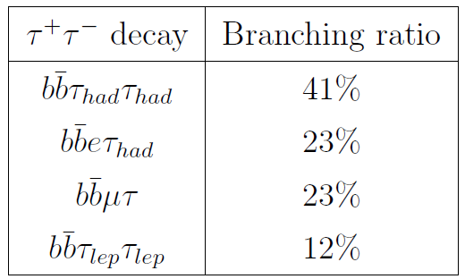

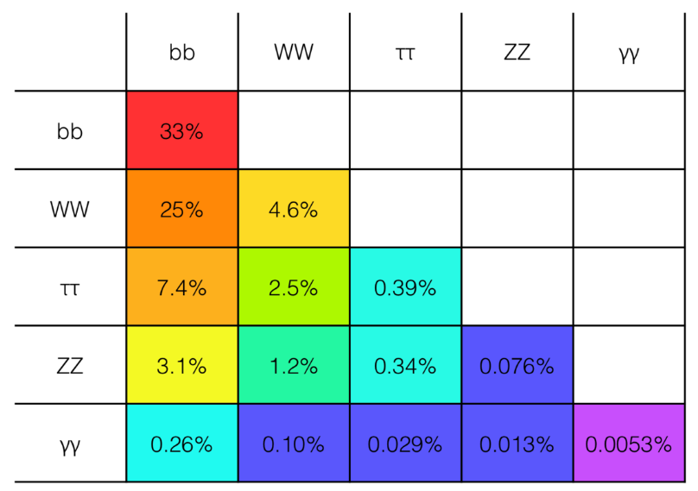
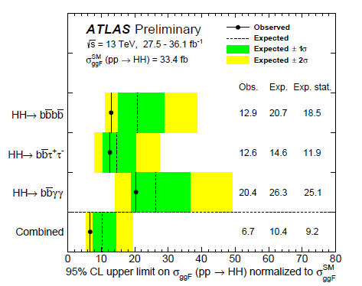
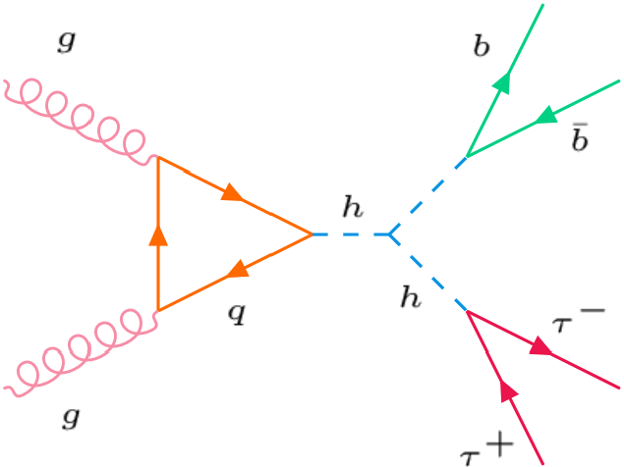
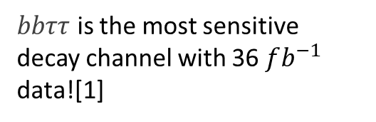
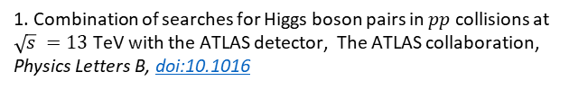
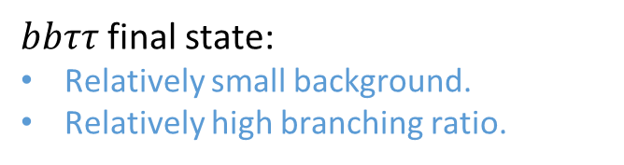
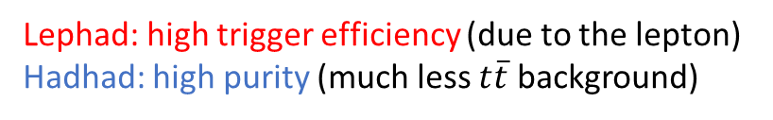
Motivation
$bbττ$final state:
Relatively small background.
Relatively high branching ratio.
HadHad channel
LepHad channel
Branching ratio:
Analysis I am working on
Lephad: high trigger efficiency (due to the lepton)
Hadhad: high purity (much less $t\overline{t}$ background)
$bbττ$ is the most sensitive decay channel with 36 $fb^{−1}$ data![1]
1. Combination of searches for Higgs boson pairs in $pp$ collisions at $\sqrt{s} =13$ TeV with the ATLAS detector, The ATLAS collaboration, Physics Letters B, doi:10.1016

Slide 5
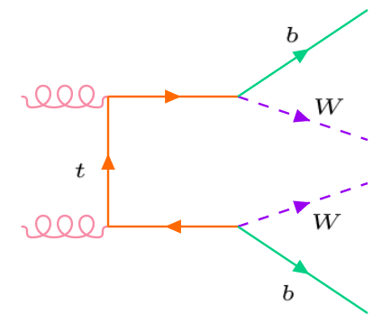
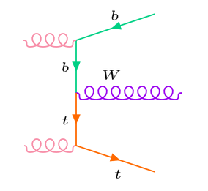
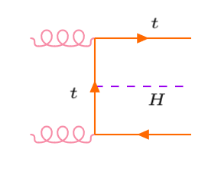
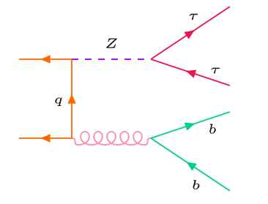

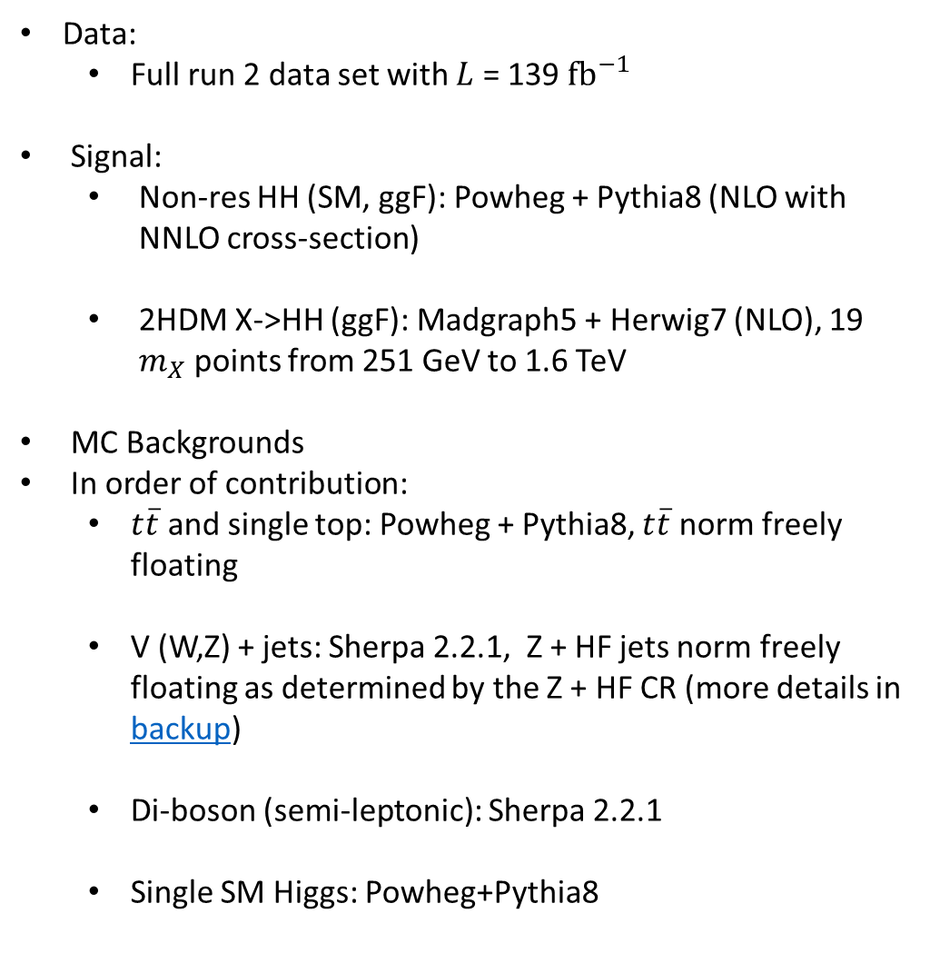
Signal and background
Data:
  Full run 2 data set with $L$ = 139 ${fb}^{−1}$
Signal:
  Non-res HH (SM, ggF): Powheg + Pythia8 (NLO with NNLO cross-section)
  2HDM X->HH (ggF): Madgraph5 + Herwig7 (NLO), 19 $m_{X}$ points from 251 GeV to 1.6 TeV
MC Backgrounds
In order of contribution:
  $t\overline{t}$ and single top: Powheg + Pythia8, $t\overline{t}$ norm freely floating
  V (W,Z) + jets: Sherpa 2.2.1, Z + HF jets norm freely floating as determined by the Z + HF CR (more details in backup)
  Di-boson (semi-leptonic): Sherpa 2.2.1
  Single SM Higgs: Powheg+Pythia8
Single top process
$t\overline{t}$ process
Single Higgs process
Z + jets process

Slide 6
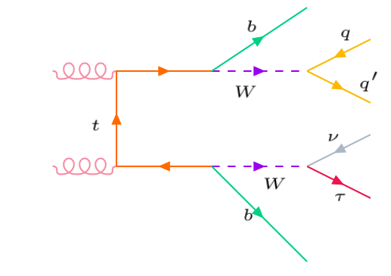
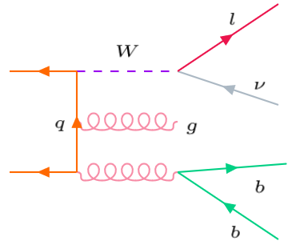
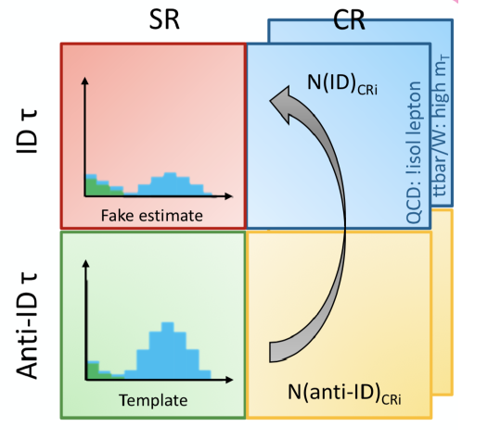
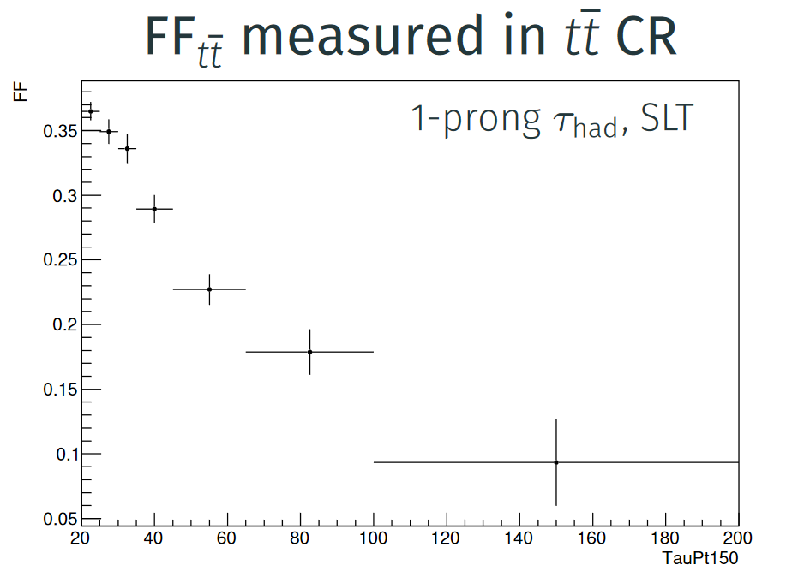

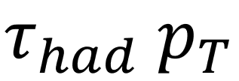
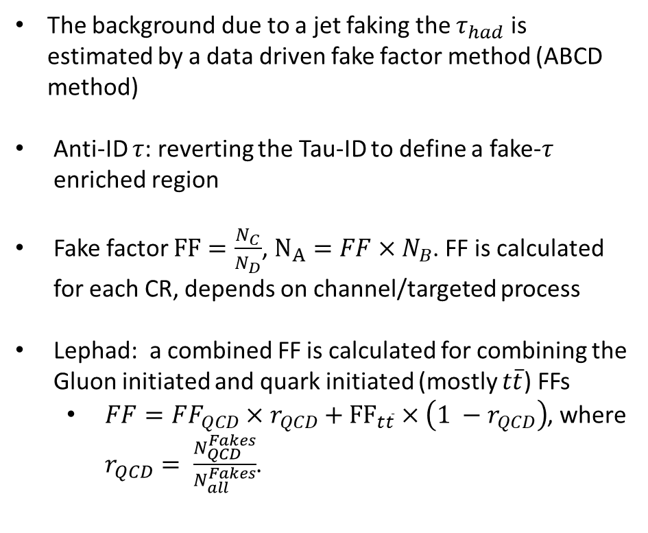


Background estimation: jet faking $τ_{had}$
jet faking $τ_{had}$
The background due to a jet faking the $τ_{had}$is estimated by a data driven fake factor method (ABCD method)
Anti-ID $τ$: reverting the Tau-ID to define a fake-$τ$ enriched region
Fake factor $FF=\frac{N_{C}}{N_{D}}$, $N_{A}=FF×N_{B}$. FF is calculated for each CR, depends on channel/targeted process
Lephad: a combined FF is calculated for combining the Gluon initiated and quark initiated (mostly $t\overline{t}$) FFs
  $FF=FF_{QCD}×r_{QCD}+{FF}_{t\overline{t}}×\left(1 −r_{QCD}\right)$, where $r_{QCD}= \frac{N_{QCD}^{Fakes}}{N_{all}^{Fakes}}$.
Quark initiated
Gluon initiated
A
C
B
D

Slide 7
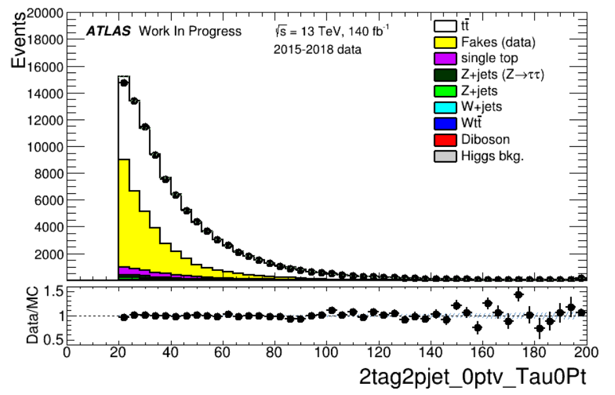

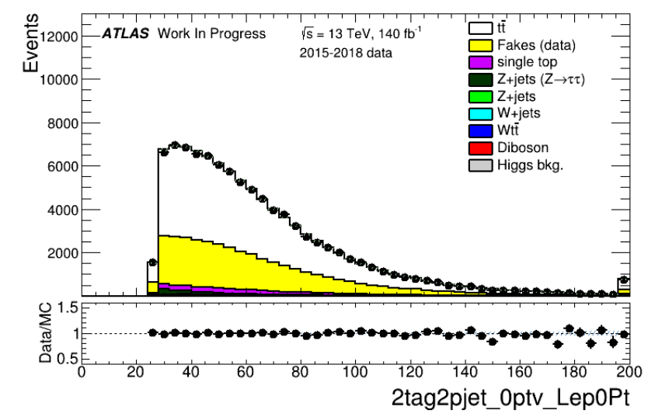
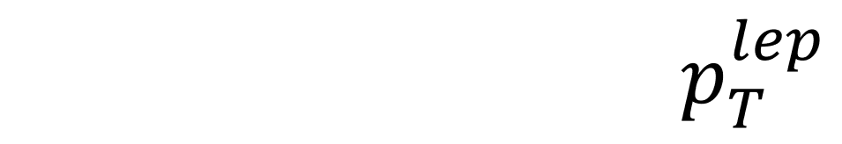
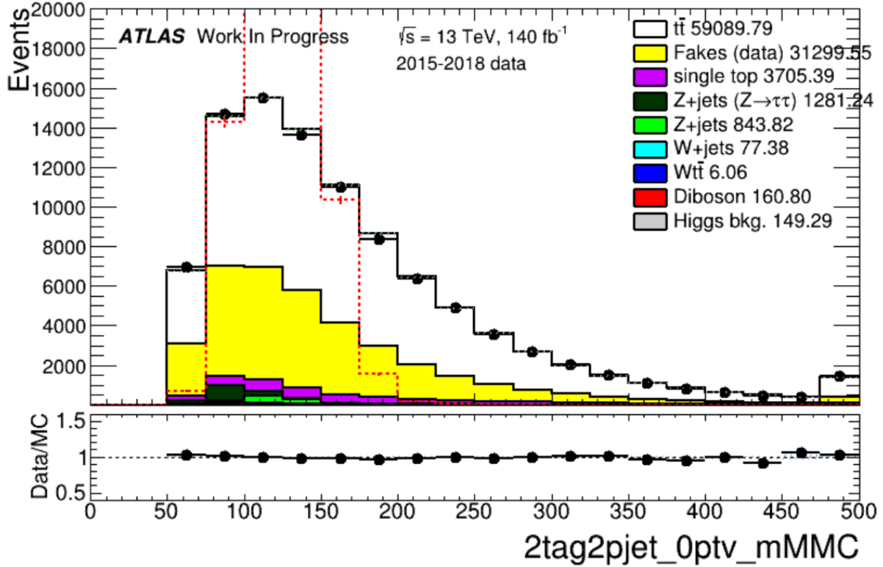


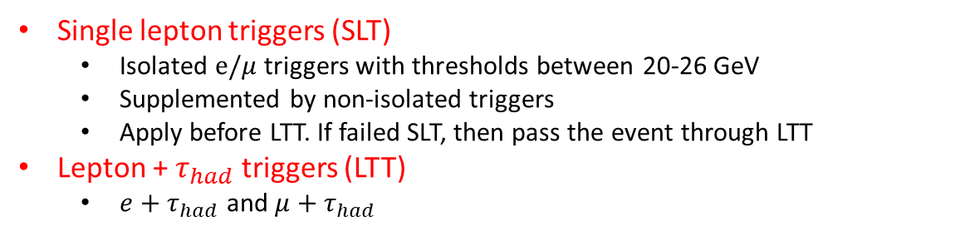
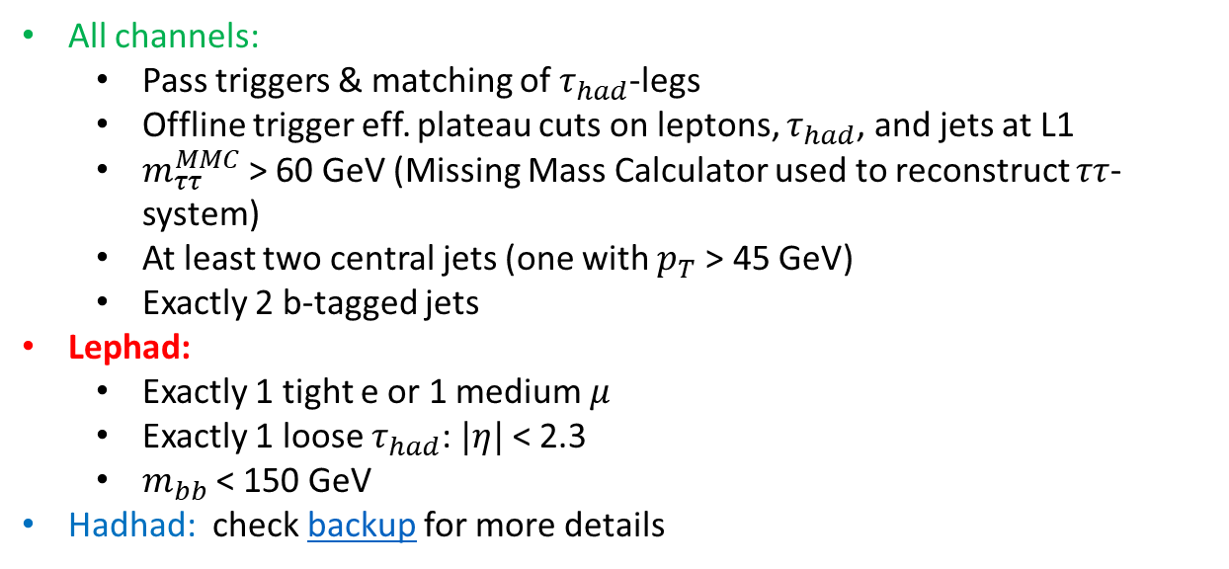

Selection
Selection
Triggers: Lephad
SR: Preselection
Single lepton triggers (SLT)
  Isolated $e/μ$ triggers with thresholds between 20-26 GeV
  Supplemented by non-isolated triggers
  Apply before LTT. If failed SLT, then pass the event through LTT
Lepton + $τ_{had}$ triggers (LTT)
  $e+τ_{had}$ and $μ+τ_{had}$
Lephad SLT: $τ_{had} p_{T}$
Event selection
Lephad SLT: lepton $p_{T}$
All channels:
  Pass triggers & matching of $τ_{had}$-legs
  Offline trigger eff. plateau cuts on leptons, $τ_{had}$, and jets at L1
  $m_{ττ}^{MMC}$> 60 GeV (Missing Mass Calculator used to reconstruct $ττ$-system)
  At least two central jets (one with $p_{T}$> 45 GeV)
  Exactly 2 b-tagged jets
Lephad:
  Exactly 1 tight e or 1 medium $μ$
  Exactly 1 loose $τ_{had}$: $|η|$< 2.3
  $m_{bb}$< 150 GeV
Hadhad: check backup for more details
Lephad SLT: $m_{ττ}^{MMC}$

Slide 8
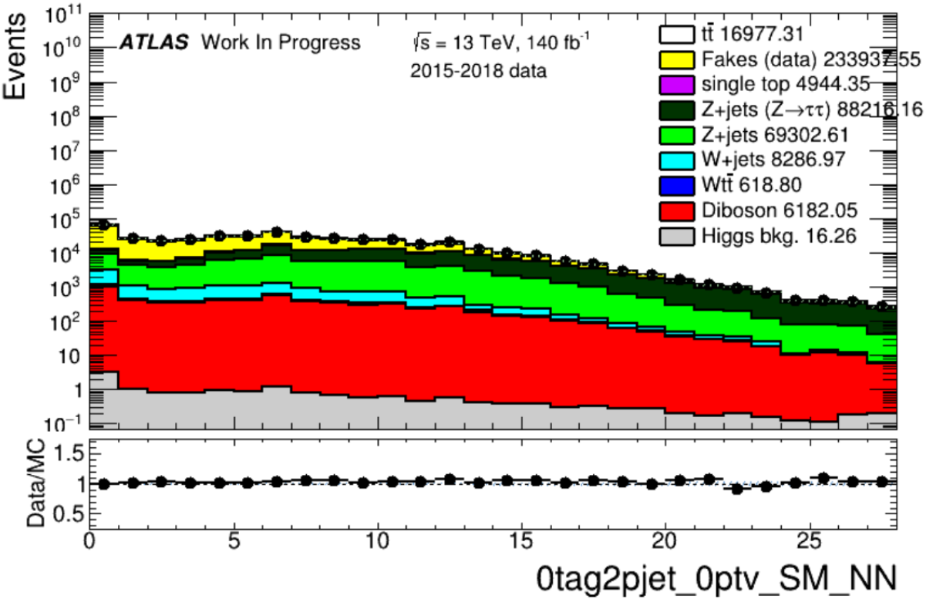
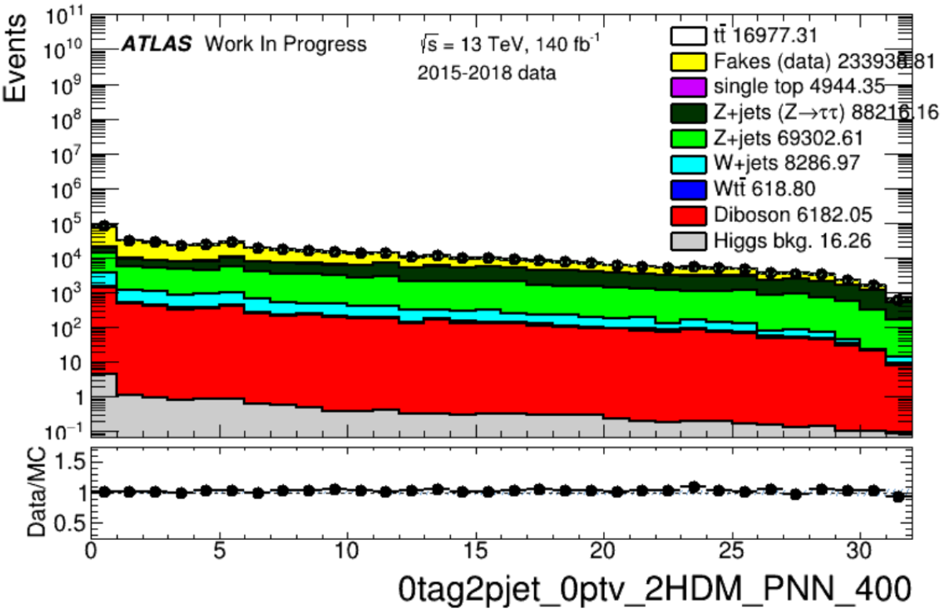
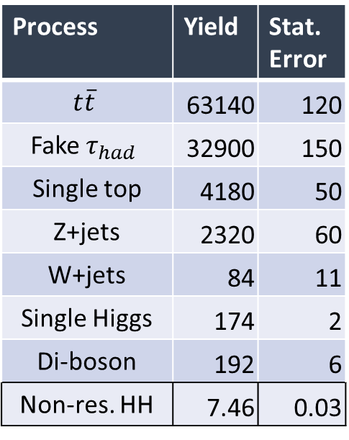
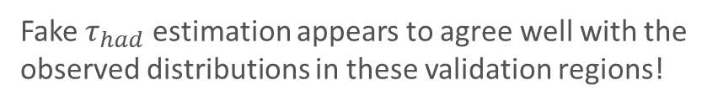
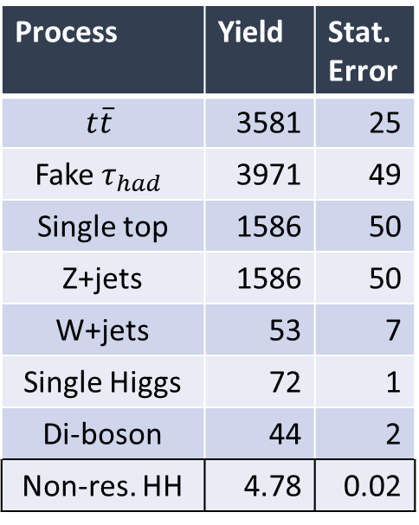
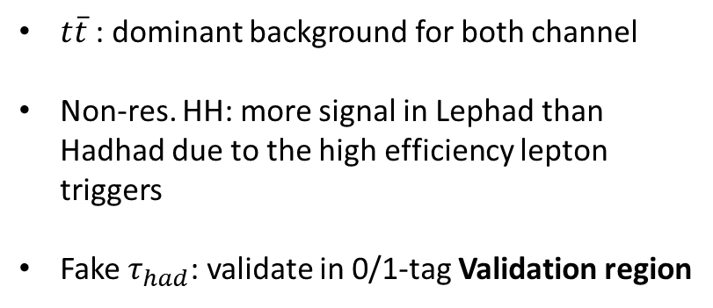
Selection: Yields
$t\overline{t}$: dominant background for both channel
Non-res. HH: more signal in Lephad than Hadhad due to the high efficiency lepton triggers
Fake $τ_{had}$: validate in 0/1-tag Validation region
Lephad
Hadhad
Process | Yield | Stat. Error
$$t\overline{t}$$ | 63140 | 120
Fake $τ_{had}$ | 32900 | 150
Single top | 4180 | 50
Z+jets | 2320 | 60
W+jets | 84 | 11
Single Higgs | 174 | 2
Di-boson | 192 | 6
Non-res. HH | 7.46 | 0.03
Process | Yield | Stat. Error
$$t\overline{t}$$ | 3581 | 25
Fake $τ_{had}$ | 3971 | 49
Single top | 1586 | 50
Z+jets | 1586 | 50
W+jets | 53 | 7
Single Higgs | 72 | 1
Di-boson | 44 | 2
Non-res. HH | 4.78 | 0.02
0-tag region: high statistics and relatively background-enriched
1-tag region: closer to the SR
Fake $τ_{had}$estimation appears to agree well with the observed distributions in these validation regions!

Slide 9
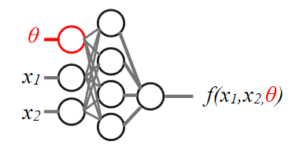
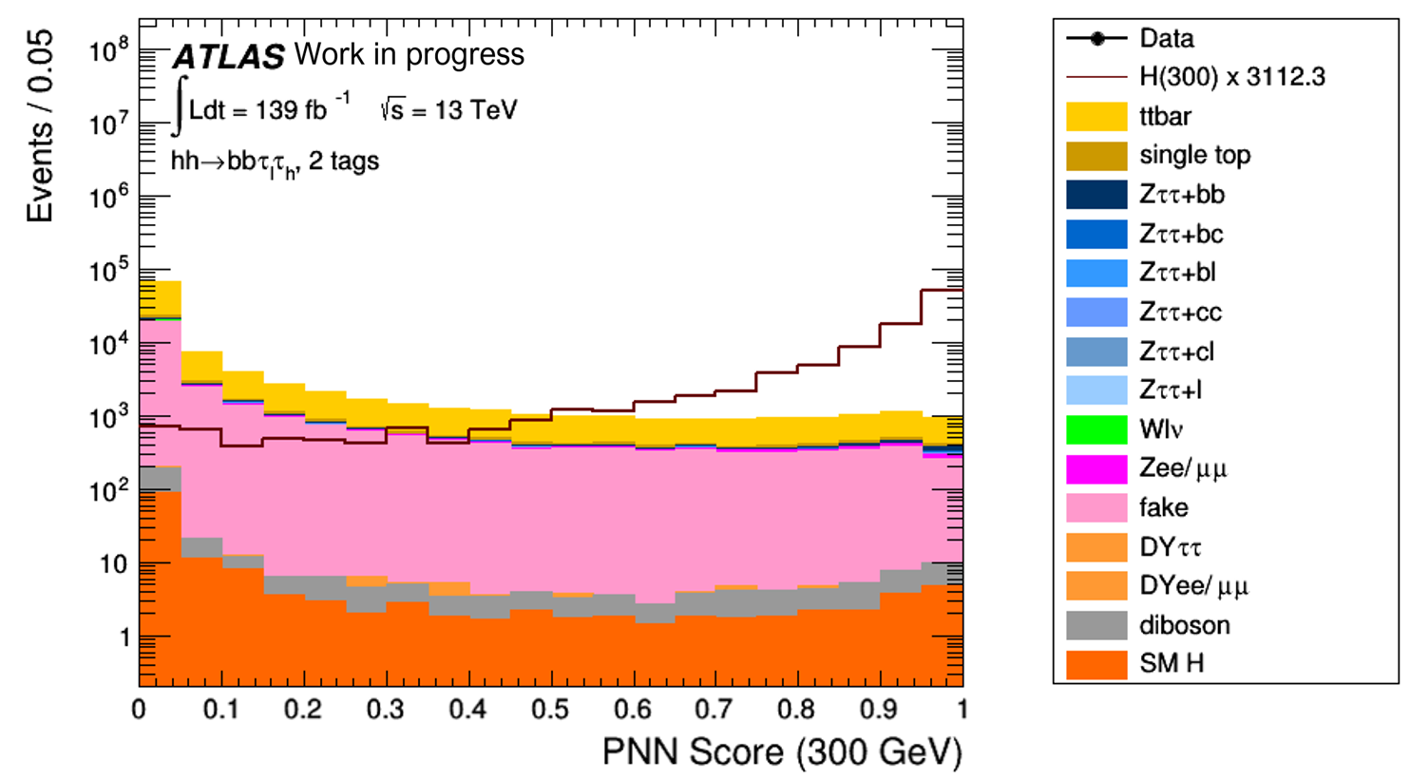

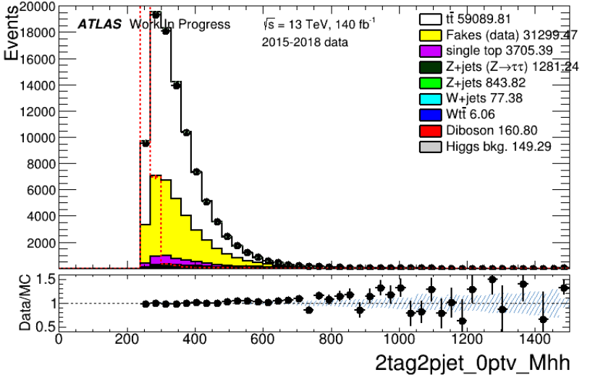

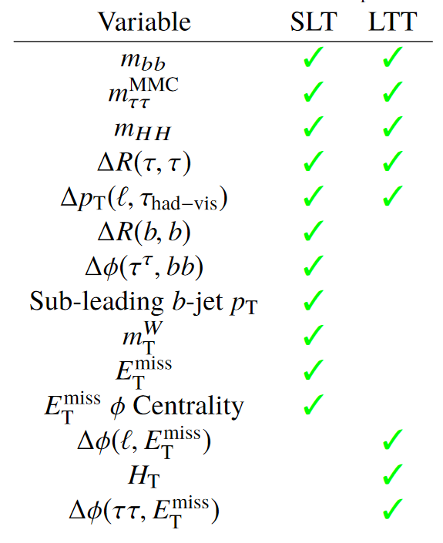
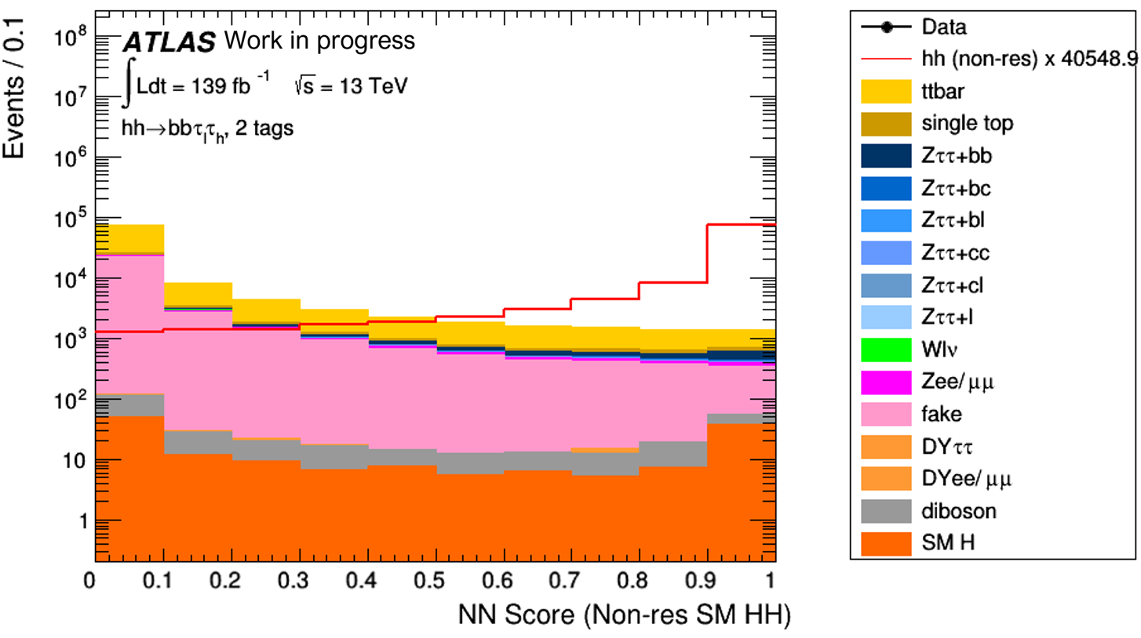
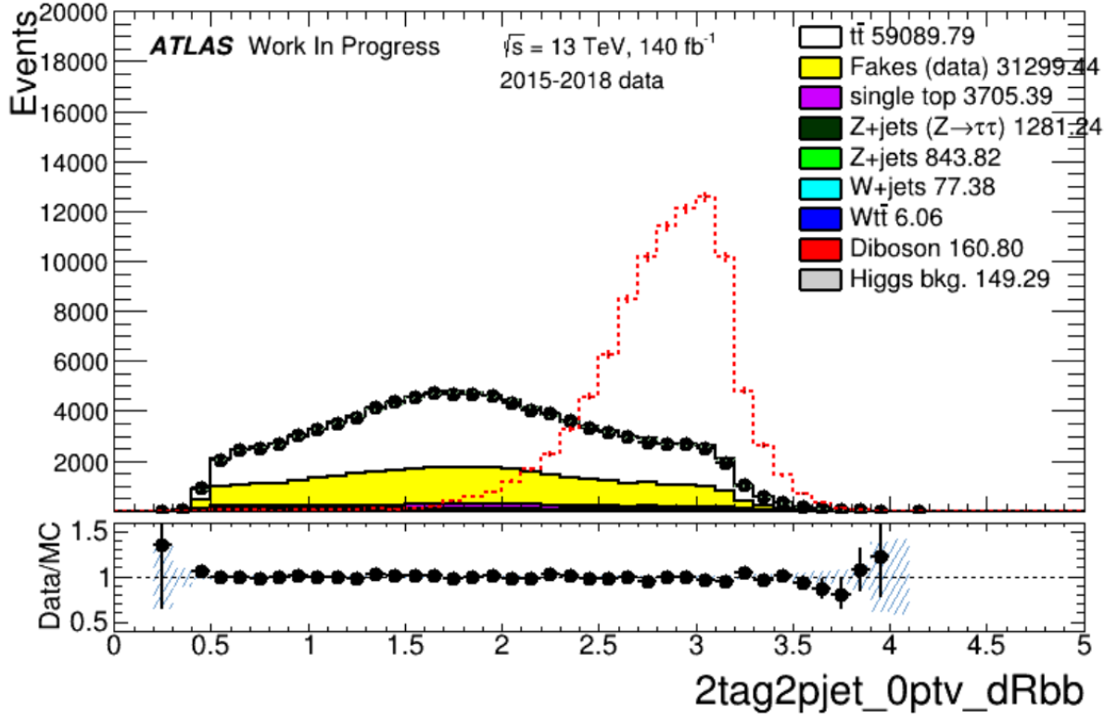

MVA classification
Parametric Neural Network (PNN) is used for the resonant signal for both Lephad and Hadhad
  Parametrised by resonant mass
NN(BDT) is used for Lephad (Hadhad) non-resonant
Signal scale to integral of background
300 GeV resonant
PNN score
SM signal
NN score
Lephad Input
(SR preselection)

Slide 10
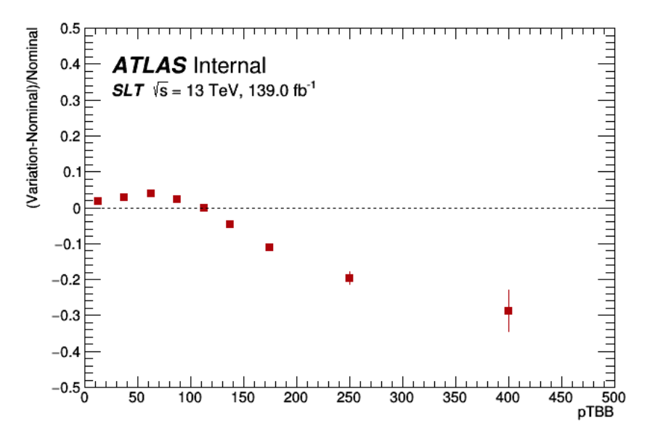



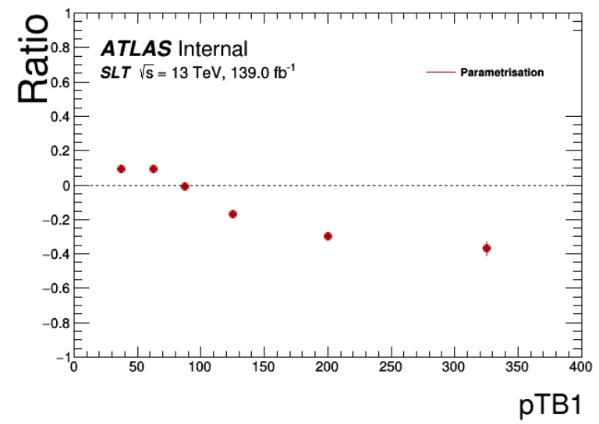


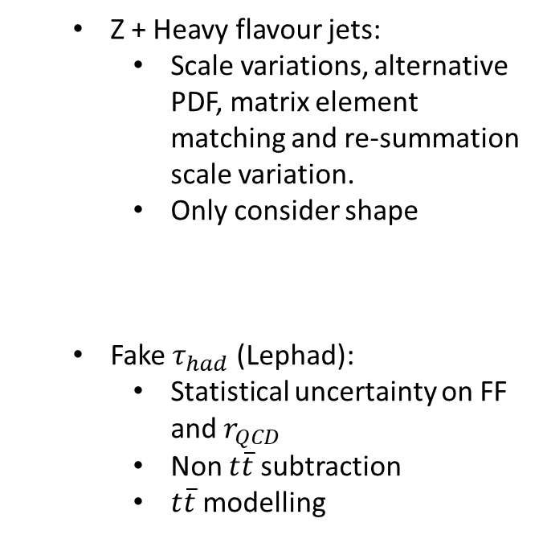
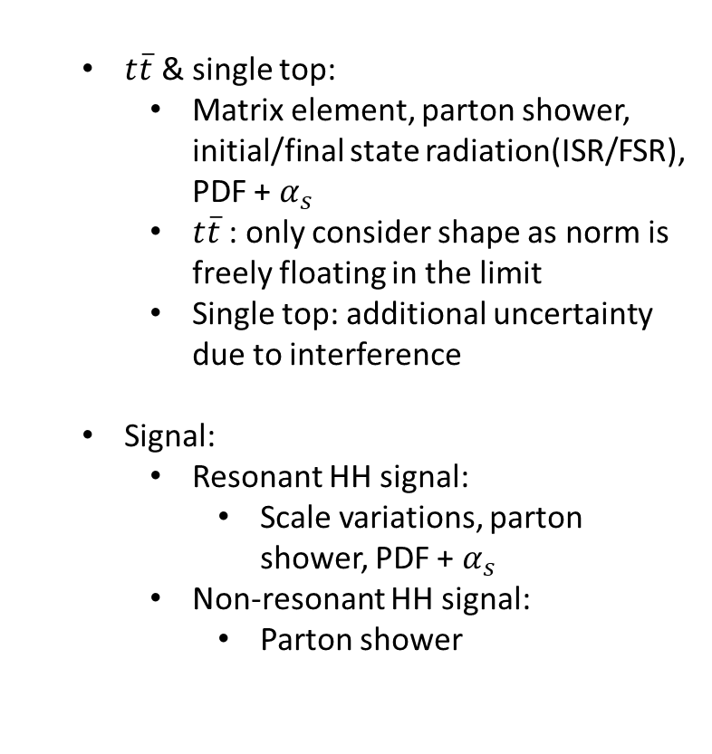
Uncertainties
Experimental uncertainties:
  Uncertainties on efficiencies, resolution, scale etc. of physics objects. Check backup for more details
General approach: split the normalisation and shape then parametrise the shape
Modelling uncertainties for major background
  $t\overline{t}$ & single top:
    Matrix element, parton shower, initial/final state radiation(ISR/FSR), PDF + $α_{s}$
    $t\overline{t}$: only consider shape as norm is freely floating in the limit
    Single top: additional uncertainty due to interference
  Signal:
    Resonant HH signal:
      Scale variations, parton shower, PDF + $α_{s}$
    Non-resonant HH signal:
      Parton shower
$$ttbar$$
  Z + Heavy flavour jets:
    Scale variations, alternative PDF, matrix element matching and re-summation scale variation.
    Only consider shape
  Fake $τ_{had}$ (Lephad):
    Statistical uncertainty on FF and $r_{QCD}$
    Non $t\overline{t}$subtraction
    $t\overline{t}$modelling
ttbar
Examples of systematics

Slide 11
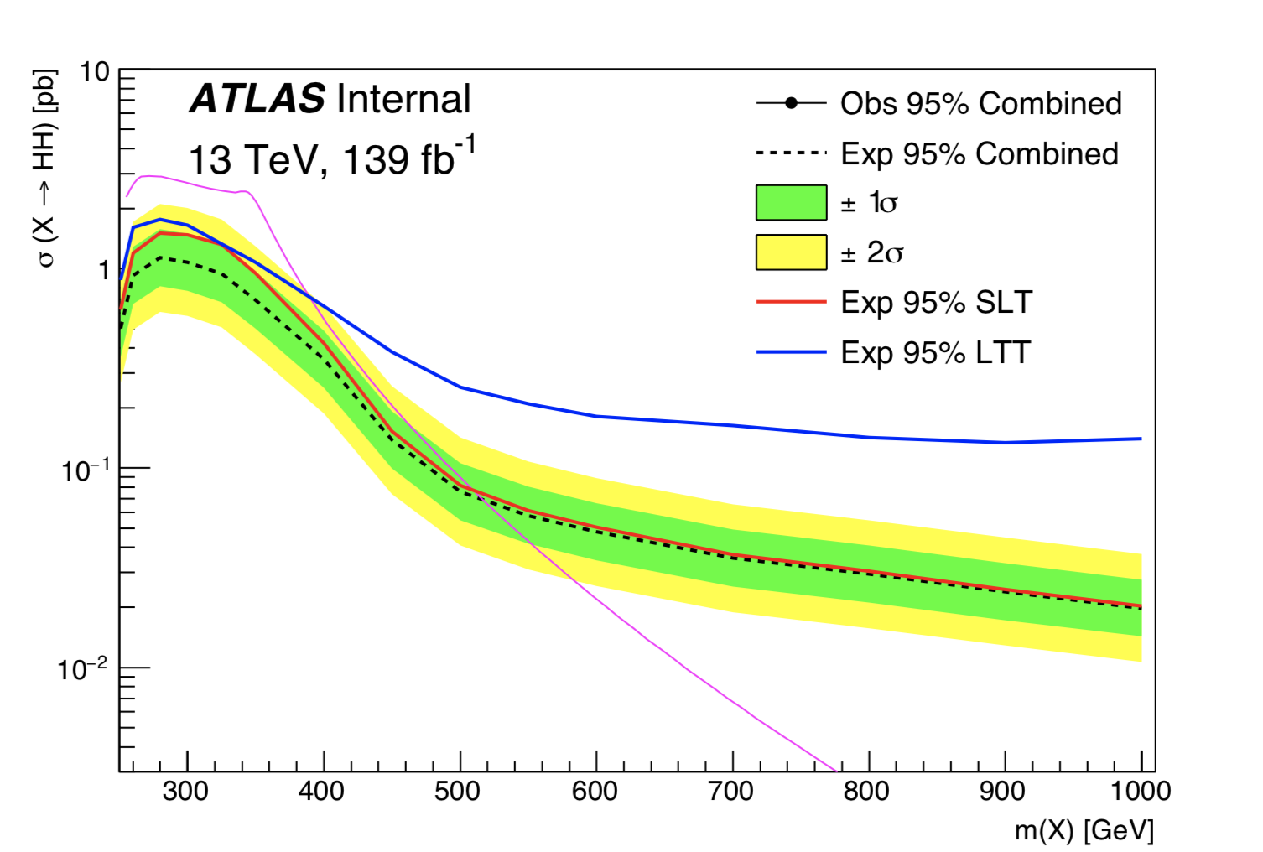
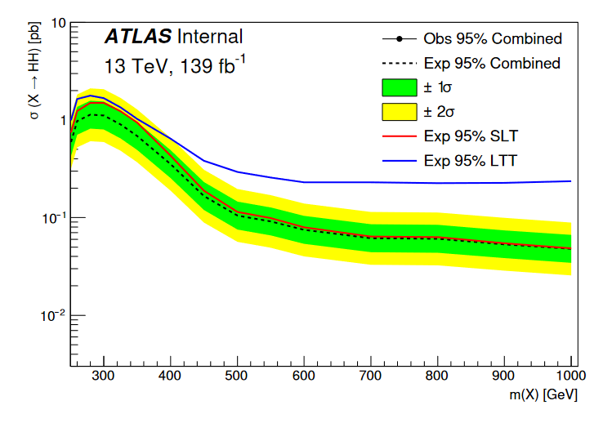

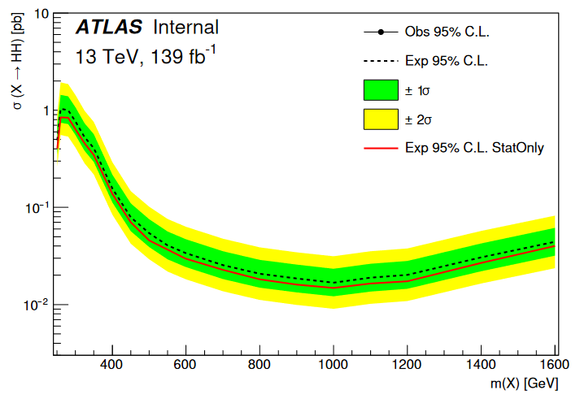



Limit setting
Unfortunately, with the current dataset we are not expecting to see the SM non-resonant di-Higgs production
We can still set limits on the upper limit on the cross section on the SM di-Higgs production (in bbtautau channel) and resonant signal mass
Expected limits: derived from simulation
Expected limit on Xs. with 36 $fb^{−1}$ data in Lephad: 26.32 * Xs. (SM)
Scale with luminosity (139 $fb^{−1}$), we expect the limit to be ~ 13 * Xs. (SM)
The Lephad expected limit is 80% better!
This is made possible by better b-tagging, tau-ID, tau-reconstruction, etc.
Limit for resonant Lephad
Limit for resonant Hadhad
 | Non resonant | -2$σ$ | -1$σ$ | Expected | $$1σ$$ | 2$σ$
Lephad Xs/Xs(SM) | Stat-Only | 3.08 | 4.13 | 5.73 | 7.98 | 10.70
 | Stat+Syst | 3.90 | 5.24 | 7.27 | 10.12 | 13.57
Hadhad Xs/Xs(SM) | Stat-Only | 2.01 | 2.70 | 3.75 | 5.22 | 7.00
 | Stat+Syst | 2.51 | 3.37 | 4.68 | 6.52 | 8.73

Slide 12
Summary
Most of the components of analysis are in place
Lots of improvement in identification, reconstruction, background estimation making a more stringent limit possible
Stay tuned for the results!
Thank you for listening!

Slide 13


Backup: object selection
Object selection
Electrons:
  Loose e-ID, loose isolation
  $p_{T}$ > 7 GeV, $\left|η\right|$ < 2.47 + crack veto
Muons:
  Loose muons with PflowLoose_VarRadIso isolation, $p_{T}$ > 7 GeV, $\left|η\right|$ < 2.7
Taus:
  Loose RNN Tau-ID, loose electron-veto
  $p_{T}$ > 20GeV, $\left|η\right|$< 2.5 + crack veto
  1- or 3-prong
Anti-Taus
  Fail loose RNN Tau-ID and RNN score > 0.01
Jets:
  Anti-$k_{t}$ R=0.4 particle flow jets
  Jet cleaning & tight JVT
  pT>20GeV, $\left|η\right|$ <2.5
b-tagging
  DL1r with 77% WP
MET
  PFLow MET (TST)
OLR
  ASG OLR tool with dedicated jet- $τ_{had}$ OLR:
  $τ_{had}$ > b-tagged jet > anti-$τ_{had}$ > untagged-jet

Slide 14
Backup: Experimental uncertainties
Jets:
  JES (CategoryReduction) & JER (FullJER)
Flavor tagging:
  medium reduction
Electrons:
  scale, resolution, efficiencies (trigger, reco, ID, isolation)
Muons:
  momentum-calibration + efficiencies (reco, TTVA, iso)(muon trigger currently missing)
Taus:
  TES + efficiencies (eVeto,τhad-ID, trigger) SoftTrk
MET:
  Scale & Resolution

Slide 15



Backup: Selection for Hadhad channel
Triggers: Hadhad
Event selection
All channels:
  Pass triggers & matching of $τ_{had}$-legs
  Offline trigger eff. plateau cuts on leptons, $τ_{had}$, and jets at L1
  $m_{ττ}^{MMC}$> 60 GeV (Missing Mass Calculator used to reconstruct $ττ$-system)
  At least two central jets (one with $p_{T}$> 45 GeV)
Single $τ_{had}$ triggers (STT)
  HLT thresholds on $τ_{had} p_{T}$ between 80 and 160 GeV, offline requirement $p_{T}$ > HLT threshold + 20 GeV
  Supplemented by non-isolated triggers
  Apply before DTT. If failed STT, then pass the event through DTT
Di-$τ_{had}$ triggers (DTT)
  Threshold on HLT $τ_{had} p_{T}$ 35 (25) GeV for leading (sub-leading) $τ_{had}$, offline requirement $p_{T}$ > HLT threshold + 5 GeV
Hadhad
  No $e/μ$
  Exactly 2 loose $τ_{had}$
  For L1Topo-triggered events: ∆R($τ_{had}$, $τ_{had}$) < 2.5

Slide 16



Backup: Z+HF CR
Pre-fit and post-fit $m_{ll}$ distribution in the Z+HF CR
The cross section of Z boson production in association with heavy flavour (b,c) jets is known to be not well predicted by the Sherpa MC and so these processes are normalised to data in a control region.
Events selected with bbll trigger selection using single-lepton and di-lepton triggers
Exactly two muons or two electrons with opposite-sign charges
Exactly two b-tagged jets
75 GeV < $m_{ll}$ < 110 GeV (select Z mass peak
$m_{bb}$< 40 GeV or $m_{bb}$> 210 GeV (to veto Higgs mass peak and to ensure orthogonality to bbll signal region).
This control region is included in the final fit as $m_{ll}$ distribution shown in above figure.
From a fit to data of this CR alone the normalisation of the Z+HF background is found to be 1.29 ± 0.019

