Slide 1


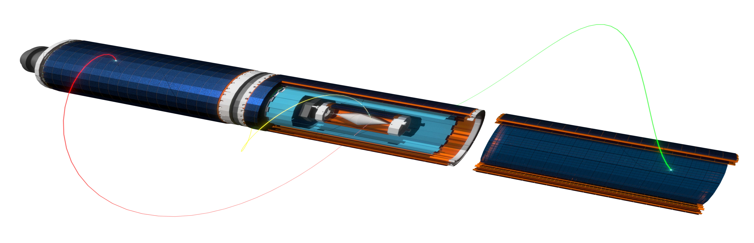
The Mu3e Experiment Searching for the Lepton Flavour Violating Decay
μ⁺ → e⁺ e⁺ e⁻
Afaf Wasili* on behalf of the Mu3e Collaboration**
*) University of Liverpool, Afaf.Wasili@Liverpool.ac.uk
**) Paul Scherrer Institute (PSI), Uni Bristol, Uni Geneva, Uni Heidelberg, KIT Karlsruhe, Uni Liverpool, UCL London, JGU Mainz, Uni Oxford, ETH Zürich, Uni Zürich

Slide 2
Overview:
Search for signal muon decays, background categories and the detector concepts for the Phase I and II of the Mu3e Experiment
Software:
Studies of Mu3e tracking performance for different categories of particle tracks when effected by:
Missing hits due to by dead layers dead chip or individual dead pixels
Misaligned detector
Noise in the pixel sensors
Hardware:
Test-Beam Data Acquisition System for Characterization of High Voltage Monolithic Active Pixel Sensors

Slide 3
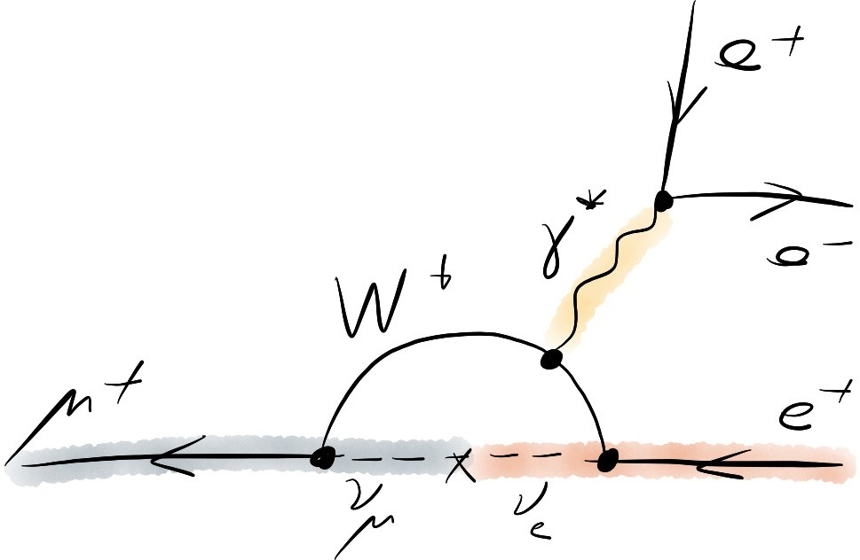
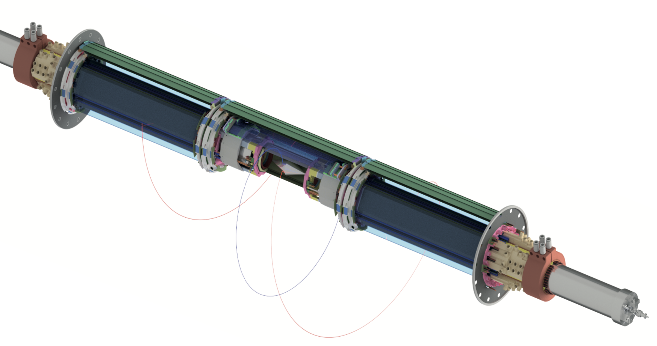
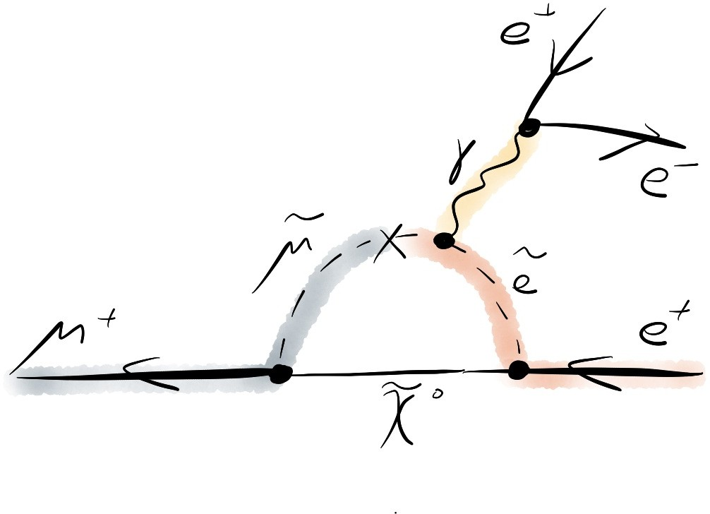
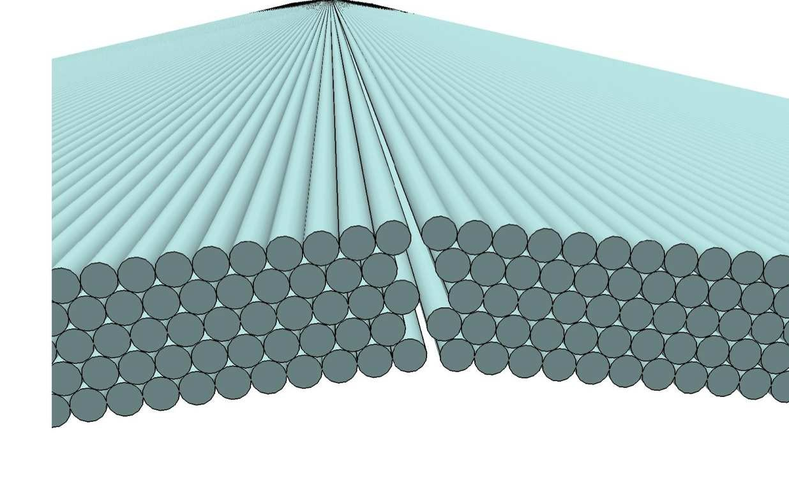
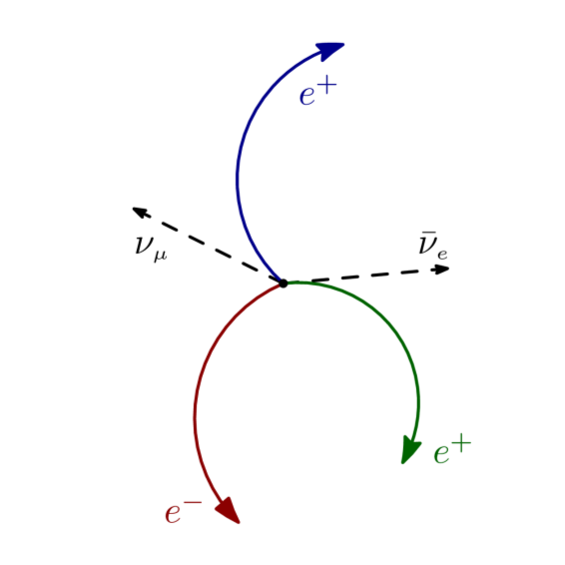
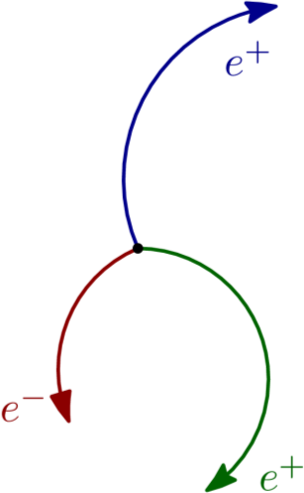
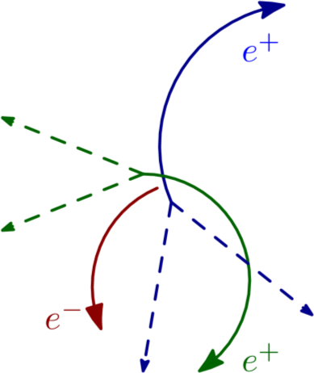
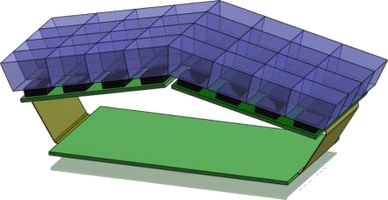
The Mu3e Experiment @ PSI
Motivation & Challenges
Mu3e Detector Design
Beam Pipe
Search for Lepton Flavour Violation:
Decay : μ⁺ → e⁺ e⁺ e –
Negligible in Standard Model (Br < 10⁻⁵⁴)
Can be enhanced in New Physics : (SUSY, leptoquarks, etc.),
any observed decay will point to NP
Current status: Br < 10⁻¹² (SINDRUM) at 90% CL
Mu3e Phase I: Aiming for O(10⁻¹⁵) sensitivity at existing πE5 beamline: 10⁸ µ/s
Mu3e Phase II: Aiming for O(10⁻¹⁶) sensitivity at a new high-intensity muon beamline (HiMB): >10⁹ µ/s
Recurl Outer Pixel Layers
Muon decay in the SM
Central Outer Pixel Layers
Inner Pixel Tracker Layers
Muon decay BSM (SUSY)
Scintillating Fibre Timing Detector
Hollow Double Cone Mylar Stopping Target
Helium Cooling Channels
Signal:
Three tracks: μ⁺ → e⁺ e⁺ e ⁻
Decay at rest
P_{e} < 53 MeV/c
Common vertex
Coincide in time
ΣP = 0 , ΣE = m_{μ}
Background:
Internal conversion background (IC BG): μ⁺ → e⁺ e⁺ e – ν⁺ ν ̄
(suppressed by good momentum resolution)
Accidental background (Acc. BG): Michel μ ⁺ → e ⁺ ν⁺ ν ̄
with e ⁺ e – , etc (suppressed by good time and vertex resolution)
Inner/outer pixel layers:
High granularity
Thin (to reduce MS) : 50 µm ≈ 10⁻³X₀
Eﬃciency > 99 %
Silicon pixel sensors (HV-MAPS)
As close as possible to target
  Pointing to vertex
  Reduce effect of MS
Scintillating Tile Timing Detector
Target:
Hollow double cone Mylar stopping target
vertex separation
Signal decay
IC BG
Acc. BG
Fibre/tile timing detector:
Precise timing
Suppress Acc. BG
Charge ID

Slide 4
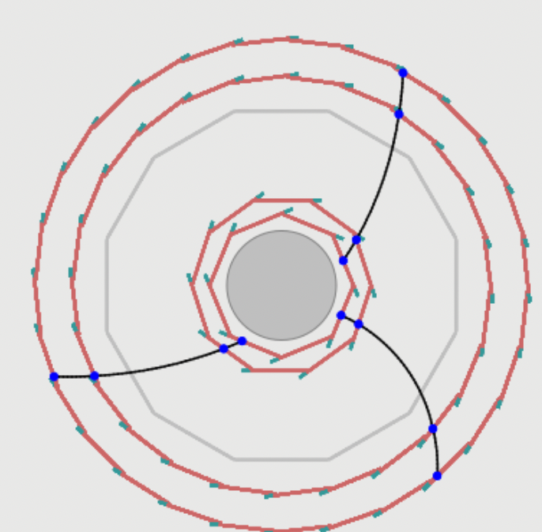
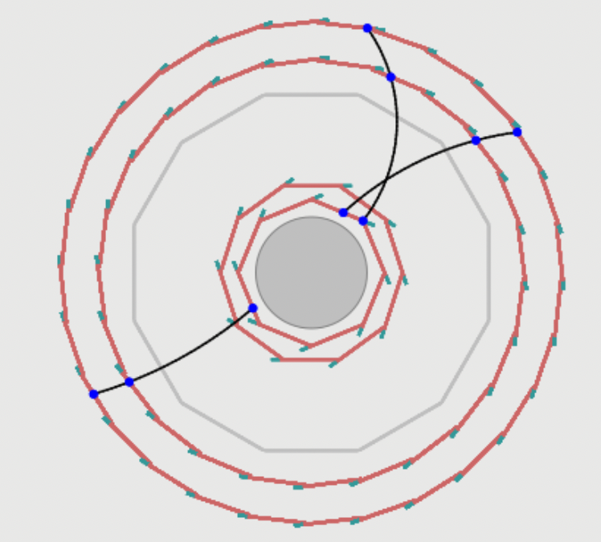
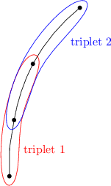
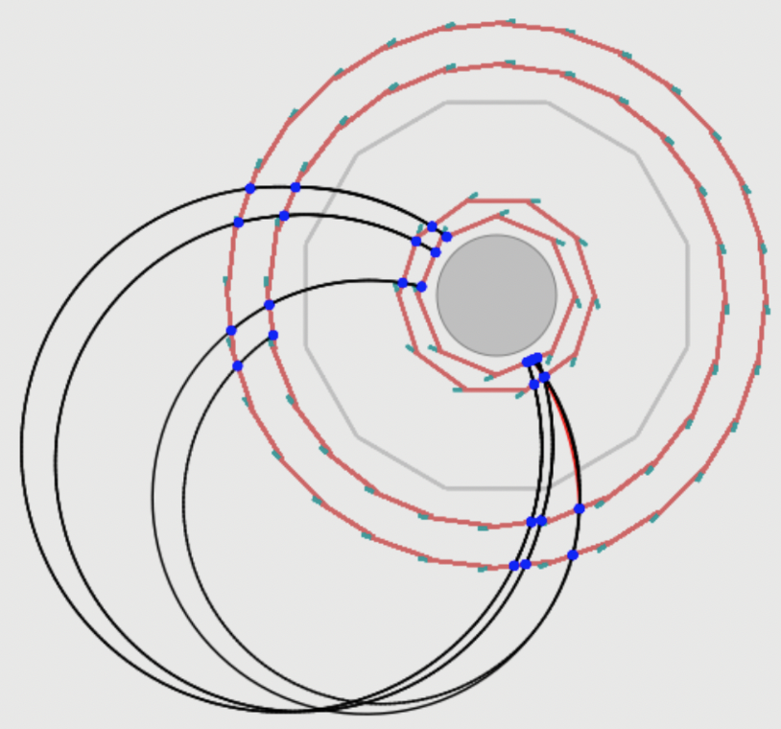
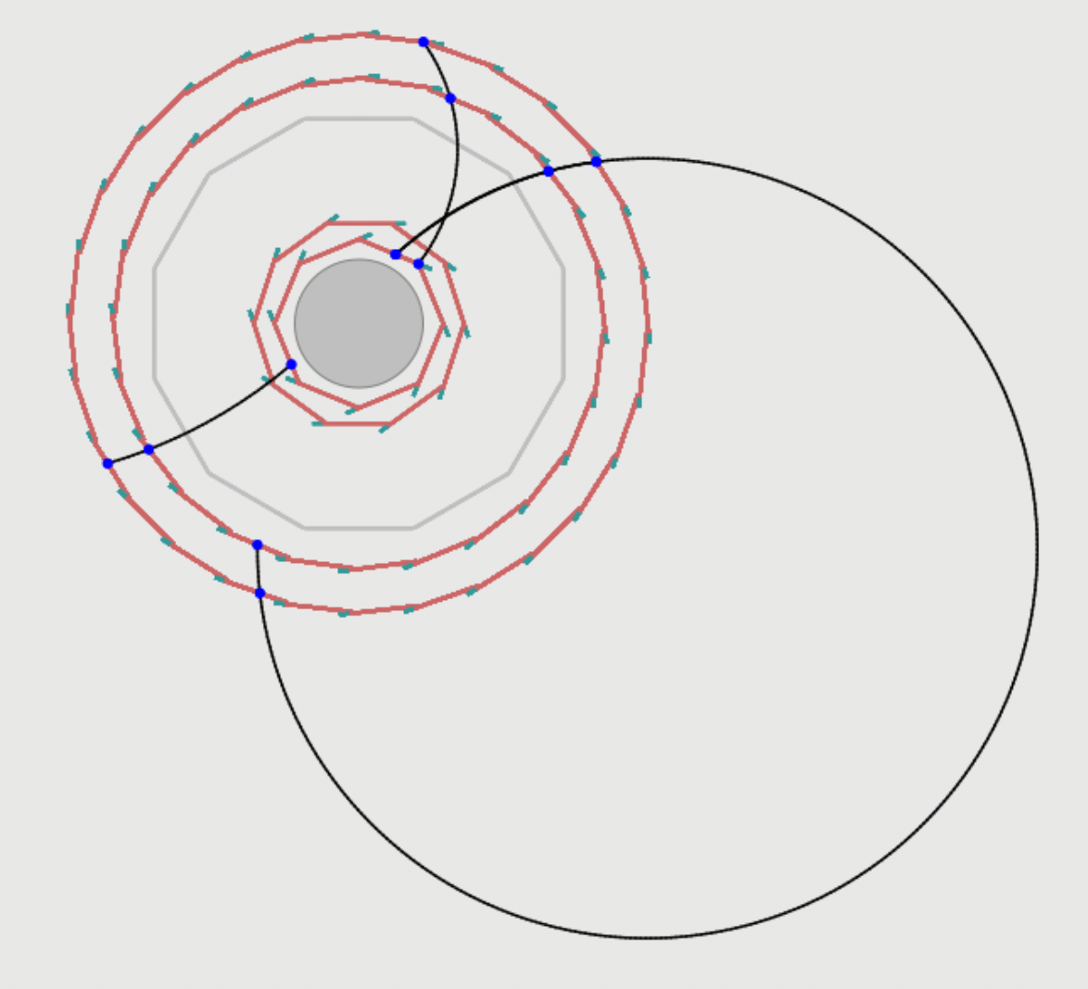
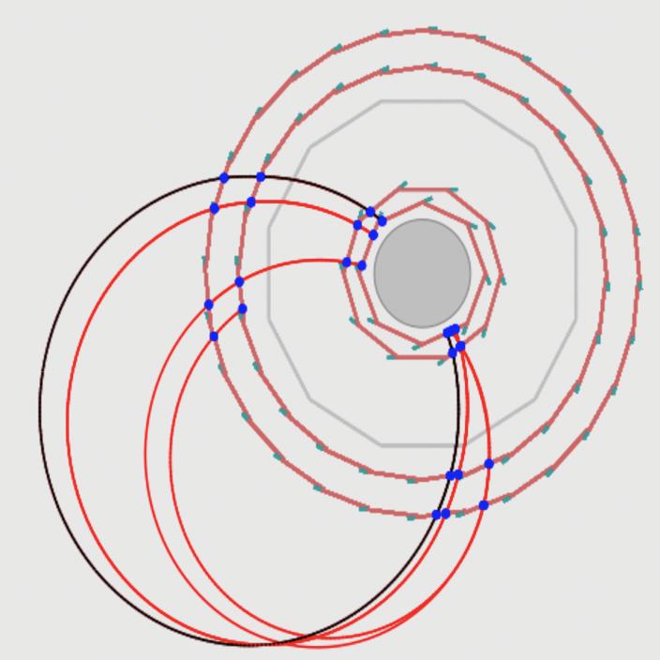
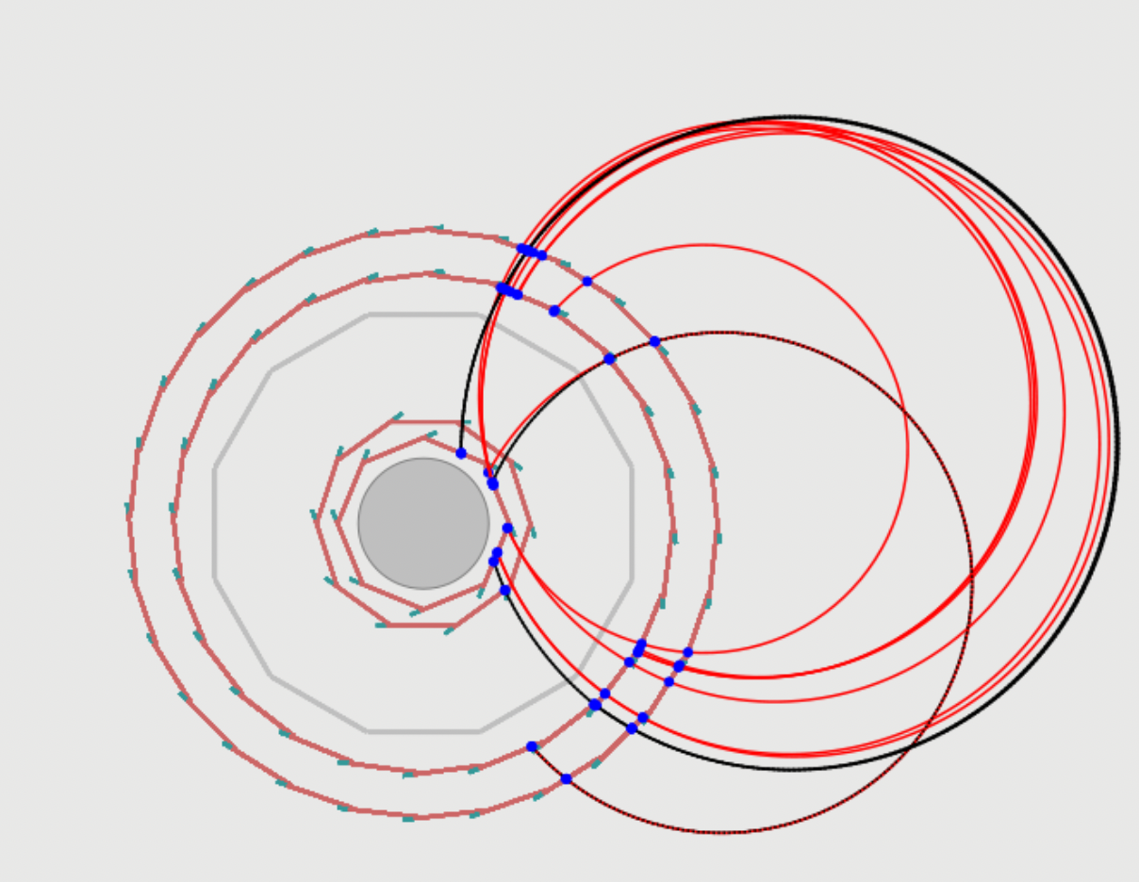
Simulation and Track Reconstruction of the Mu3e Pixel Detector
Simulation & Reconstruction
Full detector Simulation (Geant4) in 50 ns framelength
Categories of Nominal Tracks
New Categories of Tracks
Track Reconstruction
Triplet:
Track is a sequence of triplets
Basic block for track reconstruction
3 hits (combination 2 helices )
Optimization the nonlinear problem
multiple scattering
Standard short track with 4-pixel hits only in CS of the detector
Imperfect short tracks with missing pixel hit in 1-silicon layer
Standard long track including 6-pixel hits via using short tracks as seed either in CS or 2-RS of the detector
Imperfect long track including 5-hits with a missing pixel hit in 1-silicon layer via using short tracks as seed
Categories of Nominal Tracks:
Short tracks:
4 hits in the silicon layers
Seeds for long tracks
Long (recurl tracks):
Combine 1 short track with 2 hits in
recurl detector (6 hits)
Combine 2 short tracks (8hits)
Categories of New Tracks:
Artificially introduce different inefficiencies level into pixel layers in the central station and investigate recovering track efficiency by allowing holes on the track
Short tracks:
3 hits in the silicon layers with a missing pixel hit
Seeds for long tracks
Long (recurl tracks):
Combine 1 short track with 2 hits
in recurl detector (5 hits)
Using long track with 5-pixel hits
with two more hits in the CS of the
detector (7-pixel hits)
Imperfect long track including 7-hits with a missing pixel hit in 1-silicon layer via using long track with 5-hits as seed specifying which hit id (outgoing or ingoing)
Standard long track including 8-pixel hits via using 2-short tracks as seed only in CS of the detector

Slide 5
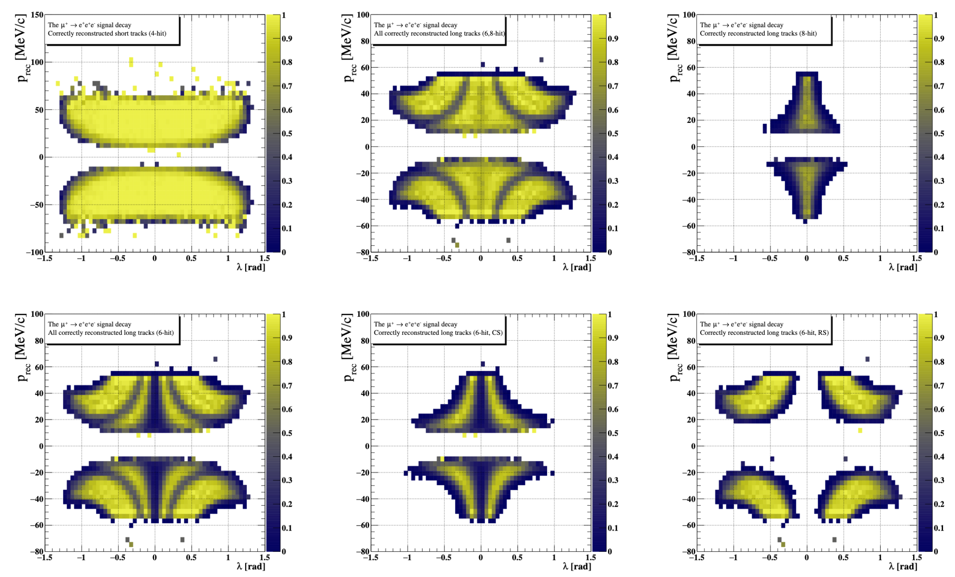
Categories of Nominal Tracks in CS or 2-RS of the Detector in 2D
Long Tracks with 6-hits in CS or RS of the Detector

Slide 6
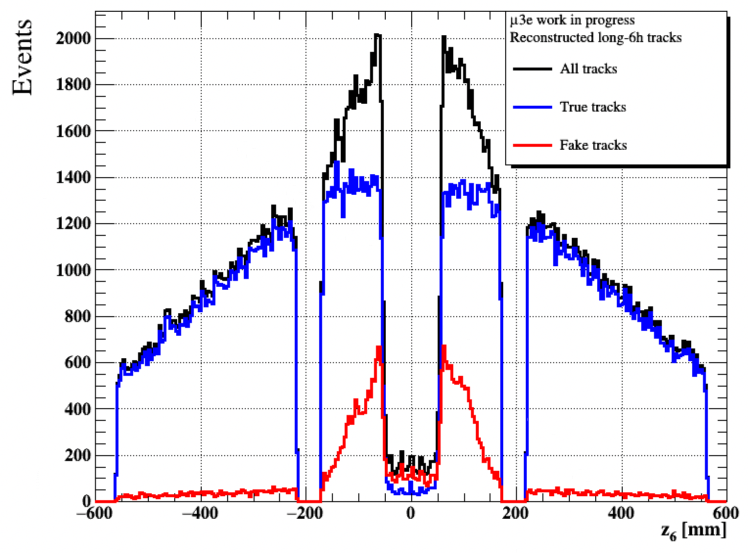
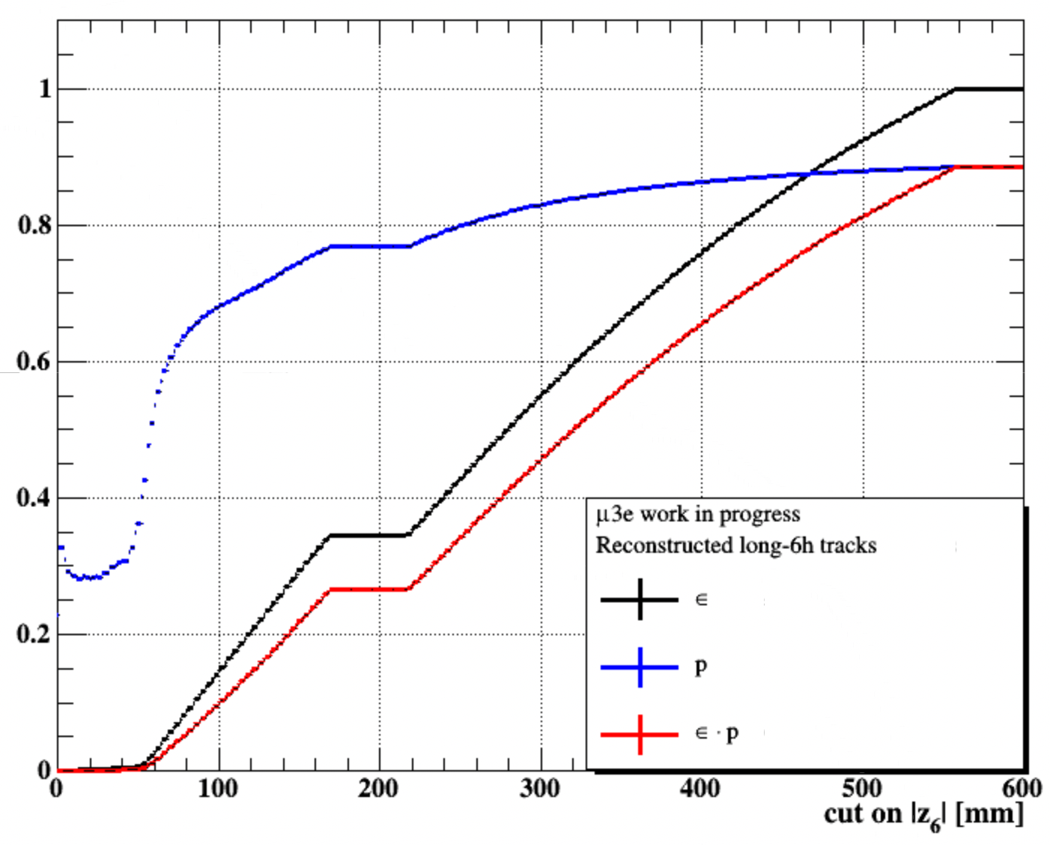
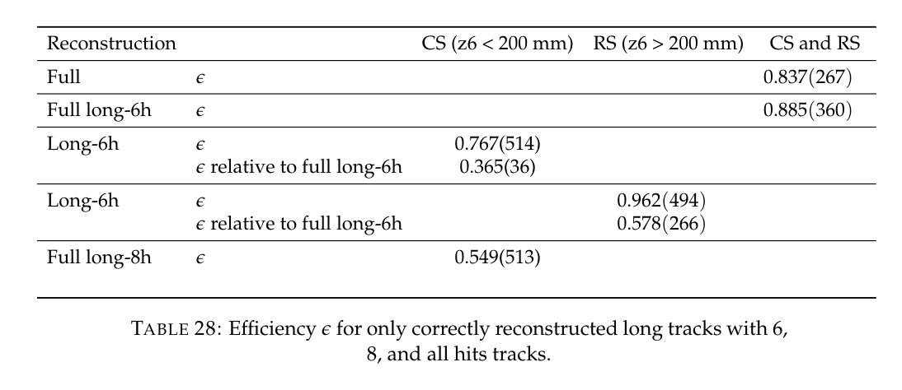
Check the High Purity for the Long Tracks with 6-hits in the 2-RS of the Mu3e Detector
A Way of Splitting the Long Tracks with 6-hits
Z6: 6th silicon hit in outer layers either in CS or RS, it is a good cut to to split long tracks with 6 hits recurl back into CS or RS of the detector
Z6 < 200 mm: tracks can recurl back into CS
Z6 > 200 mm: tracks can extrapolate into RS “that is because outer silicon detector is started from roughly 200 mm”
CS of the detector
“ingoing tracks”
RS of the detector
“outgoing tracks”
Service areas b/w stations
RS of the detector
“outgoing tracks”

Slide 7
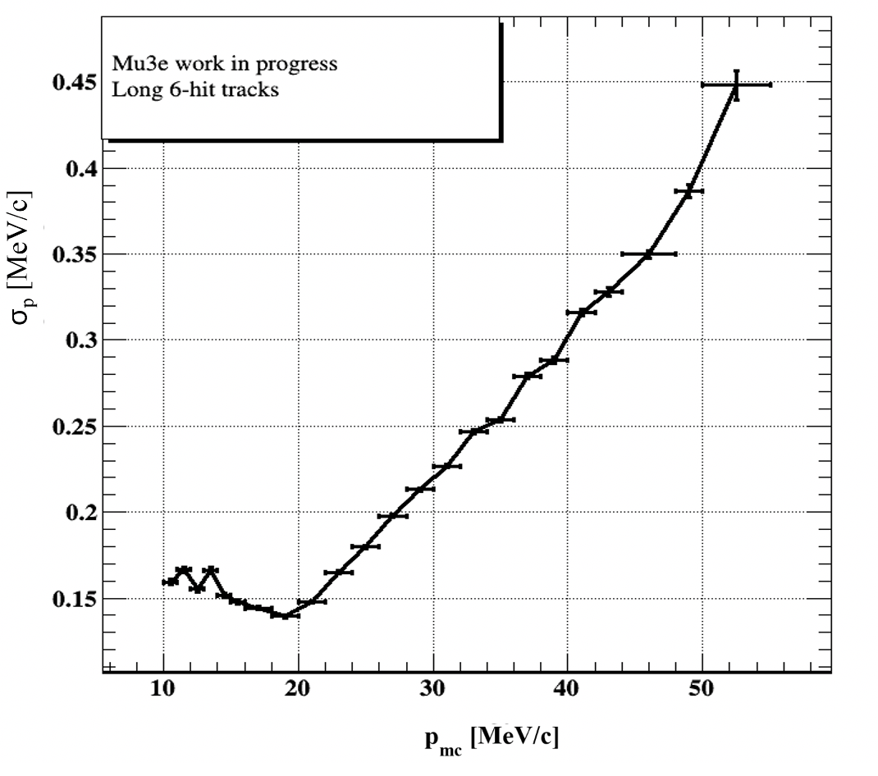
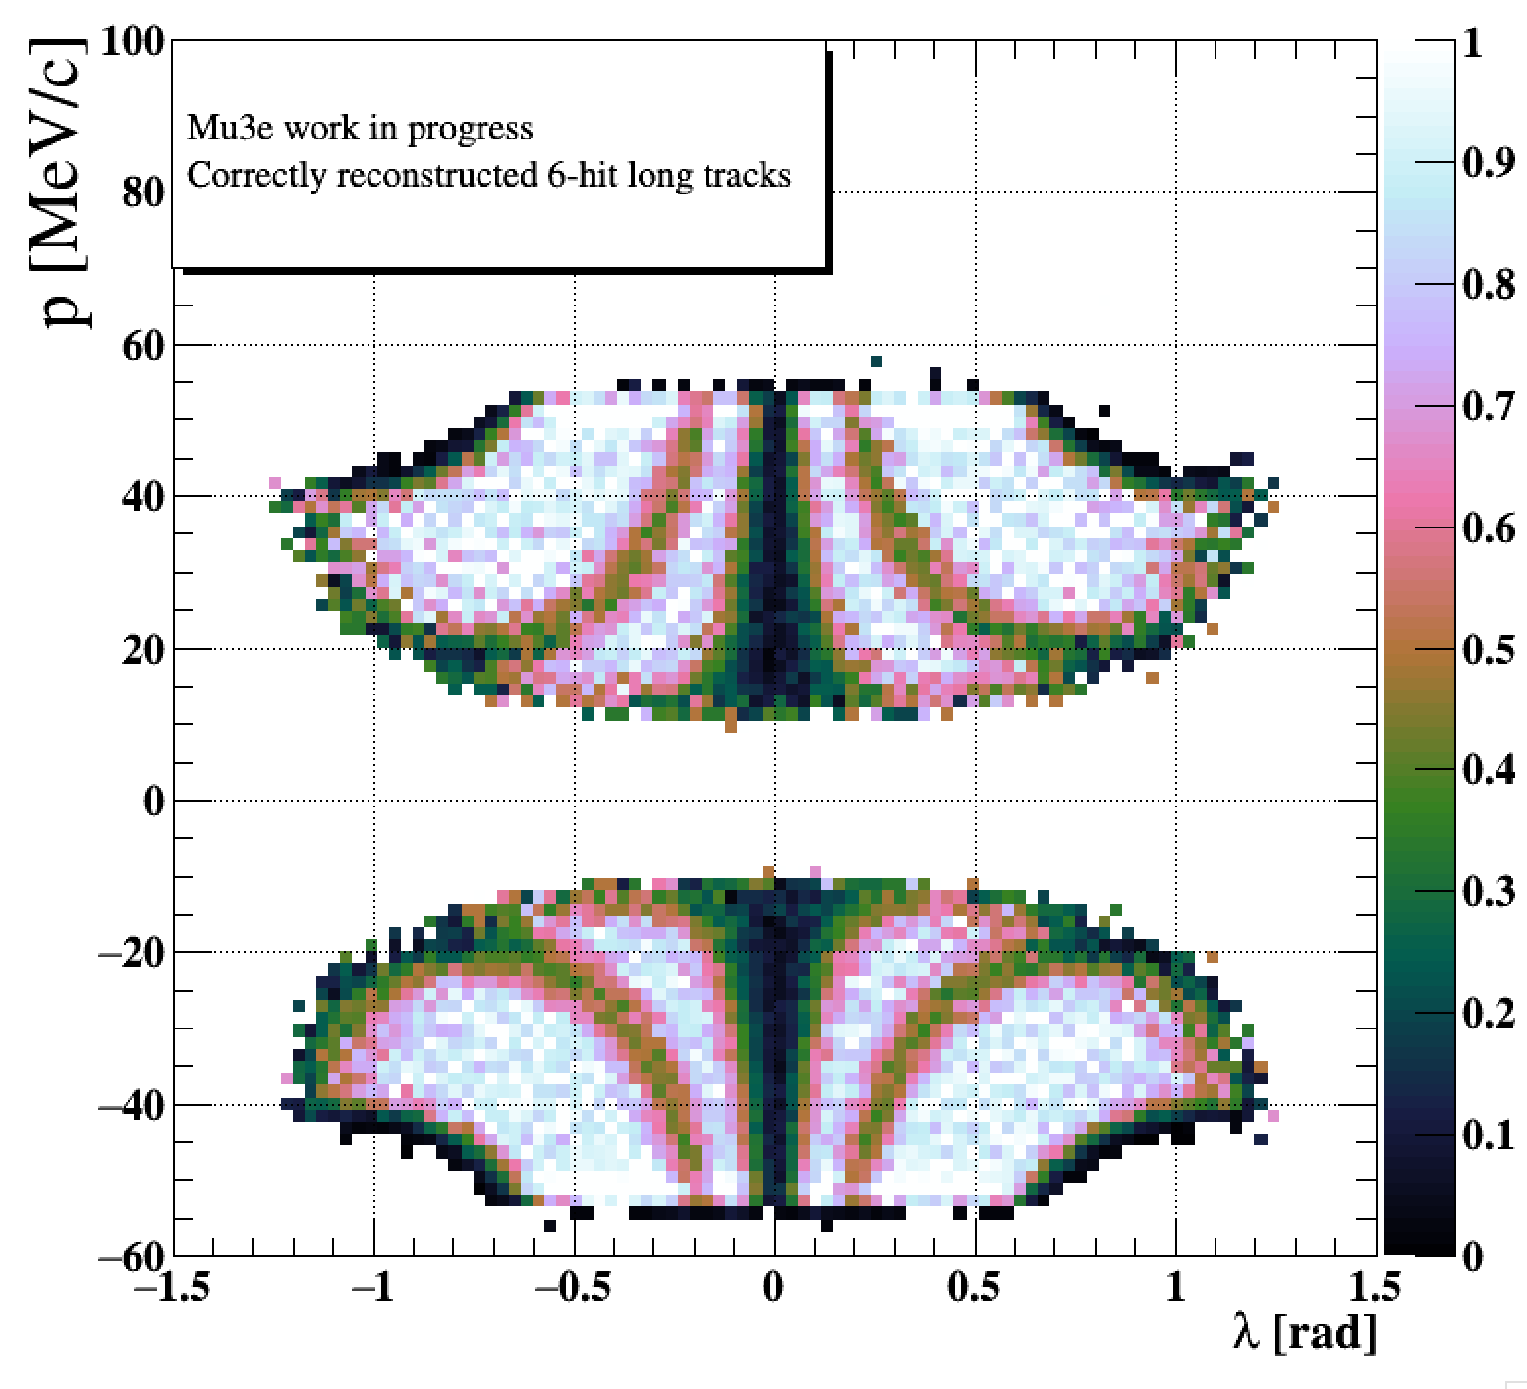
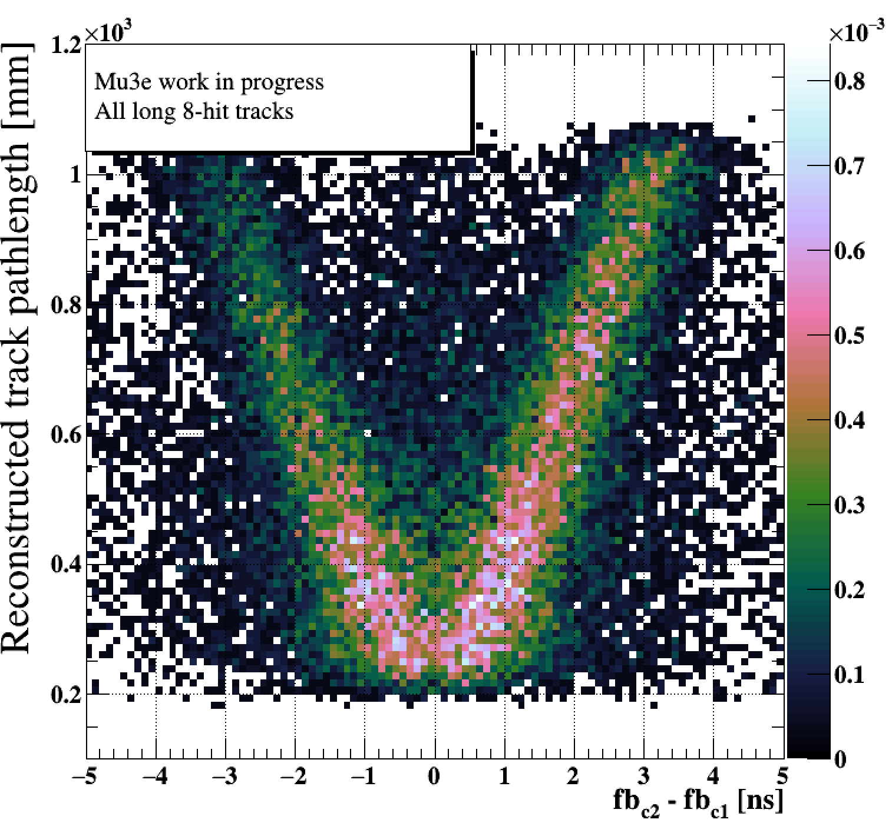
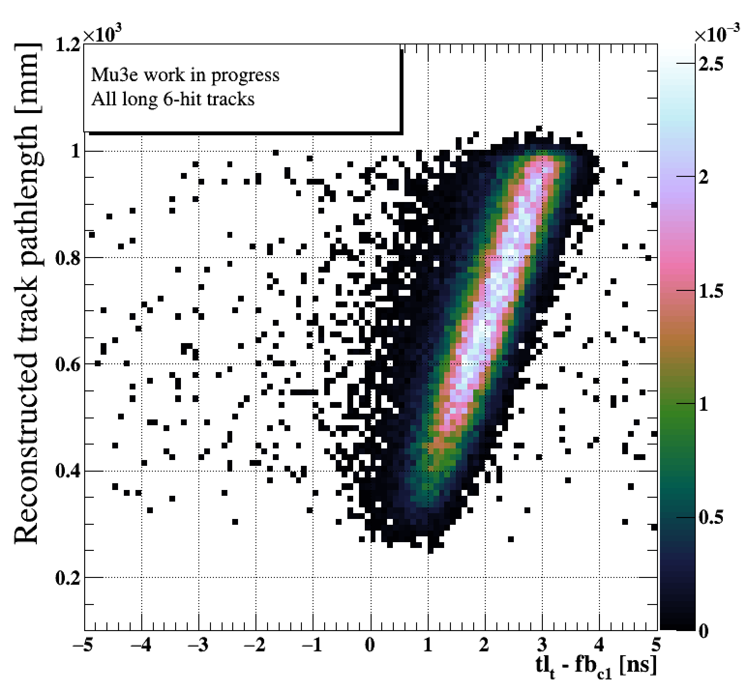
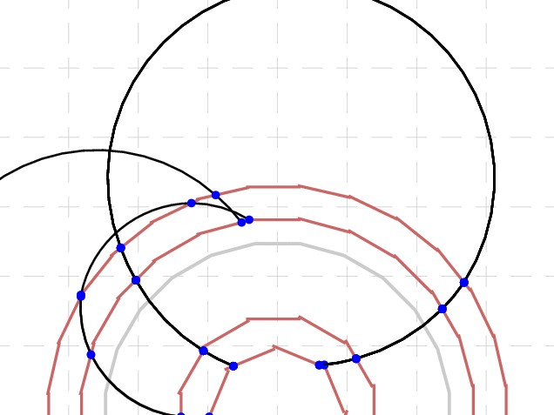
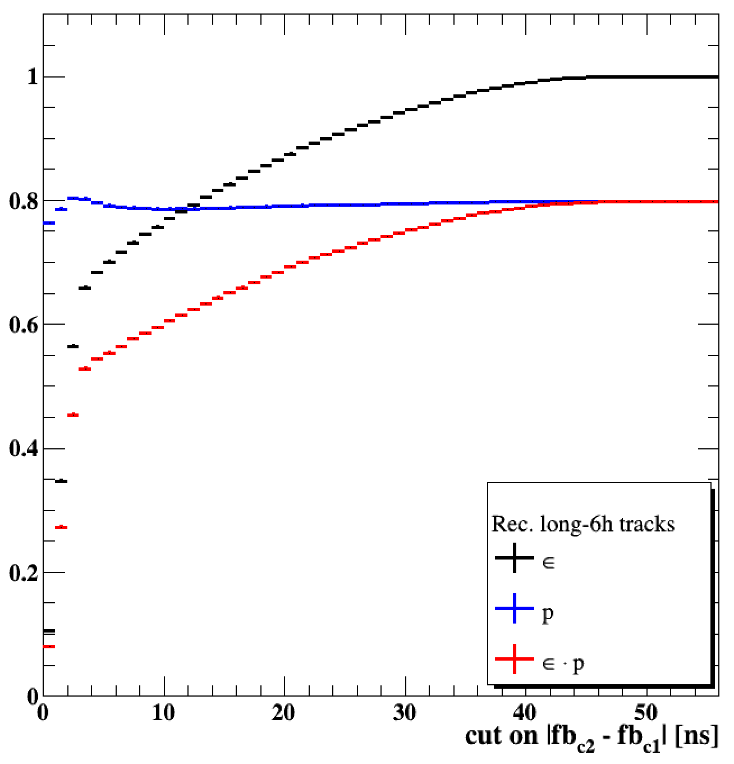
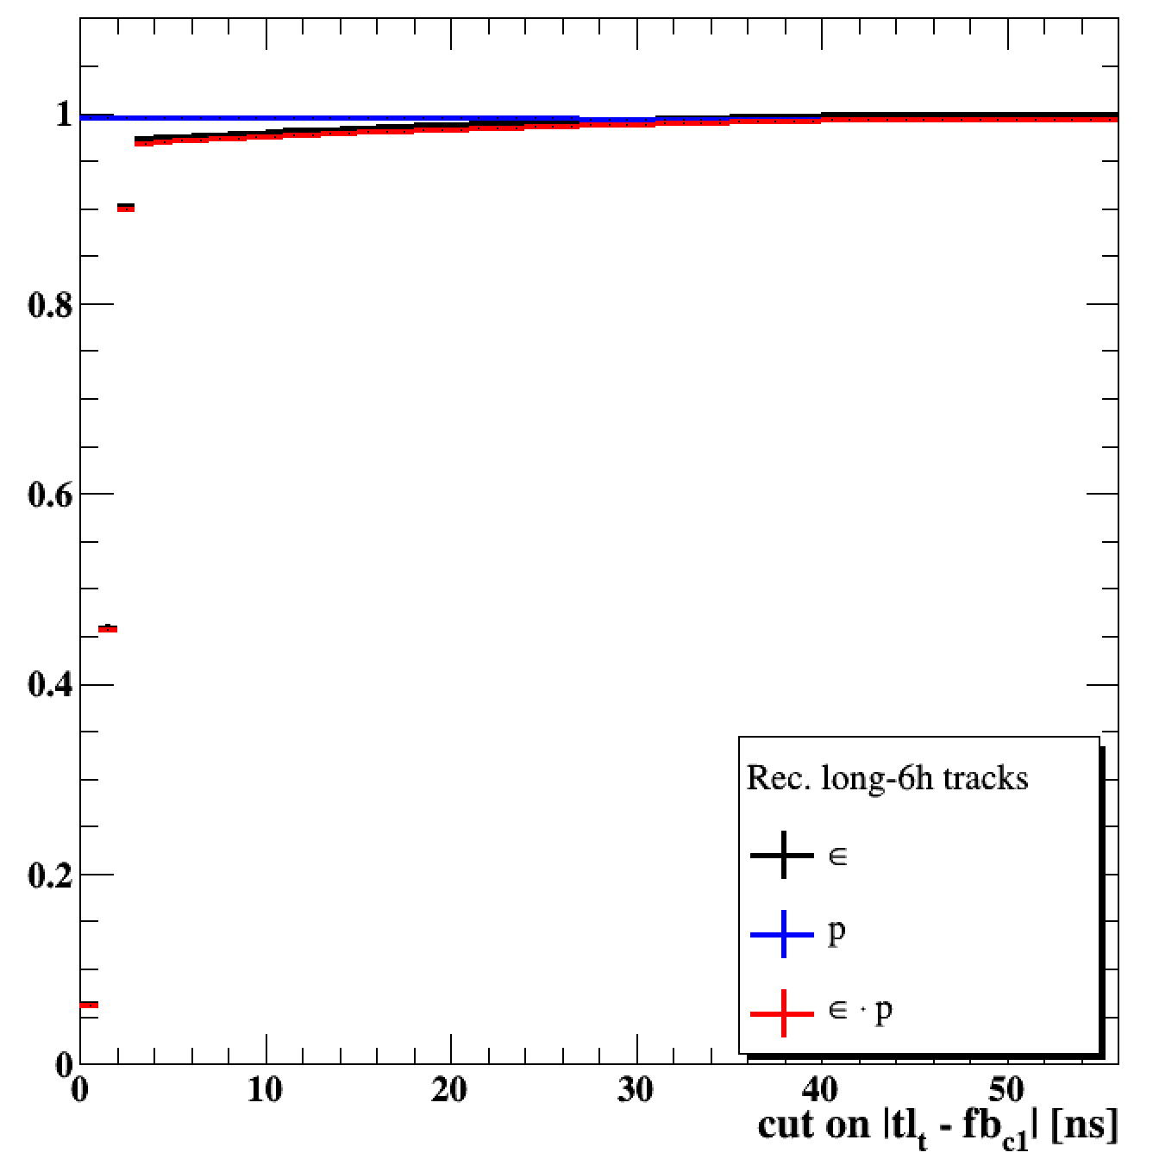
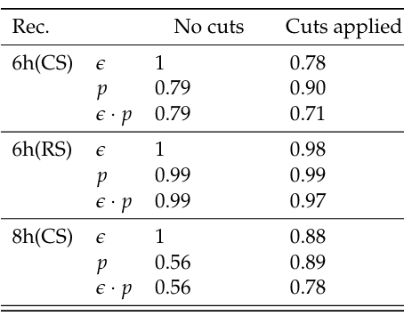
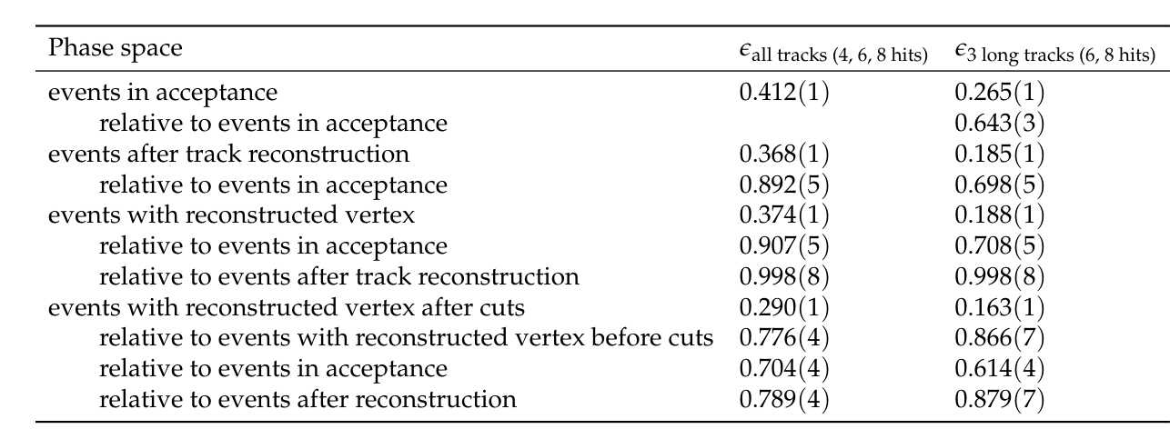
Simulation and Track/Vertex Reconstruction of the Mu3e Detector & Timing Information
Acceptance and Efficiency
Timing and Charge ID
e +?
e– ?
(p_{min} depends on λ)
tracks that have exactly half a circle outside of the outer pixel layer
Ambiguity for central 8-hit tracks:
Charge ID for long 8-hit track:
Unknown direction
Use fibre time information and pathlength between fibre hits
Wrong charge ID
Right charge ID
no ambiguity for long tracks with 6 hits
Minimum p_{T} acceptance ~ 12 MeV/c (Limited by outer layer radius)
Service areas b/w stations
Ends of recurl stations
Track/Vertex Efficiency After Track Reconstruction and Vertex Fit Step for Phase Space Distributed Signal Muons Events
(Mu3e work in progress)

Slide 8
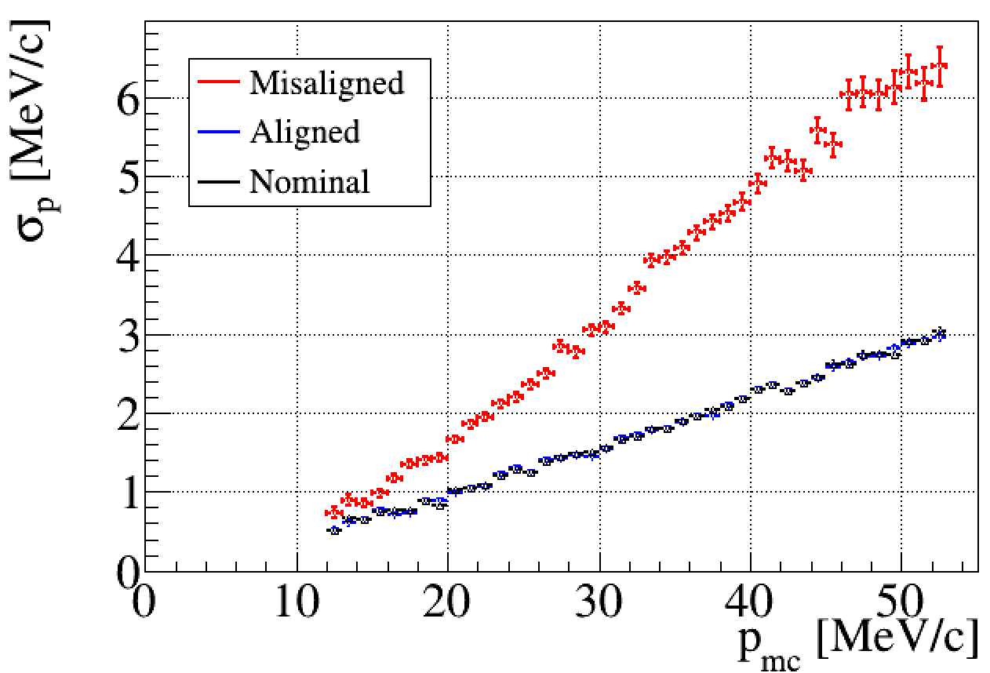
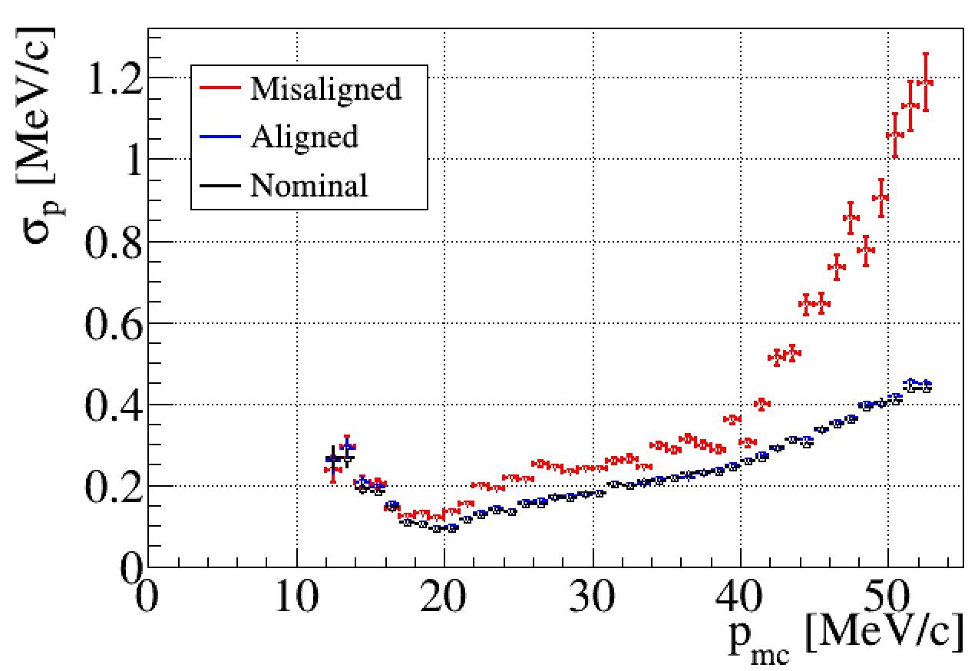
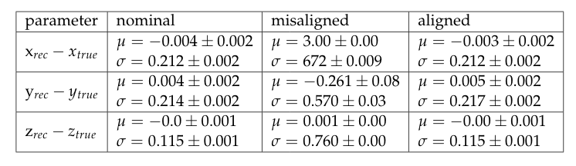
Expanded Studies to Understand Increased Mis-Alignments of the Mu3e Pixel Detector
Track Based Alignment of the Mu3e Pixel Detector Studies
Many misalignment modes can be applied for all individual sensors or composite parts level
Using Millipede-II alignment algorithm to align detector
Study the performance of nominal tracks with misaligned and aligned and compare it with nominal detector
Short tracks with 4-hits
(Mu3e work in progress)
Long tracks with 6/8-hits
Results of the vertex reconstruction of signal events with three recurlers required; for a nominal, a misaligned and an aligned detector. The mean stems from a fit of the sum of two Gaussians and the quoted width is the area-weighted mean
(Mu3e work in progress)
Notes:
check the millipede-II spelling

Slide 9
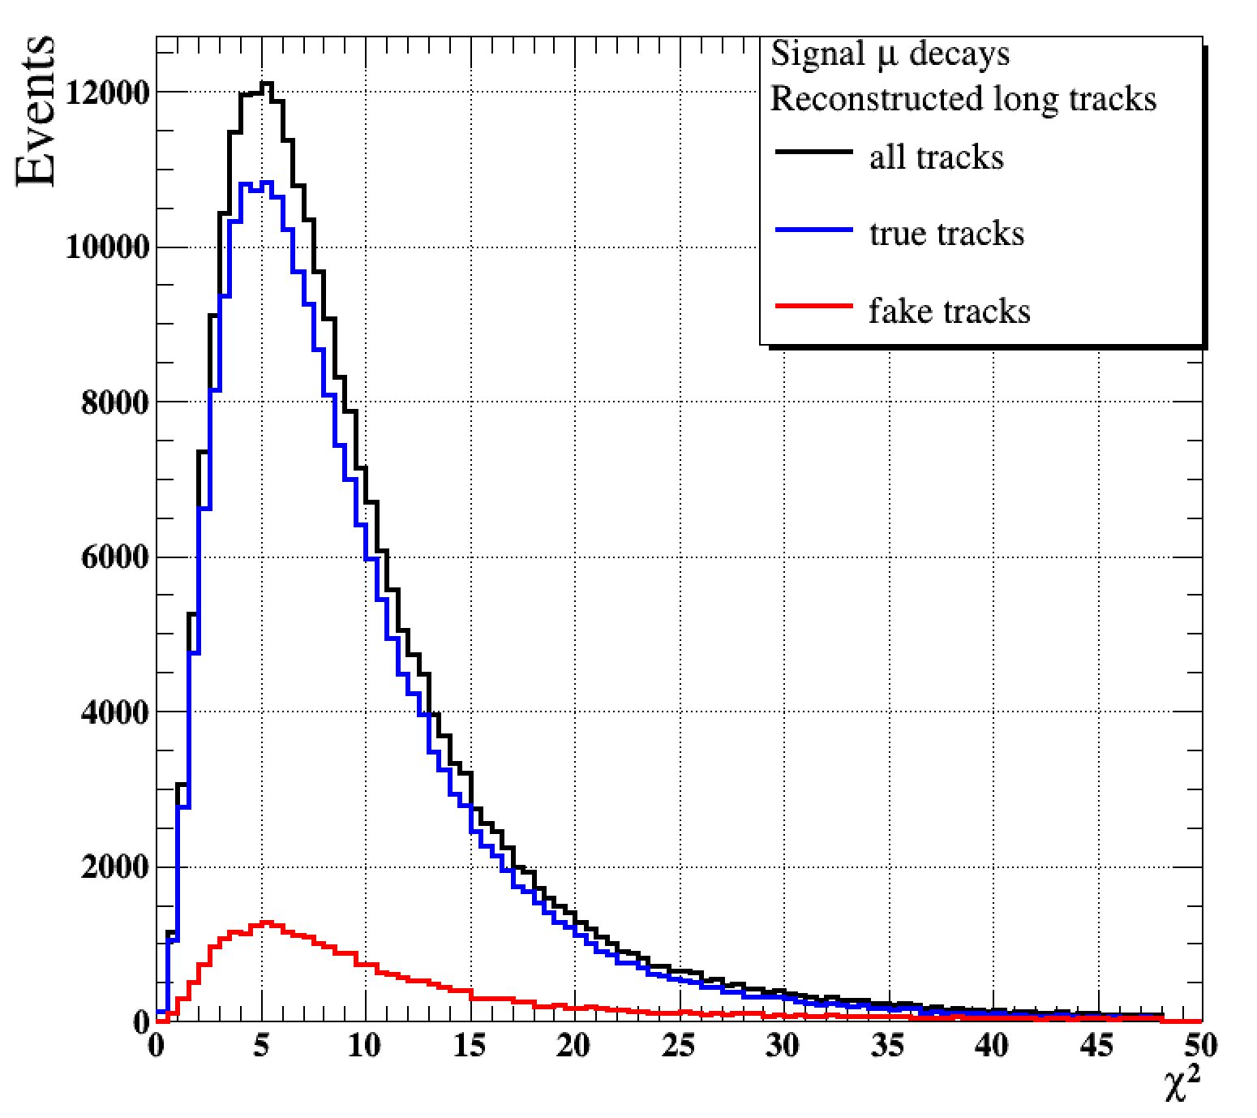
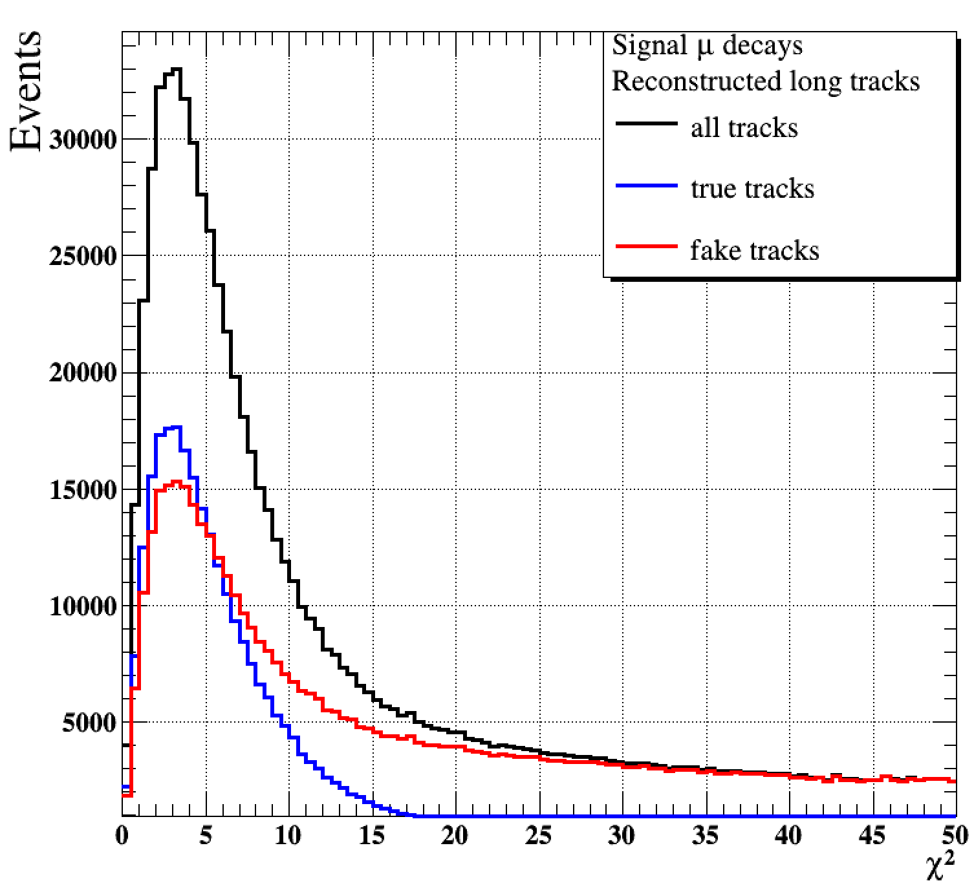
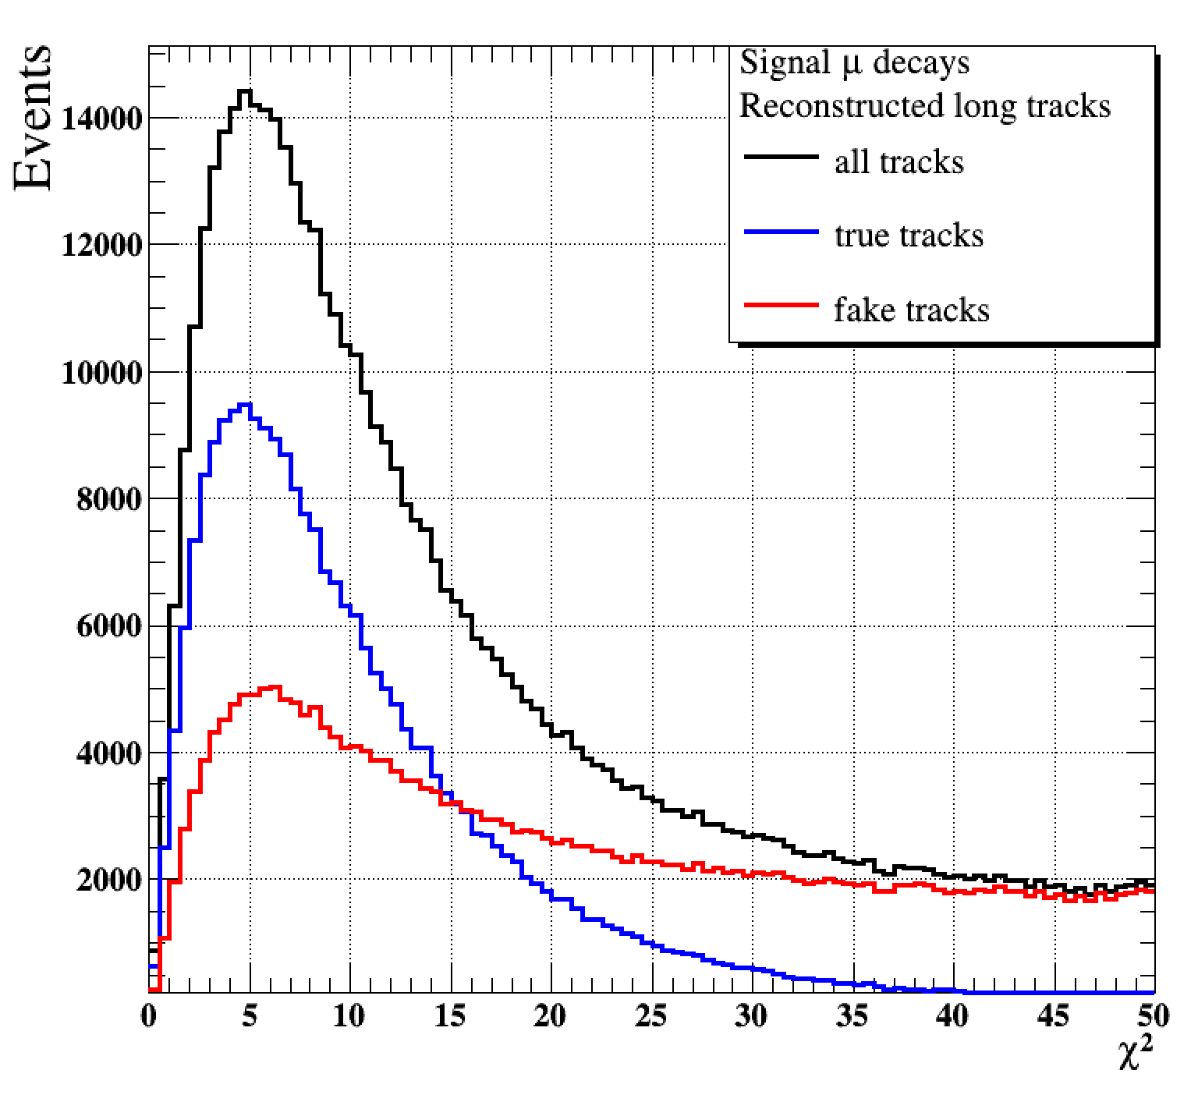
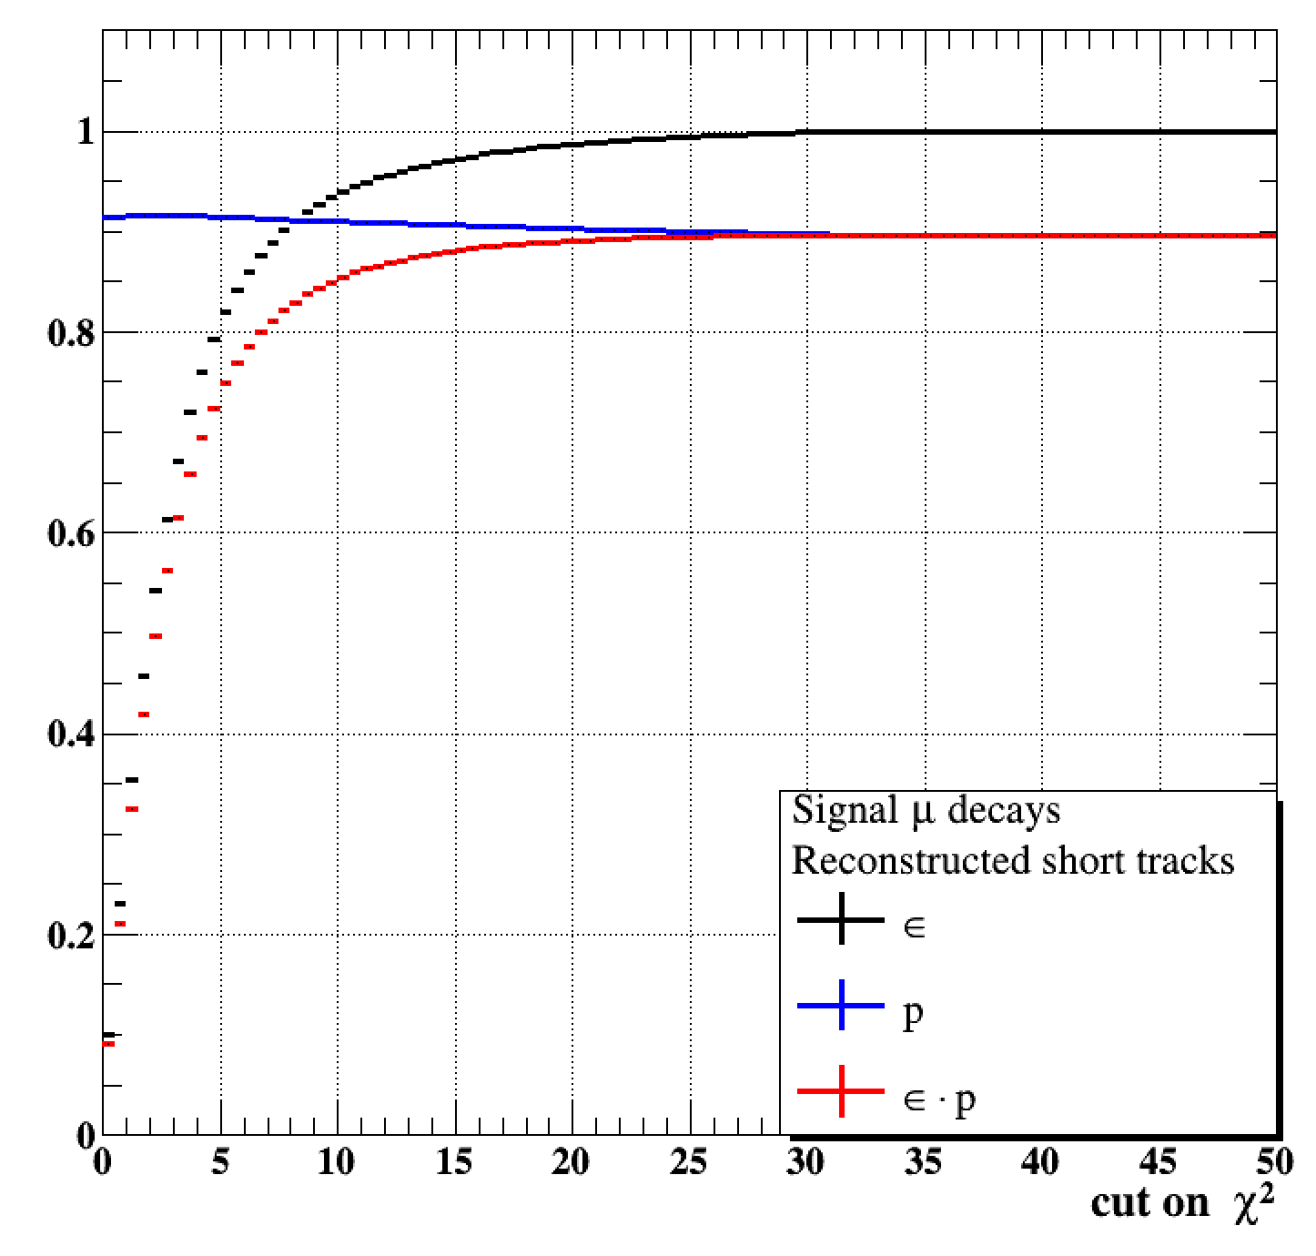
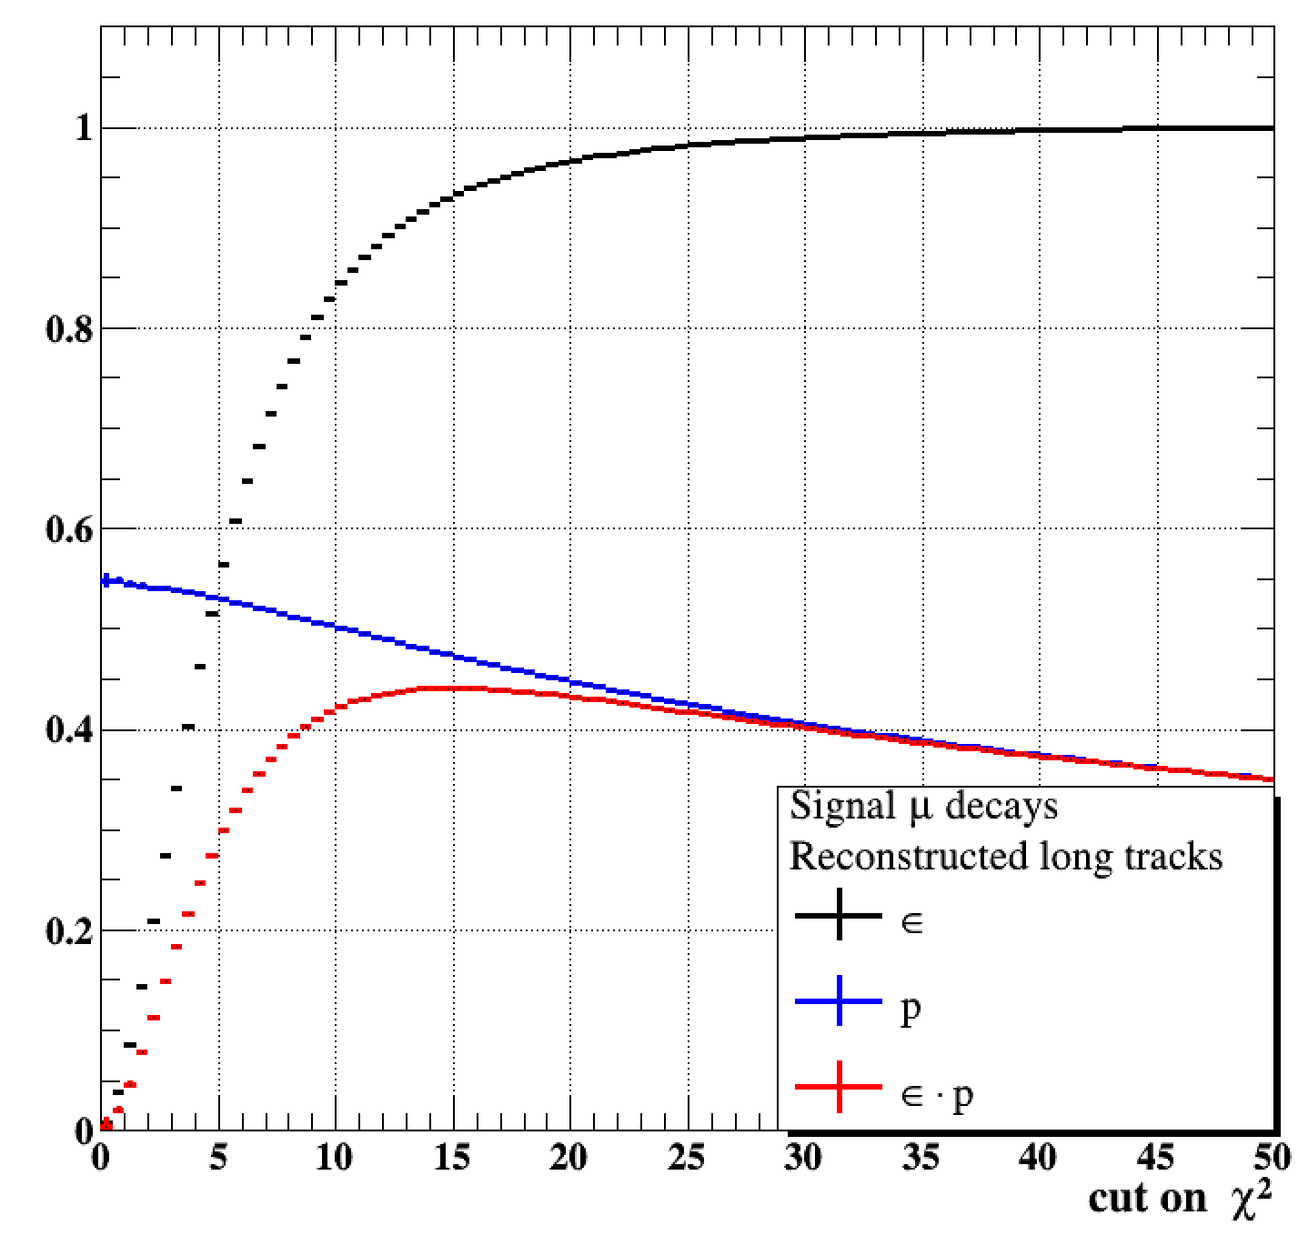
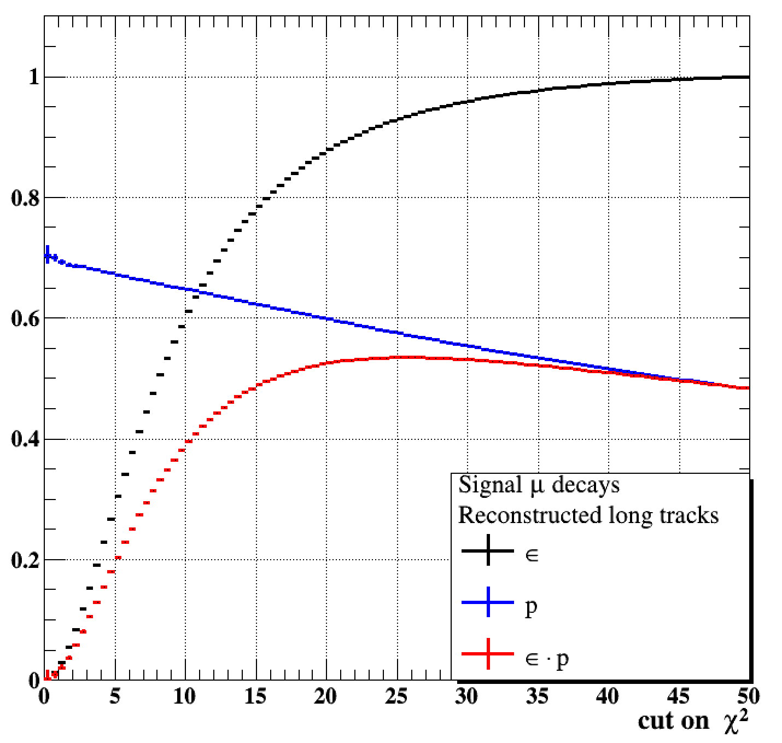
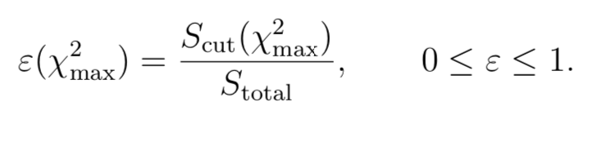
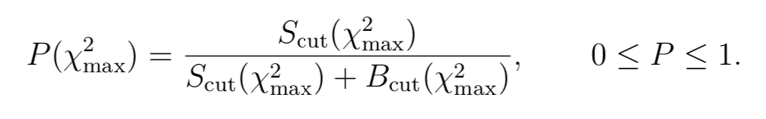
Results: The Performance of Tracks in the Reconstruction Step (Perfect & Imperfect Tracks)
Performance & Goal
Perfect tracks with 6-pixel hits
In the CS or RS of the detector
with 0% inefficiency
Imperfect tracks with 5-pixel hits
In the CS or RS of the detector(100% inefficiency in 1-pixel layer)
Imperfect tracks with 5-pixel hits
In the CS or RS of the detector(100% inefficiency in 2-pixel layer)
Study tracking performance with imperfect detector for signal muon decays. Artificially introduce 100% inefficiencies into 1/2-pixel layer in the central station of the detector
Goal was to allow tracking algorithm to access dead sensor in a missing layer
Study and optimizing the tracks cut requirements with understand the tracking efficiency, purity rates for new categories of tracks
(Mu3e work in progress)
(Mu3e work in progress)
(Mu3e work in progress)
(Mu3e work in progress)
(Mu3e work in progress)
(Mu3e work in progress)

Slide 10
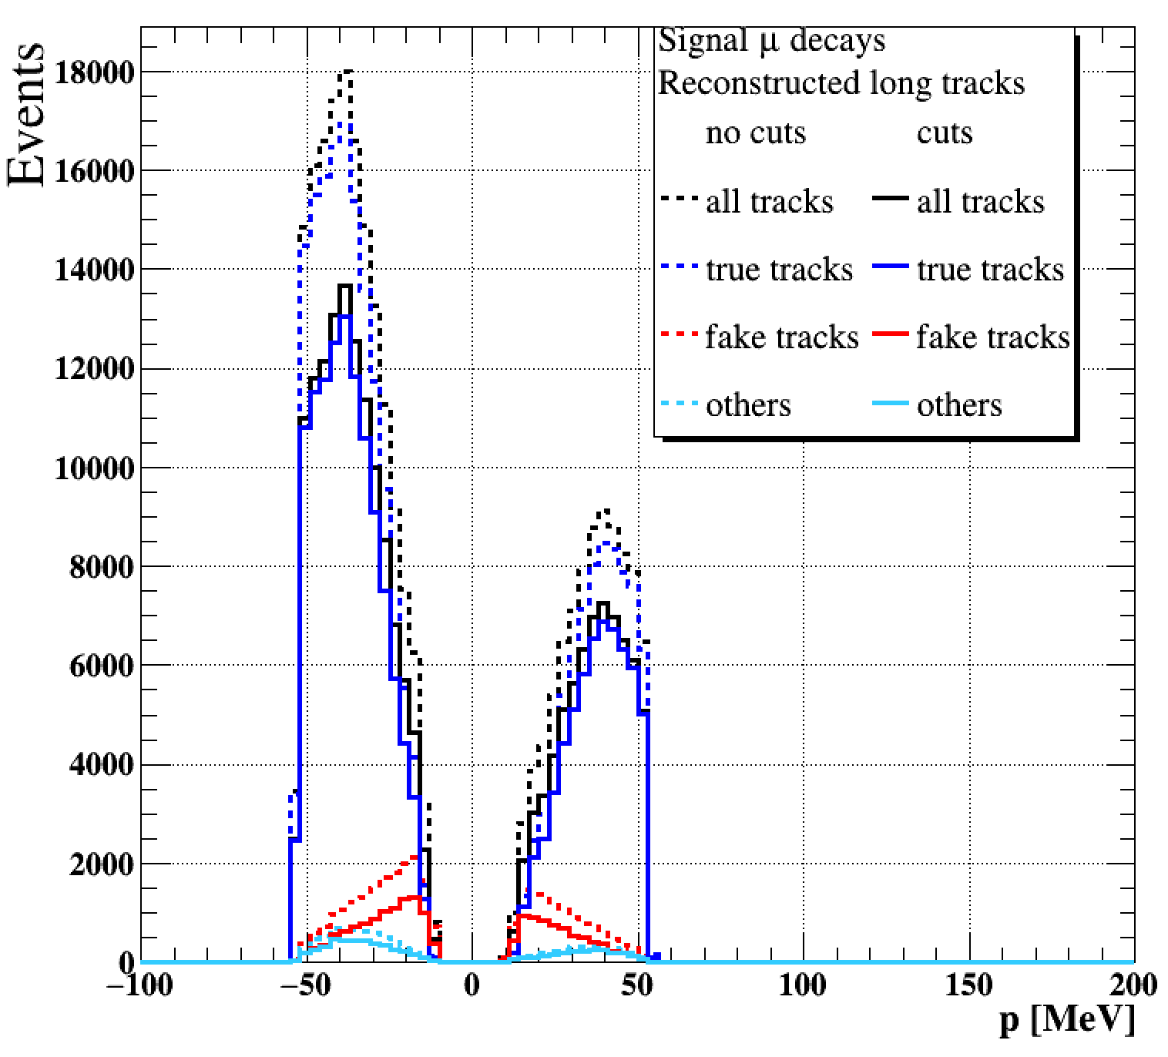
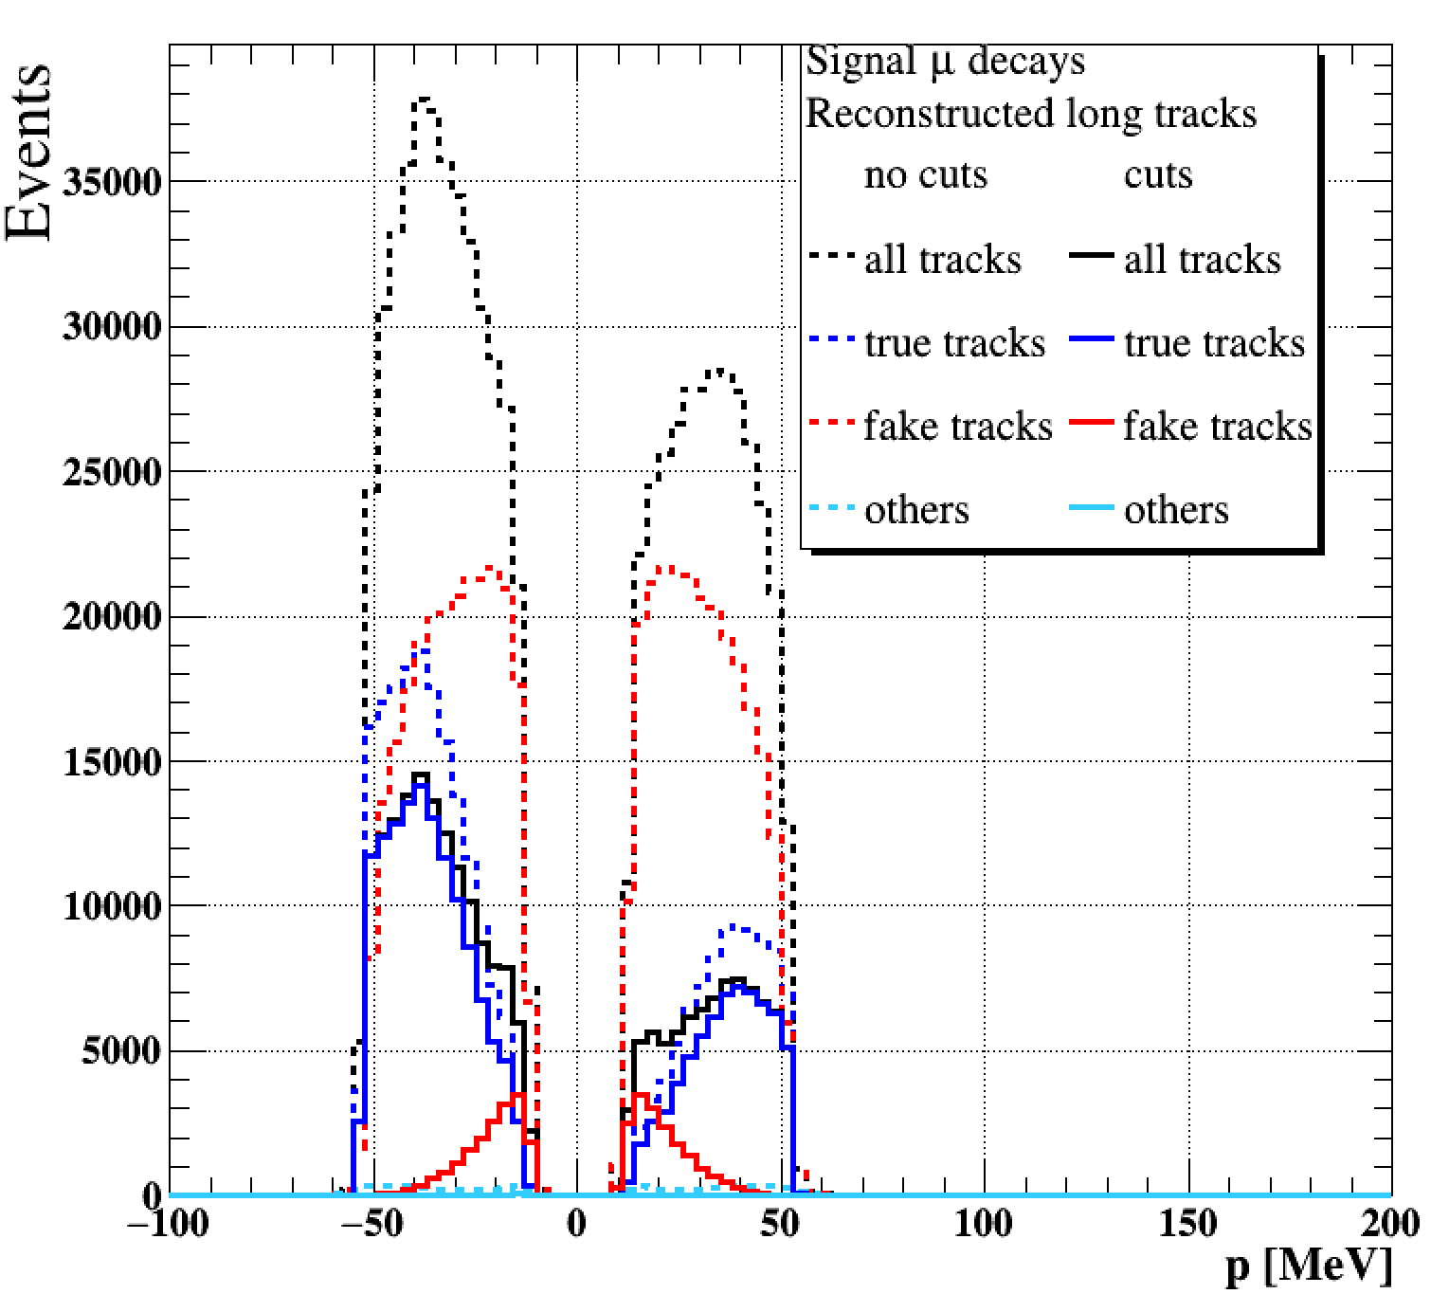
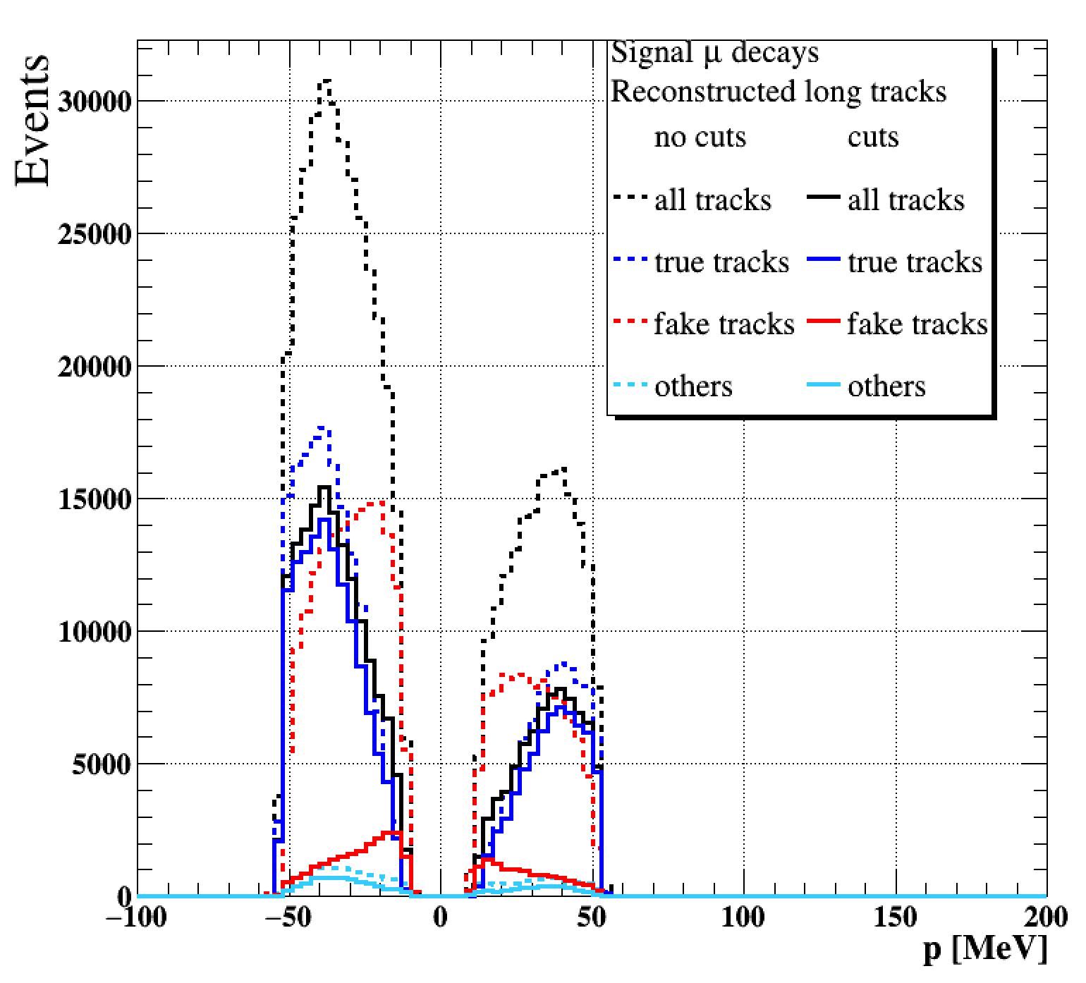
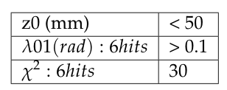
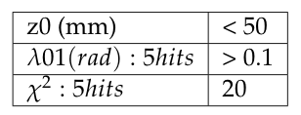
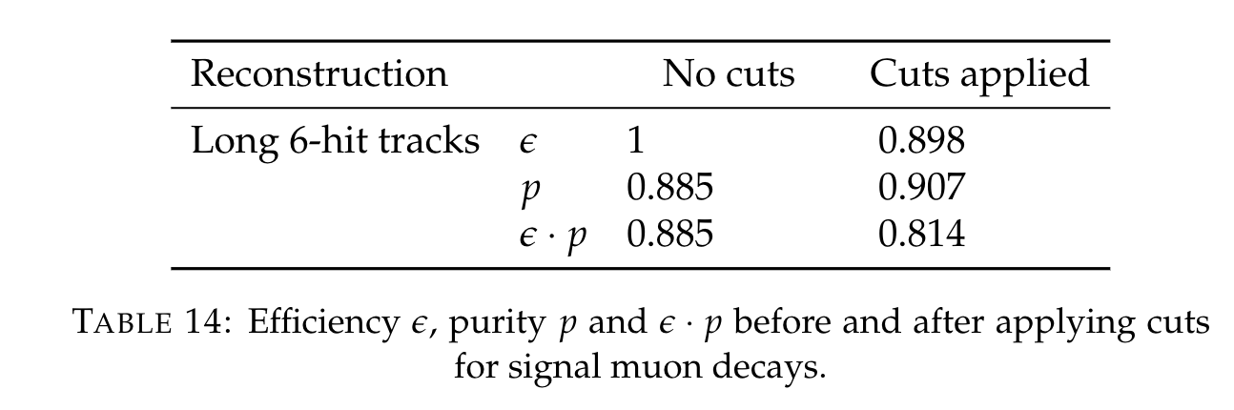
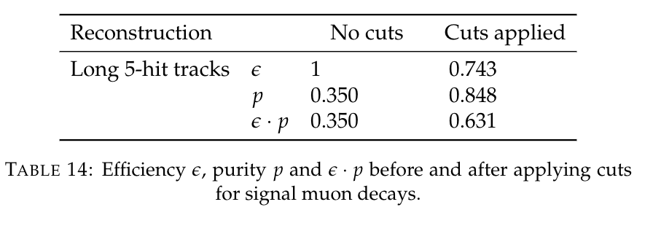
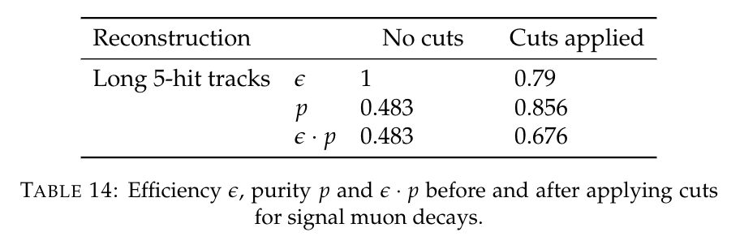
Momentum Distribution before and after applying cuts for Different Categories of Tracks
Selection cuts for long tracks with 6-pixel hits in perfect detector:
Perfect tracks with 6-pixel hits
In the CS or RS of the detector
with 0% inefficiency in 1-pixel layer
Imperfect tracks with 5-pixel hits
In the CS or RS of the detector(100% inefficiency in 1-pixel layer)
Imperfect tracks with 5-pixel hits
In the CS or RS of the detector(100% inefficiency in 2-pixel layer)
(Mu3e work in progress)
(Mu3e work in progress)
(Mu3e work in progress)
Selection cuts for long tracks with 5-pixel hits in imperfect detector:

Slide 11
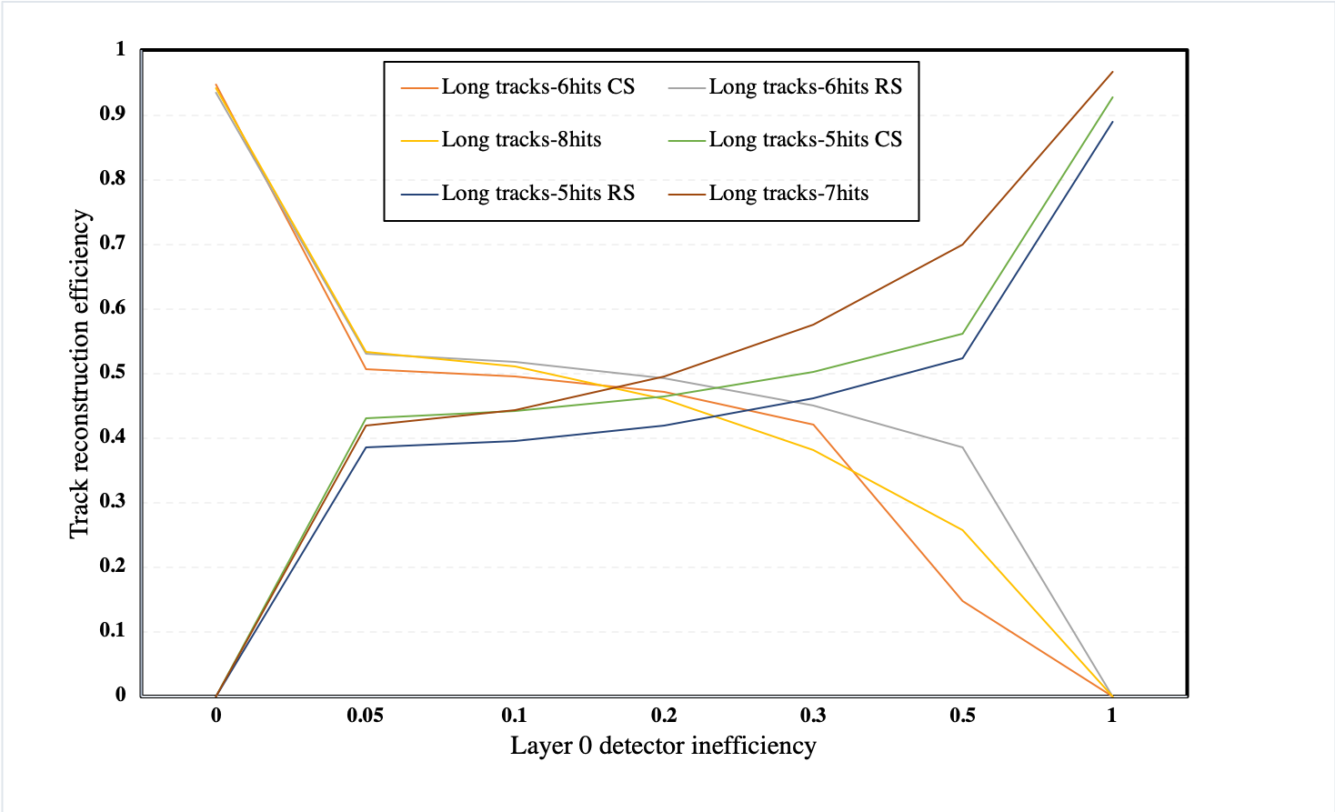
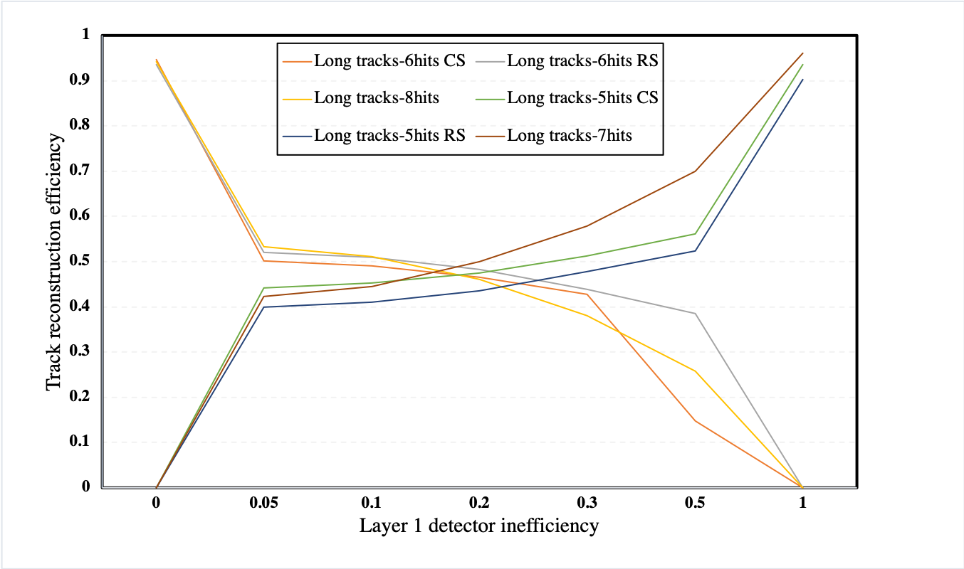

Summary Plot for How Many Imperfect Correctly Reconstructed Tracks Could Recover in the Case of a Missing Layer at a Different Level of Inefficiency
RS
RS
CS
CS
(Mu3e work in progress)
More imperfect correctly reconstructed tracks could recover at highest level of inefficiency in 0, 1 or 2-pixel layer
(Mu3e work in progress)
RS
CS
less or 0 imperfect correctly reconstructed tracks could recover at lowest level of inefficiency in 0, 1 or 2-pixel layer
(Mu3e work in progress)

Slide 12


Extended Studies on the Noise in the Mu3e Pixel Detector
What is the effect on efficiency and purity for the performance of the track reconstruction as the noise rate per pixel goes from 0 to highest rates in 20Hz as height noise rate per pixel (MuPix8)?
Purity is relatively stable until a noise rate of approximately 40Hz, which is much larger that the highest noise rate seen for the MuPix8 prototypes of 20 Hz
Summary plot for different detector noise rates per pixel go from 0 to 20 Hz vs. tracking efficiency and purity of track candidates:
(Mu3e work in progress)
(Mu3e work in progress)
highest noise rate per pixel for MuPix8 prototype
highest noise rate per pixel for MuPix8 prototype

Slide 13


Signal Efficiency After Reconstruction and Vertex Fit Step for Phase Space Distributed Events for Perfect and Noise Mu3e Detector
Track/Vertex Efficiency After Track Reconstruction and Vertex Fit Step for Phase Space Distributed Signal Muons Events in perfect or Noise detector (Mu3e work in progress )
Vertex fit step
Signal efficiency after reconstruction and vertex fit step for phase space distributed events for perfect and noise detector (injecting 20 Hz as highest noise rate per pixel)
Default selection cuts applied to distinguish μ⁺ → e⁺ e⁺ e⁻ and suppress different background categories
Noise
No is

Slide 14


What is the Single-Event Sensitivity (SES) with Noise Mu3e Detector in Vertex Fit Step and How is Vary from Perfect Detector ?
Single event sensitivity (SES) and the corresponding 90% and 95% C.L. upper limits versus data taking days for the phase I Mu3e detector
Long tracks in perfect (PD) and noise detector (ND) after applying vertex cuts
All tracks in perfect (PD) and noise detector (ND) after applying vertex cuts

Slide 15







Test-beam Data Acquisition System and Characterisation of HV-MAPS
Test-beam @ PSI
Setup of MuPix Telescope
The beam with momentum 270 MeV (pion, electrons, and muons), and electrical current is 1860.10μA at πM1 beam area in PSI
MuPix8 sensor?
3-layers of MuPix8 sensors with DUT layer
Layer 1 is DUT layer
2-classical trigger scintillators
All PCBs were connected to a HV power supply, and set to - 60 V for all MuPix8 measurements
First large prototype in MuPix group
Pixels have a size of 81×80μm²
Pixels are arrayed in
128 × 200pixel matrix
Fast charge collection (O(1ns))
Integrated readout electronics
Thickness: 100 μm
Alignment Stability
Efficiency Analysis
Efficiency and Noise Rate per Pixel for Different DAQ Runs
Efficiency of run 1429 with threshold 545 mV
Noise rate per pixel = #hits - #matched tracks
runtime . #pixels
Eff_{ROI} = #matched tracks
#total tracks
Track map
Matched track map
Efficiency map
Total tracks
= 1235869
Matched tracks = 1234423
Eff_{ROI} = 0.9988 ± 0.001

Slide 16
Summary:
Acceptance and efficiency of the detector have studied with checking sources of fake tracks by looking at timing information
The performance of imperfect tracks due to by noise or missing hits have studied with optimising selection cuts
Test-Beam data acquisition system for characterization of High Voltage Monolithic Active Pixel Sensors has analyzed

Slide 17
Thank you for listening!

Slide 18
Backup……

Slide 19


What is the Single-Event Sensitivity (SES) with Nosy Detector in Vertex Fit Step and How is Vary from Perfect Detector ?
Single event sensitivity (SES) and the corresponding 90% and 95% C.L. upper limits versus data taking days for the phase I Mu3e detector
Perfect Detector
Nosy Detector

Slide 20




Fake Long Tracks (Mis-Reconstruction Identification) by Time Information
There is a couple of variables that can be used to check the performance of tracks:
The χ2 of the track fit, the dip angle λ01 (particles perform many loops in the central detector), the intersection z0 of the track with the target region (vertices), and reconstructed curvature (a track of an electron that is mistaken for a positron).
Check sources of fake tracks by looking at timing information, χ2 of the track fit, the dip angle λ01 and the intersection z0 with the target region
The performance of imperfect tracks due to by nosy or missing hits have studied with optimising pre-selection and selection cuts

Slide 21


A way of splitting the long tracks with 5 hits in CS or RS of the detector
Z5: 5th silicon hit in outer layers either in CS or RS, it is a good cut to to split long tracks with 6 hits recurl back into CS or RS
Z5 < 200 mm: tracks can recurl back into CS
Z5 > 200 mm: tracks can extrapolate into RS “that is because outer silicon detector is started from roughly 200 mm”
This is an example if there is a missing layer (layer2)

Slide 22



Slide 23


Signal Event Sensitivity:
The sensitivity is estimated by the means of simulation, the selection efficiency is used to estimate the sensitivity of the Mu3e experiment. After applying selection cuts, it is assumed that all types of background will be suppressed. The signal-event sensitivity (SES) is defined as:
where e is the signal selection efficiency, this efficiency is calculated as defined previously in the equation. Also, Nμ is the number of muon decays on the target region in which for 300 days of data taking or the number of muon decays on the target region with the nominal Phase-I luminosity, this number is taken as Nμ=1×10^15. In the absence of signal which means zero events and because the number of signal decays follows a Poisson distribution, then an upper limit on theμ→eee branching fraction of a rare decay can be derived:
here 1−βis the required confidence level.

Slide 24


Slide 25

What the Misalignment and Alignment Tool do:
The misalignment tool MU3EMISAL has been created, there are many misalignment modes for the pixel detector
Such a scenario is obtained by estimating the expected error on each entity and modifying the nominal (simulated) geometry by random Gaussian distributed values which reflect these error estimates. In parentheses, the worse case is given.

Slide 26


