Slide 1


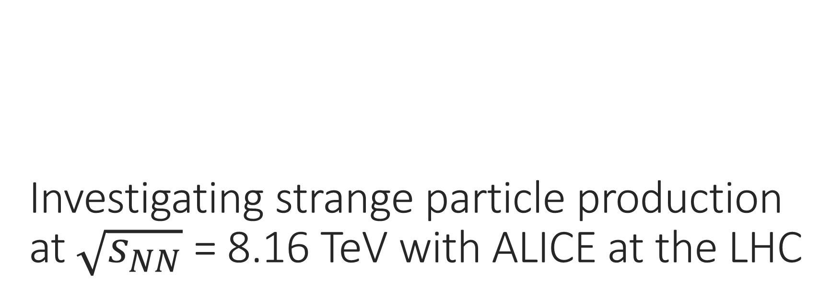
Investigating strange particle production at $\sqrt{s_{NN}}$ = 8.16 TeV with ALICE at the LHC
Oliver Jevons
Institute of Physics
Joint APP, HEPP and NP Conference 2021

Slide 2
This talk
  Introduction to the ALICE detector.
  Quark Gluon Plasmas and strangeness enhancement.
  Previous analyses
    Including different collision systems (pp, Pb-Pb)
    Latest Ξ± and Ω± results in p-Pb collisions
  Current analysis (K⁰_{S} and Λ).

Slide 3
This talk
  Introduction to the ALICE detector.
  Quark Gluon Plasmas and strangeness enhancement.
  Previous analyses
    Including different collision systems (pp, Pb-Pb)
    Latest Ξ± and Ω± results in p-Pb collisions
  Current analysis (K⁰_{S} and Λ).

Slide 4
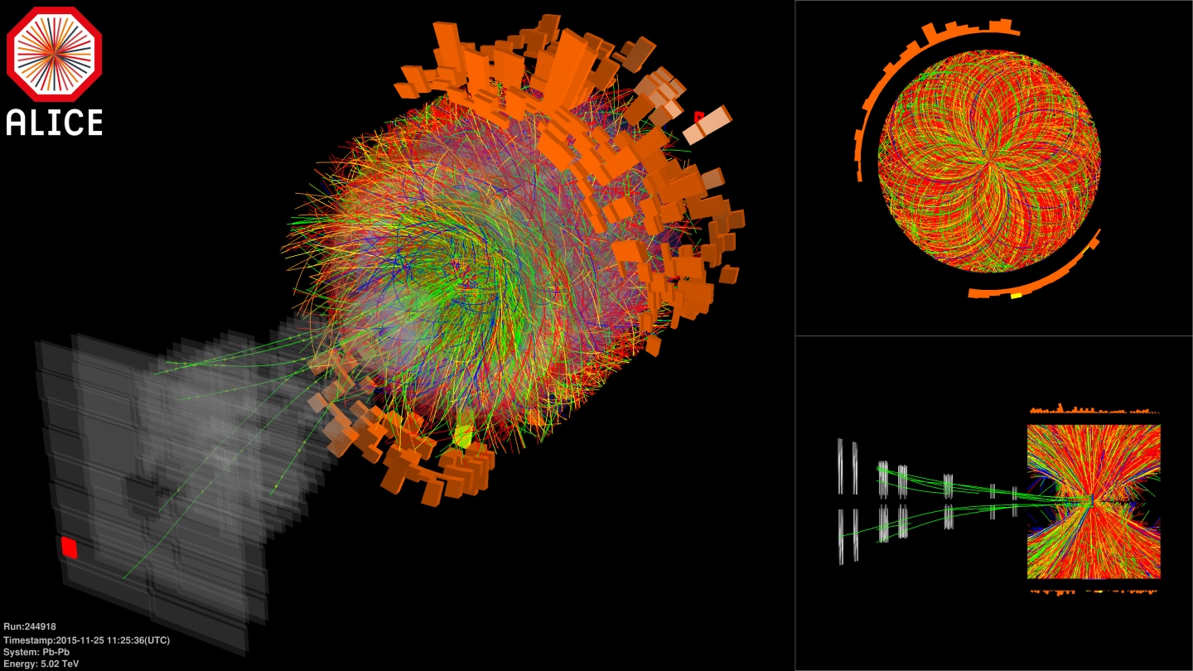
What is ALICE?
  One of four main LHC experiments; only one to be optimised for ion-ion collisions.
    Mostly lead-lead systems, but not solely (Xe-Xe provided in 2017; lighter systems proposed for future runs: O-O, Ar-Ar)
    Very high energy densities; creates extreme final state multiplicities (densities of order 10³ per unit rapidity).
  ALICE intends on studying quark gluon plasmas (QGP) created in Pb-Pb collisions.
https://cds.cern.ch/record/2108293

Slide 5
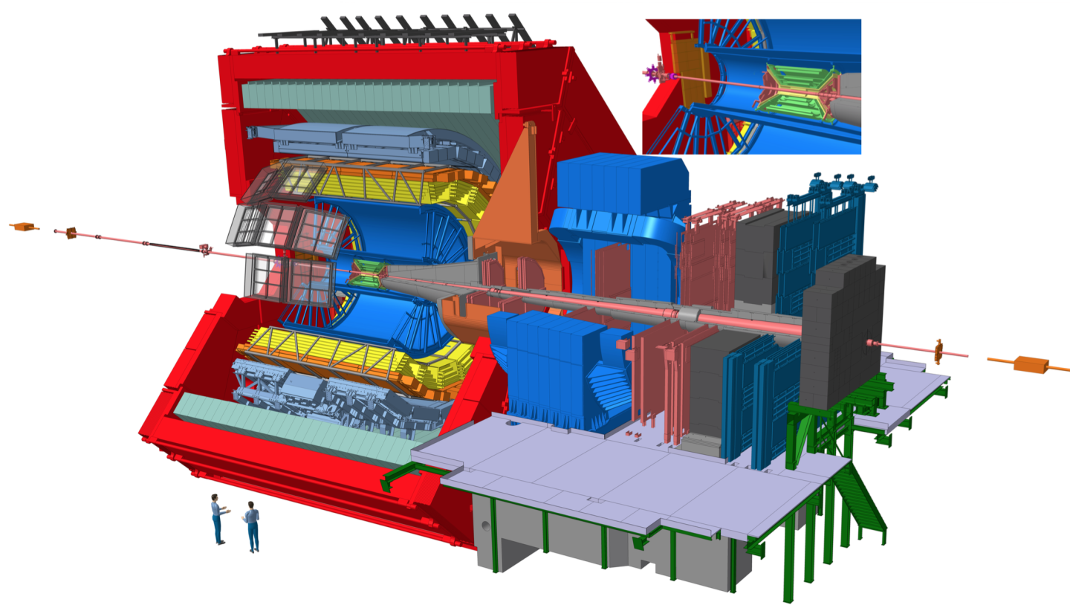
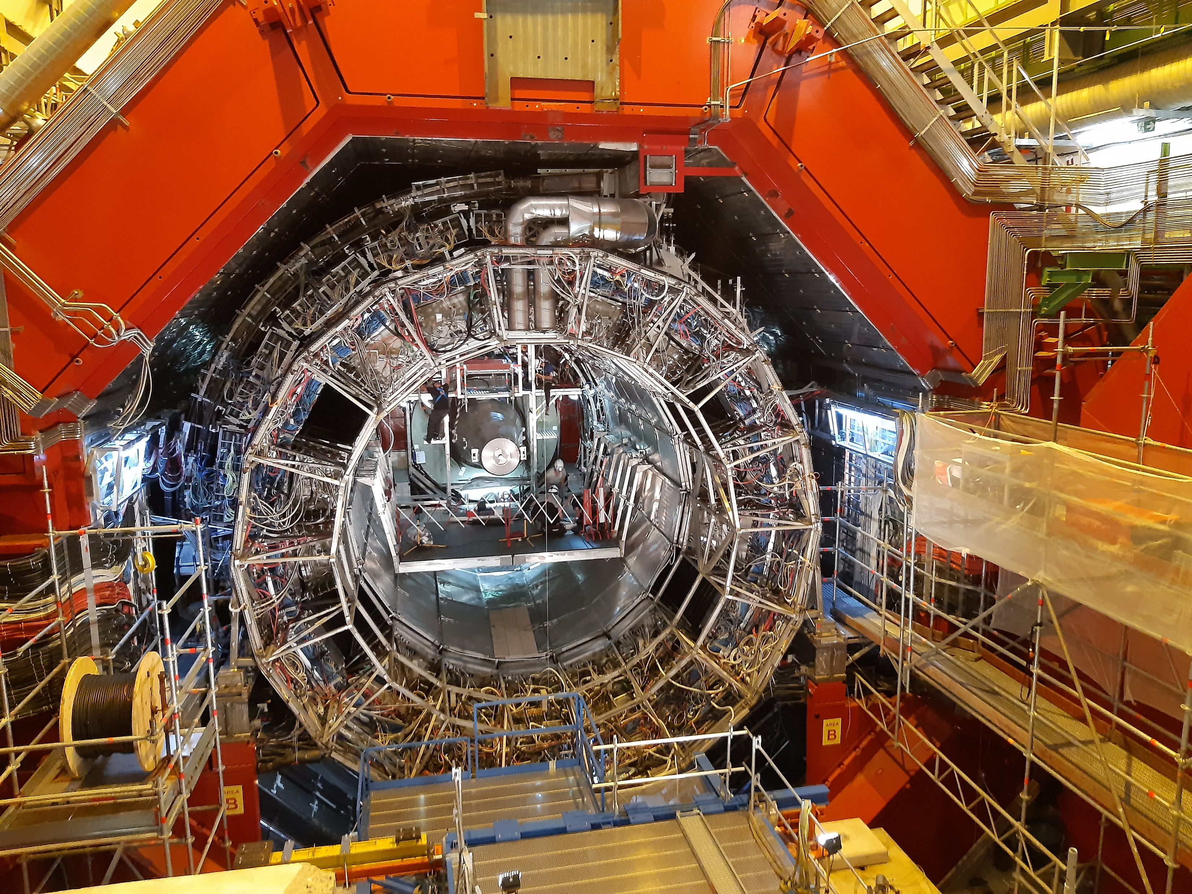
What is ALICE?
  Parts of detector utilised in strangeness analyses:
    Inner Tracking System: for primary vertex location and tracking
    Time Projection Chamber: for tracking and particle identification of large numbers of particles
    V0 scintillator arrays: for triggering and estimation of final state multiplicity.
https://cds.cern.ch/record/2263642

Slide 6
This talk
  Introduction to the ALICE detector.
  Quark Gluon Plasmas and strangeness enhancement.
  Previous analyses
    Including different collision systems (pp, Pb-Pb)
    Latest Ξ± and Ω± results in p-Pb collisions
  Current analysis (K⁰_{S} and Λ).

Slide 7
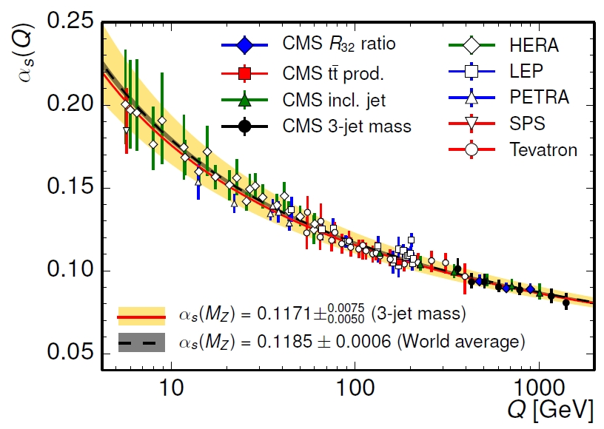
What is the QGP?
  Quark Gluon Plasma.
  Very hot, very dense state of matter in which quarks and gluons are not bound into hadrons.
    Measured average temperature nearly 300 MeV (3.5x10¹² K; 5 orders of magnitude higher than the core of the Sun).
  Predicted by lattice QCD, and hypothesised to be a result of the running of the strong force coupling constant.
    Coupling as function of 4-momentum transfer in an interaction: α_{S}(Q²) →0 as Q²→∞
  Confirmed new state of matter by seven experiments at CERN in year 2000 (NA44, NA45, NA49, NA50, WA97/NA57 and WA98).
  Confirmation of QGP existence by experiments on RHIC (STAR, PHENIX, PHOBOS, BRAHMS) in mid-2000s.
Eur. Phys. J. C 75, 186 (2015)

Slide 8
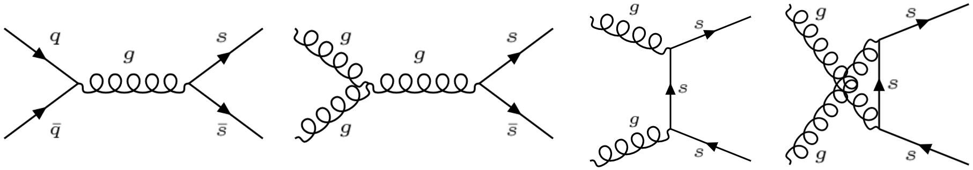
What is strangeness enhancement?
  In a hadronic gas, the only way to form strange quarks is via quark-quark interactions.
    In these conditions, quarks must be bound upon creation; take constituent mass (estimated by lattice QCD as around 480 MeV).
  In QGP systems, quarks can be formed unbound; take bare mass of 95 MeV.
    Less than half the average energy of gluons in a GQP.
    Can use gluon-gluon fusion to create strange quark pairs in a QGP.
  Therefore, there will be an enhancement of strange matter over non-strange light matter (as u and d quarks will be present in abundance in the initial state).
  Pion yields are used as non-strange reference, against which enhancement can be measured.

Slide 9
This talk
  Introduction to the ALICE detector.
  Quark Gluon Plasmas and strangeness enhancement.
  Previous analyses
    Including different collision systems (pp, Pb-Pb)
    Latest Ξ± and Ω± results in p-Pb collisions
  Current analysis (K⁰_{S} and Λ).

Slide 10
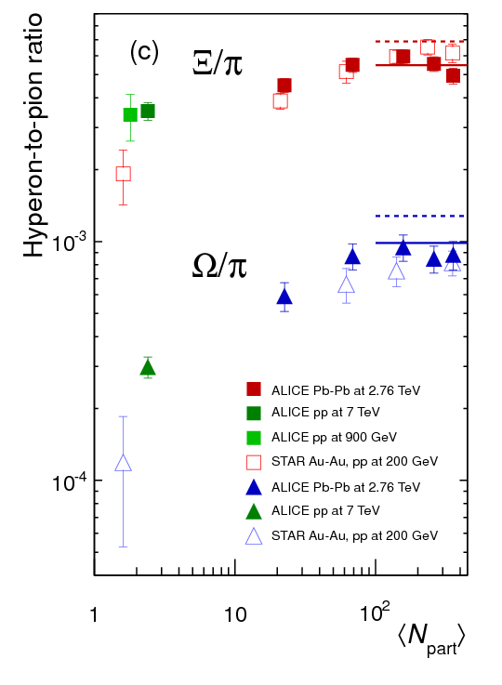
Historical results
  Level of enhancement related to strangeness content.
    More strange quarks in hadron means greater enhancement.
    Hierarchy: Ω (sss) > Ξ (ssd) > Λ (uds)
  Published results have shown increased strangeness production in heavy ion collisions since 1999 (WA97 collaboration).
  Initial results use proton-proton and lead-proton collisions to demonstrate non-QGP case.
Phys. Lett. B, 728, p 216 - 227 (2014)

Slide 11
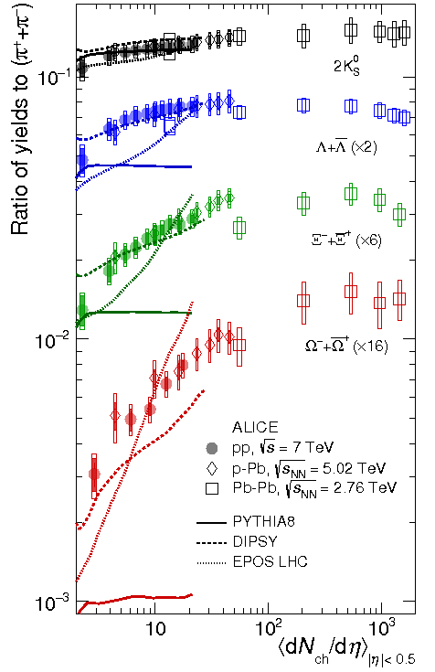
Historical results
  In 2017, results were published demonstrating strangeness enhancement in pp and p-Pb systems.
  Not the first evidence of heavy-ion phenomenology in lighter systems, but first observation of strangeness enhancement.
    Models for this exist containing the idea of the creation of QGP ‘droplets’.
  Further analyses in higher energy pp and p-Pb systems have confirmed this behaviour.
Nature Phys., vol. 13, p 535 - 539 (2017)

Slide 12
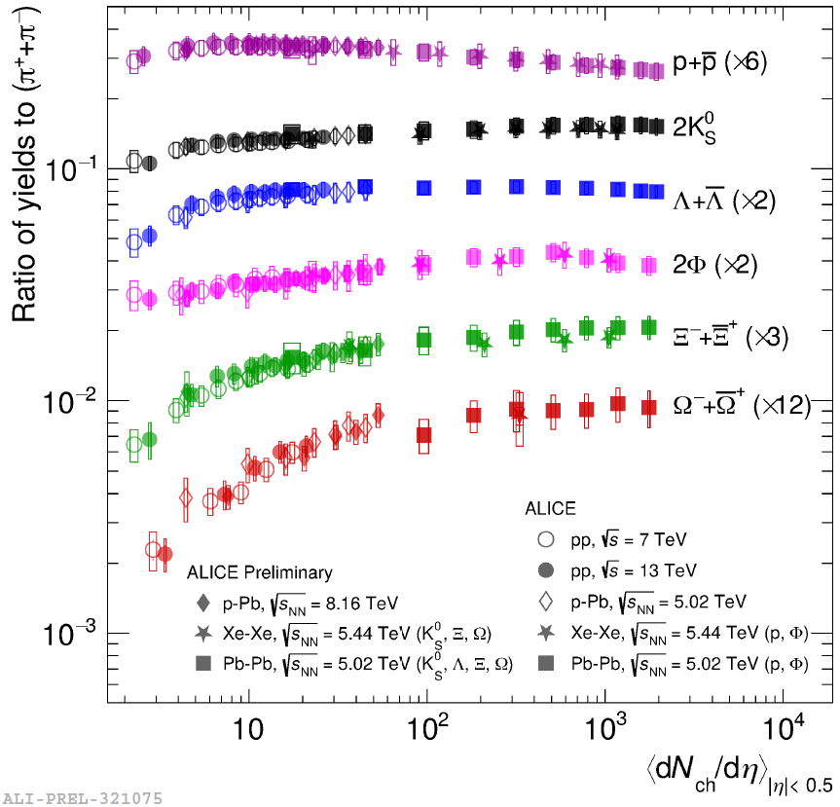
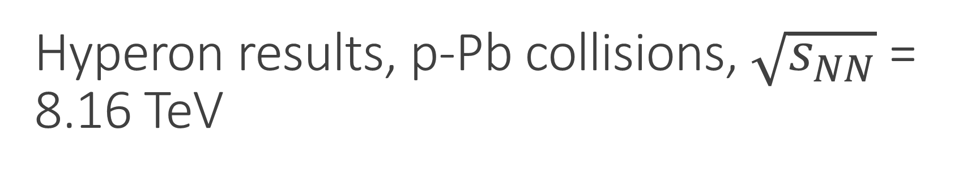
Hyperon results, p-Pb collisions, $\sqrt{s_{NN}}$ = 8.16 TeV
  Multi-strange baryon (Ξ± and Ω±) results.
    Also known as “cascades” from the behaviour of their decays.
      Ξ⁻ → Λπ⁻
      Ω⁻ → ΛK⁻
      Λ → pπ⁻
  Results presented at SQM 2019 and INPC 2019.
  Yields and enhancement in agreement with previous results.

Slide 13
This talk
  Introduction to the ALICE detector.
  Quark Gluon Plasmas and strangeness enhancement.
  Previous analyses
    Including different collision systems (pp, Pb-Pb)
    Latest Ξ± and Ω± results in p-Pb collisions
  Current analysis (K⁰_{S} and Λ).

Slide 14
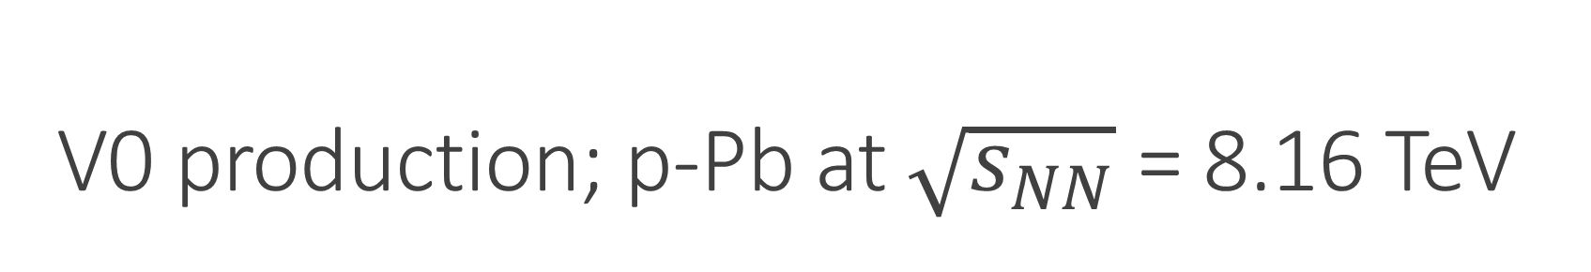
V0 production; p-Pb at $\sqrt{s_{NN}}$ = 8.16 TeV
  Singly-strange hadron (Λ and K⁰_{S}) results.
    Known as “V0s” from the shape of decays.
      Λ → pπ⁻
      K⁰_{S} → π⁺ π⁻
  Candidates chosen based on decay geometry.
π⁻
π⁺
K⁰_{S}
π⁻
PV
p
Λ
PV

Slide 15
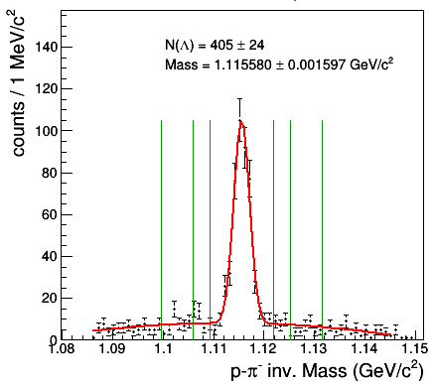
V0 production; p-Pb at $\sqrt{s_{NN}}$ = 8.16 TeV
  Singly-strange hadron (Λ and K⁰_{S}) results.
    Known as “V0s” from the shape of decays.
      Λ → pπ⁻
      K⁰_{S} → π⁺ π⁻
  Candidates chosen based on decay geometry.
  Fit invariant mass distribution to calculate yield.
Λ; p_{T} [0.6, 0.7] GeV/c; most central events

Slide 16
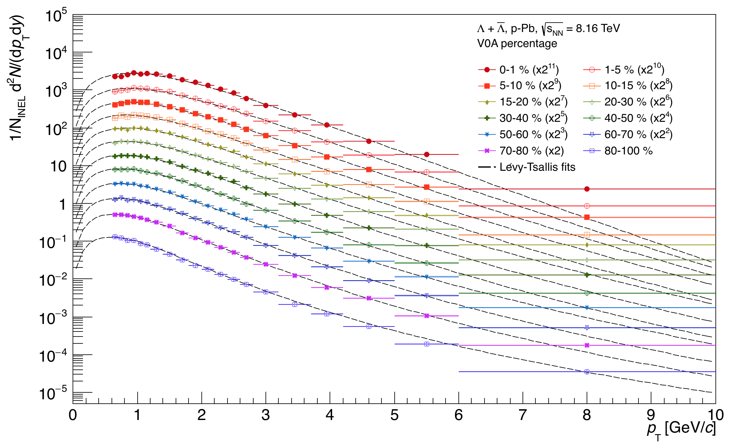
V0 production; p-Pb at $\sqrt{s_{NN}}$ = 8.16 TeV
  Singly-strange hadron (Λ and K⁰_{S}) results.
    Known as “V0s” from the shape of decays.
      Λ → pπ⁻
      K⁰_{S} → π⁺ π⁻
  Candidates chosen based on decay geometry.
  Fit invariant mass distribution to calculate yield.
  Correct transverse momentum spectra for detector efficiencies and fit.
    Extrapolate down to 0 GeV/c to extract full integrated yields.

Slide 17
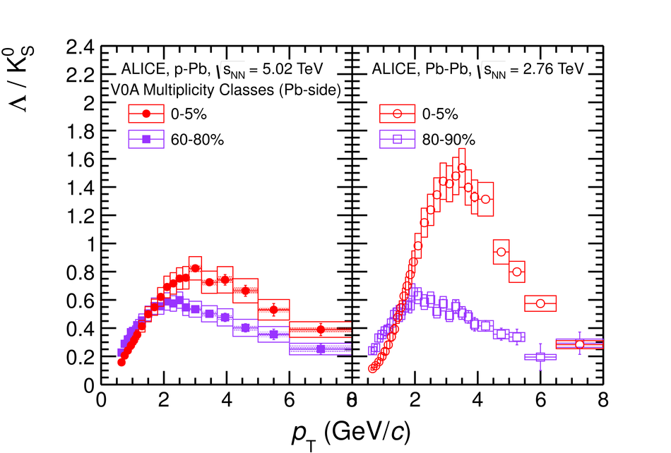
Ratio of spectra: Λ/K⁰_{S}
  Disagreement seen between measured results and perturbative QCD predictions, especially in strange sector.
  Measuring baryon-to-meson ratios can shine a light on the processes present in high-energy collisions.
  Compare results to theoretical models to identify source of effects.
    Enhancement at mid-p_{T} commonly understood in terms of collective flow and quark recombination.
Phys. Lett. B., 728 (2014), 25-38

Slide 18
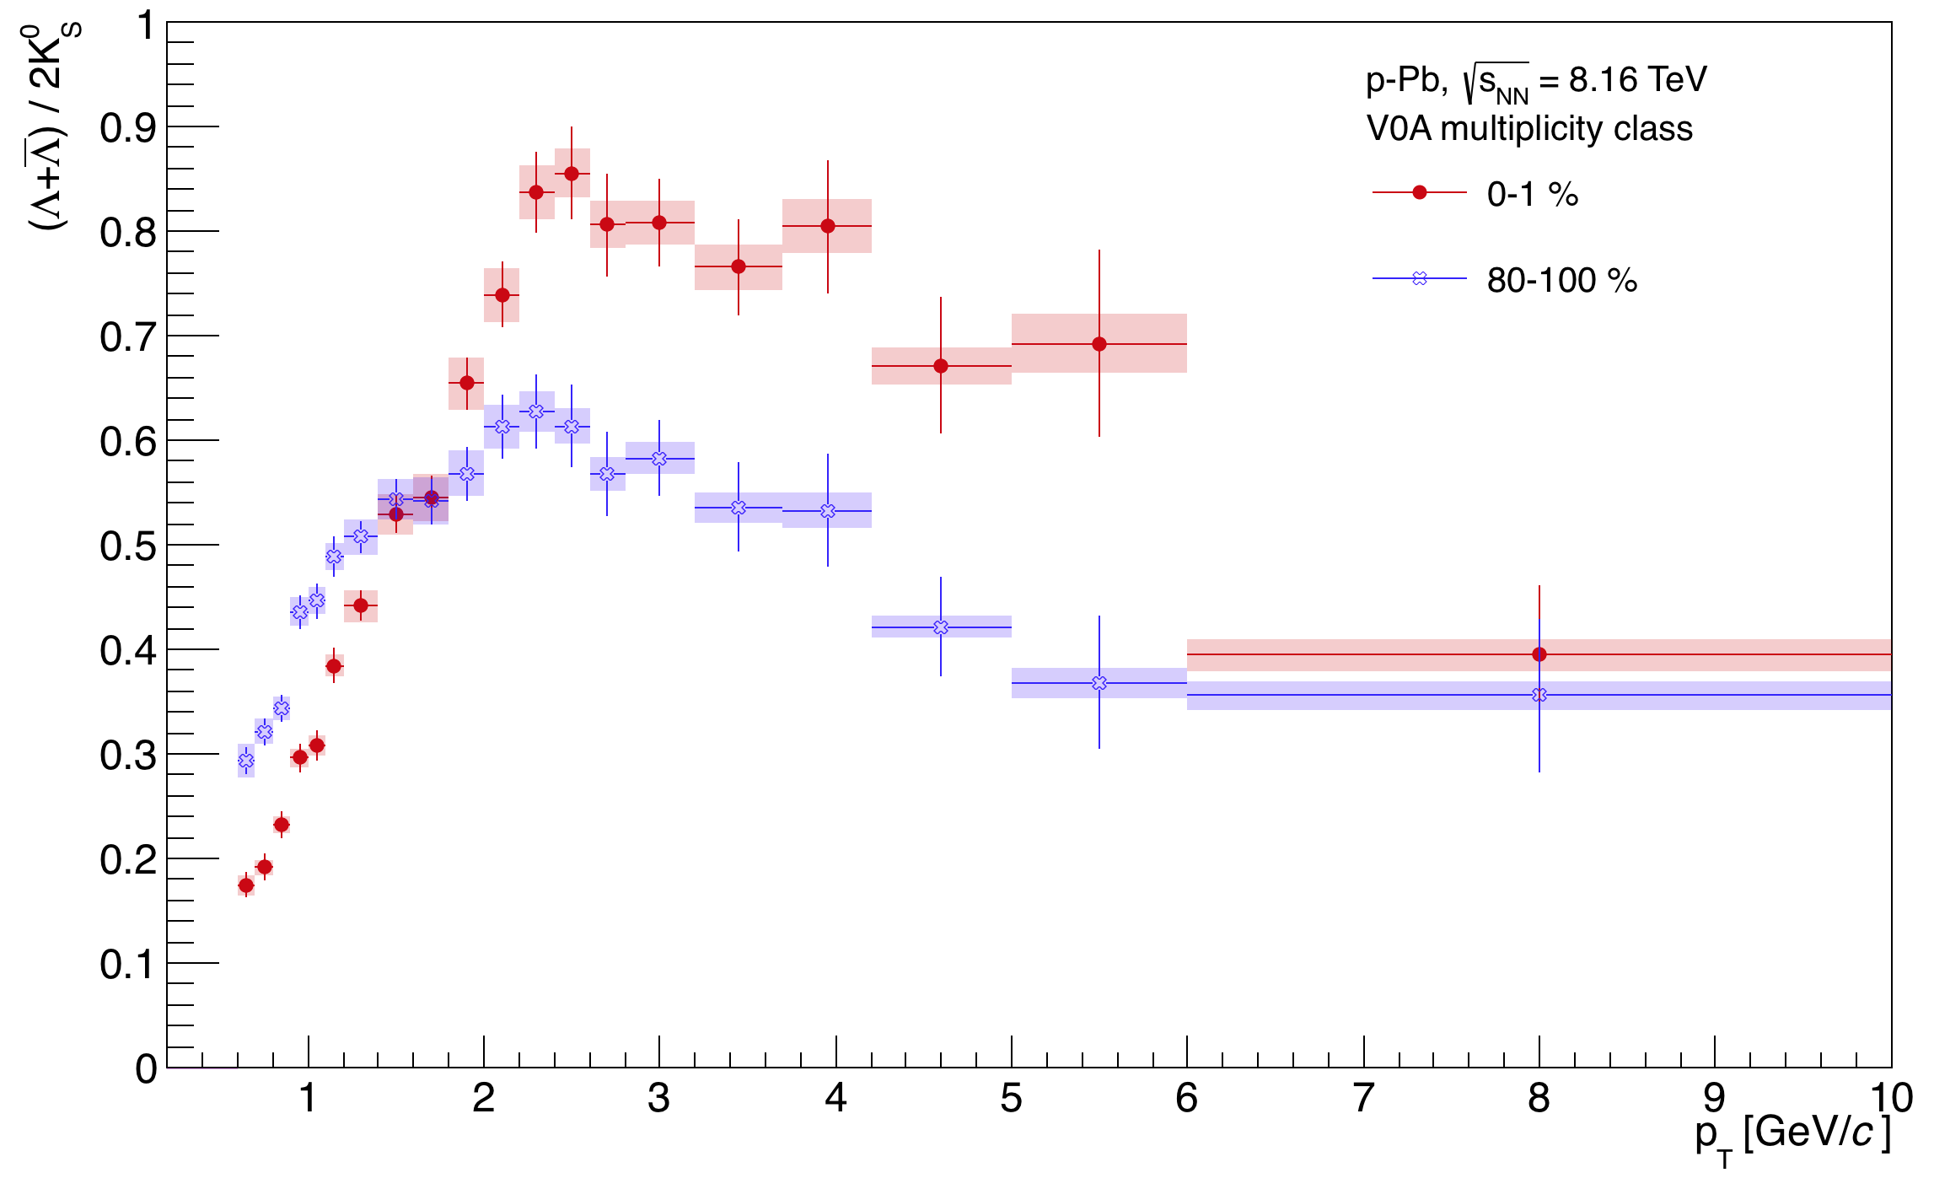
Ratio of spectra: Λ/K⁰_{S}
  Disagreement seen between measured results and perturbative QCD predictions, especially in strange sector.
  Measuring baryon-to-meson ratios can shine a light on the processes present in high-energy collisions.
  Compare results to theoretical models to identify source of effects.
    Enhancement at mid-p_{T} commonly understood in terms of collective flow and quark recombination.

Slide 19
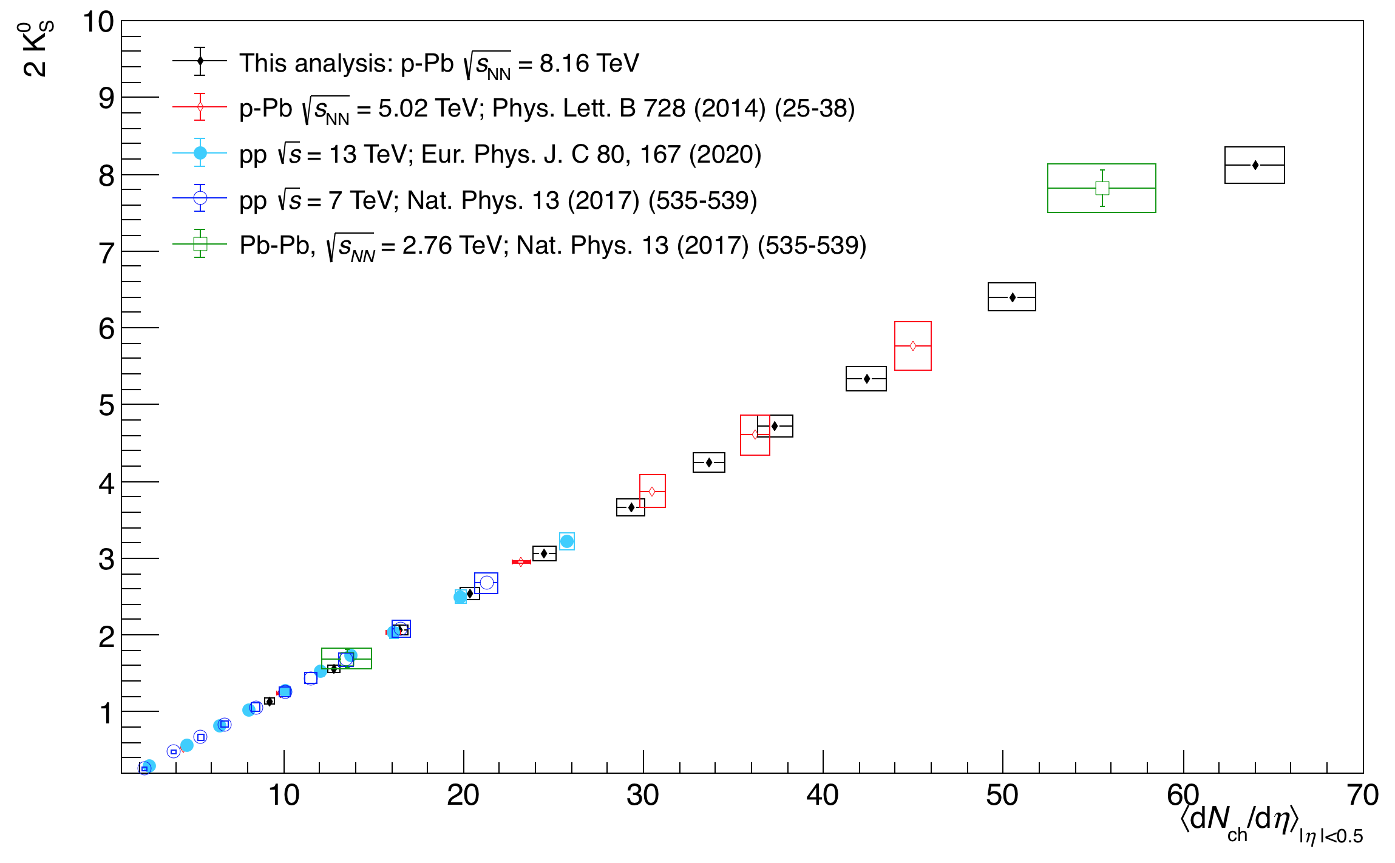
Yields (dN/dy), K⁰_{S}

Slide 20
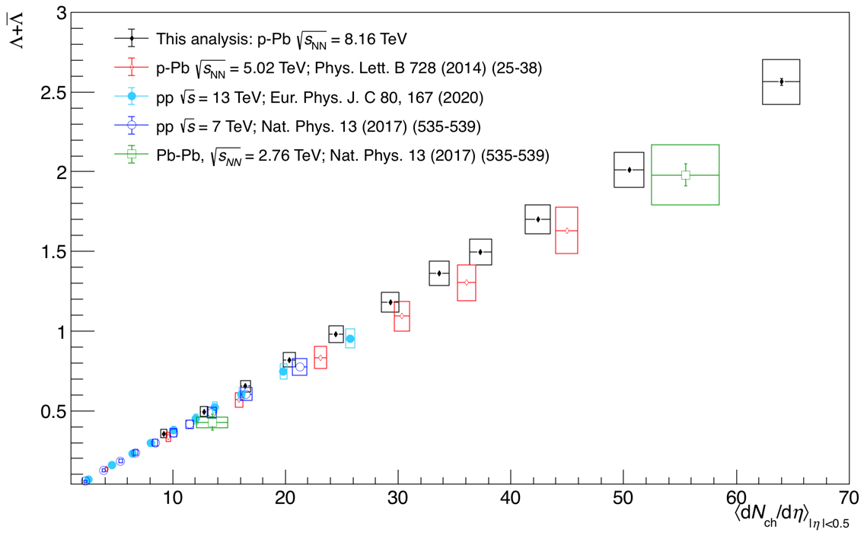
Yields (dN/dy), Λ

Slide 21
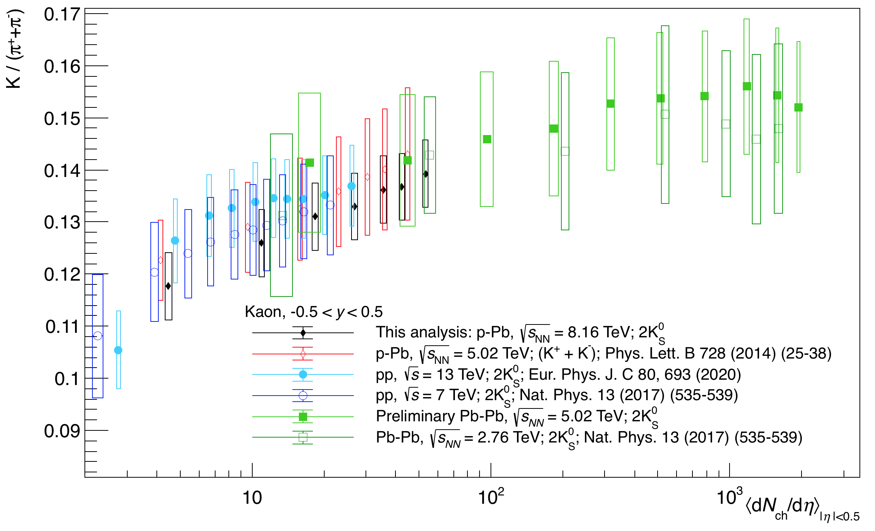
Strangeness enhancement: K⁰_{S}-to-pion ratio

Slide 22
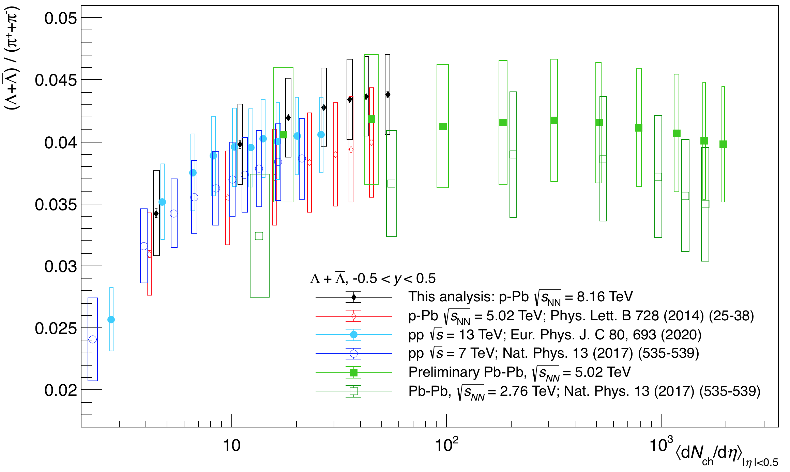
Strangeness enhancement: Λ-to-pion ratio

Slide 23
Summary
  Measurements of strange particles relative to non-strange particles used as a signature of QGP formation.
  Strangeness enhancement measurements in light systems (pp, p-Pb) from LHC Run 1 data suggests heavy-ion-like behaviour.
  Run 2 results continue to agree with this trend.
    Strangeness enhancement appears related to final state multiplicity; independent of collision system or energy.
  Future analyses will continue to fill gaps in dN_{ch}/dη using high multiplicity selections and lower mass systems (e.g. O-O, p-O).

Slide 24
Backup

Slide 25
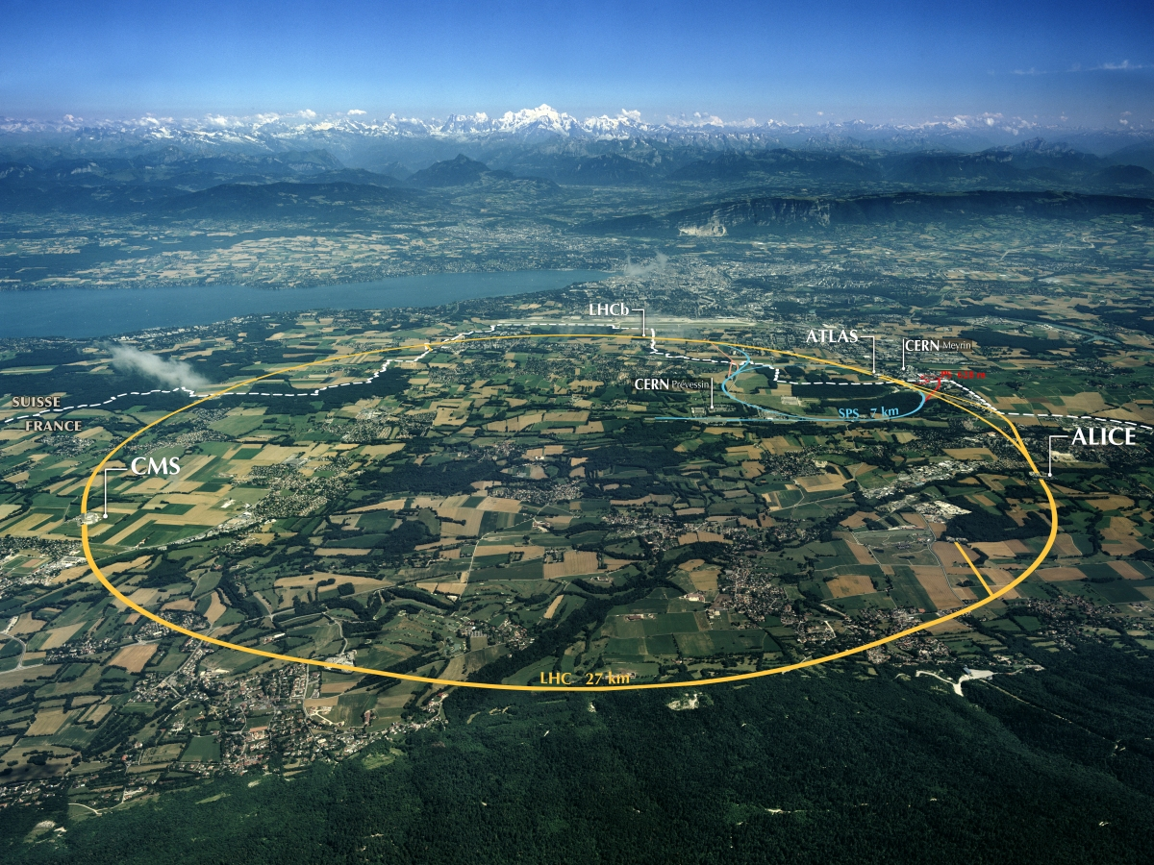
What is the LHC?
  Operated by CERN (European Council for Nuclear Research)
  27 km circumference synchrotron; ~100 m underground at French-Swiss border.
  Designed to accelerate 2 counter-rotating particle beams up to 7 TeV per beam.
  4 primary experiments:
    ATLAS – Meyrin, CH
    CMS – Cessy, FR
    LHCb – Ferney-Voltaire, FR
    ALICE – St-Genis-Pouilly, FR
https://structurae.net/en/structures/large-hadron-collider-lhc

Slide 26
What is ALICE?
  A Large Ion Collider Experiment.
  In experimental cavern 80m underground near French town of St-Genis.
  Dimensions: 16m x 16m x 24.5m:
    Central barrel inside 0.5T solenoid magnet.
    Single-arm muon spectrometer on C-side of the central barrel.
https://cds.cern.ch/record/2263642

