Slide 2
AD stochastic cooling system: leak between cooling circuit and beam vacuum – repair options reported by W. Höfle
A. Sinturel, J. A. Ferreira Somoza (TE-VSC)
S. Clement, R. Gavaggio (TE-MSC)
V. Bretin, C. Rossi, F. Caspers, R. Louwerse (SY-RF)
Acknowledgements: C. Carli, L. Ponce, L. Thorndahl

Slide 3
Stochastic cooling system in AD
installed in AD for 1998 start-up (in the AD ring in hall 193)
built from recuperated parts from the CERN AC (anti-proton “collector”)
the original AC cooling systems featured different systems for different frequency bands
in AD only the so called “Band I” system is used (~0.85 GHz to ~1.7 GHz)
  cooling in all three planes: H, V, and longitudinal plane (momentum)
  without it no anti-protons storage and deceleration in AD
  pick-ups and kickers for horizontal and vertical planes in ring
  dual use of the kickers with combined signals for the longitudinal plane
  4 vacuum tanks in machine
      horizontal kicker KHM 0307 → developed leak between cooling and beam vacuum of tank this month after bake-out
      vertical kicker KVM 0407
      horizontal pick-up
      vertical pick-up
    horizontal and vertical kicker equipment in the ring date from 1980’
    no spares, no degraded mode thought possible without

Slide 4
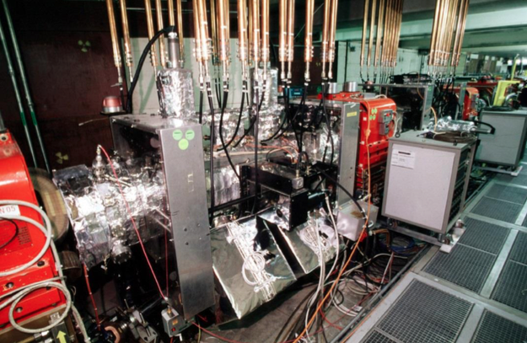
History of KHM 0307 in AD
similar leak was repaired at start-up in the year 2000 by injecting araldite
consolidation review in 2018 classified the risk of occurrence of a leak as low probability, but high impact (20 years operation w/o this problem)
  risk accepted on basis of applying the procedure from the year 2000 in case of a similar problem developing on one of the two tanks
  secured all information available from 2000 at the time (2018)
  resources in RF for building a full replacement found not available neither for defining nor implementing a project with a target installation date before LS3
KVM 0407
KHM 0307

Slide 5
CERN AD kicker (ex CERN-AC)
Static part
movement not used for kickers
(blocked in fixed position)
movable part
movable part
Water cooling
Pipes in UHV
Plunging
Static part
=beam
picture - for illustration - of a similar kicker (without the additional cooling circuits on top and bottom present in AD)

Slide 6
Vacuum leak – findings TE-VSC
Problem (February 2021)
  no vacuum leak before bake-out
  bake out at 140 degrees (limit is 150 degrees)
  vacuum leak after bake out noticed
  located the leak between the water cooling circuit and the beam vacuum by injecting He in the cooling circuit (at atmospheric pressure)
    He detected after 10 seconds with the RGA and leak detector, 1.0x10⁻⁷ mbar l s⁻¹
  too large leak to operate, too risky to do a test with higher pressure or using the water cooling
  water cooling indispensable for the RF parts inside (2.4 kW of peak RF power consumed, power distribution inside, RF loads and ferrites)
Leak developed on the same tank as in the year 2000
four cooling circuit branches present, put in series externally

Slide 7
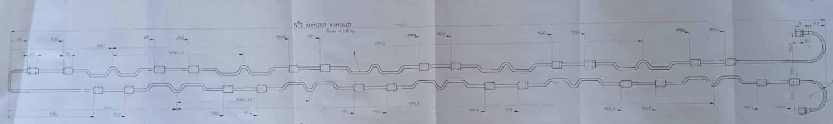
Refining location of leak
first step proposed is to identify which of the four circuits is concerned
  reconnection of RGA, 2 successive days of tests
  preparation time: small
  access possibilities driven by OP requirements
additional (optional) step
  radiography / X-ray imaging to probe geometry of the two additional cooling circuits on top and bottom (lack of documentation, for ferrites?)
    not needed if leak confirmed to concern only cooling of one of the electrode assemblies
Cooling pipe along electrode assembly

Slide 8
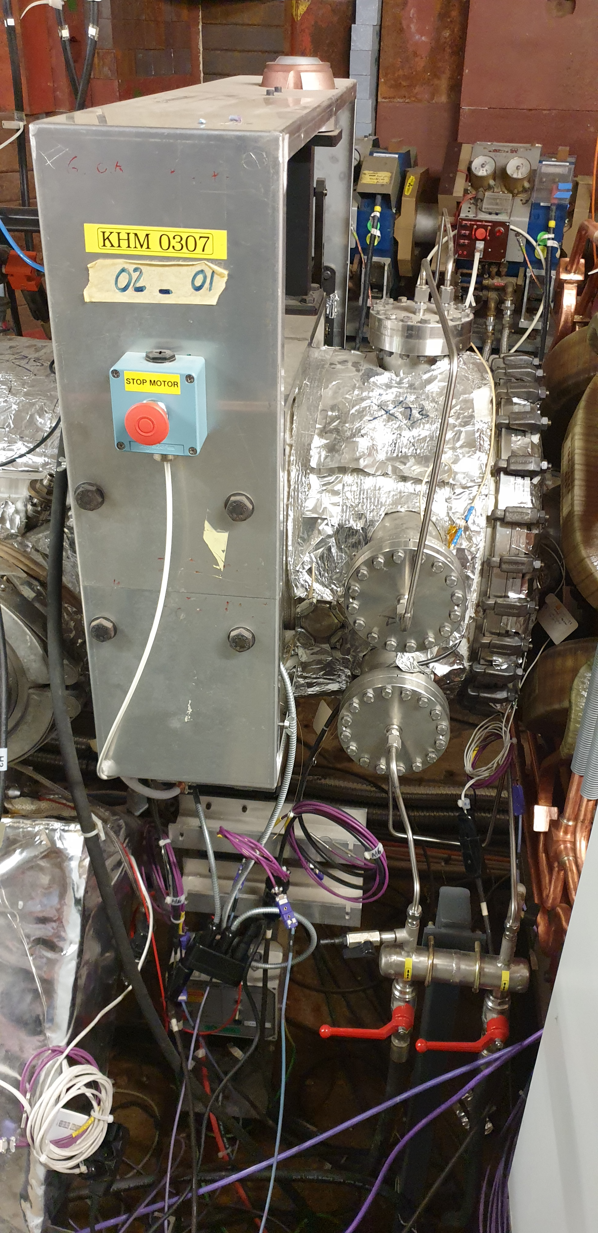
Situation in ring – KHM 0307 cooling ports
in - out
the water connections on the back side not shown
all four circuits in series
connecetion for He injection for test
out
in
water in
out

Slide 9
Option 1 – in-situ repair with araldite
repeat of year 2000 exercise, plan:
  test the procedure in the lab on a mock-up of the cooling circuit
  inject araldite mixture, blow through with compressed air
  blow hot air at 80 degrees for curing (24 h minimum)
  destructive test of mock-up to confirm no congestion is caused and a thin lining is produced
  repeat in machine (while tank under vacuum)
RF workshop to build the mock-up and jigs for the procedure
  lead time needed, under estimation
seems not impossible to recover in the shadow of start-up preparations
  multiple accesses needed and few days in the machine
  coordination with OP

Slide 10
Option 2 – extracting tank and opening
would impact the schedule
removal of equipment on top of shielding blocks
removal of shielding blocks
extraction by crane
count in addition to the extraction process few weeks for repair
bake-out after re-installation (2 to 3 weeks)
advantage: opportunity to look inside for future consolidation / re-design
> 2 months
advantage: can inspect the interior and fix the leak at source

Slide 11
Strategy for defining a full replacement
2018 review concluded feasible at the earliest for LS3
redesign of new kickers
requires a dedicated test place with a new power system
  implies development (in industry) of new solid state power amplifiers
  power system consolidation request made and is in D3 status
would permit design of a system optimized for its current use
  possibly with reduced mechanical complexity (no moving parts)
  electro-magnetic re-design optimized for present cooling plateaus (beam β)
  one horizontal and one vertical band II tank available in storage

Slide 13
AD Basic Parameters
Circumference | 182 | m
Production beam | 1.5x10¹³ | protons/cycle
Injected beam | 5x10⁷ | pbars/cycle
Beam momenta (max-min) | 3.57 – 0.1 | GeV/c
Momenta for stochastic cooling | 3.57 and 2 | GeV/c
Transverse emittances | 200 - 1 | π mmm rad
Momentum spread | 6x10⁻² – 1x10⁻⁴ | δp/p
Vacuum pressure | < 4x10⁻¹⁰ | Torr
Cycle length | 100 | s
Deceleration Efficiency | 85 | %
Production Beam very challenging for PS (26 GeV/c p+) → batch compression
Bunch rotation with 10 MHz pulsed cavity system in AD after injection

Slide 14
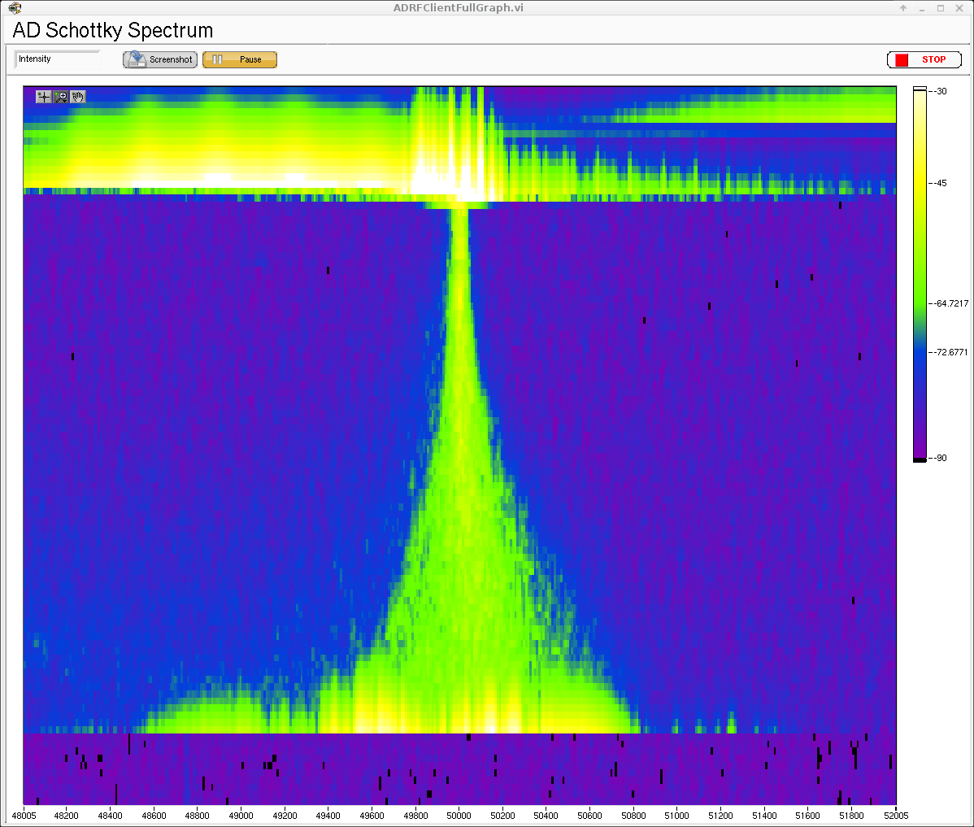
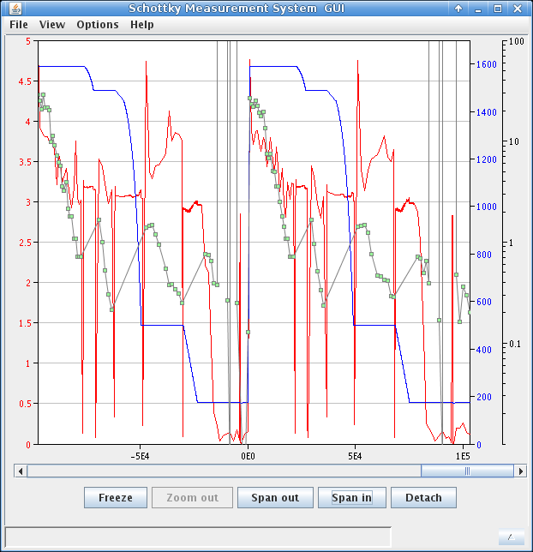
Results with optical delay line notch filter
Adjustment of gain for optimal cooling
Possibility to switch between optical delay line notch filter and old cable delay plant
Careful preparation of delay and gain making the two as equal as possible minimised time spent with beam for adjustment
Stability of adjustable optical delay will be addressed during shutdown (change of component as proposed by GSI colleague)
time
Δf
Stochastic Cooling at 3.5 GeV/c
with new optical delay line notch
Schottky and intensity measurement

Slide 15
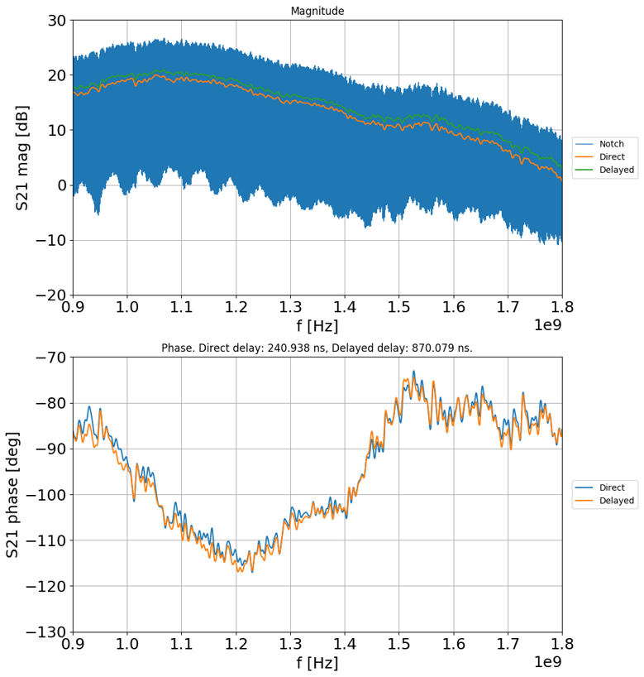
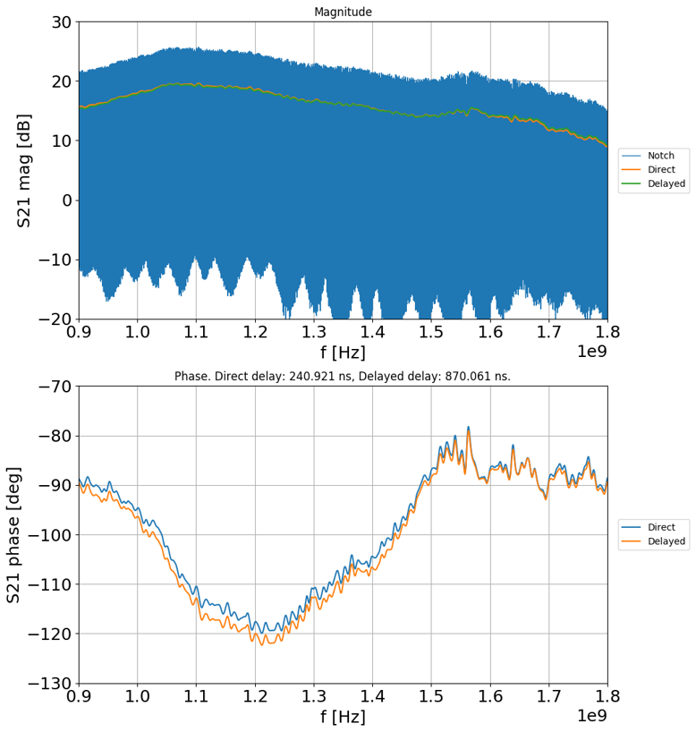
Adjustment of new path at 3.5 GeV/c
old path with cable notch
new path with optical delay notch
careful adjustment of the new path to match delay and phase shift of the old path key
note the higher gain in the high frequency part of the new branch

Slide 16
AD Stochastic Cooling – Performance 3.5 GeV/c
Circumference | Design | Achieved
Intensity at 3.5 GeV/c | 5x10⁷ | 5x10⁷
Cooling Time | 20 s | 20 s
Hor Emittance (95%) | 5 π mm mrad | 3 π mm mrad
Ver Emittance (95%) | 5 π mm mrad | 4 π mm mrad
Momentum width | +/- 0.5x10⁻³ | +/- 0.35x10⁻³
Cycle length | 60 s | 60 s – 100 s
F. Casper, EPAC’00, T. Eriksson Cool’13

Slide 17
AD Stochastic Cooling – Performance
2 GeV/c
Circumference | Design | Achieved
Intensity at 3.5 GeV/c | 5x10⁷ | (5x10⁷)
Cooling Time | 15 s | 15 s
Hor Emittance (95%) | 5 π mm mrad | 2.9 π mm mrad
Ver Emittance (95%) | 5 π mm mrad | 3.3 π mm mrad
Momentum width | +/- 0.15x10⁻³ | +/- 0.08x10⁻³
Cycle length | 60 s | 60 s - 100 s
ELENA is space charge limited; no upgrade plans for intensity
Since stochastic cooling takes considerable amount of time: some interest in faster cooling
F. Casper, EPAC’00, T. Eriksson Cool’13

