Slide 2

CERN
Warum sollte Sie das interessieren?
Notes:
Who is behind CERN?

Slide 3
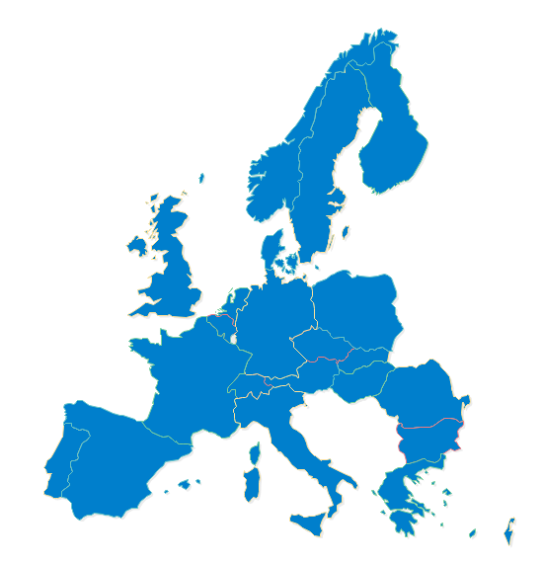







22 Mitgliedsstaaten
Deutschland
20.11%
Grossbritanien
15.51%
Frankreich
13.82%
Italien
10.21%
ca. 1100 MCHF
Spanien
6.89%
Niederlande
4.51%
Schweiz
3.94%
Polen
2.76%
Belgien
2.65%
Norwegen
2.65%
Schweden
2.61%
Österreich
2.10%
Dänemark
1.76%
Israel
1.58%
Finnland
1.30%
Griechenland
1.10%
Portugal
1.08%
Rumänien
1.00%
Tsch. Republik
0.91%
LHC
Ungarn
0.60%
Slowakei
0.50%
Bulgarien
0.29%
Jan 2018
Notes:
First, CERN is funded by 21 Members States.
Mostly European ones. But since 2008 any country in the world can apply for membership, either full or associate.
Israel is the last country which has joined CERN as full Member in 2014.
These countries give ca 1 Bn CHF (this is the budget of a mid-sized University) per year. This money allows CERN to fulfill its mission: provide and support the needed infrastructure for scientits to make experiments. That covers: equipment, transport, maintenance, factoring, paying people and… build accelerators. That does no cover the research cost itself (see collaboration on next slide).
The money is paid by each country pro rata their GDP (Gross Domestic Product). Therefore Germany which contributes to 20.27% makes the «relative» SAME effort than Bulgaria which contributes for 0.28%.
Of course, in important decisions, Germany will «weight» 20%, and Bulgaria only 0.28%
The decision treshold for important decisions is 75% of the budget represented in the vote. The big 4 countries (DE, FR, UK, IT) only account for a bit more than 60%. They need the support of smaller countries and cannot impose their views.

Slide 4
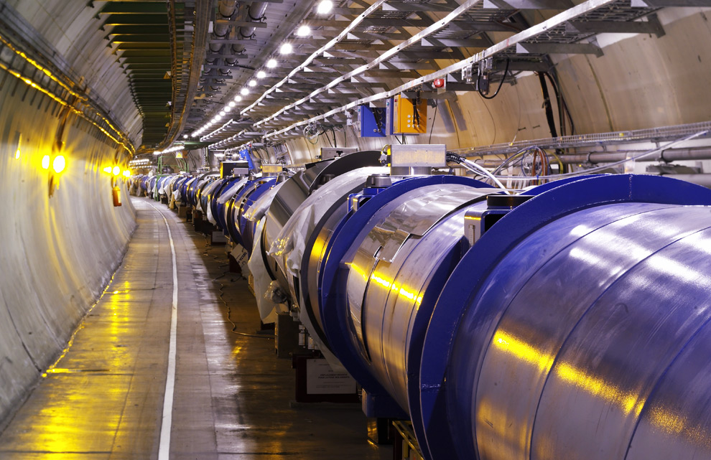
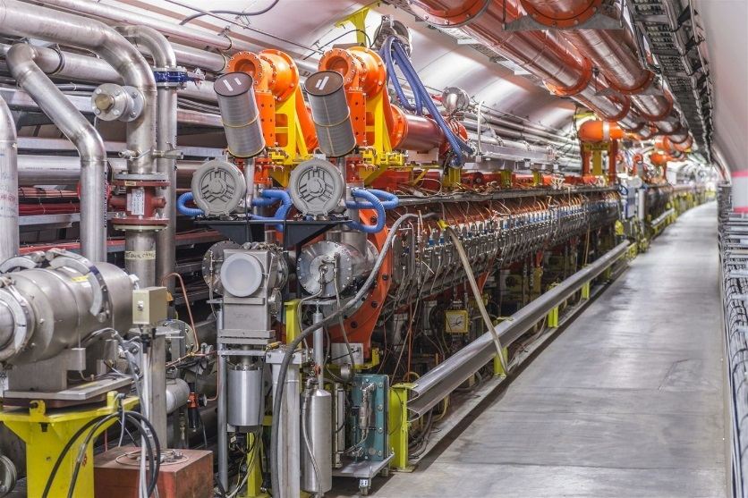
… damit haben wir unsere Beschleuniger gebaut!
Large Hadron Collider (LHC)
SPS
(Vorbeschleuniger)
Notes:
First, CERN is funded by 21 Members States.
Mostly European ones. But since 2008 any country in the world can apply for membership, either full or associate.
Israel is the last country which has joined CERN as full Member in 2014.
These countries give ca 1 Bn CHF (this is the budget of a mid-sized University) per year. This money allows CERN to fulfill its mission: provide and support the needed infrastructure for scientits to make experiments. That covers: equipment, transport, maintenance, factoring, paying people and… build accelerators. That does no cover the research cost itself (see collaboration on next slide).
The money is paid by each country pro rata their GDP (Gross Domestic Product). Therefore Germany which contributes to 20.27% makes the «relative» SAME effort than Bulgaria which contributes for 0.28%.
Of course, in important decisions, Germany will «weight» 20%, and Bulgaria only 0.28%
The decision treshold for important decisions is 75% of the budget represented in the vote. The big 4 countries (DE, FR, UK, IT) only account for a bit more than 60%. They need the support of smaller countries and cannot impose their views.

Slide 5
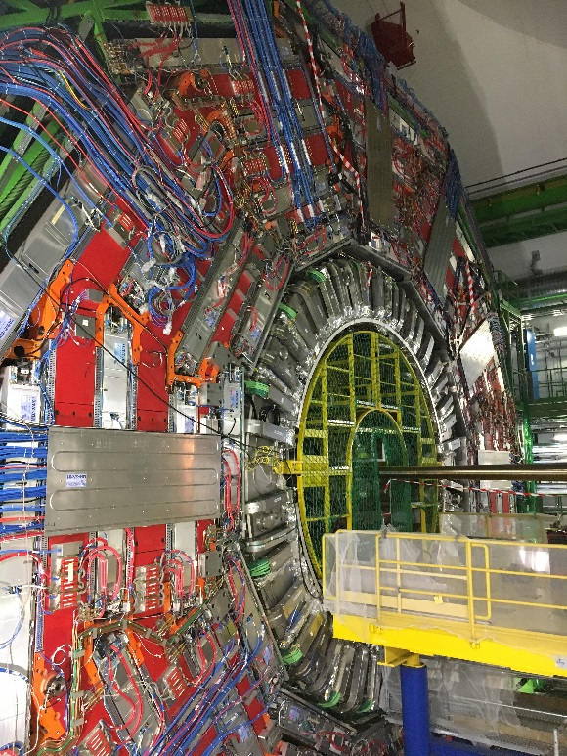
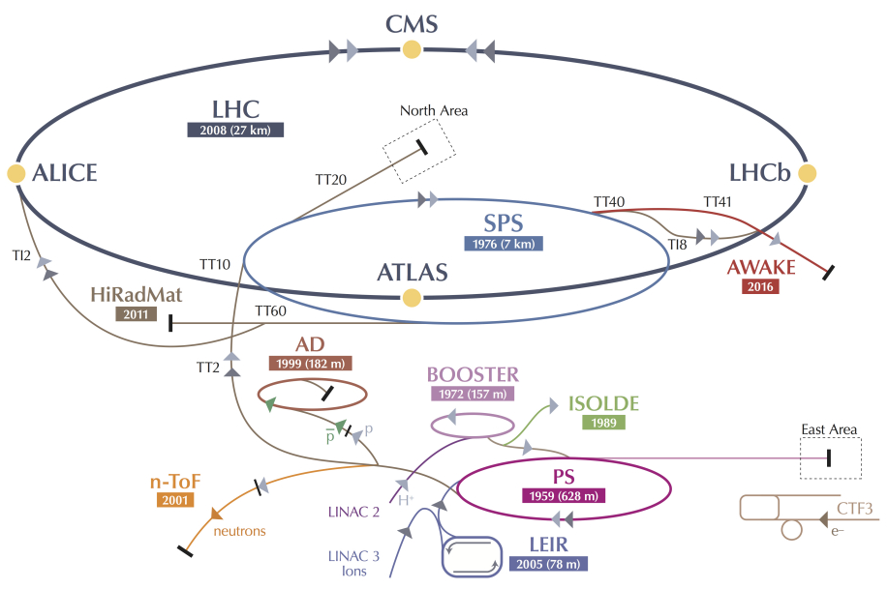
CERN Beschleuniger Complex
PS Booster
CMS
LHC – Large Hadron Collider
SPS

Slide 6
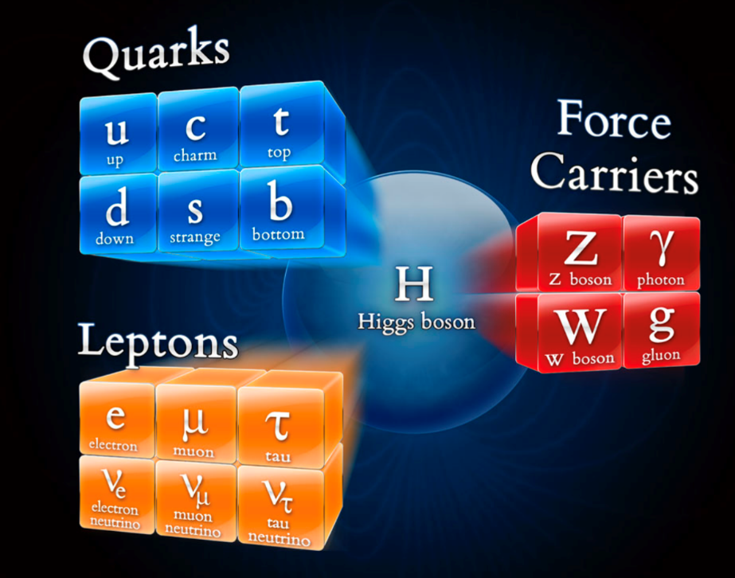
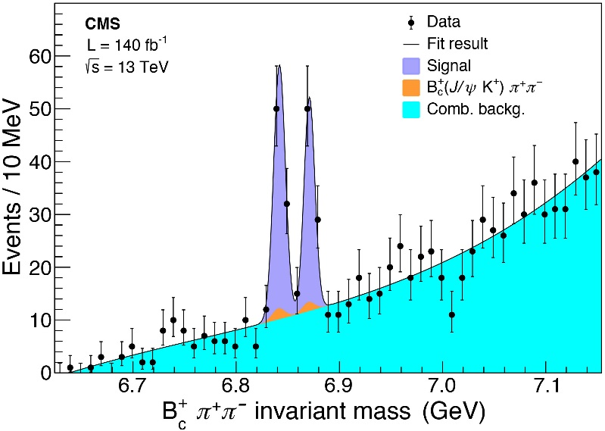
Unser Ziel: Grundlagenforschung!
François Englert
Peter
Higgs
Standardmodel der Physik
Notes:
First, CERN is funded by 21 Members States.
Mostly European ones. But since 2008 any country in the world can apply for membership, either full or associate.
Israel is the last country which has joined CERN as full Member in 2014.
These countries give ca 1 Bn CHF (this is the budget of a mid-sized University) per year. This money allows CERN to fulfill its mission: provide and support the needed infrastructure for scientits to make experiments. That covers: equipment, transport, maintenance, factoring, paying people and… build accelerators. That does no cover the research cost itself (see collaboration on next slide).
The money is paid by each country pro rata their GDP (Gross Domestic Product). Therefore Germany which contributes to 20.27% makes the «relative» SAME effort than Bulgaria which contributes for 0.28%.
Of course, in important decisions, Germany will «weight» 20%, and Bulgaria only 0.28%
The decision treshold for important decisions is 75% of the budget represented in the vote. The big 4 countries (DE, FR, UK, IT) only account for a bit more than 60%. They need the support of smaller countries and cannot impose their views.

Slide 7
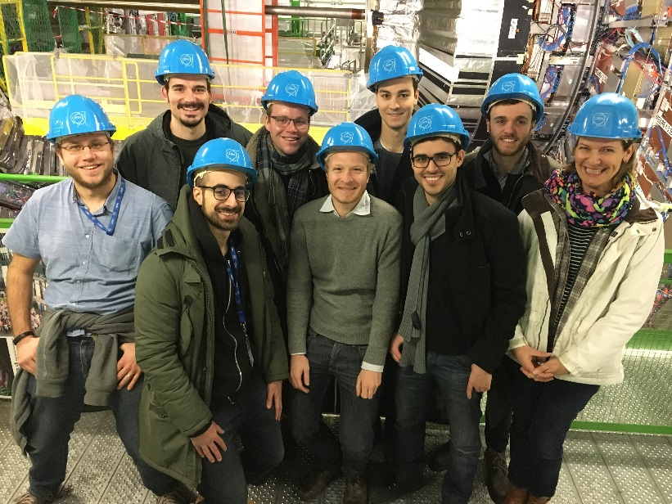






“Technical Student Programme” & BaWü Programm
In unserem Technischen Studierendenprogramm und der Kollaboration mit der HsKA sucht CERN Studierende (fast) aller Disziplinen:
ElektroingenieurInnen,
Maschinenbau-IngenieurInnen,
MechatronikerInnen,
KältetechnikerInnen,
VakuumtechnikerInnen,
VerfahrenstechnikerInnen,
InformatikerInnen, und mehr!
https://careers.smartrecruiters.com/CERN/tech
Notes:
CERN employs «only» 2500 persons. In which there are «only» 70 research physicists (you can ask the audience if they can guess this).
As Fellows and Apprentices are here for a first employement experiences.
The number of students can vary from 300 to 600 depending of the time of the year. It’s mostly university students.
The core population of CERN is made of about 11’000 «users», called like that because they are here to «use» CERN’s facilities. They are NOT employed by CERN and come in the frame of the collaborations. They are not all the time at CERN. Some spend 5% of their time at CERN (a few days a year), some spend 100% of their time. It really depends on their function in the collaboration, on the need for them to be on site, or, on the other hand, the possibility for them to work remotely.
Given the size for CERN’s population, many services are externalized (mail, transport, restaurants, etc) to firms.

Slide 8
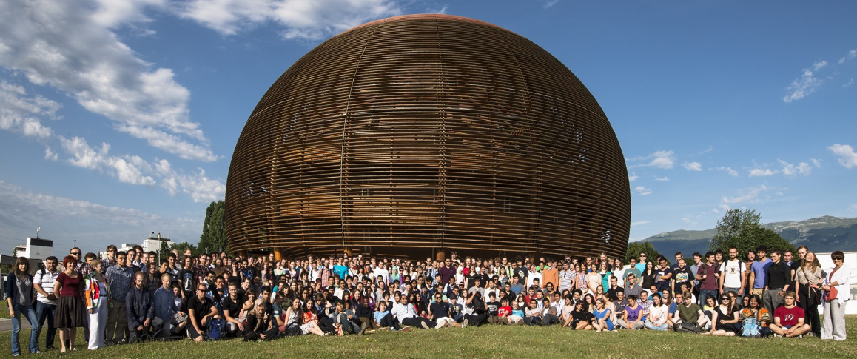
416 Studierende am CERN, die meisten davon IngenieurInnen?
Studierende 2012
Notes:
CERN employs «only» 2500 persons. In which there are «only» 70 research physicists (you can ask the audience if they can guess this).
As Fellows and Apprentices are here for a first employement experiences.
The number of students can vary from 300 to 600 depending of the time of the year. It’s mostly university students.
The core population of CERN is made of about 11’000 «users», called like that because they are here to «use» CERN’s facilities. They are NOT employed by CERN and come in the frame of the collaborations. They are not all the time at CERN. Some spend 5% of their time at CERN (a few days a year), some spend 100% of their time. It really depends on their function in the collaboration, on the need for them to be on site, or, on the other hand, the possibility for them to work remotely.
Given the size for CERN’s population, many services are externalized (mail, transport, restaurants, etc) to firms.

Slide 9
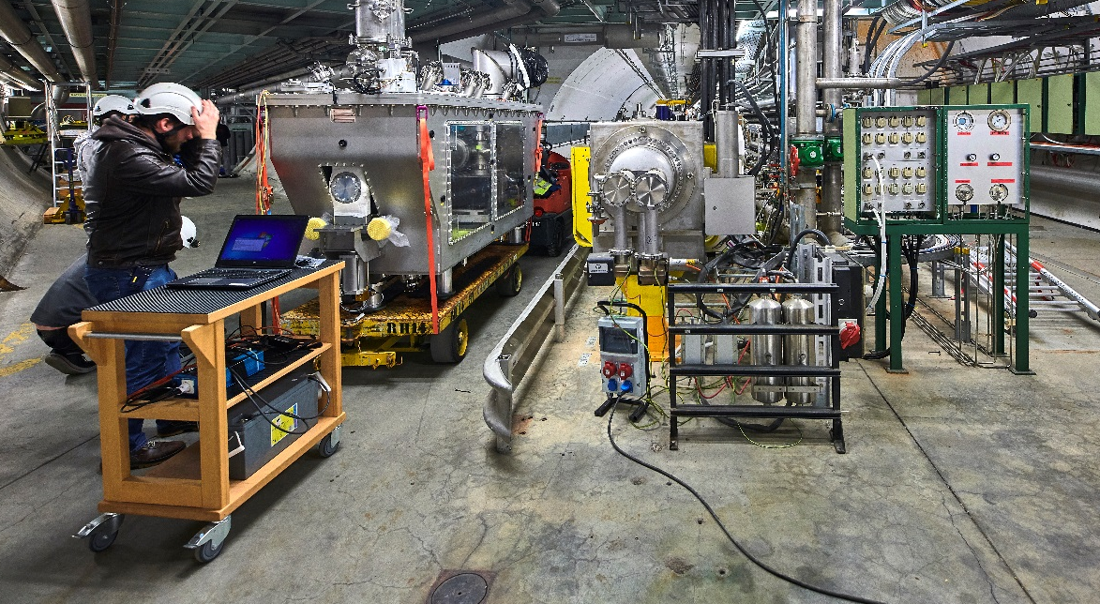
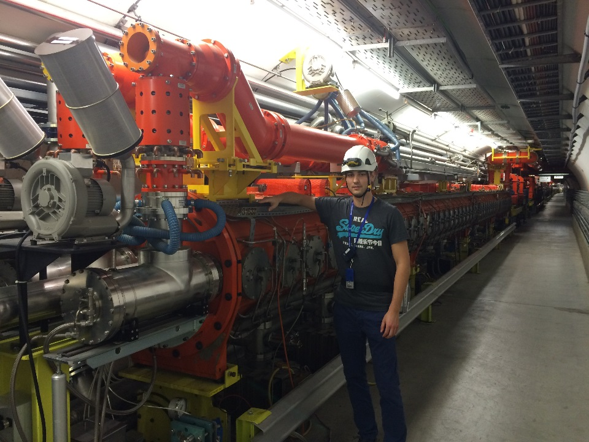
Und wenn es geklappt hat, dann…
Team beim Installieren einer Beschleunigerkomponente (Crab Cavity)
- Verschiedene Disziplinen
Doktorand an der SPS Beschleunigerkavität
- Elektroingenieur

Slide 10
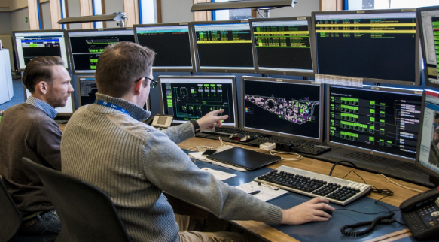
Und wenn es geklappt hat, dann…
Arbeiten im Kontrollraum der Beschleuniger…
Allgemeine Informatik &
Technische Informatik
Datenbanken,
System-administration,
Software Entwicklung (Front- und Backend),
Verwaltung von mehreren tausend Rechnern, hunderte Java Middle-Tier services, Big Data & Web-anwendungen,
Ca. 5000 C/C++ real time Prozesse…
im Kontroll-system der Beschleuniger.

Slide 11
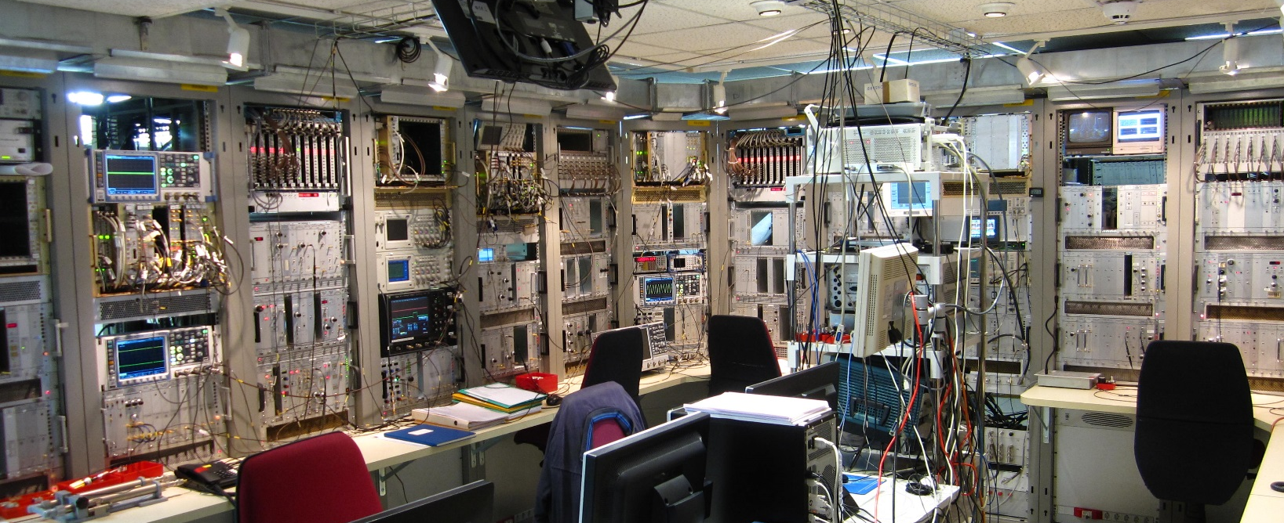
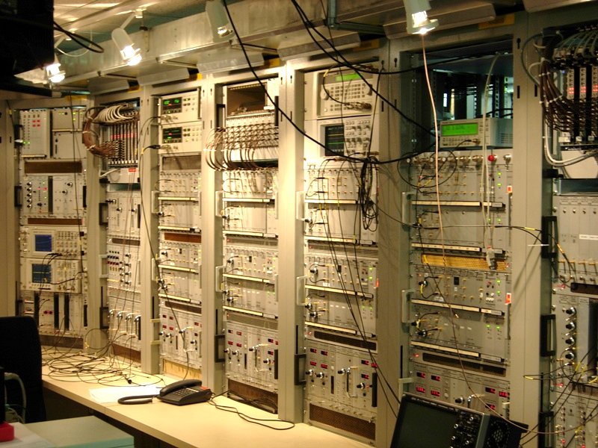
Und wenn es geklappt hat, dann…
Strahlkontrolle für Vorbeschleuniger
Viel Erfolg!

Slide 12
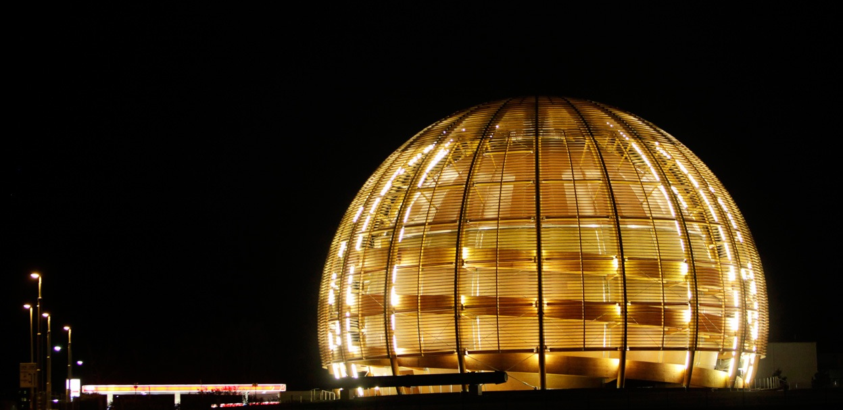
« Magic is not happening at CERN, magic is being explained
at CERN. » Tom Hanks
Notes:
Thank you for your attention!

