Slide 1
On the Normal conducting RF for muon collider
Alexej Grudiev (CERN)

Slide 2
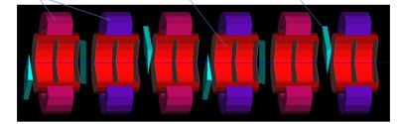
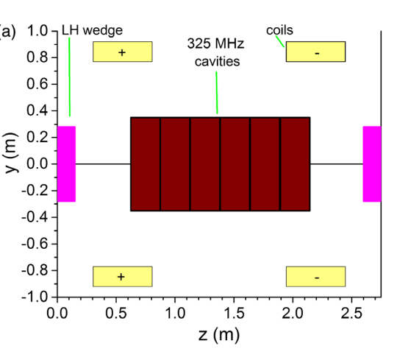
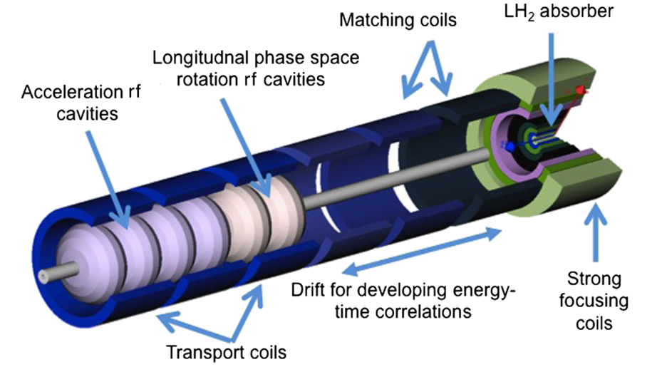
RF system for muon capture and cooling
Summarized from:
David Neuffer
Chris Rogers
Region | Length [m] | N of cavities | Frequencies [MHz] | Peak Gradient [MV/m] | Peak RF power [MW/cavity]
Buncher | 21 | 54 | 490 - 366 | 0 - 15 | 1.3
Rotator | 24 | 64 | 366 - 326 | 20 | 2.4
Initial Cooler | 126 | 360 | 325 | 25 | 3.7
Cooler 1 | 400 | 1605 | 325, 650 | 22, 30
Bunch merge | 130 | 26 | 108 - 1950 | ~ 10
Cooler 2 | 420 | 1746 | 325, 650 | 22, 30
Final Cooling | 140 | 96 | 325 - 20
Total | ~1300 | 3951 |  |  | ~4000 x ~3MW => ~12GW
It is a very large and complex RF system with high peak power

Slide 3
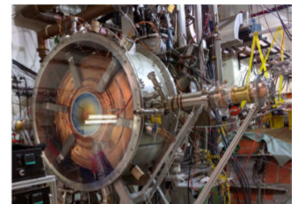
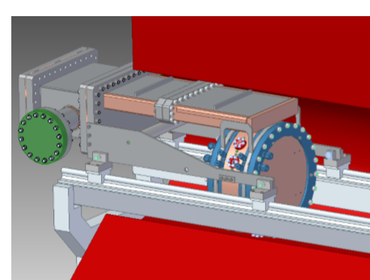
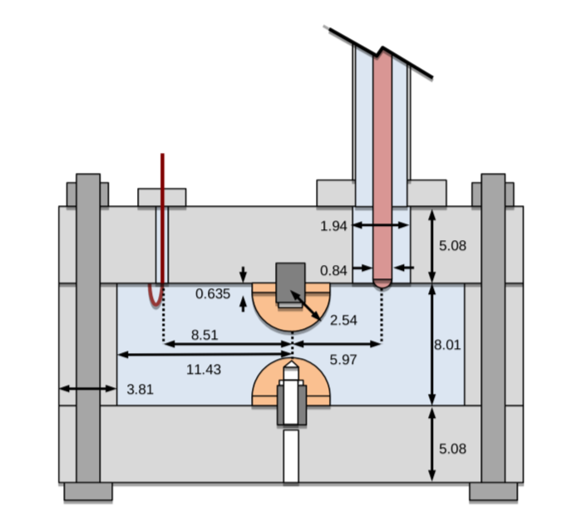
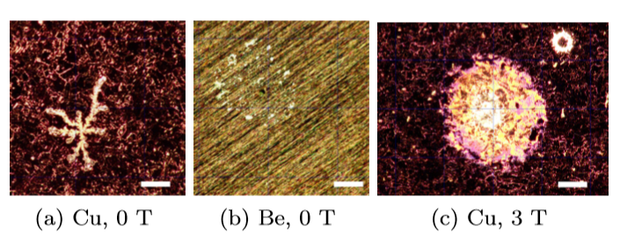
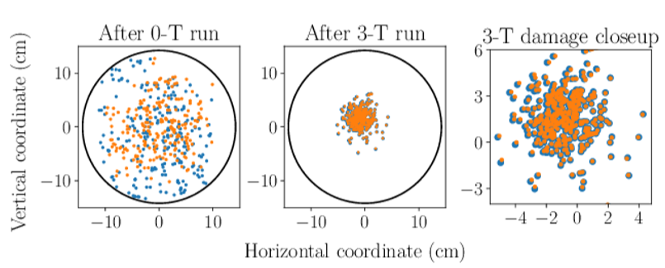
RF cavities for muon cooling
Challenges:
High Gradient
High magnetic field
High radiation
Technology far from been common
---------------------
State of the art (not complete):
MICE 200 MHz RF module prototype: 4T, 10 MV/m, 1ms@1Hz
800 MHz beryllium cavity:
3T, 50 MV/m, 30us@10Hz
Gas filled RF cavity:
Small gap, 200 MHz, >50 MV/m

Slide 4
R&D directions and test facility towards feasibility demonstration of muon cooling
Stage 1: High gradient RF test facility
  Frequency: 200 - 800 MHz
  Magnetic field: 0 - 5T, different field configurations
  Different materials: Cu, Be, Al, …
  Different temperatures: Cryogenic NC, HTS RF, …
  Different gases and pressure: 0 – few Bars
  Different designs
Stage 2: Prototype(s) for cooling test facility
  Design of realistic cavity prototypes: frequency, beam aperture, integration
  Parameters defined based on the results of Stage 1 and the (re-)design of the muon cooling complex (higher gradient,…)
  May include irradiation capability to check its impact on the performance
Stage 3: Muon cooling demonstrator

Slide 5
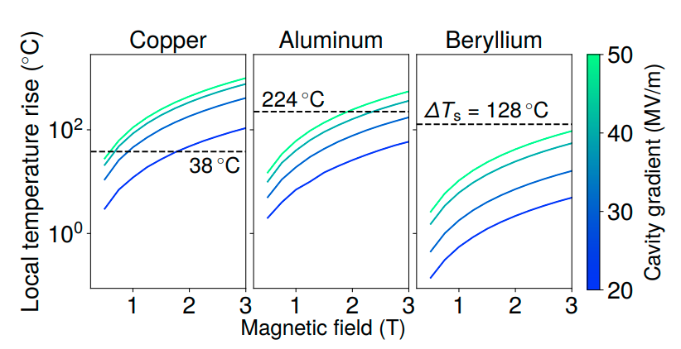
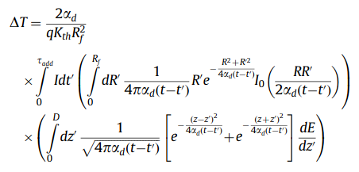
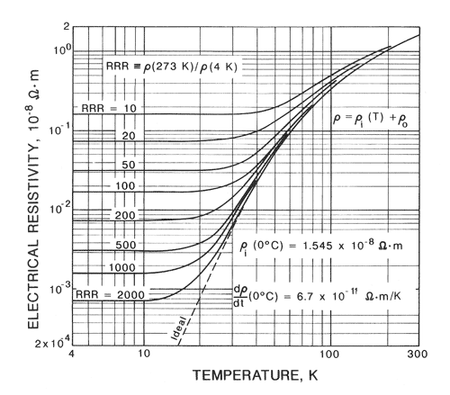

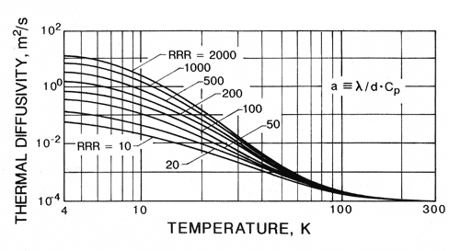
Cryogenic operation of NC cavities
RF technology challenges discussion, MC workshop, 2019 (cern.ch)
Cavities are already in the cryogenic environment of the SC solenoids
Higher gradients require even higher RF power:
  V=const, G x 2 => P x 2
Low temperature reduce ohmic losses: P x 1/3 or even lower
RF breakdown (BD) strength in high magnetic field depends on thermo-mechanical properties
Field emission induced pulsed heating model predicts (PRAB 23, 072001):
Local temperature rise
Threshold: (38K for Cu@300K)
Cu
Low temperature improves thermal and mechanical properties
=> Higher BD strength
Cu

Slide 6
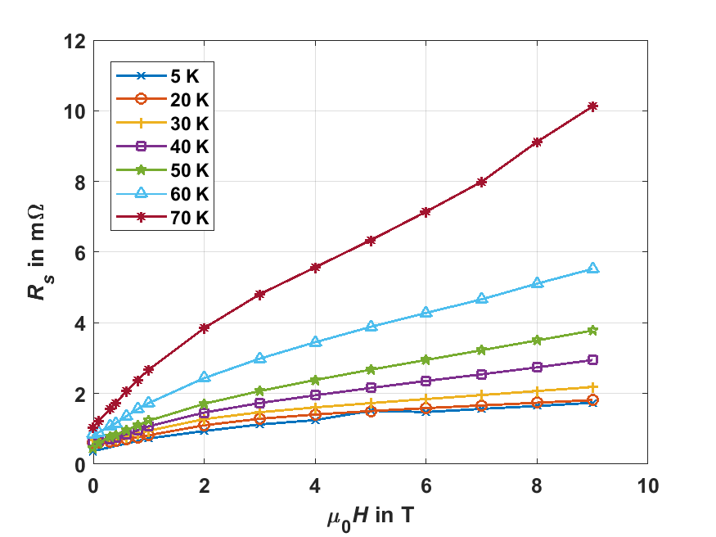
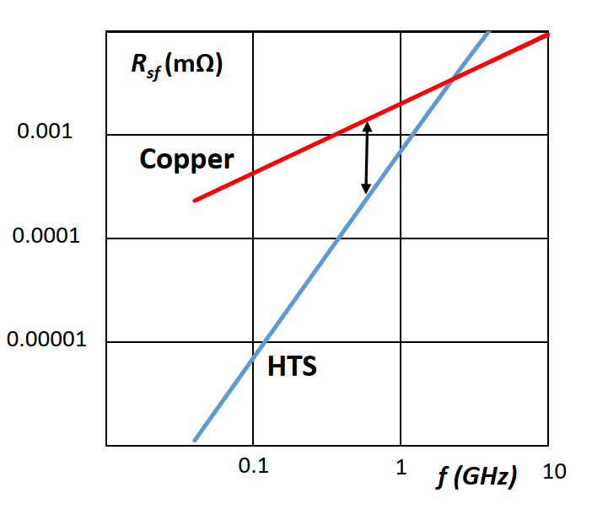

HTS for RF applications
HTS coated conductor at 8 GHz
Frequency scaling HTS vs Cu at 9 T
Cu RRR=100 @ 300 K: 25 mΩ
Cu RRR=100 @ 70 K
Cu RRR=100 @ 20 K
From: Teresa Puig – ICMAB. Developments of HTS Coated Conductors for the FCC-hh beam screen impedance mitigation

Slide 7
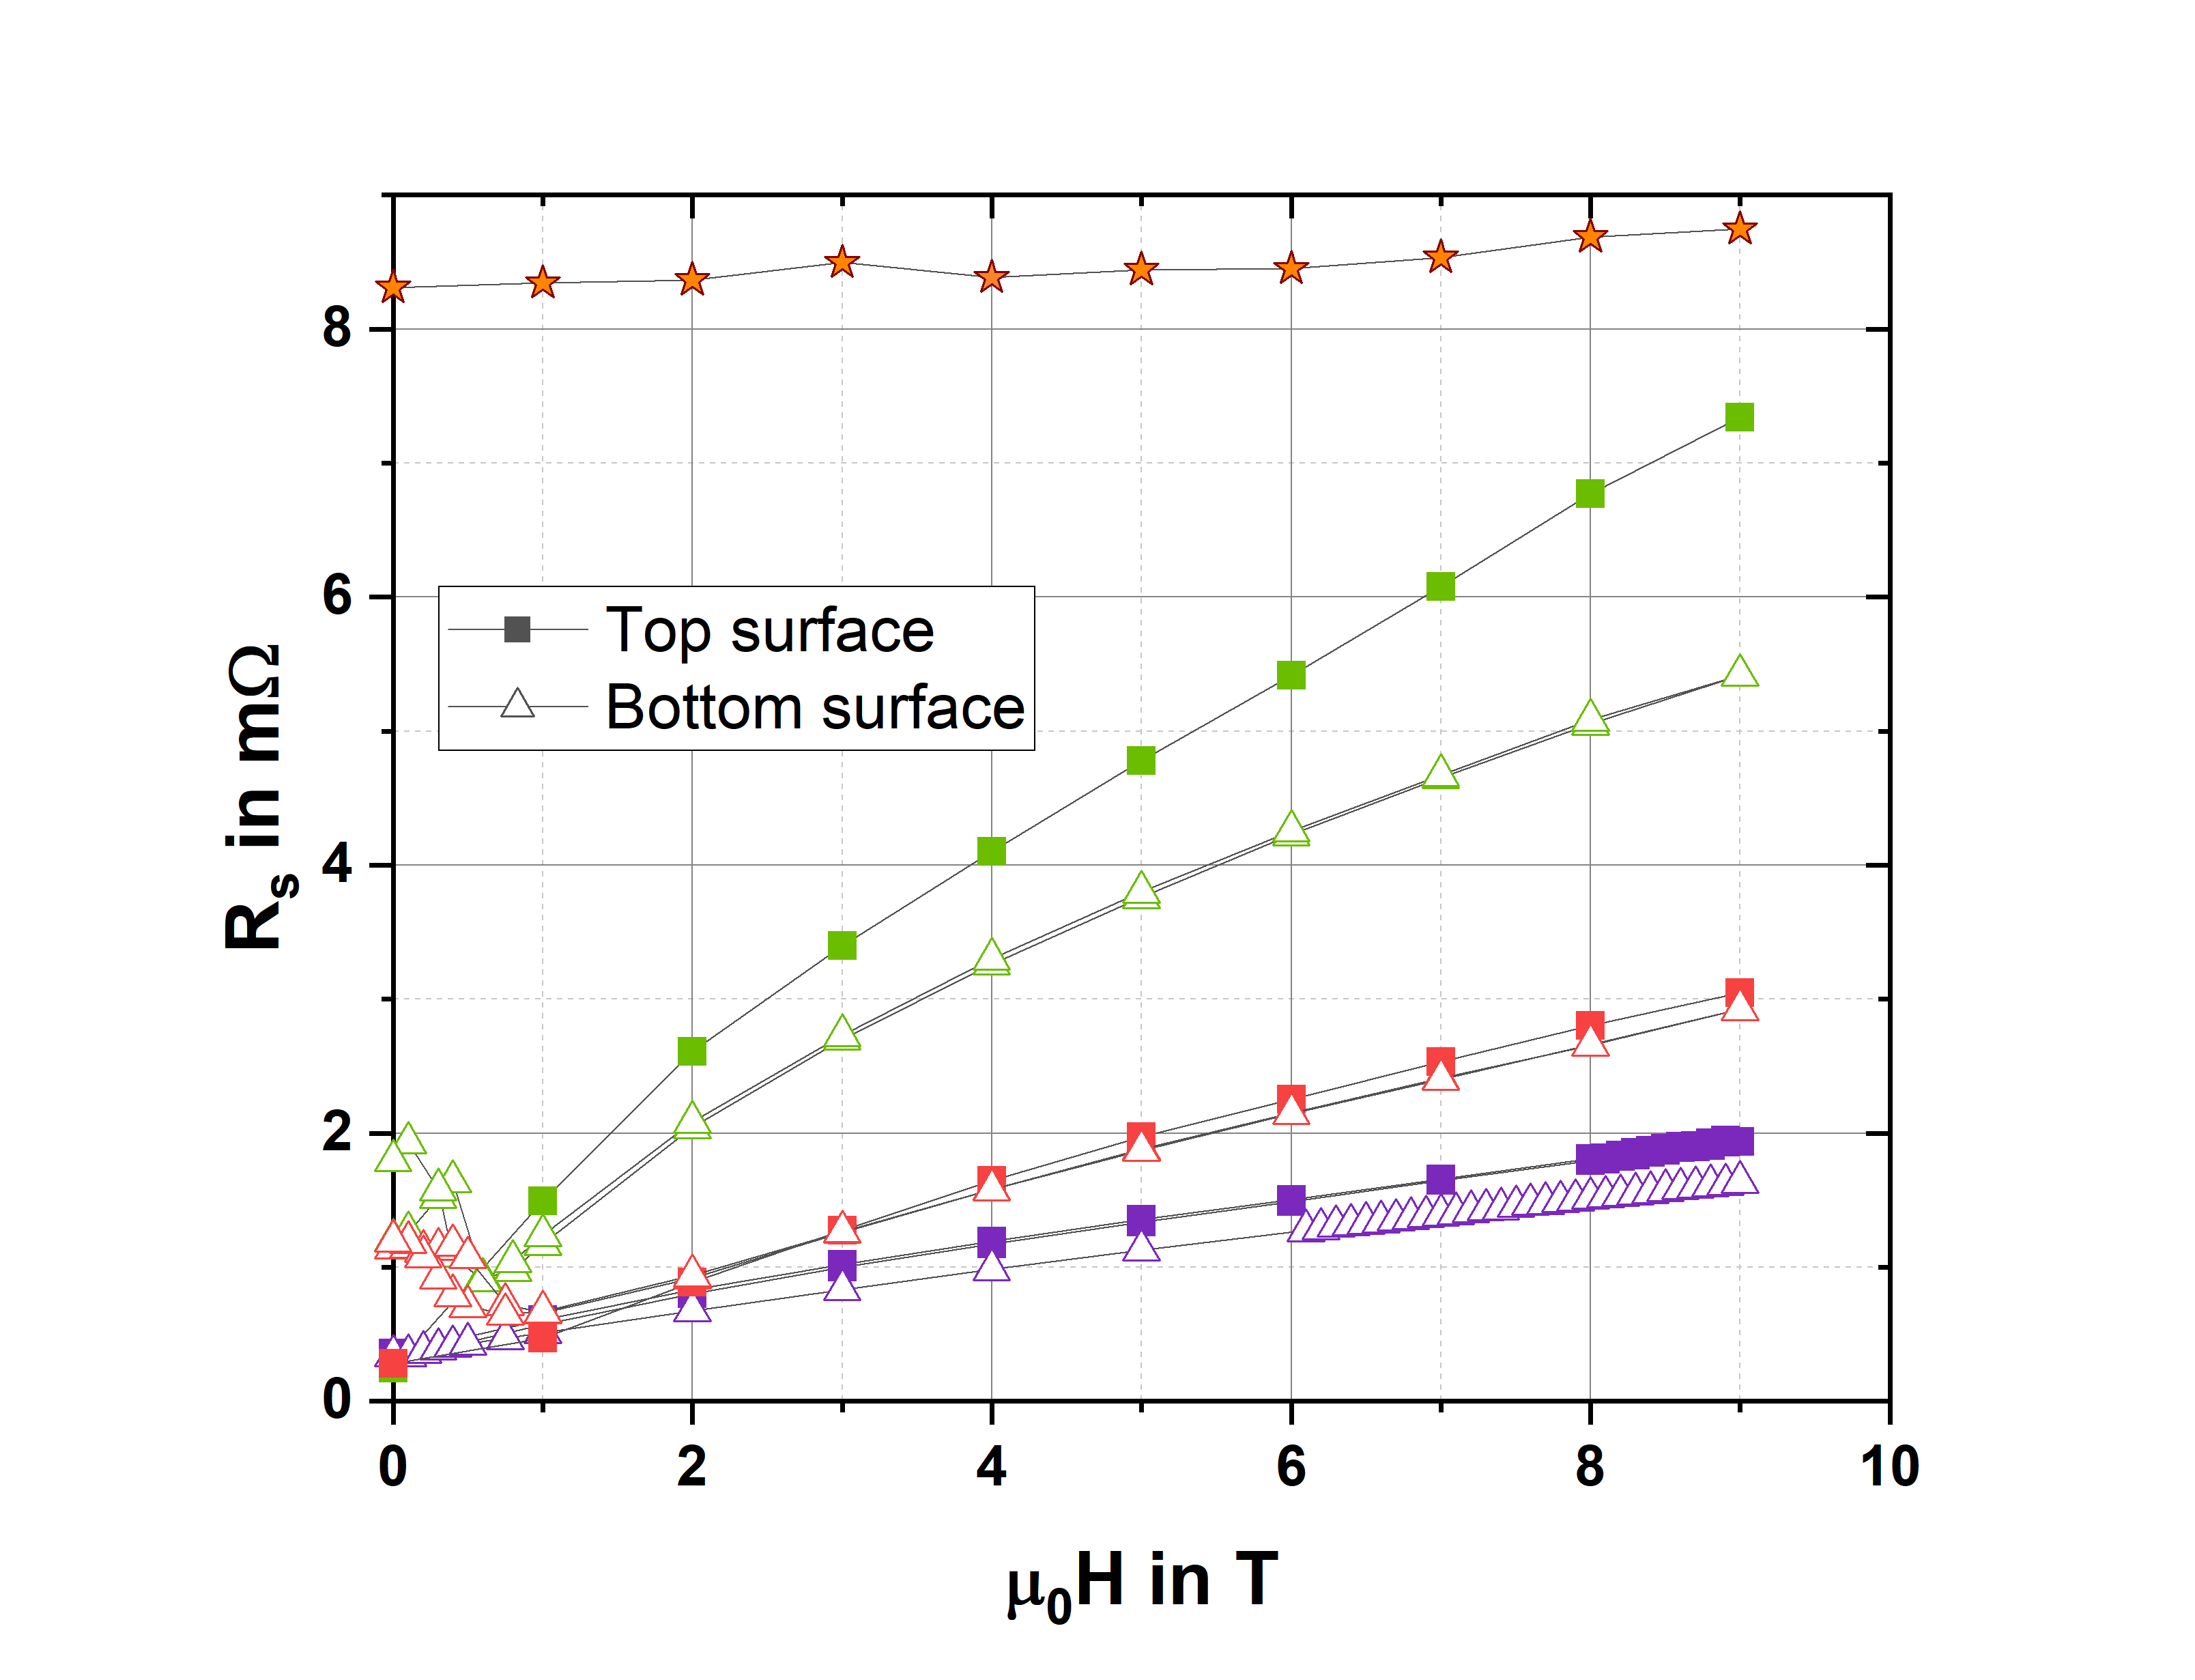
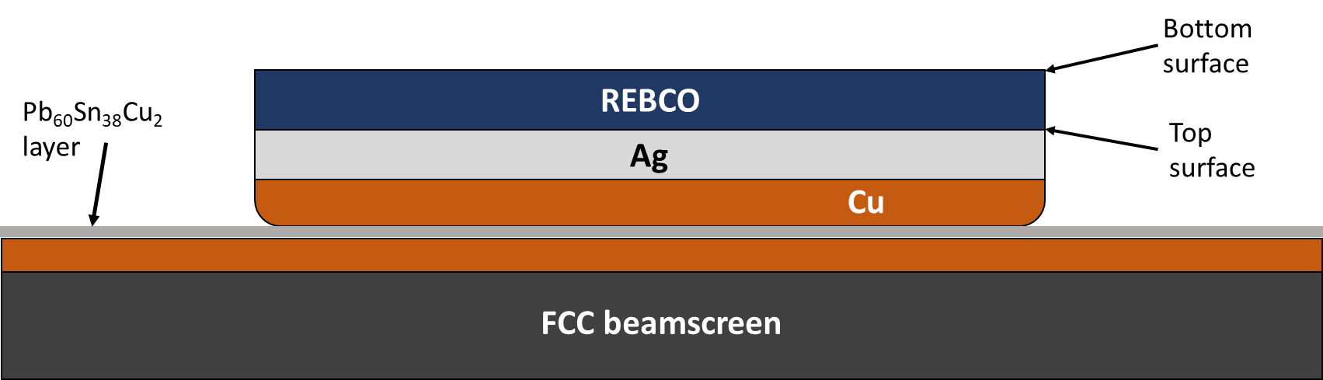
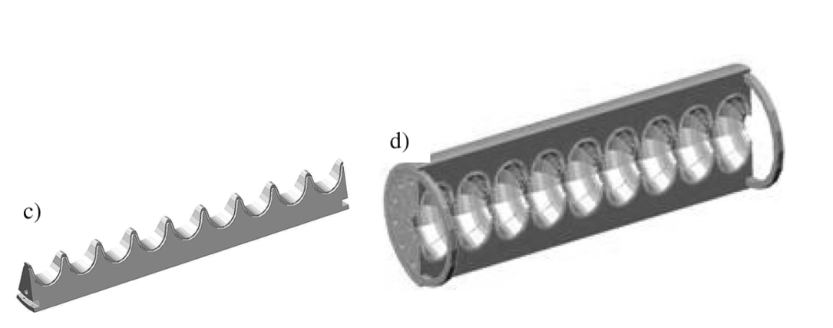

Soldering of HTS coated conductors
T = 50 K, $ν=8$ GHz
FCC Cu
CC 2
Soldered sample
Soldering mostly preserves properties
This could be used in a cavity made in sectors
Standard sample
CC 4
CC 5

